Slide 1
Programme Advisory Committee
Condensed Matter of Physics
57 meeting, 15-16 June 2023
Dubna
Notes:
Thank you very much Mr. chairman. Good morning ladies and gentlemen, dear members of programme advisory committee for condensed matter of physics. On the name of JINR directorate I like to welcome all of you and express my special thanks to those, who participate in person.

Slide 2
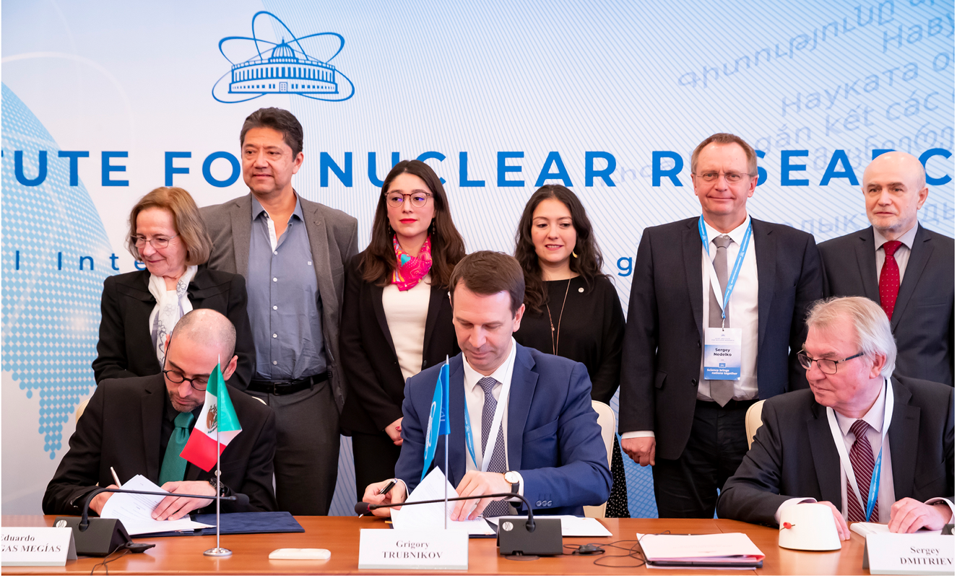
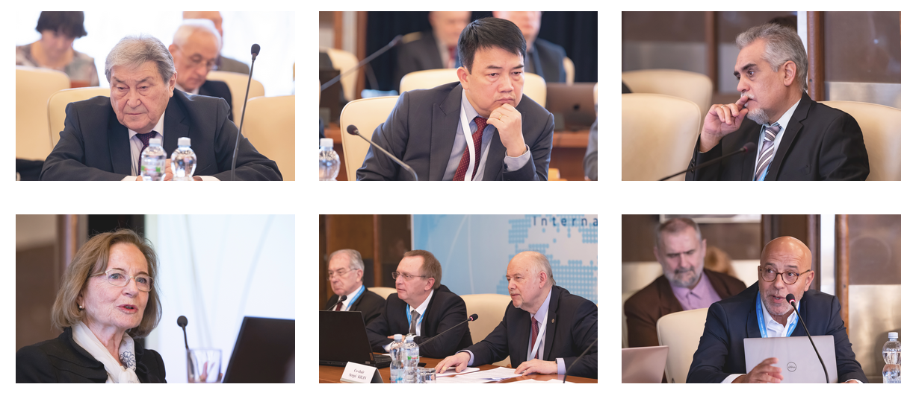
JINR Scientific Council, 16-17 February 2023
Mexico and JINR signed
an intergovernmental agreement
Notes:
In February this year a Joint Declaration of Intent Concerning Cooperative Activities in the Area of Fundamental, Frontier and Applied Scientific Research between CONACYT (Mexico) and JINR has been signed. CONACYT Director General María Elena Álvarez-Buylla Roces signed the document on the part of Mexico. JINR Director Grigory Trubnikov sighed the document in Dubna.

Slide 3
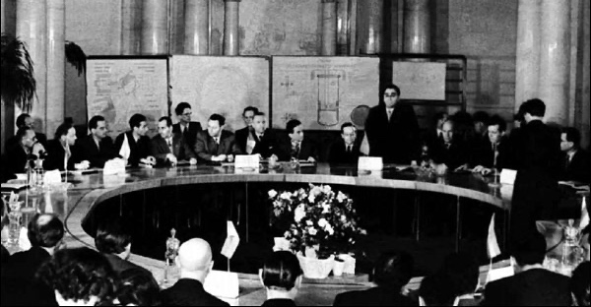
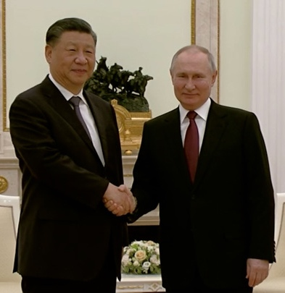
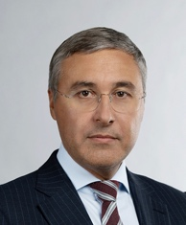
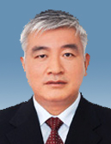
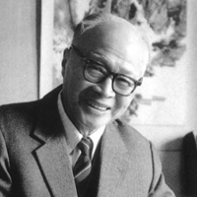
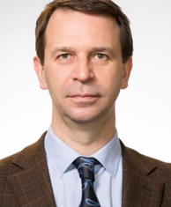
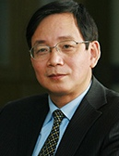
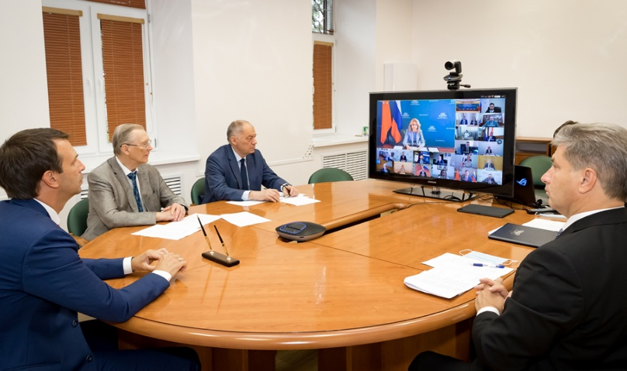
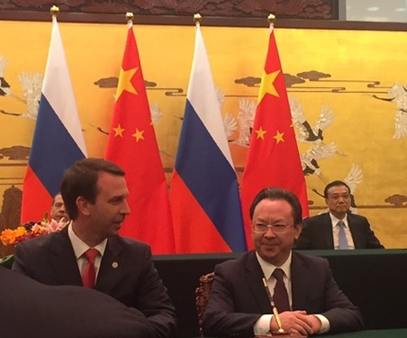
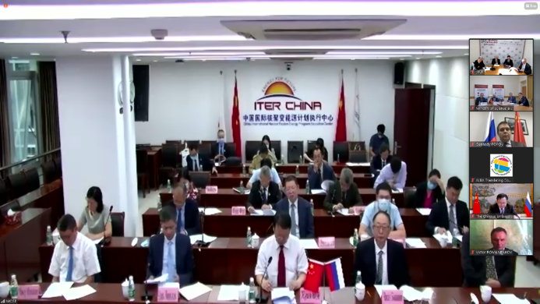
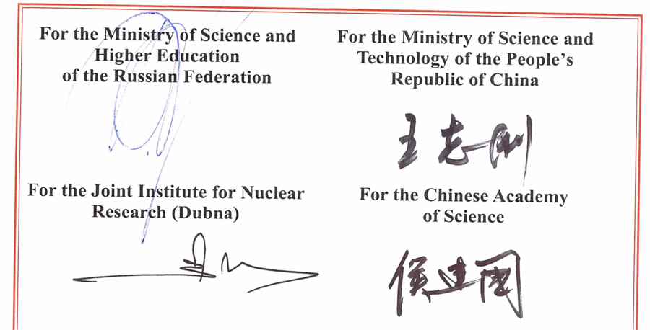
JINR‒China: New Horizons of Cooperation
The People's Republic of China was one of the JINR founding states in 1956.
WANG Ganchang, prominent Chinese scientist and researcher, Academician of the Academy of Sciences of China was Vice-Director of JINR (1958-1960).
PRC was actively and fruitfully involved into JINR from 1956 to 1965.
26.08.2020, Agreement between the Ministry of Science and Technology of China and JINR on Participation in the Construction and Operation of the Complex of Superconducting Rings for Heavy Ions Colliding Beams NICA.
In January/March 2023, JINR and China held 7 workshops with 24 scientific partner organizations from China: the common wish is to enhance the level of cooperation between JINR and China.
Acknowledging that JINR is currently recognized as one of the leaders of world science, successfully implementing international integration in scientific research;
Intending to enhance the level of China’s participation in JINR;
Reaffirming commitment to the peaceful use of research results.
21.03.2023

Slide 4
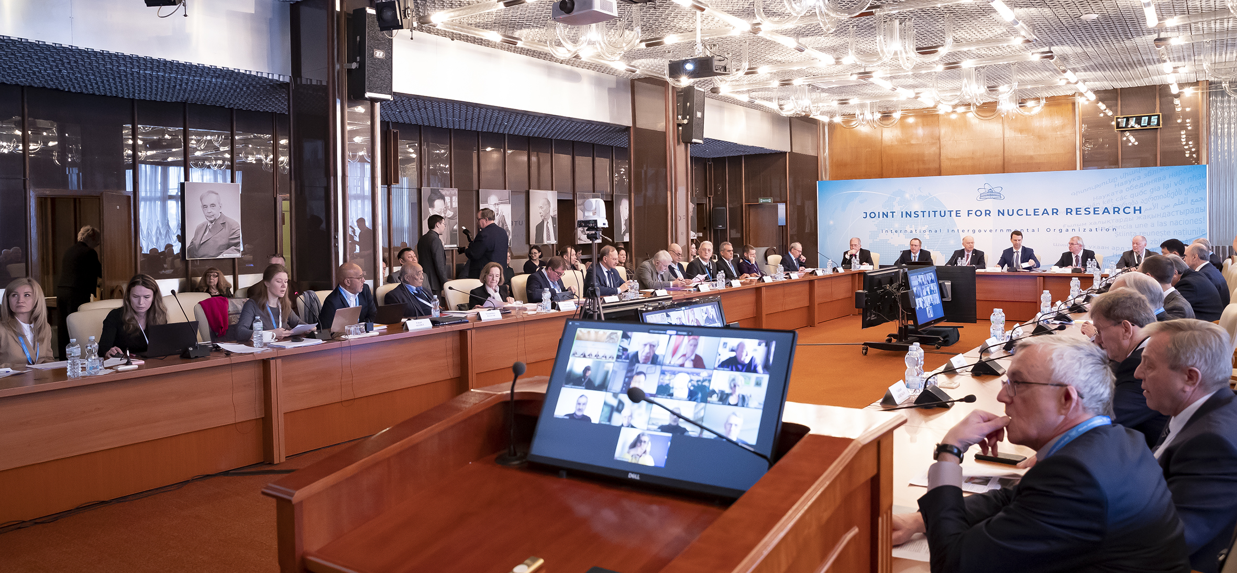
Information on the Resolution of the JINR Scientific Council
133rd session, 16-17 February 2023, hybrid mode
Co-chaired by Sergei Kilin and Grigory Trubnikov

Slide 5
The Council highly appreciated the efforts of the JINR Directorate and staff of Laboratories to realize the current seven-year plan (2017–2023) and congratulated JINR on the achievements in major areas: the NICA project, experiments at the SHE Factory, the Baikal-GVD project, condensed matter and material science research at FLNP, operation of MICC at MLIT, theoretical physics, life sciences, applied research and innovations, as well as in realization of educational programmes and outreach activities.
The Council noted with regret the withdrawal of the Czech Republic, the Republic of Poland, and Ukraine from JINR from 1 January 2023 and had strong hopes that the geopolitical crisis in Eastern Europe will soon find a peaceful solution, which will allow to reсover the lost members of JINR.
The Council welcomed the signing of the Joint Declaration of Intent between the National Council for Science and Technology of Mexico (CONACYT) and JINR, noted with satisfaction the practical measures taken by the JINR Directorate to strengthen cooperation with scientific organizations and universities in China on the basis of partnership coordinated at the governmental level, and expressed its interest in maintaining a high level of cooperation with the research organizations of all European countries, which have always played a very important role in the JINR research programme.
The Scientific Council took note of the recommendations made by the PACs at their meetings in January 2023, as reported at this session by I. Tserruya, Chair of the PAC for Particle Physics, V. Nesvizhevsky, Chair of the PAC for Nuclear Physics, and D. L. Nagy, Chair of the PAC for Condensed Matter Physics. The Scientific Council asks the JINR Directorate to consider these recommendations while preparing the Topical Plan for JINR Research and International Cooperation for the year 2024.

Slide 6
The Scientific Council noted with satisfaction that the revised Draft of the Seven-Year Plan for the Development of JINR for 2024–2030 has been significantly improved in comparison with its draft, has taken into account the recommendations of the 132nd session of the Scientific Council. The Scientific Council appreciated the inclusion of a section on risk assessment in the revised Plan. In order to complete the process of expert evaluation of the Seven-Year Plan and optimize the implementation of its first stage in the current Topical plan of scientific research at JINR, the Scientific Council has recommended that a joint working group is organized, which will include representatives of all three PACs.
SC welcomes the efforts of the JINR Directorate to update the approach to the formation of the Topical Plan for JINR by implementing the Regulations on structuring and planning scientific research at JINR.
The Scientific Council congratulated Prof. P. Apel (FLNR) on the award of the V. Dzhelepov Prize for the development of а new generation of track membranes and their applications in medicine and ecology.
The Scientific Council approved the Jury’s recommendations on awarding the JINR annual prizes for the best scientific, methodological, technological, and applied research papers.
The Scientific Council elected E. Lychagin as Director of the Frank Laboratory of Neutron Physics (FLNP) for a term of five years S. Shmatov as Director of the Meshcheryakov Laboratory of Information Technologies (MLIT) for a term of five years. The Scientific Council endorsed the appointments of E. M. Anitas, N. Antonenko, and O. Teryaev as Deputy Directors of the Bogoliubov Laboratory of Theoretical Physics (BLTP) until the completion of the term of service of the current BLTP Director, D. Kazakov.
The Scientific Council announces the vacancies of the positions of FLNP and MLIT Deputy Directors. The endorsement of appointments will take place at the 134th session of the Scientific Council, in Sept’2023.

Slide 7
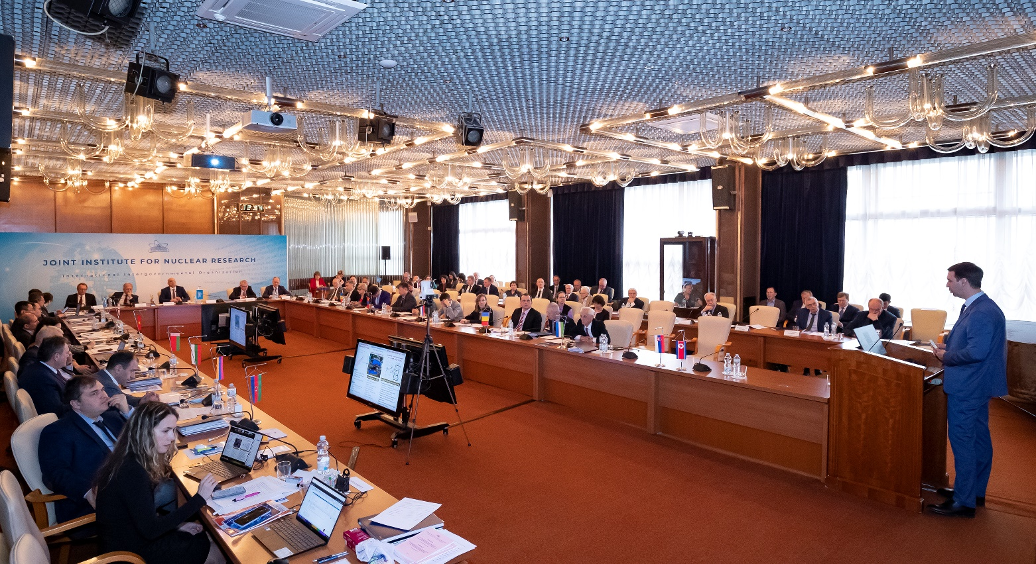
Session of the JINR Committee of Plenipotentiaries
24 March 2023, Dubna
A regular session of the Committee of Plenipotentiaries of the Governments of the JINR Member States was held in Dubna on 24 March 2023 in a hybrid form.
AGENDA
JINR Director’s report (G. Trubnikov)
Execution of the JINR budget for 2022 and draft of the revised budget of JINR for 2023 (N. Kalinin)
Results of the meeting of the JINR Finance Committee held on 22 March 2023 (A. Omelchuk)
Draft of the Seven-year plan for the development of JINR for 2024–2030 (G. Trubnikov)
It was chaired by the representative of Georgia – Professor Arsen Khvedelidze, Director, Institute of Quantum Physics and Engineering Technology of the Georgian Technical University.

Slide 8
Committee of Plenipotentiaries decided, in particular:
To take note of the information from the JINR Directorate about the recommendations of the 133rd session of the JINR Scientific Council, the implementation of the current Seven-Year Plan for the Development of JINR, the efforts of the Member States towards realization of JINR’s large projects, the new scientific and technological results obtained, and about the most important events related to JINR’s scientific research and educational activities and international cooperation.
To note with satisfaction the successful completion of the fourth technological cycle of the NICA accelerator complex, which has become the longest run in the history of VBLHEP (>3400 hours), the successful commissioning of the injection chain, including the joint operation of all its elements, the optimization of the beam dynamics, the operation of the electron cooling, the testing of the SOCHI station with heavy ions, the calibration of the new diagnostic system, and the modernization of the vacuum system in the extracted beam line.
To note the success of the Institute in ensuring long-term stable operation of the accelerator complex of the BM@N experiment for the first time in full configuration, registration of more than 550 million events with the Xe beam, which made it possible to begin the physical analysis of the recorded data.
To note the progress in developing the Baikal-GVD deep-water neutrino telescope for observing natural neutrino fluxes and the registration of 24 events indicating the presence of an isotropic neutrino flux of an astrophysical nature.

Slide 9
To note the successful continuation of experiments at the Factory of Superheavy Elements using the DGFRS-2 separator, in particular, on the synthesis of new isotopes of darmstadtium and seaborgium as well as the continuation of the preparation of experiments to study the chemical properties of elements 114 (Fl) and 112 (Cn) at the DGFRS-3 (GRAND) separator scheduled for the second half of 2023.
To take note of the information on the progress in the implementation of the work plan for the preparation of the continuation of the normal operation of the IBR-2 reactor.
To note the successful development of the JINR MICC, including the modernization of the Govorun supercomputer carried out in 2022, as a result of which its performance reached 1.1 petaFLOPS, and the total capacity of the hierarchical data storage increased to 8.6 PB.
To welcome the signing of the Joint Declaration of Intent between the National Council of Science and Technology –– CONACYT (Mexico) and the Joint Institute for Nuclear Research in February 2023, and the Protocol between the Ministry of Science and Technology of the People’s Republic of China, the Ministry of Science and Higher Education of the Russian Federation, the Chinese Academy 29 of Sciences and the Joint Institute for Nuclear Research on Strengthening Cooperation in the Field of Basic Scientific Research at the governmental level in March 2023.

Slide 10
To approve the budget of JINR for 2023. To approve the revised budget of JINR for 2023 with the income amounting to 203.5 M$ and the expenditure amounting to 275.0 M$, taking into account the positive opening balance amounting to 49.0 M$.
To endorse the measures taken by the JINR Directorate to increase the efficiency of the Institute’s supplementary divisions aimed at improving the financial indicators of their activities and achieving a balance in the calculations between the supplementary divisions and the JINR budget.
To take note of the opinion of the JINR Scientific Council that the presented revision of the draft Seven-Year Plan for the Development of JINR for 2024–2030, which took into account the recommendations of the 133rd session of the JINR Scientific Council, contains an ambitious international scientific programme, which fully complies with the JINR Long-Term Development Strategy up to 2030 and beyond, is optimally balanced in terms of the required staff and financial resources and supported by the necessary scientific and organizational, administrative, and socio-economic measures.
To support the recommendation of the 133rd session of the JINR Scientific Council to organize of a joint working group, which will include representatives of all three JINR Programme Advisory Committees, for the final examination of the scientific programme of the Plan, and instruct the JINR Directorate to take into account the comments of this working group when preparing the final version of the Plan for approval in November 2023.
To agree with an annual, at least 5%, increase in the amount of contributions of the Member States to financially support the Seven-Year Plan for the Development of JINR for 2024–2030.

Slide 11
THANK YOU
FOR YOUR ATTENTION

Slide 12
JINR Budget for 2023
Scientific Research Expenses For 2023
(including overheads)
Nuclear physics (26.0%)
Elementary particle physics and Relativistic nuclear physics
(46.1%)
51.8
91.8
199.2 М$
28.8
Condensed matter physics, Radiation and radiobiological research (14.5%)
8.4
15.6
Educational programme
(1.4%)
Theoretical physics
(4.2%)
Networking, computing, computational physics (7.8%)

