Slide 1
Proposal for opening the subproject
“Investigations of functional materials and nanosystems using neutron scattering”
in the framework of the large infrastructure project
“Pulsed neutron source and spectrometers”
D.P. Kozlenko
Frank Laboratory of Neutron Physics, Joint Institute for Nuclear Research, 141980 Dubna, Russia

Slide 2
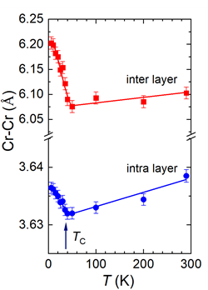
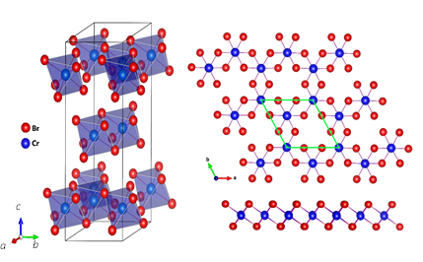
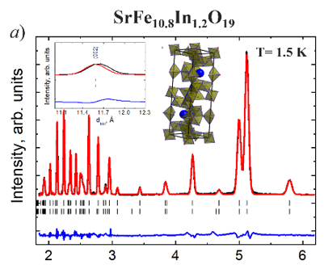
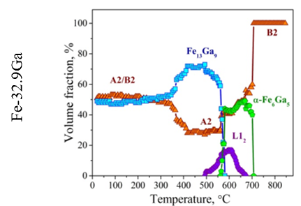
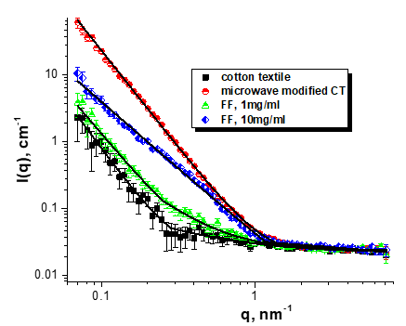
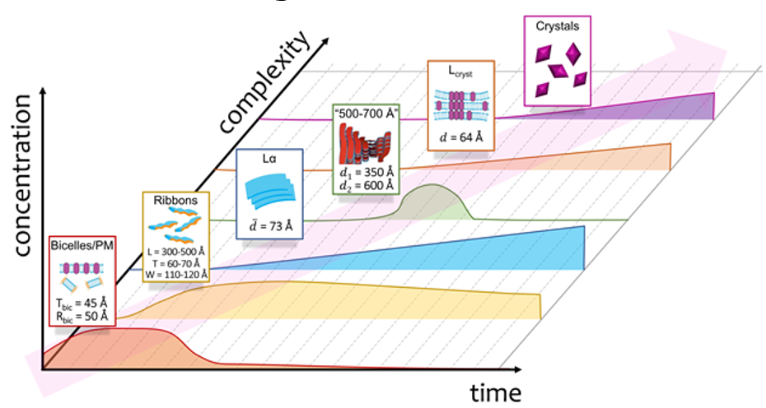
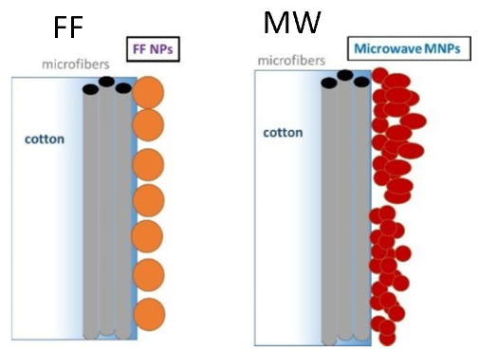
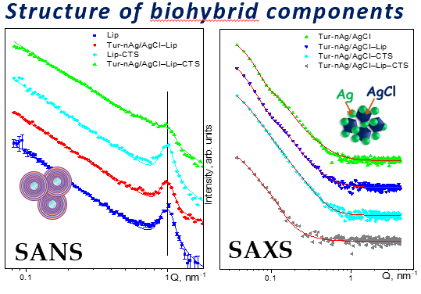
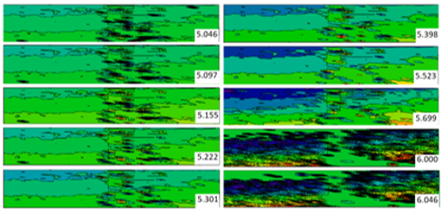
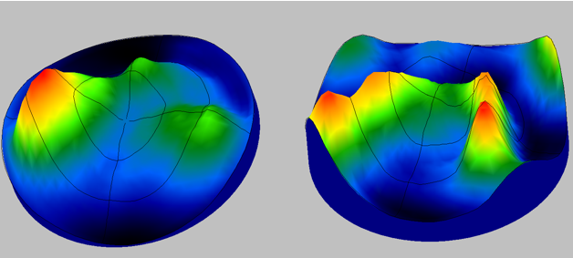
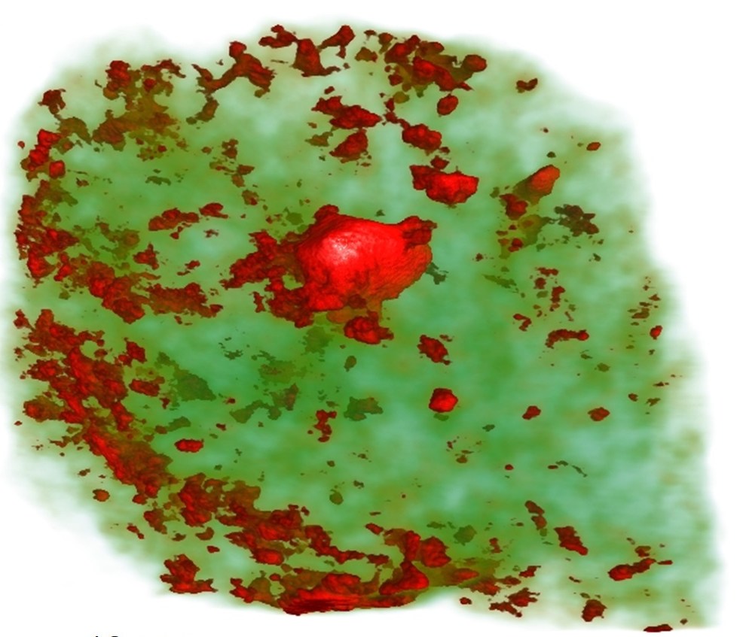
Summary of the main scientific results obtained in the theme 04-4-1142-2021/2025 “Investigations of functional materials and nanosystems using neutron scattering” in 2021 - 2023:
A discovery of spin-induced negative thermal expansion in van der Waals ferromagnet CrBr₃,
In-situ determination of structural features of phase transformations in magnetostrictive and shape memory alloys,
Analysis of structural mechanisms of multiferroic phenomena in hexaferrites,
Determination of structural organization of magnetic textiles for bio-catalysis,
Analysis of microscopic mechanisms of membrane proteins crystallization in bicelles,
Determination of structural organization of biohybrid nanocomplexes,
Microstructural analysis of the mechanical surface treatment effects of D16T alloy on its hardening,
Crystallographic texture analysis of the shells of fossil molluscs,
Analysis of the internal organization and phase composition of Kunya-Urgench meteorite.

Slide 3
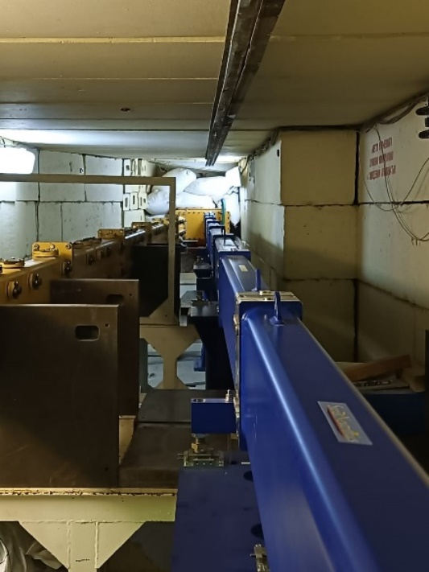
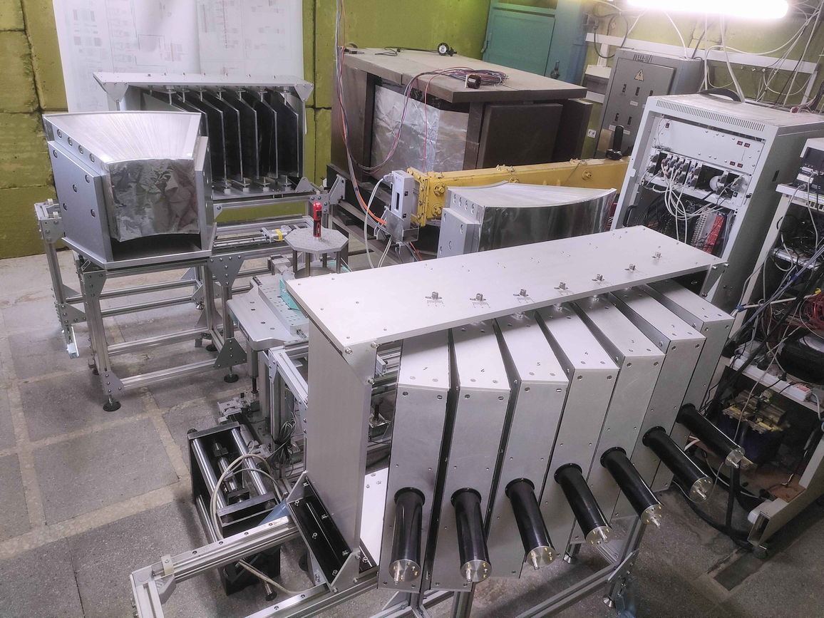
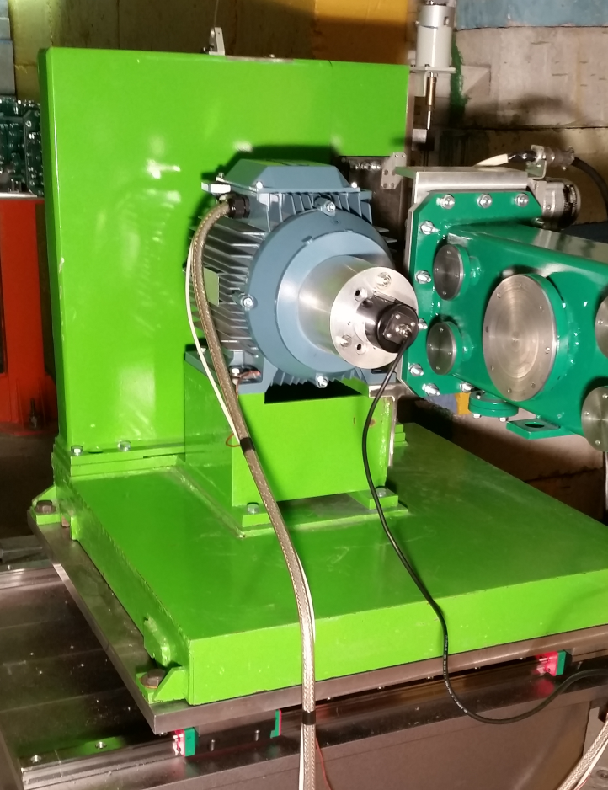
Summary of the main methodical results:
Upgrade of the neutron guide of the DN-6 diffractometer by replacement of mirrors with natural Ni coating (m = 1) to supermirror coating (m = 3),
Completion of the assembly of ASTRA scintillation detector system at the FSD diffractometer,
Replacement of Fourier chopper at the FSS spectrometer,

Slide 4
Full report of the theme (2021-2023): enclosed to PAC materials
Publications – 306
Conference reports – 210
Patents - 1
Theme expenses (2021-2022)
JINR Prizes
№№ | Items of expenditure | Full cost (kUSD) | Expenditure for the last year (kUSD)
1. | International cooperation | 244.6 | 167.6
2. | Materials | 346.5 | 303.3
3. | Equipment, Third-party company services | 764.0 | 465.1
4. | R&D contracts with other research organizations | - | -
5. | Software purchasing | 9.9 | 3.5
6. | Design/construction | 193.9 | -
7. | Service costs (planned in case of direct project affiliation) | - | -
TOTAL: |  | 1566.5 | 944.0
New structural, magnetic, and physical phenomena in geometrically frustrated functional magnetic materials at changes of thermodynamic parameters”. Authors: D. Kozlenko, N. Golosova, S. Kichanov, E. Lukin, A. Rutkauskas, B. Savenko, O. Lis, N. Belozerova, Dang Ngoc Toan, Le Hong Khiem. Second JINR Prize in Experimental Physics Research, 2021.
“Magnetism of ferromagnet – superconducting heterogeneous layered structures”. Authors: V. Aksenov, V. Zhaketov, Yu. Nikitenko, A. Petrenko, Yu. Khaidukov. Second JINR Prize in Experimental Physics Research, 2022.
“Structural reorganization in a lipid membrane triggered by amyloid-beta peptide and temperature”. Authors: O. Ivankov, N. Kučerka, T. Murugova, E. Ermakova, A. Rogachev, A. Kuklin, V. Skoi, Kh. Kholmurodov, D. Badreeva, E. Dushanov. Second JINR Prize in Applied Physics Research, 2022.
“Non-destructive microstructural analysis of promising cement materials for the construction of radioactive waste storage facilities and civil facilities: results of neutron radiography and tomography”. Authors: S. Kichanov, K. Nazarov, D. Kozlenko, M. Balasoiu, A. Bekhzodjon, B. Savenko, I. Zel, M. Kenessarin. Second JINR Prize in Applied Physics Research, 2022.
“Applying the neutron activation analysis for the assessment of the levels of elements in mussels from different regions of the World Ocean for the characterization of connection with their environment”. Authors: P. Nekhoroshkov, M. Frontasyeva, I. Zinicovscaia, D. Nikolayev, T. Lychagina, A. Pakhnevich, K. Vergel, O. Chaligava, D. Grozdov, J. Bezuidenhout. Encouraging JINR Prize, 2022.

Slide 5
Subproject
Investigations of functional materials and nanosystems using neutron scattering (2024-2028)
(former Theme 04-4-1142-2021/2025)
Leaders: D.P.Kozlenko, V.L.Aksenov, A.M.Balagurov
Subsubproject (2024-2028):
A Study of Structure and Dynamics of Functional Materials and Nanosystems at the IBR-2 Spectrometer Complex
Leader: D.P.Kozlenko
Subsubproject (2024-2028):
Development of an inelastic neutron scattering spectrometer in inverse geometry at the IBR-2 reactor
Leader: D.M.Chudoba

Slide 6
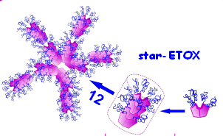
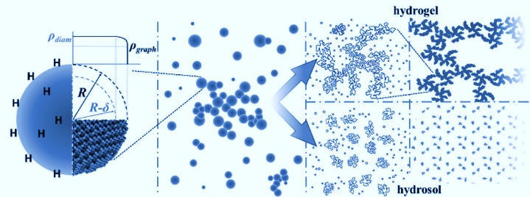
Subsubproject “A Study of Structure and Dynamics of Functional Materials and Nanosystems at the IBR-2 Spectrometer Complex”
Main research directions :
1. Condensed Matter Physics and Materials Science :
1.1 Study of structure and properties of new inorganic and organic functional materials,
2.2 Investigation of structural and magnetic properties of materials under extreme conditions,
1.3 Real-time investigations of physical and chemical processes in functional materials,
1.4 Computer simulation of structure and properties of new functional materials and nanosystems,
1.5 Study of atomic and magnetic dynamics of functional materials.
2. Physics of Nanosystems and Nanoscale Phenomena:
2.1 Investigation of structural and magnetic properties of layered nanostructures,
2.2 Investigation of structure of carbon-and silicon-containing nanomaterials.
3. Physics of Complex Liquids and Polymers:
3.1 Investigation of dispersed systems and complex fluids in bulk and at interfaces,
3.2 Investigation of structural organization of polymer nanomaterials.

Slide 7
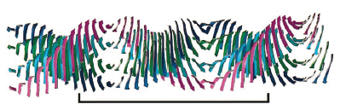
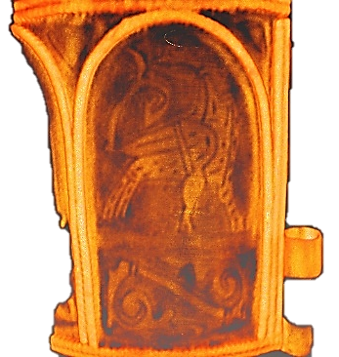
4. Biophysics and Pharmacology:
4.1 Investigation of supramolecular structure and functional characteristics of biological nanosystems,
4.2 Investigations of structure and properties of lipid membranes and complexes,
4.3 Investigations of structure and properties of biohybrid complexes.
5. Applied Materials and Engineering Sciences :
5.1 Investigation of internal stresses and microstrains in structural materials and industrial products,
5.2 Investigation of features of internal structure of cultural and natural heritage objects, structural materials and industrial products,
5.3 Investigation of texture and properties of rocks and minerals, structural materials, biological and paleontological objects,
5.4 Investigation of structure of HTSC materials after irradiation.

Slide 8
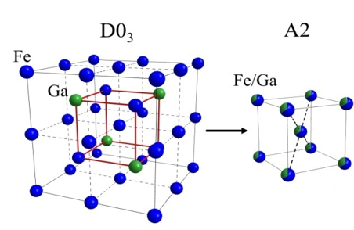
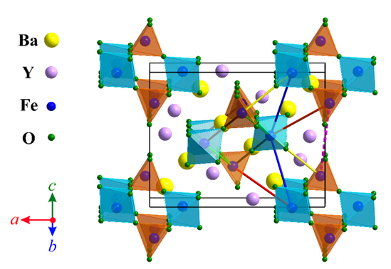
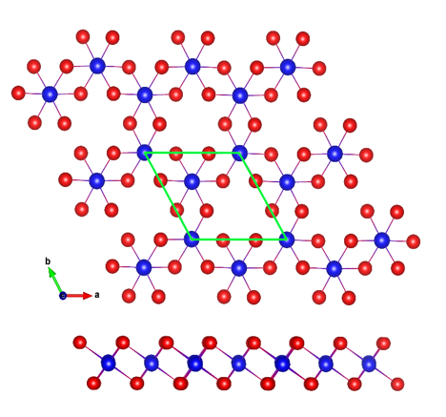
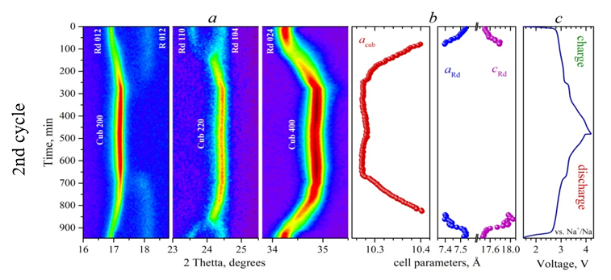
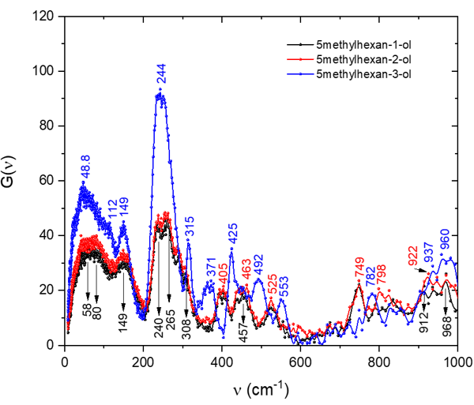
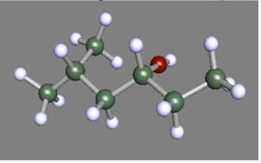
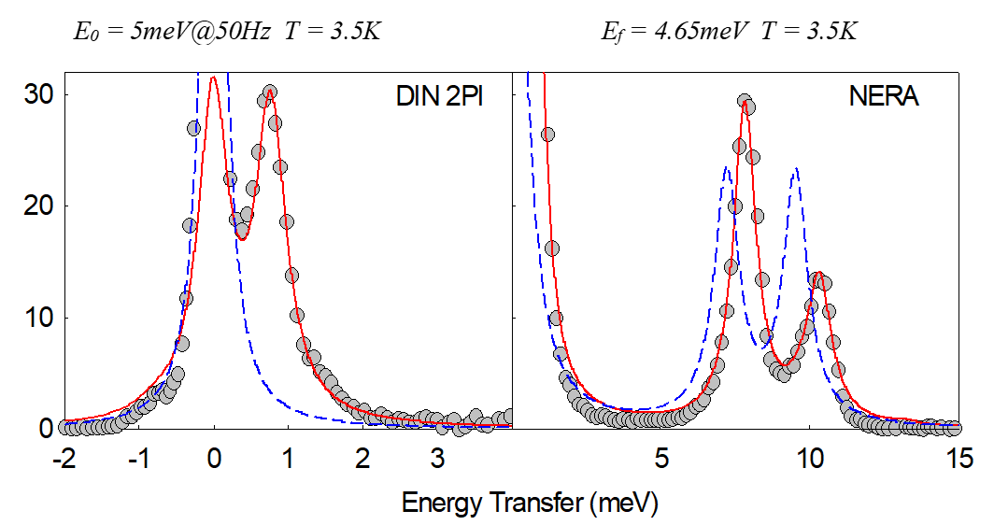
Expected scientific results
1. Condensed Matter Physics and Materials Science
  1.1 Determination of the structural parameters and phase composition of intermetallic functional materials, including magnetostriction Fe-Ga alloys and shape memory alloys.
  1.2 Determination of characteristics of the crystal and magnetic structure of functional oxide materials in a wide range of thermodynamic parameters (temperature and pressure).
  1.3 Analysis of the relationship between structural and magnetic properties of low dimensional magnetic materials.
  1.4 Analysis of complex structural and microstructural states of solid electrolytes and electrodes for metal-ionic accumulators.
  1.5 Determination of the crystal structure and analysis of the dynamics of functional materials with molecular complexes and ionic liquids.
  1.6 Analysis of the crystal electric field effects and magnetic dynamics in strongly correlated electronic systems.

Slide 9
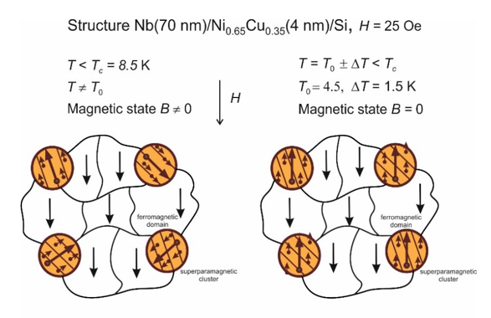
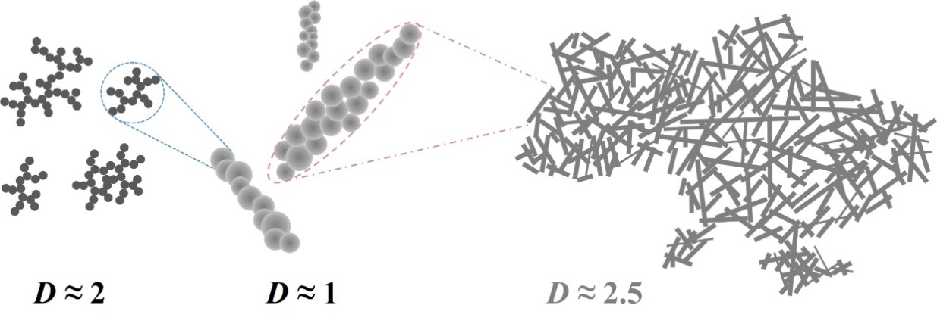
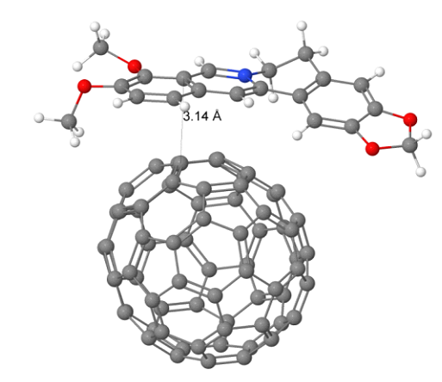
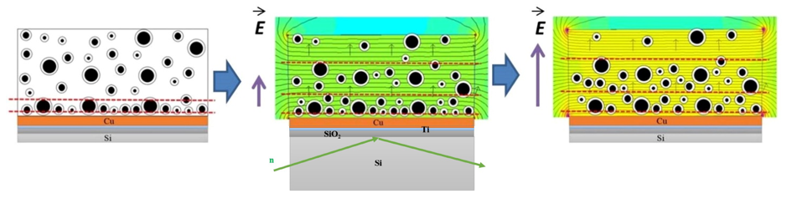
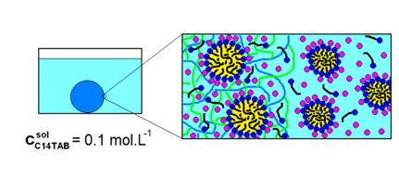
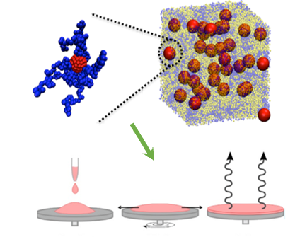
2. Physics of Nanosystems and Nanoscale Phenomena
2.1 Establishing of phenomena and effects, related to coexistence of magnetism and superconductivity in layered nanostructures composed of transition and rare-earth metals and actinide compounds, clarification of electromagnetic proximity effects on the metal-insulator interface.
2.2 Determination of structural characteristics of carbon nanomaterials, single wall carbon nanotubes on substrates. Analysis of the nanotube-substrate interface in the observed phenomena.
3. Physics of Complex Liquids and Polymers
3.1 Determination of the structural characteristics and clarification of the aggregation kinetics in fullerene solutions with various polarity, and with ammino adductes.
3.2 Analysis of the structural properties of magnetic nanosystems, including colloids, composites with magnetic nanoparticles, aggregation effects in magnetic fluids and core-shell nanostructures.
3.3 Determination of structural characteristics of polymer systems on substrates, surfactant micelles in bulk and at interfaces, surfactant-micelle complexes.
3.4 Analysis of structural organization of polymer nanomaterials, glass transition of polymers and polymer thin films.

Slide 10

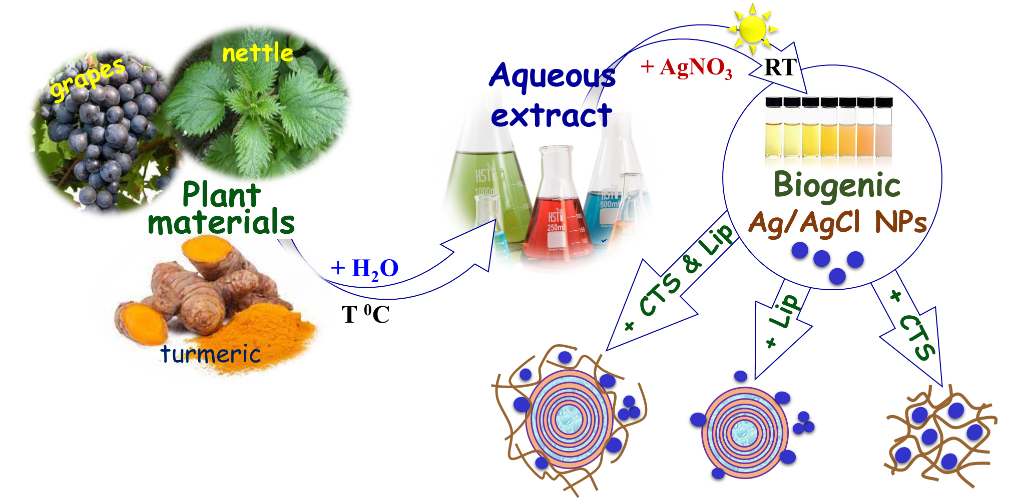
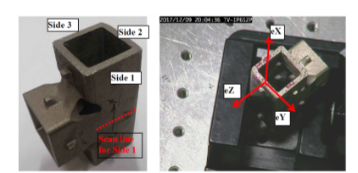
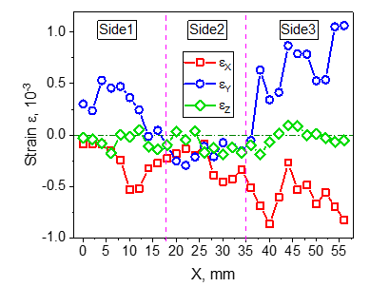
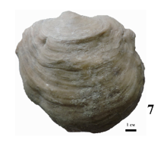
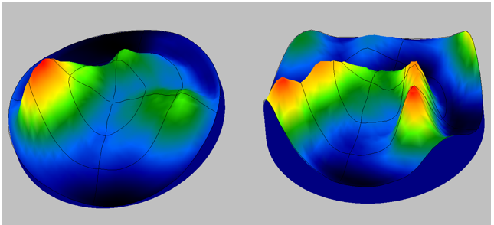
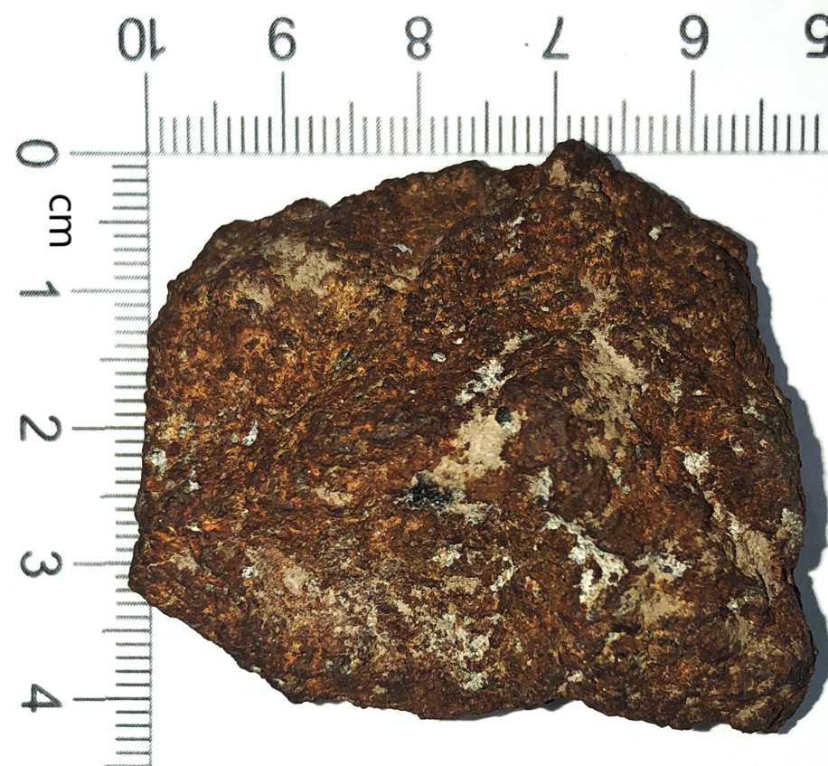
4. Biophysics and Pharmacology
4.1 Analysis of the physical and biological properties of lipid and native membranes, protein interactions, structure and properties of protein and membrane-protein complexes, crystallizaiton of proteins.
4.2 Determination of structural characteristics and clarification of properties of biohybride complexes.
5. Applied Materials and Engineering Sciences
5.1 Determination of residual stresses and microdeformations in constructional materials and bulk products, geological objects.
5.2 Texture analysis of biological objects, construction materials and earth rocks.
5.3 Analysis of internal organization and construction of 3D models of cultural and natural heritage objects, industrial materials and products using neutron radiography and tomography.

Slide 11
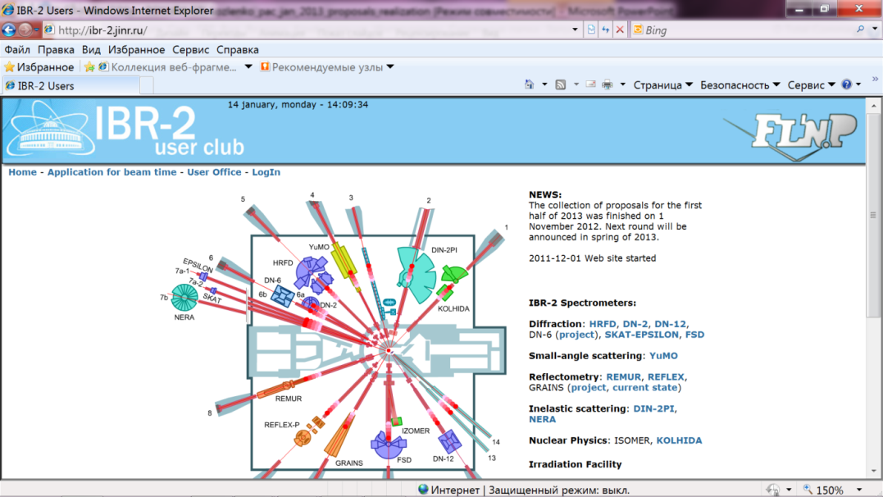
User Programme at IBR-2M Spectrometer Complex
Web-submission system: http://ibr-2.jinr.ru
Planned restart: autumn of 2024

Slide 12
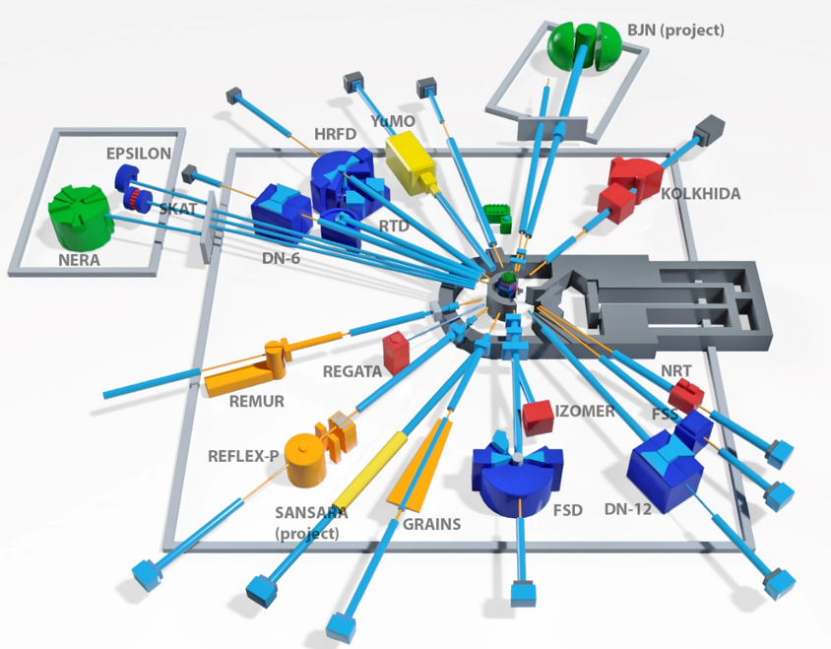
Development of the IBR-2 spectrometer complex
Expected methodical results:
Completion of construction of the basic configuration of the small-angle scattering and imaging spectrometer on beamline 10.
Development of neutron guide and detector systems for the new DN-6 diffractometer for studies of microsamples, aimed at improving its technical parameters and expanding the available range of high pressures.
Improvement of technical parameters and expansion of experimental capabilities of the GRAINS multifunctional reflectometer (startup of a new neutron beam chopper, development of electrochemical and liquid cells for experiments).
Enhancement of intensity, suppression of neutron background, development of sample environment systems for the operating spectrometers of the IBR-2 reactor (HRFD, RTD, DN-12, YUMO, FSD, REFLEX, REMUR, SKAT, EPSILON, NRT).
Upgrade of the FSS correlation spectrometer on beamline 13 and improvement of its technical parameters. Further development of the RTOF correlation method.
Enhancement of luminosity of the Xeuss 3.0 small-angle X-ray scattering and wide-angle diffraction instrument by installing a liquid-metal X-ray source, development of sample environment systems.
1. Completion of work on the development and construction of elements of basic configuration of a small-angle scattering and imaging spectrometer on beamline 10.
2. Modernization of the available IBR-2 spectrometers (HRFD, YuMO, RTD, DN-6, DN-12, FSD, NERA, REMUR, REFLEX, SKAT, EPSILON, FSS, NRT), aimed on improvement of their technical characteristics - intensity, background conditions, extension of experimental capabilities.
3. Development of laboratory equipment for samples characterization and physical properties measurements.
Notes:
Приоритетными задачами развития комплекса спектрометров реактора ИБР-2 будут являться:
Разработка и создание элементов основной конфигурации нового спектрометра неупругого рассеяния нейтронов в обратной геометрии BJN.
Завершение работ по разработке и созданию основной конфигурации спектрометра малоуглового рассеяния и имиджинга.
Модернизация и реконструкция действующих установок HRFD, YuMO, RTD, DN-6, DN-12, FSD, NERA, REMUR, REFLEX, SKAT, EPSILON, FSS, NRT, направленная на улучшение технических параметров и расширение экспериментальных возможностей.
Развитие лабораторного оборудования для характеризации образцов и измерений физических свойств.

Slide 13
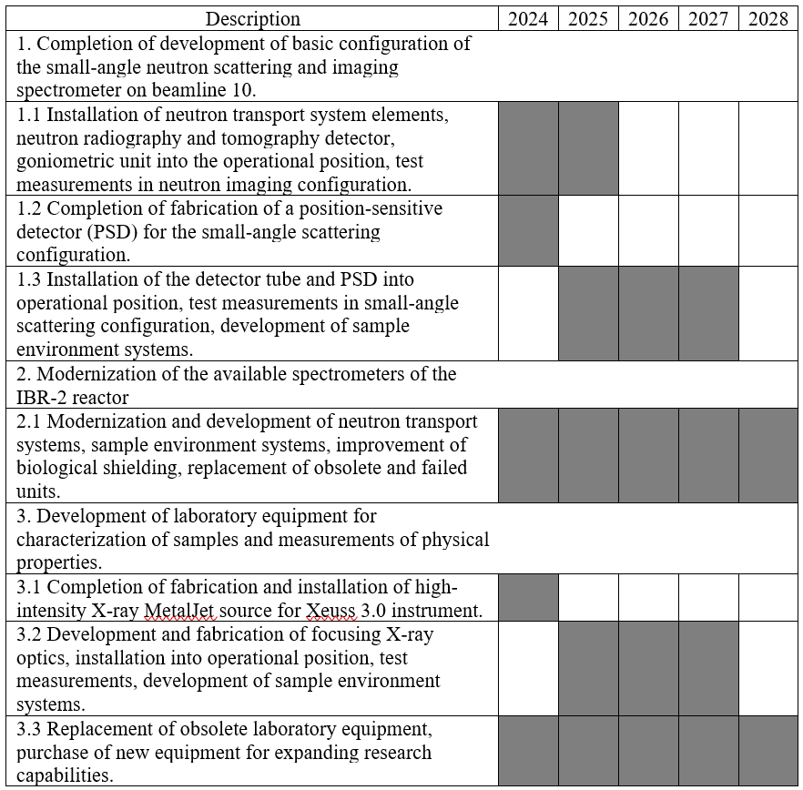
Planned schedule of methodical works and resources requirement
Names of costs, resources, sources of funding |  | Cost (kUSD) | Cost (kUSD) Expenditure per year
 |  |  | 1st year | 2nd year | 3rd year | 4th year | 5th year
 | International cooperation | 920 | 170 | 180 | 190 | 190 | 190
 | Materials | 1026 | 200 | 208 | 208 | 204 | 206
 | Equipment, Third-party services | 2160 | 460 | 400 | 400 | 450 | 450
 | Commissioning work
 | R&D contracts with other research organizations
 | Purchase of software | 50 | 10 | 10 | 10 | 10 | 10
 | Design/construction
 | Service costs
 | Total: | 4156 | 840 | 798 | 808 | 854 | 856

Slide 14
Personnel requirements
№№ n/a | Category of employee | Core staff, Amount of FTE | Associated Personnel, Amount of FTE
1. | research staff | 60.95
2. | engineers | 9.0
3. | specialists | 4.9
4. | employees
5. | workers
 | Total: | 74.85

Slide 15
International Cooperation
JINR: BLTP, LIT, FLNR, VBLHEP
Armenia – Foundation ANSL, SRCHCH (Yerevan)
Azerbaijan – AzTU, IP ANAS (Baku)
Belarus – BSTU, IAP NASB, INP BSU, RI PCP BSU, SPMRC NASB (Minsk )
Bulgaria - IE BAS, IEES BAS, INRNE BAS, ISSP BAS, UCTM (Sofia)
Cuba - InSTEC (Havana)
China – HEU (Harbin)
Arab Republic of Egypt – ASU, CU, EAEA, (Cairo)
Hungary – Wigner RCP (Budapest), US (Szeged)
Kazakhstan – INP (Almaty)
India - NIT (Patna)
Mongolia – IPT MAS (UlaanBaator)
Romania - IFIN-HH, INCDIE, UB, UPB (Bucharest), I.N.C.D.T.I.M., RA BC-N, UBB (Cluj-Napoca), MINAC, UOC (Constanta), UC (Craiova), NIRDTP, TUIASI, UAI, UAIC, USAMV (Iasi), NIMP (Migurele), SCN, UPIT (Pitesti), UVT (Targoviste), UCT, ISIM, LMF CCTFA, UVT (Timisoara), DDNI (Tulcea),
Russia - IA RAS, IC RAS, ICP RAS, IEPT RAS, IGEM RAS, IGIC RAS, IMET RAS, INMI RAS, Inst. Immunology, IPE RAS, MIET, MISiS, MSU, NNRU "MEPhI“, NRC KI, PIN RAS, SINP MSU (Moscow), SUSU (Chelyabinsk), ISSP RAS (Chernogolovka), MIPT (Dolgoprudny), PNPI NRC KI (Gatchina), Dubna State Univ. (Dubna), IKBFU (Kaliningrad), KFU, KNRTU (Kazan), HPPI RAS, INR RAS (Moscow, Troitsk), UNN (Nizhny Novgorod), IPM RAS, ICMM UB RAS, ITCh UrB RAS (Perm), RIP SFU (Rostov-on-Don), CRISM "Prometey“, IMC RAS, Ioffe Institute, SPbSU (St. Petersburg), SSPI (Sterlitamak), TSU (Tula), IMP UB RAS (Yekaterinburg)
Serbia – INS “Vinca” (Belgrade), UNS (Novi Sad)
Republic of South Africa – UP, NECSA (Pretoria)
Switzerland - PSI (Villigen)
Taiwan – NSRRC (Hsinchu)
Tajikistan – NAST, PHTI NAST, TTU (Dushanbe)
Uzbekistan - INP UAS (Tashkent)
Vietnam – DTU (Da Nang), IOP VAST (Hanoi)
Czech Republic - BC CAS, CTU, CU, IG CAS, IP CAS, NPI CAS
Germany – UniBonn, RUB, MLU, Hereon, TU Darmstadt, KIT, IFM-GEOMAR, Rostock Uni., TUBAF, MPI-FKF
Italy - UniMe
Spain – ICMAB-CSIC, BCMaterials, CENIM-CSIC
Latvia – ISSP UL
Poland – BUT, UwB, INCT, UW, AGH-UST, INP PAS, JU, UMCS, AMU, WPUT
Slovak Republic – CU, IEP SAS
USA - UC
Japan - Keio Univ. Waseda Univ.

Slide 16



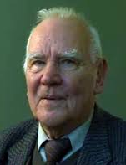
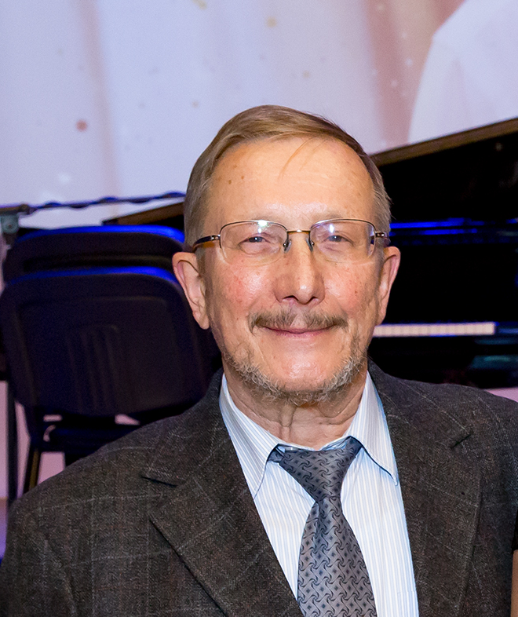
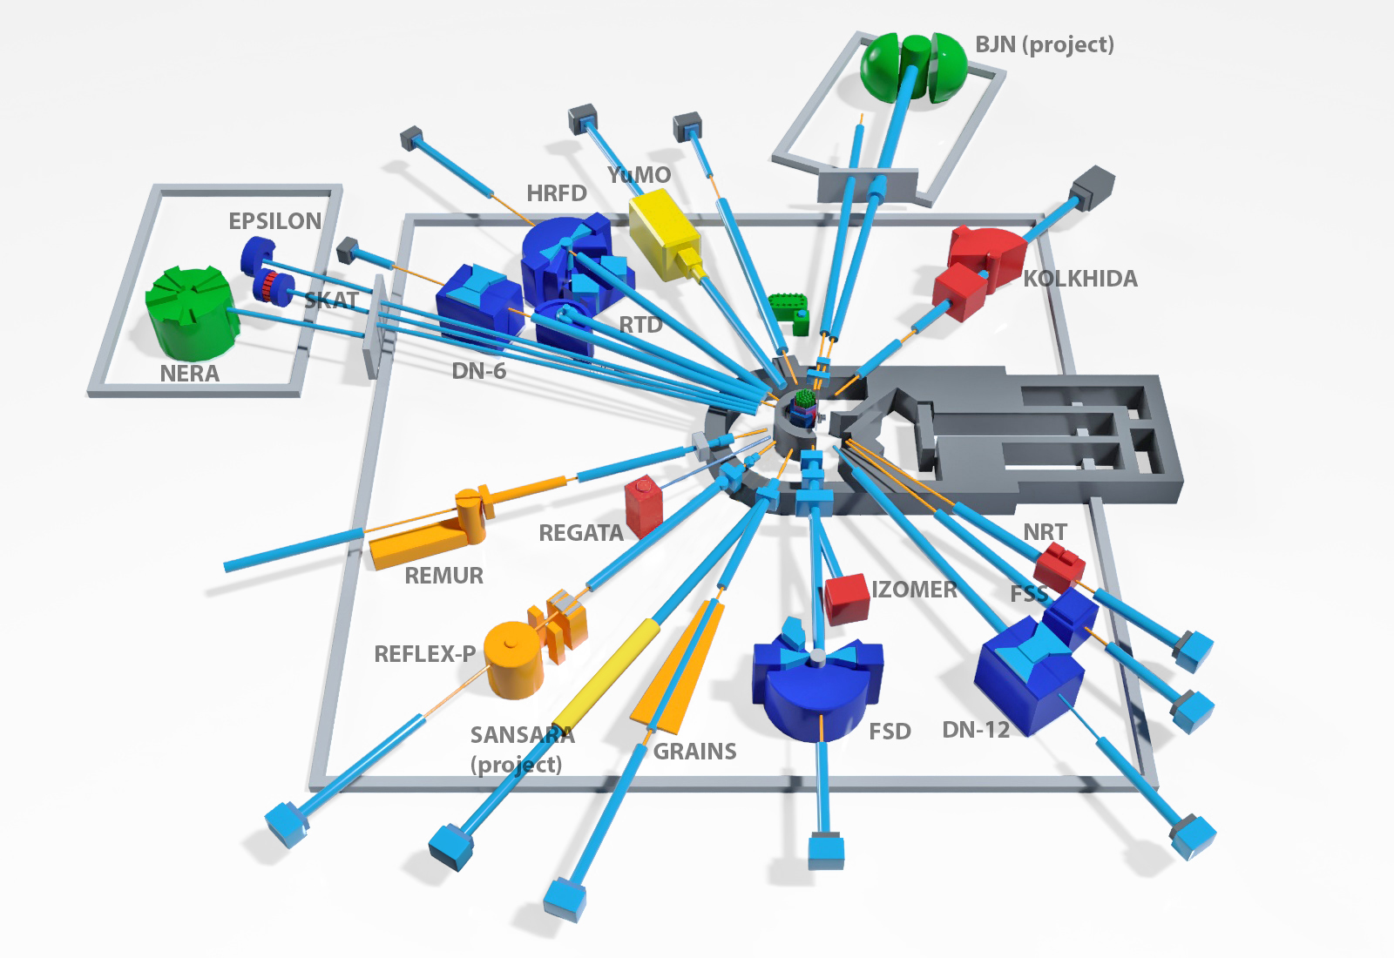
Development of an inelastic neutron scattering spectrometer
in inverse geometry
BJN (Bajorek-Janik-Natkaniec)
at the IBR 2 reactor.
Project Report (2021-2023) and
Proposal for continuation as a Subsubproject
Dorota Marta Chudoba

Slide 17
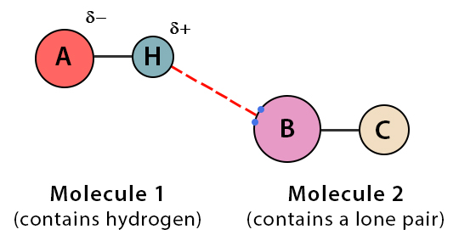
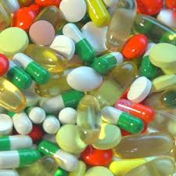
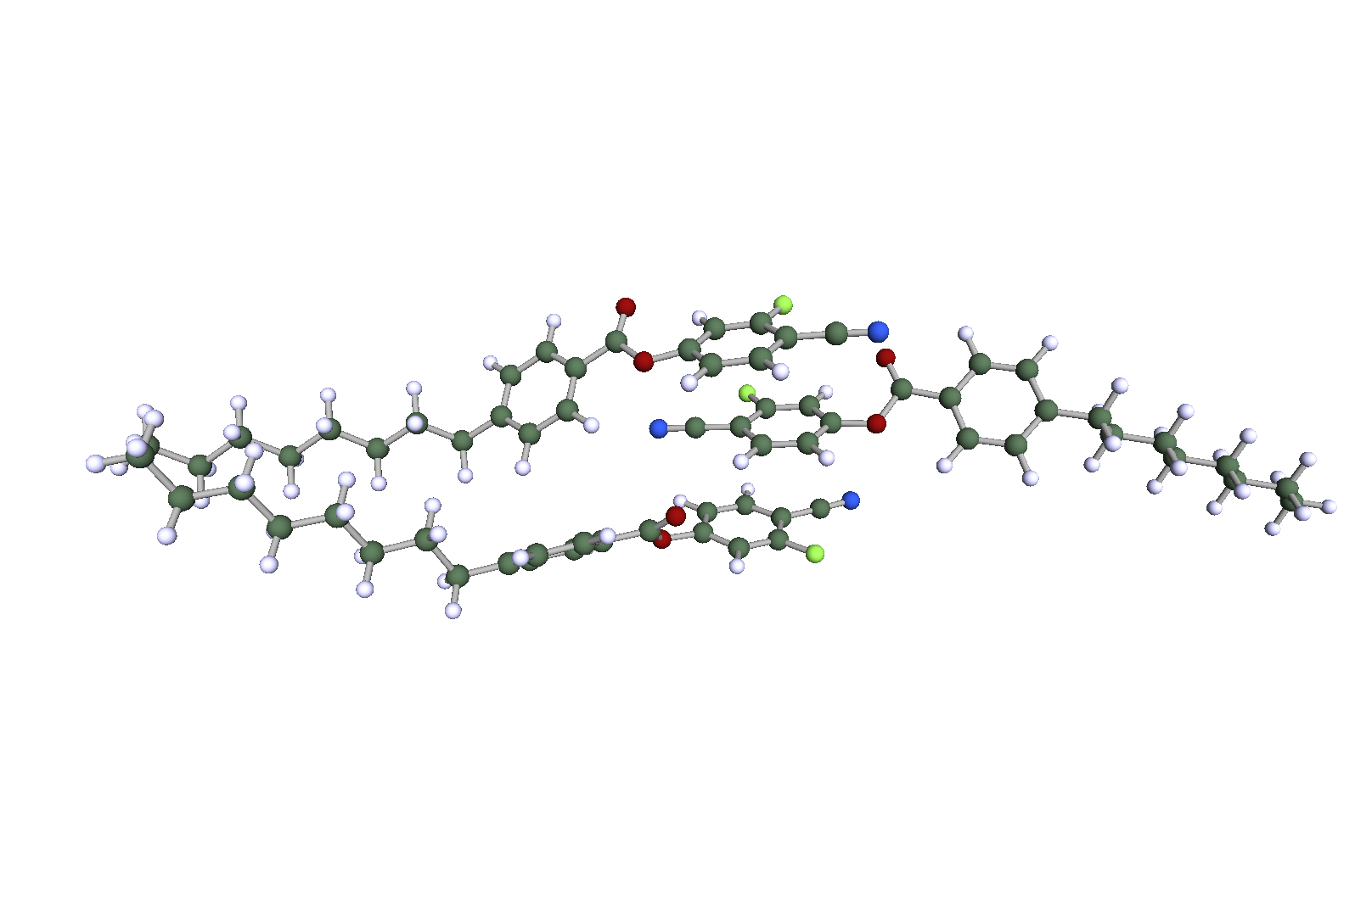
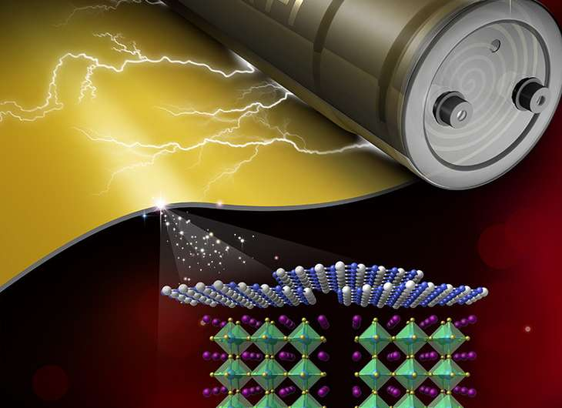
Scientific motivation
Hydrogen bonds in molecular matter (vibrational analysis)
Dynamics studies of pharmaceutics (in bulk (native) state and as “micronized” or amorphized powders)
Dynamics studies of liquid crystals
Materials for energy storage, e.g. plasticizer-SPE systems for Li batteries
Studies of soft matter (e.g. membranes)
Photonic materials of industrial applications
Desires:
- higher luminosity → smaller samples or shorter counting time – Lower sample purchase costs → more users.
- broader energy transfer range (0-330 meV / 2661 cm⁻¹) → broader range of analyzed vibrations.

Slide 18
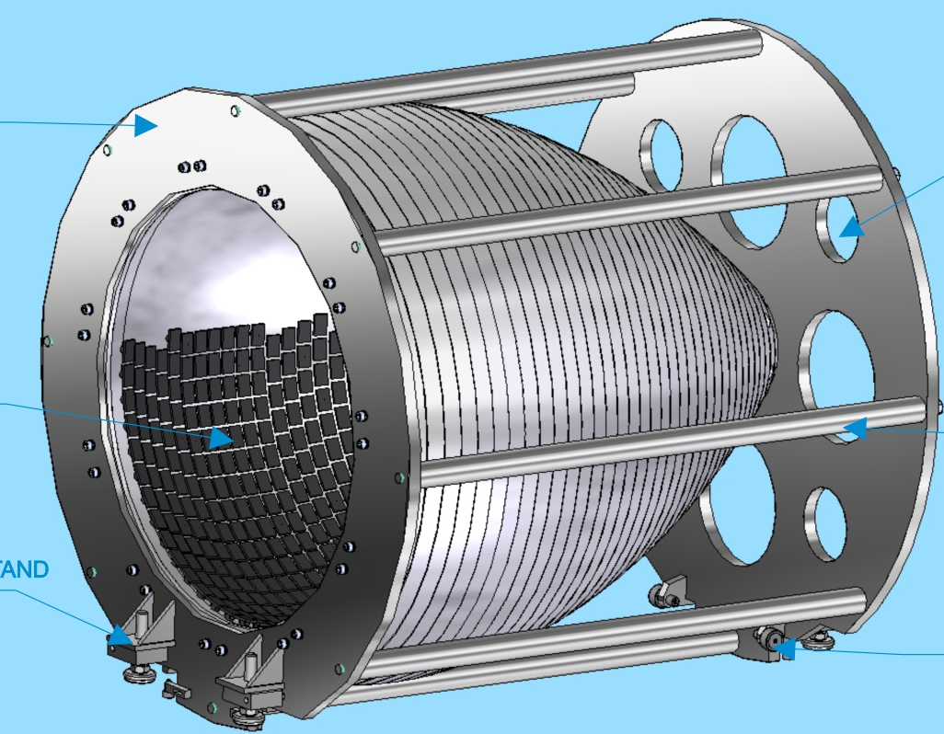
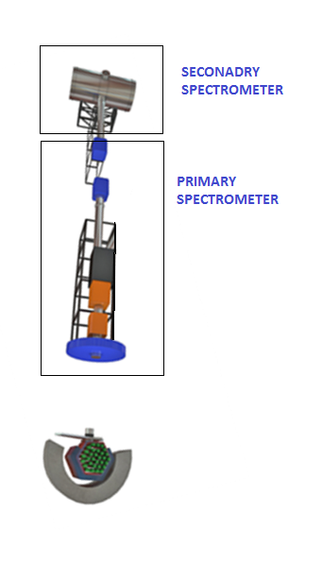
Expected characteristics
 | NERA | BJN
Analyzer area | 15х3Х25 1 125 сm² | 4x4x2100 33 600сm²
Energy transfer | Below 100 meV | Up to 330 meV
Ratio input/output to neutronguides | 16х5сm²/5x5сm² 3.2 | 20х20сm² / 3х3сm² 44.44 | a gain in flux density (without taking into account the higher quality of the neutronguide) 44.44/3.2 = 14
Solid angle | ~ 0.2 sr | ~ 6.4 sr | Solid angle gain 30
Ratio of luminosity of new spectrometer and NERA |  |  | 30х14 = 420 times higher i.e. measurements of a sample with the mass of tens of mg will be possible.

Slide 19
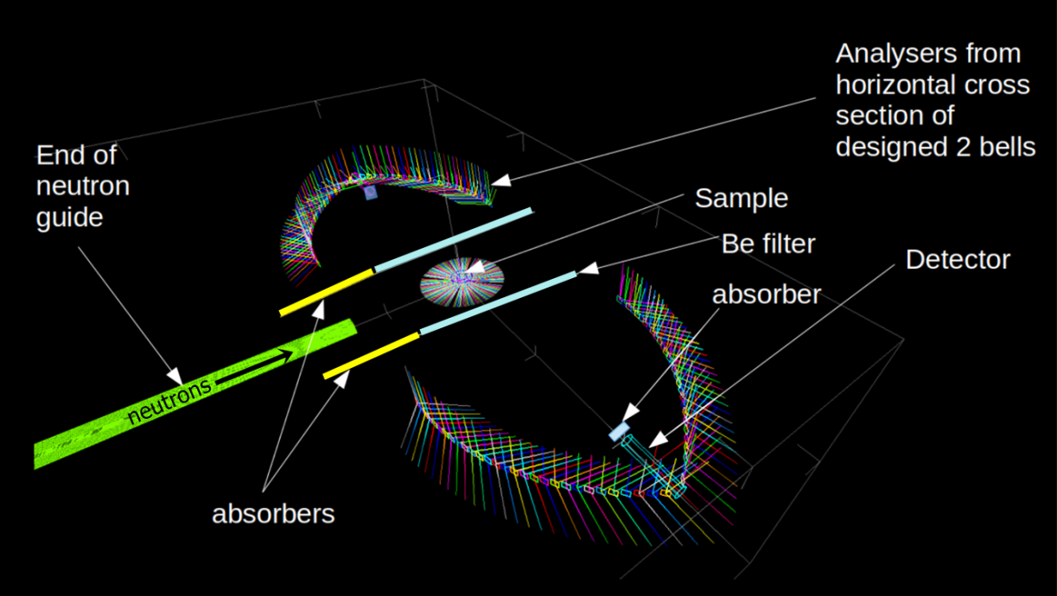



Stage I, 2021-2023, main results report
Simulations
Report
Geometry of the spectrometer
McStass
TEAM
Chudoba D.
Goremychkin
Belushkin A.
Kruglov A.
Bednarchuk V.
Sadilov V.
Churakov A.
Chernikov A.
Altynov A.
Kirilov A.
Kuznetsov А.
The scattering angle ranges from 28 deg to 80 deg giving the solid angle of 3.21 sr.
Path length between sample and detector was fixed to 1.1 m.

Slide 20


HOPG crystal system
Report
Purchase of HOPG crystal - ООО «Atomgraph AG»
2022/2023 – 600 pcs
(total amount 2100 pcs)
HOPG crystal – testing: spectrometer STOIK at IR8 reactor
The criterion for optimizing the resolution/intensity is the approximate equality of the contribution from the time width of the neutron burst and from the transmission width of the energy analyzer.
According to this criterion, the required mosaicity of HOPG should be FWHM ≈ (2.5 ± 0.5).

Slide 21








Detector mounting systems
Boron carbide
Report
Purchase of boron carbide - OJSC «Hermes»
2022/2023 – 2060 pcs
Assembly of cylindrical counters d=18 mm (analogue of SNM-18).
The counter wall thickness is 0.2 mm, 3He pressure is 8 atm.

Slide 22



Prototype
Report
FRAKO-TERM, Poland
Scheduled Manufacture date: june 2023

Slide 23




Demolition of old spectrometers
Hall renovation
Report
Not included in the Project 2021-2023
The DIN-2PR spectrometer in building 117/1 has been completely dismantled.
Dismantled background choppers in the annular corridor of the IBR-2 reactor.
The flight bases and the sample chamber of the DIN-2PI spectrometer were dismantled in the experimental hall No. 2 of the IBR-2 reactor.
Project of renovations of building 117/1 was developed – contract with Energodiagnostika LLC (194719.34 USD –t. 1142).
On March 31, 2023, the 1st stage of renovations work in building 117/1 should be completed, including the preparation of an experimental hall with a gallery for the new neutron guide (total contract: 656812.86 USD-t.1143).
6. A survey of the ceiling in the experimental hall in building 117/1 was carried out for the technical feasibility of installing a cantilever crane. Contract - JSC "GSPI„ (13112.56 USD-t.1143)

Slide 24
Report
Project expenses
Description of units and systems, resources, funding sources | Cost of units (k$).
Construction design and technical specification | 222
Highly Orientated Pyrolytic Graphite | 186 (600pc)
Boron carbide | 74 (2060pc)
Total | 482

Slide 25
Proposal for continuation 2024 -2028
Proposal for continuation (2024 – 2028)
1 step
SECONDARY SPECTROMETER
FILTERS
ANALIZATORS
DETECTORS
VACUUM CONTAINER
FRAME
CRYOSTAT & SAMPLE HOLDER
TEAM
Chudoba D.
Goremychkin
Belushkin A.
Kruglov A.
Bednarchuk V.
Sadilov V.
Churakov A.
Chernikov A.
Altynov A.
Kirilov A.
Kuznetsov А.
2 step
PRIMARY SPECTROMETER:
NEUTRONGUIDE & SPLITTER
BACKGROUND CHOPPER
CHOPPER

Slide 26
Works description 2024 -2028 | 2024 |  |  |  | 2025 |  |  |  | 2026 |  |  |  | 2027 |  |  |  | 2028
 | I |  | II |  | I |  | II |  | I |  | II |  | I |  | II |  | I |  | II
Development of a draft design of the spectrometer elements - preparation of technical drawings of the spectrometer elements, which include: Beryl filter cryostat with sample holder
Testing of Prototype
Purchase of HOPG crystal
Purchase of boron carbide block attachment systems to suppress forward scatter from the sample into the detector
Manufacturing of the Beryl filter mounting system
Manufacturing of the analyzer mounting system (bells)
Manufacturing of vacuum container and the frame
Design and manufacturing of cryogenic system
Design and manufacturing of electronic system
Purchase of neutron guide
Purchase of choppers
Instalation of neutronguide and choppers
Renovations of building

Slide 27
Resources requirement
Personnel requirement
Names of costs, resources, sources of funding |  | Cost (kUSD) | Cost (kUSD) Expenditure per year
 |  |  | 1st year | 2nd year | 3rd year | 4th year | 5th year
 | International cooperation
 | Materials | 606 | 256 | 200 | 150
 | Equipment, Third-party services | 1940 | 150 | 250 | 400 | 550 | 590
 | Commissioning work
 | R&D contracts with other research organizations
 | Purchase of software
 | Design/construction
 | Service costs
 | Total: | 2546 | 406 | 450 | 550 | 550 | 590
№№ n/a | Category of employee | Core staff, Amount of FTE | Associated Personnel, Amount of FTE
1. | research staff | 3.0
2. | engineers | 0.7
3. | specialists
4. | employees
5. | workers | 0.2
 | Total: | 3.9
Participating organizations
Organization | Country | City
FRAKO-TERM | Poland | Torun
PNPI NRC KI | Russia | Gatchina
NRC KI |  | Moscow
INR RAS
LLC Atomgraph AG

Slide 28
Thank You for Your Attention!

