Slide 1
56
th
Meeting of the
Programme Advisory Committee for Nuclear Physics
26 January 2023
Valery V. Nesvizhevsky

Slide 2
Programme Advisory Committee for Nuclear Physics, 56th. meeting, 26 January 2023
1. Opening of the meeting G. Trubnikov
2. Structure and main directions of JINR research. Scientific results in recent years and the development G. Trubnikov
of JINR for 2024–2030
3. Information on the Resolution of the 132nd session of the JINR Scientific Council (September 2022) and on the decisions of the JINR S. Dmitriev
Committee of Plenipotentiaries (November 2022) of the JINR Committee of Plenipotentiaries (November 2021)
4. Draft Seven-Year Plan for the Development of JINR in nuclear physics for 2024–2030:
4.1 FLNR main tasks: status and proposals for the Seven-Year Plan for the Development of JINR for 2024–2030 S. Sidorchuk
4.2 FLNP main tasks: status and proposals for the Seven-Year Plan for the Development of JINR for 2024–2030 V. Shvetsov
4.3 Research in non-accelerator neutrino physics and astrophysics and proposals for the Seven-Year Plan for E. Yakushev
the Development of JINR for 2024–2030
4.4 BLTP main tasks in the study of the theory of nuclear systems: status and proposals for the N. Antonenko
Seven-Year Plan for the Development of JINR for 2024–2030. Proposal for the extension of
the theme «Theory of nuclear systems»
4.5 Status and prospects of the MLIT scientific programme V. Korenkov
Closed session:
5. Meeting of the PAC members with the JINR Directorate
6. Preparation of the PAC recommendations
7. Adoption of the PAC recommendations
8. Closing of the meeting

Slide 3
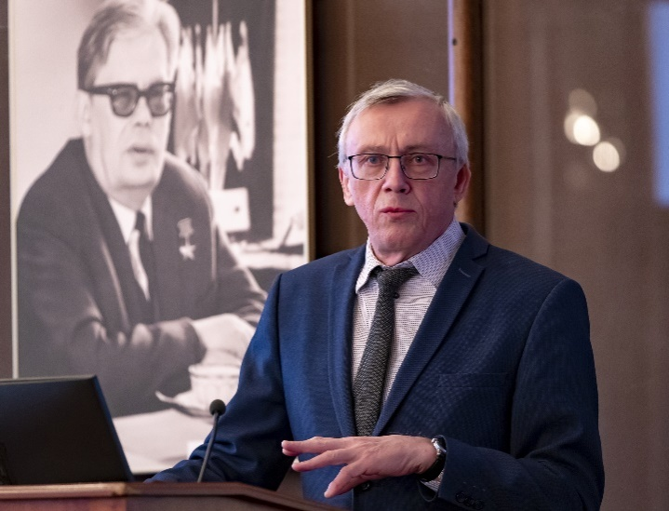
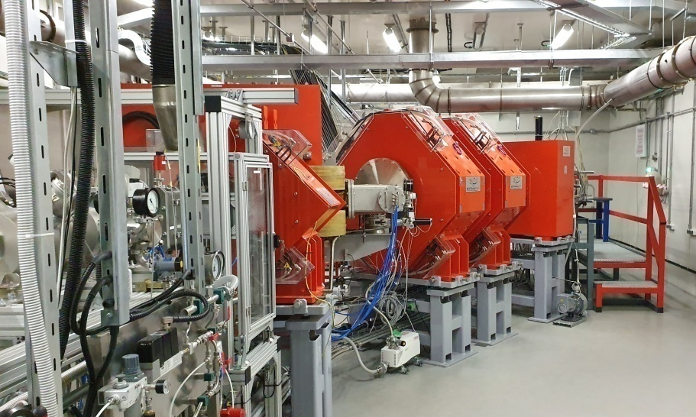
Flerov Laboratory of Nuclear Reactions (FLNR):
Status and proposals in the 7-year plan of development for 2024 - 2030
The heavy-ion research in the FLNR is performed in the framework of two themes:
“Synthesis and properties of superheavy nuclei, structure of nuclei at the limits of nucleon stability”
“Development of the FLNR accelerator complex and experimental setups (DRIBs-III)”.
Sergey Sidorchuk
First experiments at SHE Factory (2020 -2022)
Experiments: ²⁴³Am + ⁴⁸Ca → ²⁹¹Mc* ²⁴²Pu + ⁴⁸Ca → ²⁹⁰Fl*
²³⁸U + ⁴⁸Ca → ²⁸⁶Cn*
²³²Th + ⁴⁸Ca → ²⁸⁰Ds*
238 new events of synthesis of superheavy nuclides
(3 times more than in the entire history of research);
Decay properties of 33 isotopes;
5 New isotopes: ²⁸⁷Mc, ²⁶⁴Lr, ²⁷⁶Ds, ²⁷²Hs, ²⁶⁸Sg;
New decay modes: ²⁶⁸Db (alpha-decay), ²⁷⁹Rg (spontaneous fission);
Indication of the 1st excited state in ²⁸⁶Fl;
Test of target stability up to 6.5 pμA of ⁴⁸Ca;
DGFRS-2:
launch 2020

Slide 4
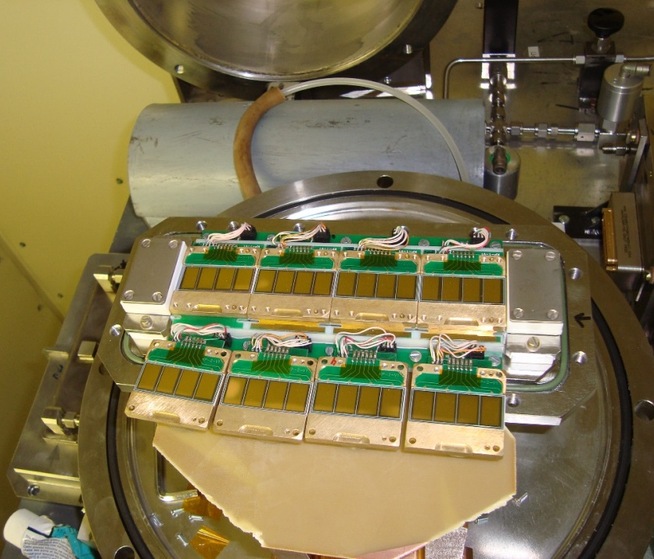
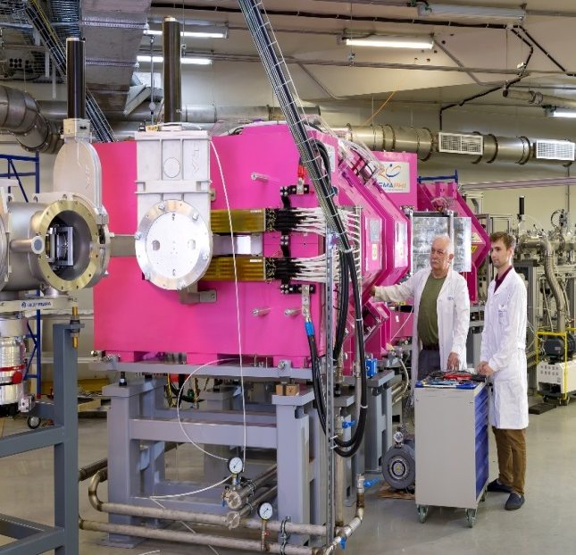
Chemistry of Cn&Fl:
At the Superheavy Element Factory, preparations are underway for the first experiment to study the chemical properties of elements 114 (flerovium) and 112 (copernicium) in the reaction of ⁴⁸Ca + ²⁴²Pu → Fl*
The first commissioning tests of the GRAND separator on a beam of ⁴⁸Ca have been successfully performed.
A fairly compact image of the recoil nuclei in the focal plane of the detector chamber was produced: 5 x 5.5 cm; this result allows to proceed to the next stages of the experiment preparation.
First run (Nov.-Dec. 2022) ⁴⁸Ca + ²⁴²Pu → Fl*
Second run is planned in 2023.

Slide 5
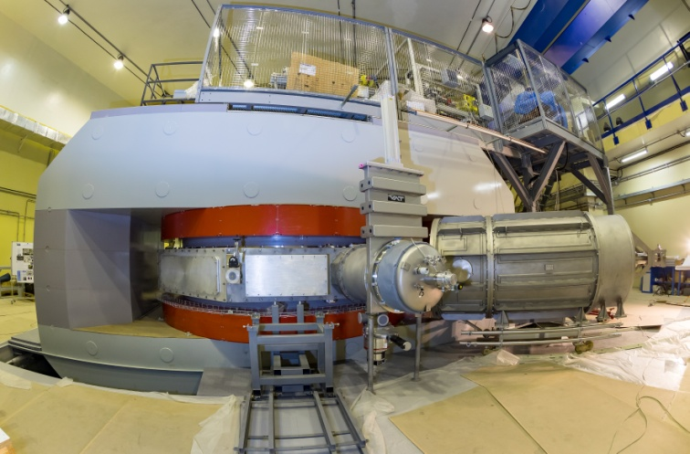
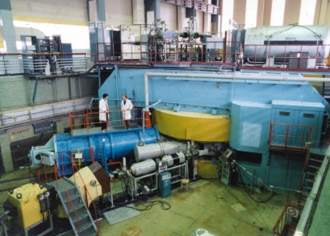
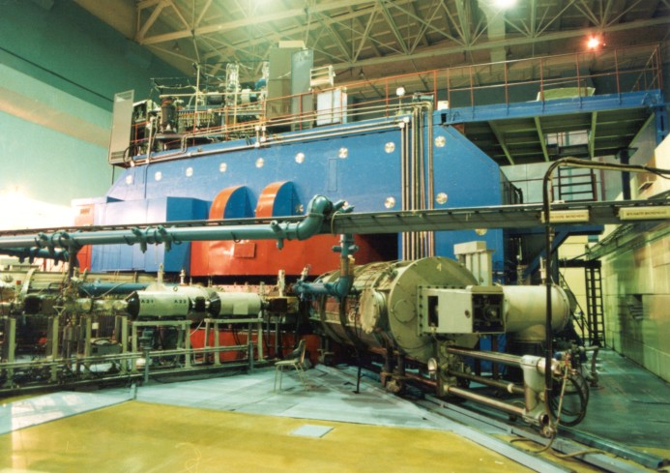
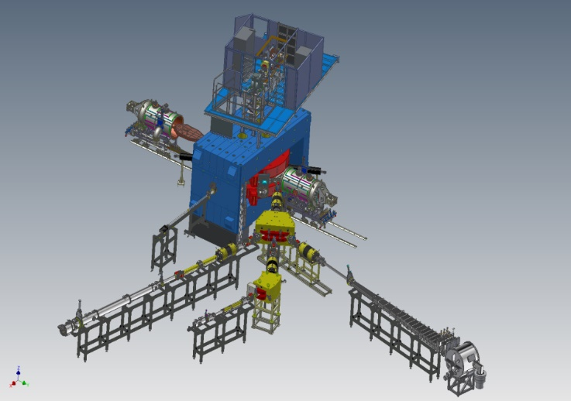
accelerator complex DRIBs-3
DC280
U400 → U400R
U400M
DC140
Main goals:
Experiments at the extremely low (σ<100 fb) cross sections:
Synthesis of new SHE in reactions with ⁵⁰Ti, ⁵⁴Cr ...;
Synthesis of new isotopes of SHE;
Search for rare decay modes of SHE;
Study of excitation functions.
Experiments requiring high statistics:
Nuclear spectroscopy of SHE;
Precise mass measurements;
Study of chemical properties of SHE.
Reconstruction:
The reconstruction of the accelerator is scheduled for the beginning of the upcoming seven-year period
CONSTRUCTION
of the NEW EXPERIMENTAL HALL (2023-2025)
Completion of modernization and launch in 2023
Development of a new facility for applied research:
The main goals of the project include studies within solid state physics, surface modifications of materials, production of track membranes and testing of electronic components for single radiation effects.
Ion beams from O to Bi with energies 4.8 and 2.1 MeV/n for applied studies.
Expected results of the upgrade in 2023:
Stable operation;
Improved beam quality;
Increase of beam intensities.
As the first experiment is planned to continue studies of the ⁷He structure in the ⁶He(d,p)⁷He reaction.

Slide 6
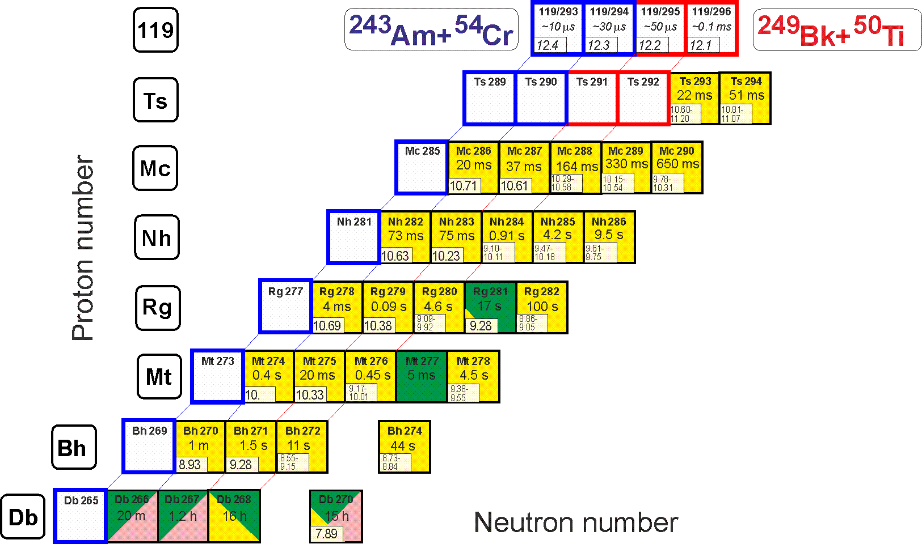
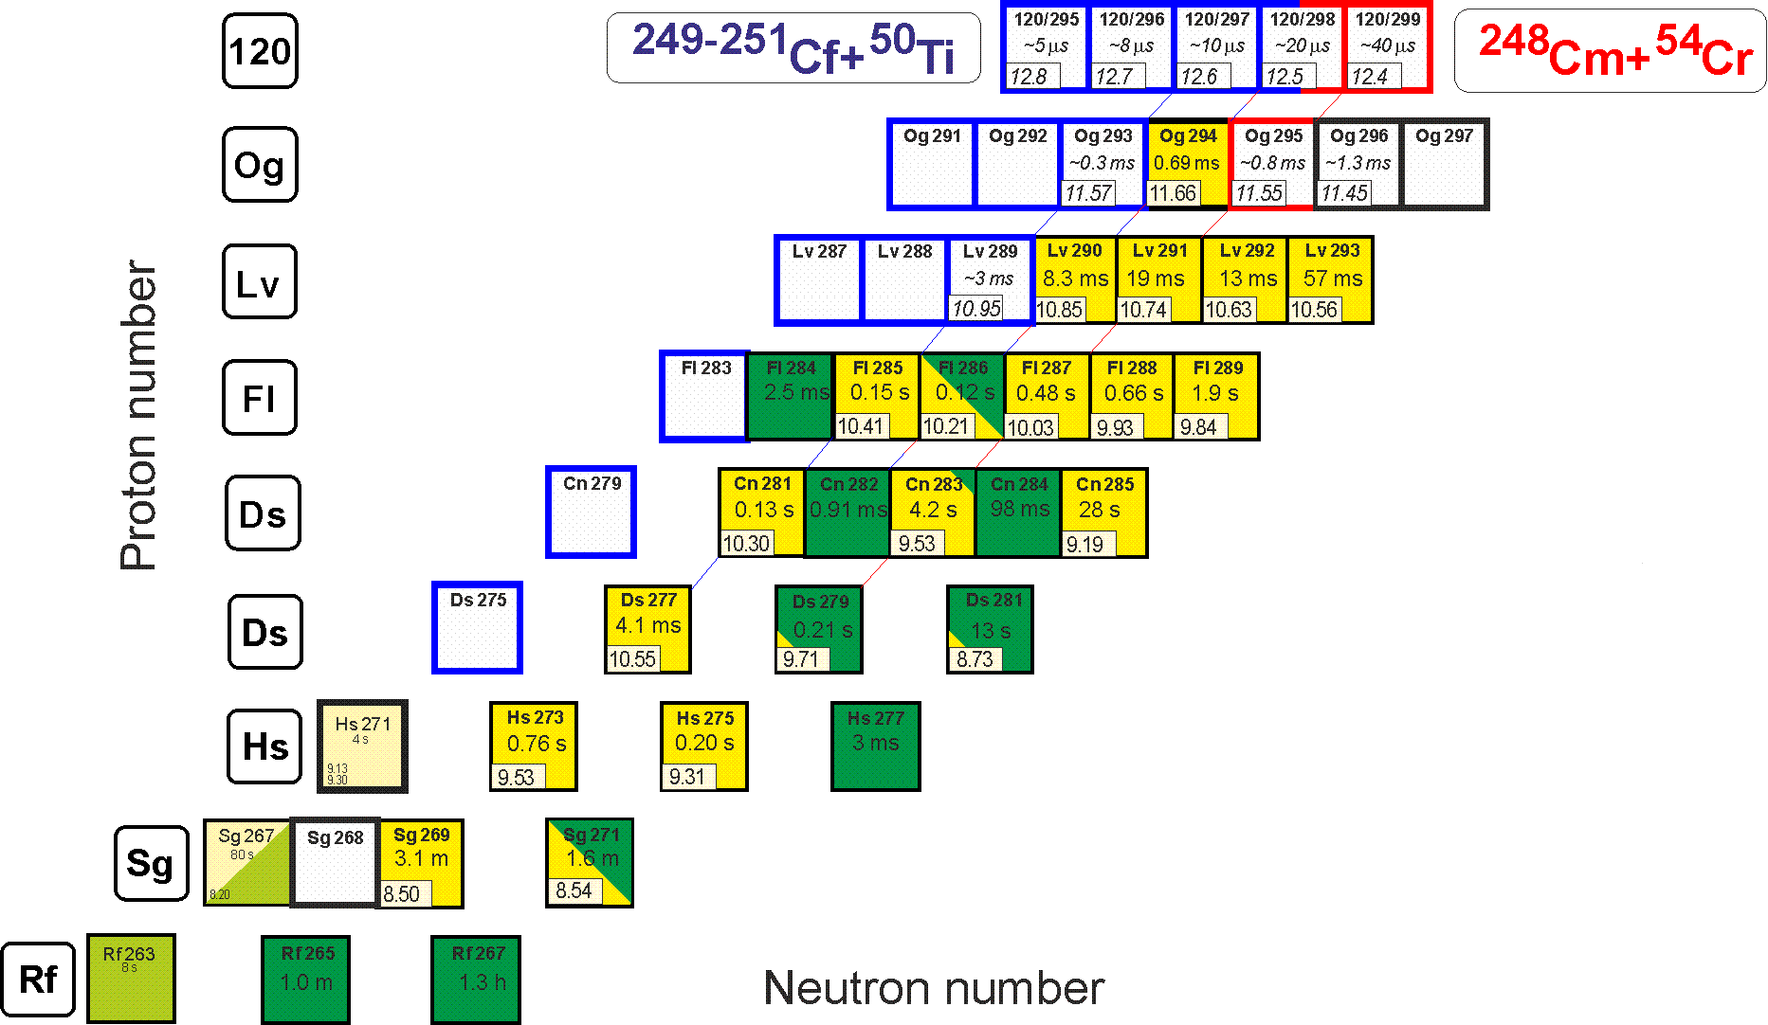
Planned research areas for 2024 – 2030
New elements
DGFRS II
²⁴³Am(⁵⁴Cr,3-4n)^{293,294}119 (σ ⁓ 0.01 pb)
²⁴⁹Bk(⁵⁰Ti,3-4n)^{295,296}119 (σ ⁓ 0.1 pb)
I_{beam}=3 pμA,
h_{t}=0.4 mg/cm²,
ε_{coll}=0.6,
σ=0.05 pb → ≈1 event per month
^{245,246,248}Cm(⁵⁴Cr,3-4n)²⁹⁵⁻²⁹⁹120
²⁴⁹⁻²⁵¹Cf(⁵⁰Ti,3-4n)²⁹⁵⁻²⁹⁸120
Tasks:
Beam intensity increase (⁵⁰Ti,⁵⁴Cr);
License to work with RM;
I class RCL at the SHE Factory (Bk,Cf).

Slide 7
Planned research areas for 2024 – 2030
Beyond the nucleon stability line with 2n-transfer
¹⁰He, ¹³Li,¹⁶Be. Ligher neutron-rich isotopes like ^{6,8}Не, ¹¹Li, ¹¹⁻¹⁴Be are also in the zone of interest;
Structure of neutron-rich isotopes in (d,p) reactions;
Impact of the reaction mechanism on the population of low energy spectra of exotic nuclear systems;
Exotic radioactivity
(formation of 2-p radioactive nuclei in (³He,n) reactions, ²⁶S);
Isotopic symmetry of nuclear reactions
(³H,³He) and (³He,³H);
Total reaction cross-sections;
β-decays of neutron-rich nuclei, β-delayed decays.
¹⁴Be
-p
¹¹Li
-α
⁸He
¹⁰He
+2n
Instrumentation Development
In-beam detectors;
Neutron detector array (increase in the number of modules);
Charged particles detector arrays (angular and energy acceptance);
RF-kicker (operational run with the ion beam);
Zero-angle spectrometer hodoscope;
Cryogenic tritium target.

Slide 8
Recommendation:
The PAC heard with interest the report on the main achievements of FLNR for the period 2017–2023.
The PAC supports the proposed strategy for the development of heavy-ion physics research in FLNR for 2024–2030.
The PAC expects that its research areas will be represented in the form of themes and projects at the next meeting of the PAC for Nuclear Physics in June 2023.

Slide 9
133 Scientific Council recommendation:
Heavy-ion research in the Flerov Laboratory of Nuclear Reactions is aimed at completing the tasks outlined in two themes: “Synthesis and Properties of Superheavy Elements, the Structure of Nuclei at the Limits of Nucleon Stability” and “Development of the FLNR Accelerator Complex and Experimental Setups (DRIBs-III)”.
The SC notes with satisfaction the discovery of 5 new isotopes in the reactions of ⁴⁸Са beams with Th, U, Pu, and Am targets at the SHE Factory. Of particular relevance is the detection for the first time of the alpha decay branch of ²⁶⁸Db and of the new isotope ²⁶⁴Lr. The first experiments are currently conducted for studying the chemical properties of superheavy elements 112 (Cn) and 114 (Fl) using the GRAND separator. A number of gamma- and neutron spectroscopy experiments with a series of Rf and Fm isotopes were performed at the upgraded SHELS-GABRIELA setup.
The SC recognizes that one of the essential tasks of FLNR in 2024–2030 is the synthesis of new elements 119 and 120 in such reactions as ⁵⁴Cr+²⁴⁸Cm and ⁵⁰Ti+²⁴⁹Bk. The further experimental studies of the structure and mechanisms of production of nuclei near and beyond the limits of nucleon stability are planned in the FLNR at the ACCULINNA-1, ACCULINNA-2, and MAVR setups. A project for upgrading the U-400 → U-400R accelerator and the new 1500 m2 experimental hall has been prepared.
The SC supports the proposed strategy for the development of heavy-ion physics research in FLNR for 2024–2030.

Slide 10
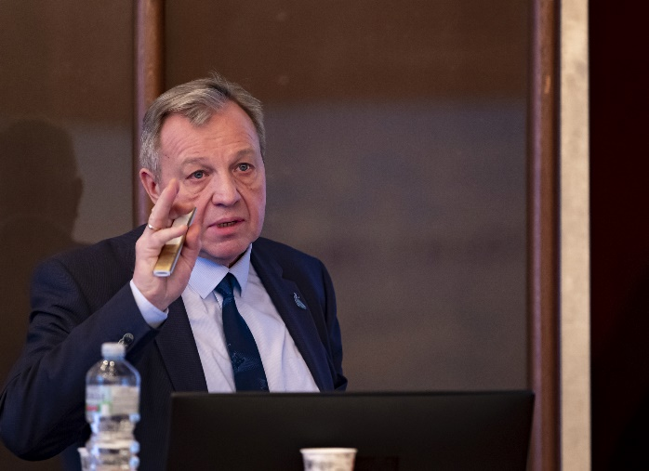
Frank Laboratory of Neutron Physics (FLNP) main tasks: status and proposals for the Seven-Year Plan for the Development of JINR for 2024–2030
Directions in research and activities:
Investigations of violation of fundamental symmetries in the neutron-nucleus interaction and collecting related nuclear data:
TRI and ROT effects in nuclear fission;
prompt neutron emission in fission (the ENGRIN project since 2022);
Parameters for (n,p) and (n,α) reactions in astrophysics and engineering;
angular distribution of gamma-ray emission at (n,n') reaction (the TANGRA project since 2014 ).
Investigations of the neutron fundamental properties and interactions, ultracold and very cold neutron physics:
quantum-mechanical effects with slow neutrons;
developing of new sources for UCN and VCN;
interaction of slow neutrons with nanoparticles.
Nuclear data.
Exploitation and development of the IREN facility.
Valery Shvetsov
Applied and methodological research: Ecology; Archeology; Nanotoxicology; Analysis of Extraterrestrial objects; Developing new technologies for electronics and applications; etc. | Neutron Activation Analysis at IBR-2 and IREN; Prompt Gamma Activation Analysis at IBR-2; Neutron Resonance Capture Analysis at IREN; Ion Beam Analysis at EG-5; Other analytical techniques (IR, ICP-MS, X-ray); Project “Modernization of EG-5”

Slide 11
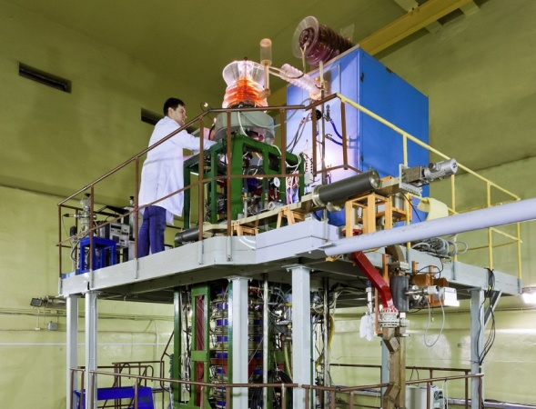
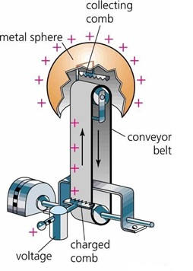
Plans for 2024-2030
IREN neutron source. It allows us to realize a research program on fundamental nuclear physics with neutrons and nuclear data measurements similar to the program at neutron sources like GELINA (IRMM, Geel).
Scientific program for IREN
Nuclear fission in resonances.
Search for and study of P- and T- violating effects.
Nuclear data for nuclear engineering and astrophysics.
Neutron activation analysis and prompt gamma analysis.
Experimental study of the isotopes production in photonuclear reactions
Tasks for the next 7years:
Increase neutron yield up to
3⋅10¹² n/sec
Electron energy up to 150 MeV;
Peak current 2,5 A;
Pulse length 150-200 ns’
modernization of experimental halls of the facility
Increase operation time up to 3000 hours/year
EG-5 electrostatic generator as neutron source and source for ion beam analysis
Scientific program for EG-5 in nuclear physics
Obtaining data for nuclear engineering and astrophysics: integral and differential neutron cross sections, angular correlations in the energy range.
Tasks for the next 7years:
increase current up to 50 $μ$A;
increase energy up to 4.1 MeV;
modernization of experimental infrastructure;
development of ion microbeam.

Slide 12
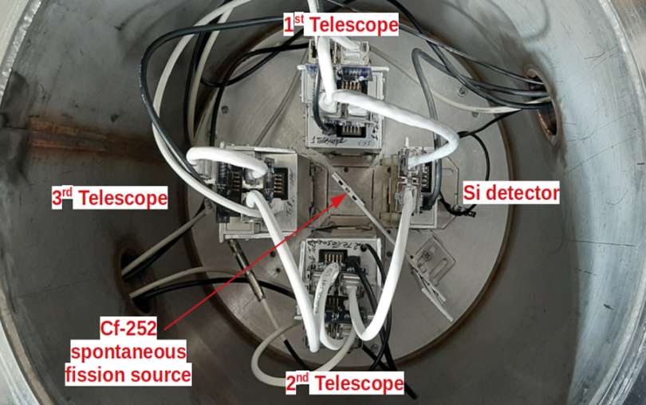
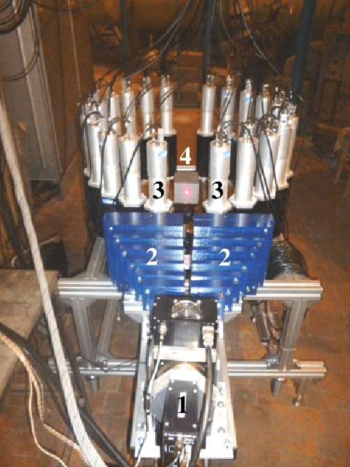
Plans for 2024-2030
NEUTRON NUCLEAR PHYSICS AT NEUTRON GENERATOR, IBR-2 AND OTHER NEUTRON SOURSES
Nuclear fission process:
measurement of mass-energy and angular distributions of fragments;
prompt and delayed neutrons and gamma-quanta;
search for rare and exotic fission modes – quaternary and quinary fission, etc.;
measurements of T-odd effects in fission.
RESEARCH WITH ULTRACOLD NEUTRONS
Study of an original method for measuring the neutron lifetime in a beam of a pulsed neutron source.
Development and application of neutron and nuclear methods: instrumental activation analysis; prompt gamma neutron activation; elemental analysis of surface layers of solids.
Development of experimental infrastructure (development of neutron polarizers, guides, new detector systems etc.)
Nuclear data
Scientific program for the UCN source in Dubna:
Plan for the next seven years is to develop and build an UCN source at the IBR-2 reactor with world-class parameters based on the time focusing method;
Measurement of the neutron lifetime (an uncertainty <1 sec).
Investigation of anomalous UCN losses
Non-stationary quantum effects and neutron optics
TANGRA Project
Application of tagged neutron method for measurements of angular and energy distributions of emitted gamma-rays and neutrons in (n,n’) reactions with neutrons at the energy of 14 MeV.

Slide 13
Recommendation:
The PAC heard with interest the report on the main achievements of FLNP during the seven-year period 2017–2023.
The PAC recommends continuing scientific research in the field of nuclear physics with neutrons using the FLNP neutron facilities, such as the IREN pulsed source of resonance neutrons, the IBR-2 pulsed reactor and the EG-5 electrostatic generator, by opening several new projects.
The PAC recommends considering the possibility of singling out the work on the development of IREN as an infrastructure project, given that this facility should become the base for research in nuclear physics at FLNP.
The PAC suggests to hear a proposal to extend the theme of scientific research and reports, with proposals to open new projects within the framework of the theme at the next meeting in June 2023.

Slide 14
133 Scientific Council recommendation:
The SC supports the proposed strategy for the development of physics research in FLNP for 2024–2030. Nuclear physics research with neutrons in the Frank Laboratory of Neutron Physics is carried out within the framework of the scientific theme “Investigations of Neutron Nuclear Interactions and Properties of the Neutron” and three projects. Physics research within the framework of the theme can be divided into three areas: study of violations of fundamental symmetries in the interaction of neutrons with nuclei, and collecting nuclear data; study of the fundamental properties of the neutron, physics of ultracold and very cold neutrons; applied and methodological research.
The SC supports the PAC’s recommendation to focus, for the seven-year period 2024–2030, on solving the following physical problems in the field of neutron physics: comprehensive study of the process of nuclear fission; study of the properties of neutron resonances; development and application of the method of tagged neutrons to study reactions of fast neutron; development and application of neutron and nuclear methods for elemental analysis and applied research. The development of a new UCN source at the IBR-2 reactor will be one of the main tasks in this field.
The SC recommends the continuation of scientific research in the field of nuclear physics with neutrons using the FLNP neutron facilities, such as the IREN pulsed source of resonance neutrons and the IBR-2 pulsed reactor. The Scientific Council supports the planned increase in the intensity of the neutron flux of the IREN facility up to 3·10¹² n/s over the next seven-year period 2024–2030.

Slide 15
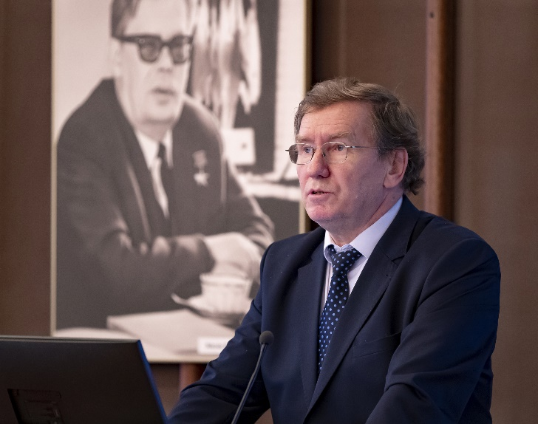
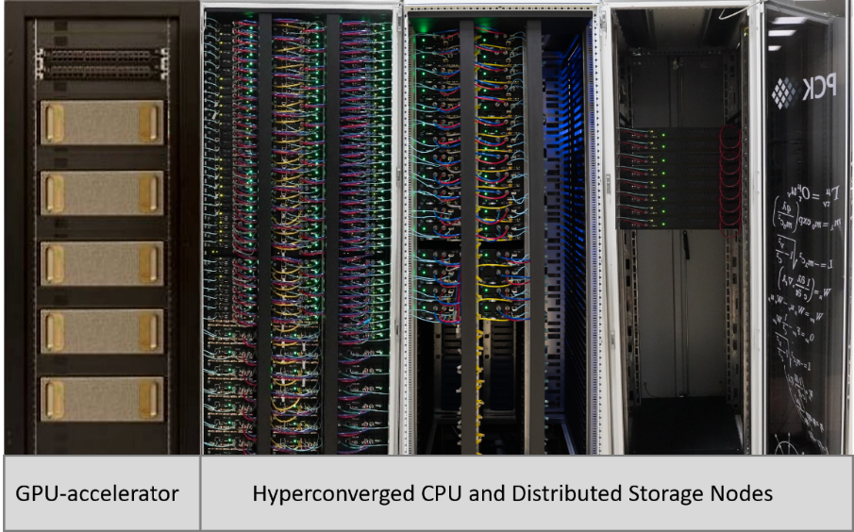
Status and prospects of the Meshcheryakov Laboratory of Information Technologies (MLIT) scientific program
The network infrastructure is a fundamental component of the IT infrastructure of JINR and of the MICC. It provides access to the Internet, computing resources and data storage systems, as well as enables experimental data processing and computing. MLIT ensures the reliable and fault-tolerant operation of all components of the network infrastructure:
JINR-Moscow 3x100 Gbit/s
JINR-CERN 100 Gbit/s and JINR-Amsterdam 100 Gbit/s
multi-site cluster network with a bandwidth of 4x100 Gbit/s for the NICA megaproject
local area network with a bandwidth of 2x100 Gb/s
Vladimir Korenkov
“Govorun” Supercomputer
The resources of the “Govorun” supercomputer are used by scientific groups from all the Laboratories of the Institute for solving a wide range of tasks in the field of theoretical physics, as well as for physics modeling and experimental data processing.

Slide 16
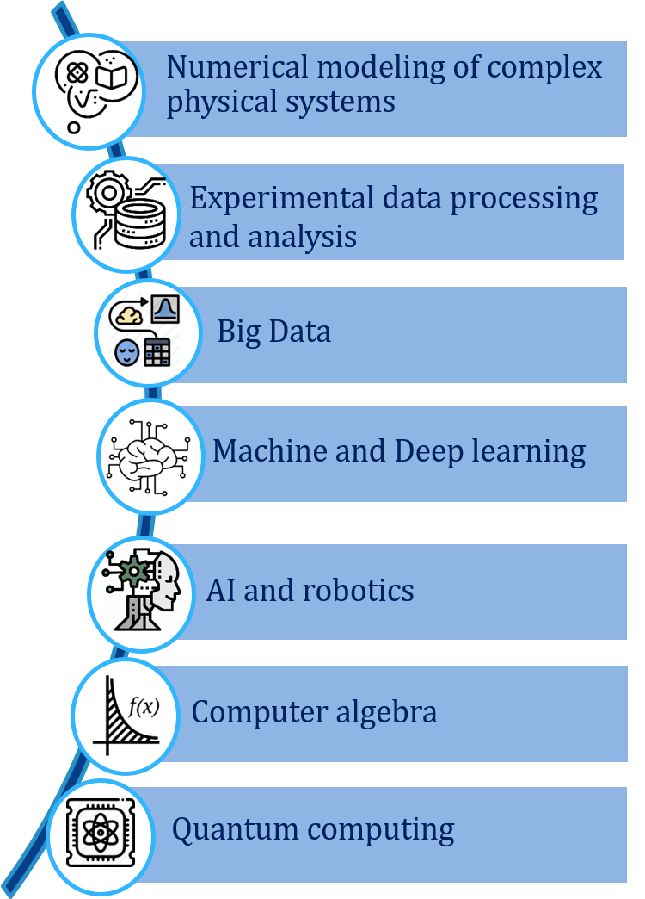
Methods, Algorithms and Software
Other activities of MLIT are related to the development and implementation of effective methods, algorithms and software for physical systems modeling, mathematical processing and experimental data analysis using the MICC resources for the successful achievement of the scientific program by scientists of JINR and its Member States.
The most important tasks are the development of new data processing and analysis algorithms based on deep and machine learning, including artificial intelligence, and the development of modern Big Data methods and algorithms for solving applied problems.

Slide 17
Recommendation:
The PAC heard with interest the report on the main achievements of МLIT for the seven-year period 2017–2023.
The PAC fully supports the MLIT scientific programme related to the development of the themes “Information and computing infrastructure of JINR” and “Methods, algorithms and software for modeling physical systems, mathematical processing and analysis of experimental data”.
The PAC recommends to hear proposals to extend the themes of scientific research and reports with proposals to open new projects within the framework of the themes at the next meeting in June 2023.

Slide 18
133 Scientific Council recommendation:
The development of reliable network and information and computing infrastructure is carried out within the theme “Information and Computing Infrastructure of JINR” and its project “Multifunctional Information and Computing Complex (MICC)” in the Meshcheryakov Laboratory of Information Technologies. Another important activity of MLIT is related to the development and implementation of effective methods, algorithms, and software for modeling physical systems, mathematical processing and analysis of experimental data for the successful implementation of the scientific programme.
The SC supports the MLIT scientific programme for the seven-year period 2024–2030 related to the development of the information and computing infrastructure of JINR and methods, algorithms and software for modeling physical systems, mathematical processing and analysis of experimental data.

Slide 19
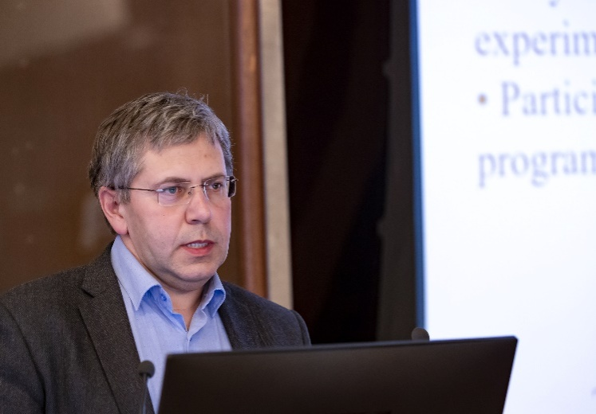
Research in Non-accelerator neutrino physics and astrophysics and proposals for the Seven-Year Plan
The research theme: Non-accelerator neutrino physics and astrophysics
Research directions:
investigation of double beta-decay by different calorimetric and track calorimetric methods;
search for the neutrino magnetic moment, neutrino-nucleus coherent scattering (CEvNS);
investigation of galactic and extragalactic neutrino sources, diffusive neutrino cosmic background, search for exotic particles, search for sterile neutrinos;
distant investigation of processes inside a nuclear reactor core using neutrinos;
development of new methods for the detection of charged and neutral particles;
development of modern radiochemistry for astrophysics and nuclear medicine.
Evgeny Yakushev
7 main projects:
Neutrinoless double beta-decay
SuperNEMO,
GERDA (Legend),
Monument,
Experiments with the reactor anti-neutrino
EDELWEISS/Ricochet,
νGeN,
DANSS,
Dedicated to deep-water investigations with the neutrino telescope on Lake Baikal
BAIKAL-GVD

Slide 20
In addition to the scientific personal involved in the theme, the following resources are available to carry out the scientific projects:
the laboratory for the production and repair of semiconductor detectors
laboratory for the development and production of scintillation materials for detectors
radiochemical sector (creation of calibration radioactive sources, purification of materials designated for low-background measurements from their contamination by natural radioactivities, etc.)
mechanical workshops
a group of computer support
a group of mass separators

Slide 21
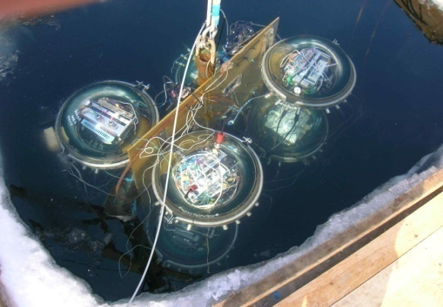
North hemisphere biggest neutrino detector BAIKAL-GVD
Neutrino telescopes brings an important information complementary to the traditional optic and radio telescopes.
Main principle : determination of direction and energy of charged particles (appearing as result of neutrino interaction) with the use of Cherenkov radiation
Baikal project: From 1980 tests and R&D, started in 1993.
Now – building BAIKAL-GVD (Gigaton Volume Detector) has huge progress and will be continued
Physics:
Investigate Galactic and extragalactic neutrino “point sources”;
Diffuse neutrino flux – energy spectrum, local and global anisotropy, flavor content;
Indirect search for Dark Matter;
Exotic particles – monopoles, Q-balls, nuclearites, …

Slide 22
Propose to reorganize the structure of the theme
The new structure will have 4 main projects:
BAIKAL-GVD
A short baseline reactor neutrino investigation (Ricochet, DANSS-2 and νGeN experiments)
Nuclear spectrometry for search and investigation of rare phenomena (all double beta decay related experiments and activities, search for Dark Matter by nuclear spectrometry methods, etc)
Radiochemistry plus spectroscopy for astrophysics and nuclear medicine

Slide 23
Recommendation:
The PAC heard with interest the report on the main work performed and achievements of DLNP for the seven-year period 2017–2023.
The PAC recommends reorganizing the structure of the theme and presenting larger projects in neutrino physics and astrophysics at the next PAC meeting.
The PAC underlines the importance of the efforts of DLNP to further improve the local infrastructure at JINR and on Lake Baikal.

Slide 24
133 Scientific Council recommendation:
The SC takes note of the research within the theme “Non-Accelerator Neutrino Physics and Astrophysics”, which is devoted to the study of rare phenomena associated with the weak interaction by the methods of modern nuclear spectrometry. The following research directions are distinguished within this theme: investigation of double beta-decay; search for the neutrino magnetic moment, neutrino-nucleus coherent scattering; investigation of galactic and extragalactic neutrino sources, diffusive neutrino cosmic background, search for exotic particles.
The SC supports the proposal of the PAC and the DLNP Directorate to reorganize the structure of the theme. The Scientific Council underlines the importance of the efforts of DLNP to further improve the local infrastructure at JINR and on Lake Baikal.

Slide 25
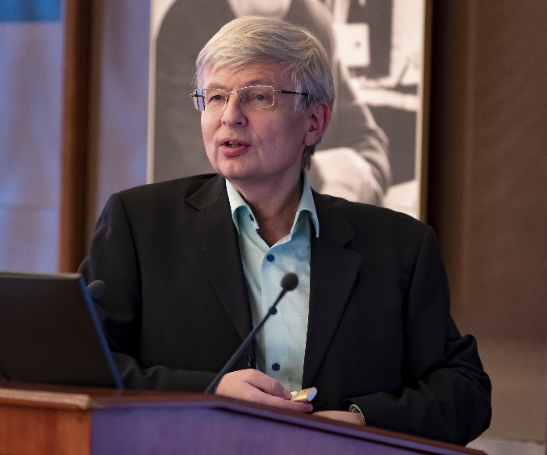
Bogolyubov Laboratory of Theoretical Physics (BLTP): Theory of Nuclear Systems
The works present the main research directions:
structure of nuclei far from stability,
structure of superheavy nuclei,
nucleus-nucleus collisions at low energies,
fusion and fission dynamics, reactions of astrophysical interest,
few-body systems,
nuclear dynamics at relativistic energies,
properties of hot and dense nuclear matter,
nonlinear quantum processes in strong polarized electromagnetic fields.
Nikolay Antonenko
For a better organization of research, the theme should consist of four projects:
“Microscopic models for exotic nuclei and nuclear astrophysics”,
“Low-energy nuclear dynamics and properties of nuclear systems”,
“Quantum few-body systems”,
“Relativistic nuclear dynamics and nonlinear quantum processes”.

Slide 26
Concept of Theme «Theory of Nuclear Systems» Development of theoretical Applications for experiments methods Multidisciplinar nature Attraction of young researchers in nuclear theory
Our future theoretical studies will be closely related to the programs of operated and commissioning facilities at JINR (SHE-factory, ACCULINA-2) and in the world (FAIR, ISOL facilities HIE-ISOLDE, SPES, SPIRAL2, FRIB, RAON, HIAF). The studies of heavy-ion collisions at high energies will be related to the NICA project at JINR.

Slide 27
Recommendation:
The PAC supports the continuation of the nuclear theory research under the ongoing theme, which should reflect a complex and broad approach to various aspects of nuclear structure and nuclear reactions and correspond to the experimental programme of JINR.
The PAC also appreciates the BLTP educational activities and the connection between theoretical studies and the JINR experimental programme.
The PAC appreciates the results obtained in the main areas of research and recommends the extension of the theme “Theory of nuclear systems” until 2030.

Slide 28
133 Scientific Council recommendation:
Research in the field of low energy nuclear physics in the Bogoliubov Laboratory of Theoretical Physics is carried out within the framework of the theme “Theory of Nuclear Systems”. Study of the structure of nuclei far from stability, structure of superheavy nuclei, nucleus-nucleus collisions at low energies, fusion and fission dynamics, and reactions of astrophysical interest are the main research directions. For the new seven-year period 2024–2030, the research in the field of low-energy nuclear physics will be focused on the study of exotic nuclei in the regions of superheavy elements and light nuclear systems at the borders of stability and beyond.
The SC appreciates the results obtained and recommends the extension of the theme “Theory of nuclear systems” until 2030.

Slide 29
THANK YOU FOR YOUR ATTENTION!

