Slide 1
57-th Session of the
JINR Program Advisory Committee
of Nuclear Physics
Sergey Dmitriev
29.06.2023, Dubna

Slide 2
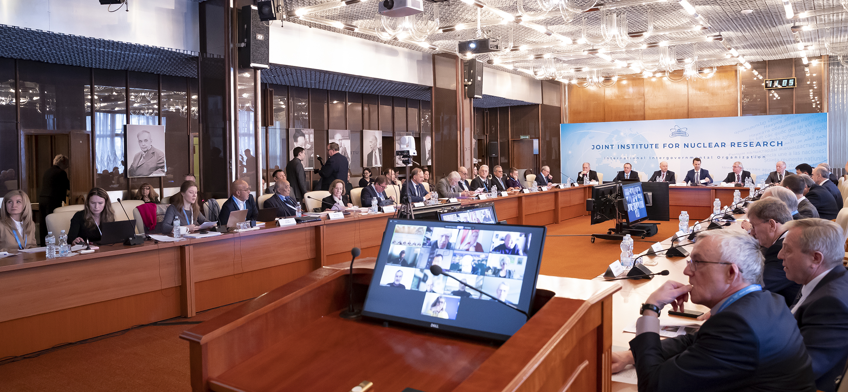
Information on the Resolution of the JINR Scientific Council
133rd session, 16-17 February 2023, hybrid mode
Co-chaired by Sergei Kilin and Grigory Trubnikov

Slide 3
The Council highly appreciated the efforts of the JINR Directorate & Lab staff to realize the current 7-year plan (2017–2023) & congratulated JINR on the achievements in the NICA project, experiments at the SHE Factory, the Baikal-GVD project, condensed matter & material science research at FLNP, operation of Multifunctional Information and Computing Complex (MICC) at MLIT, theoretical physics, life sciences, applied research & innovations, as well as in realization of educational programs & outreach activities.
The Council noted with regret the withdrawal of the Czech Republic, the Republic of Poland, & Ukraine from JINR from 1 Jan. 2023 & had strong hopes that the geopolitical crisis in Eastern Europe will soon find a peaceful solution, which will allow to recover the lost members of JINR.
The Council welcomed the signing of the Joint Declaration of Intent Concerning Cooperative Activities in the Area of Fundamental, Frontier and Applied Scientific Research between CONACYT (Mexico) & JINR, noted with satisfaction the practical measures taken by the JINR Directorate to strengthen cooperation with scientific organizations & universities in China on the basis of partnership coordinated at the governmental level, & expressed its interest in maintaining a high level of cooperation with the research organizations of all European countries, which have always played a very important role in the JINR research program.

Slide 4
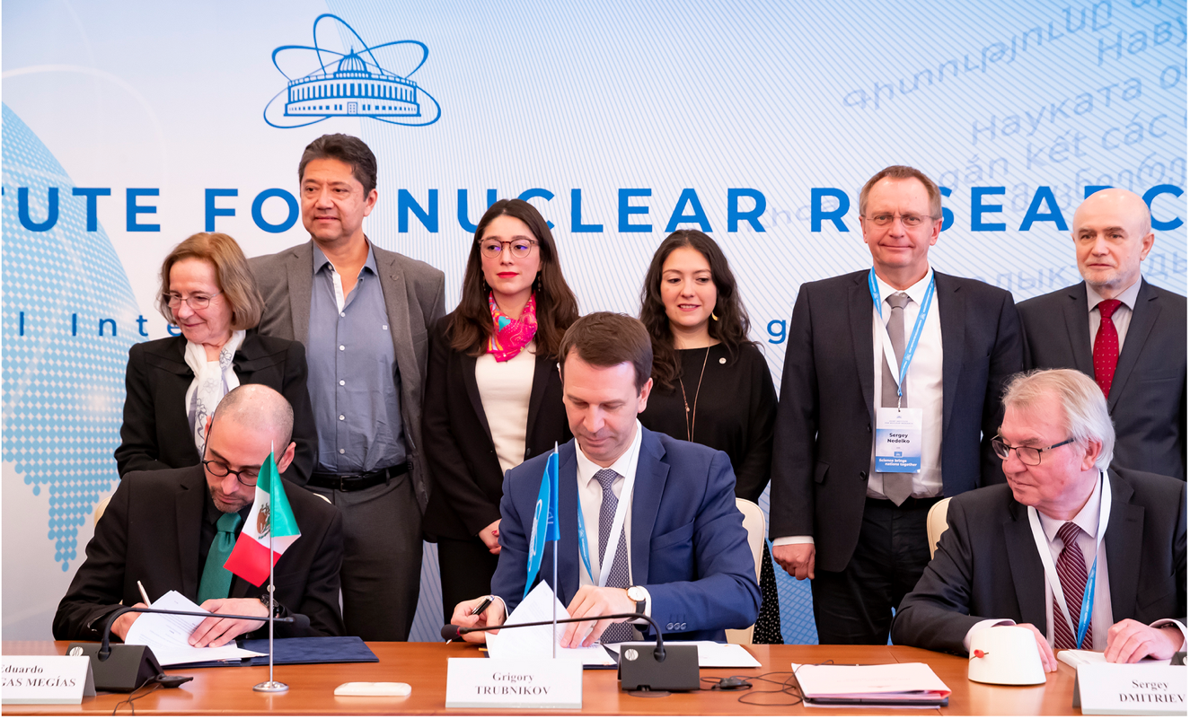
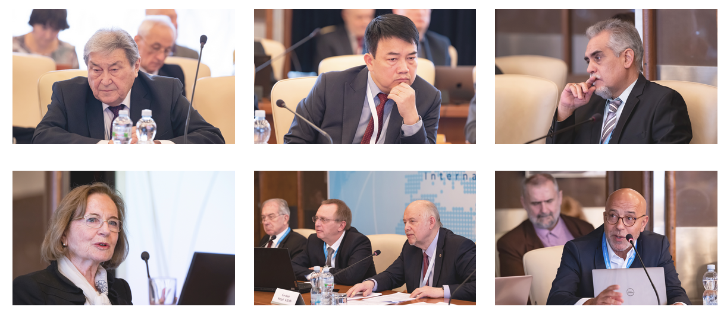
JINR Scientific Council, 16-17 February 2023
Mexico and JINR signed
an intergovernmental agreement

Slide 5
The SC took note of the PACs recommendations in Jan. ‘ 23, as reported by I. Tserruya, Chair of the PP PAC, V. Nesvizhevsky, Chair of the NP PAC, & D. L. Nagy, Chair of the CMP PAC. The SC asks the Directorate to consider these recommendations while preparing the Topical Plan for 2024.
The SC noted with satisfaction that the revised Draft 7-year Plan for 2024–2030 has been significantly improved taking into account the recommendations of the SC 132nd session. The SC appreciated the inclusion of a risk assessment section in this Plan. SC has recommended to organize a joint WG including representatives of all 3 PACs to complete the evaluation of the 7-Year Plan & optimize the implementation of its 1-st stage in the current Topical Plan.
SC welcomes the efforts of the Directorate to update the approach to the formation of the Topical Plan by implementing the Regulations on structuring & planning scientific research at JINR.
The SC congratulated Prof. P. Apel (FLNR) on the award of the V. Dzhelepov Prize for the development of а new generation of track membranes & their applications in medicine and ecology.
The SC approved the Jury’s recommendations on awarding the JINR annual prizes for the best scientific, methodological, technological, & applied research papers.
The SC elected E. Lychagin as Director of the FLNF for a term of 5 years, S. Shmatov as Director of the MLIT for a term of 5 years. The SC endorsed the appointments of E. M. Anitas, N. Antonenko, & O. Teryaev as Deputy Directors of the BLTP until the completion of the term of service of the current Director, D. Kazakov.
The SC announces the vacancies of the positions of FLNP and MLIT Deputy Directors. The endorsement of appointments will take place at the 134th session of the SC, in Sept. 2023.

Slide 6
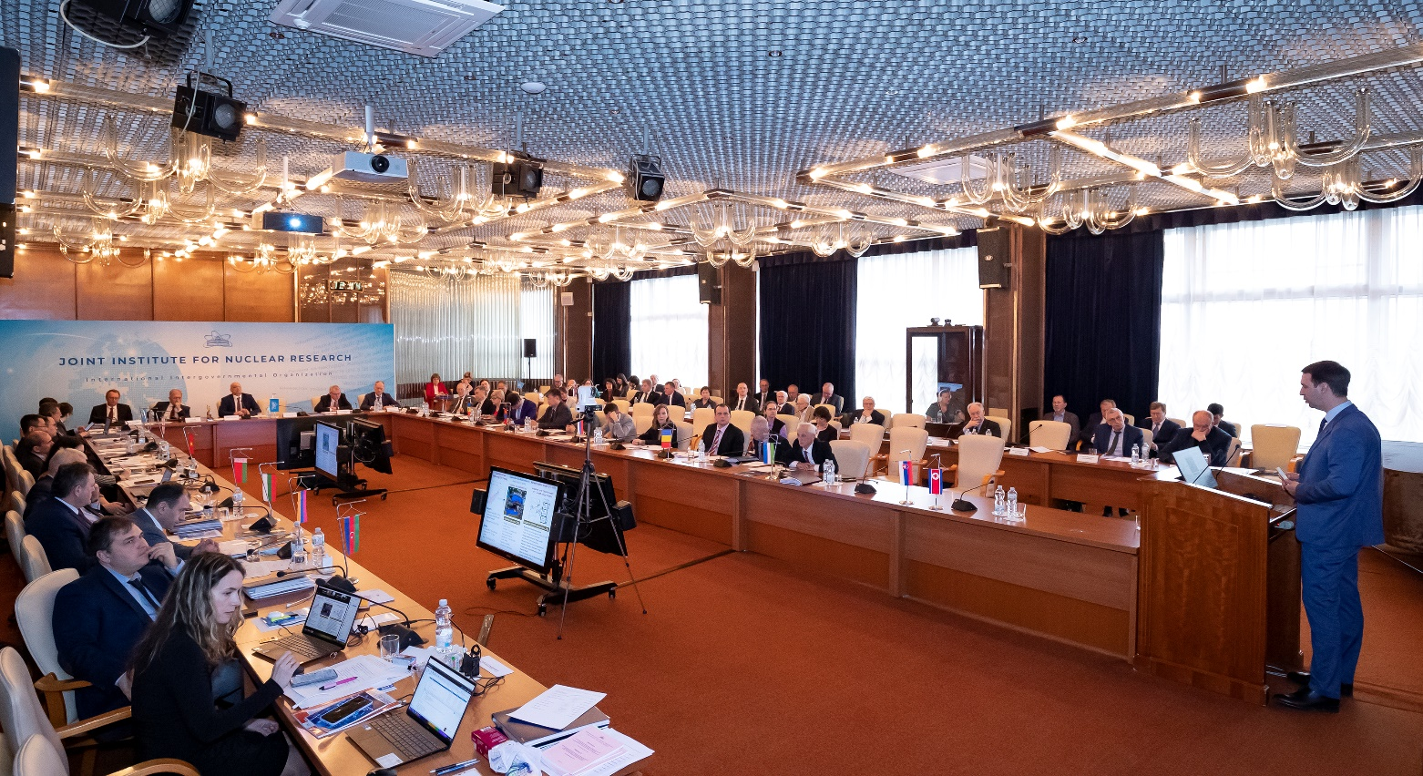
Session of the JINR Committee of Plenipotentiaries, 24 March 2023, Dubna
A regular session of the Committee of Plenipotentiaries
of the Governments of the JINR Member States
was held in Dubna on 24 March 2023 in a hybrid format
AGENDA
Director’s report (G. Trubnikov)
Execution of the JINR budget for 2022 & draft of the revised budget for 2023 (N. Kalinin)
Results of the JINR Finance Committee meeting held on 22 March 2023 (A. Omelchuk)
Draft of the 7-year plan for the development of JINR for 2024–2030 (G. Trubnikov)
It was chaired by the representative of Georgia – Prof. Arsen Khvedelidze, Director, Institute of Quantum Physics and Engineering Technology of the Georgian Technical University.

Slide 7
Committee of Plenipotentiaries decided, in particular:
To take note of the JINR Directorate information about the recommendations of the 133rd session of the SC, the implementation of the current 7-Year Plan for the JINR Development, the Member States efforts towards realization of JINR’s large projects, the new results obtained, & about the most important events of JINR’s research & educational activities & international cooperation.
To note with satisfaction the successful completion of the 4-th technological cycle of the NICA accelerator complex, which has become the longest run in the history of VBLHEP (> 3400 hours), the successful commissioning of the injection chain, including the joint operation of all its elements, the optimization of the beam dynamics, the operation of the electron cooling, the testing of the SOCHI station with heavy ions, the calibration of the new diagnostic system, & the modernization of the vacuum system in the extracted beam line.
To note the success of the Institute in ensuring long-term stable operation of the BM@N experiment for the first time in full configuration, registration of more than 550 million events with the Xe beam, which made it possible to begin the study of heavy ion collision physics.
To note the progress in developing the Baikal-GVD deep-water neutrino telescope for observing natural neutrino fluxes & the registration of 24 events indicating the presence of an isotropic neutrino flux of an astrophysical nature.

Slide 8
To note the successful continuation of experiments at the Factory of Superheavy Elements using the DGFRS-2 separator, in particular, on the synthesis of new isotopes of darmstadtium and seaborgium as well as the continuation of the preparation of experiments to study the chemical properties of elements 114 (Fl) and 112 (Cn) at the DGFRS-3 (GRAND) separator scheduled for the second half of 2023.
To take note of the information on the progress in the implementation of the work plan for the preparation of the continuation of the normal operation of the IBR-2 reactor.
To note the successful development of the JINR MICC, including the modernization of the Govorun supercomputer carried out in 2022, as a result of which its performance reached 1.1 petaFLOPS, and the total capacity of the hierarchical data storage increased to 8.6 PB.
To welcome the signing of the Joint Declaration of Intent Concerning Cooperative Activities in the Area of Fundamental, Frontier and Applied Scientific Research between the National Council of Science and Technology –– CONACYT (Mexico) & the JINR in Feb. 2023, & the Protocol between the Ministry of Science and Technology of the People’s Republic of China, the Ministry of Science and Higher Education of the RF, the Chinese Academy of Sciences and the JINR on Strengthening Cooperation in the Field of Basic Scientific Research at the governmental level in March 2023.

Slide 9
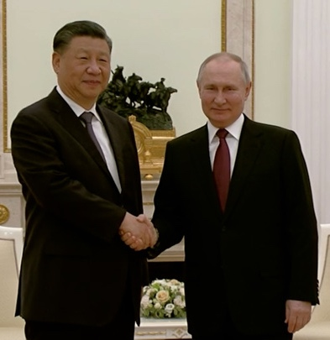
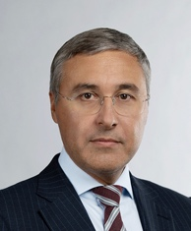
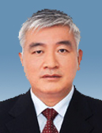
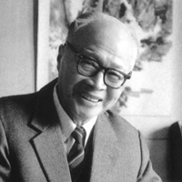
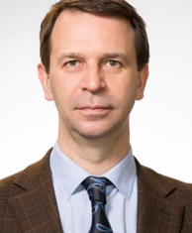
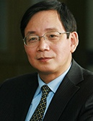
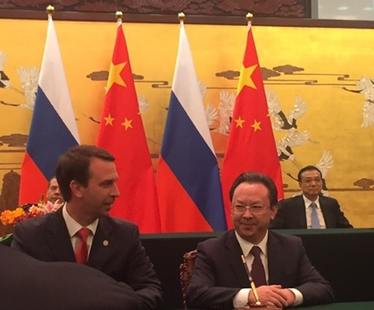
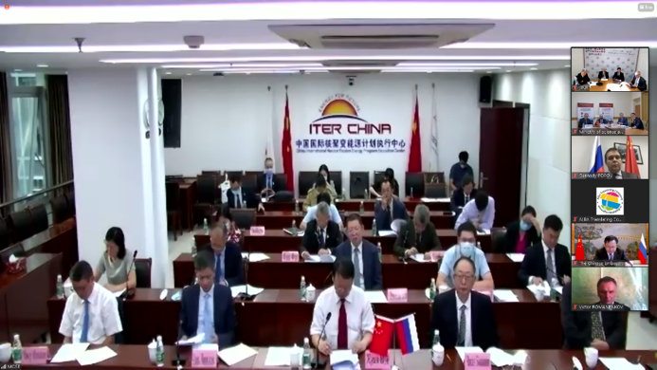
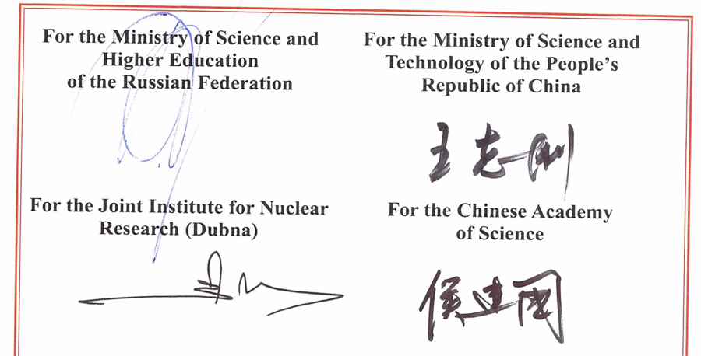
JINR‒China: New Horizons of Cooperation
The People's Republic of China - one of the JINR founding states in 1956.
Wang Ganchang, promi-nent Chinese scientist, Academician of the CAS, JINR Vice-Director in 1958-1960; was fruitfully involved into JINR in 1956-1965.
26.08.2020, Agreement between the
Ministry of Science & Technology of China & JINR on Participation in the Construction & Operation of the Complex of Supercon-ducting Rings for Heavy Ions Colliding Beams NICA.
In Jan/Mar ‘23, JINR held 7 wksh-s w/ 24 China partner organizations -the common wish is to enhance the level of cooperation
Acknowledging that JINR is recognized as one of the world science leaders,
successfully implementing international integration in scientific research;
Intending to enhance the level of China’s participation in JINR;
Reaffirming commitment to the peaceful use of research results.
21.03.2023

Slide 10
To endorse the measures taken by the Directorate to increase the efficiency of the Institute’s supplementary divisions aimed at improving the financial indicators of their activities & achieving a balance in the calculations between the supplementary divisions & the JINR budget.
To take note of the SC opinion that the revision of the draft 7-Year Plan for the Development of JINR for 2024–2030, which took into account the recommendations of the 133rd session of the SC, contains an ambitious international scientific program, which fully complies with the Long-Term Development Strategy up to 2030 & beyond, is optimally balanced in terms of the required staff & financial resources & supported by the necessary scientific & organizational, administrative, & socio-economic measures.
To support the recommendation of the SC 133rd session to organize of a joint working group, which will include representatives of all three JINR PAC’s, for the final examination of the scientific program of the Plan, & instruct the Directorate to take into account the comments of this working group when preparing the final version of the Plan for approval in Nov. 2023.
To agree with an annual, at least 5%, increase in the amount of contributions of the Member States to financially support the 7-Year Plan for the Development of JINR for 2024–2030.
To approve the budget of JINR for 2023.

Slide 11
Thank you

