Slide 1
Flerov Laboratory of Nuclear Reactions
Proposal to extend the theme
Synthesis and Properties of Superheavy Elements, Structure of Nuclei at the Limits of Nucleon Stability
for 2024 - 2030
Sergey Sidorchuk
57th meeting of the PAC on Nuclear Physics
June 29, 2023

Slide 2
56th session of the PAC on Nuclear Physics
January 26 2023
Recommendation:
The PAC supports the proposed strategy for the development of heavy-ion physics research in FLNR for 2024–2030. The PAC expects that its research areas will be represented in the form of themes and projects at the next meeting of the PAC for Nuclear Physics in June 2023.

Slide 3
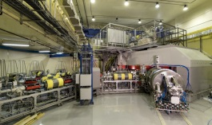
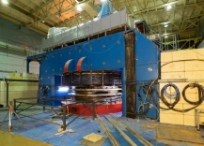
Synthesis and Properties of Superheavy Elements, Structure of Nuclei at the Limits of Nucleon Stability
Scientific program of the Flerov Lab is carried out at three dedicated cyclotrons providing heavy ion beams
Synthesis of new isotopes of SHE;
Study of decay properties of SH nuclei;
Exploring limits the Island of Stability;
Study of excitation functions;
Nuclear spectroscopy of SH nuclei;
Precise mass measurements;
Study of chemical properties of SHE.
DC280
SHE Factory
Reaction mechanisms;
α-, β-, γ-spectroscopy of heavy nuclei;
Study of MNT-reactions;
Production and study of properties of new neutron-rich isotopes;
U400R
Nucleon halo, neutron skin;
Exotic decays;
New magic numbers;
Spectroscopy of exotic nuclei;
Cluster states;
Reactions with RIBs;.
U400M

Slide 4
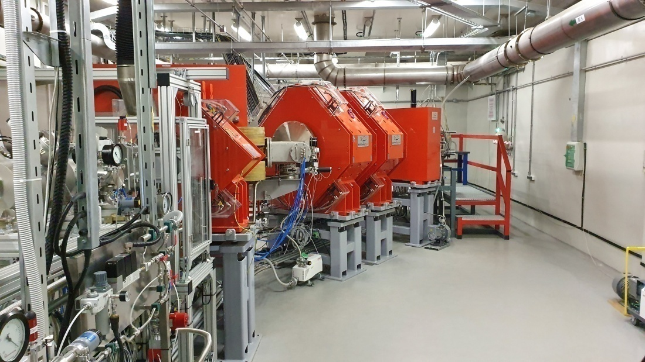
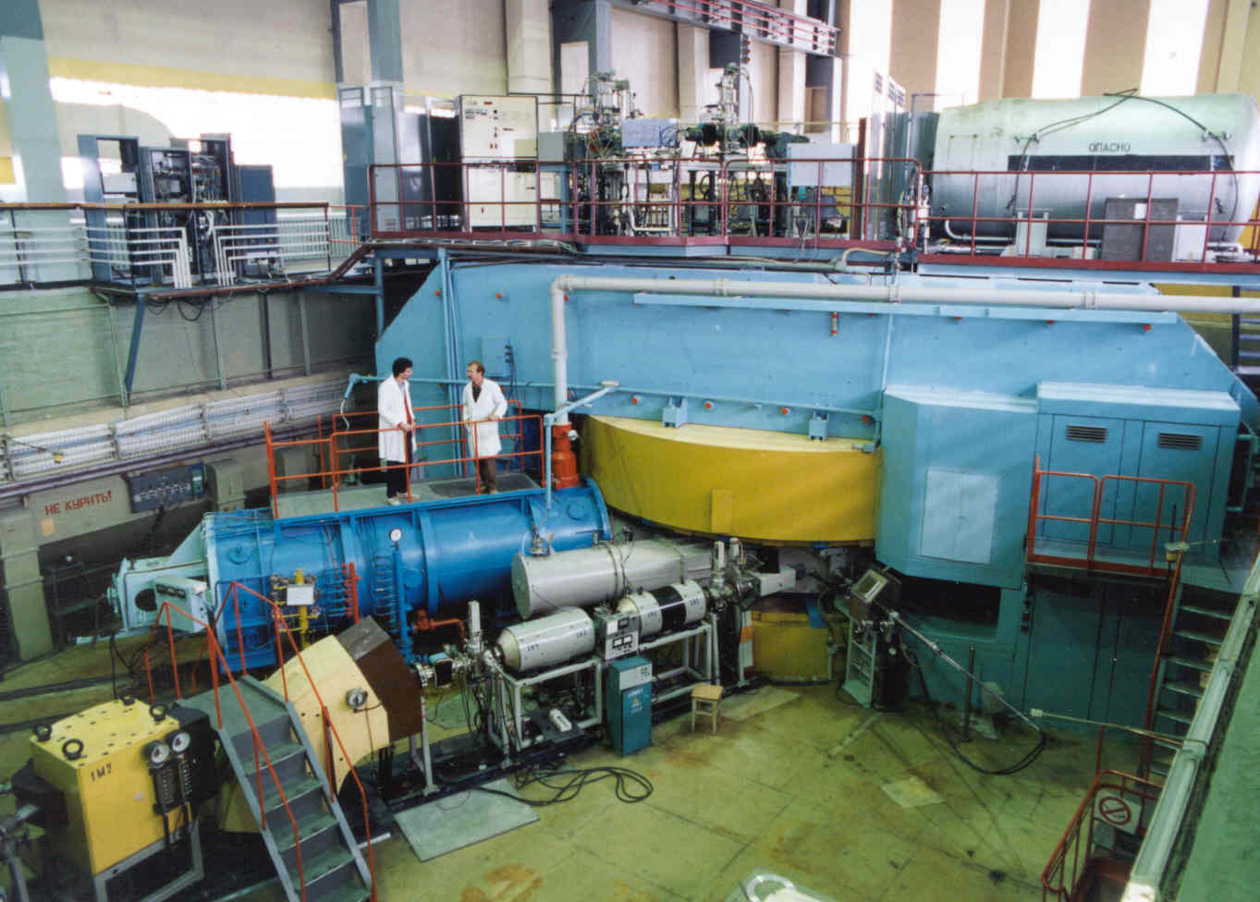
SHE Factory (operates since 2020)
U400 accelerator complex
Should be stopped in 2024 after the launch of U400M
DGFRS-2:
launch 2020
High current heavy ion cyclotron DC 280 (7 pμA of ⁴⁸Ca);
Dubna Gas Filled Recoil Separator DGFRS II;
Gas filled separator GRAND.
Separators SHELS + GABRIELA and MAVR
Observation of the new isotope ²⁴⁹No;
Structure of isotopes ²⁵³Rf, ²⁵⁰No, ²⁵¹No, ²⁴⁵Fm;
Excited states of Ra (xn, pxn, αxn);
Production mechanisms of exotic nuclei.
First successful experiments on the synthesis of SH nuclei:
238 new events; 33 isotopes obtained, 5 for the first time (²⁹¹Mc, ²⁹⁰Fl, ²⁸⁶Cn,²⁸⁰Ds).
New decay modes are observed.
RIB’s at the U400M cyclotron.
Under modernization. Scheduled to be back in operation in 2024
Fragment-separator ACCULINNA II, RF-kicker, zero-degree spectrometer, cryogenic gas target complex;
Fragment-separator ACCULINNA I.
First experiments on the study of exotic nuclear systems ^{7,9}He, ¹⁰Li, ^{6,7}H with RIB’s.

Slide 5
Flerov Laboratory: Scientific Themes
for 2024 - 2030
2024
Synthesis and Properties of SHE, Structure of Nuclei at the Limits of Nucleon Stability
Development of the FLNR Accelerator Complex and Experimental Setups (DRIBS-III)
Scientific leader: Yu.Ts. Oganessian
Leader: S.I. Sidorchuk
Scientific leader: Yu.Ts. Oganessian
Leaders: I.V. Kalagin, S.I. Sidorchuk
Structure of the
lightest nuclei
at the borders of
nucleon stability
2024 - 2028
Leaders:
G. Kaminski,
S.I. Sidorchuk
Development of the setups for the study of properties of superheavy nuclei
2024 – 2028
Leader:
A.V. Yeremin,
Investigation of
H&SH nuclei
2024 - 2028
Leaders:
M.G. Itkis,
A.V. Karpov
U400R accelerator complex
2024 - 2028
Leaders:
I.V. Kalagin,
A.G. Popeko
2028
New projects:
Mass measurements of SH nuclei;
Chemistry of short-lived SHE;
Mechanisms of MNT reactions;
Reaction mechanisms competing with fusion;
Production of new neutron-rich isotopes in MNT reactions and study of their properties;
…
New projects:
I class RCL;
Development of RIB technique;
…
2030
T

Slide 6
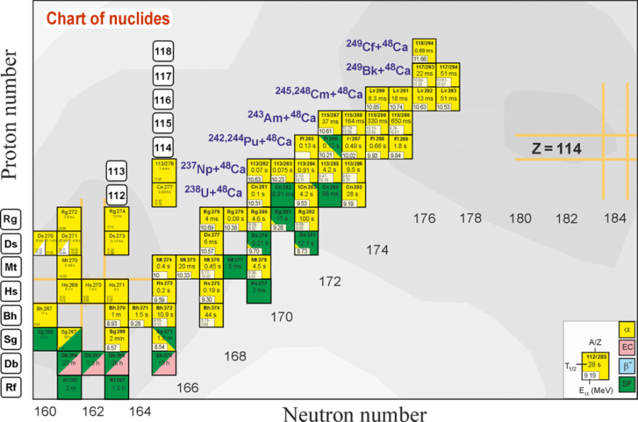
Theme: Synthesis and Properties of Superheavy Elements, Structure of Nuclei at the Limits of Nucleon Stability
Project: Investigation of Heavy and Super-Heavy nuclei
(Talk by A.V. Karpov)
SHE
Synthesis of new elements
SHE Factory – DGFRS II
119 and 120 is a task of the highest importance. ²⁴⁹Bk+⁵⁰Ti→²⁹⁹119*,
²⁴⁹⁻²⁵¹Cf+⁵⁰Ti→²⁹⁹⁻³⁰¹120* ²⁴⁸Cm+⁵⁴Cr→³⁰²120*
Synthesis of new SHE isotopes
SHE Factory – DGFRS II
2n channels of fusion reactions;
p1n- p3n channels, EC;
Multinucleon transfer reactions U+U, U+Cm;
More neutron-rich targets.
Chemistry of SHE
SHE Factory – GRAND, GASSOL
Chemical properties of SHE with Z = 112 – 114 (T_{1/2}>0.5 sec) at the GRAND separator. New experimental setups for the study of heavier elements
Nuclear SHE spectroscopy
SHE Factory – GRAND
U400R – SHELS
Radioactive decay and the structure of isotopes of heavy and superheavy elements. The first experiments on the study of Fl and Mc isotopes in the ⁴⁸Ca+²⁴²Pu,²⁴³Am reactions.
Measurement of masses of Super-Heavy isotopes
SHE Factory – MR TOF
Mass measurement of any of the nuclei in the alpha-decay chain with a precision of about 30 keV will give the masses of all the nuclei in the chain

Slide 7
Theme: Synthesis and Properties of Superheavy Elements, Structure of Nuclei at the Limits of Nucleon Stability
Project: Structure of the lightest nuclei at the borders of nucleon stability
(Talk by G. Kaminski)
Fragment-separator ACCULINNA II
First experiments with beams of the upgraded U400M ⁴He + ^{6,8}He (2n, 4n-transfer);
Multi nucleon (2n, 4n, 2p) correlations in loosely bound nuclei. Elastic/inelastic scattering, transfer reactions, QF reactions;
Structure of exotic nuclei near and beyond the neutron drip-line in the transfer reactions (d,p), (d,³He), (t,p) etc.
Structure and exotic decays of nuclei at the proton drip-line in the transfer reactions (³He,n), (d,n).
Further study of super exotic nuclear systems like ^{6,7}H, 4n.
Upgraded U400M
HI | 20202020 |  | 2024
 | E, MeV/n | I, pμA | E, MeV/n | I, pμA
⁷Li | 35 | 5 | 39 | 10
¹¹B | 33 | 3 | 34 | 6
¹⁵N | 47 | 0.5 | 51 | 2
¹⁸O | 36 | 0.5 | 40 | 1.5
^{20,22}Ne | 53/45 | 0.3 | 54/50 | 1
^{32,36}S | 51/40 | 0.2 | 52/44 | 0.4
Primary beams
RI | 2024
 | Y, pps | P, %
⁸He | 6⋅10⁵ | 90
¹¹Li | 3⋅10⁴ | 80
¹⁴Be | 2⋅10³ | 85
¹³O | 2⋅10⁵ | 55
²⁴O | 5⋅10² | 50
²⁸S | 1⋅10⁴ | 70
Instrumental development
In-beam detectors;
Neutron and charged particles detector arrays, including microstrip Si detectors;
Launch of the RF-kicker at the ACCULINNA II separator;
Zero-angle spectrometer hodoscope;
Cryogenic tritium target.
Secondary beams

Slide 8
Synthesis and Properties of Superheavy Elements, Structure of Nuclei at the Limits of Nucleon Stability
 | Funding/year, k$ | Total funding 2024-2030, k$ | Staff/researchers
Heavy&SH nuclei | 1800 | 12600 | 80/50
Light nuclei | 450 | 3150 | 47/31
Technical and engineering support | 750 | 5250
Total | 3000 | 21000 | 127/81 (DSc 12, PhD 45) FTE 105
Risks:
SHE Factory
No license to work with highly radioactive materials yet;
Delay in delivery of Bk, Cf can not be fully excluded;
U400R Complex
Unforeseen circumstances in the course of the building construction;
RIB’s at U400M
No permission from FMBA for handling tritium.

Slide 9
THANK YOU!

Slide 10
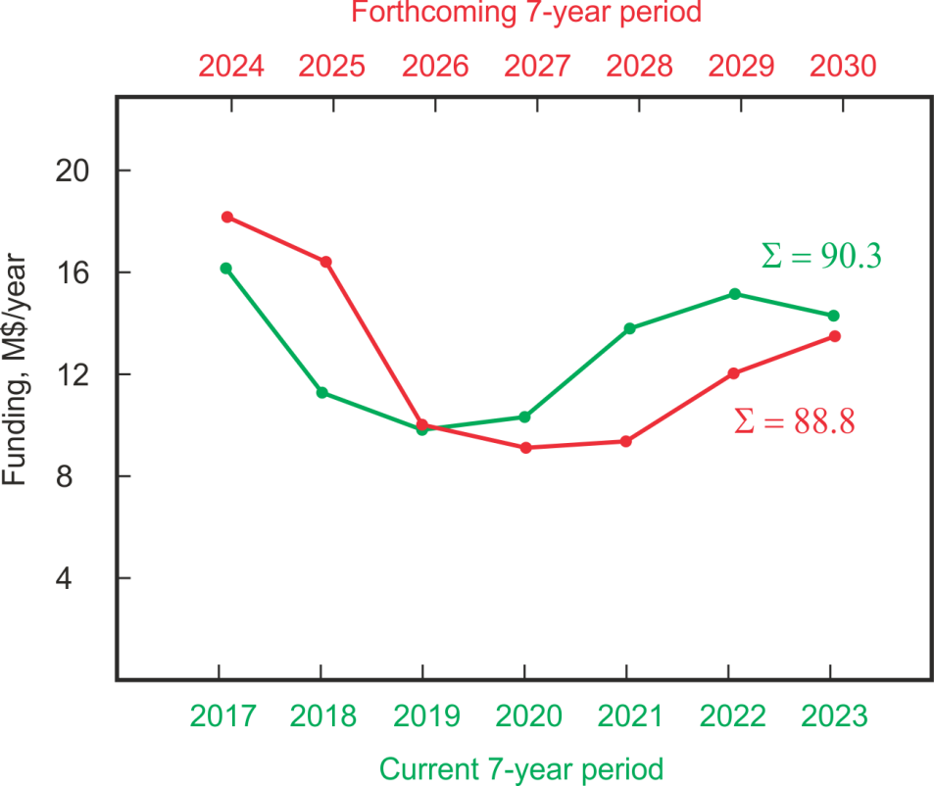
2024 - 2030
New facilities at the DC 280 cyclotron: GASSOL, MR-TOF spectrometer;
Reconstruction of U400;
New experimental hall;
New facilities at the U400R cyclotron;
SHE Factory;
DGFRS II;
GRAND;
ACCULINNA II + RF-kicker
+ zero degree spectrometer;
U400M;
DC 140.
2017 - 2023

Slide 11
Funding for the 7-year period 2024 – 2030 (k$)
(Draft)
SHE Factory
 | 2024 | 2025 | 2026 | 2027 | 2028 | 2029 | 2030 | Total
New facilities | 2500 | 2500 | 2500 | 2500 | 2500 | 2500 | 2000 | 17000
U400R accelerator complex
New U400R exp. caves | 9000 | 8000 | 1000 | 0 | 0 | 0 | 0 | 18000
U400 → U400R | 800 | 1000 | 200 | 410 | 140 | 2200 | 2000 | 2000
New facilities | 2000 | 2000 | 2000 | 2000 | 2000 | 2000 | 2000 | 14000
U400M
Replacement of resonators | 0 | 0 | 1000 | 1000 | 800 | 0 | 0 | 2800
DC140
DC140 | 1000 | 200 | 200 | 0 | 0 | 0 | 0 | 1400
Exp. Support& development | 3000 | 3000 | 3000 | 3500 | 3100 | 3000 | 3000 | 21600
1st class RCC project
RCC | 0 | 0 | 0 | 0 | 500 | 3000 | 3000 | 6500
RIB development
RIB | 0 | 0 | 0 | 0 | 500 | 2000 | 3000 | 5500
Total | 18300 | 16700 | 9900 | 9000 | 9400 | 12500 | 13000 | 88800

