Slide 1
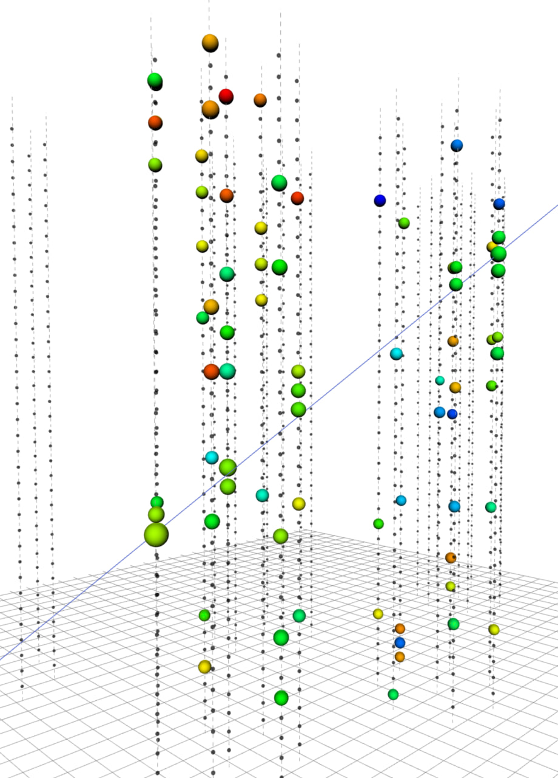
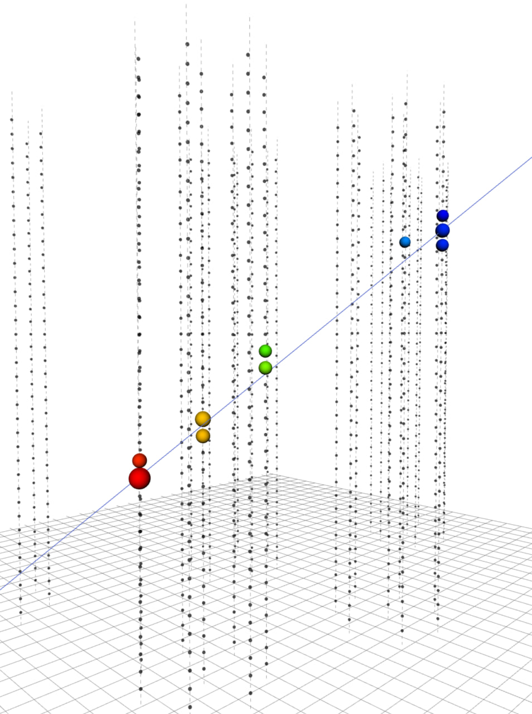

Prolongation
Project Baikal-GVD
late
The Baikal-GVD project is one of the leading projects in JINR and the largest detector of astrophysical high energy neutrino in the North hemisphere. The project is highlighted as a Large Infrastructure Project since 2024. Currently the activity is related with the theme 03-2-1100-2010/2024 (Non-accelerated neutrino physics and astrophysics).
1
1
4
4
early
Multicluster upward going muon in data 2019:
Zenith angle 125.6º
Muon energy < 1 TeV
I.Belolaptikov
30.06.2023
1
Notes:
I am presenting the Baikal-GVD project,prolongation.
The Baikal-GVD project is one of the leading …….
The picture presents selected upgoing muon before and after noise hits suppression.

Slide 2

Baikal Collaboration
~ 65 physicists
and engineers
Joint Institute for Nuclear Research (Dubna, Russia)
Institute for Nuclear Research, Russian Academy of Sciences (Moscow, Russia)
Irkutsk State University (Irkutsk, Russia)
Skobeltsyn Institute of Nuclear Physics, MSU (Moscow, Russia)
Comenius University (Bratislava, Slovakia)
Czech Technical University in Prague (Prague, Czech Republic)
Institute of Nuclear Physics ME RK (Almaty, Kazakhstan)
Nizhni Novgorod State Technical University (Nizhni Novgorod, Russia)
St.Petersburg State Marine Technical University (St.Petersburg, Russia)
Notes:
The collaboration consists of 9 organizations from 4 countries. About 65 scientists and engineers.

Slide 3
Gigaton Volume Detector (GVD) in Lake Baikal
Objectives:
  - km3-scale 3D-array of photo sensors
    - flexible structure allowing an upgrade and/or
    a rearrangement of the main building blocks (clusters)
- high sensitivity and resolution of neutrino energy,
direction and flavor content
Central Physics Goals:
- Investigate Galactic and extragalactic neutrino
“point sources” in energy range > TeV
    - Diffuse neutrino flux – energy spectrum, local and
    global anisotropy, flavor content
- Transient sources (GRB, …)
  - Dark matter – indirect search
- Exotic particles – monopoles, Q-balls, nuclearites, …

Slide 4
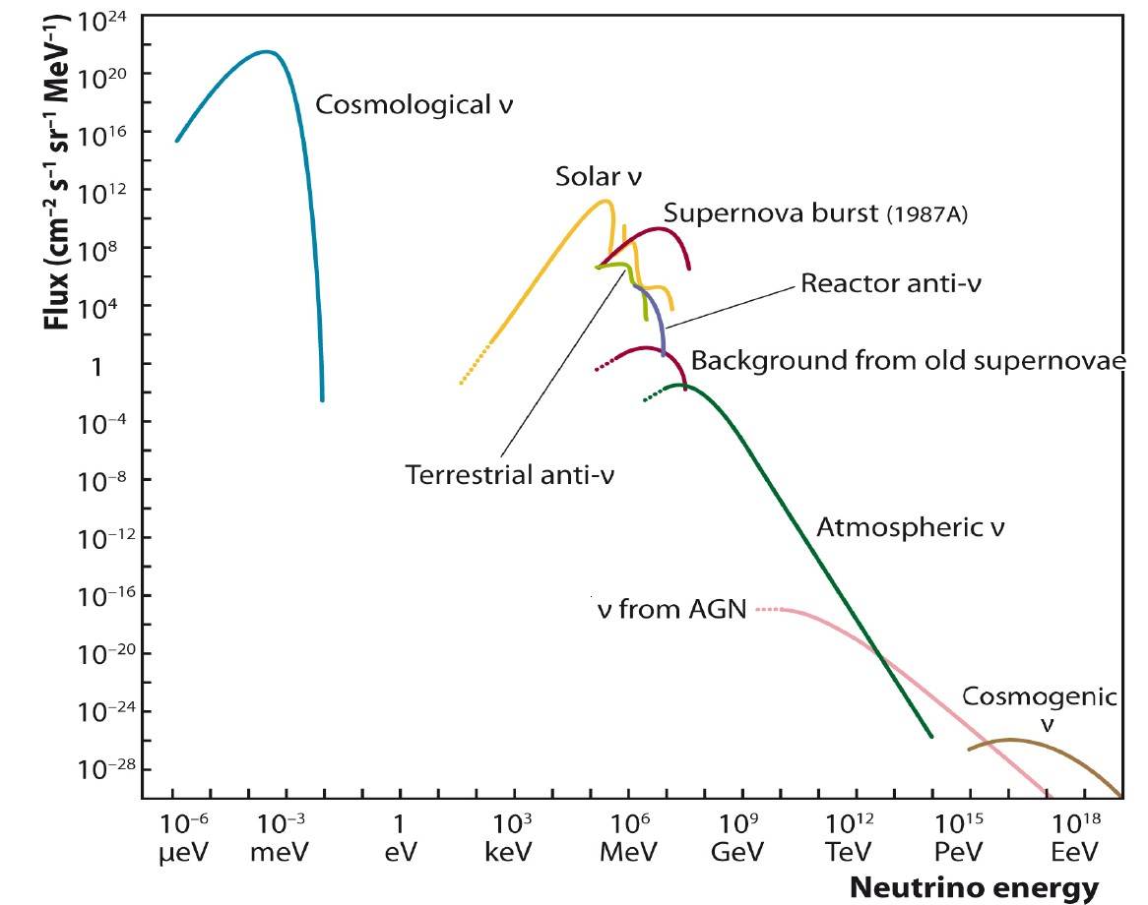
Where we are on the energy scale
Baikal-GVD
energy range
arXiv:1111.0507
Notes:
4

Slide 5
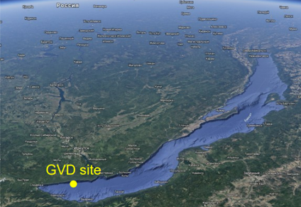
Site properties
51°46’ N 1046 24’ E
Depth of the lake is 1366 m.
Distance to shore ~4 km.
Absence of high luminosity bursts from biology.
Water properties for light:
Abs. length: 22 ± 2 m
Scatt. length: 60-80 m
Installing the telescope from the ice significantly simplifies the deployment.
The principle of operation
Registration of Cherenkov radiation generated by neutrino interaction products (muons and cascades) using a 3D array of photodetectors - optical modules.
Notes:
The GVD is located in the southern part of Lake Baikal.
Distance to the shore about 4 km. Depth of the lake in this place is 1366 m.
Baikal water characterized by light absorption length about 20 m and scattering length 60 – 80 m depends on season.
The detector is deployed using the ice cover
The principle of operation of the telescope is to register the Cherenkov radiation of charged neutrino interaction products (muons and cascades) using 3D array of photodetectors – optical modules.

Slide 6
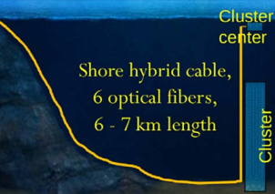
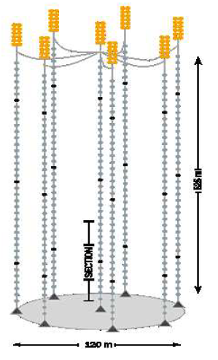
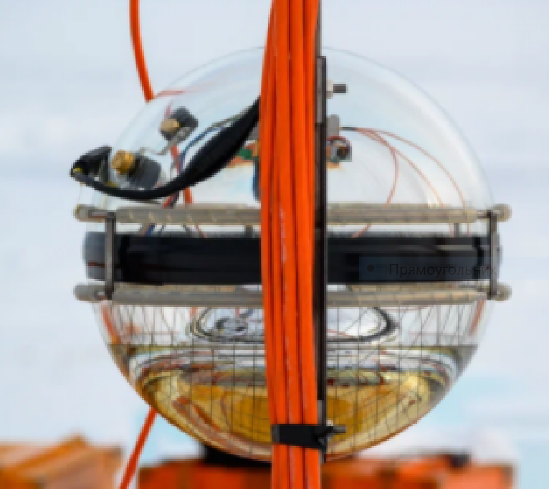
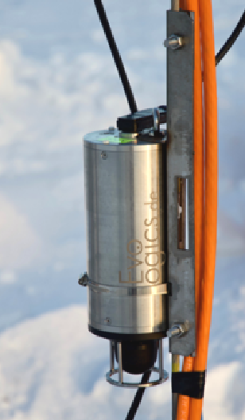
Baikal-GVD design
Optical module: one PMT,
Hamamatsu R7081-100,
10 inches, 35% q.e. (in max)
Analog output
String: 3 Sections × 12 OMs,
15 m step between OMs
Cluster: 8 strings,
60 m step between strings
Cluster center: 30 m depth.
Connection to shore:
One hybrid fiber-optical cable per cluster,
Cable connects Shore station and Cluster center. Positioning system: 3 / 4 acoustic modems per string,
Real-time positioning with ~20 cm accuracy
Optical Modulee (OM)
525 m
120 m
GVD cluster
Acoustic modem
Notes:
Basic detection unit of telescope is optical module.
OM comprises one PMT Hamamatsu R7081-100, 10-inches photocathode, 35% q.e. (in max). We use analog output of PMT for time and charge measuring.
The design of GVD telescope has a modular structure.
Basic structural unit of telescope is the string. String consists of 3 sections, 12 OMs each. Vertical step 15 m.
8 strings form a cluster. Cluster diameter 120 m, height 525 m. distances between strings 60 meters.
Cluster is full-featured detector,
Cluster connected to shore station with about 7 km electro-optical cable.
3 or 4 acoustic modems on each string forms positioning system of telescope that provide real time positioning with accuracy about 20 cm.

Slide 7
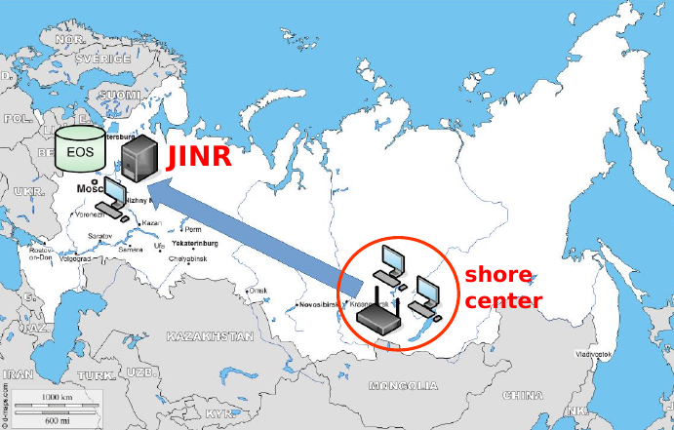
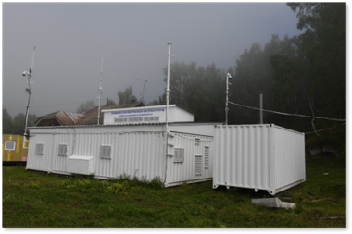
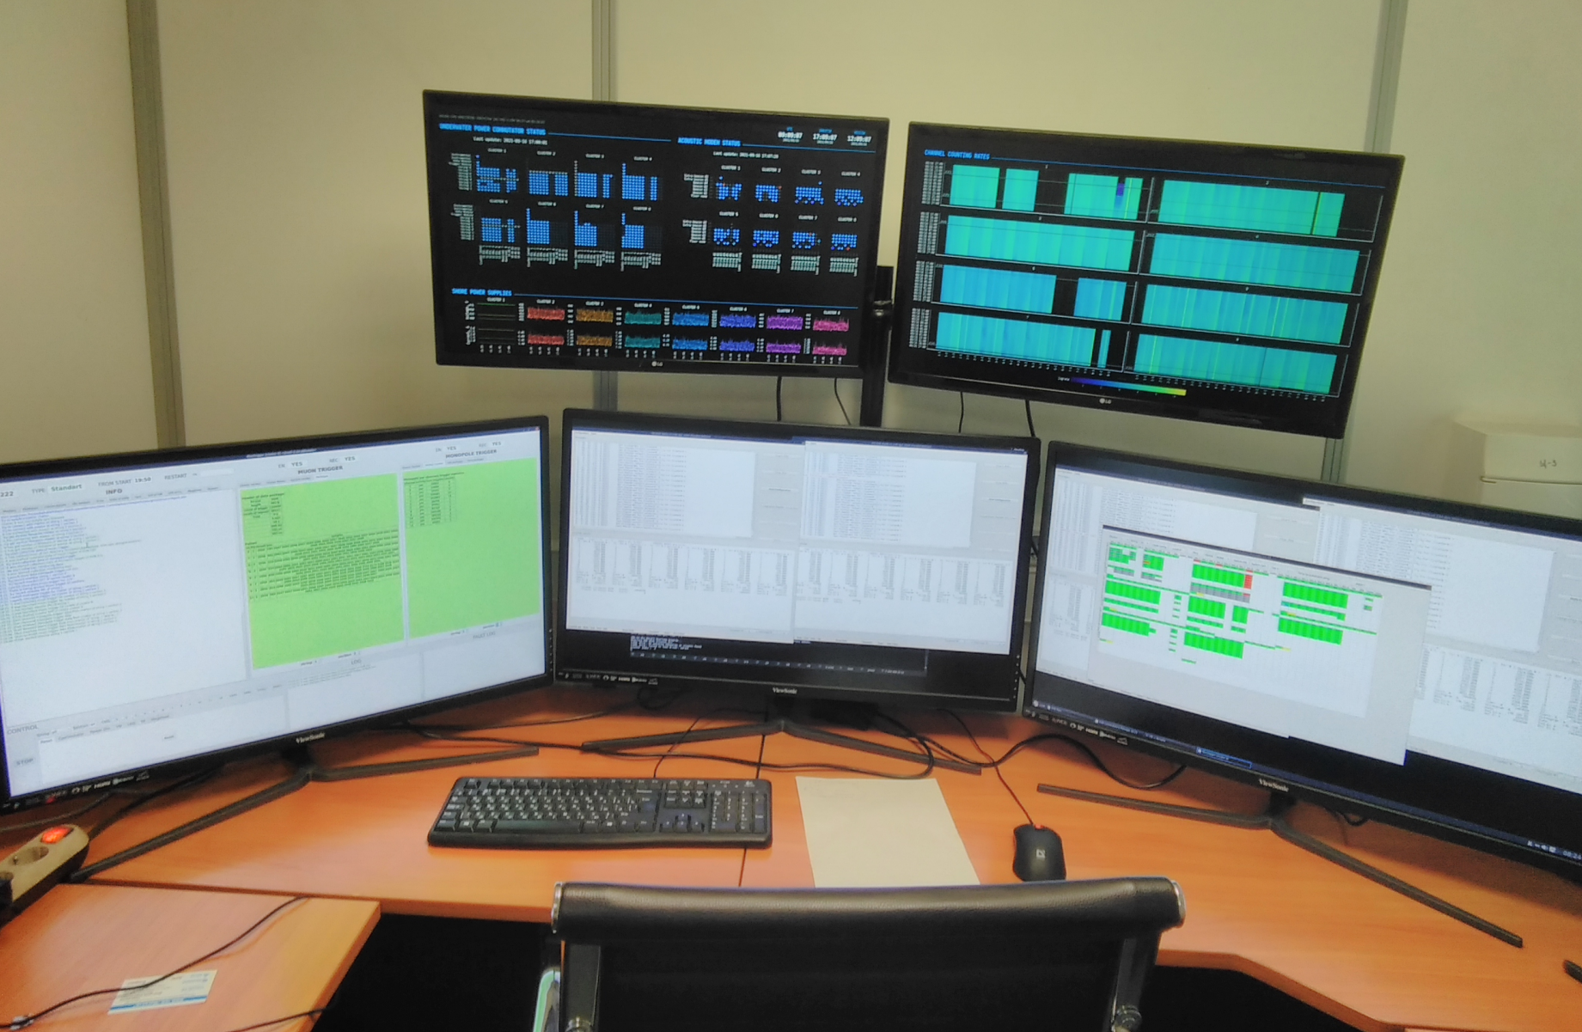
Data stream
Baikal shore center
Power distribution
Data readout hardware
Data-taking management (shifter)
Data quality control
Fast reconstruction and alert production (to be deployed)
Data is transferred from the Shore center to JINR
Shore center ➙ Baikalsk: 300 Mbit/s radio channel
Baikalsk ➙ JINR: Ethernet
Compressed data sample ~60GB per day
Delay due to shore ➙ JINR data transfer: < 1 min.
Data is stored in JINR using EOS service
Notes:
On the left picture the GVD shore center is shown. The central picture presents operator place.
The shore center functions are:
Power distribution
Data readout hardware
Data-taking management(shifters)
Data quality control
Fast reconstruction and alert production will be installed there in nearest future.
7

Slide 8

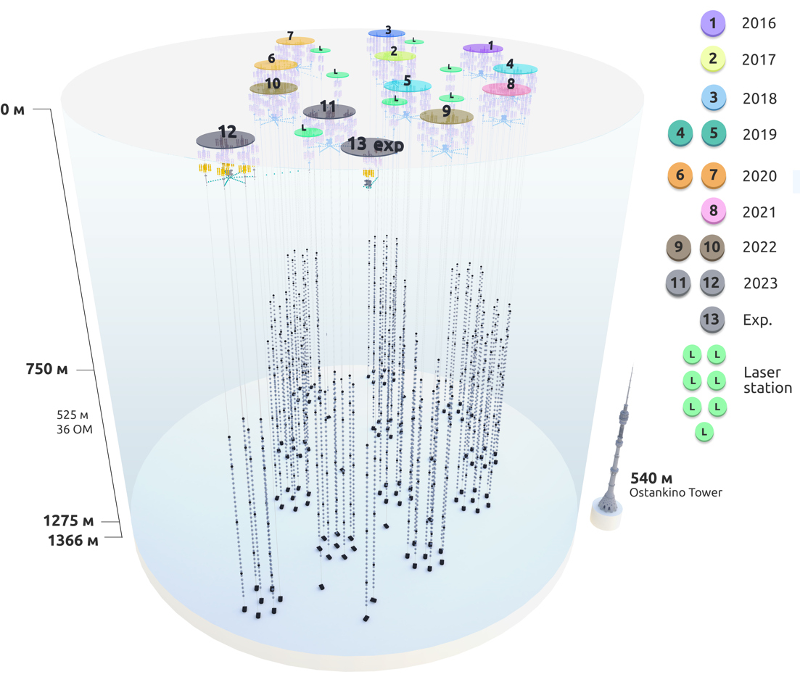
Current status of Baikal-GVD
Currently, the deployment of the Baikal-GVD neutrino telescope is successfully underway. - 12 clusters with 3456 OMs.
- About 10 astrophysical neutrinos per year.
The production and technical base of the Baikal project ensures the deployment of two clusters annually.
GVD has developed shore infrastructure: control center, laboratories, workshops, deployment tools, living quarters.
GVD is testing ground for the development the systems for next-generation telescope:
- 2 strings with fiber-optic DAQ;
- 3 inter-cluster strings.
FO string
Intercluster string
Notes:
Currently, the deployment of the Baikal-GVD neutrino telescope is successfully underway in Lake Baikal.
The view of the telescope in configuration 2023 is shown in the figure.
Telescope now comprises 12 clusters with about 3.5 thousand optical modules.
The year of installation of each cluster is shown in the right part of the figure.
At present Baikal-GVD is the largest neutrino telescope in the Northern Hemisphere, allows to register ~10 neutrinos of astrophysical nature per year.
The production and technical base of the Baikal project ensures the deployment of two clusters each year.
GVD has developed shore infrastructure: control center, laboratories, workshops, comfortable living quarters for about 50 peoples with independent power supply
GVD is testing ground for the development the systems for next-generation installation:
Currently, the telescope includes two strings with fiber-optic DAQ and three inter-cluster strings.

Slide 9
Event types
Single-cluster tracks
Multi-cluster tracks
Low energy threshold
Optimal sensitivity to nearly vertical tracks
90% of recorded track events
Moderately low energy threshold
Optimal sensitivity to inclined tracks
10% of recorded track events
ν_{μ} CC
NC, ν_{e} ν_{τ} CC
Multi-cluster cascades
Single-cluster cascades
High energy threshold
Good energy resolution
Relatively rare events
Very high energy threshold
Excellent energy resolution
Very rare events
Notes:
9

Slide 10
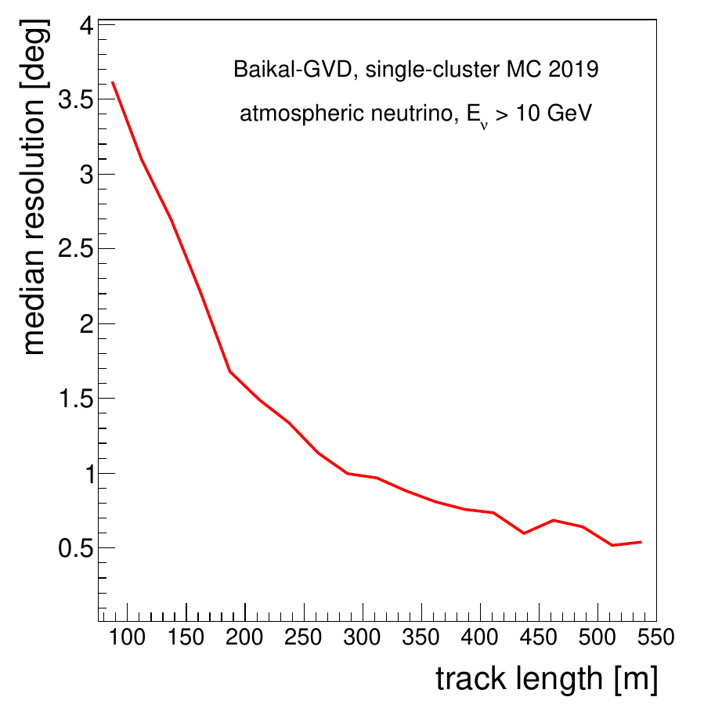
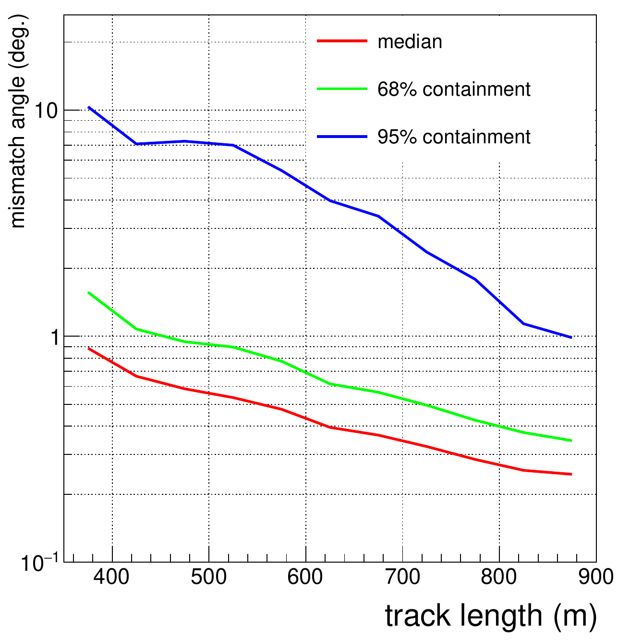
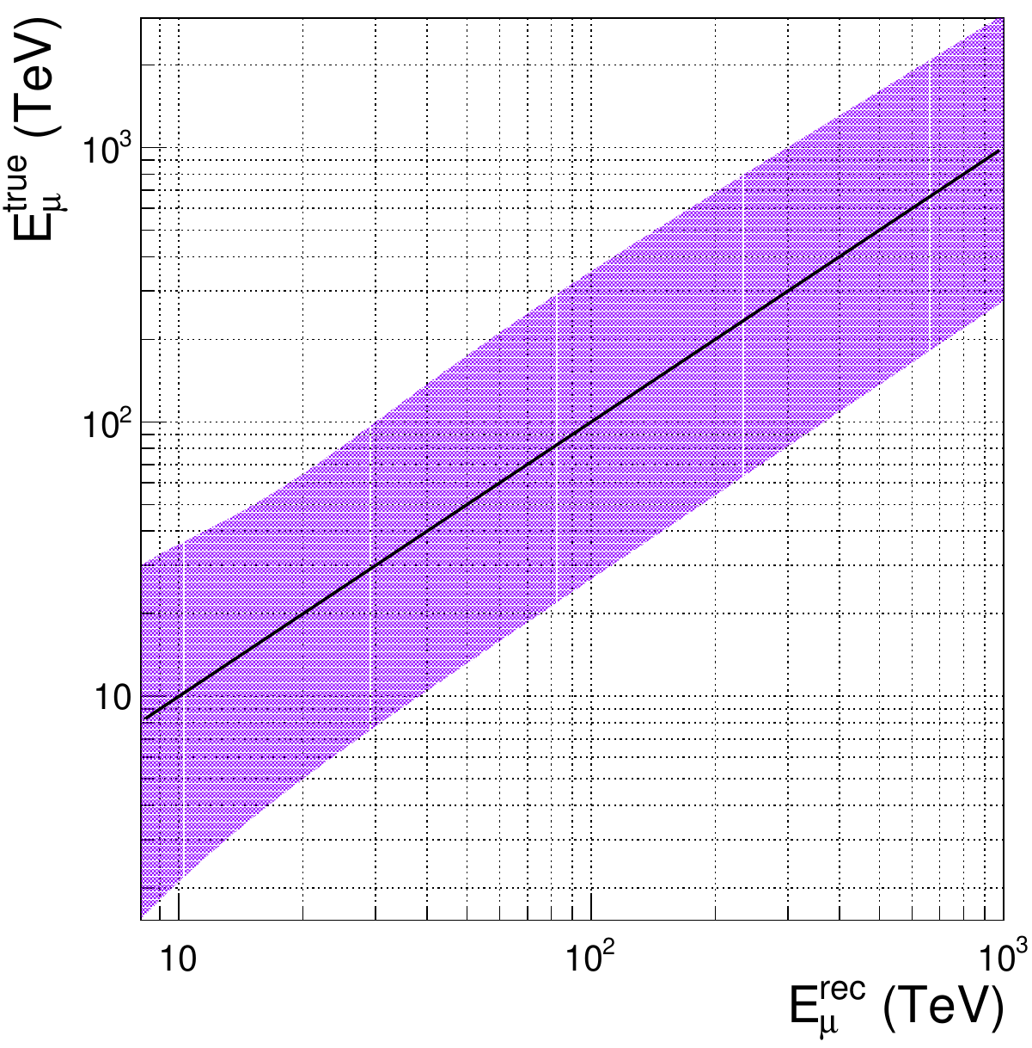
Muon track reconstruction precision
Single-cluster reconstruction
Multi-cluster reconstruction
10 < E_{μ} < 1000 (TeV)
Better than 0.5° resolution for tacks with length > ~500 m
Multi-cluster event reconstruction allows to reach the best angular precision
Factor 3 - 3.5 energy resolution in
~10 TeV - 1 PeV range
Notes:
Grigory Safronov, TAB meeting, 17/01/2022

Slide 11
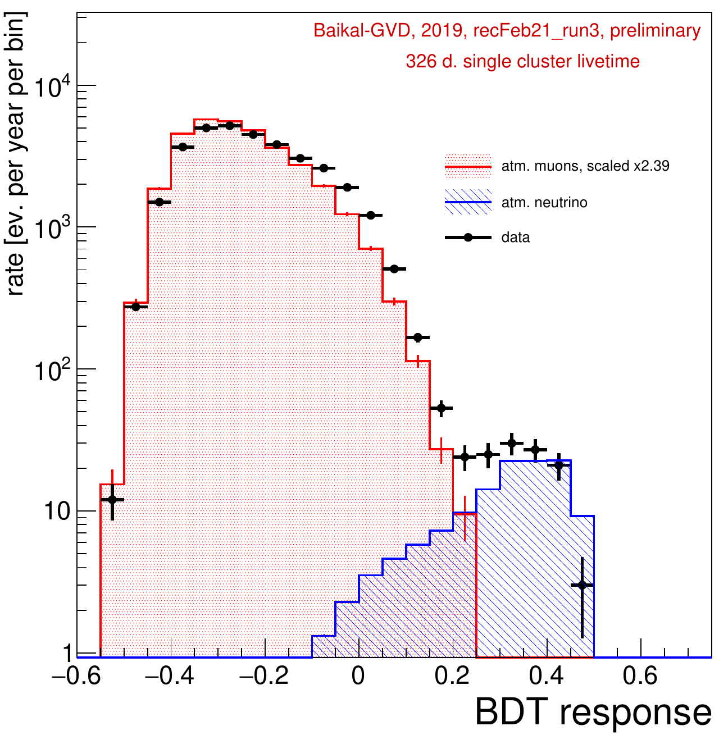
Track-like events analysis progress
Upgoing events: θ_{zenith} > 120°
Track-like reconstruction and neutrino selection techniques are being refined
An improvement in sensitivity by a factor of 2 with recent developments
[PoS(ICRC2021)1063, PoS(ICRC2021)1080]
Improvement in noise suppression techniques
More efficient neutrino selection using boosted decision trees (BDT)
take
MC expected: 81.2
Observed events: 106
Machine learning application for Baikal water noise suppression: [arXiv:2210.04653]
Notes:
Last year there was rather good progress for track reconstruction and neutrino selection, which improves efficiency for factor 2
It was due two factors:
1. Improvement in noise suppression technique (As you saw in first slide there are a lot of background hits in detector response.)
2. More efficient neutrino selection on base of boosted decision tree
The figure shows experimental and MC comparison over BDT factor. Good agreement means that we understand summary parameters of the detector rather well.
As a result for 326 days single cluster livetime was selected 106 events at 81.2 events from atmospheric neutrino.
To increase efficiency of noise suppression, machine learning application developing with promising results.
11

Slide 12
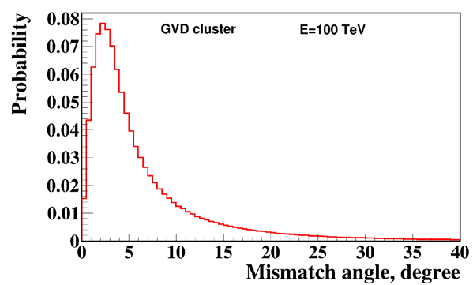
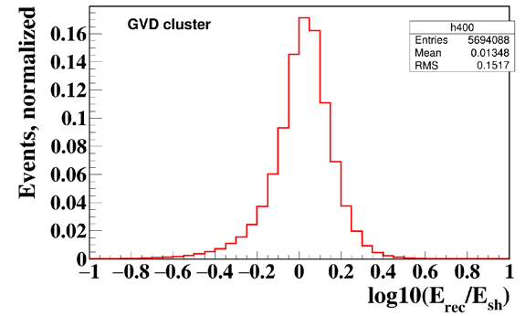
Cascade analysis performance
Directional resolution for cascades:
median mismatch angle ~ 2°÷4°
Energy resolution : δE/E ~ 10÷30%
Notes:
12

Slide 13
A search for astrophysical diffuse neutrino flux with GVD
GNN: Confirmation of diffuse neutrino flux observation by IceCube -
the first goal of upcoming Baikal-GVD and KM3NeT!!!
Data from 2018-2021, livetime: 4928 days (13.5 y)
single-cluster equivalent
All-sky search for HE cascades:
threshold of E > 100 TeV allows to observe events from upper hemisphere
(main background – atm. muon bundles)
Search for upward moving events:
lower energy threshold (E>15 TeV) due to low atmospheric
background for cascade detection channel
(main background – atm. neutrinos)
Notes:
13

Slide 14
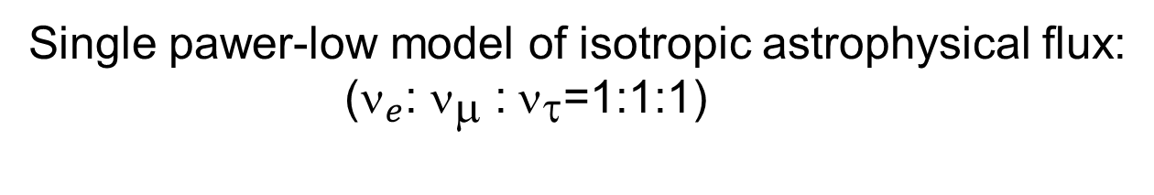
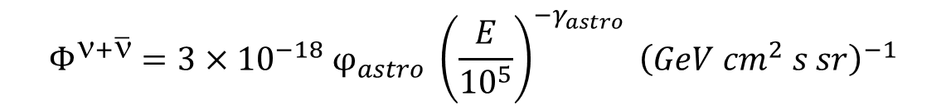


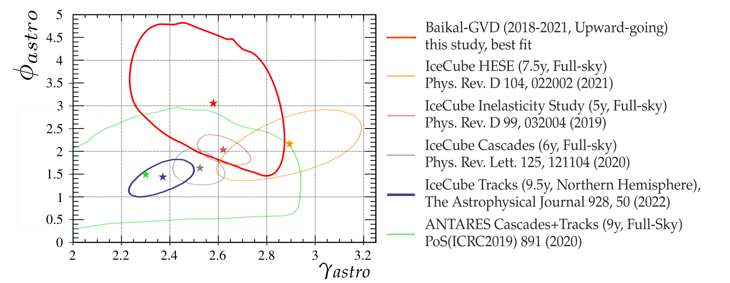
Single power-low model of isotropic astrophysical flux:
16 events: E > 70 TeV
Expected background (atm. ν and μ) of 8.2 events, signal for GVD best fit
5.8 events.
Probability for the background-only
hypothesis (stat.+sys.)
P-value = 0.026 (2.22 σ)
11 up-going cascades E > 15 TeV
Expected background of 3.2 events,
signal for GVD best fit 6.3 events.
Probability for the background-only
hypothesis (stat.+sys.)
P-value = 0.0024 (3.05 σ)
Baikal-GVD best fit :
68% C.L. contours
Notes:
So, we can say, that we finally confirm IceCube result on the diffuse astrophysical neutrino flux
14

Slide 15
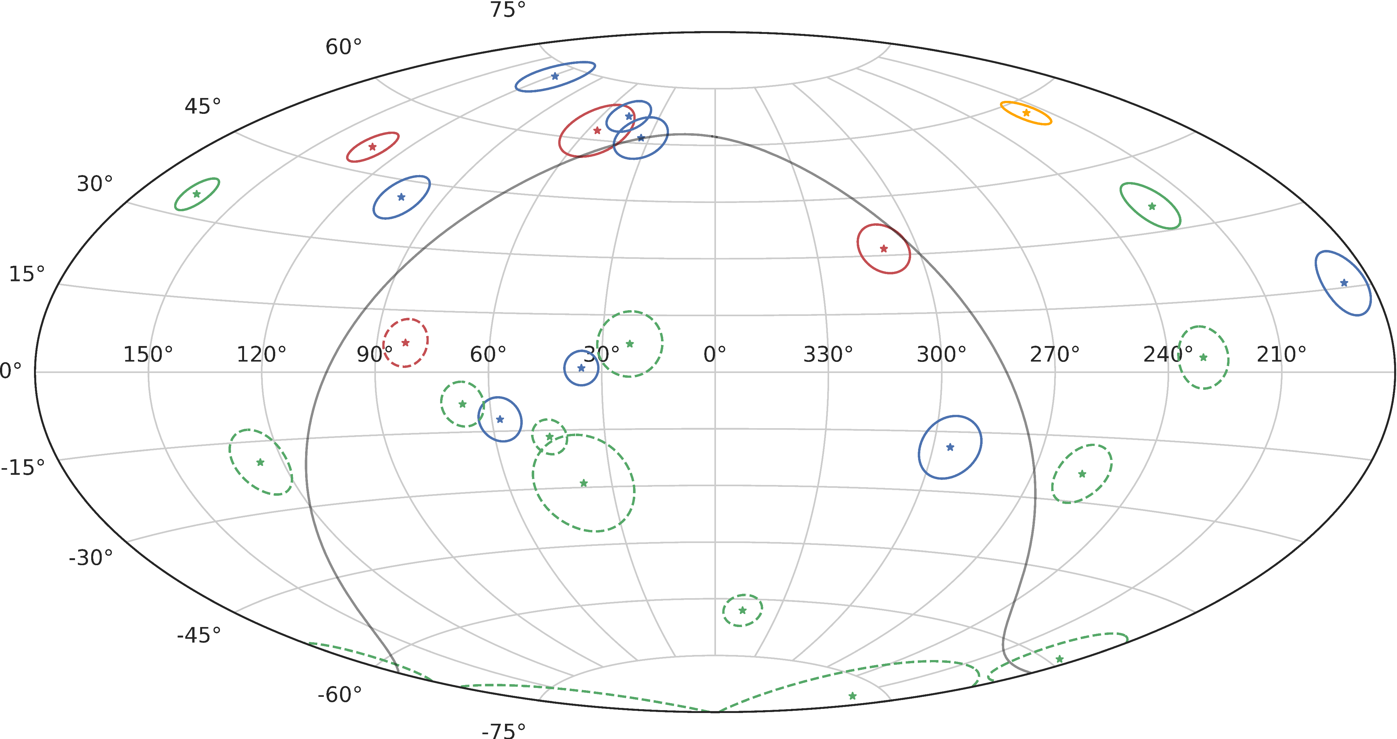
The Baikal-GVD high-energy cascade sky map (in equatorial coordinates)
224 TeV
triplet
1.2 PeV
The best-fit positions and 90%
angular uncertainty regions:
dashed circles - under-horizon events;
solid circles - above horizon events.
Colour represents event energy:
green – E < 100 TeV,
blue – 100TeV < E < 200 TeV,
red – 200 TeV < E < 1000 TeV,
orange – E > 1 PeV.
The Galactic plane is indicated
as a grey curve.
Experimental estimation: ~1 event per year per cluster (cascade mode) from astrophysical neutrinos:
91 TeV
Arrival directions of high-energy and under-horizon Baikal-GVD neutrino cascades. Phys.Rev. D 107, 042005
Notes:
This picture shows arrival directions of high-energy and under-horizon Baikal-GVD neutrino cascades and their uncertainty (90% regions) in the sky map (equatorial coordinates). Color represents energies of the events:.
For sure, there are analysis on each event/bundle events on sources, coincidences with another detectors, multimessenger analysis. Due to lack of time I will not speak about all this staff. Most bright events are highlighted.
15

Slide 16
Prospects for the development of the Baikal project
2025
The project of the Baikal telescope of the next generation ~ 10 km³
2027/28
Increasing the effective volume of the Baikal-GVD telescope:
~ 1 km³
Directed to research of the sources of astrophysical neutrinos.
The largest neutrino telescope in the world at this time point
Possibly
Preservation of the production and technical base of the project
Notes:
The Baikal project is developing in two directions.
The main direction is increasing the effective volume of the Baikal-GVD telescope up to ~ 1 km³.
With the deployment of two clusters per year, the completion of the GVD is expected by 2027/28.
Probably at this time point GVD will be largest neutrino telescope in the world .
In conditions of GVD further expansion, the production base of the project will be saved.
Simultaneously with GVD expansion, work is underway to prepare a project for a next-generation neutrino telescope with volume about 10 km3. This telescope will be directed to research of the sources of astrophysical neutrino.
.
Разработка к 2025 году проекта Байкальского телескопа следующего поколения, позволяющего проводить исследования источников нейтрино астрофизической природы: около 100 (???) нейтринный событий за три года эксплуатации.

Slide 17
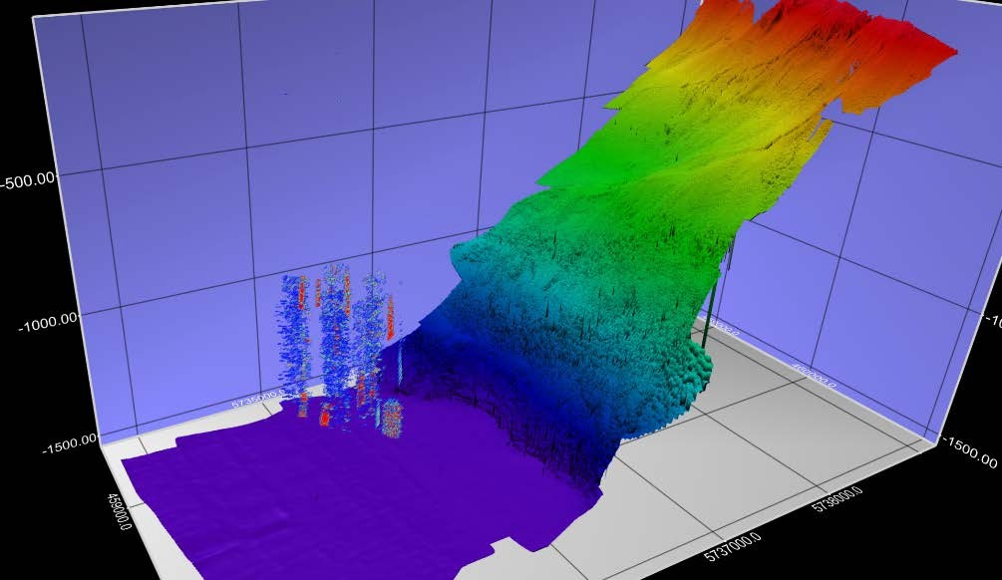
Experimental base for next generation telescope design
The next-generation telescope is planned to be placed near Baikal-GVD telescope.
The flat bottom relief allows to place new telescope close the shore.
1366 m
Sonar2020 image
Research directions for the development of the new telescope
Experiments on the implementation of a fiber-optic deep-sea data acquisition system.
Experimental studies of the characteristics of a detection system with a reduced density of photodetectors.
Studies of the possibility of increasing the sensitivity of photodetectors.
Notes:
The next-generation telescope is planned to be placed near Baikal-GVD telescope.
An important advantage of the Baikal site is the flat bottom relief close the shore.
This picture shows the view of telescope and bottom relief obtained with sonar.
There is a significant flat surface for new telescope deployment at depth 1366 m.
The development of the project is based on experimental research in the following directions:
Experiments on the implementation of a fiber-optic deep-sea data acquisition system.
Experimental studies of the characteristics of a detection system with a reduced density of photodetectors.
Studies of the possibility of increasing the sensitivity of photodetectors

Slide 18
Fiber optic(FO) DAQ: in-situ studies and plans
2021 The first FO string: three sections, 36 OMs.
Deep-sea FO cables: “Starlink” (Russia), “DWTEK” (Taiwan).
Negative FO cables operational experience.
2022 Deployment FO string on the basis “Teledyne” FO cables. Successful operation 2022 – 2023. But it was the last cable delivery from Europe.
2023 Deployment the second FO string with Chinese Hybrid Optical Cables. Reliable string operation from April 2023 to the present.
Experimental string with fiber-optic DAQ
If FO string will be successfully tested during 2023, installation of a fiber-optic strings will begin in 2024 and cross-check of the conventional cluster and the FO cluster will be possible by 2025.
Notes:
The first FO string with 3 sections was installed in 2021. We have used deep-sea FO cables: “Starlink” (Russia), “DWTEK” (Taiwan) for the string.
Negative operational experience of FO cables.
At 2022 cables communication were changed on Teledyne cables.
As a result of the search of alternative solution Chinese Hybrid Optical Cables were selected. The second FO string with Chinese Hybrid Optical Cables was installed in 2023. String shows reliable operation since April 2023 up to now.
If the string will be successfully tested during 2023, installation of a fiber-optic cluster based on Chinese cable products will begin in 2024. The task of cross check conventional Baikal-GVD cluster and FO cluster is important for GVD.

Slide 19
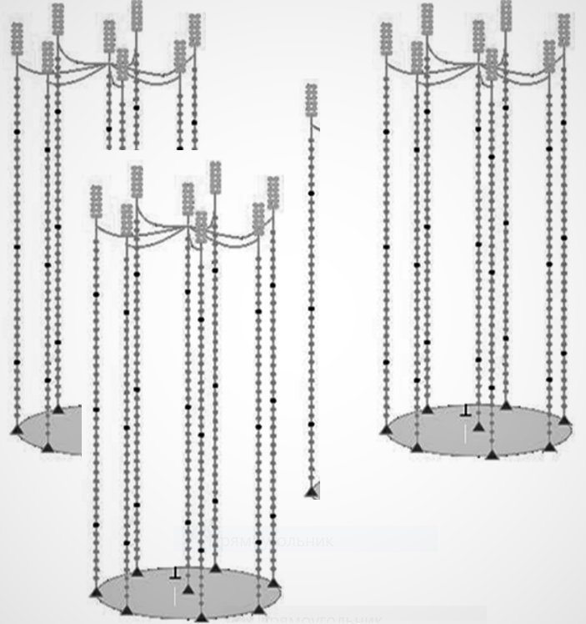
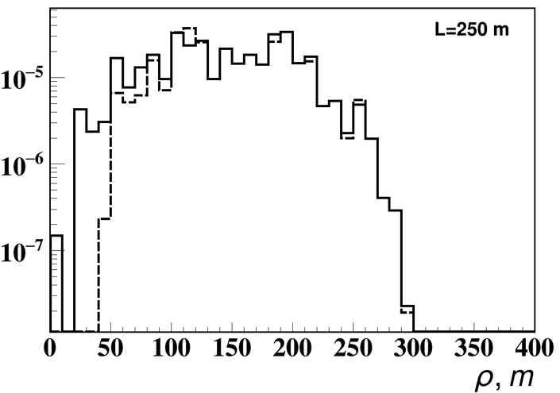
Baikal-GVD intercluster strings
2022 The first intercluster string was installed in the geometric center of clusters #5, #8, #9.
Increasing in the number of events in the cascade mode:
E > 1 TeV: 10% E > 100 TeV: 24%.
The possibility to study the detection system with increased distance between the strings: from 80 m up to 200 m.
2023. Two additional intercluster strings were installed.
It is planned to install intercluster strings between all clusters of Baikal-GVD.
Intercluster string
120 m
250 m
Distribution of events (cascades generated by neutrinos) on distance from intercluster center, E > 1 TeV
With intercluster string
Without string
Notes:
The first intercluster string was installed in the geometric center of clusters #5, #8, #9 in 2022.
From point of view GVD improvement, the intercluster string increases the detector efficiency in the cascade mode. This figure shows distribution of cascades generated by neutrinos on distance from the intercluster string, E > 1 TeV. Intercluster string gives a gain of 10% at energies greater than 1 TeV and 24% for energies greater than 100 TeV for astrophysical flux.
It gives possibility of the study the detection system of in the range of distances between strings of 80 m - 200 m.
2 additional intercluster strings were installed in this year as parts of 2 new clusters.
It is planned to install intercluster strings between all clusters of Baikal-GVD.

Slide 20
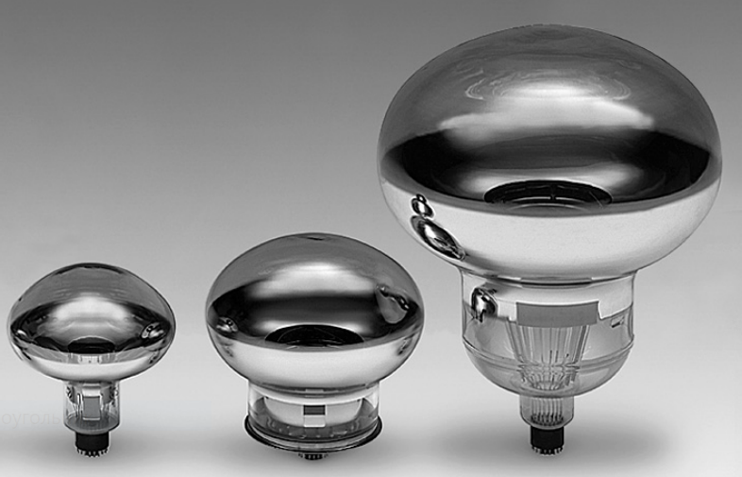
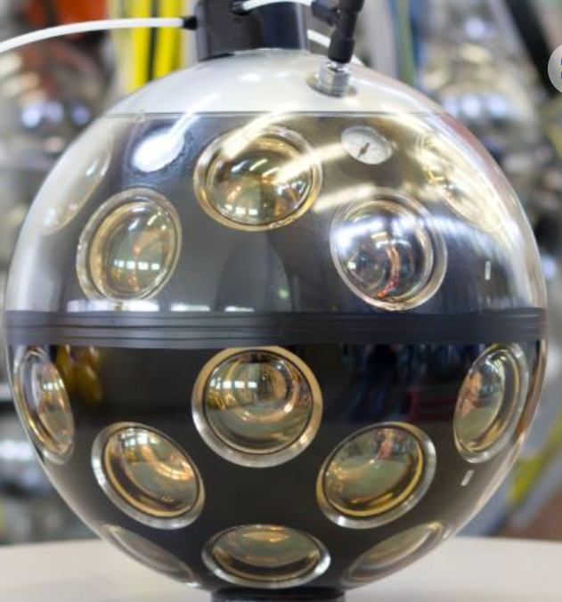
Increasing the sensitivity of photodetectors
Increasing the photocathode area
Using multi-PMT OMs
12”
10”
20”
Joint Russian-Chinese project: Prototype string with 20-inches PMTs in Baikal.
The PMTs, deep-sea housings and prototype electronics will be provided by the Chinese side
2024 – Deployment of a Prototype string in Lake Baikal as part of GVD:
12 Digital OMs with 20-inches PMT,
Fiber optic technology.
Notes:
There are two main approaches to increasing the sensitivity of the photodetector: increasing the photocathode area or using multi-PMT OMs (like KM3NeT)
At the current stage of research, an experimental test of the first approach is planned – testing of an optical module with a 20-inch PMT.
The work is carried out in the frame of Joint Russian-Chinese project: Prototype string with 20-inches PMTs in Baikal.
The PMTs, deep-sea housings and prototype electronics will be provided by the Chinese side.
At 2024 we are planning to install in Baikal prototype string with 12 20-inches PMT.
DAQ of the prototype will be designed on the basis of FO.
Prototype will operate as a part of FO GVD cluster.

Slide 21
Conclusion
Baikal-GVD is currently the largest neutrino telescope in the Northern Hemisphere and allows studying the diffuse flux of astrophysical neutrinos (~10 events per year).
The IceCube’s diffuse neutrino flux is confirmed
by Baikal-GVD with significance 3σ.
The completion of work on the creation of 1 km³ Baikal-GVD detector with ~6000 OM is planned in 2027/2028.
In 2025, it is planned to prepare a project of a next-generation neutrino telescope aimed to study the sources of astrophysical neutrinos.
Currently, experimental studies is being carried out to develop a project for a next-generation detector.

Slide 22
JINR group participation
32.4 FTE (24,5 scientists and engineers)
Assembly and test of OMs and strings;
Development of the shore infrastructure;
Main driving force in winter deployment campaigns;
Access and security service;
Data archive processing and analysis;
Detector calibration and mass processing of data;
Remote control and monitoring systems of detector;
Simulation software and MK production;
On-line software;
Development of new methods of event selection and reconstruction;
Data analysis with respect to high-energy neutrinos and their sources;
Follow-up and alert program for neutrino events.

Slide 23
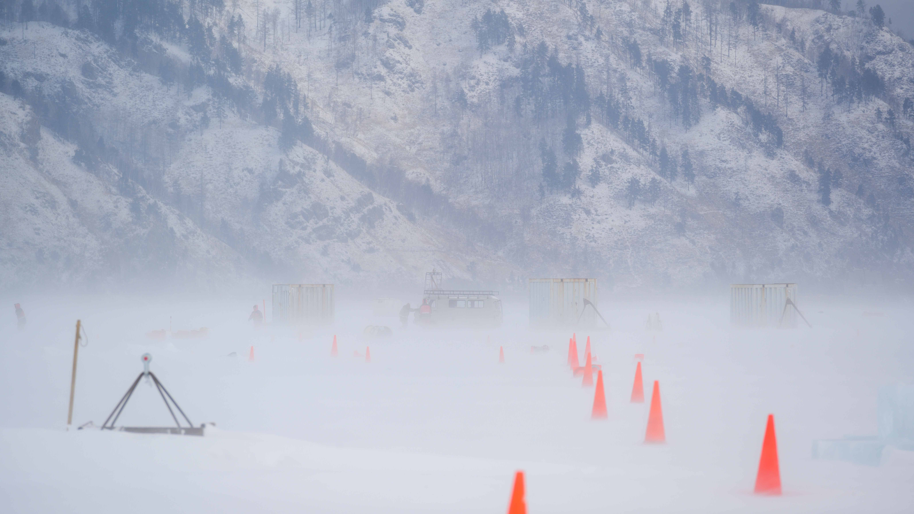
Thank you

Slide 24
Resources for the Baikal-GVD project and proposed schedule of its allocation
Resources required | Normo-hours | Resources
 |  | the amount of FTE, | 32.4 | 32.4 | 32.4 | 32.4 | 32.4 | 32.4
 |  | accelerator/installation,
 |  | reactor,….
Sources of funding | Budgetary resources | JINR budget (budget items) | 31 750 | 6950 | 6950 | 5950 | 5950 | 5950
 | Extrabudgetary (supplementary estimates) | Contributions by co-contractors Funds under contracts with customers Other sources of funding | 2 500 | 500 | 500 | 500 | 500 | 500

Slide 25
Resourses needs for the project and proposed schedule of its allocation
Names of costs, resources, sources of funding |  | Cost (k$) resource requirements | Cost, distribution by year
 |  |  | 1st year | 2nd year | 3rd year | 4th year | 5th year
 | International cooperation (IC) | 750 | 150 | 150 | 150 | 150 | 150
 | Materials | 11500 | 2900 | 2900 | 1900 | 1900 | 1900
 | Equipment and third-party services (commissioning) | 15000 | 3000 | 3000 | 3000 | 3000 | 3000
 | Commissioning work
 | Services of research organizations | 500 | 100 | 100 | 100 | 100 | 100
 | Acquisition of software
 | Design/construction
 | Service costs (planned in case of direct project affiliation) | 4000 | 800 | 800 | 800 | 800 | 800

Slide 26
Back-ups

Slide 27

Global neutrino network
ANTARES
Stopped on
16.02.2022
Baikal-GVD, 1 km³
Being deployed since 2015
P-One, >1 km³
prototyping stage
KM3NET, 1 km³
Being deployed since 2016
IceCube 1 km³
Data taking since 2011
IceCube-Gen2 10 km³
start deployment in 2023
27
Notes:
27

Slide 28
A decade of neutrino searchers in Lake Baikal
2010 – Technical Design Report “Baikal-GVD” – km³ scale NT in Lake Baikal
2011 – 2014 Preparatory Phase (cable to shore, pilot detectors, first strings)
2015 – Demonstration cluster Dubna – 192 OMs at 8 reduced strings
2016 – First baseline cluster (288 OMs), start data taking
2022 – 10 clusters in operation (2880 + 36 OMs)
2017 – Start multi-messenger studies (GW170817)
2018-2021 – First astrophysical neutrino candidates (cascades), first
atmospheric muon neutrinos
2022 – confirmation of the IC diffuse astrophysical flux at 3σ significance level,
based on an analysis of 2018-2021 data
Notes:
28

Slide 29
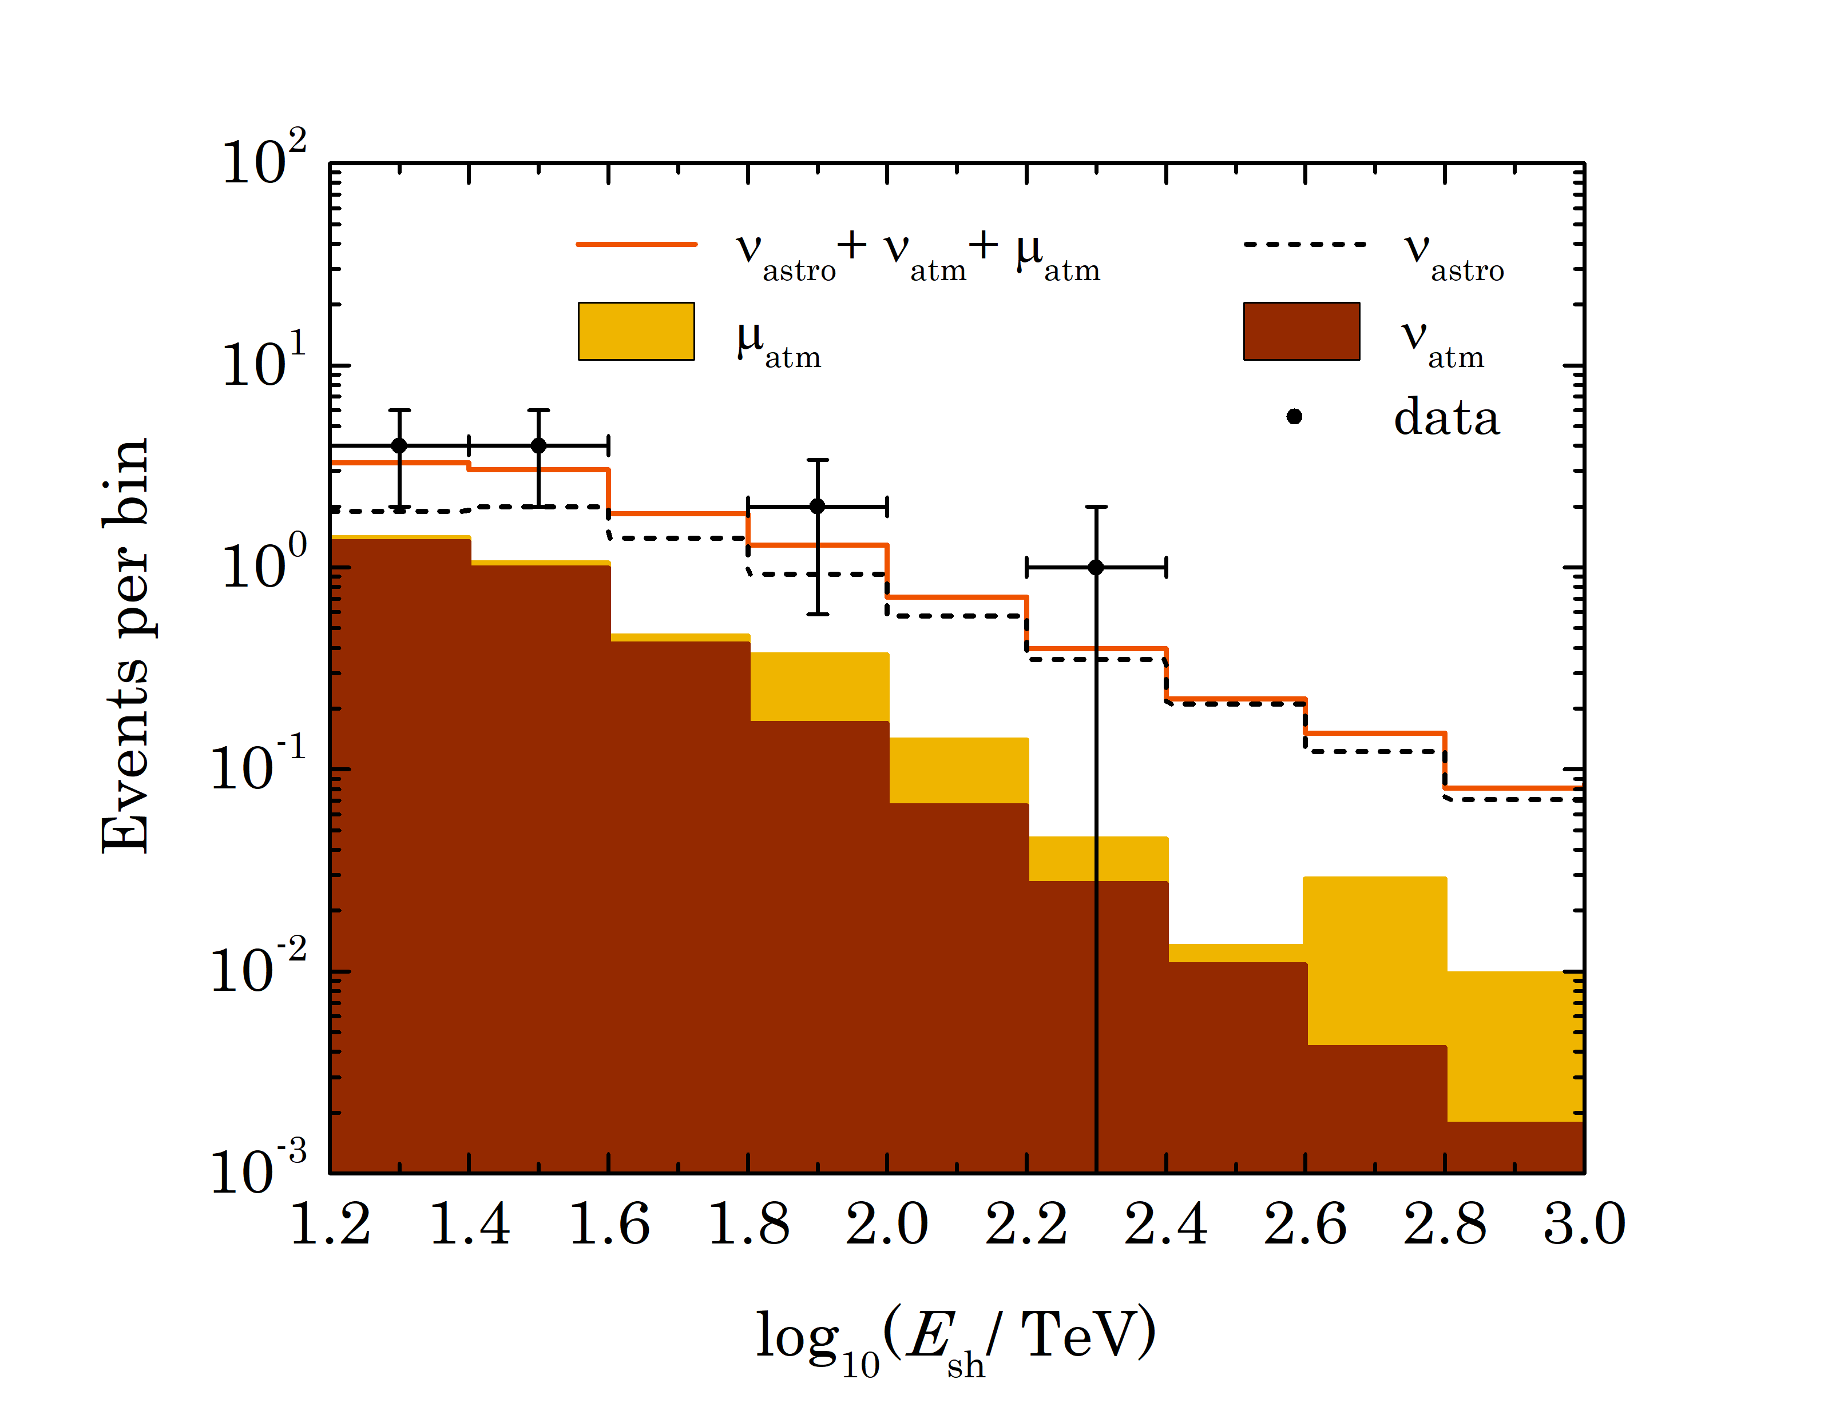
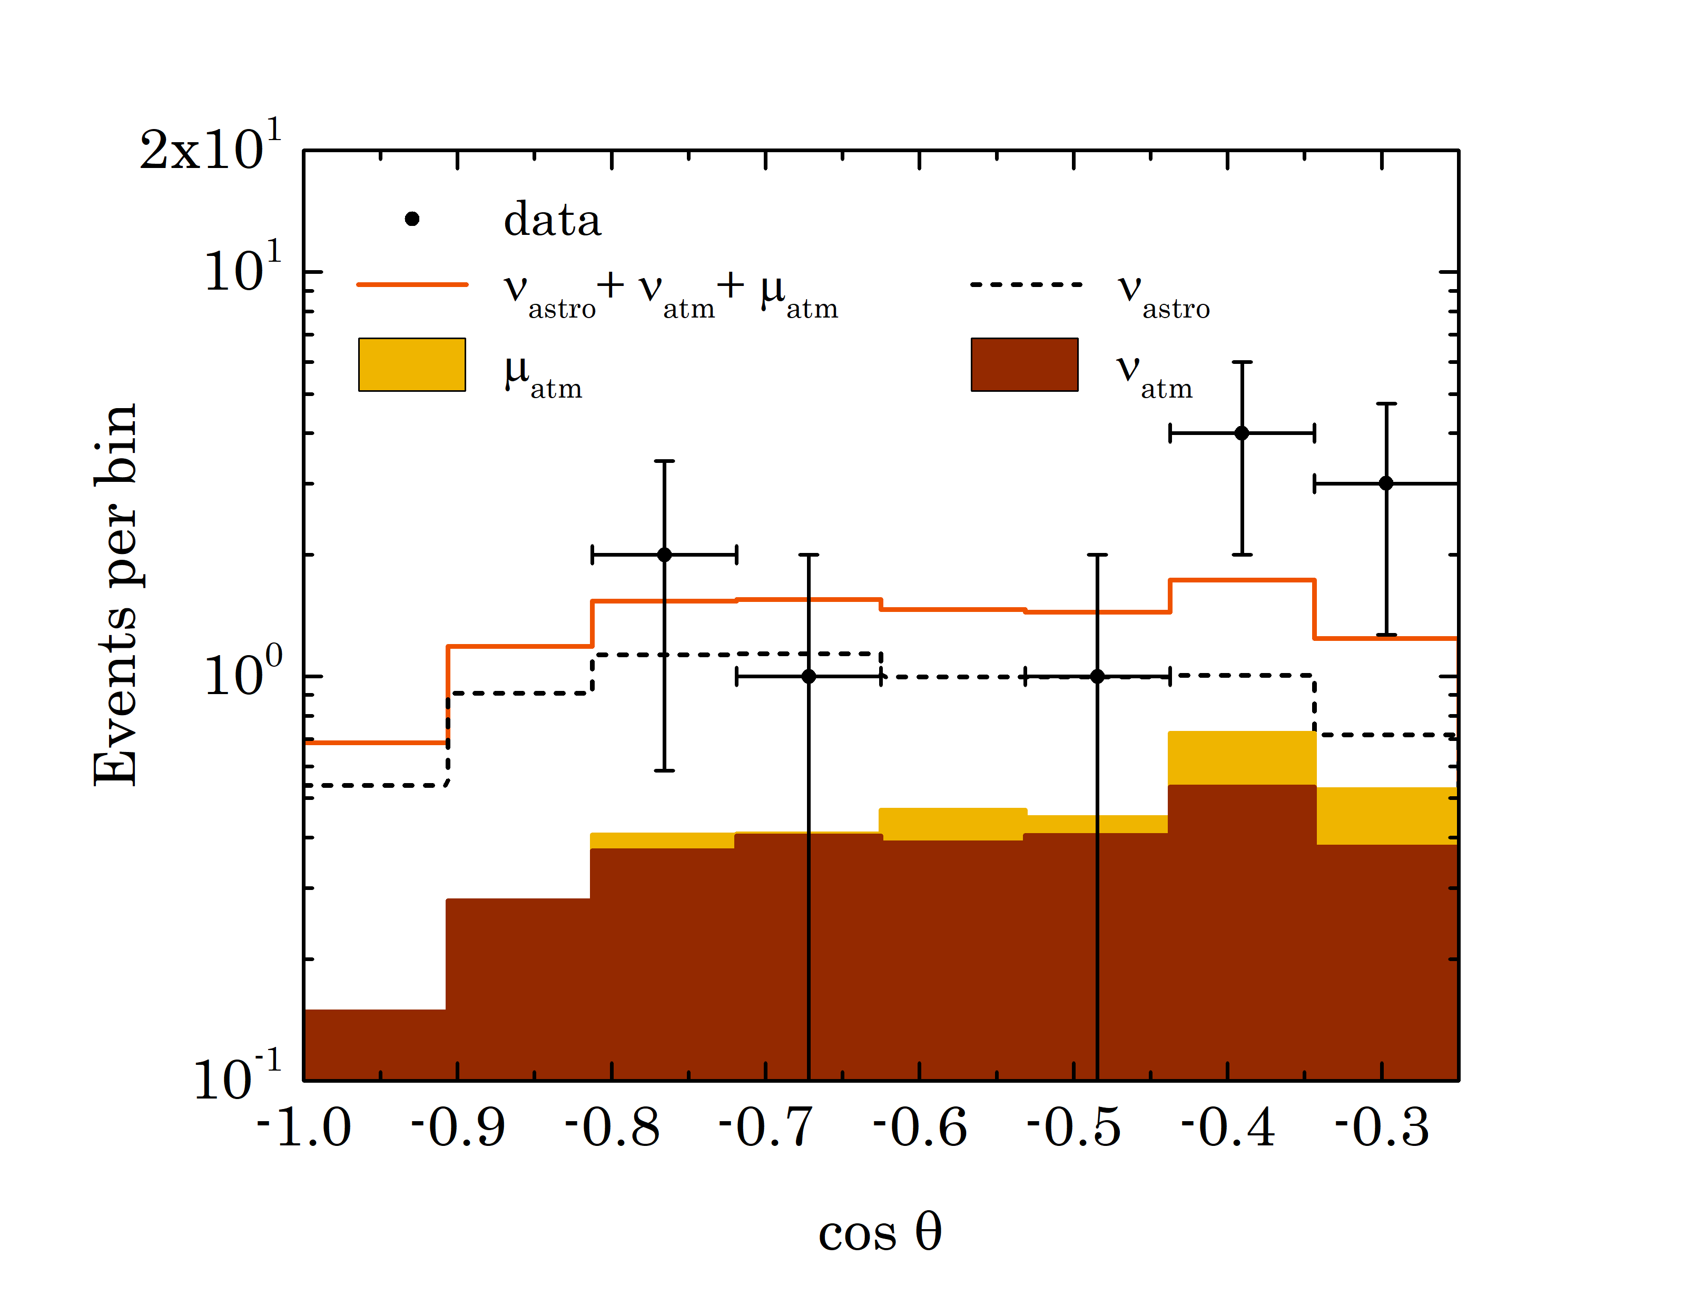
Search for upward moving events
Phys.Rev. D 107, 042005 (2023)
Energy distribution
Additional selection requirements:
E > 15 TeV & N_{hit} >11 & cosθ < -0.25
Expected:
0.5 events from atm. muons
2.7 events from atm. neutrinos
6.3 events for Baikal-GVD best fit E^{-2.58}
astrophysical flux
Found in data: 11 events
Probability for the background-only
hypothesis (stat.+sys.)
P-value = 0.0024 (3.05σ)
Zenith distribution
Notes:
29

Slide 30
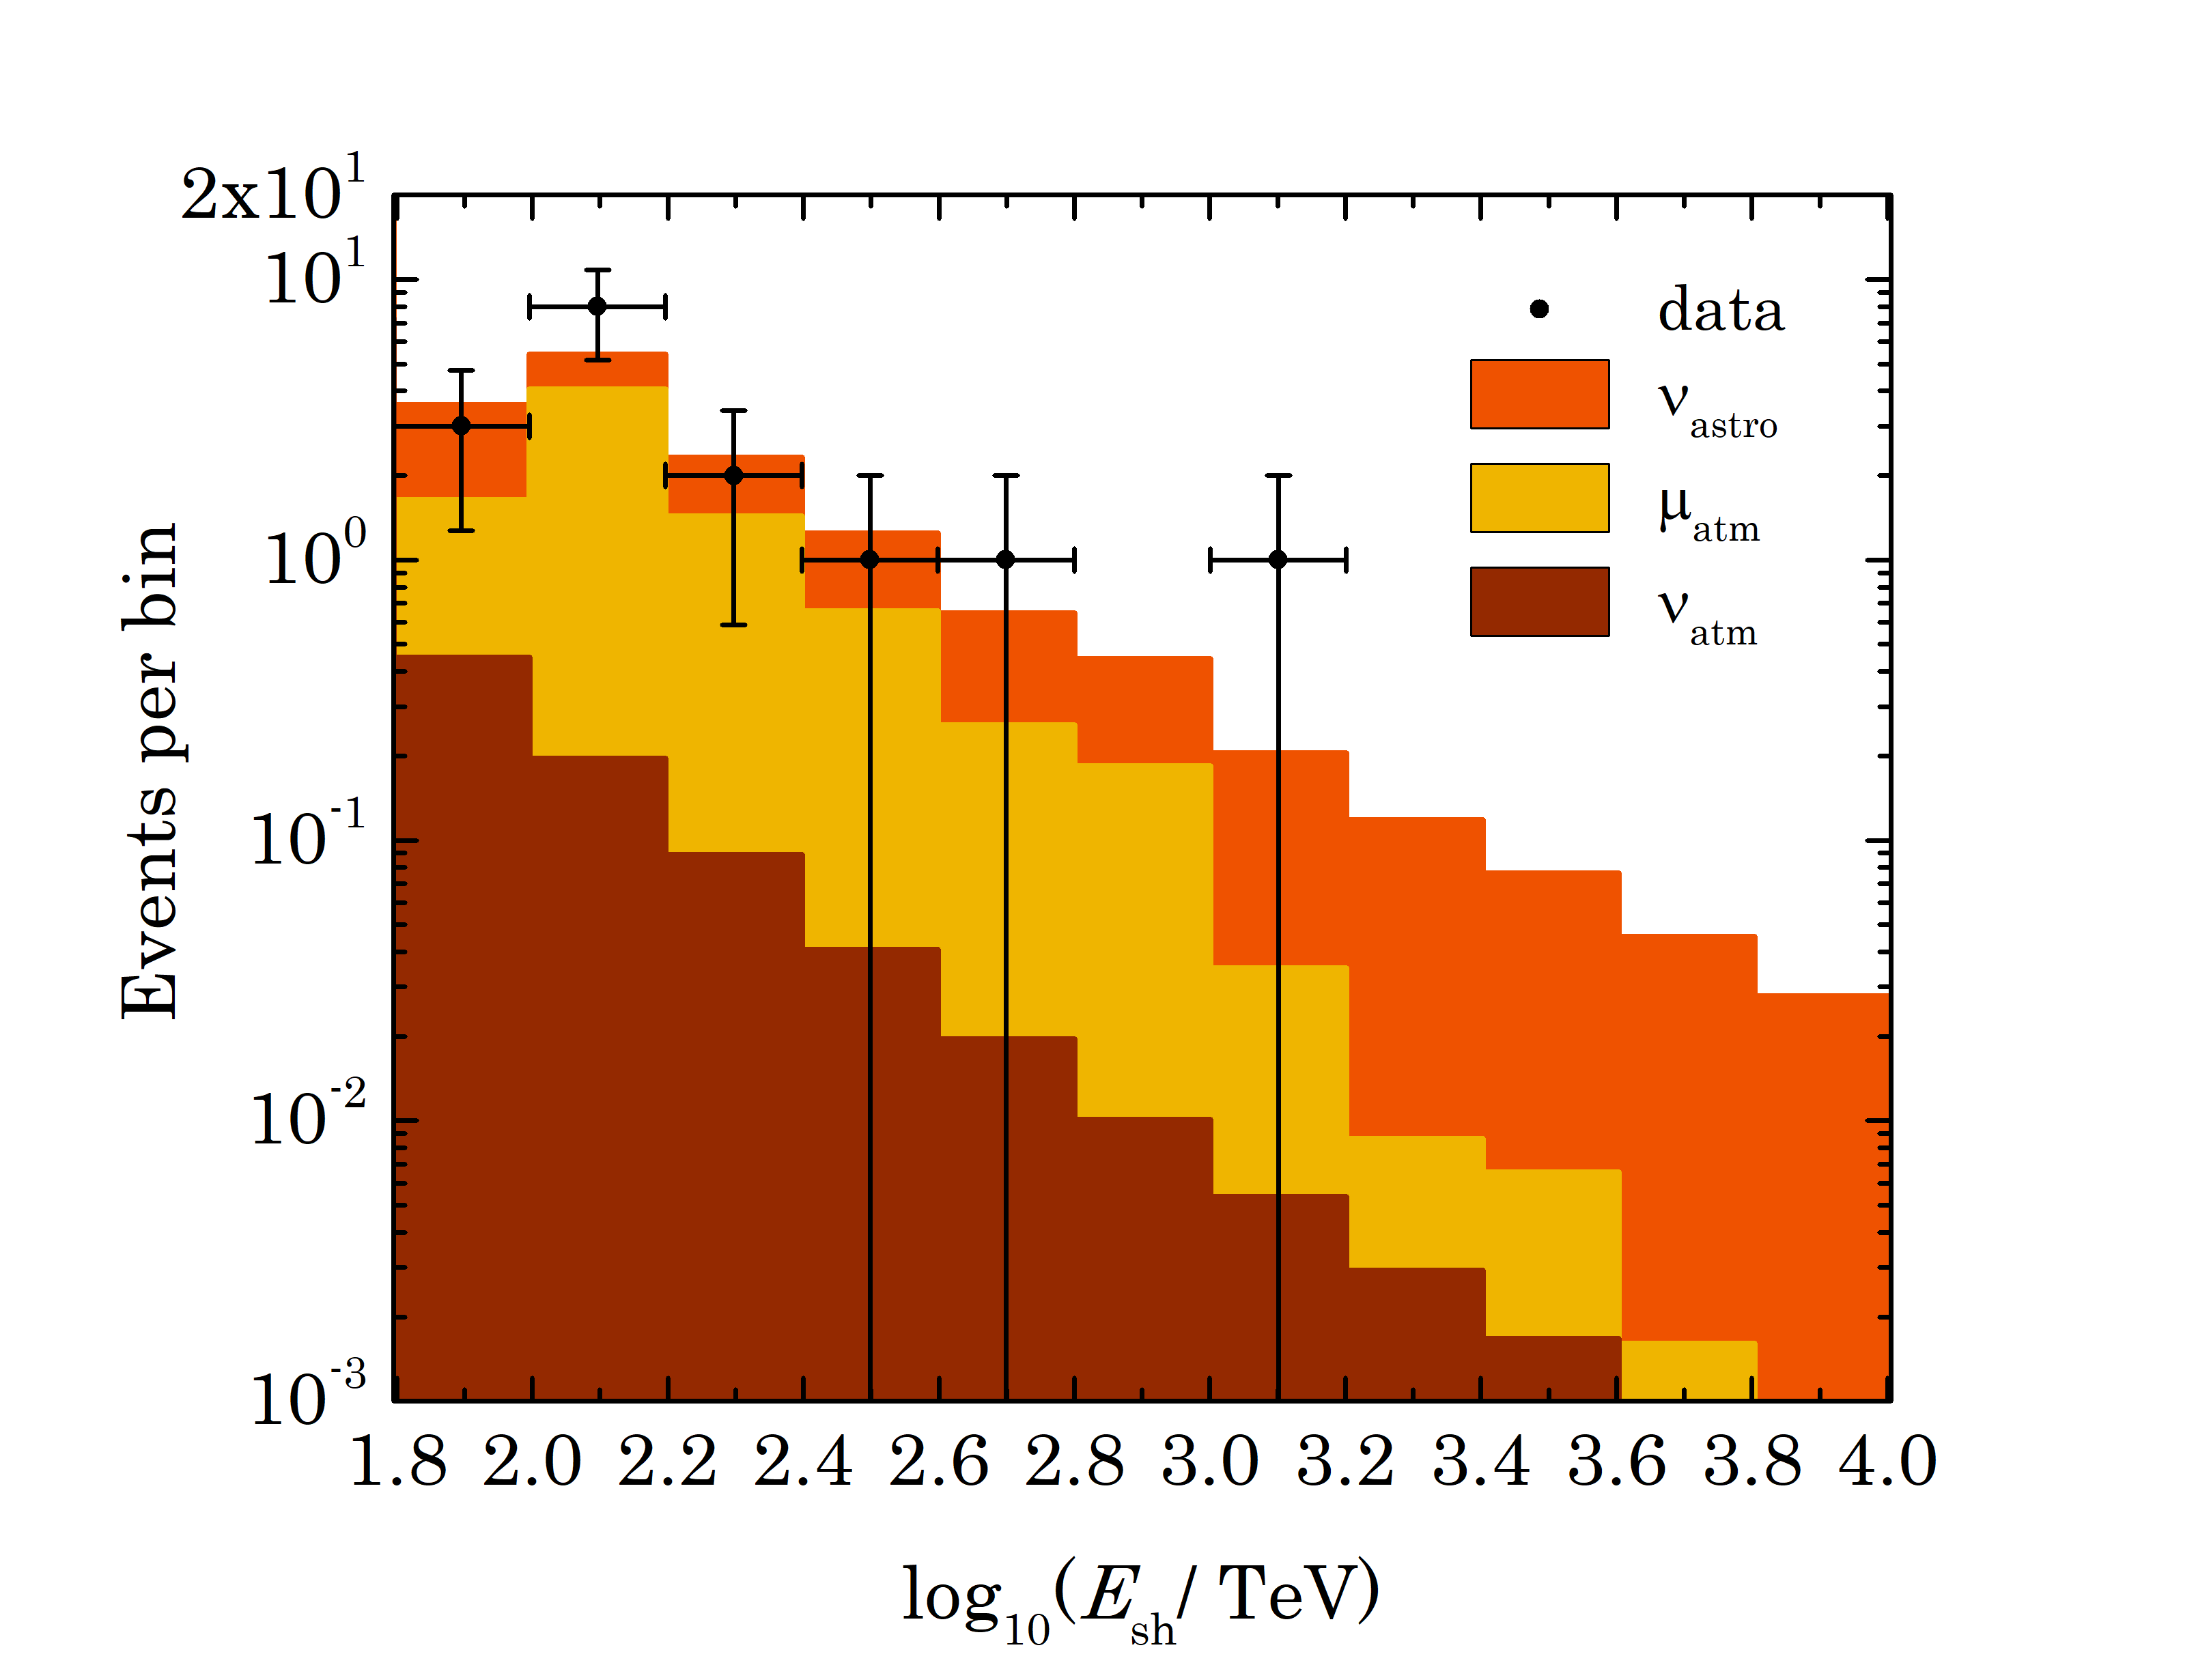
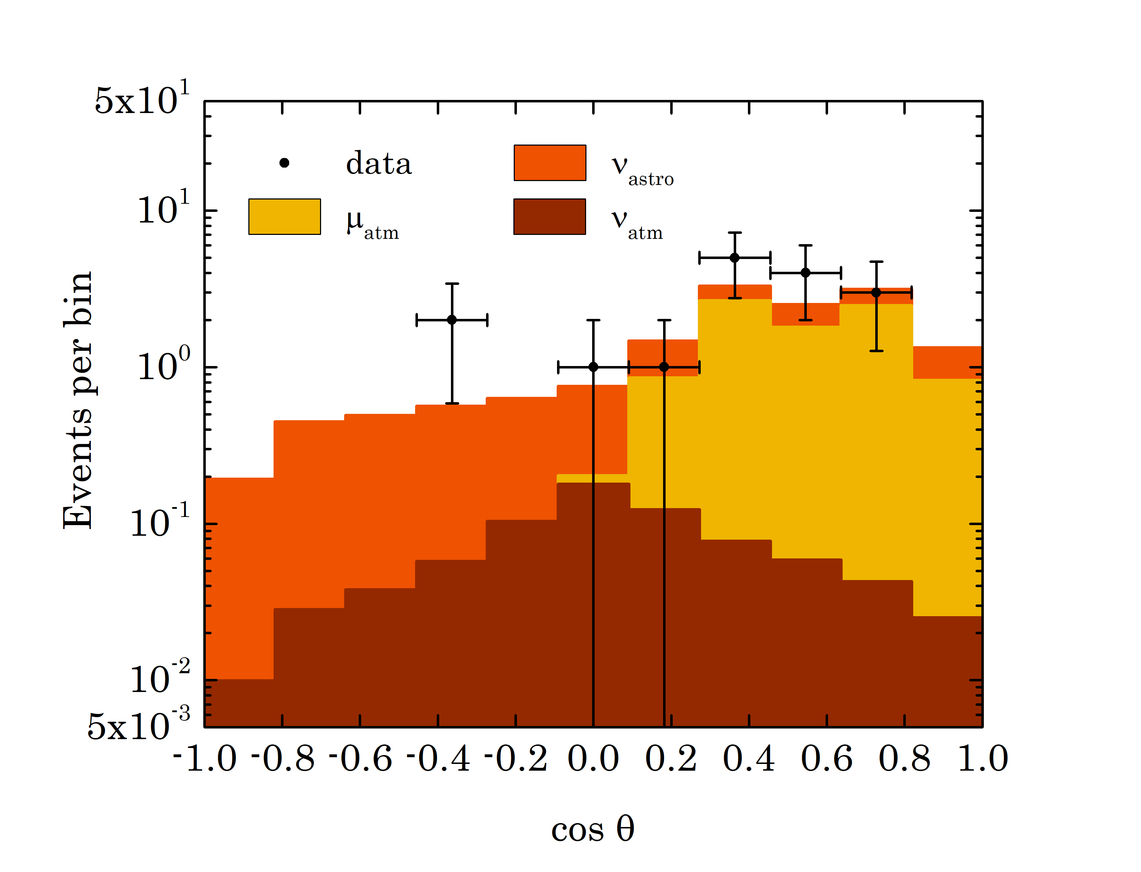
All-sky search for HE cascades
Phys.Rev. D 107, 042005 (2023)
Additional selection requirements:
(N_{hit_μ} = 0, E_{rec} ≥ 70 TeV) or
(N _{hit_μ} = 1, E_{rec} ≥ 100 TeV)
N _{hit_μ} is number of hits in time interval
where hits from muons are expected
Energy distribution
Expected:
7.4 events from atm. muons
0.8 events from atm. neutrinos
5.8 events for Baikal-GVD best fit
E^{-2.58} astrophysical flux
Found in real data: 16 events
Probability for the background-only
hypothesis (stat.+sys.)
P-value = 0.026 (2.22 σ)
Zenith distribution
Notes:
30

Slide 31
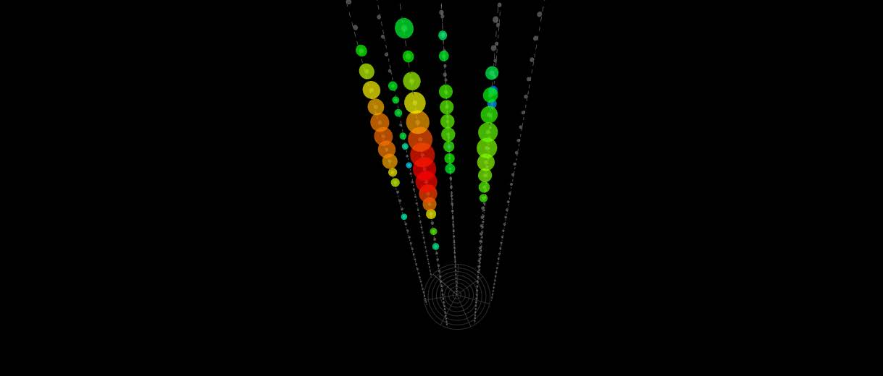
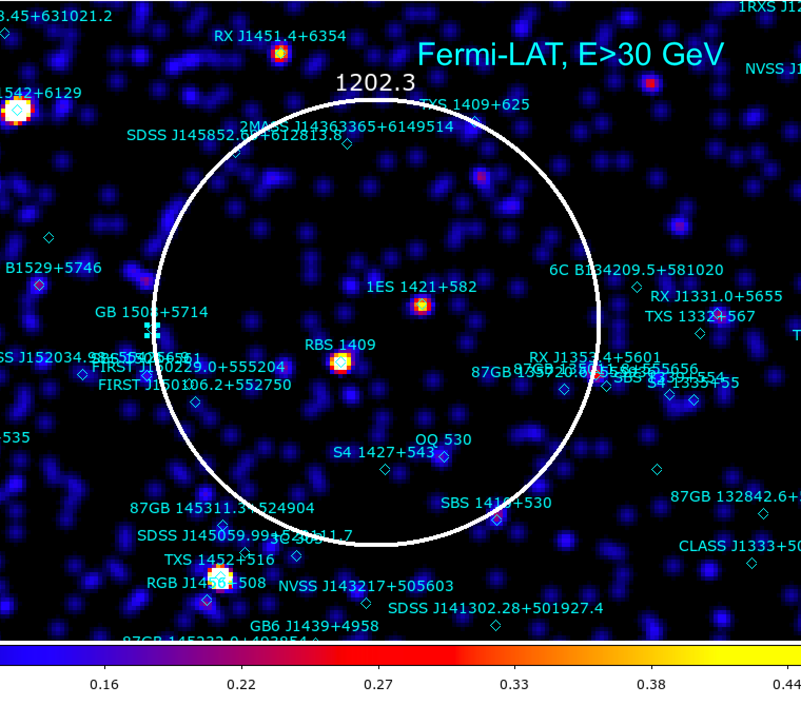
A 1 PeV cascade event (downgoing) GVD190517CA
Preliminary
Energy E = 1200 TeV (±30%)
Distance from central string r = 91 m
Zenith angle = 61°
Probability for the background-only hypothesis (stat.+sys.)
P-value = 0.0054 (2.78σ)
Signalness 96.6%
Fermi sources in 5° circle:
RBS 1409 BL Lac z=unknown
1ES 1421+582 z=unknown
both with hard spectrum
Notes:
31

Slide 32
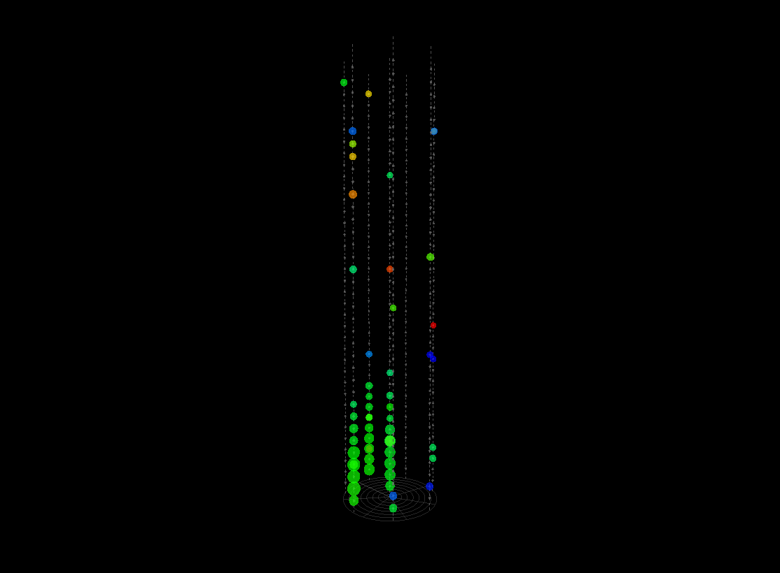
Upward-going cascade GVD210418CA
MJD = 59322.94855324
Energy E = 224 TeV (±30%)
Distance from central string r = 70 m
Zenith angle = 115°
RA = 82.4°, Dec = 7.1°
Probability for the background-only
hypothesis (stat.+sys.)
P-value = 0.0033 (2.93σ)
Signalness: 97.1%
Notes:
32

Slide 33
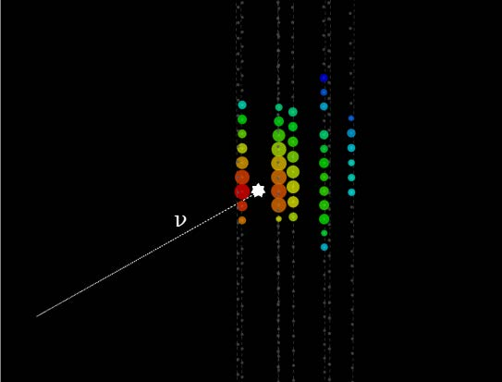
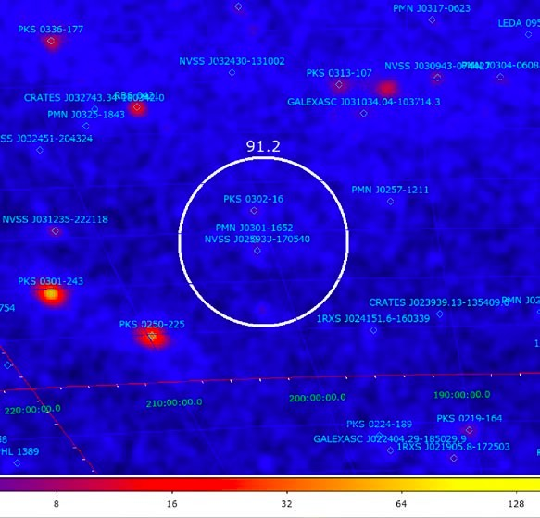
Upward-going cascade GVD190523CA
Sky plot of γ-ray sources
(credit: D.Semikoz, A.Neronov)
E ~ 91 TeV
Upgoing (19° below horizon)
Contained event (50 m off central string).
Excellent candidate for a neutrino event of astrophysical origin.
Signalness = 93.4%
Known sources in 3 degree circle:
PKS 0302-16 : unknown type of source
PMN J0301-1652 : unknown type of source
Notes:
33

Slide 34
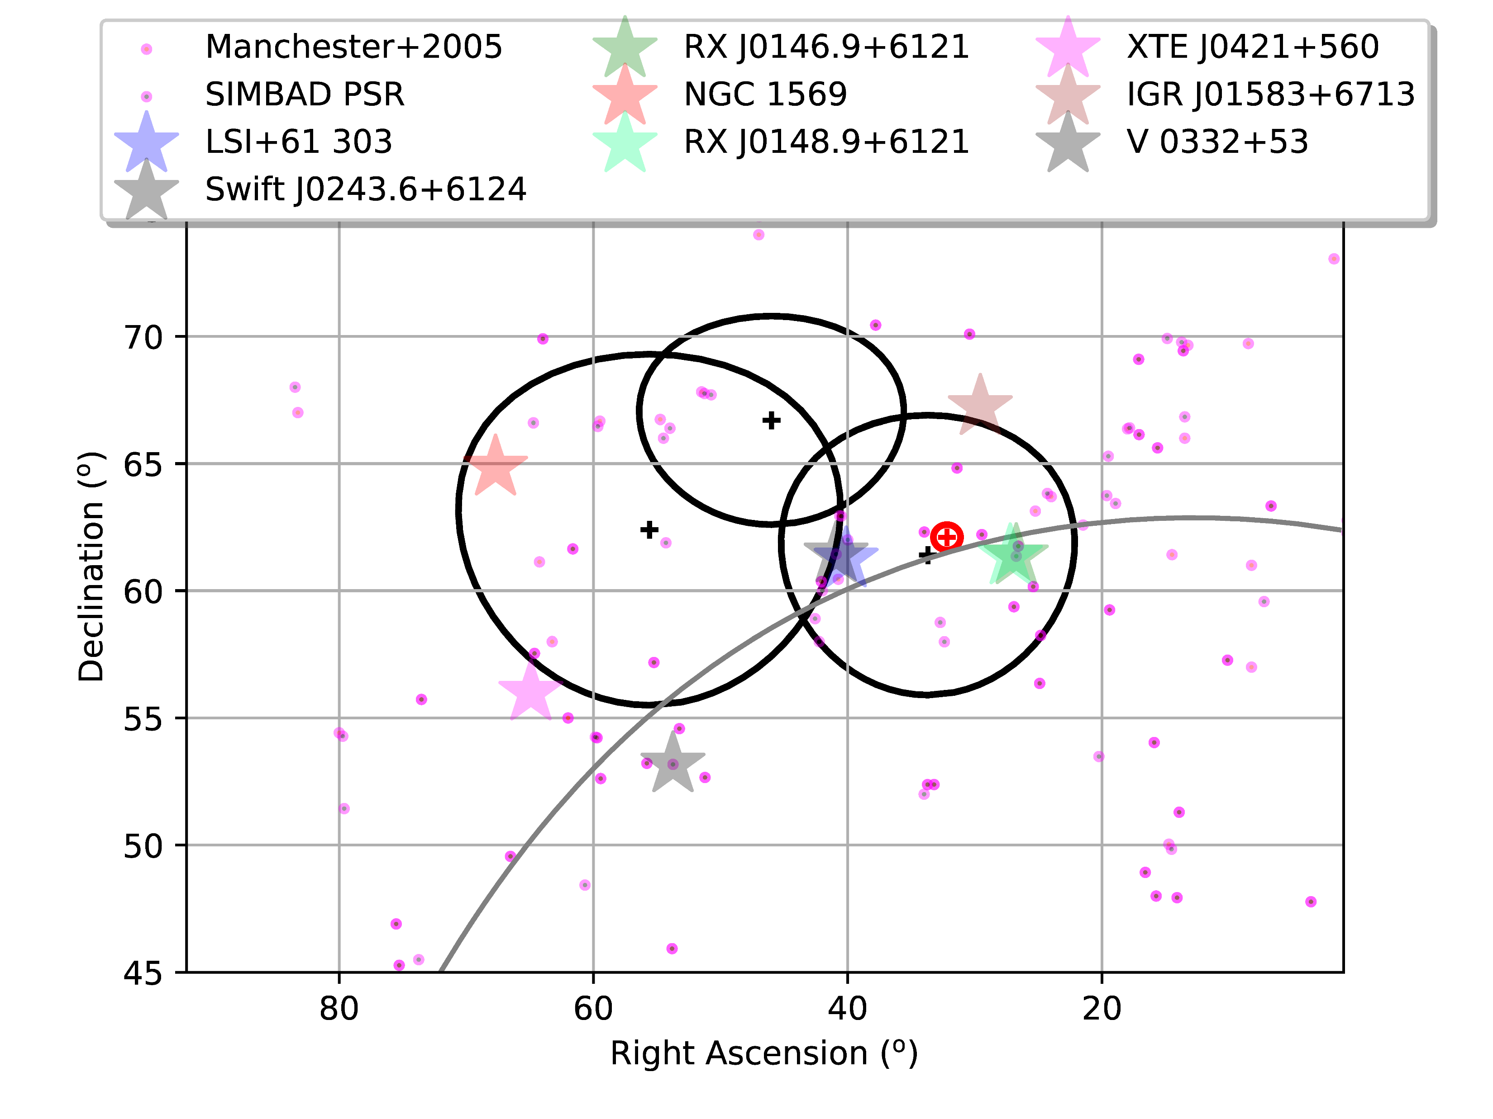
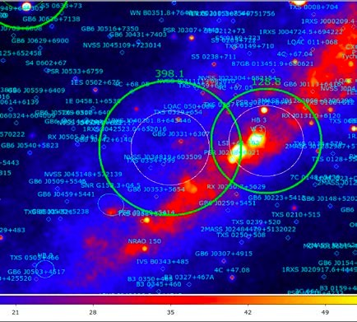
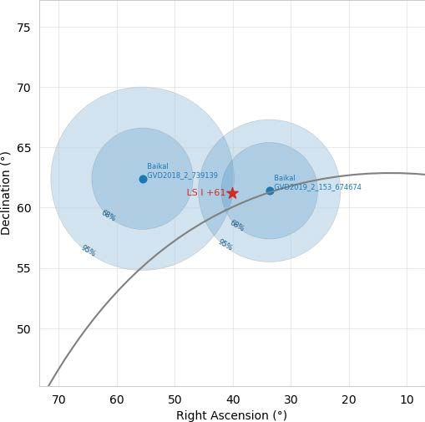
Event triplet near Galactic plane
Three events (GVD190216CA, GVD190604CA and GVD210716CA) close to
the Galactic plane (grey line) and their corresponding 90% errors (black).
The red plus and circle – IC hotspot and 0.5° uncertainty at 90% level
(Aartsen & et al. ApJ, 835,151 (2017))
Stars - Several close high-mass X-ray binaries.
Dots - Galactic pulsars (Manchester et al. 2005, SIMBAD Astronomical Database)
LSI +61° 303 γ-ray active binary system
Swift J0243.6+6124 s the only discovered pulsating ultraluminous X-ray
source (PULX) in the Galaxy.
LSI +61 303 and the two Baikal-GVD events
LSI +61 303 – γ-ray microquasar 3.1° from GVD190604CA and 7.4° from GVD190216CA (both are down-going events). Using the PSFs of all 16 HE-events, the chance probability to observe such a doublet near LSI +61 303 was estimated as 0.0187 (2.35σ) [not corrected for the “look elsewhere effect”]
Notes:
34

Slide 35
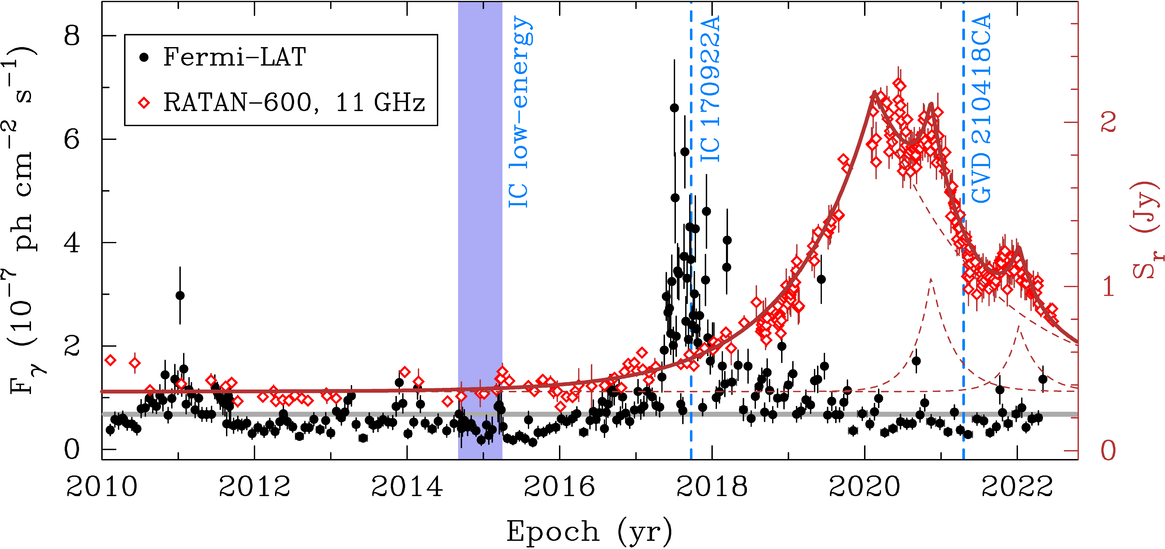
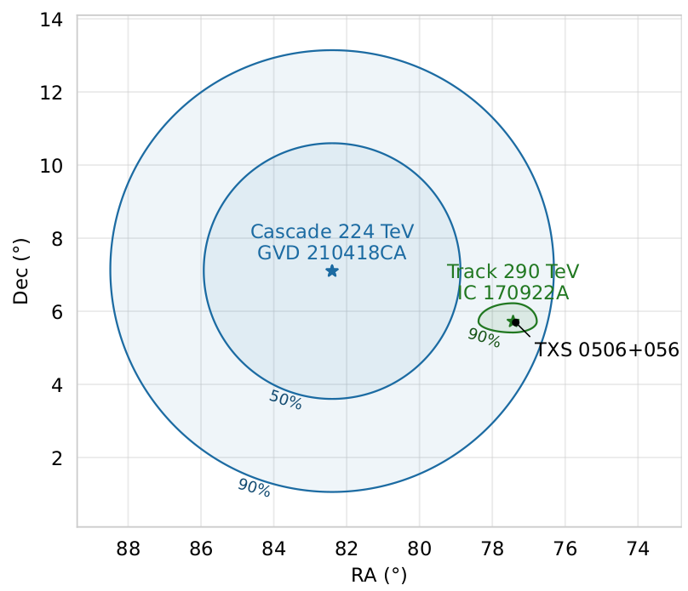
A high energy neutrino from the direction of TXS 0506+056
GVD210418CA (97% signalness) lies within
90% error circle from TXS 0506+056
Radio and gamma-ray light curves of TXS 0506+056.
Analysis of RATAN-600 radiotelescope data (11GHz) showed increased activity
IC event registered during γ flare and radio activity
Baikal-GVD event during radio activity
Probability of IC non-observation: 11%
The chance probability for such an association
to occur randomly due to the background is
p = 0.0074
arXiv:2210.01650
Notes:
35

Slide 36
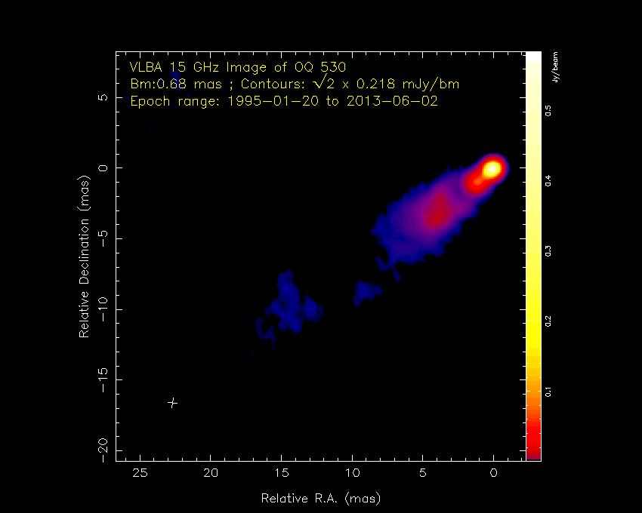
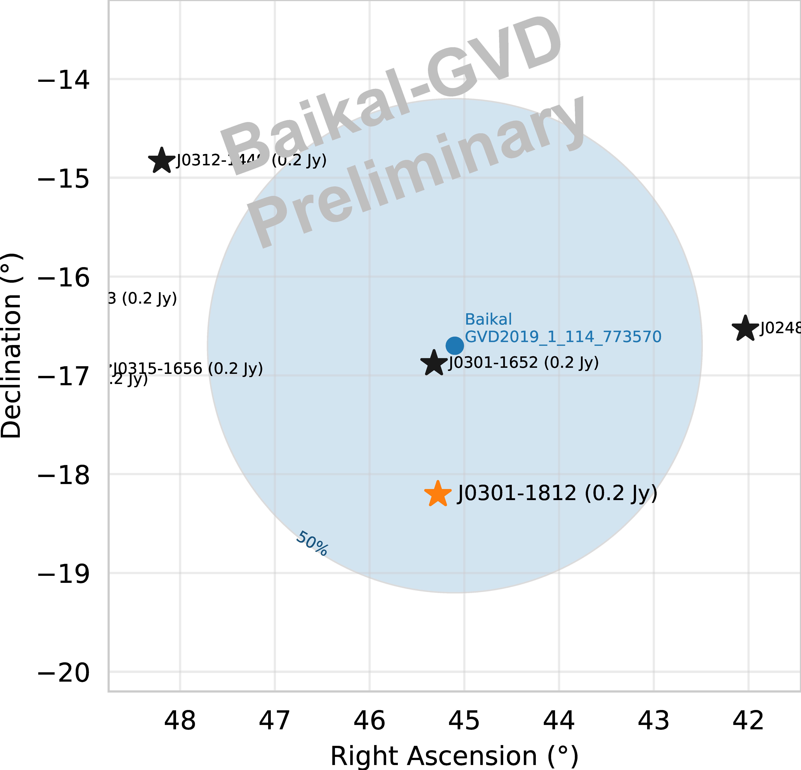
Radio-loud blazars – promising neutrino sources
A. Plavin et al., ApJ 894, 101 (2020)
A. Plavin et al., ApJ 908, 157 (2021)
OQ 530
GVD190523CA
Radio blazar J0301-1812
Sky plot of radio-bright blazars nearby neutrino event
Light curves of J0301-1812 measured by RATAN-600
Notes:
36

Slide 37
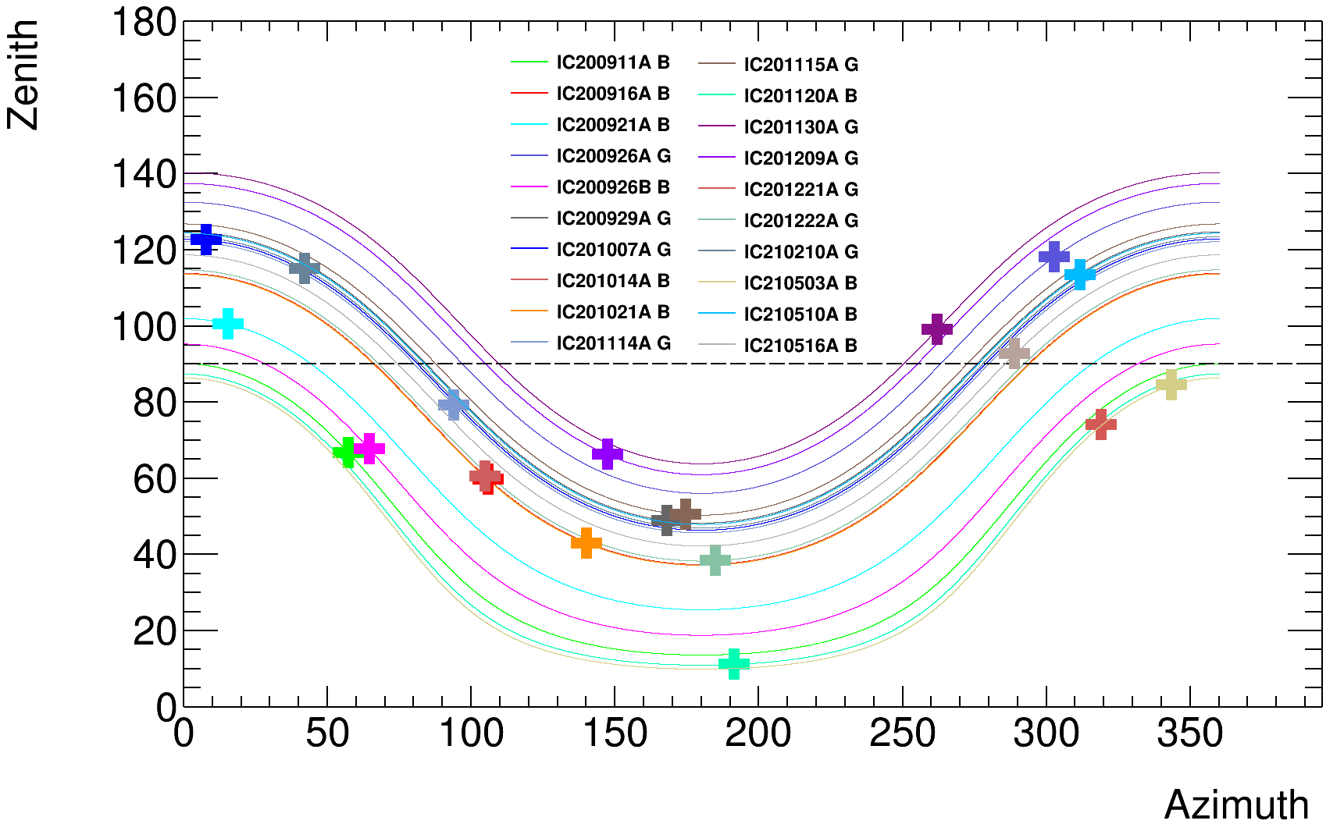
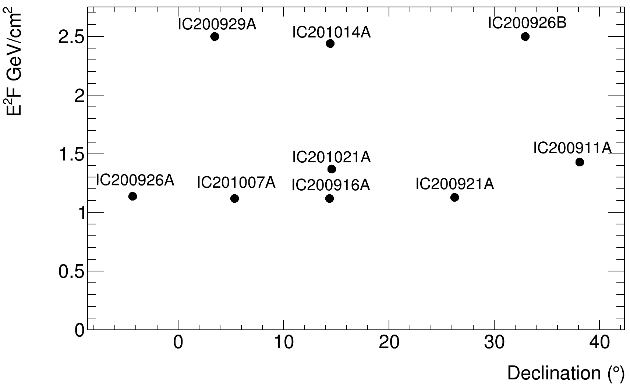
GVD follow up of IceCube alerts
Since Sep 2020, following IC alerts (GCN / upgoing muons)
No statistically significant coincidence was found in
this analysis, except possibly IceCube-211208A
(see next slide)
90% upper limits derived for E⁻² spectrum, equal fluence in all flavors, for E 1 TeV – 10 PeV and
±12 hr interval
Baikal-GVD upper limits
A.D. Avrorin et al., Astronomy Letters, Vol.47, N 2, 114 (2021)
http://dx.doi.org/10.1134/S1063773721020018
V.Y. Dik et al., JINST 16 (2021) C11008
https://doi.org/10.1088/1748-0221/16/11/C11008
Notes:
37

Slide 38
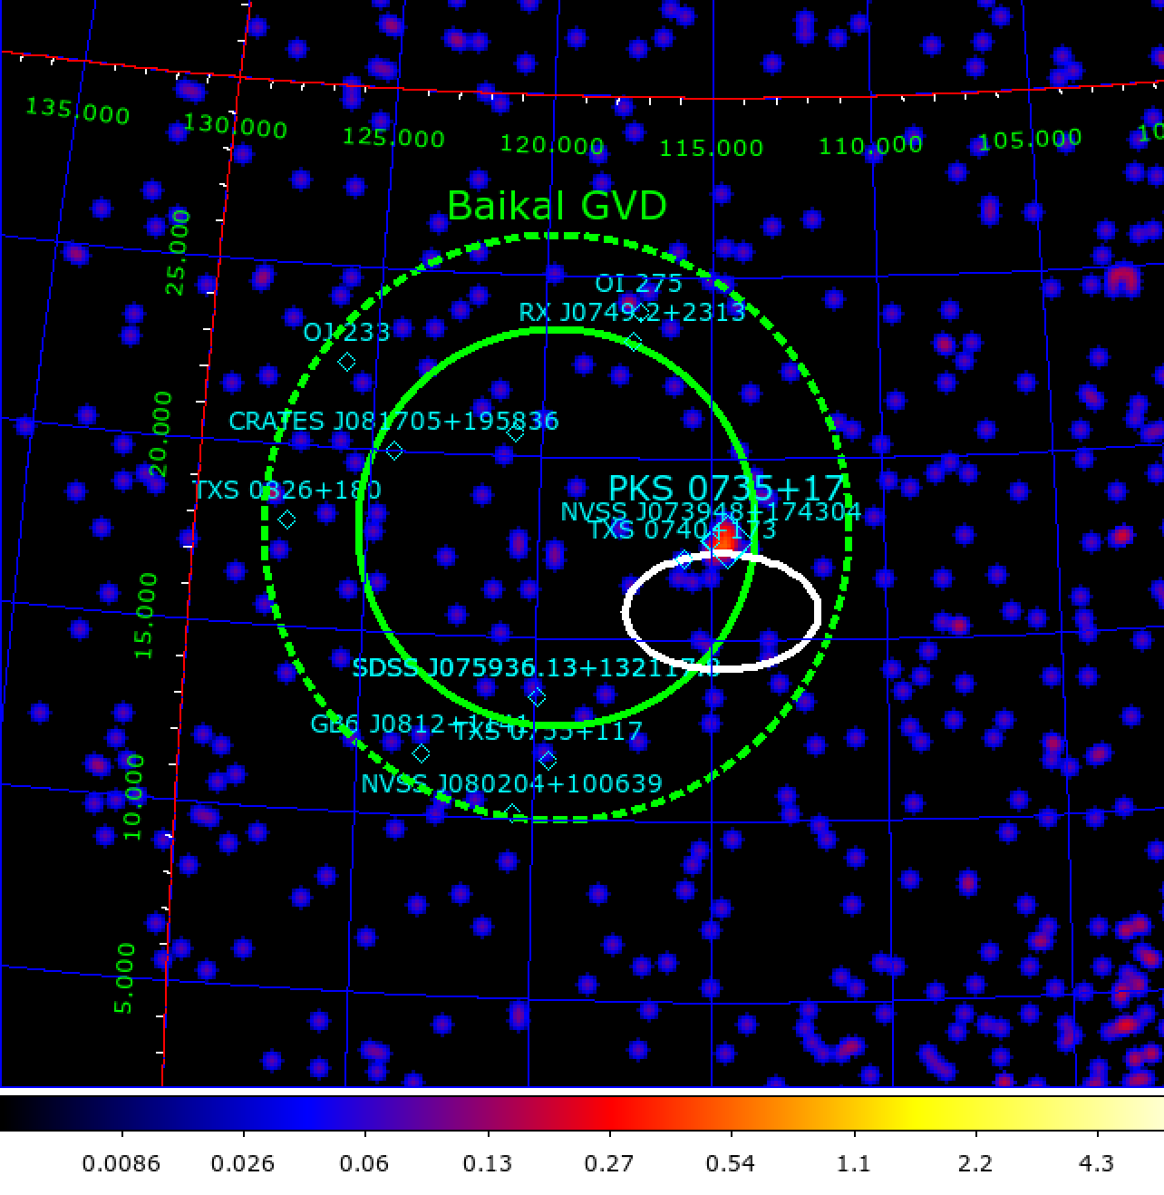
Baikal-GVD follow up of IceCube-211208A / PKS 0735+17
Dec 8, 2021 20:02: IceCube “Astrotrack Bronze” neutrino event in vicinity of bright blazar PKS 0735+17
Active state of PKS 0735+17 reported in optical (MASTER), HE gamma-rays (Fermi LAT), X-rays (Swift XRT) and radio
Baikal-GVD found a downward-going (30° above horizon) cascade-like event 4 hr after the IceCube event
5.3° from the best-fit direction of IceCube-211208A
4.7° from PKS 0735+17
E ≈ 43 TeV
PSF 50% (68%) containment radius = 5.5 deg (8.1 deg)
Pre-trial p-value = 0.0044 (2.85 σ) [24 hr, 5.5 deg cone]
Trial factor ~ 40 (total number of IceCube alerts analyzed)
Image by D.Semikoz & A.Neronov
ATeL 15112
Also see N. Sahakyan et al., arXiv:2204.05060
Notes:
38

Slide 39
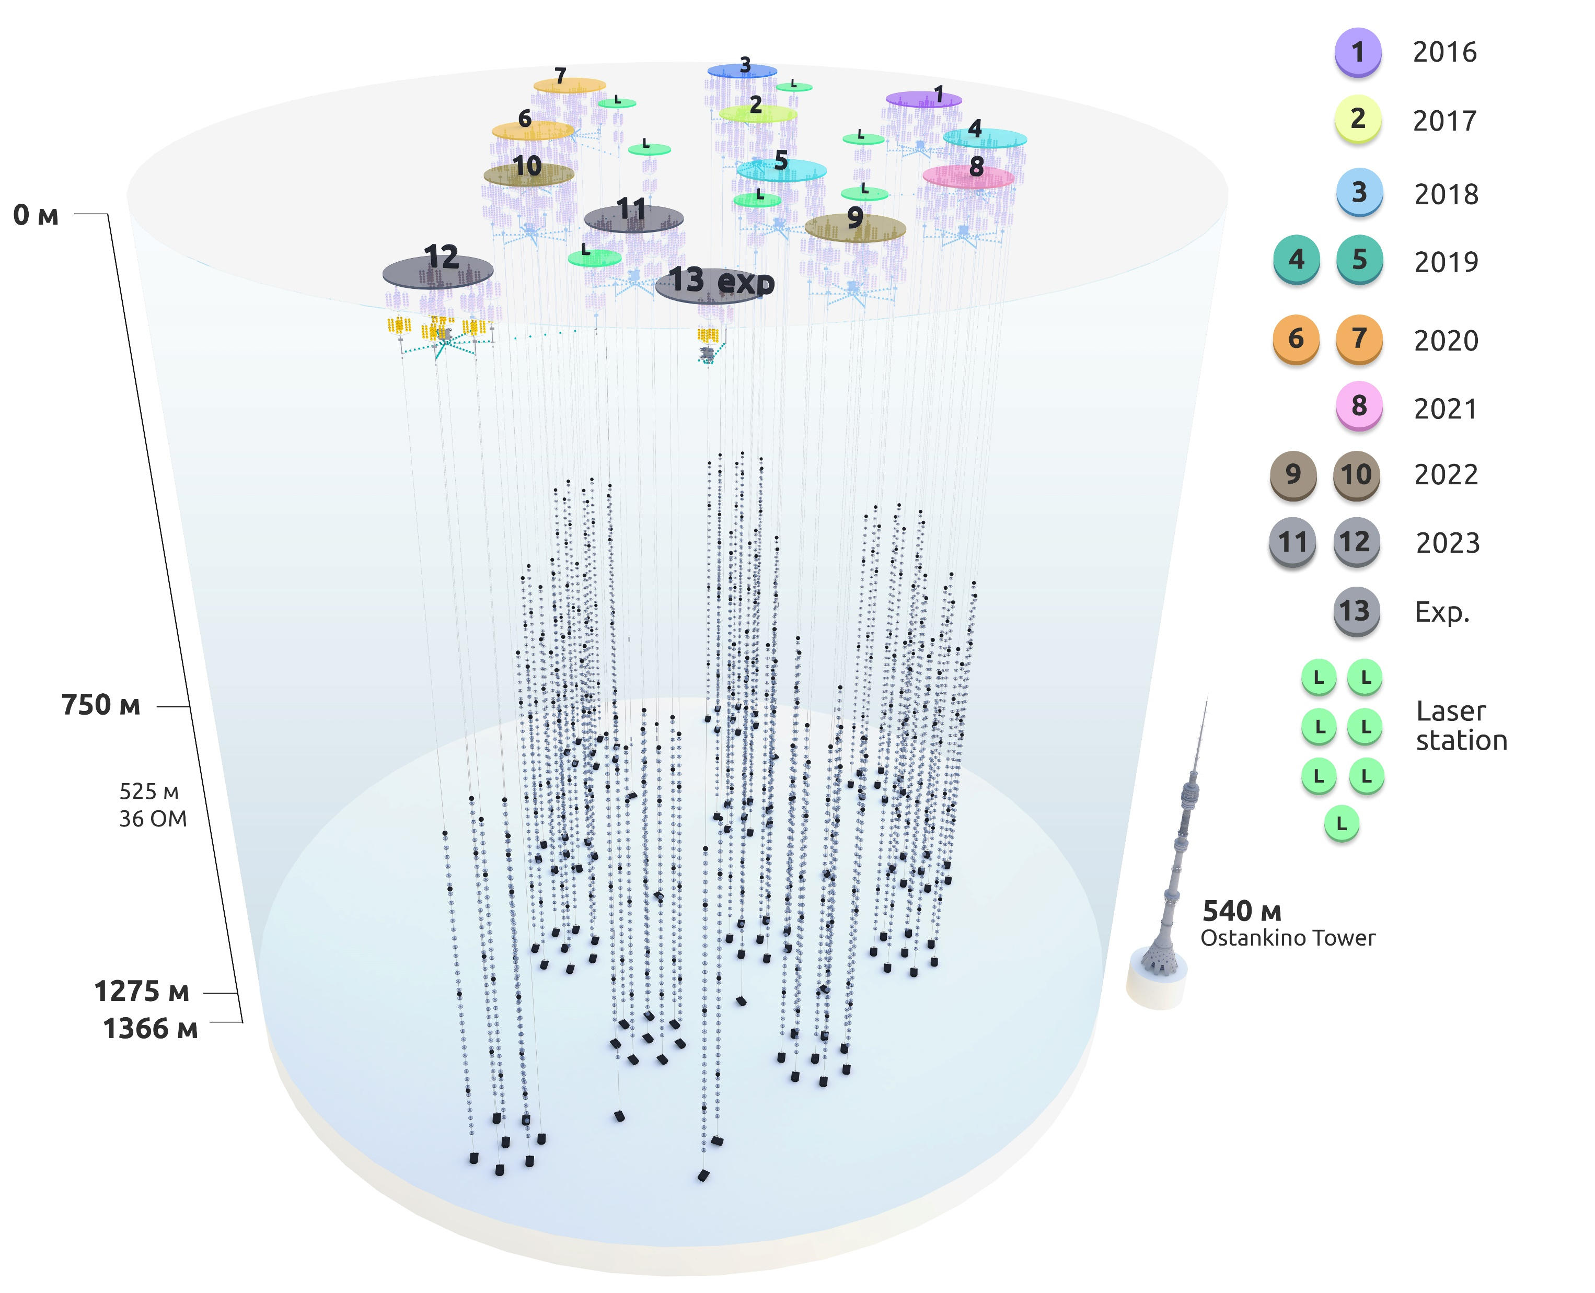
Baikal-GVD construction status 2023 and schedule
Deployment history
Year | Number of clusters | Number of strings | Number of OMs
2016 | 1 | 8 | 288
2017 | 2 | 16 | 576
2018 | 3 | 24 | 864
2019 | 5 | 40 | 1440
2020 | 7 | 56 | 2016
2021 | 8 | 64 | 2304
2022 | 10 | 80 + 3 | 2880 + 84
2023 | 12 | 93+5 | 3528
12 clusters + 3 special string (laser+36 OM)
+ 2 experimental strings + 7 laser stations
Notes:
39

Slide 40
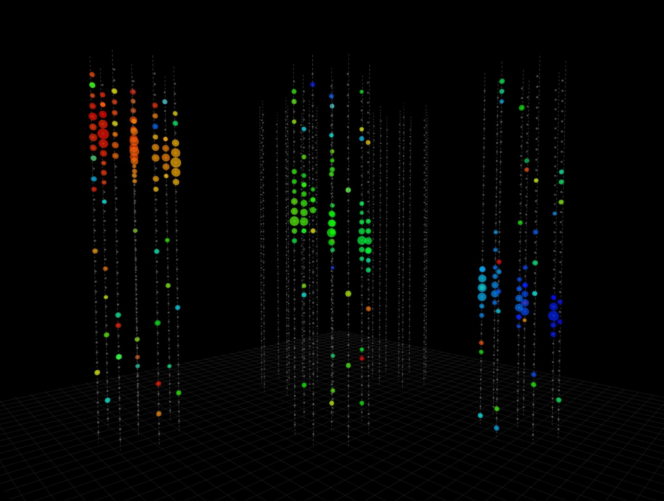
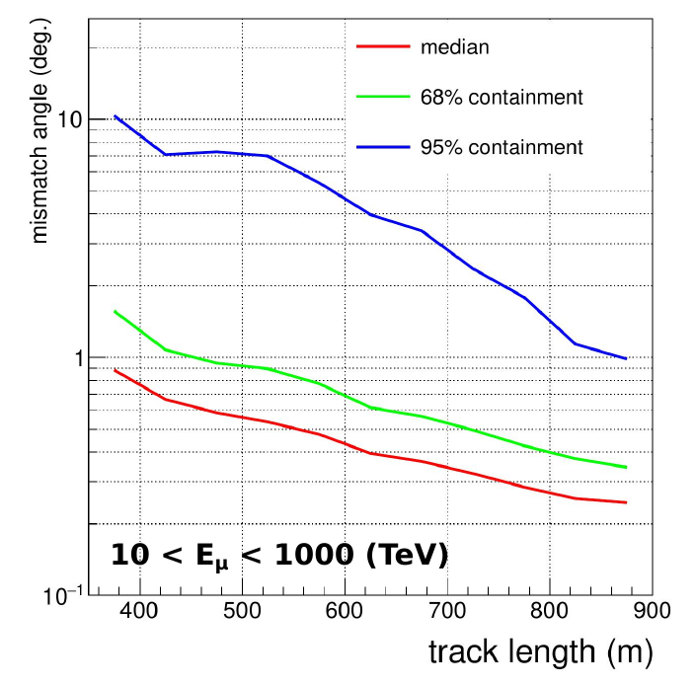
Multi-cluster track events
Example of a downgoing muon bundle event in real data
late
Median energy ~ 4 TeV
early
Notes:
40

Slide 41

Configuration 2023
Nearest future:
2028/29 – 1 km3 (20 clusters, ~6000 OMs)
Additional inter-cluster strings (36 OM + laser)
Introduce fiber optic technology for data transmission
Project of 10 km3 detector
Notes:
41

Slide 42
Fiber-optic DAQ concept
The basic structural units of DAQ: Section and String
Main technical features:
Analog signals from OMs are transmitted via coaxial cables to the control module of the section.
Data and Trigger are formed by the Master board of the section module and transmitted to the string control module via one optical fiber using CWDM multiplexor together with the Sync.
Up to 12 OMs can be connected to the section module.
Up to 8 sections can be connected to the string module.
Notes:
The structure of a fiber-optic DAQ is similar to a conventional GVD DAQ. The basic structural units of DAQ: Section and String
This figure illustrated the principle of system operation.
Analog signals from OMs are transmitted via coaxial cables to the control module of the section.
Data, Trigger and Sync are formed in the Master board of the section module and transmitted to the string control module via one optical fiber using CWDM (Coarse Wavelength Division Multiplexing) multiplexor. String electronics allows to connect up to 12 OMs to section module and up to 8 section to the string module.

Slide 43



Detector components
string
Optical module (OM)
Each string carries 36 OMs
10-inch high Q eff. PMT
15 m vertical step
OM facing the lake bottom
60 m between strings
Time calibration systems
LED photodiodes in each OM
LED beacons at each string
Isotropic lasers between clusters
Calibration precision ~2 ns
Geometry calibration system
Acoustic modems on each string
Acoustic polling each 1-6 minutes
OM positioning precision ~ 20cm
Notes:
43

Slide 44


GVD cluster
Cluster:
8 strings
Cluster
8 strings (288 OMs)
60 m step between strings
Central electronics (power, trigger, data transmission) located at 30 m depth
Hardware trigger: 4 p.e. + 1.5 p.e. on adjacent OMs in 100 ns window
Inter-section synchronisation by common trigger (~ 2 ns accuracy)
Internal network: shDSL Ethernet extenders 5.7 Mbit
Connection to shore:
Ethernet / optic fiber
525 m
120 m
Notes:
44

