Slide 1

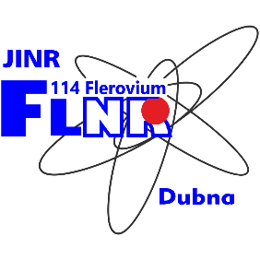
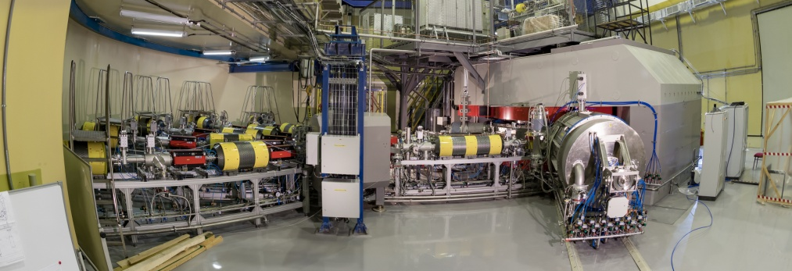
Investigation of heavy and superheavy elements
Leaders: M.G. Itkis and A.V. Karpov
Flerov Laboratory of Nuclear Reactions, JINR
Proposal for opening a project within the theme
“Synthesis and properties of superheavy elements, structure of nuclei at the limits of nucleon stability”
2024-2028
JINR PAC for Nuclear Physics Meeting, 29-30 June, 2023
ДЦ-280

Slide 2
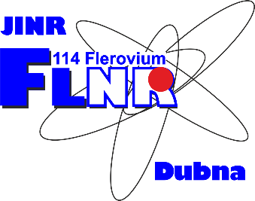
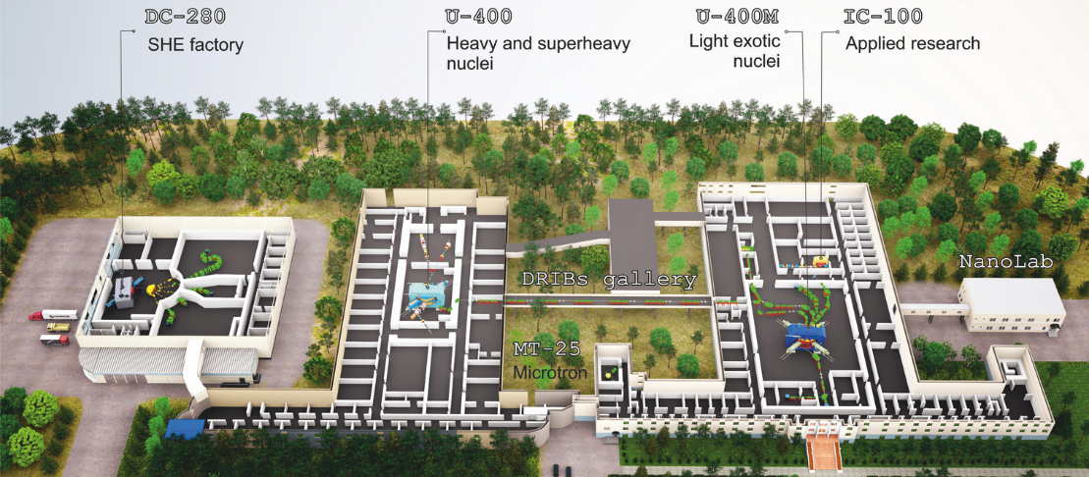
DRIBS-III ACCELERATOR COMPLEX
FLEROV LABORATORY OF NUCLEAR REACTIONS
Superheavy elements
Nuclear reactions
Light nuclei
Applied research
Intensity: ⁴⁸Ca ~7 pμA,
⁵⁰Ti ~3 pμA,
⁵⁴Cr ~4 pμA
Energy: 5 - 8 A·MeV
Efficiency: ~50%
Notes:
2
Beam intensity of Ca-48 up to 2.5 mkA
Ion energy variation on the target with factor 5
Cyclotron average magnetic field from 1.8 up to 0.8 T

Slide 3
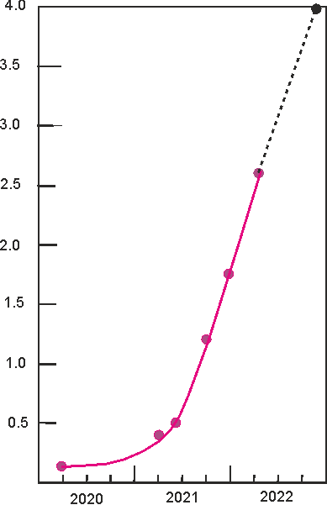
Progress at SHE-Factory
4.0
designed
3.5
Luminosity
3.0
now at the SHE Factory
2.5
Luminosity (10³¹/cm²ˑs)
DC-280 + DGFRS-2
2.0
1.5
1.0
0.5
previous level
U-400 + DGFRS-1
0.0
2000
2020
2021
2022
year
by Yu. Oganessian

Slide 4
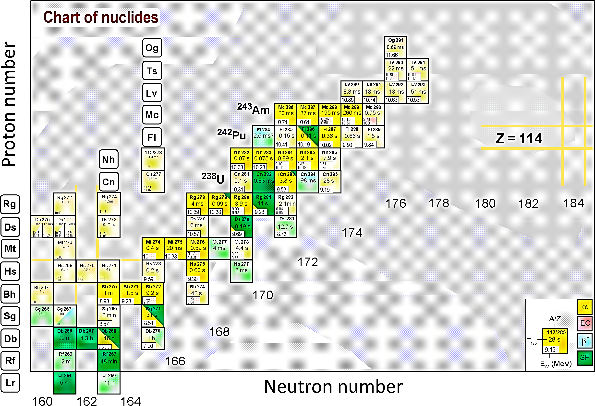
Summary of experiments @ Superheavy Element Factory in 2020-2023
Experiments:
110: ²³²Th + ⁴⁸Ca → ²⁸⁰Ds*, ²³⁸U + ⁴⁰Ar → ²⁷⁸Ds*
112: ²³⁸U + ⁴⁸Ca → ²⁸⁶Cn*
114: ²⁴²Pu + ⁴⁸Ca → ²⁹⁰Fl*
115: ²⁴³Am + ⁴⁸Ca → ²⁹¹Mc*
>240 new events of synthesis of superheavy nuclides;
Decay properties 40 isotopes;
New isotopes: ²⁸⁶Mc, ²⁶⁴Lr, ²⁷⁵Ds, ²⁷⁶Ds, ²⁷²Hs , ²⁶⁸Sg;
New decay modes: ²⁶⁸Db (alpha-decay), ²⁷⁹Rg (spontaneous fission);
Indication of the 1st excited state in ²⁸⁶Fl;
Test of target stability up to 6.5 pμA of ⁴⁸Ca;
Notes:
В течение 2021 года на Фабрике сверхтяжелых элементов выполнена первая серия экспериментов по синтезу изотопов московия (115), флеровия (114) и коперниция (112). Эти эксперименты одновременно завершили программу тестовых испытаний и явились началом реализации научной программы Фабрики СТЭ. Ускоритель ДЦ-280 проработал в 2021 году 5095 часов. В указанных реакциях с кальцием-48 суммарно зарегистрированы 177 новых событий образования сверхтяжелых ядер, что позволило на более глубоком уровне изучить свойства распада 30 изотопов тяжелейших элементов от Z=103 до Z=115, показанных на рисунке более ярким цветом. Были открыты 2 новых изотопа: московий-287 и лоуренсий-264. Впервые зарегистрирован альфа-распада дубния-268 и спонтанное деление рентгения-289. Получено указание на регистрацию первого возбужденного состояния флеровия-286. Важным результатом также явилось то, что в эксперименте с урановой мишенью была продемонстрирована ее стабильность при рекордной интенсивности пучка кальция-48 – 6.5 микроампер-частиц.
During 2021, the first series of experiments on the synthesis of moscovium (115), flerovium (114) and copernicium (112) isotopes were carried out at the Factory of Superheavy Elements. These experiments simultaneously completed the test program and were the beginning of the implementation of the scientific program at the SHE Factory. The DC-280 accelerator worked 5095 hours in 2021. In these reactions with calcium-48, a total of 177 new events of the formation of superheavy nuclei were detected, which made it possible to study at a deeper level the properties of the decay of 30 isotopes of the heaviest elements from Z=103 to Z=115, shown in the figure in brighter colors. Two new isotopes were discovered: moscovium-287 and lawrencium-264. For the first time, the alpha-decay of dubnium-268 and the spontaneous fission of roentgenium-289 have been observed. An indication was obtained of registering the first excited state of flerovium-286. An important result was also that in the experiment with a uranium target, its stability was demonstrated at a record intensity of the calcium-48 beam - 6.5 particle microampere.

Slide 5
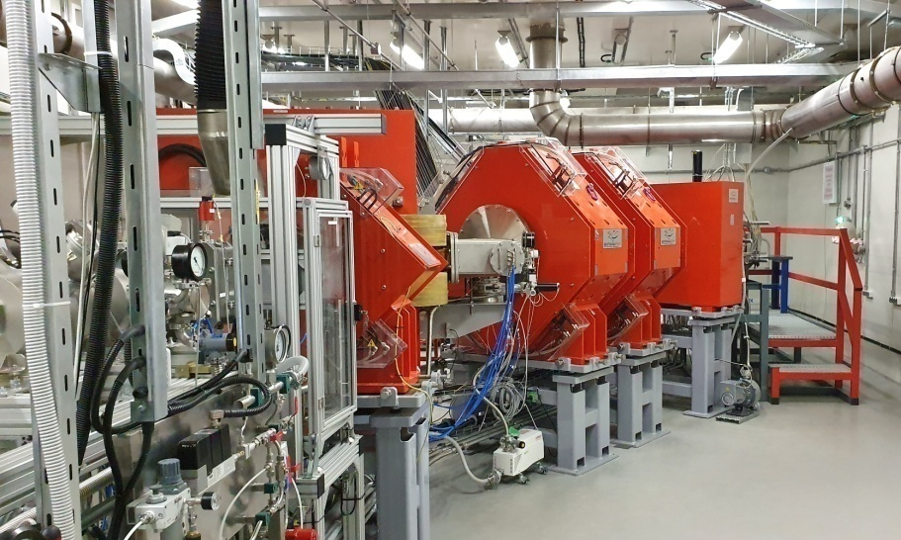
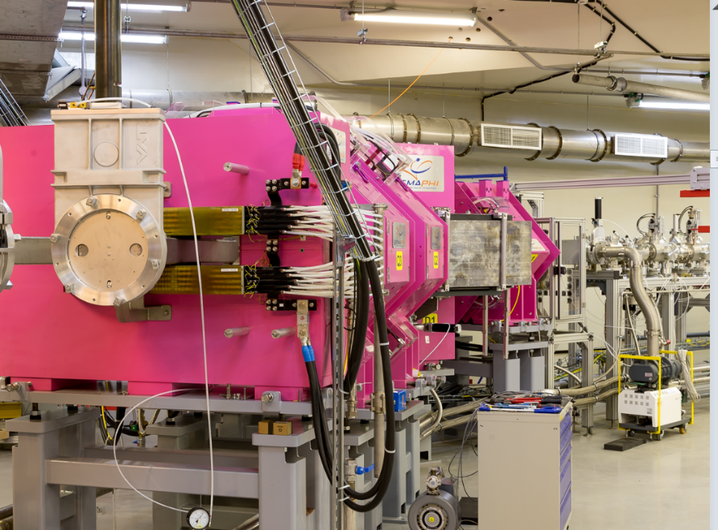
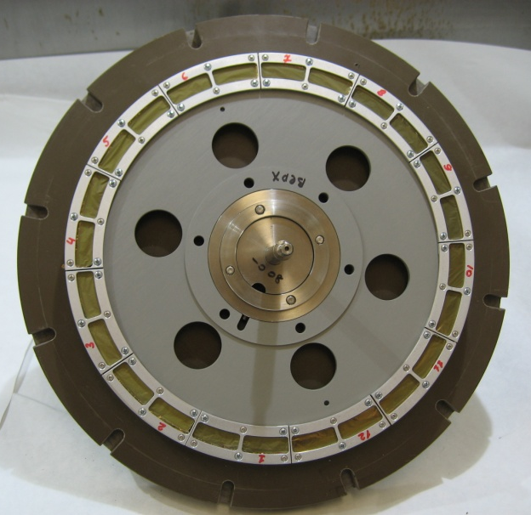
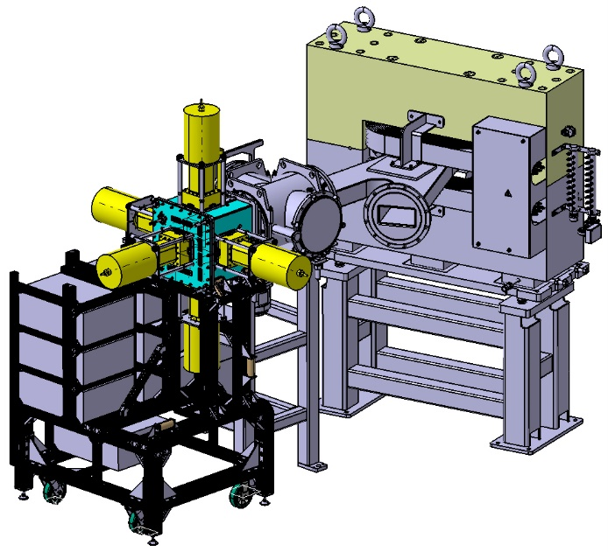
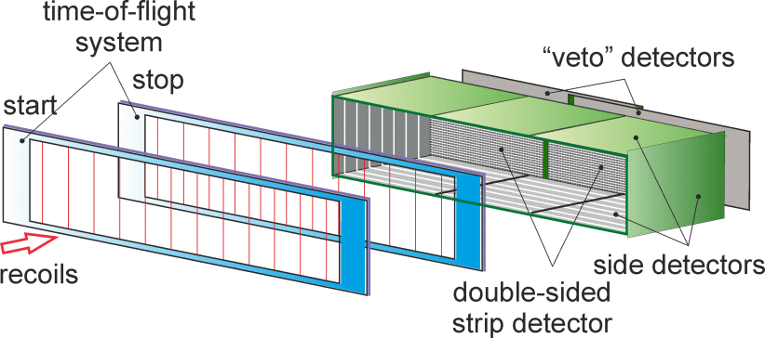
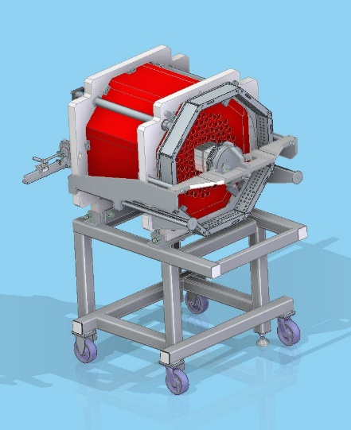
Separators @ SHE Factory
DGFRS-2:
launched in 2020
24-cm target wheel
12 sectors
GRAND:
launched in 2022
GABRIELA
SFiNX
48×220 DSSD & 60×120 SSSD
5 Ge Clover detectors
116 ³He counters

Slide 6
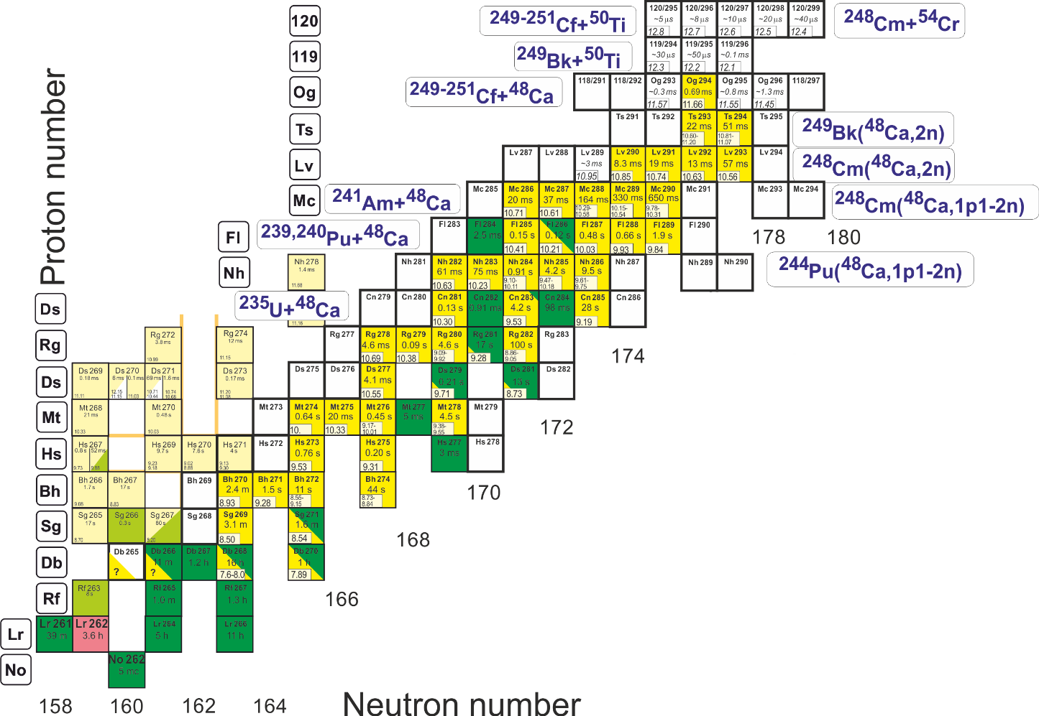
Synthesis of elements 119 and 120
Synthesis of neutron-deficient/rich SH nuclei
Reactions (new elements):
²⁴⁹Bk(⁵⁰Ti,xn) ^{299-x}119
²⁴⁹⁻²⁵¹Cf(⁵⁰Ti,xn)^{(299-301)-x}120
^{245,248}Cm(⁵⁴Cr,xn)^{299,302-x}120
Test reactions:
²³⁸U + ⁵⁴Cr → ²⁹²Lv*
²⁴²Pu + ⁵⁰Ti → ²⁹²Lv*
²⁴⁵Cm + ⁴⁸Ca→ ²⁹³Lv*
σ_{3n}= 4pb
Nh 288
Reactions (n-deficient):
²⁴¹Am(⁴⁸Ca,xn)^{289-x}Mc
²³⁵U(⁴⁸Ca,xn)^{283-x}Cn
²³¹Pa(⁴⁸Ca,xn)^{279-x}Rg
Reactions (n-rich):
²⁴⁹Bk(⁴⁸Ca,2n)²⁹⁵Ts₁₇₈
²⁴⁸Cm(⁴⁸Ca,2n)²⁹⁴Lv₁₇₈
²⁴⁸Cm(⁴⁸Ca,1p1-2n)²⁹³⁻²⁹⁴Mc₁₇₈₋₁₇₉
^{242,244}Pu(⁴⁸Ca,1p1-2n)²⁸⁷⁻²⁹⁰Nh₁₇₆₋₁₇₇
electron capture

Slide 7
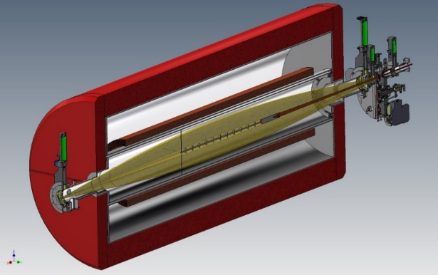
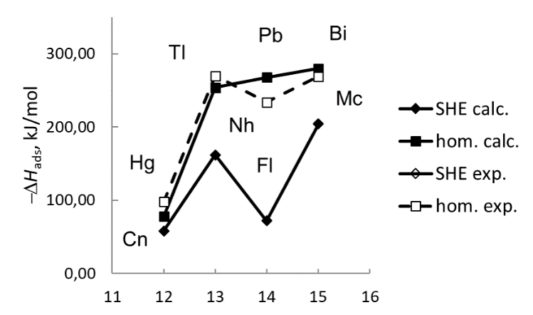
chemistry of SHE
Z | Isotope | Half-life
112 | ²⁸³Cn | 3.6 s
113 | ²⁸⁴Nh | 0.9 s
114 | ²⁸⁷Fl | 0.3 s
115 | ²⁸⁸Mc | 0,16 s
116 | ²⁹³Lv | 57 ms
117 | ²⁹⁴Ts | 51 ms
118 | ²⁹⁴Og | 0.6 ms
He/Ar
see talk by
A.V. Yeremin
GASSOL – Solenoid-based separator
Stopping SH atoms in a small volume of 1-2 cm³
Chemistry of short-lived SHE T_{1/2} ≥ 30 ms (up to elements 116-117)
Shortcoming: a relatively large volume of the stopping cell

Slide 8
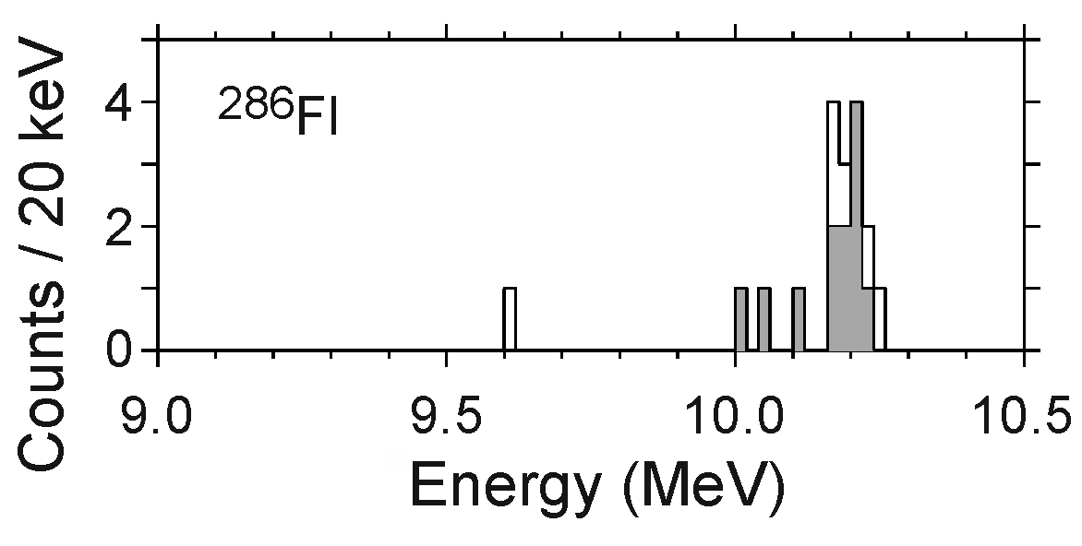
Spectroscopy of SH isotopes @ SHE Factory
β4
²⁸⁶Fl: decay on 2⁺ rotational state of ²⁸²Cn
β₂
Day-one experiments: ⁴⁸Ca + ²⁴²Pu → ²⁸⁷Fl + 3n
⁴⁸Ca + ²⁴³Am → ²⁸⁸Mc + 3n
“experiment”:
E₂₊ = 100 - 200 keV
0⁺: 82% and 2⁺: 18%
Cross section ~ 10 pb;
Target thickness ~ 0.4 mg/cm²;
Beam intensity of ⁴⁸Ca ~ 3 pµA;
ε_{transmission} ~ 50 %;
100 days → ~200-300 events → >100 gamma quanta
β₂ = 0.13

Slide 9
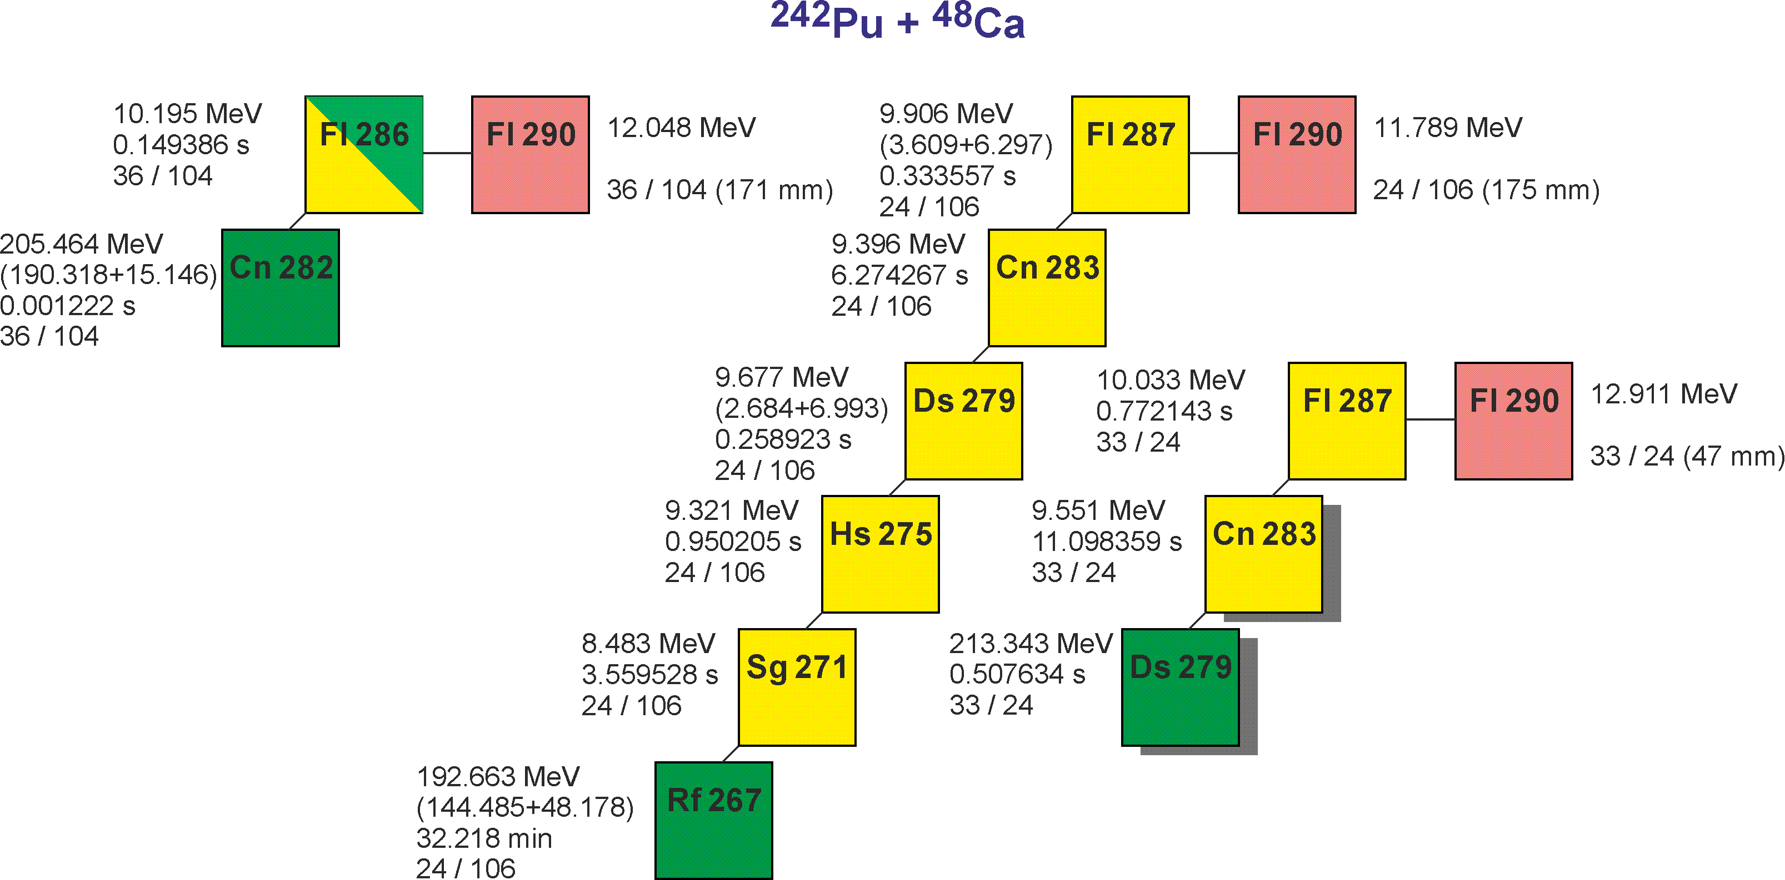
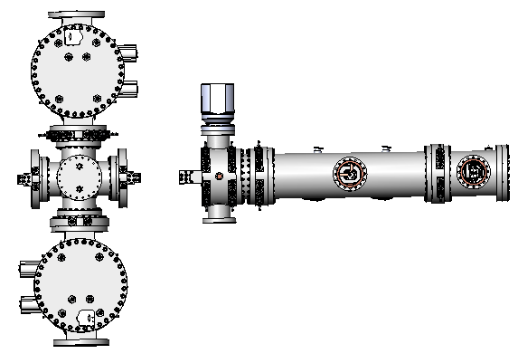
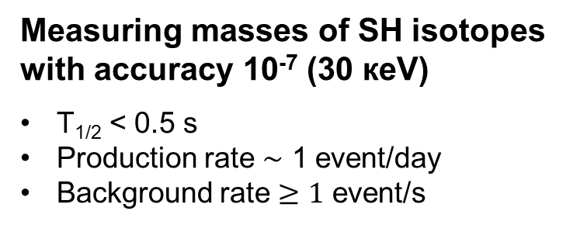
Precise mass measurements of SH nuclei @ SHE Factory
Measuring masses of SH isotopes
with accuracy 10⁻⁷ (30 кeV)
T_{1/2} < 0.5 s
Production rate $\sim$ 1 event/day
Background rate $≥1$ event/s
MR-TOF Mass-Analyzer
see talk by A.V. Yeremin
M.I. Yavor, Journal of Instrumentation,17 (2022) 11033

Slide 10
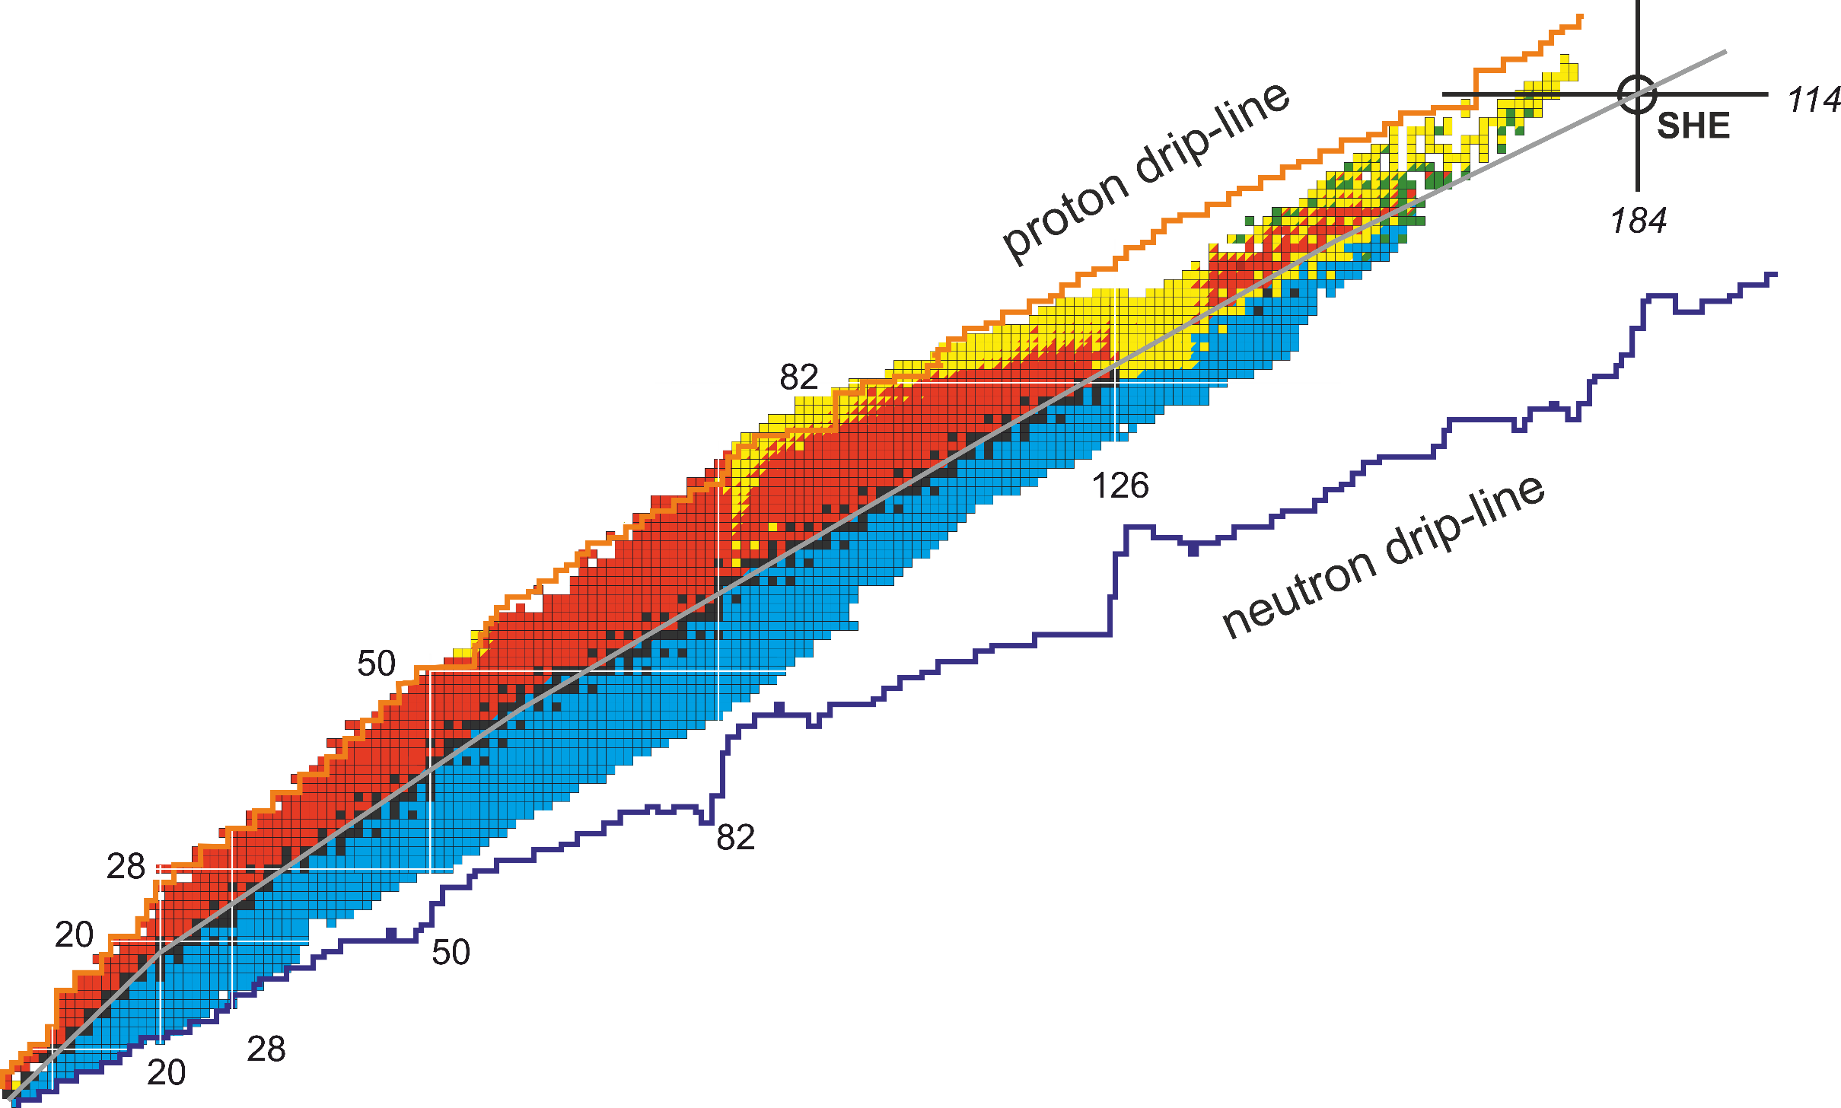





Multinucleon transfer reactions. Some of the open questions
MNT?
162
Fusion
Fragmentation
Fission
Angular distributions of various reaction products. Their energy dependence.
Cross sections for neutron-enriched products. Their energy dependence.
Kinetic and excitation energies of reaction products.
Optimal reaction choice for production of various nuclei in heavy (N=126) and transuranium mass regions.

Slide 11
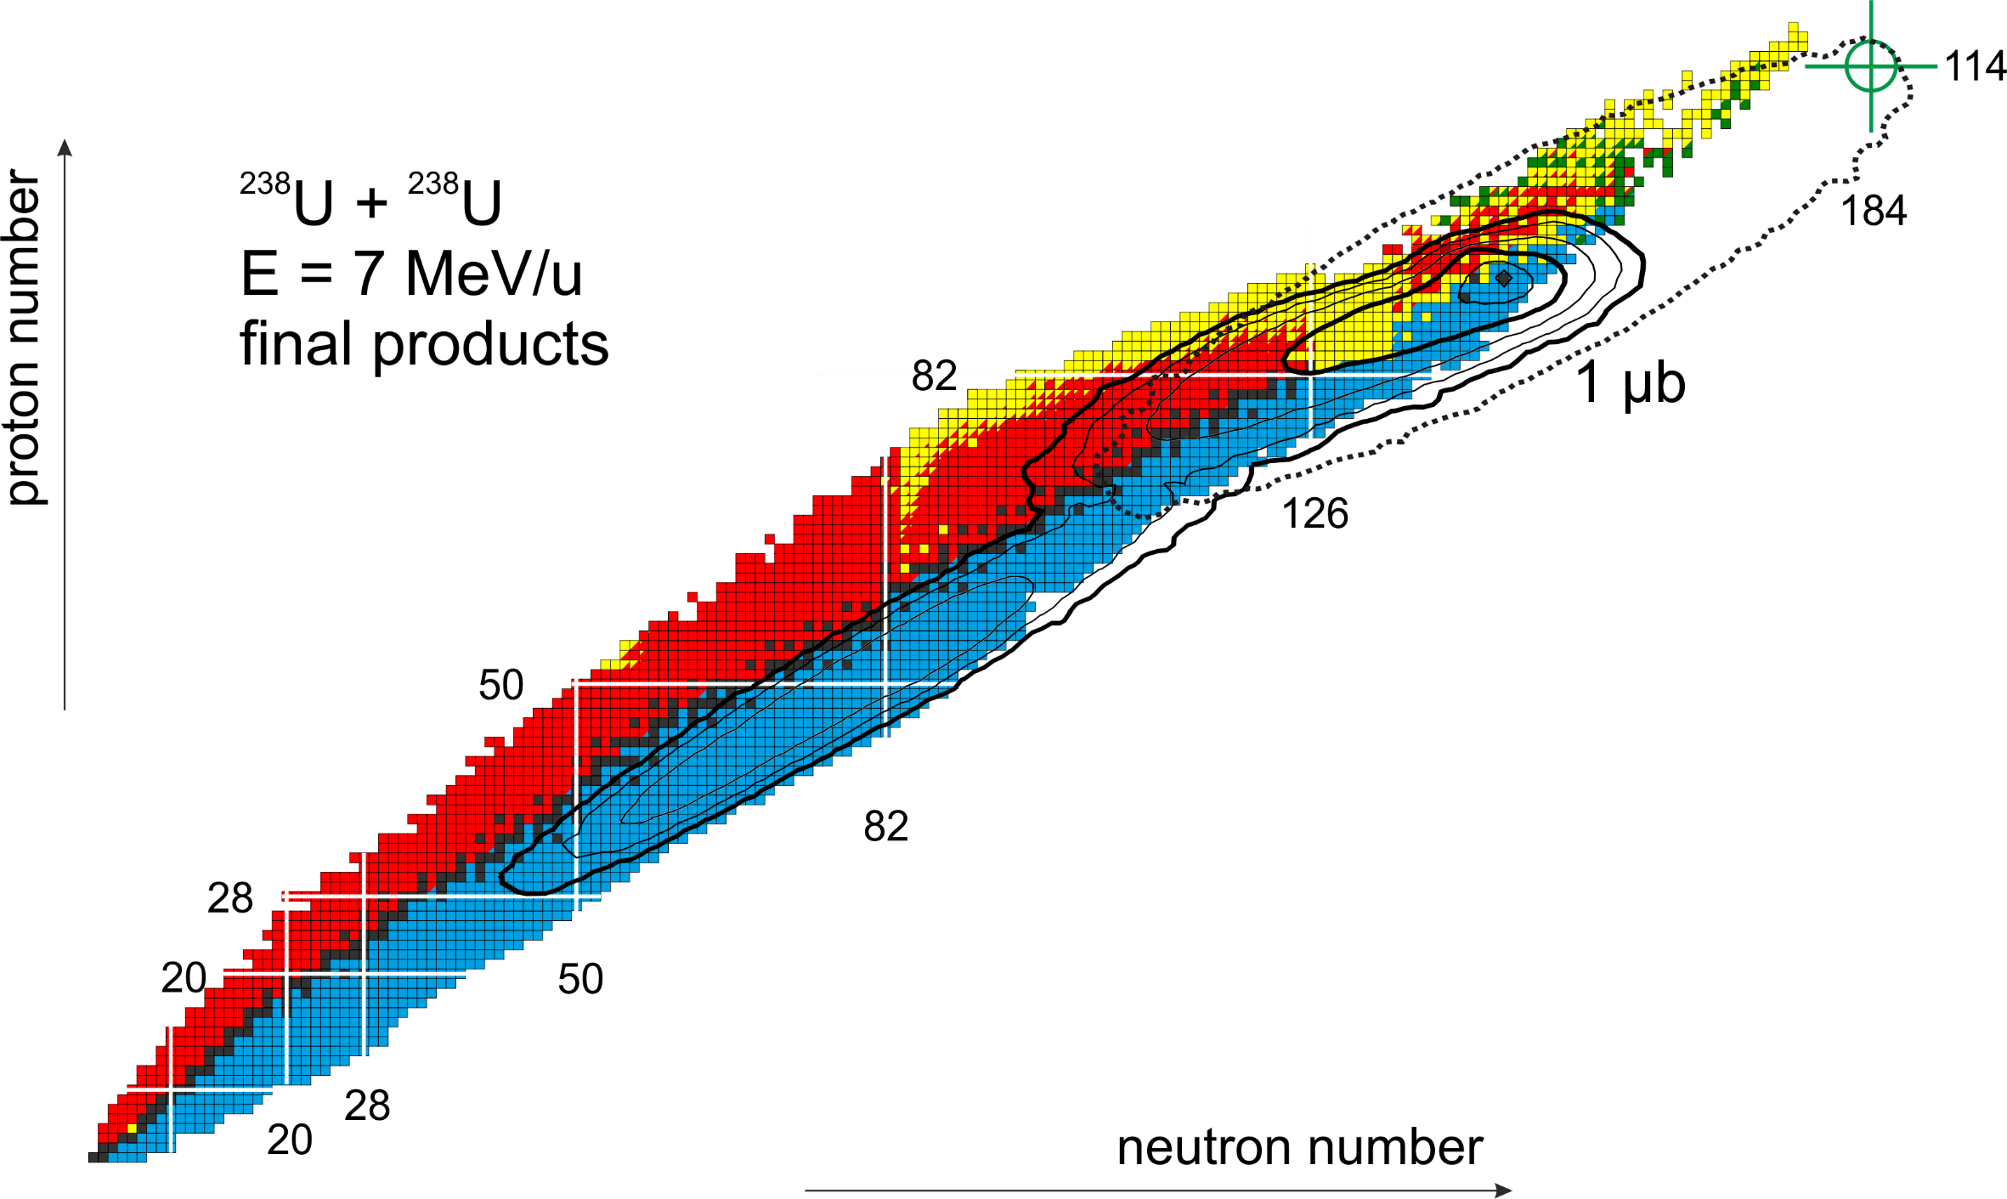
Multinucleon transfer processes in U + U reaction
excited
cold

Slide 12
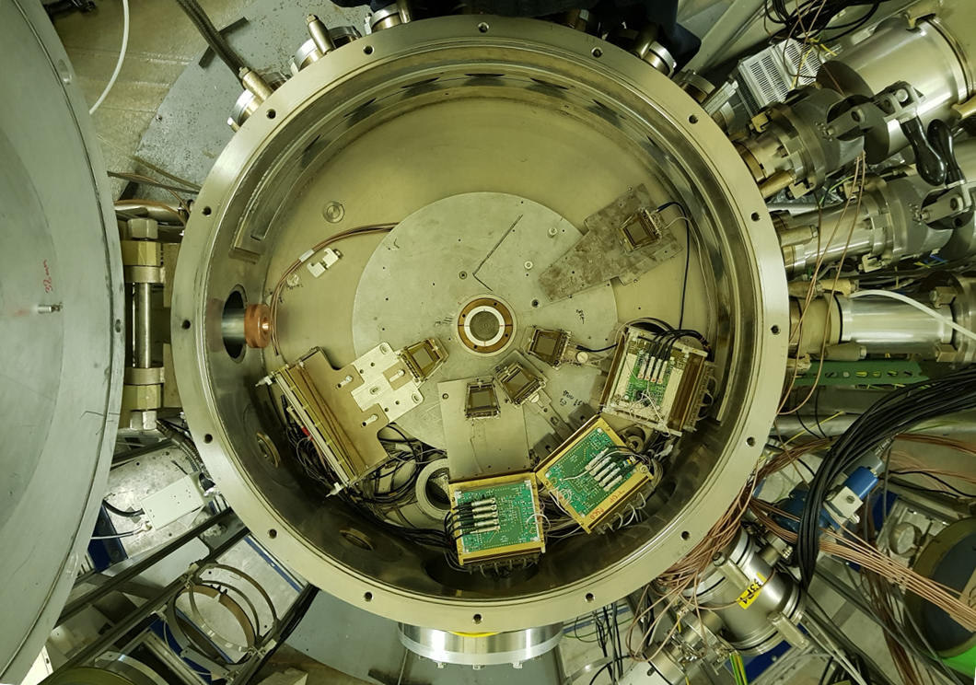
Studying the ²³⁸U + ²³⁸U reaction
²³⁸U
²³⁸U
F₁
Z=184
A=476
2
Modernized COREST set-up
²⁶⁸No*
²⁰⁸Pb
3
F₂
1
Neutrons
EVR
1
No

Slide 13
Summary
Main directions of research:
Synthesis of new superheavy elements
Synthesis of superheavy nuclei and study of their decay properties
Spectroscopy of the radioactive decay of heavy and superheavy nuclei
Measurement of masses of superheavy nuclei
Study of the chemical properties of SHE
Dynamics of heavy-ion nuclear reactions
Financial resources (equipment and materials): 1800 kUSD/year
Human resources: 62 FTE (80 people)

Slide 14
Thank you for your attention!

Slide 15
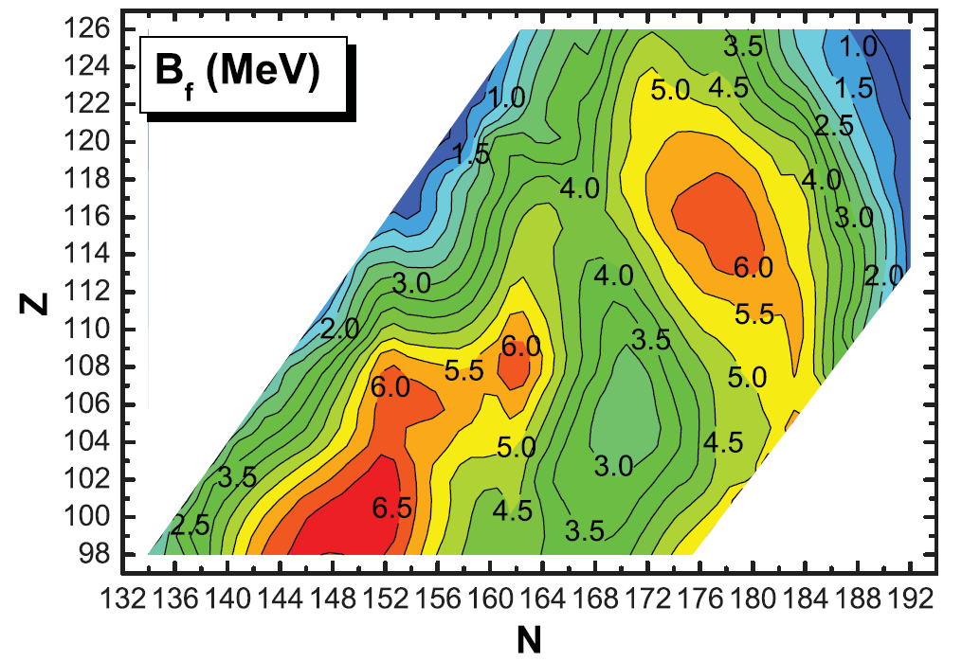
Fission barriers for even-even superheavy nuclei (MeV)
^{245, 246}Cm + ⁵⁴Cr
²⁴⁸Cm + ⁵⁴Cr
²⁴⁵Cm + ⁴⁸Ca
²⁴⁰Pu + ⁴⁸Ca
²³²Th + ⁴⁸Ca

Slide 16
