Slide 1
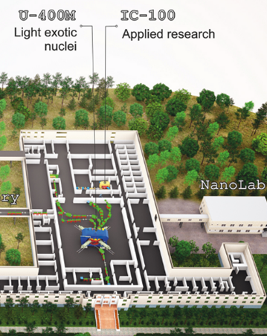
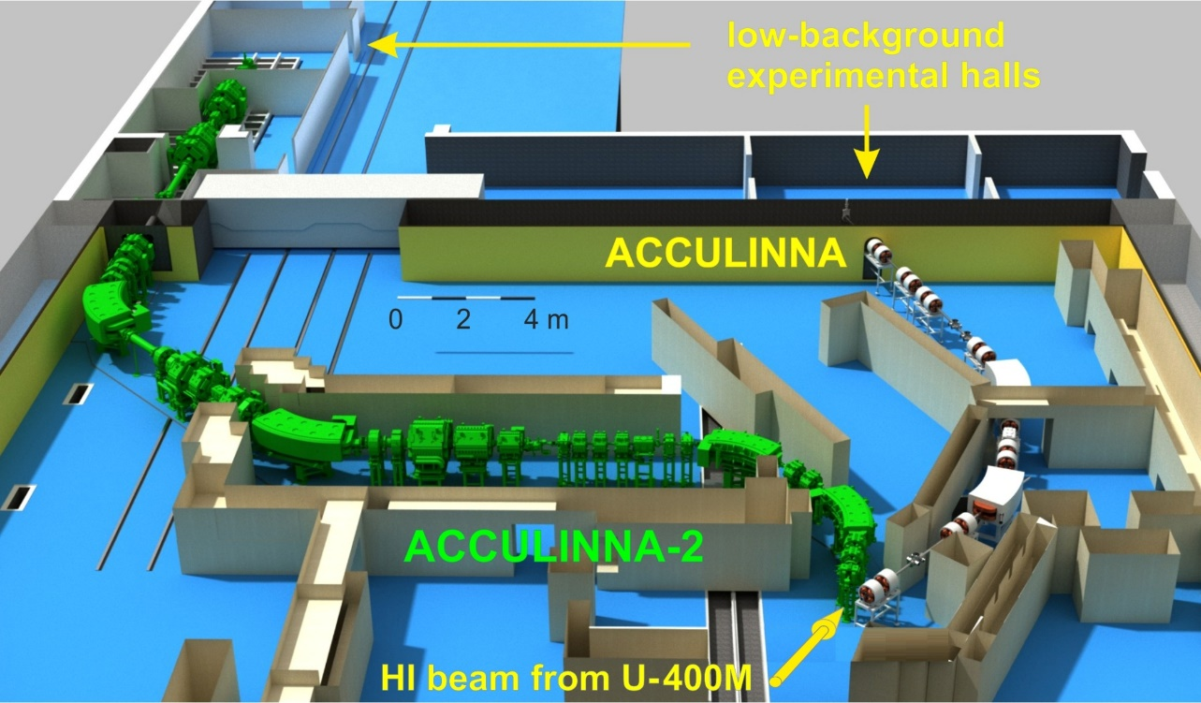

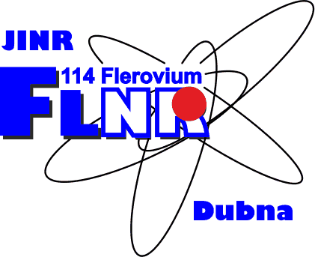
Light exotic nuclei at the borders of nuclear stability
Project Leaders: G. Kaminski, S.I. Sidorchuk
Proposal for opening a project within the theme
“Synthesis and properties of superheavy elements, structure of nuclei at the limits of nucleon stability”
2024-2028
JINR PAC for Nuclear Physics meeting, 29-30 June, 2023
Notes:
1

Slide 2
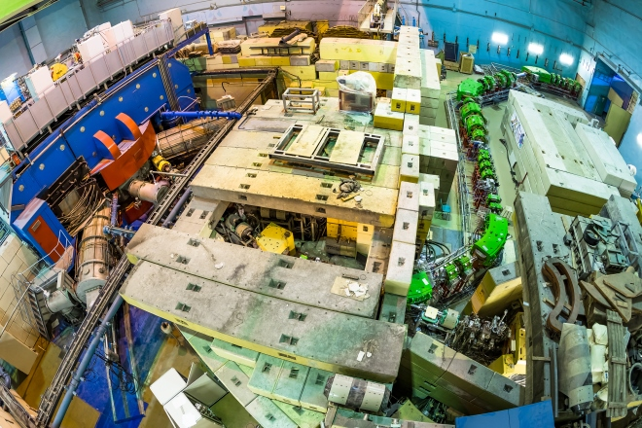
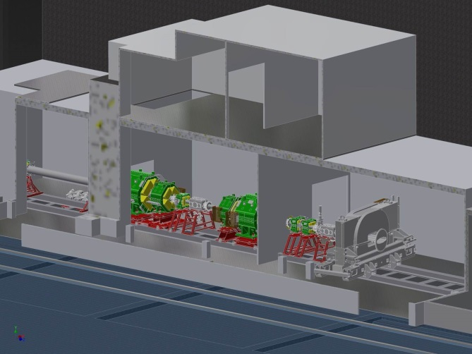
ACCULINNA-2 at U-400M cyclotron
Status of RIB research at ACCULINNA-2 during two years of operation
The ACCULINNA-2 separator commissioned in 2017
Tritium target complex
2025
D2
F2
F3
Magnet of zero degree
spectrometer
D1
F4
Cyclotron U-400M
RF-kicker
F5
F1
The main results in the years 2018 – 2020
Isotope | Task, reaction, method | Status
⁶He | Elastic and inelastic scattering in ⁶He+d interaction | B. Zalewski thesis, NIM_B
⁷H and ⁶H | Low energy spectra and decay modes, ⁸He+d → ^{3,4}He+^{7,6}H | PRL, PRC, Bulletin of RAS
⁹Li and ⁸Li | Reference reactions (d,³He) and (d,⁴He) with ¹⁰Be | NIM_B
4n and 3n | ⁸He+d → ^{6,7}Li+^{4,3}n, coincidences with neutrons | Under analysis
⁷He | Low energy spectra, ⁶He(d,p)⁷He, p-⁶He-n coincidences | To be published
⁹He | Low energy spectra, ⁸He(d,p)⁹He, p-⁸He-n coincidences | Under analysis
¹⁰Li | Low energy spectra, ⁹Li(d,p)¹⁰Li, p-⁹Li-n coincidences | Bulletin of RAS (method)
²⁷S | Rare decay modes, implantation into OTPC | Under analysis

Slide 3
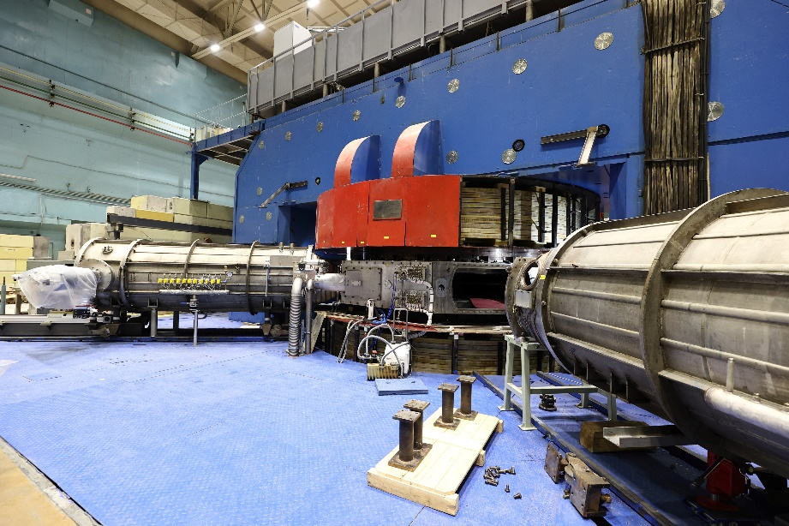
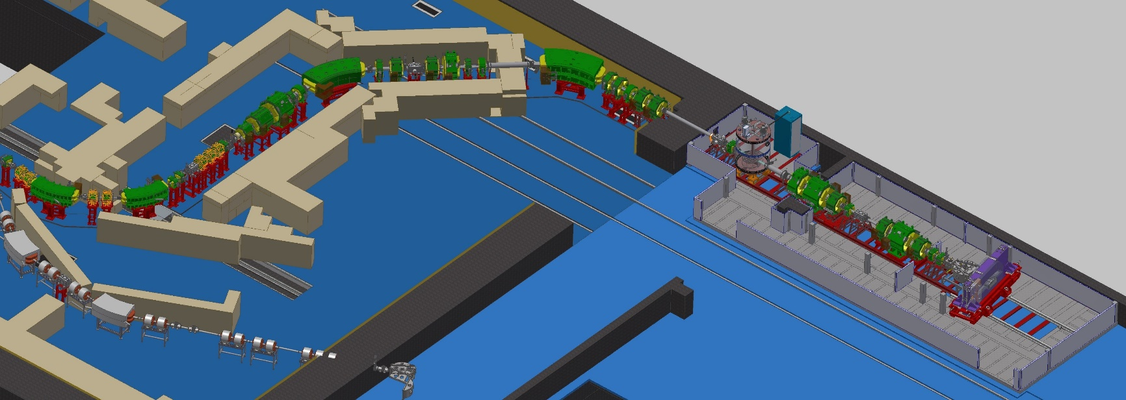
Modernization of the U-400M cyclotron complex & instrumentation development
U-400M
upgrade
Improved beamline:
smaller focuse,
new beam diagnostic
Neutron array
(number increase)
ACCULINNA-2
Telescope array
(number increase)
In-beam instrumentation
Velocity filter
RF-kicker
ACCULINNA-1
Cryogenic tritium target system
Zero-angle spectrometer hodoscope
Intensities and energies of typical primary heavy ion beams after modernization of the U-400M
Secondary ion beams
at ACCULINNA-2
Expected experimental conditions in 2024
Ion | 2020 |  | Expected in 2024
 | E (MeV/u) | I(pμA) | E (MeV/u) | I(pμA)
⁷Li | 35 | 5 | 39 | 10
¹¹B | 30 | 3 | 33 | 6
¹⁵N | 47 | 0.5 | 51 | 2
¹⁸O | 36 | 0.5 | 40 | 1.5
^{20,22}Ne | 53/45 | 0.3 | 54/50 | 1
^{32/36}S | 51/40 | 0.2 | 52/44 | 0.4
⁴⁸Ca | 34 | - | 38 | 0.1
⁵⁶Fe¹⁵⁺ | 36 | 0.01 | 40 | 0.1
RI | 2024
 | Y, pps | P, %
⁸He | 6*10⁵ | 90
¹¹Li | 3*10⁴ | 80
¹⁴Be | 2*10³ | 85
¹³O | 2*10⁵ | 55
²⁴O | 7*10² | 50
¹⁷Ne | 5*10⁵ | 80
²⁸S | 1.2*10⁴ | 70
U400M: Improved beam quality, increased intensity,
stable operation
ACC-2: intensive, high quality secondary beams
ACC-1: available for tests measurements, detectors testing, applied studies etc.
Energy increase ~10%
Intensity increase ~2÷10 times

Slide 4
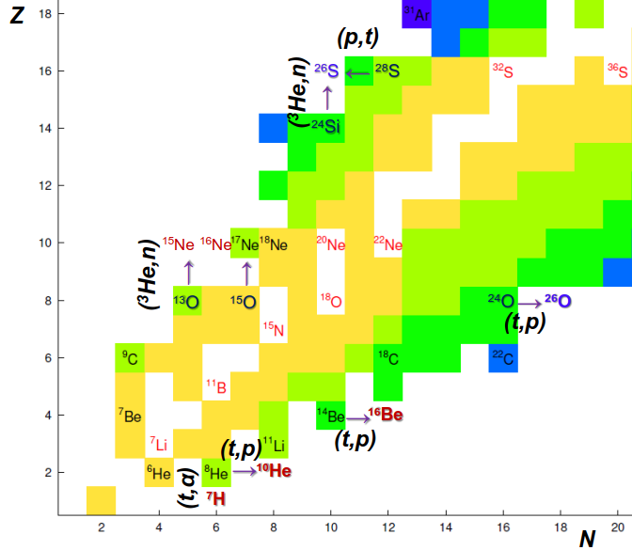
Planned research areas: 2024 - 2028
Structure of neutron-rich isotopes in (d,p), (d,t), (d,³He) reactions
Impact of the reaction mechanism on population of low energy spectra of exotic nuclear systems
Exotic radioactivity - formation of 2p radioactive nuclei in (³He,n) and (p,d) reactions
Study of production cross sections of exotic nuclei
Beyond the nucleon stability line with 2n-transfer ¹⁰He,¹³Li,¹⁶Be using tritium-target. Lighter neutron-rich isotopes like ^{6,8}Не, ¹¹Li, ¹¹⁻¹⁴Be are also in the zone of interest
Study the energy dependence of total reaction cross section in the reactions ¹⁰⁻¹⁴Be+²⁸Si, ¹²⁻¹⁵B+²⁸Si, etc.
Transfer reactions via ²H target
⁶He(d,³He)⁵H
⁶He(d,t)⁵He
⁶He(d,p)⁷He
Transfer reactions on ³He target
¹³O(³He,n)¹⁵Ne
²⁴Si(³He,n)²⁶S
Transfer reactions on H target
⁷Be(p,d)⁶Be
⁸B(p,d)⁷B
⁹C(p,d)⁸C
Transfer reactions on ³H target
⁸He(t,p)¹⁰He
¹⁴Be(t,p)¹⁶Be
⁸He(t,α)⁷H
σ_{R}(E) and σ_{Σ}(E)
¹⁰⁻¹⁴Be+²⁸Si
¹²⁻¹⁵B+²⁸Si
Charge-exchange reactions
(p,n),(³He, ³H),(³He, ³H)

Slide 5
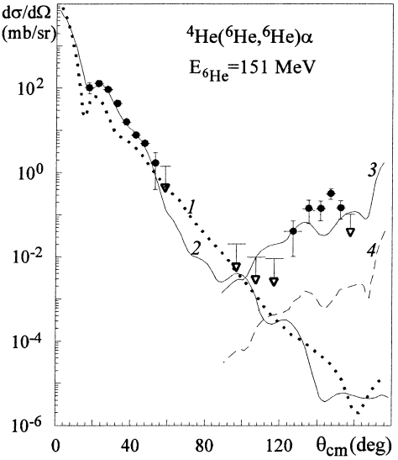
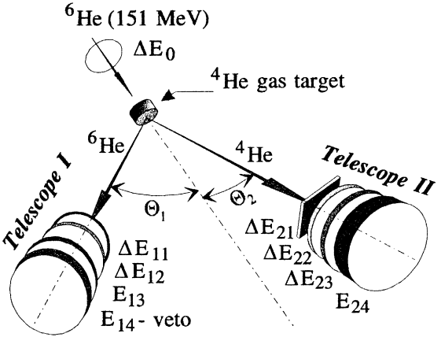

First experiments at ACCULINNA-2 since in 2024
Search for the „di-neutron” configuration of the ⁶He - a kind of “performance test”
of the new upgraded U400M complex and the ACCULINNA-2 separator
⁴He(⁶He,⁶He)⁴He: ACCULINNA-1
⁴He(⁶He,⁶He)⁴He, ⁴He(⁸He,⁸He)⁴He : more statistics at ACCULINNA-2 with high quality, event by event mode ($I_{6_{He}}$< 3*10⁶ s⁻¹)
Physics Letters B 426 (1998) 251,
Two-neutron exange observed in the ⁶He + ⁴He reaction.
Search for the „di-neutron” configuration of the ⁶He
G.M. Ter-Akopian, A.M. Rodin, A.S. Fomichev, S.I. Sidorchuk, S.V. Stepantsov, R. Wolski, M.L. Chelnokov, V.A. Gorshkov, A.Yu. Lavrentev, V.I. Zagrebaev, Yu.Ts. Oganessian
Stilbene based neutron array
(64 modules)
“di-neutron”
configuration
cigar-like
configuration
⁶He 10⁶ s⁻¹
30 AMeV
Cigar-like configuration of ⁶He (4) could contribute negligibly to the obtained 2n exchange, which is ~100% due to the di-neutron configuration (3).
⁶He beam: I ~ 10⁵ s⁻¹ (6.5 mm beam spot without tracking)
⁴He target: ~ 5.6*10²⁰ cm⁻² (5 atm @ 78K, 12 mm thick)
Detectors: two units with ~ 75 msr solid angle
< Factor ~100 >
⁶He beam: I ~ 2*10⁶ s⁻¹ (X,Y ~ 1.5 mm, DE/E ~ 1 %)
⁴He target: ~ 0.6*10²⁰ cm⁻² (2 atm @ 10K, 4 mm thick)
Detectors: four units ~ 100 msr solid angle each

Slide 6
Experiments on neutron-rich nuclei
Experiments on proton-rich nuclei
Experiments with ⁶He beam (I~10⁶ 1/s, E~30 AMeV) on D₂ target at ACCULINNA-2
⁵H-⁵He-⁷He :
⁶He(d,³He)⁵H
⁶He(d,³H)⁵He
⁶He(d,p)⁷He
Spectroscopic studies of proton drip-line nuclei ⁶Be, ⁷B and ⁸C via (p,d) reactions in inverse kinematics at energy ~25 MeV/nucleon.
Study the properties of isospin-analogue states in ⁶He*, ⁷He* and ⁸He*. Isospin symmetry test: broken or conserved?
⁸He – ⁸C case: comparison of the excitation energy spectra / complex scaling method, T. Myo, M. Osuren and K. Kato, Phys. Rev. C 104 (2021) 044306 /
Excited states of ⁸C have not yet been confirmed experimentally
From the configuration mixing, ⁸He and ⁸C give the similar results, which indicates the good symmetry in two nuclei
Resolution in the ⁵H spectrum is expected to be FWHM 400 keV (g.s.)
The occurrence of the ⁵H excited-state resonances (5/2⁺ and 3/2⁺ at ~ 3 MeV)
is not excluded in the data
New information regarding ⁵He decay channels t+d, t+p+n, ³He+n+n is expected
Detail information on low energy spectra of ⁷He and dσ/dΩ in a wide angular
range will be obtained
??
Korsheninnikov et al.,
Phys. Lett. B 316 (1993) 38.
M.S. Golovkov et al.,
Phys. Lett. B 672 (2009) 22.
Investigation of isobar analog nuclei
⁷B in ⁸B(p,d)⁷B reaction: ⁷He – ⁷B puzzle
Investigation of hard-to-access neutron-rich nuclei along with their isobar analogs for studying the properties of atomic nuclei and for testing nuclear models. Studies of mirror nuclei have been used to test the symmetry properties of the nuclear forces, and to investigate the role of isospin symmetry in nuclear structure. They also play an important role in astrophysics
Four-body resonances of ⁷B using the complex scaling method
T. Myo, Y. Kikichi and K. Kato, Phys. Rev. C 84 (2011) 064306.
For only the ground state of ⁷B, he mixing of the ⁶Be(2+) state is larger than that of ⁶He(2+) in ⁷He, which indicates a breaking of mirror symmetry.
⁵He-⁵H:
⁶He(d,³He)⁵H
⁶He(d,³H)⁵He
⁷H-⁷He-⁷B:
⁸He(p,d)⁷He, ⁶He(d,p)⁷He, ⁸He(d,³H)⁷He
⁸He(d,³He)⁷H, and ⁸He(t,⁴He)⁷H
⁸B(p,d)⁷B, ⁷Be(p,n)⁷B
¹⁰He-¹⁰Li-¹⁰N:
⁸He(t,p)¹⁰He
⁹Li(d,p)¹⁰Li
⁹C(d,n)¹⁰N

Slide 7
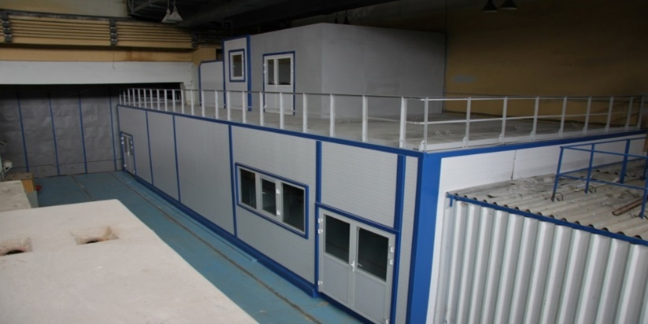
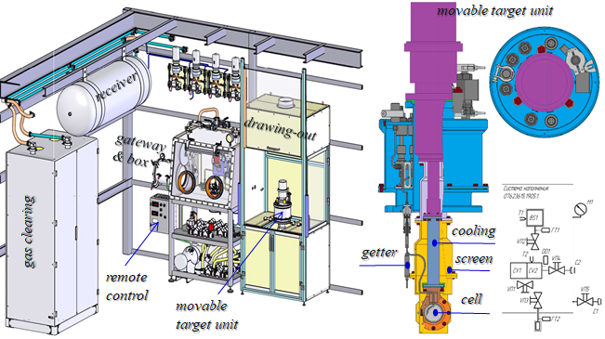
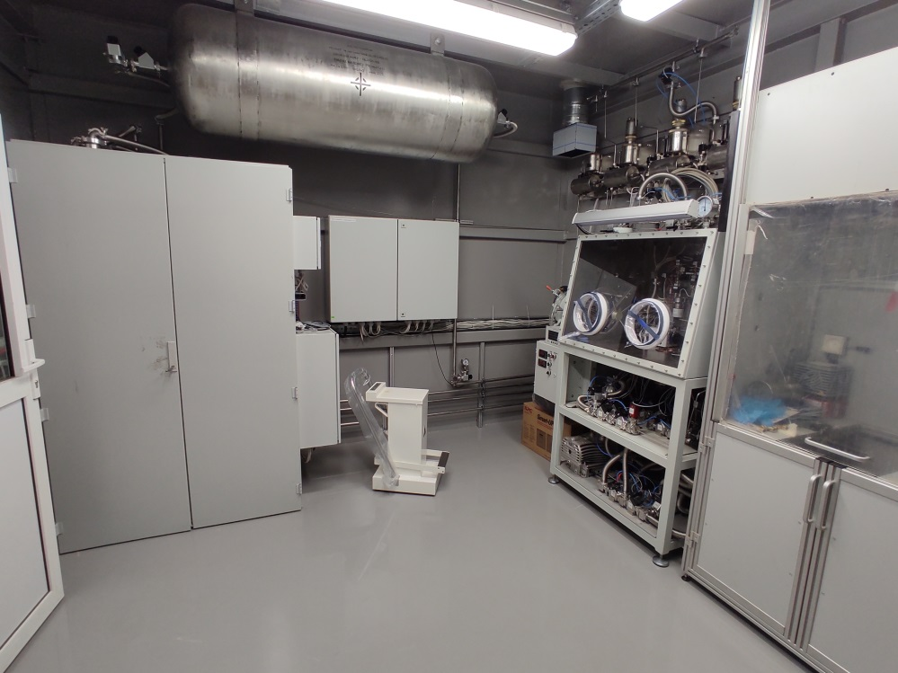
Cryogenic tritium target complex
Availability for study of cryogenic tritium target (expected in 2025)
! A kind of turning point of the research programme !
Technical specification:
2.7 kCi T₂;
Liquid (T⁓25 K): h=0.4 mm;
Gas: h=4 mm;
Three stages of radiation protection;
Radiation safety control;
Automatic control and parameter setting;
The cell can also be filled with H₂, D₂, ³He, ⁴He;
Thickness in a wide range ~10²⁰ ÷ 5*10²¹ atoms/cm²
Tritium target infrastructure:
Completion of work on special ventilation and liquid radioactive waste - 2024
Certificate for work in the 2nd class room - 2025

Slide 8
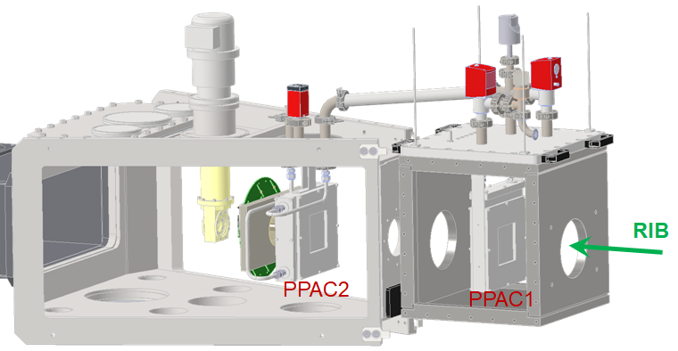
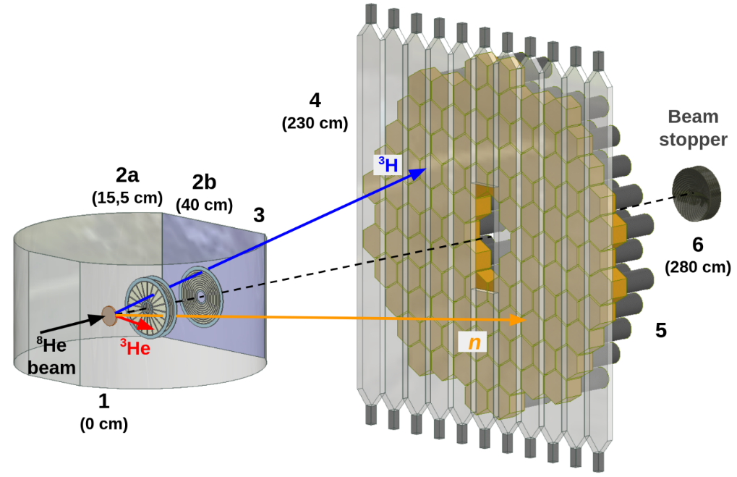
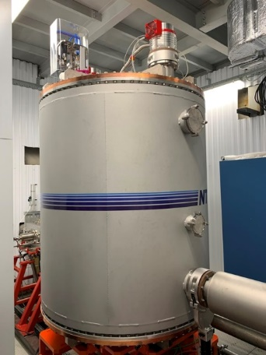
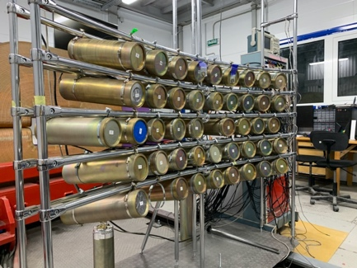
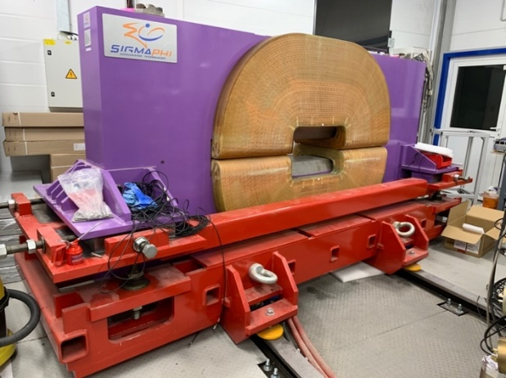
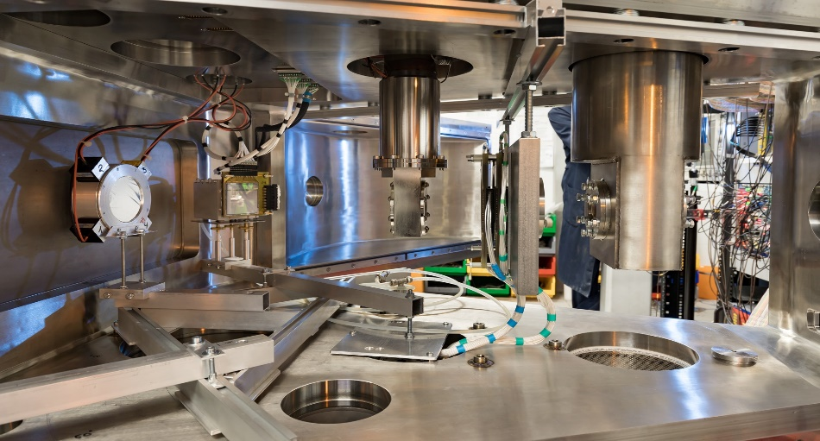
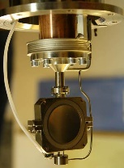
PPACs
Instrumentation development
RF-kicker (operational run with ion beam)
Zero-angle spectrometer hodoscope
Neutron detector array (increase in number of modules)
In-beam detectors
Charged particles detector arrays (angular and energy acceptance)
Multiparametric detectors setups
Others
PPACs from IBS, Daejeon
Neutron array
Charged particles & neutron array
RF-Kicker
Zero-degree spectrometer
Cryogenic target cell & detectors

Slide 9
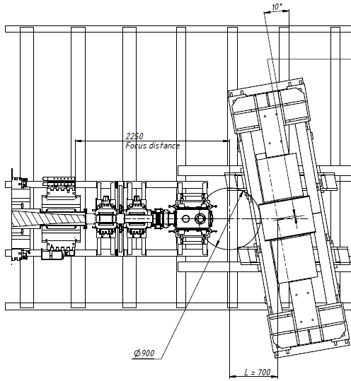
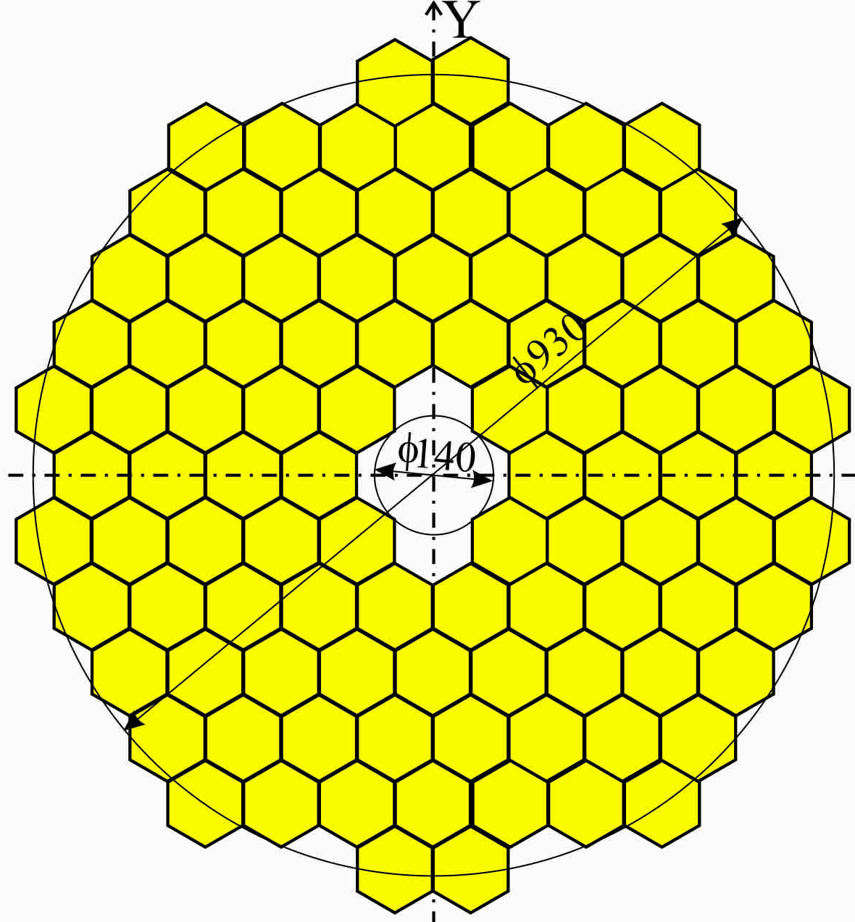
2025+: experiments with H₂, D₂, T₂, ^{3,4}He targets and new technique
ACC-2 - full experimental setup
¹³O(³He,n)¹⁵Ne
²⁴Si(³He,n)²⁶S
DSSD 1000 μ, 10x10 cm, (128x128 strips)
Dipole magnet D3 should improve a neutrons detection
and exit channel identification
RF-kicker should enhance RIBs
purification by a factor of 10÷20
X_Y_DE_E
decay particles
Bρ = 0.4 ~ 1.0 Tm
Cone 0 ~ 14°
Si – telescopes
MWPC or PPAC
RIB
Neutrons,
Cone 0° ~ 14°
Stilbene array
48 unit (80x50mm)
⁸He(t,p)¹⁰He
¹⁴Be(t,p)¹⁶Be
⁸He(t,α)⁷H
⁸He(α, 2α) QFS
X_Y
Si - 300 μ
64x64 strips
Plastic BC-404 array
100 units (100x75mm)
cryogenic target
Notes:
SIGMAPHI PRESENTATION - JUNE 2001

Slide 10
THANK YOU!

Slide 11


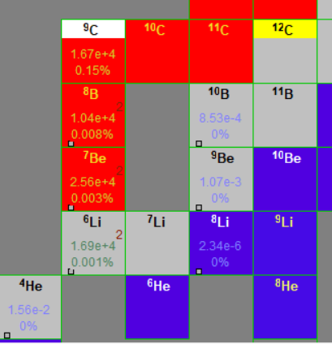
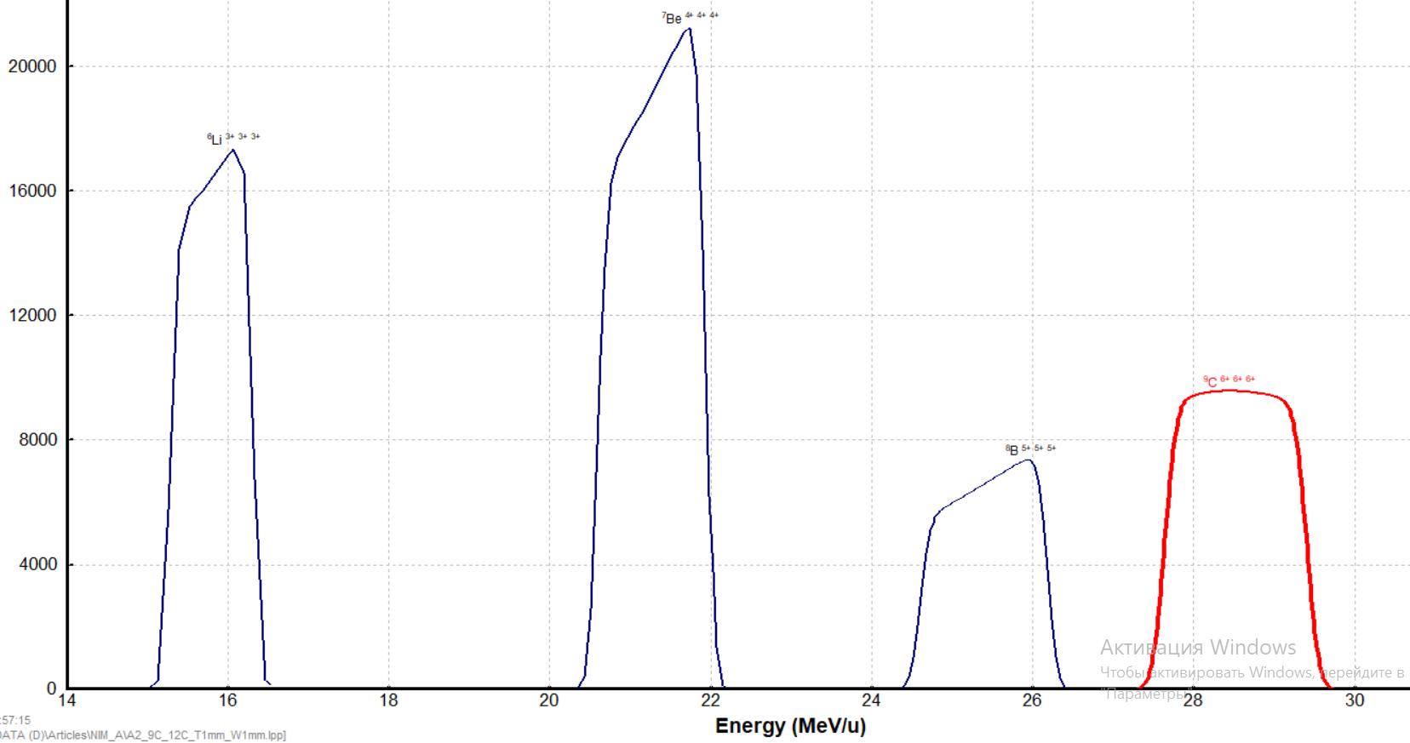
⁷Be ⁸B ⁹C

Slide 12
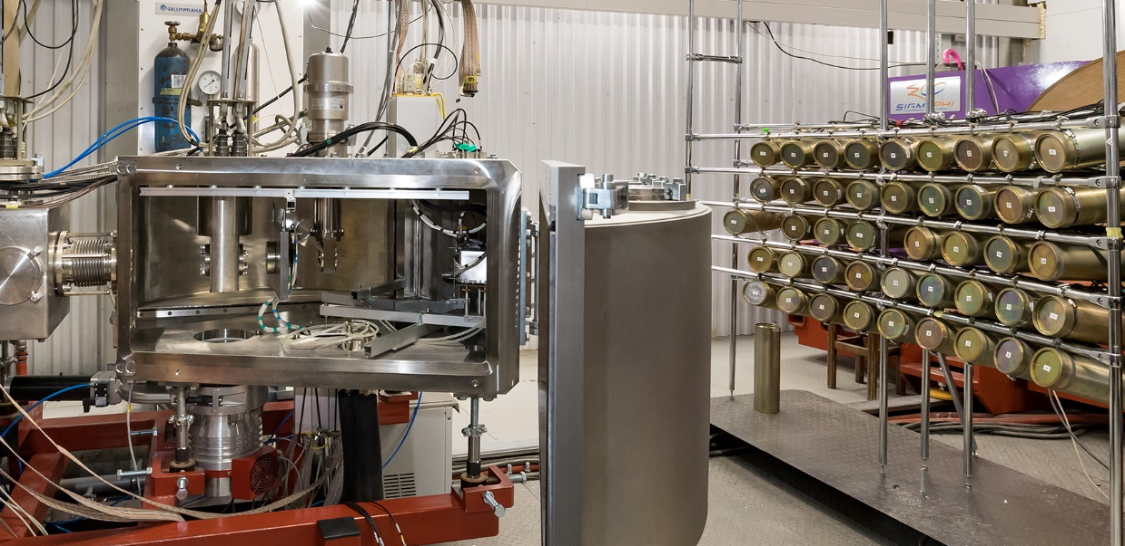
2019/20: setup for the study ⁷He, ⁹He and ¹⁰Li isotopes in the reaction (d,p)
⁶He(d,p)⁷He → n + ⁶He
⁸He(d,p)⁹He → n + ⁸He
⁹Li(d,p)¹⁰Li → n + ⁹Li
Stilbene based modules for neutrons, 48 pcs.
MWPC
Exit window
(Fe 180µ)
target
ToF detector
(EJ-212 125μ)
DSSD
(for protons)
⁶He, ⁸He, ⁹Li beams
with E ~ 29 АМeV
Deuterium target:
6 mm thick @ 99.7 %
1.48 / 1.0 atm @ 26K

Slide 13
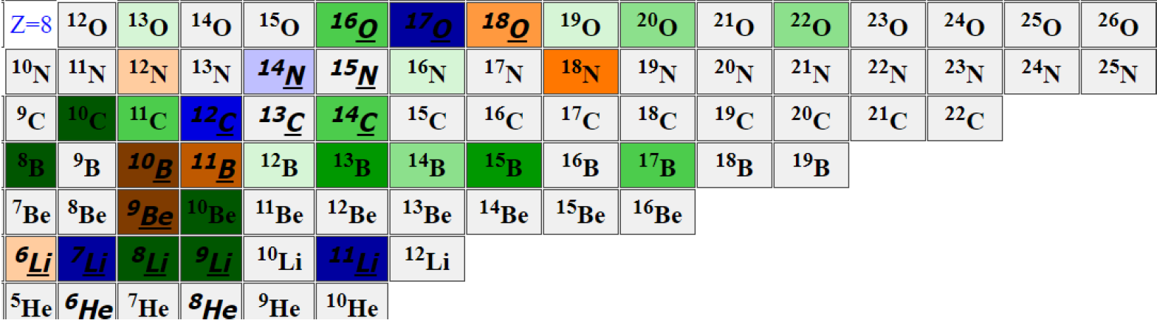
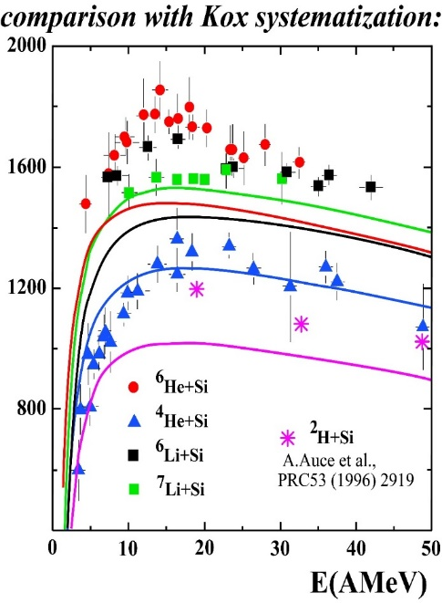
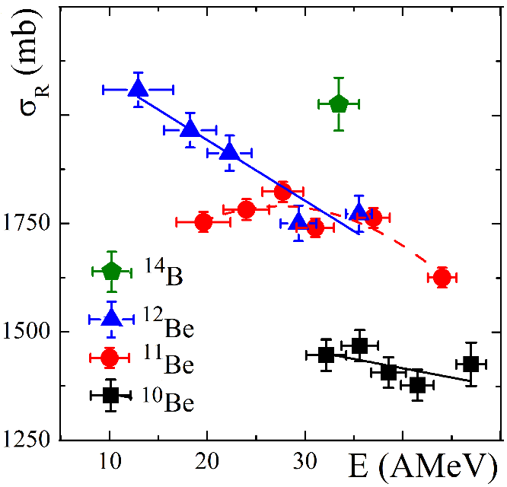
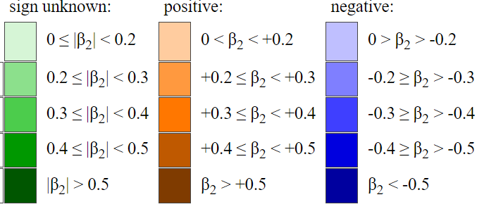
Study the energy dependence of total reaction cross section in the reactions
In this E_{LAB} range, there are practically no data on σ_{R}(E) and σ_{Σ}(E) in reactions with ^{10‑12,14}Be,^{12‑15…}B,^{14‑18…}C,^{16‑20}N.
In the reactions ^{4,6,8}He,^{6,7,9,11}Li,^{10,11,12}Be+²⁸Si an anomalous increase in σ_{R}(E) at E_{LAB}~10÷20 AMeV, where the velocities of colliding nuclei are comparable to the average velocities of nucleons in nuclei.

Slide 14
Investigation of hard-to-access neutron-rich nuclei along with their isobar analogs or mirror nuclei. Isobar analogues are important for studying the properties of atomic nuclei and for testing nuclear models. By comparing the properties of isobar analogues, one can gain insights into the underlying nuclear forces and interactions that govern the behavior of atomic nuclei. Studies of mirror nuclei have been used to test the symmetry properties of the nuclear forces, and to investigate the role of isospin symmetry in nuclear structure. They also play an important role in astrophysics, as mirror nuclei can be used to study the nucleosynthesis of light elements in stars.
⁵He-⁵H: same combination of beam+target: ⁶He(d,³He)⁵H and ⁶He(d,³H)⁵He. Two-neutron decay ⁵He-⁵H essential for understanding the interactions between neutrons. By investigating the behavior of the t+n+n, correlations, we can gain insights into the structure of ⁵H and the dynamics of the two-neutron decay process. Like ⁵H, ⁵He also exhibits a two-neutron decay, which in this case corresponds to the ³He+n+n channel. Investigating the behavior of this decay mode can shed light on the structure of ⁵He and the interactions between neutrons in neutron-rich nuclei.
⁷H-⁷He-⁷B: All these isotopes are undoubtedly of great interest. The available combinations of beams and targets provide us with the possibility to populate low-lying states through different reaction mechanisms and investigate their impact on the structure of these states. Neutron-rich isotopes, such as ⁷H and ⁷He, can be populated in reactions with ⁶He and ⁸He beams hitting proton, deuterium, or tritium targets, such as ⁸He(p,d)⁷He, ⁶He(d,p)⁷He, ⁸He(d,³H)⁷He, ⁸He(d,³He)⁷H, and ⁸He(t,⁴He)⁷H, in inverse kinematics. Low-lying states of ⁷B can be populated through the neutron transfer reaction ⁸B(p,d)⁷B or the charge-exchange reaction ⁷Be(p,n)⁷B. Investigating the ⁷B nucleus, a mirror nucleus for ⁷He, offers better experimental access to ⁷He properties. Moreover, due to the employment of a neutron detection wall, we will be able to detect all particle products. Additionally, the expected decay chain ⁷B→⁶Be →⁵He will provide further access to the ⁵He isotope mentioned above.
These experimental approaches not only contribute to our understanding of the properties and structure of neutron-rich isotopes but also help refine theoretical models used to describe nuclear systems. By carefully selecting appropriate combinations of beams and targets, one can investigate the behavior of these isotopes in various reaction mechanisms, gaining valuable insights into the fundamental forces governing nuclear interactions and the limits of nuclear stability.
¹⁰He-¹⁰Li-¹⁰N: These isotopes represent some of the most complex and hardly accessible isobars with a mass number A=10. They can be populated through ⁸He(t,p)¹⁰He, ⁹Li(d,p)¹⁰Li, and ⁹C(d,n)¹⁰N reactions. The use of a liquid tritium target allows for larger statistics of ¹⁰He, enabling more detailed studies of its properties and decay modes. Measuring all reaction products for both mirror nuclei, ¹⁰Li and ¹⁰N, will allow for comparative analyses of their nuclear structure properties. This comparison can provide valuable insights into the behavior of these exotic isotopes and their interactions, helping to refine theoretical models that describe their properties and decay mechanisms.

