Slide 1
Proposal for prolongation of the Theme:
Flerov Laboratory of Nuclear Reactions
Development of the FLNR Accelerator Complex
and Experimental Setups (DRIBs-III)
to 2030
transformation into a Large Infrastructure Project (LIP)
Leaders: I.V. Kalagin
S.I. Sidorchuk
Scientific leader: Yu.Ts. Oganessian
57th meeting of the PAC on Nuclear Physics
June 29, 2023

Slide 2

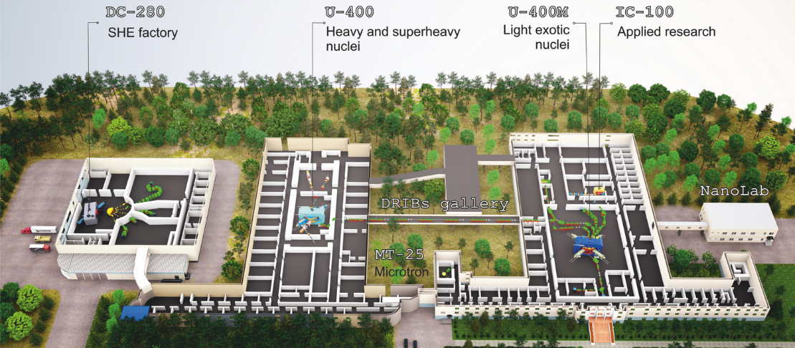
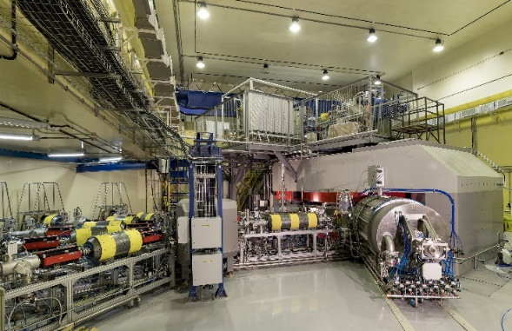
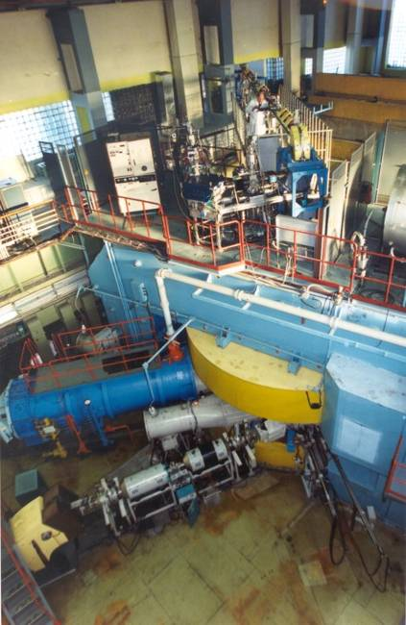
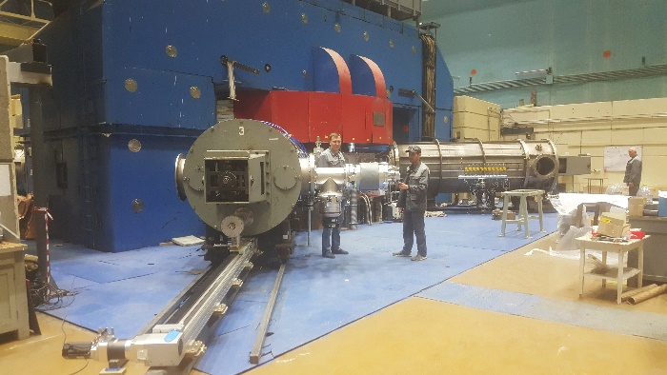
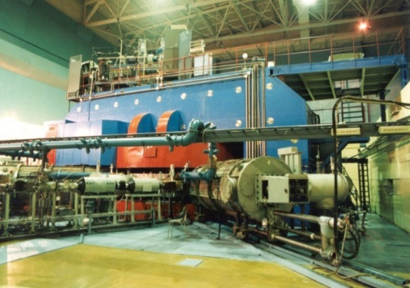
DRIBS-III ACCELERATOR COMPLEX
FLEROV LABORATORY OF NUCLEAR REACTIONS
Superheavy elements
Nuclear reactions
Light nuclei
Applied research
Montage hall
New experimental hall
DC-140
Setups:
DGFRS-2
GRAND
Setups:
SHELS
MAVR
CORSET
SEE tests
Setups:
ACCULINNA-2
COMBAS
MASHA
SEE tests
DC-280
U-400
U-400М (modernization)
Notes:
2
Beam intensity of Ca-48 up to 2.5 mkA
Ion energy variation on the target with factor 5
Cyclotron average magnetic field from 1.8 up to 0.8 T

Slide 3
Projects and activities of Theme | Leaders
Project 1. U-400R accelerator complex. 5 years | I.V. Kalagin, A.G. Popeko
Subproject I. Upgrade of the U400 cyclotron.
Subproject II. Extension of experimental areas through the construction of a new building.
Subproject III. Development of new experimental facilities to be placed in a new building. Activity. SCIF-D facility.
2. Project 2. Development of the experimental setups for the study of chemical and physical properties of superheavy nuclei. (For SHE Factory) 5 years | A.Y. Yeremin
Subproject I. Superconducting gas filled separator GASSOL
Subproject II. Multi-reflection TOF mass spectrometer.
Construction and launching the DC-140 cyclotron for applied research | I.V. Kalagin, Semin V.A.
Support for basic facilities
Igor Kalagin
Alersander Yeremin

Slide 4
Project 1. U-400R accelerator complex
Subproject I. Upgrade of the U400 cyclotron
MAIN PURPOSES OF UPGRADE
Improvement of the quality and intensity of stable and radioactive beams (⁴⁸Ca – 2÷2.5 pμA );
Upgrade of a beam extraction system (electrostatic deflector in addition to recharging foils )
Providing a smooth variation of ion energy in the range of 0.8 – 27 MeV/A;
Decrease the total cyclotron power consumption from 1 to 0.4 MW.
Upgrade: 2024 - 2026
Endorsed by the PAC at the 54th PAC session in 2021
U400 cyclotron (launched in 1978)

Slide 5
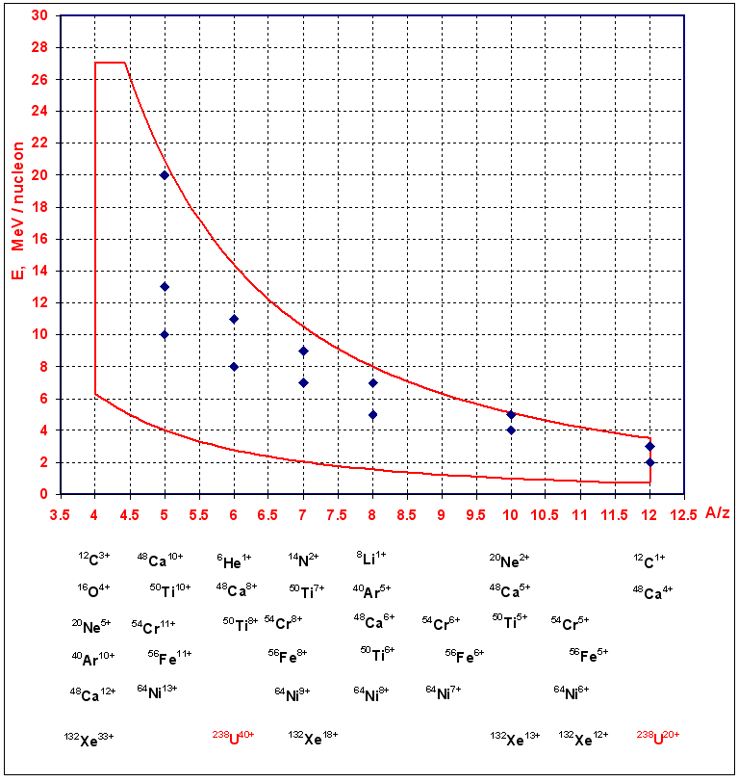
Working Diagram of the U400R Cyclotron
with working points of U400 Cyclotron

Slide 6
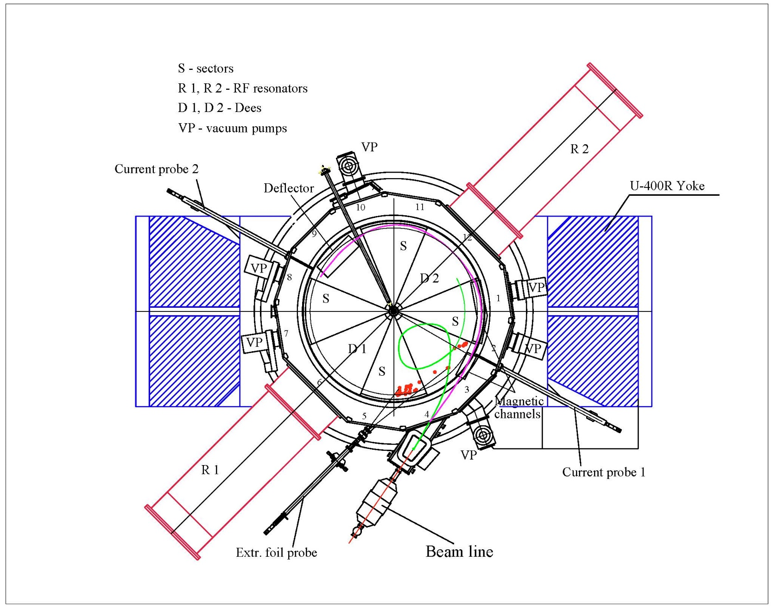
Scheme of the U-400R accelerator

Slide 7
Comparative characteristics of U400 and U400R ion beams
 | U400 A/Z=5÷12, E=3÷20 MeV/u |  | U400R A/Z=4÷12, E=0.8÷27 MeV/u
beam | E/A (MeV) | intensity | E/A (MeV) | intensity | Physics
6<A<40 ⁷Li ¹⁸O ⁴⁰Ar | 17 19 5 | 6×10¹³ 2×10¹³ 9×10¹² | 17 19 5 | 1×10¹⁴ 1×10¹⁴ 3×10¹³ | fragmentation, transfer, structure of light exotic nuclei. superheavy elements- SHE, spectroscopy of SHE, fusion-fission, quasi-fission, etc. multi-nucleon transfer, new neutron-rich nuclei, shell effects. neutron-rich SHE, new heavy isotopes.
A ~ 60 ⁴⁸Ca ⁵⁴Cr ⁵⁸Fe | 5 5 5 | 7.5×10¹² 4×10¹² 4.4×10¹² | 5 5 5 | 2×10¹³ 6×10¹² 6×10¹²
A ~ 150 ¹²⁴Sn ¹³⁶Xe | 5 5 | 3×10¹¹ 5×10¹¹ | 5 5 | 2×10¹² 3×10¹²
A ~ 240 ²³⁸U | 7 | 3×10¹⁰ | 7 | 10¹¹

Slide 8
Comparative parameters of U400 and U400R
Parameters | U400 | U400R
A/z range | 5÷12 | 4÷12
Magnetic field | 1.93÷2.1 T | 0.8÷1.8 T
K factor | 530÷625 | 100÷500
RF modes | 2 | 2, 3, 4, 5, 6
Ion energy range | 3÷20 MeV/n | 0.8÷27 MeV/n
Number of sectors | 4 | 4
Number of dees | 2 | 2
Beam extraction | stripping | Stripping, deflector
Power consumption | ~1 MW | ~0.4 MW

Slide 9
Project 1. U-400R accelerator complex
Subproject II. Extension of experimental areas through the construction of a new building.
Nowadays the total experimental area of the U400 cyclotron is about 200 m² (building 131). Physical facilities located on two levels of the building occupy almost the entire available area. New facilities of U400R complex require additional space.
MAIN PURPOSE
Extension of experimental areas by construction of experimental building with a total area of about 1200 m² for placing new experimental facilities

Slide 10
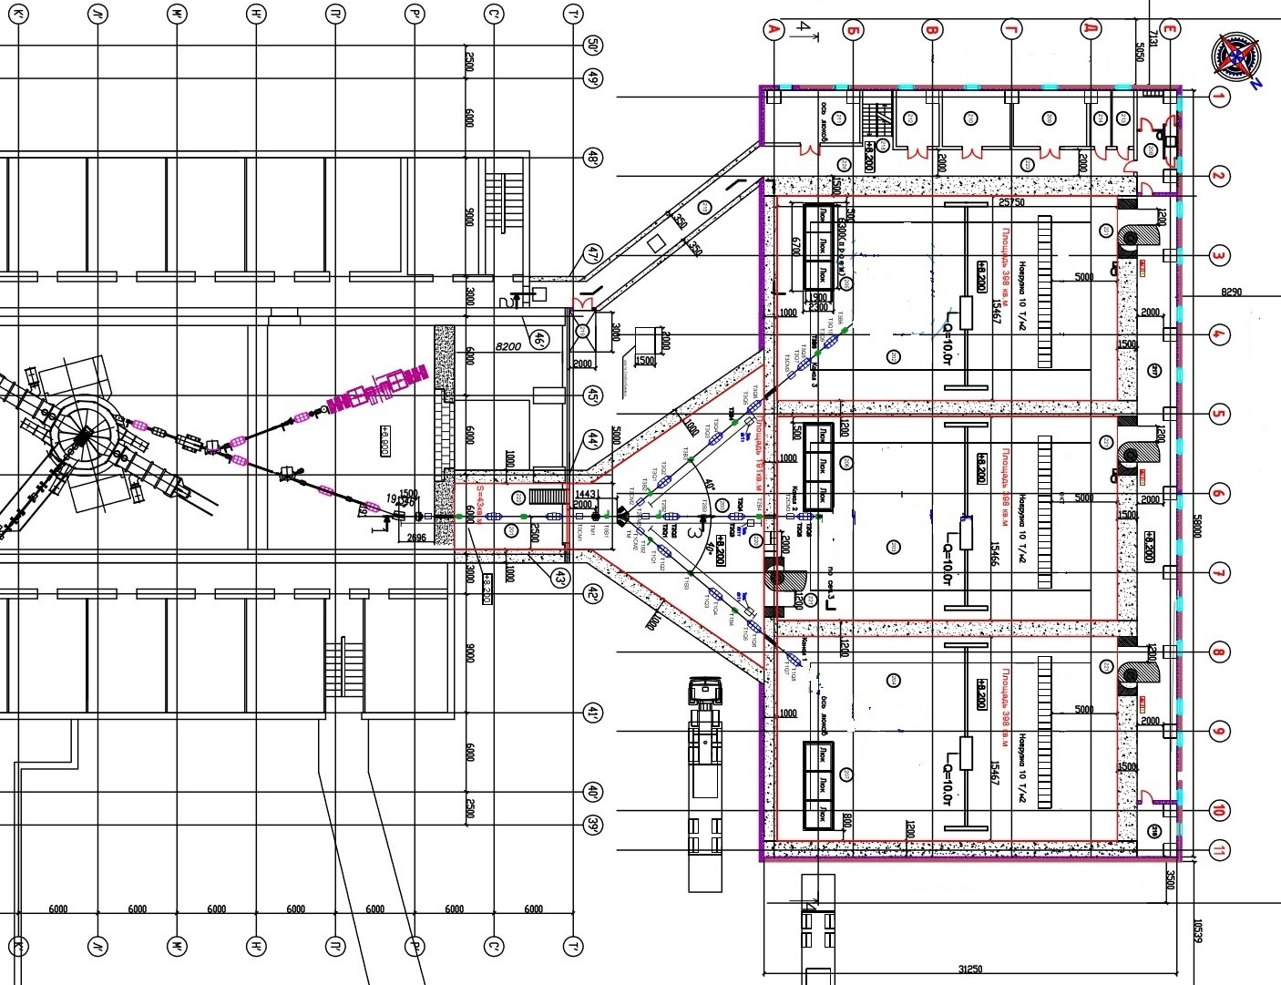
The building is the new Experimental Hall of U400R
Construction 2023-2026
Building 131
Experimental Hall of U400
U400R
Existing
New Experimental Hall of U400R
The proposal was appreciated by PAC at the 54th PAC session in 2021.

Slide 11
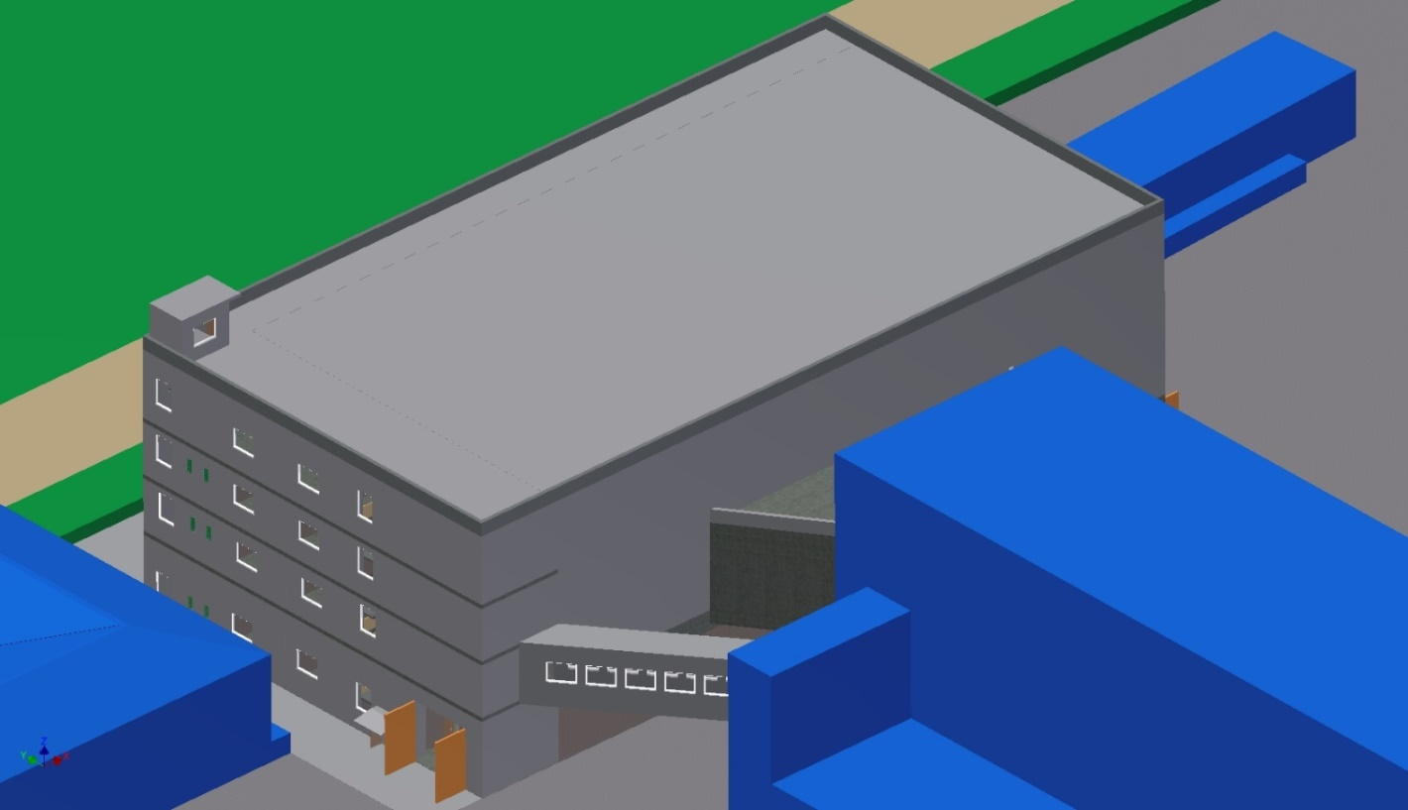
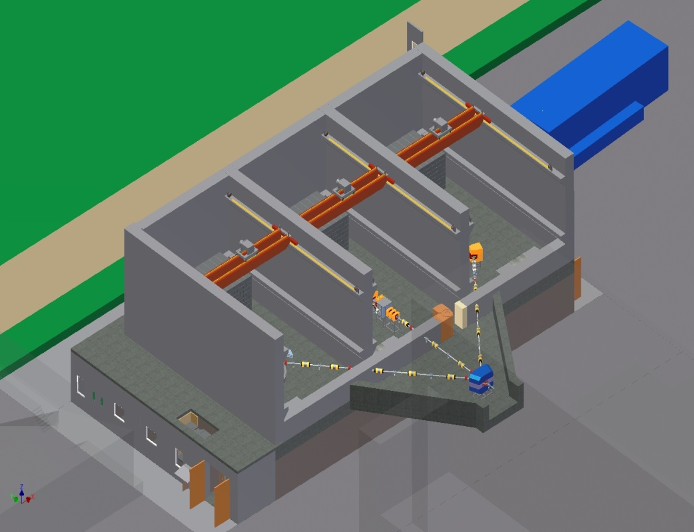
New Experimental Hall of U400R
Storehouse
The building consists of 4 floors.
The experimental facilities will be separated by protective walls, which make it possible to preparation for one experiment while another is underway.
New Experimental Hall of U400R
Building of U400R cyclotron
Storehouse
The 1st floor: technological systems (water cooling, ventilation, gas cleaning, fore-vacuum), rooms for the temporary storage and release of solid and liquid radioactive waste.
The 2nd floor: three physical cabins and two galleries to the cyclotron building.
The 3rd floor: control rooms of physical setups.
The 4th floor: electric boards and power supplies of physical setups.

Slide 12
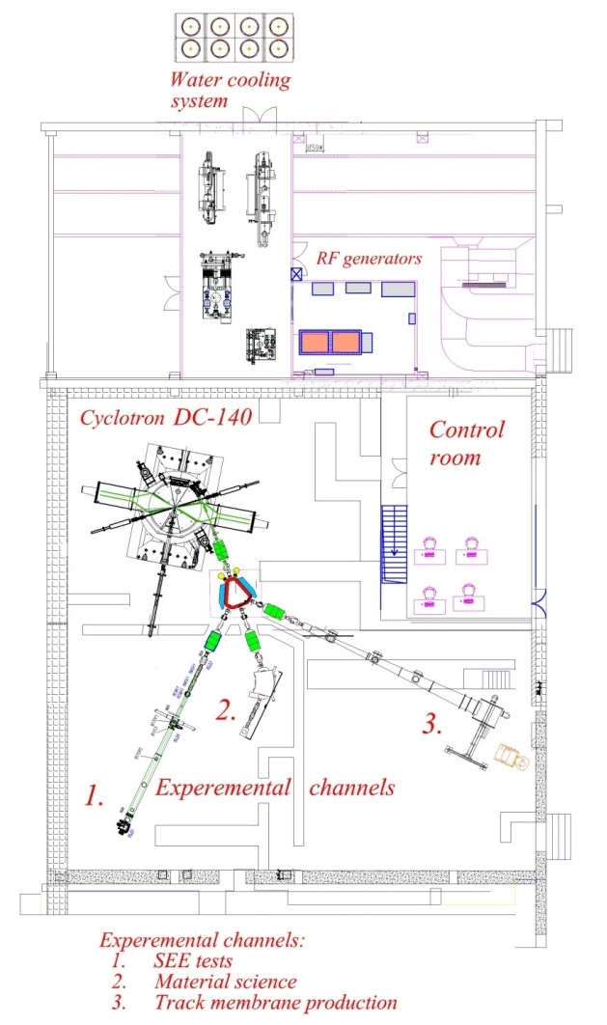
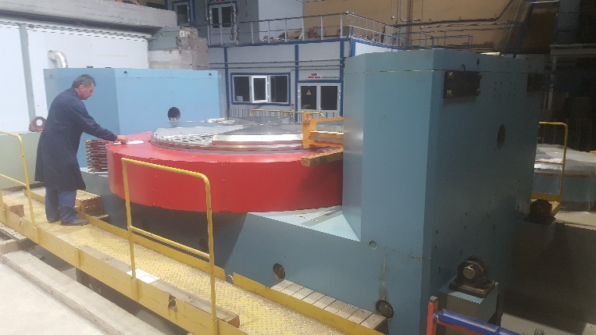
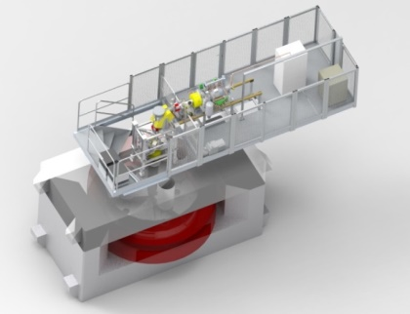
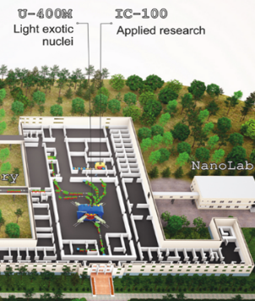
Construction and launching the DC140 cyclotron for applied research
(Creation 2021-2024)
The construction and launching of the DC140 cyclotron in building 101 aimed creation of the accelerator complex for basic research and applied application of heavy ion beams:
solid state physics studies, surface modifications of materials;
production of track membranes;
testing of electronic component base components (ECB) on single radiation effects (SEE).
DC140 technical parameters:
Magnetic field: 1.377 - 1.554 T;
RF frequency : 8.452 MHz;
Ions of elements: O – Bi;
Injection from ECR 18 GHz;
Ion energies:
2.124 MeV/nucleon (A/Z=7.35 – 8.25)
4.8 MeV/nucleon (A/Z=4.9 - 5.5)
Arrangement of DC140 accelerator complex in the building 101
10⁵ ÷ 10¹² ions/s

Slide 13
Financing of Theme for 7 years
No. | Items of expenditure | Cost k$ | Expenditure per year (thousands of the US dollars)
 |  |  | 2024 | 2025 | 2026 | 2027 | 2028 | 2029 | 2030
1. | Project 1 | 30 700 | 11 300 | 10 600 | 2 700 | 1 500 | 1 600 | 1 500 | 1 500
 | U400R upgrade | 3 800 | 800 | 1 000 | 2 000
 | New building | 18 000 | 9 000 | 8 000 | 1 000
 | Experimental set ups | 7 700 | 1 500 | 1 600 | 1 500 | 1 500 | 1 600
2. | Project 2 | 13 500 | 2 000 | 2 000 | 2 000 | 2 000 | 2 000 | 2 000 | 1 500
 | GASSOL | 4 500 | 1 000 | 800 | 800 | 900 | 1 000
 | MR-TOF | 5 500 | 1 000 | 1 200 | 1 200 | 1 100 | 1 000
3. | New projects for the rest of the 7-year period (RCL of I class, development of RIB technique etс. ) | 12 000 |  |  |  |  | 1 000 | 5 000 | 6 000
4. | Completing of DC-140 accelerator complex creation | 1 400 | 1 000 | 200 | 200
5. | Support for basic facilities | 9 800 | 1 000 | 1 000 | 2 000 | 2 000 | 1 800 | 1 000 | 1 000
TOTAL: |  | 67 400 | 15 300 | 13 800 | 6 900 | 5 500 | 6 400 | 9 500 | 10 000
Personnel of Projects
Items | People | FTE
Project 1 | 40 | 19.7
Scientists | 10 | 6.4
Engineers | 20 | 10
Specialists | 5 | 1.5
Technicians | 5 | 1.8
Items | People | FTE
Project 2 | 23 | 15.6
Scientists | 13 | 9.2
Engineers | 8 | 5.2
Technicians | 2 | 1.2

Slide 14
Risks of the Theme
The main risks are linked to restrictions on the purchase of a number of equipment manufactured in the EU and the USA (vacuum equipment, high-voltage power supplies, detectors and electronic equipment), which may cause delays in the implementation of the project.
In addition, the risk of construction delay due to the fault of the contractor is not excluded.
THANKS FOR YOUR ATTENTION!

Slide 15
Formation of magnetic field in U400R
Current of magnet main coil - 1200A Trim coil current 20A
Radial Distribution of Average Magnetic Field without Trim Coil’s Shimming
Radial Distribution of Magnetic Field of Trim Coils
Formation of Isochronous Magnetic Field

Slide 16
Total financing of Theme for 7 years
No. | Items of expenditure | Cost | Expenditure per year (thousands of the US dollars)
 |  |  | 2024 | 2025 | 2026 | 2027 | 2028 | 2029 | 2030
1. | Materials | 13 300 | 1100 | 1300 | 1100 | 1300 | 1400 | 3400 | 3700
2. | Equipment, Third-party company services | 35 500 | 5110 | 4410 | 4700 | 4140 | 4940 | 6000 | 6200
3. | Commissioning | 240 | 30 | 30 | 40 | 30 | 30 | 40 | 40
4. | R&D contracts with other research organisations | 360 | 60 | 60 | 60 | 30 | 30 | 60 | 60
5. | Design/construction | 18 000 | 9000 | 8000 | 1000 | - | - | - | -
TOTAL: |  | 67 400 | 15 300 | 13 800 | 6 900 | 5 500 | 6 400 | 9 500 | 10 000

