Slide 1
Development of the FLNR Accelerator Complex and Experimental Setups (DRIBs-III) Projects and activities
Project 1. U-400R accelerator complex
Leaders: I.V. Kalagin, A.G. Popeko
Subproject I. Upgrade of the U400 cyclotron.
Subproject II. Extension of experimental areas through the construction of a new building.
Subproject III. Development of new experimental facilities to be placed in the new building. Activity. SCIF-D facility.

Slide 2
Subprojects I+II Reconstruction of U400 & the new Experimental Hall of U400R
old
new

Slide 3
Scientific background
Synthesis of new heavy and super-heavy isotopes;
Spectroscopy of isotopes of transfermium elements;
Study of nuclei at high excitation energies;
Multi-nucleon transfer reactions:
Search for processes like:
²³⁸U + ²³⁸U → ²⁹⁸Fl + ¹⁷⁸Yb
²³⁸U + ²³⁸U → ²⁰⁸Pb + ²⁶⁸No
²³⁸U + ²³⁸U → ²⁰⁸Pb + ²⁰⁸Pb + ⁶⁰Ca
²³⁸U + ²³⁸U → ¹³²Sn + ¹³²Sn + ²⁰⁸Pb + α
Fusion-fission, quasi-fission, ternary fission, etc;
Design and testing of detectors.

Slide 4
G.N. Flerov “Synthesis and study of new isotopes and elements” (report at the conference 100 years of M. Curie, October 1967)
Considerably more promising are the synthesis and study of new isotopes and elements in reactions involving the merging of heavy nuclei, enabling compound nuclei of the ⁴⁷⁶184 type (²³⁸U + ²³⁸U) to be obtained.
Such compound nuclei will undergo fission almost instantaneously. However, among their fragments there may be nuclei of element 114 with a high mass number. We may well expect a relatively high yield of super element nuclei with long half lives among the fission fragments.

Slide 5
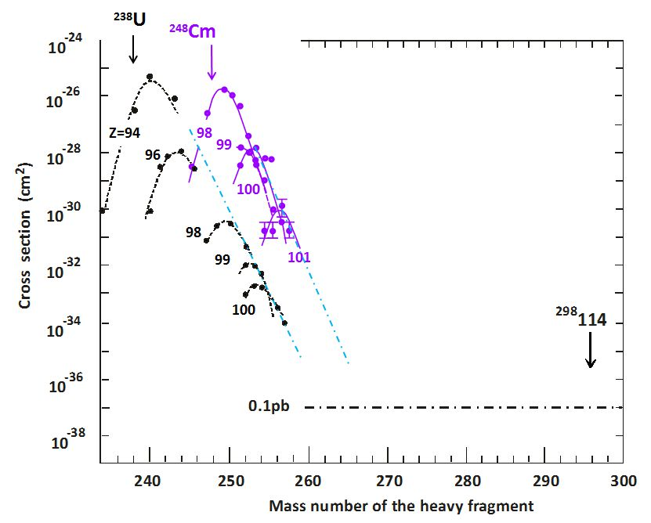
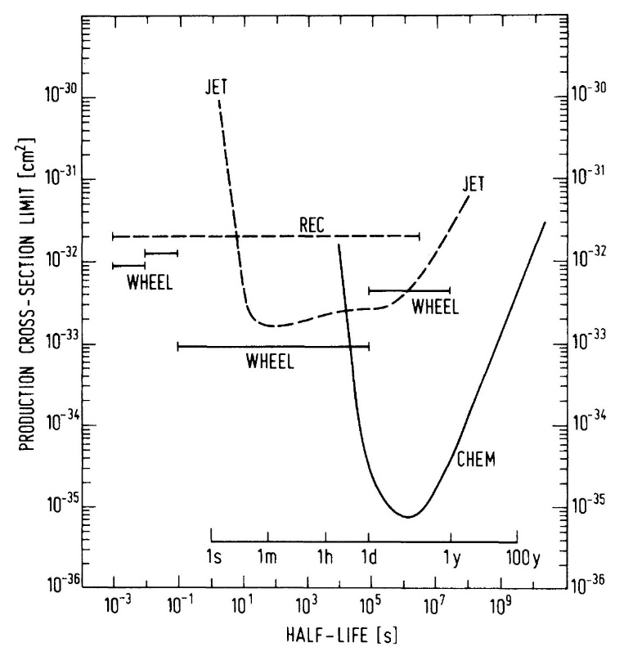
Subproject III. Development of new experimental facilities to be placed in the new building.
Synthesis and study of neutron-rich heavy isotopes formed in MNT reactions.
Study MNT reactions mechanisms.
²³⁸U + ²³⁸U, ²³⁸U + ²⁴⁸Cm, GSI, 1977 - 1981
Upper limits for the production cross sections of SHE in the ²³⁸U+²³⁸U reaction

Slide 6
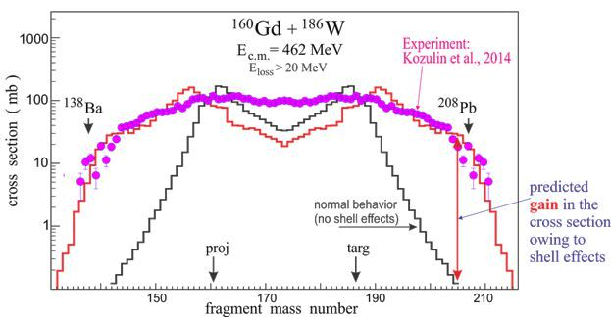
Test reaction ¹⁶⁰Gd + ¹⁸⁶W E.M. Kozulin et al., PRC 96, 064621 (2017)
In search of a way to the Island of Stability
Notes:
The Island of Stability (Z~114, N~184) is inaccessible in fusion reactions. Other reaction mechanisms have to be searched for synthesis of long-leaving neutron rich superheavy nuclei located in the center of this Island. Multi-nucleon transfer reactions can be used for this purpose if the shell effects play significant role in such processes. First experiment has been performed (Gd+W) revealing strong shell effects in heavy ion damped collisions leading to formation of trans-target nuclei. This opens a way to the production of neutron rich superheavy isotopes.

Slide 7
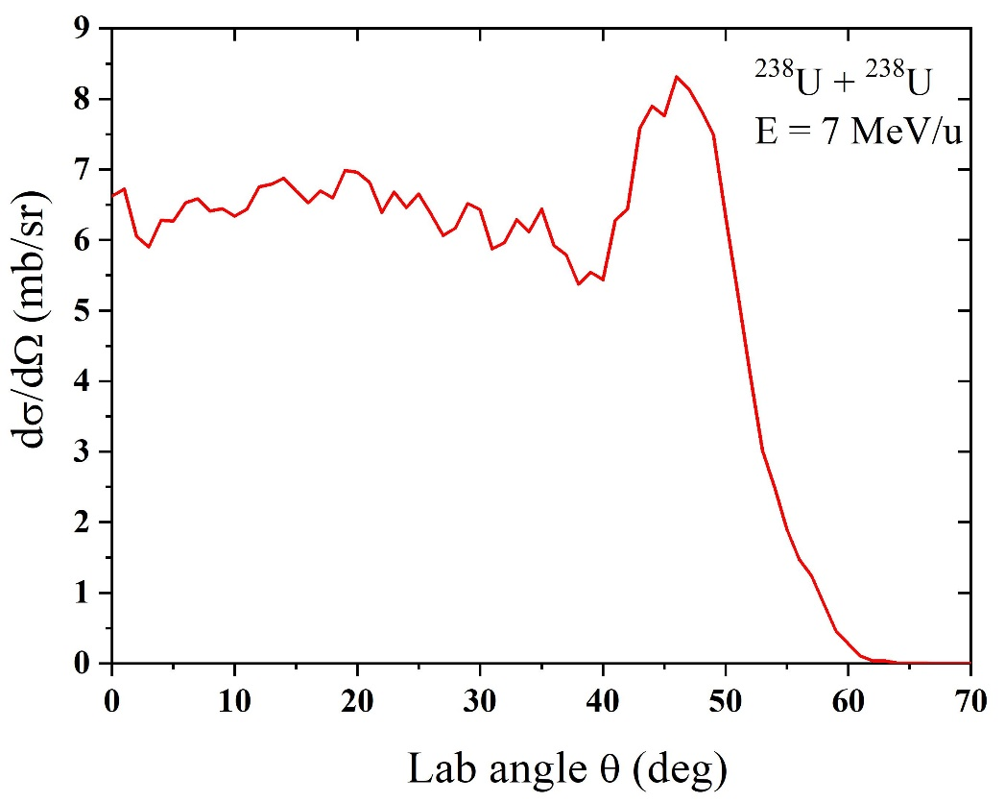
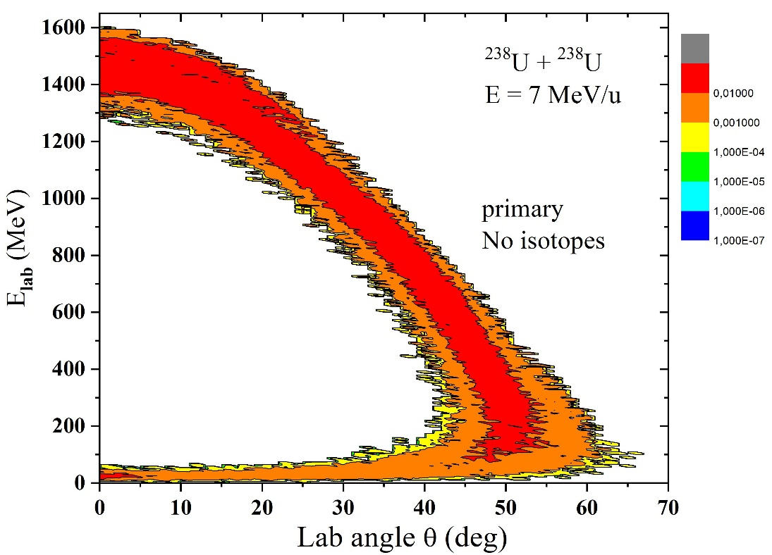
Angular & Energy distributions of ²⁶⁸No from ²³⁸U + ²³⁸U reaction
A. Karpov & V. Saiko

Slide 8
How to separate?
Magnetic separator:
$Bρ_{1}\sim \frac{m∙v}{q}$
Electrostatic separator:
E$ρ_{2}\sim \frac{m∙v^{2}}{q}$
Gas filled separator:
$q\sim v∙Z^{x}$
$Bρ\sim \frac{m}{Z^{x}}$
Velocity filter:
v = f(E,B)
Dispersions
angular
energy
charge
velocity

Slide 9
²³⁸U + ²³⁸U → ≈ ²⁶⁸No + ≈ ¹⁰⁸Pb
Nucl. | Е(МeV) | Bρ (vac. Т∙m) | Bρ (He. Т∙m) | Bρ (H₂. Т∙m) | V (cm/ns) | E/q_{vac} (MV)
²³⁸U | 1666 | 1.32 | 1.63 | 1.63 | 3.67 | 24.2
²⁶⁸No | 1596 | 1.30 | 1.68 | 1.68 | 3.39 | 22.0
²⁰⁸Pb | 1589 | 1.30 | 1.55 | 1.55 | 3.84 | 25.0
Bρ (Т×m) | E/q (MV)
1.5 | 25 | rotatable

Slide 10
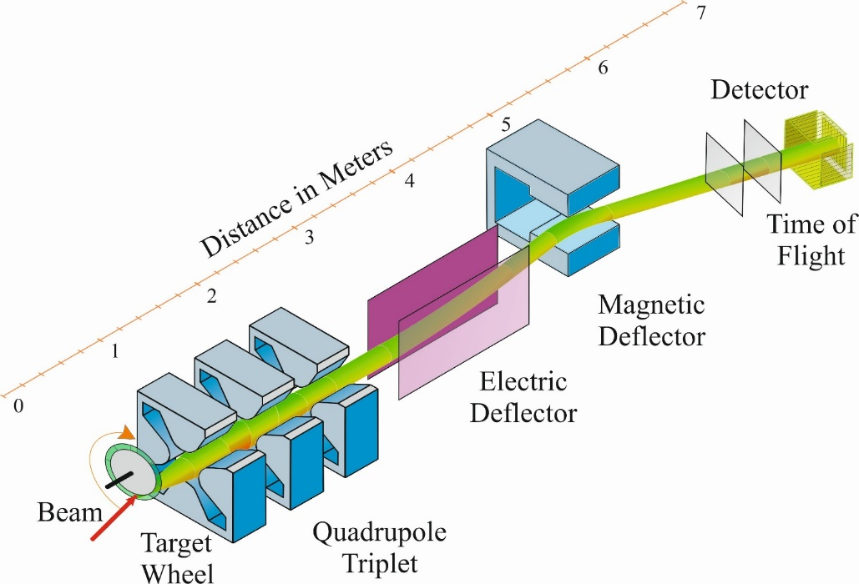
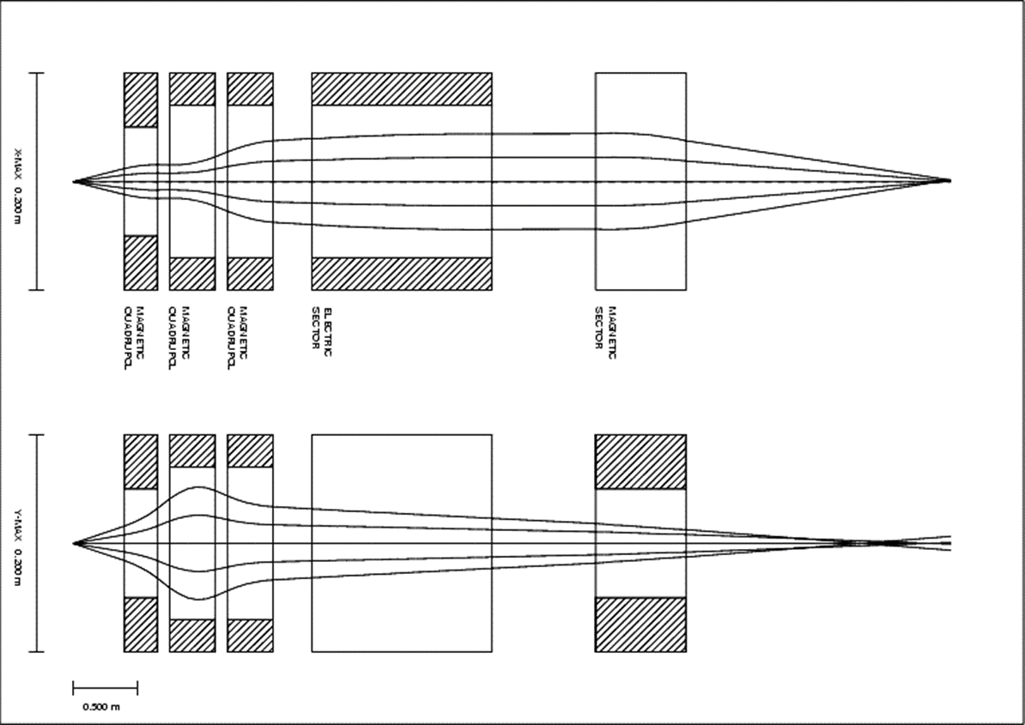
Possible conceptual design of the separator

Slide 11
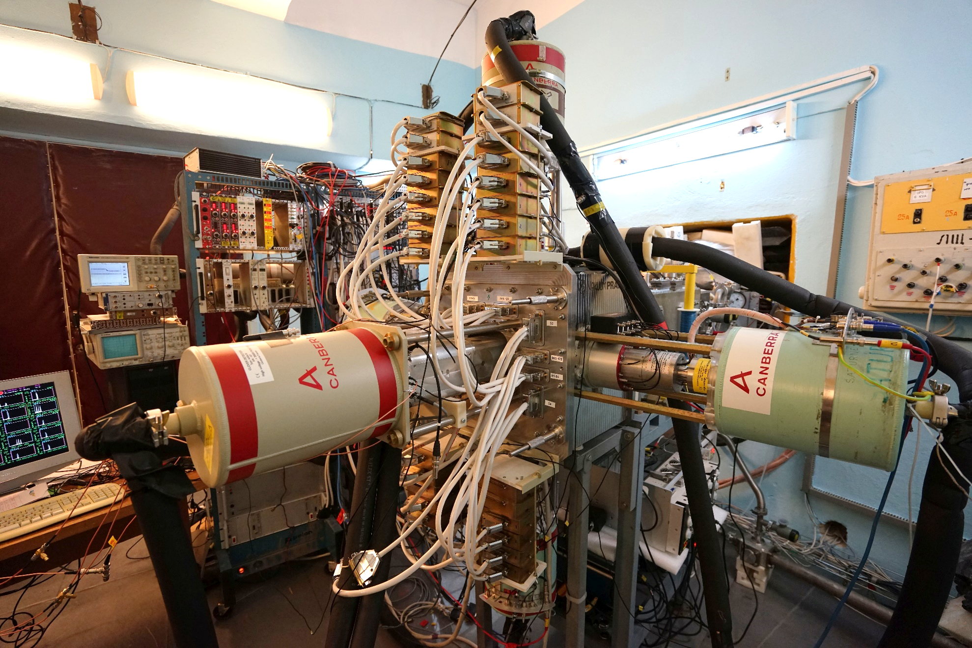
New focal plane detector GABRIELA
GABRIELA - Gamma Alpha Beta Recoil Investigation with the Electromagnetic Analyser

Slide 12
Subproject III. Activity: SCIF-D facility. System for Correlated Investigation of Fragments (SCIF)
Study of mechanisms of fusion-fission and
incomplete fusion reactions.
SСIF consists of:
CORSET spectrometer - measuring mass-energy and angular distributions of reaction fragments;
Bragg chambers - measuring of charge distributions of reaction fragments;
Magnetic Spectrometer providing precise measurements of the charge of fragments with masses up to 200 a.m.u.;
Assembly of DSSD - measurement of the quasi-elastic scattering cross sections;
Gamma-spectrometer - measurement of multiplicity and energy of γ-quanta;
Electrostatic deflector + α, f-f, n, γ- spectrometer - measuring fragments or evaporation residues as well as γ-quanta and neutrons.

Slide 13
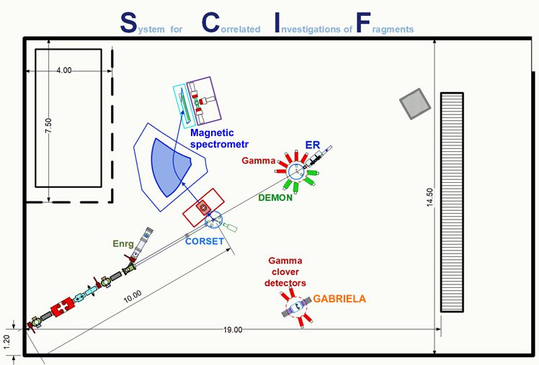
Conceptual design of SCIF

Slide 14
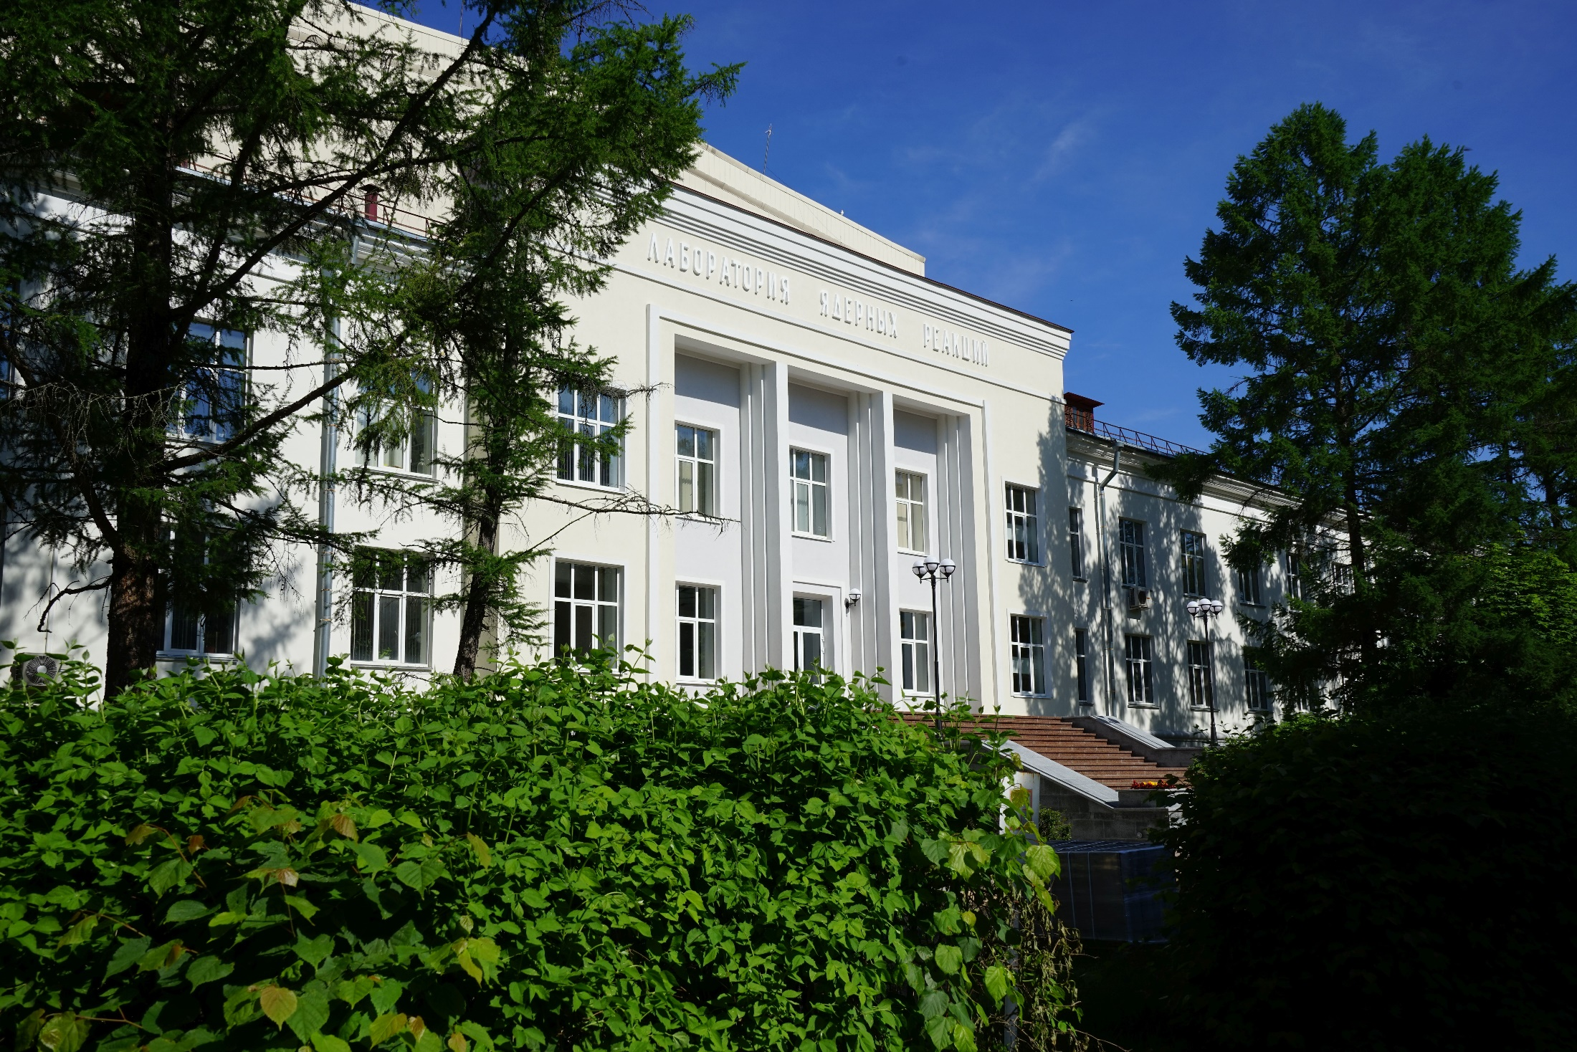
Thank you for your attention

Slide 15
Main optical elements of STAR
²⁹⁸Fl (Z=114)
Magnetic quadrupoles 1 & 2 & 3
E_{ls} (MeV) | 1570
V (cm/ns) | 3.19
<q> | 75.5
Bρ (T×m) | 1.3
E/q (MV) | 20.8
Effective length | 0.45 m
Bore diameter | 0.15 m
Maximum field gradient | 13 T/m
Weight | 3 t
Magnetic dipole
Electrostatic dipole
Gap | 0.12 m
Bending angle | 25⁰
Bending radius | 1.8 m
Maximum field | 1.0 T
Weight | 15 t
Rear pole rotation angle | 55⁰
Effective length | 1.5 m
Bending angle | 8⁰
Bending radius | 11 m
Gap | 0.1 m
High voltage | 2×300 kV

