Slide 1
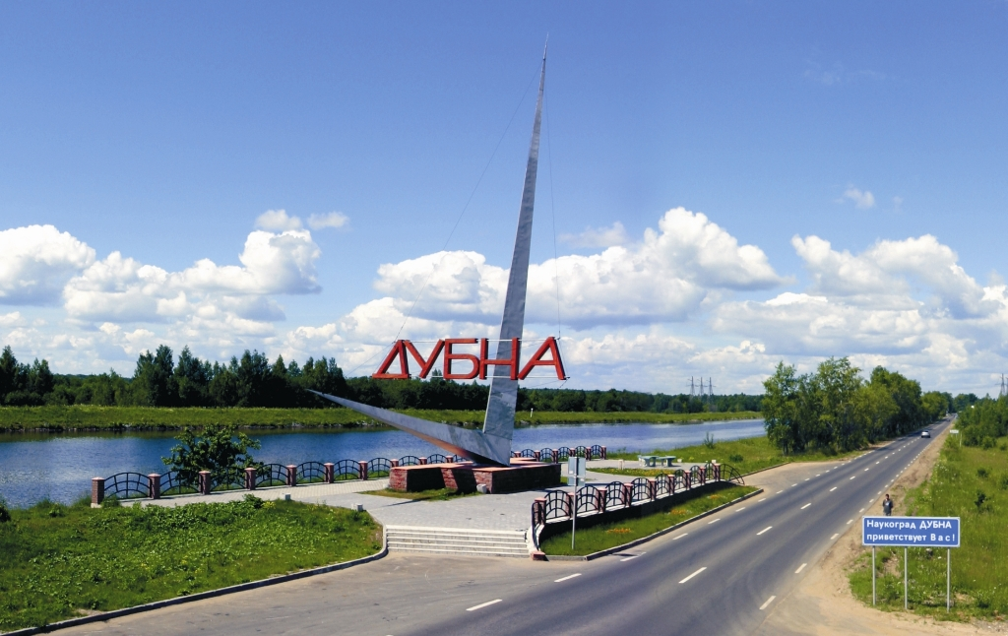
57th meeting of the PAC on Nuclear Physics, June 29-30, 2023
Development of the FLNR Accelerator Complex and Experimental Setups (DRIBS-III)
Project “The U-400R accelerator complex”
Project “Development of experimental setups to study the chemical and physical properties of superheavy elements”
Alexander Yeremin

Slide 2
Large Research Infrastructure Project (LRIP)
Development of the FLNR Accelerator Complex and Experimental Setups (DRIBS-III)
Project
Project
The U-400R Accelerator Complex
Development of the experimental setups for the study of chemical and physical properties of superheavy elements”
Subprojects
modernization of the cyclotron U-400 ( U-400R after upgrade);
Subprojects
construction of a new experimental hall;
SC solenoid GASSOL
construction of new physical separators and ion beam lines for transporting beams from the U-400R.
MR-TOF spectrometer

Slide 3
The project “The U-400R Accelerator Complex”
Subsubproject I. Modernization of the cyclotron U-400
(U-400R after upgrade);
Subsubproject II. Construction of a new experimental hall;
Subsubproject III. Construction of new physical separators and ion beam lines for transporting beams from the U-400R.
Activity. SCIF-D facility.

Slide 4
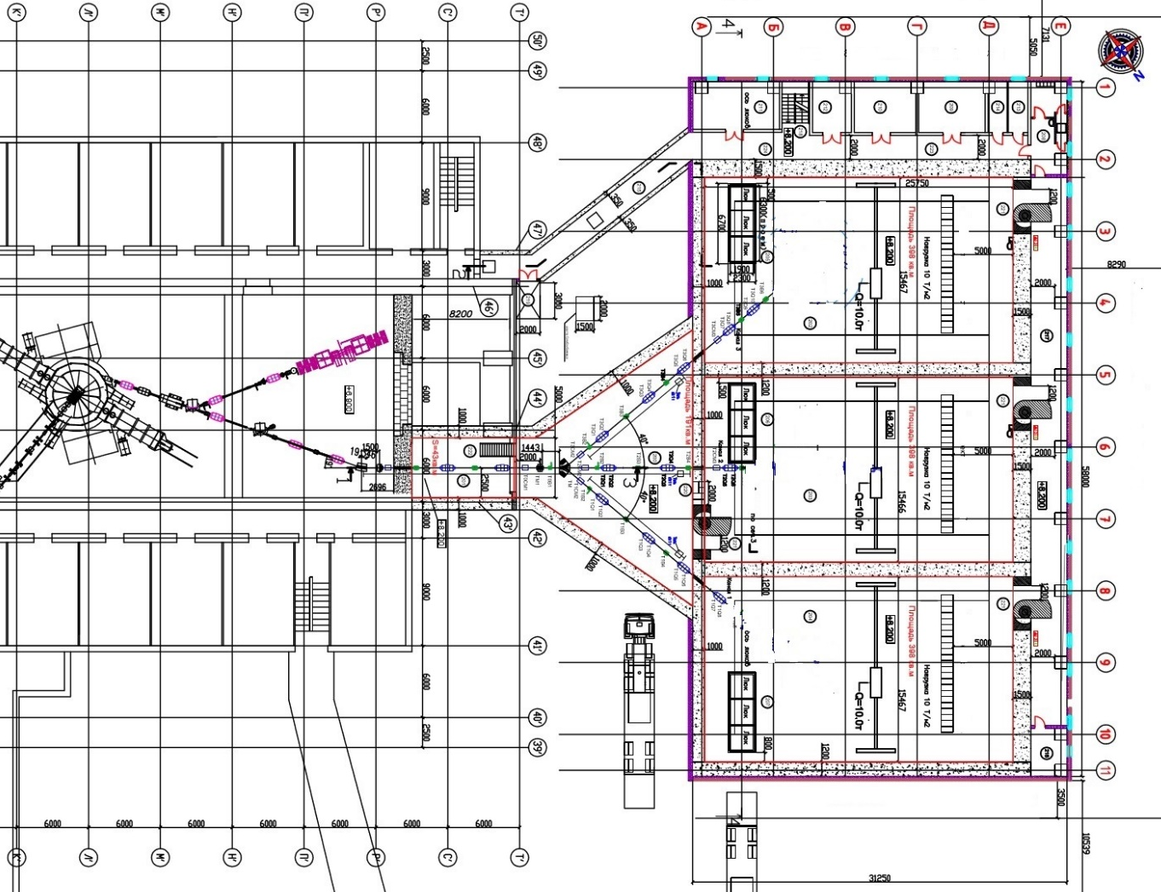


Reconstruction of U400 & the new Experimental Hall of U400R
old
new
Existing experimental set ups: SHELS and CORSET

Slide 5
Scientific background for the U-400R Accelerator Complex
▪ Synthesis of new heavy and super-heavy isotopes;
▪ Spectroscopy of isotopes of transfermium elements;
▪ Study of nuclei at high excitation energies;
Existing SHELS separator
▪ Multi-nucleon transfer reactions:
Search for processes like:
²³⁸U + ²³⁸U → ²⁹⁸Fl + ¹⁷⁸Yb
²³⁸U + ²³⁸U → ²⁰⁸Pb + ²⁶⁸No
²³⁸U + ²³⁸U → ²⁰⁸Pb + ²⁰⁸Pb + ⁶⁰Ca
²³⁸U + ²³⁸U → ¹³²Sn + ¹³²Sn + ²⁰⁸Pb + α
Proposed new kinematic separator (subproject III).
▪ Fusion-fission, quasi-fission, ternary fission, etc;
Existing CORSET set up.
Proposed new set up (activity SCIF-D).

Slide 6
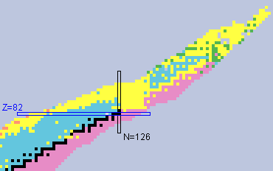
Regions of interests in MNT reactions
3
1
Study of neutron deficient isotopes in the region 82 < Z < 100
1
2
Study of isotopes in the region N = 126, r – process in astrophysical nucleosynthesis
3
Study of neutron rich isotopes in the region Z > 100
2

Slide 7
Experimental methods of MNT reactions studies
● Radiochemical methods
Radiochemical methods (offline) 100% collection efficiency, nearly
background-free High-yield chemical separation of individual elements (40-90 %).
Most sensitive for isotopes with half-lives between about one hour and a few months that
undergo alpha decay or spontaneous fission (SF).
Target thickness: ²³⁸U, ²⁴⁸Cm (1 to 3 mg/cm² ), No kinematics.
cross section limit: down to nanobarn. region 3 – region Z > 100
● Gas cell system + ISOL + detectors (KEK, Japan), IGISOL (JYFL, Finland)
0.01 to 1 % detection efficiency for transfer products. Most sensitive for isotopes with half-lives from
about milliseconds.
Target thickness: ~ 10 mg/cm², No kinematics. 2 – region N ~ 126
Beam intensity (²³⁸U) – 50 pnA, yield > 100 counts / day, mass measurements (200 keV).
● Separation of MNT products with existing kinematic separators
0.1 to 1 % detection efficiency for transfer products (Zero angle). Most sensitive for isotopes with
half-lives from about microseconds to few hours.
Target thickness: 300 to 500 μg/cm^{2,} MNT products velocity determination.
Cross section limit: down to nanobarn within 5 hours of irradiation with beam intensity
of 5×10¹² proj/sec. 1 – region 82 < Z < 100; 3 – region Z > 100
● Future development of dedicated experimental set ups. MNT products velocity
and angular distribution determination. 3 – region Z > 100

Slide 8
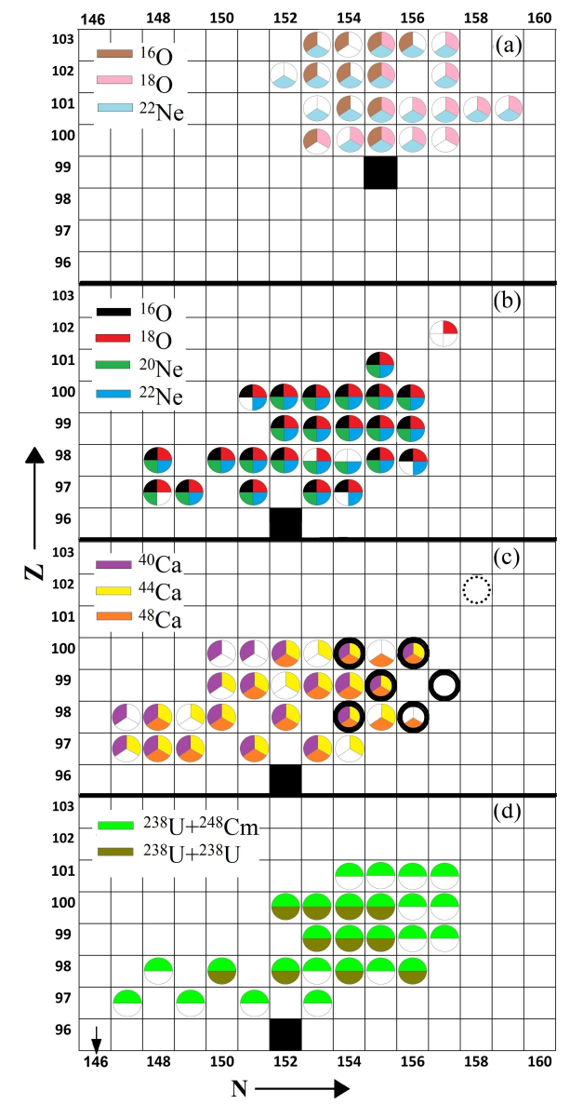
First studies of transuranium nuclei in MNT reactions
O, Ne + Es
▪ years 1975 – 1995, LBL and GSI
▪ radiochemical methods for isotope
separation and identification
▪ sensitivity:
σ ~ 20 nb; T_{1/2} > 1 min.
▪ observation:
- MNT products with Z ≤ 103
- no new nuclides observed
O, Ne + Cm
Ca + Cm
U + Cm

Slide 9
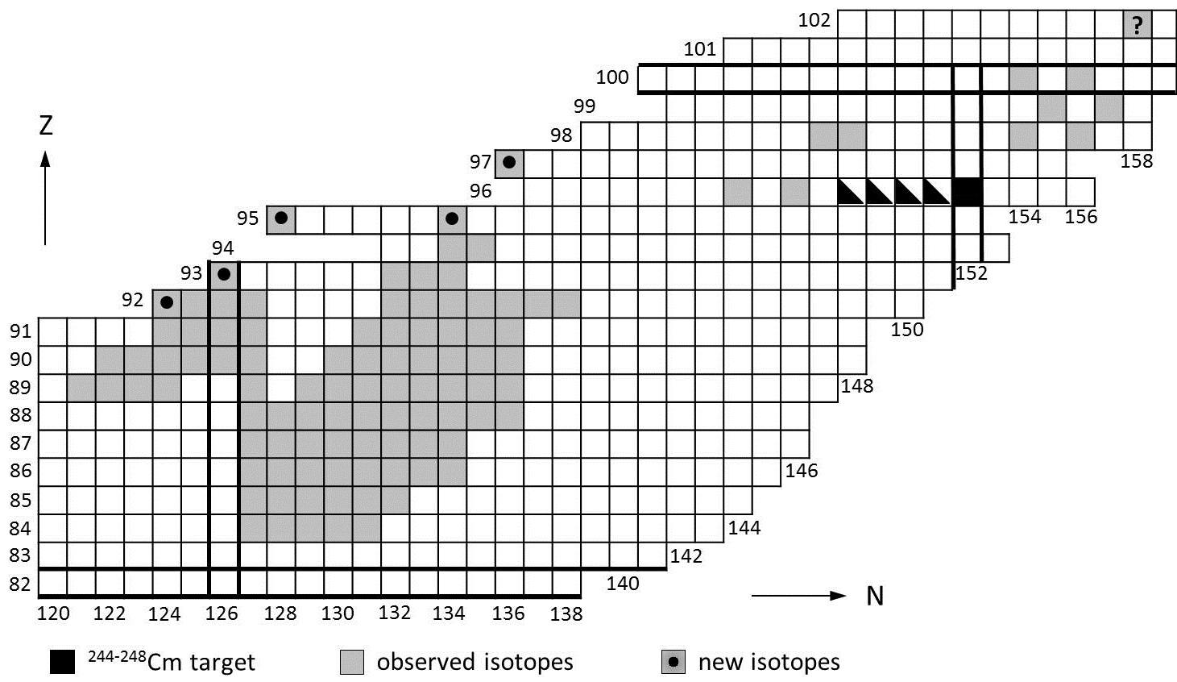
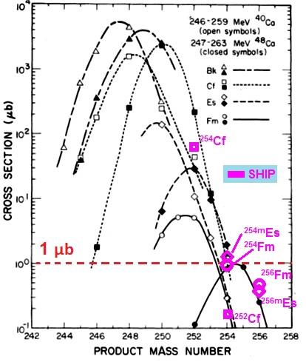
Population of „above-target“ nuclei @ SHIP
3 – region Z > 100
²⁶⁰No
²⁶⁰No would be the so far heaviest transfer product observed with
²⁴⁸Cm targets: Cm (Z=96) + 6p; previously only seen with Es (Z=99)

Slide 10
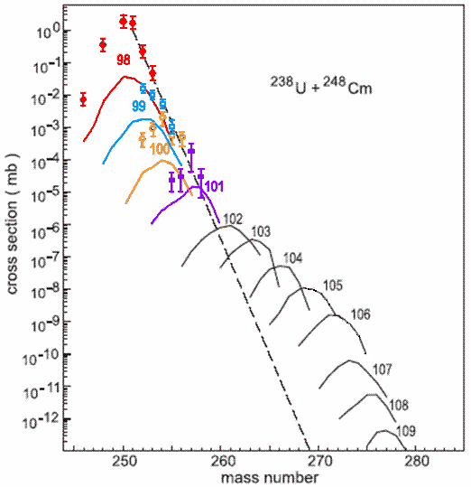
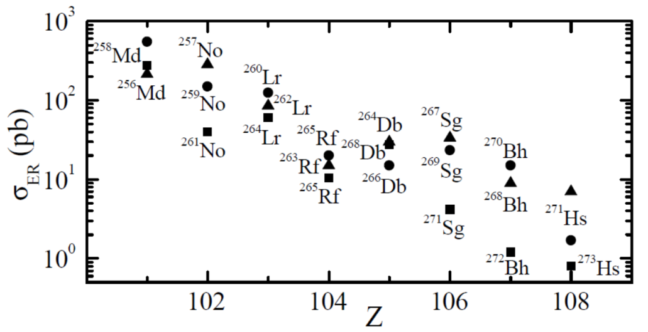
MNT products beyond Z = 102 ?
Theoretical predictions
U + Cm
⁴⁸Ca + ²⁴⁸Cm
²³⁸U + ²⁴⁸Cm
1 nb
1 nb
σ < 1 nb
▪ Dinuclear system model
(G. Adamian, N. Antonenko et al.)
▪ diabatic internuclear potentials
▪ adiabatic internuclear potentials
(V. Zagrebaev, W. Greiner et al.)
→ New n-rich superheavy isotopes up to Z ~ 108 appear feasible

Slide 11
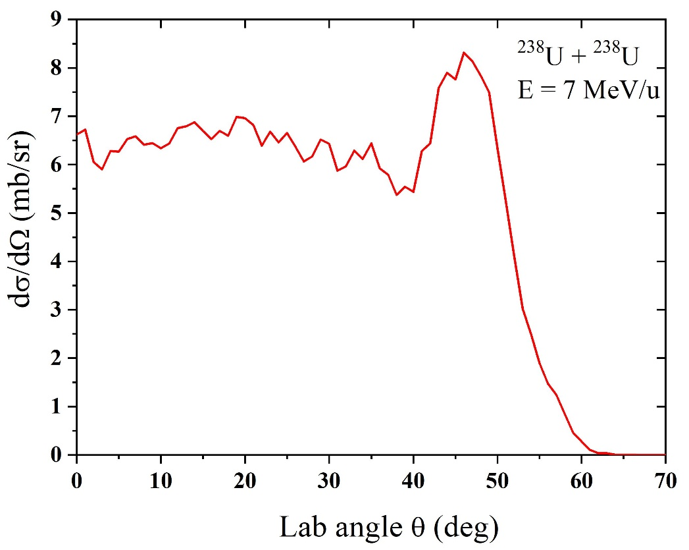
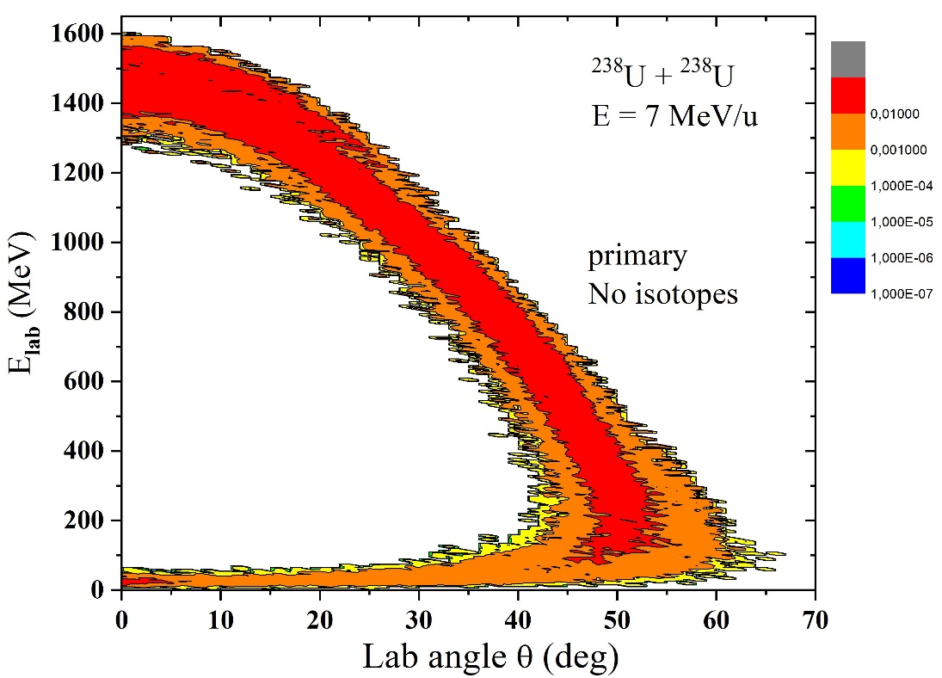
Angular & Energy distributions of ²⁶⁸No from ²³⁸U + ²³⁸U reaction
A. Karpov & V. Saiko

Slide 12
Charged particle in electric and magnetic fields
Magnetic rigidity:
Electric rigidity:
Resolving power:
Deflection angles in electric field:
Universal features:
- Both electric and dipole fields are needed
- Beam is dumped inside the target chamber.
Mass resolving power about 350 FWHM can be reached
(with 2 mm beam spot size and use of ToF system)
- Possibility for positioning at different angles (rotary platform)

Slide 13
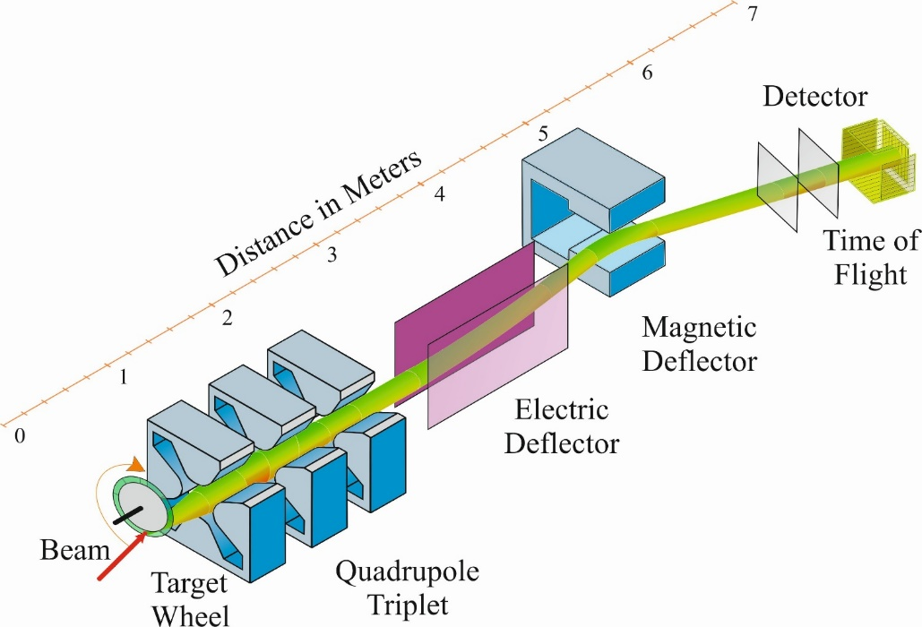
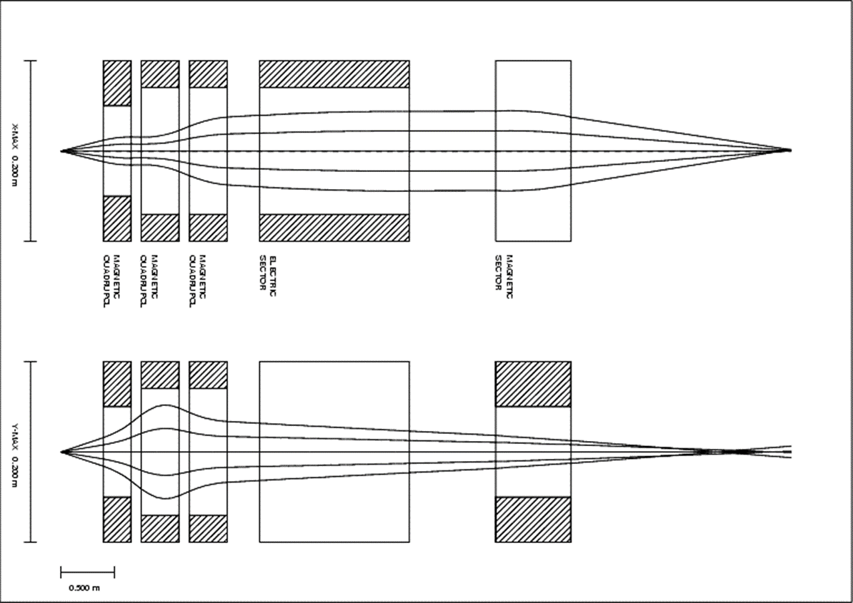
Possible conceptual design of the separator

Slide 14
Activity: SCIF-D facility.
System for Correlated Investigation of Fragments in Dubna (SCIF - D)
Study of mechanisms of fusion-fission and
incomplete fusion reactions.
SСIF-D consists of:
CORSET spectrometer - measuring mass-energy and angular distributions of reaction fragments;
Bragg chambers - measuring of charge distributions of reaction fragments;
Magnetic Spectrometer providing precise measurements of the charge of fragments with masses up to 200 a.m.u.;
Assembly of DSSD - measurement of the quasi-elastic scattering cross sections;
Gamma-spectrometer - measurement of multiplicity and energy of γ-quanta;
Recoil sepatator with Electrostatic deflectors + α, f-f, n, γ- spectrometer - measuring fragments or evaporation residues as well as γ-quanta and neutrons.

Slide 15
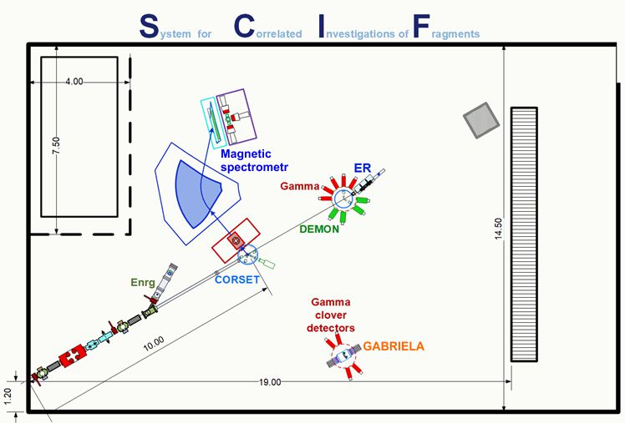
Conceptual design of SCIF-D

Slide 16
Main fields of research:
▪Synthesis and study of the decay properties of the isotopes of heavy and superheavy nuclei
▪Spectroscopy of the radioactive decay of heavy and superheavy nuclei
▪ Multi-nucleon transfer reactions
▪ Fusion-fission, quasi-fission, ternary fission
Expenses for 2024-2028
Subproject I+II
U400R modernization, new building: 20.0 М$
Subproject III
Experimental set ups of U400R: 6.7 М$

Slide 17
The project “Development of the experimental setups for the study of chemical and physical properties of superheavy elements”
  Subsubproject I. Pre – Separator for study of chemical properties of short-lived SH nuclides based on a superconducting solenoid (GASSOL);
  Subsubproject II. Multi-Reflection Time-Of-Flight
  (MR-TOF) spectrometer for precise measurement of masses of heavy and superheavy nuclides.
New experimental setups at the working DC280 cyclotron
(SHE factory). At SHE factory we have 2 working experimental
set ups: DGFRS2 and GRAND

Slide 18
  Subsubproject I. Pre – Separator for study of chemical properties of short-lived SH nuclides based on a superconducting solenoid (GASSOL);
  DC280 (SHE factory)

Slide 19

Standing target
²⁸⁷114
0.51 s
10.02 MeV
²⁸³112
4.0 s
9.54 MeV
Disadvantages: limit on the beam intensity of 0.5 pμA,
the presence of aerosols in the target chamber
²⁷⁹Ds
0.18 s
SF

Slide 20
He/Ar
Gas stopper
Window
3µm Mylar
Disadvantages: quite a large volume of “recoil stop" chamber. Separator transmission ~ 35%.

Slide 21
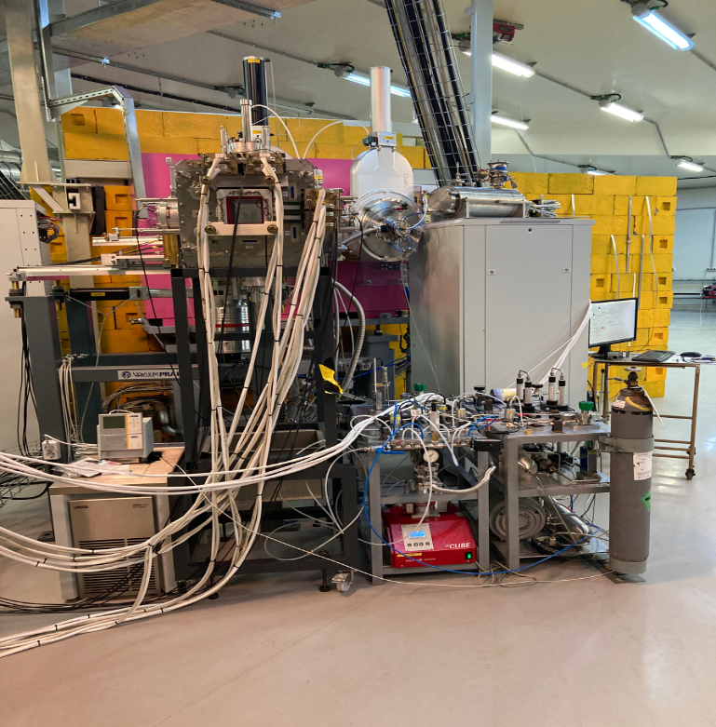
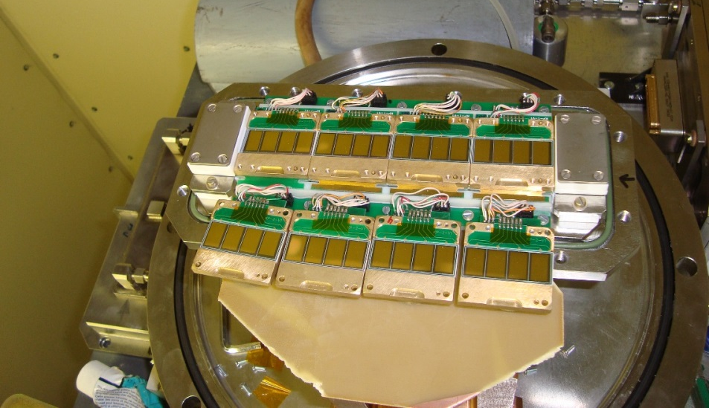
Chemistry of Cn & Fl: first runs
at the GRAND separator (SHE Factory, 2022)
Test measurements
⁴⁸Ca + ¹⁷⁴Yb → ²²²Th*
⁴⁸Ca + ²⁰⁶Pb → ²⁵⁴No*
First run (Nov.-Dec. 2022)
⁴⁸Ca + ²⁴²Pu → Fl*
ER’s distribution at the focal
plane of GRAND separator
Notes:
На Фабрике сверхтяжелых элементов продолжается подготовка к проведению первого эксперимента по изучению химических свойств 114 (флеровия) и 112 (коперниция) элементов в реакции калиций-48 + плутоний-242. Успешно прошли первые пуско-наладочные испытания сепаратора GRAND на пучке ионов кальция-48. Удалось получить достаточно компактное изображение ядер отдачи в фокальной плоскости детекторной камеры: 5 x 5.5 см, что позволяет перейти к следующим этапам подготовки эксперимента. Начала химического эксперимента намечено на конец весны – начало лета этого года.
At the Superheavy Element Factory, preparations are underway for the first experiment to study the chemical properties of elements 114 (flerovium) and 112 (copernicium) in the reaction of calcium-48 + plutonium-242. The first commissioning tests of the GRAND separator on a beam of calcium ions-48 have successfully passed. It was possible to obtain a fairly compact image of recoil nuclei in the focal plane of the detector chamber: 5 x 5.5 cm, which allows us to proceed to the next stages of the experiment preparation. The beginning of the chemical experiment is scheduled for late spring - early summer of this year.

Slide 22
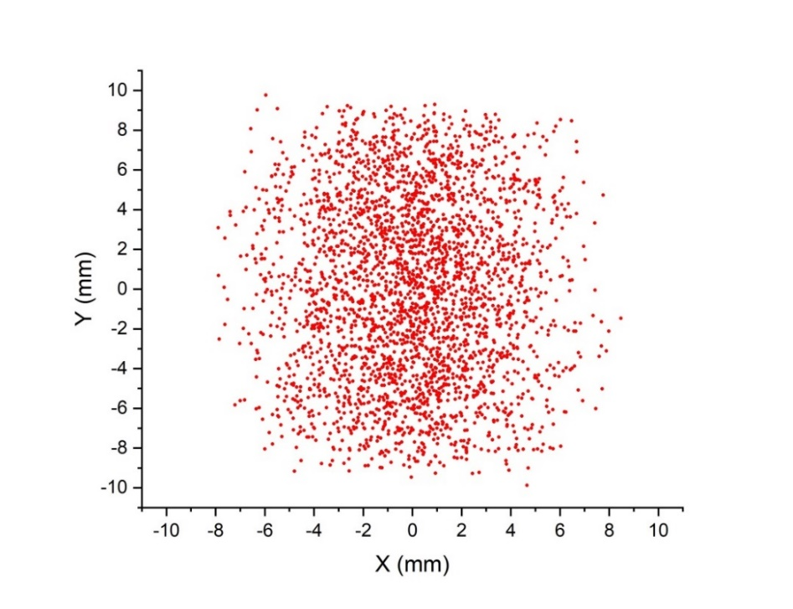
²⁸⁷Fl (0.34 s), ²⁸⁸Mc (0.19 s), ²⁹³Lv (0.06 s), ²⁹⁴Ts (0.05 s), ²⁹⁴Og (0.07 s)
Recoil chamber volume
V_{cam} = 58 cm³ ( D = 60 mm)
He/Ar gas flow 3 l/min
Volume refresh time: t ~ 1.0 s
Decay loses at Т_{1/2} = 0.48 s
ε₂ = 0.24
Total efficiency
ε_{tot} = ε₁ˑε₂ˑε₃∙ε₄ = 0.05
Target ²⁴²Pu___________0.56 mg/cm²
Beam ⁴⁸Ca_______________ 3 pµA
Cross section ²⁴²Pu(⁴⁸Ca,3n)²⁸⁷Fl__4 pb
N = 0.4 /day at beam intensity 3 pµA
Decay loses at Т_{1/2} = 0.1 s ε₂ = 0.01. Volume reduction is urgently needed
V_{cam} = 8 cm³ ( D = 12 mm)
→
Volume refresh time: t ~ 0.15 s → ε₂ = 0.37
Decay loses at Т_{1/2} = 0.34 s
ε₂ = 0.135
Total efficiency
ε_{tot} = ε₁ˑε₂ˑε₃∙ε₄ = 0.027
N = 0.22 /day at beam intensity 3 pµA

Slide 23
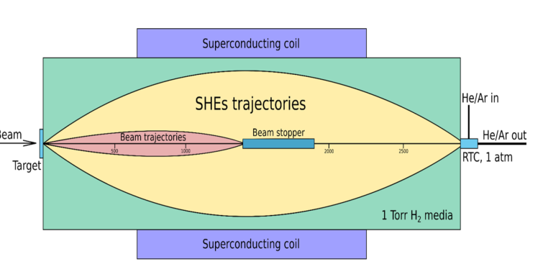
Chemistry of SHE: GASSOL
Superconducting gas-filled solenoid
The task is:
To ensure the delivery of synthesized SH ions in a time comparable with their lifetimes;
To ensure a high level of separation.
Fast delivery of ions requires as little gas in a stopping cell as possible. Reaction products must be focused to the minimum size.

Slide 24
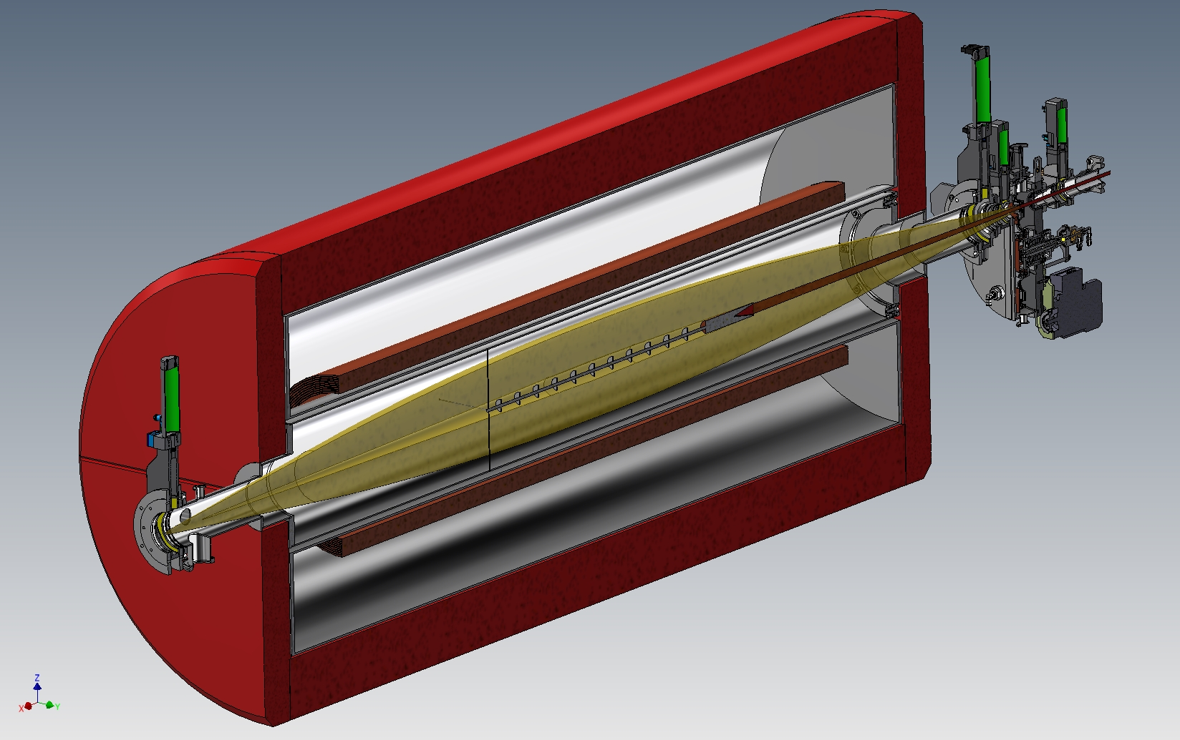
The concept of the magnetic separator GASSOL.
rotating
target
GASSOL
beam
axial screens
radial
screens
EVRs
beam
axial screens
SC-coils
to He-stop
chamber
beam stopper
3 kW

Slide 25
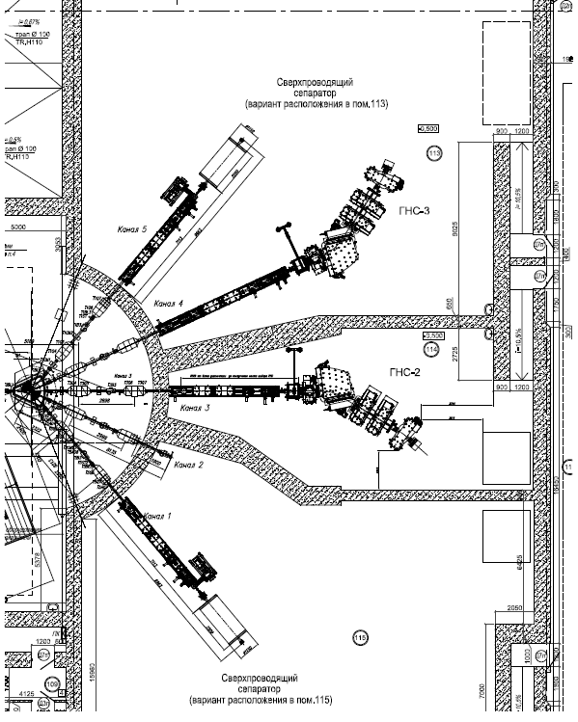
Placement of GASSOL separator at the cave 115 DC280.
GRAND
DGFRS2
GASSOL

Slide 26
  Subsubproject II. Multi-Reflection Time-Of-Flight (MR-TOF) spectrometer for precise measurement of masses of heavy and superheavy nuclides.
  DC280 (SHE factory)

Slide 27
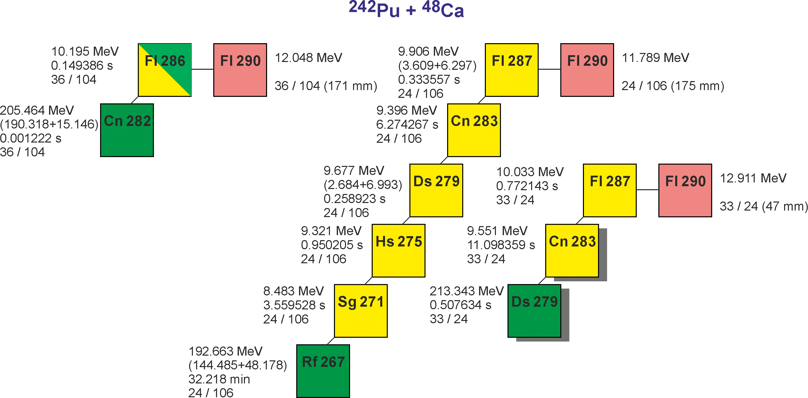
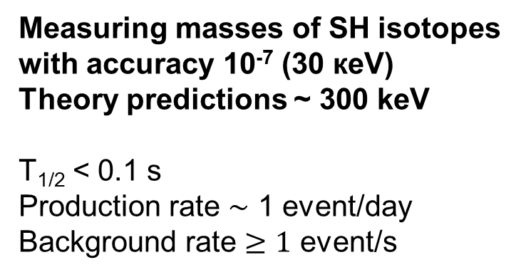
Precise mass measurements of SH isotopes
Measuring masses of SH isotopes
with accuracy 10⁻⁷ (30 кeV)
Theory predictions ~ 300 keV
T_{1/2} < 0.1 s
Production rate $\sim$ 1 event/day
Background rate $≥1$ event/s
Requirements for a facility:
High rate of analysis;
Low losses;
High degree of purification;
Accuracy 10⁻⁷ (30 кeV);
Mass range 266 – 300.
The mass measurement accuracy depends on
Mass resolution R_{m}
Statistics N (number of events)
∆m/m = 10⁻⁷, N = 10 => R_{m} = 1 000 000
The only type of spectrometers gives an opportunity to reach
R_{m} > 1 000 000 at the analysis time < 0.1 сек:
MR-TOF Mass-Analyser

Slide 28
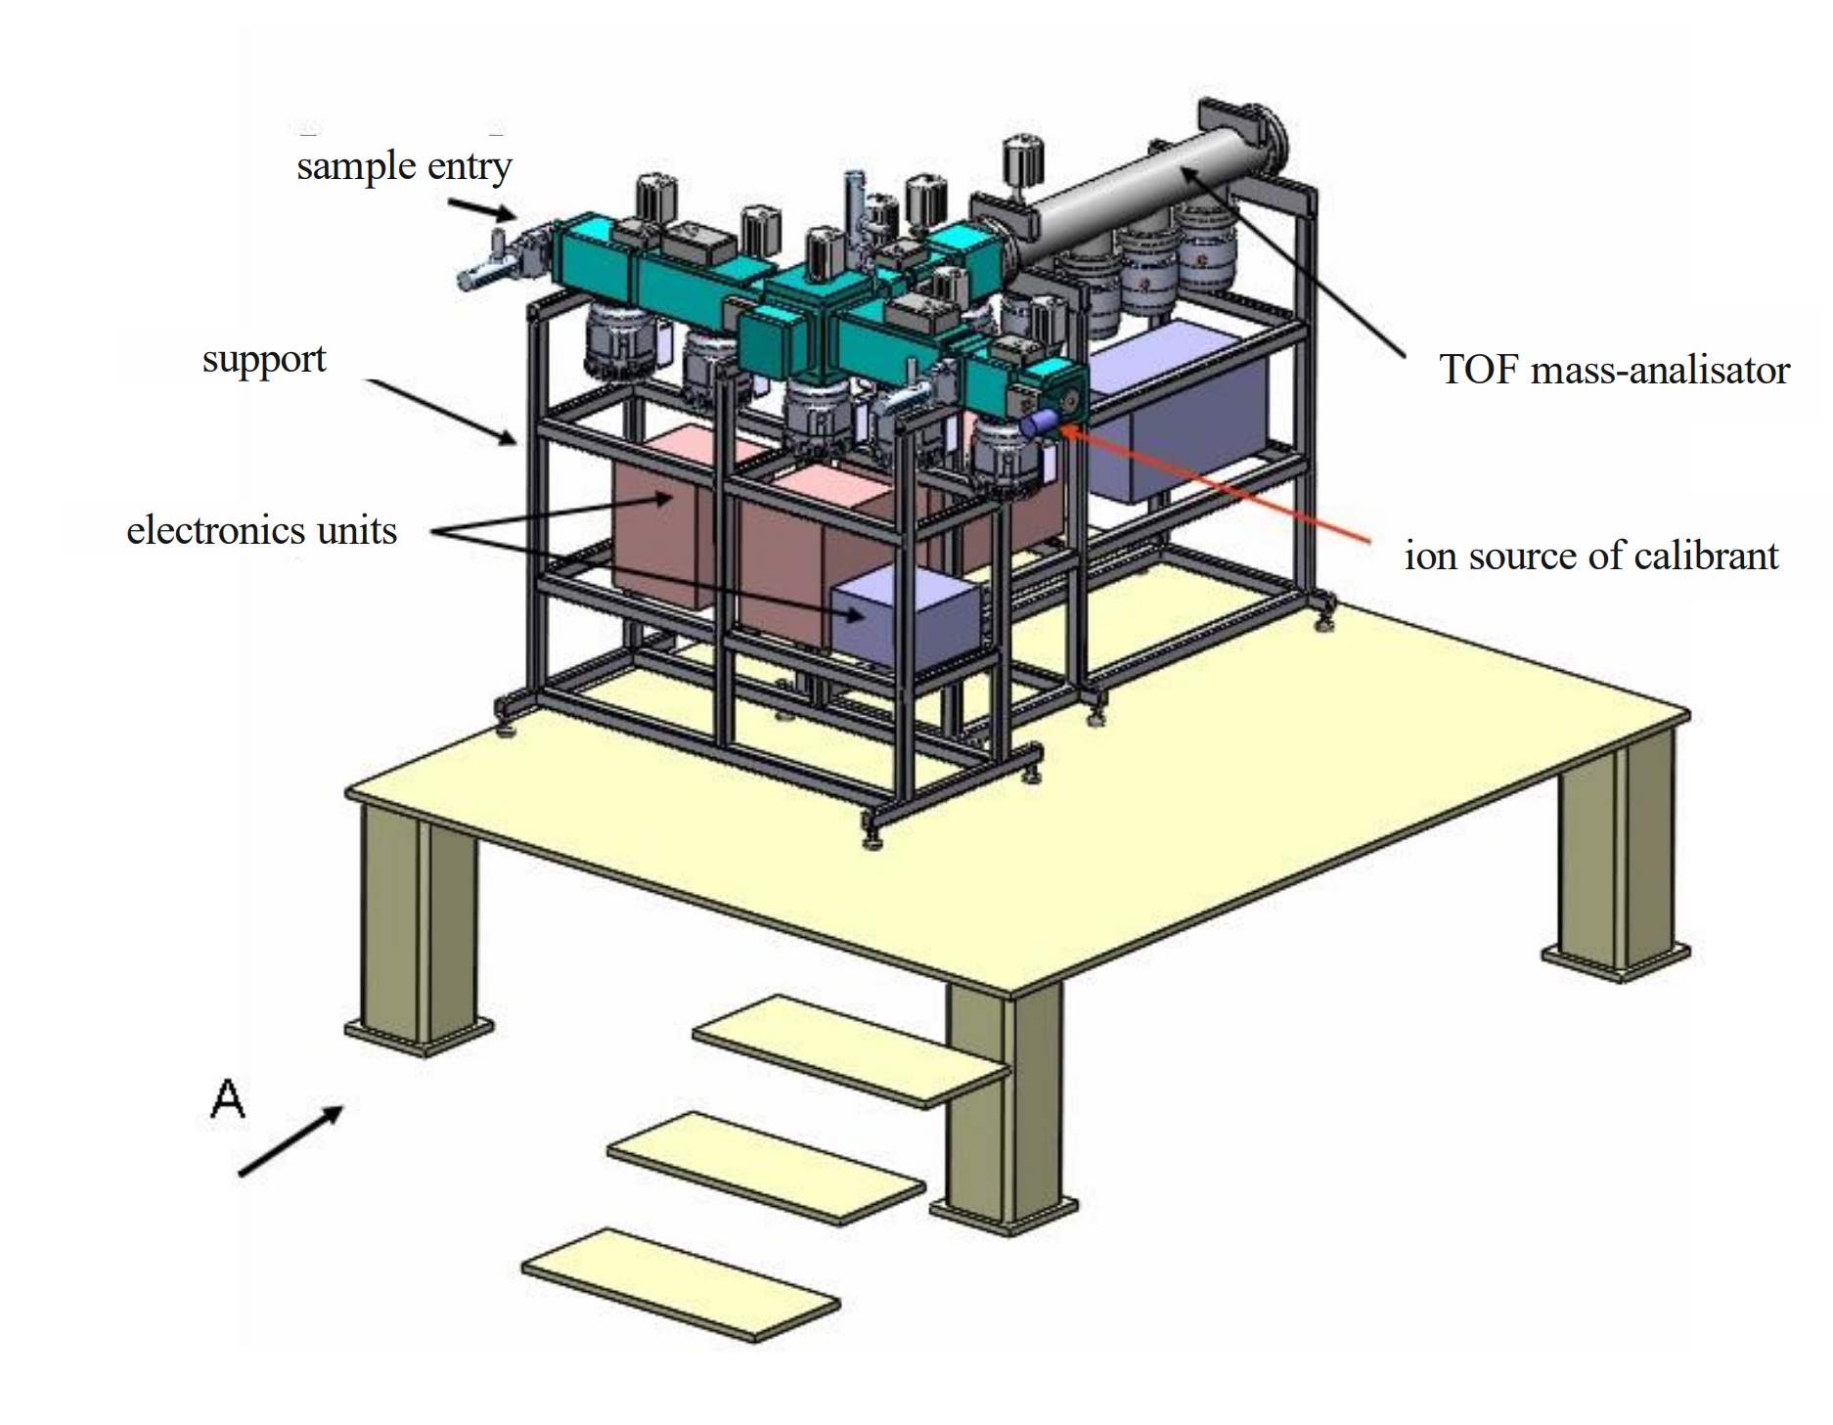
Conceptual design of MR ToF spectrometer
The division of the mass spectrometer into its main structural units. 1 - node of the multi-turn time-of-flight mass analyzer; 2 – node of quadrupole mass filters; 3 - node of the channel for introducing sample ions; 4 - node of the channel for introducing calibrant ions; 5 - node of detectors.

Slide 29
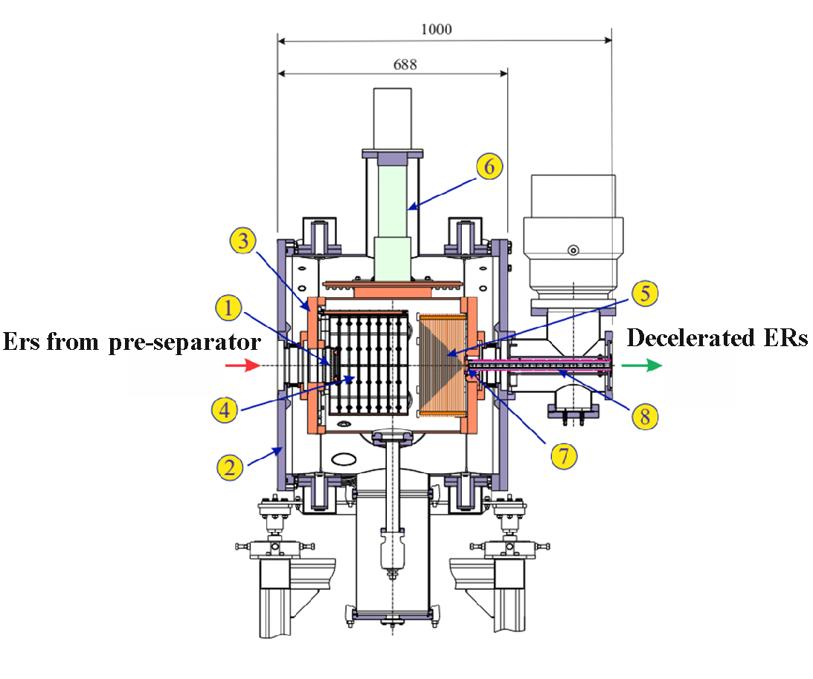
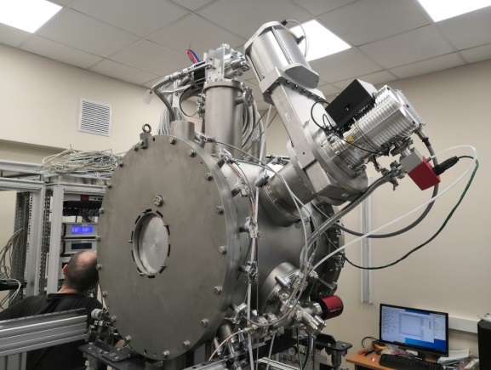
General view of cryogenic gas catcher: 1 - entrance window; 2 - external warm vacuum shell; 3 - internal cold chamber; 4 - cylindrical electrodes of constant electric field; 5 - radio-frequency multielectrode cone; 6 - head of cryo-refrigerator; 7 - supersonic nozzle; 8 - transport radio frequency quadrupole.

Slide 30
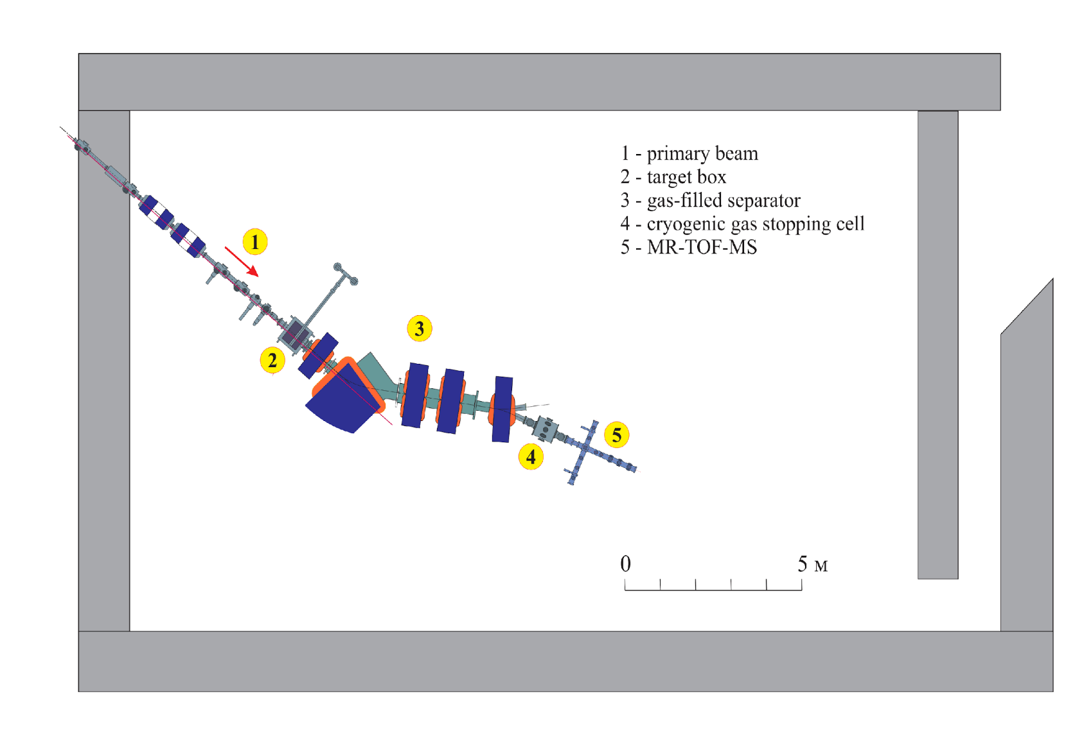
The scheme of the installation for studying the properties of the isotopes of heavy and super heavy elements: 1 - heavy ion beam, 2 - target box, 3 – gas filled separator (pre-separator), 4 - cryogenic gas ion trap, 5 - MR-ToF spectrometer.

Slide 31
Main fields of research:
▪Synthesis and study of the decay properties of the isotopes of heavy and superheavy nuclei
▪Spectroscopy of the radioactive decay of heavy and superheavy nuclei
▪ Measurement of the masses of superheavy nuclei
▪ Study of the chemical properties of SHE
Total estimated cost of the project 2024 – 2028.
▪ International cooperation: 100 k$
▪ Experimental set ups: 10.0 М$
▪ Software purchasing: 100 k$
▪ Human resources: ~ 20 FTE

Slide 32
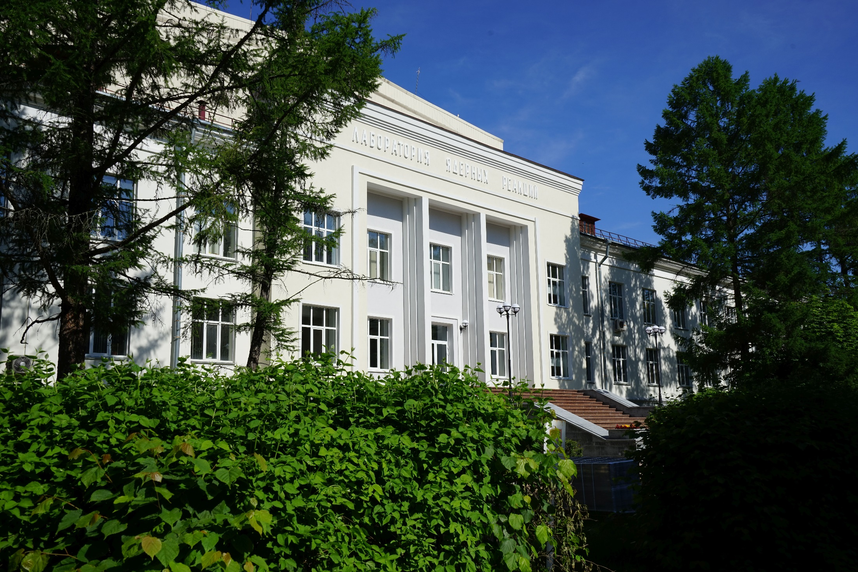
Thank you for your attention

