Slide 1
Report on the theme “Investigations of Neutron Nuclear Interactions and Properties of the Neutron” and on the projects “TANGRA”, “ENGRIN” and “Modernization of EG-5”.
Proposals for extending the projects “TANGRA” and “Modernization of EG-5”
Theme leader: Lychagin E.V.
Deputies: Kopatch Y.N., Sedyshev P.V.
Projects in 2023:
1. TANGRA. Leader Kopatch Y.N. (2014-2023)
2. ENGRIN. Leader Zeinalov Sh. S. (2022-2023)
3. Modernization of EG-5. Leader Doroshkevich A.S. (2022-2023)
Speaker: Yuri Kopatch

Slide 2
The theme 1128 “Investigations of Neutron Nuclear Interactions and Properties of the Neutron” was started in 2017 and was extended in 2022 for one year.
The project “TANGRA” was started in 2014 and was extended in 2022 for one year.
The projects “ENGRIN” and “Modernization of EG-5” were started in 2022, also for one year.
The report will be given for the period of one year.
It was decided to close the theme and open a new one.
The project ENGRIN will be a part of the new project within the new theme.
(see next report by V.N.Shvetsov)
The projects TANGRA and “Modernization of EG-5” will be extended within the new theme for 5 and 3 years, respectively.

Slide 3

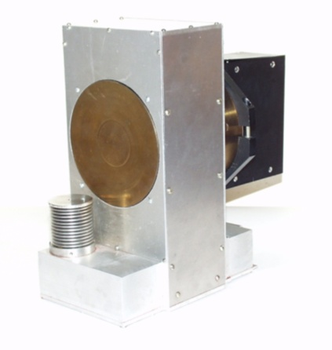



Report on the Project TANGRA
(TAgged Neutrons & Gamma-RAys)
«Design and development of the tagged neutron method for determination of the elemental structure of materials and nuclear reaction studies» for 2022-2023
Project leader: Yu.N. Kopatch
Deuteron ~100 кeV
D + T → ⁴He (3.5МeV) + n (14.1МeV)
α-particle 3,5 МeV
Triton
Neutron 14.1 МeV
Neutron generator ING-27

Slide 4
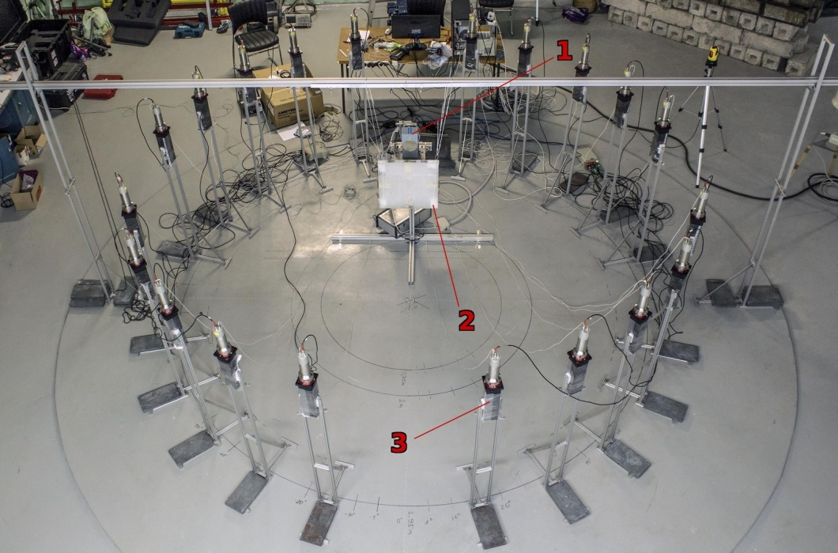
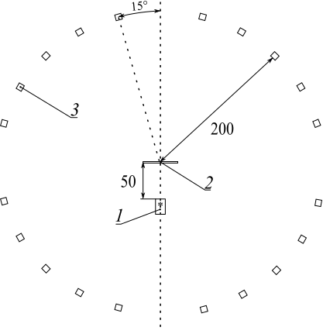
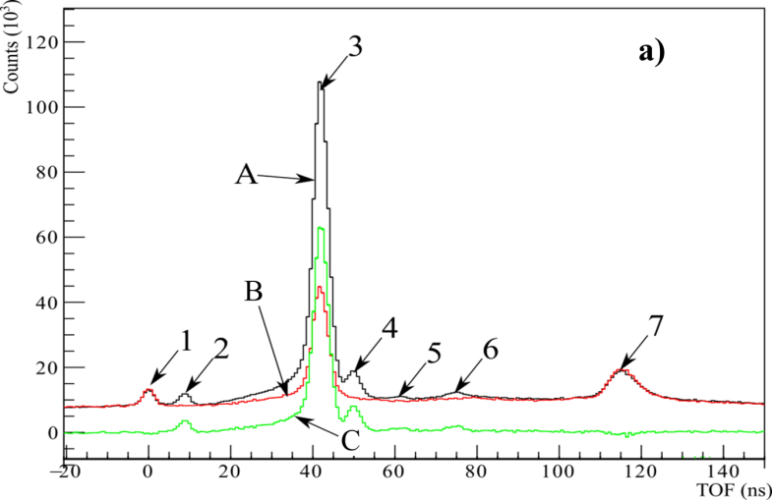
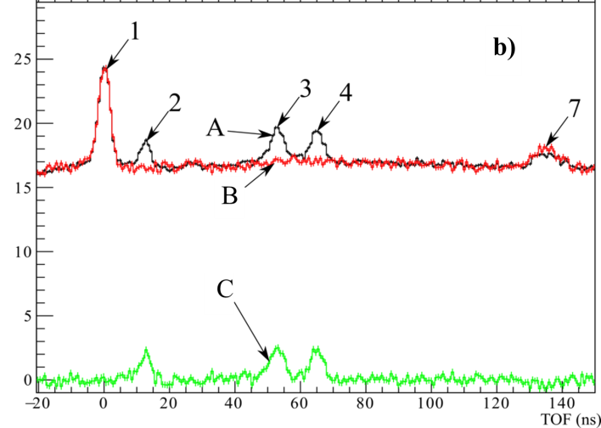
Project TANGRA: main results
Measurement of the angular distributions of scattered neutrons on carbon
Scheme of the TANGRA setup for measuring
the angular distribution of neutrons:
1 – ING-27 neutron generator;
2 – carbon sample;
3 – neutron detector.
Distances are in cm.
Time-of-flight (TOF) spectra for
θ = 36º - a), and θ = 170º - b):
1 – peak of γ-rays from ING-27;
2 – peak of γ-rays from ¹²C-sample;
3 – peak from neutrons elastically scattered on the ¹²C-sample ;
4, 5, 6 – peaks from neutrons scattered
from the 1st, 2nd and3rd excited states of ¹²C;
7 – peak of backscattered radiation
A – TOF with ¹²C-sample,
B – TOF without ¹²C-sample,
C – The net TOF spectra.
1. N.Yu. Milovanov, I.D. Dashkov, N.A. Fedorov et al., UZFF, 4 (2022) 2240301
2. I.D. Dashkov, N. A. Fedorov, D.N. Grozdanov et al., Izv . RAS, ser. Phys. 86 (2022) 1081

Slide 5
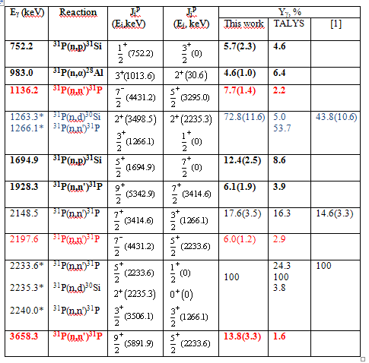
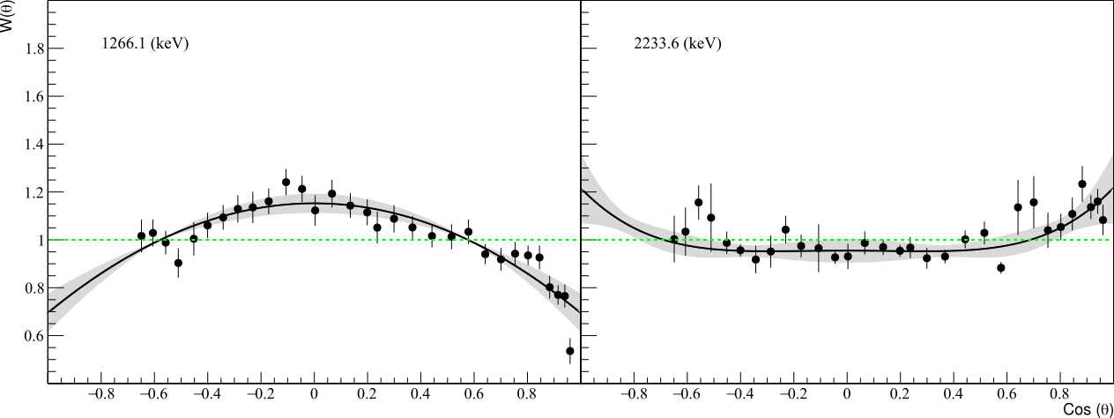
Project TANGRA: main results
Determination of the yields and angular distributions of the of γ-quanta from the interaction of 14.1 MeV neutrons with
Oxygen, Phosphorus, and Sulphur nuclei
1266.1 keV
³¹P(n, n'γ)
^{W(θ)}
2233.6.1 keV
³¹P(n, n'γ)
^{W(θ)}
Parameters of the measured γ-transitions for phosphorus.
^{cos θ}
D.N. Grozdanov, N.A. Fedorov, I.D. Dashkov, et al., Measurement of yields and angular distributions of
γ-quanta from the interaction of 14.1 MeV neutrons with oxygen, phosphorus and sulfur nuclei.

Slide 6
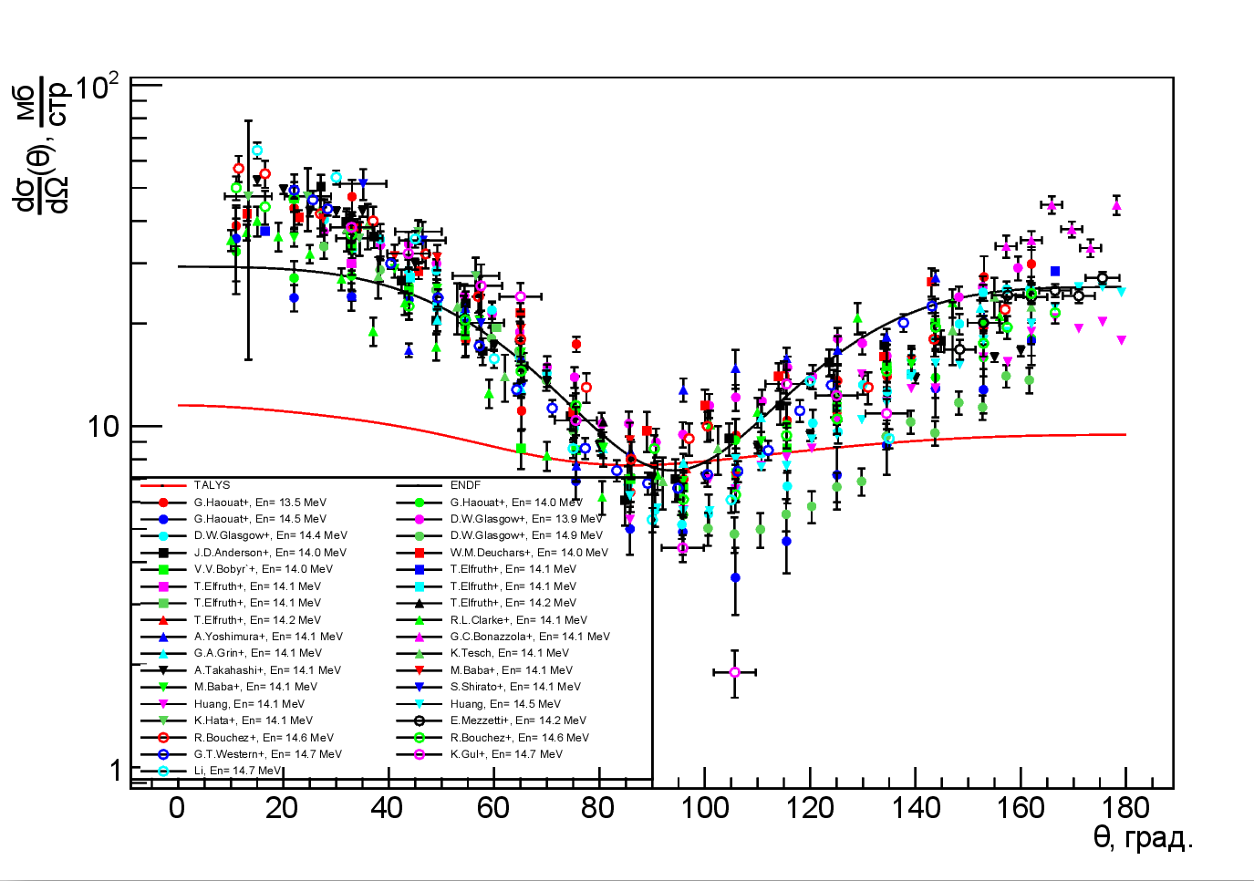
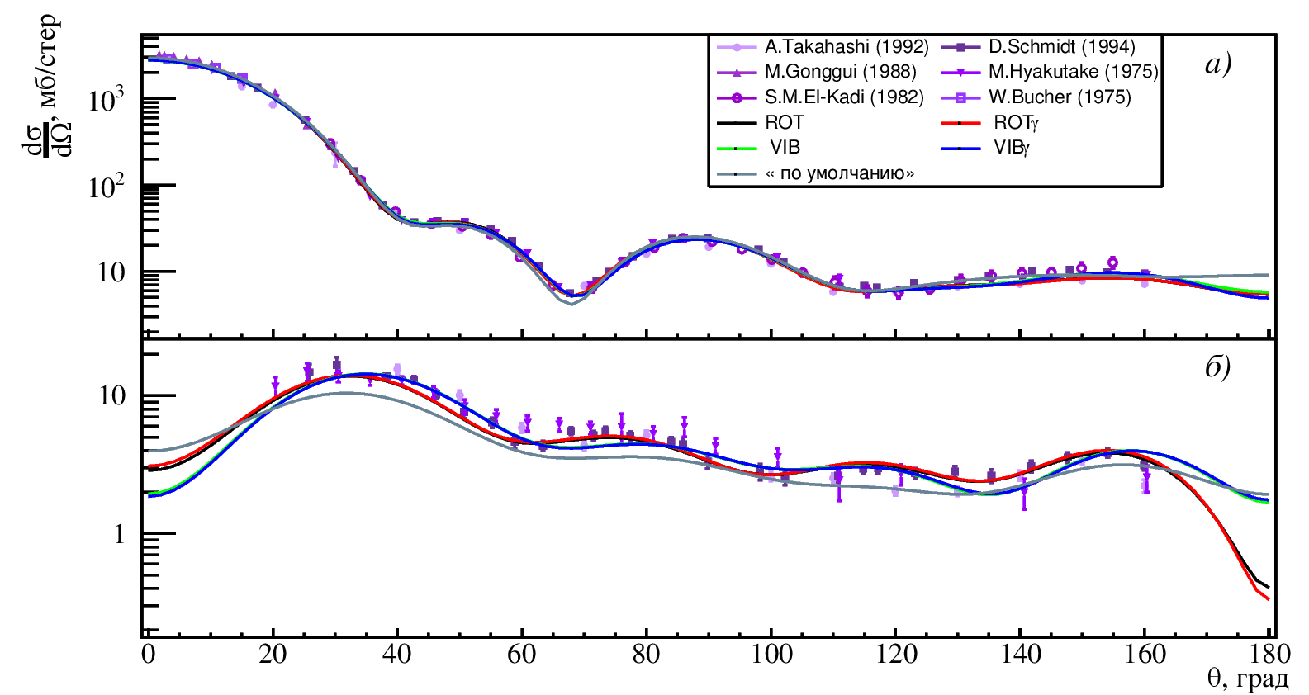
Development of the TalysLib library to simplify access to experimental and calculated data, as well as to optimize the parameters of the optical potential.
Project TANGRA: main results
A set of experimental data on inelastic scattering of neutrons by ¹²C with energies in the range of 13-15 MeV retrieved using TalysLib. The results of calculations in TALYS and the evaluated data from ENDF/B-VIII.0 are shown by red and black lines.
An example of estimating the parameters of optical expansion for elastic a) and inelastic scattering of 14-MeV neutrons on ⁵⁶Fe nuclei with excitation of its first state b) obtained using TalysLib. The curves of different colors suggest the use of different approaches to describing the nature of the excited state.

Slide 7
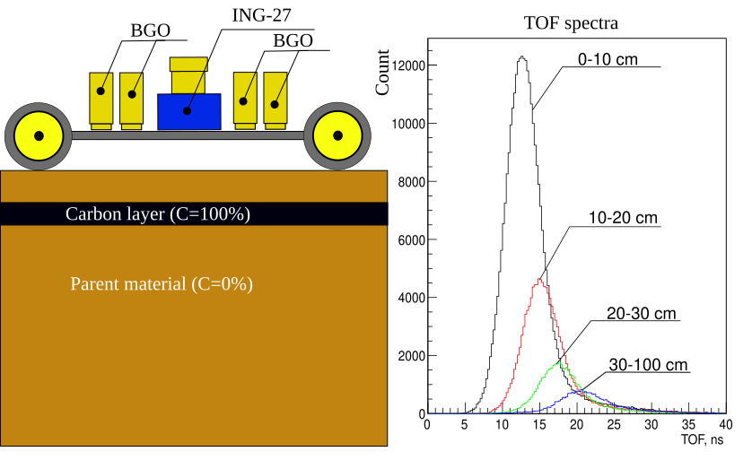
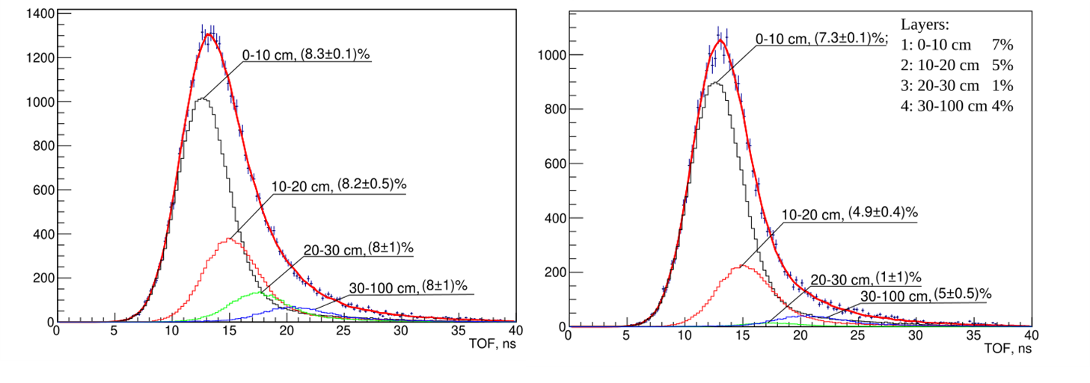
Modeling of an experimental setup for determining the carbon content in soil using the TNM.
Project TANGRA: main results
General view of the setup model (left).
Time spectrum components corresponding to different depths (right).
Decomposition of the time spectrum into components formed by reactions at different depths for cases with constant (left) and variable (right) carbon concentrations.

Slide 8
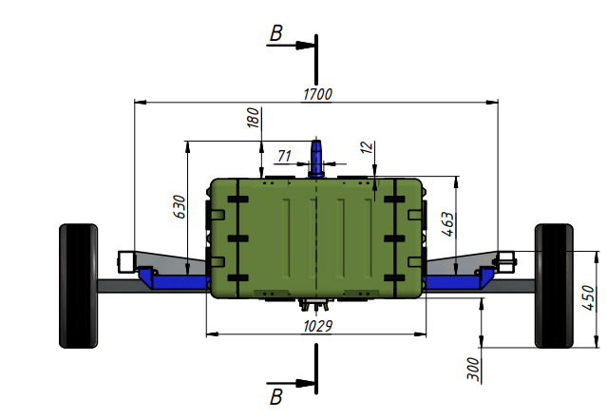
Project TANGRA: main results
Creation of a pilot setup for determining the carbon content in soil using Tagged Neutron Mthod
(together with LLC “Diamant”).
Planned in 2023-2024
№ | Item | Contributor
1 | Neutron generator ING-27 9 px | Diamant LLC
2 | DAQ | Diamant LLC
3 | Controlling PC | Diamant LLC
4 | BGO γ-detectors | JINR
5 | HV power supply for γ-detectors | JINR
6 | Power supply for ING-27 and complementary electronics. | Diamant LLC
8 | Power cable | Diamant LLC
10 | Setup case | Diamant LLC
11 | Documentation | Diamant LLC
12 | HV cables | JINR
13 | Signal cables | JINR
14 | GPS system | JINR
15 | Shielding | JINR
16 | Power generator | Diamant LLC
17 | Cart
18 | Materials | JINR
Layout of the field setup for soil elemental analysis (creation is planned in 2023-2024).

Slide 9
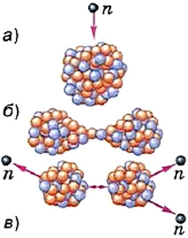
Report on the Project ENGRIN
«Emission of Neutrons and Gamma-quanta in Reactions Induced by Neutrons (ENGRIN)» for 2022-2023
Project leader: Zeynalov Sh. S.
The main goal of the project is to verify the current knowledge of prompt fission neutron (PFN) multiplicity fluctuations and to study correlations of PFN emission with fission fragment properties, in particular, in resonance neutron induced fission.

Slide 10
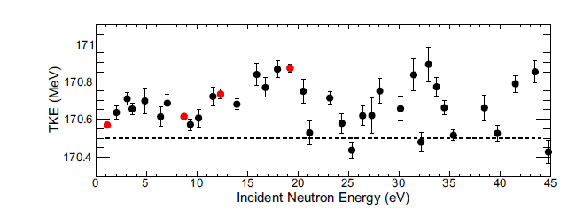
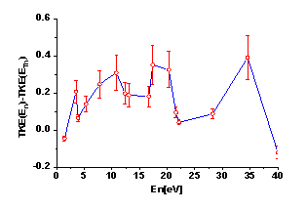
Project ENGRIN: main results
In the current year, studies were carried out on variations in the average number of prompt fission neutrons (PFN) in the resonance region of neutrons. In experiments carried out on IREN channel 2 using a double ionization chamber with Frisch grids in combination with a fast neutron detector, new data were obtained.
Variations of the total kinetic energy (TKE) in the ²³⁵U(n_{res},f) reaction as a function of energy of resonance neutrons. Left: data from GELINA source; Right: data from IREN.
Dependences of the average number of PFN in the reaction ²³⁵U(n,f) in the thermal energy range of incoming neutrons. These data were included in the EXFOR database and make it possible to increase the resolution in the spectrometry of fission fragments using an ionization chamber.

Slide 11
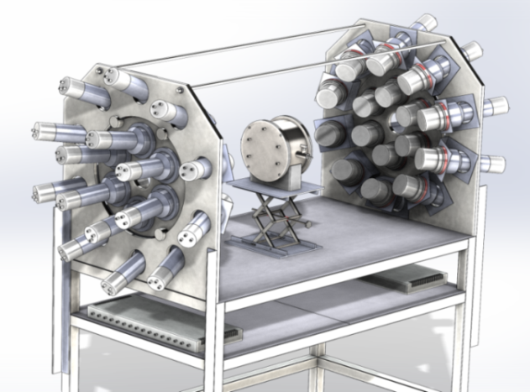
Project ENGRIN: main results
A new facility for studying the properties of PFN is installed on the second channel of IREN and is ready to measure the properties of fission with PFN emission on a beam of resonance neutrons.
The setup consists of 32 neutron scintillation detectors with a BC501 liquid scintillator and a double ionization chamber for measuring fission fragments.
Starting from 2024 this installation will be a part of the project “Investigations of Neutron Nuclear Interactions and Properties of the Neutron”
(see report of V.N.Shvetsov)

Slide 12
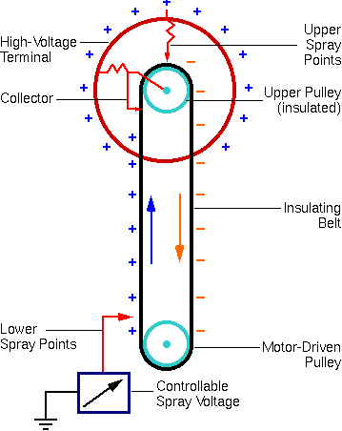
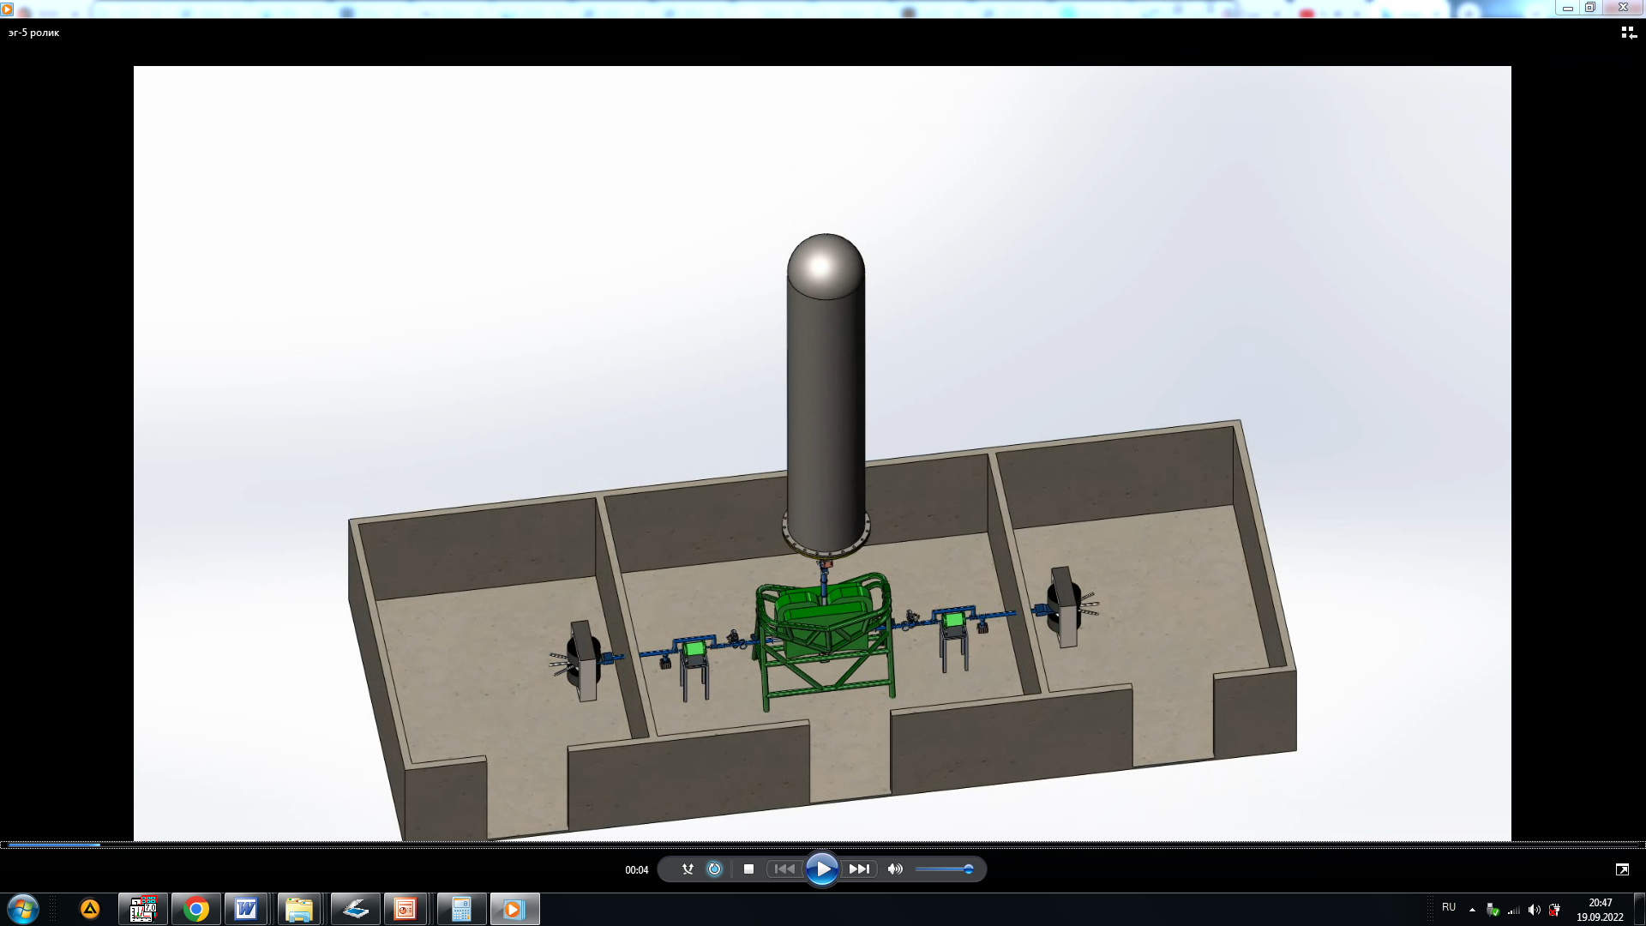
Report on the Project
“Modernization of the EG-5 accelerator and its experimental infrastructure” for 2022-2023
Project leader: Doroshkevich A.A.
6
3
5
2
4
1
1
Main goal of the project: restoration of technical parameters of the accelerator
Before modernization | After modernization
Terminal voltage - 2,5 MV Beam current – ~ 1 mkA Ion Energy – 1 - 2,5 MeV | Terminal voltage - 4,1 MV Beam current – 50-100mkA Ion Energy – 0,8 - 4,1 MeV

Slide 13

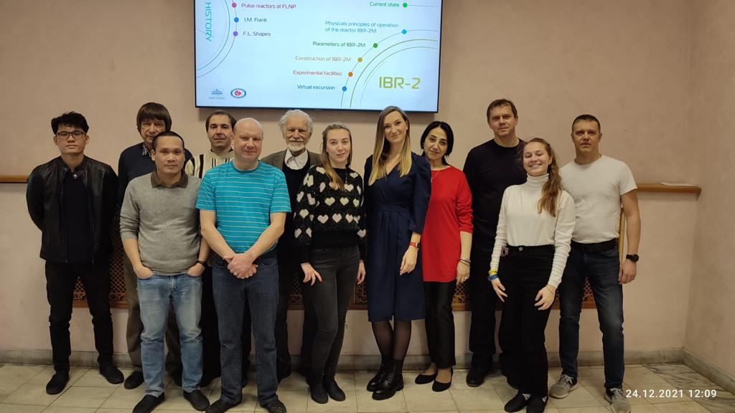
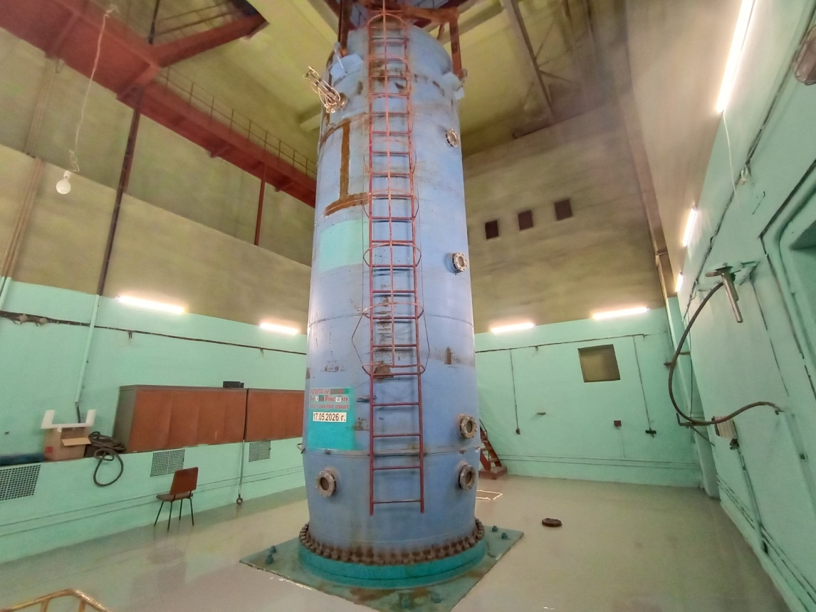
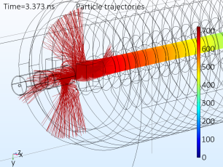
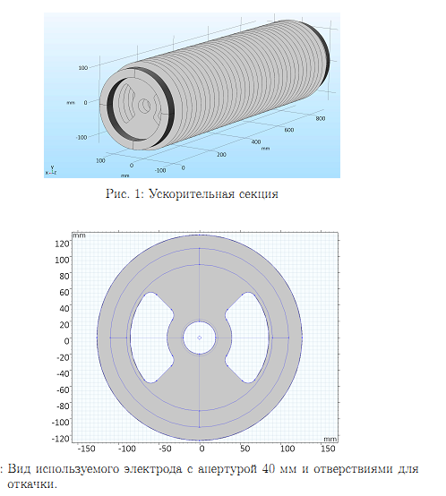
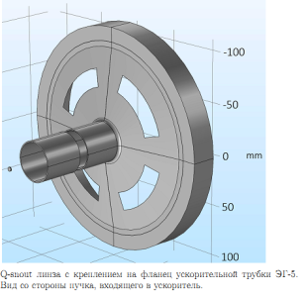
Project “Modernization of EG-5”: main results
Preparation for the replacement of the HV-tube
I.A. Chepurchenko
Studnev K.E.
Budker Institute of Nuclear Physics (Novosibirsk)
The accelerator hall has been prepared for the replacement of the HV-tube
Floors are filled with epoxy enamel, walls are painted, trash is removed
Calculations of the HV tube (R&D) were carried out
Contract for the manufacturing of a new ion source is prepared

Slide 14
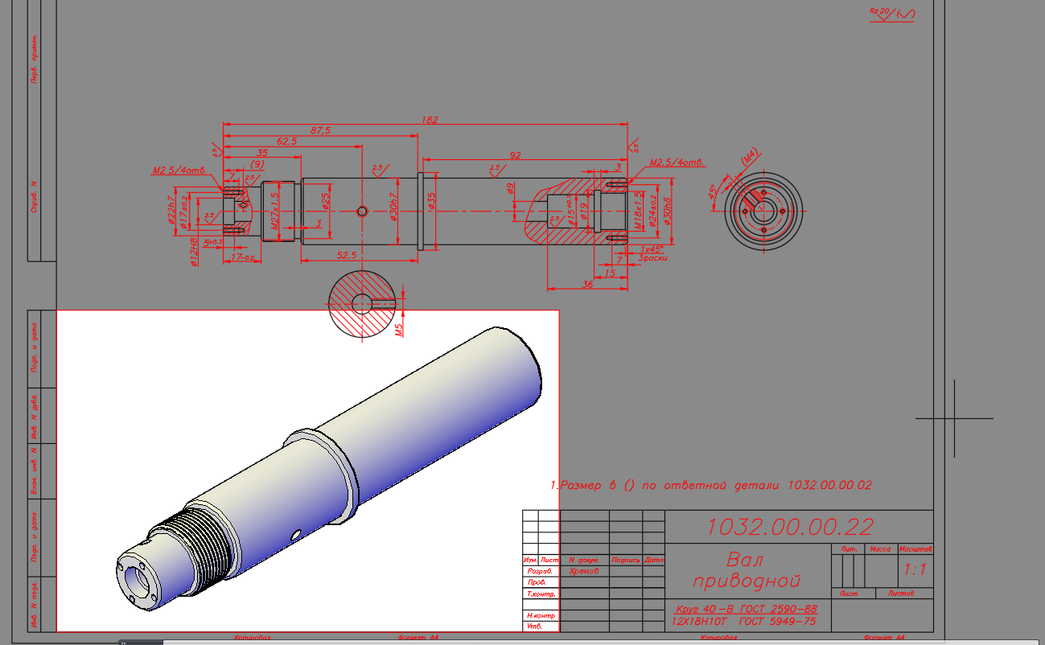
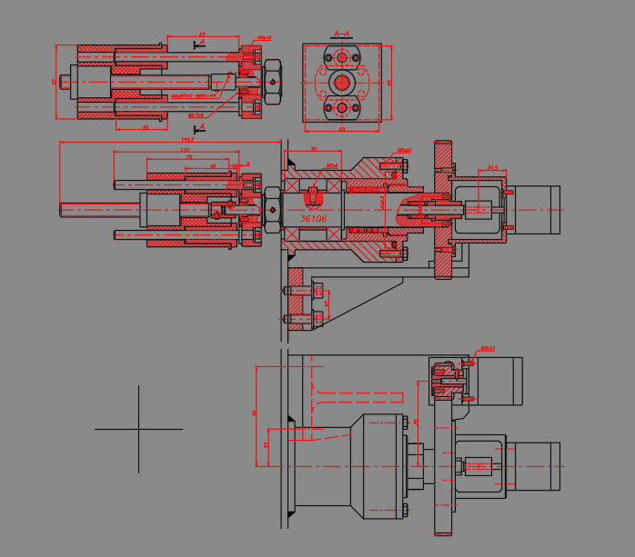
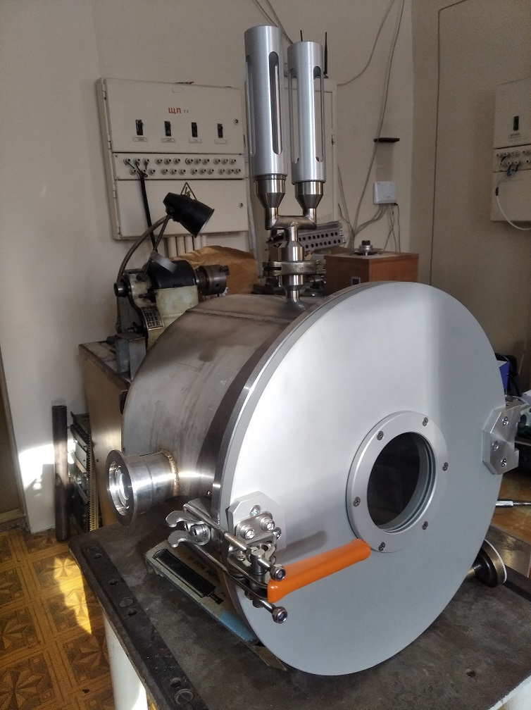
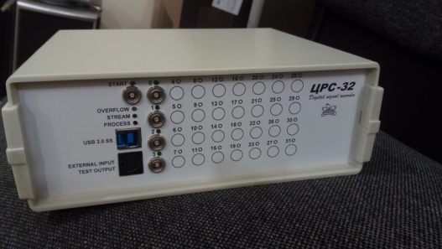
Project “Modernization of EG-5”: main results
A new module of ion-beam spectrometers has been developed
I.A. Chepurchenko
Pumping station is purchased
Data processing module is purchased

Slide 15
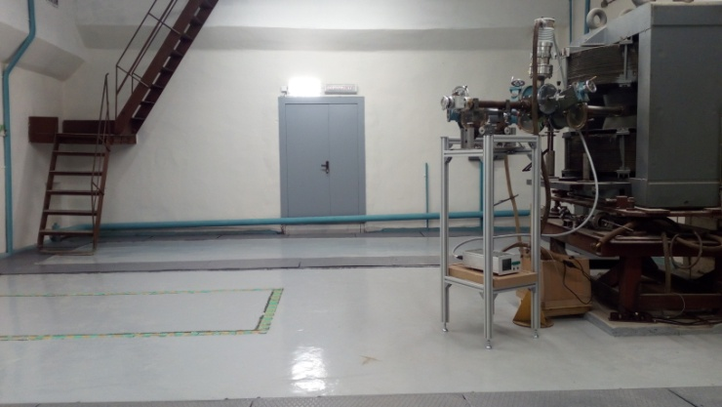
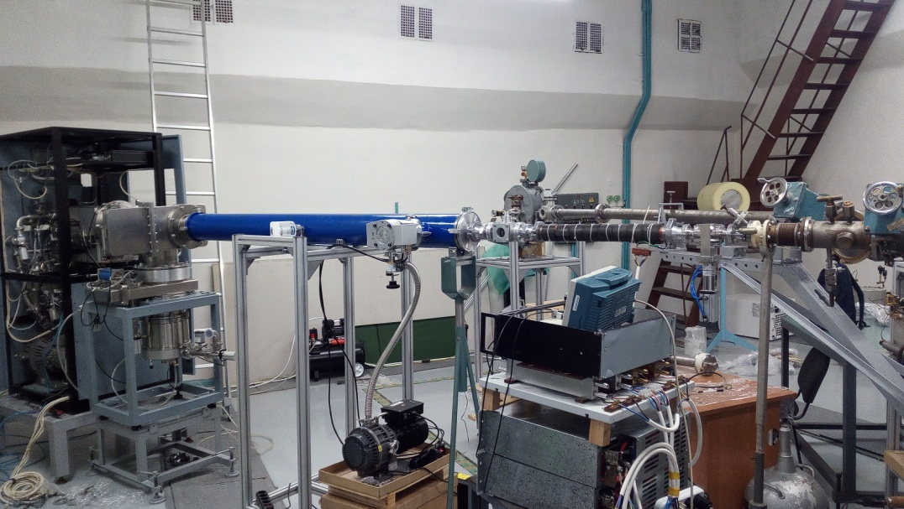
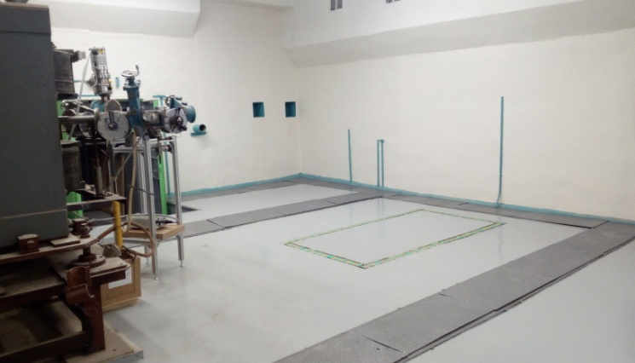
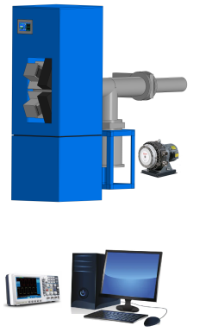
Project “Modernization of EG-5”: main results
The left experimental hall has been renovated
Ion implantator from JSC "Micron"
The system of scanning a beam into a raster
Vibration-resistant foundation
Cooperation with industrial partners:
JSC "Micron";
JSC "Angstrom“
ROSATOM State Corporation
Neutron generator
RBS spectrometer
The ion implantator "DNEPR" (JSC Micron) was set up

Slide 16
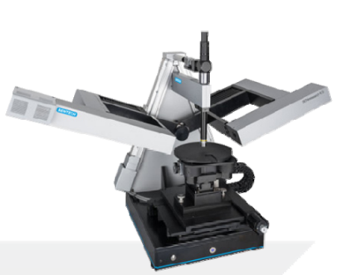
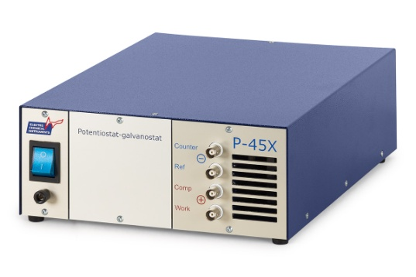
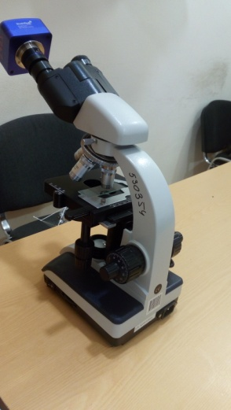
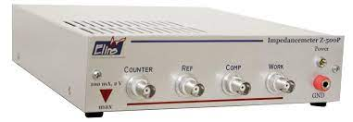
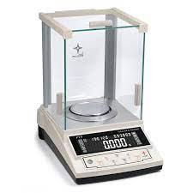
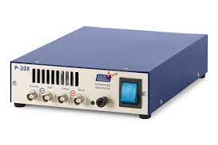

Project “Modernization of EG-5”: main results
A set of Computer controlled complementary methods for the study of surface layers of materials has been purchased and put into operation
Ellipsometer (optical and electronic features),
Impedance meter and
Potentiostat (electrical properties),
Microweights,
Optical microscope,
General laboratory equipment.
Remote control
Comprehensive study of physical properties and elemental composition of multilayer structures for optics, electronics, materials science.

Slide 17
Report on the theme “Investigations of Neutron Nuclear Interactions and Properties of the Neutron”
for 2022-2023
Theme leader: Lychagin E.V.
Deputies: Kopatch Y.N., Sedyshev P.V.
Activities which are not included in the projects.

Slide 18
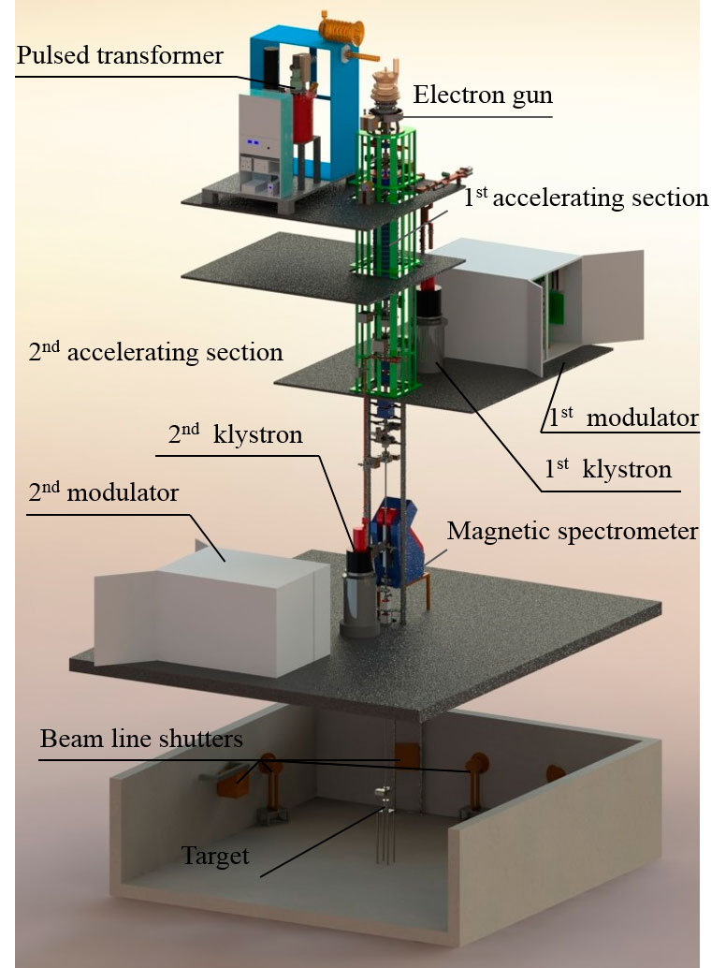
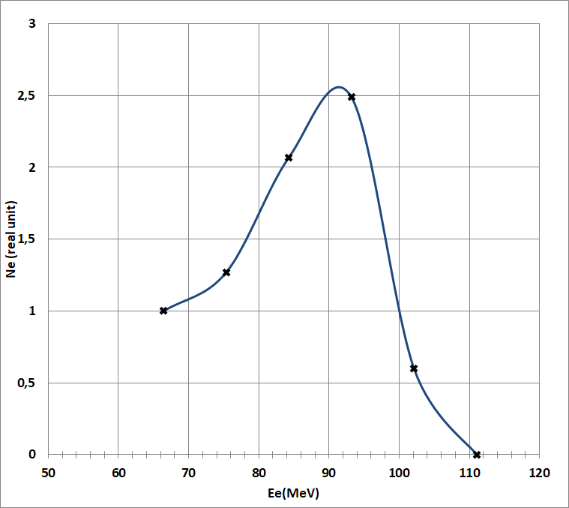
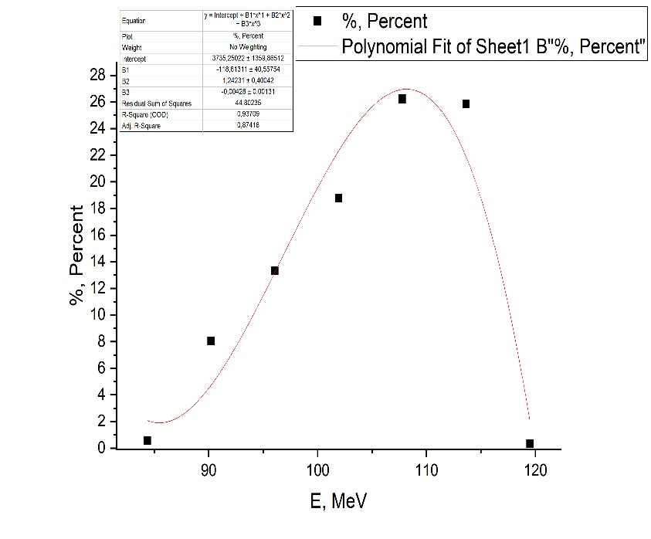
Theme 1128: main results
Development and operation of the IREN facility
Energy spectra of the accelerated electrons beam obtained in December 2019 (left) and in 2022 (right).
Last year, the IREN facility worked in the experiment for more than 1000 hours, of which 450 hours at cycle frequencies of 50 Hz; 390 hours at cycle frequencies of 25Hz; 192 hours at 2 Hz.

Slide 19
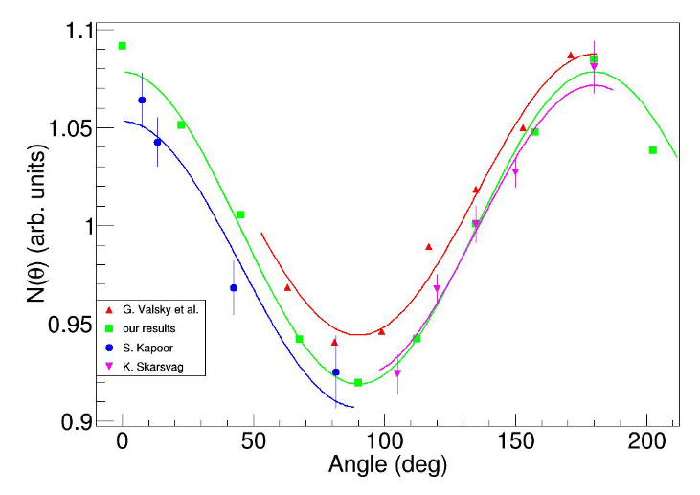
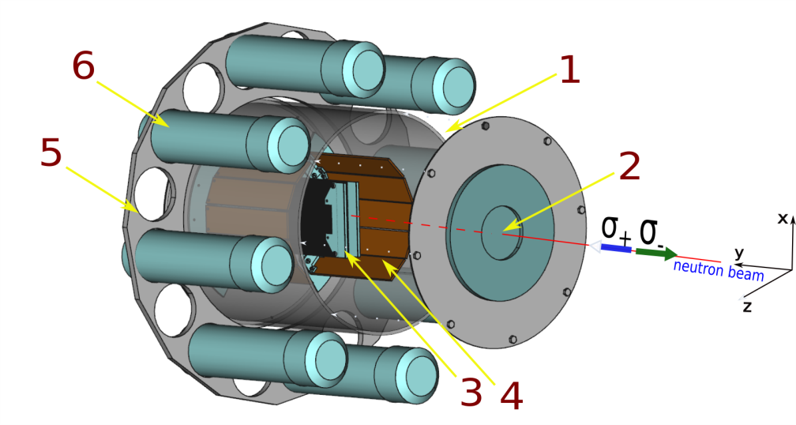
Theme 1128: main results
Determination of the angular distribution of fission gamma quanta from ²³⁵U in the resonance 0.3 eV.
A series of experiments were performed in 2012-2018 at the FRM-2 reactor in Garching aimed at measurements of T-odd effects in fission of uranium induced by polarized neutrons.
In 2022 from these experimental data new results on angular distribution of fission γ-rays were obtained.
Scheme of the experimental setup:
1 – fission chamber ; 2 – neutron beam; 3,4 – start and stop FF detectors; 5 – γ-ray detector holder; 6 – γ-ray detector s.
Angular distribution of gamma quanta. Angular anisotropy coefficient A = 0.1570 ± 0.0053

Slide 20
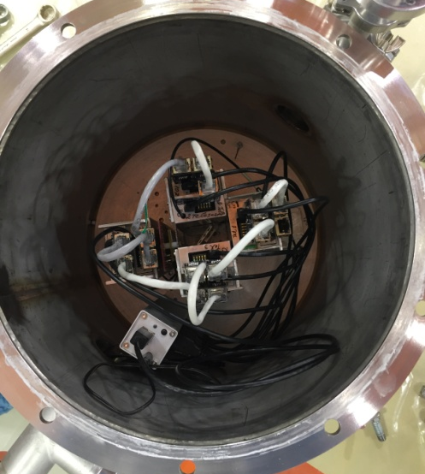
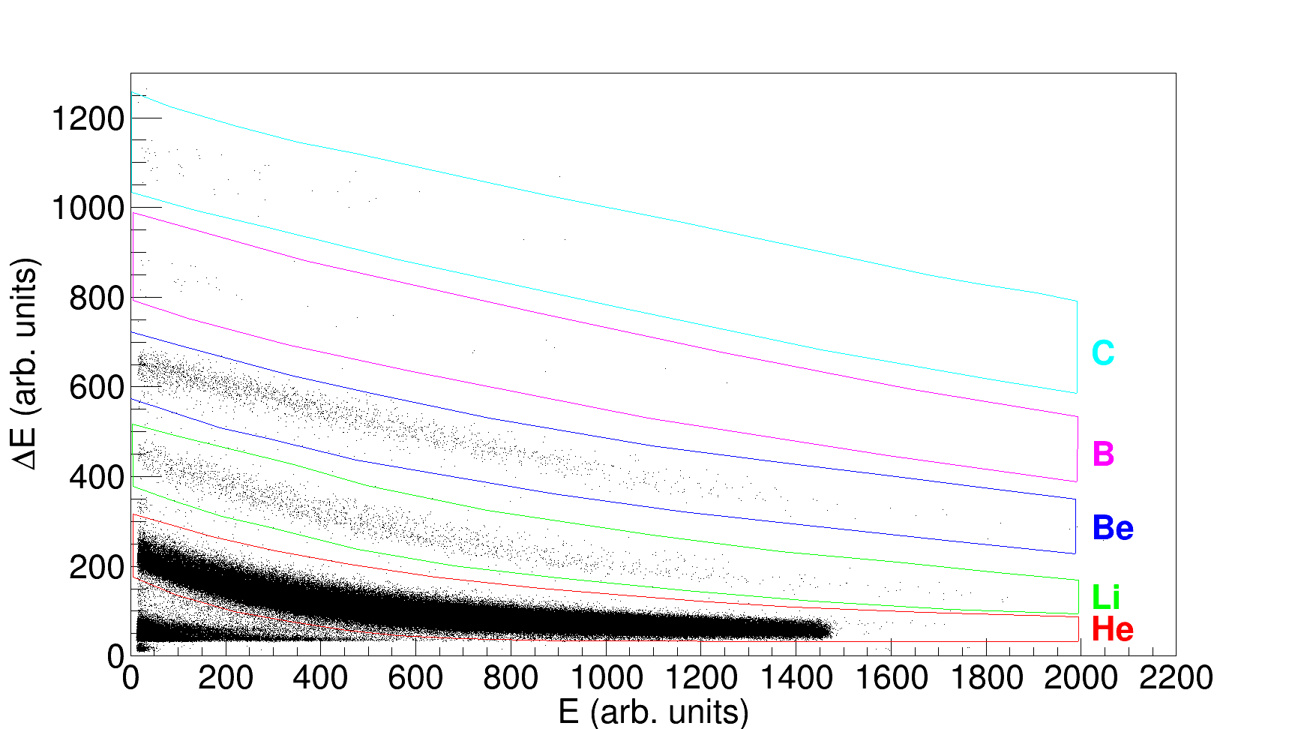
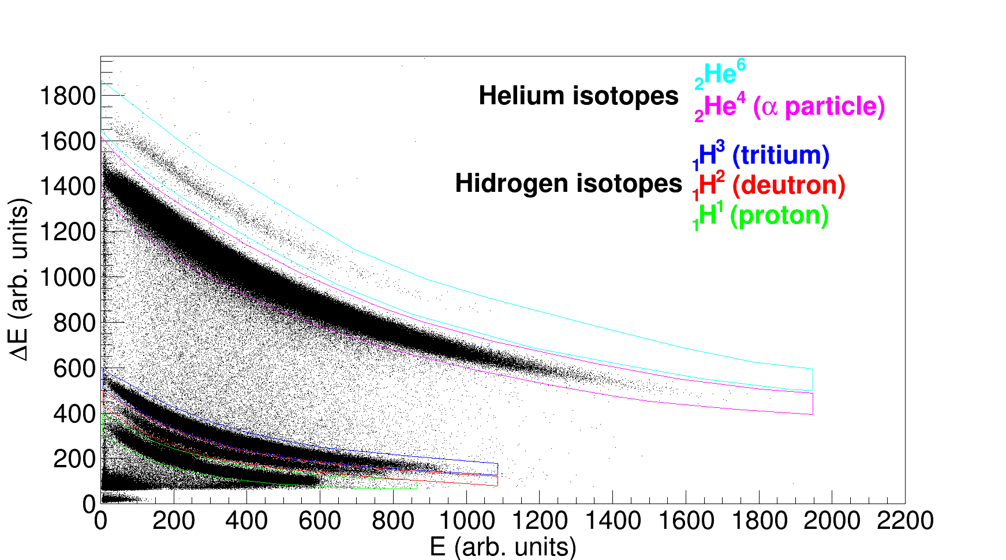
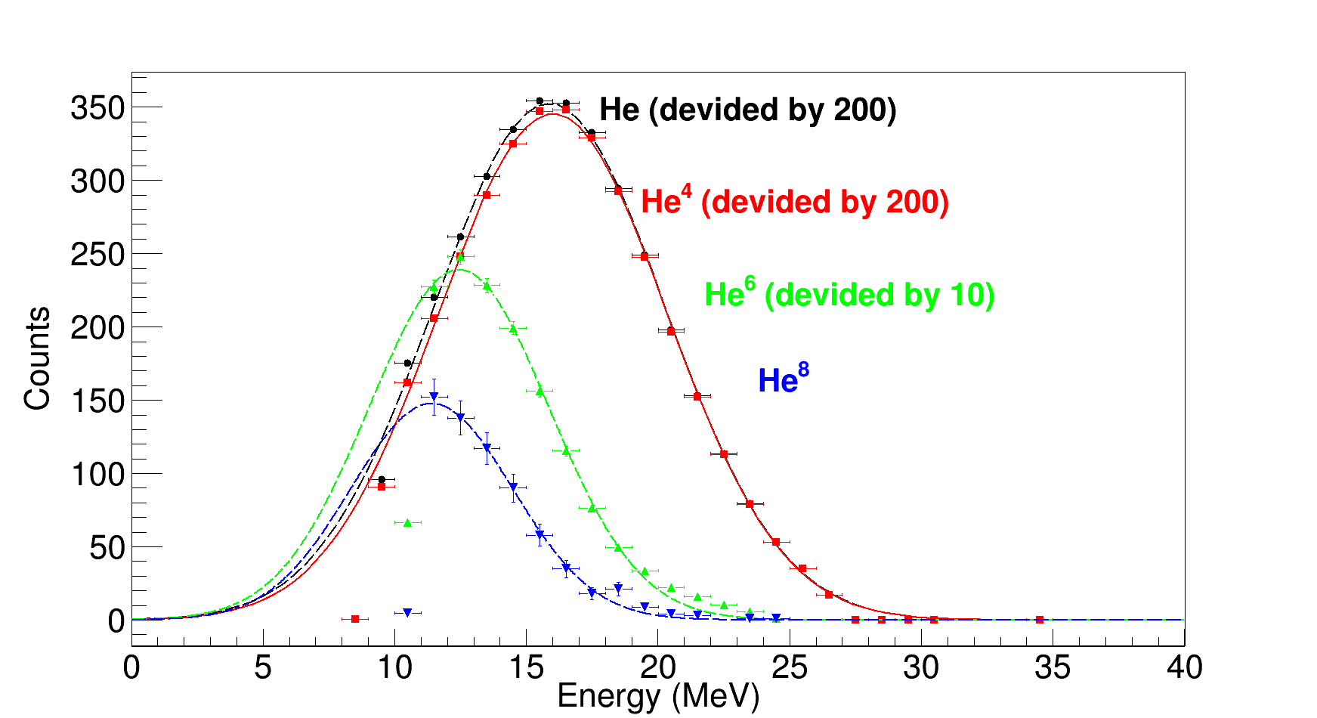
Theme 1128: main results
The spectra of light charged particles in the ternary fission of ²⁵²Cf were measured
Experimental setup.
ΔE-E two-dimensional curves for the separation of light charged particles for "thin" and "thick" telescopes.
Energy spectra of helium isotopes.

Slide 21
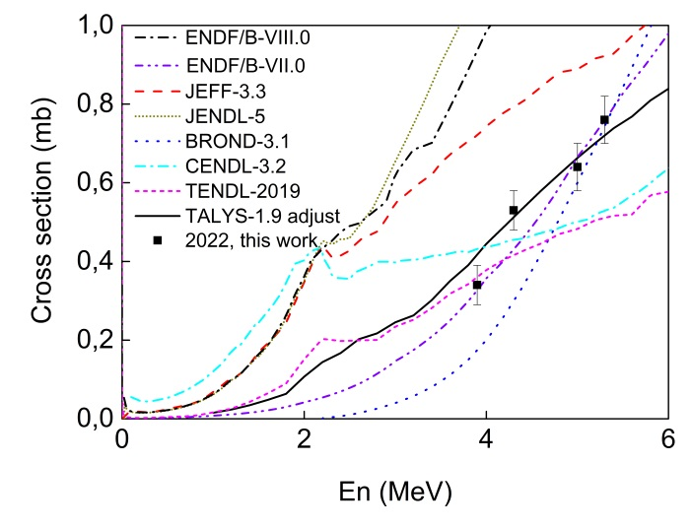
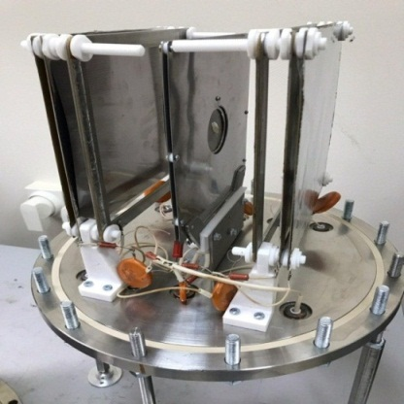
Theme 1128: main results
⁹¹Zr(n,α)⁸⁸Sr reaction in the 3.9 - 5.3 MeV
Zhang G., Sansarbayar E., Gledenov Yu. M., et al. Phys.Rev. C. 106, 064602 (2022)
Group of Yu.M. Gledenov
Experimental and evaluated cross sections for the ⁹¹Zr(n,α) ⁸⁸Sr reaction and calculated results by TALYS-1.9
The experiment was performed at the EG-5 facility in FLNP.
21

Slide 22
Theme 1128: main results
New data on the cross sections for (n,α) reactions with fast neutrons have been obtained
Cross sections of ⁴⁰Ca(n,α₀)³⁷Ar and ⁴⁰Ca(n,α)³⁷Ar reactions.
Measurements were performed at the on the HI-13 tandem accelerator of China Institute of Atomic Energy (CIAE).

Slide 23
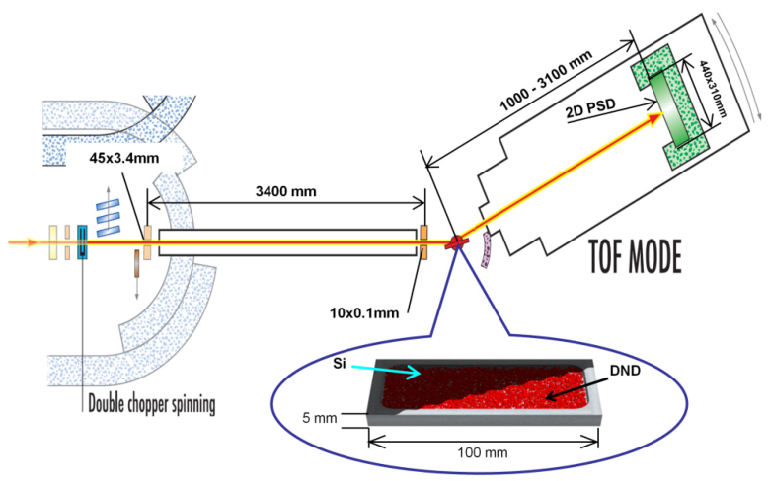
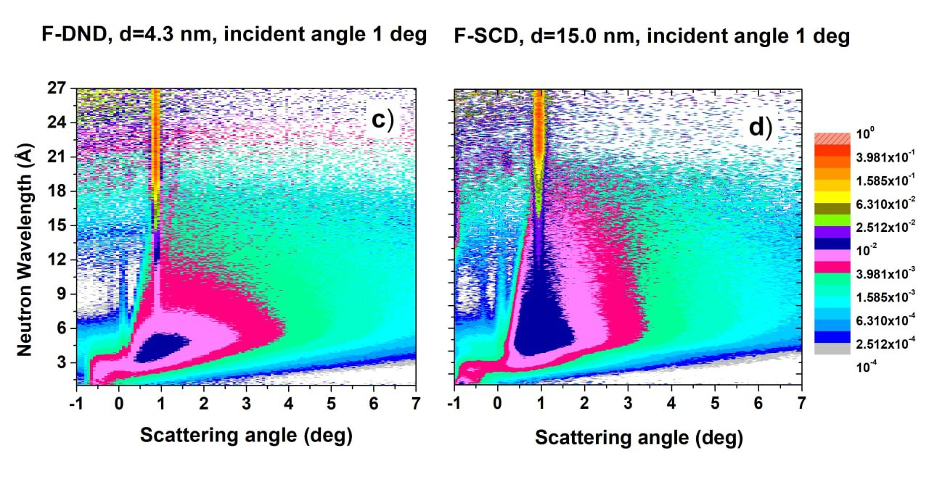


Theme 1128: main results
Quasi-specular reflection (QSR) of cold neutrons from nanodimond powders
Fig. 1. Scheme of the experiment..
Fig. 2. Probability of neutron scattering from the surface of ND samples as a function of the neutron wavelength (vertical axis) and the polar scattering angle. Samples: (c) F-DND;
(d) F-SCD. The angle of incidence of the neutron beam onto the sample was 1°.
Fig. 4. Neutron scattering probability as a function of neutron wavelength (horizontal axis) within the D17 detector acceptance. (b) F-DND and F-SCD samples. Incident angles 1°, 2° and 3°.
Fig. 5. Simulated and measured angular distributions of QSR neutrons for the F-DND sample at three wavelengths: (a) 2.5 Å, (b) 4.5 Å and (c) 8.5 Å.
The angle of incidence was 1°.
Nanodimond powders can serve as effective reflectors for cold and very cold neutrons. Other effective reflectors - supermirrors, unlike nanodiamond powders, are not radiation-resistant and are destroyed in intense fields of ionizing radiation, for example, near the core of a nuclear reactor.

Slide 24


Theme 1128: main results
Data on the elemental composition of archaeological artifacts by neutron resonances at the IREN facility
Element | Mass, g | Content, %
Cu Sn As Ag | 59.7± 3.9 5.29 ± 0.23 0.1892± 0.0081 0.0131± 0.0014 | 68.8±4.5 6.10±0.26 0.2179±0.0094 0.0151± 0.0016
The results of measurements of the elemental composition of the kiaf (bowl) using the NRCA method

Slide 25

Theme 1128: main results
Work continued on the mass study of samples of various origins by neutron activation analysis (NAA) and additional methods in the NAA group at IREN
For the first time in Russia, sensitive neutron methods were used to study the elemental composition of pigments and plaster bases - neutron activation analysis and activation analysis on prompt gamma quanta. The conducted research allowed to determine the elemental and mineral composition of pigments and plaster bases used in the creation of frescoes; identify the technique of painting; make assumptions about the different time of creation of the murals in the main volume and in the tower of the cathedral; as well as to reconstruct the original appearance of the fresco depicting St. George. The discovery of an expensive lapis lazuli pigment testified to the high status of the customer of the cathedral's murals. The obtained data are compared with the simultaneous paintings of Byzantine and Italian temples.
Research on archaeological fragments of frescoes in the Church of John the Baptist on Opoki (XII century) and the Resurrection Cathedral of the Derevyanitsky Monastery (XVI and XVI centuries) in Veliky Novgorod.

Slide 26

Theme 1128: main results
Analytical research at the REGATA facility using NAA
In the Sector of Activation Analysis and Applied Research a multi-element analysis of about 1500 samples was carried out: vegetation, soils, technological, biological and geological samples within the framework of cooperation programs with JINR Member and Non-Member countries.
Sampling map of mosses-biomonitors in the Republic of Crimea

Slide 27
Theme 1128: main results
Analytical studies on beams of charged particles of the EG-5 accelerator continued
Studies of archeological specimens (glasses) dated to the 11th century AD.
a
b
RBS (left) and PIXE (right) spectra of the sample C-11539.

Slide 28
Publications:
56 journal publications in 2022.
More than 60 conference abstracts
Dissertations:
N.A. Fedorov, “Inelastic scattering of fast neutrons on the nuclei of magnesium, aluminum, silicon and iron.” Dissertation for the degree of Ph.D. (2021)
Turlybekuly Kylyshbek, Ph.D. at the Eurasian National University named after L.N. Gumilev on the topic "Investigation of the interaction of cold and very cold neutrons with nanodiamond particles" (supervisor - Lychagin E.V.)
Zinkovskaya Inga, head of the NAA sector. Defense of the thesis for the title of Doctor of Chemistry on "Influence of some elements determined by the method of neutron activation analysis on the quality of the environment" at the Moldovan State University (council DH 145.01-22-4).
D.N. Grozdanov, "Development and use of the method of tagged neutrons with an energy of 14 MeV, to study nuclear reactions and determine the elemental structure of substances containing carbon, oxygen or chromium." Dissertation for the degree of Ph.D. (2023)
Lychagin E.V., “Reflectors of very cold and cold neutrons based on ultradisperse diamonds”, Doctor of sciences (2023)

Slide 29
Proposal for extending the projects TANGRA and “Modernization of EG-5”

Slide 30

Proposal for extending the project
“Development of the tagged neutron method for determining the elemental structure of matter and nuclear reactions research”
(project TANGRA - Tagged Neutrons and Gamma Rays) for 2024-2028
Project leader
Yu. N. Kopatch
Deputy
N. A. Fedorov

Slide 31

Studying of (n,xγ) reactions using TNM
Avalible data on (n,xγ) reactions is not accurate:
Poor cross-section accuracy (up to several times discrepancy)
Angular distributions for low-intense γ-transitions have not been measured before
Planned:
Measurements of (n,xγ) reaction cross-sections (in the framework of RSF grant 23-12-00239)
Possible upgrade of the setup with LaBr₃(Ce) γ-detectors to measure angular distributions
Layout of the modified HPGe setup. 1-ING-27, 2-iron-, 3-lead parts of the collimator, 4-sample, 5-HPGe crystal, 6-case of the detector.

Slide 32


Experimental and theoretical study of (n’,γ) correlations
(n’,γ) correlations are important for:
Understanding of the reaction mechanism
Testing of the theoretical predictions
Checking of nuclear forces invariance for n and p
Data for testing was extracted from experiment for n’ angular distribution measurement
Planned:
Development of the setup for (n’,γ) correlations measurement
Theoretical studies of the phenomenon

Slide 33


Studying of reactions (n,α) and (n,2n)
Reactions (n,α) and (n,2n) are important for:
Theoretical model testing and parameters adjustment
Understanding of stellar nucleosynthesis
    Planned:
    New experimental setup development
Purchasing of new neutron detectors

Slide 34

TANGRA: applied research
Development of the position-sensitive elemental analysis (RSCF grant 23-12-00239)
Development of method and setup for measurements of carbon concentration in soil

Slide 35
Expected results:
Performing experiments to study the angular distributions of scattered neutrons
Experimental study of (n,γ) and (n’,γ)-correlations.
Theoretical description of the studied reactions.
Conducting experiments to study the reaction (n,2n)
Conclusion on the applicability of the TNM for elemental analysis of soils. In case of a positive result, the creation of prototypes of stationary and mobile installations, as well as methodological recommendations for their use for agricultural and environmental monitoring purposes.

Slide 36
Required resources in 2024-2028
Expenditures, resources, funding sources |  |  | Cost (thousands of US dollars)/ Resource requirements | Cost/Resources, distribution by years
 |  |  |  | 1st year | 2nd year | 3rd year | 4th year | 5th year
 |  | International cooperation | 100 | 20 | 20 | 20 | 20 | 20
 |  | Materials | 150 | 30 | 30 | 30 | 30 | 30
 |  | Equipment, Third-party company services | 350 | 100 | 50 | 100 | 50 | 50
 |  | Commissioning
 |  | R&D contracts with other research organizations | 25 | 5 | 5 | 5 | 5 | 5
 |  | Software purchasing | 50 | 10 | 10 | 10 | 10 | 10
 |  | Design/construction
 |  | Service costs (planned in case of direct project affiliation)
Sources of funding | JINR Budget |  | 675 | 165 | 115 | 165 | 115 | 115
 | Extra fudning (supplementary estimates) | Contributions by partners Funds under contracts with customers Other sources of funding

Slide 37

Proposal for extending the project
"Modernization of the EG-5 accelerator and development of its experimental infrastructure“ for 2024-2026
Project leader: Doroshkevich A.S.
Technical task: Restoration of the technical parameters of the EG-5 accelerator: Energy up to 4.1 MeV at a beam current up to 100 - 250 μA.
Ways to implement the project:
Replacement of HV tube, ion source;
Modernization of the infrastructure of EG-5;
Training of young personnel.
Future goal: implementation of the micro-beam project

Slide 38


  Significant Features of ESA EG-5
  - high energy stability of ion beam;
  accelerated particles (H⁺, He, D );
  accelerated voltage (from 800 keV to 3MeV).
  possibility of obtaining of quasi-monoenergetic neutron beams.
  Areas of use
  - Nuclear reactions with fast quasimonoenergetic neutrons;
  - Ion Beam Spectrometry (Multilayer structures, isotope determination, elemental depth profiling);
  - Radiation technologies (Science, technology, medicine, etc.).
Ion beam parameters
Range of ion beam currents - 0,01 - 3 мкА (100 – 150mkA*);
Real ion beam energy range - 800 keV – 2,5MeV (4,1 MeV*);
Energy spread (H⁺, He²⁺) – about 500 eV;
Charged particles flux (H⁺, He²⁺) – 10¹²−10¹³ part /s sm⁻²
        Neutrons flux – 5 10⁷ n/s sm²
        Max. neutron energy - 5,5±0,1 MeV (Deutron current – 2mkA, deutron energy – 2,5MeV);
*- will be after
modernization
Notes:
Одноступенчатый электростатический ускоритель Ван-де Граафа исправно работает в ОИЯИ с 1965г. Это надежный универсальный инструмент для решения широкого спектра задач в области ядерной физики, физики твердого тела, радиационных технологий. Ввиду конструкционных особенностей ускорителей данного типа, ионный пучок ЭГ-5 при относительно высоком токе обладает очень высокой энергетической стабильностью. Благодаря чему, ЭГ-5 может работать как в режиме нейтронного генератора, так и источника для комплекса ионно-лучевых спектрометров. В настоящий момент с использованием ЭГ – 5 проводятся исследования ядерных реакций с быстрыми нейтронами, исследование элементных глубинных профилей многослойных полупроводниковых архитектур, а так же облучение материалов быстрыми нейтронами, дейтронами, протонами и альфа частицами в режиме имитации радиационных условий в ядерных и термоядерных реакторах и т.д. В настоящий момент разрабатывается метод исследования элементного состава материалов на быстрых нейтронах. В настоящее время аналогичные приборы исследуют поверхность Марса на предмет наличия легких элементов и органических субстанций.

Slide 39
Modernization of the EG-5 accelerator and development of its experimental infrastructure
  Goal
  Providing technical conditions for the implementation of the scientific program of JINR TP.
Stage 1 (2024-2026)
Stage 2 (2026-2030)
Microbeam spectrometer
Strengths of EG-5
High quality of ion beam (current level and focusing);
Maintainability and full autonomy of the accelerator complex for a long time;
Low operational cost;
Availability of the necessary technical infrastructure and material base;
Minimal amount of construction work and concentration of resources on improving the experimental equipment base.
Replacement of AT and HV-source;
modernization of service systems
Neutron generator
20keV – 5,1 MeV
Human resource forming
Ion implantator
Complementary methods base
  Main Tasks
  Revival in JINR of the research of reactions with fast quasimonoenergetic neutrons;
  Providing the microbeam project implementation;
  Laying a technical and human resource for a period of more than 20 years;
  Developing of new methods for elemental analysis.

Slide 40








Expected results of modernization in 2024-2026
Restoration of technical parameters of the accelerator
Before modernization | After modernization
Terminal voltage – 2.5 MV Beam current – ~1mkA Ion Energy – 2.5 MeV | Terminal voltage – 4.1 MV Beam current – 50-100mkA Ion Energy – 0.8 - 4.1 MeV
- Nuclear physics experiments conducting is not possible, - NRA (3,1 MeV) - not possible | - Nuclear physics experiments conducting (up to 6MeV) is possible, - NRA (3,1 MeV) - possible
Microbeam option installing – not possible | Microbeam option installing – possible;
Work with biological objects - not possible | Work with biological objects – possible
Microbeam spectrometer
Unique
Fast neutron reactions
Ion Beam Analysis & complementary methods
Rare
Gas Target
D(d,n)³He
Rare
        Neutron flux – 5 10⁷ n/s sm²
        - Max. neutrons energy - 5,5 ± 0,1 MeV
Solid-state target
¹H + ⁷Li - ⁷Be + n
        Neutrons flux – 5 10⁷ pat/s sm²
        - Energy region – 20 – 800keV
⁷Li
The elemental composition of multilayer systems, isotopic composition, stoichiometry of films.
- Optical, electronic and electrical properties using complementary methods (ellipsometry voltammetry impedance spectroscopy).
E
20keV
800keV
3.3MeV
5,1 MeV
Quasi-monochromatic neutrons in a wide range of energies
Pulse mode for TOF techniques
Currently in progress
Perspective 2025
Notes:
It is able to simultaneously provide

Slide 41



Microbeam capabilities (after 2026)
(Technical project is ready)
Methodological and technological capabilities:
Precision studies of elemental depth profiles (1 ppm) with a step of 1 microns (two-dimensional distribution of elements / mapping) without destruction of the sample :
IBA of planar objects with an area of less than 0.1 mm²;
IBA of objects with a rough surface (powder objects, etc.);
scanning transmission ion microscopy (STIM);
measurement of ion beam induced charge (IBIC) in semiconductors.
2. Direct proton beam writing (PBW):
- proton lithography,
creation of small 3D nanostructures (electronic nanotechnology);
physical (phase transformations) and chemical modification (chemical reduction) of localized areas of samples at a strictly defined depth (microelectronics, photonics etc.).
The prospects:
Determination of small concentrations of elements in local zones (1 ppm at ~1 microns):
zones of segregation of impurities in structural materials under operating loads;
definition of diseases [2];
cancer cell research [3];
study of geological samples;
effects caused by single events (SEE - Single Event Effect) [4,5];
The possibility of obtaining nanocomponents (electronics) with a high aspect ratio (160:1), which allows us to consider such a structure as essentially three-dimensional:
local exposure of organoids.
[1] A.G. Ponomarev NUCLEAR SCANNING MICROPROBE: THE CURRENT STATE IN THE WORLD, FIELDS OF APPLICATION AND PROSPECTS OF DEVELOPMENT // 9th International Conference "Interaction of radiation with a solid body", September 20-22, 2011, Minsk, Belarus pp.438-440,
[2]. Barapatre N., Morawski M., Butz T. et al. // Nucl. Instr. and Meth. B. – 2010. - Vol. 268. - P. 2156.
[3]. Kirkby K.J., 260. - P. 97.
[4]. Watt F., van Kan J.A., Rajta I. et al. // Nucl. Instr. and Meth. B. – 2003. - Vol. 210. - P. 14.
[5]. Spemann D., Reinert T., Vogt J. et al. // Nucl. Instr. and Meth. B. – 2002. - Vol. 190. - P. 312.

Slide 42
Project Cost (2024-2026)
Stage / Option 2024 - 2026 |  | Cost k$
1 | Repair of technical premises | 50
2 | Replacement of a high-voltage tube with divider and ion source | 120
3 | Replacing a compressor in the gas compressor section | 100
4 | Automation of technological systems of EG-5 | 100
5 | Modernization of EG-5 technical and research infrastructure: | 220
Total |  | $ 600
Stage / Option 2024 |  | Cost k$
1 | Repair of technical premises | 30
2 | Replacement of a high-voltage tube with divider and ion source | 120
3
4 | Automation of technological systems of EG-5 | 30
5 | Modernization of EG-5 technical and research infrastructure: Installation of the IBA spectrometers complex (RBS, PIXE, ERD) | 20
6
Total |  | $ 200
Estimated cost of the project:
∑= $600 k$ (3 years).

Slide 43
Required resources in 2024-2026
Expenditures, resources, funding sources |  |  | Cost (thousands of US dollars)/ Resource requirements | Cost/Resources, distribution by years
 |  |  |  | 1st year | 2nd year | 3rd year
 |  | International cooperation | 60 | 20 | 20 | 20
 |  | Materials | 150 | 50 | 50 | 50
 |  | Equipment, Third-party company services | 450 | 150 | 150 | 150
 |  | Commissioning
 |  | R&D contracts with other research organizations
 |  | Software purchasing
 |  | Design/construction
 |  | Service costs (planned in case of direct project affiliation)
Sources of funding | JINR Budget |  | 660 | 220 | 220 | 220
 | Extra fudning (supplementary estimates) | Contributions by partners Funds under contracts with customers Other sources of funding

Slide 44
Thank you for your attention

