Slide 1
57th meeting of the PAC for Nuclear Physics
June 29, 2023
Proposals for opening a new theme "Nuclear Physics with Neutrons" and a new project "Investigations of neutron nuclear interactions and properties of the neutron"
Valery Shvetsov

Slide 2
Research Strategy Based on Unique and Rare Facilities
Utilization of their Specific Features
Keeping on and Developing Scientific Heritage
of the Laboratory

Slide 3
IBR-2
Idea of F.Shapiro on the UCN source at pulsed reactor;
Proposal of A.Frank and R.Gahler on time focusing;
Two active groups at FLNP joined efforts in construction of the UCN source at IBR-2;

Slide 4


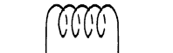
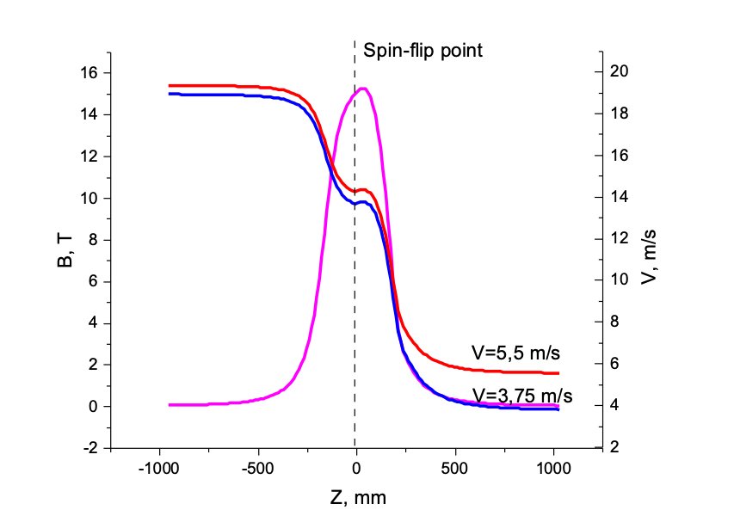
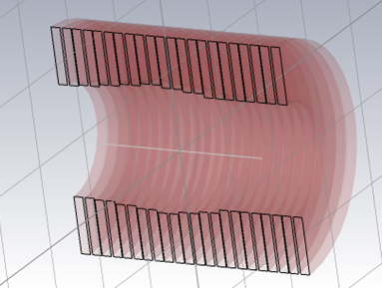


UCN Source at IBR-2
Decelerator — broadband gradient (adiabatic) spin flipper in high magnetic field
Moderator
$$B_{res}+ΔB$$
$$B_{res}=\frac{ℏω_{hf}}{2μB}$$
$$V$$
$$B_{res}$$
$$B_{res}−ΔB$$
VCN
z
$$ΔB≫\left|H_{1}\right|$$
$$ΔE=2μB=ℏω$$
Thin converter
Neutron guide
Time lens
Pulsed valve
UCN Trap
Stationary gradient field – 15T superconducting solenoid
Decelerator reduces the energy of all neutrons by the same amount
Time lens is necessary to compensate the dispersion of the time of subsequent deceleration
The dependence of the magnetic field and neutron velocities from the coordinate along the axis

Slide 5
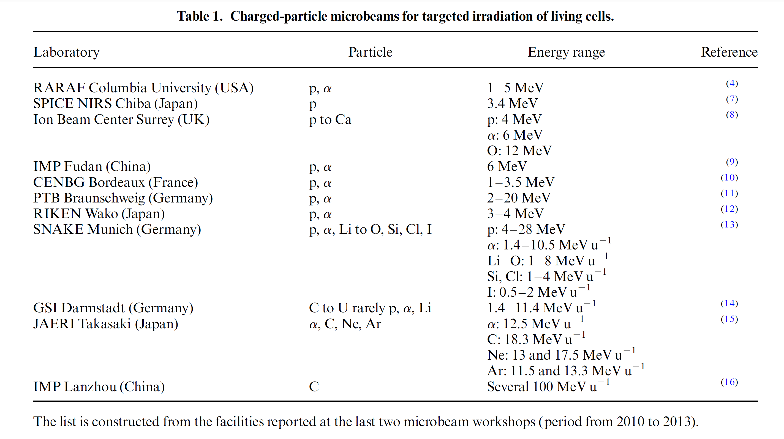
Microbeam at EG-5 accelerator

Slide 6
Neutron nuclear physics: fields of research
Investigations of neutron nuclear interactions and properties of the neutron.
  P, T – parity conservation in nuclear reactions
  Fission physics (ROT & TRI effects, rare modes)
  Nuclear reactions for nuclear data & nuclear theory
  Cold & ultracold neutrons, neutron optics
  Applied research (NAA, PGNAA, RBS, neutron mutagenesis, etc.)
Development of the tagged neutron method (TNM) for determining the elemental structure of matter and studying nuclear reactions (TANGRA project).
  TNM for nuclear reaction research & nuclear data
  Fast elemental analysis (method & compact facilities)
Modernization of the EG-5 accelerator and its experimental infrastructure.
  To realize nuclear reactions research program
  For applied research
Notes:
I started from ROT effect investigation. This activity is going in cooperation with physicist from ITEP, PNPI, FRM2.
Angle distribution of gamma rays emitted in fission is measured in experiment for different polarization of neutrons and asymmetry of the distribution relative the fission axe is determined. The planned measurement at a resonance of 1.14 eV of compound nucleus ²³⁶U has not been implemented because of the impossibility of carrying out the required modernization of the neutron beam of the POLI set-up at FRM2 facility, resulting from the pandemic. This measurement interesting because the partial contributions of different states of the nuclear compound depend on the neutron energy, and one can expect a change in the magnitude and even sign of the observed effect.
But a detailed analysis of the previously obtained results at a neutron energy of 0.06 eV was carried out.

Slide 7
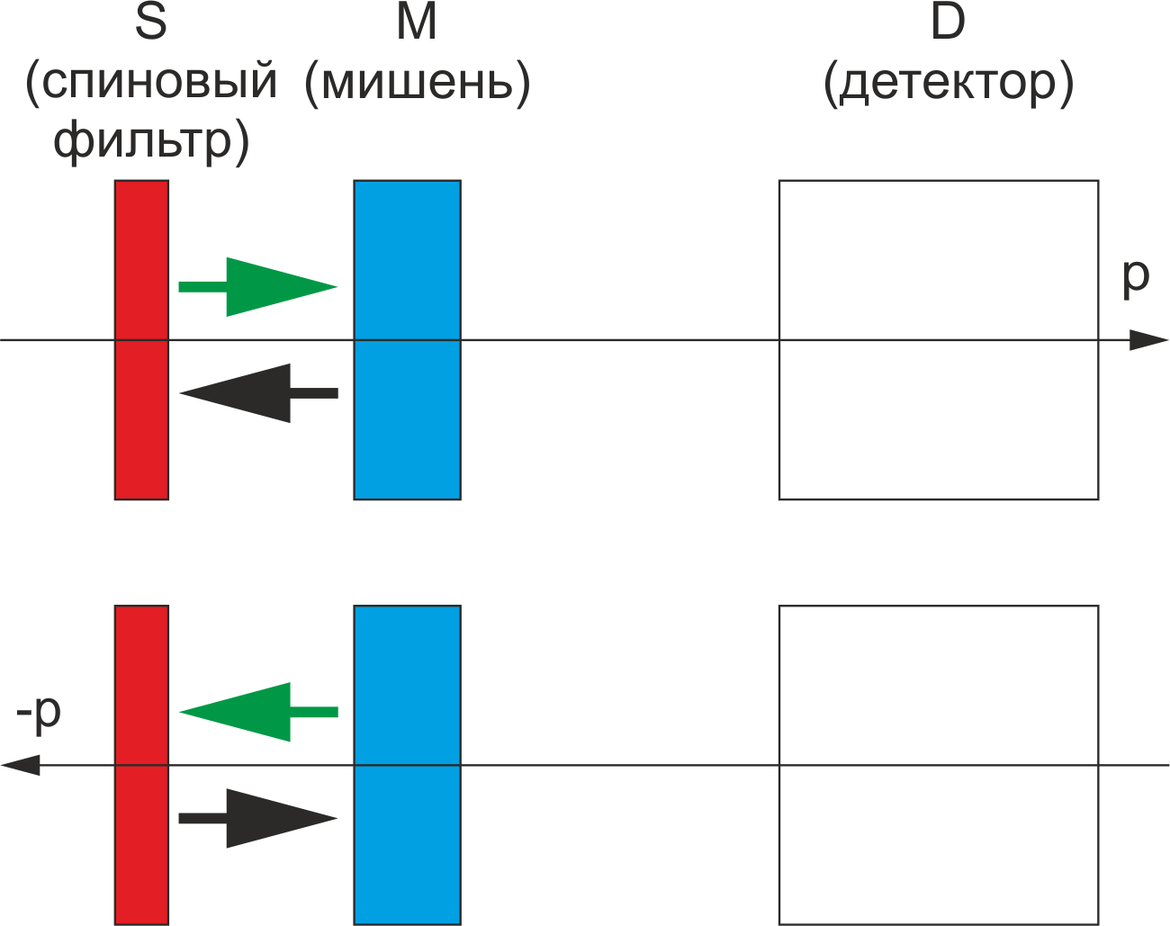


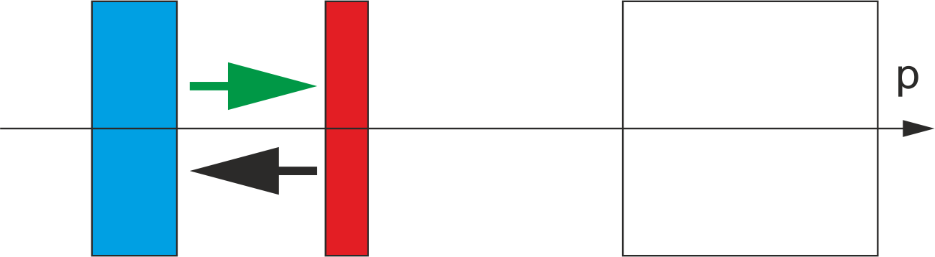


Investigations of neutron nuclear interactions and properties of the neutron.
T
target
D
detector
P, T – parity conservation in nuclear reactions
  Parity violation is a manifestation of the weak interaction
  P-violation is well known in weak decays (β-decay, decay of π-mesons, etc.), observed in n-induced reactions (i.e. on ²³²Th, ¹¹⁷Sn, ⁸¹Br, ¹³⁹La)
  T – violation (the same – CP – violation according CPT-theorem) was observed in K⁰, B_{S} and D⁰ – decays only. It is important to find other manifestation of this phenomenon
  An experiment was proposed at IREN/IBR facilities to study T-violation in neutron-nucleus interaction
polarizer
T-inv
P-inv
Notes:
P-violation also in Th-232, Sn-117, Br-81, La-139, Ag-107, Ag-109. Determining parameters of neutron resonances such as energy, spin, parity, partial neutron widths of s - and p - wave resonances which mix to cause parity violation is also important.

Slide 8
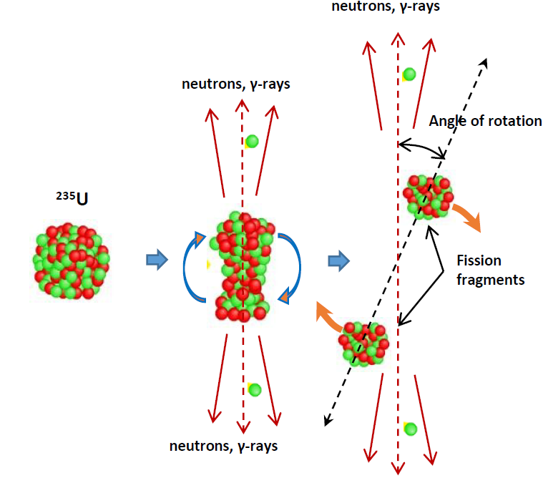
Investigations of neutron nuclear interactions and properties of the neutron.
Fission physics: TRI & ROT effects
False T-violation effects observed in asymmetry of fission products angular distribution in relation to the fission axis
Reason – rotation of the nucleus at the break-up moment
Source of information about nuclear spin near break-up (J,K values)
Needed for theoretical models testing
Studied for cold, thermal neutrons and for the first isolated resonance of ²³⁵U. Data for higher energies is needed

Slide 9
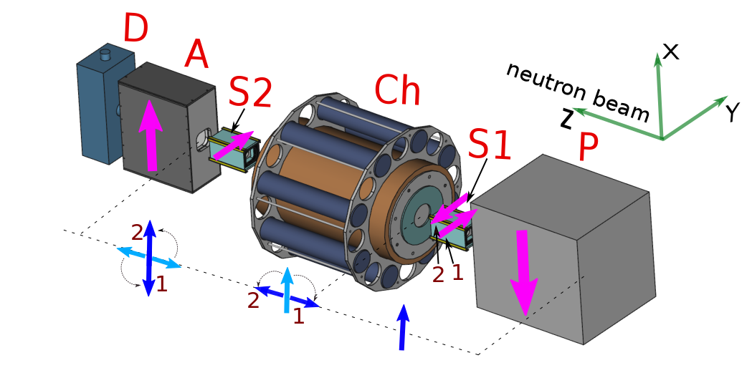
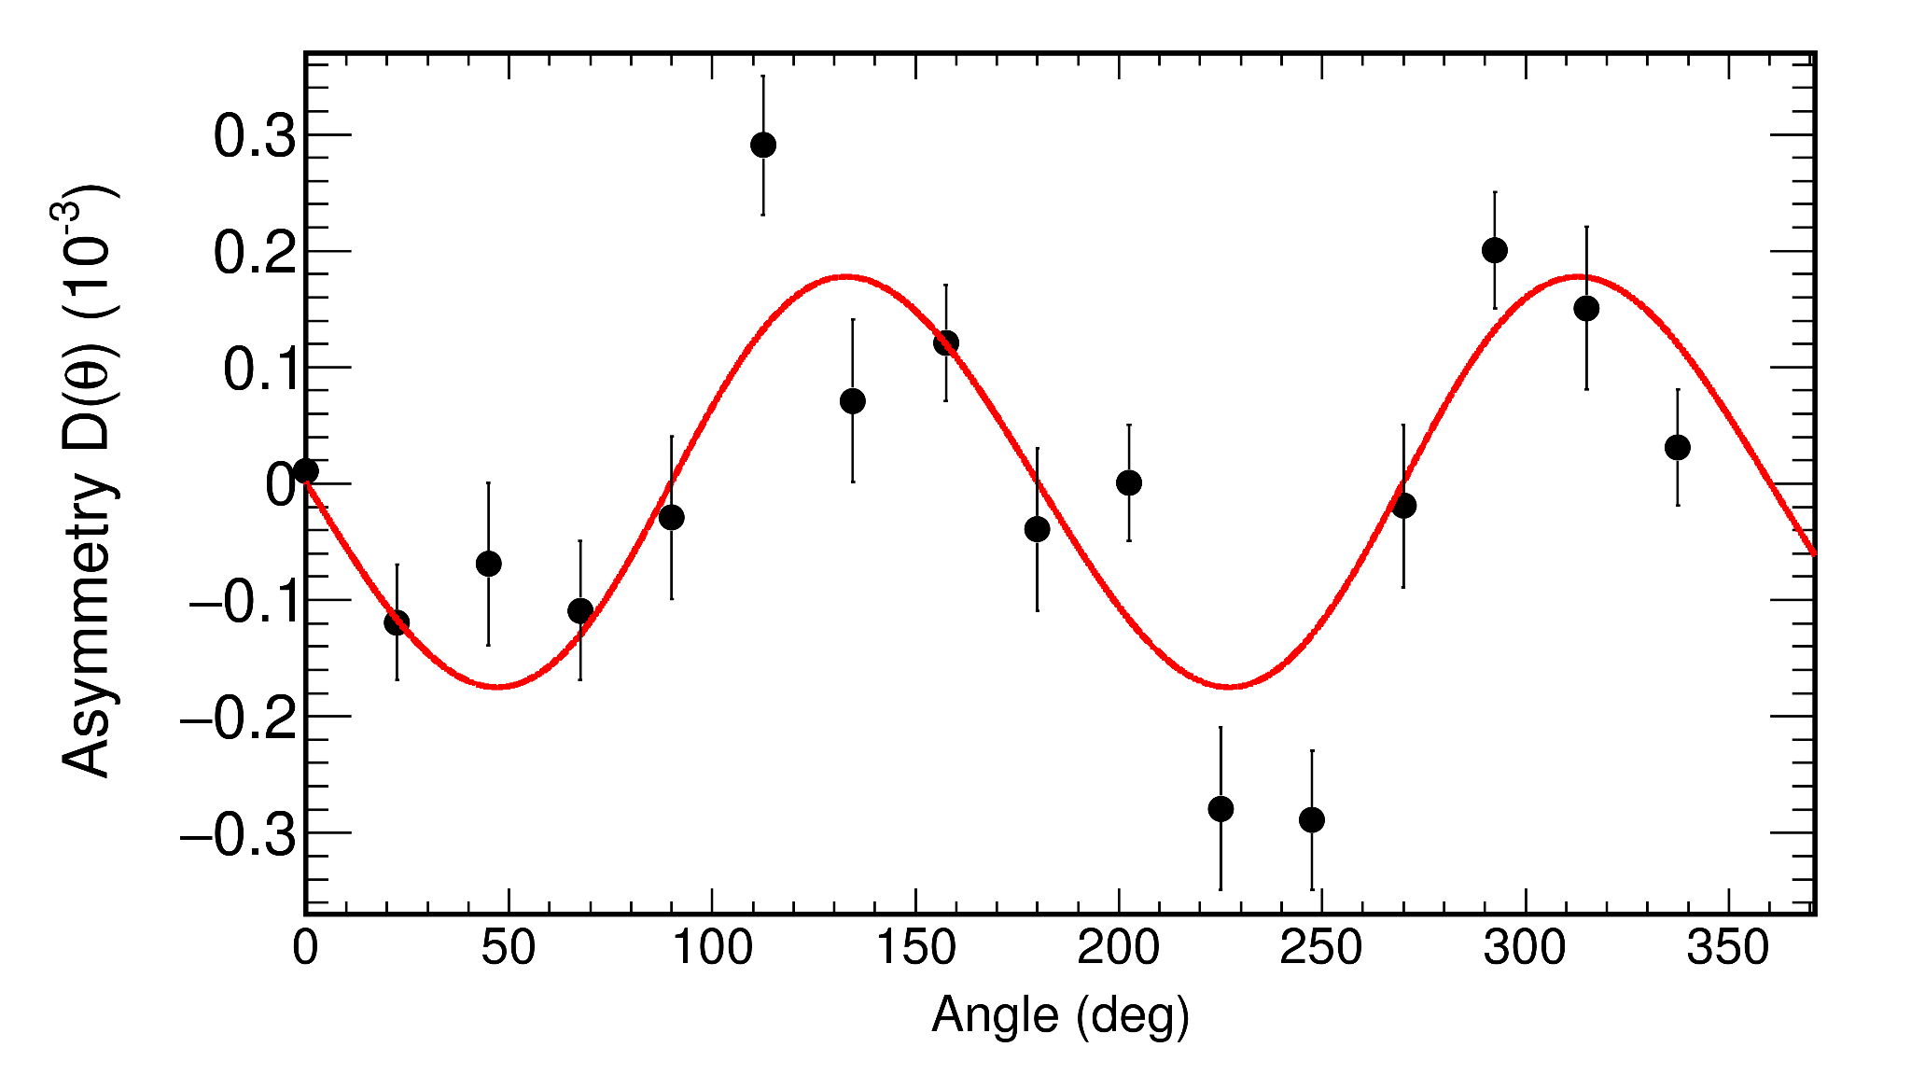
Experiments at the FRM II: ROT-effect in gamma-ray and neutron emission.
Plans to transfer at the IBR-2
Experimental setup: P - SEOP polarizer; Ch - fission chamber surrounded by gamma/neutron detectors; A - analyzer; D - neutron detector; S1,S2 - spin control coils. The blue arrow in the figure indicates the direction of the magnetic field, the red arrow direction of the neutron spin respectively.
Asymmetry ratio D as a function of angle for the gamma-rays
D. Berikov, G. Ahmadov, Yu. Kopatch et. al., Phys. Rev. C 104, 024607 (2021)
D. Berikov, G. Ahmadov, Yu. Kopatch and V. Novitsky, JINST
17, P08030 (2022)
More detailed description in
D. Berikov, V. Hutanu, Yu. Kopatch et al., JINST 15, P01014 (2020)

Slide 10
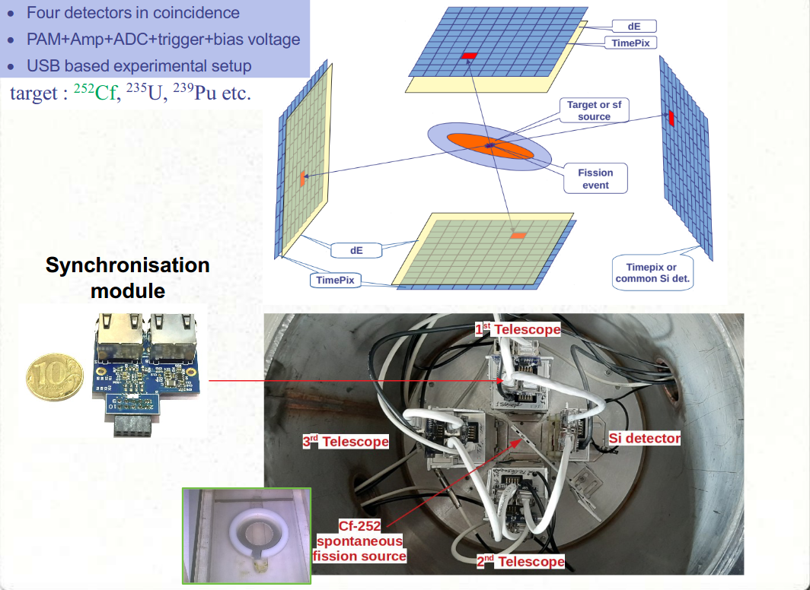
Rare fission mode processes: ternary, quaternary, and quinary.
Goals
Measurement of angular and energy distributions of ternary and quaternary particles from ²⁵²Cf spontaneous fission;
Determination of quaternary fission yields with high accuracy and sensitivity;
Direct observation of ⁸Be emission as a ternary particle in the ground and excited state;
Search for other rare decay modes in fission – e.g. quinary fission;
Measurement of H¹, H² and H³ ternary particles and estimation of their yields.
Principle of the experiment and experimental setup

Slide 11
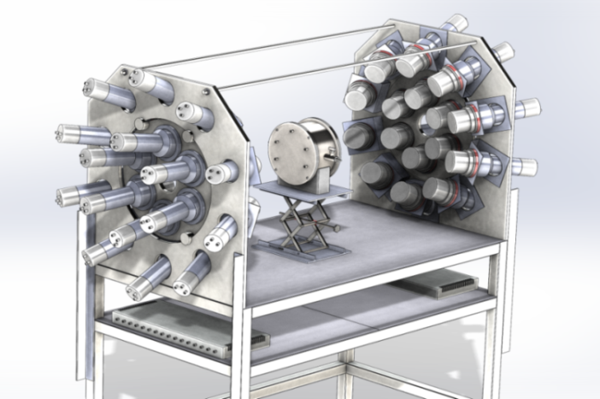
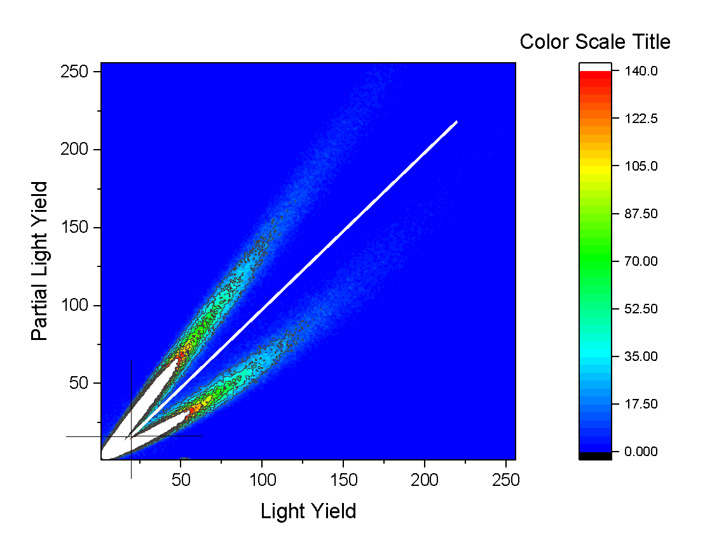
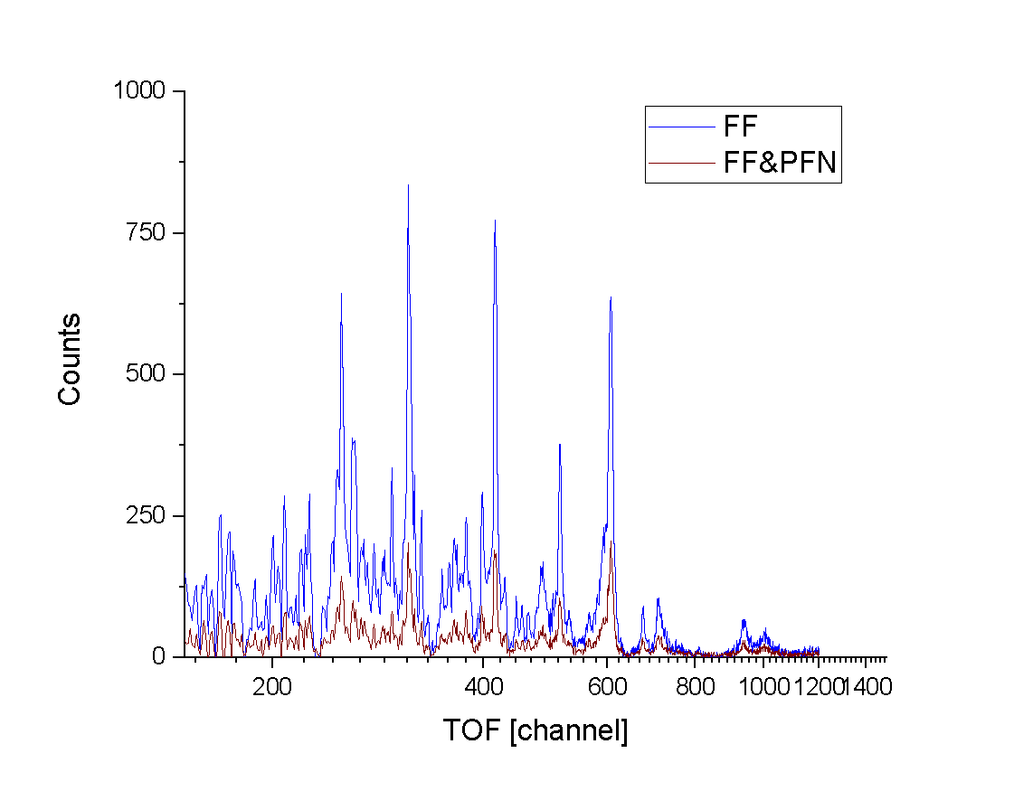
Investigations of neutron nuclear interactions and properties of the neutron.
Fission physics: fission modes and neutron multiplicity
Measurement of the fission process at resonance energies
More details about variety of break-up properties
ЕNGREN
Experimental setup for studying of fission neutron multiplicity and fragment mass distribution
To measure mass distribution a position-sensitive ionization chamber is used
BC501 scintillators are used for neutron registration
Data for ²³⁵U was obtained
IREN facility
It is planned to continue measurements to investigate other fissile nuclei

Slide 12
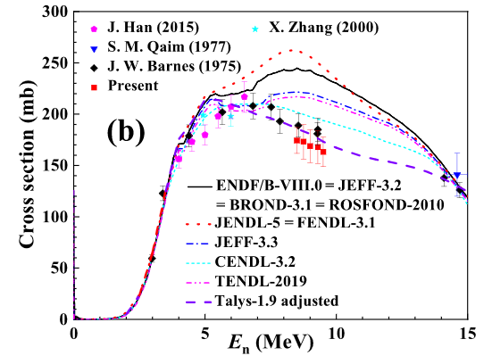
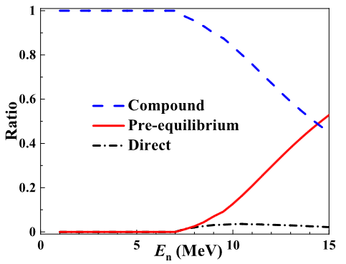
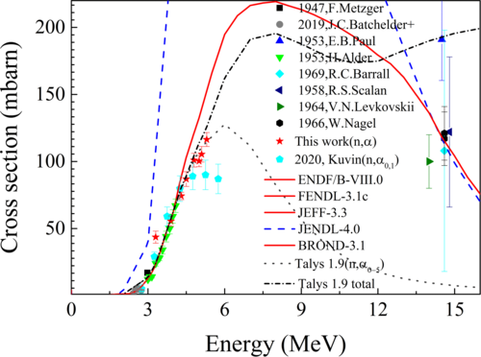
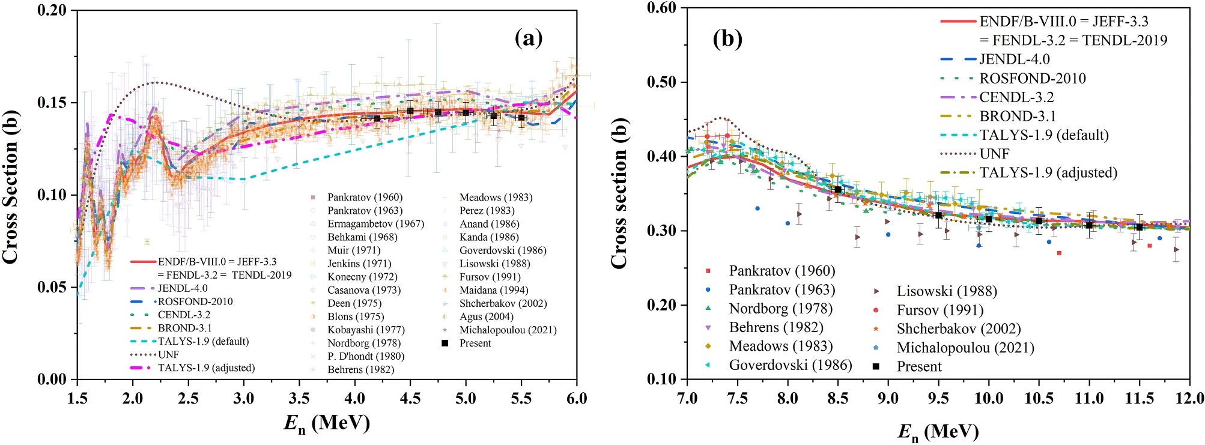
Nuclear Data in MeV region at the Electrostatic Generators
  Nuclear reactions for nuclear data & nuclear theory
Nuclear data is important for modelling of prospective nuclear facilities
Information about nuclear reactions is mandatory for theoretical models verification and adjustment of their parameters
Data on (n,p), (n,α), (n,f)cross-sections and angular distributions is needed to deduce reaction mechanism
⁹¹Zr(n,α), ⁴⁰Ca(n,α), ³⁵Cl(n,α), ^{58,60,61}Ni(n,α), ²³²Th(n,f) reactions cross-sections were measured in FLNP, CIAE (China), PU (China). Data was analyzed to adjust parameters of TALYS 1.9
Haoyu Jiang, Yu. M. Gledenov et.al, Chinese Physics C, 2020
E. Sansarbayar, et.al, Phys. Rev. C 104, 2021
Haoyu Jiang, Yu. M. Gledenov et.al, Chinese Physics C, 2022
Guohui Zhang, E. Sansarbayar,et.al, Phys. Rev. C 106, 2022
Jie Liu, Yu. M. Gledenov, E.et.al, Phys. Rev. C 106, 2022
Yu. M. Gledenov,et.al, EPJ A, 58, 2022
⁴⁰Ca(n,α)
⁴⁰Ca(n,α)
³⁵Cl(n,α)
²³²Th(n,f)
It is planned to continue (n, α) reaction measurements cross sections at ¹⁷¹Yb, ¹⁴⁸Sm, ⁹¹Zr, ⁶³Cu, ³⁵Cl, ¹⁴N and investigate angle correlation.
Modernization of EG-5 is needed

Slide 13
NAA at IBR-2

Slide 14
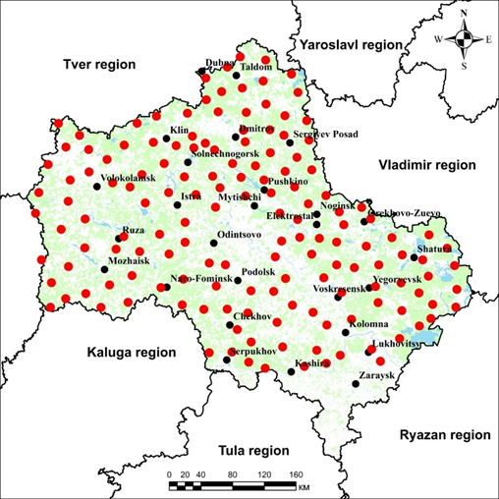

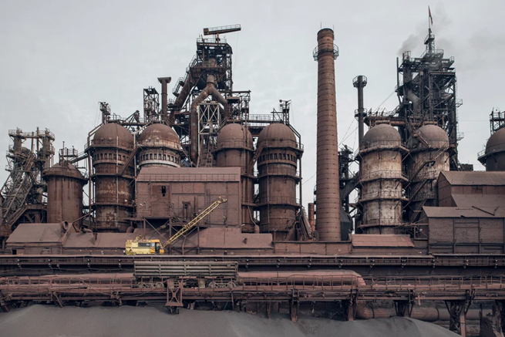
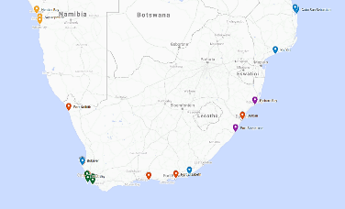
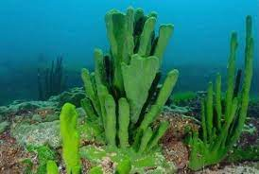

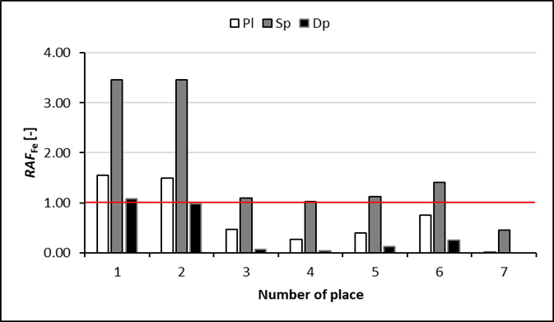
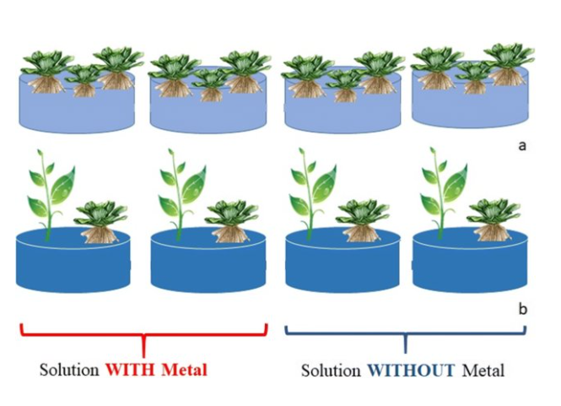


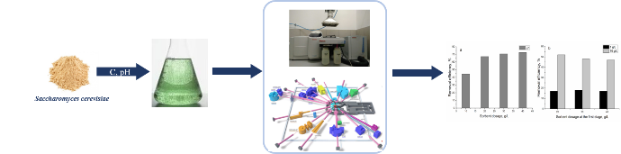
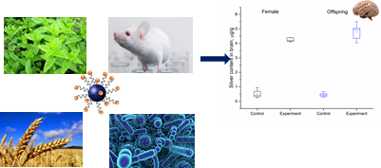


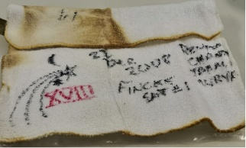
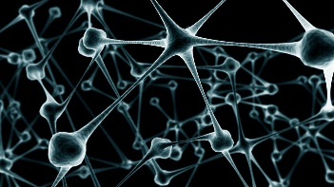
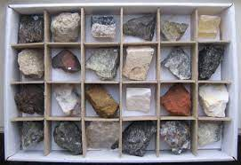
Water biomonitoring
Active and passive biomonitoring
Soil bioremediation
Wastewater treatment
Scientific directions
Nanotoxicology
Food quality assessment
Analysis of extraterrestrial and new materials
Archeology and geology

Slide 15
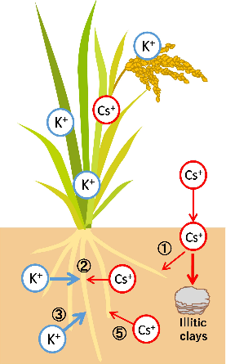

Elemental analysis
Further modernization of the REGATA facility at the IBR-2 reactor;
Application of neural networks for automatization of the gamma spectra processing;
Certification of optical emission spectrometry with inductively coupled plasma for elemental analysis;
Analysis of environmental, biological, archeological, geological samples as well as new materials.
Radioecological investigations
Determination of natural and anthropogenic radionuclides in environmental objects
Study of radionuclides accumulation in soil –plants, water –water organisms systems

Slide 16

Research areas of GNAA –
Group of Neutron Activation Analysis
Development of existing and introduction of new neutron methods at the IREN facility
  Implementation and modernization of the pneumatic transport system for automation of NAA and GAA (poster presentation by V. Lobachev)
  Implementation of PGAA
Applied research
  Cultural heritage studies
  Geo-ecological investigations
Determination of resonance integrals and capture cross sections of several isotopes using IREN facility (in collaboration with Vietnam scientists)

Slide 17
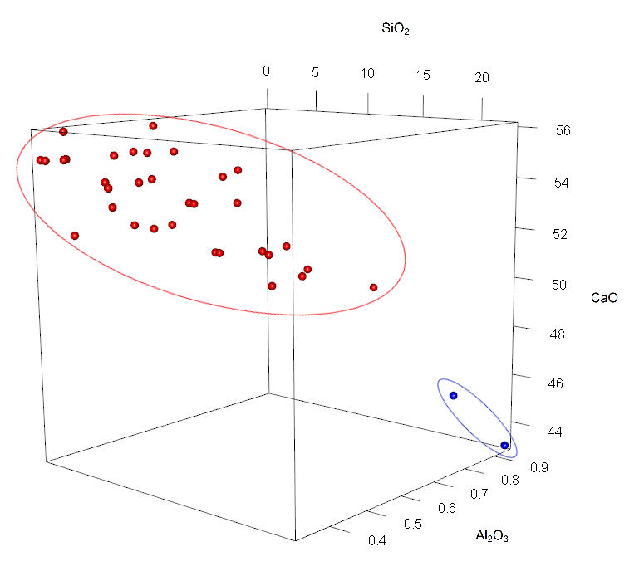

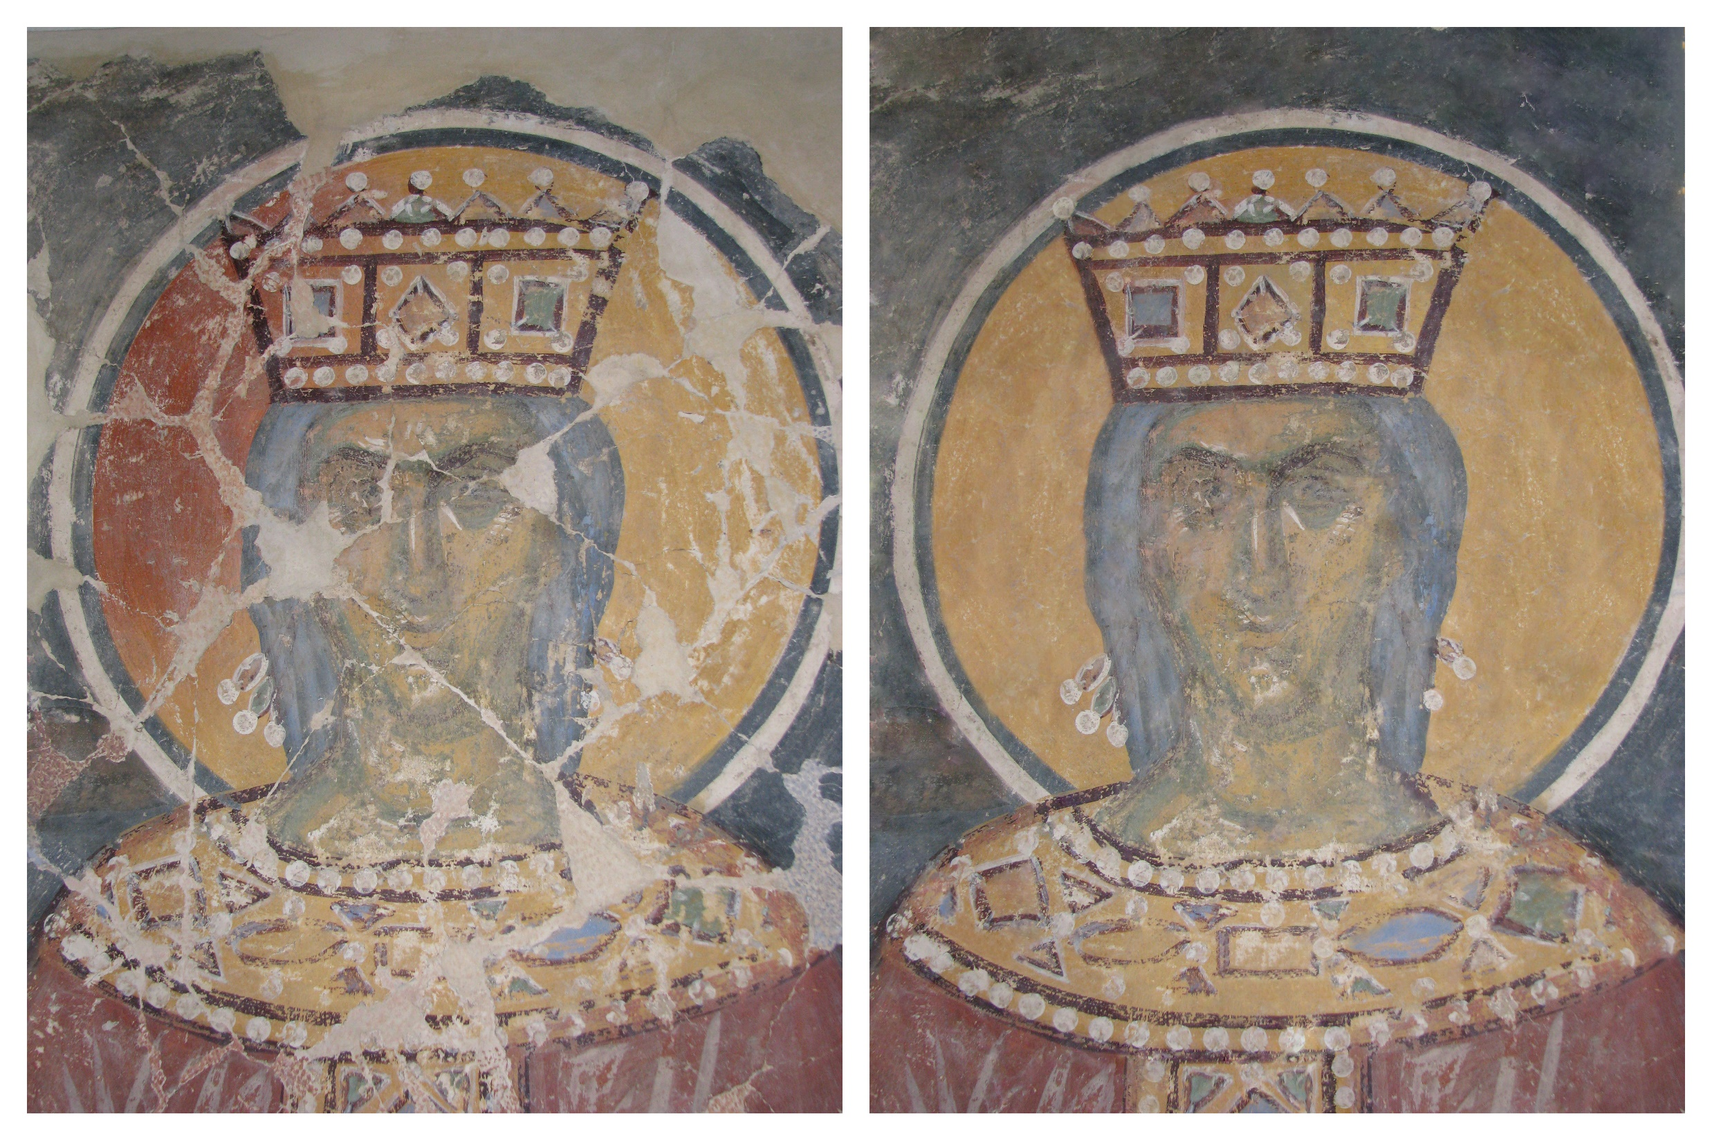
Wall painting investigations
Art history
  Comprehensive interdisciplinary research
    Multiple validation of key results by different analytical methods
    Indirect dating of mural fragments
    Answer actual questions of art history based on the results obtained
    Solving the problem of change in coloration in wall paintings
    Digital reconstruction of presumable original view
Restoration
  Taking part in preparation of restoration projects of unique monuments for the Ministry of Culture
    Christ’s Transfiguration Cathedral of Mirozhsky Monastery in Pskov (12th c.)
    Cathedral of Nativity of Theotokos of Snetogorsky Monastery in Pskov (14th c.)
3D-plot: two 16th c. samples separate from main group of 14th c. fragments
Image of St. Helena
current view digital reconstruction

Slide 18
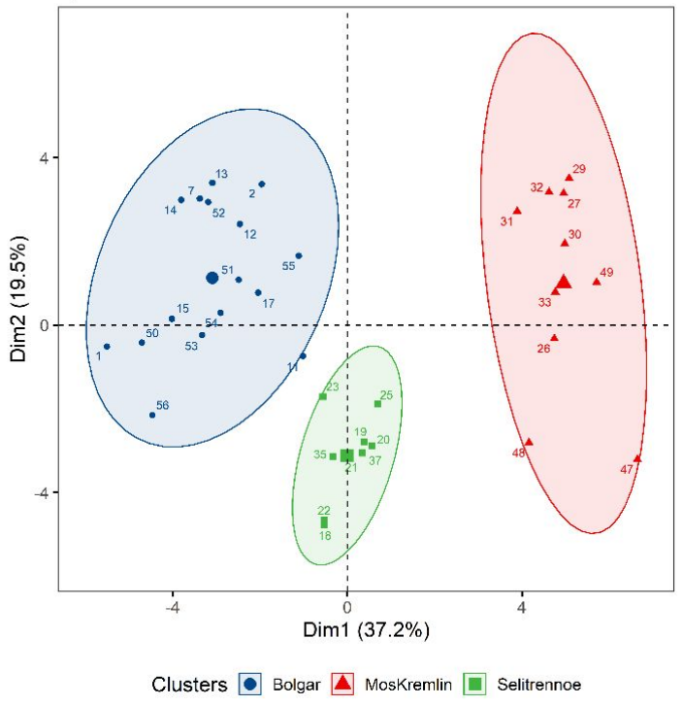
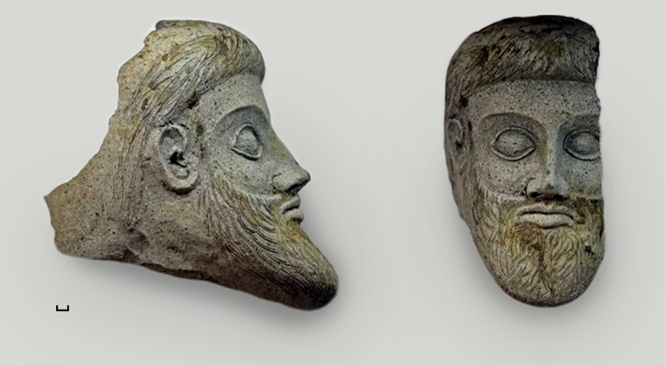
Archaeological investigations
PCA: archaeological ceramics discriminated by locations
Archaeological ceramics
  Elemental analysis
    neutron activation analysis
    prompt gamma activation analysis
    x-ray fluorescence analysis
  Origin determination
    statistical treatment of data obtained
    first dataset of archaeological ceramics collected from three different locations in Russia (Bolgar, Moscow Kremlin, Selitrennoe settlement)
  Raw materials origin determination
    antique terracotta found during the construction of the Crimean bridge was studied
    origin of raw materials for the manufacture of antique terracotta was revealed
antique terracotta

Slide 19
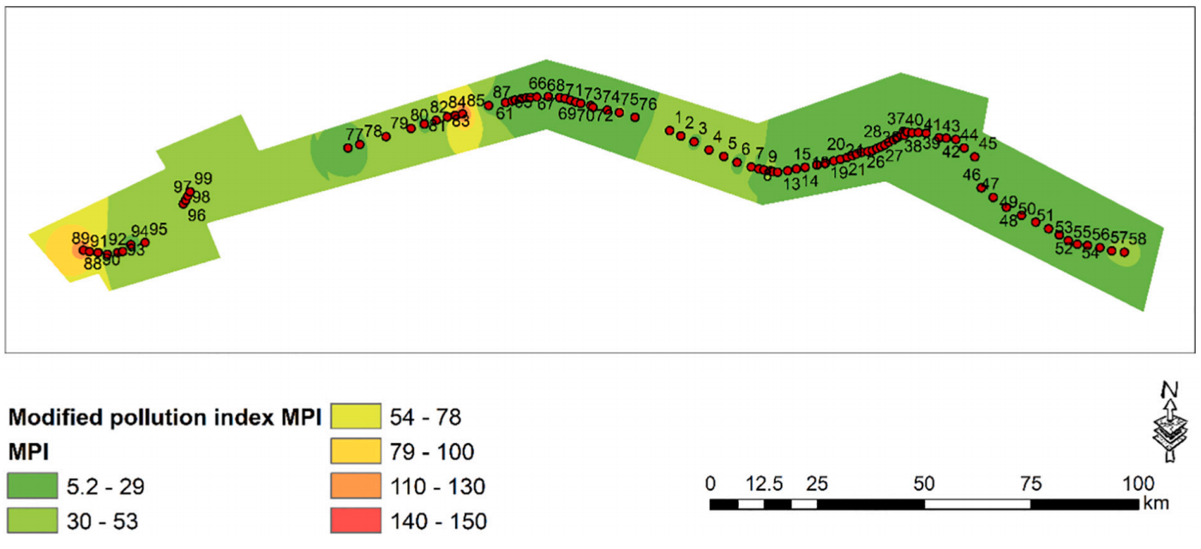
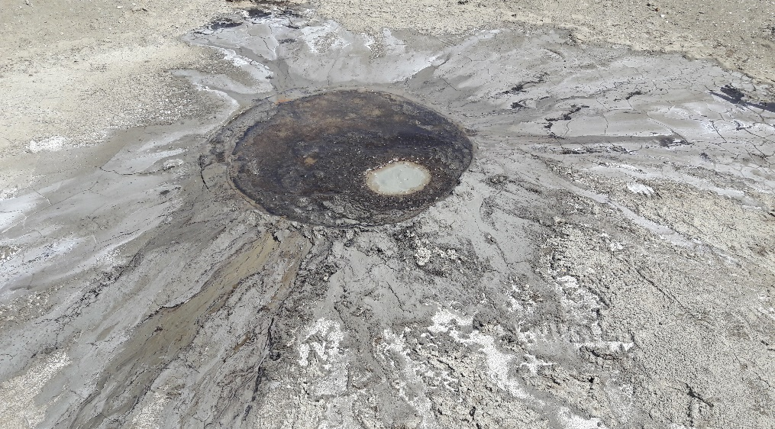
Geo-ecological investigations
Spatial distribution of MPIs for Egyptian samples
Ecological
  coastal sediments along the Egyptian Mediterranean Sea
    pollution indices were calculated and mapped
    four places were revealed with elevated concentrations of the elements
  air pollution in the Czech Republic
    transboundary transfer of combustion products of coal (used for local heating in Poland) was established
Geological
  rock samples from Egypt mines
    remarkable amounts of gold were found
    directions with elevated amounts of gold were identified
  mud volcanos from Azerbaijan
    stratigraphic age of solid emissions from mud volcanoes was determined
mud volcano Agzybir

Slide 20
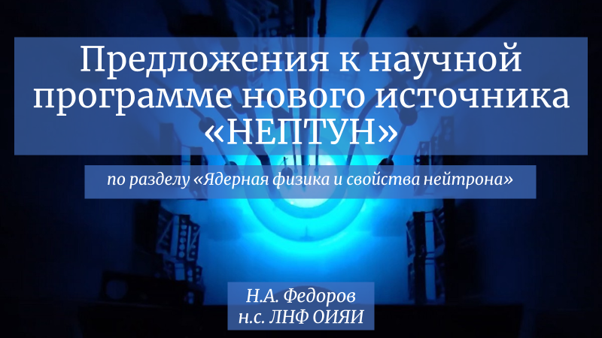
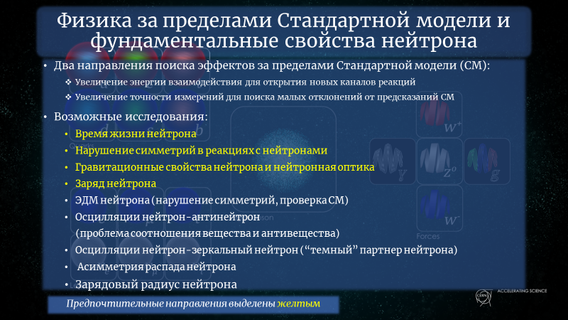
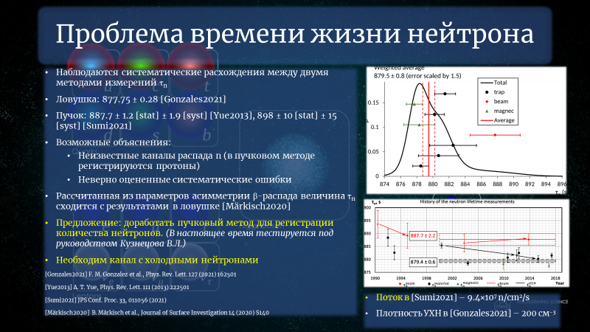
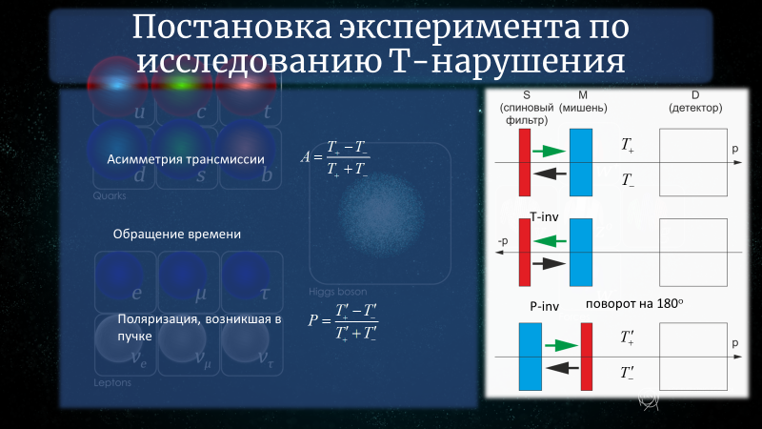
Conclusion

Slide 21
Thank you for your attention!
KEEP WELL!

