Slide 1
ADSR project
(Accelerator Driven Subcritical Reactor)
Proposal for extension of the project
Mihaela Paraipan
(on behalf of the team)
1

Slide 2
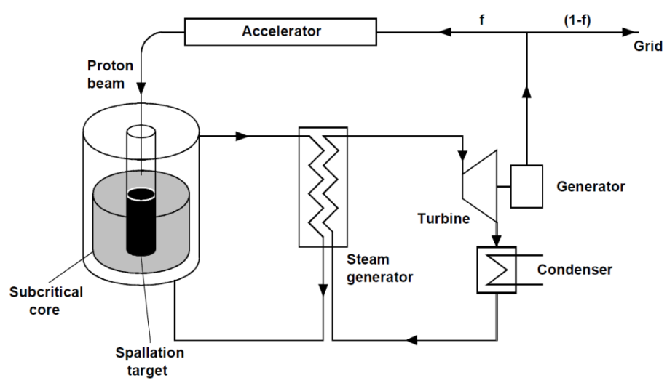

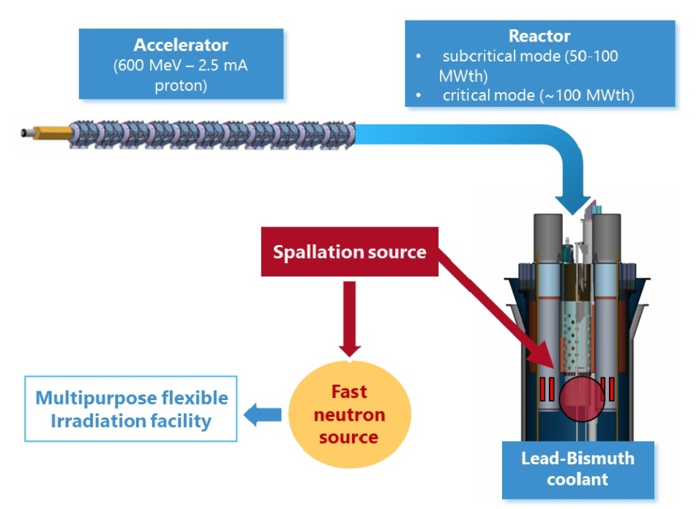
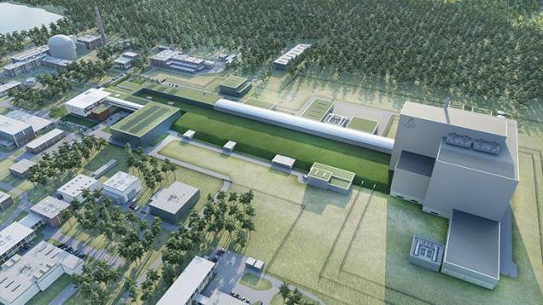
ADSR as energy amplifier
Advantages:
- the reactor works in subcritical regime – safer exploitation
- harder neutron spectrum – better incineration of the actinides
The almost generalized opinion is that the optimal beam for ADSR is a proton beam with energy around 1-1.5 GeV [1-3].
Project MYRRHA
Rubbia C. et al. . CERN/AT/93-47, November 1993.
Hashemi-Nezhad S.R. et al. Ann. Nucl. En. 38 (2011) 1144–1155
Zhao, Z. et al. Prog. Nucl. Energy 71 (2014).
2

Slide 3
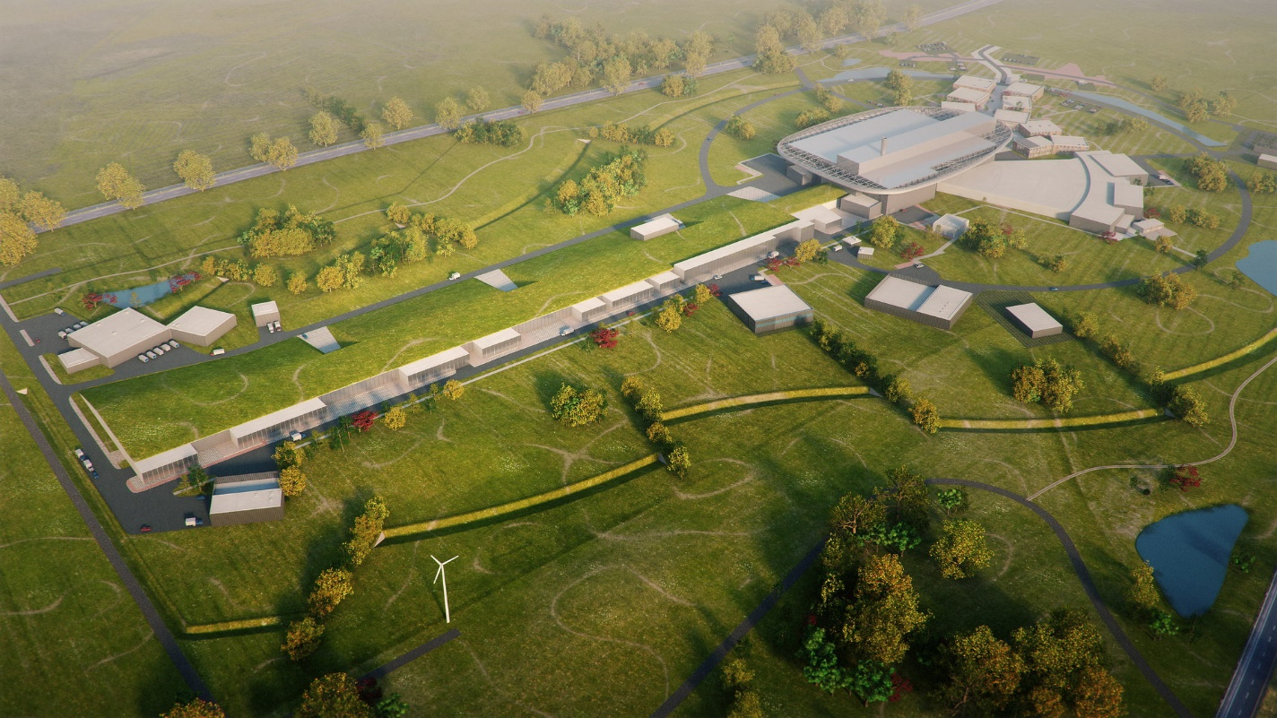
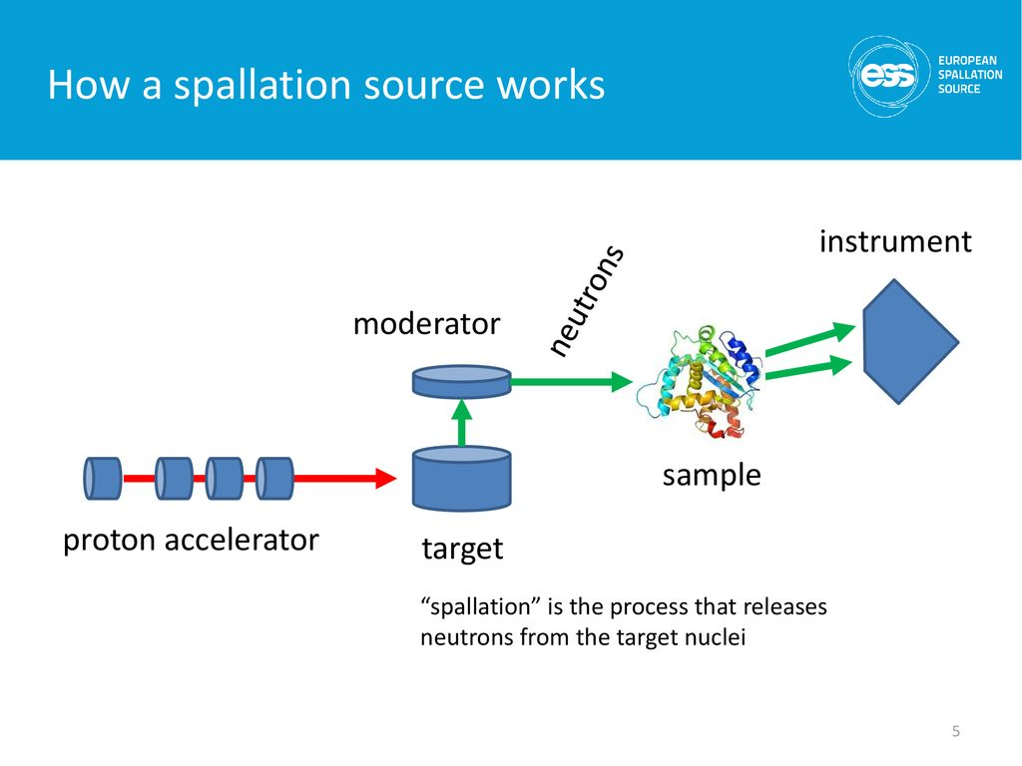
European Spallation Source
J. Womersley, 2016
The European Spallation Source is under construction in Lund, Sweden.
Leading neutron sources, enabling new opportunities for researchers in various fields: materials and life sciences, energy, environmental technology, cultural heritage and fundamental physics.
Facilities based on the principle of spallation reaction are the neutron sources for research purposes.
3

Slide 4


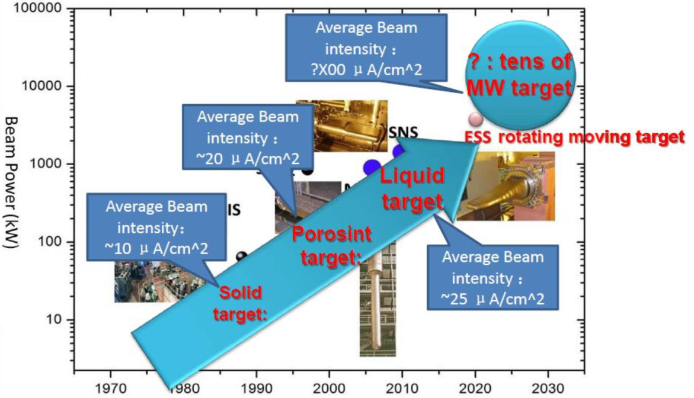
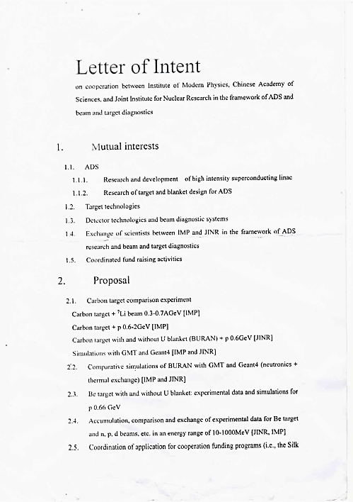
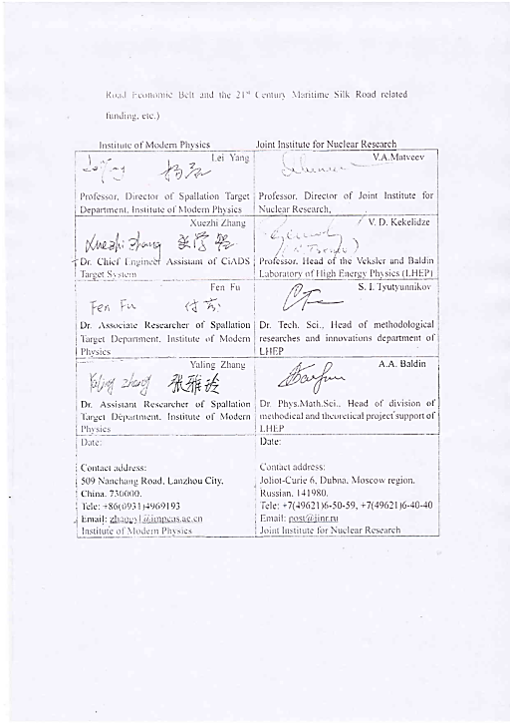
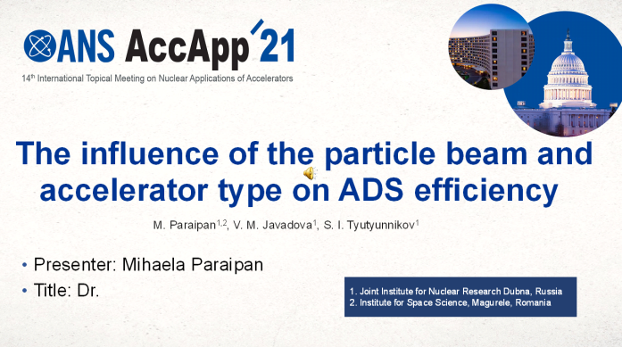
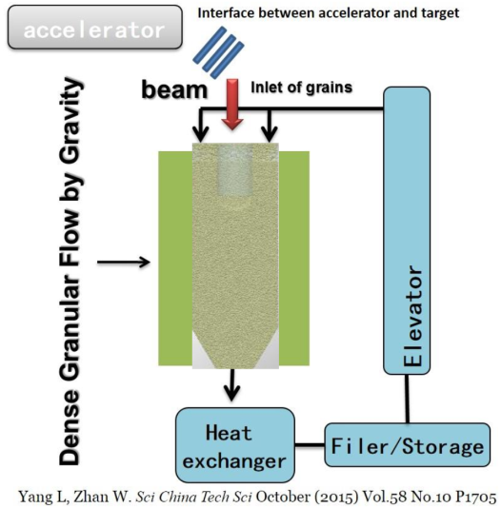
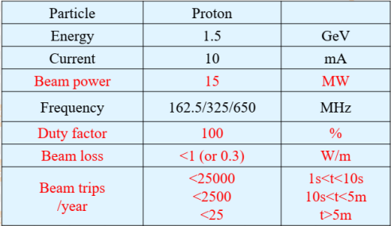
Chinese ADS project
Letter of Intent
on cooperation between JINR and Institute of Modern Physics of Chinese Academy of Sciences in the field of ADS (2019)
M. Paraipan, V. M. Javadova & S. I. Tyutyunnikov (2023), Influence of Particle Beam and Accelerator Type on ADS Efficiency, Nuclear Science and Engineering, DOI: 10.1080/00295639.2023.2175582
4

Slide 5
Main objectives of the project
Experimental study on the influence of the material used for the converter by measurement of the neutron yield for various beam-converter combinations.
The design of an extended graphite target for the experimental verification of the efficiency of proton and ion beams with different converters.
Factors which influence the efficiency of ADSR
A systematic study of the conditions which maximize the energy gain, ensure high fuel burnup and long period between refueling:
- factors related with the core structure and composition
- particle beam and energy
- accelerator type
5

Slide 6
Core optimization
M. Paraipan, V. M. Javadova, S. I. Tyutyunnikov, Aspects of target optimization for ADS with light ion beams at energies below 0.5 AGeV, Progr. Nucl. En. 120 (2020) 103221
M. Paraipan, A. A. Baldin, E. G. Baldina, S. I. Tyutyunikov, Conceptual Design of Accelerator Driven Systems with Light Ion Beams, Nuovo Cimento 42 C (2019) 66
The core is an assembly of fuel rods surrounding the converter and immersed in a bath of coolant.
Fuel composition: metal (alloy U-Pu-Zr), carbide, oxide
Cooling with Pb, Pb-Bi eutectic (LBE), and Na.
The variation in actinide composition and the cooling with metals conserve the shapes of the neutron spectra and the ratio between the energies deposited by different ions.
The scheme of the target.
Regarding the core, three factors are the most relevant for the functioning of ADSR:
- the material used for the converter.
- the level of enrichment
- the working value of k_{eff}.
6

Slide 7
The choice of the converter
Light materials are preferable especially for ion beams at low energy.
The best results are obtained with Be converter. Besides the increase in ion range, Be acts as good neutron moderator and reflector.
The energy released increases with the increase of the dimensions of the converter.
One relevant advantage of a Be converter with high dimensions is the fact that allows to diminish the level of enrichment, increasing the period of functioning without refueling and the burn-up.
The neutron spectra in fuel blanket with Li, Be, C and LBE converters, irradiated with a beam of ⁷Li with energy 0.3 AGeV.
The level of enrichment
cores with metallic fuel (U-Pu-10%wtZr), k_{eff} 0.988, but with different enrichment, irradiated with a beam of ⁷Li with energy 0.25 AGeV and intensity 1.25·10¹⁶. The converter is a Be cylinder with radius 10 cm, and length 120 cm. The thermal power is 550 MW.
A lower level of enrichment is preferable because it ensure longer period between refueling and higher burning of the actinides.
With a proper core configuration the fuel allows to burn in ADS until 25 % from actinides in one cycle, in comparison with 6-7 % in a fast reactor.
The evolution of ²³⁹Pu in cores with 5.6%, 7.8% and 8.9% ²³⁹Pu, irradiated with a beam of ⁷Li with energy 0.25 AGeV and intensity 1.25‧10¹⁶.
7

Slide 8
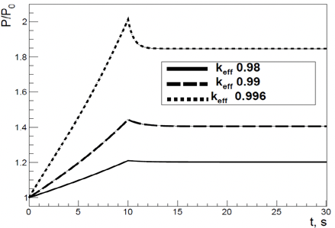
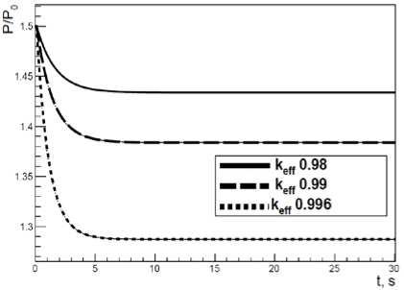
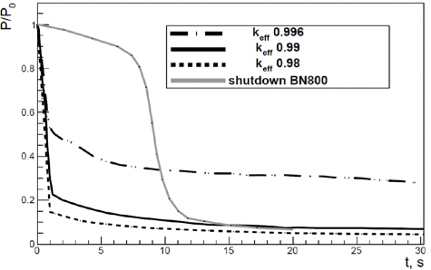
Optimal value of k_{eff}
The optimal value of k_{eff} must be able to ensure in the same time a safe exploitation and a maximum energy gain.
UTOP (unprotected transient overpower)
UBOP (unprotected beam overpower)
Beam shutdown
b)
c)
a)
The power evolution in UTOP (a), in UBOP (b) transients and after the beam turn off (c) in ADS with U-Pu-10%Zr fuel and k_{eff} 0.98, 0.99, 0.996.
Values of k_{eff} below 0.99 are advantageous from the point of view of the evolution of UTOP transient.
In the case of UBOP transient a higher initial value of k_{eff} is favorable because conduces to a new steady state at a power level closer to the initial one.
From the point of view of the quick shutdown of the reactor after the beam stopping a k_{eff} 0.99 is safe enough.
A working value of 0.985-0.988 for k_{eff} would be safe enough.
8

Slide 9
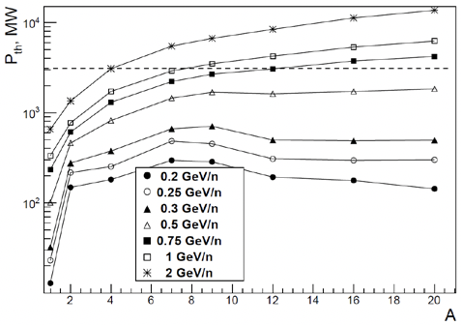
Beam and accelerator
A core optimized for ADS (metallic rods U-Pu-Zr, LBE coolant, Be converter with length 110 cm, k_{eff} 0.985) was used in simulation. The core was irradiated with protons and ion beams from D to ²⁰Ne, energies from 0.2 AGeV to 2 AGeV and beam intensity 1.5·10¹⁶ p/s.
M. Paraipan, V. M. Javadova & S. I. Tyutyunnikov (2023), Influence of Particle Beam and Accelerator Type on ADS Efficiency, Nuclear Science and Engineering, DOI: 10.1080/00295639.2023.2175582
The system capacity to remove the heat limits the maximum thermal power in ADSR at approximately 3 GW.
The objective to maximize the efficiency imposes the use of beams with intensity as high as possible.
The values of the energy released correlated with the beam intensity limit the maximum ion energy that can be used in ADSR. In our conditions we can accelerate ⁷Li and ⁹Be until ~ 1 AGeV, while ¹⁶O and ²⁰Ne at maximum 0.75 AGeV.
The thermal power as a function of projectile mass number and energy.
9

Slide 10
Linear accelerator
a)
b)
The energy gain G (a) and the net electrical power produced P_{net} (b) as a function of projectile energy for particles accelerated in a linac, core with k_{eff} 0.985.
A beam of ⁷Li 0.25 AGeV realizes the same P_{net} as a beam of 1.5 GeV proton with the minimal length of the accelerator (length 2.5 times smaller than for proton).
10

Slide 11
Cyclotron
a)
b)
The energy gain G (a) and the net electrical power produced P_{net} (b) as a function of projectile energy for particles accelerated in a cyclotron, core with k_{eff} 0.985.
Optimal energy of proton beam is ~ 1 GeV with G ~ 12.
A beam of ⁷Li with energy 0.2 AGeV is equivalent with 1 GeV proton beam with respect to the energy gain and the net power produced.
Ion beams starting with ⁷Li and energy above 0.3 AGeV realize 2-3 times higher G.
11

Slide 12
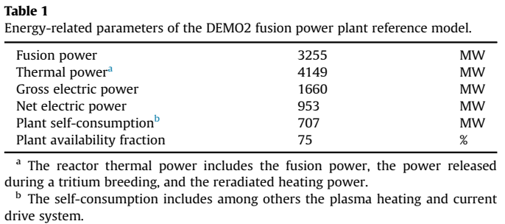
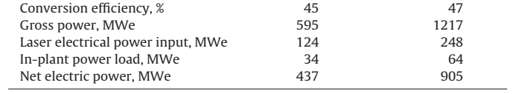
Comparison with fusion power plants
ITER project – magnetic plasma confinement
LIFE project – laser inertial plasma confinement
G ~ 3
G ~ 4
Entler S., Horacek J., Dlouhy T., Doctal V., Approximation of the economy of fusion energy, Energy 152 (2018) 489-497
Meier W.R. et al., Fusion technology aspects of laser inertial fusion energy (LIFE), Fusion Engineering and Design 89 (2014) 2489-2492
The values of energy gain that could be achieved in ADSR are significantly higher (until 10 times) that the G values estimated for fusion power plant.
12

Slide 13
Proposals for future experiments
The most relevant data about the efficiency of proton and ion beams are obtained in experiments with fuel blanket.
The design of the experimental target must reproduce at a small scale the situation in a real ADSR. It should allow also to check the effect of converters with length until 110 cm.
The interest is to determine the minimal dimensions and minimal amount of fuel necessary for a correct reproduction of the ratio of the energy released (amount of fissions) produced with proton and ion beams.
Paraipan M., Kryachko I. A., Javadova V. M., Levterova E. A., Tyutyunnikov S. I., Main Results of Neutronical Study about ADS with Ion Beams and Implications on Experiments Planning, Phys. Part. Nucl. Lett. 19 2 (2022) p. 129-144
The design of the graphite target GAMMA-4
13

Slide 14
Summary of the proposal
In previous years, the conditions which maximize the efficiency of ADSR were investigated. The main factors related with the core, relevant for the ADSR efficiency are the criticality coefficient of the core k_{eff} , the material used for the converter and the level of the enrichment. The optimal value of k_{eff} is in the range 0.985 - 0.988.
It was suggested that the best choice for the converter is Be, especially for ion beams at low energy. A converter with radius 10-20 cm and length 100-120 cm maximizes the energy released and lowers the necessary level of enrichment, ensuring larger period between refueling and higher actinide burn-up. In ADSR until 25 % from the actinides can be fissioned during a cycle, 3.5 times more than it can be achieved in a fast reactor.
The maximum energy gain of protons is obtained at 1.5 GeV when they are accelerated in a linac, and at lower energy (0.75-1 GeV) when a cyclotron is used. In both situations ion beams starting with ⁴He realize higher energy gain than protons. When particles are accelerated in a linac, at low accelerator length a beam of ⁷Li with energy 0.25 AGeV represents the best option. High energy gain from 20 (with 0.25 AGeV ⁷Li beam) to 45 (with 0.75 AGeV ¹⁶O and ²⁰Ne beam) can be obtained in ADSR, which makes ADSR an efficient source of energy.
Within the next 4 years the ADSR project will be concentrated on:
Research activities, involving simulation study, on an optimal design of the target;
Verification of a principally new concept of a system based on the use of ion beams instead of protons;
Implementation of the first stage of experimental program focused on measurement of the
neutron yields with different converter combinations.
14

Slide 15
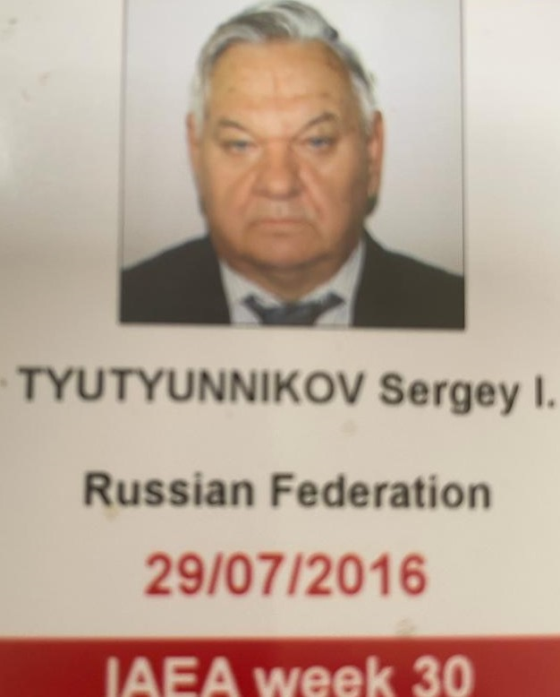

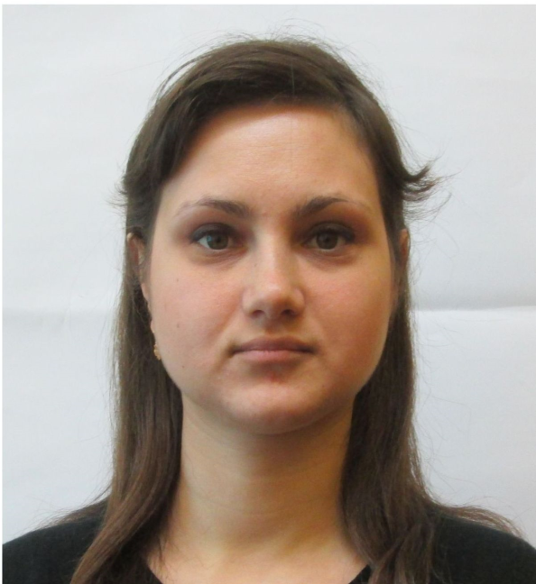



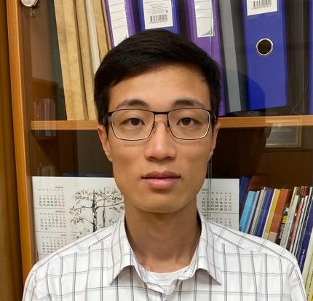
Project team
Mihaela Paraipan
Krystsina Husak
Vafa Javadova
Sergey Tyutyunnikov
Toan Tran
Polina Sushkova
Igor Kryachko
15

Slide 16
Manpower
For the first year of implementation
JINR staff 8.6 FTE
associated personel from partner organizations 10.5 FTE
Financing: total estimated cost (for 4 years period)
780000 USD

Slide 17
Main papers by the team
Paraipan M., Javadova V. M., Tyutyunnikov S. I., The influence of the particle beam and accelerator type on ADS efficiency, Nucl. Sci. Eng. (2023), DOI: https://doi.org/10.1080/00295639.2023.217558
Paraipan M., Javadova V. M., Tyutyunnikov S. I., Aspects of target optimization for ADS with light ion beams at energies below 0.5 AGeV, Progr. Nucl. En. 120 (2020) 103221
Paraipan M., Kryachko I. A., Javadova V. M., Levterova E. A., Tyutyunnikov S. I., Main Results of Neutronical Study about ADS with Ion Beams and Implications on Experiments Planning, Phys. Part. Nucl. Lett. 19 2 (2022) p. 129-144
Baznat M. et al., Cascade models in simulation of extended heavy targets irradiated by accelerated proton and deuteron beams, Phys. Part. Nucl. 53, 5 (2022), p. 1000-1020.
A.Baldin et al., Using TFBC for the neutron field characterization in experiments on “QUINTA” setup, Phys. Part. Nucl. 52, 6 (2022), p. 1033-1043.
Paraipan M., Javadova V. M., Tyutyunnikov S. I., High efficiency ADS, International Conference “Modern Problems of Nuclear Energetics and Nuclear Technologies”, Institute of Nuclear Physics of Uzbekistan Academy of Sciences, Tashkent, Uzbekistan (2021)
Paraipan M., Javadova V. M., Tyutyunnikov S. I, Target design for experimental investigation of ADS with proton and light ion beams, LXXII International conference "Nucleus-2022", Lomonosov Moscow State University, Moscow, Russia (2022)
Paraipan M., Javadova V. M., Tyutyunnikov S. I, Perspectives of ADS with protons and light ion beams, IV International Scientific Forum “NUCLEAR SCIENCE AND TECHNOLOGIES” dedicated to the 65th anniversary of the Institute of Nuclear Physics, Алматы, Казахстан (2022)
Paraipan M., Javadova V. M., Tyutyunnikov S. I, The influence of the particle beam and accelerator type on ADS efficiency, 14th International Topical Meeting on Nuclear Applications of Accelerator AccApp`21, Washington DC, USA (2021)
16

Slide 18
Thank you for your attention!
17

Slide 19
Backup slides
18

Slide 20
References
Rubbia C. et al., "An Energy Amplifier for cleaner and inexhaustible nuclear energy production driven by a particle beam accelerator”. CERN/AT/93-47, November 1993.
Hashemi-Nezhad S.R., Westmeier W., Zamani-Valasiadou M., Thomauske B., Brandt R., Optimal ion beam, target type and size for accelerator driven systems: Implications to the associated accelerator power, Ann. Nucl. En. 38 (2011) 1144–1155
Zhao, Z., Chen, Z., Chen, H., Preliminary optimization of proton energy and target for Lead- Bismuth Eutectic target of a demonstration ADS. Prog. Nucl. Energy 71 (2014).
Paraipan, M., Javadova. V., Tyutyunnikov S. I., Aspects of target optimization for ADS with light ion beams at energies below 0.5 AGeV, Progress in Nuclear Energy 120 (2020) 103221
Paraipan M., Baldin A. A., Baldina E. G., Tyutyunikov S. I., “Light Ion Beams for Energy Production in ADS”, EPJ Proceedings MMCP2017, 173 (2018) 04011; Ann. Nucl. En.,110 (2017) p 973.
M. Paraipan, V. M. Javadova & S. I. Tyutyunnikov (2023), Influence of Particle Beam and Accelerator Type on ADS Efficiency, Nuclear Science and Engineering, DOI: 10.1080/00295639.2023.2175582
Yu.K. Alexandrov, V.A. Rogov, A.S. Shabalin, “Main features of the BN-800 passive shutdown rods”, Proceeding of a Technical Committee meeting held in Obninsk, Russian Federation, 3-7 July 1995, IAEA-TECDOC-884, p. 107-112
Paraipan M., Kryachko I. A., Javadova V. M., Levterova E. A., Tyutyunnikov S. I., Main Results of Neutronical Study about ADS with Ion Beams and Implications on Experiments Planning, Phys. Part. Nucl. Lett. 19 2 (2022) p. 129-144
Tohru Suzuki, Xue-Nong Chen, Andrei Rineiski, Werner Maschek, Transient analyses for accelerator driven system PDS-XADS using the extended SIMMER-III code, Nuclear Engineering and Design 235 (2005) 2594–2611
Rui Li, Xue-Nong Chen, Claudia Matzerath Boccaccini, Andrei Rineiski, Werner Maschek, Study on Severe Accident Scenarios: Pin Failure Possibility of MYRRHA-FASTEF Critical Core, Energy Procedia 71 (2015) 14 – 21
ESS Technical Design Report April 23, 2013 ESS-doc-274
Craddock M. K., Symon K. R., “Cyclotrons and Fixed-Field Alternating-Gradient Accelerators”, Reviews of Accelerator Science and Technology, 1(1), pp. 65-97 (2008)
M. Okamura et al., “Demonstration of an intense lithium beam for forward‑directed pulsed neutron generation”, Scientific Reports 12, 14016 (2022) https://doi.org/10.1038/s41598-022-18270-0.
Entler S. et al., Approximation of the economy of fusion energy, Energy 152 (2018) 489-497
Meier W.R. et al., Fusion technology aspects of laser inertial fusion energy (LIFE), Fusion Engineering and Design 89 (2014) 2489-2492
19

Slide 21

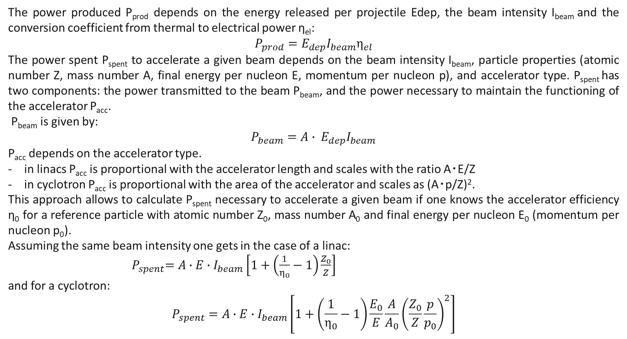
The energy gain factor G is used as measure of the energy efficiency. It is defined as the ratio of the produced electrical power P_{prod} to the power spent to accelerate the beam P_{spent} :
The power produced P_{prod} depends on the energy released per projectile Edep, the beam intensity I_{beam} and the conversion coefficient from thermal to electrical power η_{el}:
$${P_{prod}=E_{dep}I}_{beam}η_{el}$$
The power spent P_{spent} to accelerate a given beam depends on the beam intensity I_{beam}, particle properties (atomic number Z, mass number A, final energy per nucleon E, momentum per nucleon p), and accelerator type. P_{spent} has two components: the power transmitted to the beam P_{beam}, and the power necessary to maintain the functioning of the accelerator P_{acc}.
P_{beam} is given by:
$${P_{beam}={A∙ E}_{dep}I}_{beam}$$
P_{acc} depends on the accelerator type.
in linacs P_{acc} is proportional with the accelerator length and scales with the ratio A‧E/Z
in cyclotron P_{acc} is proportional with the area of the accelerator and scales as (A‧p/Z)².
This approach allows to calculate P_{spent} necessary to accelerate a given beam if one knows the accelerator efficiency η₀ for a reference particle with atomic number Z₀, mass number A₀ and final energy per nucleon E₀ (momentum per nucleon p₀).
Assuming the same beam intensity one gets in the case of a linac:
${ P}_{spent}=A∙E∙I_{beam}\left[1+\left(\frac{1}{η_{0}}−1\right)\frac{Z_{0}}{Z}\right]$
and for a cyclotron:
$$P_{spent}=A∙E∙I_{beam}\left[1+\left(\frac{1}{η_{0}}−1\right)\frac{E_{0}}{E}\frac{A}{A_{0}}{\left(\frac{Z_{0}}{Z}\frac{p}{p_{0}}\right)}^{2}\right]$$
20

Slide 22
Doses
Lateral detector
Backward
detector
Forward
detector
Beam
a)
b)
c)
The set-up used for the simulation of the source term (a), the neutron fluence in the forward (b) and lateral (c) detectors.
The source term - neutron doses in lateral, backward and forward detectors.
The shielding of the experimental room.
21

Slide 23
The neutron fluence in the fuel rods placed in Pb target (a), and GAMMA4 target (b) with different converters, irradiated with 0.25 AGeV ⁷Li.
The energy released and the number of fissions obtained in GAMMA4 target irradiated with proton,⁷Li and ²⁰Ne beams.
22

