Slide 1

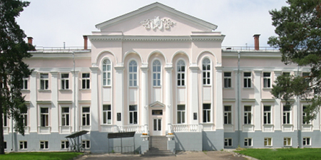
A Study of the Nucleon Spin Structure in Strong and Electromagnetic Interactions
Experiments with Polarized Targets and Beams
Project ”GDH & SPASCHARM & NN”
Dubna – Protvino – Prague – Moscow – Mainz – Glasgow– Basel – Lund – Zagreb – Pavia – Kharkov – Bochum – Bonn– Giessen– Kent – Regina – Sackville – Washington – York
2023

Slide 2
V.P. Dzhelepov Laboratory of Nuclear Problems, JINR
N.A. Bazhanov, N.S. Borisov, A.S. Dolzhikov, A.N. Fedorov,
I.V. Gapienko, I.S. Gorodnov, G.M., V.L. Kashevarov,
A. Kovalik, E.S. Kuzmin, A.B. Neganov, Yu.A. Plis, A.A. Priladyshev, A.B. Sadovski, Yu.A. Usov, Yu.N. Uzikov, V.P. Volnikh
N.N. Bogoliubov Laboratory of Theoretical Physics, JINR
S.B. Gerasimov
V.I. Veksler and A.M. Baldin Laboratory of High Energy Physics, JINR
V.V. Fimushkin, L.V. Kutuzova, M.V. Kulikov
Leader of the Project Yu.A. Usov
Deputies of the Leaders I.S. Gorodnov, Yu.A. Plis

Slide 3
The project consists of three main parts:
1. GDH
- A2 Collaboration at MAMI, Mainz
Participation from 2008. 21 papers were already published. A lot of talk at different International Conferences and A2 Collaboration Meetings were presented.
- CBELSA/TAPS Collaboration, Bonn
- P2 Collaboration at MESA, Mainz
2. SPASCHARM
3. NN
Technically, three parts of the project are unified by the use of frozen-spin polarized proton and deuteron targets. Participation of LNP team in beam experiments is with full responsibility for the operation of a polarized target.
Participation from 2018. Preliminary results were presented.
Participation from 2019. Research and development stage.
Participation from 1978.
Participation from 1984.

Slide 4
This project covers three spin physics problems:
Experiments with a real photon beam: meson photoproduction on nucleons and nuclei and Compton scattering on nucleons. The main goals: experimental verification of the Gerasimov-Drell-Hearn (GDH) sum rule, investigation the helicity structure of partial reaction channels, resolve the excitation spectrum of light-quark baryons, search for missing baryon resonances and exotic states (dibaryons, narrow nucleon resonances), study the structure of hadrons.
4

Slide 5
(SPASCHARM) Experimental study of single-spin asymmetries in the production of miscellaneous light particles with the use of 28 GeV π⁻-beam at first stage and the study of single-spin and double-spin asymmetries in dozens of reactions including charmonium production with the use of polarized proton beam.
The second stage of the SPASCHARM project is to study spin structure of the proton, starting from determination of gluon contribution into the proton spin at large values of the Bjorken variable x through a study of spin effects in charmonium production.
5

Slide 6
(NN) Measurement of ∆σ_{T} and ∆σ_{L} in the nd transmission experiment at neutron energies < 16 MeV where limited experimental data exist and where theory predicts the essential effect of the 3NF. This part of the project is the continuation of measurement of the same quantities in neutron-proton scattering being performed previously.
6

Slide 7

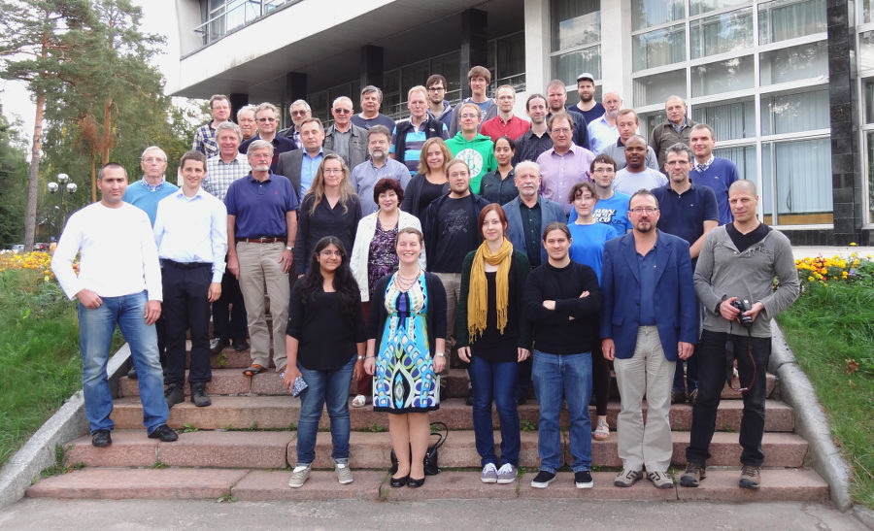
A2 Collaboration at MAMI
25th International A2 Collaboration Meeting, Dubna, Russia, September 2014

Slide 8
MAMI-C electron accelerator
Notes:
8
14 Block diagram of MAMI C accelerator is shown in the slide. It produces continuous beam of electrons with maximum energy over 1.5 GeV and longitudinal polarization about 85%.
8

Slide 9
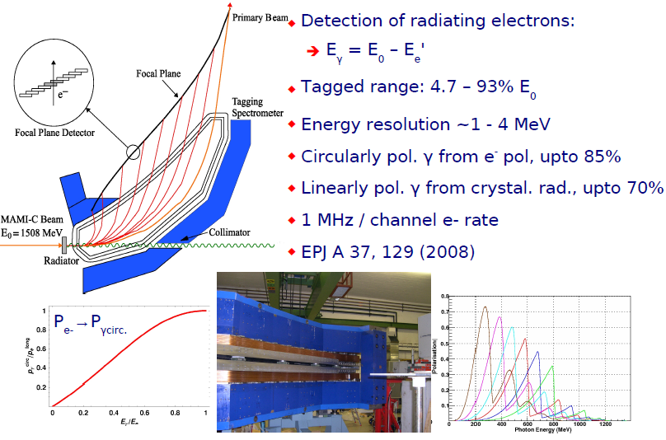
Upgraded A2 Tagging system (Glasgow, Mainz)
N_{γ} ~ 10⁷ s⁻¹ MeV⁻¹
circular
polarization
linear
polatization
Notes:
9
15 The electron beam produced by the MAMI accelerator was passed through a radiator, producing polarized Bremsstrahlung photon beam. The energy of the radiated photon was determined via the detection of the scattered electron in the Glasgow photon tagger, and selected
for the range of 270 – 303 MeV. Resulting photons have a circular polarization if a 10 micron copper radiator is used, or linear polarization if a single crystal (diamond) radiator is used. Maximum circular polarization equals ~85%, for linear polarization ~70%.
After collimation by a 2.5 mm diameter lead collimator, the photon beam strikes a proton target. Two types of targets were used in experiments:
9

Slide 10
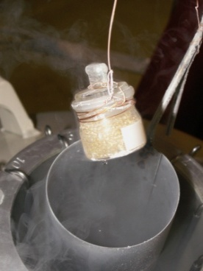
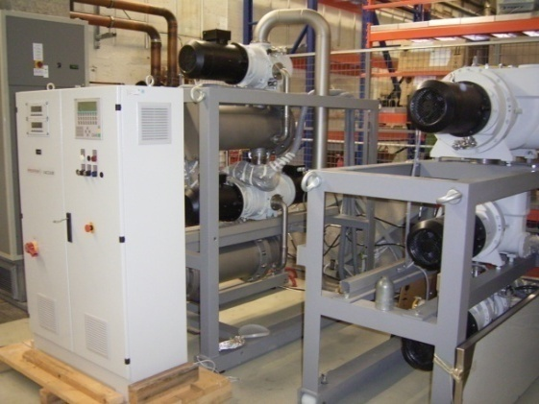
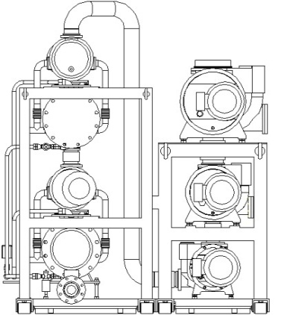
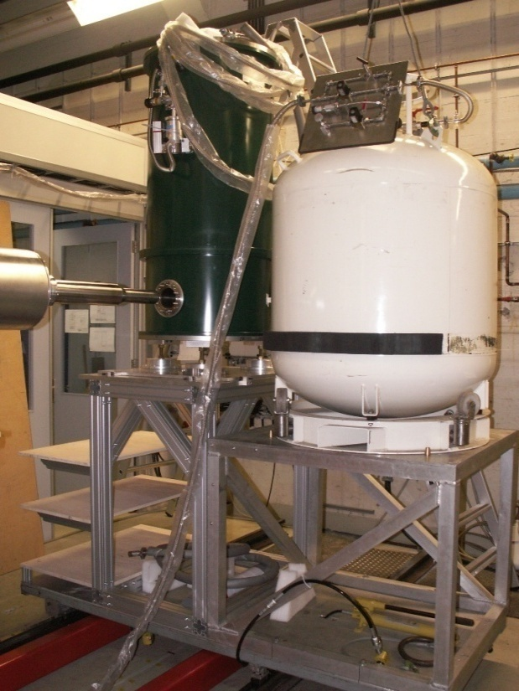
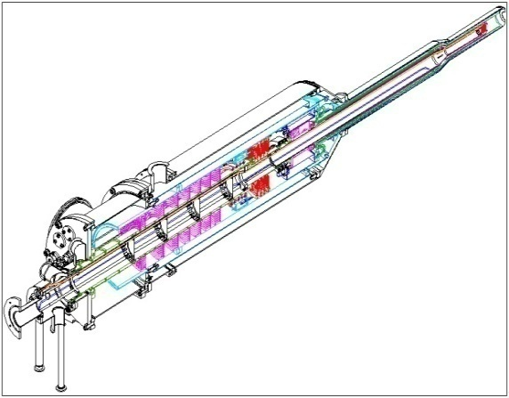
He³/He⁴ Roots
4000 m³/h
Vacuum system
Components of the polarized target
for the Crystal Ball detector
Similar to Bonn Target
[C.Bradtke et al., NIM A436, 430 (1999)]
Target material
[Meyer, Bochum]
H-Butanol
D-Butanol
Microwaves
70GHz
Dynamic
Nuclear
Polarization
Horizontal He³/He⁴ Dilution refrigerator
(25 mKelvin)
with internal
holding coil
NMR-Apparatus
106MHz
Polarisation meas.
Superconducting
Polarization magnet
5 Tesla

Slide 11
Dubna-Mainz Frozen-Spin Target (available since 05.2010).
For the double polarization large horizontal ³He/⁴He dilution refrigerator was built in cooperation with the JINR. Trityl doped butanol and deuterated butanol are the best materials for this experiment.
Main parameters are:
At a total tagged photon flux of 5 × 10⁷ sec⁻¹ and a target temperature 30 mK relaxation times of about 2000 hours was obtained.
Maximum polarizations at 2.5 T are: for protons ≈90%, for deuterons ≈75%.
11

Slide 12
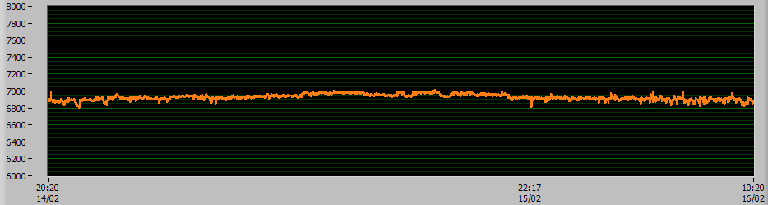
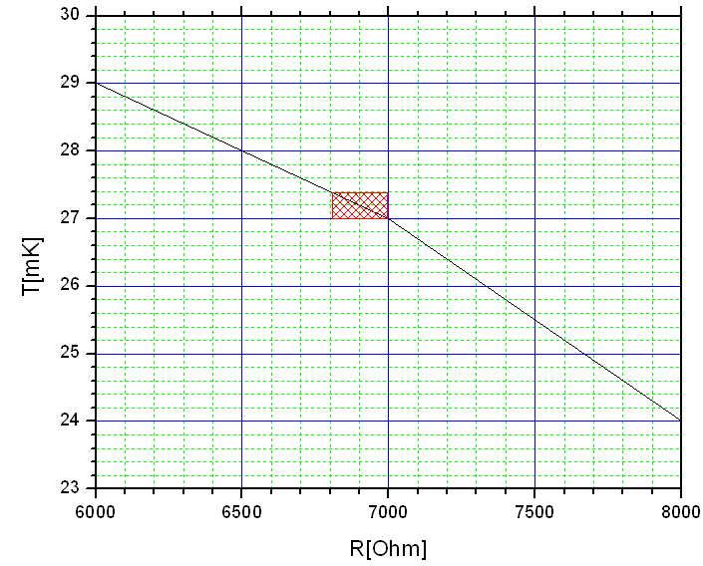
Cryostat Performance
T=24mK
T=27mK
T=29mK
Δt=40h
Temperature stability:
ΔT ~ +- 0.2 mKelvin (one day)
(typical one week measurement period).

Slide 13
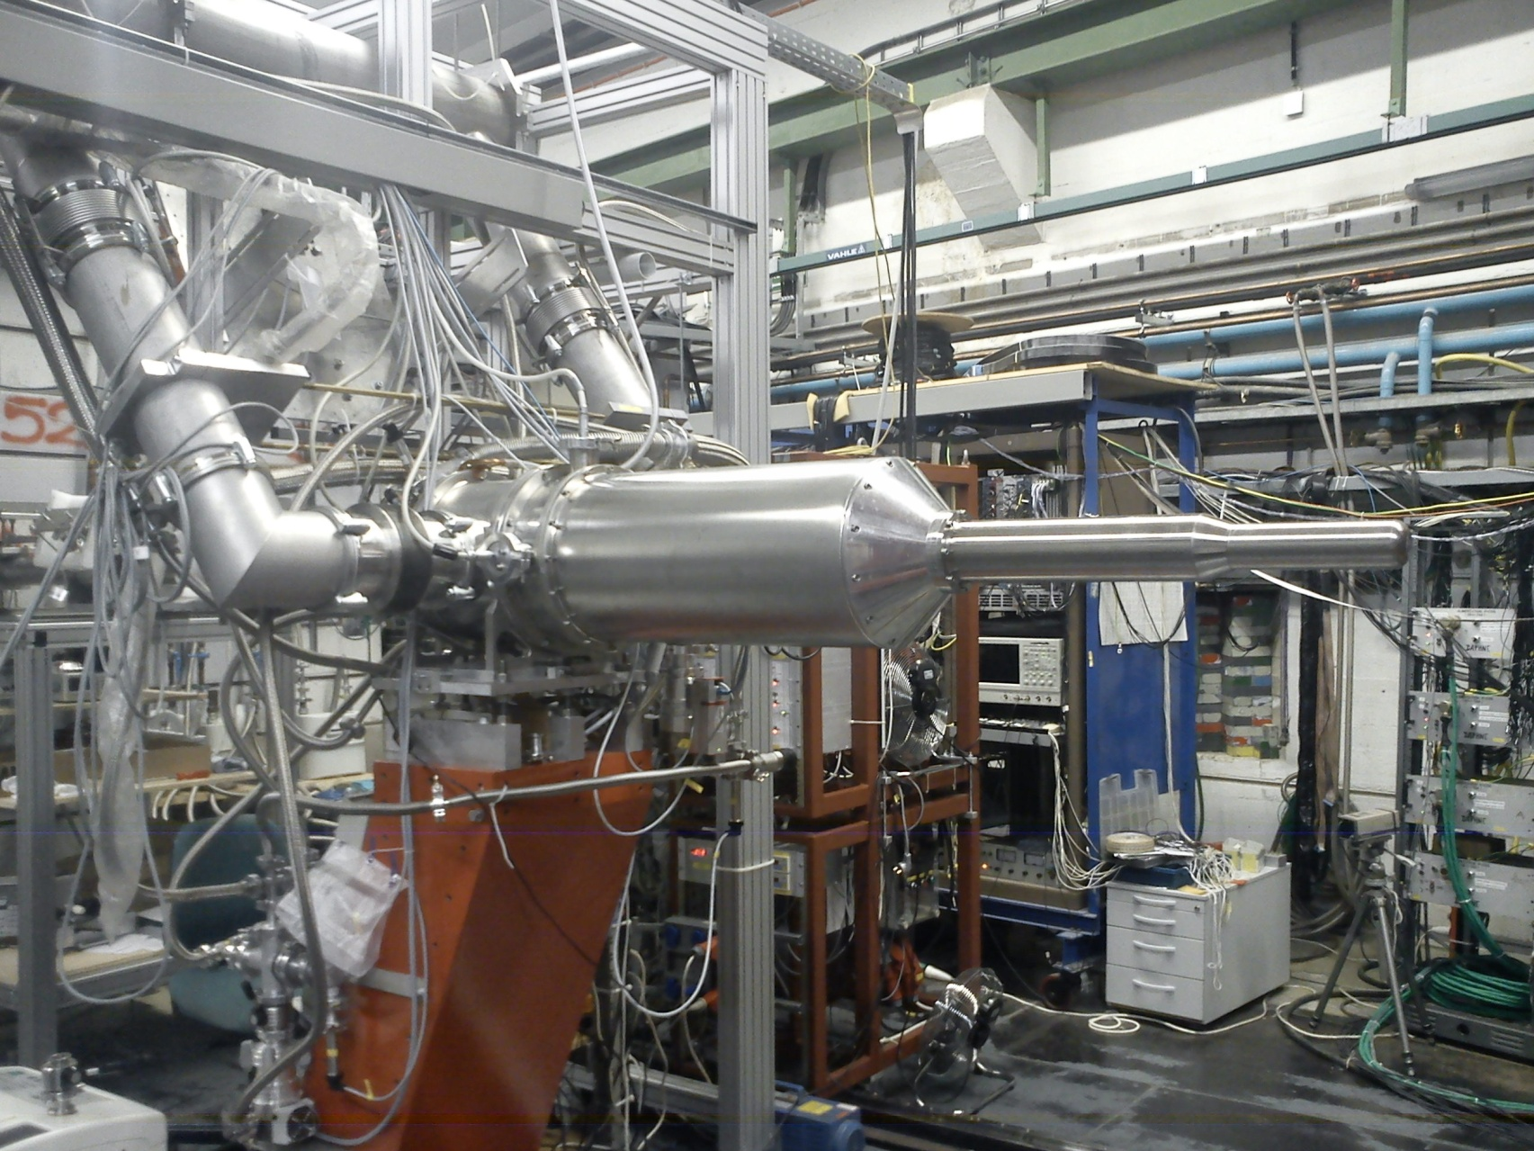
Mainz polarized target

Slide 14
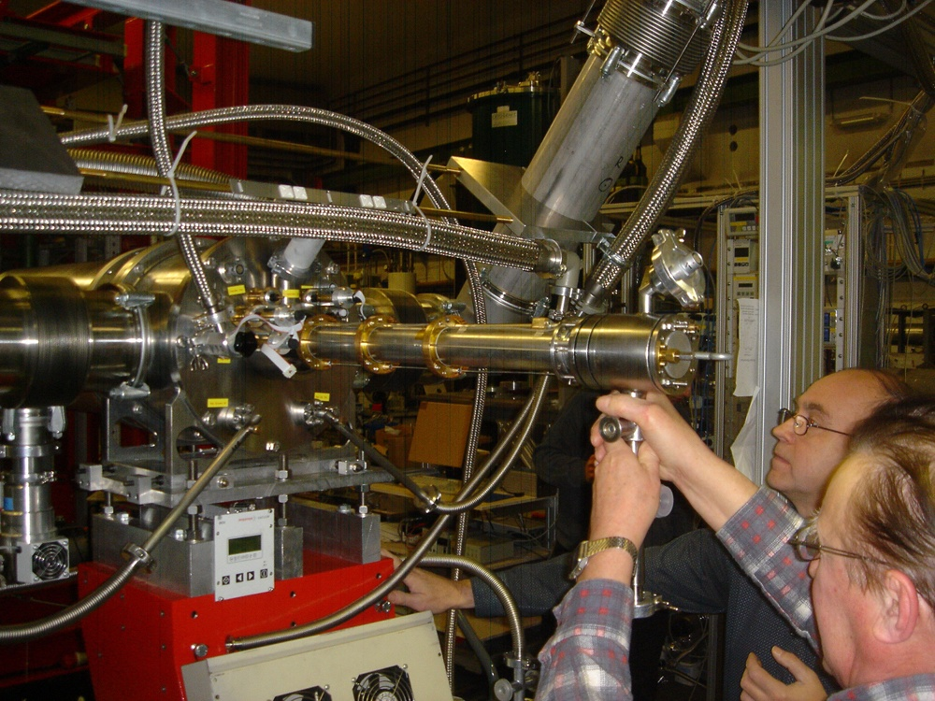

Slide 15
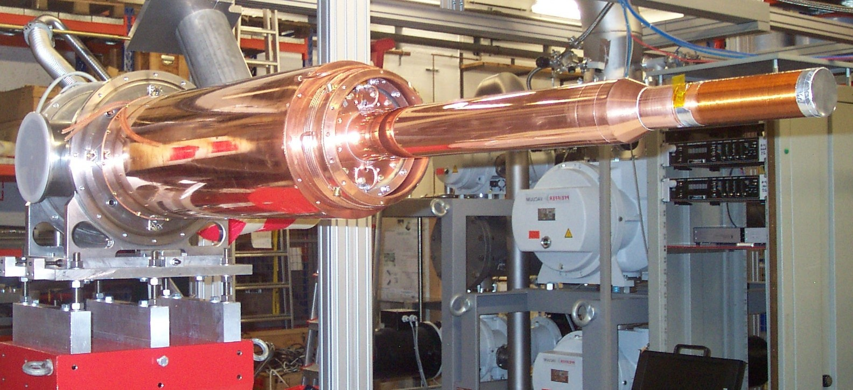
Internal longitudinal Holding coil
(solenoid coil manufactured of 0.227-μm multifilamental NbTi cable and consisting of four layers, each having 600 turns wound around a 0.3-mm thick copper holder, T ≈ 1.5 K)

Slide 16
EXPERIMENTS
1) Experimental verification of the GDH sum rule
Prediction on the absorption of circularly polarized photons by longitudinally polarized hadrons.
Helicity dependence of meson photoproduction
More detailed information on resonance properties and multipole amplitudes by investigating the helicity structure of partial reaction channels.
Single π⁰ production , (D₁₃(1520), F₁₅(1680))
η production, S₁₁(1535), D₁₃(1520))
Double π⁰ production, D₁₃(1520), P₁₁(1440), P₁₁(1710))
3) Hadron polarizabilities
They are measured in Compton scattering experiments, where the polarizabilities cause a deviation of the cross section from the prediction of Compton scattering from a structureless Dirac particle.
4) Search for exotic six-quark states (dibaryons)
16

Slide 17

CBELSA-BONN
Besides Mainz, the frozen-spin target is used at the Electron Stretcher Accelerator (ELSA) located in Bonn. It provides a beam of polarized electrons with energy up to 3.2 GeV. Physical motivation for experiments in Bonn in principle the same as for A2 at MAMI Collaboration. But more higher beam energy allows to search for missing baryon resonances. In the next slide spectra of the nucleon (top) and delta resonances (bottom) as a dependence of mass (vertical axis) are schematically shown. A cryostat of dilution refrigerator designed for experiments in Mainz is currently being used in Bonn. Contract Bonn – JINR No. 40960106

Slide 18
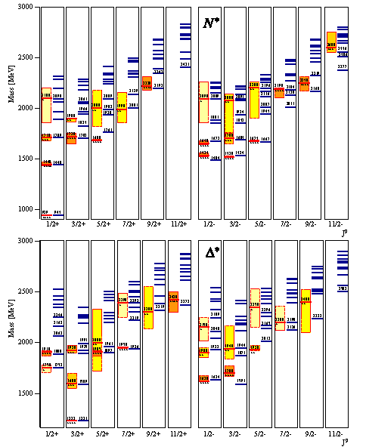
QCD predictions for spectra of the nucleon (top) and delta resonances (bottom). Red and yellow boxes correspond to known resonances. The missing resonances are blue lines.

Slide 19
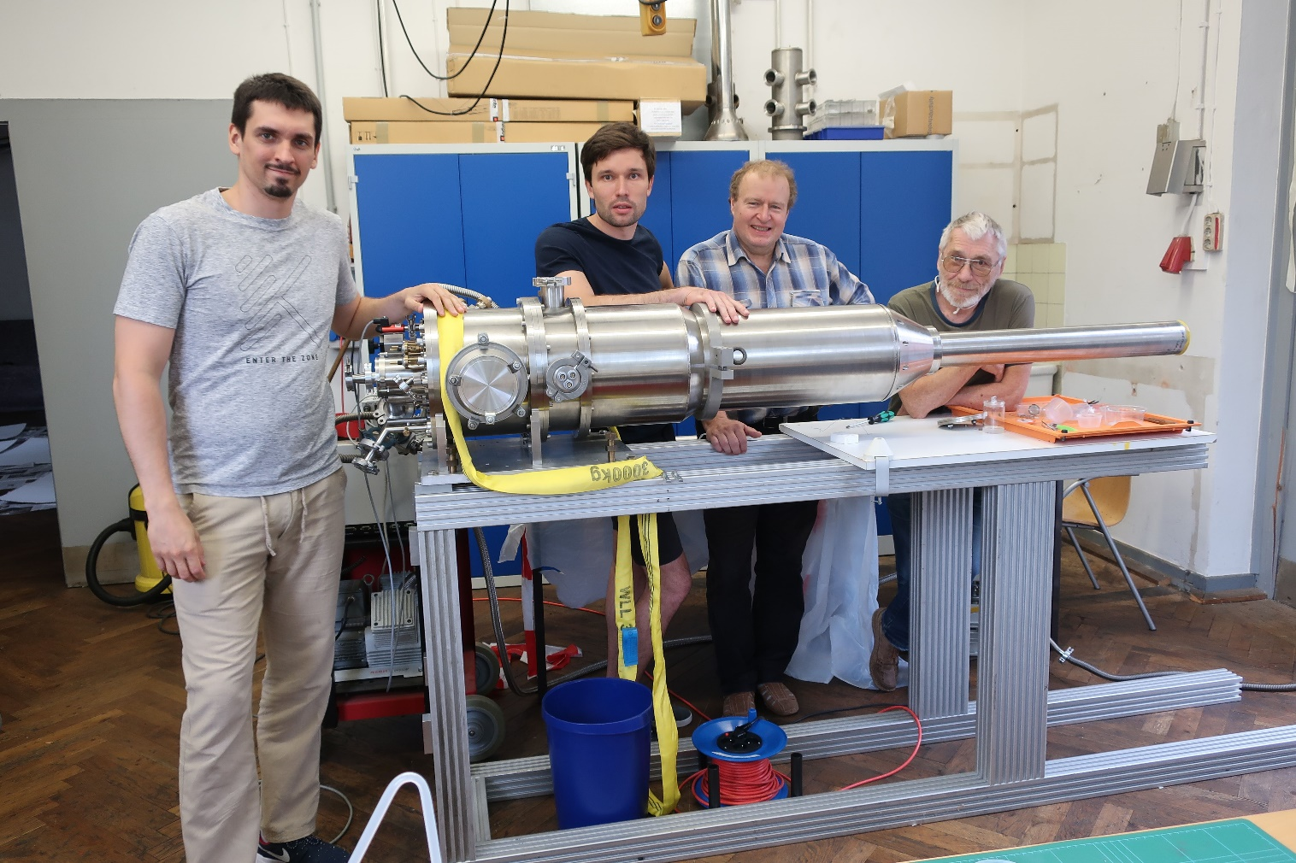
New cryostat for a polarized target in Bonn. Laboratory tests.

Slide 20
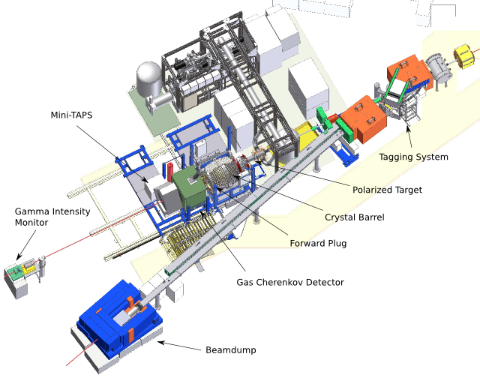
Incident electron beam energies of up to 3.2 GeV
Notes:
20

Slide 21
Research and development for polarization equipment for “MESA”
One of aims for the new electron accelerator “MESA” is to measure the weak mixing angle in electron-proton scattering to a precision of 0.13%. The MØller polarimeter proposed by V.Luppov and E.Chudakov opens the way to reach a sufficiently precise determination of polarization. At the moment the polarized atomic hydrogen target is under construction by Mainz-JINR team. Main part of this “polarized atomic hydrogen target” is dilution refrigerator where JINR has a long-term experience.
Purchase order – 4500189093 “GSI – JINR”
21

Slide 22
SPASCHARM
Experiments:
The measurement of polarization effects (single- and double-spin asymmetries, polarization, alignment et al.) in the production of particles consisting of light (u, d, s) quarks with the use of different beams in the energy range of 12-50 GeV.
The measurement of the charmonium mechanism production, single- and double-spin asymmetries in its production.
22

Slide 23
Polarized frozen-spin target at Protvino
In the dynamic nuclear polarzation (DNP) mode, the magnet poles are in the position when the magnetic circuit is closed, the magnetic field is as high as 2.5 T. Target material was 1,2-propanediol C3H8O2 (volume 20 cm³) with a paramagnetic Cr(V) impurity. The maximum obtained proton polarization was 93% and 98% for positive and negative values, respectively. In the DNP mode, T = 200 mK.
In the frozen-spin mode the target is maintained at a temperature of 20 mK in the holding magnetic field of 0.45 T. Under these conditions, the spin relaxation time was 1200 h for positive polarization and 800 h for negative polarization.
23

Slide 24
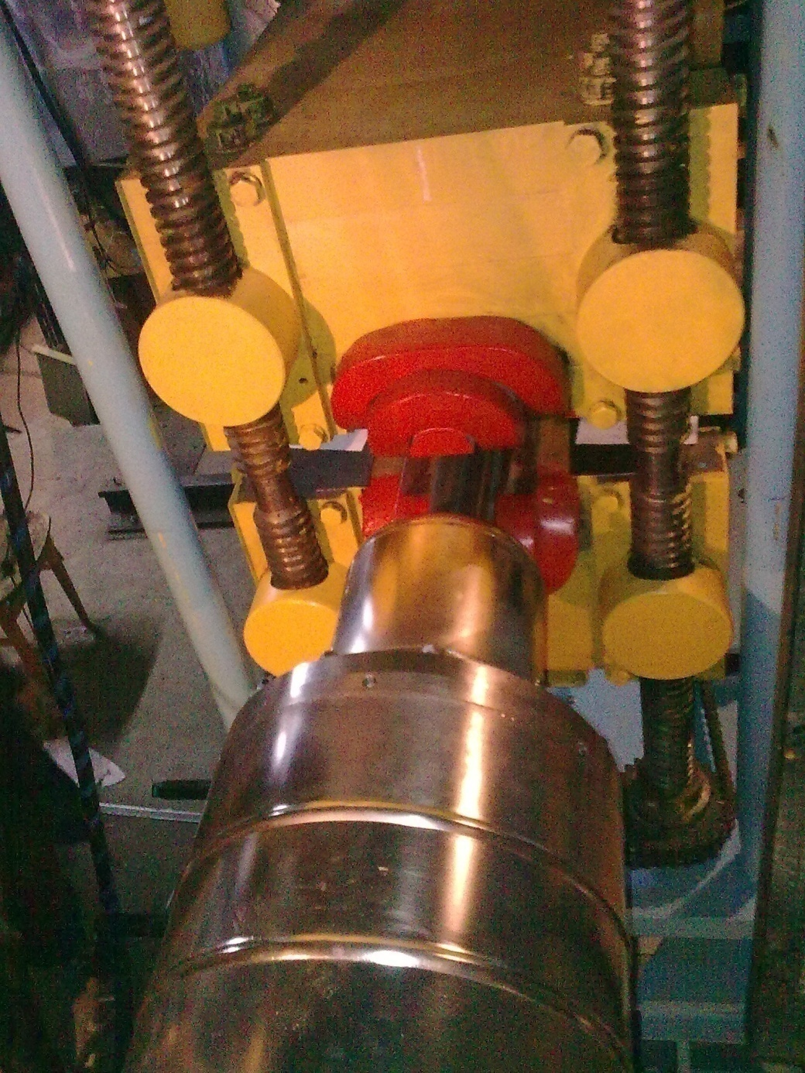
The polarized target magnet

Slide 25
NN-interactions
The spin-dependent cross-section difference, ∆ϭ_{L}(nd), in the nd total cross section is sensitive to the three nucleon forces (3NF). ∆ϭ_{L} =ϭ_{p} - ϭ_{a} is the difference in the nd total cross section for beam and target spins parallel and anti-parallel to each other, with both spins aligned with the beam momentum axis.
∆ϭ_{T} is similarly defined. The Tucson-Melbourne three-nucleon forces (TM3NF) change ∆ϭ_{L} by 5-10% from its value calculated using only NN interaction potentials (H. Witala et al. 1999).
25

Slide 26
The total cross-section difference ∆ϭ_{L} (nd) was measured firstly at TUNL for incident neutron energies of 5.0, 6.9 and 12.3 MeV (R.D. Foster et al. PR C 73 (2006)
But comparison with the theoretical predictions based on the CD Bonn NN potential calculations, with and without the inclusion of the TM-3NF, showed that data are not of sufficient precision to distinguish the presence or absence of 3NF contribution to the cross-sections.
26

Slide 27
At the Charles University Nuclear Center the measurements of ∆ϭ_{L}(np) and ∆ϭ_{T} (np)
were performed using the transmission method, i.e., the relative difference in attenuation of a polarized neutron beam passing through a polarized proton target (PPT) was measured.
A polarized neutron beam (P=(-13.5 ± 1.4)%) was based on the Van de Graaff electrostatic accelerator HV 2500 of the Nuclear Center, Charles University (now belongs to IEAP CTU), using the reaction T(d, n)⁴He with a deuteron beam (Ed = 1.82 MeV).

Slide 28
The PPT was transformed into the frozen spin deuteron polarized target (DPT).
Deuterated 1,2 propanediol with a paramagnetic Cr(V) impurity having a spin concentration
about 10²⁰ cm⁻³ was used as a target material. The maximum deuteron vector polarization
achieved was 40%.
28

Slide 29
Now a modernization of the facility is in
progress with an aim to increase the deuteron polarization of the polarized target and the
intensity and polarization of the neutron beam. We will replace current target material
(propanediol) with the novel material, trityl-doped butanol.
With this material, polarizations as high as ≈80% were achieved by the Mainz group.
29

Slide 30
To improve the parameters of the neutron beam it is proposed to use the reaction T(d, n)⁴He with polarized deuterons at resonance energy 100 keV.
As a first step, it will be production of the deuterium beam with polarized nuclei at an energy up to 200 keV using channeling of the deuteron beam through a magnetized single crystal Ni film with a capture of polarized electrons.
30

Slide 31
Electron polarization transferes to the nuclei due hyperfine interaction. If this deuterium beam collides with a tritium target (TiT), the 14-MeV neutrons of the dt-reaction produced at an angle of 90° (center of mass) have almost the same vector polarization as the deuterons.
We propose to apply the Sona method, zero-field transition with maximum possible transfer of the electron polarization to deuterons in the atomic beam. The magnetic field is directed along the foil plane (vertically), and we must use Sona transition with vertical magnetic fields.
This is different from the standard configuration.
31

Slide 32
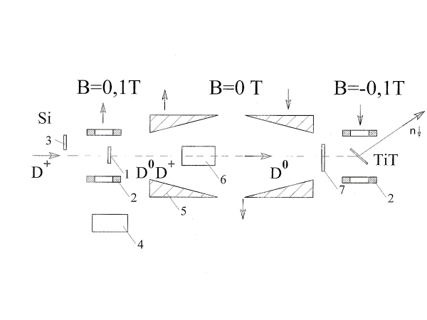
Scheme of the polarized deuteron source; 1 – nickel foil, 2 – permanent magnet (0.08 T), 3 – solid state detector, 4 – a goniometer, 5 – polarizing permanent magnets (for the Sona transition), 6 – electrostatic plates, 7 – the target of a polarimeter.

Slide 33
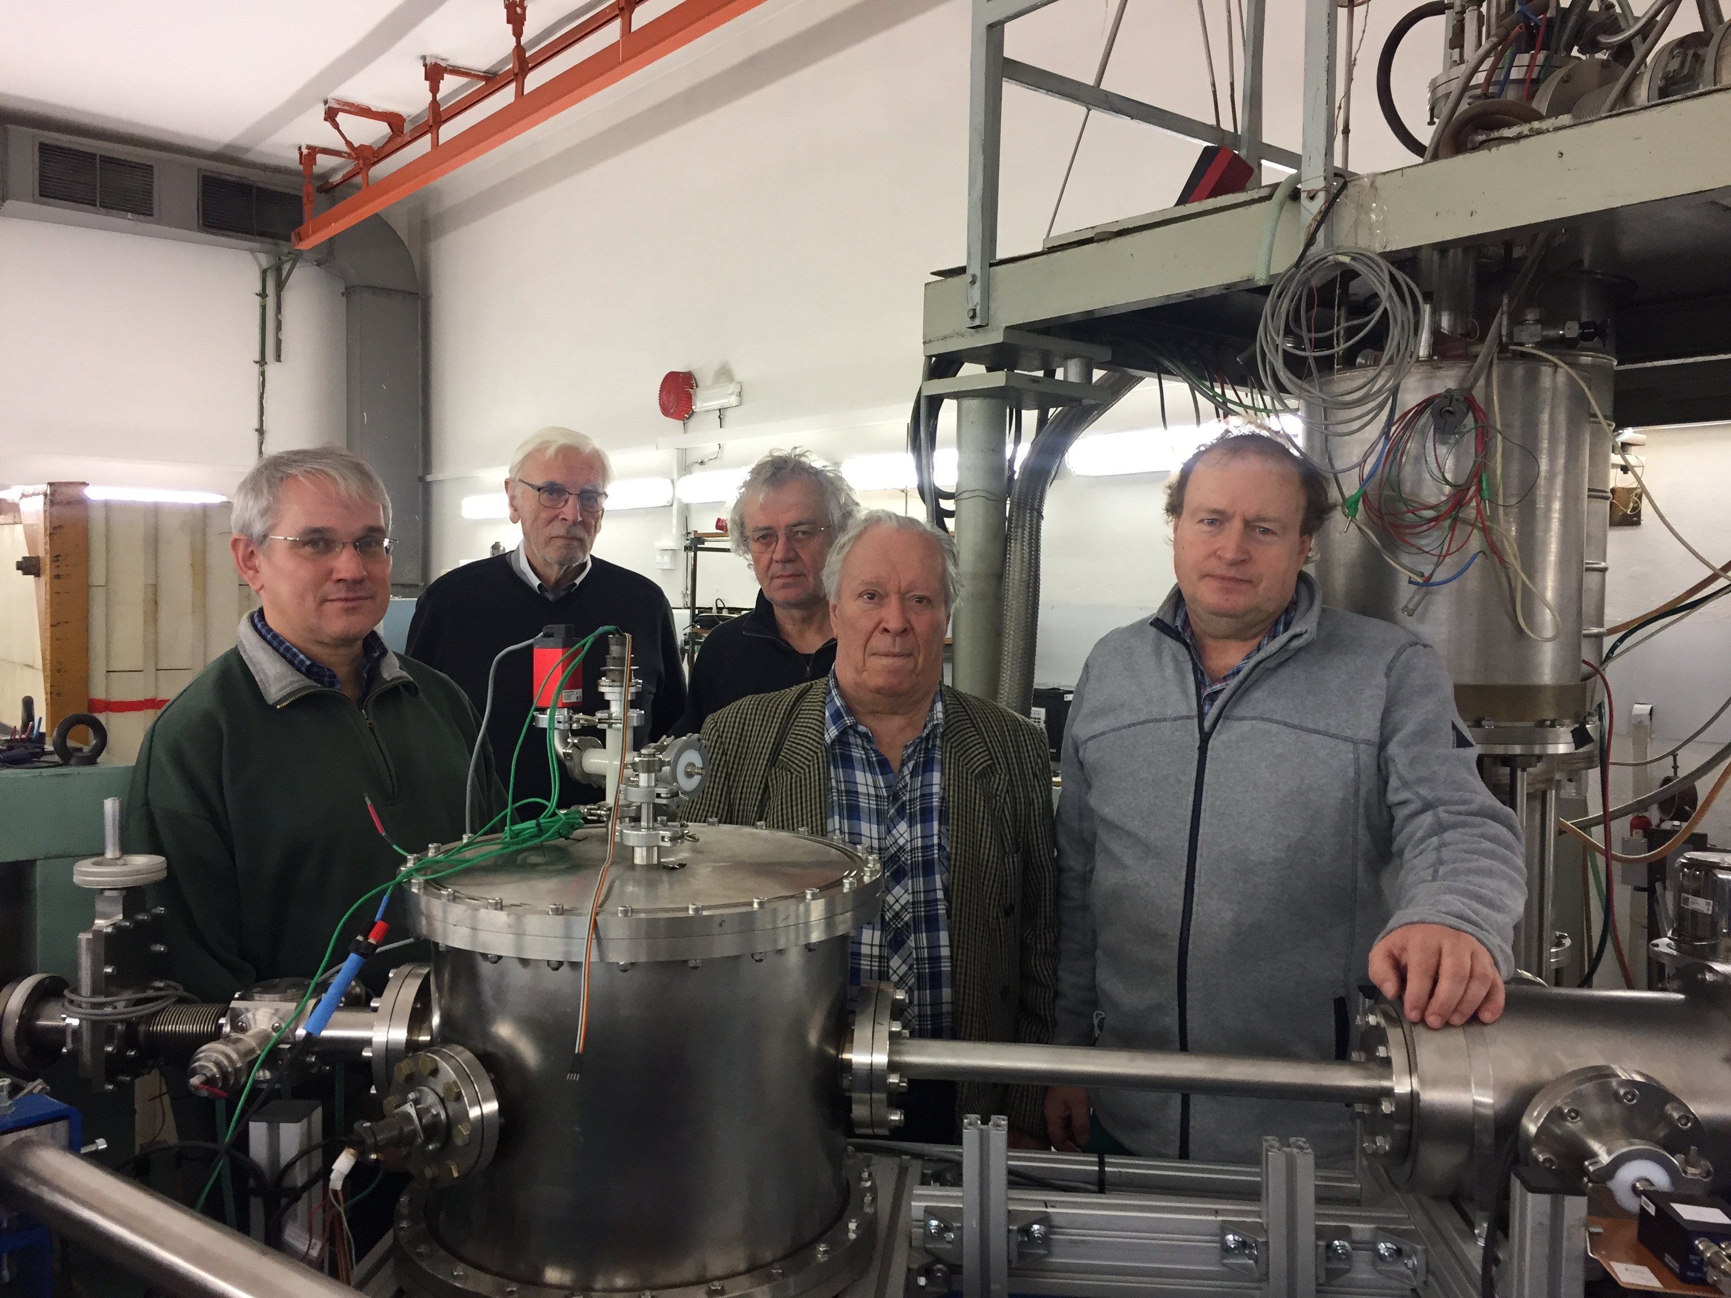
Czech and Russian colleagues with setup made in JINR

Slide 34
The deuteron vector polarization may be measured using the reaction D(d, p)T .
At first, we measured the tensor polarization with TiT target as the cross section for the reaction
T(d, n)⁴He is approximately 200 times higher than for dd-reaction.
The cross section depends on the c.m. angle between the spin and α-particle direction θ:
Ϭ(θ)= Ϭ₀[1-0.25(3cos²θ-1)P_{zz}]
As a result, Pzz =-0.10±0.02 (theoretical maximum value is Pzz = -1/3, without Sona transition) at the deuteron energy of 500 keV for the Ni foil thickness 1.5 µ (the deuterium atom energy was 250 keV).
34

Slide 35
Main results for one year:
In December 2022, a methodical run was conducted on the polarized target at IHEP (Protvino) in order to determine the state of the equipment for subsequent operation on the beam. Based on the results of the launch of the facility, the SPASCHARM collaboration decided to develop and manufacture a new cryostat for the polarized target.
During the year under review, cooperation was also carried out in a remote regime on the operation of the polarized target in Bonn, instructions were drawn up for launching the dilution cryostat of this polarized target. Work was carried out to process the obtained physical data on the accelerators "MAMI C" and "ELSA.
35

Slide 36
The results of experiments at the setup of a source of polarized deuterons at the Czech Technical University in Prague were processed. A corresponding publication was prepared and a report was made at the seminar on April 6, 2023.
Research and development for MESA polarization equipment has already started. At the moment the polarized atomic hydrogen target is under construction by the Mainz-JINR team. The important part of this target is the dilution refrigerator where JINR has a long-term experience.
36

Slide 37
PUBLICATIONS
1. E. Mornacchi et al., (A2 Collaboration). Measurement of Compton Scattering at MAMI for the extraction of the electric and magnetic polarizabilities of the proton. Phys. Rev. Lett.. 128 (2022) 132503.
2. F. Cividini et al., (A2 Collaboration). Measurement of the helicity dependence for single π0 photoproduction from the deuteron. Eur. Phys. J. A58 (2022) 113.
3. S. Garni et al., (A2 Collaboration). Target and beam-target asymmetries for the γp→ π0π0p reaction. https://arxiv.org/abs/2207.14079.
4. M. Bashkanov et al., (A2 Collaboration). First measurement of polarization transfer C in deuteron photodisintegration and the signatures of the d ∗ (2380) hexaquark. https://arxiv.org/abs/2206.12299.
5. M. Bashkanov et al., (A2 Collaboration). Neutron polarization transfer C in π+ photoproduction off the proton. https://arxiv.org/abs/2211.09688.
37

Slide 38
PUBLICATIONS
6. V.V. Abramov et al. Conceptual project of the experiment SPASCHARM. PEPAN, 2023 v. 54, iss. 1, pp. 6-189.
7. I.V. Gapienko et al. Research and development of the polarized deuteron source for electrostatic accelerator. Submitted to PEPAN Lett., Preprint JINR E13-2023-12.
38

Slide 39
Working plan
• Development and creation of a new cryostat for the frozen-spin target of the SPASCHARM setup - 2024-2026.
• Development and creation of the main components of a powerful 3He/4He dilution refrigerator for the “MESA” facility – 2024-2025.
• Completion of work on the creation of a cryostat for the polarized target at the University of Bonn. – 2024.
• Return transportation and full launch of the polarized target in Mainz for the GDH project - 2024-2025.
Carrying out polarization studies using a frozen-spin target at the MAMI C accelerator,
- 2026-2028.
• Carrying out polarization studies on a new polarized target at the accelerator of the University of Bonn “ELSA” - 2025-2028.
• Assembly, installation and testing of a powerful 3He/4He dilution refrigerator on the beam channel of the MESA facility. – 2026-2027.
•

Slide 40
• Launch of the modified polarized target of the “SPASCHARM” installation and the beginning of the collection of physical statistics at the U-70 accelerator, - 2027-2028.
• According to the NN-interaction program, channeling experiments will be carried out at the test bench of a source of polarized deuterons, - 2024-2025.
• An accurate measurement of the vector and tensor polarizations of deuterons will be carried out at the VdG- 2025-2026.
• Preparation of a special device for using a new target material based on trityl-doped butanol, - 2025.
• Manufacture and installation of equipment for measuring neutron polarization using scattering on a 4He target, - 2026-2027
• Carrying out the depreservation of the polarized deuteron target and the beginning of measurement the difference between the cross sections ΔσΤ and ΔσL in the experiment on nd transmission at neutron energies <16 MeV, - 2027-2028.

Slide 41
Proposed schedule and resource request for the Project
 | Cost (thousands of US dollars)/ Resource requirements | Cost/Resources, distribution by years
 |  | 1st year | 2nd year | 3rd year | 4th year | 5th year
International cooperation | 220.0 | 50.0 | 50.0 | 50.0 | 35.0 | 35.0
Materials | 42.0 | 10.0 | 8.0 | 8.0 | 8.0 | 8.0
Equipment, Third-party company services | 96.0 | 22.0 | 22.0 | 22.0 | 15.0 | 15.0
Commissioning | 15.0 | 9.0 | 4.0 | 2.0
R&D contracts with other research organizations | 9.0 | 4.0 | 1.0 | 1.0 | 3.0
Software purchasing | 5.0 | 2.0 | 2.0 | 1.0
JINR budget (budget items) | 387.0 | 97.0 | 87.0 | 84.0 | 61.0 | 58.0

Slide 42
Spin plays a dramatic role in the theater of elementary particle physics,
acting sometimes as the harbinger of the demise of a current theory,
sometimes as a powerful tool in confirmation of such a theory.
Elliot Leader, Spin in Particle Physics, Cambridge Univ. Press, 2023
Polarization data have often been the graveyard of fashionable theories.
If theorists had their way the might well ban such measurements
altogether out self-protection.
James Bjorken, Proc. Adv. Research Workshop on QCD Hadronic
Processes, St Croix, Virgin Islands, 1987.
42

Slide 43
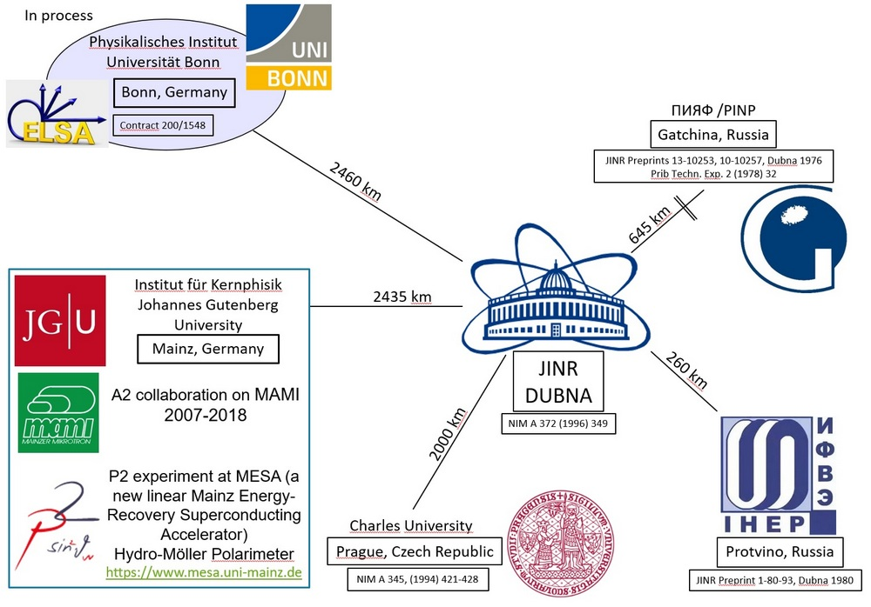

Slide 44
Thank you for attention

