Slide 1
Project in the framework of the theme
Non-Accelerator Neutrino Physics and Astrophysics:
Radiochemistry and spectroscopy for astrophysics and nuclear medicine
Project Leader
D. V. Filosofov
Project Deputy Leaders
A. Baimukhanova, A. I. Velichkov, Yu. B. Gurov, A. Kh. Inoyatov, D. V. Karaivanov, J. H. Khushvaktov
AYAGOZ Baimukhanova
57th meeting of the PAC for Nuclear Physics
June 30, 2023

Slide 2
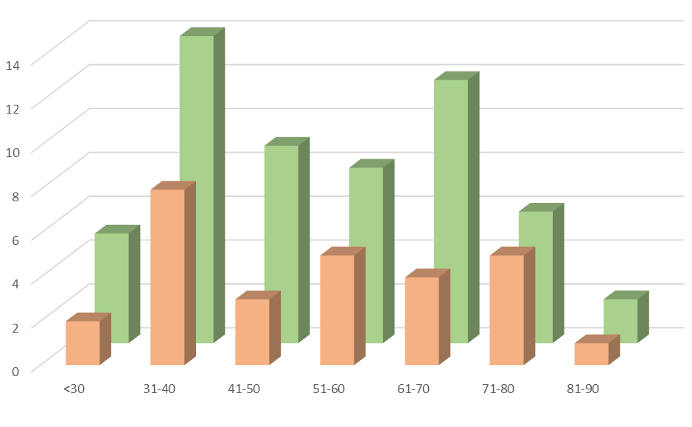
Radiochemistry and spectroscopy for astrophysics and nuclear medicine
The Department of Nuclear Spectroscopy and Radiochemistry, Dzhelepov Laboratory of Nuclear Problems
All personal: 56 (av. age 52 y)
Scientific personal: 28 (av. age 53 y)
PhD+DrS: 18
experience in high-precision nuclear spectroscopy using semiconductor, scintillator and other types of detectors;
experience of rare processes studies in different underground environments
experience in the production of radionuclides and radiopharmaceutical synthesis
experience in hyperfine interaction nuclear spectroscopy
Uzbekistan: 8
Kazakhstan: 2
Bulgaria: 2
Azerbaijan: 1
Notes:
2

Slide 3
Radiochemistry and spectroscopy for astrophysics and nuclear medicine
The Department of Nuclear Spectroscopy and Radiochemistry, Dzhelepov Laboratory of Nuclear Problems
Experimental base:
SCD (HPGe, Si, SiC, CZT): nuclear spectroscopy;
Detectors based on nonorganic scintillators NaI(Tl), NAIL, …;
Neutron detectors (He-3, …);
Mass-separator;
Mass-spectrometer
Resources:
SCD production / repair group;
Organic scintillators group;
Radiochemistry group;
Spectroscopy group;
Simulation group

Slide 4
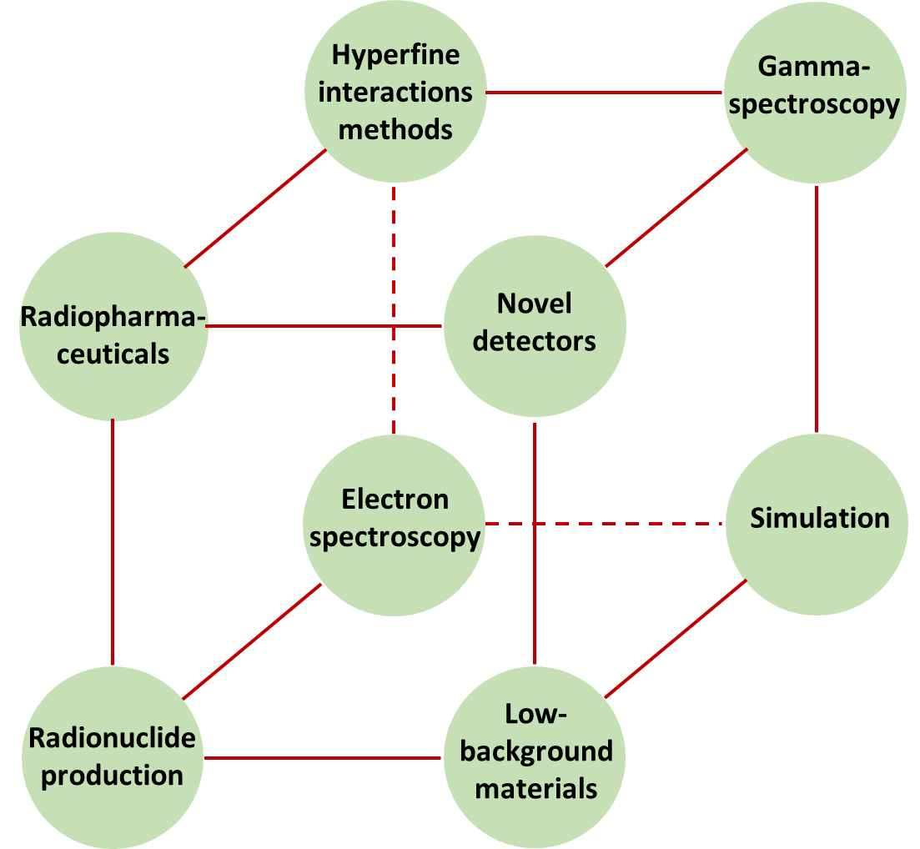
Radiochemistry and spectroscopy for astrophysics and nuclear medicine
Scientific directions

Slide 5
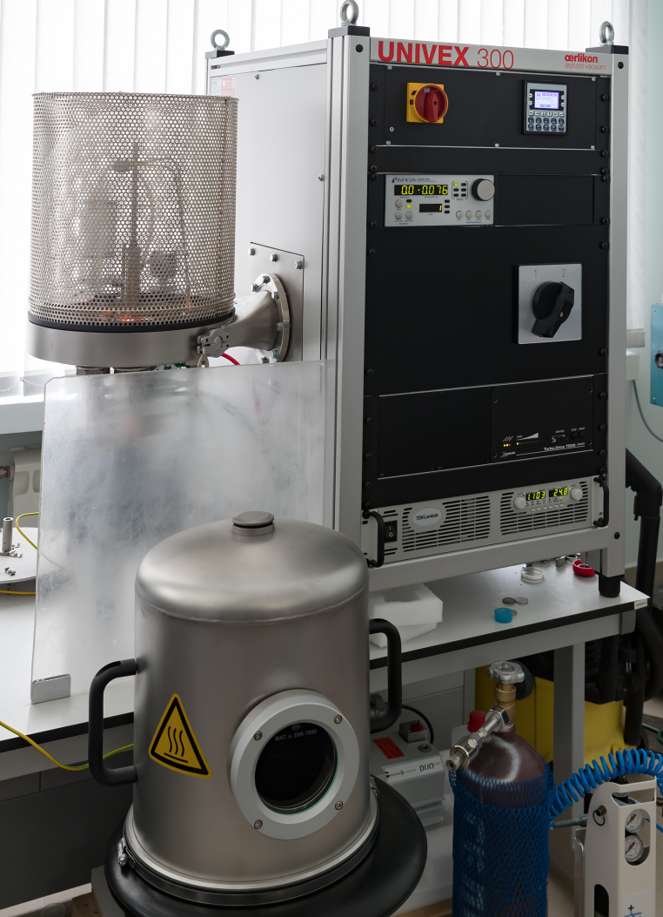
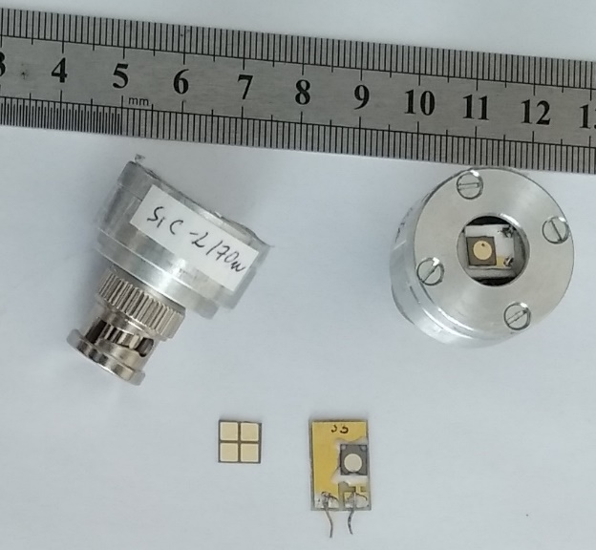
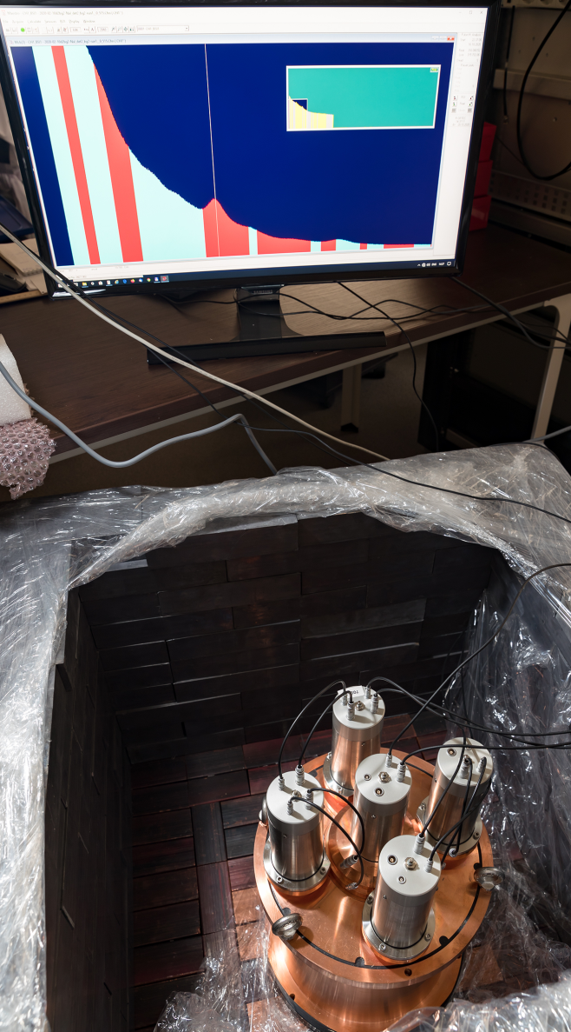
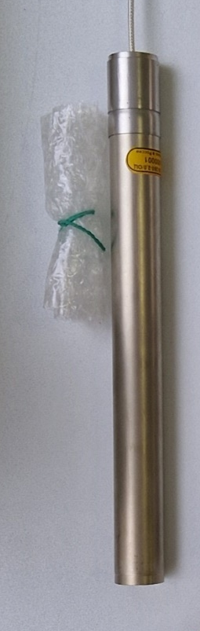
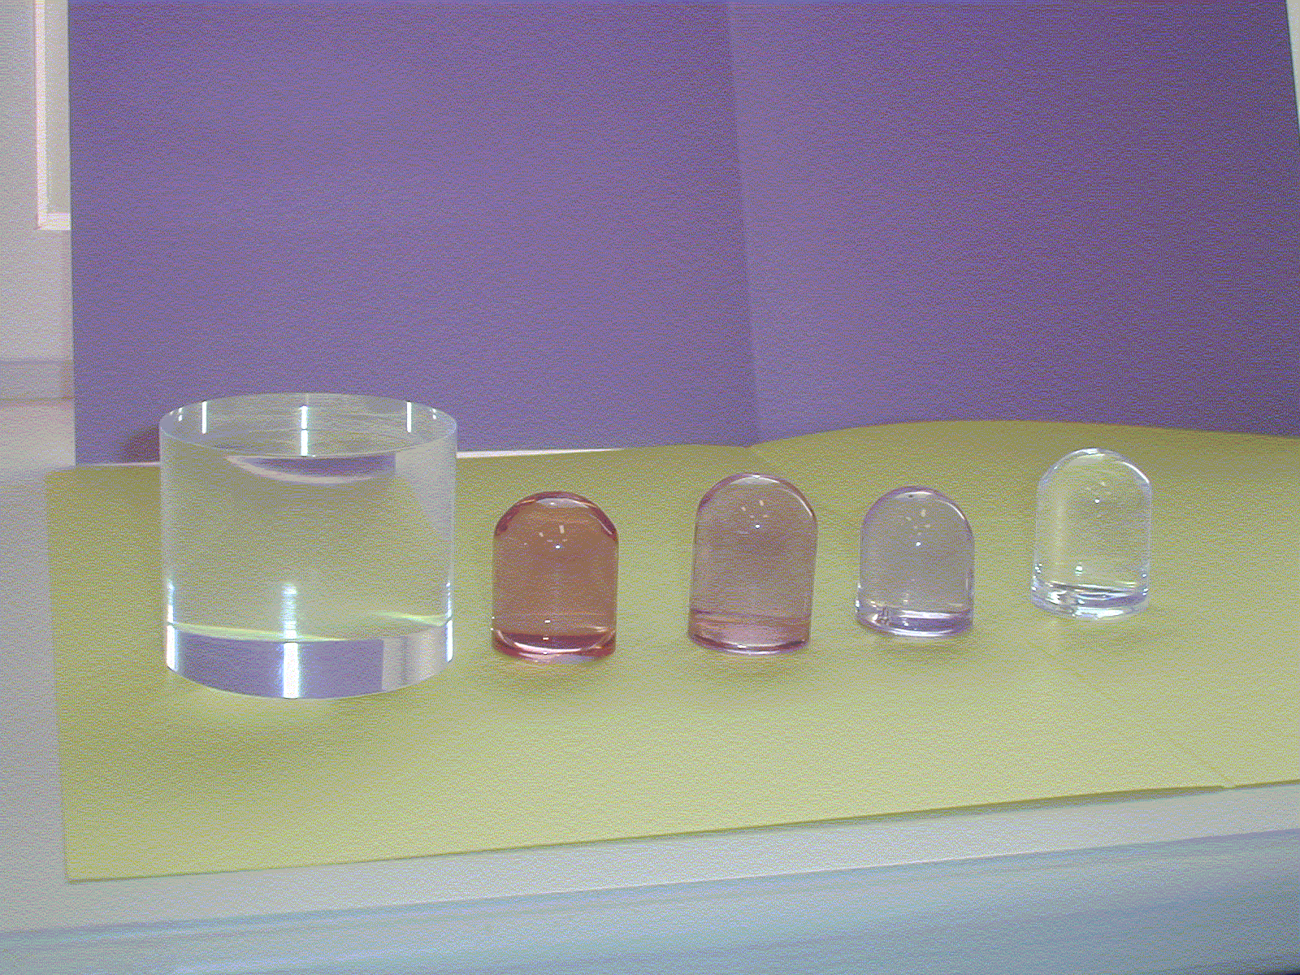
Radiochemistry and spectroscopy for astrophysics and nuclear medicine
Novel detectors
semiconductor detectors, liquid and plastic organic scintillators, composite scintillation detection systems, neutron and radon detectors, etc.
1
4
5
2
3
6

Slide 6
Radiochemistry and spectroscopy for astrophysics and nuclear medicine
Novel detectors
semiconductor detectors, liquid and plastic organic scintillators, composite scintillation detection systems, neutron and radon detectors, etc.
detectors based on silicon carbide (SiC)
liquid tellurium-containing scintillators
composite scintillators
³He counters
nuclear radiation registration
search of neutrinoless double β-decay
neutrino experiments
detecting low neutron fluxes
to monitor the operation of high-current accelerators and nuclear reactors /
hot plasma diagnostics
JUNO large-scale detector /
other types of liquid and plastic scintillators
sensitive radon detector
to monitor of radon in the low-background rooms and equipment

Slide 7
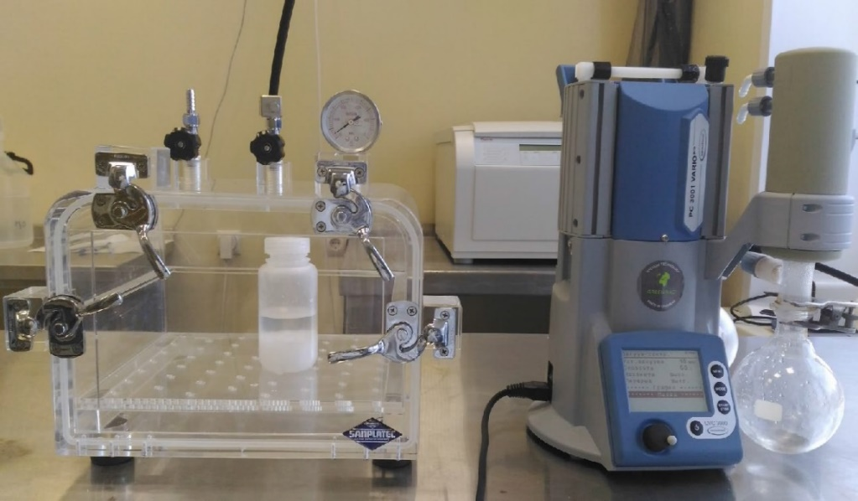
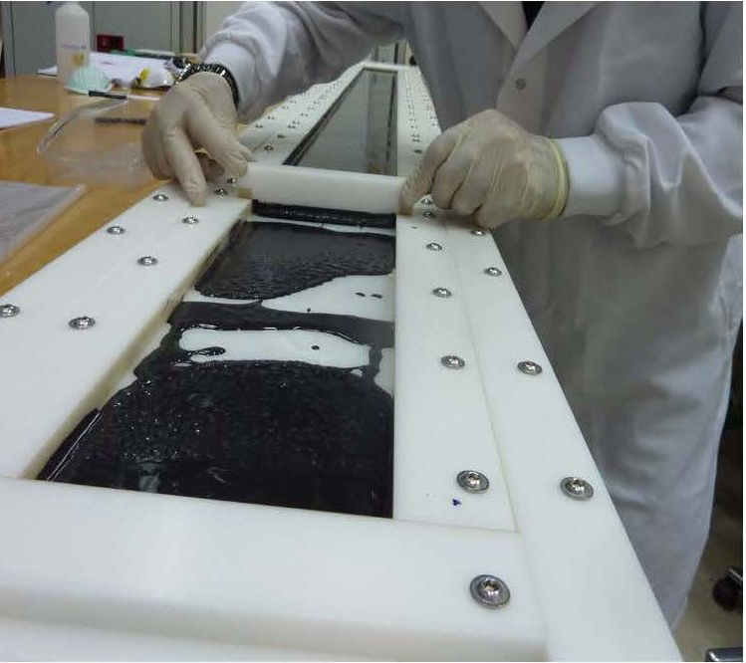
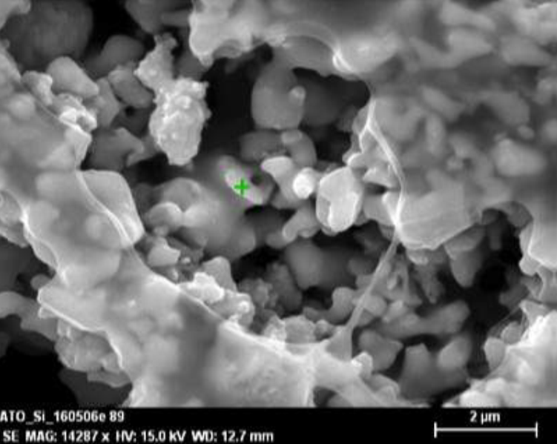
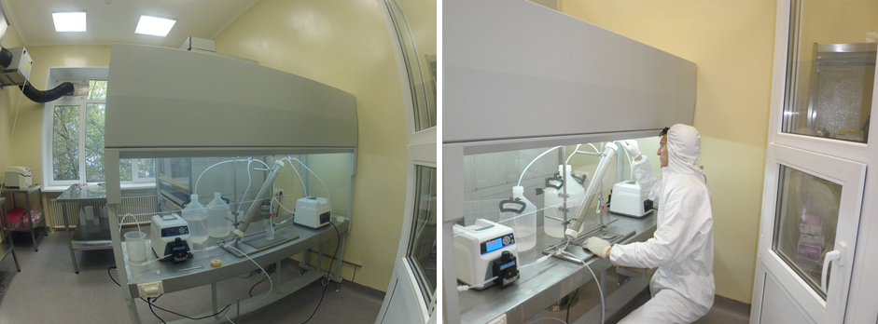
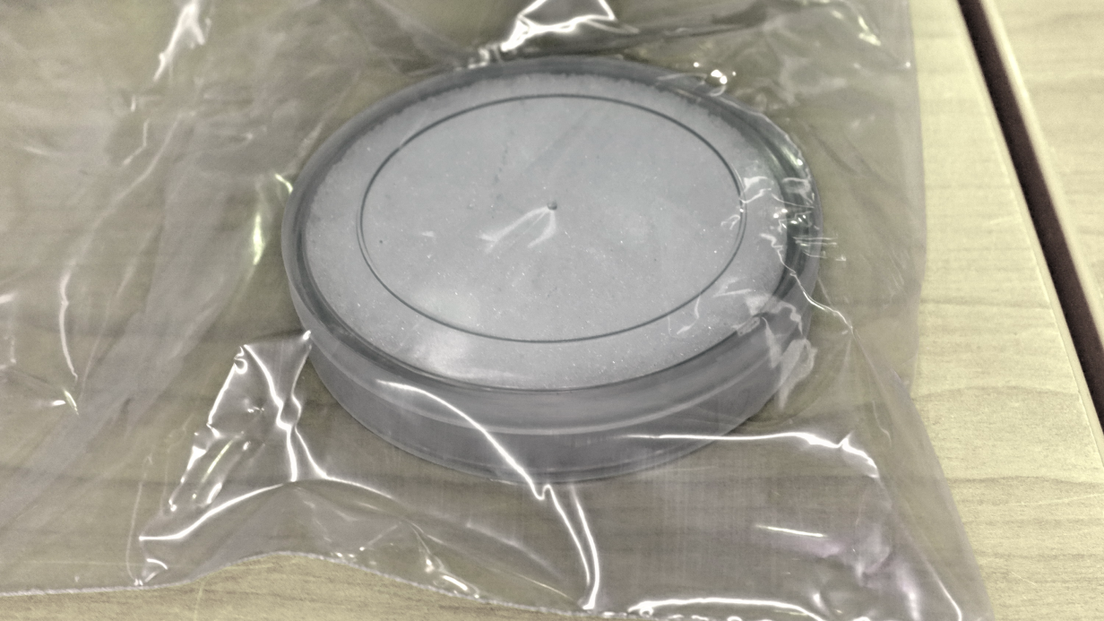
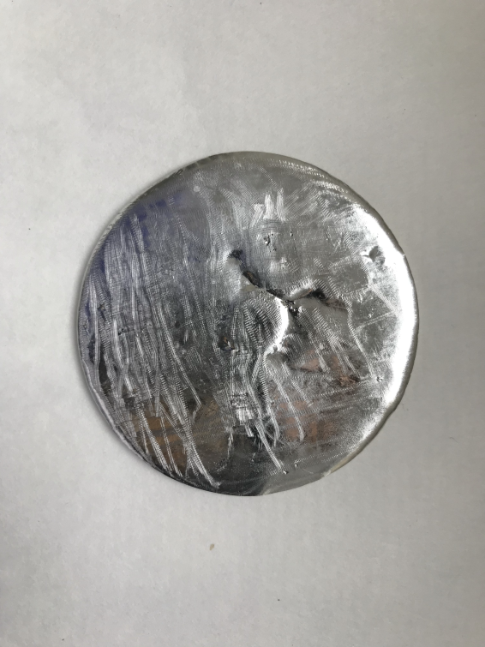
Radiochemistry and spectroscopy for astrophysics and nuclear medicine
Methods and techniques for the production and analysis of low-background materials
with low content of radioactive impurities
Radiopure ⁸²Se
Low-radioactive flux
Solder (60% Sn and 40% archPb)

Slide 8
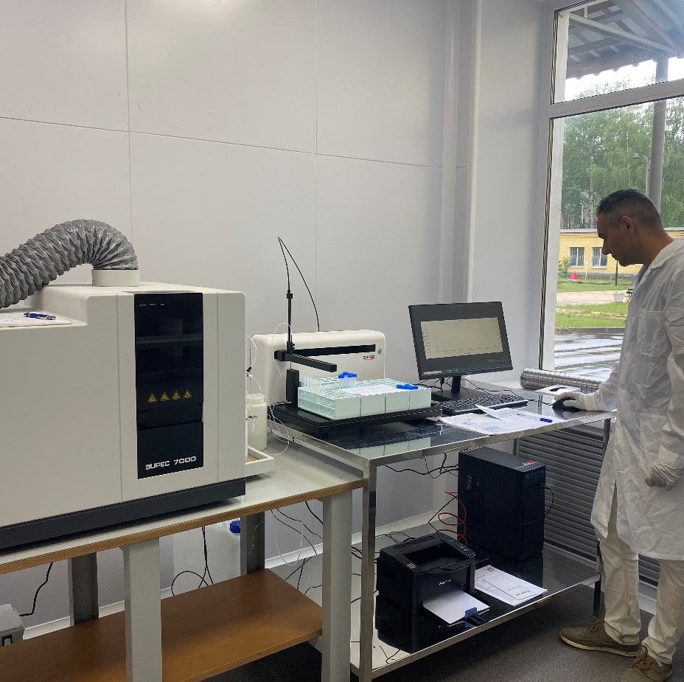
Radiochemistry and spectroscopy for astrophysics and nuclear medicine
Methods and techniques for the production and analysis of low-background materials
with low content of radioactive impurities
Development of samples production methods (⁸²Se; ⁹⁶Zr;
shielding materials – Pb, Cu, Zn; solder; etc.) with impurity content μBq/kg
Development of samples analysis methods at an ultra-low sensitivity level using inductively coupled plasma mass spectrometry (ICP-MS) and other analytical and nuclear spectroscopic methods

Slide 9
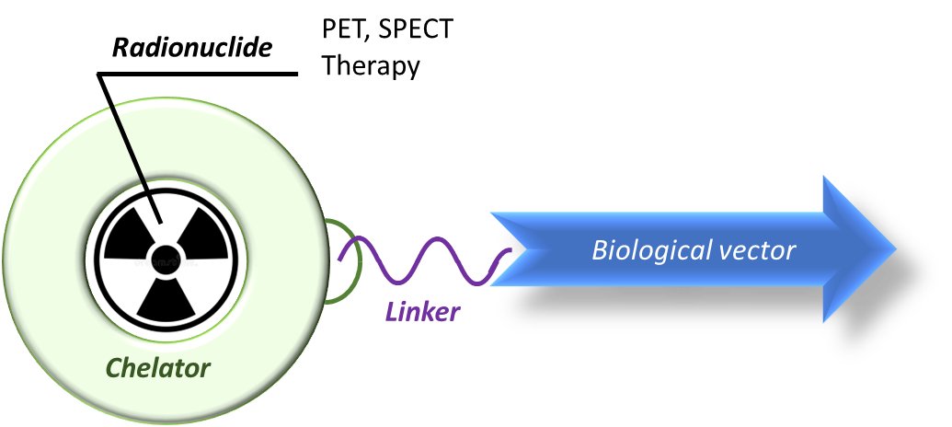
Radiochemistry and spectroscopy for astrophysics and nuclear medicine
Production and purification methods of radionuclides
for radiopharmaceuticals synthesis
Stages of development of a radiopharmaceutical:
Radionuclide choice
Development of biological vectors and chelators
Radionuclide production
Target dissolution
Radionuclide extraction
Radionuclide purification
Radionuclide conditioning
Synthesis of a radiopharmaceutical
Quality assessment of a radiopharmaceutical
Physicochemical studies of a radiopharmaceutical
Experiments on cells and animals
Preclinical and clinical tests
The structure of a modern radiopharmaceutical
Zacherl M. et.al. First clinical results for PSMA targeted alpha therapy using 225Ac-PSMA-I&T in advanced mCRPC patients. J Nucl Med. 2020 DOI: 10.2967/jnumed.120.251017

Slide 10
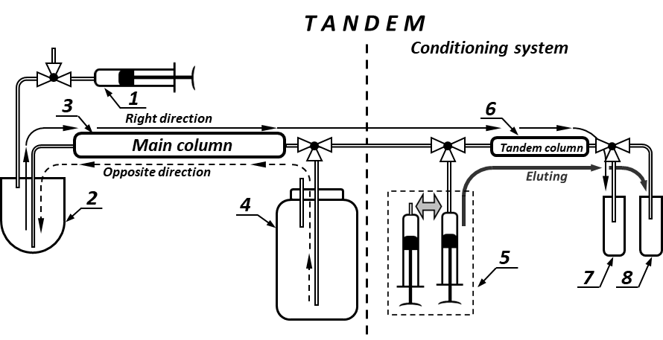
Radiochemistry and spectroscopy for astrophysics and nuclear medicine
Production and purification methods of radionuclides
for radiopharmaceuticals synthesis
Radionuclide generators:
⁴⁴Ti → ⁴⁴Sc; ⁶⁸Ge → ⁶⁸Ga; ⁷²Se → ⁷²As; ⁸⁶Zr → ⁸⁶Y;
⁹⁰Sr → ⁹⁰Y; ¹¹¹In → ^{111m}Cd; ¹⁷²Hf → ¹⁷²Lu;
²²⁹Th → ²²⁵Ra → ²²⁵Ac
Chromatogram of separation of radiolanthanides
with ammonium α–hydroxyisobutyrarate
Radionuclide production on the accelerators:
¹⁷⁷Lu from Yb target
²²⁵Ac from Th target
⁴⁴Sc from Ca target
⁸⁶Zr from Y target
⁹⁰Nb from Mo, Zr targets
¹¹¹In from Ag, Sb targets
Lanthanides from Ta target
Radionuclides from Th target

Slide 11
Radiochemistry and spectroscopy for astrophysics and nuclear medicine
Production and purification methods of radionuclides
for radiopharmaceuticals synthesis
I. Study of sorption processes for various solution-sorbent systems
IV. Development of radionuclide generators
⁴⁴Ti → ⁴⁴Sc, ⁶⁸Ge → ⁶⁸Ga, ⁹⁰Sr→ ⁹⁰Y, ²³⁸U → ²³⁴Th, ²³⁷Np → ²³³Pa,
²²⁹Th → ²²⁵Ac,
²²⁷Ac→ ²²⁷Th → ²²³Ra,
²²⁸Th → ²²⁴Ra,
²⁰²Pb → ²⁰²Tl,
¹⁹⁴Hg → ¹⁹⁴Au, ³²Si → ³²P, etc.
II. Development of the production and isolation methods of radionuclides
Radionuclides Radiopharmaceuticals
III. Development of radiolabeling methods based on chelators with "slow" kinetics

Slide 12
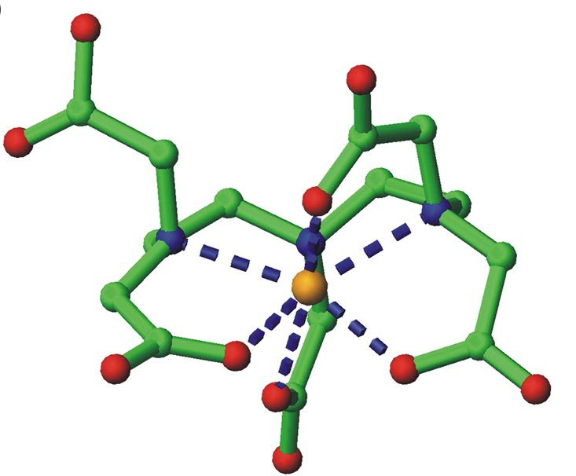
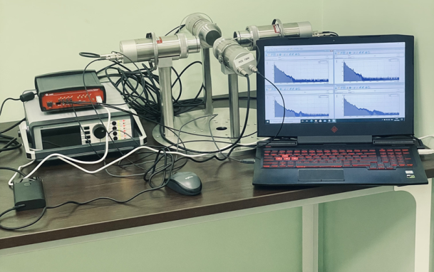
Radiochemistry and spectroscopy for astrophysics and nuclear medicine
Hyperfine interactions methods
using radioactive tracers
¹¹¹In
^{111m}Cd
DTPA
¹¹¹In, ^{111m}Cd, ¹⁵²Eu, ¹⁵⁴Eu
with DOTA, DTPA
¹⁵²Eu
¹⁵⁴Eu
L₂ – PAC parameter

Slide 13
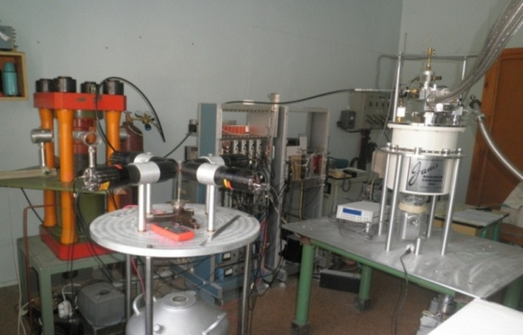
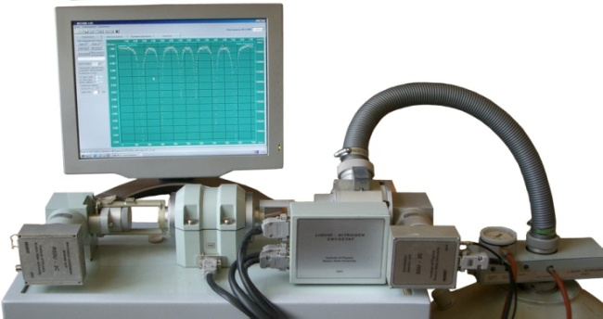
Radiochemistry and spectroscopy for astrophysics and nuclear medicine
Hyperfine interactions methods
using radioactive tracers
¹¹¹In, ¹⁵²Eu, ¹⁵⁴Eu, ¹¹⁹Sb, ^{119m}Sn, ⁵⁷Co, ¹⁶¹Tb, etc.
Radiopharmaceuticals and their precursors in aqueous systems and other matrices
Perturbed angular correlations (PAC)
Mössbauer spectroscopy (emission mode)

Slide 14
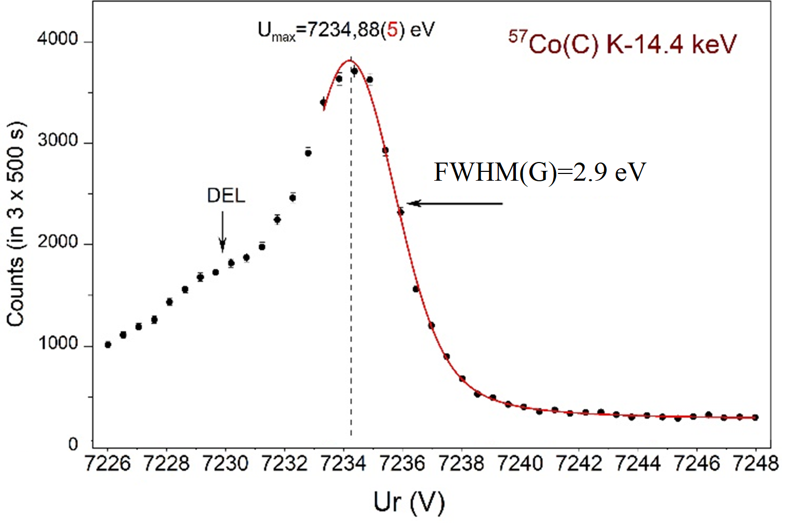
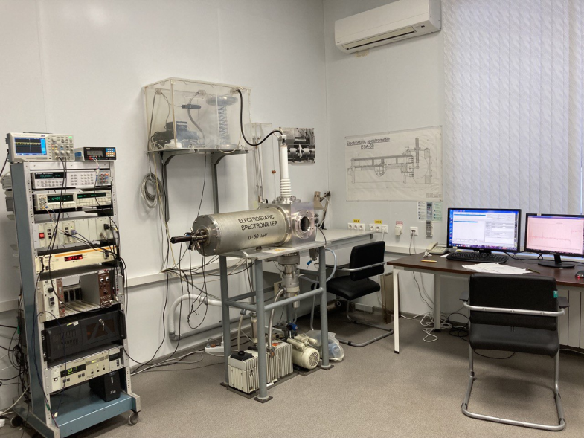
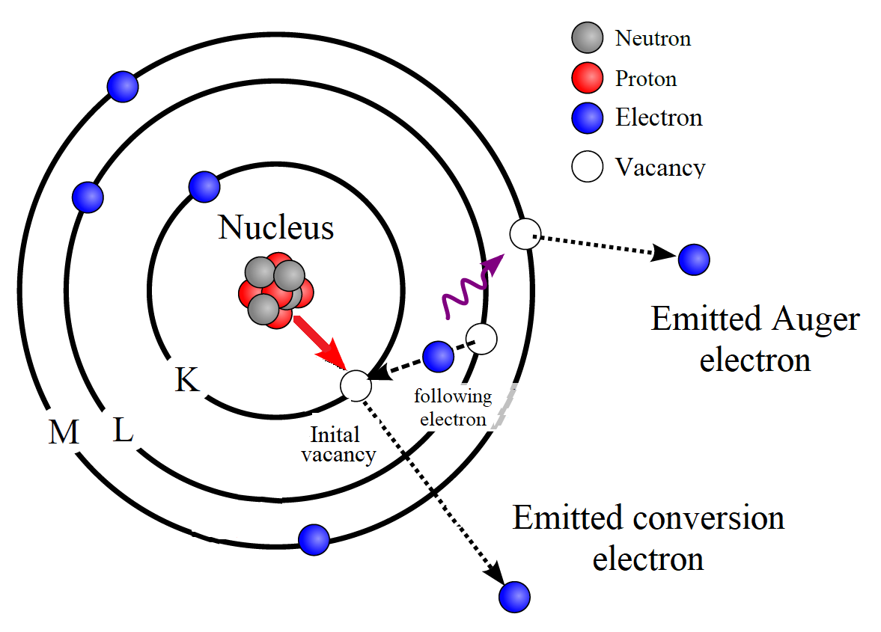
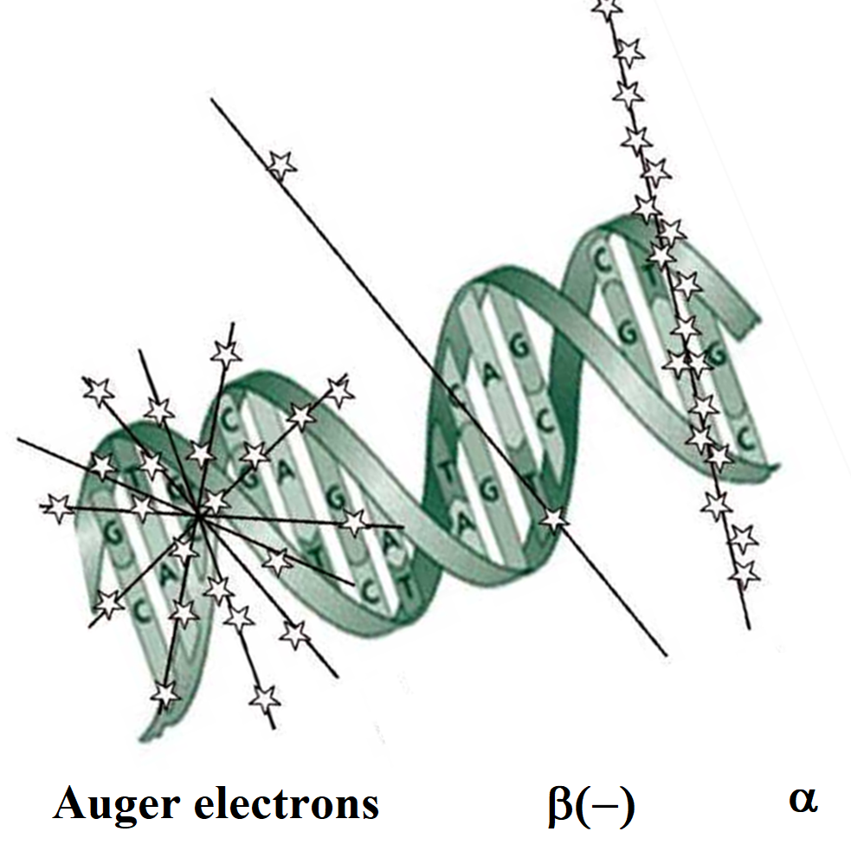
Radiochemistry and spectroscopy for astrophysics and nuclear medicine
Electron spectroscopy
in the range of extremely low energies
The Internal Conversion and Auger electron emission processes from radioactive decay of nucleus
ESA-50 spectrometer
Obtaining of experimental data for evaluation of Auger-electrons application in nuclear medicine

Slide 15
Radiochemistry and spectroscopy for astrophysics and nuclear medicine
Electron spectroscopy
in the range of extremely low energies
experimental study of the low-energy electrons (from decay of ^{229m}Th, ²²⁷Ac, ²²⁵Ra etc.) spectra (0 -50 keV)
on the ESA-50 spectrometer
search for spectrometry and simulation ways of electrons in the energy range 1-200 eV
search for spectrometry ways of post-decay photons in the energy range 1-200 eV

Slide 16
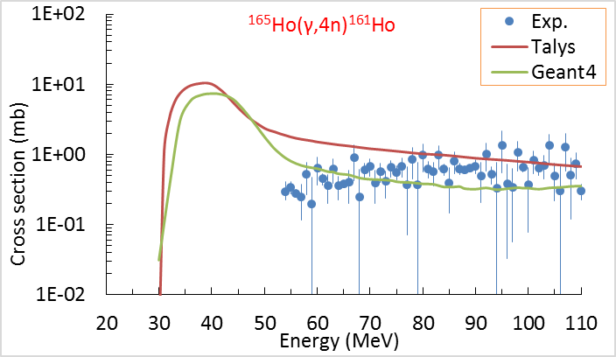
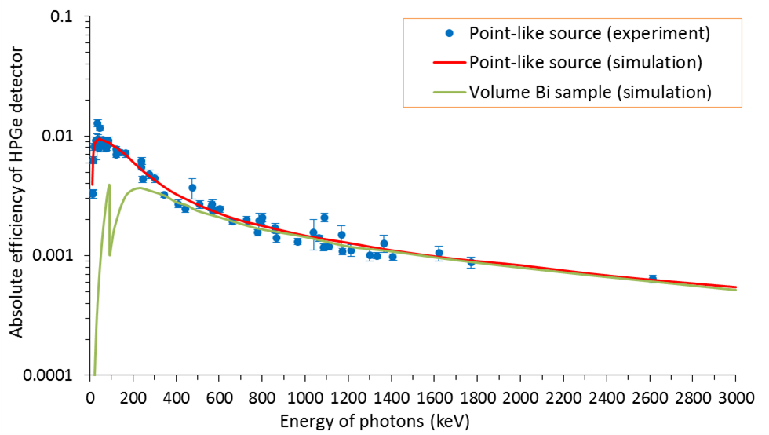
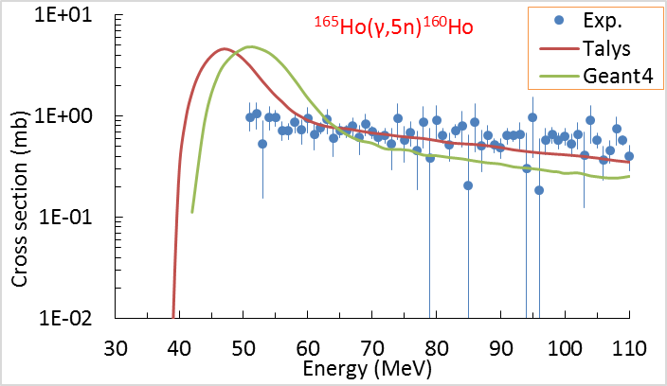
Radiochemistry and spectroscopy for astrophysics and nuclear medicine
Gamma-spectroscopy (simulation)
based on semiconductor detectors
¹⁶⁵Ho(γ,4n)¹⁶¹Ho
¹⁶⁵Ho(γ,5n)¹⁶⁰Ho
Comparison of experimental and simulated efficiency of HPGe detector

Slide 17
Radiochemistry and spectroscopy for astrophysics and nuclear medicine
Gamma-spectroscopy (simulation)
based on semiconductor detectors
Study of rare process
Decay modes of radionuclides (⁹⁶Zr), production of radionuclide impurities in samples and “interaction with new particles”
Common nuclear spectroscopy
Determination of cross sections of nuclear reactions and decay modes of radionuclides, design of calibration bulk sources
Design of sources, targets and protecting materials, etc.
Design of sources (⁴⁰K, ¹³⁸La) and targets
Irradiations, measurement of irradiated targets and sources
Measurement of spectra on detector
Simulation and comparation with experimental data
Development of methods for modeling codes application (Geant4, MCNP and FLUKA) of the HPGe spectrometer characteristics and comparation with experimental data

Slide 18
Radiochemistry and spectroscopy for astrophysics and nuclear medicine
Publications
Citation | Autor | Title | Journal
343 | Agostini M. | Final Results of GERDA on the Search for Neutrinoless Double- β Decay | Physical Review Letters
148 | Arnaud Q. | First Germanium-Based Constraints on Sub-MeV Dark Matter with the EDELWEISS Experiment | Physical Review Letters
58 | Abusleme A. | Calibration strategy of the JUNO experiment | Journal of High Energy Physics
44 | Abusleme A. | Optimization of the JUNO liquid scintillator composition using a Daya Bay antineutrino detector | Nuclear Instruments and Methods in Physics Research A
36 | Filosofov D. | Potent candidates for Targeted Auger Therapy: Production and radiochemical considerations | Nuclear Medicine and Biology
31 | Abusleme A. | Feasibility and physics potential of detecting ⁸B solar neutrinos at JUNO | Chinese Physics C
31 | Agostini M. | First Search for Bosonic Superweakly Interacting Massive Particles with Masses up to 1 MeV/c² with GERDA | Physical Review Letters
31 | Agostini M. | Modeling of GERDA Phase II data | Journal of High Energy Physics
2020-2022: Scopus - 48
Physical Review Letters (9.161) 4
Cosmology and Astroparticle Physic (7.28) 1
High Energy Physics (6.376) 4
Physical Review D (5.296) 2
Inorganic Chemistry (5.436) 1
Chromatography A (4.759) 1
Physics Letters B (4.95) 1
European Physical Journal C (4.994) 7
European Physical Journal A (3.131) 1
Radiochimica Acta (2.083) 1
Solvent Extraction and Ion Exchange (2.513) 1
Chinese Physics C (2.944) 3
Nuclear Medicine and Biology (2.947) 4
18

Slide 19
Radiochemistry and spectroscopy for astrophysics and nuclear medicine
FTE and budget
Schedule proposal and resources required for the implementation of the Project
Names of costs, resources, sources of funding |  |  | Cost (thousands of dollars) resource requirements | Cost, distribution by year
 |  |  |  | 1st year | 2nd year | 3rd year | 4th year | 5th year
International cooperation (IC) |  |  | 550 | 110 | 110 | 110 | 110 | 110
Materials |  |  | 600 | 120 | 120 | 120 | 120 | 120
Equipment and third-party services (commissioning) |  |  | 1500 | 300 | 300 | 300 | 300 | 300
Commissioning work |  |  | 100 | 20 | 20 | 20 | 20 | 20
Services of research organizations |  |  | 50 | 10 | 10 | 10 | 10 | 10
Acquisition of software |  |  | 100 | 20 | 20 | 20 | 20 | 20
Design/construction
Service costs (planned in case of direct project affiliation) |  |  | 100 | 20 | 20 | 20 | 20 | 20
Resources required | Normo-hours | Resources
 |  | the amount of FTE, | 29.5 | 29.5 | 29.5 | 29.5 | 29.5 | 29.5
 |  | accelerator/installation
 |  | reactor,….
Sources of funding | Budgetary resources | JINR budget (budget items) | 3000 | 600 | 600 | 600 | 600 | 600
 | Extrabudgetary (supplementary estimates) | Contributions by co-contractors Funds under contracts with customers Other sources of funding
№ | Category employee | Core staff, Amount of FTE
1. | scientific staff | 16.35
2. | engineers | 11.05
3. | professionals | 1.00
4. | employees | -
5. | workers | 1.10
 | Total: | 29.50

Slide 20
Thank you for your attention!

