Slide 1

Proposal for opening a new project "Investigations of reactor neutrinos on a short baseline“
Joint Institute for Nuclear Research
Dzhelepov Laboratory of Nuclear Problems
Program Advisory Committee for Nuclear Physics, 30th June 2023
Code of theme : 03-2-1100-2010/2024
Project leader: I.Zhitnikov
Project deputy leaders: A. Lubashevskiy, S. Rozov, M. Shirchenko

Slide 2
Scientific program:
the search for and investigations of Coherent Elastic neutrino Nuclear Scattering (CEνNS) with low-threshold germanium detectors (νGeN) and low-threshold cryogenic detectors (Ricochet)
the search for the neutrino magnetic moment (νGeN and Ricochet)
the search for short-baseline reactor antineutrino active-sterile oscillations with a highly-segmented plastic scintillator detector (DANSS, DANSS-2)
remote monitoring of nuclear reactor core operation measuring the antineutrino flux (DANSS, DANSS-2)

Slide 3
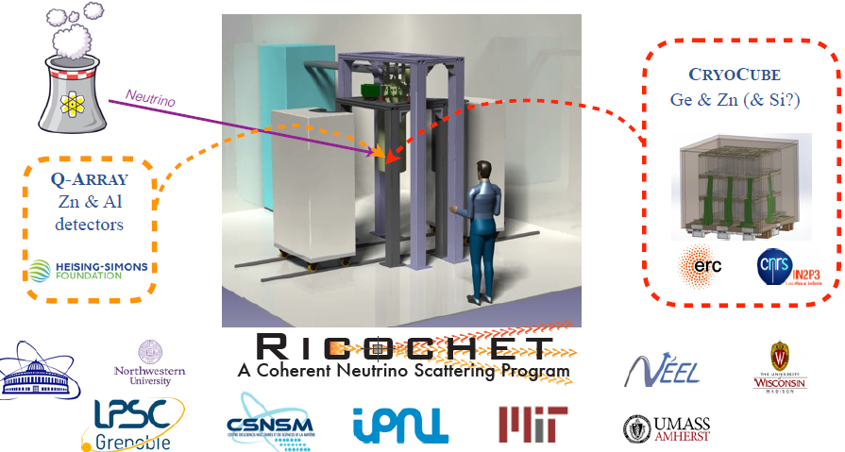
RICOCHET experiment: New physics with precision measurements of CEvNS at reactors.
RICOCHET aims at building the ultra low-energy CEνNS neutrino observatory dedicated to physics beyond the Standard Model
50 eV energy threshold with a 10³ background rejection down to the threshold
The CRYOCUBE: a compact tabletop size setup
27 x 33 g detectors
8 x 8 x 8 cm³
radio-pure infrared-tight copper box
The first key feature of the RICOCHET program, compared to other planned or ongoing CEνNS projects, is to aim for a kg-scale experiment with significant background rejection down to the O(10) eV energy threshold.

Slide 4
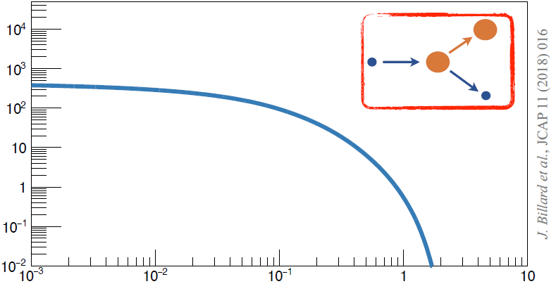
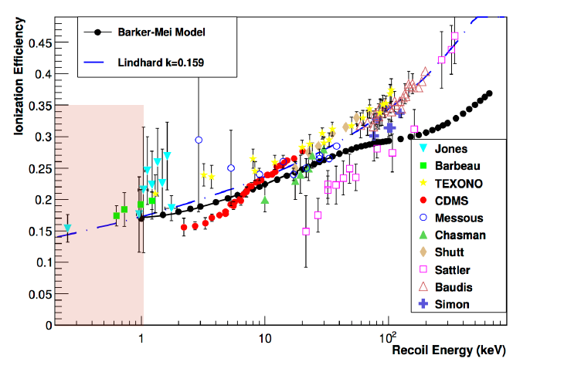
Coherent elastic neutrino-nucleus scattering (CEνNS)
The use of bolometers makes it possible to measure the energy of the nucleus directly (heat signal), in contrast to semiconductor detectors that measure ionization.
This it the way to the precision measurements.
Counts per day per 1 keV for 1 kg Ge
ν flux10¹² cm⁻² sec⁻¹
E_{NR}, keV

Slide 5
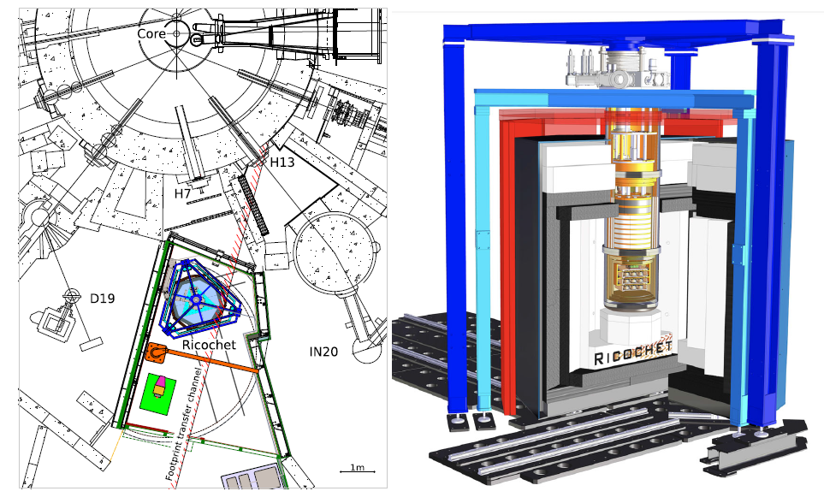
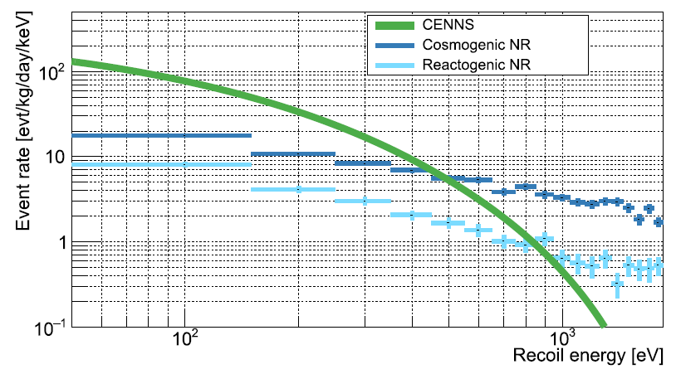
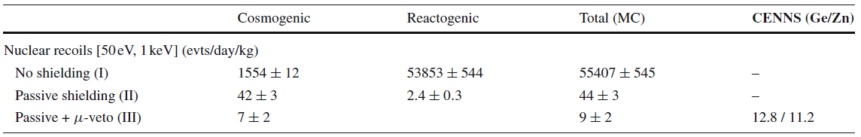
The experiment will deploy a kg-scale low-energy-threshold detector array combining Ge and Zn target crystals 8.8 m away from the 58MW research nuclear reactor core of the ILL
The Ricochet experiment should reach a statistical significance of 4.6 to 13.6 σ for the detection of CENNS after one reactor cycle. The start of the data taking in the experiment is planned for end 2023, 2024

Slide 6
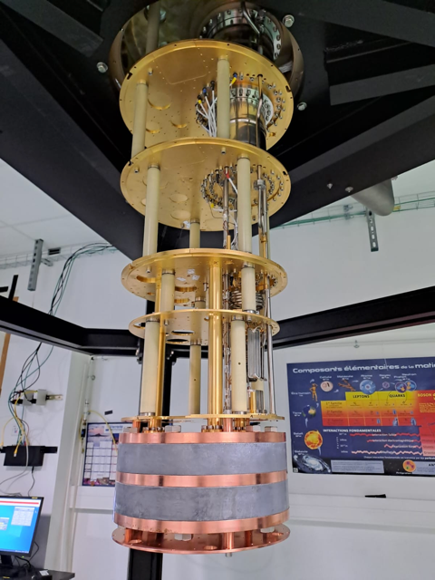
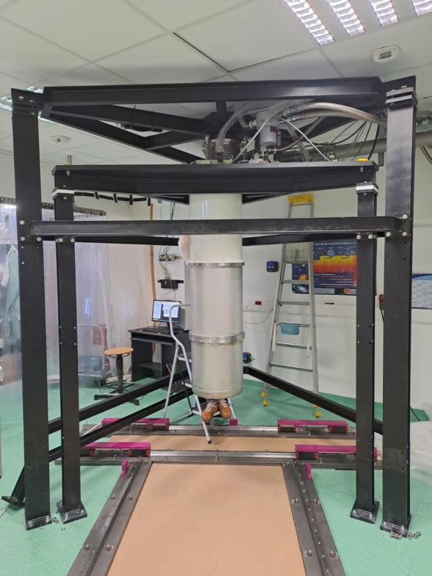
Dubna team participates and make commitments to the following parts of the RICOCHET project:
    The Ricochet cryosystem (together with IP2I);
    Development of methods for low background measurements;
    New supplementary detectors;
    Muon veto systems: partly some plastic panels development and building;
    Data taking (this includes daily routine procedures, as well as regular and special calibration runs);
    Low background study and development of methods of neutron and radon detection;
    Selection and production of less radioactive materials;
    Detector simulations and data analysis; Publication of results.

Slide 7

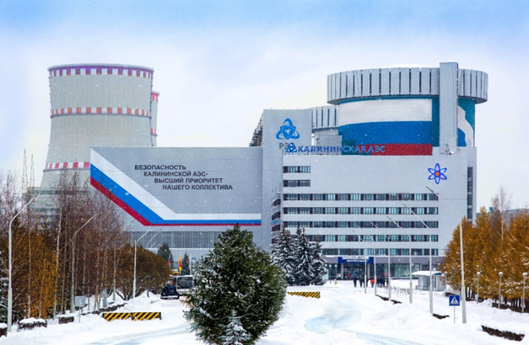
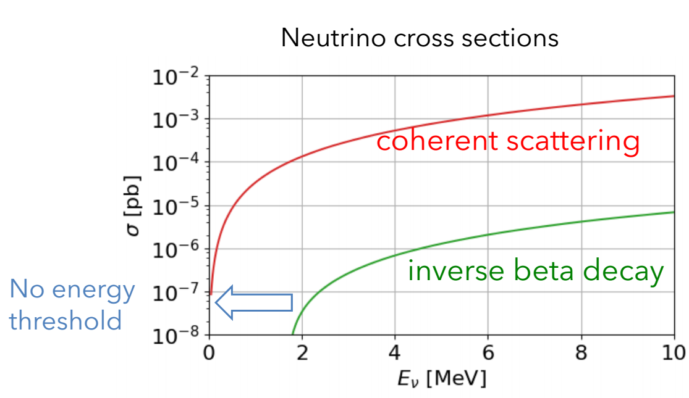

experiment: search for CEvNS and other rare processes
The experiment νGeN is aimed at studying the properties of reactor’s antineutrinos. The search for the coherent elastic neutrino-nucleus scattering (CEνNS) and other rare process (search for neutrino magnetic moment, etc) is performed. The projects is conducted mostly by JINR group.
CEνNS is a process for low energy neutrino, E_{ν} < 50 MeV (full coherency below ∼ 30 MeV)
Cross section is enhanced by several orders of magnitude
Proportional to the number of neutrons squared, N²
Recoil energy is very low – less than few keV
Often only a small part of recoil energy can be detected due to quenching (<25% for HPGe).
$$\overline{ν}$$
$$\overline{ν}$$
e-
γ
Additional EM component
A magnetic moment is a fundamental parameter of neutrino and its investigation may lead to results beyond the standard concepts of elementary particle physics and astrophysics. The observation of NMM above 10^{–14} μ_{B} would be a New Physics beyond the SM and indicate Majorana nature of neutrino.

Slide 8
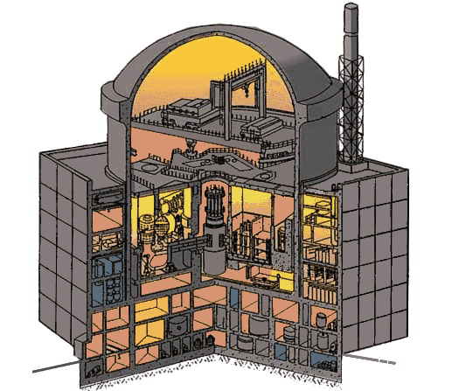
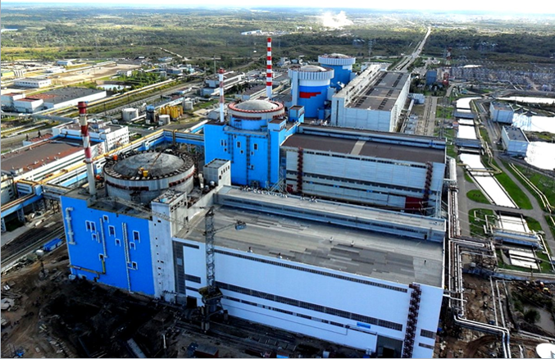
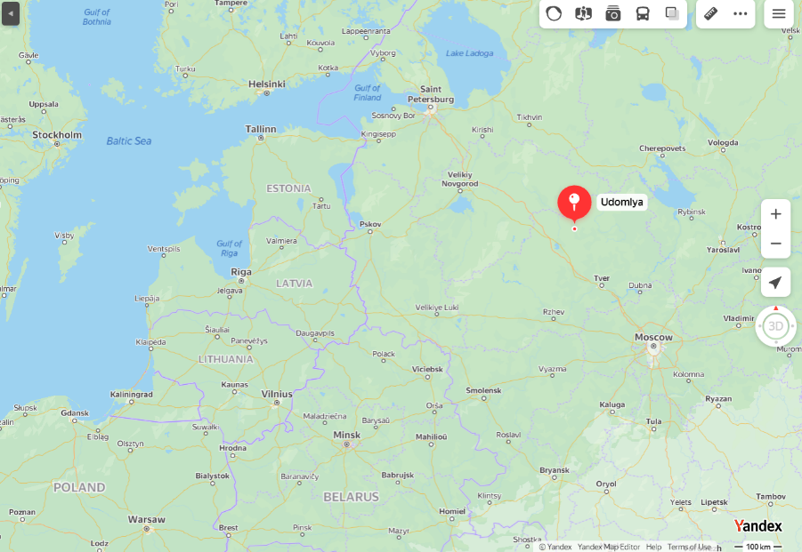
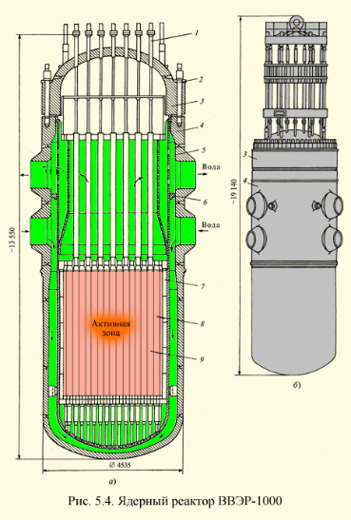
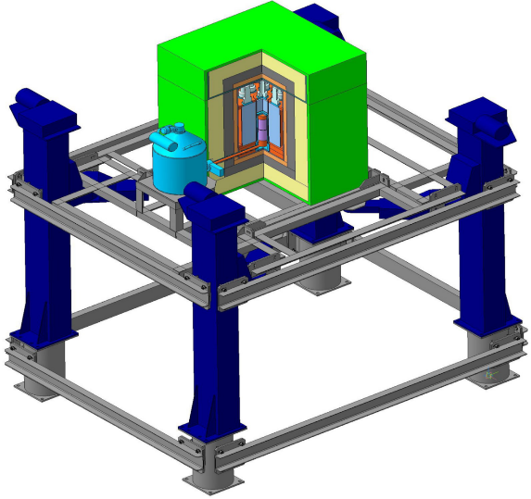
experiment: search for CEvNS and other rare processes
KNPP #3
The experiment νGeN is aimed at studying the properties of antineutrinos from the reactor of the Kalinin NPP (Udomlya, Russia). The search for the coherent elastic neutrino-nucleus scattering and other rare process (like search for neutrino magnetic moment) is performed.
Spectrometer νGeN is located under the reactor unit #3 (3.1 GW_{th} – thermal power)
Distance to the center of the reactor core is about 11 m, this gives ∼ 4⋅10¹³ ν/(sec⋅cm²)
Overburden ∼ 50 m w.e. − good shielding against cosmic radiation due to reactor’s surrounding
Distances to the center of reactor core: 11.1 – 12.5 m

Slide 9
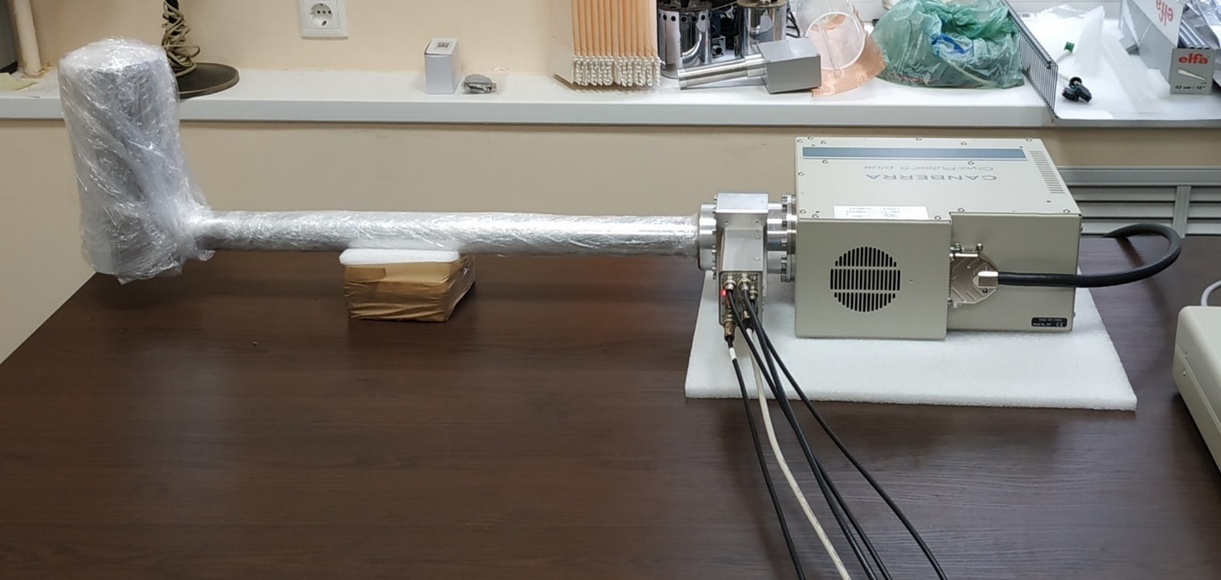
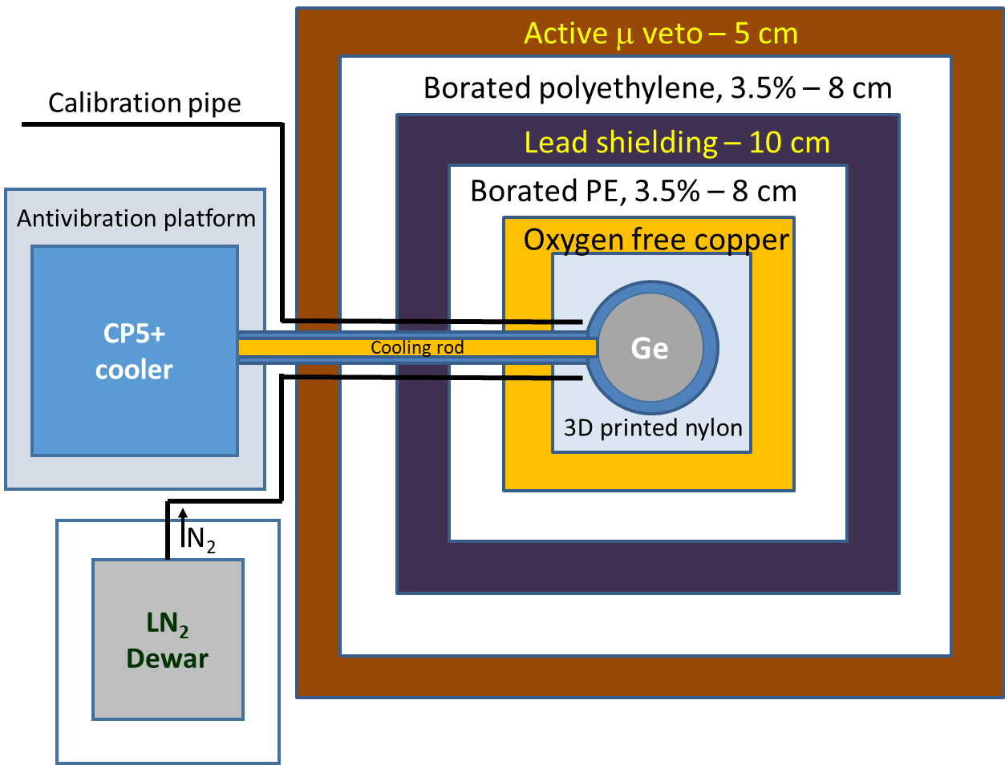
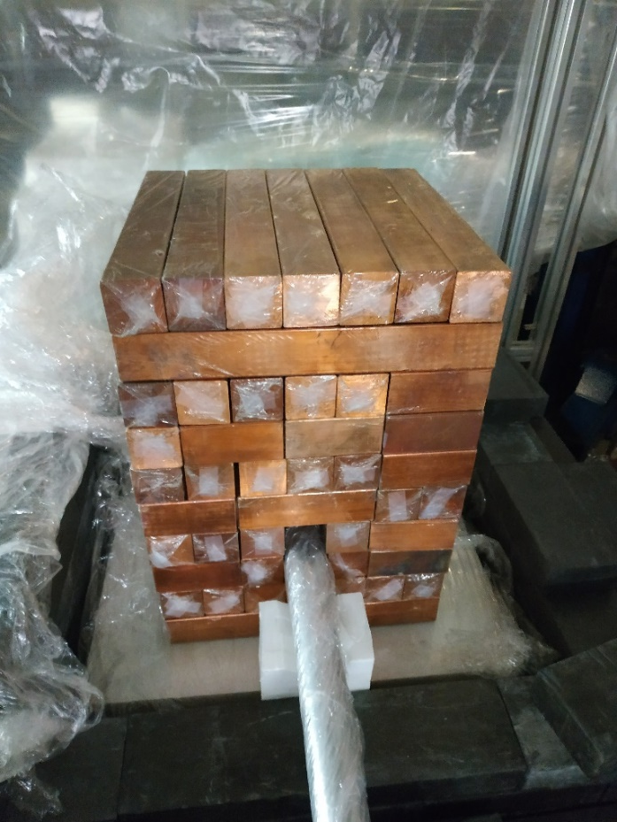
experiment: search for CEvNS and other rare processes
To detect signals from neutrino scattering we use a specially produced by CANBERRA (Mirion, Lingosheim) low-threshold, low-background HPGe detectors. At the moment, only one detector with a mass of 1.4 kg and e-cooling is used for the detection at KNPP.
The passive and active shielding has been organized in order to suppress background from surrounding. Additional systems to suppress radon background and microvibrations were developed. Special acquisition system has been developed to detect weak signals.

Slide 10
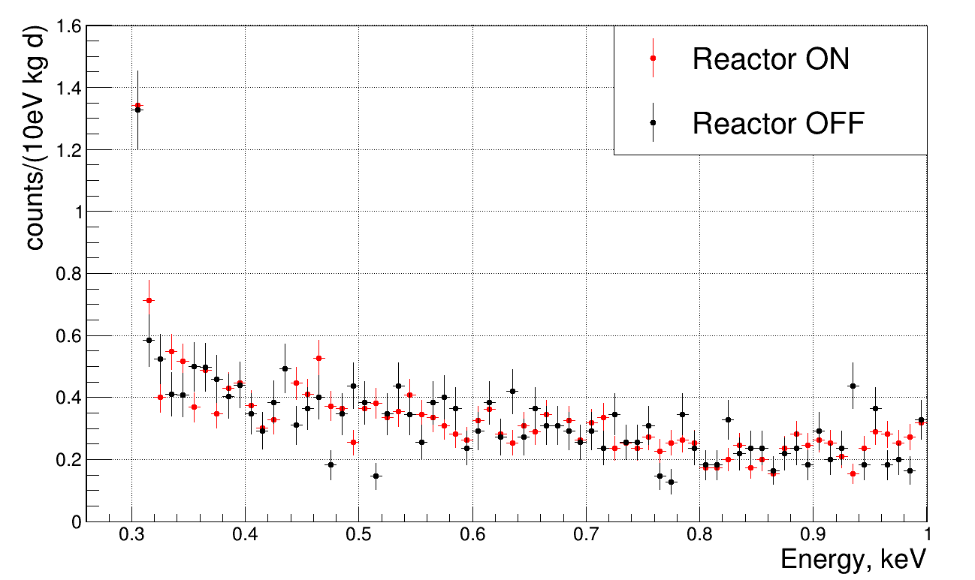
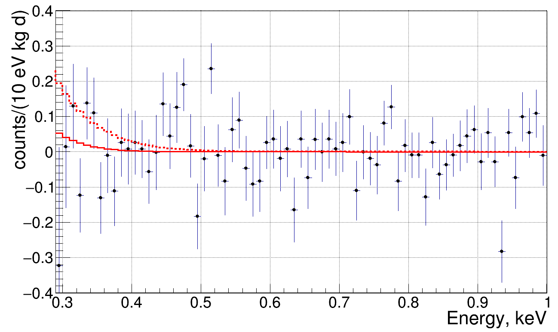
experiment: search for CEvNS and other rare processes
Analysis of the first data shows no significant difference in background level during reactor ON and OFF regimes. No excess at low energy connected with the CEνNS has been observed. The upper limit on the quenching parameter k < 0.26 with 90% CL has been obtained (dashed line). Red solid line for quenching parameter k = 0.179.
Measurements with the νGeN spectrometer at Kalinin Nuclear Power Plant are ongoing.
First results have showed that achieved background level allows to search for CEνNS at KNPP. No significant difference between regimes with reactor ON and OFF has been observed so far.
More than 1200 kgd of data has been accumulated so far. Since 09/2022 the data taking are performed at reduced distance to the reactor core.
The optimization of data taking is performed as well. New results with more statistics are expected soon.

Slide 11
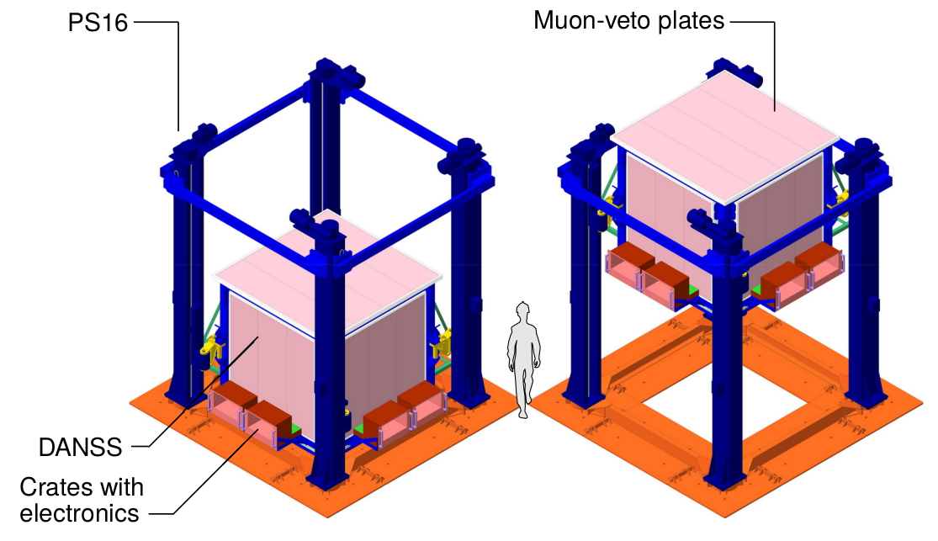
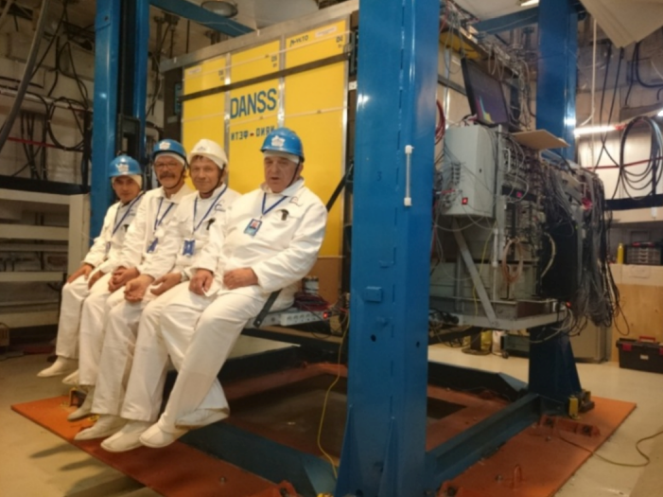
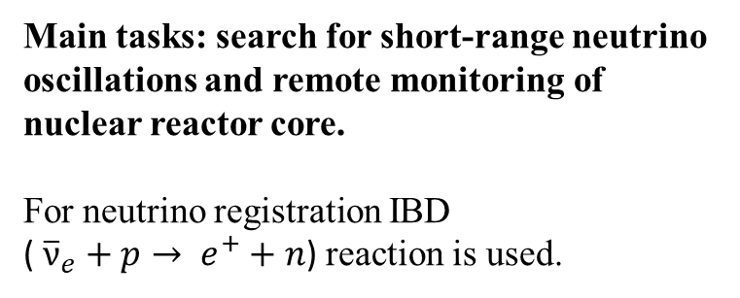
DANSS experiment
DANSS is installed on a movable platform under 3.1 GW WWER-1000 reactor at Kalinin Nuclear Power Plant
(Core:h=3.7m, ∅=3.1m) at Kalinin NPP.
~50 mwe shielding => μ flux reduction ~6!
No cosmic neutrons!
Detector distance from reactor core 10.9-12.9m
(center to center) is changed 2-3 times a week
Trigger: ΣE(РМТ)>0.5-0.7MeV=>Read 2600 wave forms (125MHz), look for correlated pairs offline.
KNPP #4
Water
Core
20.3
DANSS
Fuel fission fractions: average,
start and end of campaign [%]
235U 54.1 63.7 44.7
239Pu 33.2 26.6 38.9
238U 7.3 6.8 7.5
241Pu 5.5 2.8 8.5
(for a typical campaign)
Main tasks: search for short-range neutrino oscillations and remote monitoring of nuclear reactor core.
For neutrino registration IBD
( ${\overline{ν}}_{e}+p→ e^{+}+n$) reaction is used.

Slide 12
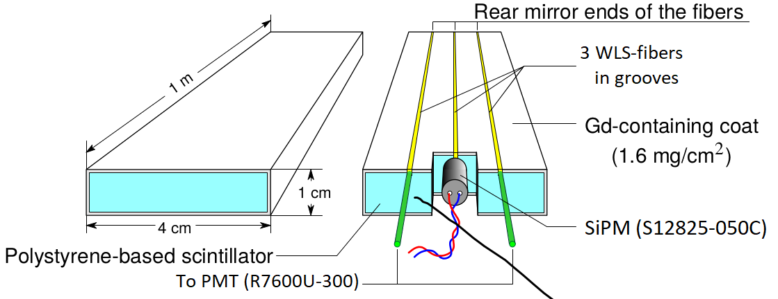
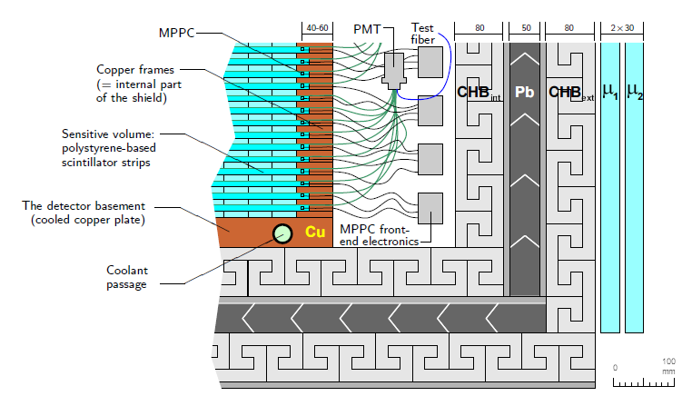
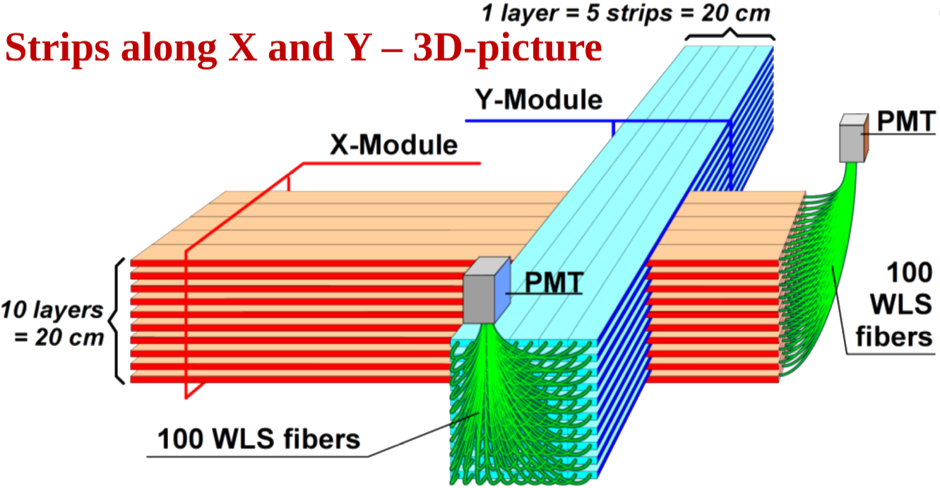
DANSS Detector design
JINST 11(2016)no11,P11011
Two-coordinate detector with fine segmentation – spatial information
Multilayer closed passive shielding: electrolytic copper frame ~5 cm, borated polyethylene 8 cm, lead 5 cm, borated polyethylene 8 cm
2-layer active μ-veto on 5 sides
2500 scintillator strips with Gd containing coating for neutron capture
Light collection with 3 WLS fibers
Central fiber read out with individual SiPM
Side fibers from 50 strips make a bunch of 100 on a PMT cathode = Module

Slide 13
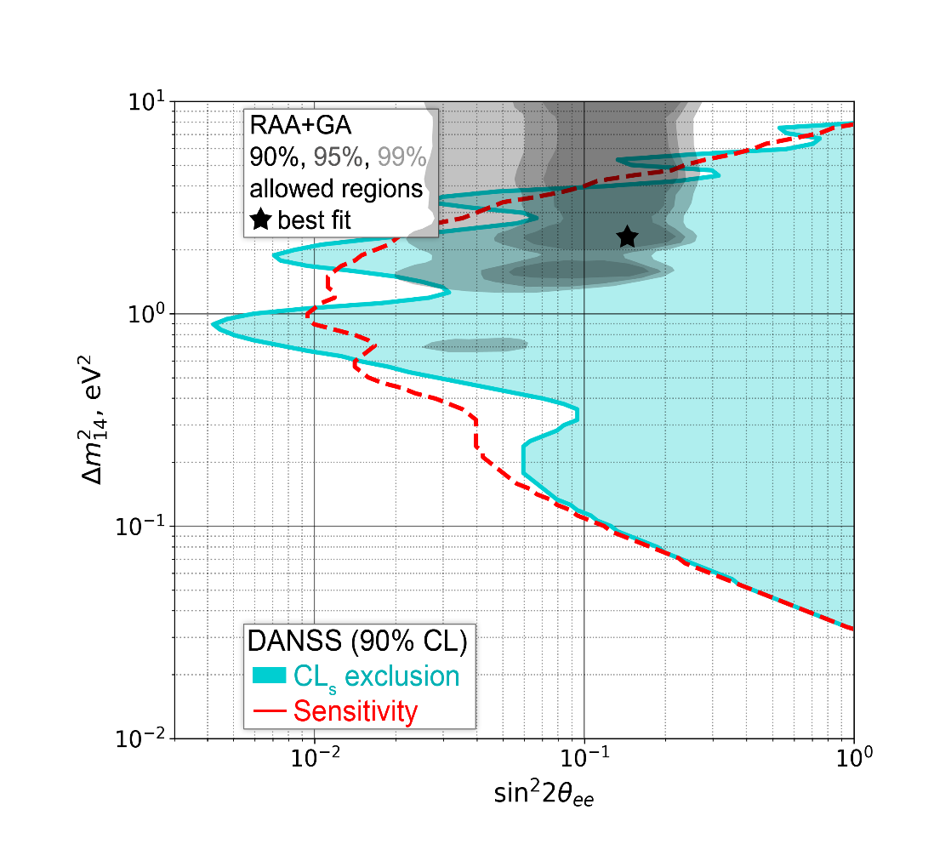
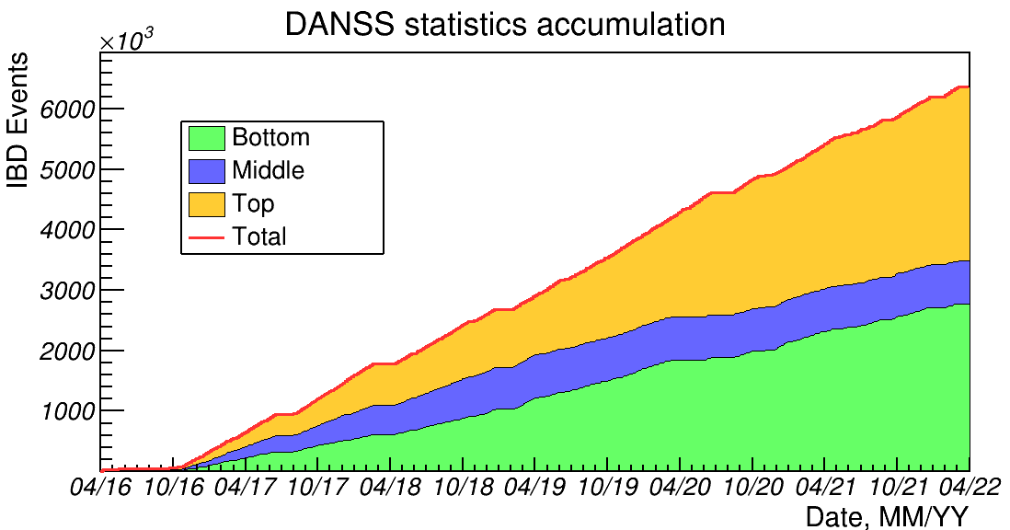
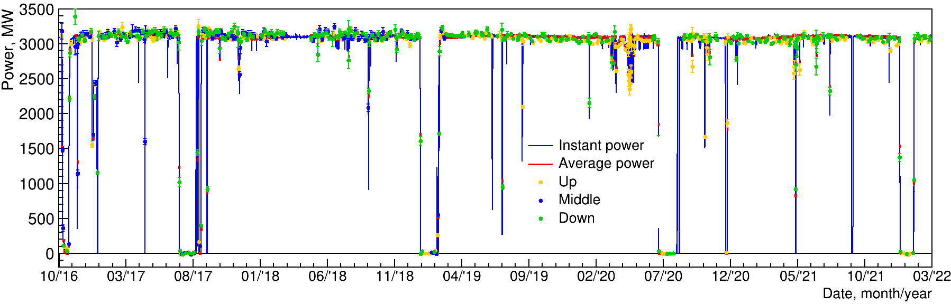
DANSS status
Total statistics accumulated is 6M IBD-events in 6 years and 4 reactor off periods
(4.4M events in oscillation analysis)
Reactor off
Reactor off
Exclusion region was calculated using Gaussian CLs method for E_{e+} in 1.5-6 MeV region
The most stringent limit reaches
sin²2θ < 4x10⁻³ level.
A very interesting part of 4v parameters is excluded.
The most probable point of RRA+GA is excluded at >5σ confidence level already in 2018
Neutrino reactor power monitoring with 1.5% accuracy in 2 days during 6 years
With fuel H-M correction
Normalized by 2016 data

Slide 14
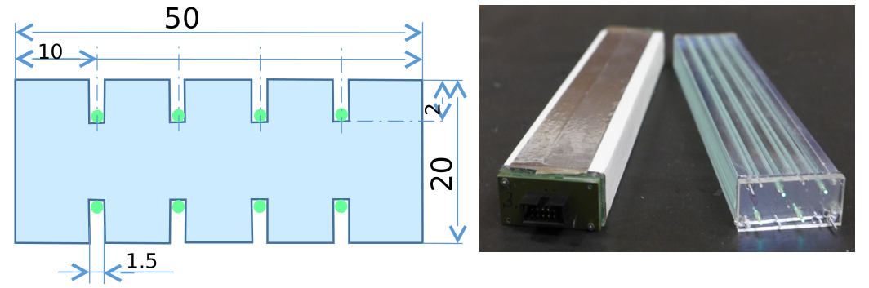
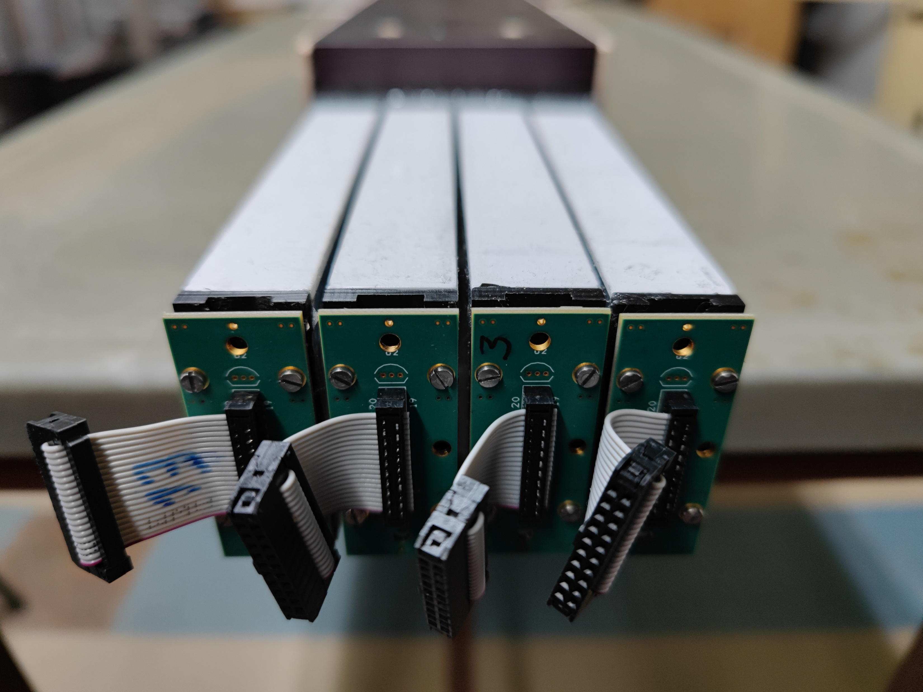
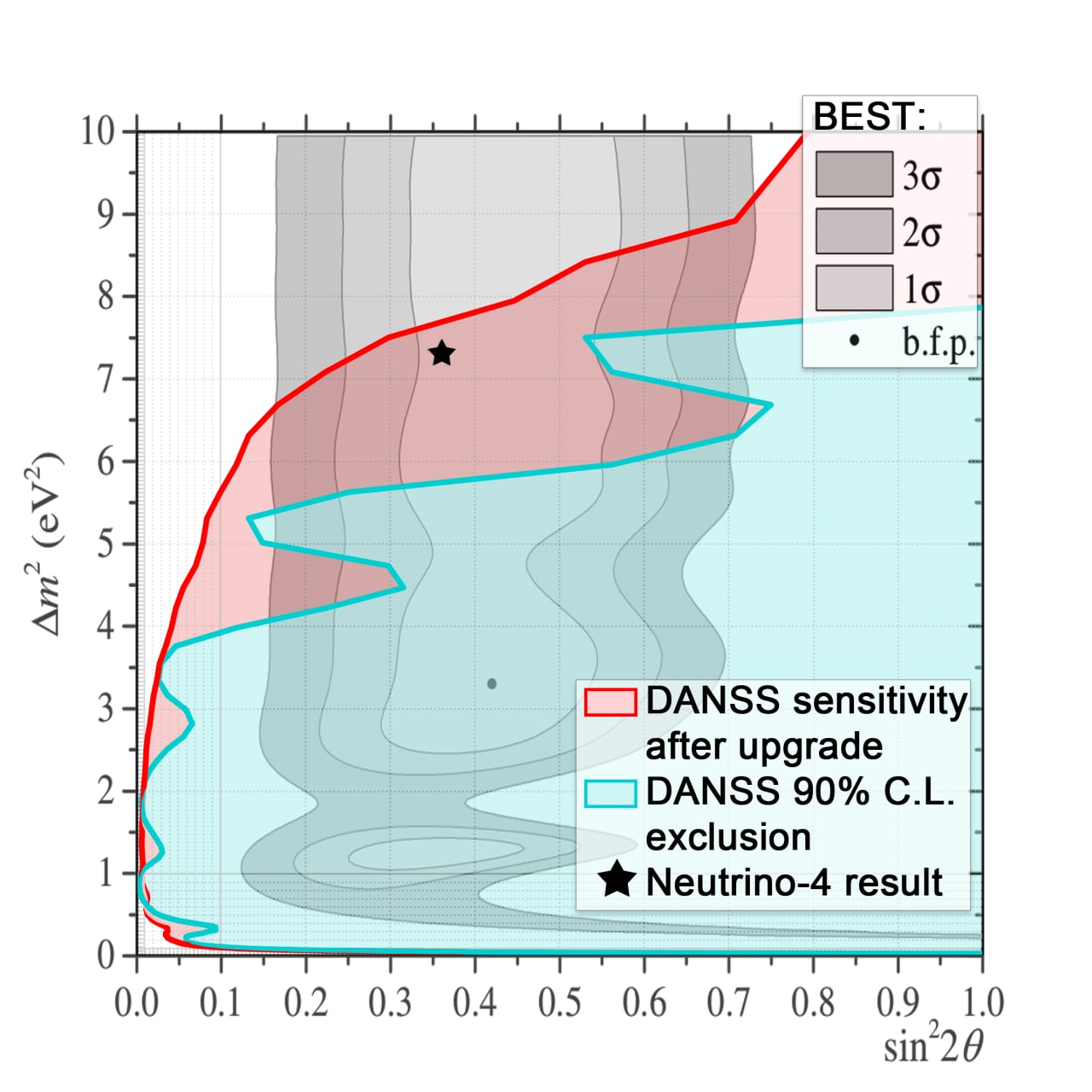
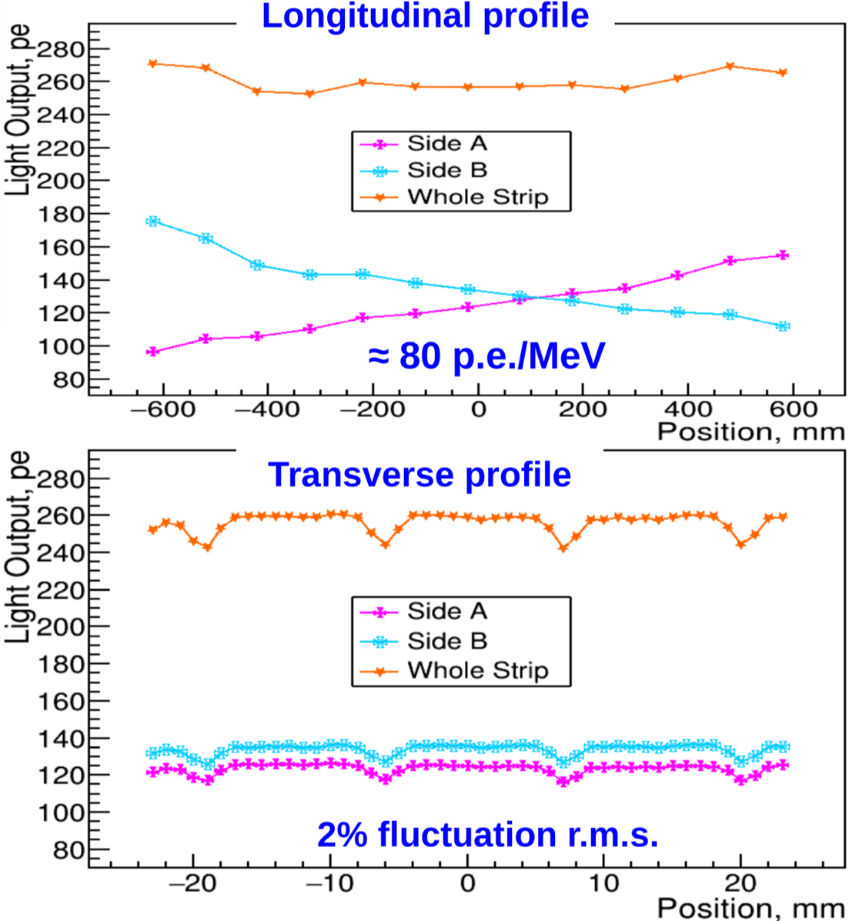
DANSS upgrade
New scintillator strips
Main goal:
to reach resolution 13%/√E
current very resolution is 34%/√E.
WLS fiber positions were optimized for better uniformity of response
New fast (4ns decay time) YS2 fiber will be used
1.5 years of
data taking after
upgrade
New geometry:
Strips: 2x5x120 cm,
2-side 4SiPM readout Structure: 60 layers x 24 strips: – 1.7 times larger fiducial volume
Setup uses the same shielding and moving platform.
Gd is in foils between layers.

Slide 15
Participation
νGeN:
  The Lebedev Physical Institute of the Russian Academy of Sciences (LPI RAS)
  Institute of Experimental and Applied Physics Czech Technical University in Prague (IEAP)
Ricochet:
  Claude Bernard University Lyon 1 (UCBL)
  Centre de Spectroscopie Nucleaire et de Spectroscopie de Masse (CSNSM)
  Univ. Grenoble Alpes (UGA)
  Institut Laue-Langevin (ILL)
  Laboratory for Nuclear Science, Massachusetts Institute of Technology (LNS)
  Department of Physics & Astronomy, Northwestern University
  University of Massachusetts (UMass)
DANSS:
  Institute for Theoretical and Experimental Physics (ITEP)
  The Lebedev Physical Institute of the Russian Academy of Sciences (LPI RAS)

Slide 16
JINR Participation at experiments
νGeN:
  Experiment performed mainly by JINR group
  JINR have purchased all the equipment and made the experimental setup
  Data analysis and MC simulations
  JINR stuff carry out all data taking at KNPP
DANSS:
  Experiment performed with a fundamental role of JINR group
  Production and testing of strips.
  Lifting mechanism creation and exploitation.
  Measurement methods development; DAQ development.
  Development and creation of a muon veto system.
  Detector assembly at the Kalinin Nuclear Power Plant.
  Provision of experimental data collection, permanent presence of personnel at KNPP.
  Study of background conditions and development of new methods for accounting and background suppression.
  Participation in data analysis.
Ricochet:
  Experiment performed with a key role of JINR group
      Development and running of the Ricochet cryosystem (together with IP2I);
      Development of methods for low background measurements;
      New supplementary detectors;
      Muon veto systems: partly some plastic panels development and building;
      Data taking (this includes daily routine procedures, as well as regular and special calibration runs);
      Low background study and development of methods of neutron and radon detection;
      Selection and production of less radioactive materials;
      Detector simulations and data analysis

Slide 17
Publications of experiments for 2021–2022:
Augier, C et al. "Fast neutron background characterization of the future Ricochet experiment at the ILL research nuclear reactor." European Physical Journal C 83.1, 2023, ISSN 1434-6044, https://doi.org/10.1140/epjc/s10052-022-11150-x
Alekseev, I et al. "First results of the νGeN experiment on coherent elastic neutrino-nucleus scattering." Physical Review D 106.5, 2022, ISSN 2470-0010, https://doi.org/10.1103/PhysRevD.106.L051101
Suslov, I.A et al. "Development of a new tellurium loaded liquid scintillator based on linear alkylbenzene." Nuclear Instruments and Methods in Physics Research, Section A: Accelerators, Spectrometers, Detectors and Associated Equipment 1040, 2022, ISSN 0168-9002, https://doi.org/10.1016/j.nima.2022.167131
Alekseev, I et al. "Observation of the temperature and barometric effects on the cosmic muon flux by the DANSS detector." European Physical Journal C 82.6, 2022, ISSN 1434-6044, https://doi.org/10.1140/epjc/s10052-022-10471-1
Alekseev, I et al. "Optimized scintillation strip design for the DANSS upgrade." Journal of Instrumentation 17.4, 2022, ISSN 1748-0221, https://doi.org/10.1088/1748-0221/17/04/P04009
Sokolov, A et al. "Segmented HPGe Detector for Nuclear Reactions Research." IEEE Transactions on Nuclear Science 68.1, 2021, pp. 54-58., ISSN 0018-9499, https://doi.org/10.1109/TNS.2020.3037336
Ponomarev, D et al. "NaI(Tl+Li) scintillator as multirange energies neutron detector." Journal of Instrumentation 16.12, 2021, ISSN 1748-0221, https://doi.org/10.1088/1748-0221/16/12/P12011

Slide 18
Investigations of reactor neutrinos on a short baseline
Experiment | νGeN | DANSS | Ricochet
Goal | CEνNS, the neutrino magnetic moment | Sterile oscillations, nuclear reactor monitoring | CEνNS, non-standard neutrino interactions
Place | KNPP Unit#3, Russia | KNPP Unit#4, Russia | Research nuclear reaсtor, ILL, France
Thermal reactor power, MW | 3100 | 3100 | 58
Distance from the nuclear reactor core | 11.1 – 12.5 m | 10.9-12.9 m | 8.8 m
JINR infrastructure | Yes | Yes | Yes
JINR group expertise | Background measurements and estimations; low background study; development and creation of a muon veto system; selection of less radioactive materials; data analysis

Slide 19
Project plan:
νGeN
  2023-2024 measurements in the current configuration.
  2024 plans to upgrade the setup, install a new internal veto, improve the lifting mechanism to work closer to the detector, and reconfigure the muon veto.
  2024-2028 data set. The continuation of the experiment beyond 2028 will depend on the results.
RICOCHET
2024 year: commissioning of the setup at ILL site, start data taking with Ge bolometers, continue development of improved cryogenic detectors. Improved MC model based on real data.
The experiment needs minimum 10 reactor cycles to achieve the sensitivity level needed for 1% precision level. Thus, the measurements will be continued minimum 3 years (this depends on the ILL).
The developing Zn cryo array will be added to the setup at once ready (most probably not early than end of 2024).
During all time of the project we will continue to study the setup environmental background, perform intensive calibration program and R&D for further experiments.
All years: data analysis, preparation of publications.
DANSS
2023 year: methodological works and purchases for DANSS-2
2023-2024: The continuation data taking with DANSS, data analysis, preparation of publications
2023-2024: R&D and final construction of DANSS-2 at KNPP area. Start data taking.
Measurements are planned until 2028. The continuation of the experiment after 2028 will depend on the results obtained.

Slide 20
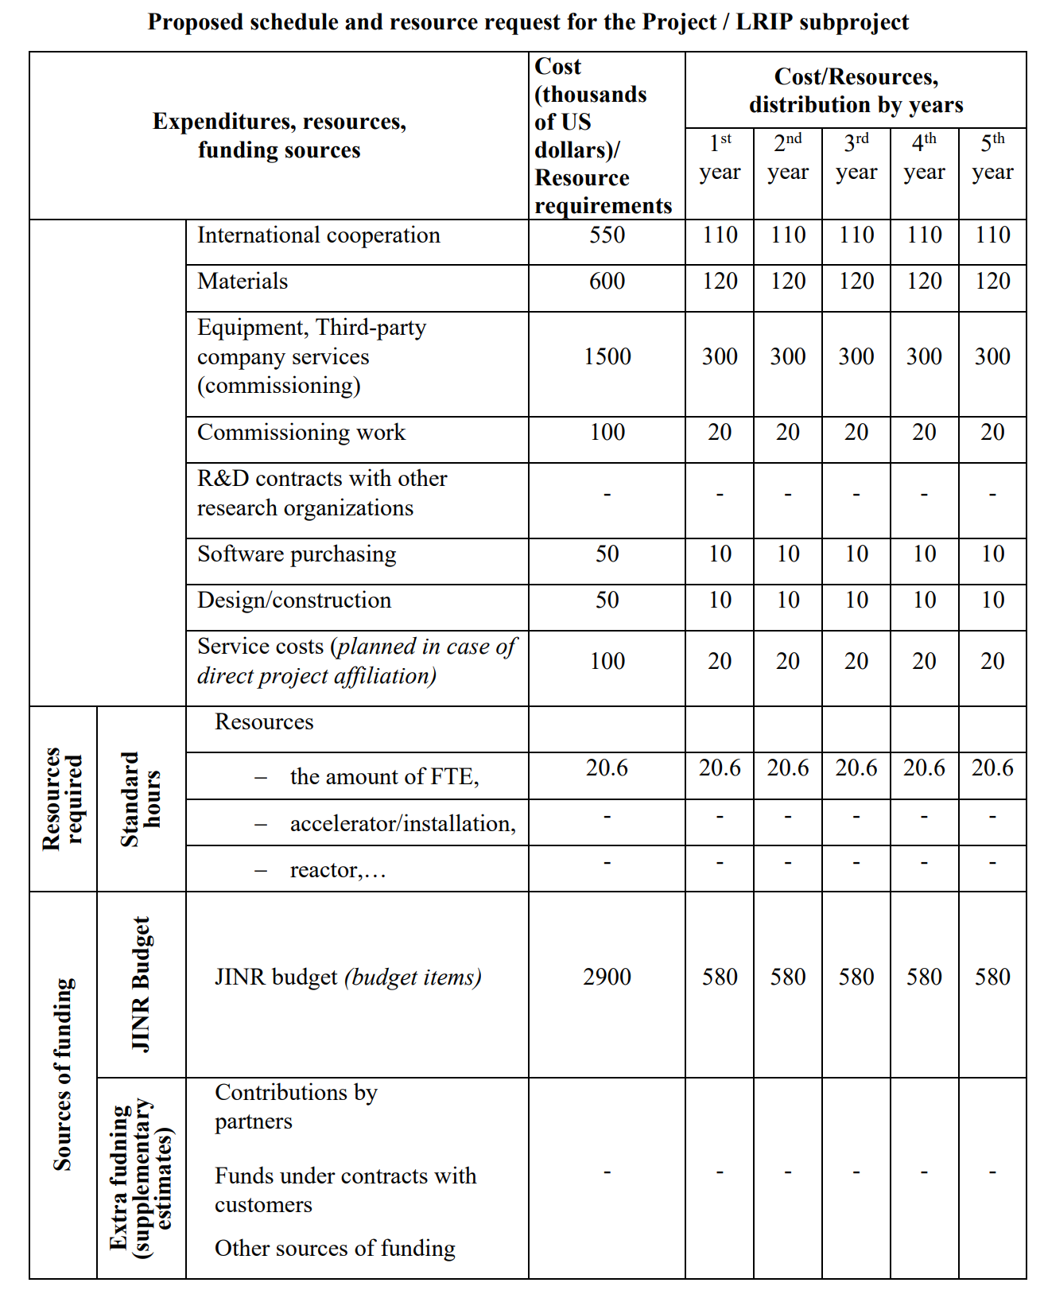
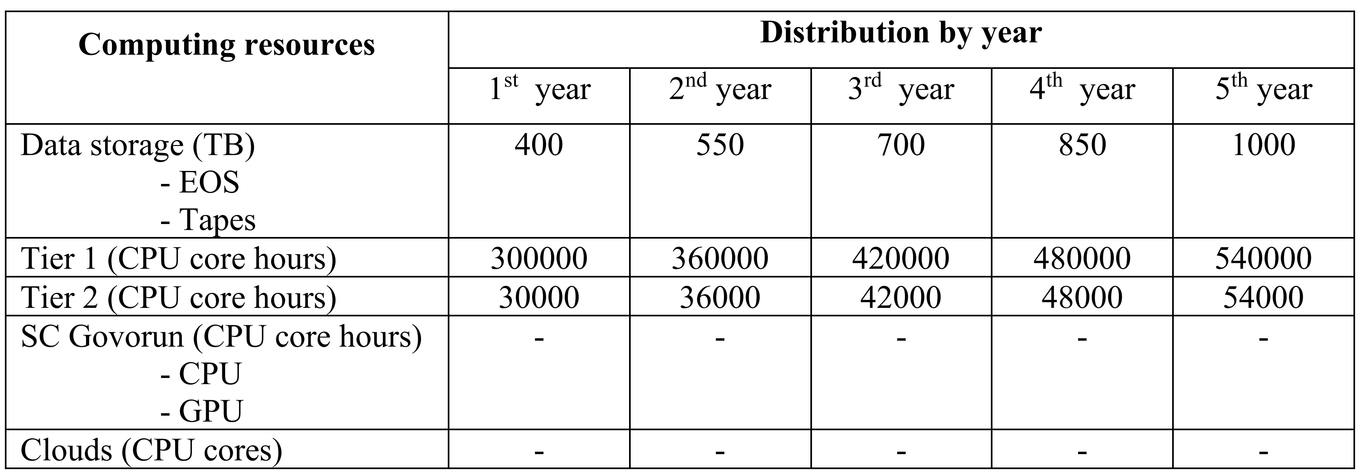
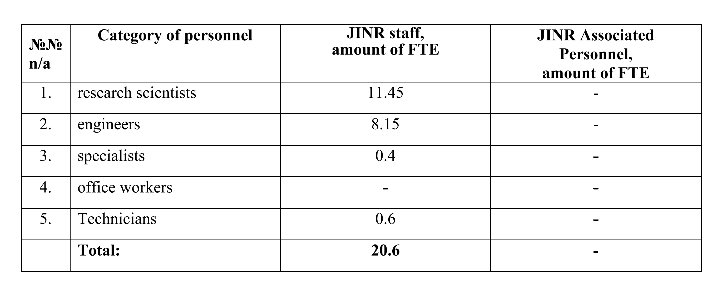
Proposed resource request for the Project

Slide 21
Conclusions
The project combines 3 experiments aimed to study of antineutrino fluxes from nuclear reactors at distances of less than 20 meters : DANSS (DANSS-2), νGeN and RICOCHET.
The project is a next stage of neutrino projects developed and realized in DLNP. It is based on a resent activities and achievements made by the JINR team.

Slide 22
Thank you for your attention!

