Slide 1



Heavy ion physics: what do we know at the start of NICA
Alexey Aparin, LHEP JINR

Slide 2
Part 1 Setting the scene
Introduction
Model description of HIC
Equation of State
Phase diagram of QCD

Slide 3

How do we study nuclear matter?

Slide 4
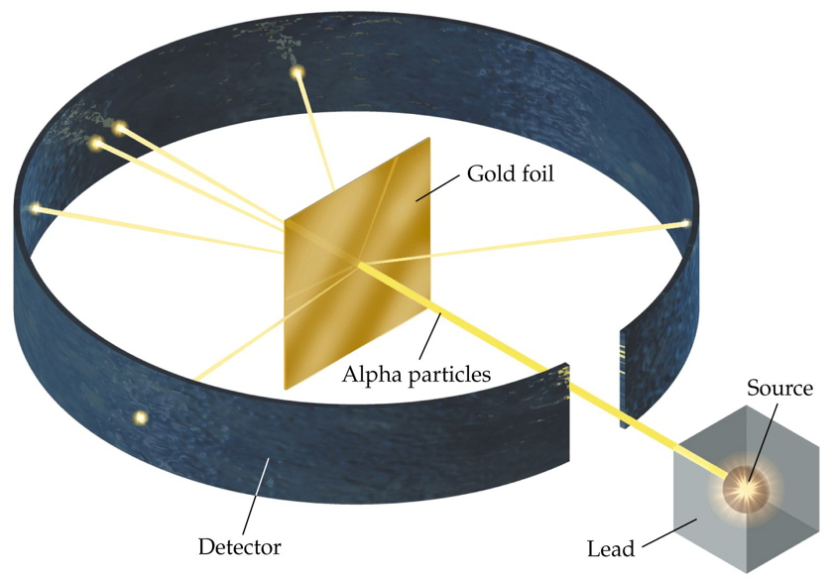
How do we study nuclear matter?
Typical scale of high energy experiment 1 fm = 10⁻¹³ sm
Typical timeframe ~ 1 – 100 fm/c = 0.3 – 30 * 10⁻²³ sec
We need to use some beam of test particles to collide it into the sample we want to investigate

Slide 5

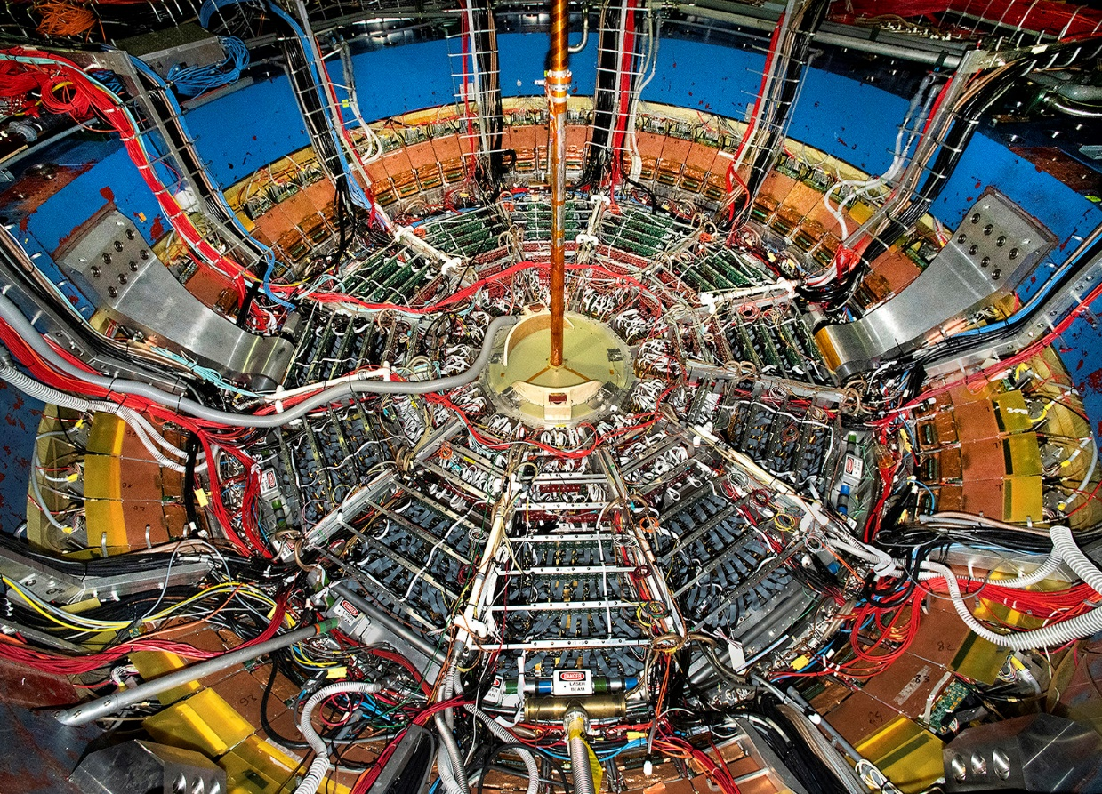
How do we study nuclear matter?
We need to understand well what we are going to collide!

Slide 6

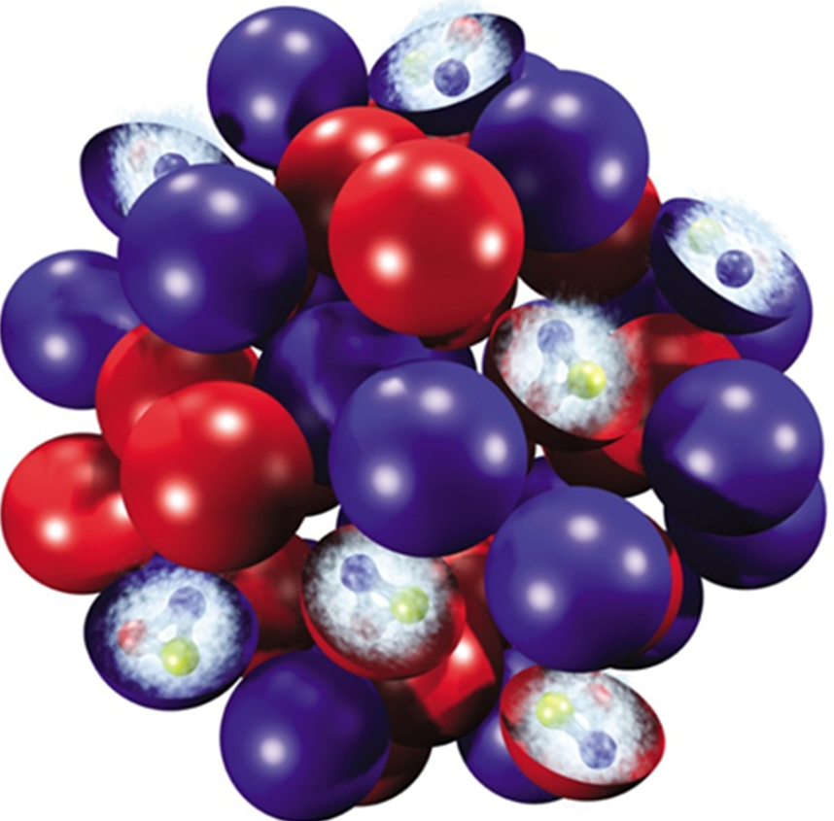
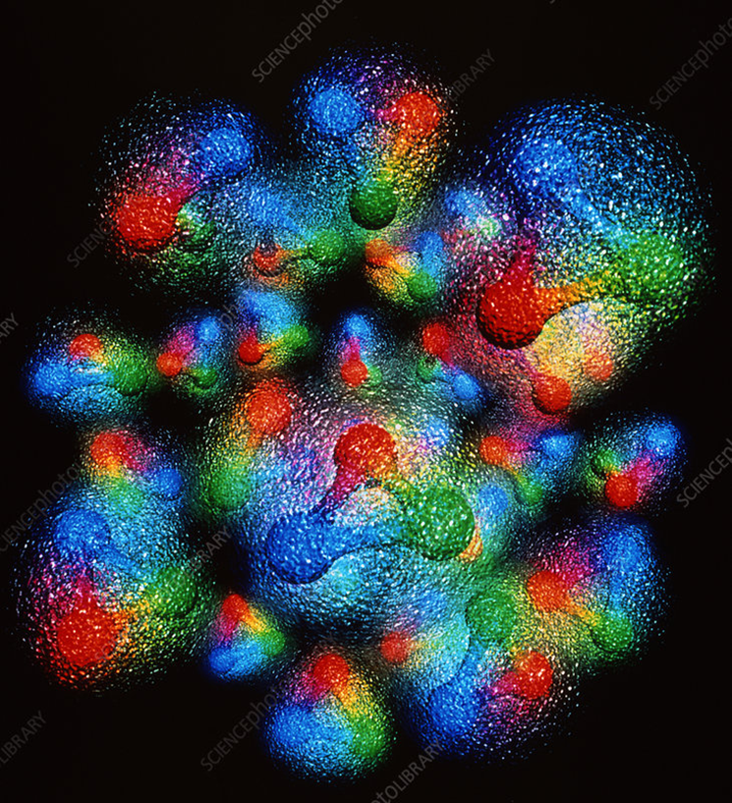
How does the nucleus look like?
Which of the Si nucleus models is more realistic and why?

Slide 7
How does the nucleus look like – it depends!
deBroglie wavelength of constituent partons is effected by the beam energy.
At lower energy, nucleons are opaque, and the valence quarks are stopped in the fireball.
Excess quarks ➔ higher μ_{B}
At higher energy, nucleons are transparent, and the valence quarks are pass through and exit the fireball.
Equal quarks and anti-quarks ➔ lower μ_{B}

Slide 8
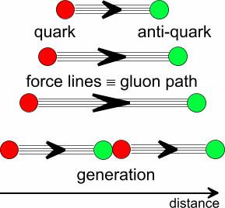
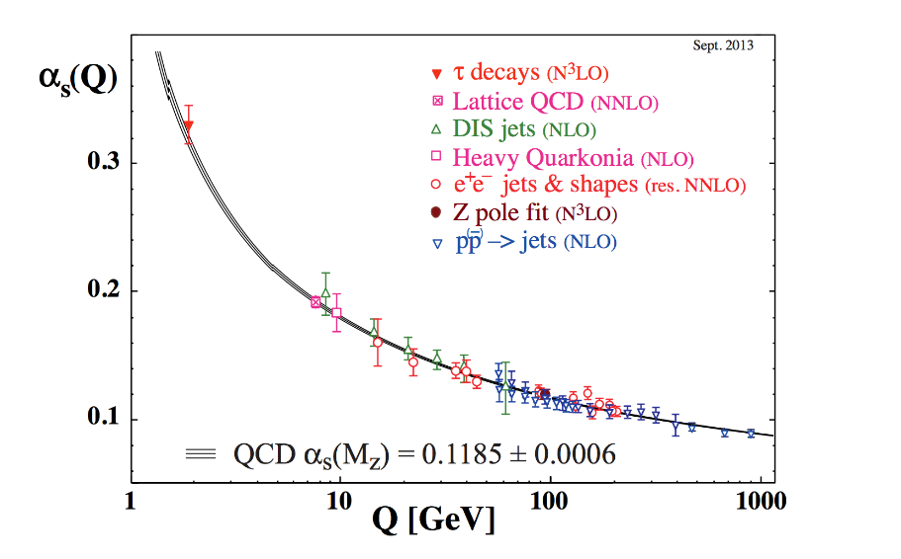
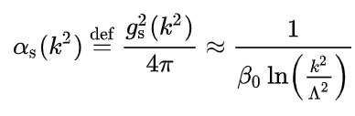
Two regimes of the strong force
Confinement for color objects
Attraction force can create new quark – antiquark pair from vacuum to remain color neutral
Asymptotic freedom at very small scales/large energies
(Wilczek, Gross and Politzer)
Nobel prize 2004
Λ_{QCD} ≃ 1 fm⁻¹ – sets scale most important parameter in QCD

Slide 9
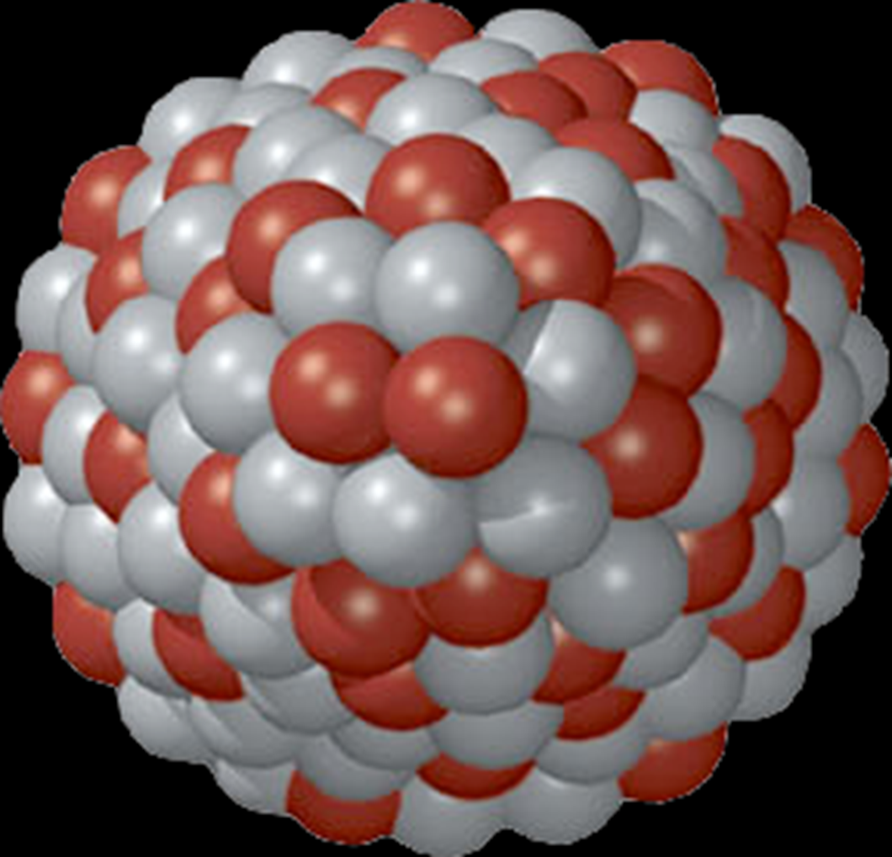
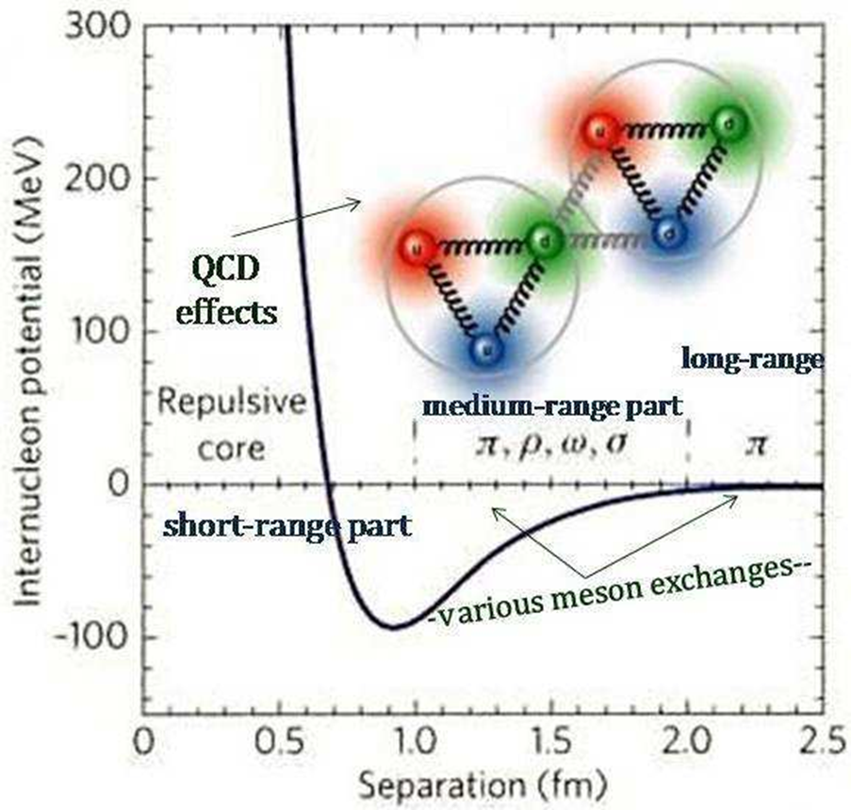
Strong interaction potentials
Gold nucleus

Slide 10
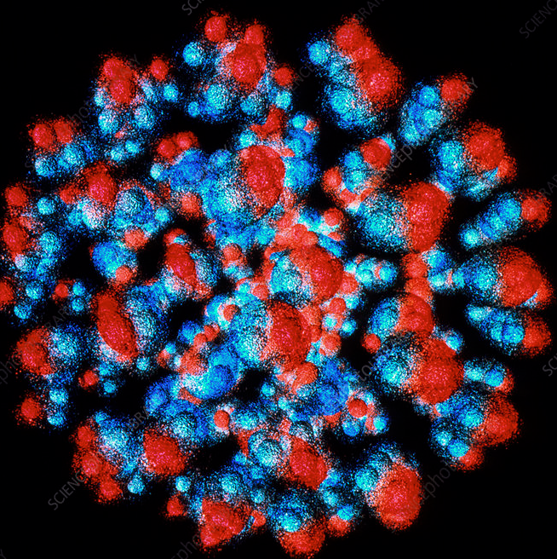
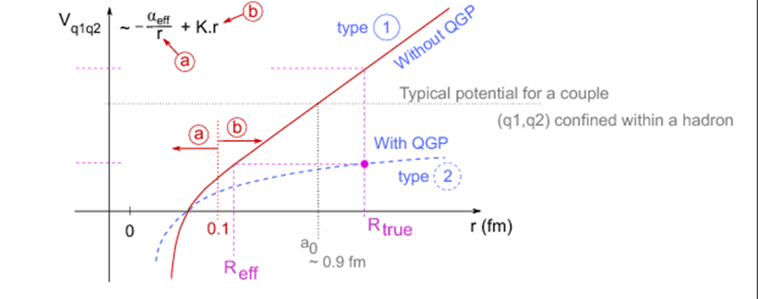
Strong interaction potentials
Gold nucleus

Slide 11
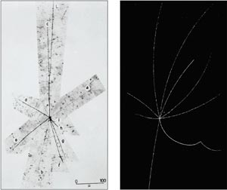
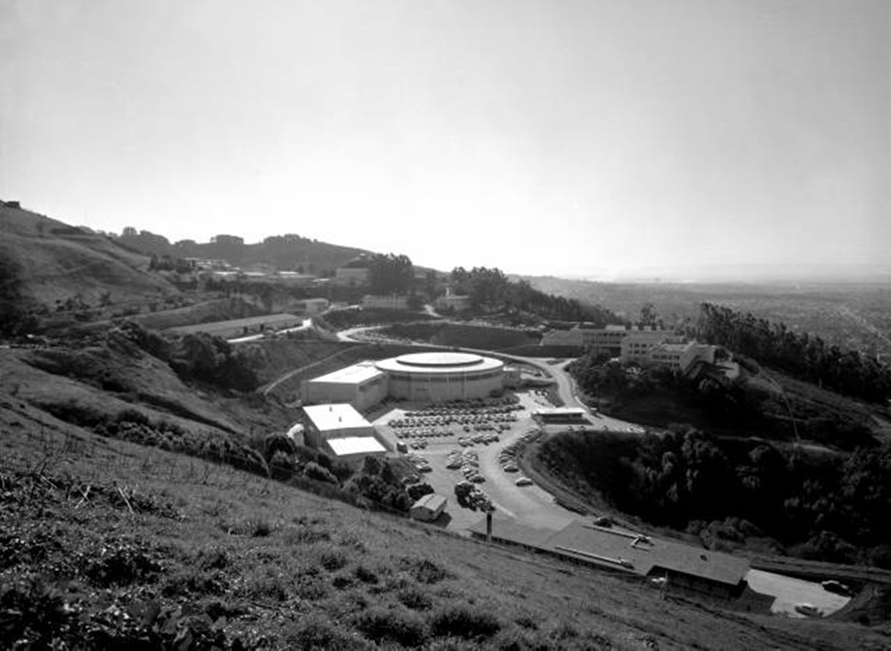
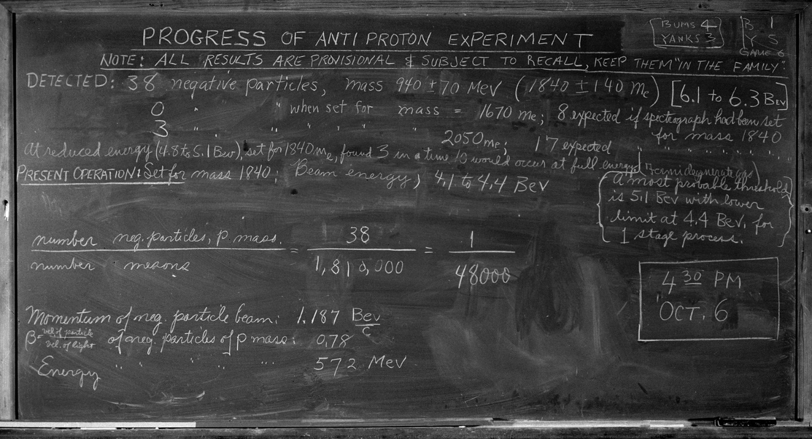
Antiproton discovery at Bevatron 1955
anti-proton
annihilation

Slide 12
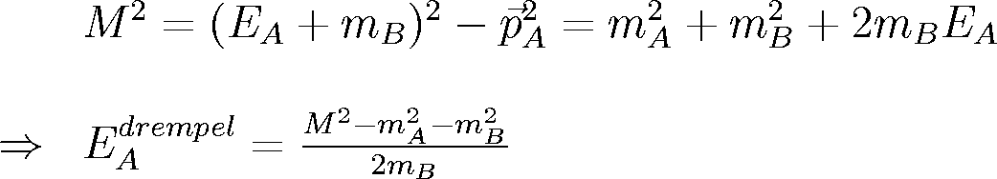

Reactions on the threshold
Lab.:
Lab.
1
→
E_{A}
B
2
c.m.:
→
c.m.
Threshold energy in Lab.
4
3
(assumed m_{A}=m_{B} …)
  Threshold energy in c.m. frame: all particles produced at rest!
⇒ energy in c.m. frame:
c.m.
⇒
$$p_{tot}^{}=\left(M,\vec{0}\right)$$
Example: anti-proton
  Use this minimum energy (M) in the c.m.
  to calculate threshold energy in Lab.:
p+p → p+p+p+p
∼ 6.4 GeV

Slide 13
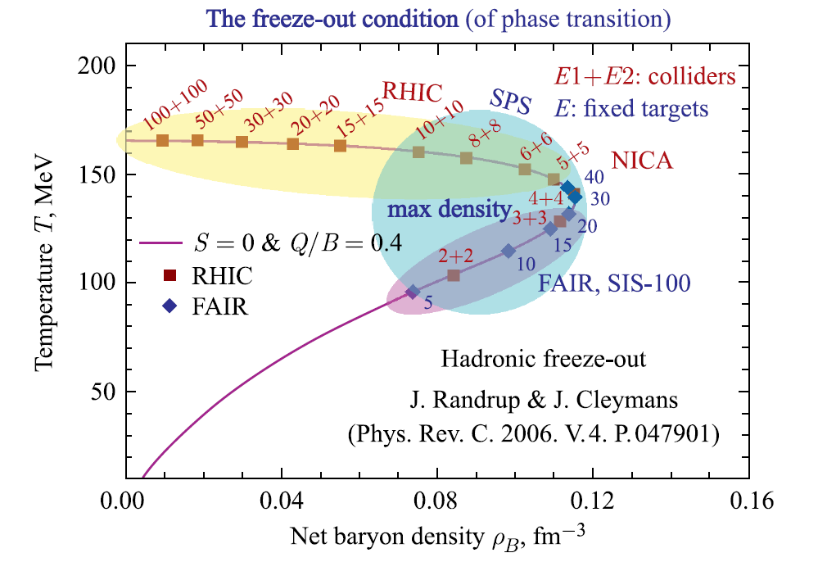
High baryon density region
Study of the QCD medium at extreme net baryon densities, phase transition at ρ_{с} ~ 5ρ₀
Studied in several ongoing and future experiments:
  collider experiments: maximum phase space, minimally biased acceptance, free of target parasitic effects
  fixed-target experiments: high rate of interactions, easily upgradeable, better vertex-finder for heavy flavor decays

Slide 14
Can accelerate p+p, p+A, A+A
Maximal beam collision energy:
11 GeV for Au+Au
27 GeV for p+p
Energy region is well suited for precise study of the onset of deconfinement and QCD phase transitionin a variety of colliding systems (Bi+Bi, Au+Au, Cu+Cu, Ar+Ar, C+C)
Spin measurements on polarized proton and deuteron beams at SPD
NICA (Nuclotron-based Ion Colliding fAcility)
Ring circumference, m | 503,04
Number of bunches | 22
r.m.s. bunch length, m | 0,6
β, m | 0,35
Energy in c.m., Gev/u | 4-11
r.m.s. Δp/p, 10⁻³ | 1,6
IBS growth time, s | 1800
Luminosity, cm⁻² s⁻¹ | 1x10²⁷

Slide 15
Overview of HIC experiments
Experimental programs at SPS, ALICE, RHIC, NICA, SIS, J-PARC
picture by Daniel Cebra

Slide 16
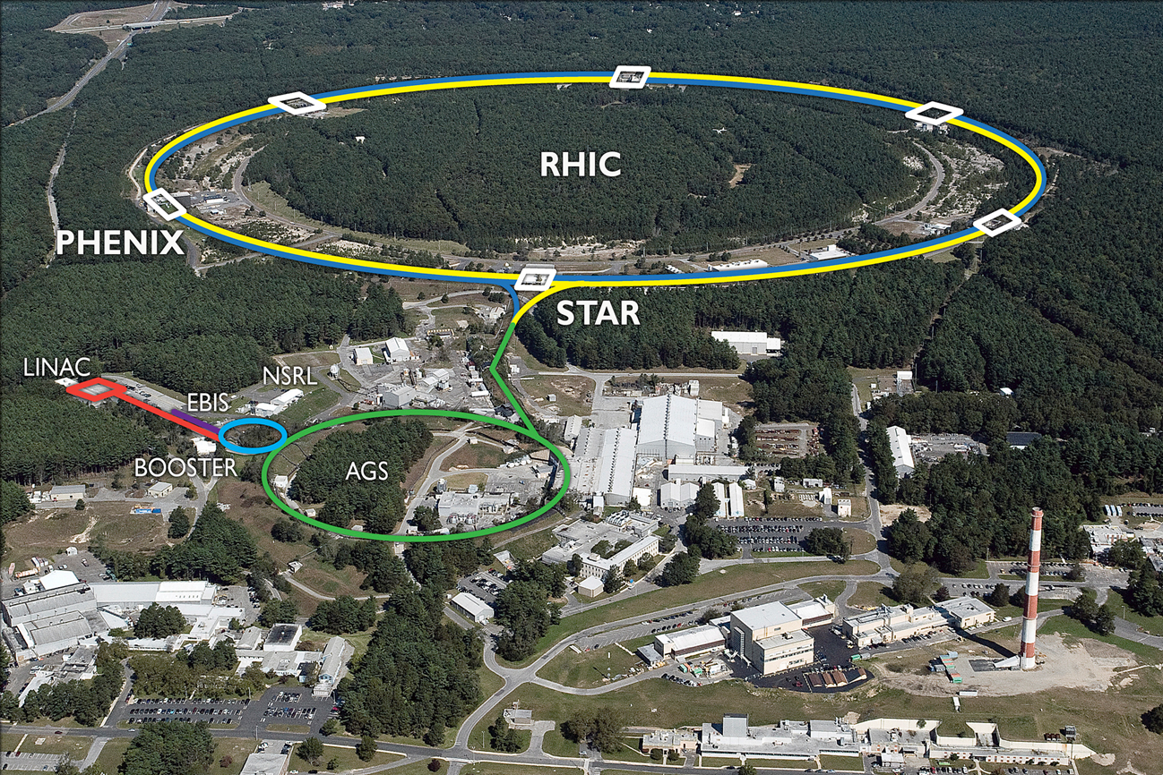
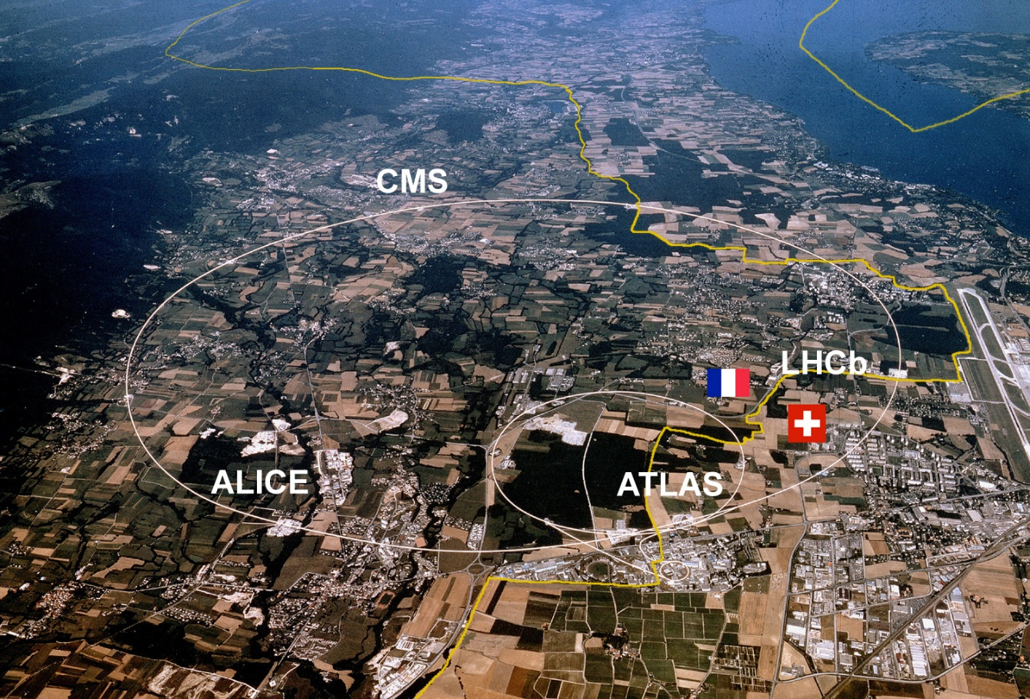
Accelerator complexes for HIC
Relativistic Heavy Ion Collider (RHIC)
Large Hadron Collider (LHC)
Brookhaven National Laboratory
In operation since 1999 Collider length 3,83 km
200 GeV Au+Au
510 GeV p+p
European Organization for Nuclear Research (CERN)
In operation since 2008 Collider length 27 km
5,02 TeV Pb+Pb
13 TeV p+p

Slide 17
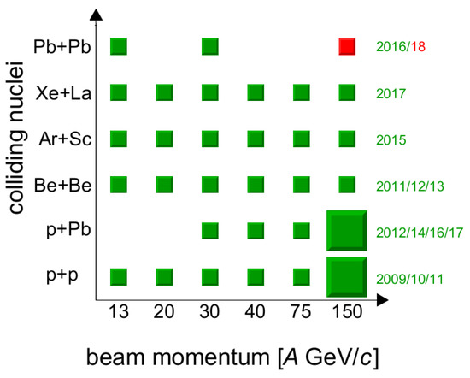
Data systems available at HIC experiments
STAR
NA61/SHINE

Slide 18
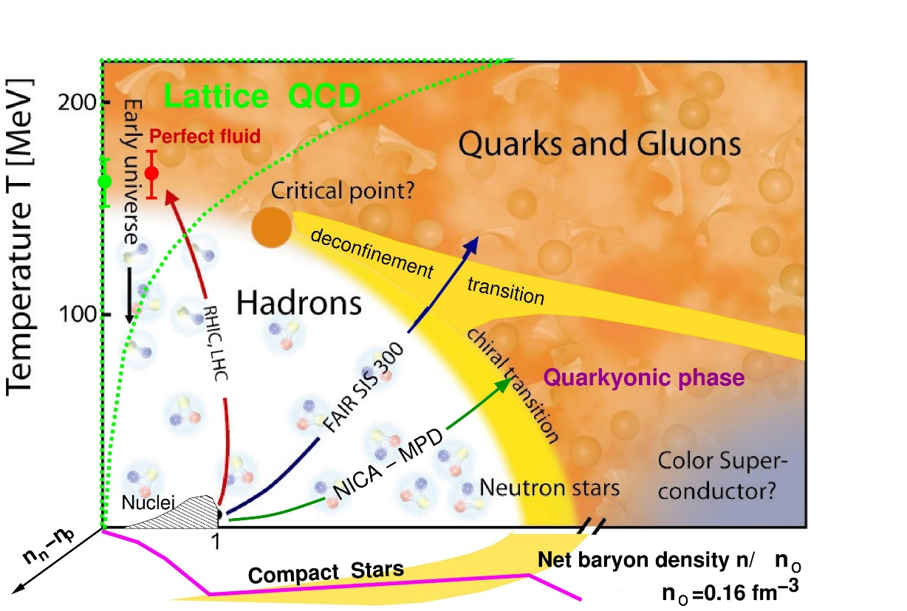
Theory of QGP
The energy scan covers the transition region from baryon to meson dominance in the chemical freeze-out regime. At the same time, this is the challenging domain of the transition from baryon stopping to nuclear transparency, where new experimental data would be very useful to progress in the theoretical understanding.
There is a minimum in the freeze-out volume related
to the “softest point” in the EoS in the NICA
energy window which is accessible to verification by
femtoscopy measurements.

Slide 19
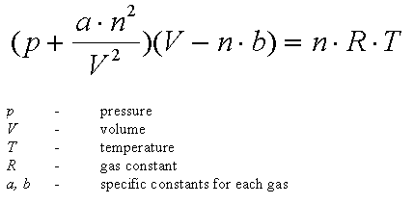
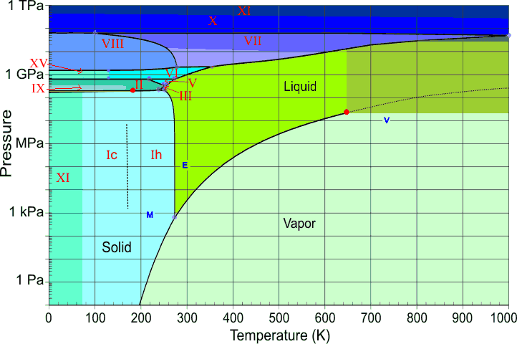
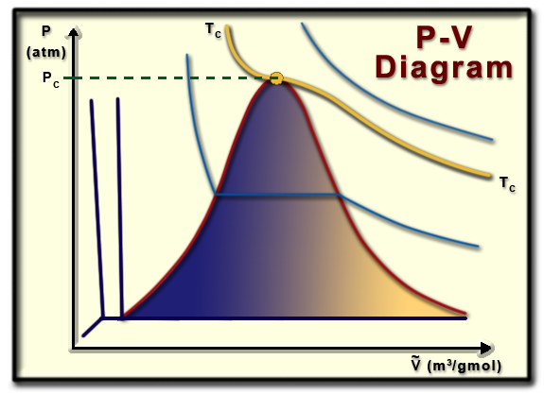
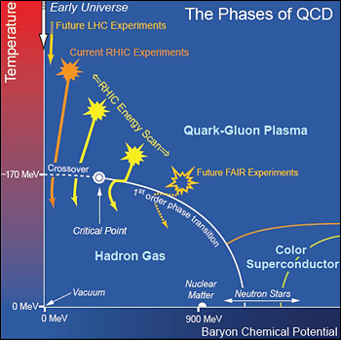
Thermodynamic systems
Van-der-Waals Equation of State
well studied
Phases
Phase boundaries
Transition types
Critical Point
under investigation

Slide 20
Equation of State. Ideal gas
In simple Bag model QGP is described as an ideal gas of massless quarks (zero chemical potential) and gluons
Equations of State (Bag model):
  Т – gas temperature
  В – pressure in the bag ~ 0.4 GeV/fm³
  к – number of degrees of freedom

Slide 21
Equation of State. Ideal liquid
Relativistic hydrodynamic equation set for ideal liquid
T^{μν} – energy-momenta tensor
N^{μ} – number of particles flow through the liquid cell μ,
u^{μ} – local 4-speed of liquid cell μ,
ε – energy density
n – particle number density
p – pressure
If we know EoS p=p(ε) and initial conditions this system can be resolved (analytically or numerically)
5 equations for 5 independent variables

Slide 22
Equation of State. Viscous liquid
Relativistic hydrodynamic equation set for a viscous liquid
T^{μν} – energy-momenta tensor
N^{μ} – number of particles flow through the liquid cell μ,
u^{μ} – local 4-speed of liquid cell μ,
ε – energy density
n – particle number density
p – pressure
g^{μν} – metric tensor
9 additional variables, now it’s not guaranteed to have a solution

Slide 23
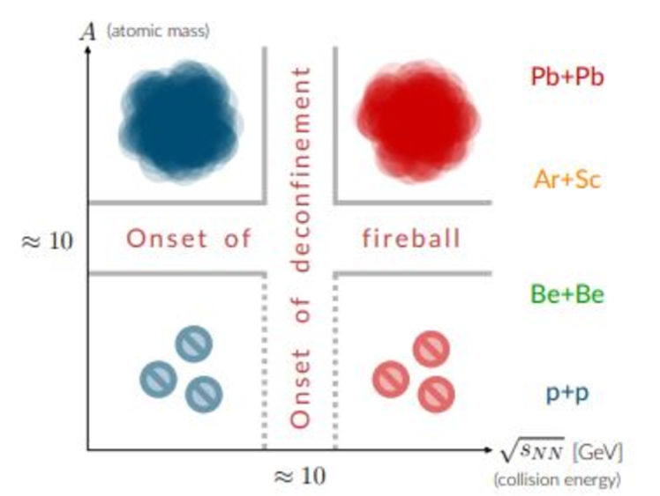
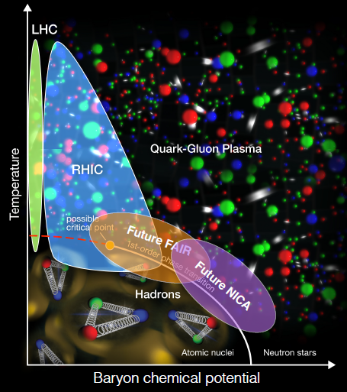
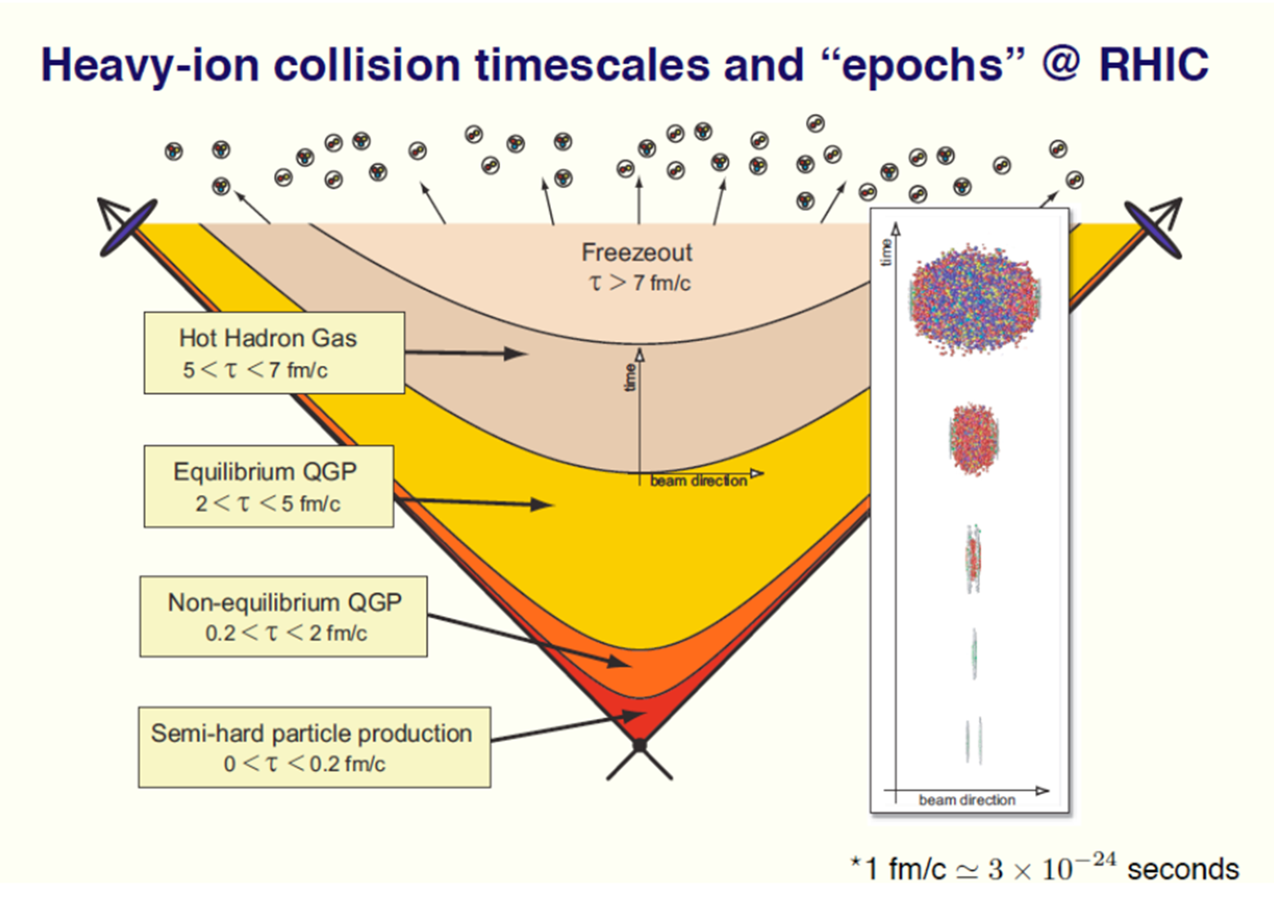
Phase diagram of QCD matter

Slide 25
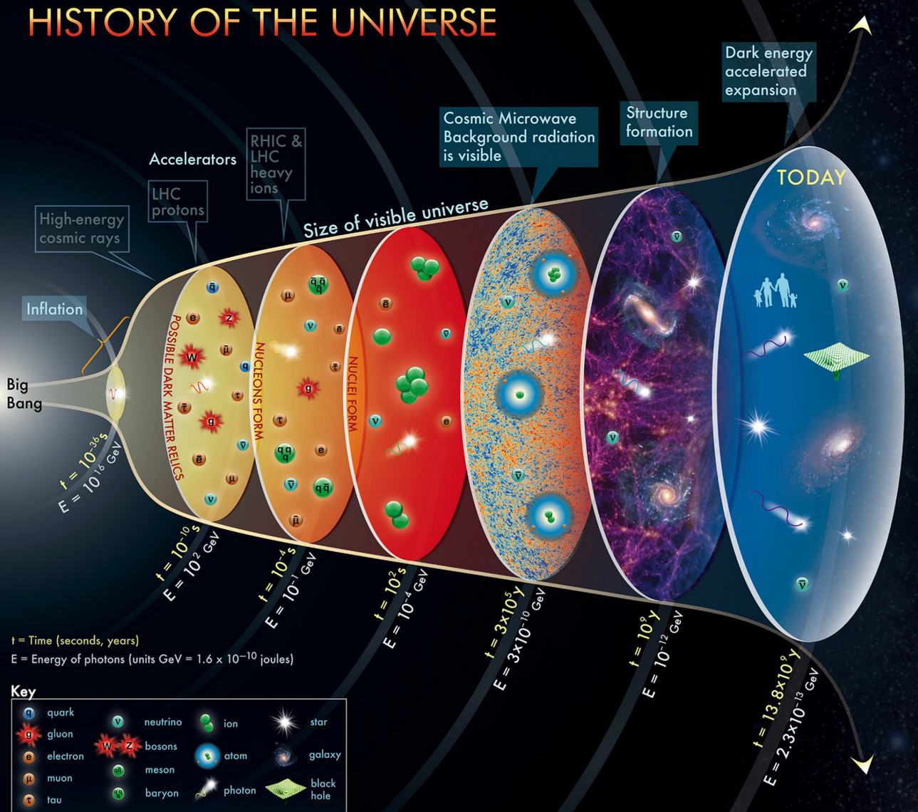

Slide 26
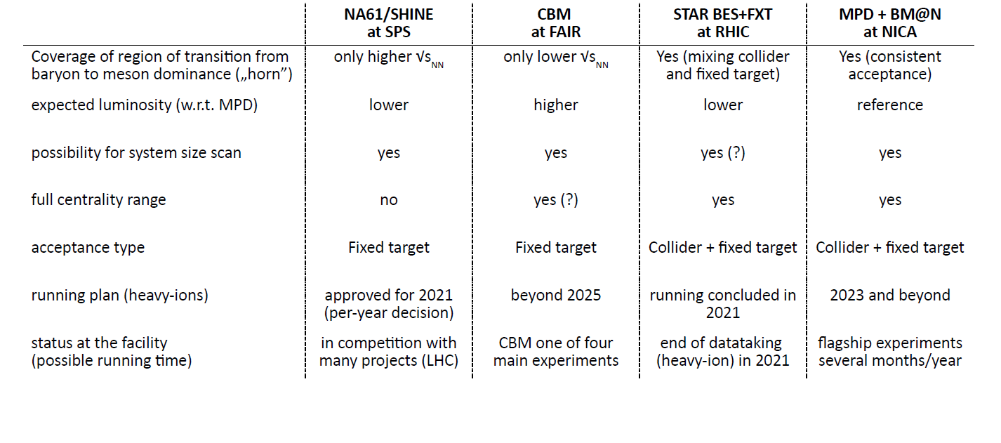
MPD position in the physics landscape
Cover story for EPJ A
The MPD strategy consists of performing a high-luminosity scan in energy and system size, looking for a wide variety of signals sensitive to the phase transition and presence of the critical point
The scans are going to be performed using the same apparatus with all the advantages of collider experiments
Eur.Phys.J. A 58 (2022) 7, 140

Slide 27
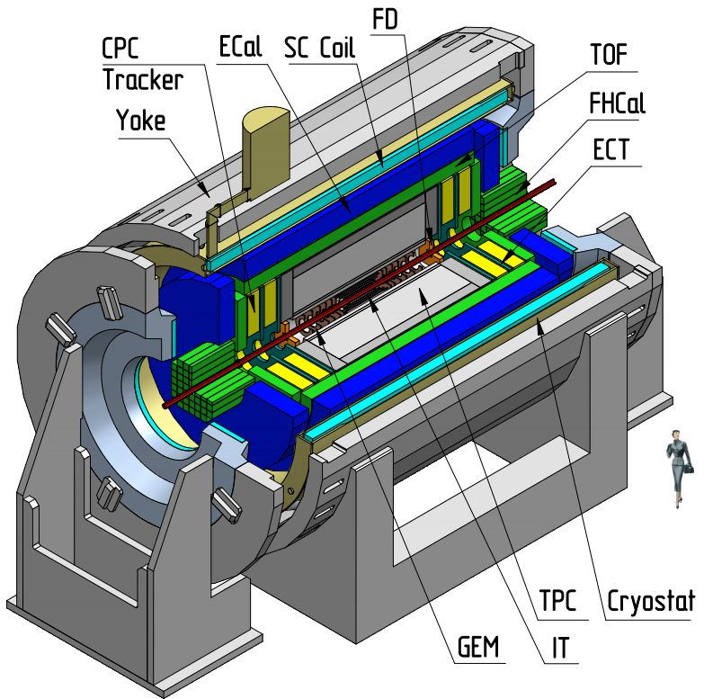
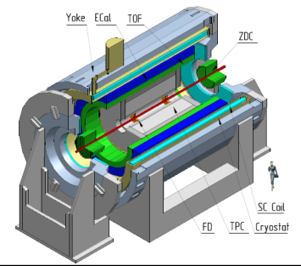
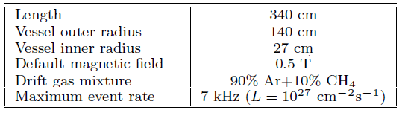
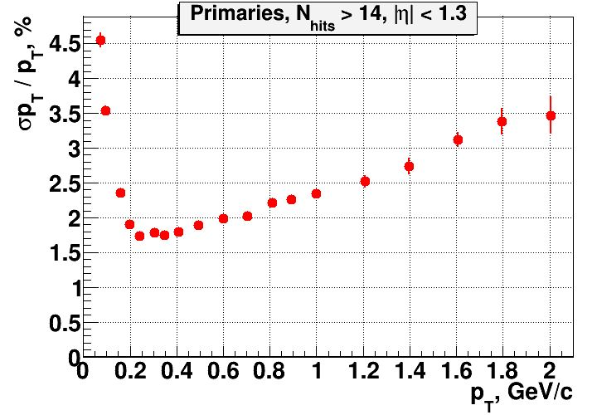
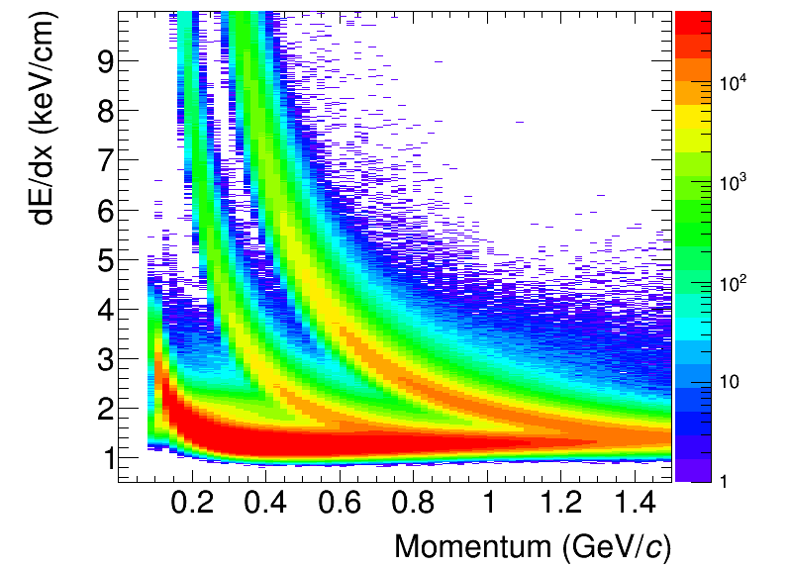
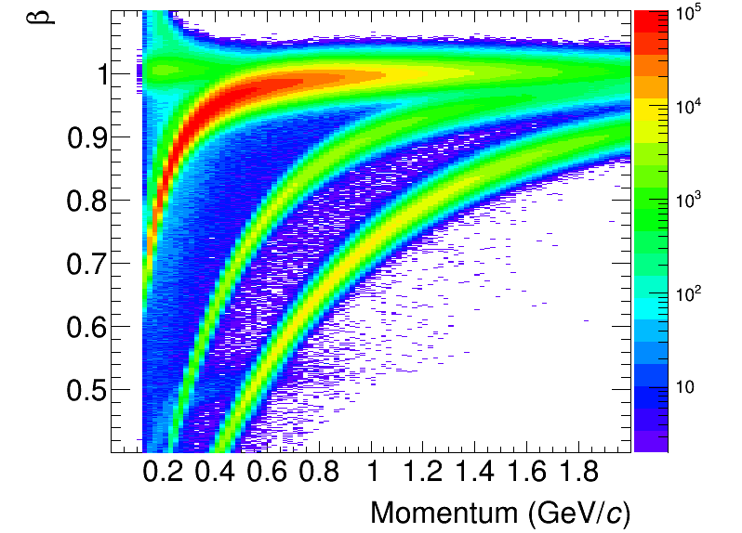
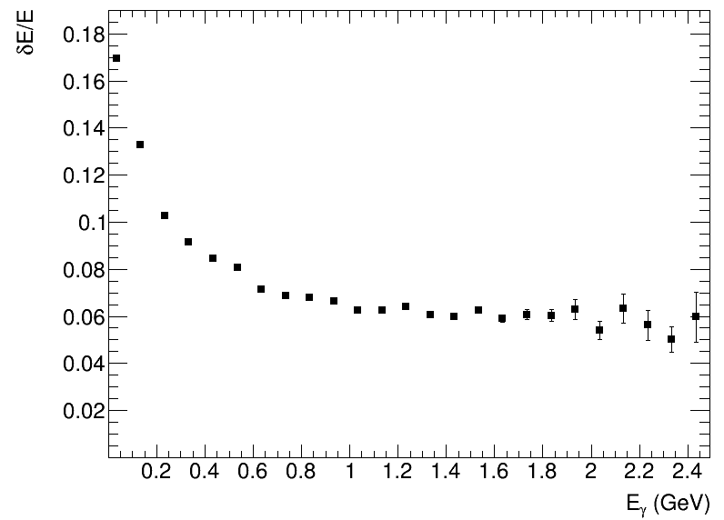
Multi-Purpose Detector
Stage- I
upgrade
Stage- II
TPC: |Δϕ| < 2π, |η| ≤ 1.6
TOF, EMC: |Δϕ| < 2π, |η| ≤ 1.4
FFD: |Δϕ| < 2π, 2.9 < |η| < 3.3
FHCAL: |Δϕ| < 2π, 2 < |η| < 5
+ ITS (heavy-flavor measurements)
+ forward spectrometers
Au+Au @ 11 GeV (UrQMD + full chain reconstruction)
TPC
ECAL
energy resolution
TPC momentum resolution
TOF

Slide 28
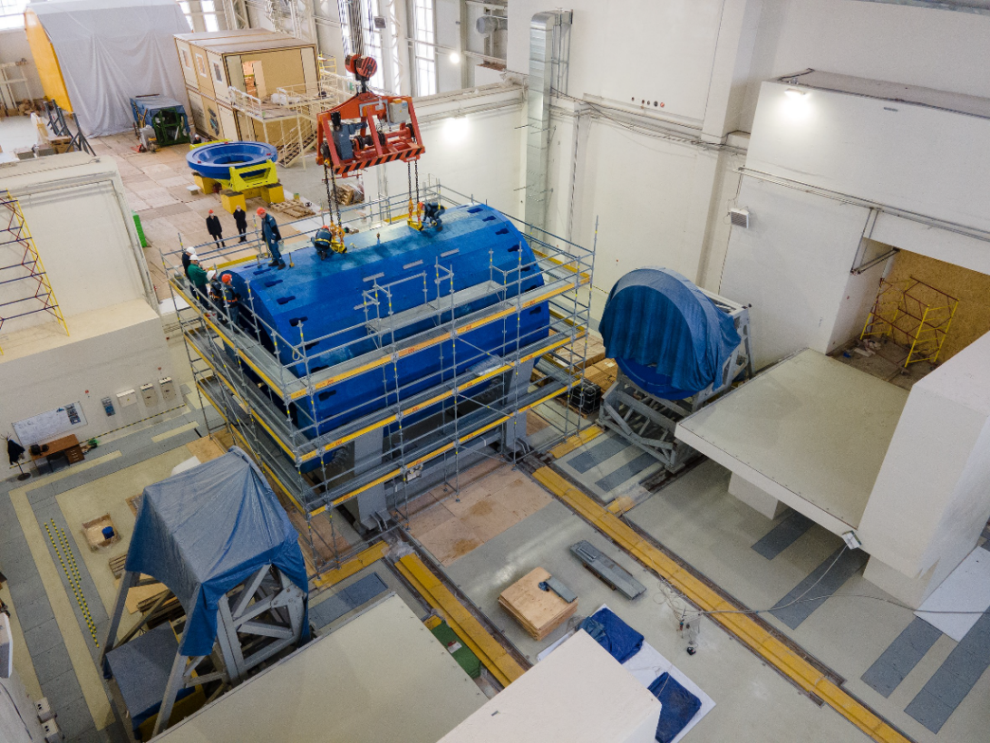
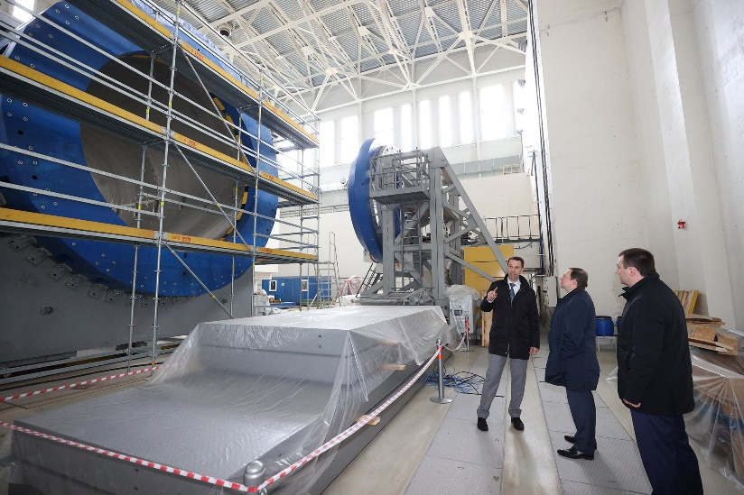
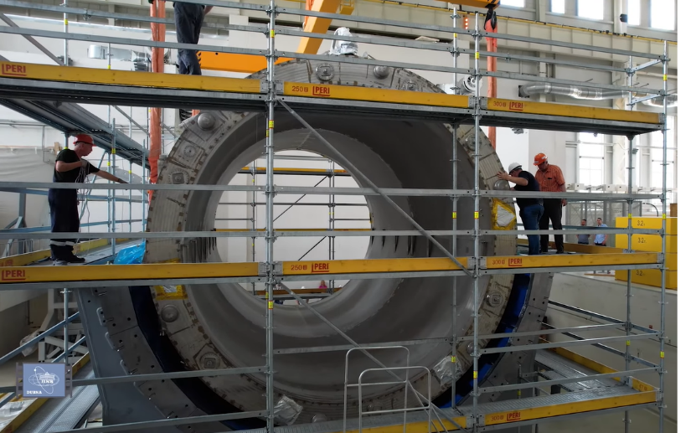
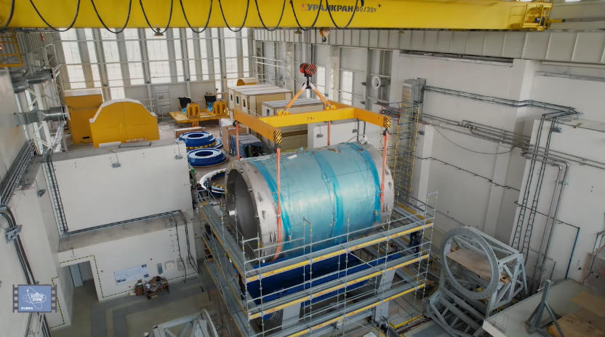
MPD assembly
MPD hall is available for detector activities
Installation of the MPD superconducting coil inside the magnet yoke - 29 July, 2021, followed by alignment of cold mass, pressure test of thermal shield and cryostat cold mass, replacement of flanges, vacuum test of solenoid vessel, leak test of cryostat
Ongoing: temperature probes cables, assembling magnet yoke, alignment, installation of top platform, chimney installation, cryogenic system with control systems, magnetic field measurement

Slide 29
Cryogenic system assembly
Barrel Magnet Yoke is completely assembled
Cryogenic platform has been mounted, next step is mounting of the refrigerator, vacuum pumps, control electronics, etc.
Assembling the refrigerator for installation on the platform
Works on the magnet control system, cryogenics and power supplies
Magnetic field mapper and magnetic field measurements

Slide 30
Part 2 Signatures of QGP
Nuclear shape effects
Particle spectra and Yields
Collective flow
Femtoscopy
Global polarization

Slide 31
Nuclear shape effects
Gold nuclei is well shaped almost an ideal sphere, so is lead nuclei
Other nuclei has much more variable shapes, thus we need to carefully take into account trivial effects of interaction region geometry due to the shapes and exact conditions of the collision

Slide 32
Chiral magnetic effect

Slide 33
CME measurements

Slide 34
STAR results on un-blind CME analysis

Slide 35
Neutron skin effects

Slide 36

Time evolution of the collision
freeze-out and hadrons
initial phase
hydrodynamic phase
pre-equilibrium
hadronization
«Soft» probes (p_{T} ~ T_{kin}= 150 MeV)
particle spectra at small transverse momenta p_{T} and momentum correlations
flow effect
thermal photons and dileptons
strange particle yields
“Hard” probes (p_{T} >> T_{kin}= 150 MeV)
particle spectra at large transverse momenta p_{T} and angle correlations
hadron jets
quarkonia
heavy quark probes

Slide 37
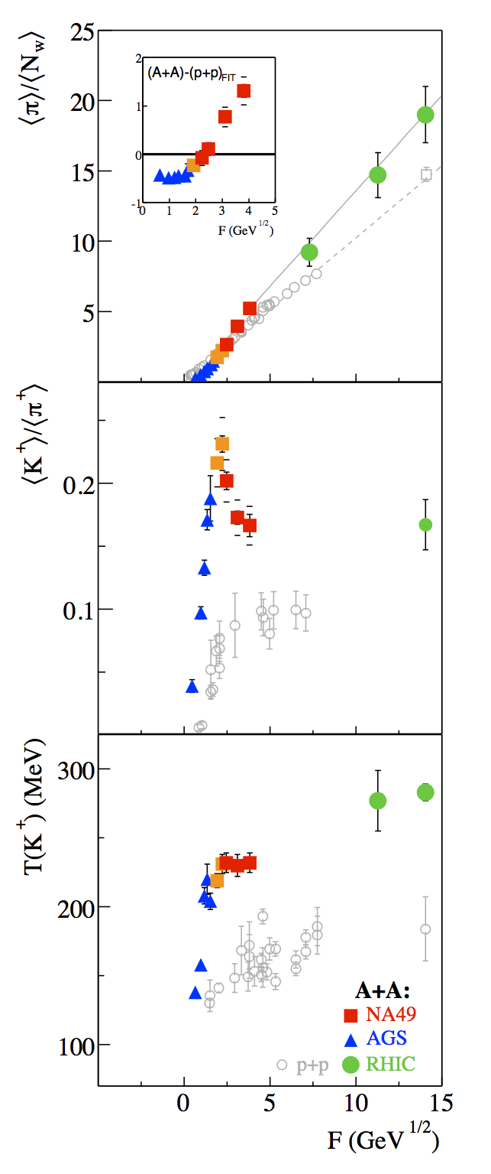
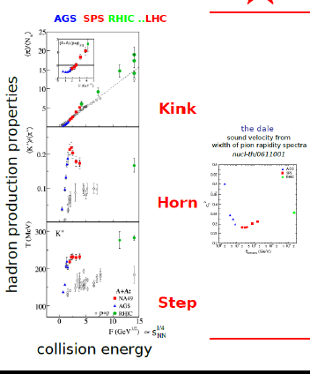

What we knew from early experiments
Summary of AGS, SPS, and early RHIC Results
Inclusive observables ➔ onset of deconfinement at 7-8 GeV.
The observables suggest a change in the nature of the system.
More discriminating studies were needed to understand the nature of the phase transition and to search for critical behavior.
It is best to study regions above and below the possible onset energy.

Slide 38
Blast-Wave model and chemical freeze-out

Slide 39
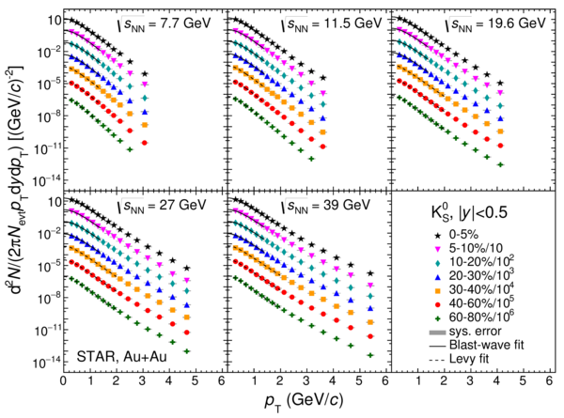
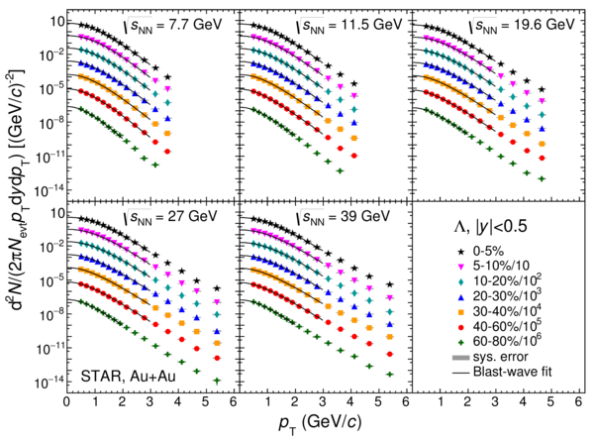
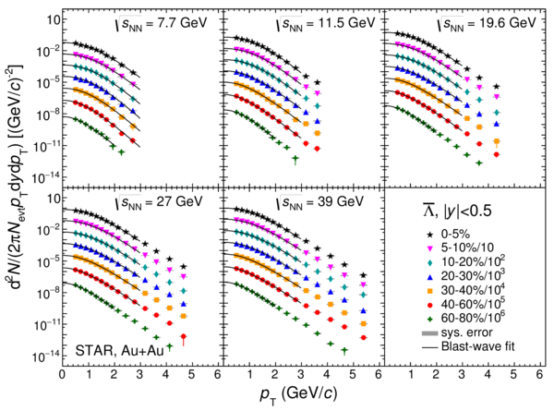
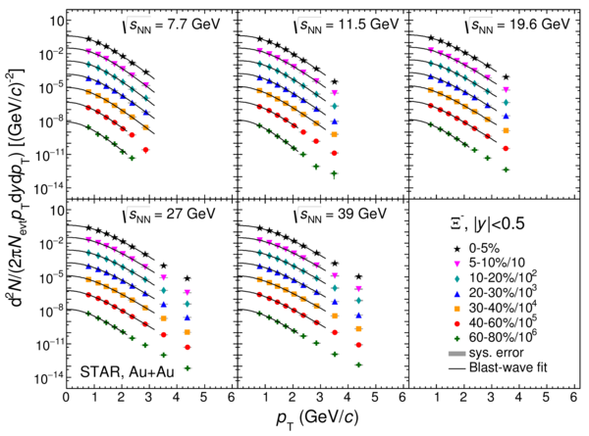
Momentum spectra of strange particles
Phys. Rev. C 102 (2020) 34909
K⁰_{s}, Λ, anti-Λ, Ξ⁻ transverse momentum spectra
at midrapidity |y| < 0.5
Levy fit
Blast-wave fit

Slide 40
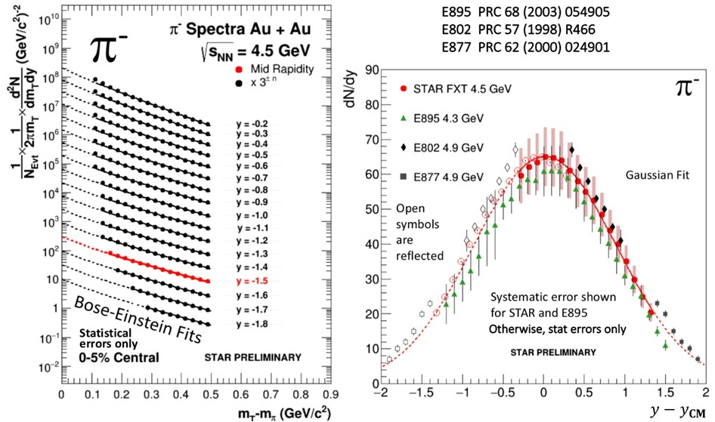
Particle production differential and integral

Slide 41
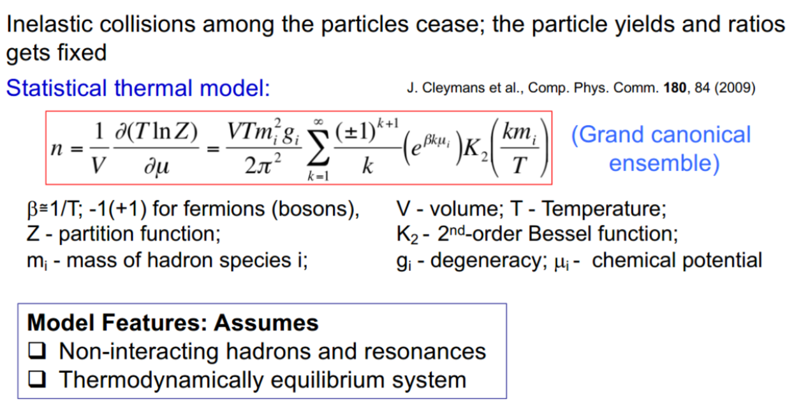
Thermal model and kinematic freeze-out

Slide 42
Energy dependence of yields

Slide 43
Energy dependence of
Energy dependence of particle ratios
Ratios shows interesting trends for energy dependence
Au+Au 14.5 and U+U 193 fit well in established trend
Almost no barion asymmetry at high energies
At lower energies

Slide 44
Thermal model particle production

Slide 45
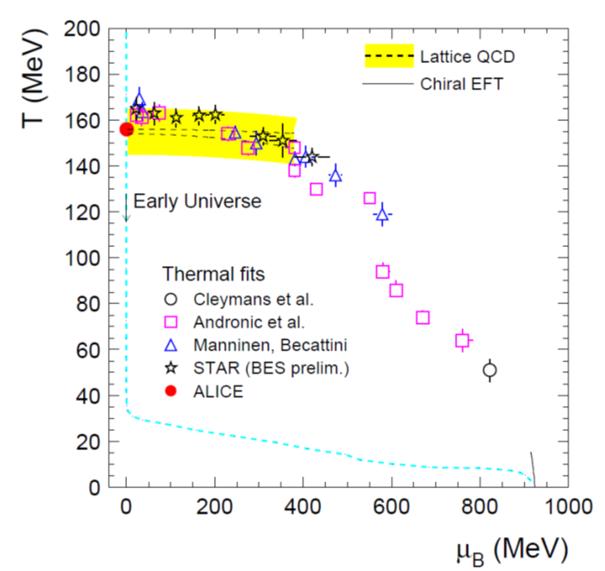
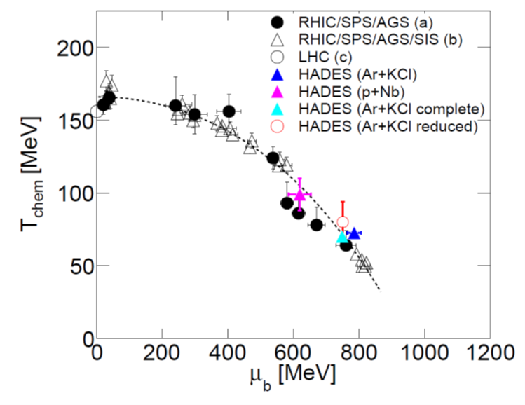
Phase diagram scan
T_{c}⁰
T_{c}⁰
A. Andronic et al., Jour. Phys. G38 (2011)
G. Agakishiev et al., arXiv:1512.07070

Slide 46

Phase diagram scan
T_{ch}
T_{c}⁰
T_{chem} and T_{kin} diverge at around 7 GeV.
T_{kin} and <β> flatten
T_{kin}
T_{c}⁰
Softening of the EoS?
L. Adamczyk, et al. STAR Collaboration Phys. Rev. C96 (2017) 044904

Slide 47

Strange particle production
Pike is observed in particle ratios for strange/non-strange particles for HIC and not observed for light collision systems

Slide 48
Collective flow

Slide 49
Collective flow
Initial spatial asymmetry is transferred to the final momentum asymmetry

Slide 50
Kinematic effects in flow
Squeeze-out: due to large passage time of the spectators results in the particles being predominantly emitted in the out-of-plane directions
v2 > 0
v2 < 0

Slide 51

Elliptic flow, NCQ-scaling

Slide 52
Elliptic flow, NCQ-scaling
All data from RHIC and LHC are consistent with the interpretation that collective flow is established at the quark level and imprinted on the flow pattern of hadrons.
Valence quark scaling laws of flow observables are our most direct evidence that light quarks are unconfined in the QGP

Slide 53
Directed and elliptic flow

Slide 54
Search for the first order phase transition

Slide 55

HBT and femtoscopy
1,2 — detectors; a,b — sources
(a) — general idea
(b) — astronomy R>>d
(с) — nuclear physics R<<d
Similar to the astrophysics, HBT correlations
Sov.J.Nucl.Phys. 35 (1982) 770
Phys.Lett.B 373 (1996) 30-34

Slide 56
Correlation function effects

Slide 57




Two particle correlation analysis
General case
S – is the source parameter
for non-point source
For the assumption of Gaussian shaped emittance source the correlation function С(q,K)

Slide 58
Femtoscopy results at low energies

Slide 59



The most vortical fluid
The most vortical fluid
STAR, Nature, 2017, 1701.06657
Phys. Rev. C 98 (2018) 014910

Slide 60



Global polarization of particles

Slide 61
Thank you!
&
Ready for questions

Slide 62
QGP – was it really discovered?
The press conference at BNL on 24 April 2005
Speakers will include: Dennis Kovar, Associate Director, Oce of Nuclear Physics, U.S. Department of Energy's Oce of Science; Sam Aronson, Associate Laboratory Director for High Energy and Nuclear Physics, Brookhaven National Laboratory. Also on hand to discuss RHIC results and implications will be: Praveen Chaudhari, Director, Brookhaven National Laboratory; representatives
of the four experimental collaborations at the Relativistic Heavy Ion Collider; and several theoretical physicists.
Evidence for a new type of nuclear matter:
At the Relativistic Heavy Ion Collider (RHIC) at Brookhaven National Lab (BNL), two beams of gold atoms are smashed together, the goal being to recreate the conditions thought to have prevailed in the universe only a few microseconds after the big bang, so that novel forms of nuclear matter can be studied. At this press conference, RHIC scientists will sum up all they have learned from several years of observing the world's most energetic collisions of atomic nuclei. The four experimental groups operating at RHIC will present a consolidated, surprising, exciting new interpretation of their data…

Slide 63

QGP – was it really discovered?
At the RHIC Users' Meeting June 9-12, 2015 a 10 year anniversary session “The Perfect Liquid at RHIC: 10 Years of Discovery" was held, the press release of June 26, 2015 says:
“RHIC lets us look back at matter as it existed throughout our universe at the dawn of time, before QGP cooled and formed matter as we know it,” said Berndt Mueller, Brookhaven's Associate Laboratory Director for Nuclear and Particle Physics. “The discovery of the perfect liquid was a turning point in physics, and now, 10 years later, RHIC has revealed a wealth of information about this remarkable substance, which we now know to be a QGP, and is more capable than ever of measuring its most subtle and fundamental properties.”

Slide 64

QGP – was it really discovered?
CERN special seminar 10 February 2000
At the seminar spokespersons from the experiments on CERN's Heavy Ion programm presented compelling evidence for the existence of a new state of matter in which quarks, instead of being bound up into more complex particles such as protons and neutrons, are liberated to roam freely.
Professor Luciano Maiani, CERN Director General, said:
"The combined data coming from the seven experiments on CERN's Heavy Ion program have given a clear picture of a new state of matter. This result verifies an important prediction of the present theory of fundamental forces between quarks. It is also an important step forward in the understanding of the early evolution of the universe. We now have evidence of a new state of matter where quarks and gluons are not confined. There is still an entirely new territory to be explored concerning the physical properties of quark-gluon matter. The challenge now passes to the Relativistic Heavy Ion Collider at the Brookhaven National Laboratory and later to CERN's Large Hadron Collider."
In an interview in January 2017 with Luciano Maiani, Director General of CERN from 1999 to 2003 we read:
Luciano Maiani: I think that the announcement was quite clear. I have the text of it with me, it reads: “The data provide evidence for color deconfinement in the early collision stage and for a collective explosion of the collision fireball in its late stages. The new state of matter exhibits many of the characteristic features of the theoretically predicted Quark-Gluon Plasma.” The key word is “evidence”, not discovery, and the evidence was there, indeed

Slide 65


QGP – was it really discovered?
Looking back at the Universe the Size of a Melon
Already in the mid-90s there was some indication for quark-gluon plasma in heavy ion experiments at CERN and at Brookhaven National Laboratory. However, I was at that time due to fragmentary data very cautious. In hindsight I know my position was too cautious…
Actually, I hoped that this procedure would switch off the
quark-gluon plasma in a controlled manner, but this attempt failed. Also at SPS energies there are in the now much more extensive data records unmistakable signatures.
In the book “Quark-Gluon Plasma: Theoretical Foundations An Annotated Reprint Collection” prepared in 2002 by Berndt Muller, Joseph Kapusta and Johann Rafelski.
This book introduces the theoretical roots of QGP with a time cut off in 1992. The rationale of the authors was to look more than 10 years back in 2002/3, since in 1992 QGP was already discovered but recognized only by a small subset of researchers.
Eur. Phys. J. Special Topics 229, 1-140 (2020)

Slide 66


How do we see the ion collisions
https://online.star.bnl.gov/aggregator/livedisplay/
Au+Au @ STAR 200 GeV
Pb+Pb @ ALICE 2,76 TeV
Heavy ion collisions provide a huge number of produced particles. We detect hundreds and thousands charged particles after each collision.
At 200 GeV ~ 1 000 charged particles are produced and at 2,76 GeV ~ 8 000 to 10k

Slide 67

Kinematic coverage
Q² is the Lorentz invariant four-momentum transfer and
x = Q²/(2m(E-E’))

Slide 68




HIC experiments
NA61
STAR
CBM
ALICE

Slide 69

MPD detector

Slide 70

Standard Model
General theory of matter and fundamental interactions.
But what do we learn from it and what else is there unattended?

Slide 71

*
Standard Model
*Note: Thomas Gutierrez, an assistant professor of Physics at California Polytechnic State University, transcribed the Standard Model Lagrangian for the web. He derived it from Diagrammatica, a theoretical physics reference written by Nobel Laureate Martinus Veltman. In Gutierrez’s dissemination of the transcript, he noted a sign error he made somewhere in the equation. Good luck finding it!

Slide 72
How to extract properties of the medium

Slide 73

Nuclear modification of produced particles

Slide 74


Nuclear modification factor
STAR, Phys. Rev. Lett. 121 (2018) 32301

Slide 75


Hypertriton and anti-hypertriton
This ratio allow to test the CPT symmetry from the perspective of experiment. Mass difference consistent with zero which is supporting the CPT symmetry

