Slide 1
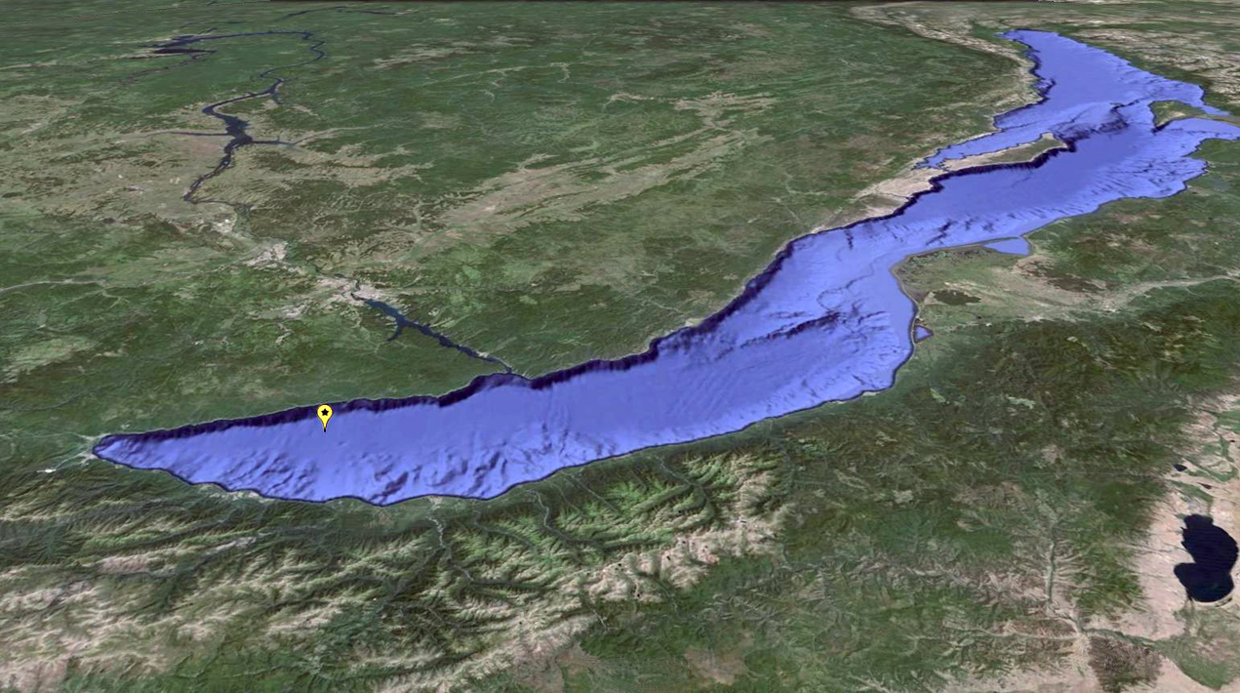
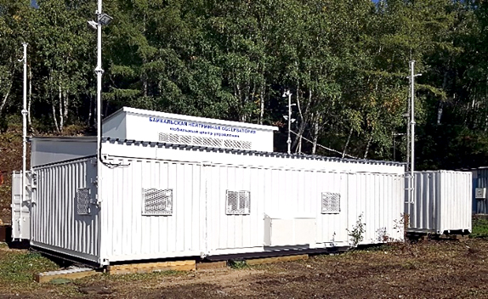
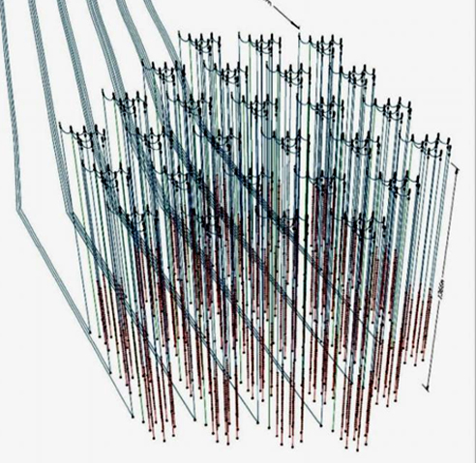
Prolongation
Project Baikal-GVD
I.Belolaptikov
DLNP, 07.12.2017

Slide 2
Gigaton Volume Detector (GVD) in Lake Baikal
Objectives:
  - km3-scale 3D-array of photo sensors
    - flexible structure allowing an upgrade and/or
    a rearrangement of the main building blocks (clusters)
- high sensitivity and resolution of neutrino energy,
direction and flavor content
Central Physics Goals:
- Investigate Galactic and extragalactic neutrino
“point sources” in energy range > TeV
    - Diffuse neutrino flux – energy spectrum, local and
    global anisotropy, flavor content
- Transient sources (GRB, …)
  - Dark matter – indirect search
- Exotic particles – monopoles, Q-balls, nuclearites, …

Slide 3
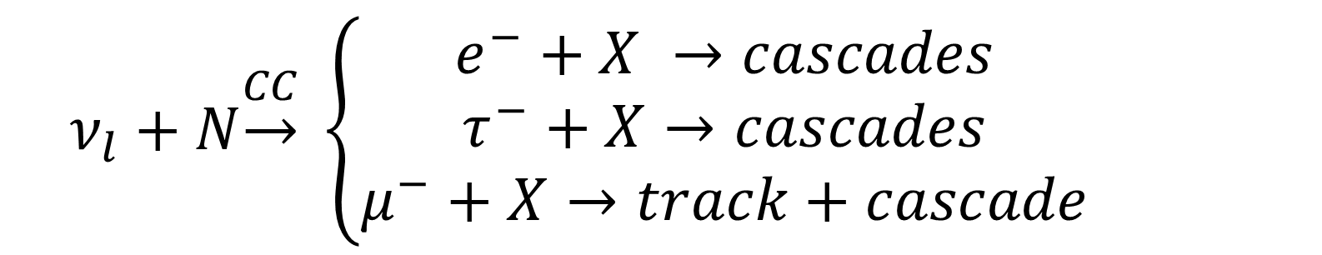
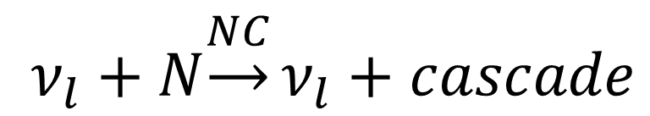
Detection Modes – cascades&muons
$$ν_{l}+N\underset{→}{CC} \left\{\begin{aligned}e^{−}+X →cascades \\ τ^{−}+X→cascades \\ μ^{−}+X→track+cascade\end{aligned}\right.$$
$ν_{l}+N\underset{→}{NC}ν_{l}+cascade$
μ/casc. ~ 1/3 for 1:1:1

Slide 4

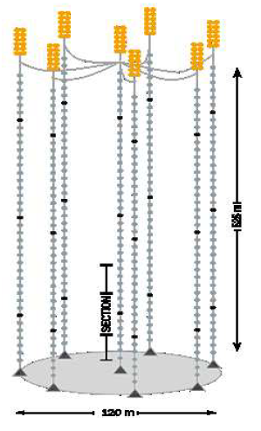
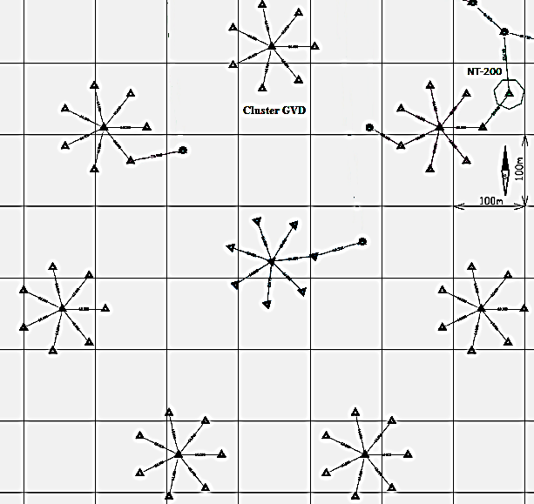
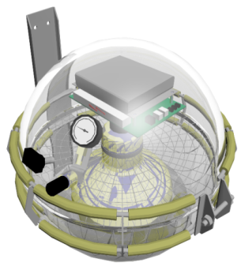
Baikal-GVD : phase 1 (up to 2020)
525 m
Optical module
String: 36 OMs
120 m
700 m
Cluster: 8 strings
GVD-1: 8 clusters
 | GVD-1
OMs | 2304
Clusters (8 Strings) | 8
Depths, m | 750 – 1275
Eff. Volume (E_{SH} > 100 ТeV) | 0.4 km³
Directional resolution
Cascades: ~3°
Muons: 0.25° - 0.5°

Slide 5

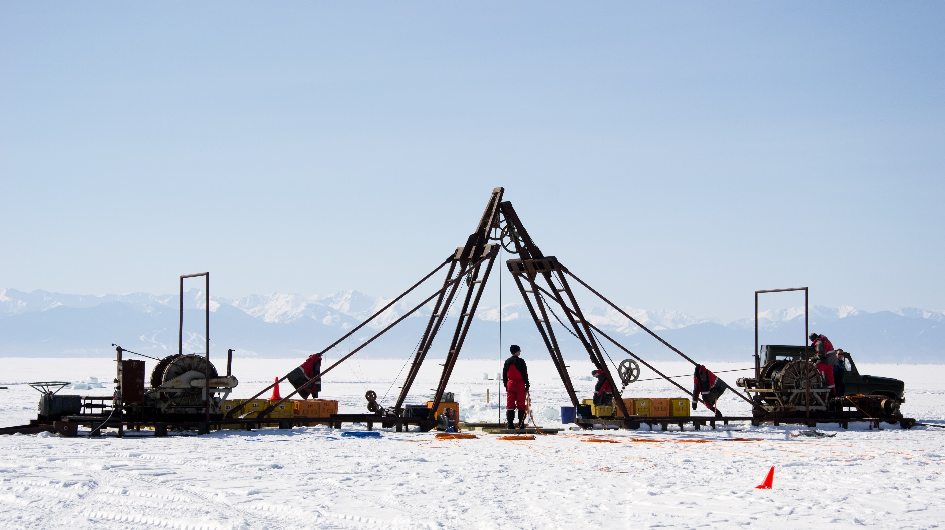
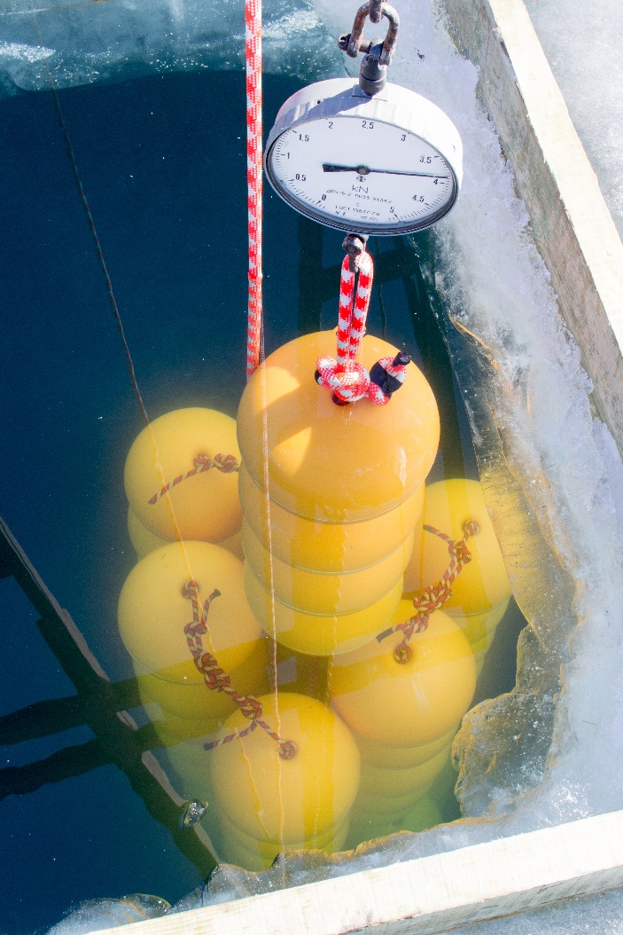
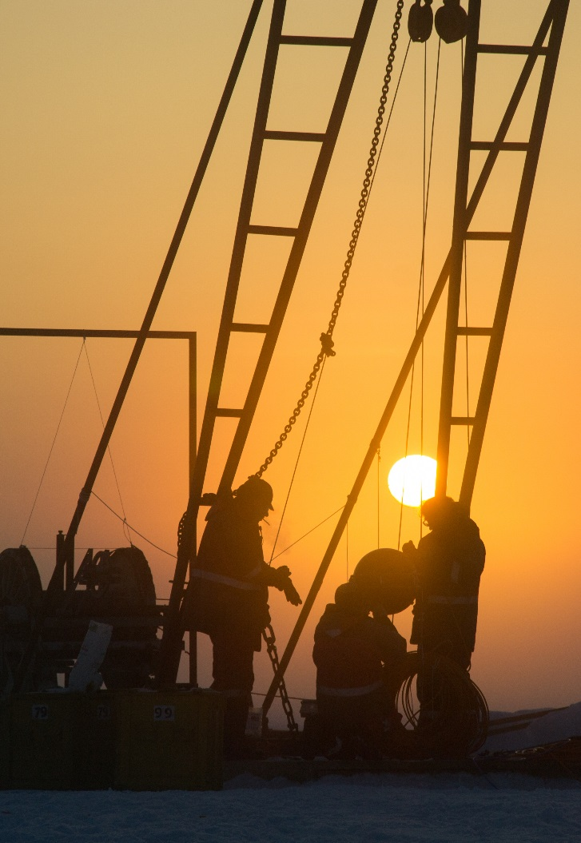

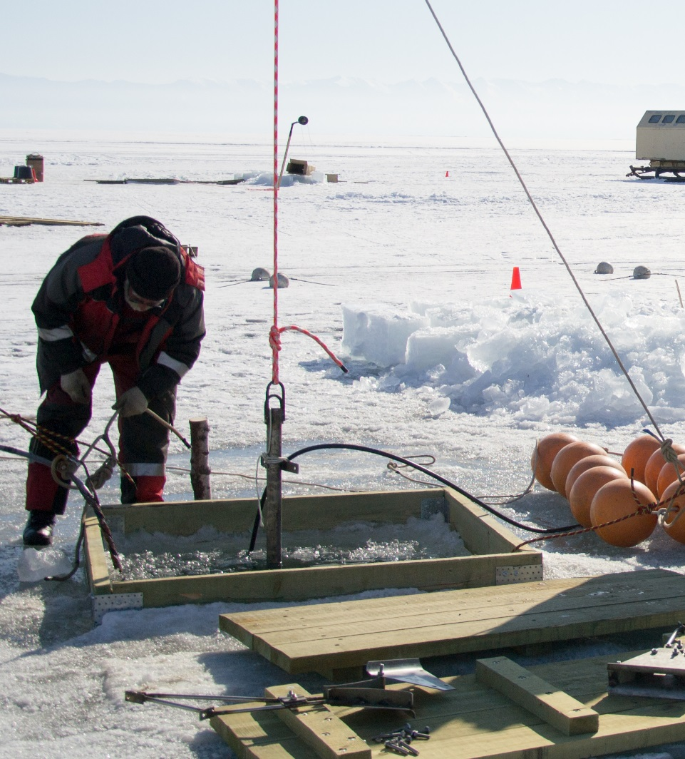
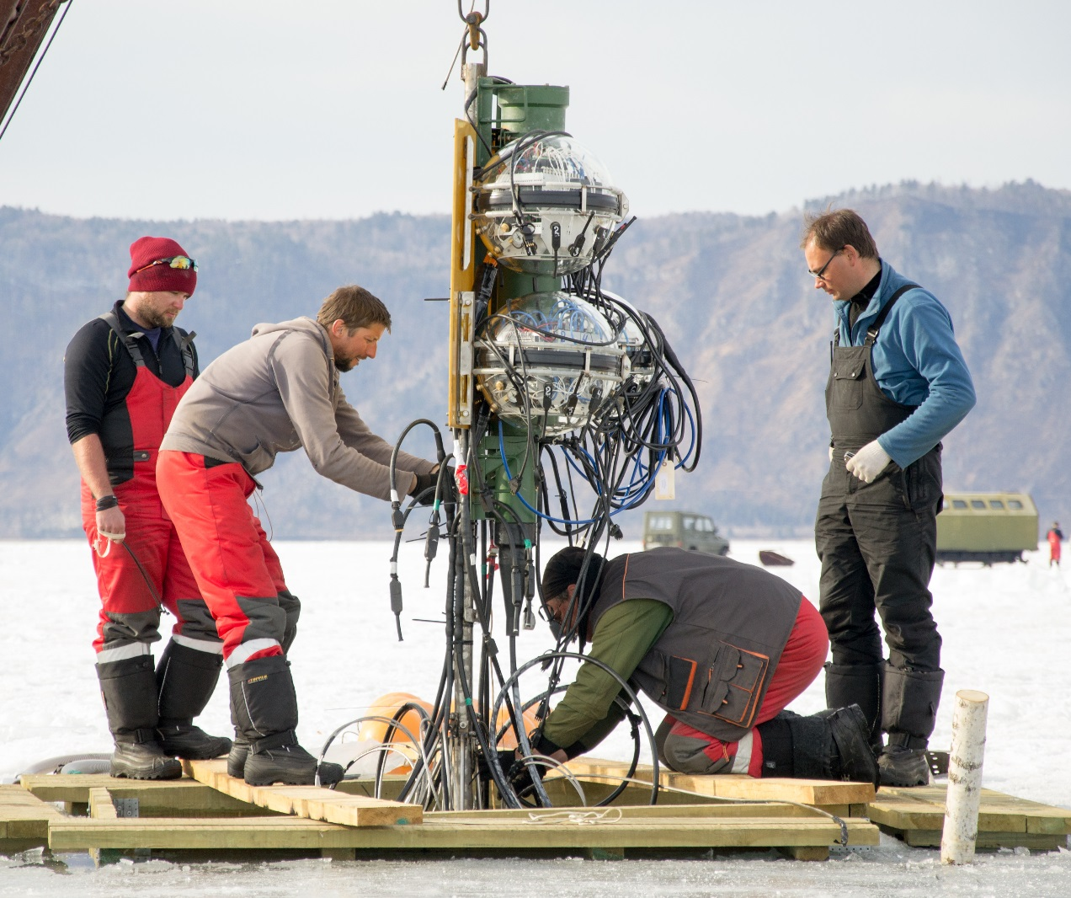
Assembling the detector
Detector deployment from the ice.
Deployment period: ~20 February … ~10 April

Slide 6
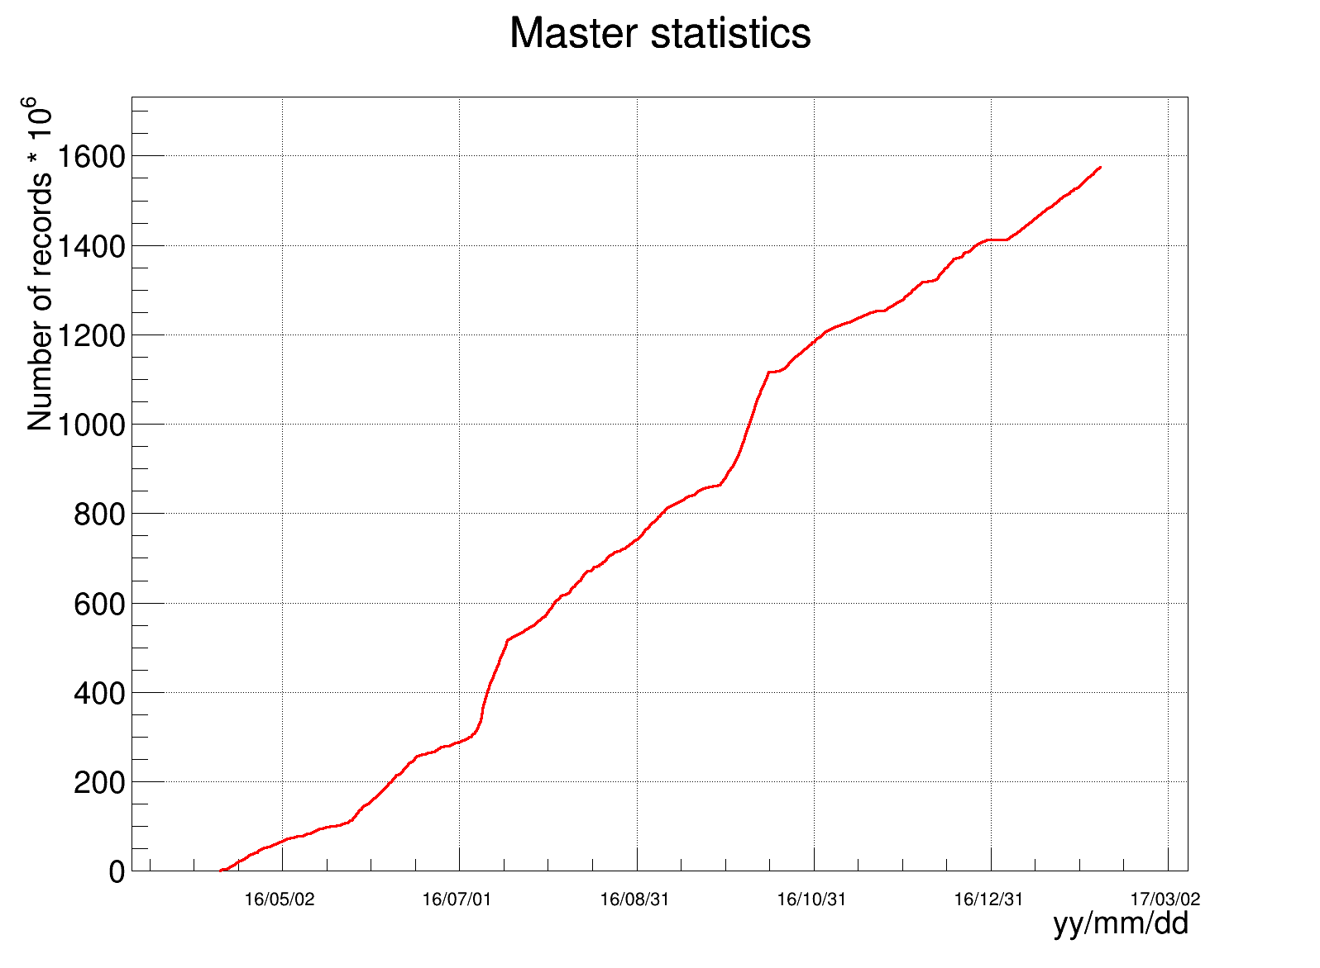
Stages of deployment of the Baikal-GVD
Configuration | 2015 | 2016 | 2017
The number of OMs | 192 (8str×24) | 288 (8str×36) | 576
Geometric sizes | ∅80m×345m | ∅120m×525m | 2×∅120m×525m
Eff. Vol. (E > 100TeV) | 0.03 km³ | 0.05 km³ | 0.1 km³
Cluster-2016 operation
Live time | Full time | Eff % | Master Records
235d 0h | 302d 15h | 77.7 | 1,796,646,941

Slide 7
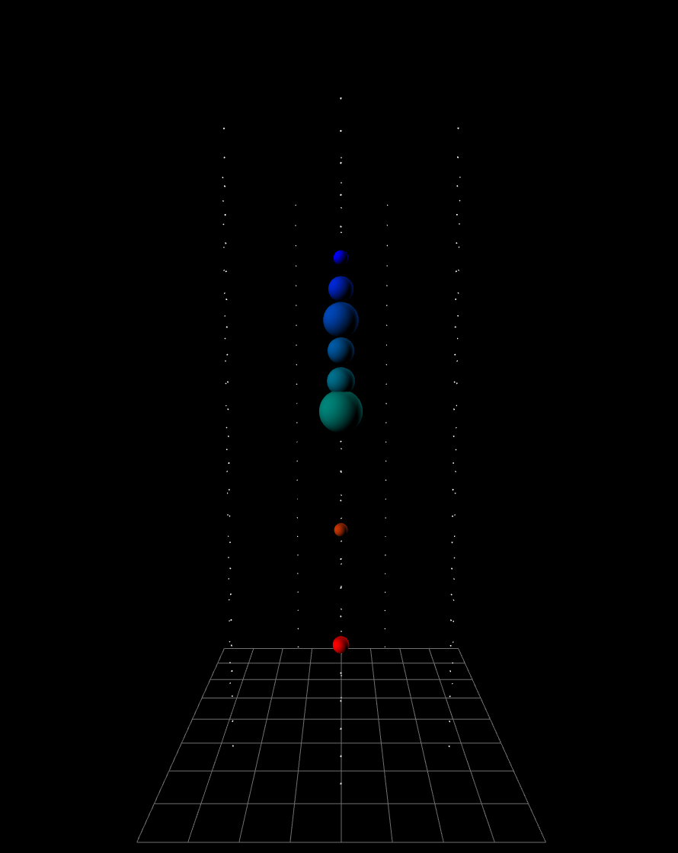
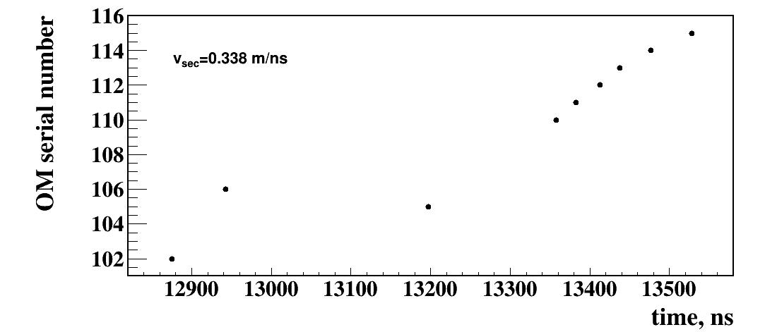
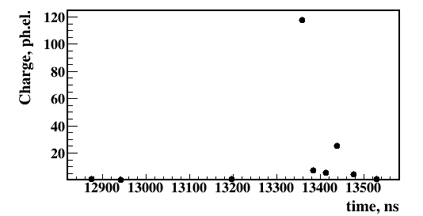
#3101111 - ν candidate
v_{sec} = 0.338 m/ns
Arrival times
Amplitude vs time

Slide 8
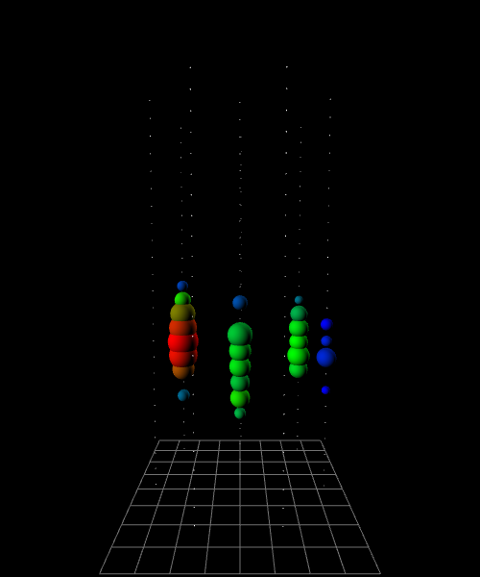
E = 158 TeV, θ = 59°, ρ = 73 m, z = -62 m
γ
ν
≈shower

Slide 9
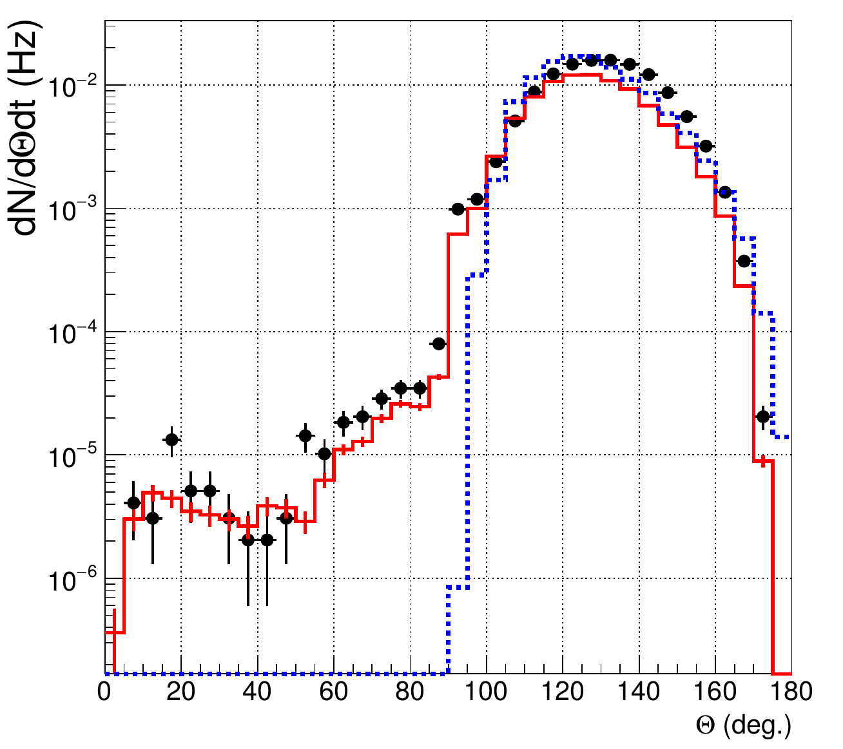
Reconstructed zenith angle distribution with cuts
Polar angle distribution of muons selected with the requirement of
at least 6 hit OM's
at 3 strings.
Data (black dots)
is compared to the atmospheric muon flux generated with CORSIKA (dashed histogram)
and passed through
the detector simulation (histogram)

Slide 10
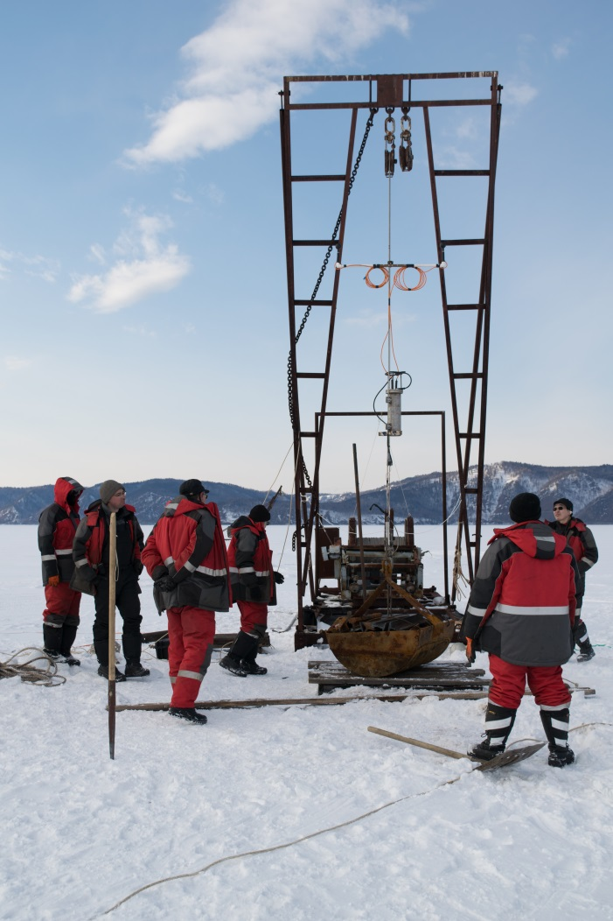
Expedition 2017
The scope of work
Cluster-1: preventive maintenance
Installation of new calibration systems
Cluster-2: deployment
Cluster-1
A new way to connect acoustic positioning
systems was tested
Calibration system designed for IceCube
was installed
Problem
Defective sealant tape
The first anchor
of the second cluster

Slide 11
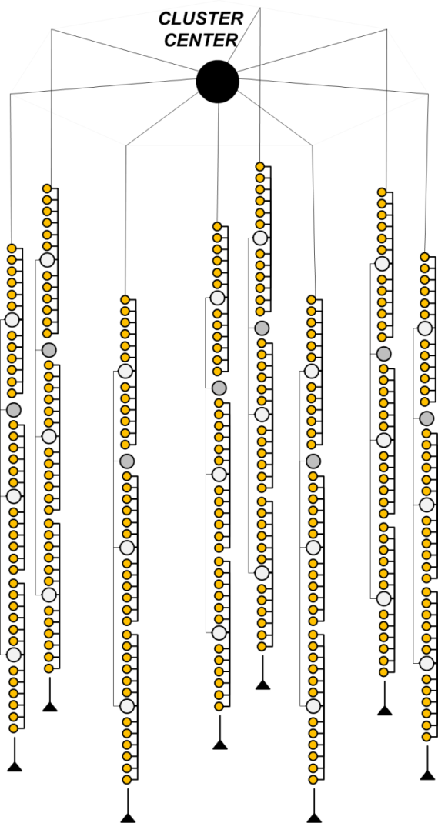
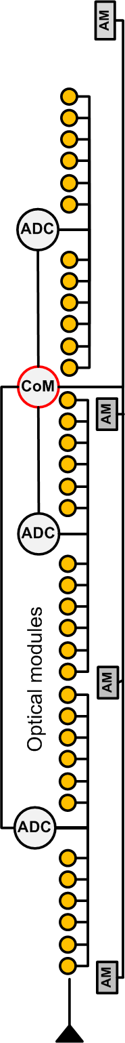
Cluster-2 deployment
Cluster:
8 strings × 36 OMs
4 Acoustic Modems on each string
5 LED calibration units
Fully unified electronics
and firmware.
Optical modules are equipped with humidity sensors.
Size: 525 m × ∅ 120 m

Slide 12
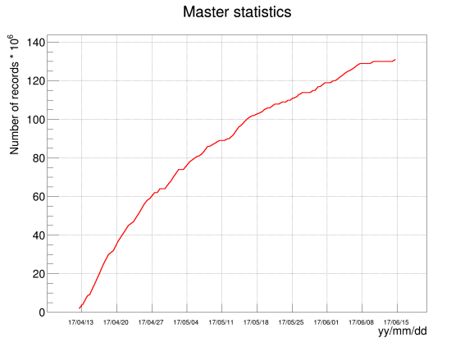
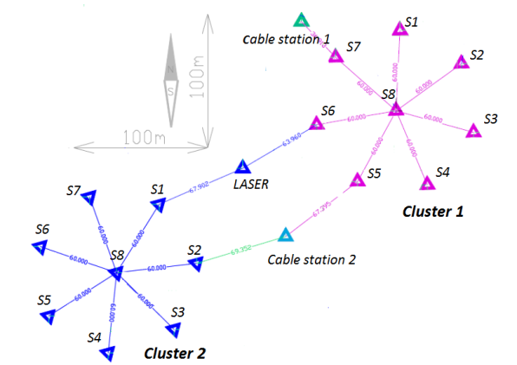
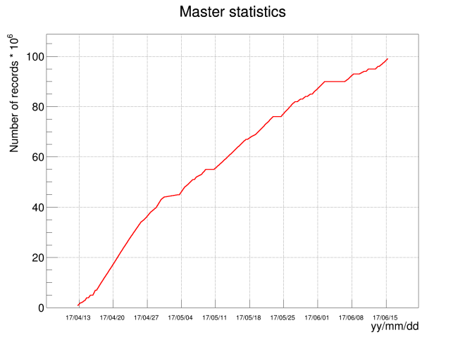
Detector operation -2017
13 April – 15 Jun 2017
Cluster 1
Eff. Vol. (E > 10² TeV) ~0.1 km³
Cluster 2
 | Full time | Eff., % | Event
Cluster-1 | 64d 7h | 84.4 | 1.87×10⁸
Cluster-2 | 64d 0h | 87.6 | 1.45×10⁸

Slide 13


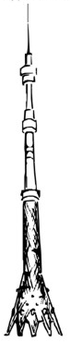

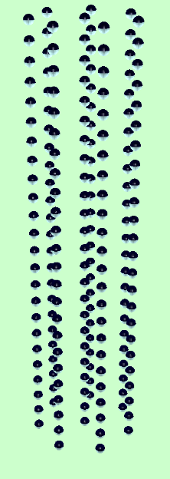
BAIKAL-GVD-1
2304 light sensors combined
in 8 clusters of vertical strings
at 750 – 1300 m depths.
Detection volume 0.4km³
Deployment plan for expedition 2018
April 2017
Taking data
April 2016
Taking data
300 m
~600 m
“Dubna”
Demonstration
Cluster (2015)
~1 km
120 m

Slide 14
Baikal-GVD Stage 1 timeline
2017 | 2018 | 2019 | 2020
2 clusters (deployed) | 4 clusters | 6 clusters | 8 clusters
GVD Stage 2: extension to 14 clusters
(possibly technologically upgraded) Timeline Phase-2:
A further extension of Phase 2 to more 14 clusters will depends on the worldwide physics situation in the 2020s and last but not least on the performance and physics output of the BAIKAL-GVD detector.
2021 | 2022 | 2023
10 clusters | 12 clusters | 14 clusters

Slide 15
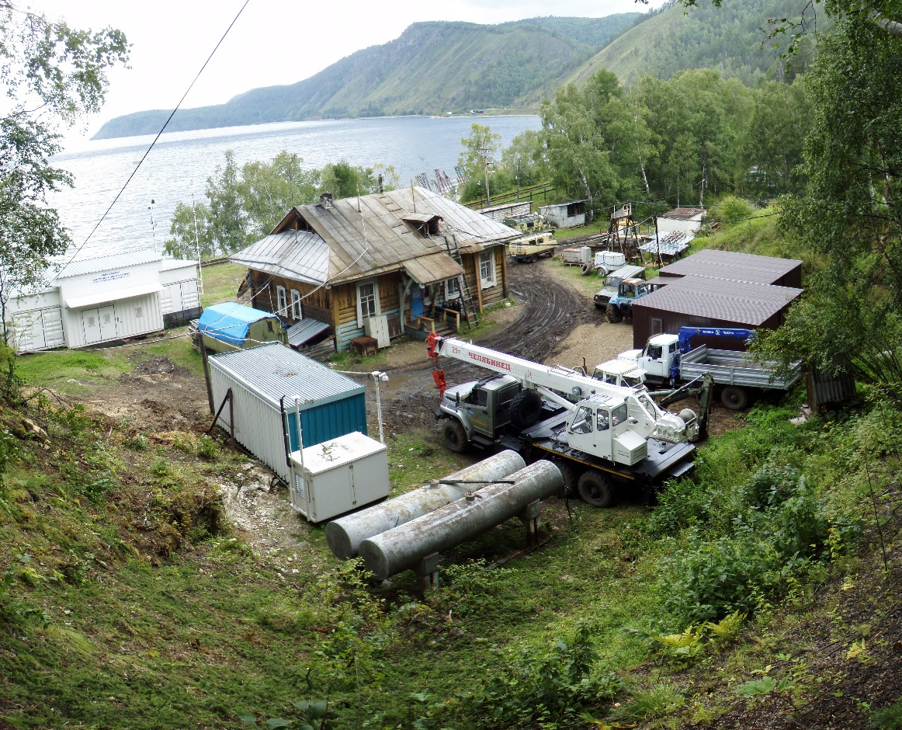
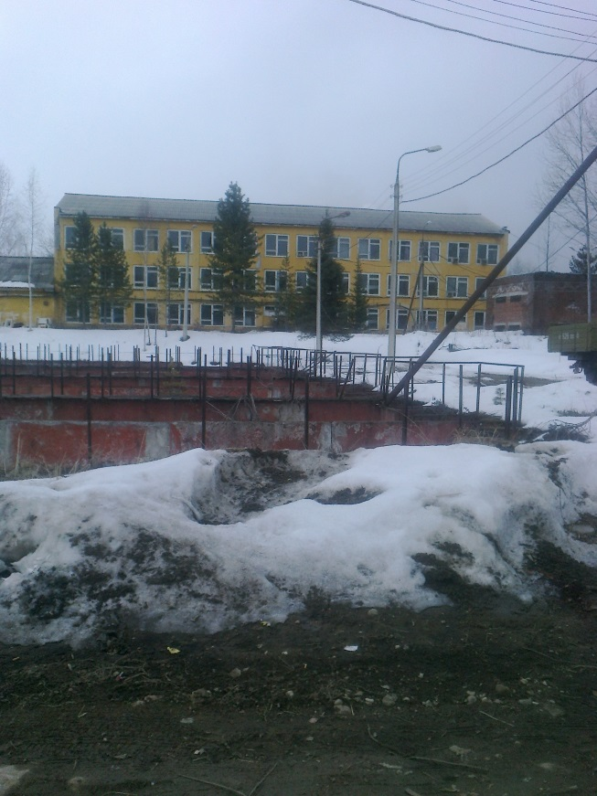
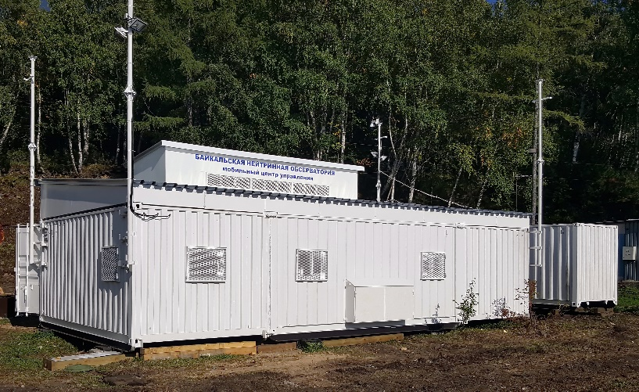
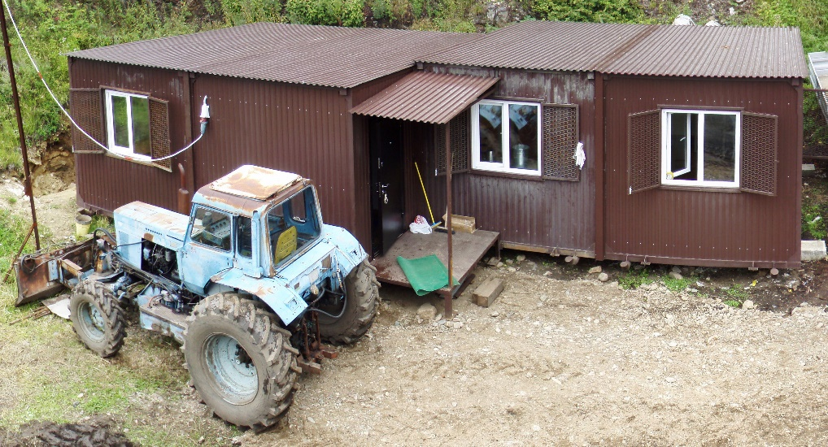
Infrastructure (site)
Status:
The DUBNA cluster installed on April 2015 has been
upgraded to a final state one with 288 optical odules
in 2016 spring . The second cluster started to operate
on April 2017.
The new data taking center at the array site
has been installed.
The new shore lab was installed on the site during
summer 2017.
The building in Baikalsk is prepared for a local lab and
a temporary storage for optical modules of the next
stages of the detector.

Slide 16
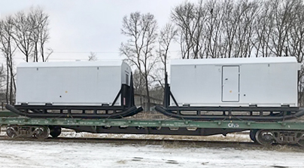
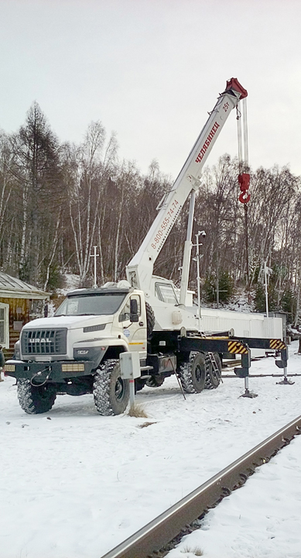
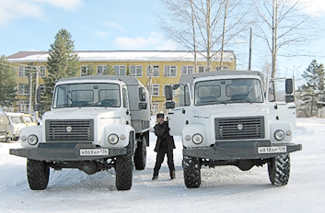
Infrastructure (site)
Status (continue):
New living boxes will be deployed on the site up to the end of 2017
Transportation problem
from the temporary store in Baikalsk to the shore and cargo handling at the site
was resolved by getting 2 cargo vehicles and the crane
All shore infrastructure extension, emergency transportation executed by excavator, track and speed boat.

Slide 17
Infrastructure development plans for 2018-2020-21 (on a base of the developed general plan)
Due to zoning issues, it is impossible to determine exact time frames for the following tasks. However, while resolving zoning situation might take 1-2 years, all possible preparations will be made so that once the necessary permits are acquired, the infrastructure development plans will be implemented rapidly.
Design and build a 30-person canteen and 8-10 person dormitory near the 106 km shore center.
Restore 2 houses: an old shore center at 106 km, and a house at 107 km (both buildings are recognized as a cultural heritage by the Russian government).
Build a pier on 106 km capable of housing 2 boats.
Paperwork and property rights on 460 000 sq. m. of land at 106-107km and 220 000 sq. m. of land in the Baikalsk city.
Renovate mobile housing at 106 km.
Resolve sewage and water supply issues for facilities at 106-107 km.
Build a cable channel underneath the railroad at 106km.
Finish building renovations in Baikalsk.
General improvements for sites at 106-107 km and in Baikalsk.

Slide 18
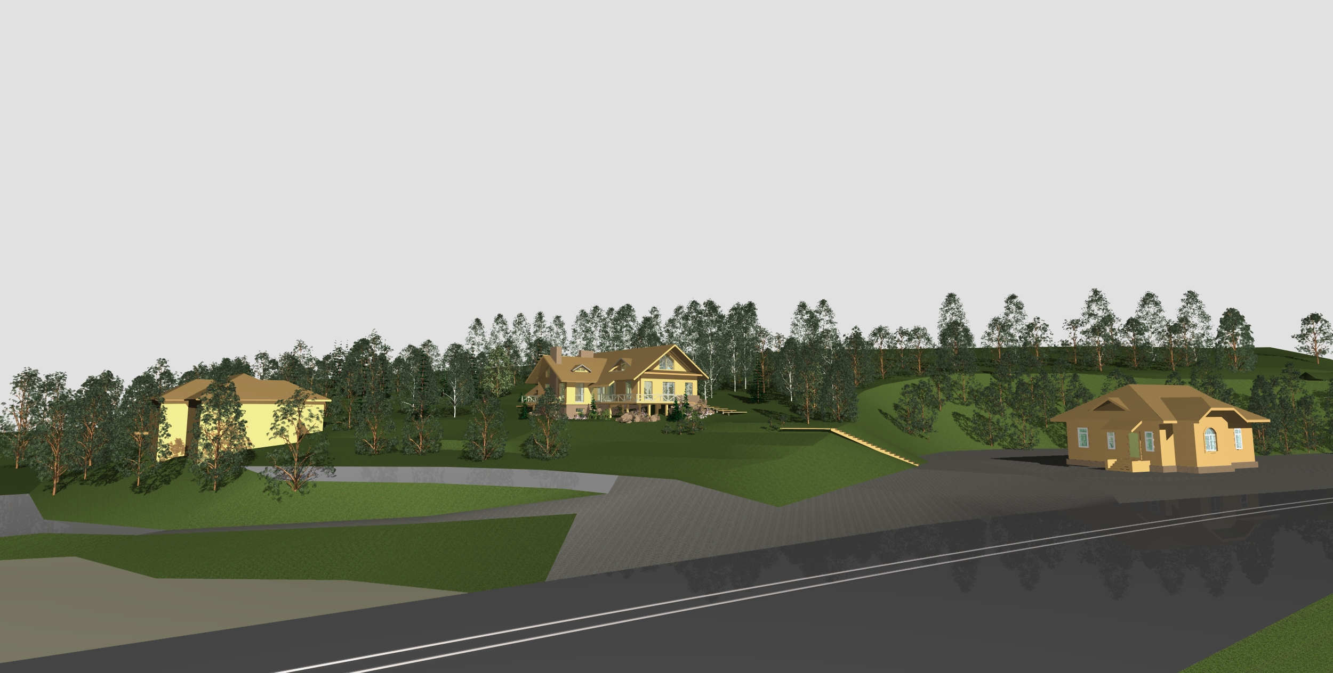
View of the 106 km shore base

Slide 19
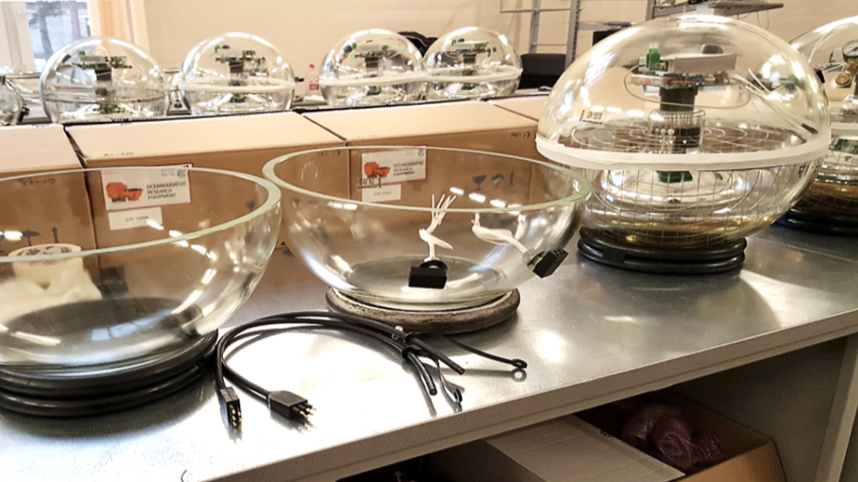
Optical modules assemble
2016
The assembly and testing of optical modules was
carried out in period 21.09.2016 - 10.03.2017
In total, 305 OMs have been prepared and tested
Production rate (including testing) was
up to 6 OM/day for 2-3 people

Slide 20
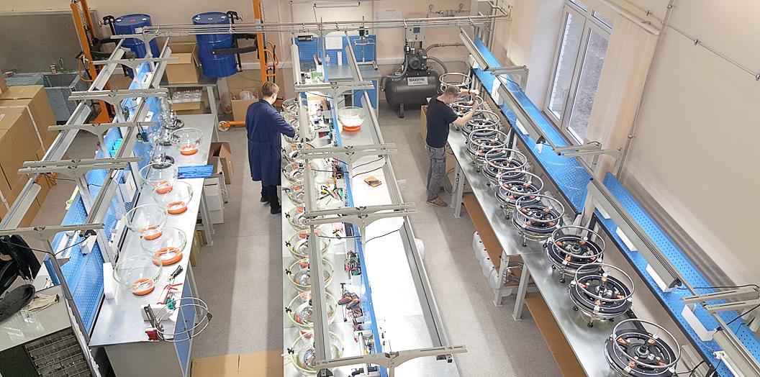
The optical modules production facility (Rearrangeed 2017)
The facility allows to produce and test up to 12 OM per day
We need to produce and send to the site 600 OM up to end of February

Slide 21
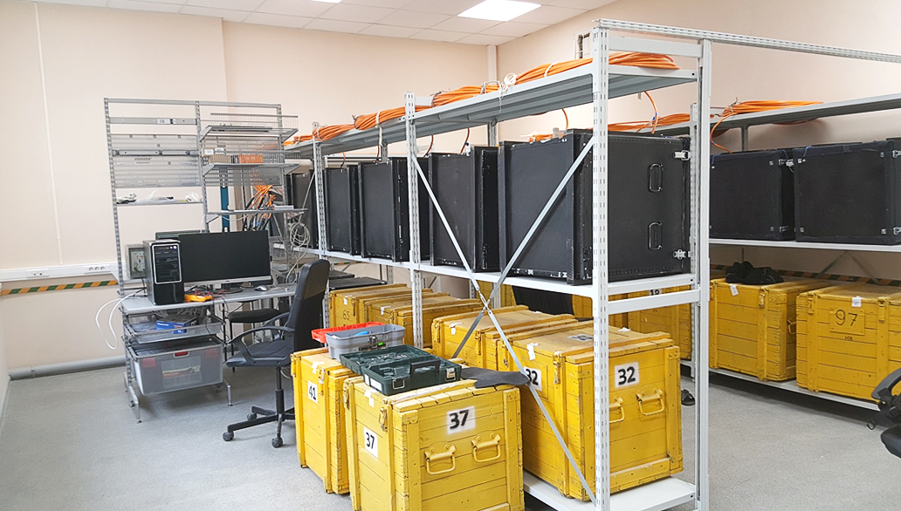
Long-term testing room (OMs and sections)

Slide 22
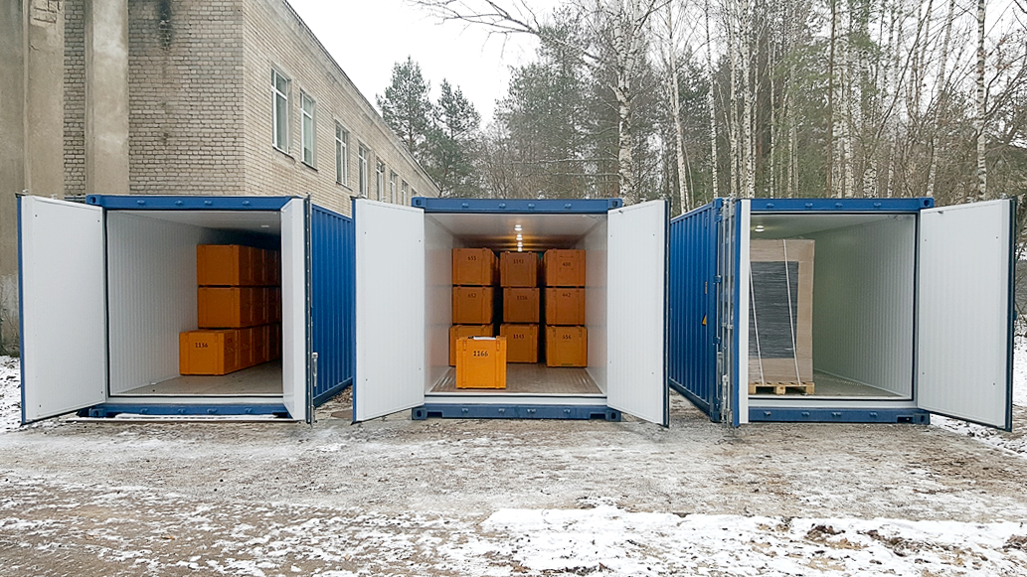
Warm storages

Slide 23
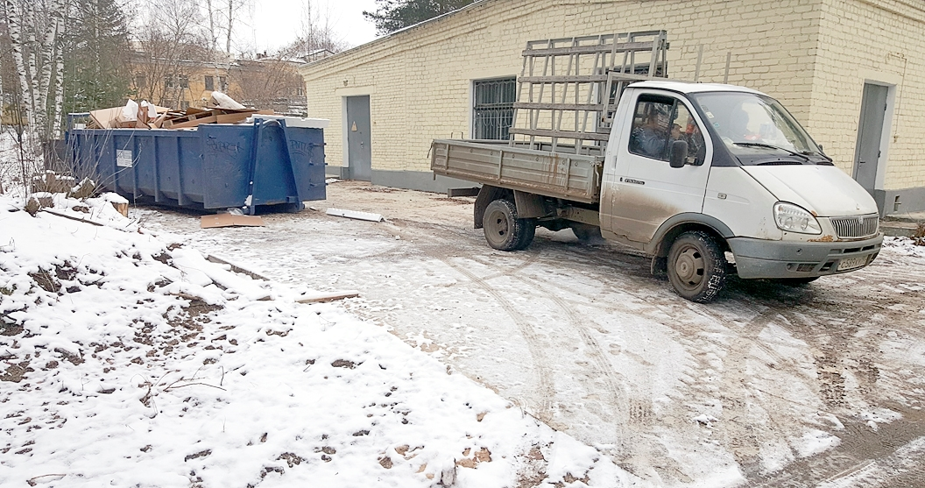
Prepared place for a container where we are going
to make long-term tests at least a one equipped full string

Slide 24
Recourses needs for the BAIKAL project
and proposed schedule of its allocation
Expenditures, resources, financing sources |  | Cost of parts (US$), resources needs | Proposals of the Laboratory on the distribution of finances and resources
 |  |  | 1 year | 2 year | 3 year
Main parts and equipment | 1. Underwater optical module elements 2. Underwater connectors 3. Elements of underwater electronic system of control and data acquisition 4. Elements of underwater cable communications 5. Elements of the acoustic positioning system 6. Infrastructure development and vehicles 7. Electro-optical cable and deployment tool Total | 8 430 K 2 100 K 1 950 K 1 500 K 2 400 K 2 400 K 1 800 K 20 580 K | 2 810 K 700 K 650 K 500 K 800 K 800 K 600 K 6 860 K | 2 810 K 700 K 650 K 500 K 800 K 800 K 600 K 6 860 K | 2 810 K 700 K 650 K 500 K 800 K 800 K 600 K 6 860 K

Slide 25
Resources | Standard hour | JINR workshop DLNP workshop | 6 000 3 300 | 2 000 1 100 | 2 000 1 100 | 2 000 1 100
Financial sources | Budgetary resources Budgetary resources | Budget spending | 18 000 K | 6 000 K | 6 000 K | 6 000 K
 | External resources | Contribution from collaboration(s); Grants; Sponsors; Contracts; Other sources | 3 000 K | 1 000 K | 1 000 K | 1 000 K

Slide 26
Estimate of expenditures for the project BAIKAL-GVD,
Deep underwater muon and neutrino detector on Lake Baikal
№ | Designation for outlays | Full cost | 1st year | 2nd year | 3rd year
 | Direct expenses for the project
1 2 3 4 5 6 7 | Networking DLNP workshop JINR workshop Materials Equipment R&D on a contract base Travel expenses | 30.0K US$ 3 300 h. 6 000 h. 14 280.0K US$ 6 300.0K US$ 210.0K US$ 180.0K US$ | 10.0 1 100 2 000 4 760.0 2 100.0 70.0 60.0 | 10.0 1 100 2 000 4 760.0 2 100.0 70.0 60.0 | 10.0 1 100 2 000 4 760.0 2 100.0 70.0 60.0
Total |  | 21 000.0K US$ | 7 000.0K$ | 7 000.0K$ | 7 000.0K$
Including budget spending JINR 18 000.0K$ 6 000.0k$ 6 000.0K$ 6000.0K$

Slide 27
Baikal Collaboration
~ 65 physicists
and engineers
Institute for Nuclear Research, Moscow, Russia
Joint Institute for Nuclear Research, Dubna, Russia
Irkutsk State University, Irkutsk, Russia
Skobeltsyn Institute of Nuclear Physics MSU, Moscow, Russia
Nizhny Novgorod State Technical University, Russia
Saint Petersburg State Marine University, Russia
Institute of Experimental and Applied Physics, Czech Technical University, Prague, Czech Republic
Comenius University, Bratislava, Slovakia
EvoLogics GmbH, Berlin, Germany

Slide 28
Main publications for 2015-2017 years.
A. Avrorin (Moscow, INR) et al., The optical module of Baikal-GVD, Phys.Part.Nucl.Lett. 13 (2016) no.6, 737-746
A. Avrorin et al., Dark matter constraints from an observation of dSphs and the LMC with the Baikal NT200, Published in JETP Vol. 152 (7) (2017) – results in PDG2017
A. Avrorin et al., Data acquisition system for the Baikal-GVD neutrino telescope, Phys.Part.Nucl. 47 (2016) no.6, 933-937
A. Avrorin et al., Neutrino signal at Baikal from dark matter in the Galactic Center, Phys.Part.Nucl. 47 (2016) no.6, 926-932
A. Avrorin et al., Baikal-GVD: first cluster Dubna, PoS EPS-HEP2015 (2015) 418
A. Avrorin et al., Search for neutrino emission from relic dark matter in the Sun with the Baikal NT200 detector, Astropart.Phys. 62 (2015) 12-20
PHD thesis:
Avrorin A.D. Muons registration with deep underwater neutrino telescope Baikal-GVD, Moscow, 2016
Kuleshov D.A. The DAQ system of the telescope NT1000, Moscow, 2014
Sheifler A.A. Optical module of the Baikal deep underwater neutrino telescope Baikal-GVD (development and testing of the detecting system), Moscow, 2016

Slide 29
JINR group participation
Total FTE (Engineers): 8.8, Total FTE (Scientific staff): 8.3
Assembly and test of OMs and strings
Participation in winter deployment campaigns and summer infrastructure extension expeditions
Access and security service.
Data archive processing and analysis.
Detector calibration and mass processing of data.
Remote control and monitoring systems of detector
Analysis frame software (BARS)
Simulation software and MK production.
On-line software
Development of new methods of event selection and reconstruction.
Data analysis with respect to high-energy neutrinos and neutrinos from dark matter annihilation

Slide 30
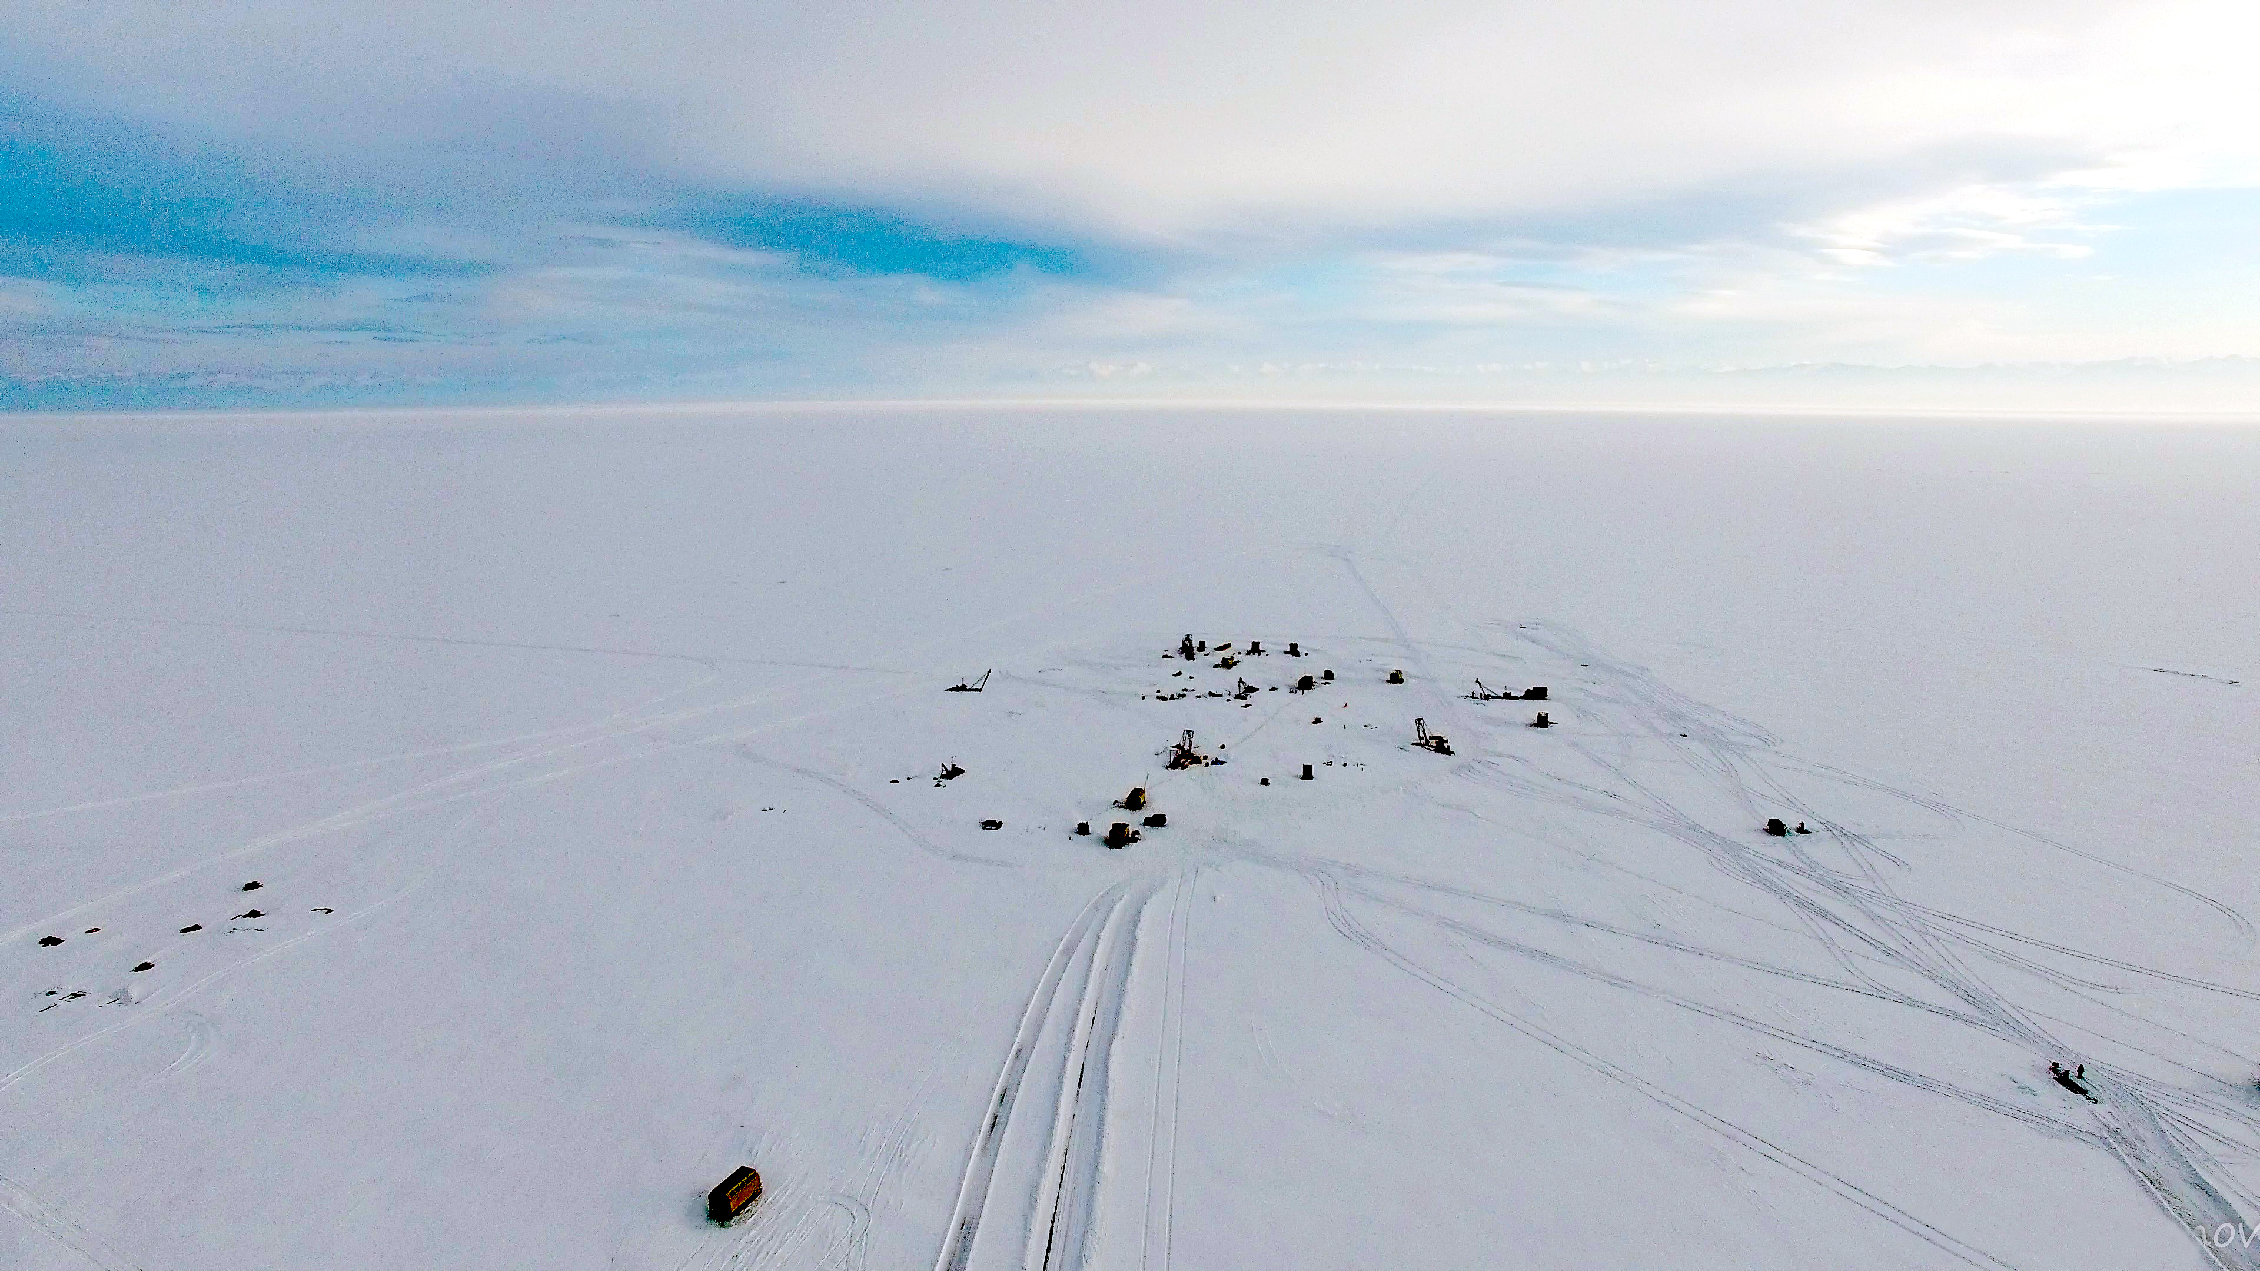
Thank you

Slide 31
Power supply problem
Heavy thunderstorm of June 17, 2017
Cluster-2: critical failure
Both shore PSU failing simultaneously;
Underwater power control system is partially out of operation.
Cluster-1: was not affected
Failed power supplies have been sent to the manufacturer for repairs. At the moment, the second cluster operates on backup power; it is sufficient to keep four out of eight strings operational.
Detector configuration (July – October)
Cluster-1: 8 strings Cluster-2: 4 strings

Slide 32
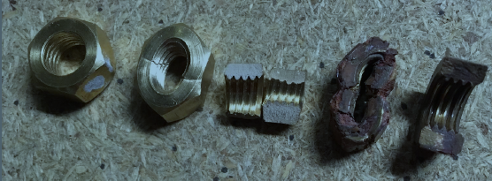

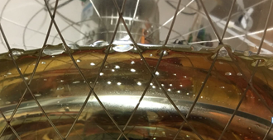
Cluster-1: defective nuts and sealant
Defective nuts:
corrosion and destruction
→ emersion of underwater
modules.
Defective sealant:
condensate inside the modules
→ sharp decrease in reliability
~100 OMs were installed with defective sealant.
~30 OMs were restored during expedition 2017

Slide 33
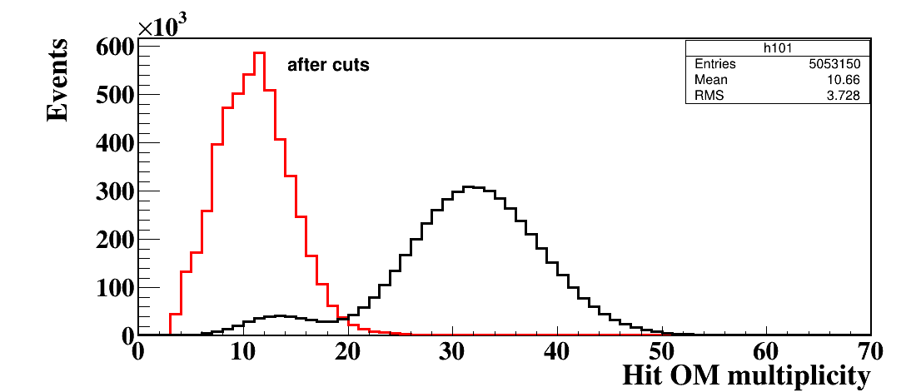
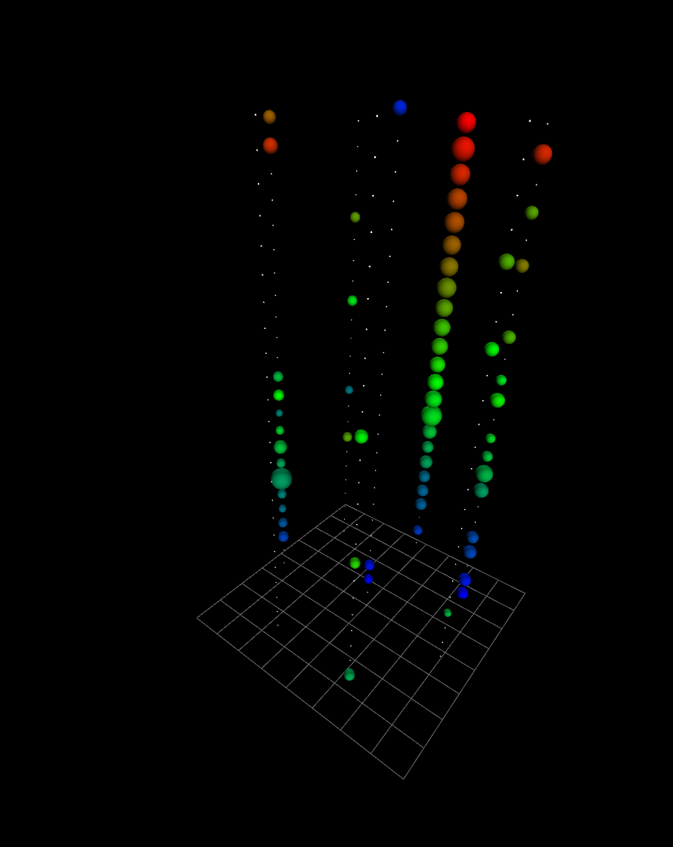
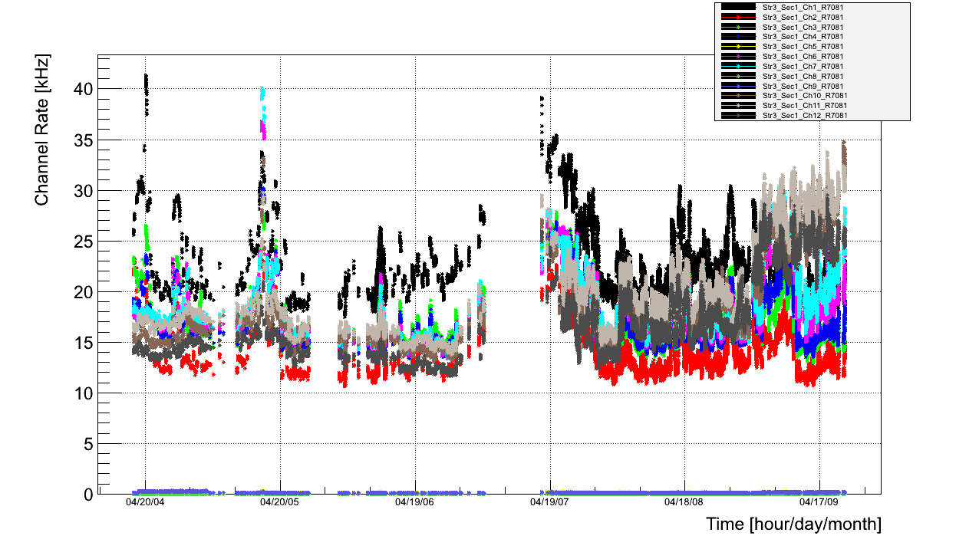
Множественность сработавших ОМ
Фоновое событие - группа мюонов

Slide 34
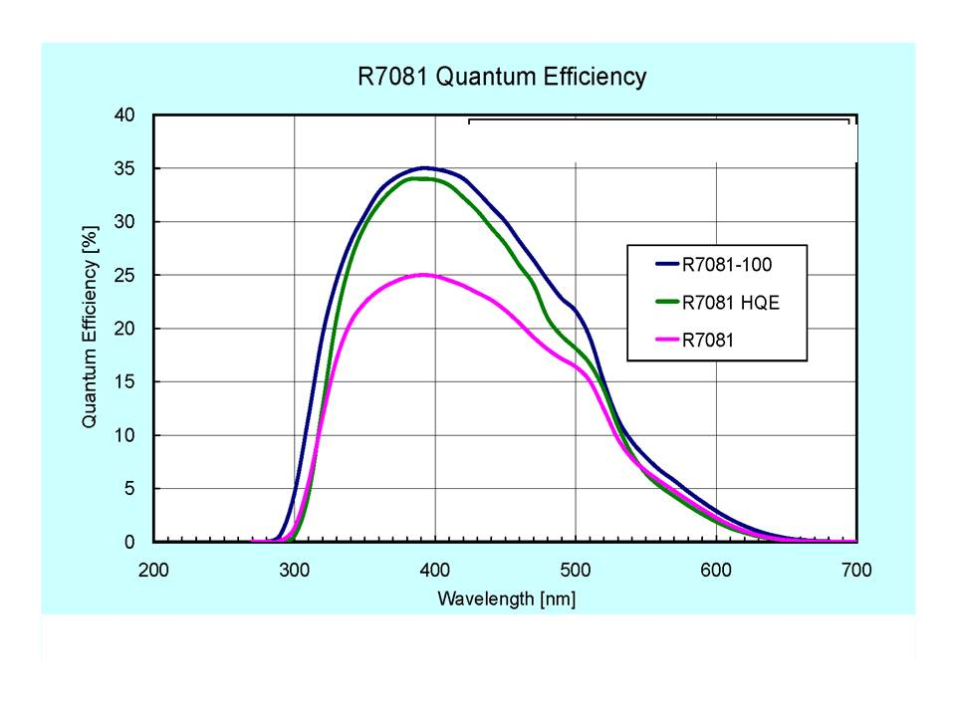
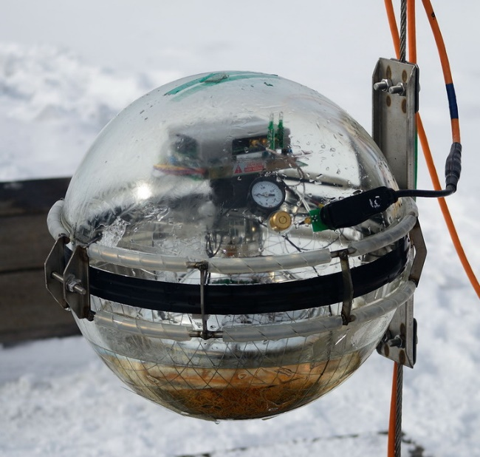
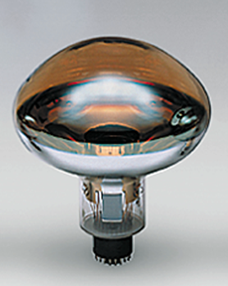
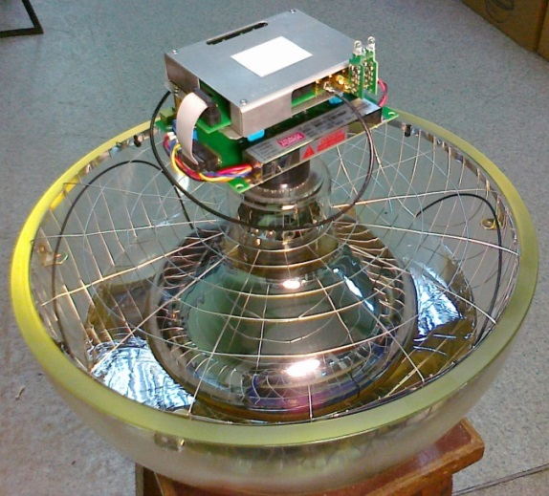

Optical module
Quantum efficiency
R7081-100 Hamamatsu
D=10 inch. SBA photocathode QE ≈ 35% @ 400nm;
Gain ~10⁷, dark current ~8 kHz
Angular sensitivity
Φ220 mm
OM electronics
Mu-metal cage
PMT
Optical gel
Glass pressure-resistant
sphere VETROVEX (17”)

Slide 35



DAQ system
Channel
OM: analog output, gain ~10⁸
ADC: 12-bit 200 MSPS (waveform)
Section: 12 optical modules
Trigger: coin. any pairs of nearby OMs
Master records: waveforms of 12 channels
Data transmitting: 2-wire Eth. Extenders
(time intervals without pulses are clipped)
String: 3 sections
Section power control
Cluster: 8 strings
Data transmitting: optical line
Event rate: 50 – 250 Hz
GVD Section: 12 channels

Slide 36
KM3NeT
 | 2015 | 2016 | 2017 | 2020
Foreseen |  |  | 24 Str. ARCA 7 Str. ORCA | 230 Str.(ARCA) 115 Str. (ORCA)
Realized so far | 1 DU (36 OMs) ARCA | 2 DUs (72 OMs) ARCA | 1 DU (36 OMs) ORCA
Baikal-GVD-1
Foreseen | Dubna 192 OMs | 1 Cluster 288 OMs | 2 Clusters 576 OMs | 8 Clusters 2304 OMs
Realized so far | Dubna 192 OMs | 1 Cluster 288 OMs | 2 Clusters 576 OMs

Slide 37




Deep-water pulsed laser
Wavelength: 532 nm
Pulse energy: 0.37 mJ (~10¹⁵ photons)
Flash duration ~1 ns
Attenuation steps: 10⁻⁵, 10⁻⁴, 10⁻³, 10⁻², 10⁻¹, 1
Purposes:
- inter-cluster calibration
- cascade emulation

Slide 38




The first tests of the laser operation
The first Laser Runs: Jun 2017
Q, pe
S6
Amplitude
S5
S7
S8
S4
S1
S3
LASER
64 m
Check up of main parameters
of the detector with laser:
Uncertainties of the timing
calibration of the channels
Precision of the OMs positioning
Time

Slide 39







New LED light sources
for inter-string calibration
3 new LED light sources (LED beacon) for the time calibration of the Strings were installed.
Each LED beacon comprises 12 synchronized LEDs: 6 vertical and 6 horizontal.
470 nm
LED: Kingbright L7113 PBC-A
Str 1
Str 8
Str 1 Section 1
Str 8 Section 1
Str 8 Section 2

Slide 40

POCAM connection to the DAQ of the Cluster-1
NPort
Remote access
RS-485
POCAM
300 V
300 VDC
NPort 5250: Ethernet – RS485 converter
300 VDC power commutator

Slide 41
Repair of Cluser-2
1. Repair of cluster center – power module
(thunderstorm)
2. Repair of central modules of the upper sections
String #1 Section #3 Channels #9, #10 (RS485 output of RELE board)
String #2 Section #3 Channels #9, # 10, #11, #12 (restriction on power supply)
String #4 Section #3 Channels #9, #10, #11, #12 (restriction on power supply)
String #6 Section #3 Channels #7, #8, #9, #10, #11, #12 (restriction on power supply)
String #7 Section #1 Channels #1, #2, #3, #4, #5, #6, #7, #11 (restriction on power supply)
String #1 Section #1 Channel #11
String #3 Section #1 Channel #12
- String #8 Section #2 Channel #7

Slide 42


Operation - 2014
Counting rates of OMs during
April –September 2014
Amplitude distribution
of selected OM recorded pulses
Run 214 – 20 kHz
Run 318 - 50 kHz
1ph.el.= 8 codes
Deep water light background at 1ph.el. level !

Slide 43

Prototype string: muon reconstruction
Noise suppression procedure:
The time difference between the pulses of any pair of OMs should be smaller than the light propagation time.
- Performance of time measuring systems.
- Reliability of calibration methods.
Efficiency of background suppression.
Selected sample of 2010 string data:
- Trigger condition: >3 hit OMs
- PMT noise: ~15kHz
Muon track reconstruction:
Zenith angular distributions
of experimental
and MC-simulated
events after cut on χ2 value

Slide 44


Prototype string: time calibration
2009
2010
Tests with LED
LED flasher produces pairs of delayed pulses, which are transmitted to each OM via individual optical fibre. Time between pulses dT was calculated from
the waveform data.
OM#1
OM#2
OM#3
OM#4
OM#5
Time resolution: σ(dT) = 1.6 ns
=> σ(1 pulse) ~ 1ns
OM#6
110 m
OM#7
Tests with LASER
ΔT = <dT_{EXPECTED} – dT_{LASER} >
dT_{EXPECTED} = (r₂-r₁)×c_{water}
dT_{LASER} - time difference between two channels measured for Laser pulses.
OM#8
OM#9
r₁
OM#10
OM#11
LASER
r₂
OM#12
XP1807
R8055
R7081HQE R8055
Time error: ΔT ~ 2 ns
97 m
97 m

Slide 45


The site
Site:
1370 m maximum depth
Distance to shore ~4 km
No high luminosity bursts from biology
No K⁴⁰ background
Location:
104º25’ E; 51º46’ N
Shore station
Baikal water
Abs.Length: 22 ± 2 m Scatt.Length: 30-50 m
36 km
Baikal’sk
Workshop&Storage facilities

