Slide 1
Прогресс 2020 – 2023 гг. в разработке аэрогелевых черенковских счетчиков в Новосибирске
А. Ю. Барняков и др.
План:
Счетчики АШИФ
  Эксперимент КЕДР и СНД
  Долговременная стабильность счетчиков АШИФ
  АШИФ с КФЭУ, модернизация счетчика АШИФ для эксперимента СНД
Детекторы черенковских колец с фокусировкой
  Счетчики с линзой Френеля (mRICH for EIC project)
  ФАРИЧ для Супер С-Тау фабрики
Позиционно-чувствительные фотодетекторы
  Матрицы КФЭУ
  ФЭУ с МКП

Slide 2
Progress 2020 – 2023 in aerogel Cherenkov counters development in Novosibirsk
A. Yu. Barnyakov & other.
Contents:
ASHIPH counters
  The KEDR and the SND experiments
  Long-term stability of the ASHIPH counters
  ASHIP with SiPM, upgrade of the ASHIPH system for the SND experiment
RICH detectors with focusing of the light
  RICH with Fresnel lens (mRICH for EIC project)
  FARICH for the Super Charm-Tau Factory
Position-sensitive photon detectors
  SiPM arrays
  MCP-PMTs

Slide 3
ASHIPH technique is 30 years old!!!

Slide 4
ASHIPH detectors
Aerogel SHIfter and PHotomultiplier
PMMA light guide doped with BBQ dye
is used as wavelength shifter
Suggested at BINP. A.Onuchin et.al. NIM A315(1992)517

Slide 5
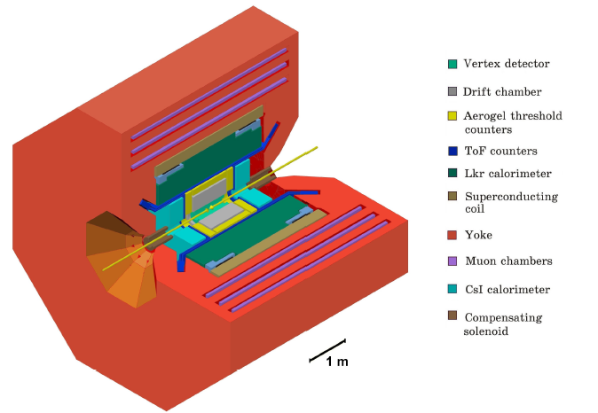
KEDR experiment at VEPP-4M
VEPP-4M
Symmetric e⁺e⁻⁻ collider
E_{c.m.} = 2–10 GeV
L = (1÷80) x 10³⁰ cm⁻²s⁻¹
Precise energy calibration:
  RD: (5÷15)x10⁻⁶
  CBS: 3x10⁻⁵
Physics program
Precise particle mass measurements: J/ψ, ψ(2S), ψ(3770), τ lepton, D mesons, Υ mesons
Measurements of ψ and Υ mesons lepton width
R measurement in 2-10 GeV c.m. energy range
γγ→hadrons and other 2γ processes
Branching fractions measurements in charm and bottom quark systems (above 10⁻⁴)

Slide 6
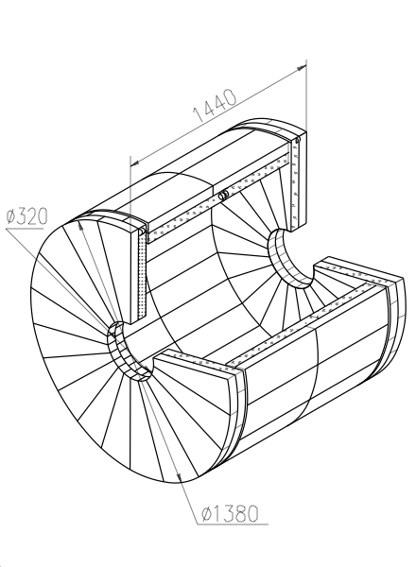
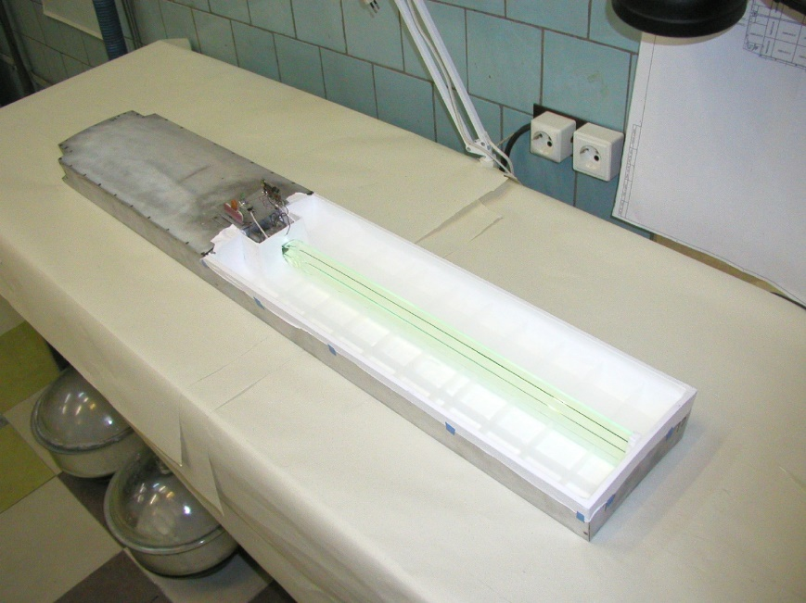
KEDR ASHIPH system
160 counters in 2 layers
Solid angle 96% of 4π
n=1.05, V_{Σ}=1000 l, high transparency SAN-96 aerogel
π/K- separation in the momentum range 0.6÷1.5 GeV/с
160 MCP PMTs, photocathode diameter ø18mm, able to work in the magnetic field up to 2 T
Fully installed in the detector in 2013. Now is in operation.

Slide 7
KEDR ASHIPH system (2)
Npe = 6.4±0.2 – layer 1
Npe = 5.0±0.2 – layer 2
Npe = 10.9±0.2 – sum of the signals in 2 layers (80%)
π/K-separation at 1.2GeV/c is 4.3σ
A.Yu.Barnyakov et al., NIM A824 (2016) 79

Slide 8

SND at VEPP-2000
Symmetric e⁺e⁻ collider with round beams
2E_{max}=2000 МeV
L=10³¹сm⁻²s⁻¹ at E=510 МeV
L=10³²сm⁻²s⁻¹ at E=1000 МeV
VEPP-2000 beam pipe
Tracking system
Aerogel Cherenkov counters
NaI(Tl) crystals
Vacuum phototriodes
Fe absorber
Muon system
VEPP-2000 s.c. focusing solenoids
EMC

Slide 9
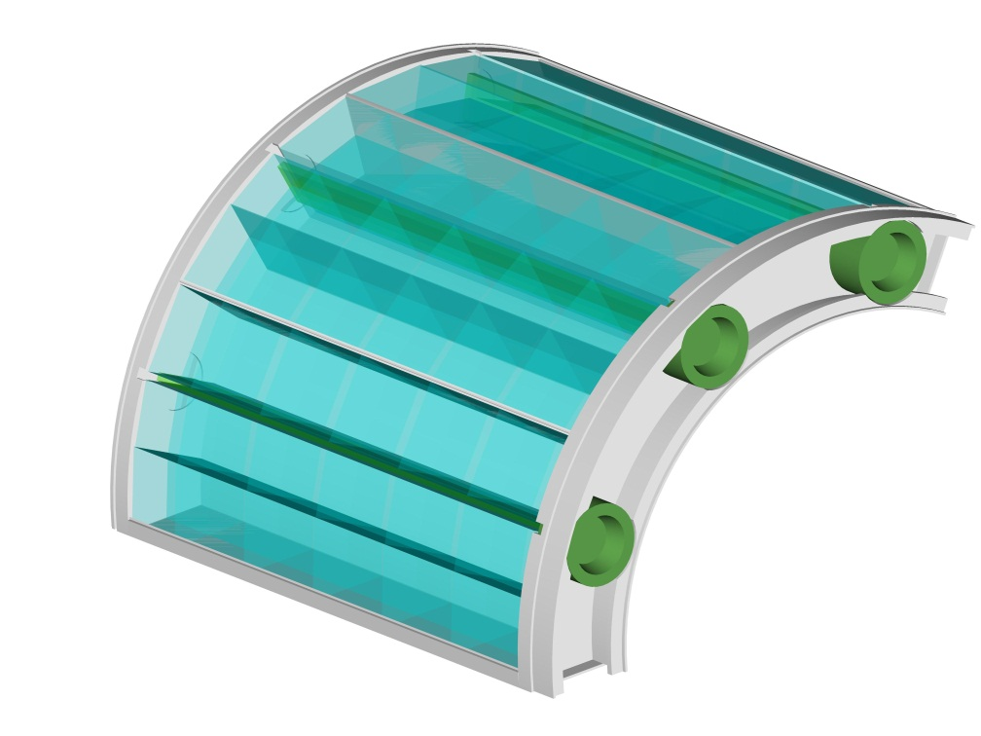
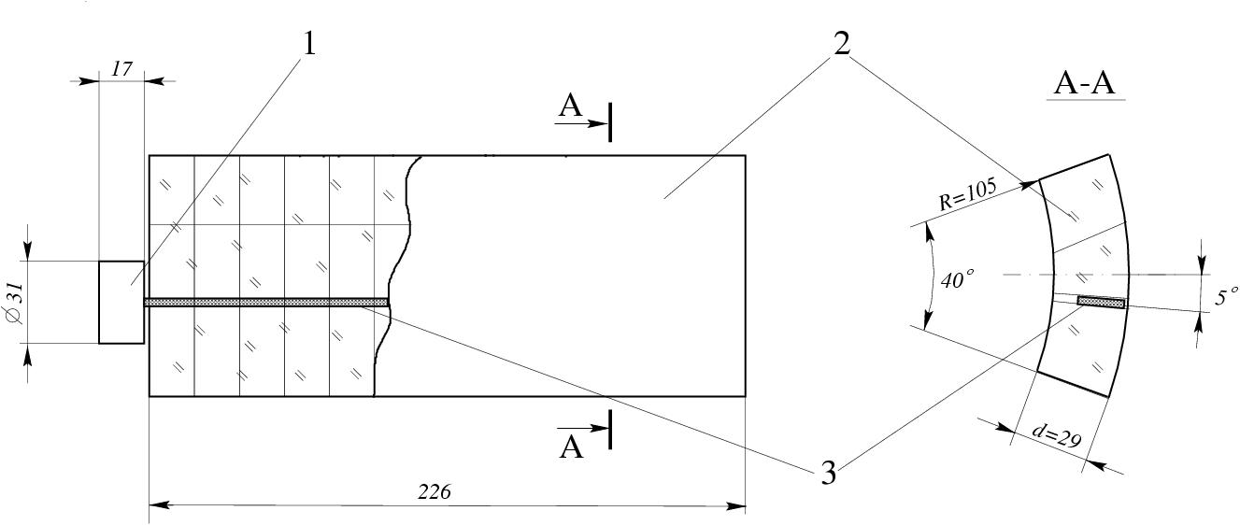
ASHIPH counters for SND
3
2
1
Counter Design
Scheme: ASHIPH
WLS position: displaced by ~5° from counter center
Aerogel thickness: ~30 mm
1 - PMT, 2 – aerogel, 3 - WLS
Outline
π/K separation from 300 to 870 MeV/c
Cylindrical shape: R=105÷141 mm
Case material: 1mm of Al
3 segments of 3 counters in each
Solid angle: ~60% of 4π
Thickness: 0.09 X_{o}
Aerogel parameters
Refraction index: n=1.13±0.01
Density: ρ=0.65 g/cm³
L_{sc}=19 mm at λ=400 nm
L_{abs}=100 cm at λ=400 nm

Slide 10
SND ASHIPH: π/К separation
Amplitude
Efficiency
● π
○ K
● π
○ K
P, MeV/c | ε_{K} , % | Ε_{π} , % | Sep, σ
300 | ~10 | 68 | 1,7
350 | ~7 | 90 | 2,8
400 | ~5 | 96 | 3,4
600-800 | ~9 | >99 | 3,7
For momenta above 350 MeV/с separation level is sufficient
Below 350 MeV/c separation will be supplemented by other subsystems (DC)
A Yu Barnyakov et al 2014 JINST 9 C09023

Slide 11
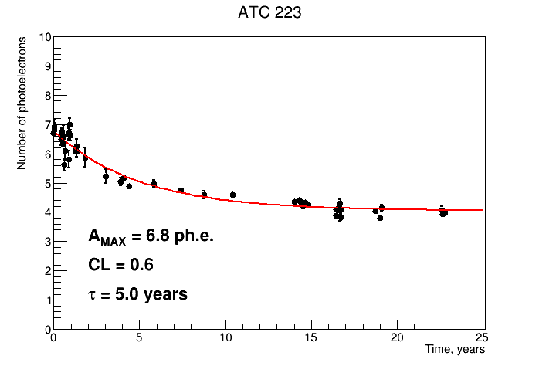
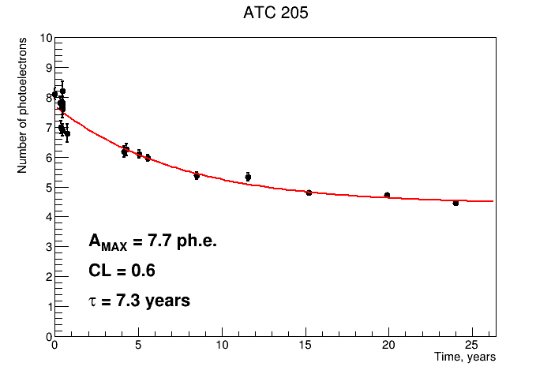
Long-term stability of ASHIPH counters
ASHIPH prototype for the KEDR.
After tests with mixed hadron beams at JINR (Dubna) in 2000 is under operation from time to time.
One of the first ASHIPH counters for the KEDR detector was under operationin the experiment from 2000 to 2003.
A Yu Barnyakov et al 2014 JINST 9 C09005

Slide 12
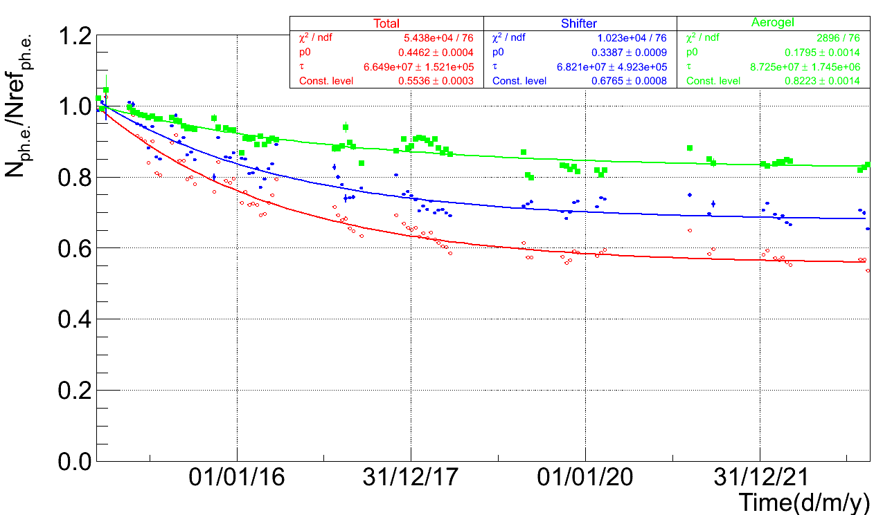
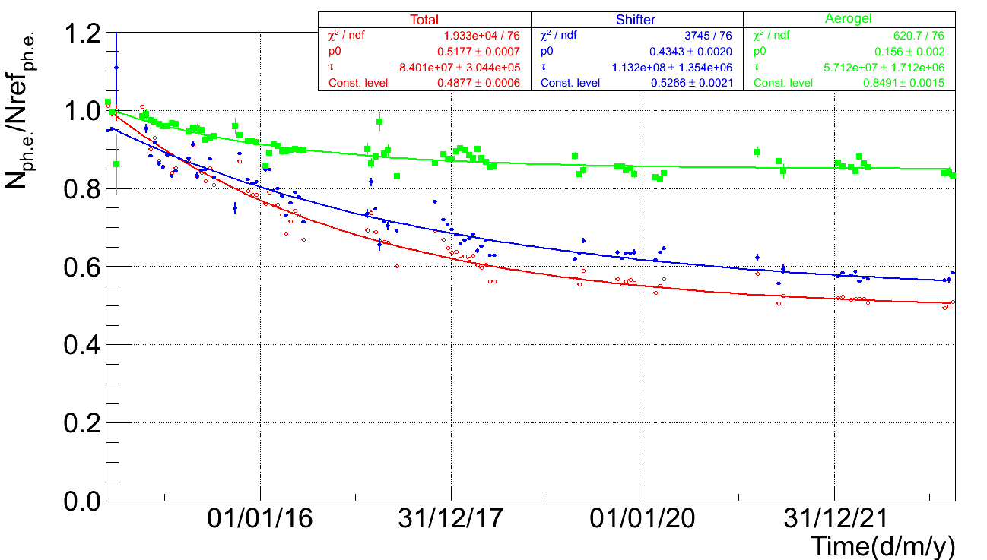
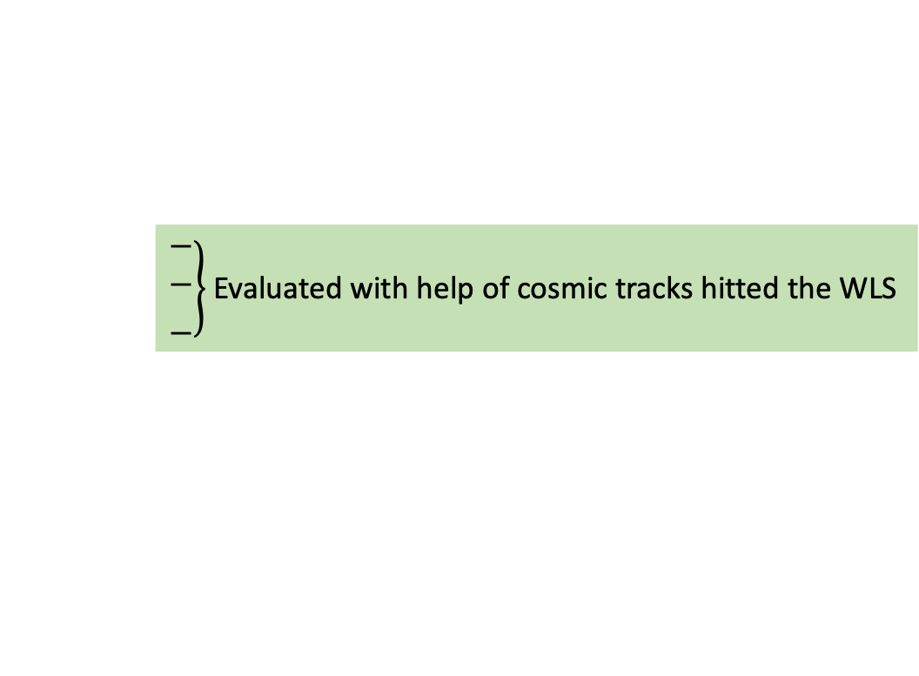
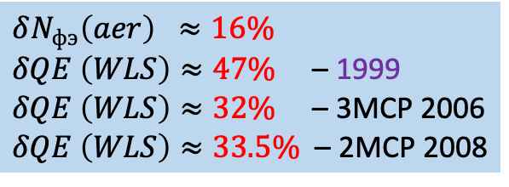
Amplitude decrease reasons for the ASHIPH system which is in operation at the KEDR detector since 2014
ASHIPH counters with 2MCP-PMTs from 1999÷2000
ASHIPH counters with 3MCP-PMTs from 2006÷2007
$δN_{фэ}\left(aer\right) ≈16\%$
$δQE \left(WLS\right)≈47\%$ – 1999
$δQE \left(WLS\right)≈32\%$ – 3MCP 2006
$δQE \left(WLS\right)≈33.5\%$ – 2MCP 2008
$\left.\begin{matrix} \\ \begin{aligned}− \\ −\end{aligned} \\ \begin{aligned} \\ −\end{aligned}\end{matrix}\right\}$ Evaluated with help of cosmic tracks hitted the WLS

Slide 14
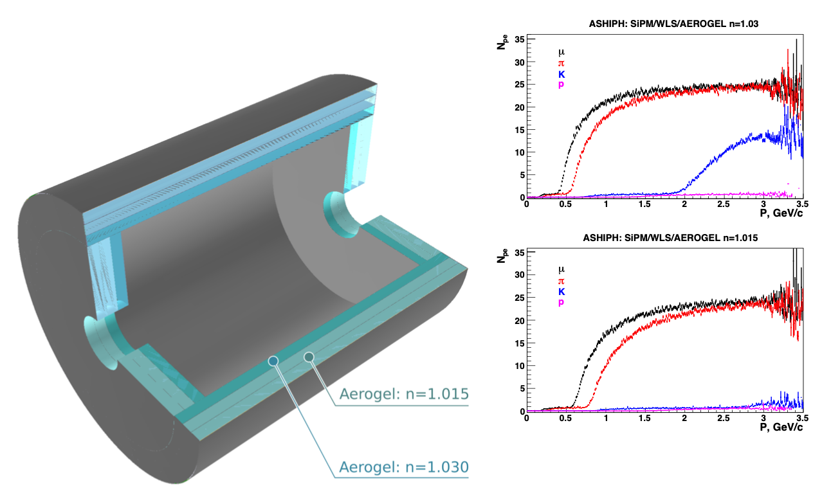
ASHIPH option for Super C-Tau factory
1400 counters 18x30x8 cm³
System consists of 3 layers:
n=1.03 (8 cm) – 2000 liters
n=1.015 (8+8 cm) – 4000 liters
28k SiPM 3x3 mm²
WLS based on PMMA doped by BBQ
0.3x6x28 cm³
π/К – separation up to 3.5 GeV/c
µ/π – separation from 0.5 to 0.9 GeV/c

Slide 15
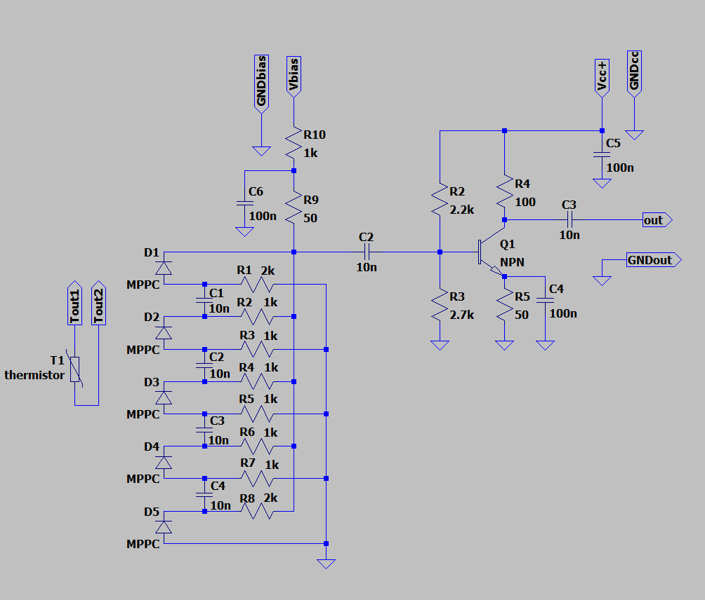
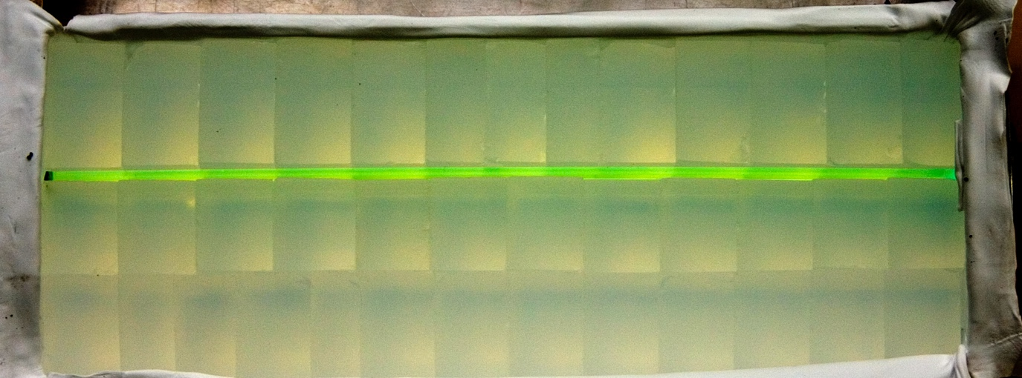
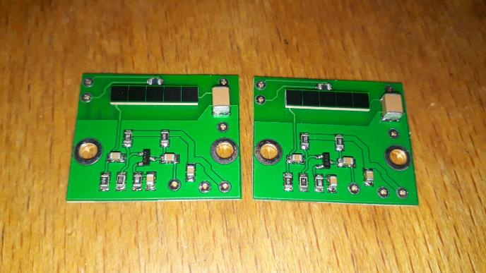
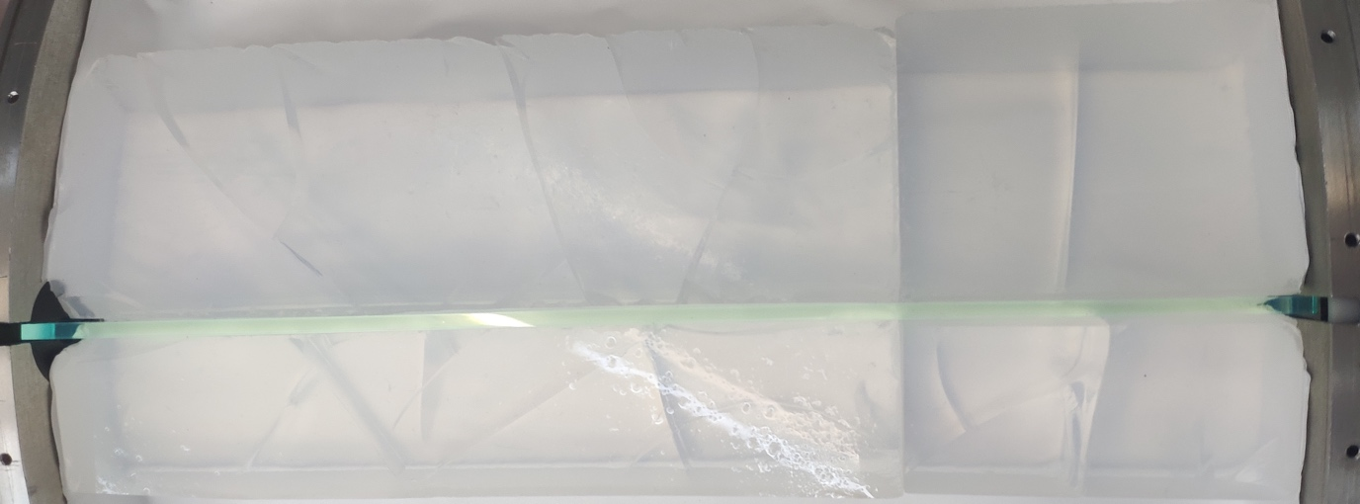
Upgrade of ASHIPH system for the SND
n=1.13
Change of MCP-PMT to SiPM lead to increase of amplitude by two or more times:
– ASHIPH system with n=1.05: 4.5 pe → 8÷10 pe
– ASHIPH system with n=1.13: 9.5 pe → 18÷20 pe
π/K-separation become more reliable
Parametric simulation results
Scheme with consequently-parallel
connection of SiPM
Aerogel radiator made from 38 sintered blocks 50х50х25 mm³
Aerogel radiator made from single block 200х200х40 mm³

Slide 16
RICH with Fresnel lens

Slide 17
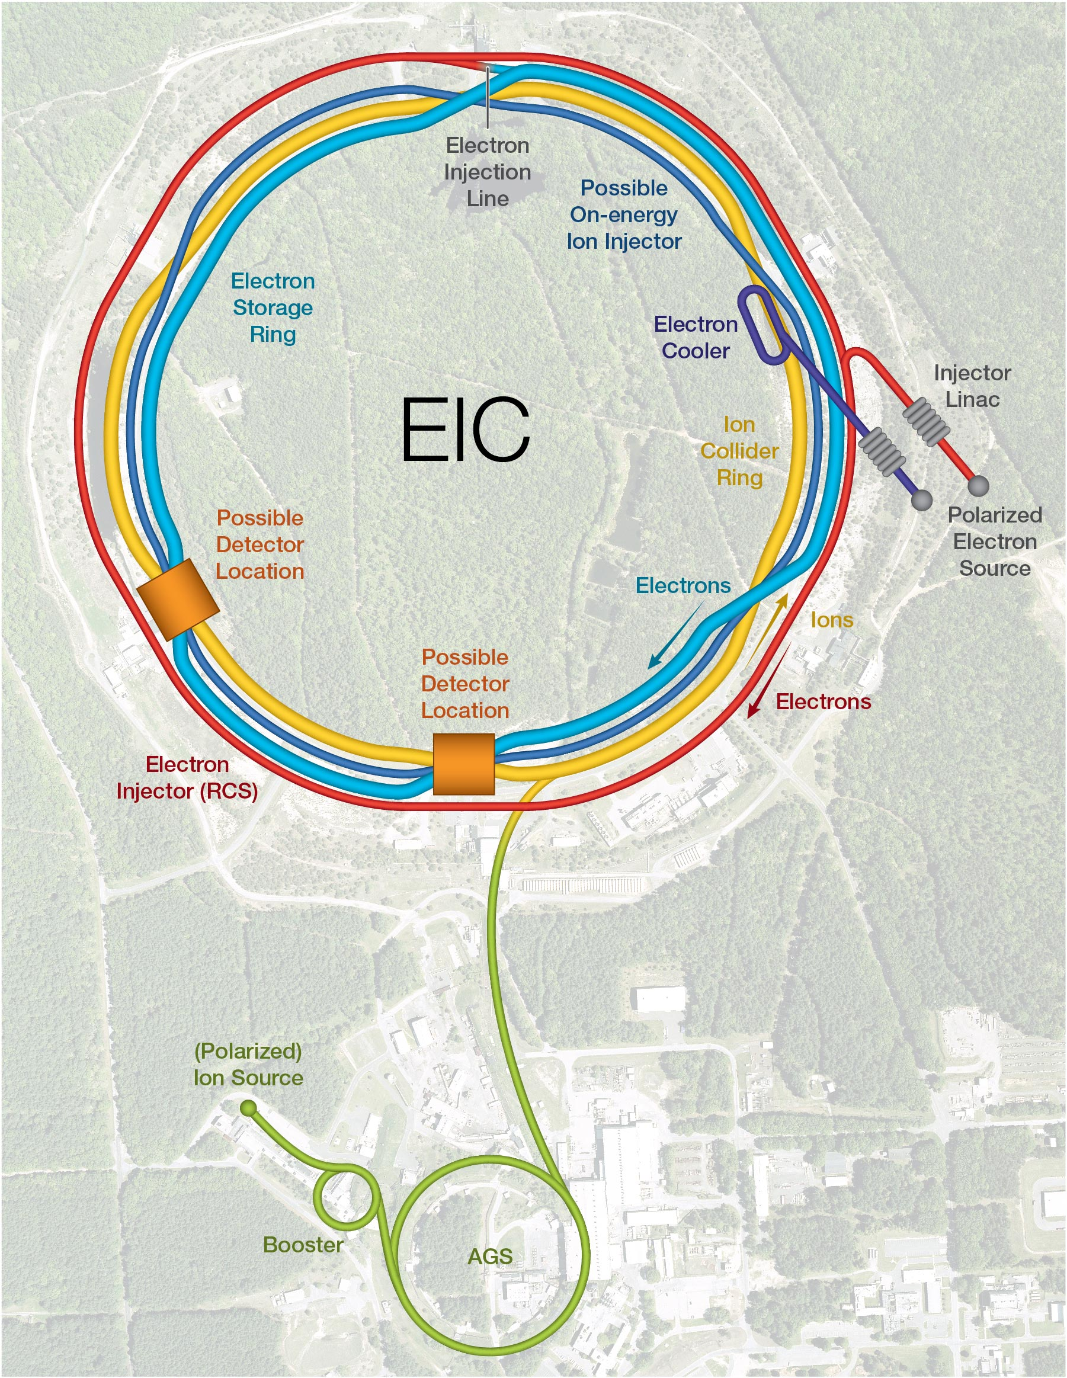
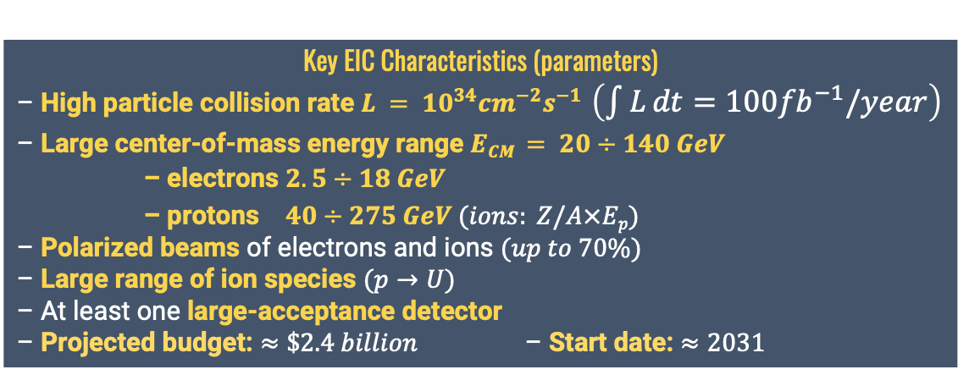
EIC project
Key EIC Characteristics (parameters)
– High particle collision rate $L = {10}^{34}{cm}^{−2}s^{−1}$ $\left(\int{L}dt=100{fb}^{−1}/year\right)$
– Large center-of-mass energy range $ECM = 20÷140 GeV$
– electrons $2.5÷18 GeV$
– protons $40÷275 GeV (ions: Z/A×Ep)$
– Polarized beams of electrons and ions $(up to 70\%)$
– Large range of ion species $(p→U)$
– At least one large-acceptance detector
– Projected budget: $≈\$2.4 billion$ – Start date: $≈2031$
Almost approved concept since begin of 2022

Slide 18
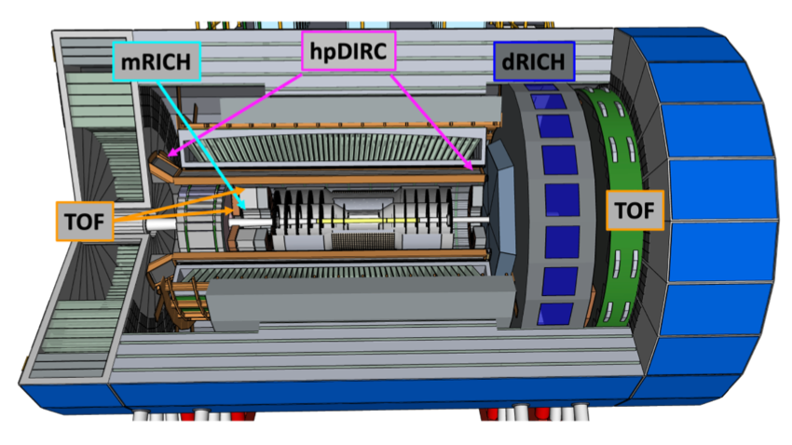
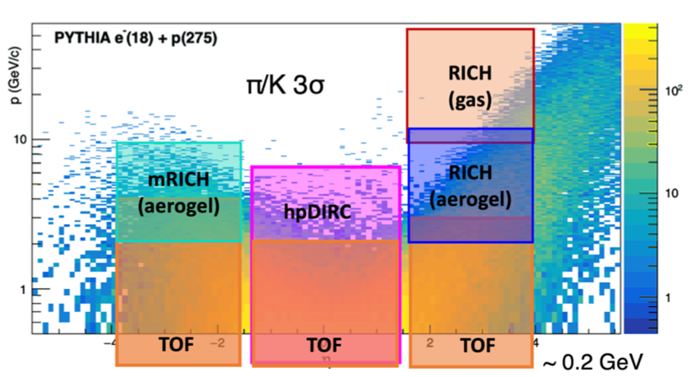
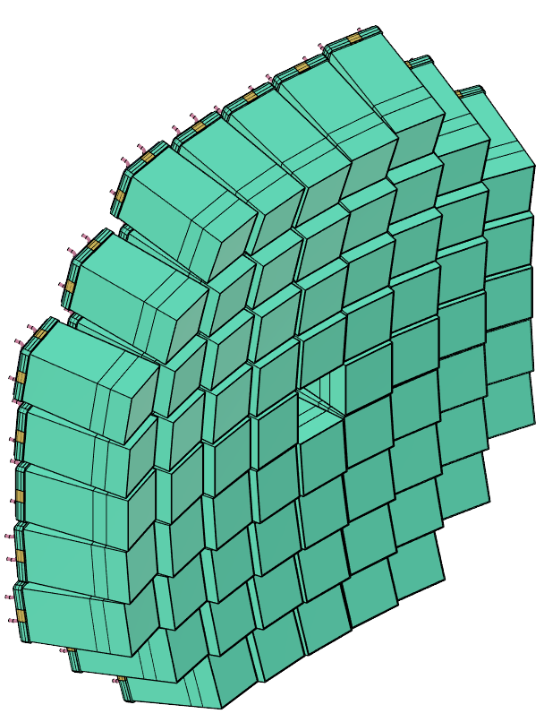
ECCE-PID & mRICH system concepts
ECCE = EIC Comprehensive Chromodynamics Experiment
Physics requirements
  pion, kaon and proton ID
  over a wide range |η| ≤ 3.5
  with better than 3σ separation
  significant pion/electron suppression
Momentum-rapidity coverage
  forward: up to 50 GeV/c
  central: up to 6 GeV/c
  backward: up to 10 GeV/c
Demands different technologies
Cherenkov detectors:
  dRICH = dual RICH (aerogel + gas)
  hpDIRC = high-performance DIRC (synthetic fused silica)
  mRICH = modular RICH (aerogel + Fresnel lens)
68 modular counters oriented to IP:
– aerogel n=1.03 100x100x40 mm³
– acrylic Fresnel lens with focal distance 6”
– position sensitive photon detector HRRPD (MCP-PMT) or SiPM arrays

Slide 19
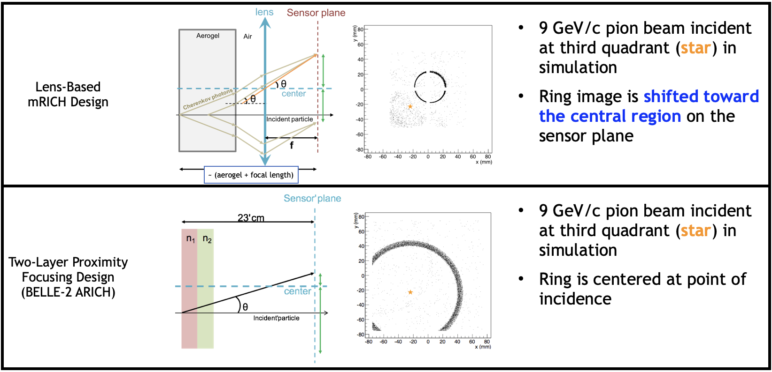
Aerogel RICH with Fresnel lens
Such approach allows us to improve Cherenkov angle resolution and optimize photo detectors area!

Slide 20
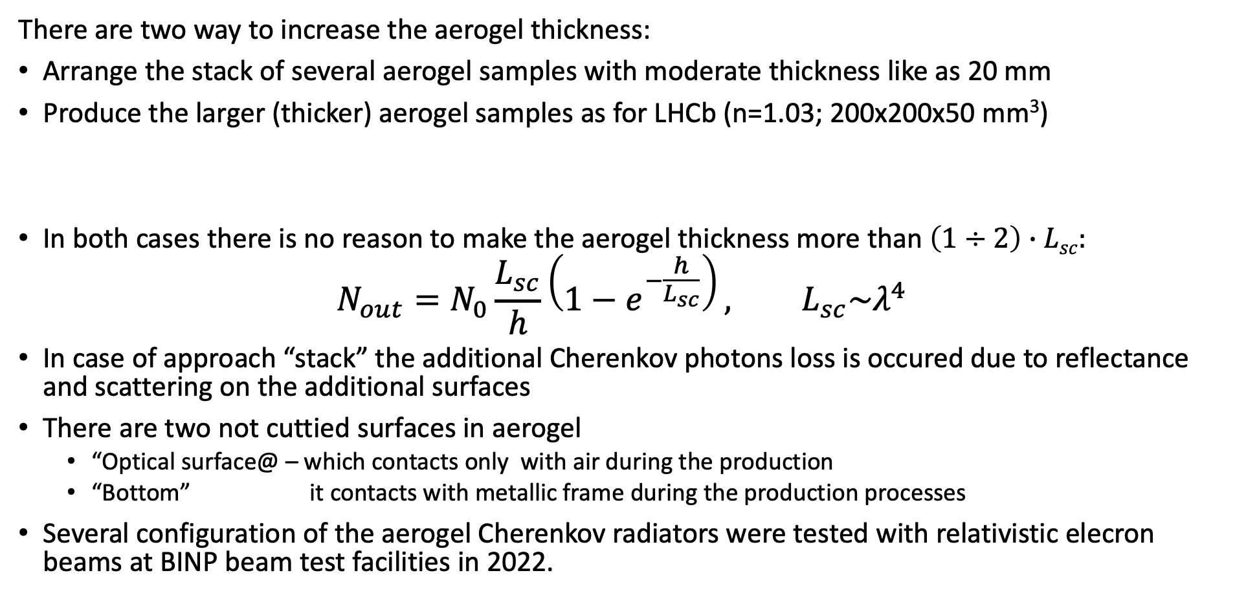
The thick aerogel for mRICH
There are two way to increase the aerogel thickness:
Arrange the stack of several aerogel samples with moderate thickness like as 20 mm
Produce the larger (thicker) aerogel samples as for LHCb (n=1.03; 200x200x50 mm³)
In both cases there is no reason to make the aerogel thickness more than $\left(1÷2\right)∙Lsc:$
$$N_{out}=N_{0}\frac{L_{sc}}{h}\left(1−e^{−\frac{h}{L_{sc}}}\right), L_{sc}\sim λ^{4}$$
In case of approach “stack” the additional Cherenkov photons loss is occured due to reflectance and scattering on the additional surfaces
There are two not cuttied surfaces in aerogel
  “Optical surface@ – which contacts only with air during the production
  “Bottom” it contacts with metallic frame during the production processes
Several configuration of the aerogel Cherenkov radiators were tested with relativistic elecron beams at BINP beam test facilities in 2022.
According to Marco Contalbrigo, so far the only manufacturer that achieved thickness larger than 2cm is in Russian.

Slide 21
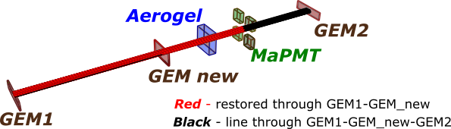
Beam tests schem of aerogel RICH in 2022 at BINP
Three short runs (2 shifts: 12+12 hours) with electrons E=2.5 GeV was done in May, November and December 2022.
Four MaPMTs H12700 (Hamamatsu) with pixel 6x6 mm were placed in such way to register 85% (for May run) and 60% (for Nov and Dec run) of Cherenkov photons per track.
Three GEMs with spatial resolution 𝜎_{𝑋,𝑌}≤100 µm were used at beamline.
  Two before aerogel sample and one behind
Two approaches to create a thick aerogel Cherenkov radiators (single thick tile or stack of two tiles) were compared with help of beam tests and G4 simulation
GEM3
GEM2
GEM1

Slide 22
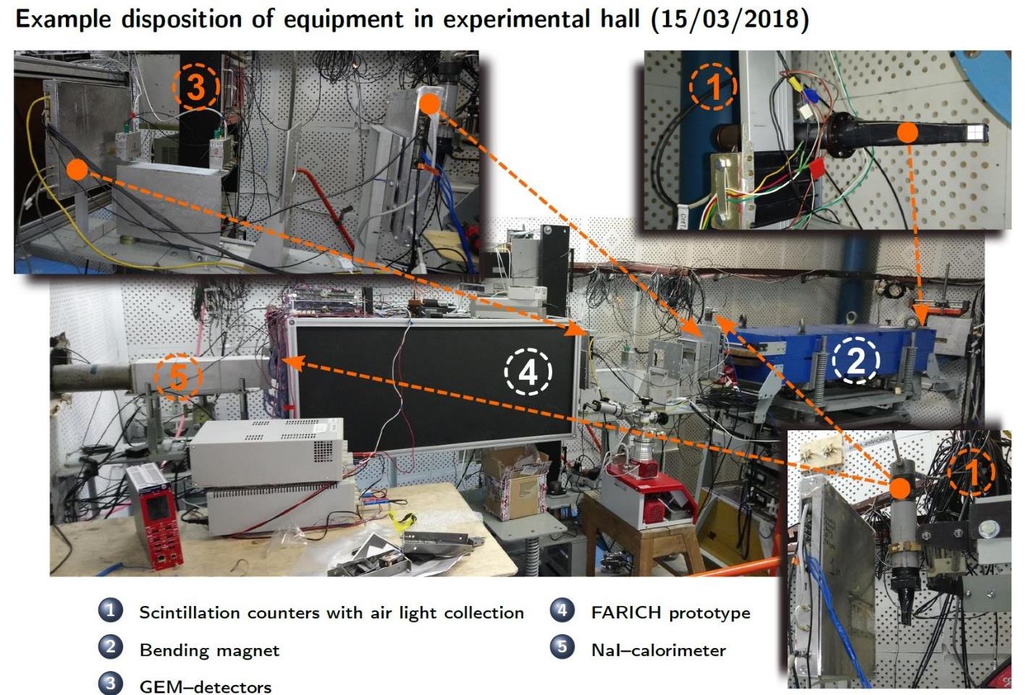
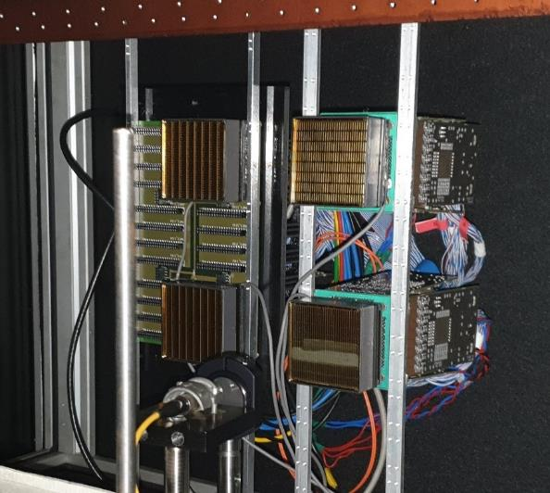
BINP beam test facility
4 MaPMT H12700

Slide 23
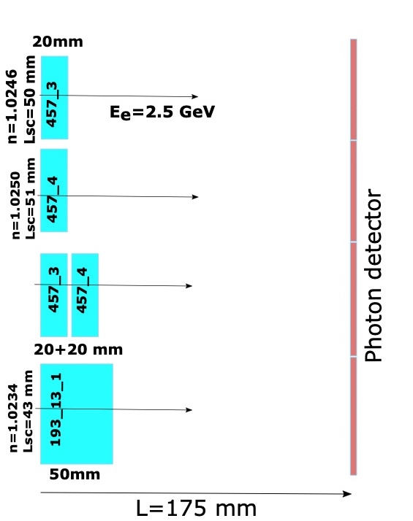
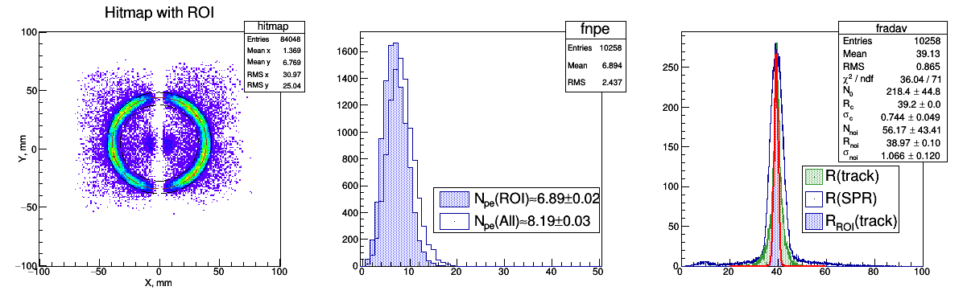
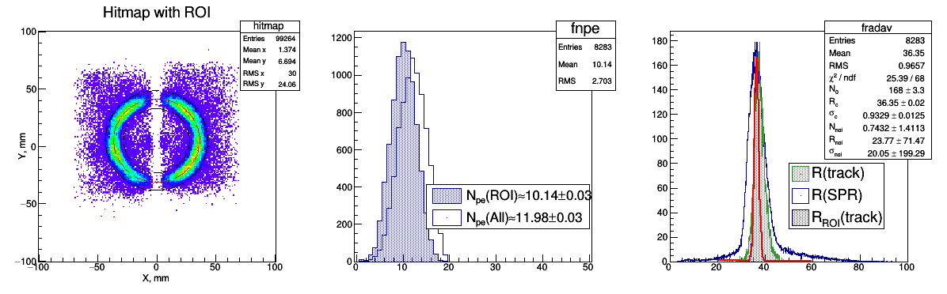
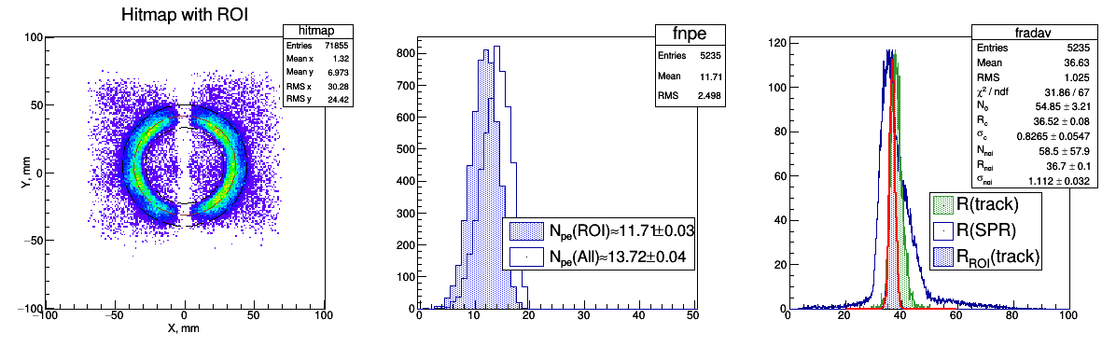
Scheme&Results of beam test (May 2022)

Slide 24
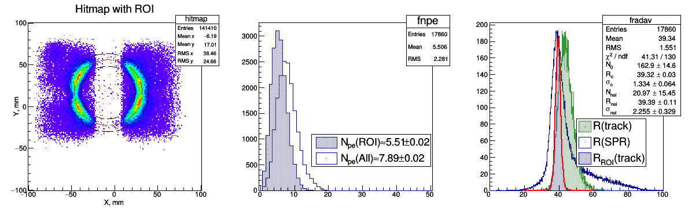
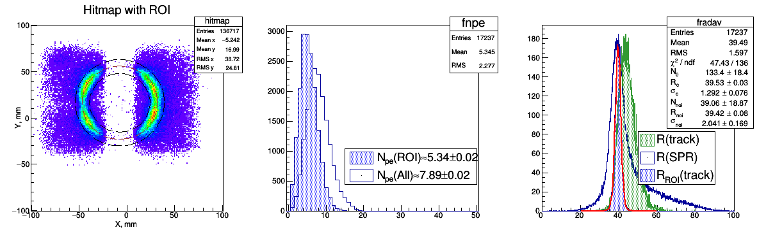
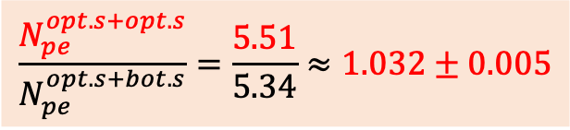
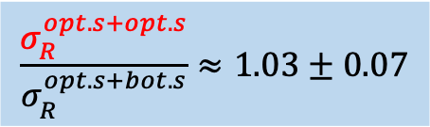


Влияние эффектов поверхности в стопке (457f3+457f4)
“Opt.s”+“Opt.s” $→$ PD
$$\frac{σ_{R}^{opt.s+opt.s}}{σ_{R}^{opt.s+bot.s}}≈1.03±0.07$$
$$\frac{N_{pe}^{opt.s+opt.s}}{N_{pe}^{opt.s+bot.s}}=\frac{5.51}{5.34}≈1.032±0.005$$
“Opt.s”+“Bot.s” $→$PD

Slide 25

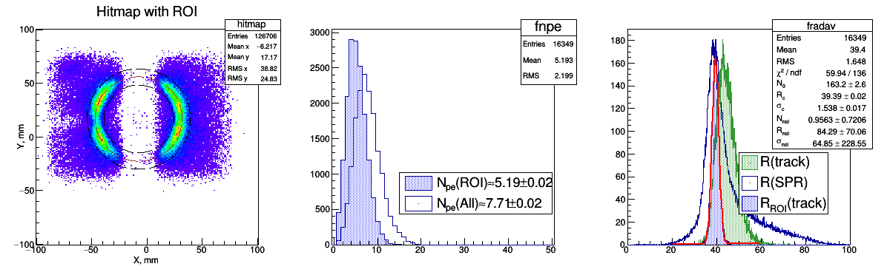
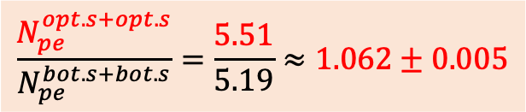

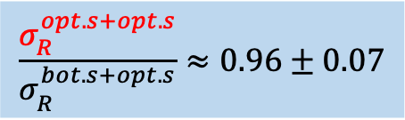

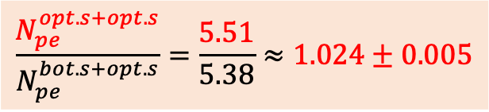
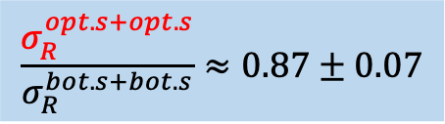
Влияние эффектов поверхности в стопке (457f3+457f4)(2)
“Bott.s”+“Opt.s” $→$ PD
$$\frac{σ_{R}^{opt.s+opt.s}}{σ_{R}^{bot.s+opt.s}}≈0.96±0.07$$
$$\frac{N_{pe}^{opt.s+opt.s}}{N_{pe}^{bot.s+opt.s}}=\frac{5.51}{5.38}≈1.024±0.005$$
$$\frac{σ_{R}^{opt.s+opt.s}}{σ_{R}^{bot.s+bot.s}}≈0.87±0.07$$
“Bot.s”+“Bot.s” $→$PD
$$\frac{N_{pe}^{opt.s+opt.s}}{N_{pe}^{bot.s+bot.s}}=\frac{5.51}{5.19}≈1.062±0.005$$
Due to scattering effects on the bottom aerogel surfaces the N_{pe} loss is about 3–4% for single layer samples and about 6% for stack of two samples. While the resoultion degradation becomes sensable (13%) only in case of stack of two aerogel samples.

Slide 26
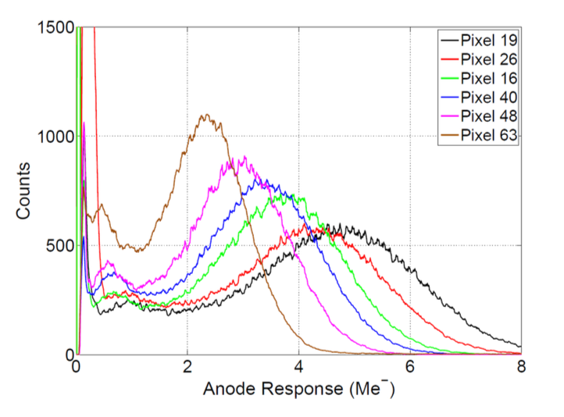
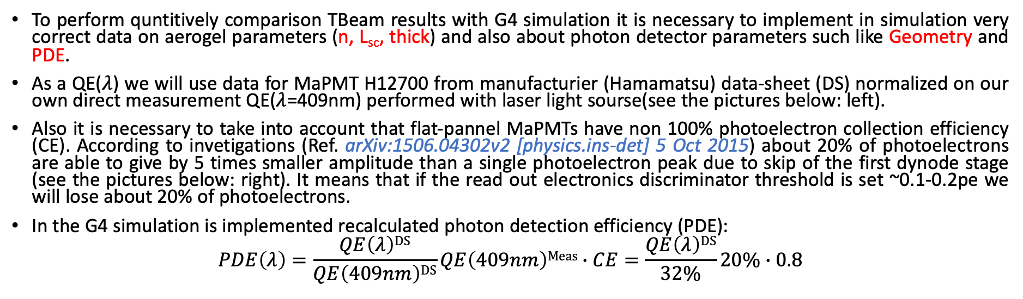
TBeam simulation with G4: input data.
To perform quntitively comparison TBeam results with G4 simulation it is necessary to implement in simulation very correct data on aerogel parameters (n, L_{sc}, thick) and also about photon detector parameters such like Geometry and PDE.
As a QE($λ$) we will use data for MaPMT H12700 from manufacturier (Hamamatsu) data-sheet (DS) normalized on our own direct measurement QE($λ$=409nm) performed with laser light sourse(see the pictures below: left).
Also it is necessary to take into account that flat-pannel MaPMTs have non 100% photoelectron collection efficiency (CE). According to invetigations (Ref. arXiv:1506.04302v2 [physics.ins-det] 5 Oct 2015) about 20% of photoelectrons are able to give by 5 times smaller amplitude than a single photoelectron peak due to skip of the first dynode stage (see the pictures below: right). It means that if the read out electronics discriminator threshold is set ~0.1-0.2pe we will lose about 20% of photoelectrons.
In the G4 simulation is implemented recalculated photon detection efficiency (PDE):
$$PDE\left(λ\right)=\frac{QE\left(λ\right)DS}{QE\left(409nm\right)DS}QE\left(409nm\right)Meas∙CE=\frac{QE\left(λ\right)DS}{32\%}20\%∙0.8$$

Slide 27

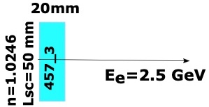
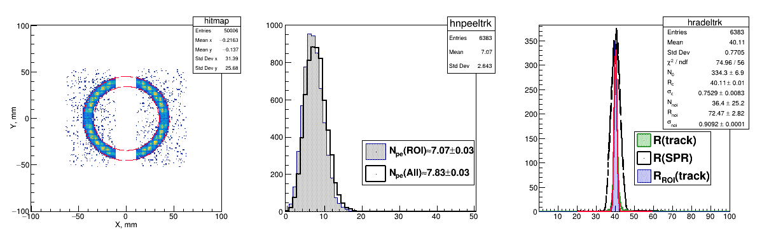
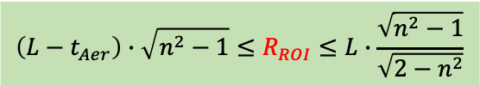
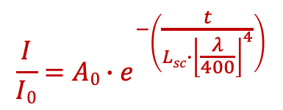
Tbeam and G4sim comparison (single – thin 457-3)
Experiment
$${\left(L−t_{Aer}\right)∙\sqrt{n^{2}−1}≤R}_{ROI}≤L∙\frac{\sqrt{n^{2}−1}}{\sqrt{{2−n}^{2}}}$$
19.0 mm
n=1.027
A₀=0.78
L_{sc} = 50 mm
(2)
457_3
Simulation
$$\frac{I}{I0}=A0∙e^{−\left(\frac{t}{Lsc∙{\left\lfloor \frac{λ}{400}\right\rfloor }^{4}}\right)}$$

Slide 28
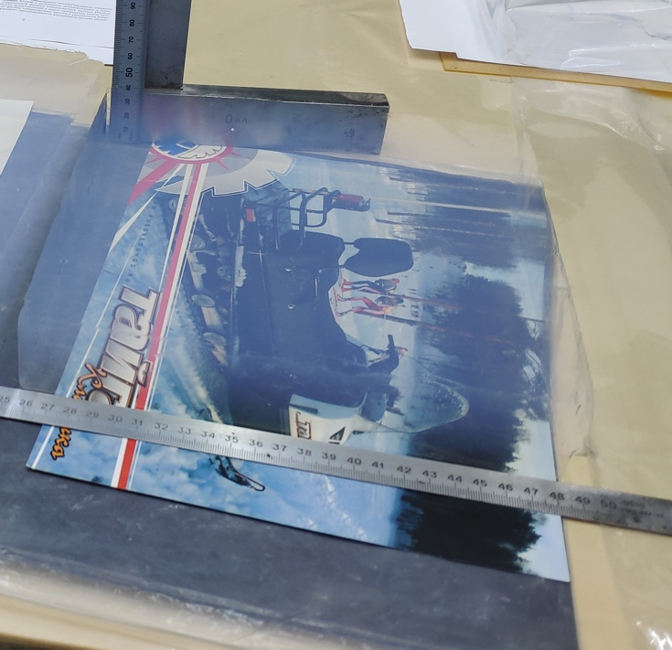
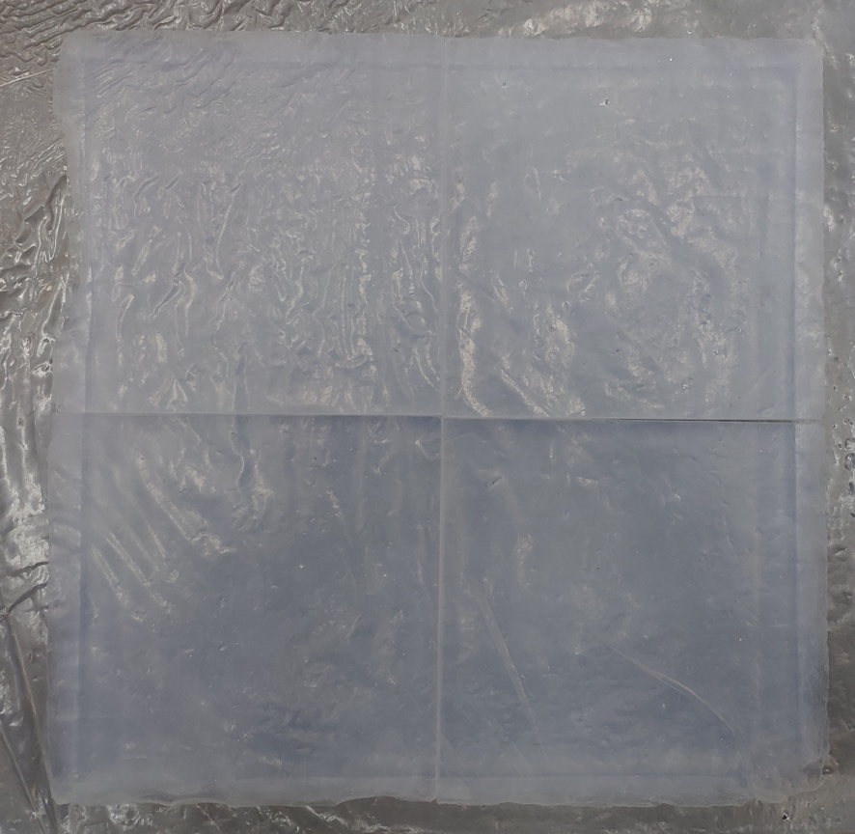
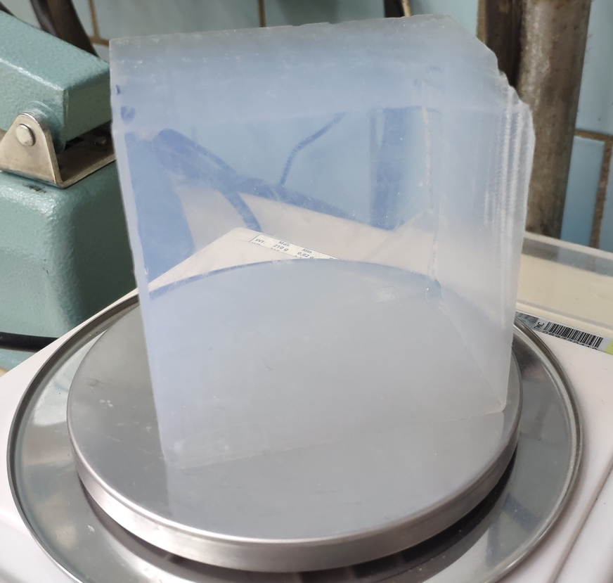
Scheme&Results of beam test (Dec 2022)
The new aerogel samples were produced in 2022 to be tested in mRICH prototype with mixed hadron beams in 2023-2024.
    Refractive index of all tiles n = 1.028±0.001;
    L_{sc}(400nm) for all blocks ≥43mm;
    7 aerogel tiles 30 mm 100x100 mm
    4 aerogel tiles 40 mm 100x100 mm
    1 aerogel tile 50 mm 80x80 mm;
The general idea of the experiment was to investigate the quality of new aerogels and estimate the impact from aerogel itself to overal mRICH prototype resolution.
PD and beamline configurations were the same as in Novembe 2022. It allow us to perform direct comparison of results from these two beam test campaigns (Nov and Dec 2022).
op460f11
50
80
230
230
80
115
40
n=1.027
115

Slide 29
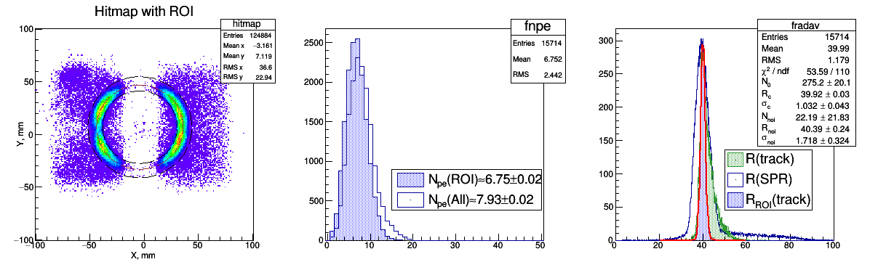
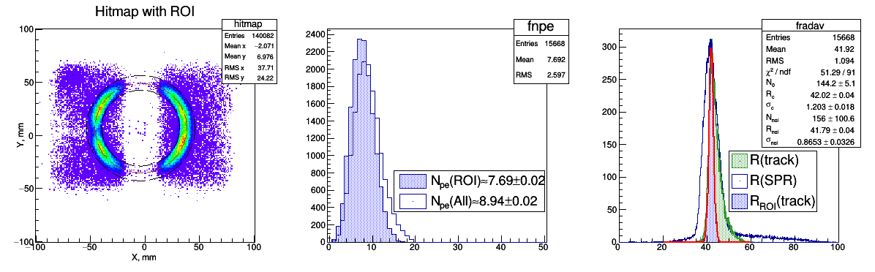
Aerogel with 30 mm thickness (460f4)
460f4_4
T(5 hours)=470˚C
n=1.027
L_{sc}(400nm)=47.0±0.7 mm
460f4_3
T(5 hours)=600˚C
n=1.029
L_{sc}(400nm)=41.8±0.7 mm

Slide 30


Aerogel with 40 mm thickness (460f11)
460f11_21
T(5 hours)=470˚C
n=1.028
L_{sc}(400nm)=48.2±0.7 mm
460f11_22
T(5 hours)=600˚C
n=1.029
L_{sc}(400nm)=42.7±0.7 mm

Slide 31


Aerogel with 50 mm thickness (460f15)
460f15_1
T(5 hours)=470˚C
n=1.027
L_{sc}(400nm)=43.7±0.6 mm
460f15_3
T(5 hours)=600˚C
n=1.029
L_{sc}(400nm)=41.7±0.6 mm

Slide 32



Dependence of N_{pe} and $σ_{R}$ on aerogel thickness
N_{pe} dependes on the aerogel thickness as expected and limitted by the Releigh light scattering law.
Some ssytematical increase of N_{pe} (~13÷15%) are observed in new thick aerogels after increase of backing temperature (470˚C –> 600˚C). This effect could not be quantatively explained by increase of refractive indexes (1.027 –> 1.029) and it is contra to N_{pe} decrease (~5÷6%) expected due to Releigh light scattering decrease $(Lsc\left(400nm,1.027\right)≈47mm →Lsc\left(400nm,1.029\right)≈41mm)$
$σ_{R}\sim \sqrt{thickness}$ (as expected), while for several aerogel samples some deviations $σ_{R}$ from the dependence are observed. The reason of this effect could be in some impurites inside the aerogel which are able to give additional small angle forward scattering.

Slide 33









Cherenkov angle single photon resolution (SPR)
17.6 mm
457f4
19.0 mm
457f3
30.0 mm
460f4_3
19.0+17.6 mm
457f3+457f4
40. mm
460f11_22
50. mm
460f15_3
 | 457f4 | 457f3 | 460f4_3 | 457f3_f4 | 460f11_22 | 460f15_3
t/L, mm | 17.6/185 | 19.0/175 | 30.0/185 | 36.6/185 | 40.0/185 | 50.0/185
$σ_{θ_{C}}^{SPR}$, mrad | 14.46±0.06 | 15.92±0.06 | 16.96±0.05 | 20.8±0.1 | 24.0±0.1 | 26.7±0.1
N_{pe}^{* – 60% of the ring} | 4.01±0.01 | 4.16±0.01 | 7.69±0.02 | 5.51±0.02 | 8.22±0.03 | 8.05±0.02
$σ_{θ_{C}}^{trk}=\frac{σ_{θ_{C}}^{SPR}}{\sqrt{N_{pe}}}$,mrad | 7.2 | 7.8 | 6.1 | 8.9 | 8.4 | 9.4
$σ_{R_{C}}^{ROI}$, mm | 1.11±0.03 | 1.08±0.04 | 1.20±0.02 | 1.33±0.06 | 1.35±0.04 | 1.37±0.07
$$σ_{θ_{C}}^{R}≈\frac{1}{n^{2}}\frac{σ_{R_{C}}}{L−t/2}$$ | 5.9 | 6.15 | 6.65 | 7.5 | 7.7 | 8.1
Photon detector
t
$$R_{C}$$
Cherenkov light
L=175 mm
$θ_{C}^{R}=\arctan\left(\frac{R_{C}}{L−t/2}\right)$,
$σ_{θ_{C}}^{R}=\cos^{2}{θ_{C}}\left(\frac{1}{L−t/2}\right)∙\sqrt{{σ_{R_{C}}}^{2}+\tan^{2}{θ_{C}∙\left(σ_{L}^{2}+σ_{t}^{2}\right)}}≈\frac{1}{n^{2}}\frac{σ_{R_{C}}}{L−t/2}$,
How much effect from Fresnel lens is expected?!

Slide 34
FARICH – Focusing Aerogel RICH

Slide 35





FARICH option for SCTF
The first 4-layer monolithic sample
n=1.030 6.0mm
n=1.027 6.3mm
n=1.024 6.7mm
n=1.022 7.0mm
Increase N_{pe} due thickness increase without σ_{Θc} degradation
T.Iijima et al., NIM A548 (2005) 383
A.Yu.Barnyakov et al., NIM A553 (2005) 70
The Belle II (ARICH) is the first application of the method
The capability of µ/π-separation at the level of ≥3σ for P=1 GeV/c was shown at CERN beam test in 2012
Proximity focusing RICH
4-layer focusing aerogel
  n_{max} = 1.05 (1.07?), total thickness 35 mm
  $S_{aer}=15 m^{2}$
21 m² – total area of photon detectors
  • SiPMs – barrel part (16 m²)
  • MCP-PMT – endcap parts (4 m²)
~10⁶ pixels 3х3 mm² with pitch 4 mm
A.Yu. Barnyakov, et al., NIM A 732 (2013) 352
Notes:
Идея ФАРИЧ появилась в 2004 г.
Точность измерения черенковского угла связана с точностью измерения скорости, а значит с качеством разделения частиц.

Slide 36





The largest 4-layers focusing aerogel samples
MaPMT H12700 (Hamamatsu)
with mask 3х3 mm²
2 aerogel pcs
230x230x35 mm
GEM
$$e^{−}$$

Slide 37


Beam test results
Pixel 6x6 mm
Geom.Eff. ~ 80%
Pixel 3x3 mm
Geom.Eff. ~ 20%

Slide 38




Cherenkov angle Single PhotoElectron (SPE) resolution
Belle II
PTEP 2016, 033H01
Measured
Simulation
Аэрогель: 20+20 mm (Tchiba Univ.)
n(400nm): 1.045 +1.055
Pixel: 5x5 mm
4-layers (Novosibirsk) –>
1.039 ÷ 1.046
6x6 mm
–
–
3x3 mm
4-layers (ideal profile)
1.041 ÷ 1.050
3x3 mm

Slide 39
Position-sensitive photon detectors

Slide 40






FEE based on FPGA-TDC
Amplifier board
27×27 mm² size
14-layer PCB
30x gain, 64 channels
couples to KETEK 8×8 SiPM array
TDC board
64 channels
2 TDC + 4 threshold FPGAs
10ps precision
• Each module readouts 6 arrays 8x8 pixels and equipped with optical transceiver.
• Thickness of 5-layer design is less than 5 cm.
Simulated single photon pulse shapes from amplifier for different input resistance. ~ 22mV amplitude can be achieved.
DC-DC convertor board
goes behind the backplane
51×84 mm² size
provides power to SiPMs, amplifiers, FPGA
uses air inductive coils to operate in the detector magnetic field
power, trigger & clock connectors

Slide 41
The first tests of FaRICH-Auslese-System
FPGA-TDC (FaRICH-Auslese-System) to readout 2304 SiPMs developed and produced in GSI.
ToT
Time, ns
Time, ns
The tests performed bu Mechael Traxler, Matthias Hoek and Merlin Böhm at HIM-Institute in Mainz.
Everything works as expected: ToT(Time) is as expected for single photon distribution.
Single photon detection time resolution without any corrections and proper TDC calibration is about 380ps (it is good enough value for FARICH), while intrinsic resolution of TDC is about 8÷12 ps.
A lot of dark counts are in the data (every 3rd hit is noise). Thermostabilization or cooling is needed for future tests.

Slide 42




Позиционно-чувствительные ФЭУ с МКП
Hamamtsu R10754-016-M16(N)
59 мм
4х4 пикселя; 5х5 мм
Цена: 900 тыс. Йен
Planacon XP85112
8х8 пикселей; 6х6 мм
Цена: 15k$
HRPPD (Income)
10x10 см; пиксел 2.5x2.5 мм
Цена: ~20k$
NNVT (Китай)
Цена: 18кЕвро
Коллектор ФЭУ с МКП
Концепция Экран ФЭП
(лето 2022г.)
Доступность: ???
Цена: ???

Slide 43






Round vs Square MCP-PMT for the RICH
516 PMTs $∎$58х58 mm (PC $∎$50x50 мм) –>
$$Eff=\frac{516∙5×5}{S_{endcap}}=\frac{12900 {cm}^{2}}{18850{ cm}^{2}}≈0.68$$
16х16=256 pixels 2.9х2.9 mm
$$Eff=\frac{516∙256∙0.29×0.29}{S_{endcap}}=\frac{11109 {cm}^{2}}{18850{ cm}^{2}}≈0.59$$
594 PMTs Ø58 mm (PC Ø50 mm) –>
$$Eff=\frac{594∙π∙{2.5}^{2}}{S_{endcap}}=\frac{12370 {cm}^{2}}{18850{ cm}^{2}}≈0.65$$
216 pixels 2.9х2.9 мм
$$Eff=\frac{594∙216∙0.29×0.29}{S_{endcap}}=\frac{11444 {cm}^{2}}{18850{ cm}^{2}}≈0.57$$

Slide 44




Round vs Square MCP-PMT for the RICH (2)
To evaluate expected performance we can use recent FARICH beam test data:
$N_{pe}^{H12700}≈16$
${CE}^{H12700}≈0.8$ – photoelectron collection efficiency (${CE}^{MCP}≈0.6$)
${GE}^{TB}≈0.8$ – Geometrical Efficiency of Test Beam setup (${GE}^{exp}$is determined by fill factor of photon detectors for the experimental setup)
$$N_{pe}^{expect}=\frac{N_{pe}^{H12700}{∙CE}^{MCP}{∙GE}^{exp}}{{CE}^{H12700}{∙GE}^{TB}}$$
Square shape MCP-PMT
${GE}^{exp}≈0.59$
$N_{pe}^{expect}=\frac{16∙0.6∙0.59}{0.8∙0.8}≈8.8pe$ (for $β=1$)
$σ_{tr}^{θ}=\frac{σ_{SPE}^{θ}}{\sqrt{N_{pe}}}=\frac{7÷8 mrad}{\sqrt{8.8}}=2.3÷2.7 mrad$
Round shape MCP-PMT
${GE}^{exp}≈0.57$
$N_{pe}^{expect}=\frac{16∙0.6∙0.57}{0.8∙0.8}≈8.5pe$ (for $β=1$)
$σ_{tr}^{θ}=\frac{σ_{SPE}^{θ}}{\sqrt{N_{pe}}}=\frac{7÷8 mrad}{\sqrt{8.5}}=2.4÷2.7 mrad$
µ/π @ 1 GeV/c: $\frac{θ_{C}^{μ}−θ_{C}^{π}}{σ_{tr}^{θ}}=\frac{292−278}{2.5}=5.6σ$
π/K @ 6 GeV/c: $\frac{θ_{C}^{π}−θ_{C}^{K}}{σ_{tr}^{θ}}=\frac{309−299}{2.5}=3.9σ$

Slide 45
Addendum

Slide 46

HRPPD
Hihg Rate Picosecond Photon Detector

Slide 47


Aerogel degradation due to water adsorption(1)
Aerogel internal surface is 10⁶ times greater than external. Adsorption of water is very fast process (1-10 hours).
Degradation of the light absorption length is very slow process (1-2 months) after water absorption.
The time and the level of the degradation are depend on the impurities in aerogel from raw materials and production procedure (Fe, Mn, Cr, etc.).
Concentration of metals in aerogel, ppb
Fe | Cu | Mn | Cr | Ni
500 | 56 | 7 | 26

Slide 48

Aerogel degradation due to water adsorption(2)
The refractive index (n-1) and light scattering length depends on amount of adsorbed water and are changed less than 10% after water adsorption of 2-4% of aerogel mass.
The light absorption length (L_{abs}) in different aerogel samples after baking is the same, but after water impregnation could be very different
It is possible to make aerogel selection after water impregnation
One atom Fe is able to attract 6 molecules of water
To achieve maximum degradation of L_{abs} it is enough to adsorb 1ppm of water.
(NIM A598 (2009) 166-168)

