Slide 1
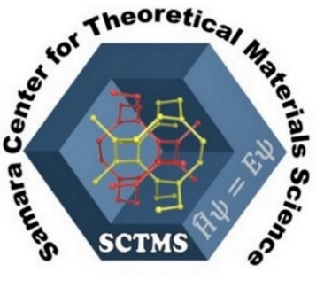
Discovery of new materials using theoretical materials science
Kabanov Artem
Samara University, 27 October 2023

Slide 2
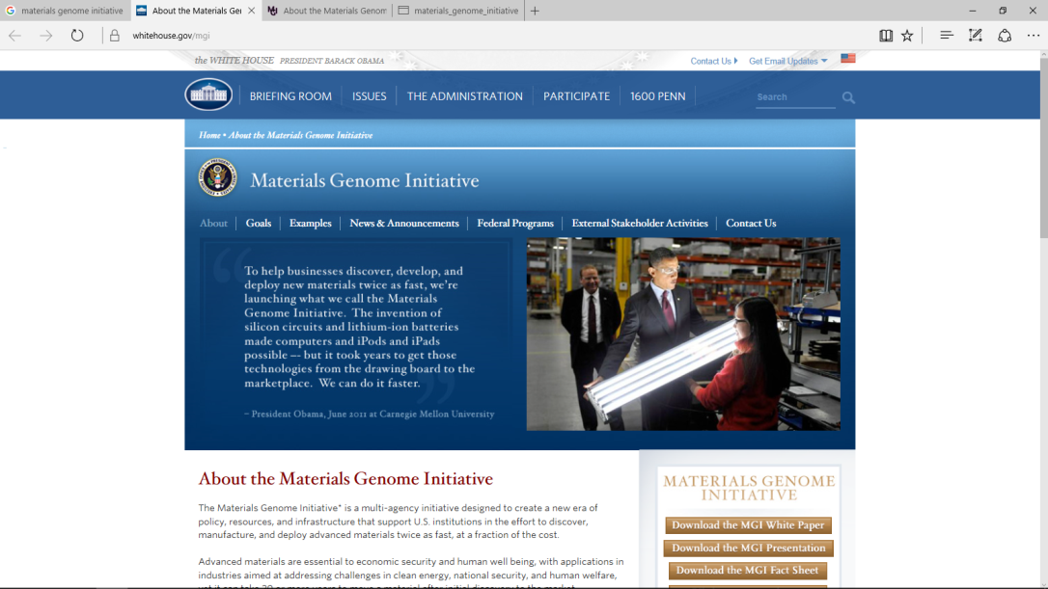
Why theoretical materials science?
Incorporating new materials into applications takes 10-20 years.
We should decrease this time down to 2-3 years.
Solution is in developing algorithms and software for modeling materials & data exchange systems
Materials Genome Initiative (2011)
Modeling
2

Slide 3
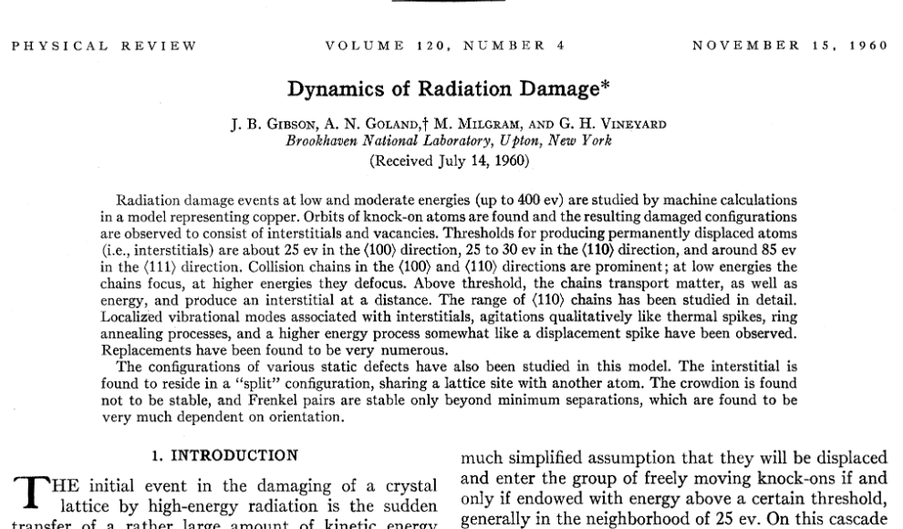

Slide 4
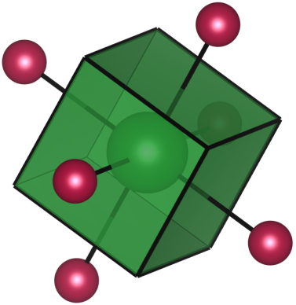
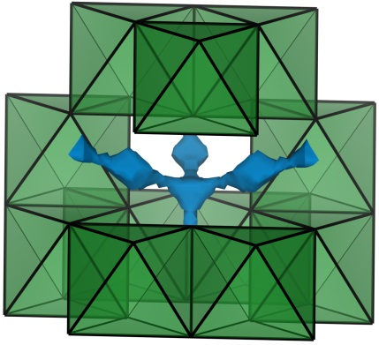
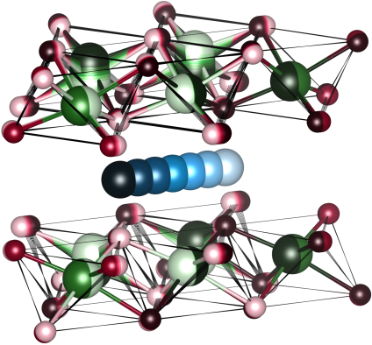
Methods of theoretical materials science:
Voronoi Partitioning
Bond-Valence Energy-Landscape
Density Functional Theory Molecular Dynamics
∼ Seconds
∼Minutes
∼ Days
Empirical
Ab initio
Geometry-based
Energy-based
4

Slide 5
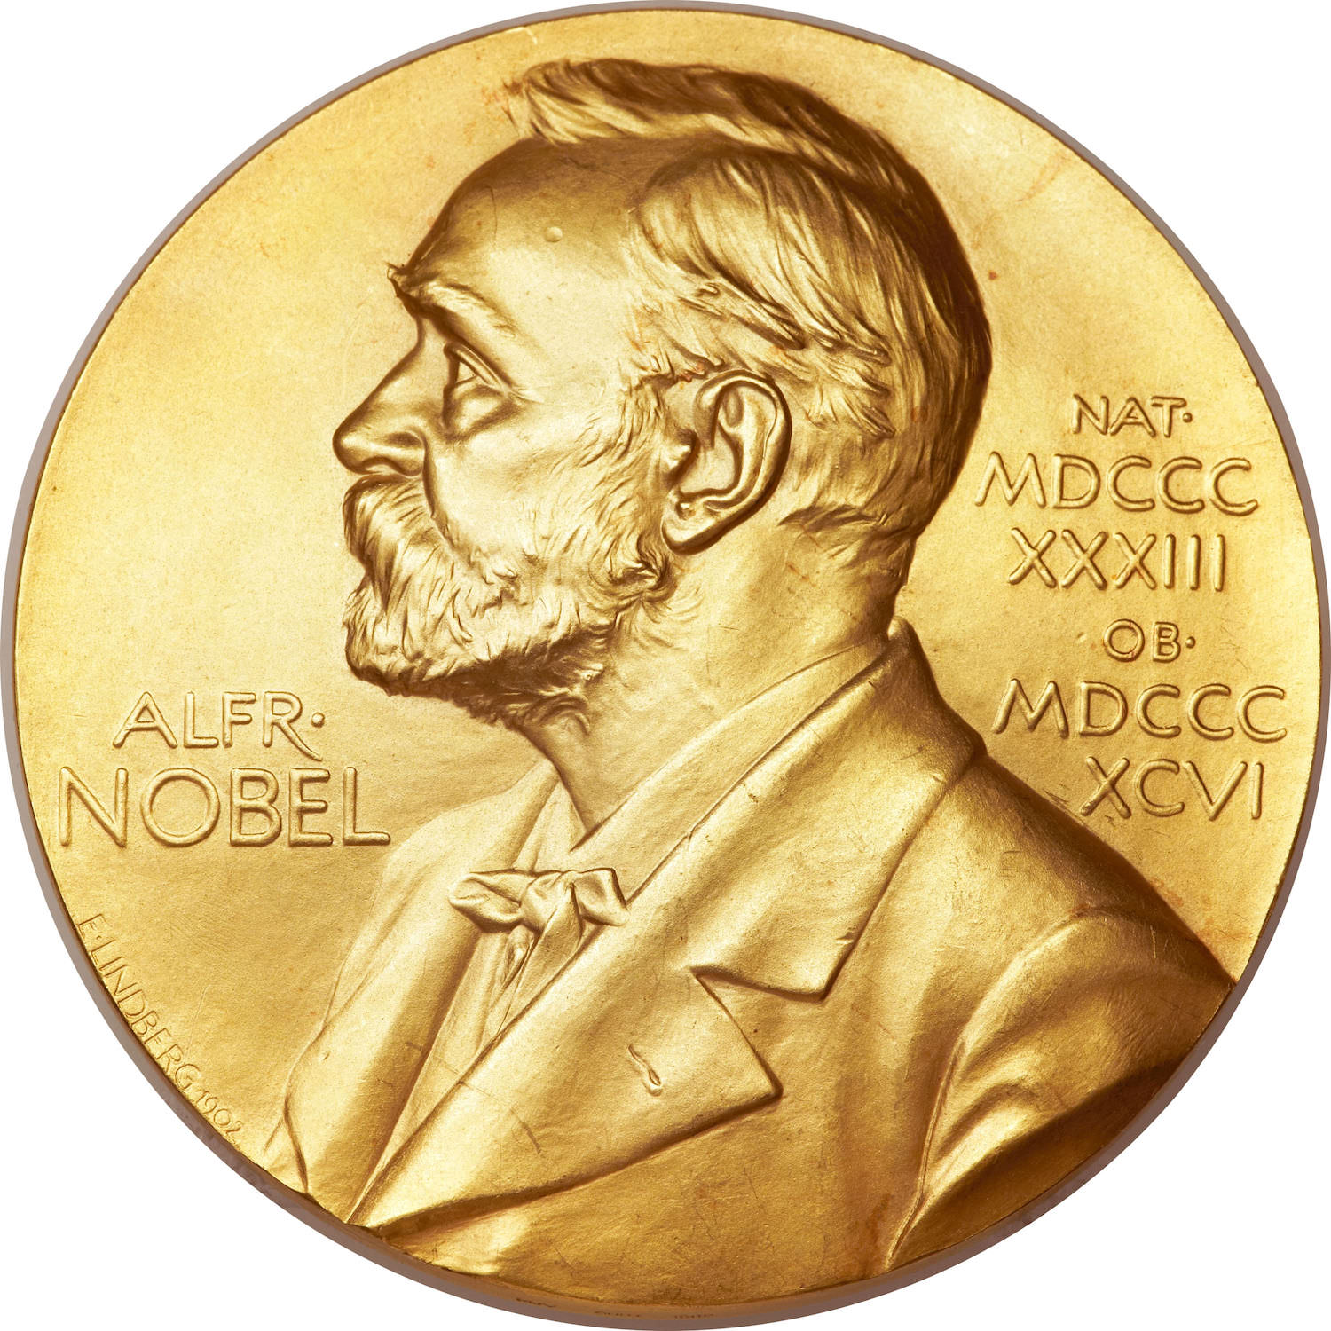
I. Density Functional Theory (DFT)
1964-1965 гг.
1998
W.Kohn
J. Pople

Slide 6
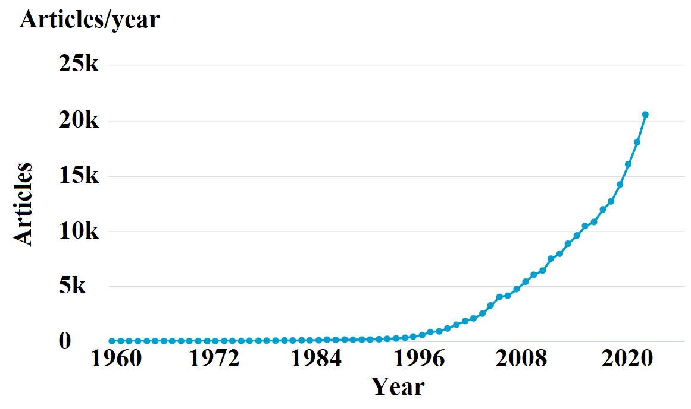

Slide 7
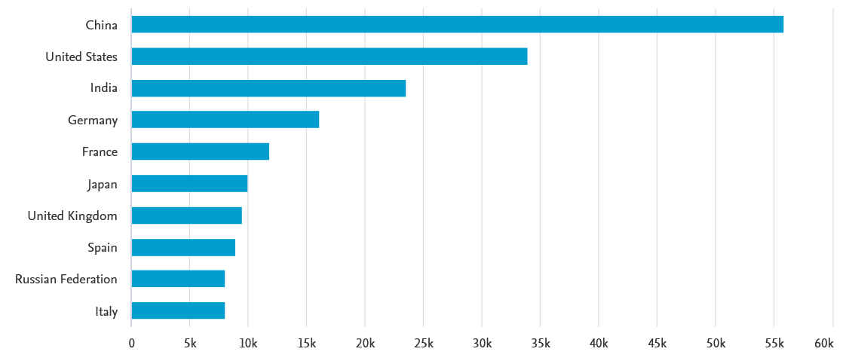

Slide 8
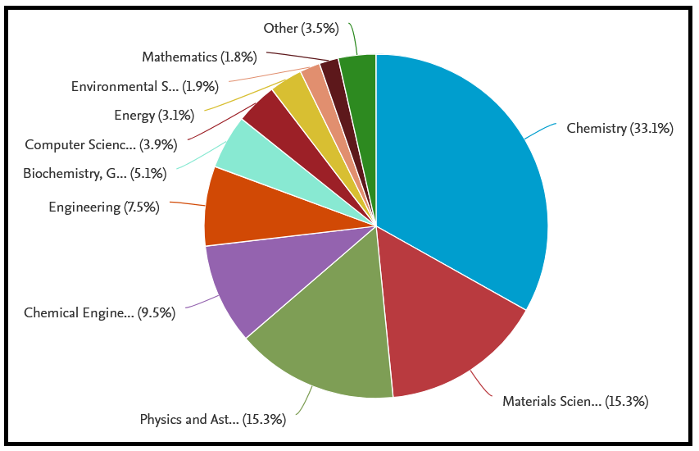

Slide 9
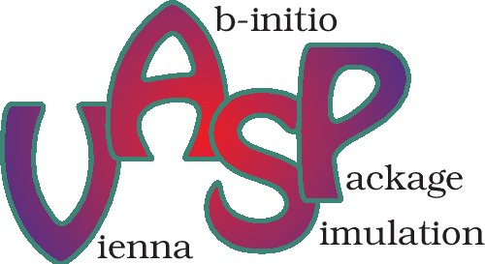
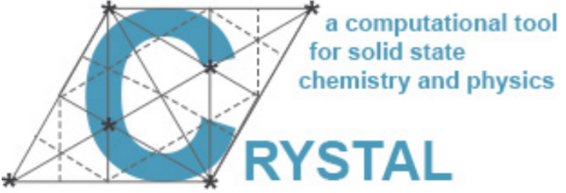
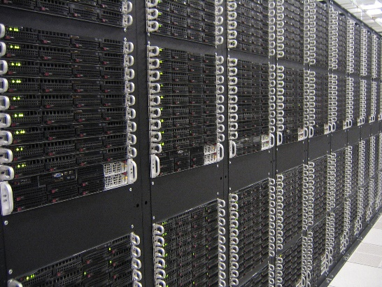
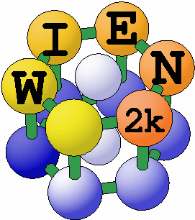
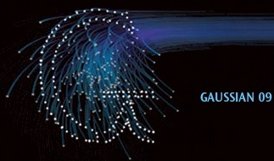
Some DFT codes

Slide 10
DFT can compute:
Elastic matrix С_{ij}
Young modulus E(T)
Shear modulus G(T)
Bulk modulus K(T)
Poisson's ratio 
Hardness H
Fragility/elasticity - G/K
Oxidation processes
Heat capacity Сp, Cv
Thermal expansion coefficient α(P,T)
Electronic band structure
Magnetic susceptibility
Dielectric constant tensor
Optical properties: refractive index, absorption coefficient, reflectivity
Phonon spectra
IR and Raman spectra
etc.

Slide 11
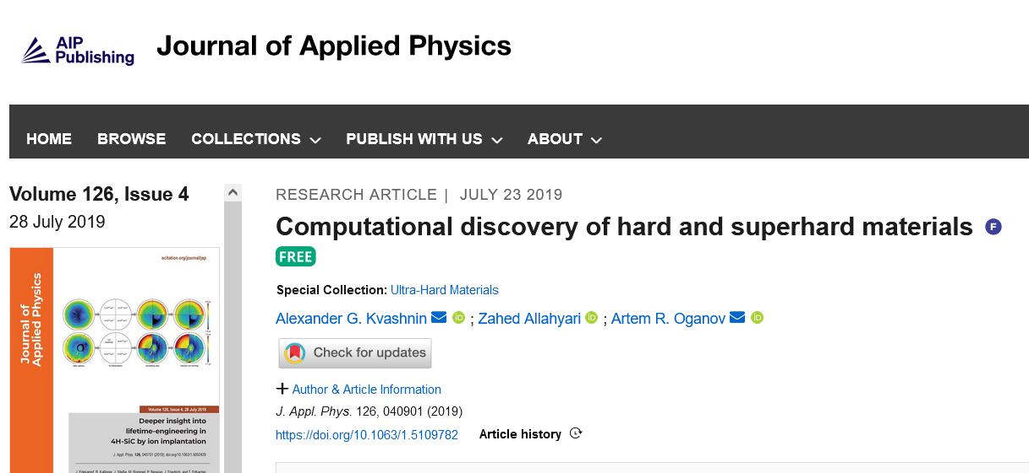
DFT can compute:
Elastic matrix С_{ij}
Young modulus E(T)
Shear modulus G(T)
Bulk modulus K(T)
Poisson's ratio 
Hardness H
Fragility/elasticity - G/K
Oxidation processes
Heat capacity Сp, Cv
Thermal expansion coefficient α(P,T)
Electronic band structure
Magnetic susceptibility
Dielectric constant tensor
Optical properties: refractive index, absorption coefficient, reflectivity
Phonon spectra
IR and Raman spectra
etc.

Slide 12
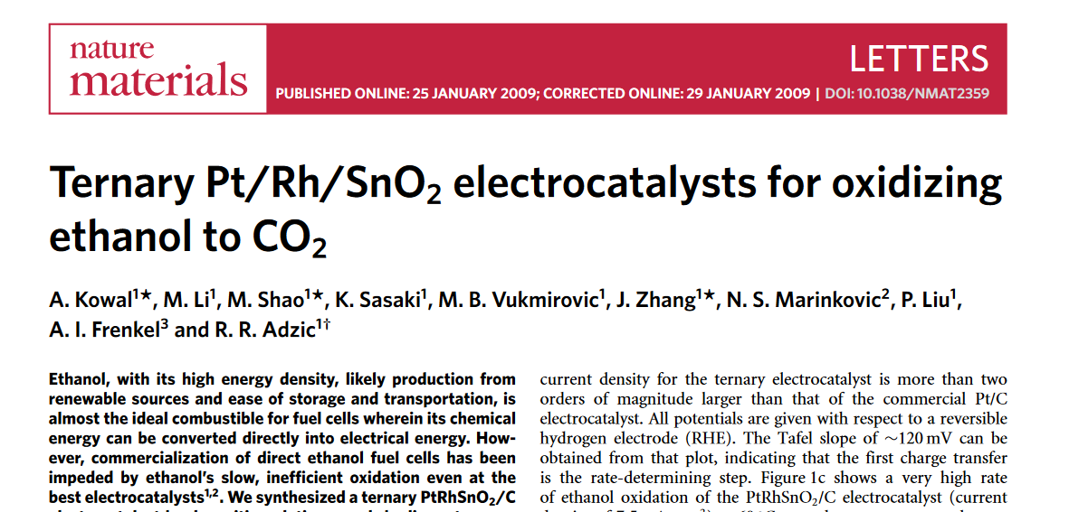
DFT can compute:
Elastic matrix С_{ij}
Young modulus E(T)
Shear modulus G(T)
Bulk modulus K(T)
Poisson's ratio 
Hardness H
Fragility/elasticity - G/K
Oxidation processes
Heat capacity Сp, Cv
Thermal expansion coefficient α(P,T)
Electronic band structure
Magnetic susceptibility
Dielectric constant tensor
Optical properties: refractive index, absorption coefficient, reflectivity
Phonon spectra
IR and Raman spectra
etc.

Slide 13
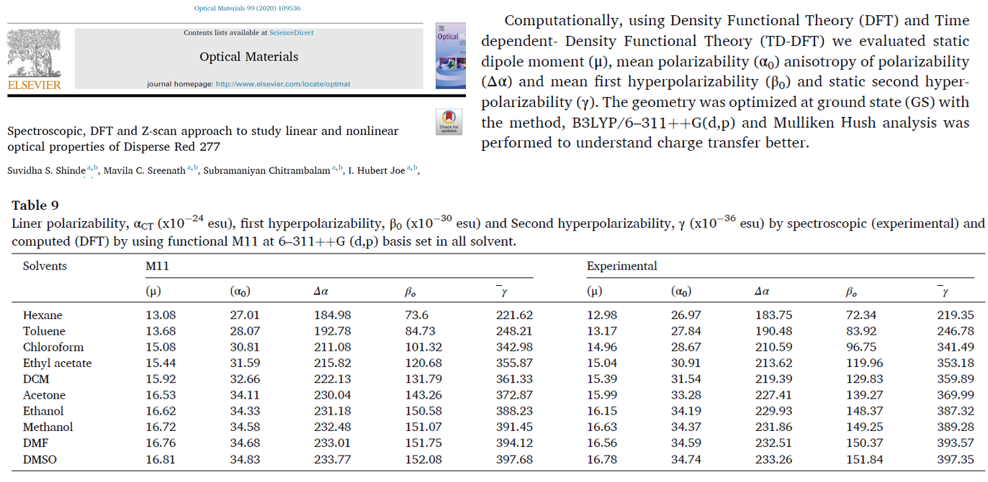
DFT can compute:
Elastic matrix С_{ij}
Young modulus E(T)
Shear modulus G(T)
Bulk modulus K(T)
Poisson's ratio 
Hardness H
Fragility/elasticity - G/K
Oxidation processes
Heat capacity Сp, Cv
Thermal expansion coefficient α(P,T)
Electronic band structure
Magnetic susceptibility
Dielectric constant tensor
Optical properties: refractive index, absorption coefficient, reflectivity
Phonon spectra
IR and Raman spectra
etc.

Slide 14
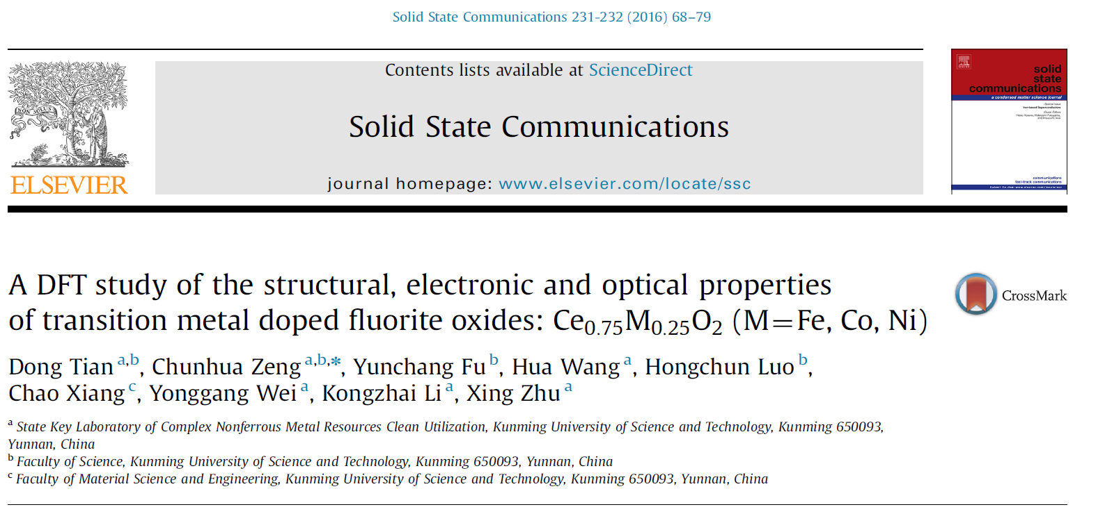
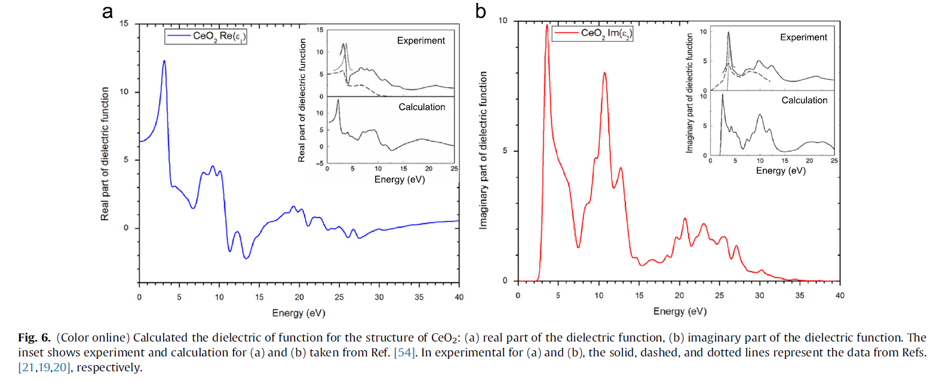
DFT can compute:

Slide 15
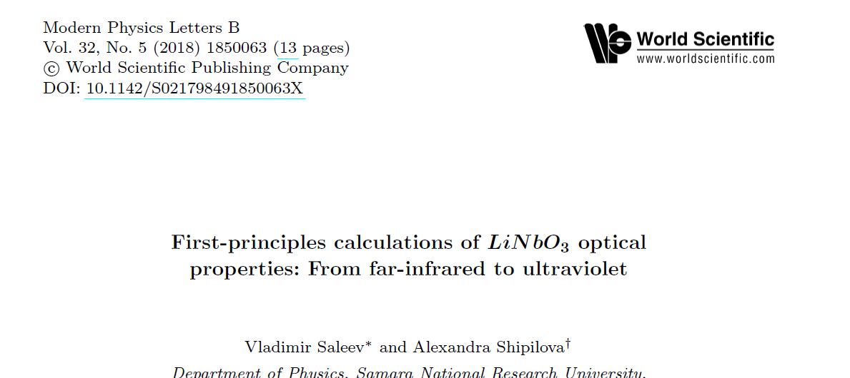
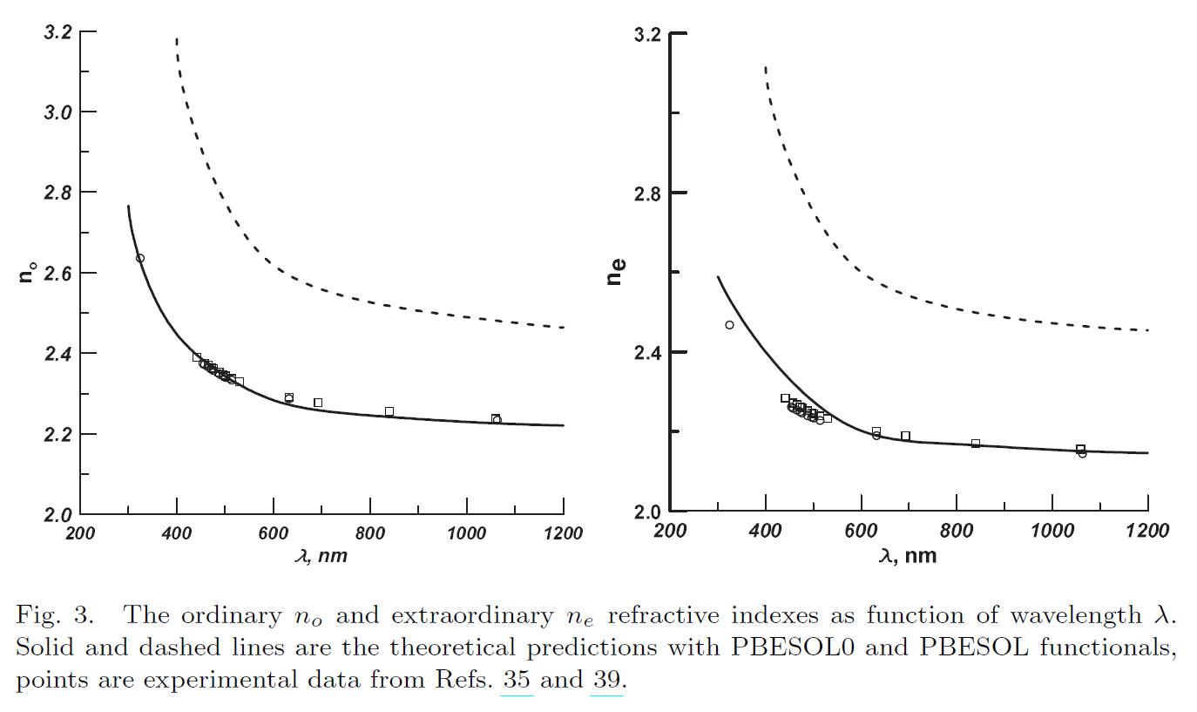
DFT can compute:

Slide 16
DFT can compute:
Scientific reports 9 (1), 1-12 (2019)

Slide 17
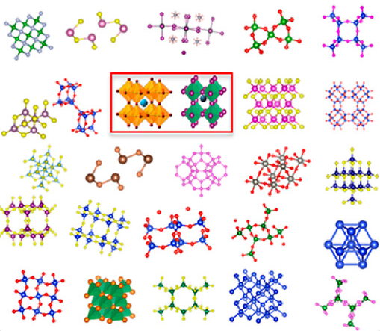
II. High throughput screening (HTS)
is the use of automated algorithms to rapidly test hundreds to thousands of materials.

Slide 18
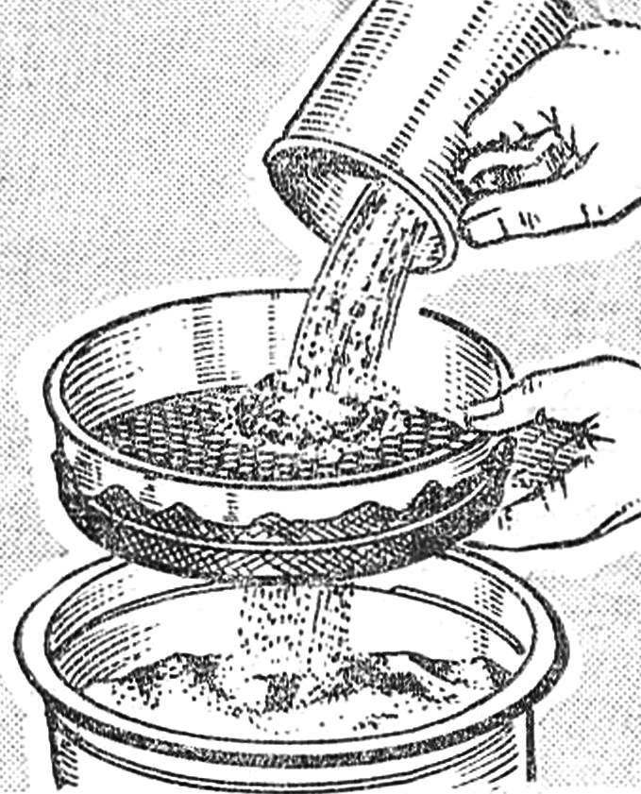
II. High throughput screening (HTS)
is the use of automated algorithms to rapidly test hundreds to thousands of materials.

Slide 19
Crystal structure sampling / SUPERCELL
10¹⁰
10⁴
10³⁻⁴
10²⁻³
10¹⁻²
Topological (Geometrical) analysis ToposPro
Bond valence site energy / 3DBVSMAPPER, softBV
Molecular Dynamics (classical and ab initio) / LAMMPS, Gulp, CP2K
etc.
DFT/ VASP, CASTEP

Slide 20
Crystal structure sampling / SUPERCELL
10¹⁰
10⁴
10³⁻⁴
10²⁻³
10¹⁻²
Topological (Geometrical) analysis ToposPro
Bond valence site energy / 3DBVSMAPPER, softBV
Molecular Dynamics (classical and ab initio) / LAMMPS, Gulp, CP2K
etc.
DFT/ VASP, CASTEP

Slide 21
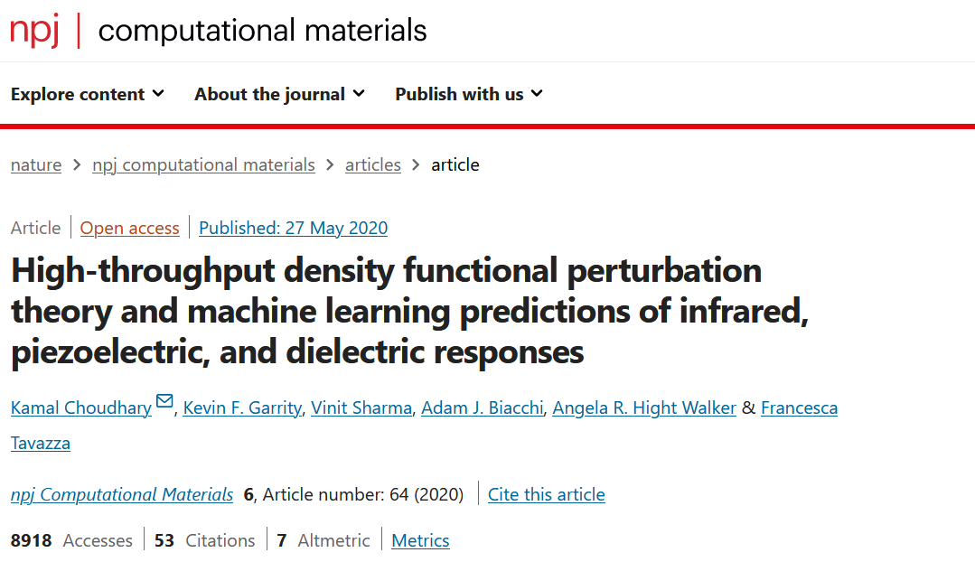

Slide 22
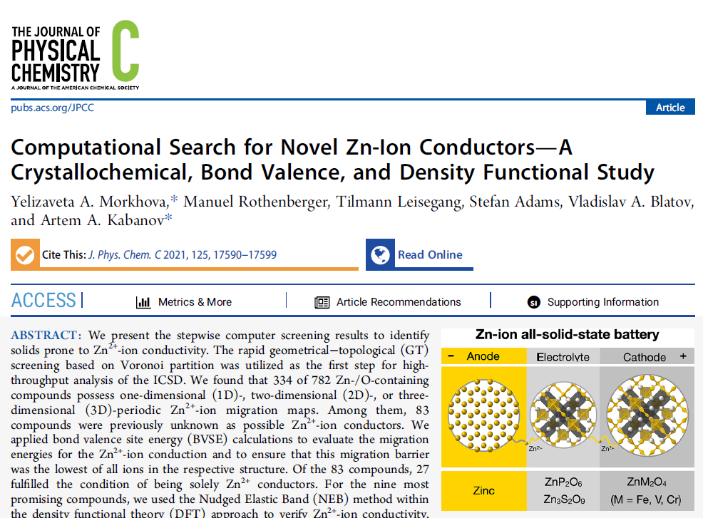

Slide 23
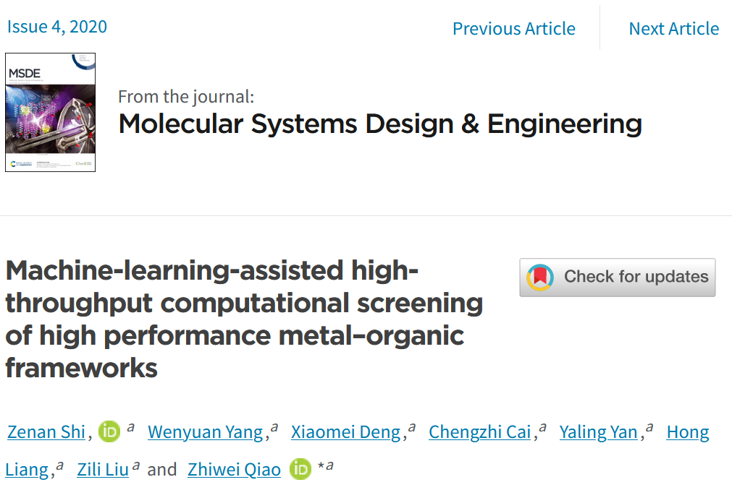
III. ML-assisted high throughput screening

Slide 24
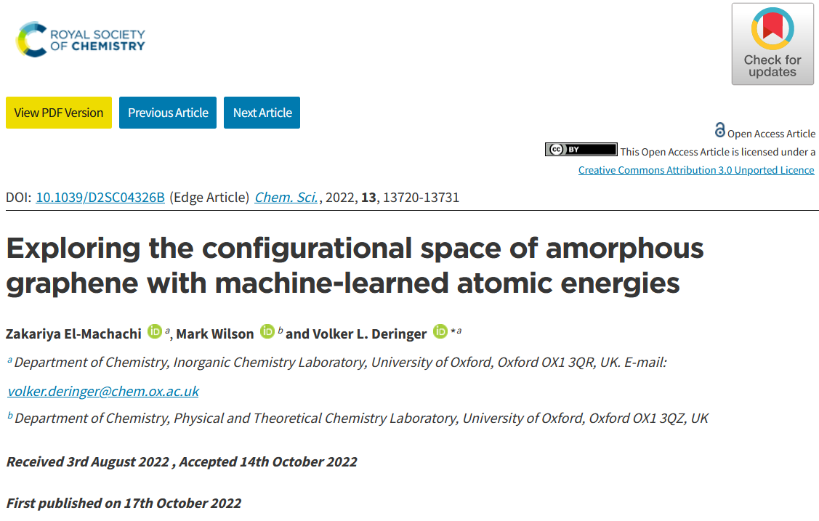
III. ML-assisted high throughput screening

Slide 25
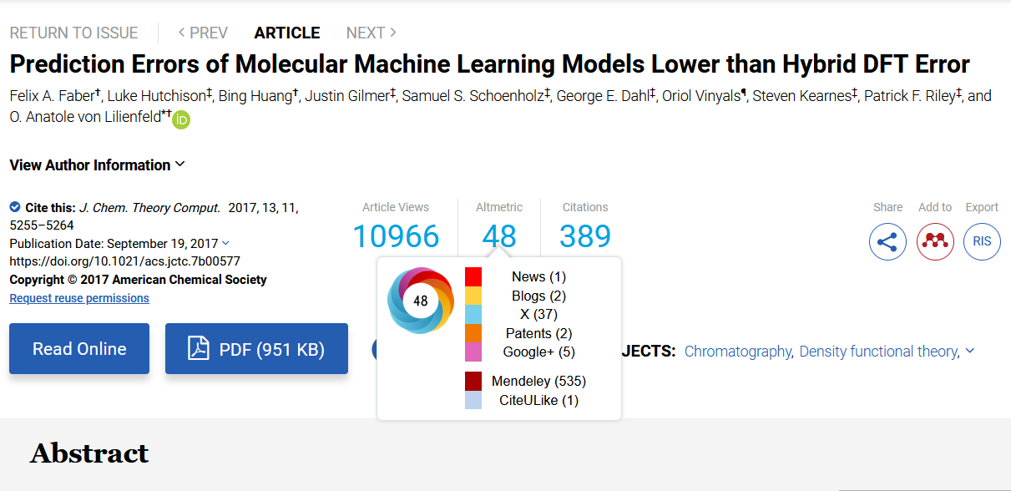
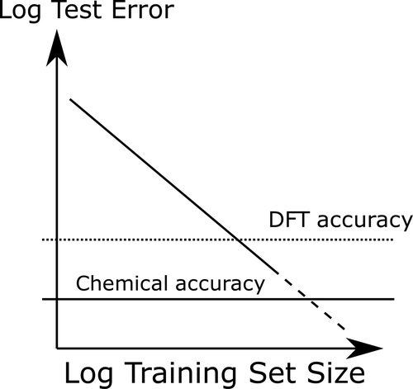

Slide 26
IV. Our online databases
Sacada and BatteryMaterials
https://www.sacada.info
https://batterymaterials.info

Slide 27
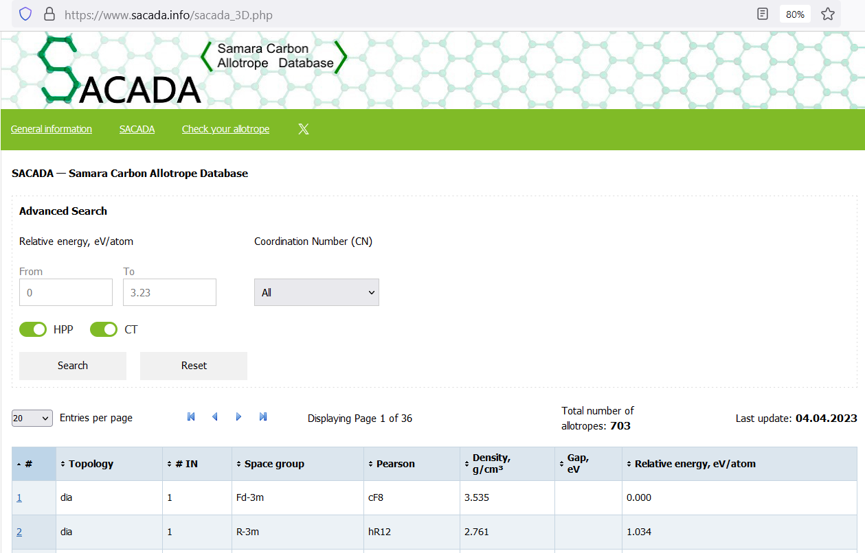

Slide 28
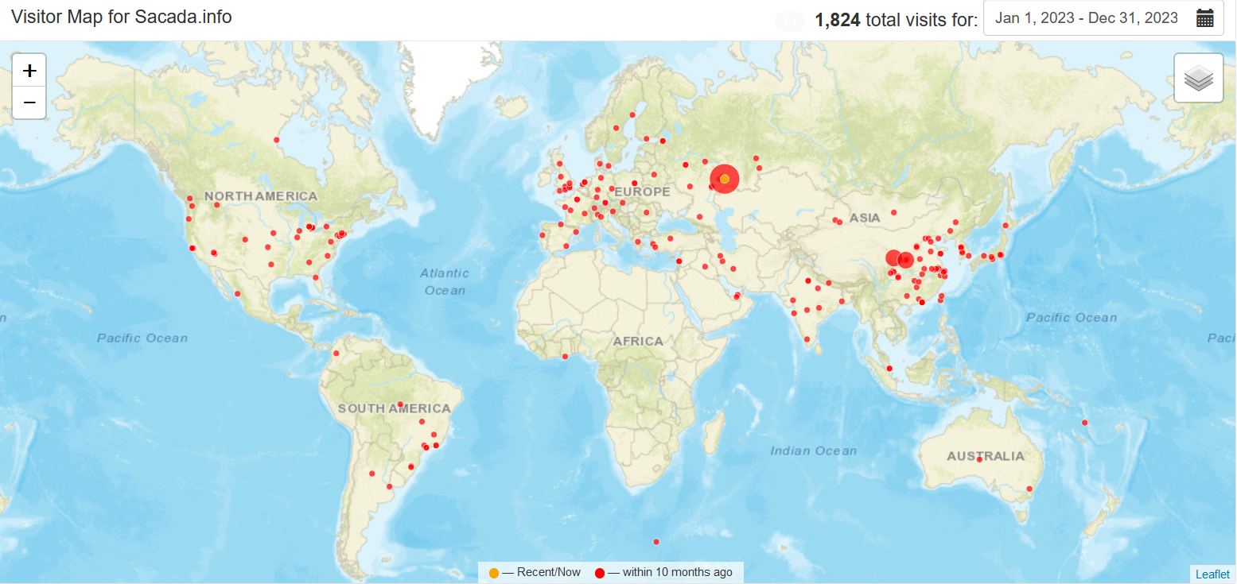

Slide 29
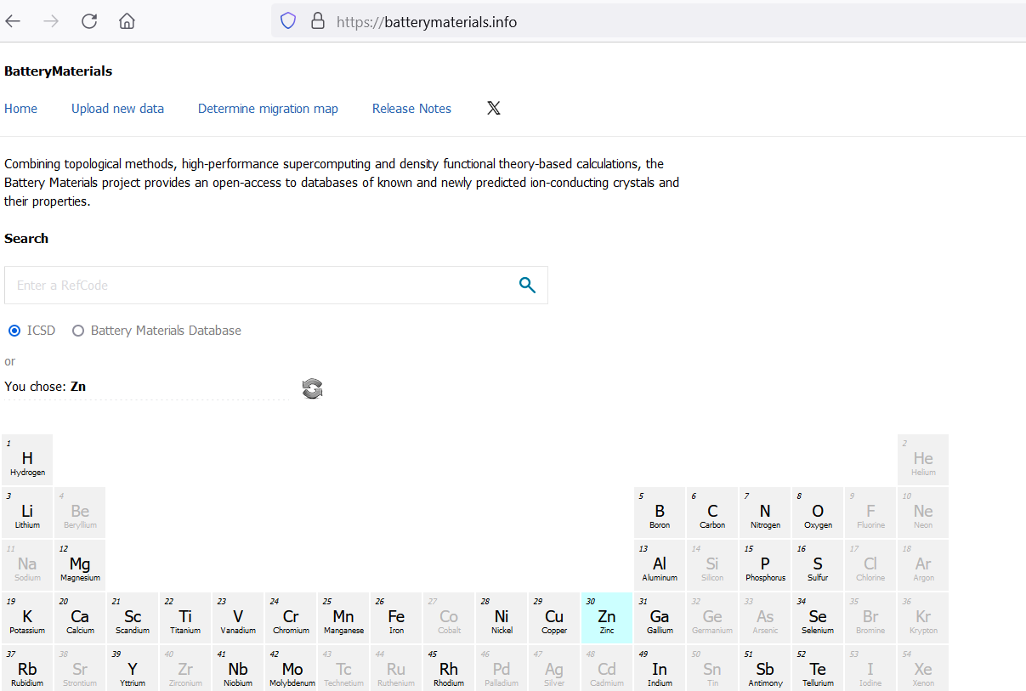

Slide 30
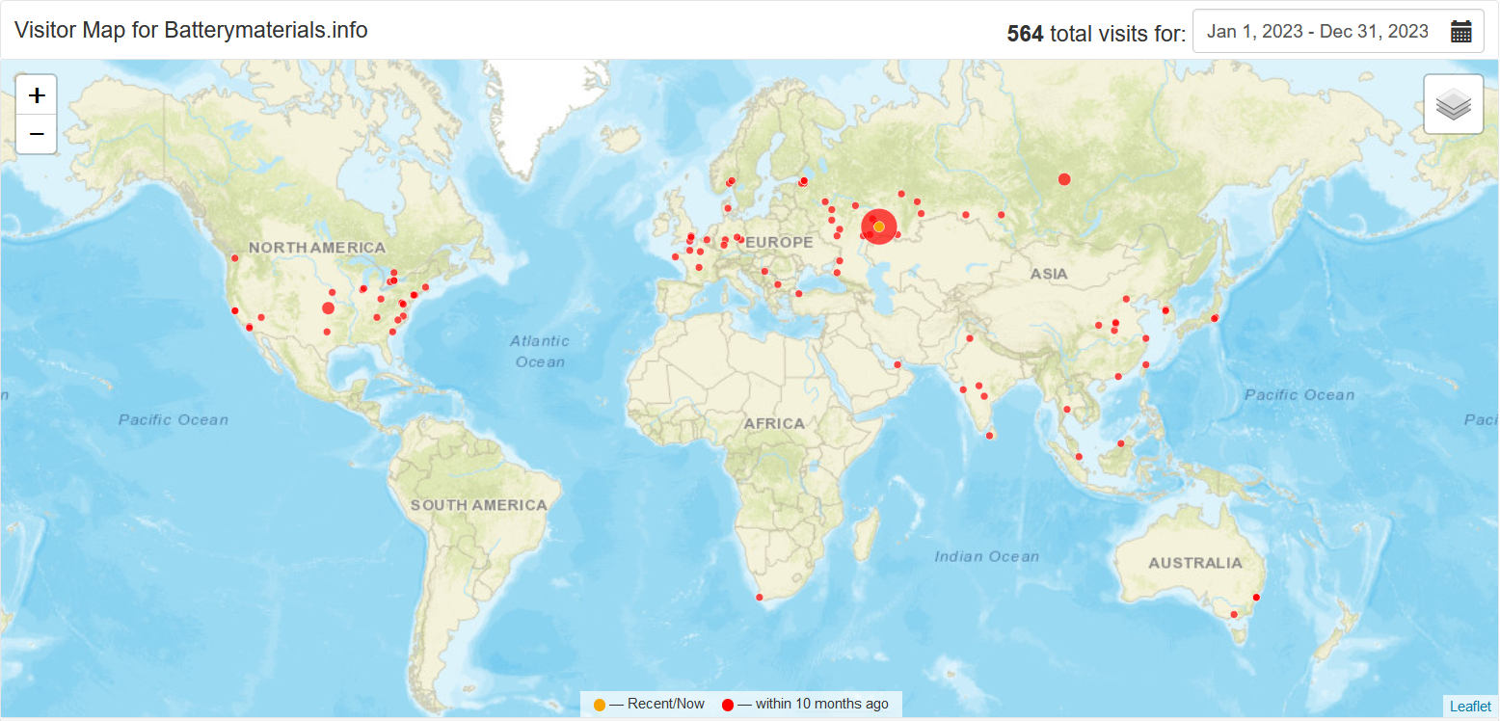

Slide 31
Thank you!
email: artkabanov@mail.ru

