Slide 1
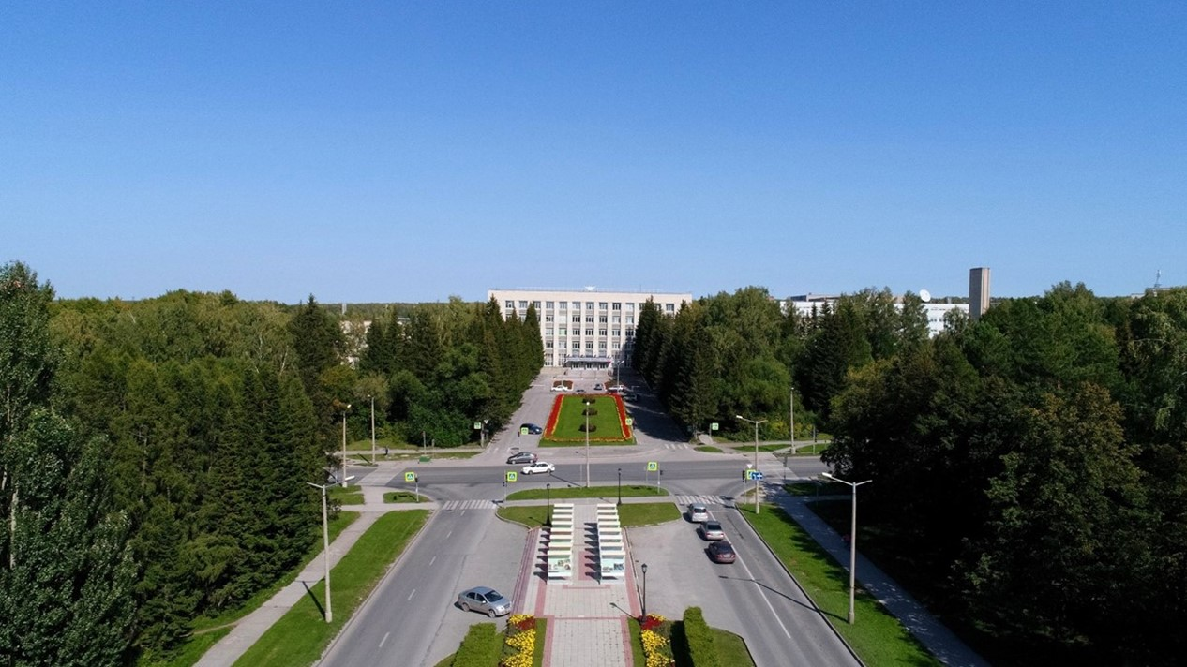
SPD solenoid
E.Pyata, S.Pivovarov, A.Erokhin, M.Kholopov, E.Antokhin, T.Bedareva, A.Orlova BINP, Novosibirsk

Slide 2
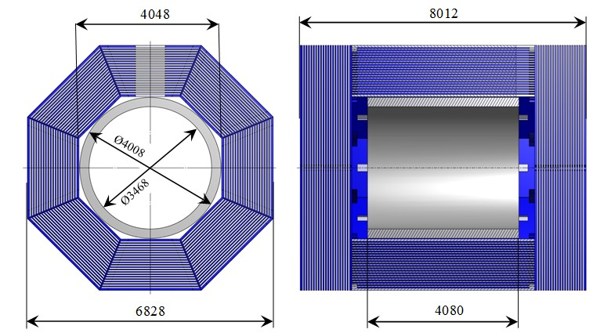
SPD solenoid
The magnetic field along the solenoid axis should be 1.0 T.
Main Dimensions and Parameters of the Magnet
The cryostat of the magnet with the coils, cold mass and thermal shields is located inside the yoke. A distribution box named Control Dewar is located on the worked platform of the yoke.
The overall dimensions are driven by the space planned for the detectors of SPD and the magnet field parameters. Outside diameter of the cryostat is 4008 mm and a gap between the yoke and the cryostat about 20 mm.
Radially a free diameter of 3468 mm is left for the SPD detectors. The length of the magnet is 4080 mm and the magnet should be installed symmetrically inside the iron yoke for magnetic flux return.
The total weight of the cryostat, transfer line and Control Dewar is ~24 t.

Slide 3
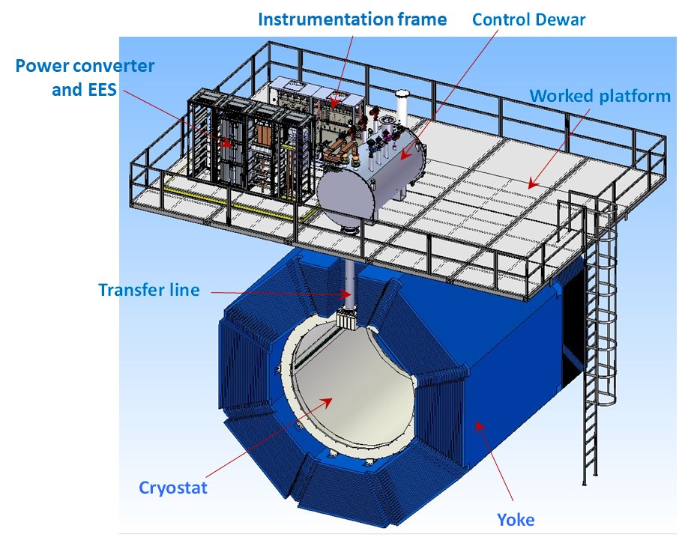
SPD solenoid
The magnetic field along the solenoid axis should be 1.0 T.
BINP presents our participation in SPD project with the following items:
Magnetic and engineering design of the magnet including tools and support;
Production and delivery of the magnet (consisting of the cryostat with cold mass, alignment components, proximity cryogenics, supports);
Power converter, energy extraction system, quench protection and instrumentation.

Slide 4
SPD solenoid design
• Magnetic design of the magnet including of calculations of the magnetic forces. The results of the calculations will be presented in the middle of November;
• Engineering design of the magnet including of calculations of all loads and forces;
• Design of the superconductive conductors, coils and cold mass;
• Design of the cryostat with alignment components, supports and suspend system;
• Design of the proximity cryogenics with flow scheme and all instrumentation for cryogenics and insulation vacuum for the cryostat and control Dewar, current leads;
• Design of the power supply system and energy extraction system;
• Development quench protection and detection scheme;
• Development of the procedures for assembly of the magnet and the preparation of installation solenoid into the yoke;
• Development of the worked conditions of the cryogenic system;
• Define the list of FAT and SAT and requirements for tests;
• Documentation which will include: 3D models, assembling drawings of important components, part lists, welding procedures, thermal calculations, calculations of the thermo-syphon circuit, mechanical calculations and a mechanical analysis with failure modes (e.g. loss of insulation vacuum), description of the cryogenic control system as well as Process and Instrumentation Diagrams for the cryogenic process.
Design works: 2023 – December 2024

Slide 5
SPD coils
The cold mass of the SPD solenoid consists of three epoxy resin impregnated coils reinforced by shells made of structural aluminum.
Cryostat: OD – 4008 mm; ID – 3468 mm; Length - 4080 mm; Thickness – 270 mm;
Coils (3 pc.): Vertical winding PANDA conductor – 2 layers; Turns = 750.
Weight: - cryostat about 16200 kg
- thermo shields – 1020 kg
- coils about 5240 kg
Total: ~22 ton

Slide 6
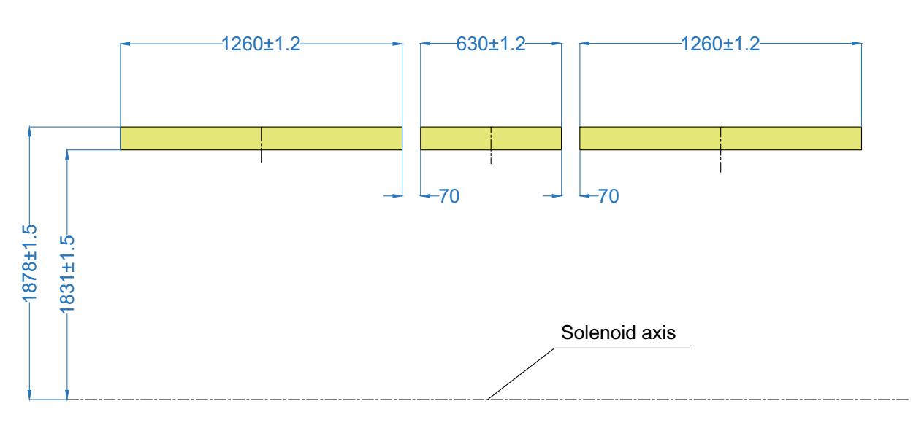
SPD coils
The cold mass of the SPD solenoid consists of three epoxy resin impregnated coils reinforced by shells made of structural aluminum.
The Upstream and Downstream winding packs are identical and feature 2 layers of 150 turns. The Center coil instead is smaller featuring 2 layers of 75 turns. The conductor is wound around the aperture with a tension. The coils should be prepared and impregnated in vacuum according to the standard BINP technological scheme TTS4 STO 103-2011.

Slide 7
SPD magnet analysis
Input conditions for 3D simulations had been taken as:
The configuration of the superconducting coil and magnetic design according to the latest STEP model with three coils. The current of the coil is 5000 A.
The calculations were carried out on the 3D software package TELMA of Evgeniy Antokhin team.
Distribution of induction modulus (Tl).

Slide 8
SPD magnet analysis
Comparison of the distributions of the longitudinal field component
when the edge coils are displaced by ±5 cm.

Slide 9
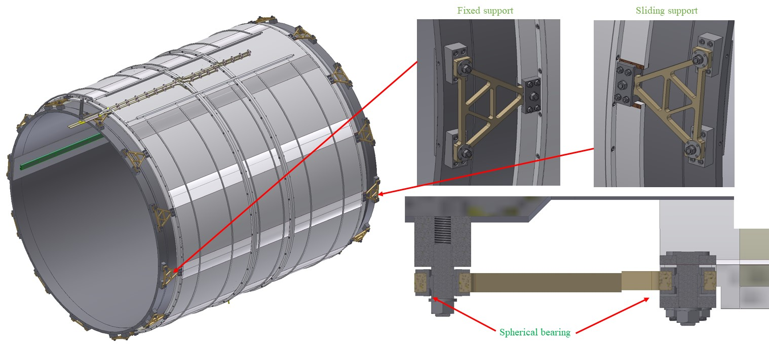
SPD solenoid (triangular supports)
Fixation of the cold mass is made with help of triangular supports, 12 pieces on each side. On one side the supports are fixed between vacuum shell and cold mass, the other side of the cold mass a type of connection of the supports is sliding to compensate temperature shrinkage of the coil. The Suspensions have spherical bearings to avoid bending during thermal changes in the dimensions of the cold mass.

Slide 10
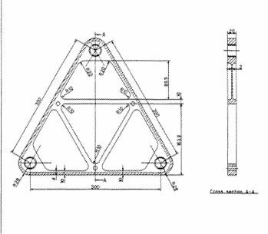
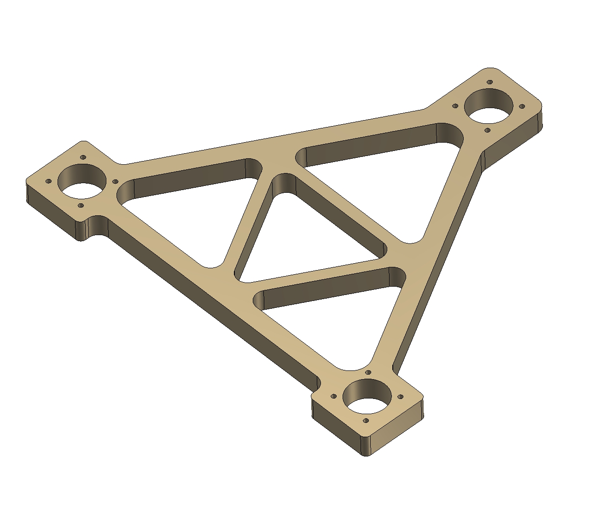
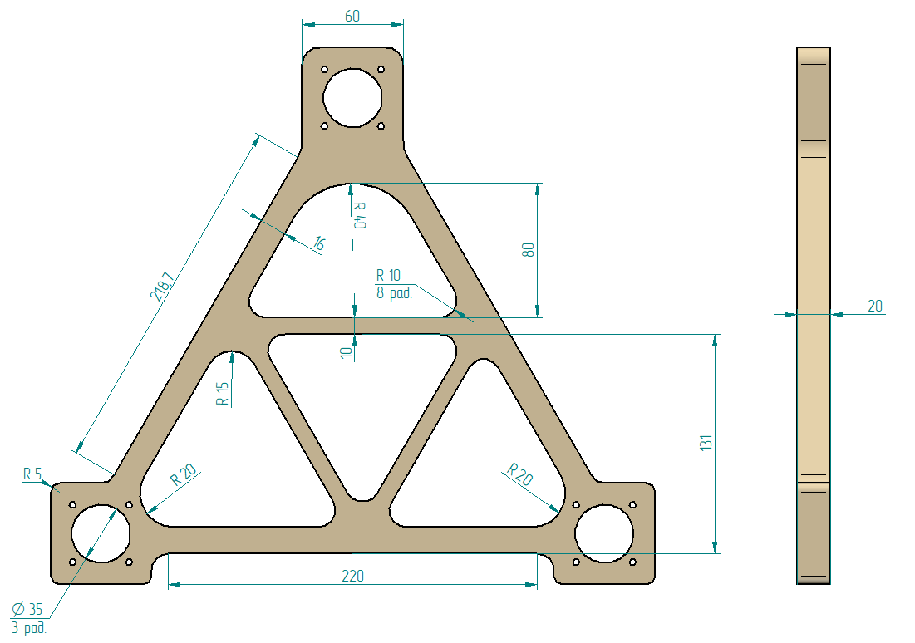
SPD solenoid. Cold mass support
Choice of a support system's type for SPD cold mass.
ATLAS type BINP 1st variant BINP 2nd variant

Slide 11
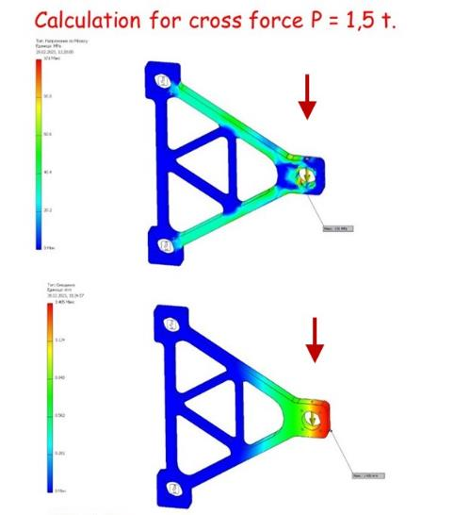
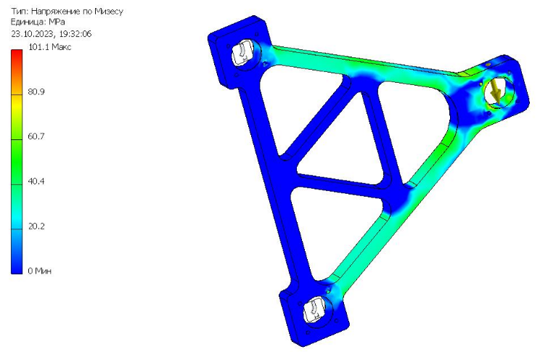
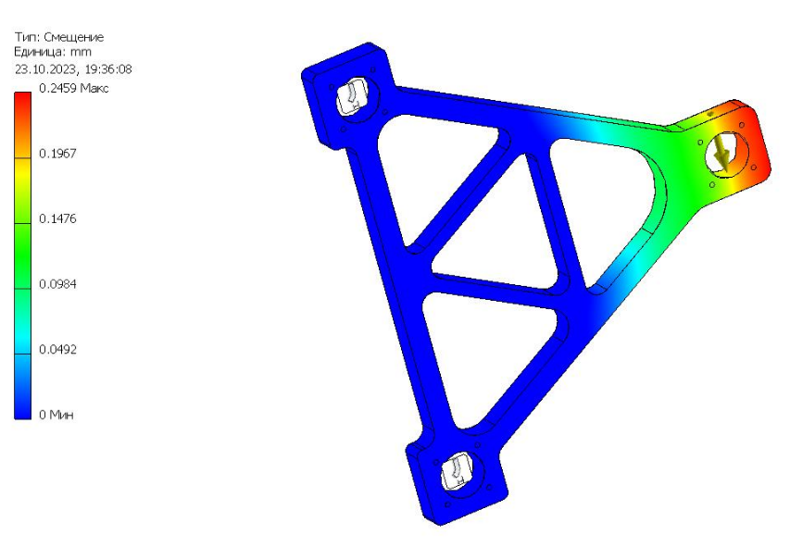
STEF 1 The maximum equivalent stress is 101 Mpa The maximum deformation is 1,4 mm.
Comparison of the characteristics of two materials
Сarbon fiber The maximum equivalent stress is 101 Mpa The maximum deformation is 0,25 mm.

Slide 12
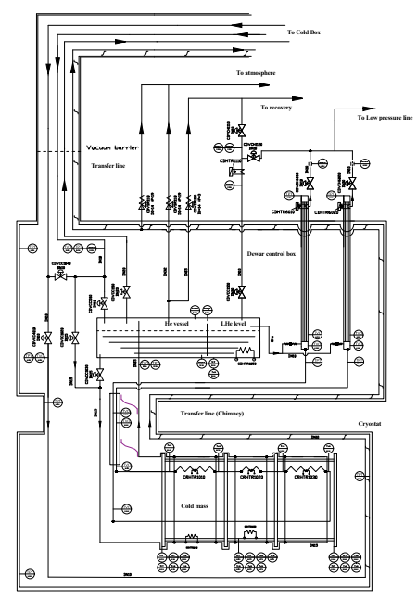
SPD solenoid. Flow scheme
The cryogenic system of the cryostat and the control Dewar shall be designed in order to take the loads resulting from all operation scenarios. Design pressure for all pipelines and helium vessel is 19 bar absolute (bar-a).
Liquid helium that is used for cooling the cold mass is fed from the liquefier at 4.5 K. Thermal shields of the solenoid surround the cold internal parts and are cooled by liquid nitrogen, which passes through a pipes of the heat exchanger of serpentine type.
The Process Flow Diagram (PFD) of the SPD cryogenic system has the same principle as for CMS solenoid (CERN) and PANDA (FAIR).

Slide 13
SPD heat loads
Table 1. Estimated heat loads of the SPD solenoid
T = 4,5 К | Heat loads
 | Worked condition | Without m.f. | With m.f.
Cryostat
Radiation | 7,8 | 7,8 | 7,8
Supports | 3,6 | 3,6 | 3,6
Eddy current loss in casing | - | - | 11,50*
Eddy current loss in conductor | - | - | 0,09*
Current leads, 4,5 kA B=1.0 T | 10 | 8 | 8
Distribution box**
Radiation | 0,50 | 0,50 | 0,50
Supports of the LHe vessel | 0,26 | 0,26 | 0,26
Cold control valves | 0,93 | 0,93 | 0,93
Safety relief valves | 4,30 | 4,30 | 4,30
Vacuum barrier | 0,35 | 0,35 | 0,35
Transfer line**
Radiation | 0,12 | 0,12 | 0,12
Supports | 0,32 | 0,32 | 0,32
Total | 28,18 | 26,18 | 37,77
* Data of PANDA solenoid

Slide 14
SPD heat loads
T=60K | Heat loads, W
 | Normal condition | Without magnetic field | Current ramping
Cryostat
radiation | 160,00 | 160,00 | 160,00
supports thermal shields | 12,00 | 12,00 | 12,00
eddy current loss in thermal shields | - | - | 47,00
Control Dewar
radiation | 11,60 | 11,60 | 11,60
supports thermal shields | 6,50 | 6,50 | 6,50
supports Helium vessel | 9,12 | 9,12 | 9,12
cold valves | 11,70 | 11,70 | 11,70
safety relief valves | 1,10 | 1,10 | 1,10
vacuum barrier | 1,18 | 1,18 | 1,18
Transfer line
radiation | 1,05 | 1,05 | 1,05
supports | 2,35 | 2,35 | 2,35
Total | 216,60 | 216,60 | 263,60

Slide 15
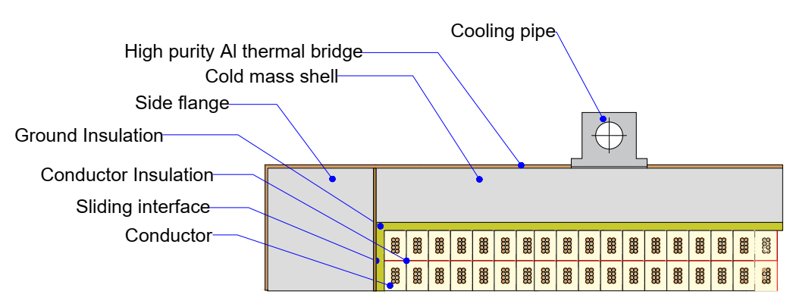
SPD solenoid. Superconductor.
BINP continues work on the fabrication of a working sample conductor for SPD solenoid.
The SPD solenoid is designed to operate at a current of 4,5 – 5,2 kA, i.e. about 24 – 28 % of its critical current at 4.5 K and 2,0 T peak magnetic field in the coils.
The insulated conductor dimensions at 4.5 K are 10.90 mm in width and 7.90 mm in height. The Rutherford cable is composed of 8 strands with a diameter of 1.40 mm and a Cu/SC ratio of 1.0. The critical current density of the superconductor at 4.2 K and 5 T shall be larger than 2800 A/mm2 to ensure a temperature margin for quench well above 2.0 K.

Slide 16
Status of the SPD conductor development/ procurement for fabrication of a sample
Rutherford cable co-extrusion/ conklad in a high purity Al
Plan
Purchasing about 2000m NbTi strands. Contract should be signed in November.
Production of 100m of SPD cable prototype and tests – 12/2023 – 01/2024. Contract signed.
Production A995/998 wire 9,5 mm
Conklad – 10/2024 in SARKO with SPD cable prototype and A995/998 wire 9,5 mm.
Tests of the prototype PANDA cable and A995/998 matrix after Conklad – 12/2024
VNIINM decided technologic tasks for production of the strands with a diameter of 1.40 mm and a Cu/SC ratio of 1.0. Purchasing high purity Cu C10100 in China is in progress.
Production of the strands for SPD coils – 07-08/2024.

Slide 17
SPD Current Source and Energy Extraction System
Basic requirements for the Current Source and Energy Extraction System:
Current in a circuit 5200 A;
Current setup accuracy and longterm stability – 100ppm
The amount of the stored energy to be extracted ~ 20MJ. Stored energy should be extracted to the external dump resistor with the value of 0.1 Ohm. The active elements of the dump resistor should not be hotter than 100C;
Middle point should be introduced and grounded in order to minimize the voltage between the coil and ground.
Dump resistor should have as minimal as possible stray inductance and must be installed in parallel with the extraction switch;
The opening time of the energy extraction switch ~ 20ms;
Development is in progress
Commutator. Colleagues from JINR - agree with the proposed mechanical switching scheme of the solenoide.

Slide 18
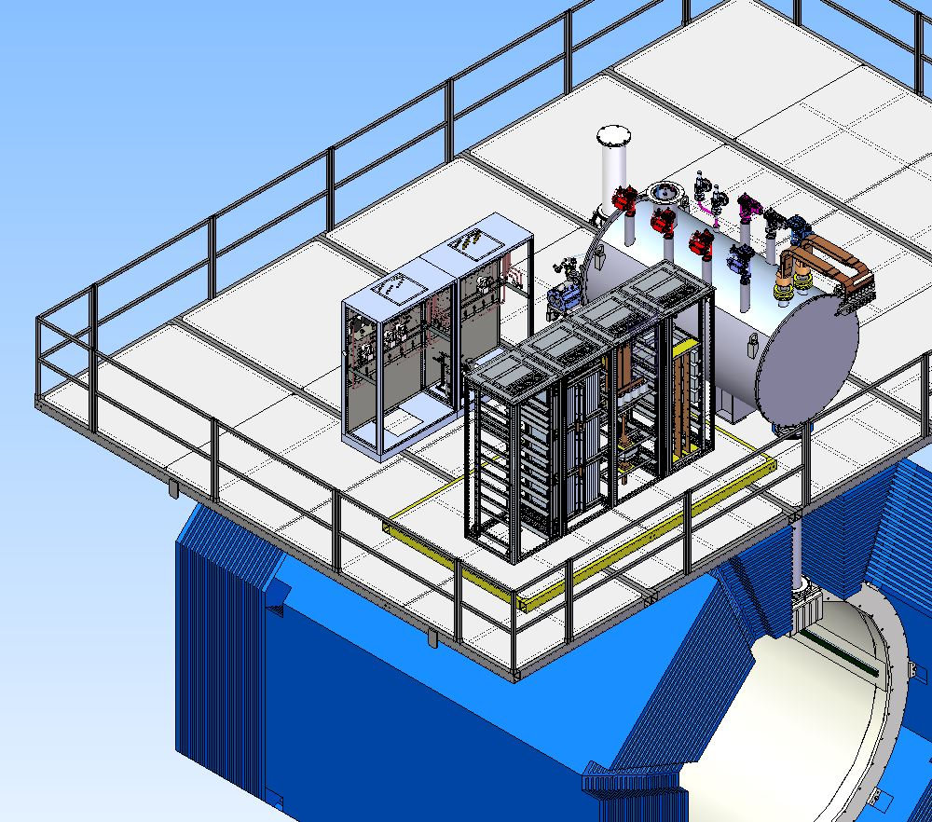
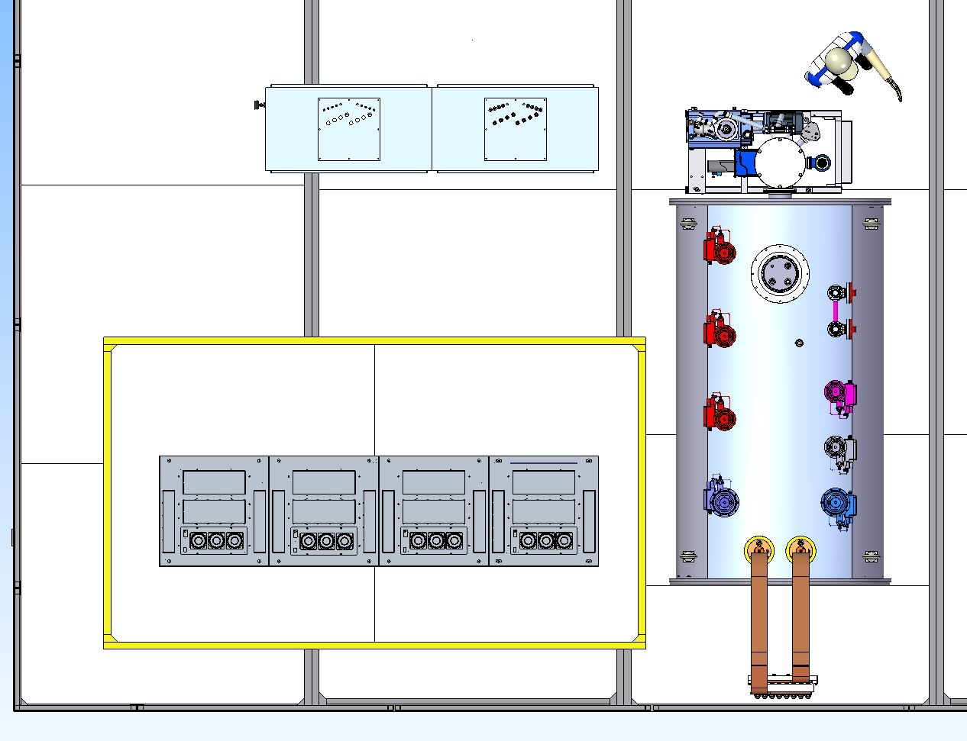
SPD location of cryogenic and racks

Slide 19
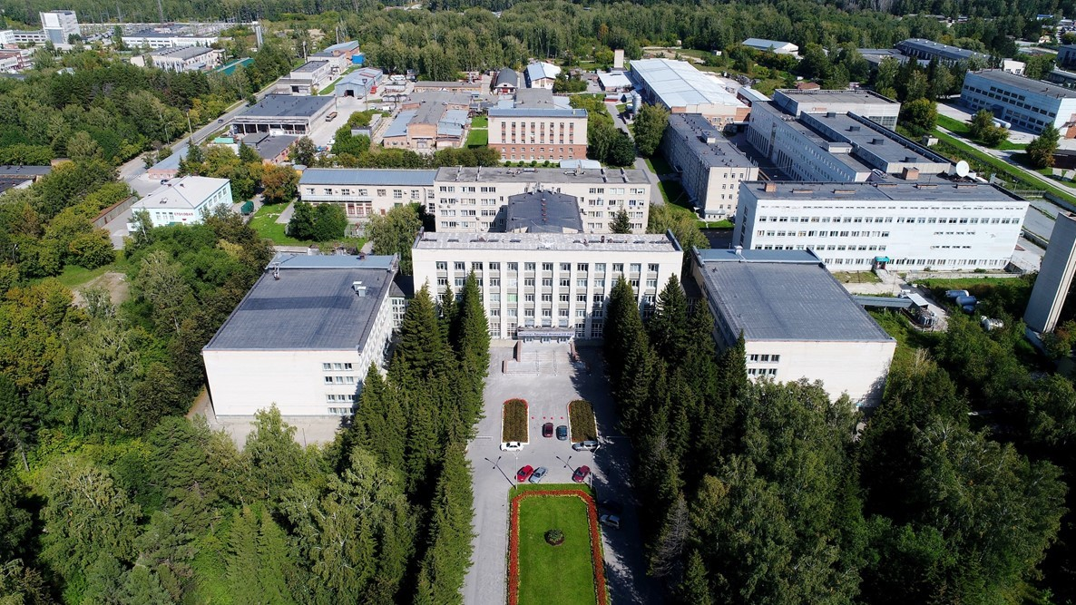
Thank you for your attention

