Slide 1
Cryogenic system of SPD
Speaker: PhD Dr. Nikiforov Dmitry

Slide 2
Outline
Cryogenic system
Helium system
3. Nitrogen system
4. Steps of creation
5. Conclusions

Slide 3
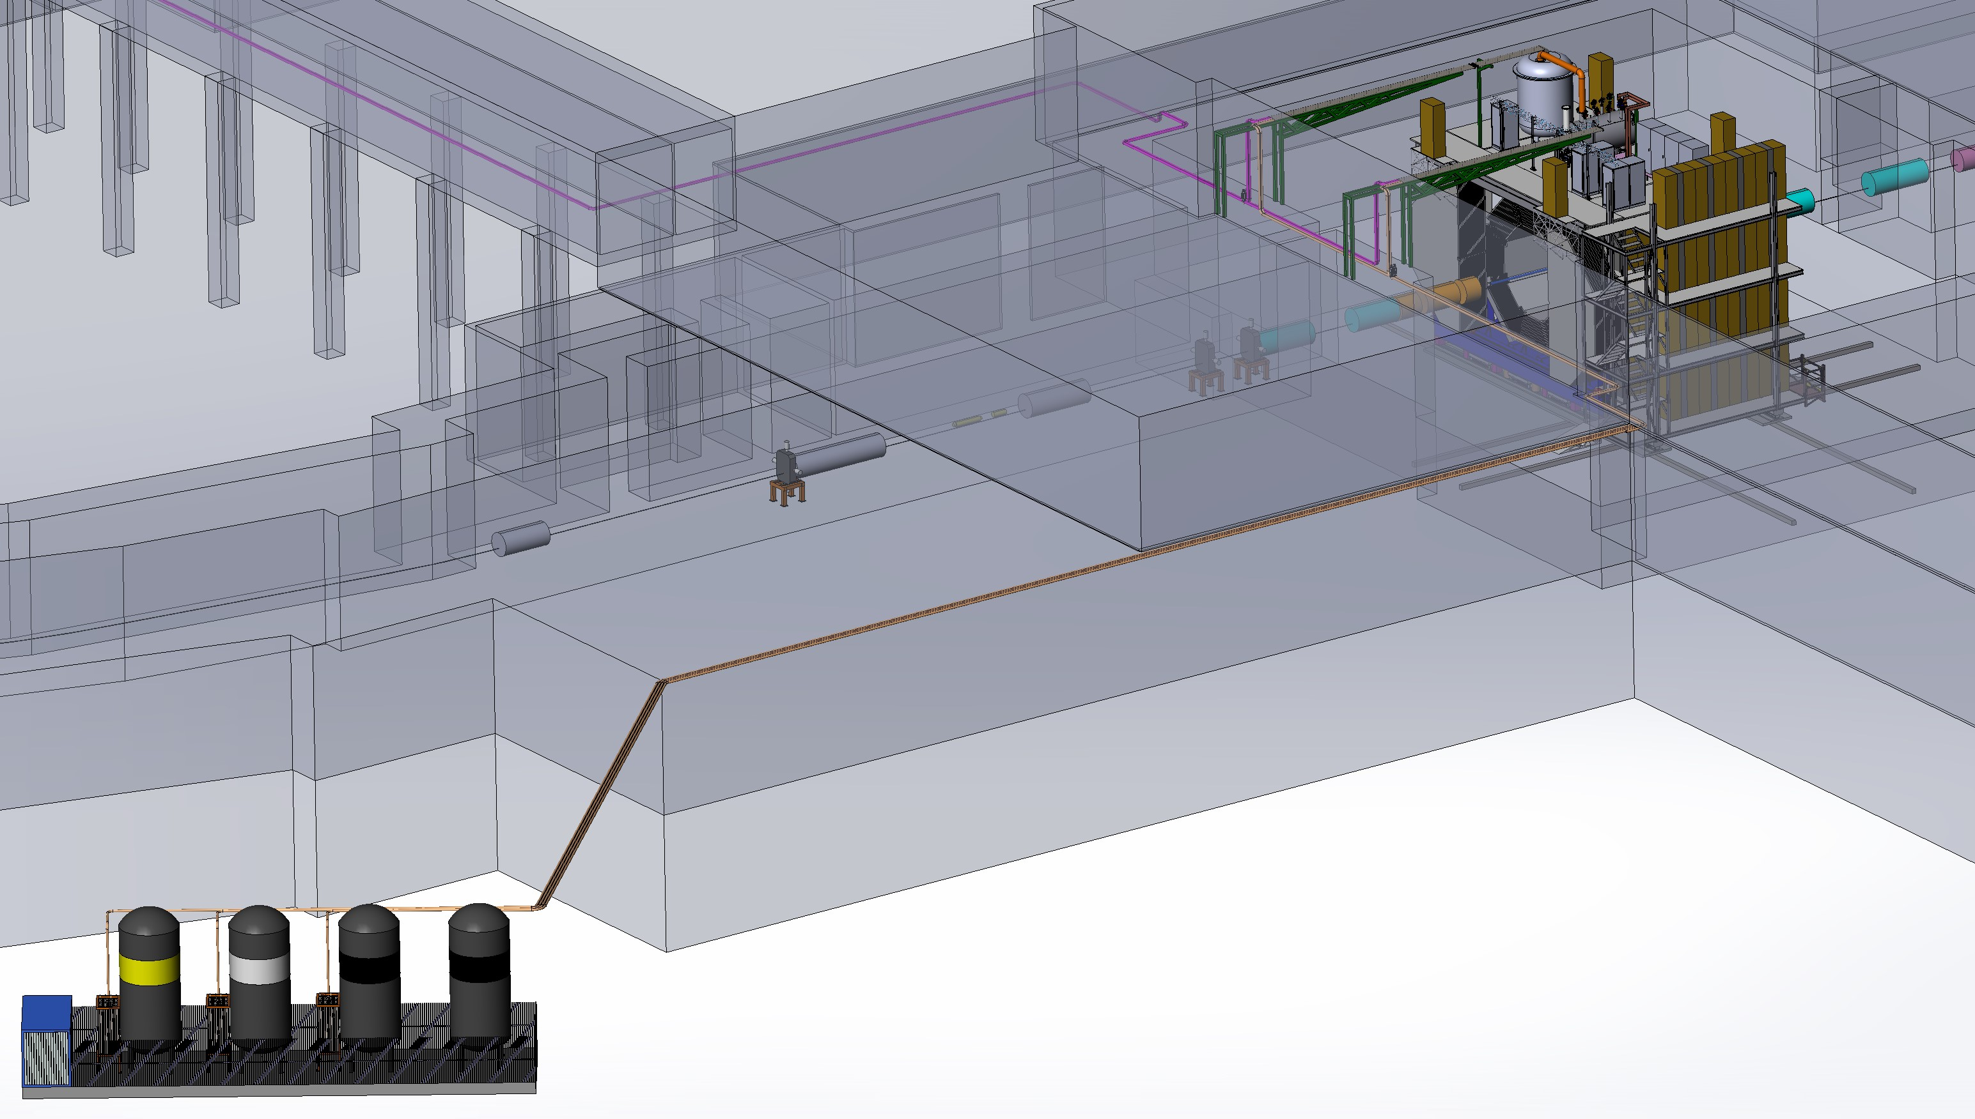
Cryogenic system
Helium liquefier
Helium pipelines
N2, Ar, CO2 pipelines
Cryogenic storage tanks

Slide 4
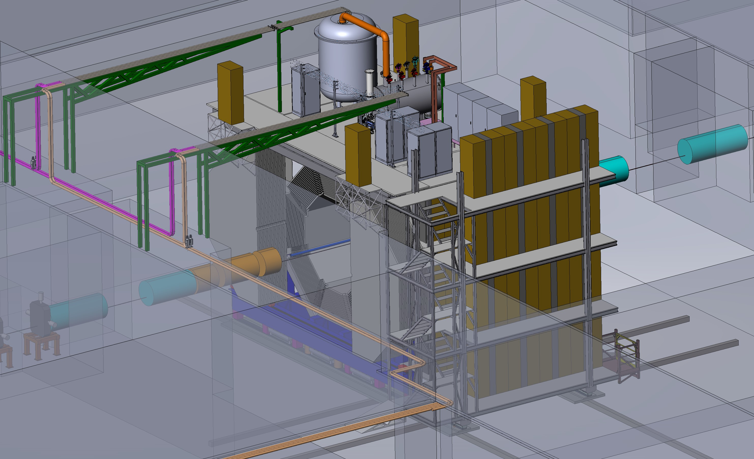
Helium system

Slide 5
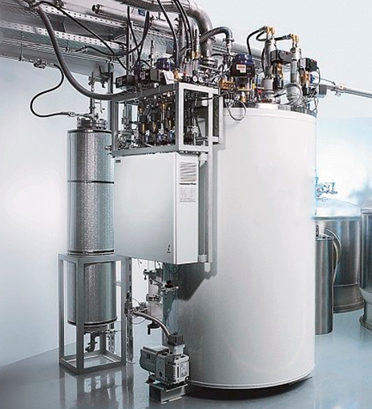
Helium system
 | Operating parameters | Unit
1 | Cooling capacity (for 4.5 K) | 100 - 130 l/h
 | Cooling capacity (for 50 K) | 150 W
2 | Temperature of outlet flow from the SPD | 4.3 K (1.05 bar)
3 | Temperature of inlet flow from the SPD | 4.5 К (1.15 bar)
4 | Hydraulic resistance of the SC coil | 0.1 bar
5 | Cold weight | 4000 kg
6 | Maximum pressure in coil | 5 MPa
7 | Heat load | 60 – 80 W
8 | Equipment Requirement | Maximum reliability, energy efficiency, compactness, automatic mode
9 | Interval of repair/regulatory work of the plant | Not more than once a year

Slide 6
Helium system
Service position
Working position
Power supply
Control cryostat
Liquefier

Slide 7
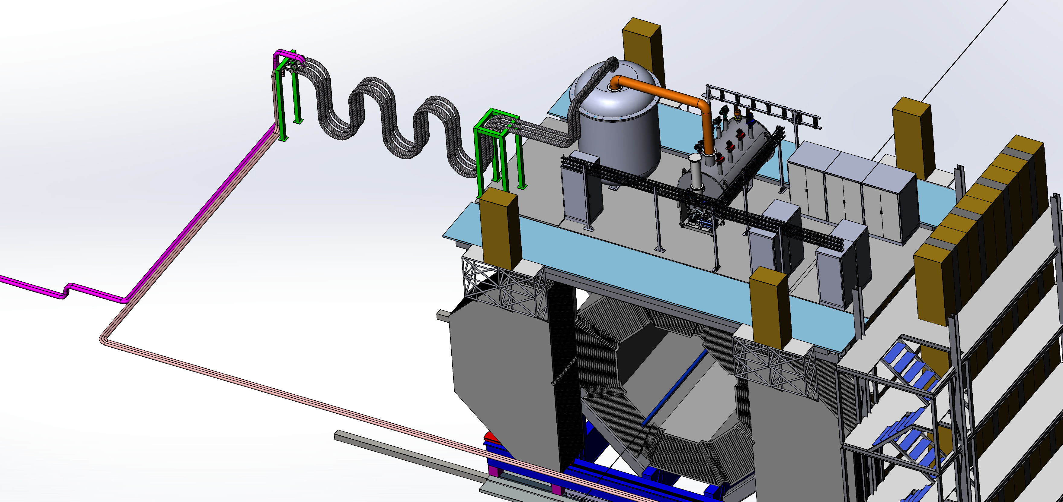
Helium system
First option

Slide 8
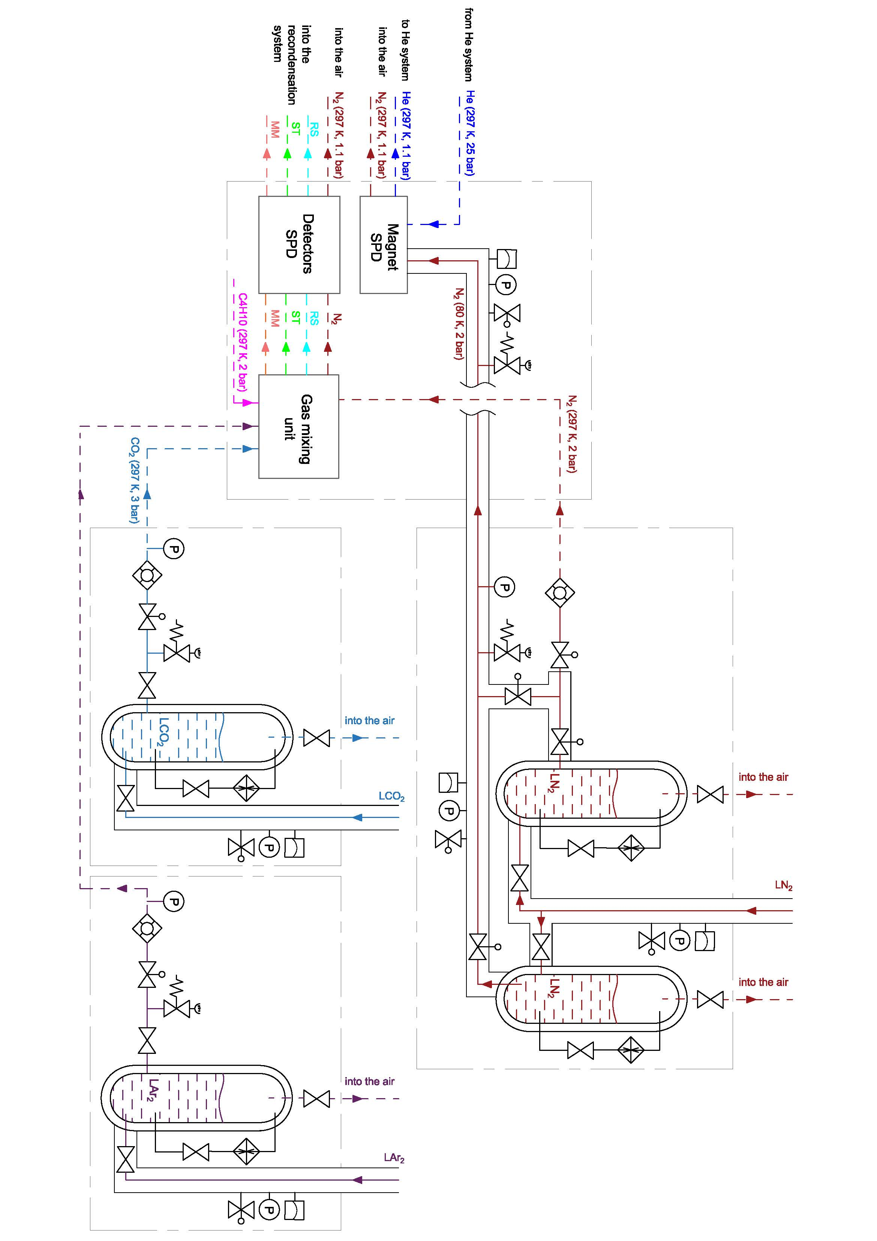
Nitrogen system
First option

Slide 9
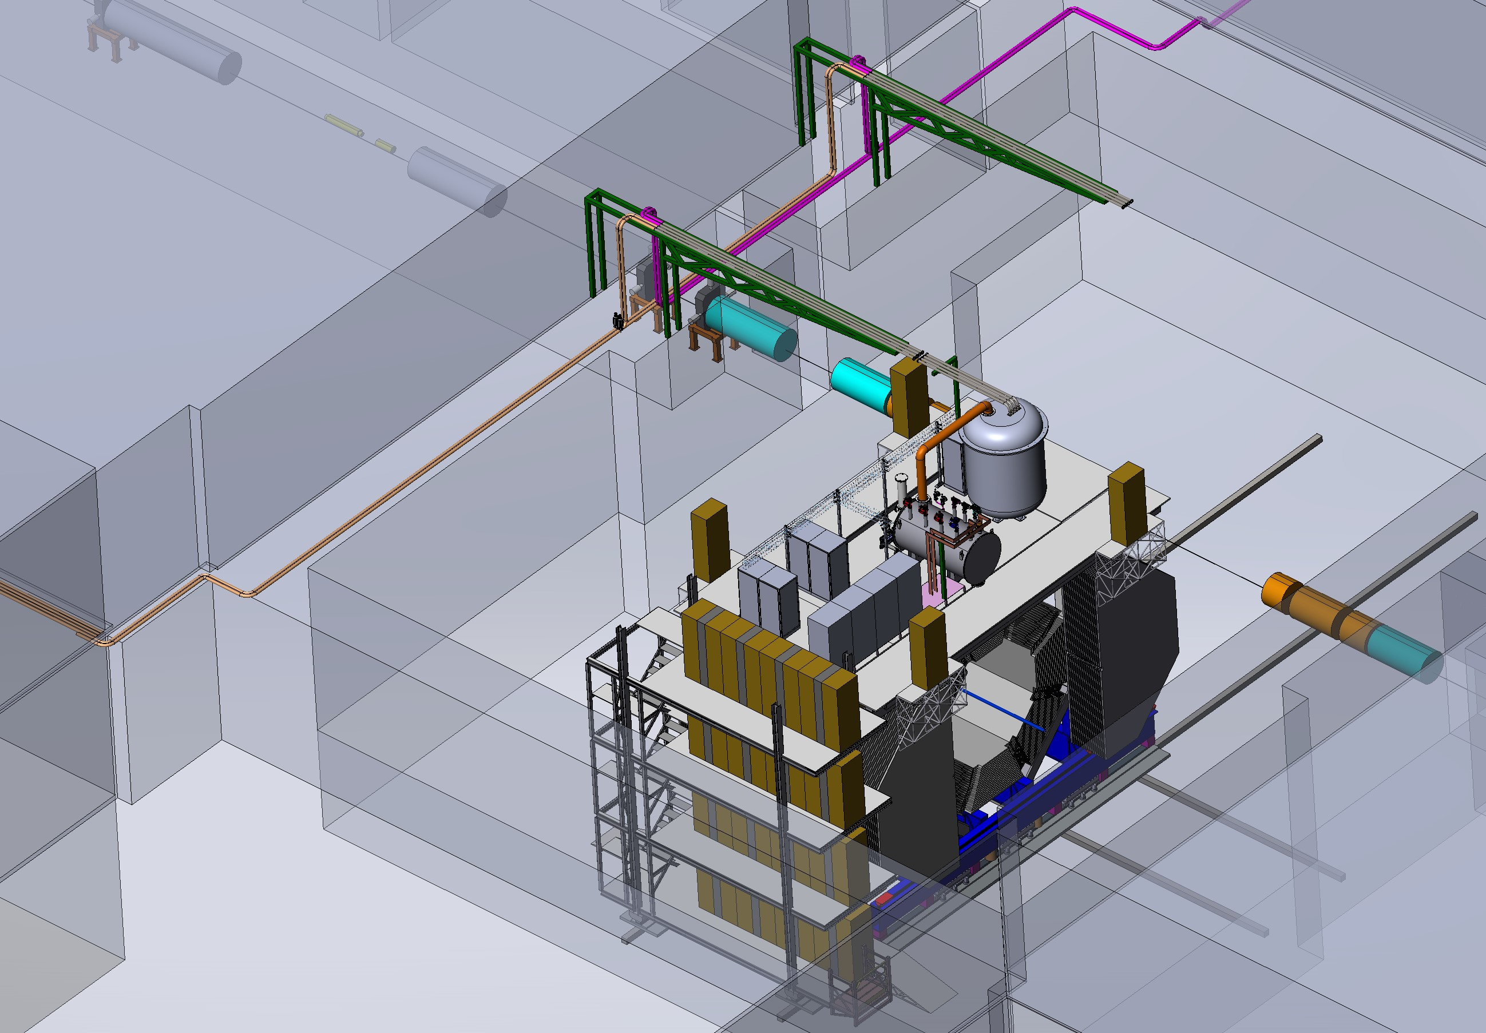
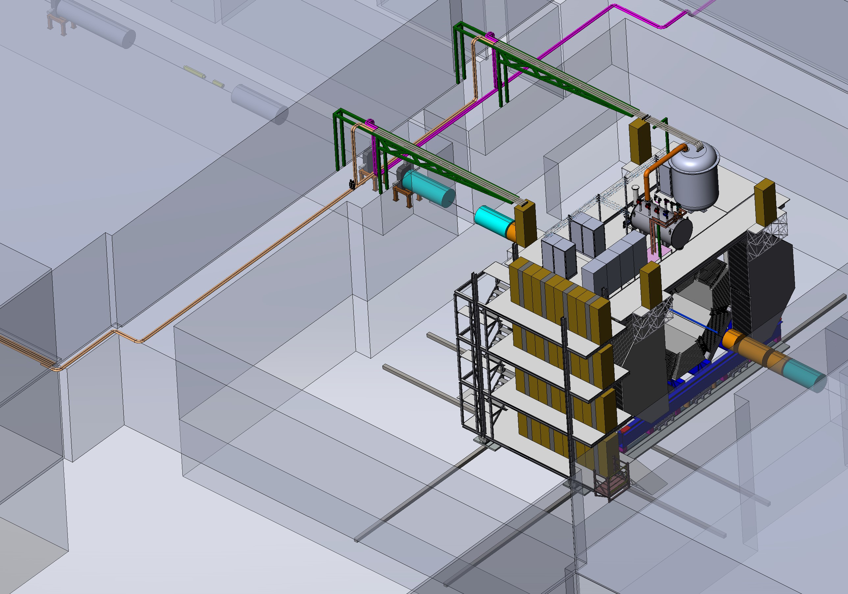
Helium system
Service position
Working position

Slide 10
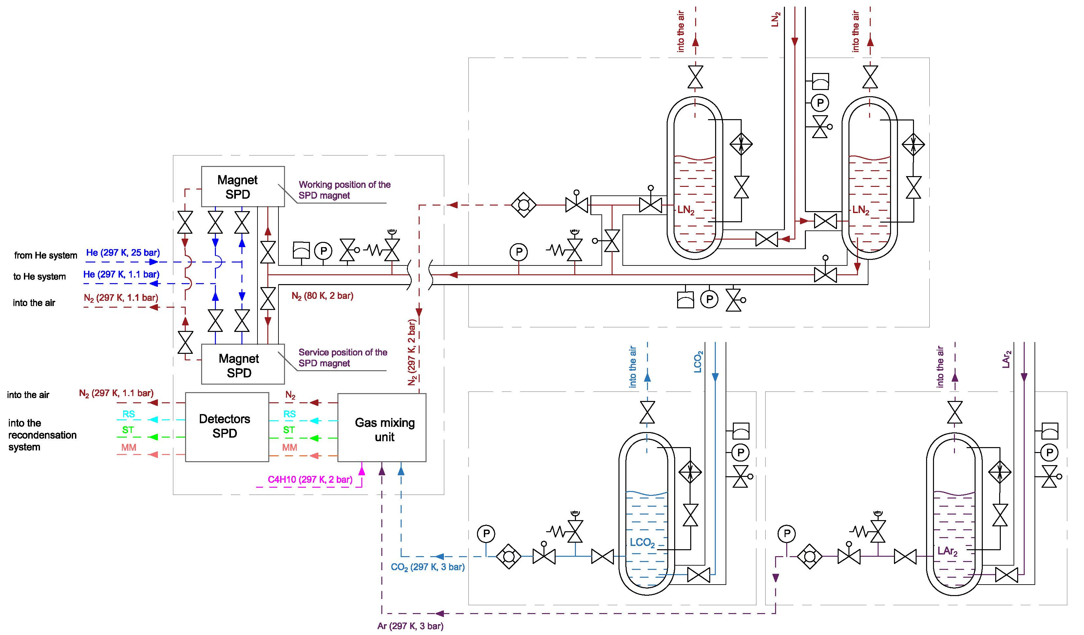
Nitrogen system
Second option

Slide 11
Nitrogen system
Gas consumption for SPD detectors during 1 month of operation
Detectors/Gas | N2 | Ar | CO2 | C4H10
RS | 0,4 t | 0,9 t | 0,4 t | -
ST | - | 4,5 t | 2,1 t | -
MM | - | 0,029 t | - | 0,0045 t
Cryo plant | ≈ 15 t | - | - | -
Total | 15,4 t | 5,429 t | 2,5 t | 0,0045 t

Slide 12
Steps of creation
SPD | 2022 |  |  |  | 2023 |  |  |  | 2024 |  |  |  | 2025 |  |  |  | 2026 |  |  |  | 2027
 | I | II | III | IV | I | II | III | IV | I | II | III | IV | I | II | III | IV | I | II | III | IV | I | II | III | IV
Cryogenic plant
Helium pipeline
Nitrogen system
Vacuum system
Pneumatic system
Cryogenic system control
 |  | Technical task |  |  |  |  | Contract execution |  |  |  |  |  | Assembly & Test |  |  |  |  | Commissioning

Slide 13
Conclusions:
The manufacturer of the SPD magnet and the type of cryogenic plant were determined.
The location of cryogenic tanks, their volumes and gas consumption for SPD were determined.
The maximum cooling capacity of the cryogenic plant is calculated.
The development of technical specifications for a cryogenic plant and a platform for cryogenic tanks is in an active phase.
The work is being carried out in accordance with the plan.

Slide 14
Thank you for your attention!

