Slide 1
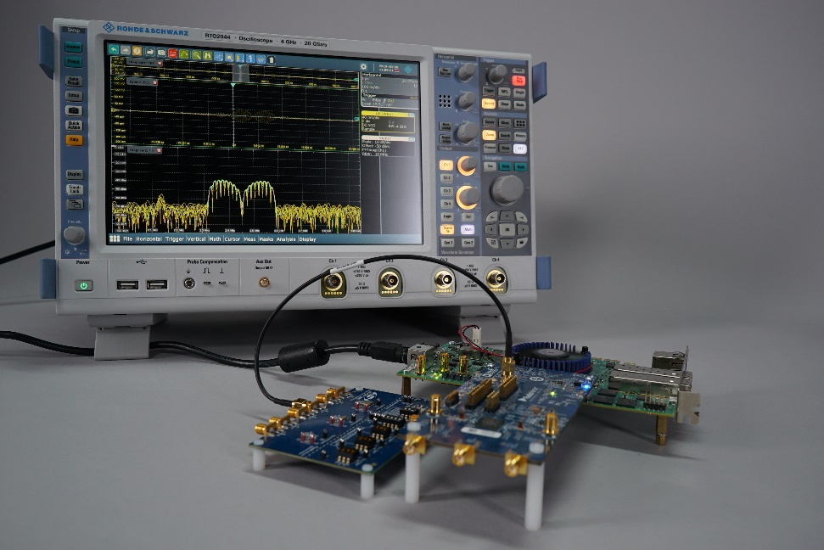
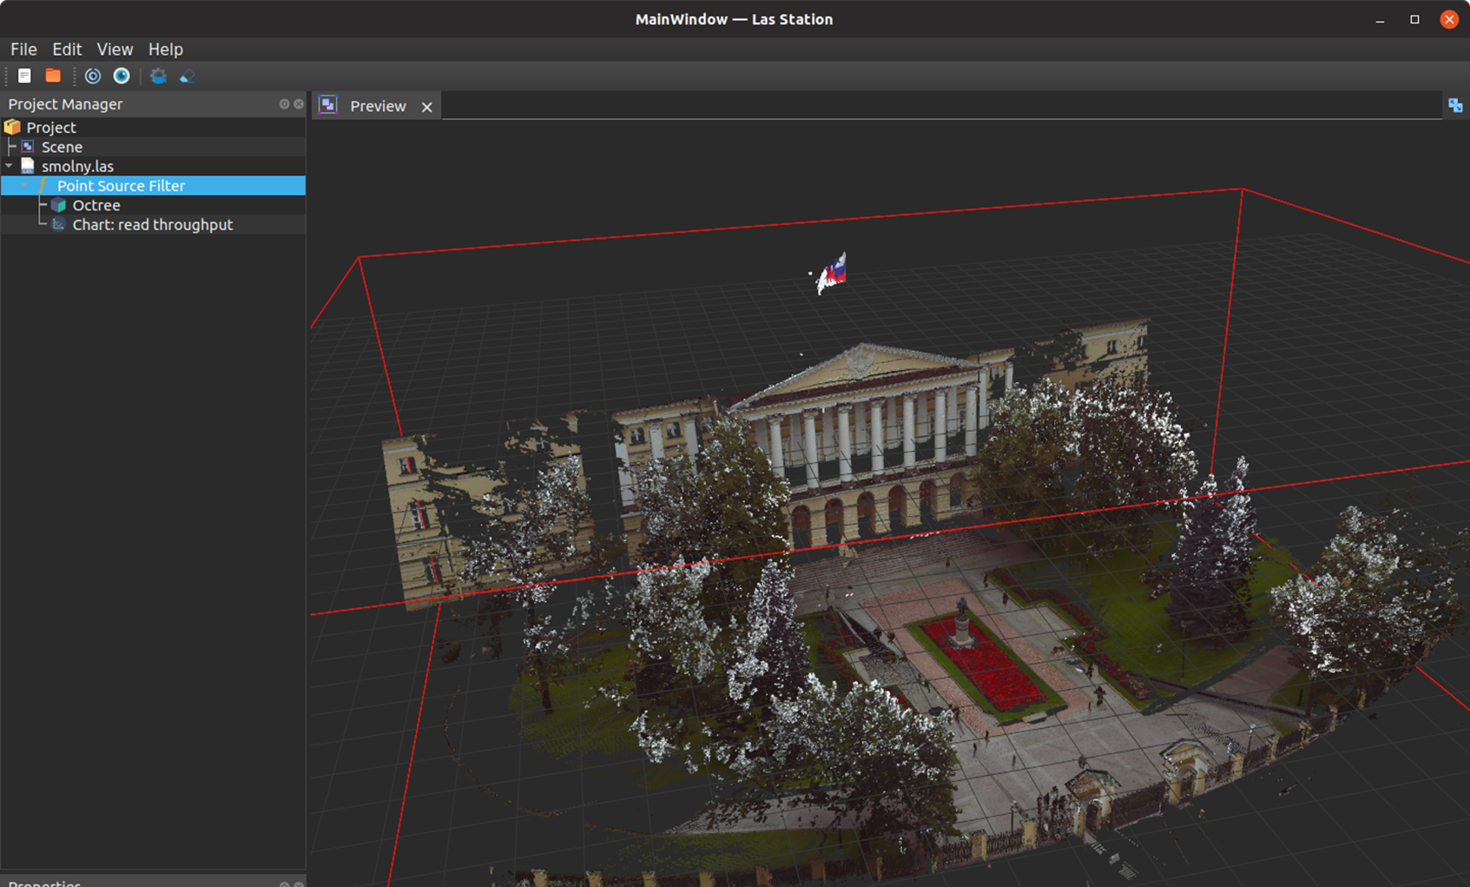
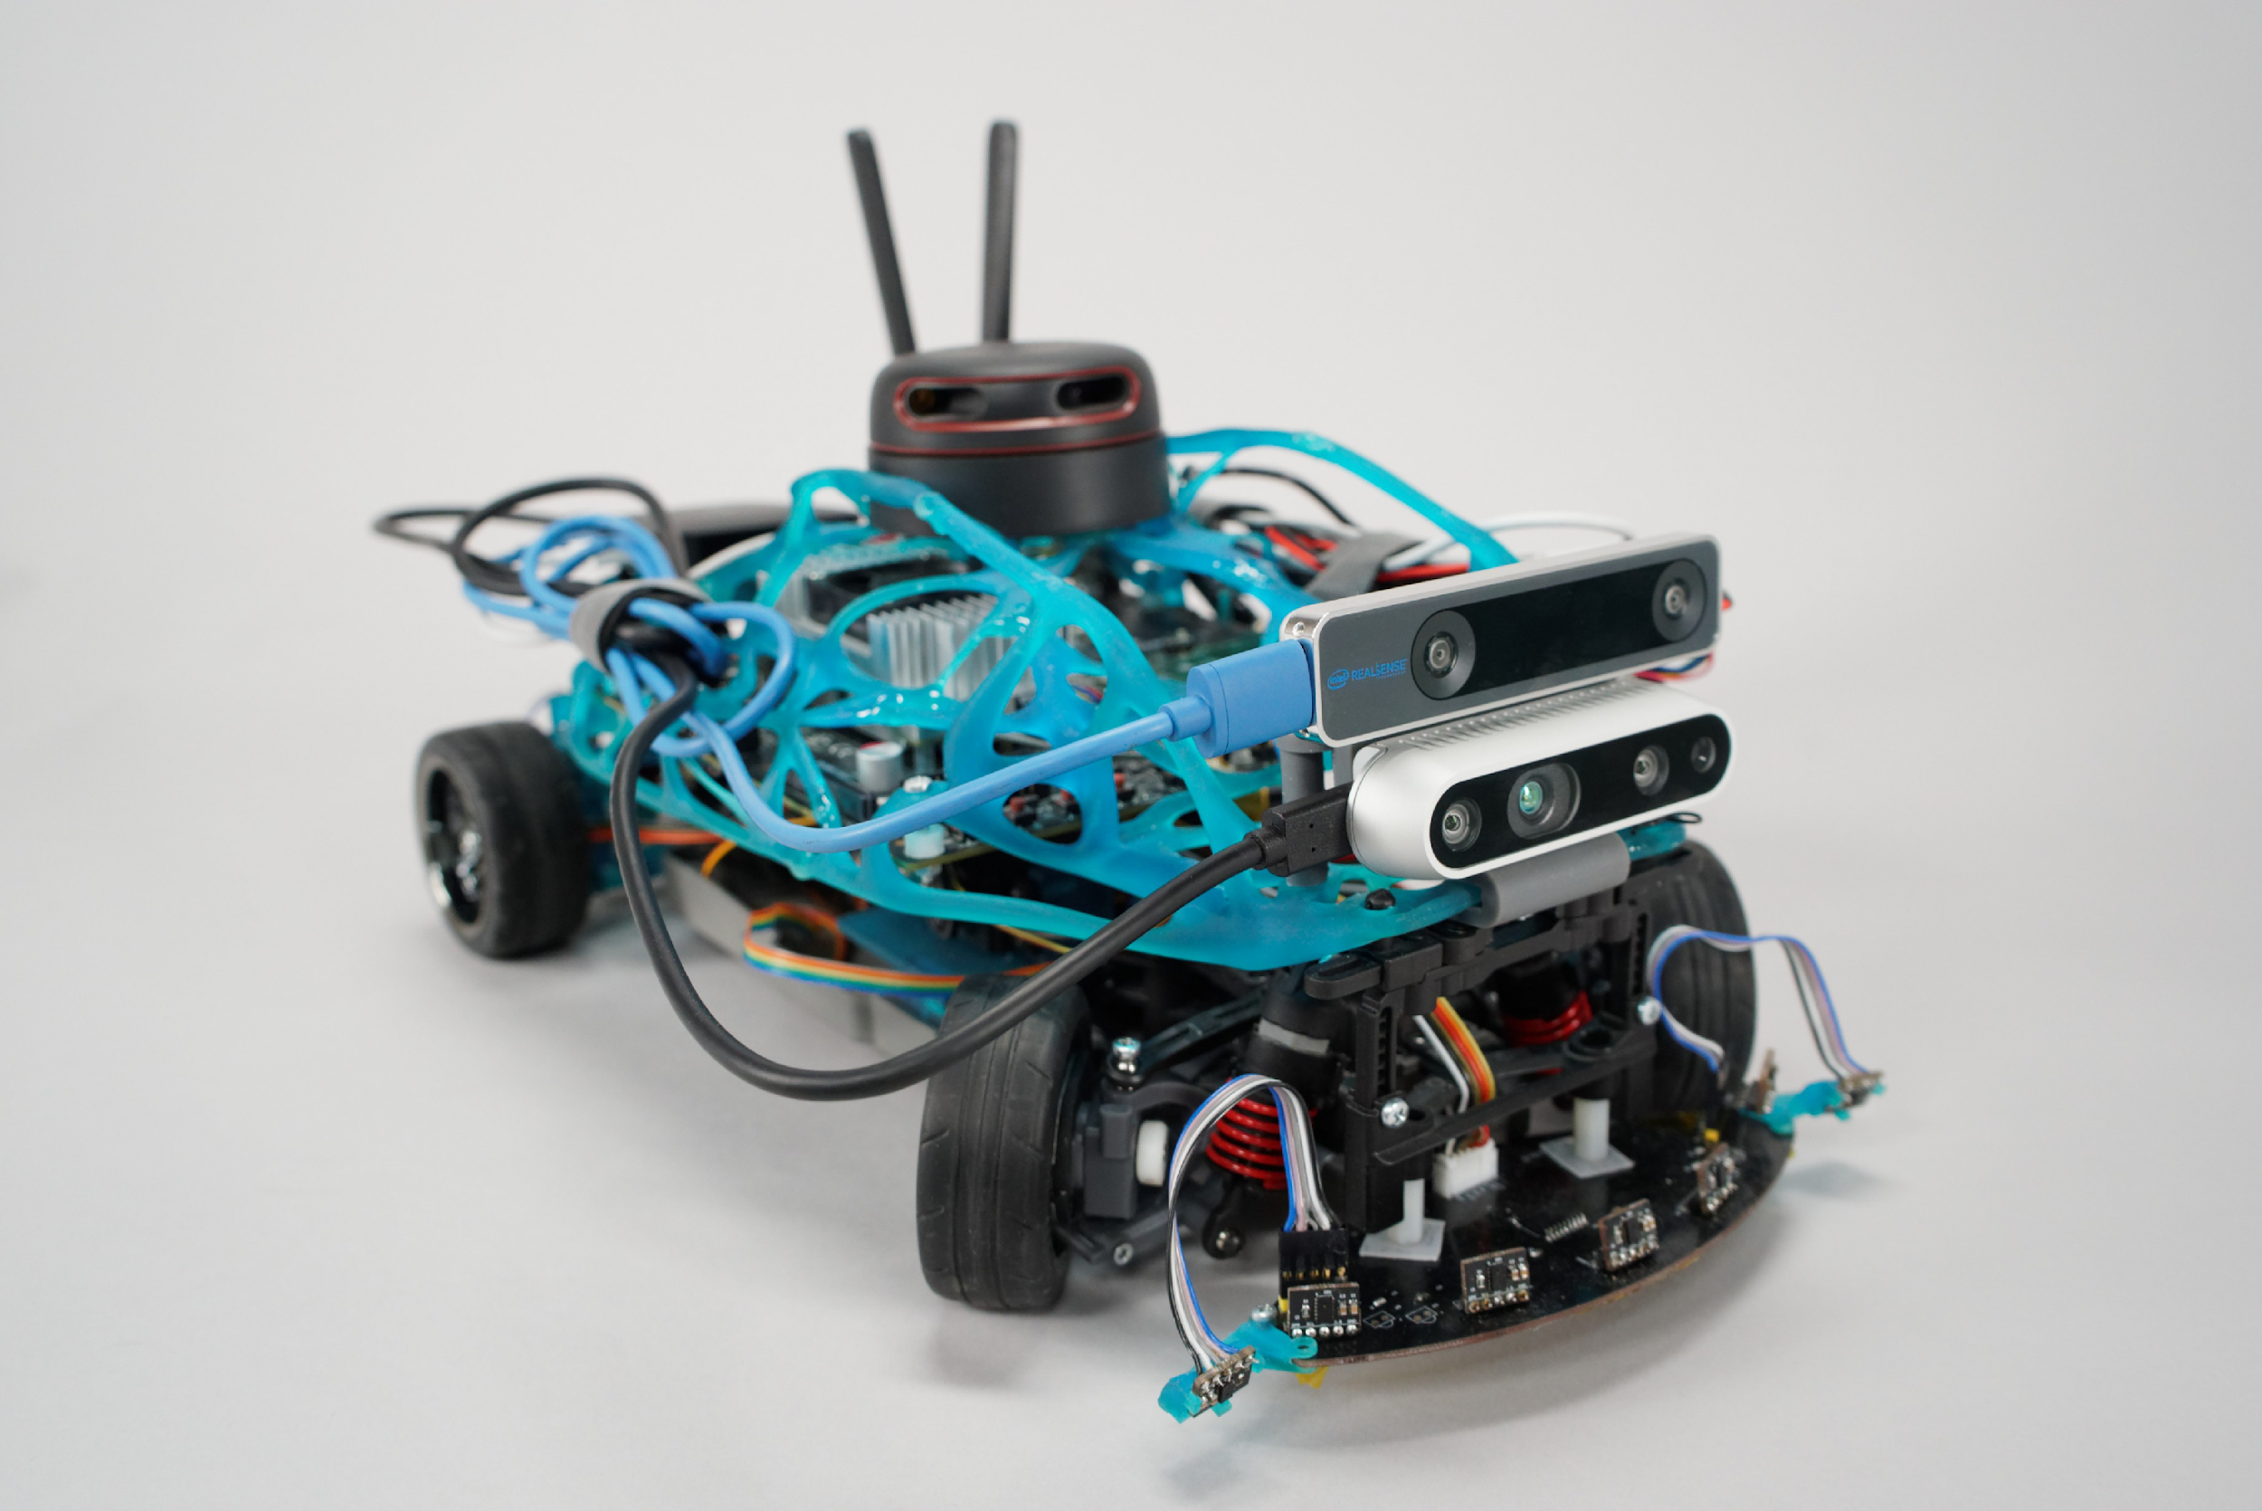
White-Rabbit evaluation device for SPD TSS prototyping Dmitry Ryabikov Industrial Systems for Streaming Data Processing Laboratory, “Digital Engineering” Advanced Engineering School, SPbPU
SPD collaboration meeting
___________________________________
October 24th, 2023

Slide 2
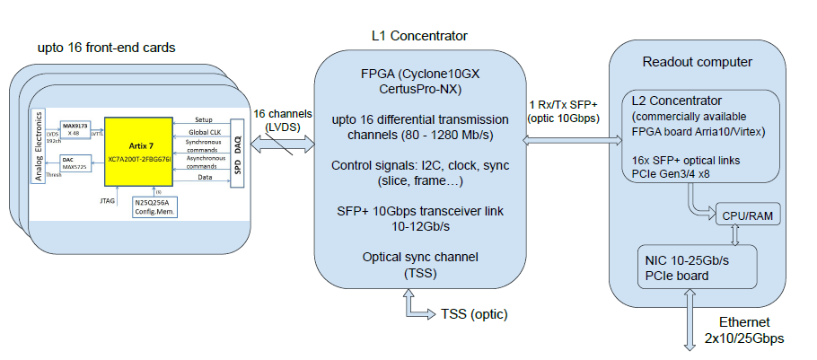
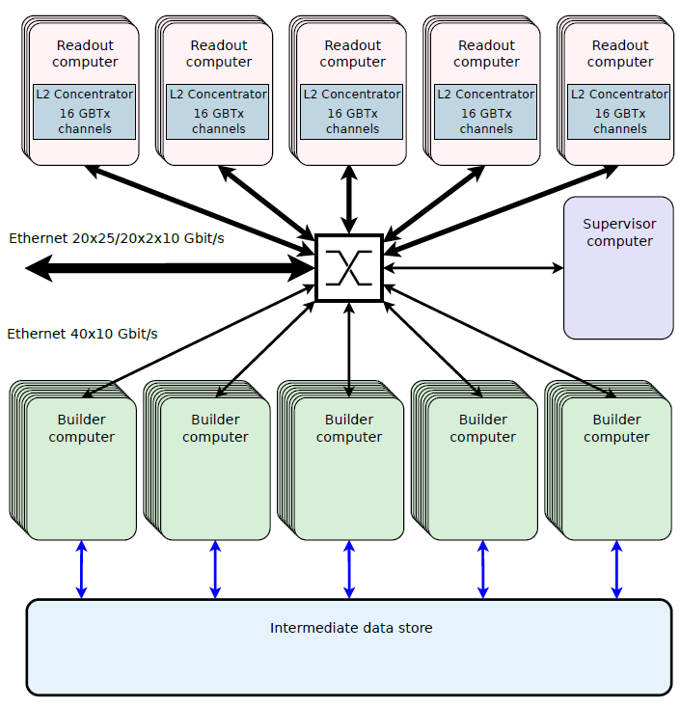
TSS instead of TCS
TCS – Trigger and Control System
TSS – Time Synchronization System
Triggerless
Higher precision
Versatile
More complex
Synchronizes with NICA
Propagates bunch crossing signal into DAQ system
Synchronizes all the DAQ units
Controls data acquisition process
SPD slice building
SPD readout chain

Slide 3
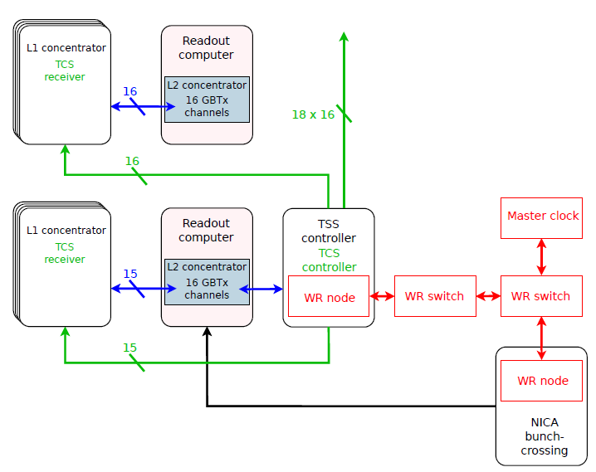
TSS architecture options. TCS-based approach
TCS – well-known method of clock and control distribution
TSS should have different interfaces for NICA and for DAQ
Might be difficult to achieve the required 1 ns accuracy

Slide 4
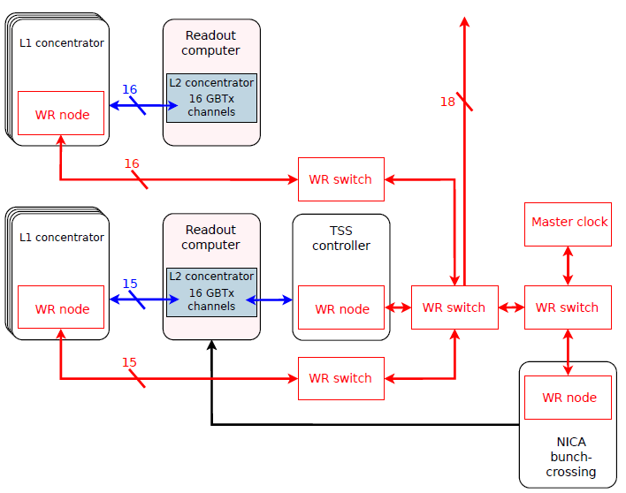
TSS architecture options. WR-based approach
WR PTP – standard protocol developed and widely used by CERN
Same interfaces for all connections
More elegant but expensive and sophisticated solution
Guaranteed accuracy is much better than 1 ns

Slide 5
White Rabbit in TSS
No matter what option we will choose – anyway TSS will contain at least one WR node.
NICA uses White Rabbit protocol, so it is the most convenient way for SPD-DAQ to obtain synchronization with NICA.
Decided to start from developing WR-compatible hardware platform.
It should have enough resources and performance.

Slide 6
TSS development roadmap
HW platform: Schematic and PCB
White Rabbit node project porting to the HW platform
2022
TSS design option choosing: TCS-based or WR-based
TSS control protocol implementation
2023
In-system debugging and testing
2024
NICA interface implementation
White Rabbit switch project implementation
Optional

Slide 7
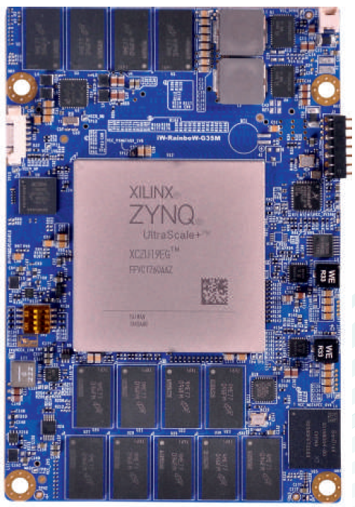
White-Rabbit evaluation board. FPGA
Xilinx Zynq UltraScale+
iWave iW-RainboW-G30M SoM with everything needed on-board
Up to 504K Logic cells & 230K LUTs
PL GTH High Speed Transceivers x 16 @ 16.3 Gbps
DDR4 RAM: 4GB on PS, 2GB on PL
Flash: 8GB eMMC
ARM Cortex-A53 hard processor system on-board – some TSS functions could be implemented in software

Slide 8
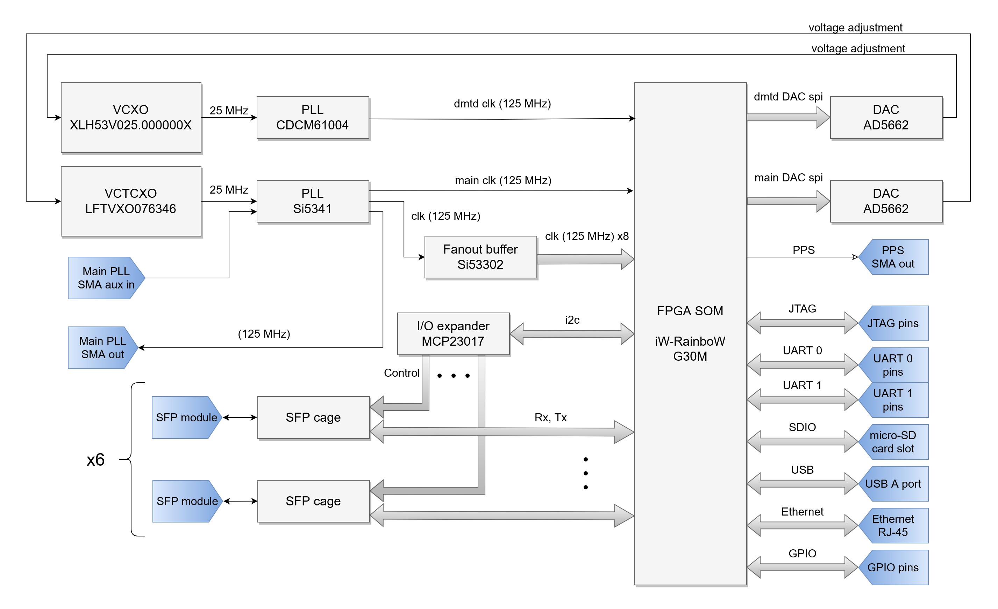
White-Rabbit evaluation board. Top level view

Slide 9
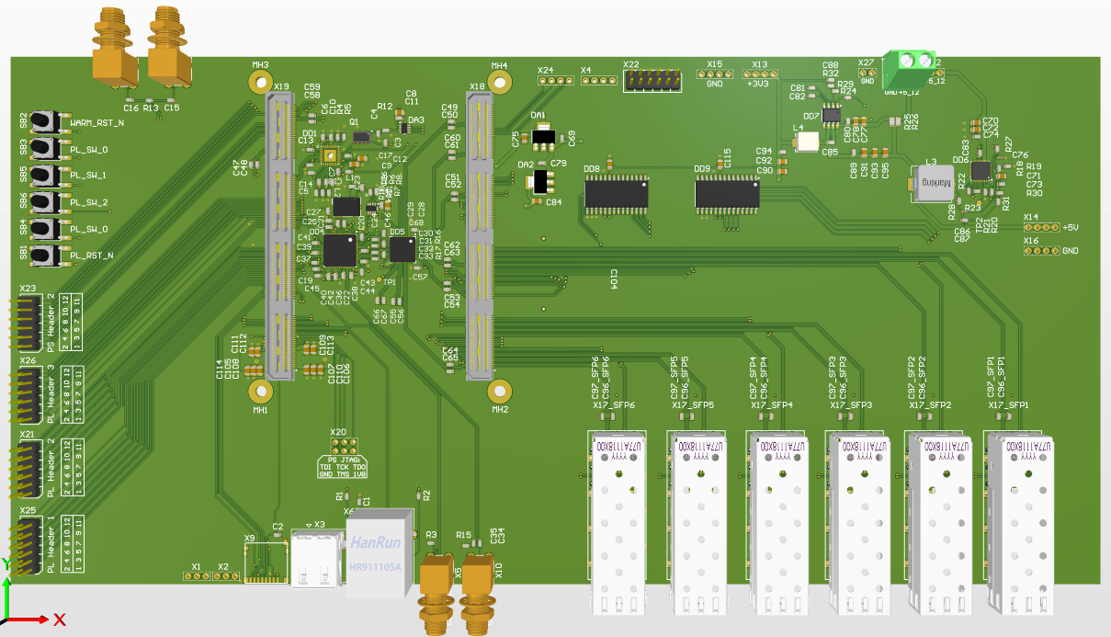
White-Rabbit evaluation board. PCB
Custom board based on CERN White Rabbit reference design
Multi-port baseboard with WR switch functionality – could be a multipurpose device

Slide 10
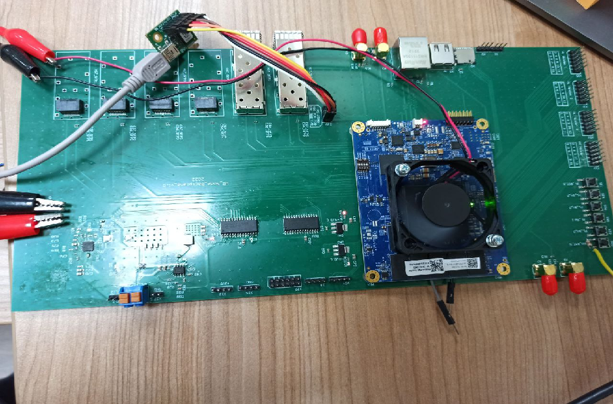
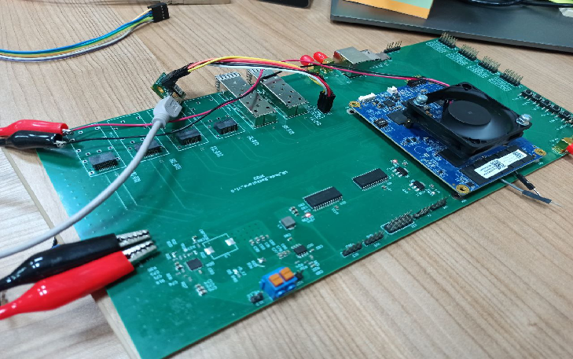
White-Rabbit evaluation board. PCB

Slide 11
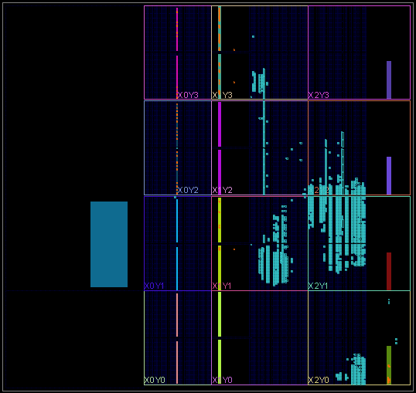
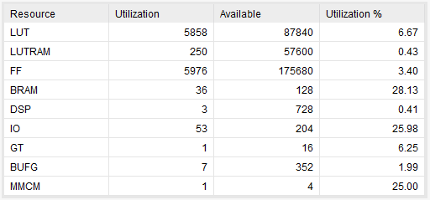
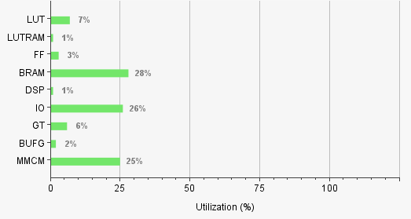
FPGA project
Taken the most relevant WR reference design for Xilinx Zynq UltraScale+ FPGA from CERN’s open hardware repository
Ported it to our hardware platform
Hardware debug

Slide 12
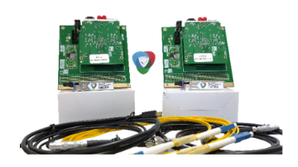
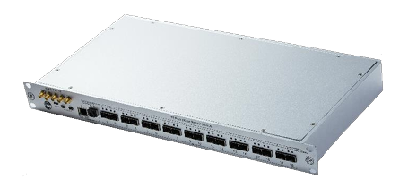
White-Rabbit evaluation board. Current and further steps
Board setup and refinement
Setup with SyncTechnology equipment: WRS-18A, Cute-WR-A7-PKG
Evaluation different configuration our platform with SyncTechnology equipment

Slide 13
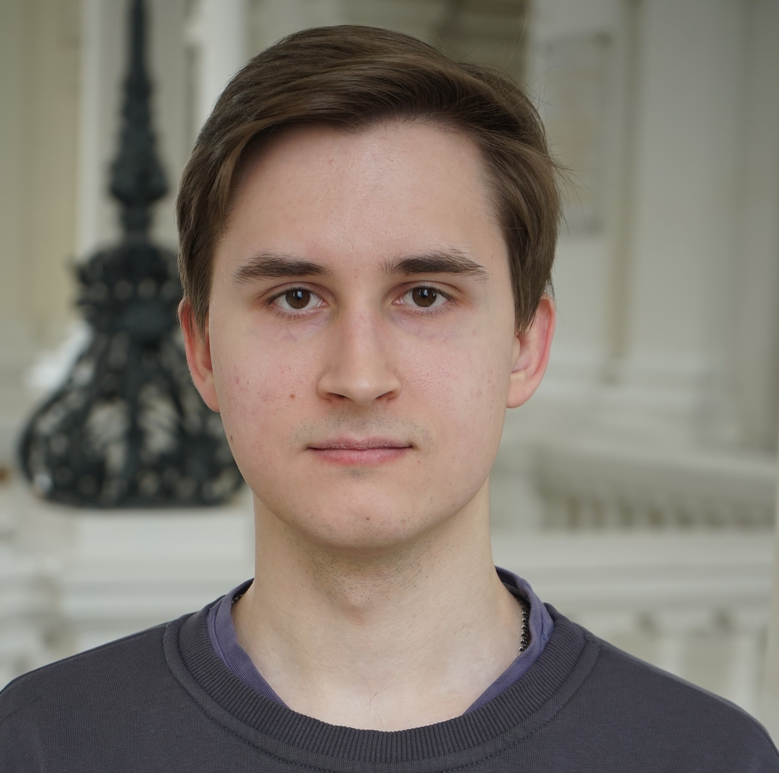
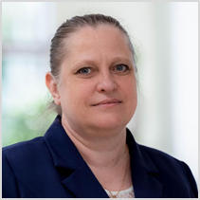
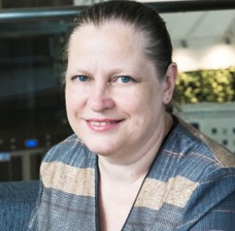
Contacts
Dmitry Ryabikov
Marina Bolsunovskaya,
Cand. of Engineering
Junior Engineer
Head of Laboratory
Tel: +7 (812) 980-11-31
E-mail: marina.bolsunovskaia@spbpu.com
E-mail: dmitry.ryabikov@spbpu.com

