Slide 1
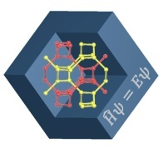
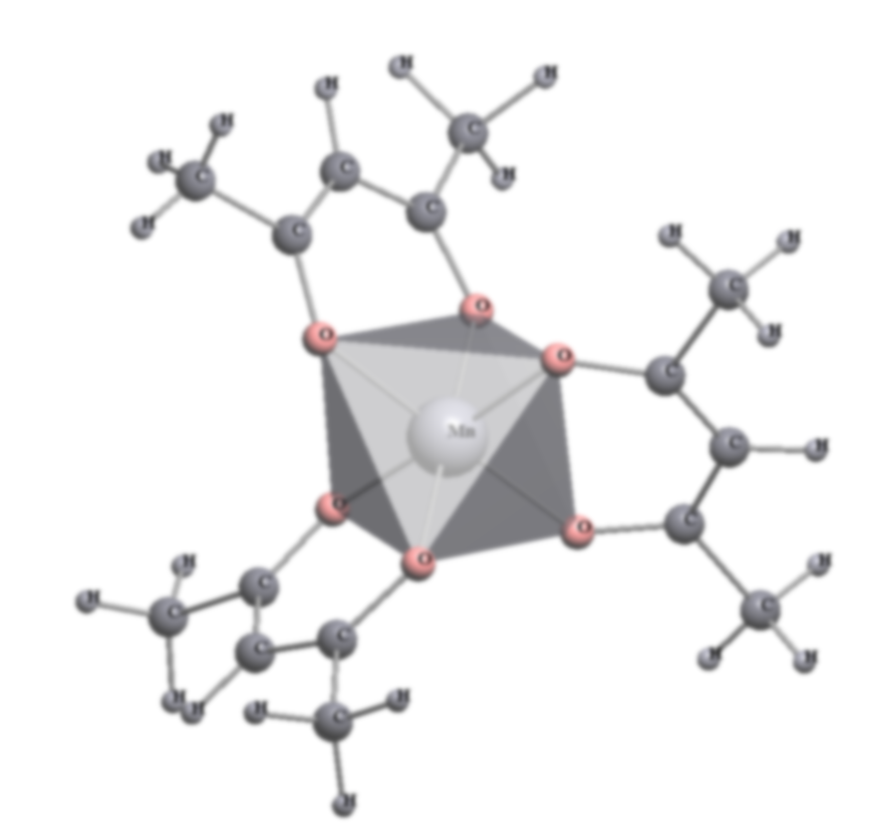
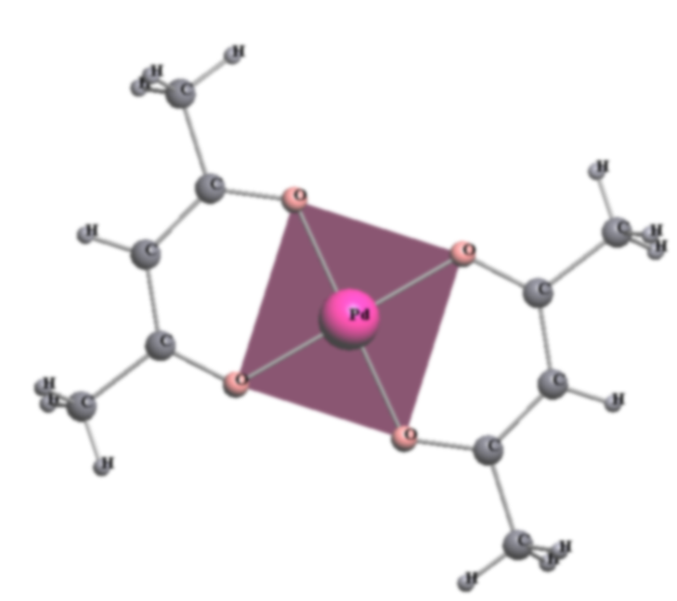
SCTMS
A data dashboard is a useful tool for identifying structure-property correlations in monoligand complexes
Barabanova E.D., Junior Research Scientist
Shevchenko A.P
Senior Research Scientist

Slide 2
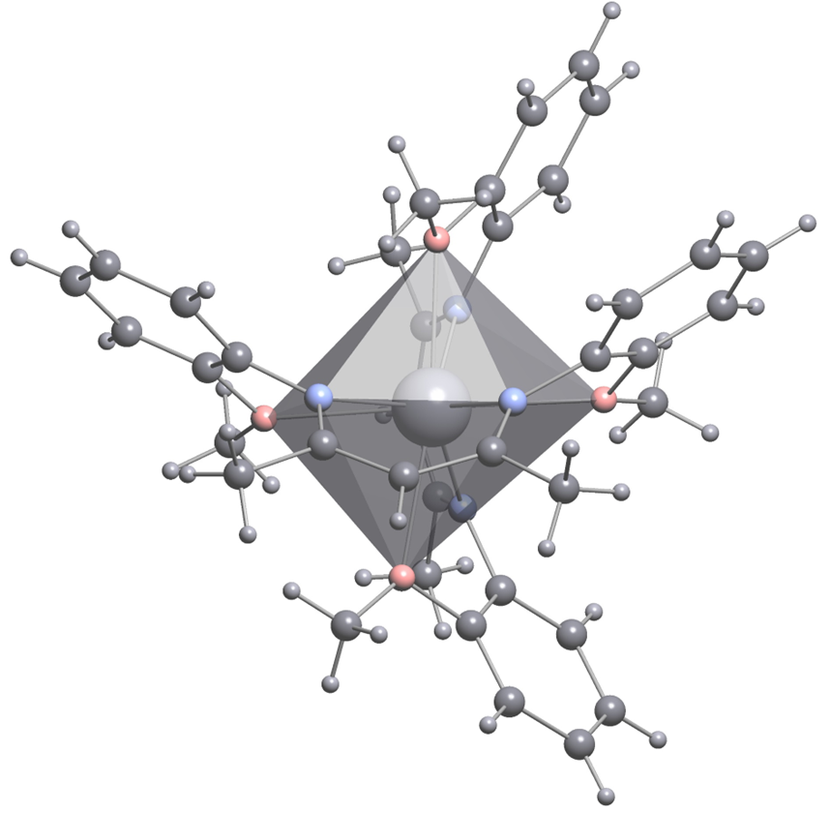
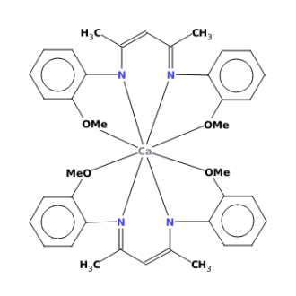
Monoligand Complexes
Specificity:
Central metal atom All the ligands are identical
Application:
Catalysts*
Organic Light-Emitting Diode**
High efficiency OLEDs***
*Sagnik K. R., Mrinmay M., Debashis C., et al.; Polym. Chem.,12, 3953-3967, 2021
**Akira T., Hironobu I., Manabu F., et al,. Am. Chem. Soc. 2003, 125, 42, 12971–12979, 2003
***Man Chen; Li-Ding Wang; Yue Wang, et al.; Organic Electronics, ISSN: 1566-1199, Vol: 75, Page: 105439
M.H.Chisholm, J.C.Gallucci, K.Phomphrai,Inorganic Chemistry, 2004, 43, 6717

Slide 3
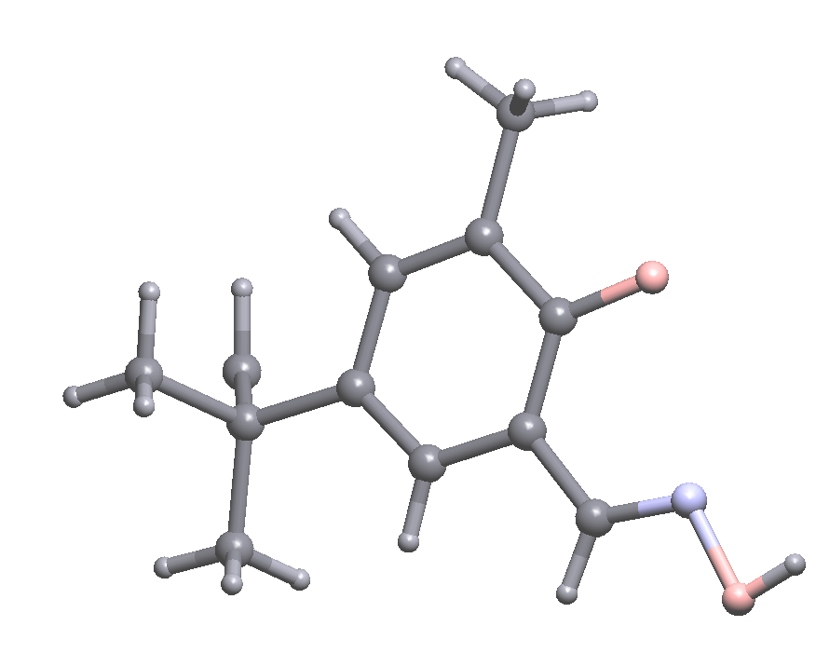
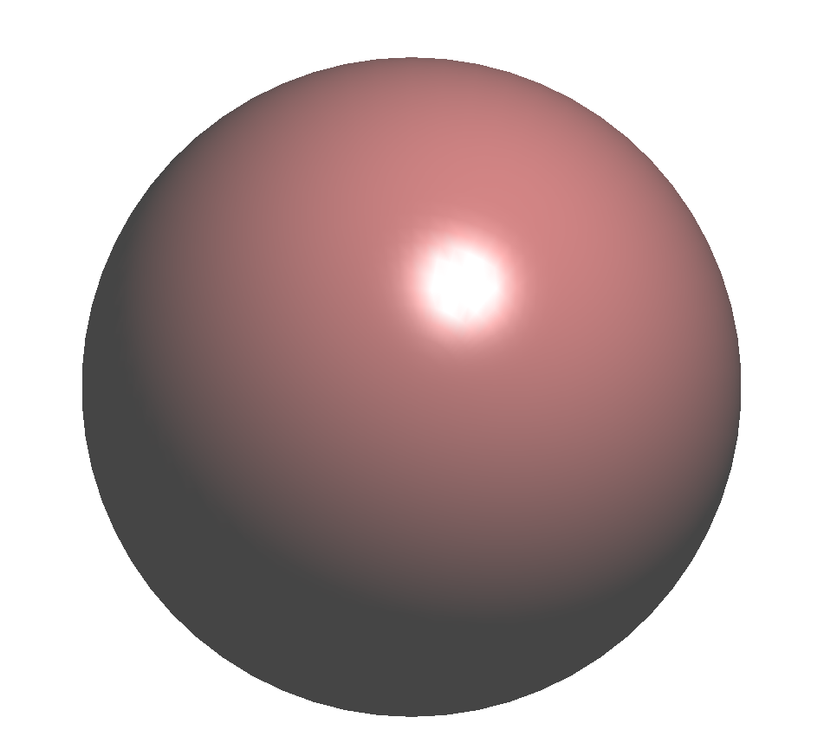
Correlations
Structure – property
x
y
z
?
Prediction of chemical compounds properties
Process Design and Optimization
Designing New Materials
Solving real problems
Additional features
High efficiency OLEDs

Slide 4
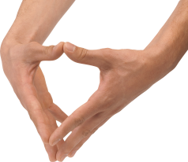
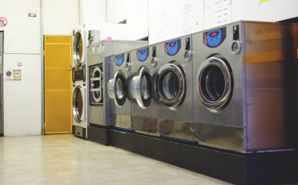
The role of Data Dashboards
Instrument

Slide 5
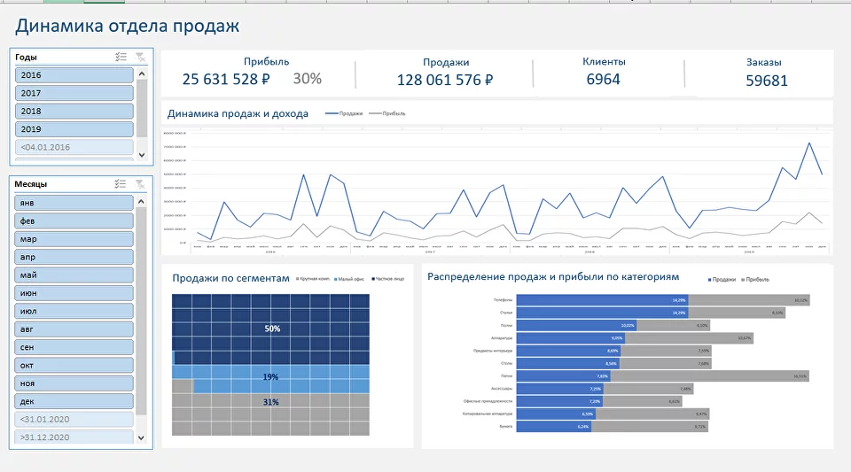
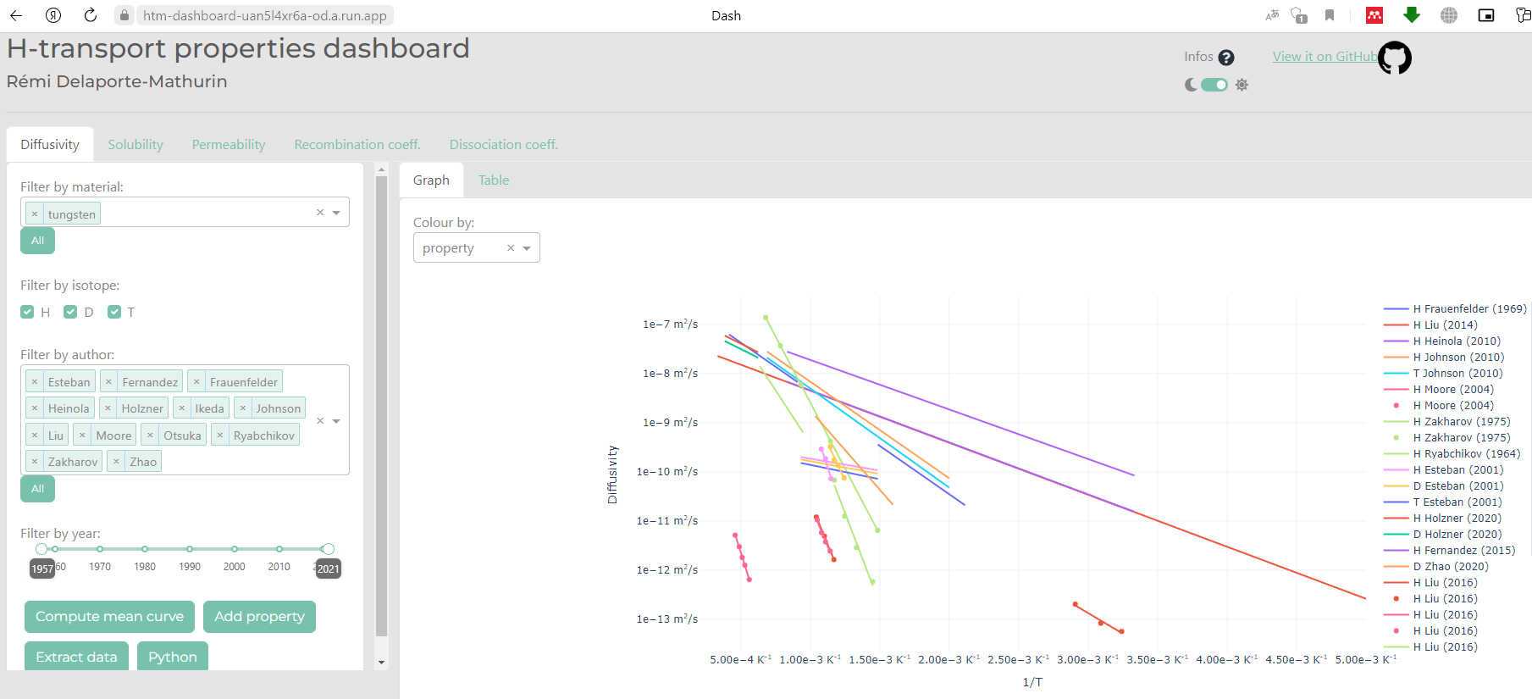
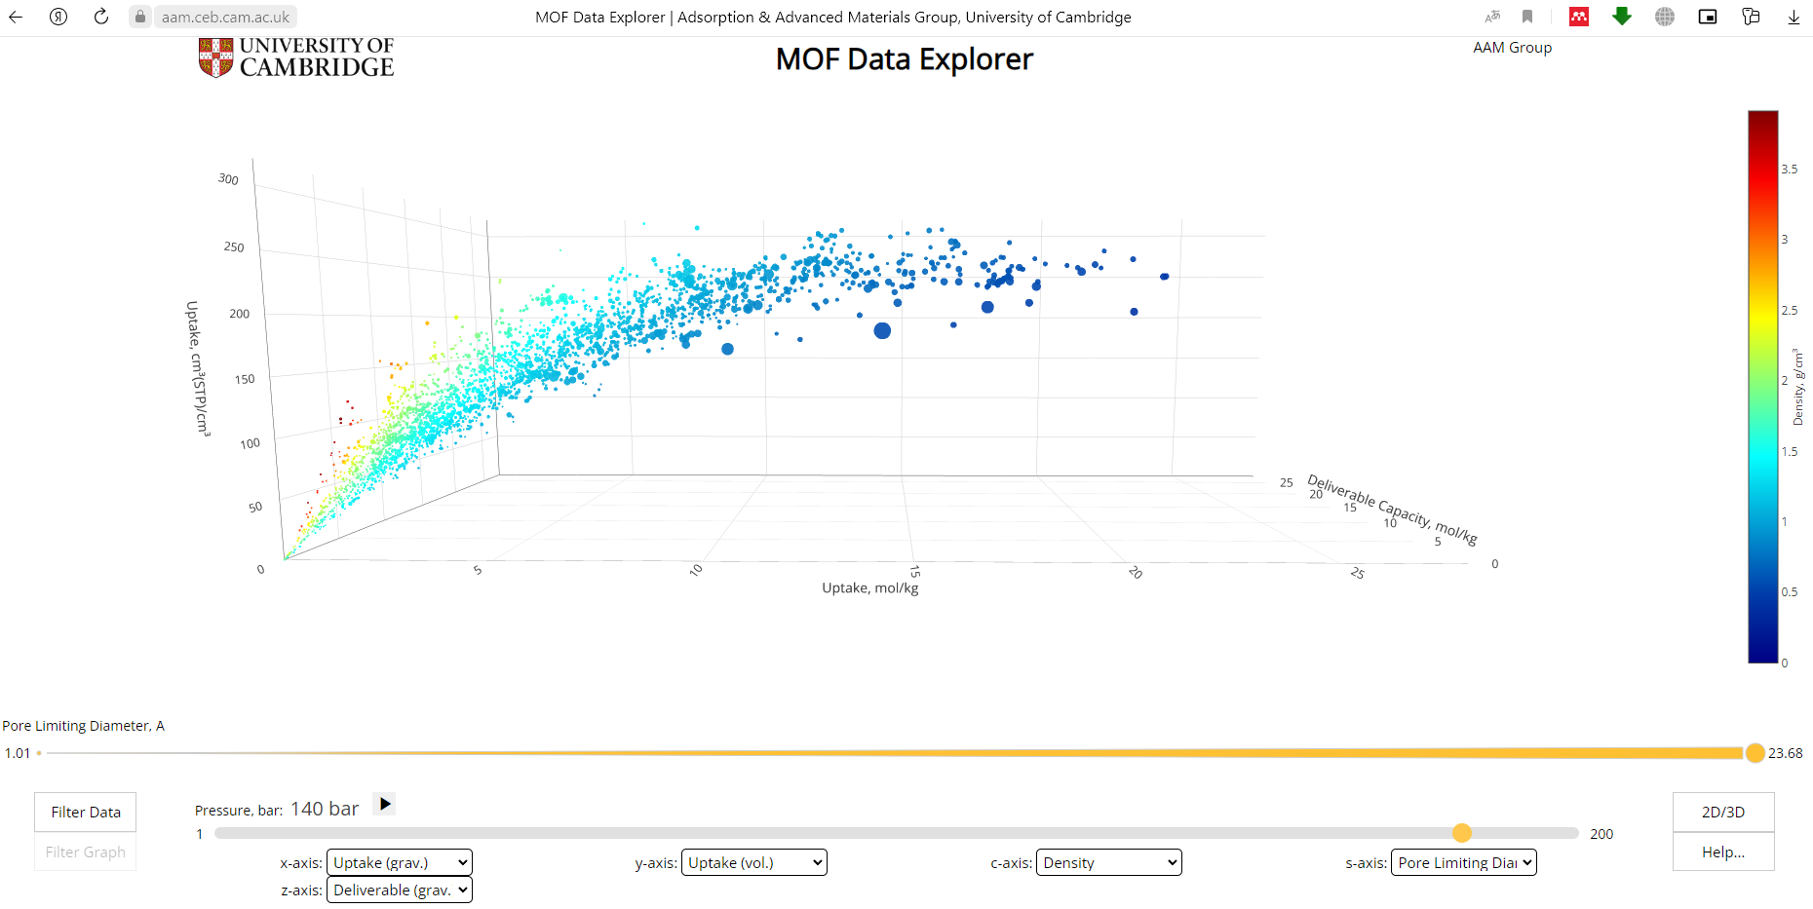
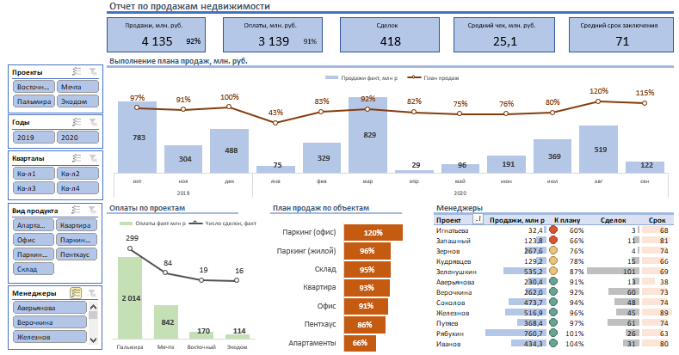
Data dashboard examples
https://htm-dashboard-uan5l4xr6a-od.a.run.app/
https://alexkolokolov.com
https://aam.ceb.cam.ac.uk/mof-explorer/

Slide 6
Creating a Dashboard
Search for all monoligand complexes
Make calculations of Me atoms parameters (V, S, G₃, VCP, CP et al.) ligands, composition of external particles et al.
Determination of oxidation states
Data Analysis
Determination of the important parameters
Design development
Creating a Dashboard
The Cambridge Crystallographic Data Centre
A comprehensive system for geometrical and topological analysis of crystal structures
http://topospro.com/
2013; 2016

Slide 7
Parameters used for the dashboard
Coordination number (CN) – the total number of neighbors of a central atom in a molecule or ion.
Atomic Voronoi–Dirichlet polyhedron (VDP) is a convex polyhedron whose faces are perpendicular to segments connecting the central atom of VDP (VDP atom) and other (surrounding) atoms*
V_{VDP} – The volume of the Voronoi-Dirichlet (VD) polyhedra
Radius of spherical domain (R_{sd}) is the radius of a sphere of VDP volume
Coordination polyhedra (CP) is a ligands' geometric pattern or spatial arrangement directly linked to the centre atom or an ion
***
G₃ – normalized second moment of inertia
The smallest value, G₃ = 0.07697, corresponds to a sphere
VDP of Cu atom at bis(4-t-Butyl-2-((hydroxyimino)methyl)-6-methylphenolato)-copper(ii) crystal structure. CN of Cu atom is 4 **
R is the distance between the atom and a point inside the Voronoi-Dirichlet polyhedron
* Блатов В.А., Шевченко А.П., Сережкин В.Н. // Кристаллография. 1995. Т. 51А. №6. С. 909.
** R.S.Forgan, B.D.Roach, P.A.Wood, F.J.White, J.Campbell, D.K.Henderson, E.Kamenetzky, F.E.McAllister, S.Parsons, E.Pidcock, P.Richardson, R.M.Swart, P.A.Tasker, Inorganic Chemistry, 2011, 50, 4515.
*** Cережкин В.Н., Сережкина Л.Б. // Журнал неорганической химии. 1994. Т. 39. № 12. С. 1871.

Slide 8
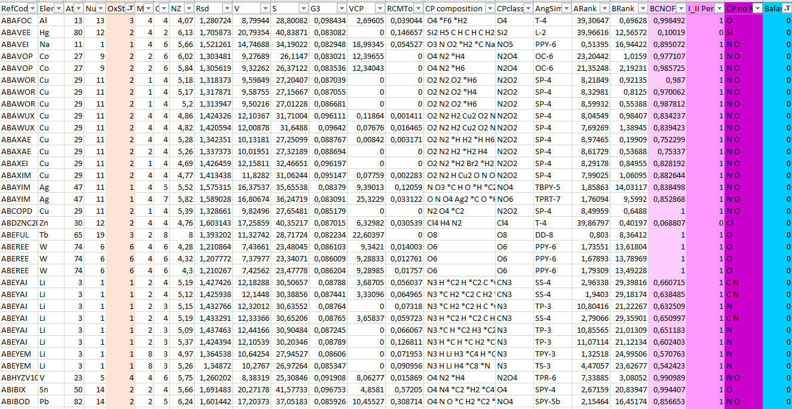
Creating a Dashboard

Slide 9
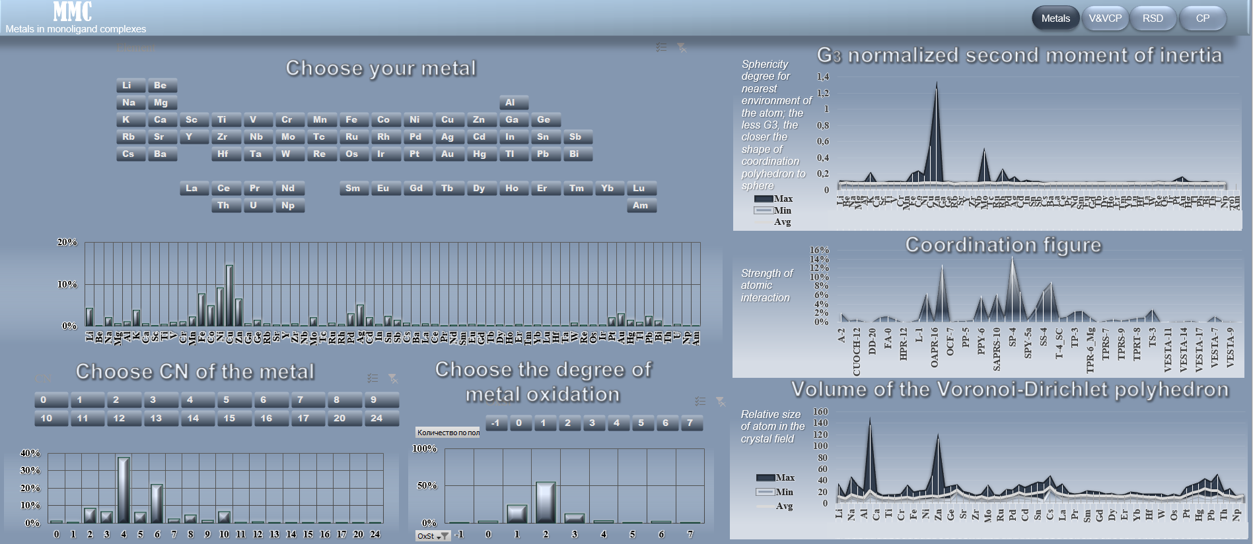
Interactive Features

Slide 10
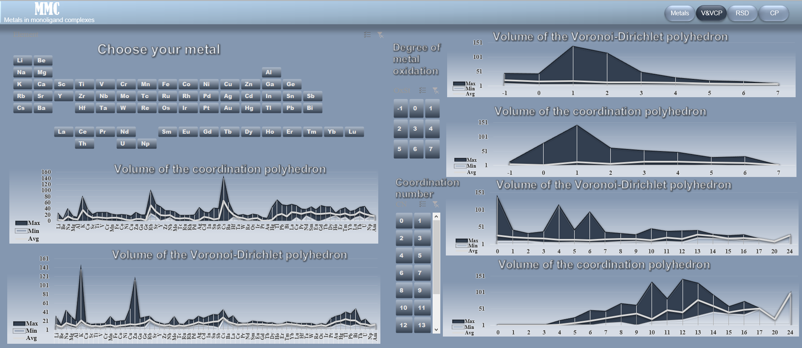
Interactive Features

Slide 11
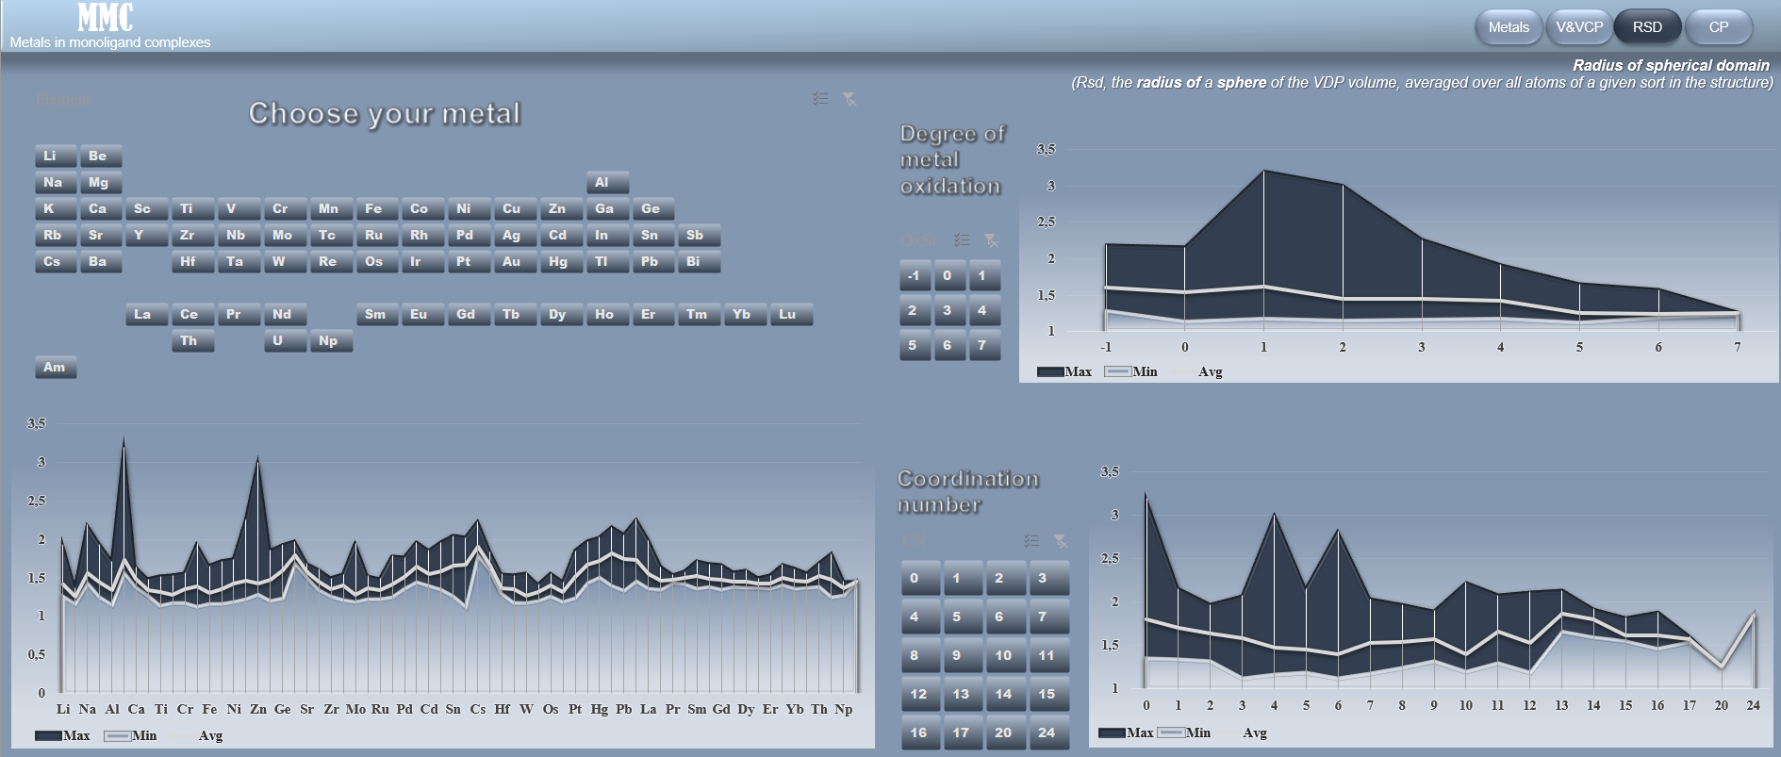
Interactive Features
11

Slide 12
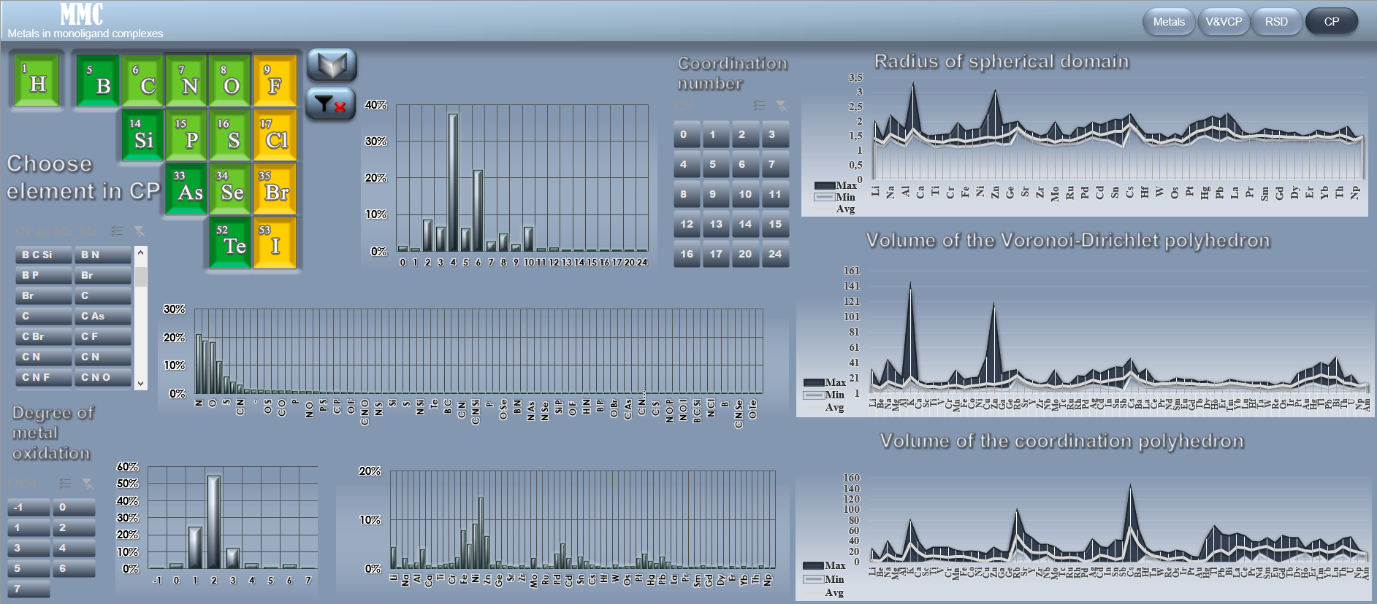
Interactive Features
12

Slide 13
Our Internet resources
https://topcryst.com/

Slide 14
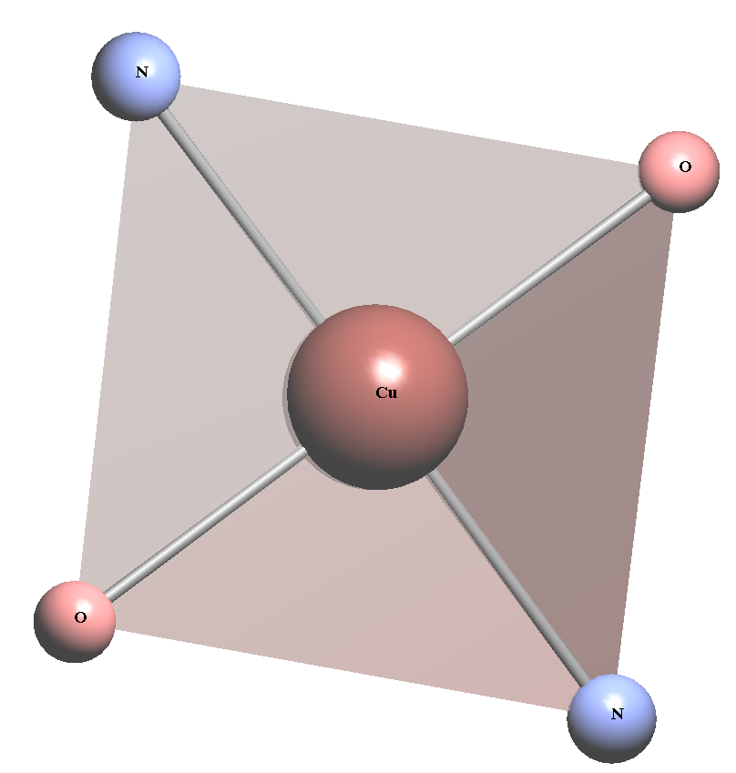
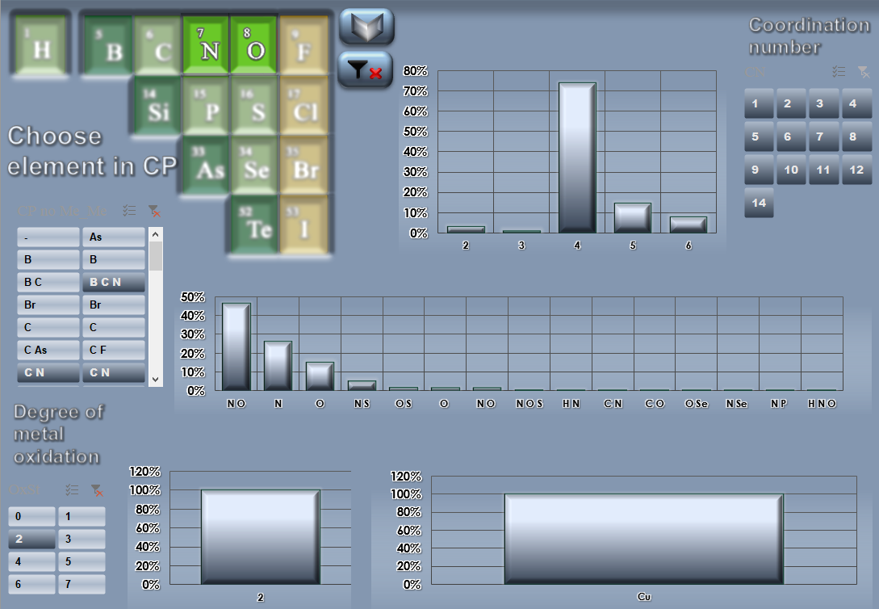
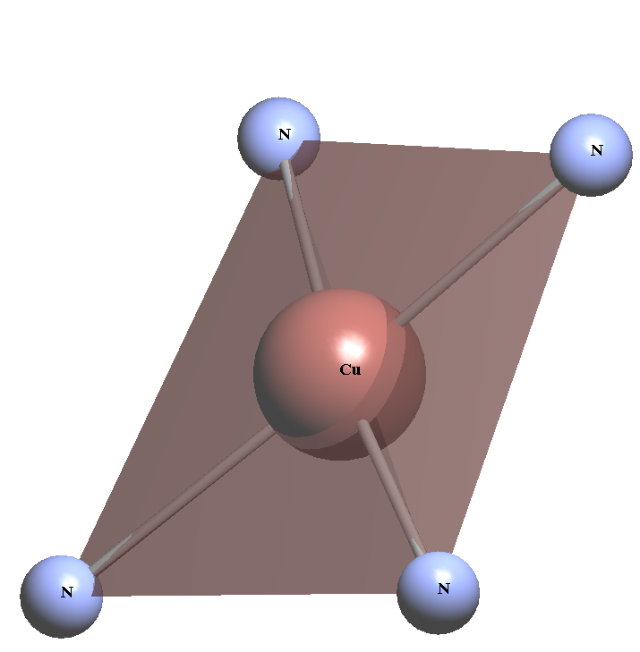
Case
Задача:
Спрогнозировать КЧ для соединения с атомом Cu со степенью окисления +2 и координационным полиэдром в состав которого входят атомы N и/или O

Slide 15
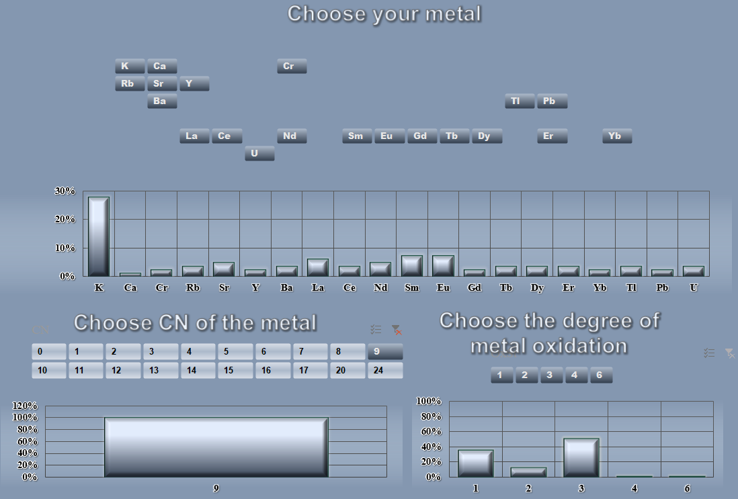
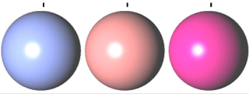
Case
Задача: Комбинация каких параметров приведёт к соединению с КЧ металла 9?
X
Y
Z

Slide 16
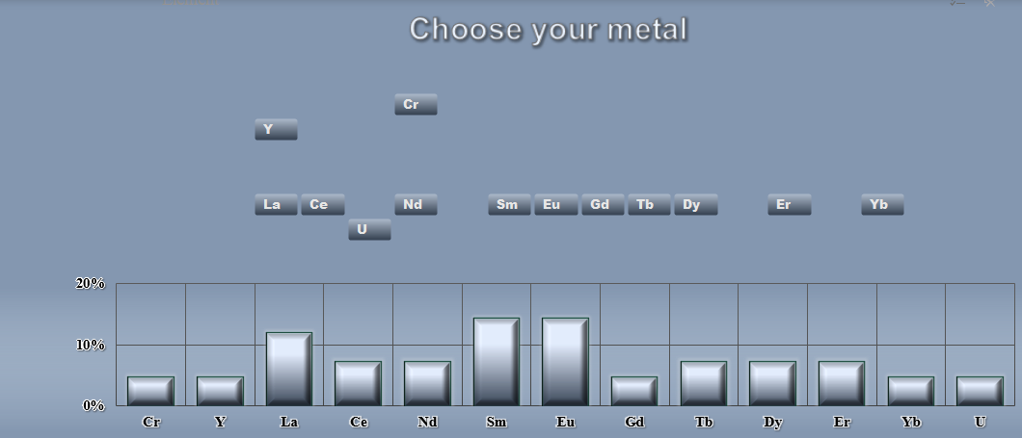
Case
Задача: Комбинация каких параметров приведёт к соединению с КЧ металла 9?
X
Y
Z⁺³

Slide 17
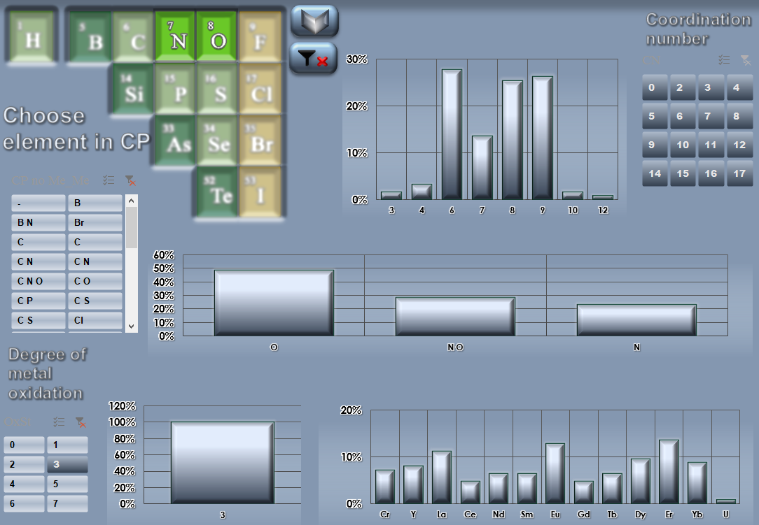
Case
Задача: Комбинация каких параметров приведёт к соединению с КЧ металла 9?
N/O
N/O
Z⁺³

Slide 18
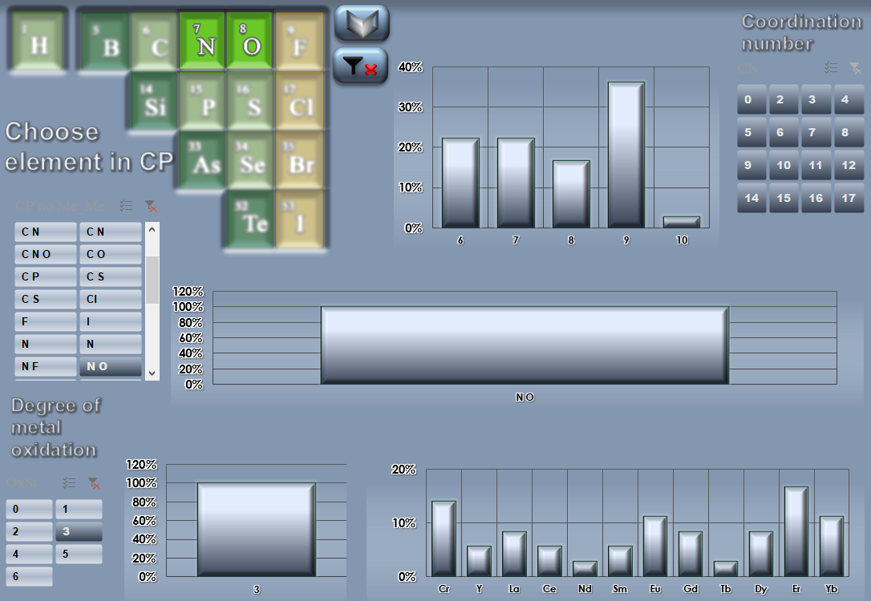
Case
Задача: Комбинация каких параметров приведёт к соединению с КЧ металла 9?
N
O
Z⁺³

Slide 19
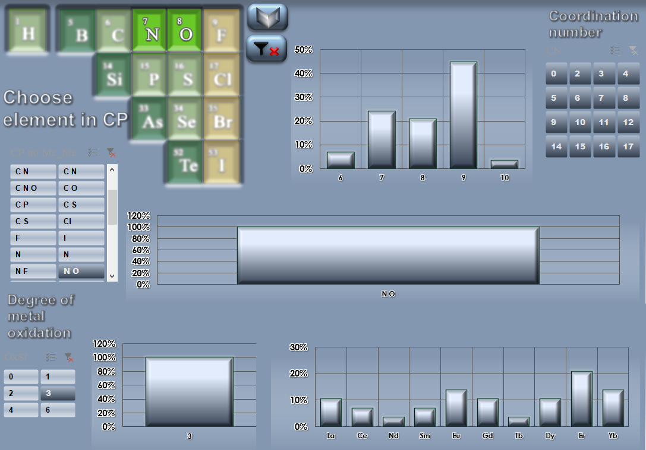
Case
Задача: Комбинация каких параметров приведёт к соединению с КЧ металла 9?
N
O
Ln⁺³

Slide 20
Thank you for your attention!

