Slide 1
BM@N Run 8 raw data production on distributed infrastructure with DIRAC
Konstantin Gertsenberger
Igor Pelevanyuk
LHEP
MLIT
AYSS Conference 2023, 30 October - 03 November 2023

Slide 2
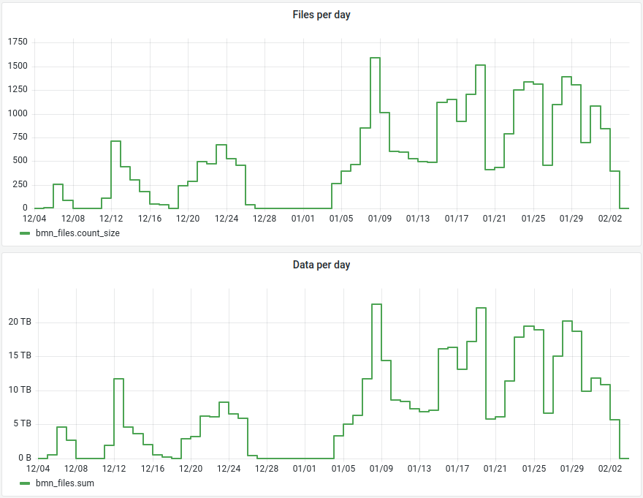
Run8 Data collection
Total files: 31306
Total raw size ~ 436 TB

Slide 3
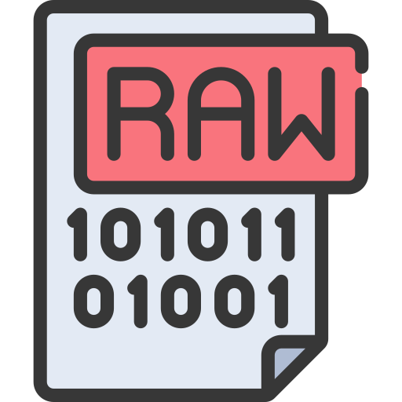

Workflow of production
RawToDigi
DigiToDst
DIGI
DST

Slide 4
The main task:
Develop fast and repeatable way to consistently perform BM@N productions for all data in general,
and for BM@N Run8 in particular
Side task:
Develop methods to record and use information about current productions
for estimation of future productions

Slide 5

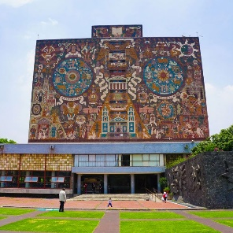




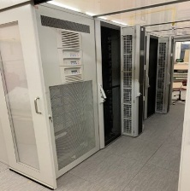
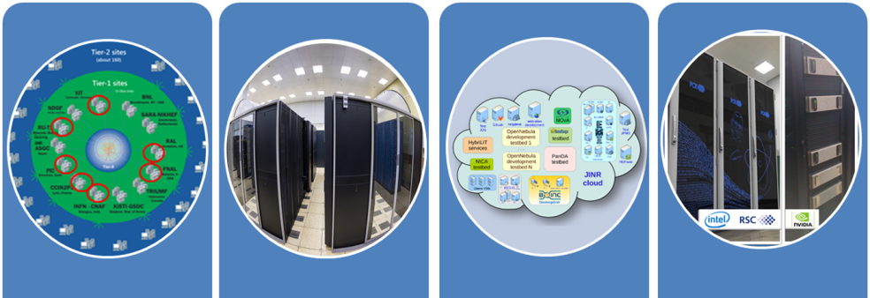

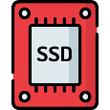
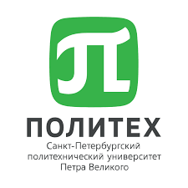

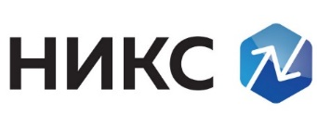
DIRAC in JINR
UNAM
MICC basic facility
NICA cluster
MLIT EOS
Clouds
Tier-1
Tier-2
Govorun
Lustre
Ultra-fast storage
NRCN (National Research Computer Network) is the Russia's largest research and education (R&E) network. May allow execution of jobs submitted to Govorun on a resources of the network. Massive tests with MPD jobs were performed successfully in the beginning of 2022
Polytech
MSC

Slide 6


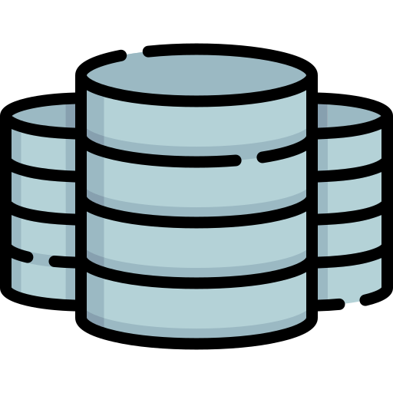
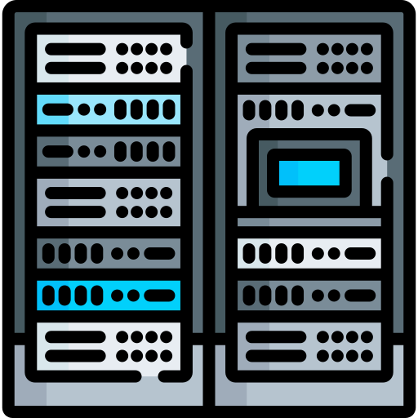
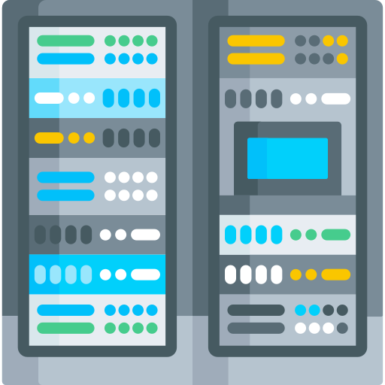
General scheme of resources
Step 1: data transfer
EOS MLIT
EOS LHEP
Tier1
Tier2
Govorun
NICA Cluster

Slide 7
Step 1: Data transfer
EOS MLIT
EOS LHEP
20 DIRAC Jobs
Tier1
Tier2
Govorun
NICA Cluster
Single stream of xrootd transfer can not exceed 100MB/s. Transfer would take ~ 50 days.
NCX interface node can sustain not more than 10 streams(1GB/s total). And that would overload its network.
So, 20 independent DIRAC jobs were sent to NICA cluster to perform transfers with one stream each.

Slide 8
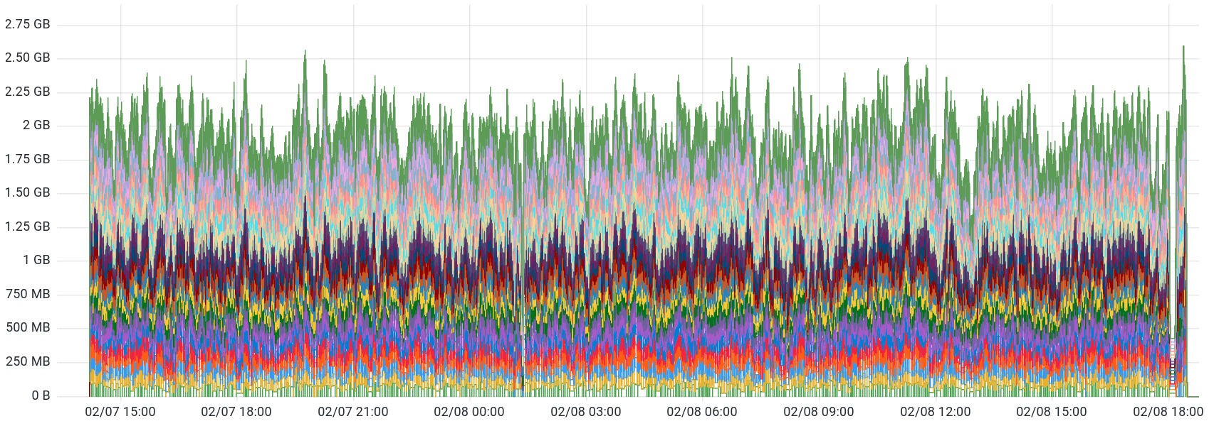
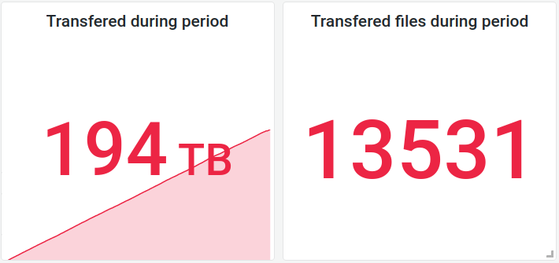
Step 1: Data transfer
Average transfer speed on 20 streams
1.92 GB/s
Total transfer duration:
2d 15h

Slide 9
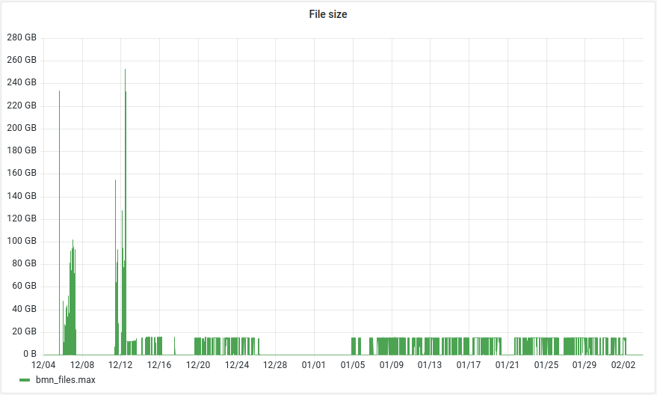
Step 2: Estimate the load
Size of files created during Run 8

Slide 10
Step 2: Raw2Digi job profiling
$ root macro.C(input)
$ job_monitoring root macro.C(input)
User job
(root)
job_monitoring
With the help of developed script we may record information about:
CPU used
RAM used
DISK read/write
Main issue was to record not only parameters of initial root process, but also its child processes.
User job
(root)
Here is a standard process run
Monitoring DB
(InfluxDB)

Slide 11
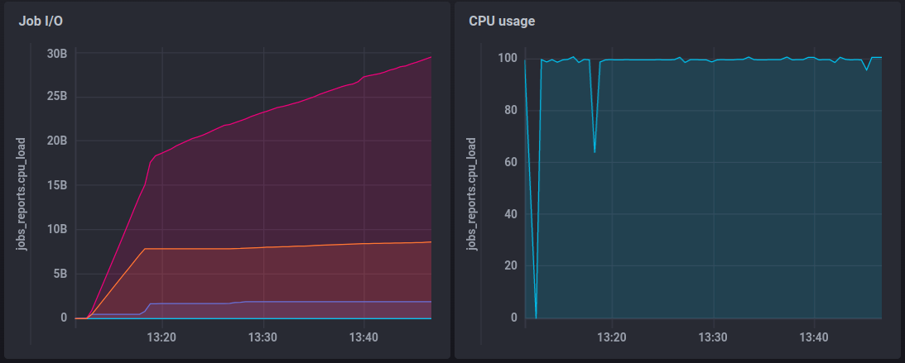
Step 2: Raw2Digi job profiling
Bytes read from disk
Read raw file and temporary file
Bytes written to disk
Write resulting Digi file
RAM usage
Disk usage
Temporary file: +8 GB
Result file: 800MB
Total disk usage per 15 GB job: 25 GB
Initial read of 15GB raw file and creation of temporary 8 GB file
RAM usage : ~2GB

Slide 12
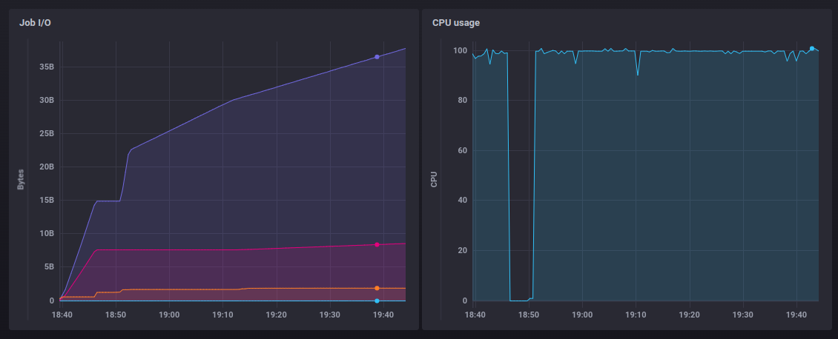
Step 2: Raw2Digi job profiling
Once Raw2Digi had strange 5m idle period.
Reason is a request to a database which failed by timeout.

Slide 13
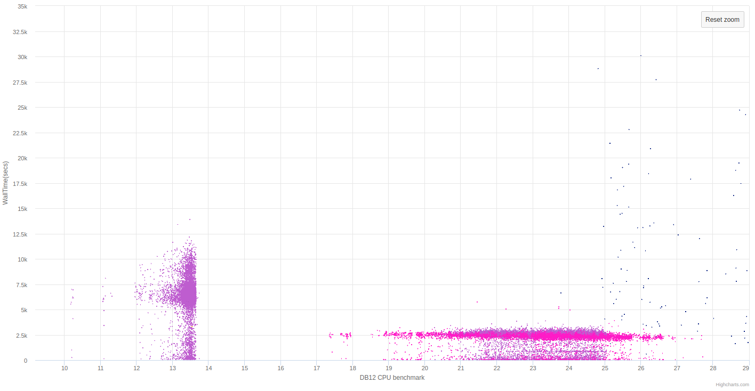
Step 3: Massive production Raw2Digi
Total duration of Raw2Digi campaign – 35 hours
Duration of a job
Each point is a job with particular duration on a core with particular perfomance the benchmark
Tier1 old cores
Govorun
Tier1 new cores
and NICA cluster
CPU core performance on benchmarks

Slide 14
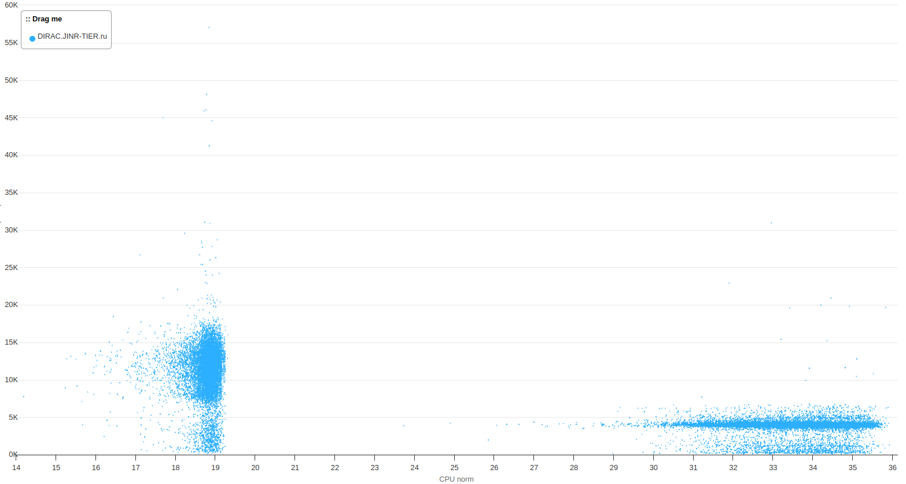
Step 3: Massive production Raw2Digi
Average Raw2Digi calculation time increased by 60%
(from 35 hours to 56 hours)

Slide 15
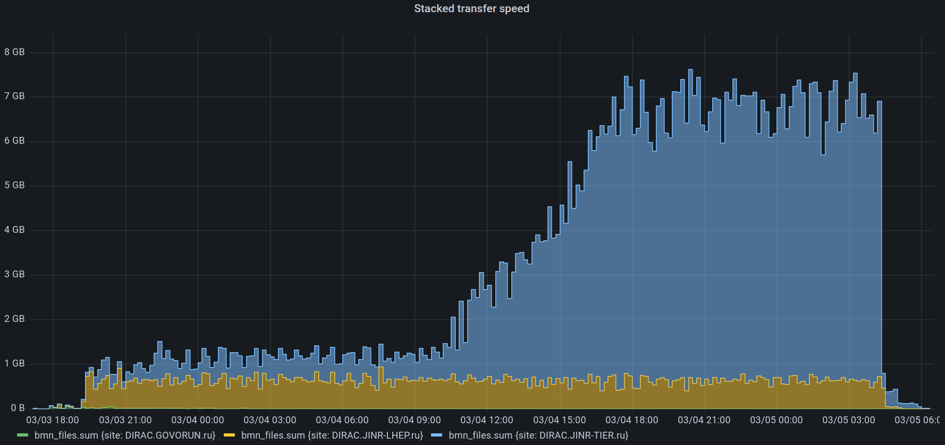
Step 3: Network usage
300 jobs running
4 MB/s per job
NICA Cluster
Tier1
1580 jobs running
4.1 MB/s per job
Maximal transfer speed (Read+Write) with EOS in MLIT – 7.5 GB/s

Slide 16
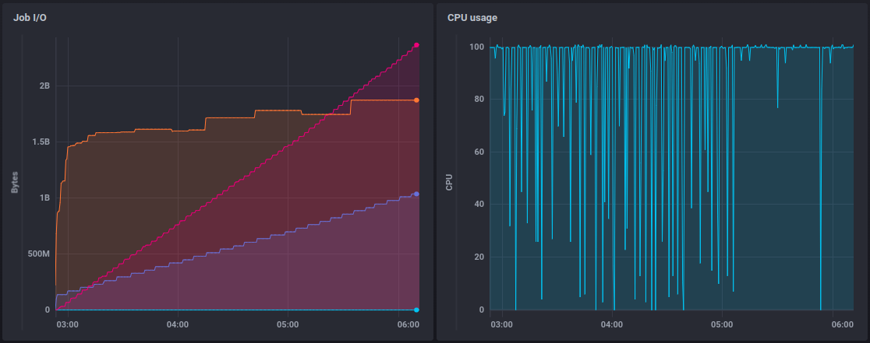
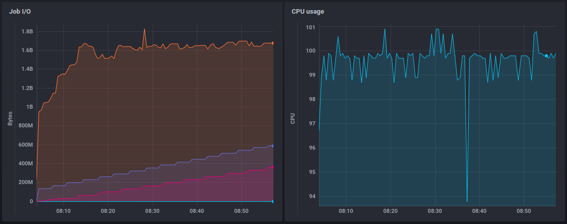
Step 4: Digi2Dst profiling
Write
RAM usage
Read
Write
RAM usage
Read

Slide 17
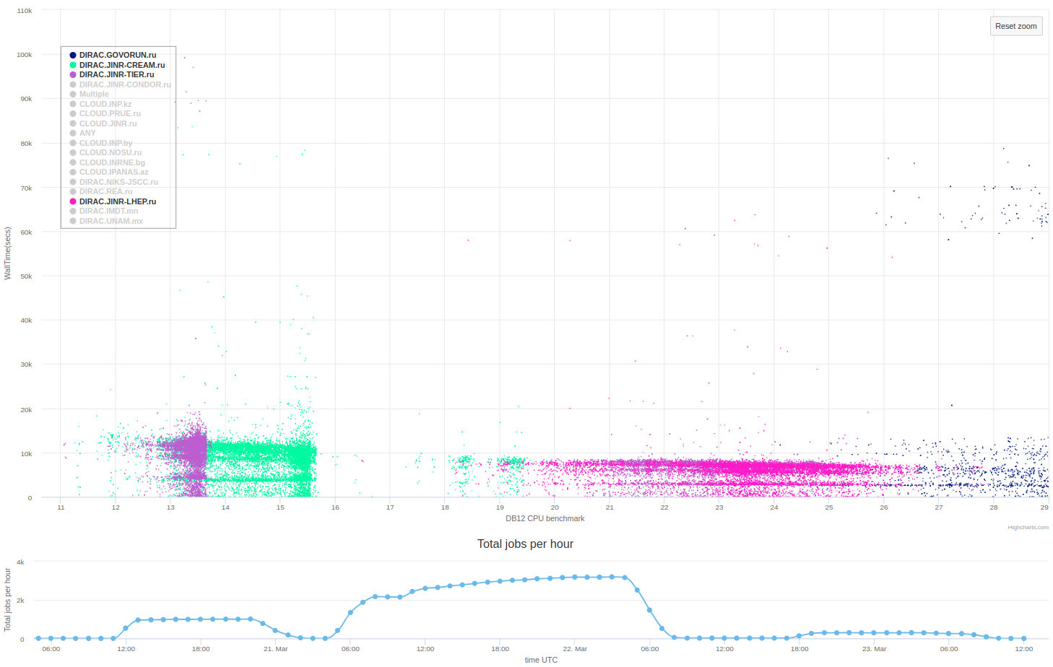
Step 5: Initial production Digi2Dst
Tier2
Govorun
Tier1 old cores
Tier1 new cores
NICA Cluster
~3100 Running jobs

Slide 18
Step 5: Initial production Digi2Dst

Slide 19
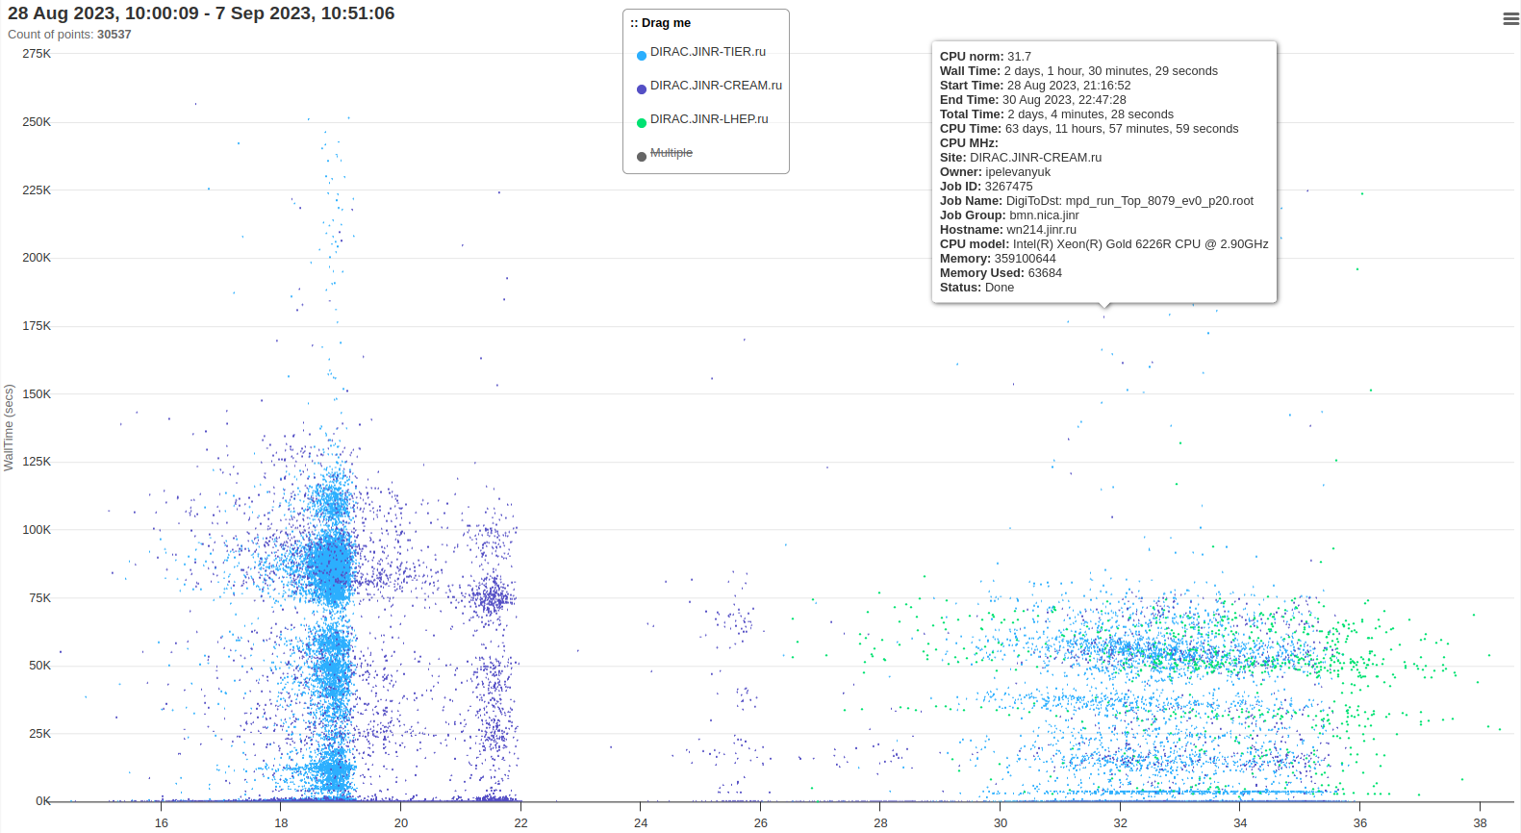
Step 5: New VF Digi2Dst

Slide 20
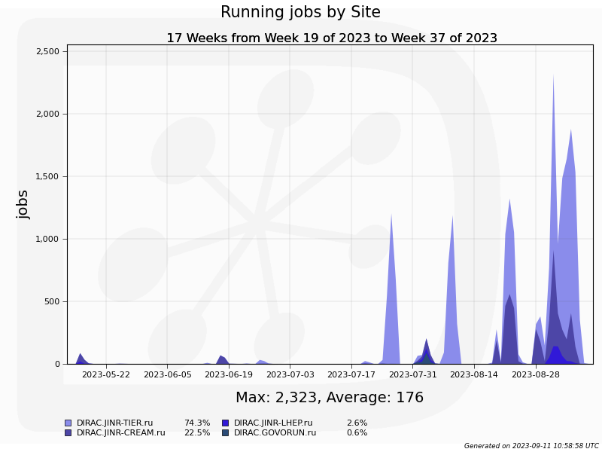
How we have got there
4
5
3
1
2
1
2
3
4
5

Slide 21
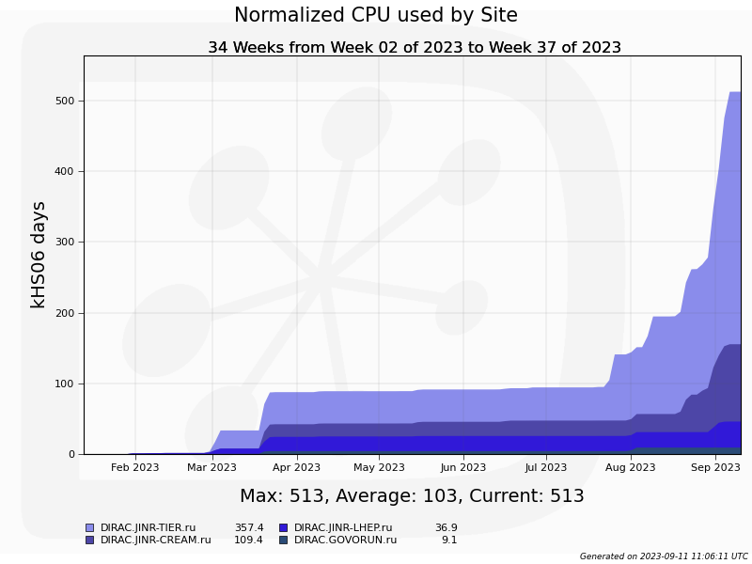
Consumed resources
We consumed roughly 70 CPU core years
BM@N Collaboration Meeting

Slide 22
The whole BM@N collaboration
Responsible for resources:
Tier-1,Tier-2, EOS: Valery Mitsyn
Govorun: Dmitry Podgainy, Dmitry Belyakov, Aleksandr Kokorev
NICA cluster: Ivan Slepov
Network: Andrey Dolbilov
Acknowledgments

Slide 23
For the first time JINR computing infrastructure united by DIRAC was used for raw data reconstruction not in test mode but in production.
Results
Full BM@N run8 production took considerable amount of resources. Up to now ~70 CPU core years has been consumed.
Fast and repeatable way to consistently perform B@MN productions for all data was proposed!
It was successfully applied several times for BM@N Run8 during 2023.
A set of methods was developed and applied to record the information
about running productions.
It proved to be useful not only for estimation of future productions,
but also for evaluation of current workloads and their comparison with previous.

Slide 25
Individual CPU core performance study
Centralized job management gives possibility for centralized and unified performance study of different computing resources.
Before running user jobs DIRAC Pilots execute benchmark for CPU core they are running on.
Benchmark is DiracBenchmark2012 or DB12. It evaluate just CPU core performance. Disk I/O, RAM speed, Network, CPU caches and other highly important aspects of performance are neglected by DB12.

Slide 26
DB12 benchmark study
Piece of road from point A to B
A Monte-Carlo task
Speed of the car
Performance of the computer
Time to complete
Time to complete
$$Time= \frac{Amount of work}{Speed of computer}$$
DB12 gives results like: 10(old slow core), 17 (standard server core), 27 (high performance core)
What if we build a plot, where X is DB12 result, Y is time in seconds. Then, every point on the plot represent one job.
It would be mostly useless if all jobs were unique and different. But, in the real life there are usually many similar jobs.

Slide 27
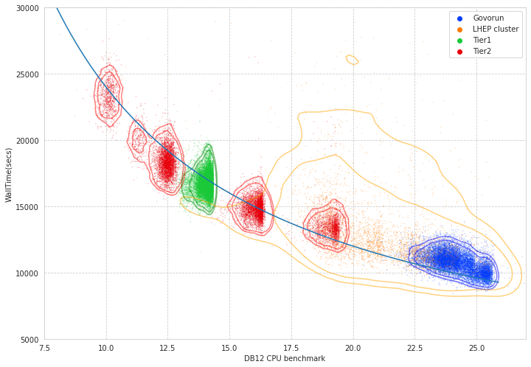
Performance analysis

Slide 28
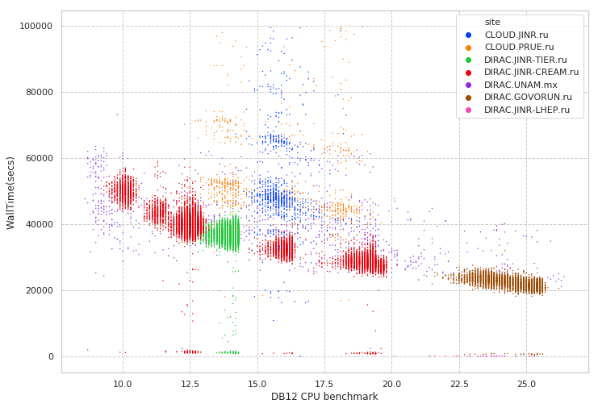
Performance analysis
Folding@Home
MPD MC
Immediate errors or short jobs
Errors during execution

Slide 29
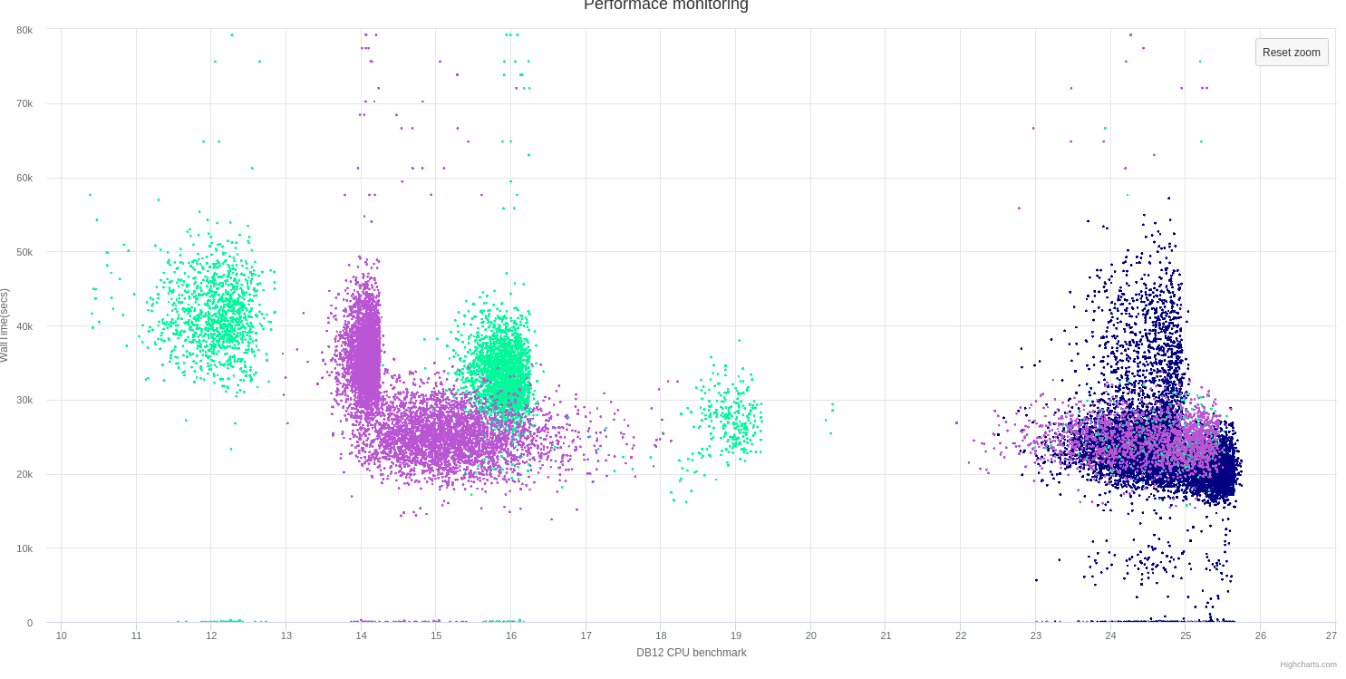
Discoveries
Wrong AMD processors estimation
Occasional speed loss on high ram Govorun nodes
Walltime
DB12 benchmark

Slide 30
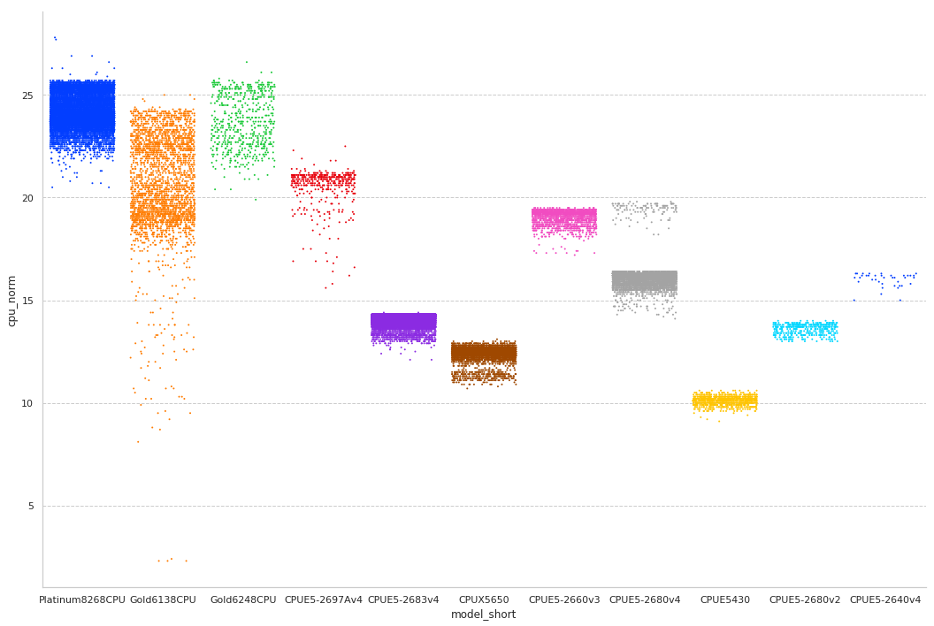
CPU core performance

Slide 31
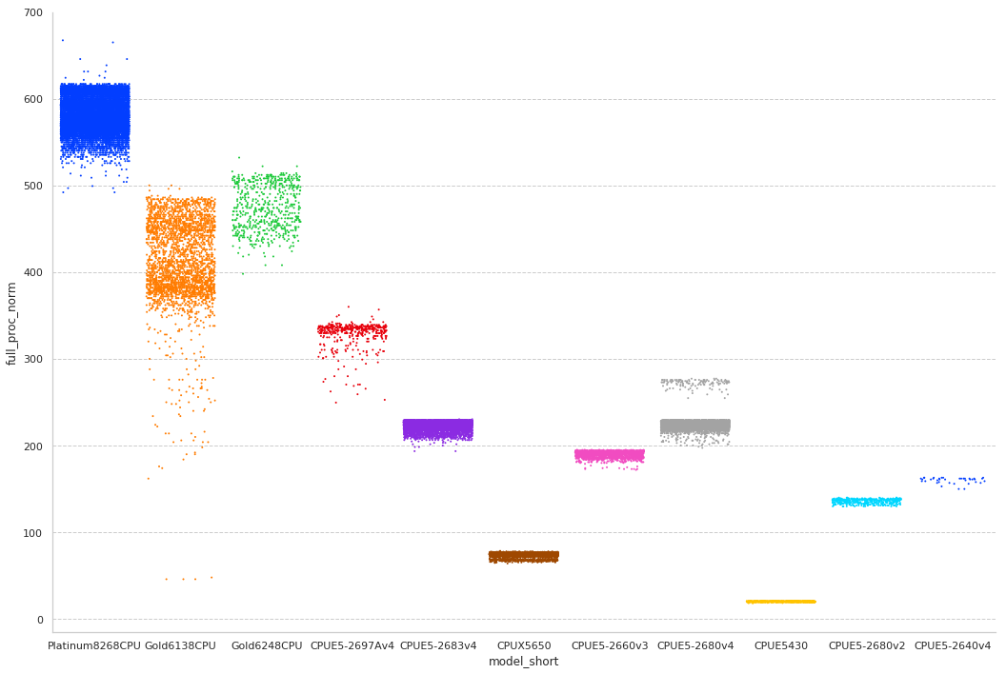
Total CPU performance

Slide 32
User job monitoring
$ root macro.c(input)
$ job_monitoring root macro.c(input)
User job
(root)
job_monitoring
User job
(root)
Monitoring DB
(InfluxDB)

Slide 33
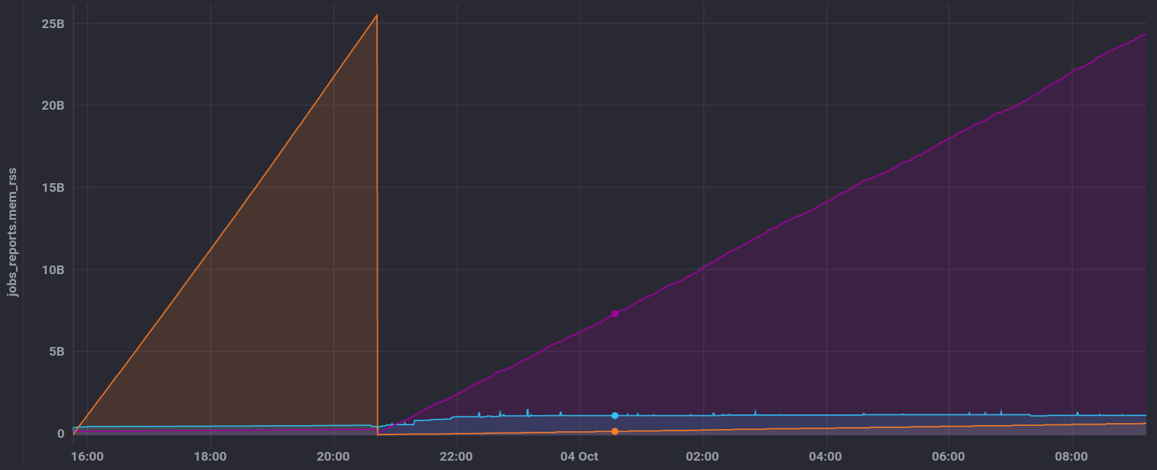
User job monitoring
GenToDst job on Govorun
Disk write
Disk read
RAM usage

Slide 34
Detailed articles
1. Gergel, V., V. Korenkov, I. Pelevanyuk, M. Sapunov, A. Tsaregorodtsev, and P. Zrelov. 2017. Hybrid Distributed Computing Service Based on the DIRAC Interware.
2. Korenkov, V., Pelevanyuk, I. & Tsaregorodtsev, A. 2019, "Dirac system as a mediator between hybrid resources and data intensive domains", CEUR Workshop Proceedings, pp. 73.
3. Balashov, N.A., Kuchumov, R.I., Kutovskiy, N.A., Pelevanyuk, I.S., Petrunin, V.N. & Tsaregorodtsev, A.Y. 2019, "Cloud integration within the DIRAC Interware", CEUR Workshop Proceedings, pp. 256.
4. Korenkov, V., Pelevanyuk, I. & Tsaregorodtsev, A. 2020, Integration of the JINR hybrid computing resources with the DIRAC interware for data intensive applications.
5. Kutovskiy, N., Mitsyn, V., Moshkin, A., Pelevanyuk, I., Podgayny, D., Rogachevsky, O., Shchinov, B., Trofimov, V. & Tsaregorodtsev, A. 2021, "Integration of Distributed Heterogeneous Computing Resources for the MPD Experiment with DIRAC Interware", Physics of Particles and Nuclei, vol. 52, no. 4, pp. 835-841.
6. Pelevanyuk, I., "Performance evaluation of computing resources with DIRAC interware", AIP Conference Proceedings 2377, 040006 (2021)

