Slide 1
JOINT INSTITUTE FOR NUCLEAR
RE
S
EARCH
DZHELEPOV LA
BORATORY OF NUCLEAR
PRO
BL
E
MS
DEVELOPMENT OF COMPTON CAMERA FOR MEDICAL PURPOSES BASED ON HYBRID DETECTOR TIMEPIX3
Truong Hoai Bao Phi ^{1,} ², Rozhkov Vladislav Andreevich ¹
¹ Joint Institute for Nuclear Research, Dubna, Russia
² Institute of Physics, Vietnam Academy of Science and Technology, Hanoi, Vietnam
AYSS-2023 г.

Slide 2
Content
Introduction
Materials and methods
Experiments
Data processing
Results
Conclusion and discussion

Slide 3
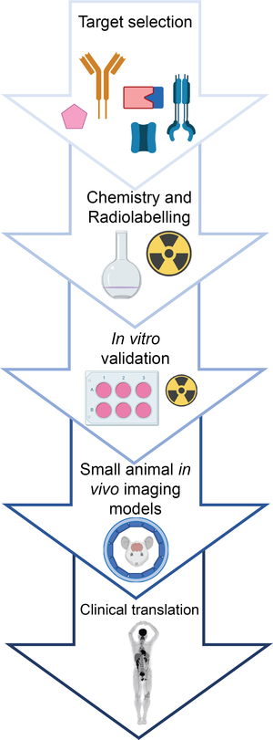
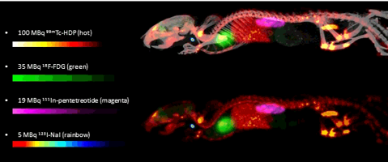
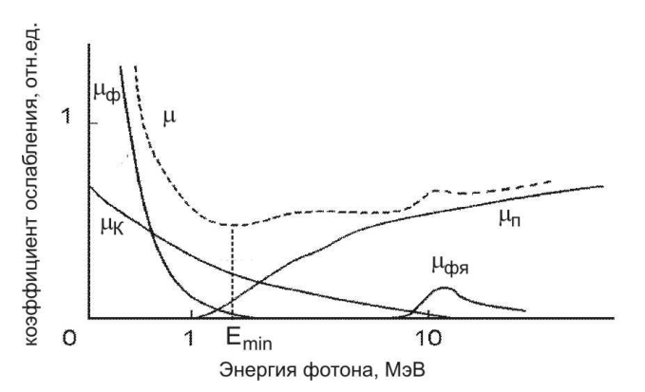
Relevance
P.E.B. Vaissier, et al. TvNG, 2013

Slide 4
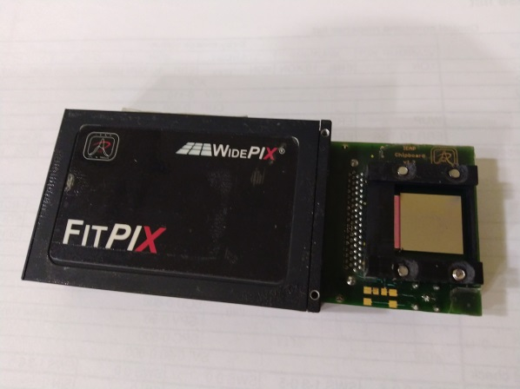
Relevance
TIMEPIX3
Hybrid
Pixelated
Semiconductor sensor

Slide 5
PURPOSE AND OBJECTIVES
Purpose: Software development for Compton cameras based on detector Timepix3.
Objectives:
  To develop an algorithm for identifying Compton events.
  To develop software to reconstruct the spatial location of gamma sources.
  Assessing the feasibility of using image quality improvement algorithms used in medical imaging.

Slide 6
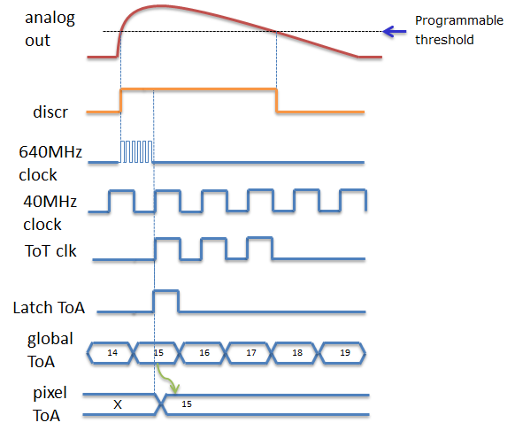
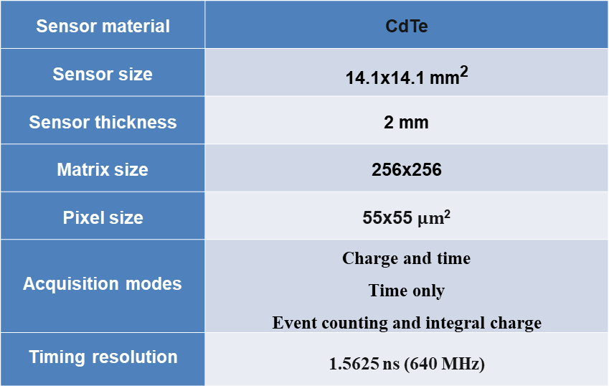
Materials and method
Detector Timepix3:
Sensor material | CdTe
Sensor size | 14.1х14.1 mm²
Sensor thickness | 2 mm
Matrix size | 256х256
Pixel size | 55х55 $μm$²
Acquisition modes | Charge and time Time only Event counting and integral charge
Timing resolution | 1.5625 ns (640 MHz)
1. Time-over-Threshold (TOT): each pixel records the deposited energy of particles interaction with corresponding sensor segment
2. Time-of-arrival (TOA): each pixel records the arrival time of particles interaction with corresponding sensor segment
T. Poikela et al. Timepix3: a 65K channel hybrid pixel readout chip with simultaneous ToA/ToT and sparse readout. 2013.

Slide 7
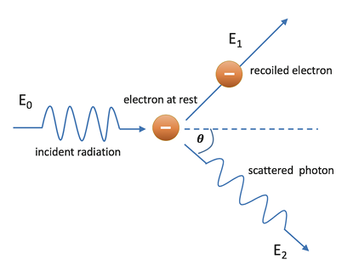
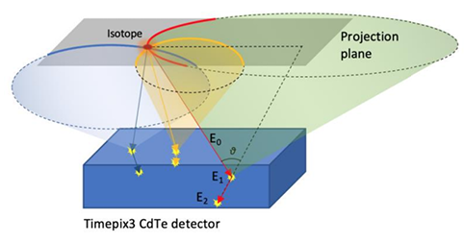
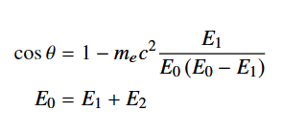
Materials and method
Operating principle of a Compton camera:
G. Amoyal et al. Development of a hybrid gamma camera based on Timepix3 for nuclear industry applications.
D. Turecek et al. Compton camera based on Timepix3 technology.

Slide 8
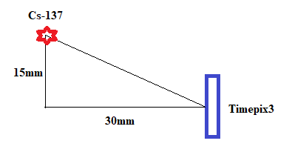
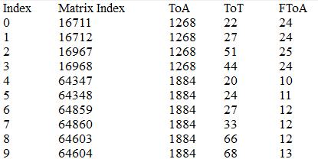
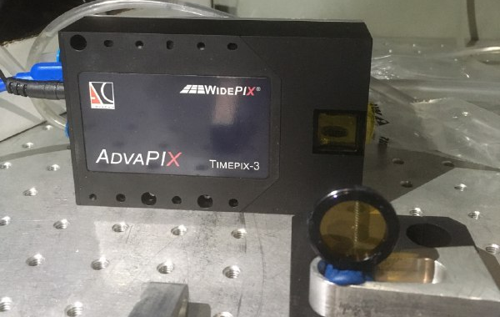

Experiments
~ Энегия
Matrix index = 256*y+x
$$t \left[нс\right]=ToA∙25−FToA∙1.5625$$

Slide 9
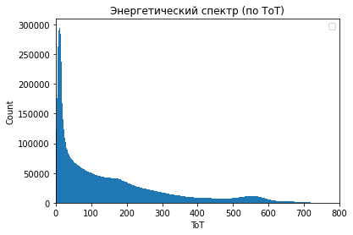
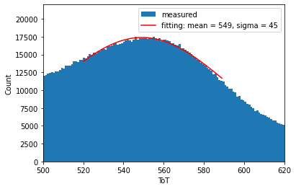
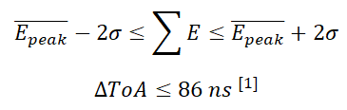
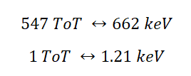
Identification of Compton events
Energy spectrum obtained for a point source of Cs-137
Spectrum peak fitting with Gaussian distribution
[1] D. Turecek et al. Single layer Compton camera based on Timepix3 technology.

Slide 10
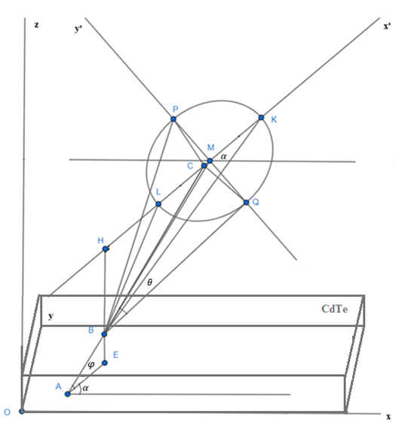
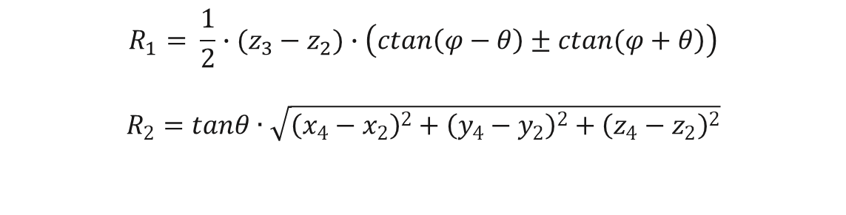
Calculation justification
$$R_{1}= \frac{1}{2}∙(z_{3}−z_{2})∙\left(\left.ctan\left(φ−θ\right)±ctan(φ+θ\right)\right)$$
$$R_{2}=tanθ∙\sqrt{{\left(x_{4}−x_{2}\right)}^{2}+{\left(y_{4}−y_{2}\right)}^{2}+{\left(z_{4}−z_{2}\right)}^{2}}$$
where
A (x₁, y₁, z₁) – the point at which the scattered photon was detected
B (x₂, y₂, z₂) – the point at which the recoil electron was detected
C (x₃, y₃, z₃) – intersection of line AB with the source plan
M (x₄, y₄, z₄) – ellipse center

Slide 11
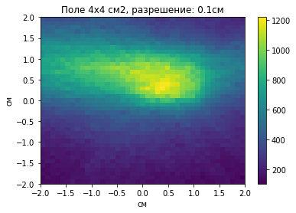
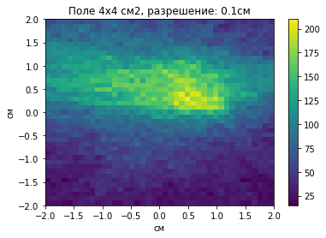
Result
Images obtained by developed software
FOV 4х4 см², size of each pixel of the images: 1 мм (right), 0.1 мм (left)
Actual source coordinates: x = 0.7см ; y = 0.8см

Slide 12
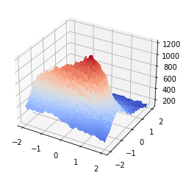
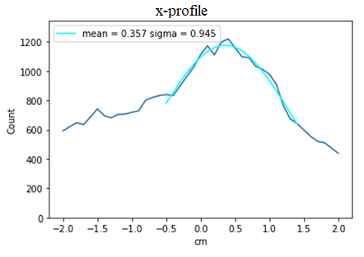
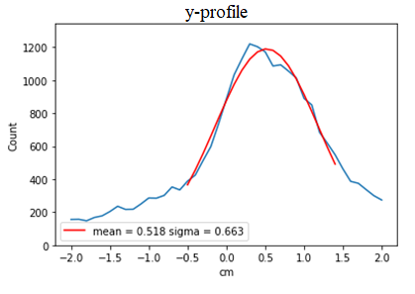
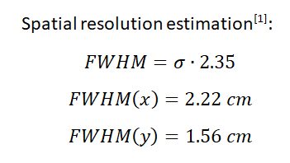
FWHM
[1] D. Cecchin, D. Poggiali, L. Riccardi, P. Turco, F. Bui and S. De Marchi, Analytical and experimental FWHM of a gamma camera: theoretical and practical issues, PeerJ 3 (2015) e722.

Slide 13
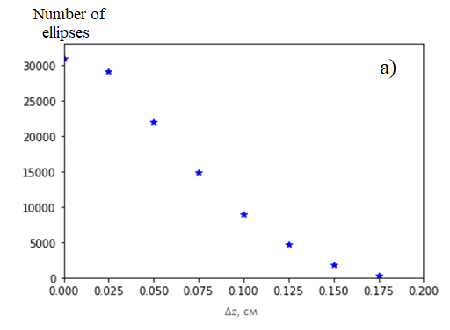
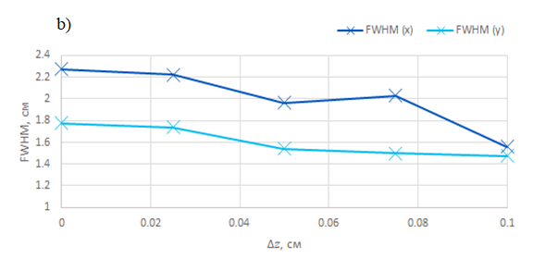
The dependence of the detection efficiency (a) and the spatial resolution (b) on the smallest difference in depth of registration of the recoil electron and scattered photon

Slide 14
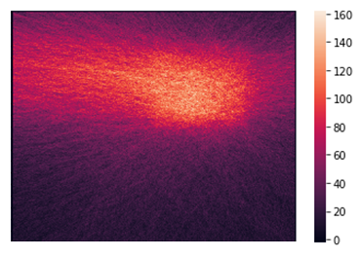
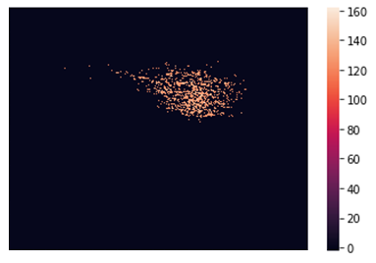
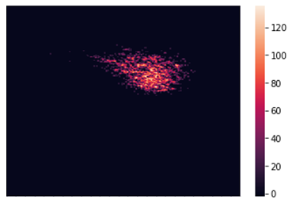
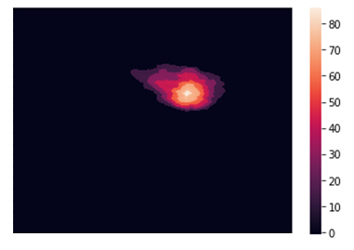
Processing obtained images
Input image
Filter I > 75% I(max)
Linear smoothing filter(3х3) Median filter (20х20)

Slide 15
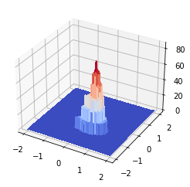
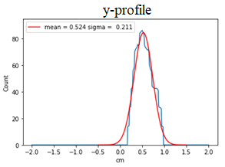
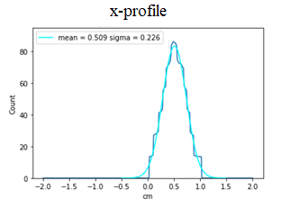

Processing obtained images
$$FWHM\left(x\right)=0,53 см$$
$$FWHM\left(y\right)=0,50 см$$

Slide 16
Conclusions and Discussion
Based on hybrid pixelated semiconductor detector Timepix3, a Compton camera with software was built that allows to obtain two-dimensional images of a gamma radiation source.
An analysis of the dependence of the efficiency and the spatial resolution of the Compton camera on the smallest difference in depth between registration points of recoil electron and scattered photon was carried out. The value of the smallest difference in depth corresponding to the best compromise between efficiency and spatial resolution can be determined to the particular situation.
Processing algorithms were applied to process the resulting images. As a result, the spatial resolution was improved and reached 5mm.
Due to the fact that detector's sensor is not perfect, there is slight variation between the pixels of the Timepix3 ^{[1]}. The precise per-pixel calibration will allows to more accurately determine deposited energy of gamma ray. Additional experiments to determine depth of event detection will help improving the spatial resolution of Compton camera.
[1] А. Батлер и др. Измерение энергетического разрешения и калибровка гибридных пиксельных детекторов на основе GaAs:Cr и микросхемы TIMEPIX / - ОИЯИ, Дубна. , 2014. – 20с.

Slide 17
THANK
FOR ATTENTION!

Slide 18
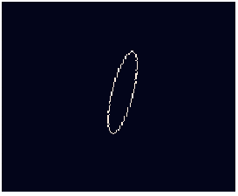
Восстановление изображения
Эллипс в среде компьютерной графики, полученный алгоритмом построения окружности со средней точкой (Midpoint circle algorithm)

Slide 19
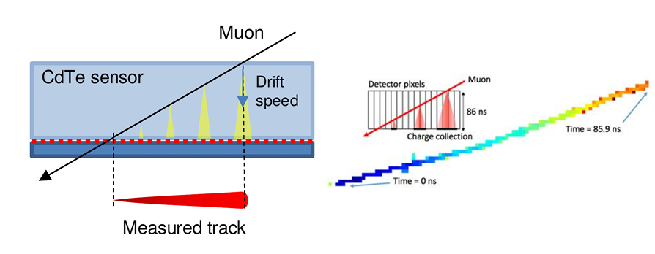

Slide 20
