Slide 1
Coherent elastic neutrino-nucleus scattering search in the νGeN experiment.
Χοηερεντ ελαστιχ νευτρινο−νυχλευσ σχαττερινγ σεαρχη ιν τηε νΓεΝ εξπεριμεντ.
D.Ponomarev^{1,2} on behalf of the νGeN collaboration
¹Joint Institute for Nuclear Research, Dubna, Russia
²Lebedev Physical Institute of the Russian Academy of Sciences, Moscow, Russia

Slide 2
Detection of CEνNS
Energy of nuclear recoil from CEvNS is very
low:
₌ 2𝐸 (1−𝑐𝑜𝑠𝜃)
2
𝐸
𝐴
2𝑀𝐴
A.Drukier and L.Stodolsky,
Phys.Rev.D 30, 2295 (1984)
The detection of this process is very challenging, also taking into account that often only part of the energy can be detected due to quenching.
Powerful neutrino source in full coherency regime < 30 MeV.
Low threshold and low background detector.
Effective separation of signals from background.
Big target mass and good efficiency.
Stable performance and knowledge of systematical errors.
< 1 keV
QR<<1
2

Slide 3
νGeN experiment is aimed to study neutrino scattering using antineutrinos from the reactor core of Kalinin Nuclear Power Plant (KNPP) at Udomlya, Russia. Main searches:
Coherent elastic neutrino-nucleus scattering (CEvNS).
Non-standard neutrino interactions.
Magnetic moment of neutrino.
Sterile neutrino.
Other rare and exotics processes.
Applied usage: reactor monitoring.
3

Slide 4
Reactor unit #3 @ KNPP
Typical regime: ON: 18 months
OFF: 2 months
KNPP #3
Spectrometer νGeN is located under the reactor unit #3 (3.1 GW_{th} – thermal power)
Distance to the center of the reactor core is about
11 m, this gives > 4⋅10¹³ ν/(sec⋅cm²)
Overburden ∼ 50 m w.e. − good shielding against
cosmic radiation due to reactor’s surrounding
Good support from KNPP administration
νGeN
iDream
4

Slide 5
Comparison of the reactor sites
Experiment | Location | Neutrino flux ν/(cm² s) | Overburden [m w. e.]
νGeN | KNPP, Russia | ∼(3.6-4.4)×10¹³ | ∼50
CONUS | Brokdorf, Germany | 2.4×10¹³ | 10-45
TEXONO | Kuo-Sheng NPP, Taiwan | 6.4×10¹² | ∼30
RED-100 | KNPP, Russia | 1.7×10¹³ | >50
CONNIE | Angra 2, Brazil | 7.8×10¹² | 0
RICOCHET | ILL, France | 2×10¹² | ∼15
MINER | Texas A&M, USA | 2×10¹² | ∼5
NUCLEUS | Chooz, France | 2×10¹² | ∼3
NCC-1701 | Dresden-II, USA | 4.8×10¹³ | -
NEON | Hanbit 6, Korea | 7.1×10¹² | ∼8
SBS | Laguna Verde, Mexico | 3×10¹²? | ?
5

Slide 6
HPGe detector for νGeN
To detect signals from neutrino scattering we use a specially produced by CANBERRA (Mirion, Lingosheim) low-threshold, low-background HPGe detectors. The detectors are chilled by electric and nitrogen types of cooling. At the moment, only one detector with a mass of 1.4 kg and e-cooling is used for the detection at KNPP.
6

Slide 7
Current scheme of νGeN shielding
Photo from installation at
KNPP in 11.2019
7

Slide 8
νGeN @ KNPP – lifting mechanism
A special lifting mechanism has been installed to move the spectrometer towards the reactor core to change the neutrino flux through the detector.
11.09 m – top position (current)
Distances to the center of reactor core:
12.14 m – first position
∼12.5 m – lower position
Changes of the ν flux help to suppress systematic errors connected with changes of the background while the reactor ON/OFF
8

Slide 9
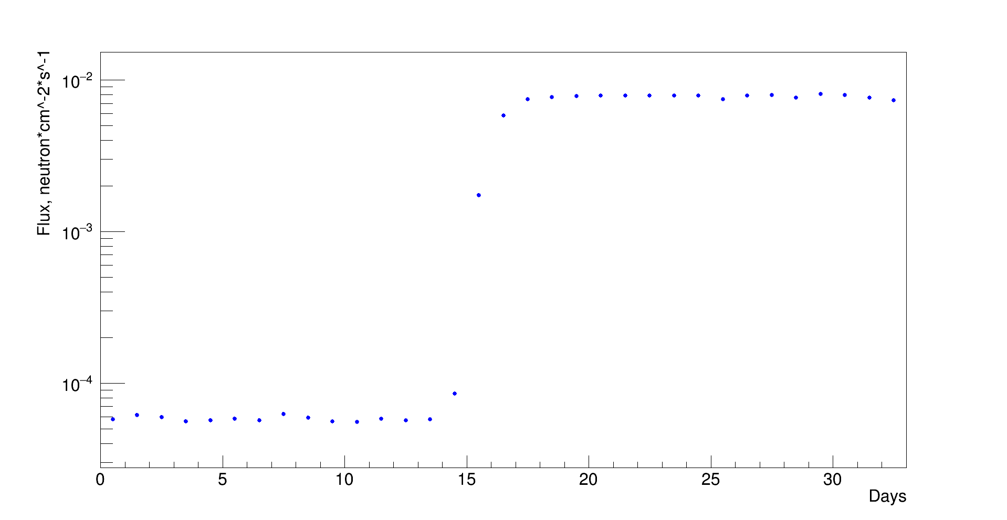
Control of experimental conditions
The stable measurement conditions are very important, because instabilities can change amplification and noise level.
Cosmogenic activation products slowly decay in time and have to be taken into account during analysis.
Air temperature condition in the experimental hall is stabilized by three air-conditioners.
Temperature and humidity are constantly monitored by two sensors.
Neutron background outside shielding (fast and thermal) is measured by special low background He3 counter and NaI detector.
Thermal neutron flux outside of the shield
Reactor OFF
Reactor ON
9

Slide 10
Noise cuts
Pulser
Data
Different shaping times of preamplifiers are used to suppress the noise with the help of graphical cuts.
Time cuts allow to suppress signals generated by reset of the preamplifier and other artificial signals.
Even at 200 eV efficiency is > 40% after applying cuts
Pulser
Data
22.03.2023

Slide 11
Muon veto & time cuts
Coincidences with muon veto allow to suppress background connected with muons
Efficiency of all cuts together with muon veto determined by 10.37 keV line is 85.3(19)%

Slide 12
2022 ANALYSIS
ON - OFF
Analysis of the first data showed no significant difference in background level during reactor ON (94 days) and OFF
(47 days) regimes. Distance to the center of the reactor is 11.84m. No excess at low energy connected with the CEνNS has been observed. The upper limit on the quenching parameter k < 0.26 with 90% CL has been obtained (dashed line).
Red solid line for k = 0.179.
Published article
I. Alekseev et al. Phys. Rev. D 106,L051101
https://doi.org/10.1103/PhysRevD.106.L051101
 | Counts in region [320..360] eV | Measurement time, days | Counts per kgd (stat. error only)
Reactor ON | 251 | 94.5 | 2.32 ± 0.15
Reactor OFF | 126 | 47.1 | 2.34 ± 0.21
ON-OFF |  |  | -0.017 ± 0.255
CEνNS, k = 0.26 | 55 |  | 0.46

Slide 13
2023 ANALYSIS (preliminary)
There are no significant difference in low energy spectra during reactor ON (154 days) and OFF (39 days).
Red solid line – expected CEνNS spectra.
Purple line – best fit

Slide 14
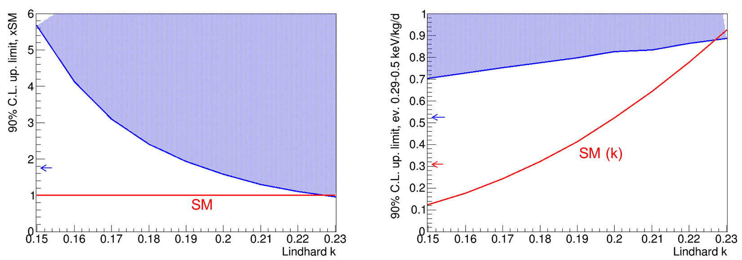
Limits (preliminary)
The upper limit on the quenching parameter k < 0.23 with 90% CL has been obtained.

Slide 15
Conclusion
Measurements with the νGeN spectrometer at Kalinin Nuclear Power Plant are ongoing.
No significant difference between regimes with reactor ON and OFF due to CEvNS has been observed so far.
More than 1200 kgd of data has been accumulated so far.
The limit on the k<0.23 factor is obtained.
The optimization of data taking is performed as well. New results in the upper position with more statistics are expected soon.

Slide 17
Backup slides

Slide 18
Signals from detector
Detectors are equipped with reset preamplifier.
signals
There is a special inhibit signal that indicates the time when the reset
happens.
The signals are
with and
shaped amplifiers
processed with a
real-time ADC.
preamplifier’s reset

Slide 19
Simplified scheme of measurements
HPGe
Muon veto
Pulse
generator
Preamplifier
OUT E
OUT E2
Inhibit
ORTEC
672
6 μs
ORTEC 672
6 μs
ORTEC 672
10 μs
ORTEC 672
6 μs (HE)
ORTEC
671
ORTEC 671
ORTEC
671
VME Realtime ADC CAEN V785N
VME CAEN V976 (Trigger)
Signal acquisition is organized with the real- time ADC system based on CAEN electronics. We use several preamplifiers with different shaping times to suppress noise signals.
PC
HDD
ROOT
DUBNA offline analysis
27

Slide 20
Calibration at low energies
Energy calibration at low energy is performed by means of 10.37 keV
cosmogenic line and pulse generator.
Calibration check with 1.3 keV line
Data taking shows very good stability of peak position during all measurement time.
Energy resolution of 1.4 kg detector at KNPP is 101.6(5) eV (FWHM).
68,71_{Ge (K)}
10.367 keV
68,71_{Ge (L)}
1.3 keV
68,71_{Ge (L)}
1.2977 keV
Peak from pulse generator

Slide 21
Thermal power of reactor unit #3
Move spectrometer to the upper position
Some improvements: new power, grounding
lower noise level
Installation of the antivibration platform 11.12.2020
Total statistics:
ON period: 1117 kgd, OFF period: > 173 kgd

Slide 22
High energy part of the spectrum
High energy part of the spectra is calibrated with the help of welding rods (with 2% of Th)
Before
μveto
After
μveto
28

Slide 23
νGeN reactor site at Udomlya, Russia
Kalinin Nuclear Power Plant (KNPP) 4xWWER – 3.1 GW_{th}
JINR, Dubna, 285 km from KNPP
23

Slide 24
The significant improvements of the noise and background level were obtained by improving measurement conditions (including new
power
antiradon
supply, grounding, better
flushing, …).

Slide 25
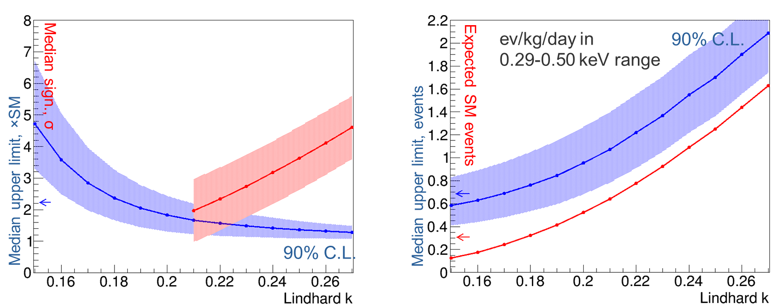
Sensitivity studies (preliminary)
Taking into account OFF spectrum (55 kgd) and Azimov data sets (generated spectra contains CEνNS signals + OFF, taken statistic equivalent to current real one – 217 kgd), we created a predictions for sensitivity for CEνNS.

Slide 26
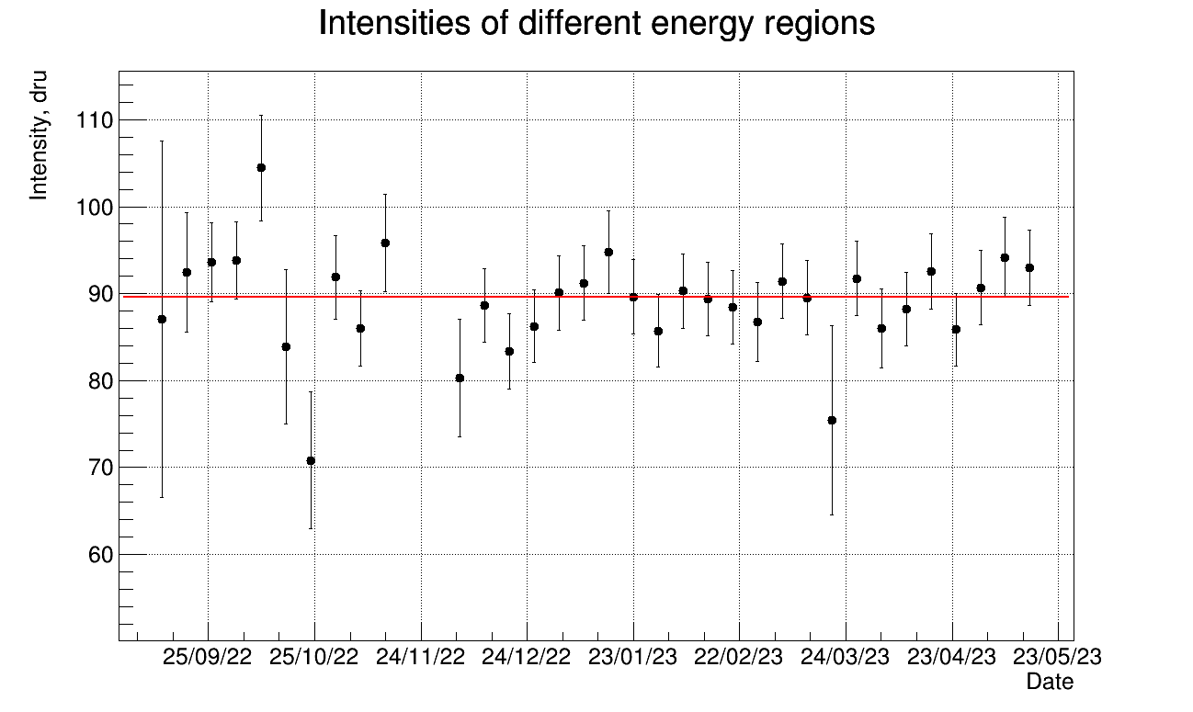
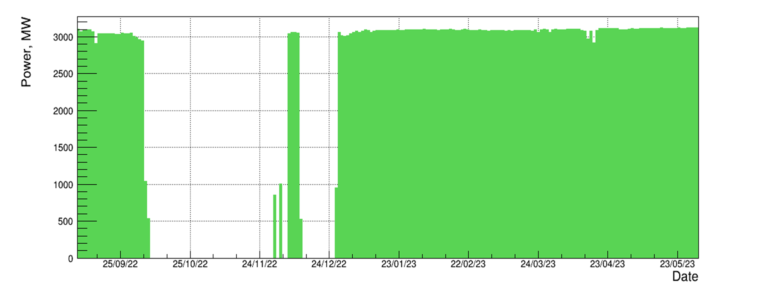
Stability (after all cuts)
Chi2/NDf = 29.3/33
At the moment in the upper position we accumulated ON: 217 kgd and OFF: 55 kgd (after all cuts).

