Slide 1
ПАВЛОВ И ПАРТНЕРЫ
AYSS-2023
Detection of the atmospheric neutrinos
in the NOvA experiment
Отчет о продажах за январь 2025 г.
Aleksandra Ivanova, Andrey Sheshukov
DLNP JINR
30.10.23
Ежемесячный доклад Карины Лопатиной

Slide 2
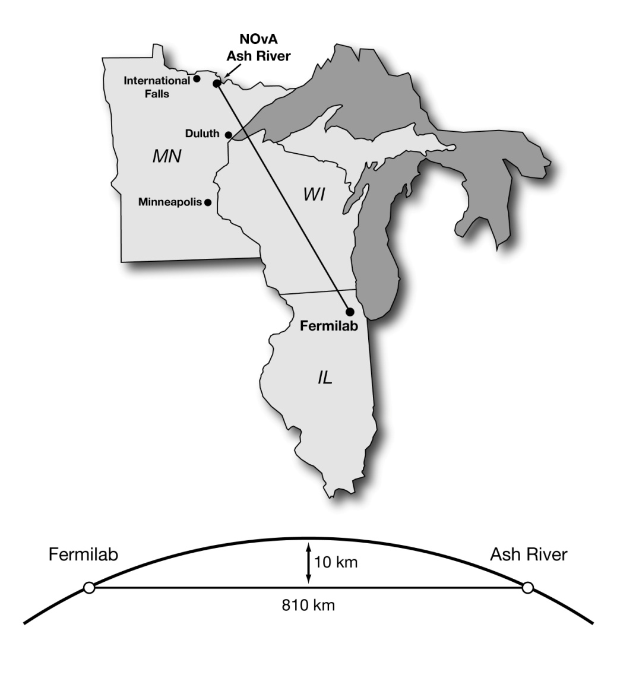
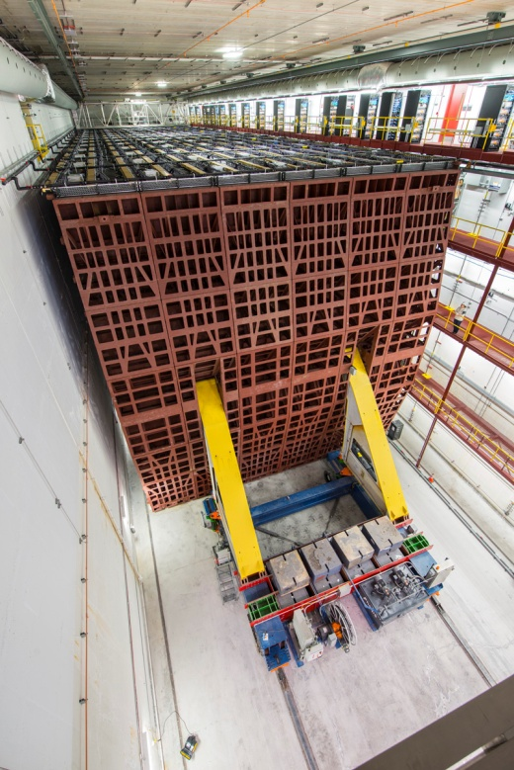
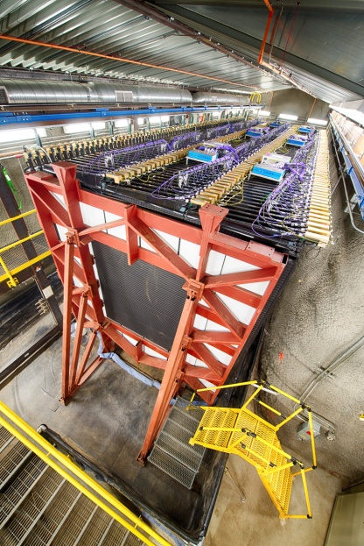
The NOvA experiment
NuMI Off-Axis 𝜈𝑒 Appearance;
14 mrad off-axis beam;
2 GeV peak energy;
measure 𝜈 (𝜈 ) disappearance and 𝜈 (𝜈 ) appearance;
two detectors:
- near detector (ND, 300 tons) at a distance of 1 km from target;
- far detector (FD, 14 kilotons) at a distance of 810 km, in Ash River, MN;
PVC tubes filled with liquid scintillator based on mineral oil.
μ
μ
e
e
2

Slide 3
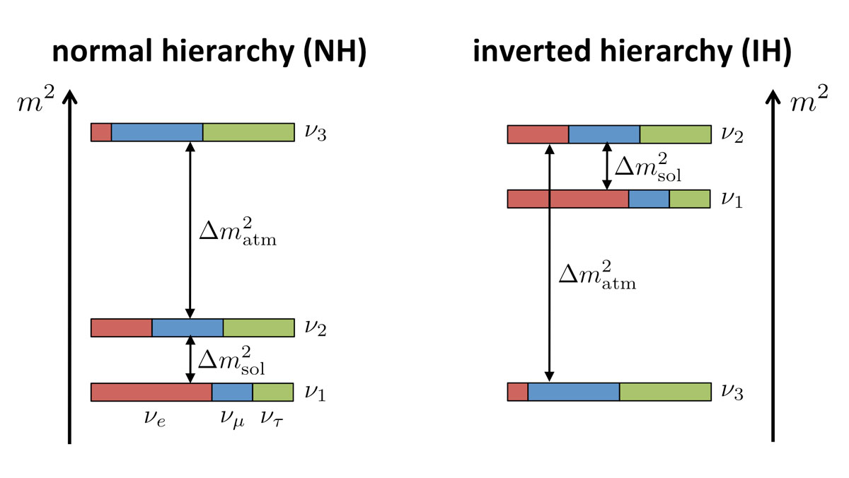
NOvA physics goals
- determination of the neutrino mass hierarchy;
- definition of the octant θ , the refinement θ ;
- restrictions on the δ ;
- sterile neutrinos, exotic searches, neutrino cross-sections.
main analysis
23
13
cp
3

Slide 4
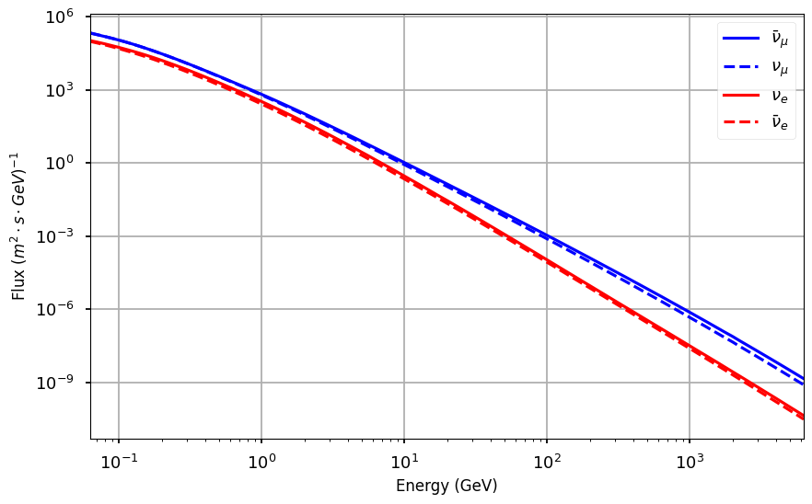
Atmospheric neutrinos
the search for Dark Matter particles;
studying of proton decay;
registration of the shadow from the Moon and so on.
Atmospheric neutrinos are the background for solving many additional physical problems:
Atmospheric neutrino flux vs energy
The task was set to measure the atmospheric neutrinos spectrum in the NOvA.
4

Slide 5
Simulated signal sample
Signal event from the atmospheric neutrinos
• simulated using GENIE software package;
• 10k signal events from all directions (2.3 year, ~ 4300 events/y).
5

Slide 6
Simulated background sample
Background event from the cosmic rays (for 550 µs)
mostly atmospheric muons and other activity induced by cosmic rays (150k μ per sec in FD);
simulated using CORSIKA (COsmic Ray Simulations for KAscade).
The propagation of particles inside the detector is performed by GEANT4.
6

Slide 7
DDTriggers: description
By default, events are selected that coincide in time with the beam.
All data is written to a circular buffer and analyzed by fast algorithms that allow you to save the necessary data for later offline analysis.
It’s a system of software triggers - Data Driven Triggers (DDT) data.
Data Acquisition System in NOvA
For analysis based on stored data, two existing triggers were considered:
«Upmucontained» and «Neutronosc», allowing to separate ν CC events and ν NC, respectively.
7

Slide 8
Running DDT jobs on simulation
We tried different ways to pass the data from offline to DDT:
standard methods fail because of different versions of ART and ROOT;
saving and reading in binary format → it worked!
Now it’s possible to run a DDT job on the offline data!
Saving all the DAQHits to binary file in a simple custom format: independent of ROOT or ART versions
Work in progress…
8

Slide 9
Reconstruction steps
RawDigits
CellHits
Cluster
HoughResult
Vertex
Apply calibrations, look up geometry information
Cluster in space and time to isolate separate physics interactions
Search cluster for prominent straight line features
Using line features, look for major points of intersection
9

Slide 10
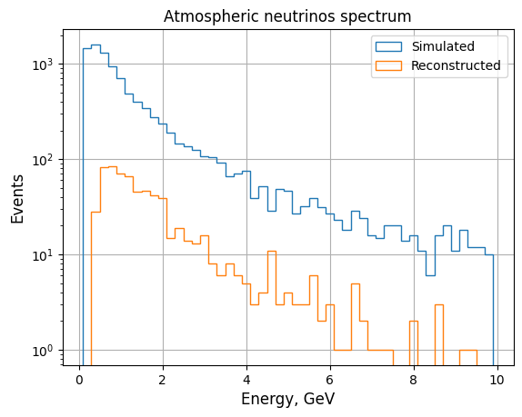
Reconstruction of the neutrino events
Energy spectrum: the blue color shows simulated neutrinos, the orange – reconstructed ones
Integral reconstruction efficiency - 45%.
10

Slide 11
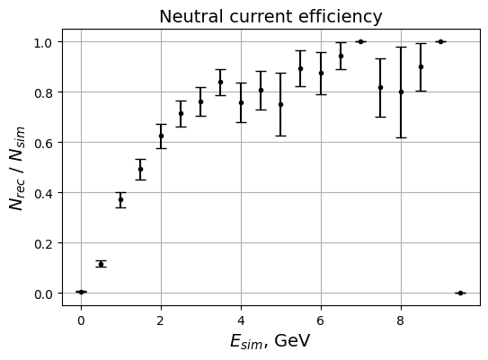
Reconstruction of the neutrino events
For charged currents (CC) events the efficiency is stable, for neutral currents (NC) the more E , the greater the efficiency
ν
11

Slide 12
Summary
Status:
created the signal and background samples;
launched the reconstruction of the signal events and its integral efficiency was obtained;
found the way to run a DDT job on the offline data
Plans:
estimate the selection efficiency of the existing triggers;
write the dedicated trigger for future data;
create the procedure for the signal/background selection.
Thank you for your attention!
12

