Slide 1
Measurements of the Deuteron and Proton Beam Polarizations at Nuclotron
Volkov Ivan
DSS Collaboration, LHEP JINR

Slide 2
Motivation
The measurement of vector polarization of the polarized deuteron and proton beams at energies up to 650 MeV/n using quasi-elastic proton-proton scattering;
First result of the polarization measurement for the run with polarized proton beam.

Slide 3
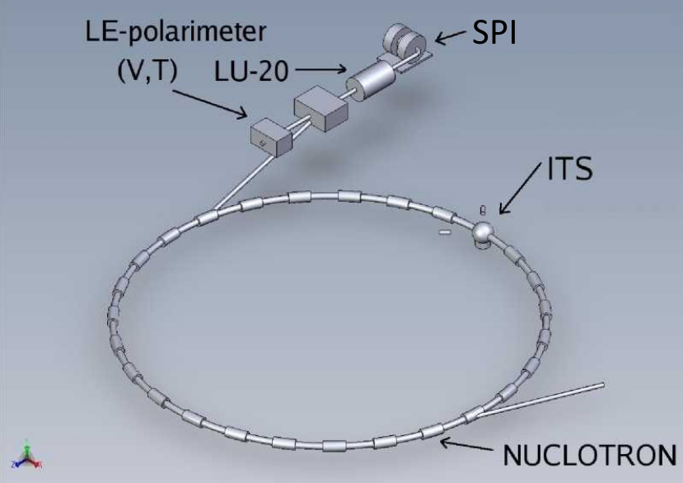
Scheme of the experiment at NUCLOTRON

Slide 4
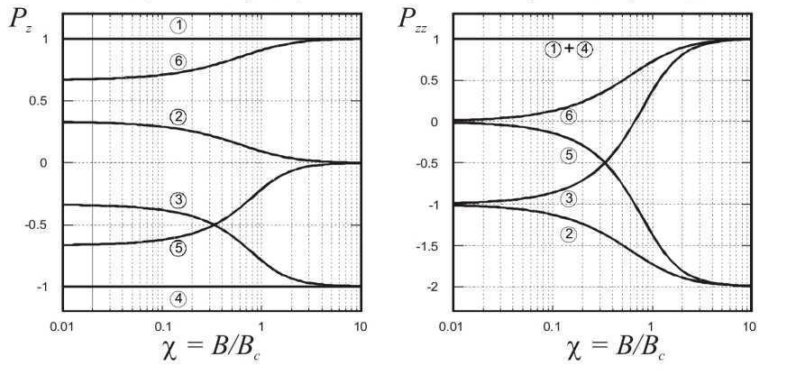
Deuteron beam polarization
3 modes of the ion source were used:
Vector polarization values obtained with dp elastic scattering at 135 MeV/n
 |  | (P_{z}, P_{zz})
"2-6" | "+" | (1/3, +1)
"3-5" | "-" | (1/3, -1)
Unpolarized | "0" | (0, 0)
P_{Z}⁺ | ΔP_{Z}⁺ | P_{Z}⁻ | ΔP_{Z}⁻
0.231 | 0.008 | 0.245 | 0.006
0.211 | 0.007 | 0.239 | 0.005
500, 650 MeV/n
200, 550 MeV/n
~70% of the ideal values!

Slide 5
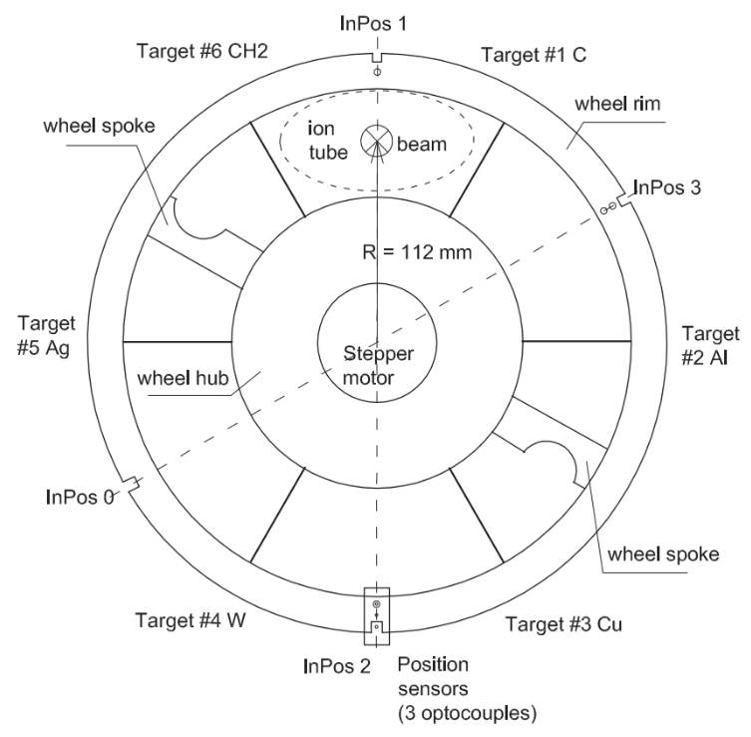
Target Changing System
In the experiment
were used:
Target #6 CH2.
Film with
10 μm thickness.
Target #1 C.
Filament from
10 threads with each 8 μm thickness.

Slide 6
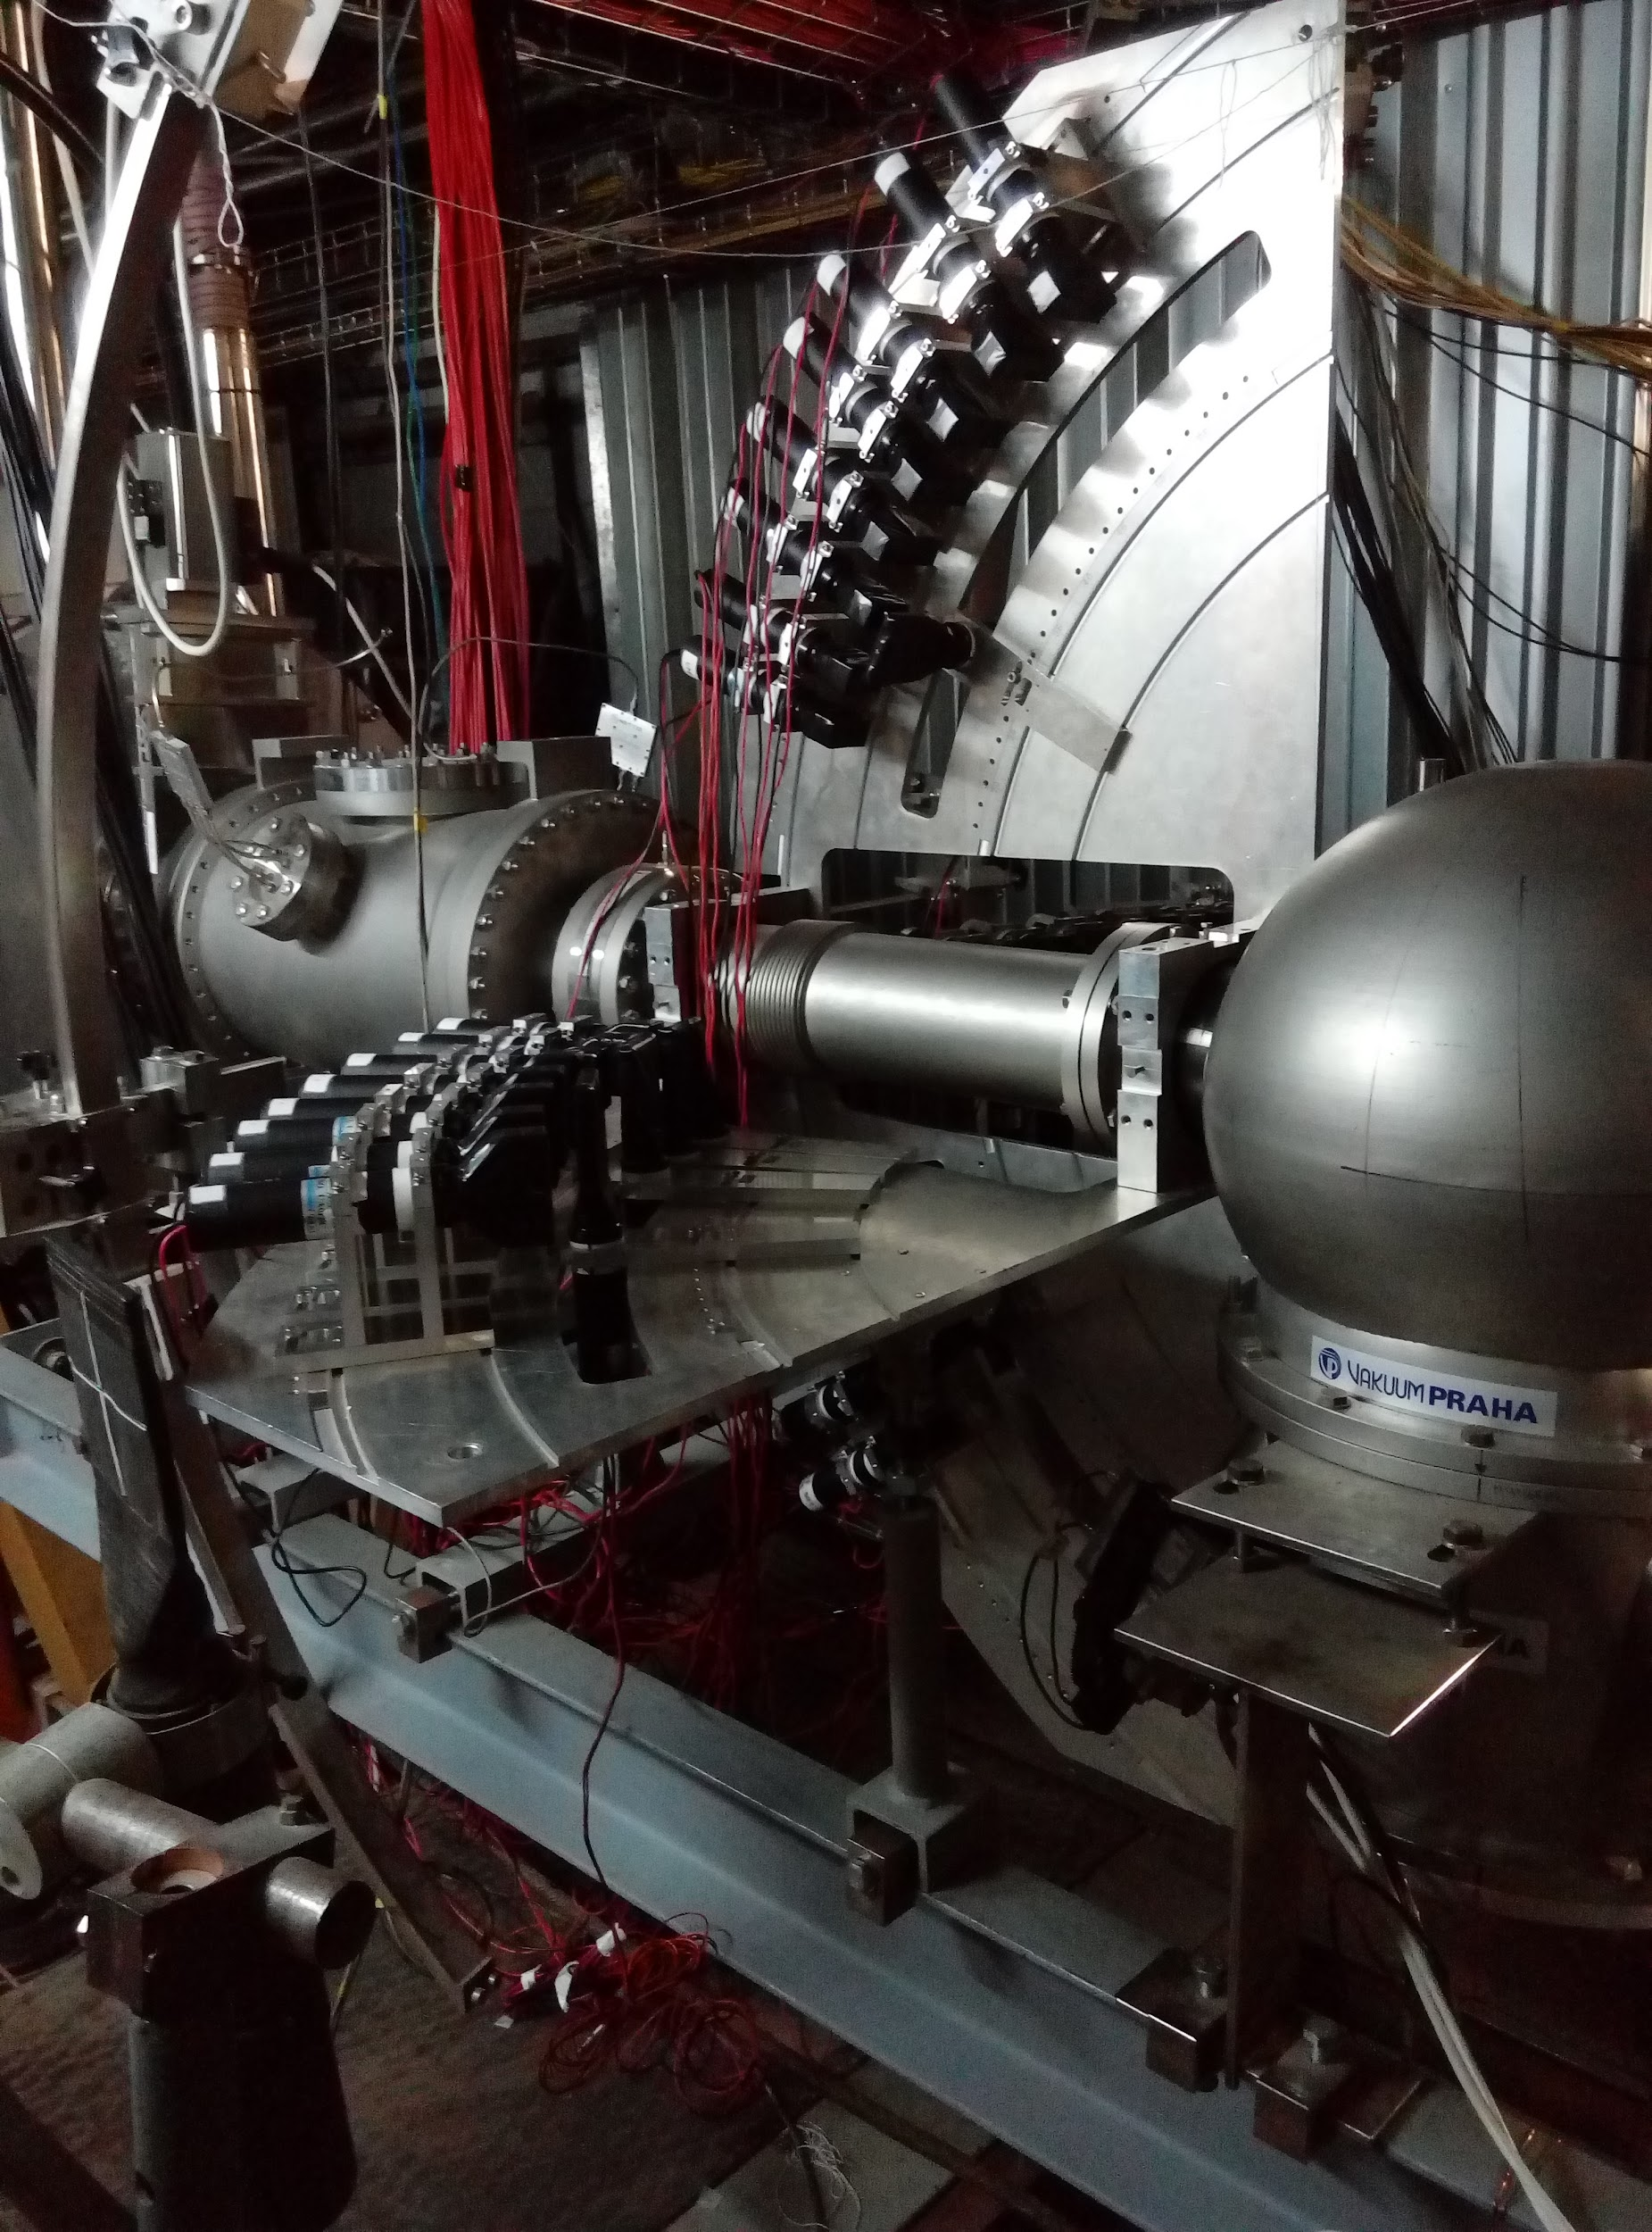
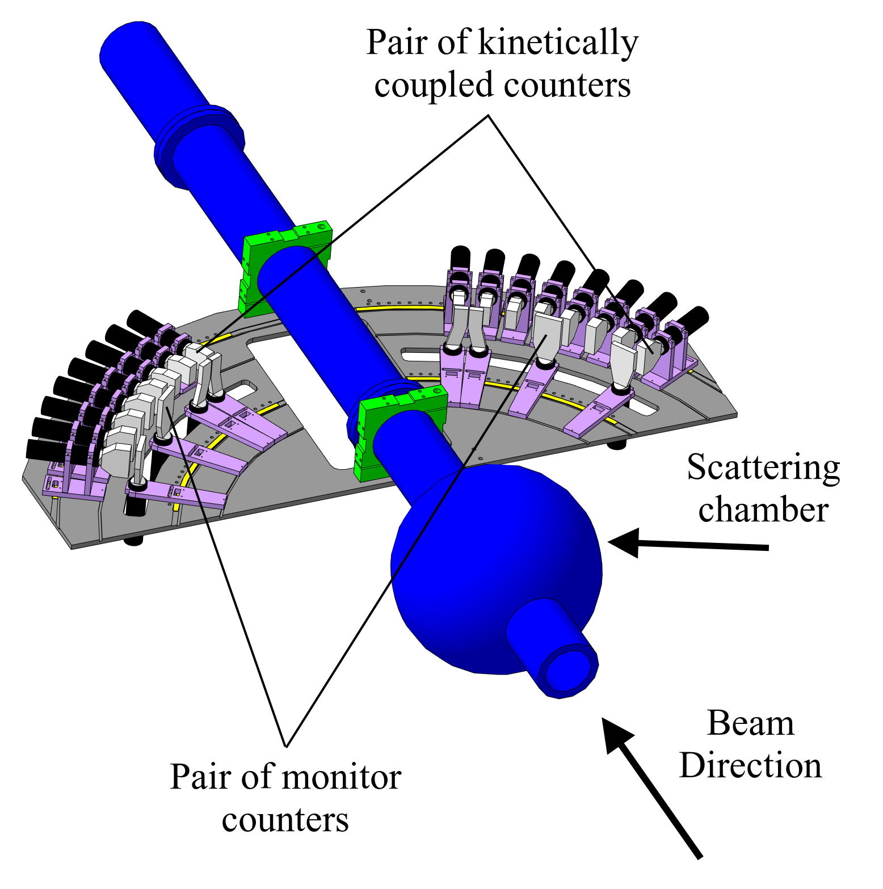
The DSS Setup
- 6 pairs to the left, 6 pairs to the right;
from 55° to 85° in the CM system;
- 1 pair to 90° in CM;
- pp-elastic kinematics.

Slide 7
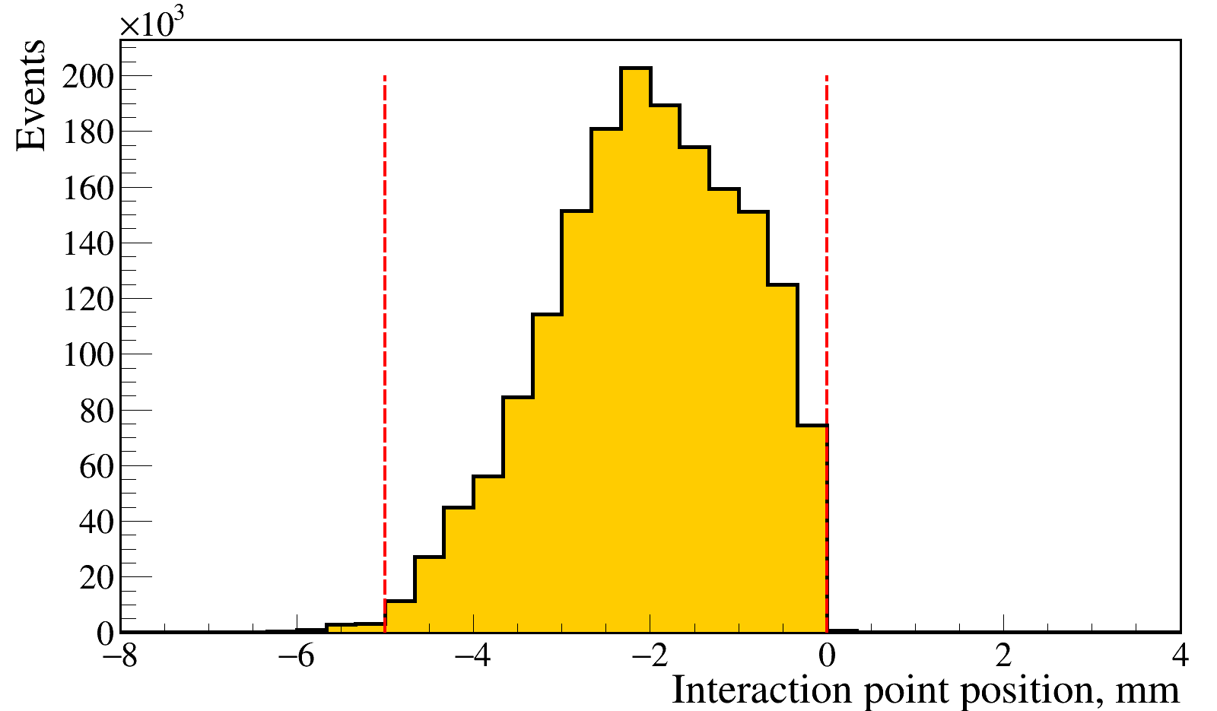
Selection of useful data by the event position of the target inside the ion tube. Deuteron beam
Based on the rotation of the target changing system wheel.
Data from the stepper motor.

Slide 8
Selection of useful data.
Deuteron beam
Ionization loss correlation for the counters pair
Time-of-flight difference for the pair
Cuts
applied one after
the other
to achieve
better result

Slide 9
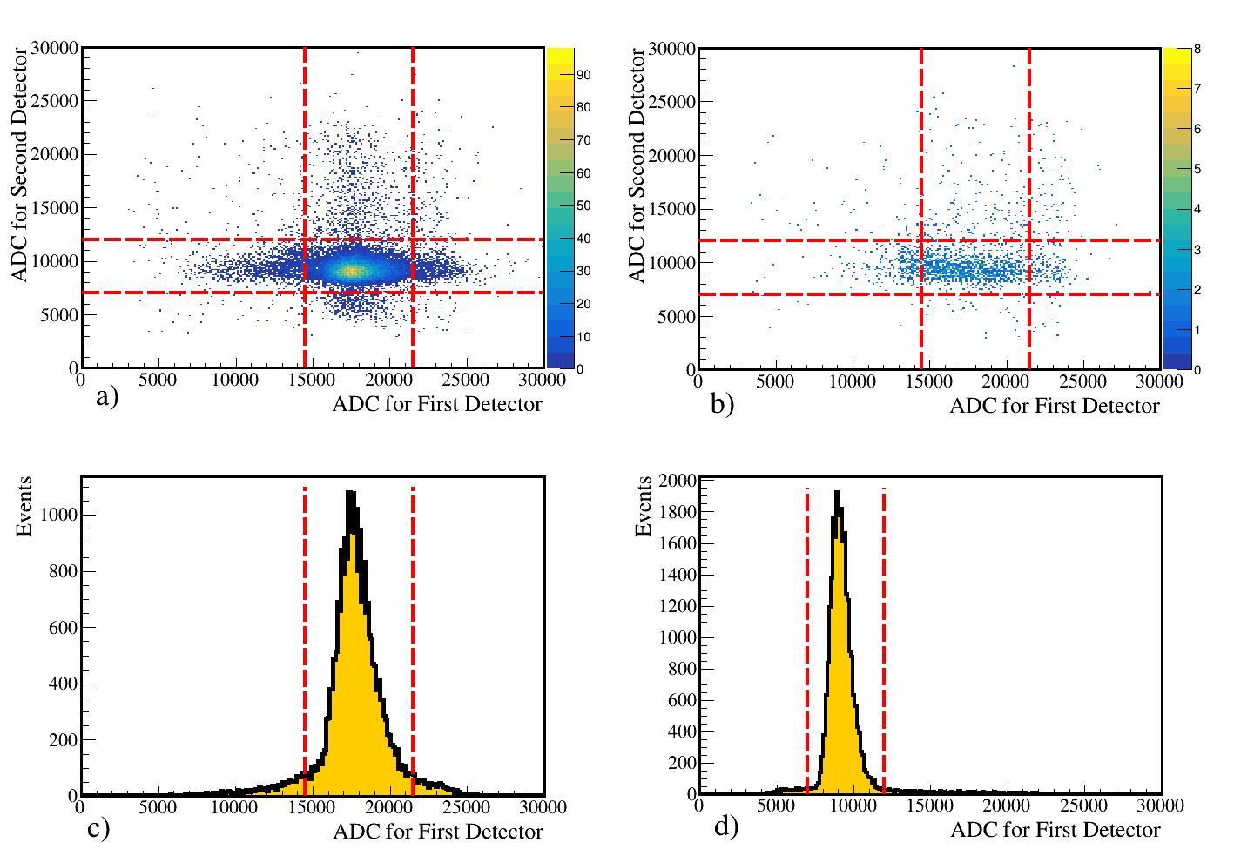
Background subtraction procedure.
Deuteron beam
Polyethylene
Carbon
X polyethylene projection
Y polyethylene projection

Slide 10
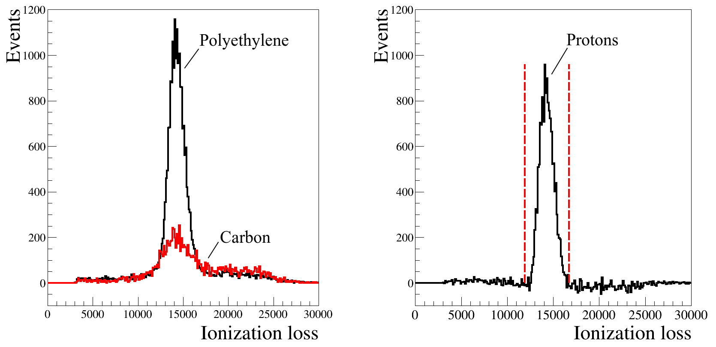
The result of the background subtraction.
500 MeV/n, 85° in CM system
~50% of events is background.
Unpolarized data
Red lines - cut on ADC.

Slide 11
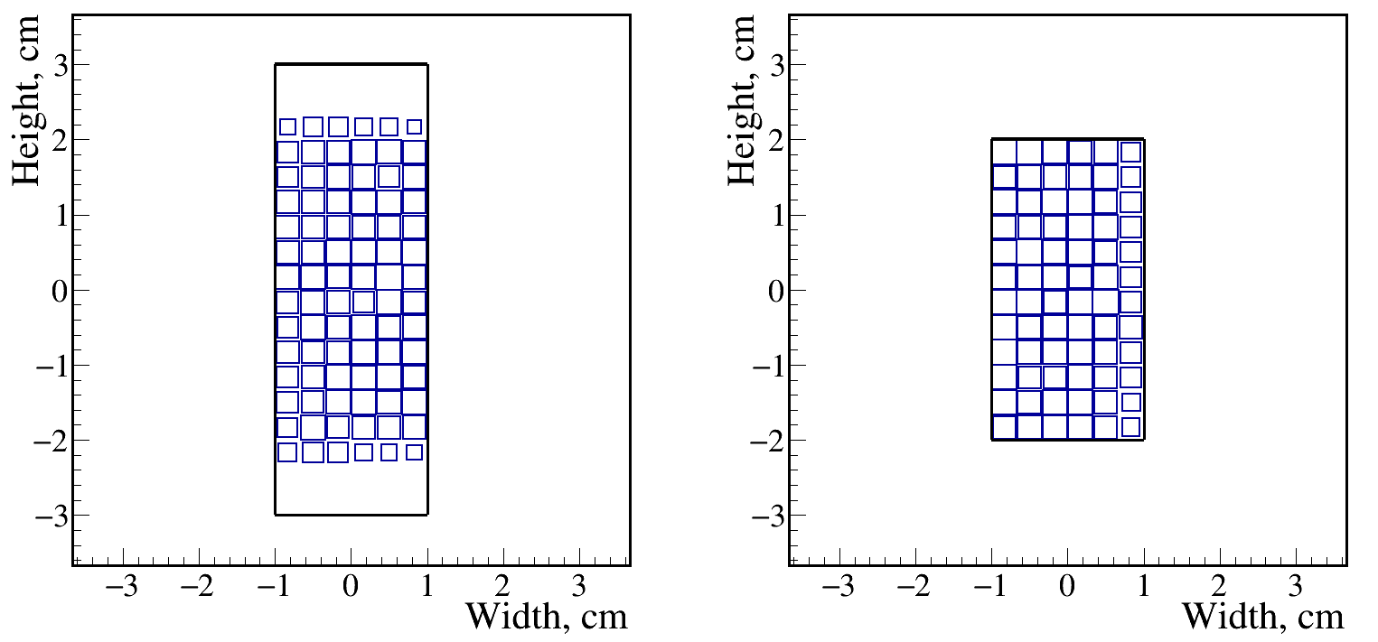
Coincidence hits distribution in the detectors from the simulation. 500 MeV/n, 85° in CM system
Left detector
Right detector
It needs to correct angles at which events were recorded via the beam shift.
Pluto Generator for ROOT Framework was used.
pp elastic scattering has been simulated.

Slide 12
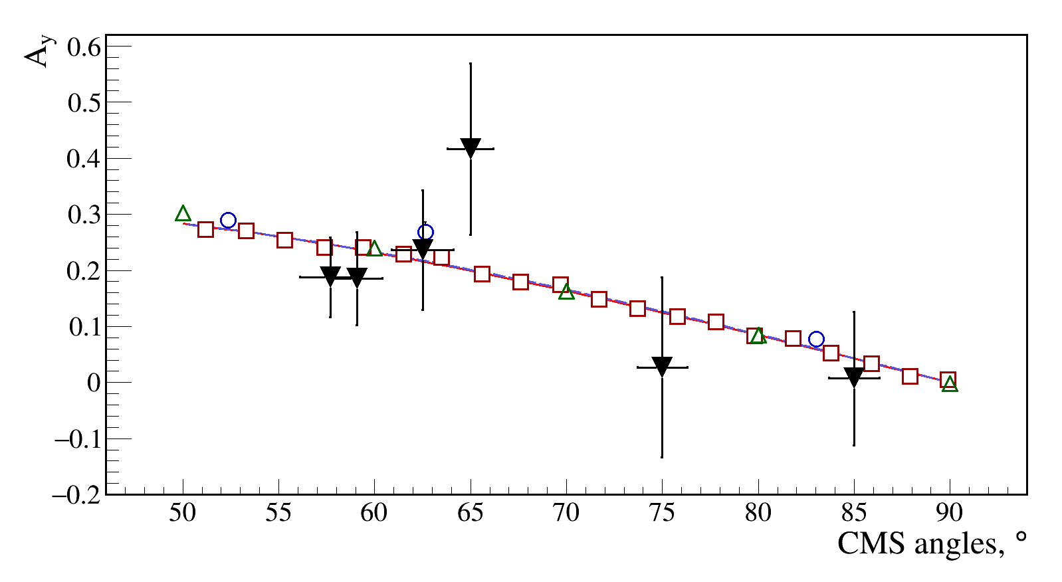
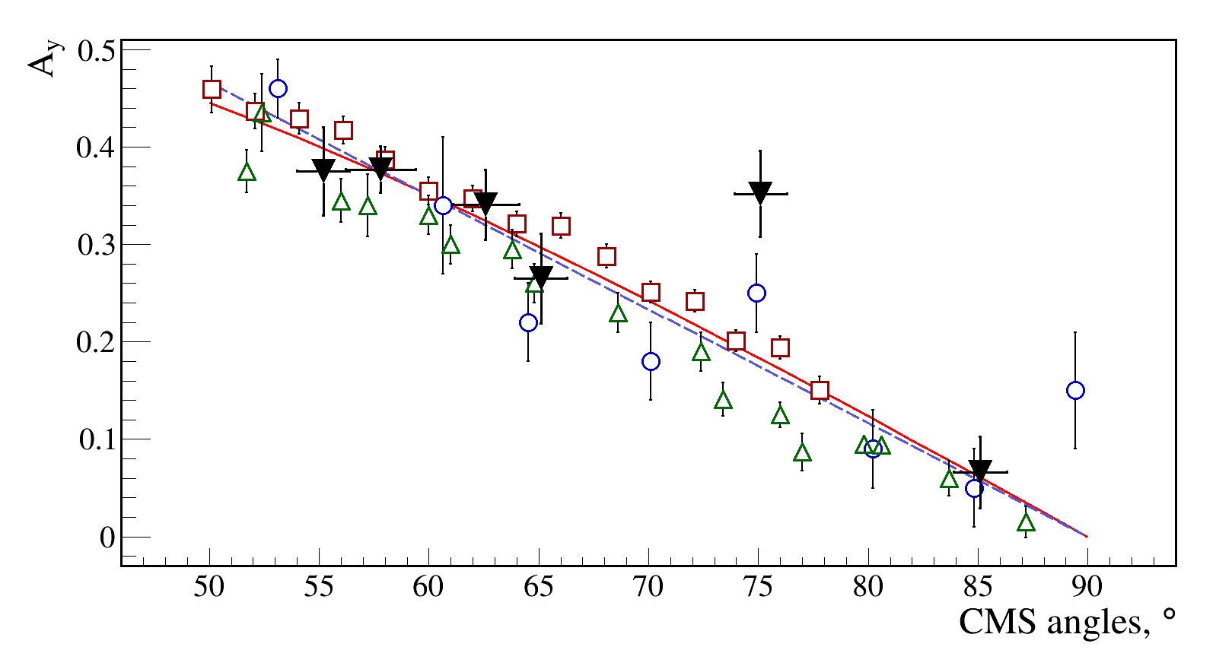
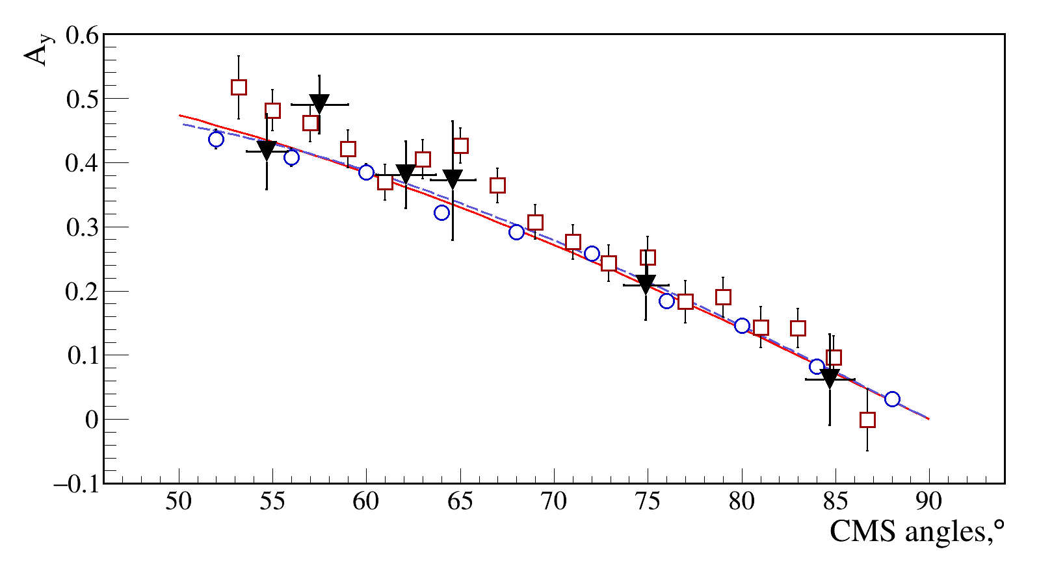
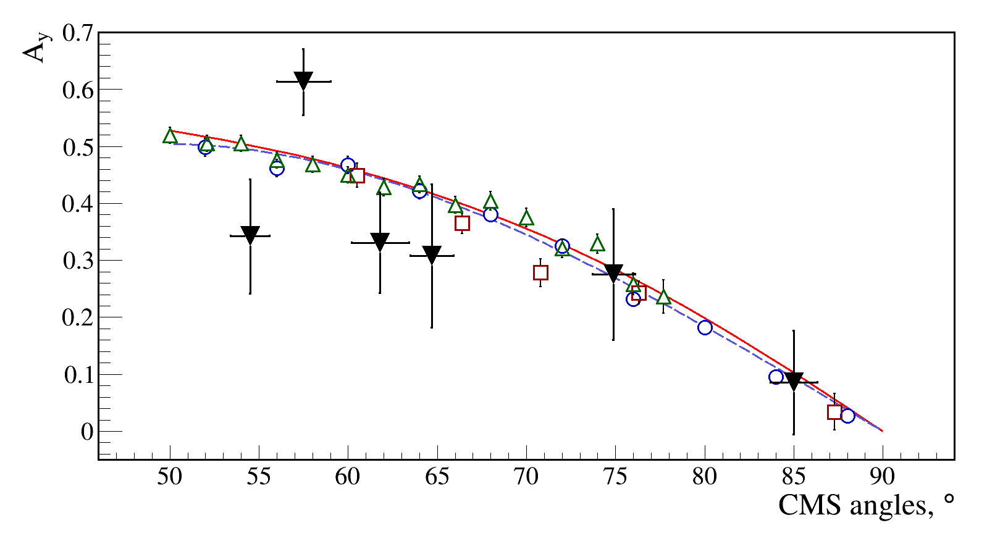
The vector analyzing power
200 MeV/n
500 MeV/n
550 MeV/n
650 MeV/n
SAID SP07
Our data - filled triangles ▼
Fit, 3rd degree polynomial

Slide 13
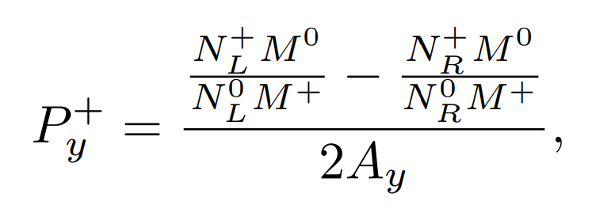
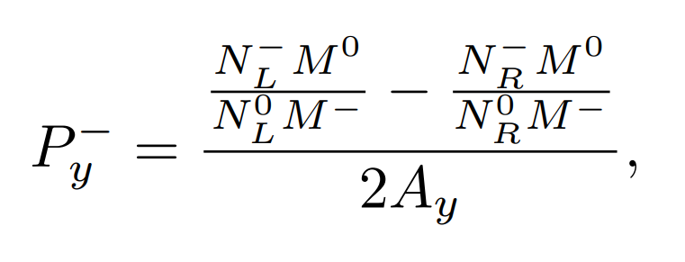
The vector polarization definition formulas
"2-6"
"3-5"
P_{y}⁺ and P_{y}⁻ - the vector polarization for the SPI mode "2-6" and "3-5".
N - number of events for the particular angle. L to the left, R to the right.
M - number of events in the monitor counters.
A_{y} - vector analyzing power for the particular angle.

Slide 14
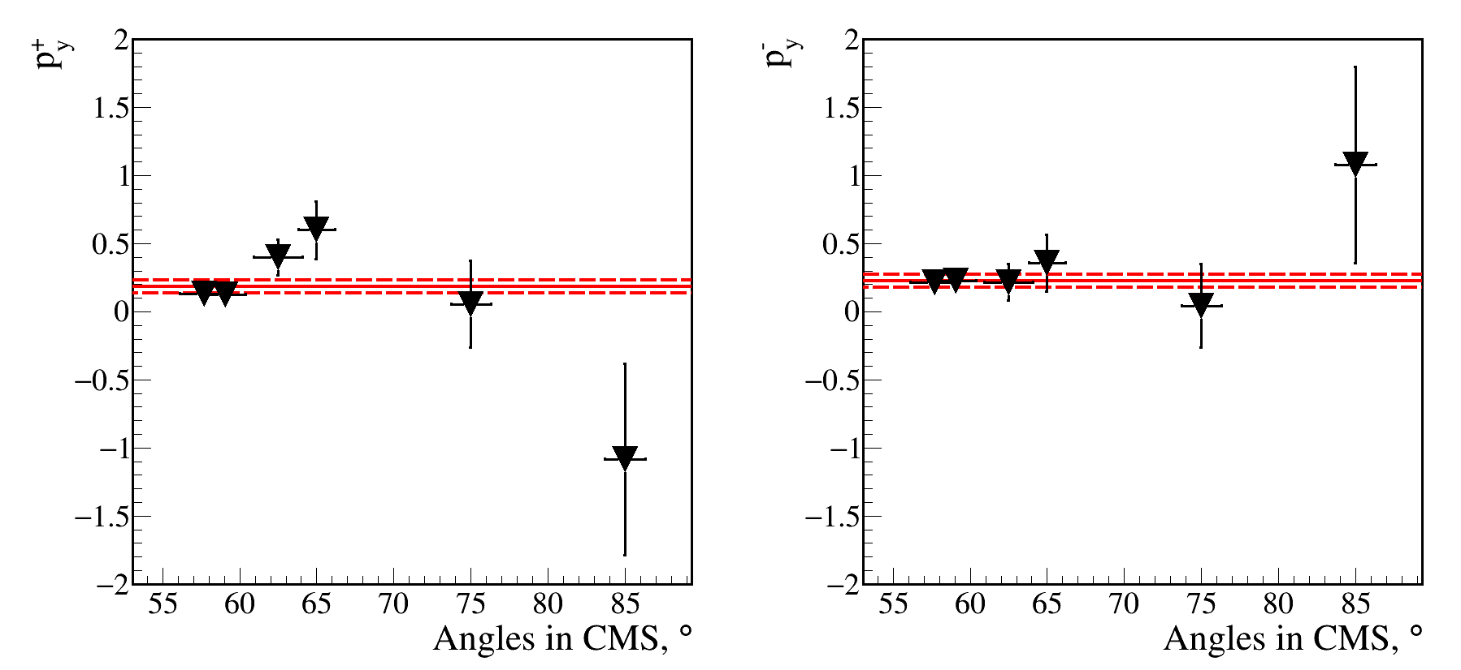
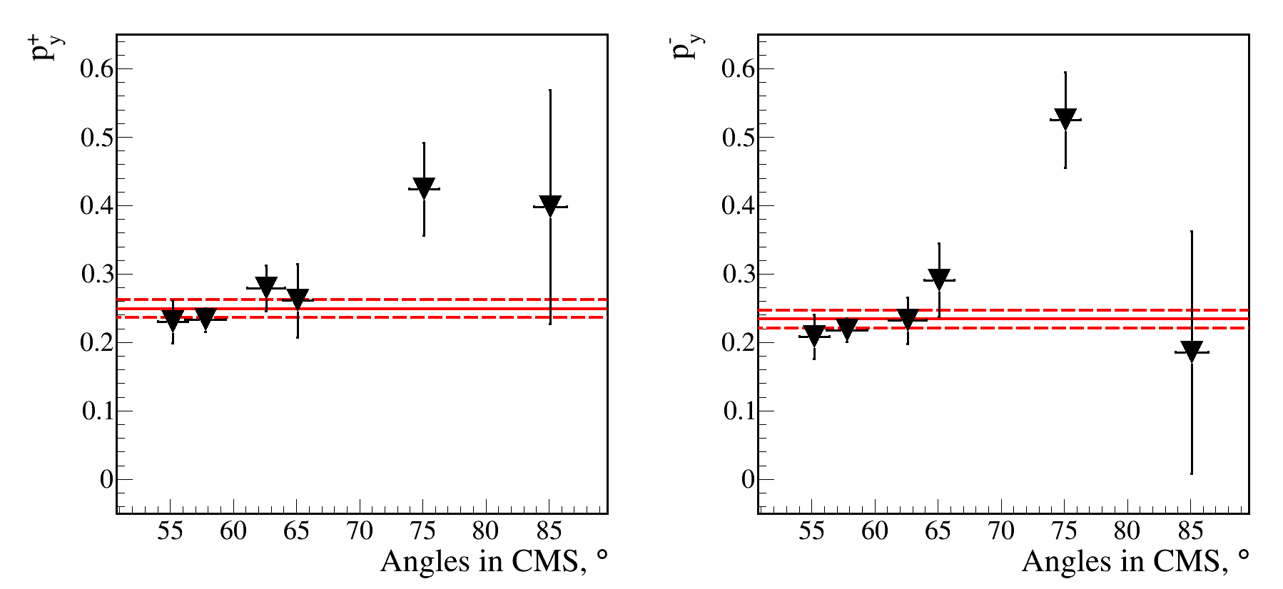
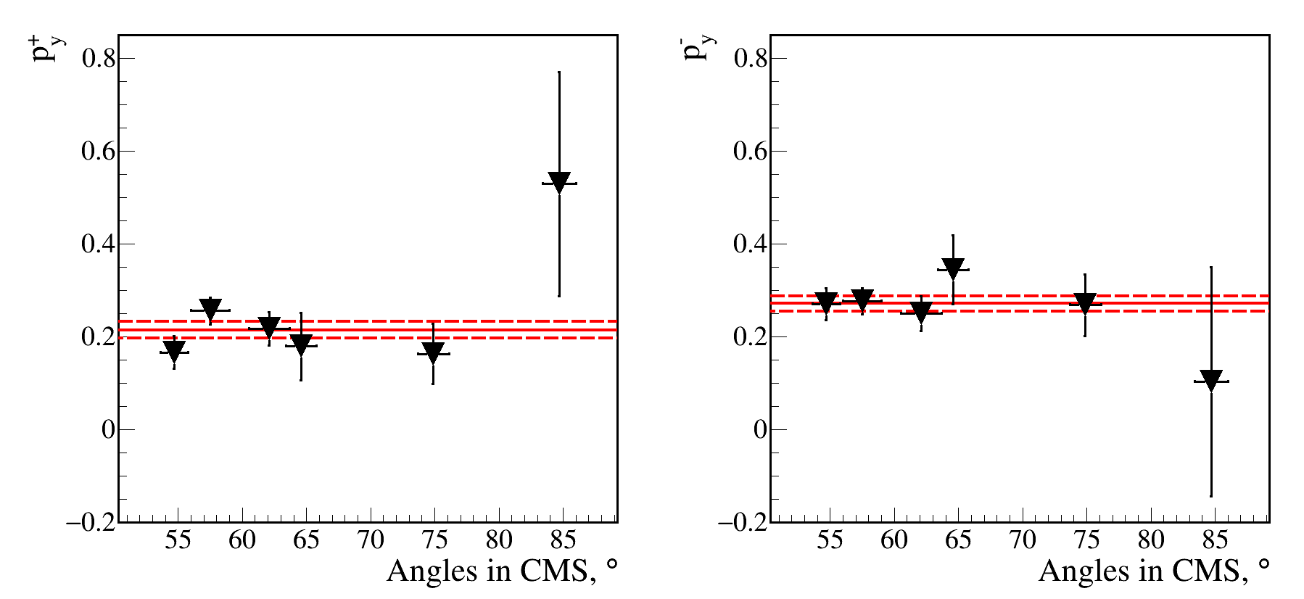
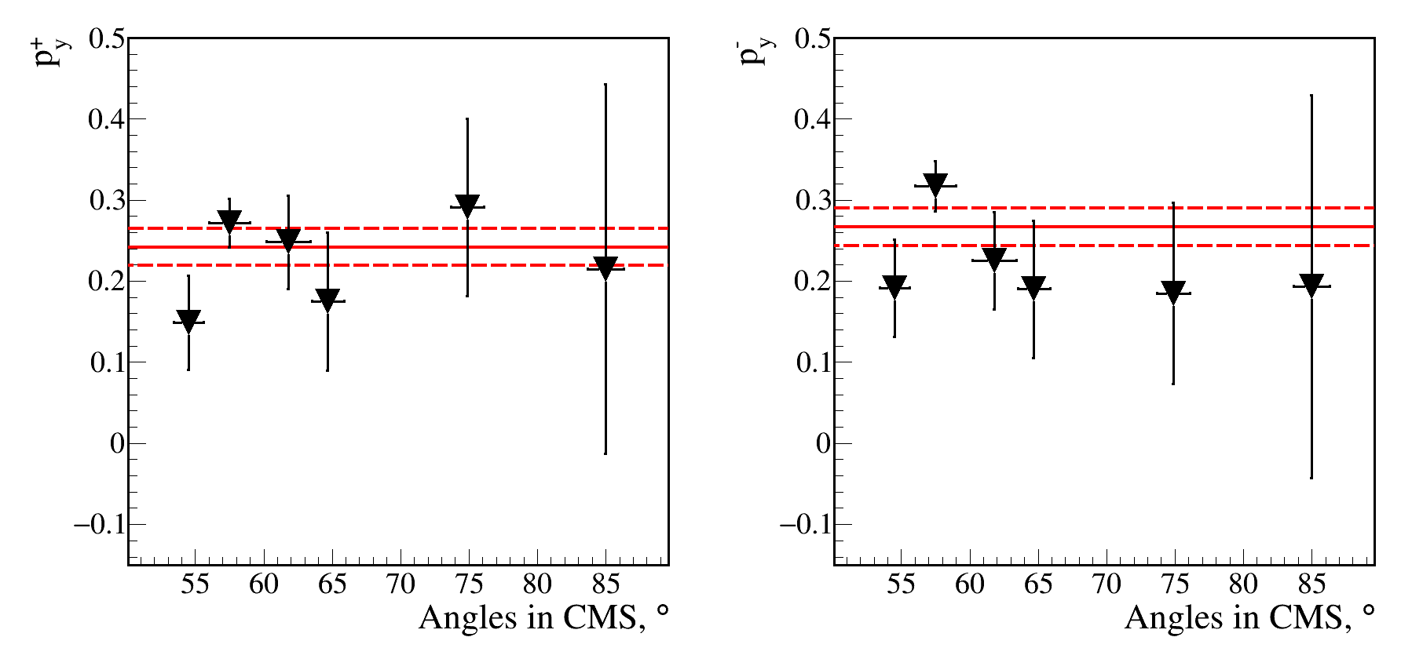
The deuteron beam polarization values
200 MeV/n
500 MeV/n
"2-6"
"3-5"
"2-6"
"3-5"
550 MeV/n
650 MeV/n
"2-6"
"3-5"
"2-6"
"3-5"
Values for each angle (detectors pair) in CM system.
Red lines - weighted average.

Slide 15
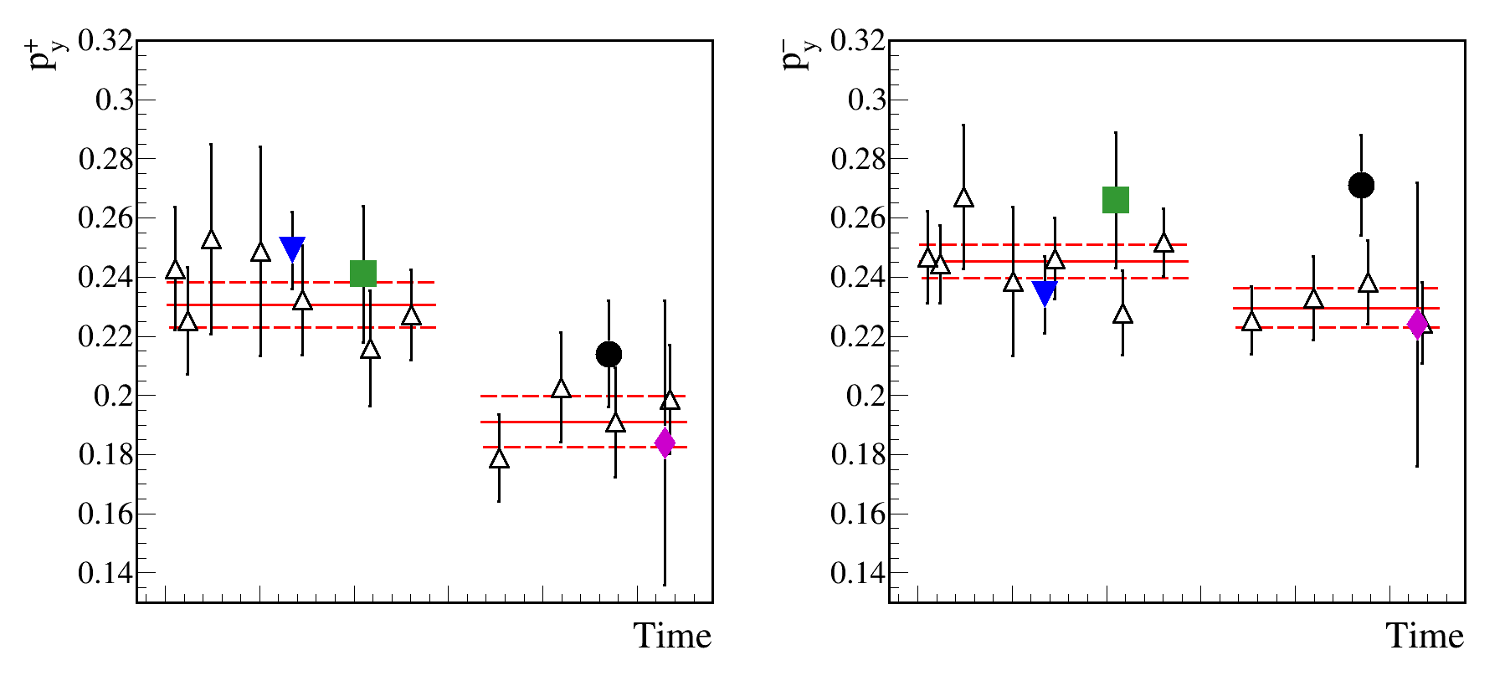
The averaged deuteron beam polarization values
"2-6"
"3-5"
△ - polarization values for dp elastic scattering (135 MeV/n)
▼- polarization values for pp quasi-elastic scattering (500 MeV/n)
■ - polarization values for pp quasi-elastic scattering (650 MeV/n)
●- polarization values for pp quasi-elastic scattering (550 MeV/n)
⯁ - polarization values for pp quasi-elastic scattering (200 MeV/n)

Slide 16
Selection of useful data.
Proton beam
Ionization loss correlation for the counters pair
Time-of-flight difference for the pair
Cuts
applied one after
the other
to achieve
better result

Slide 17
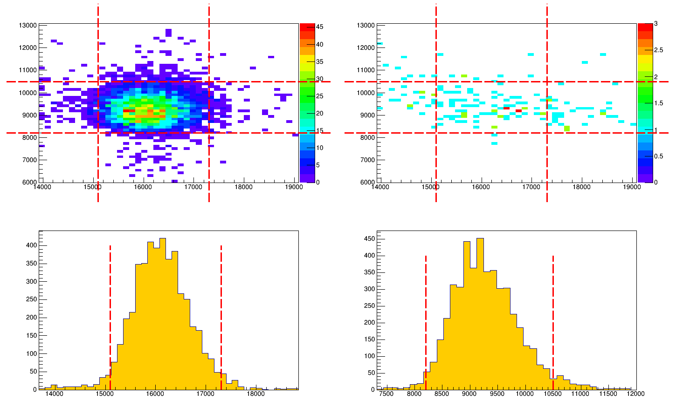
Background subtraction procedure.
Proton beam
Polyethylene
Carbon
X polyethylene projection
Y polyethylene projection

Slide 18
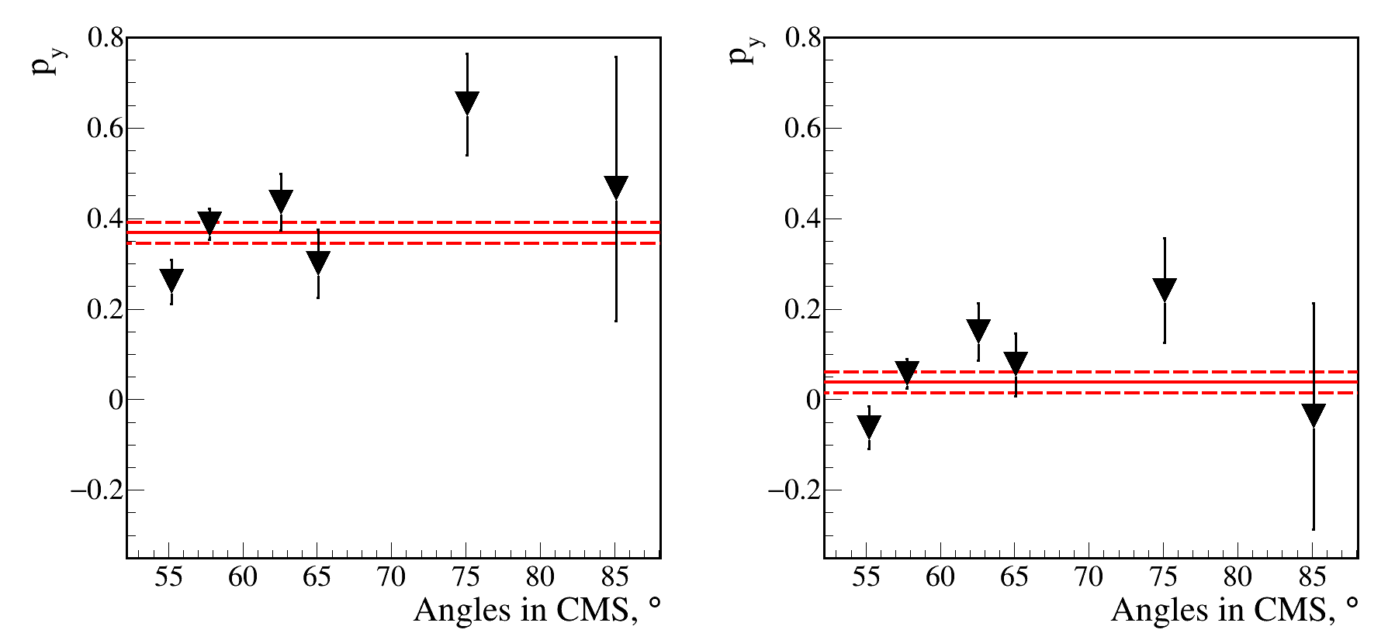
The proton beam polarization values.
500 MeV
Polarized beam, "1-3" mode of SPI
Unpolarized beam
p_{y} = 0.368 ±0.023
p_{y} = 0.038 ±0.023

Slide 19
Conclusion
The vector polarization values of the deuteron beam at modes "2-6" and "3-5" were obtained at the beam energies of 200, 500, 550 and 650 MeV/n;
The vector polarization values are in good agreement with the polarization values that were obtained using dp elastic scattering at the beam energy of 135 MeV/nucleon;
The polarization values of the proton beam at mode "1-3" and unpolarized were obtained at the energy of 500 MeV;
The vector analyzing power values of the pp-quasielastic scattering reaction were obtained using the same asymmetry. They are in good agreement with the world data and SP07.
The experimental setup is suitable for the deuteron and proton beam polarimetry.

Slide 20
Thank you for your attention!

