Slide 1

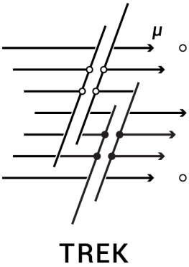
National Research Nuclear University MEPhI
(Moscow Engineering Physics Institute)
Large-scale tracking detector TREK for cosmic ray muon bundle investigations
at large zenith angles
Presenter: Troshin I.Y.
E-mail: IYTroshin@mephi.ru
MEPhI – IHEP Collaboration
Moscow, 2023

Slide 2
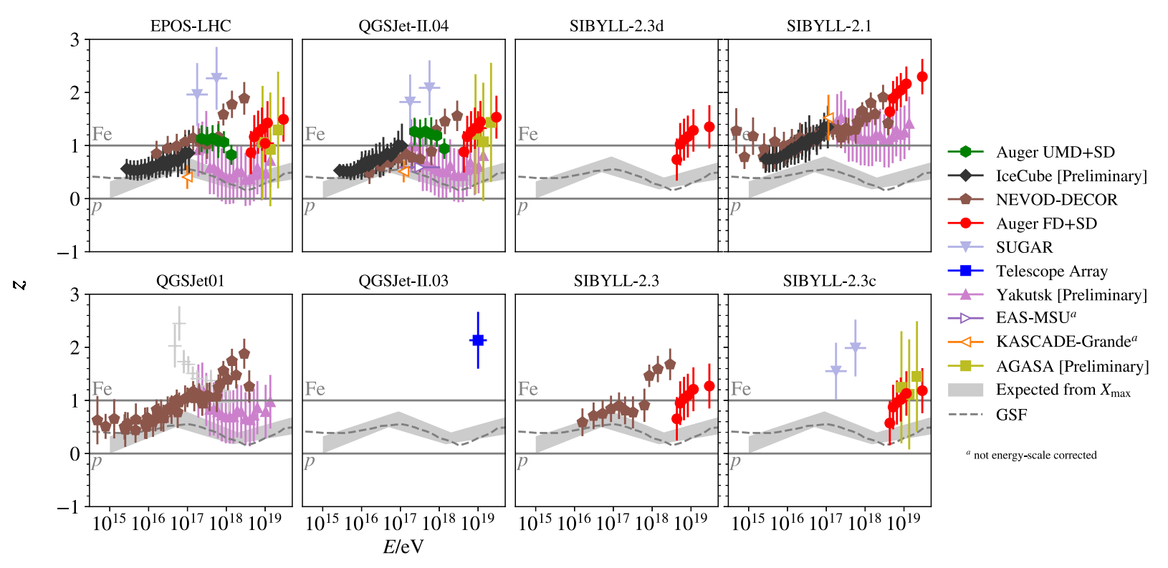
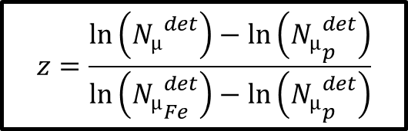
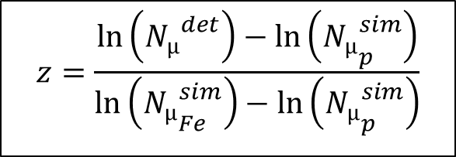
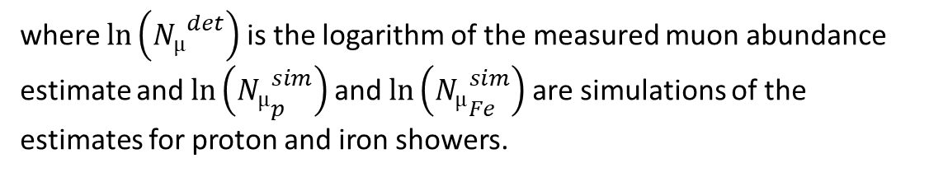
Muon puzzle
$$z=\frac{\ln\left({N_{µ}}_{ }^{det}\right)−\ln\left({N_{µ}}_{p}^{det}\right)}{\ln\left({N_{µ}}_{Fe}^{det}\right)−\ln\left({N_{µ}}_{p}^{det}\right)}$$
$$z=\frac{\ln\left({N_{µ}}_{ }^{det}\right)−\ln\left({N_{µ}}_{p}^{sim}\right)}{\ln\left({N_{µ}}_{Fe}^{sim}\right)−\ln\left({N_{µ}}_{p}^{sim}\right)}$$
where $\ln\left({N_{µ}}_{ }^{det}\right)$ is the logarithm of the measured muon abundance estimate and $\ln\left({N_{µ}}_{p}^{sim}\right)$and $\ln\left({N_{µ}}_{Fe}^{sim}\right)$are simulations of the estimates for proton and iron showers.

Slide 3
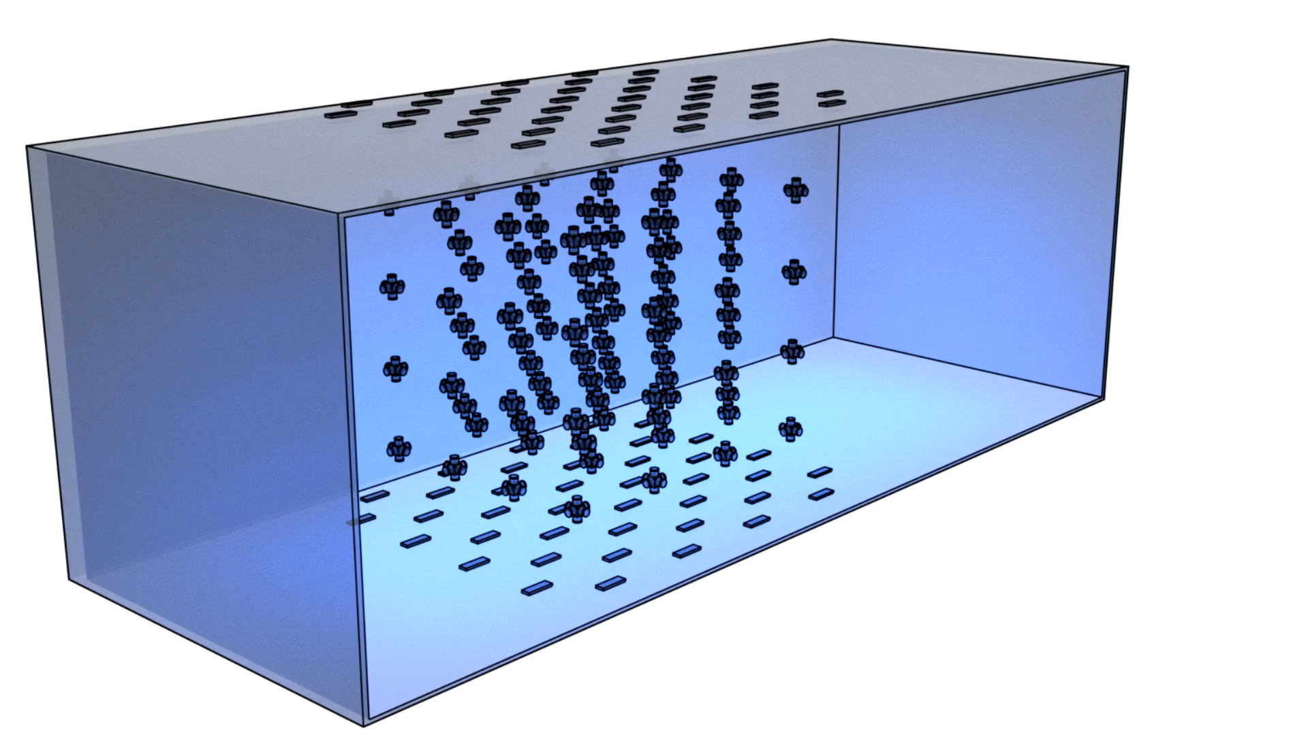
NEVOD-DECOR experiment
System of calibration telescopes (SCT)
Cherenkov Water Detector (CWD)
DECOR
Model of the NEVOD-DECOR
Disadvantages: DECOR does not cover full NEVOD side surface and its area is not continuous.

Slide 4
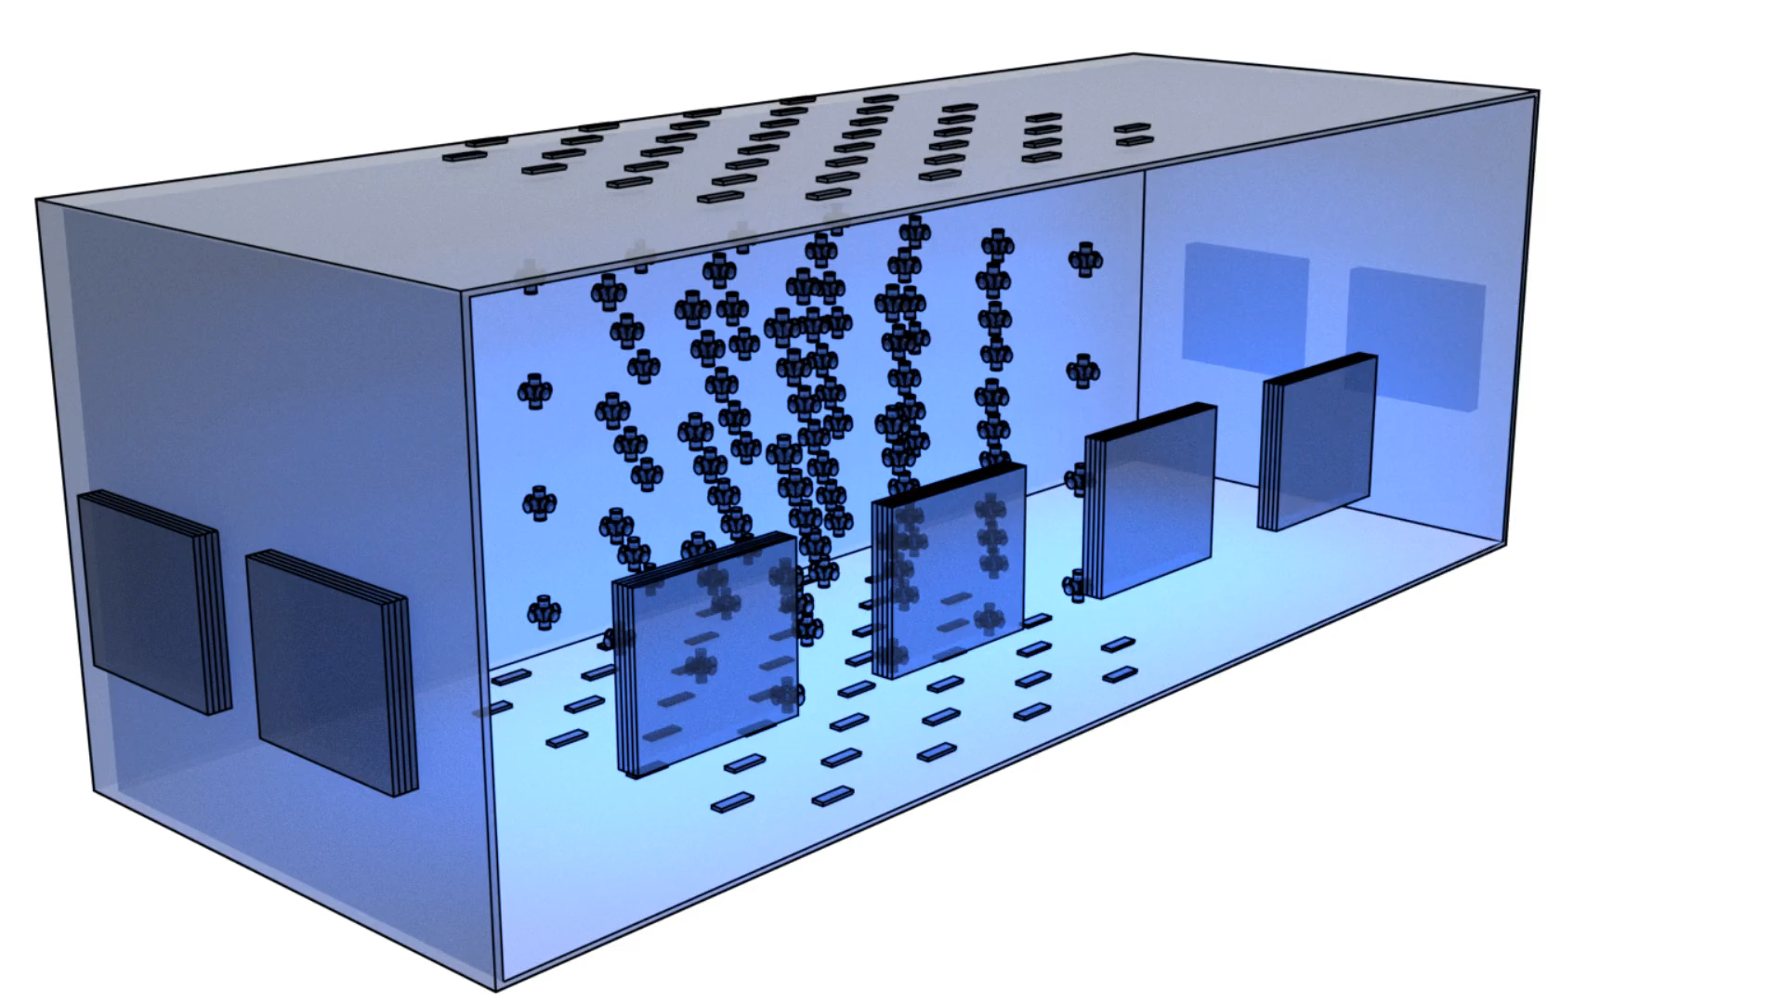
Detector TREK and other detectors of the experimental complex NEVOD
System of calibration telescopes (SCT)
Outer plane
of drift chambers
Cherenkov Water Detector (CWD)
The TREK consists of 264 drift chambers
The area of one chamber is 1.85 m²
Detector TREK area is 250 m²
DECOR
SCT
Inner plane
of drift chambers

Slide 5
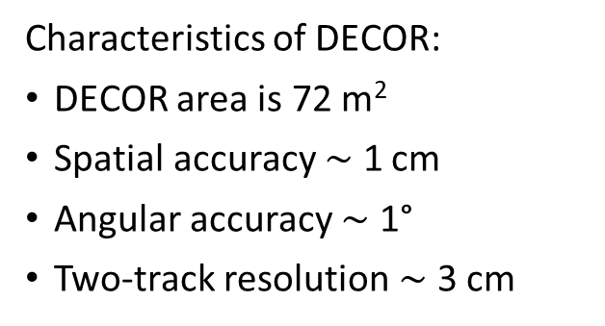
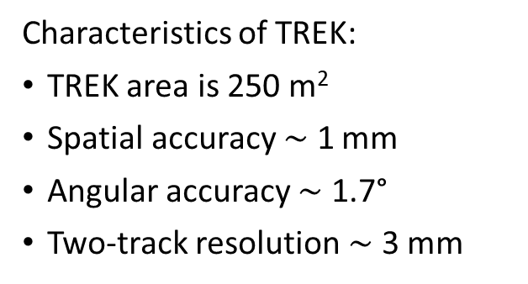
The principle of operation of TREK drift chamber:
t
Field strength
4
t
Field strength
3
t
~7000 V/cm
2
60 mm
500 V/cm
t
1
250
mm
250
mm
DECOR chamber:
–
field-forming wires
–
signal wires
–
cathode wires
–
anode wires
–
security wires
Characteristics of DECOR:
DECOR area is 72 m²
Spatial accuracy $\sim$ 1 cm
Angular accuracy $\sim$ 1°
Two-track resolution $\sim$ 3 cm
Characteristics of TREK:
TREK area is 250 m²
Spatial accuracy $\sim$ 1 mm
Angular accuracy $\sim$ 1.7°
Two-track resolution $\sim$ 3 mm

Slide 6
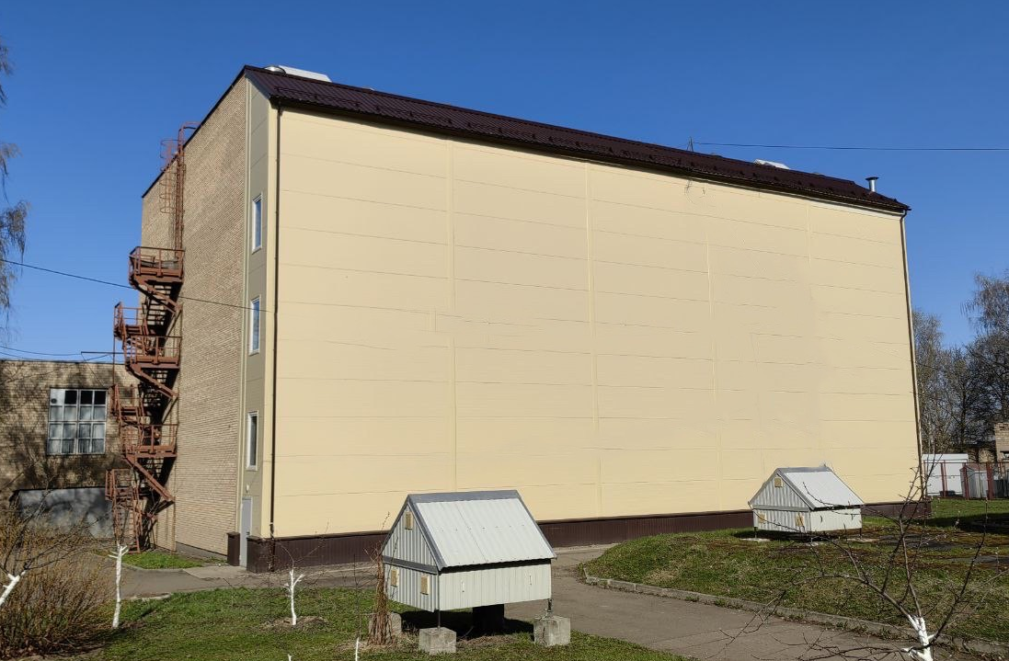
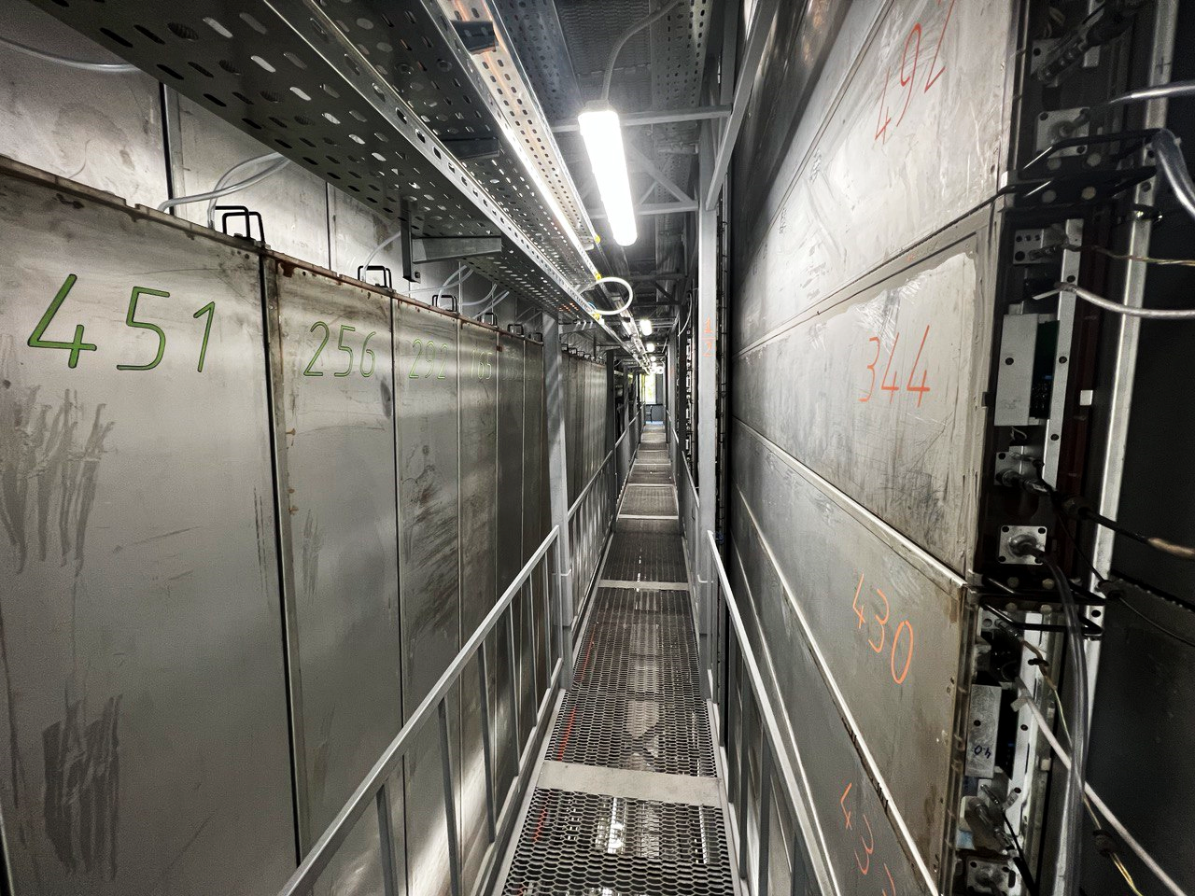
Detector TREK
Photo of the TREK detector from the outside
Photo of the TREK detector from the inside

Slide 7
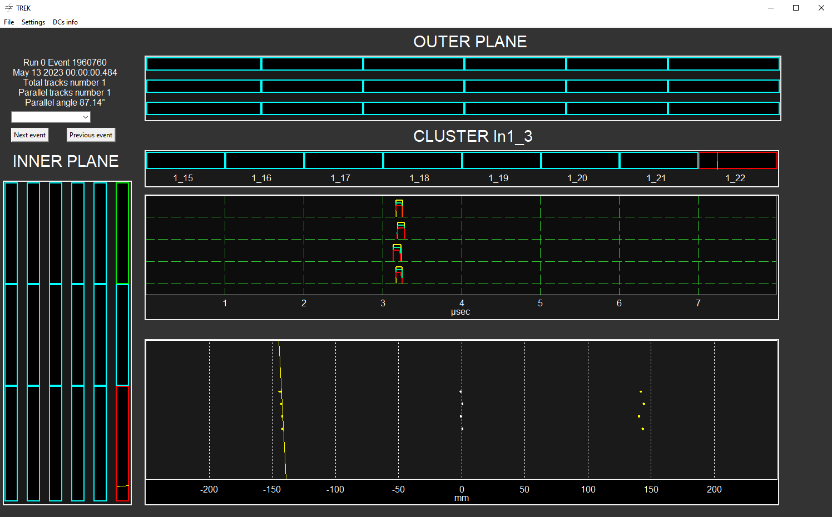
Reconstructed single-particle event on the TREK
Selected drift chamber
Time scan of signals in the selected chamber
Part of the Inner plane
Displaying the reconstructed track
7

Slide 8
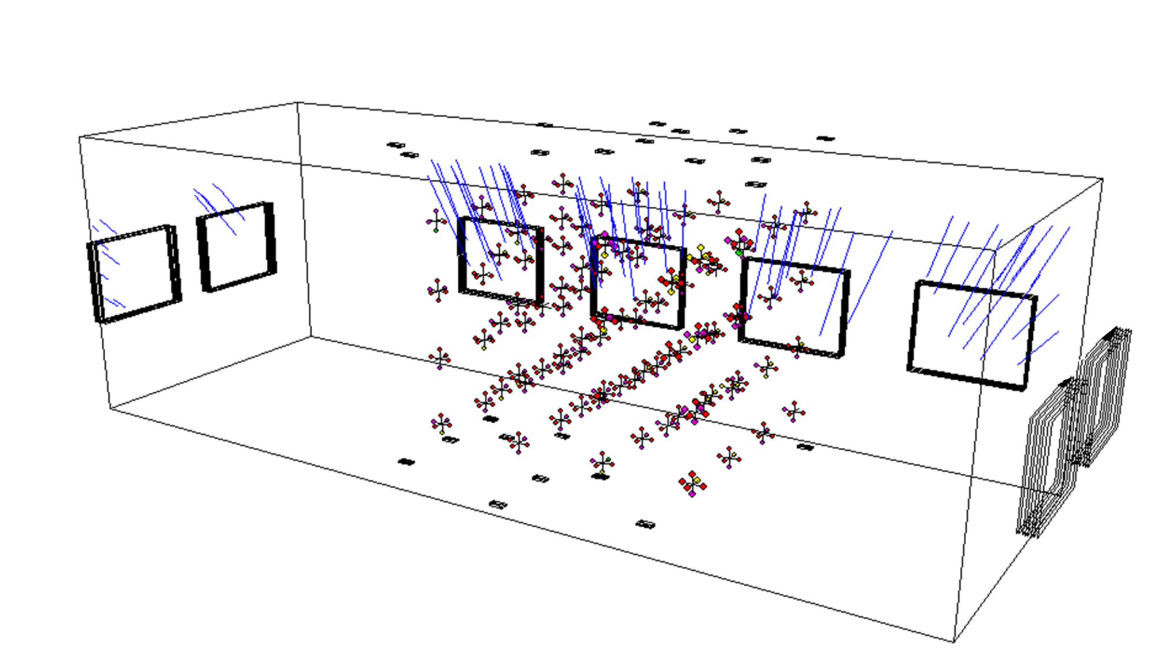
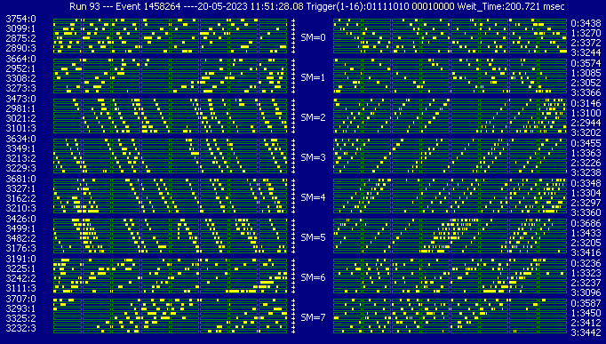
The event with high muon density in DECOR
A reconstructed event with a large particle multiplicity, blue lines
are particle tracks
Two projections of a multi-particle event

Slide 9
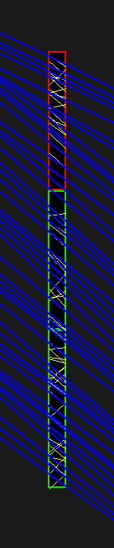
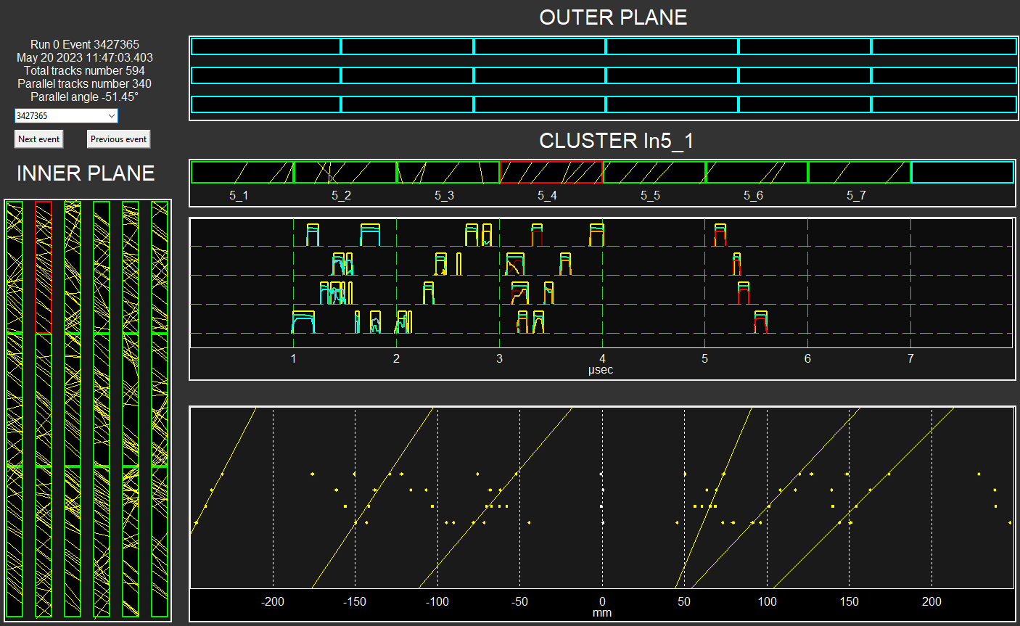
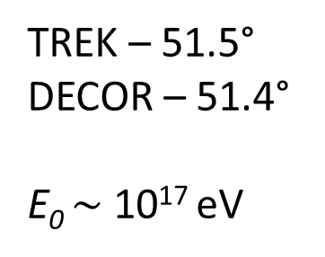
Reconstruction of the event with a high muon density in TREK
Selected drift chamber
TREK – 51.5°
DECOR – 51.4°
E₀ $\sim$ 10¹⁷ eV
Part of the Inner plane

Slide 10
Reconstruction of multi-particle events

Slide 11
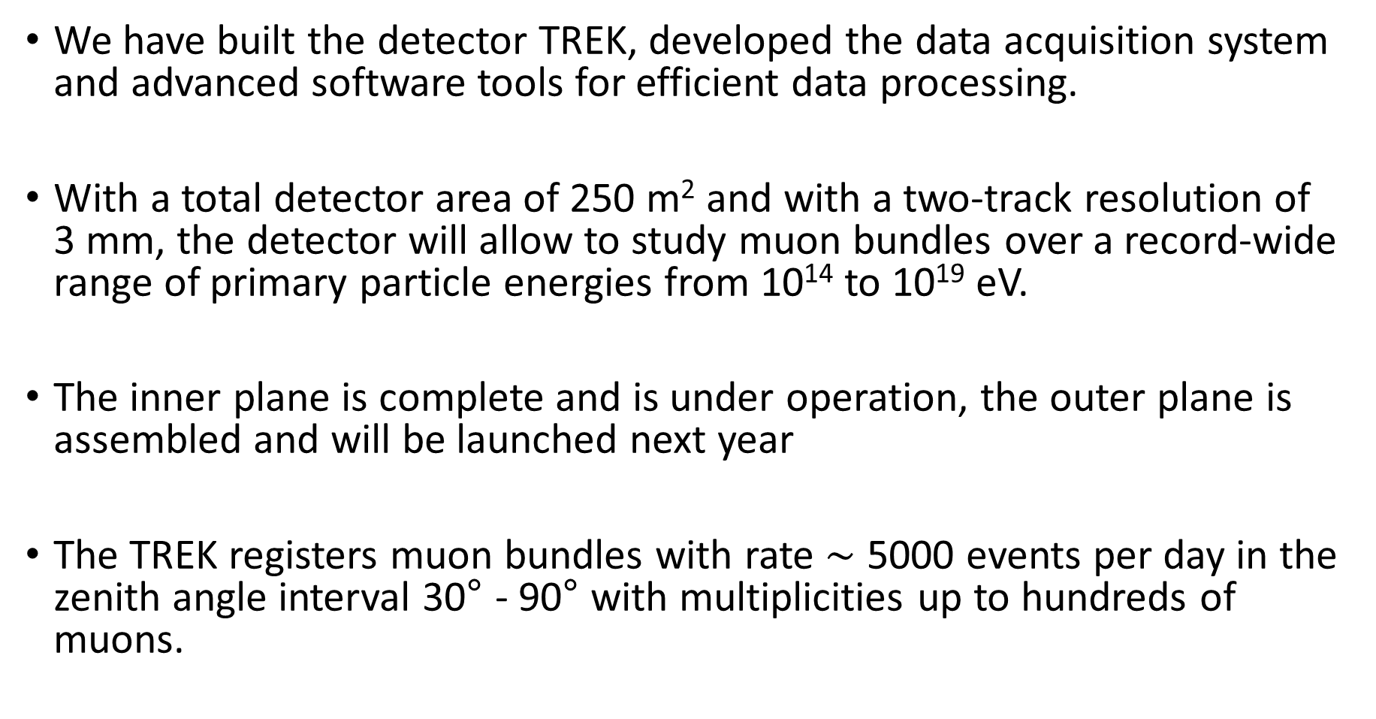
Conclusion
We have built the detector TREK, developed the data acquisition system and advanced software tools for efficient data processing.
With a total detector area of 250 m² and with a two-track resolution of 3 mm, the detector will allow to study muon bundles over a record-wide range of primary particle energies from 10¹⁴ to 10¹⁹ eV.
The inner plane is complete and is under operation, the outer plane is assembled and will be launched next year
The TREK registers muon bundles with rate $\sim$ 5000 events per day in the zenith angle interval 30° - 90° with multiplicities up to hundreds of muons.

Slide 12
Thanks for your attention
Presenter: Troshin I.Y.
E-mail: IYTroshin@mephi.ru
MEPhI – IHEP Collaboration
12

Slide 13
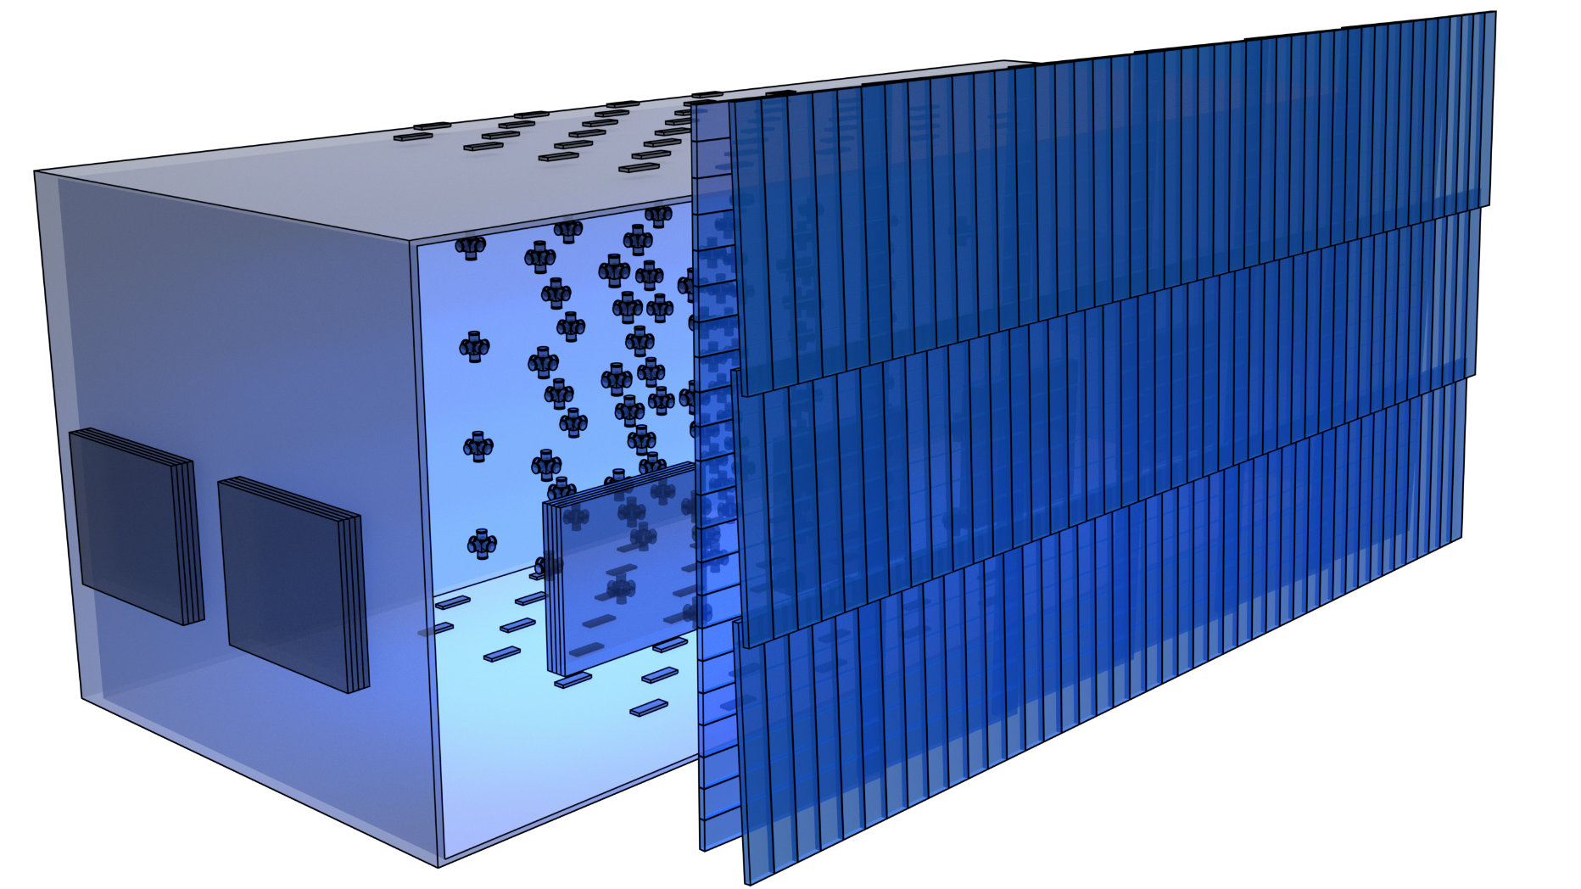
Detector TREK and other detectors of the experimental complex NEVOD
System of calibration telescopes (SCT)
Outer plane
of drift chambers
Cherenkov Water Detector (CWD)
The TREK consists of 264 drift chambers
The area of one chamber is 1.85 m²
Detector TREK area is 250 m²
DECOR
SCT
Inner plane
of drift chambers

Slide 14
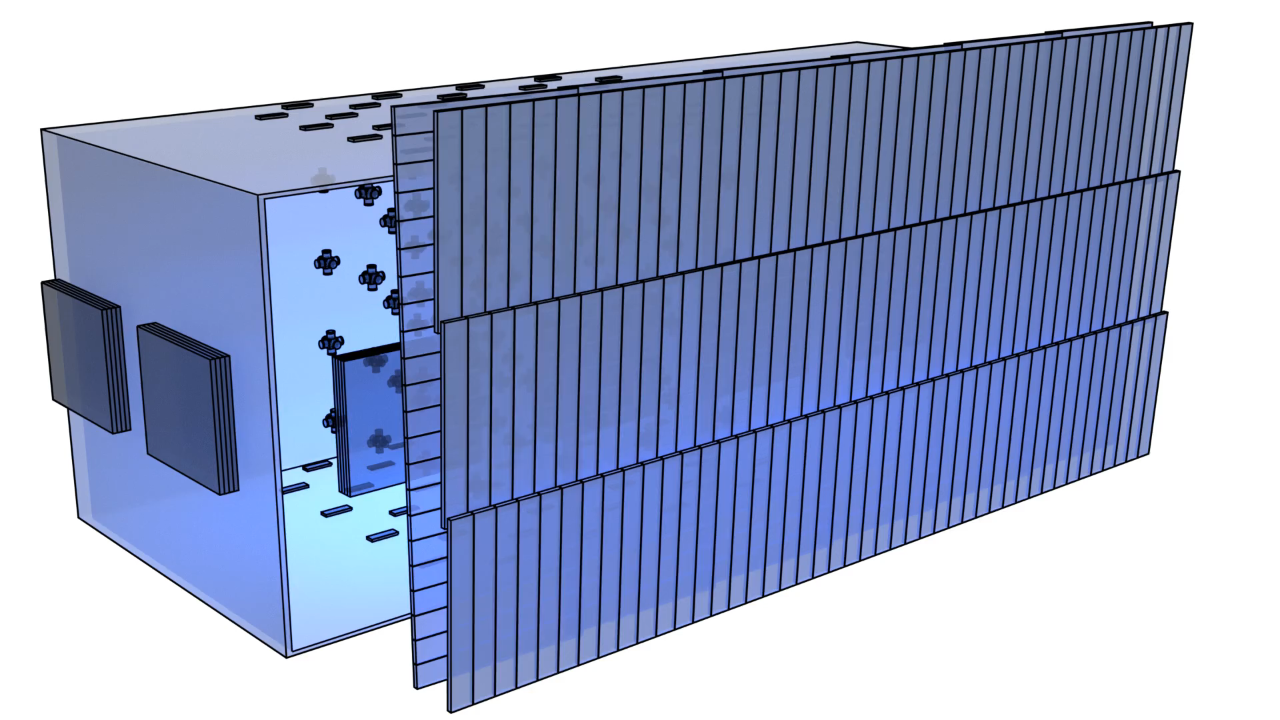
Detector TREK and other detectors of the experimental complex NEVOD
Calibration Telescopes System (CTS)
Outer plane
of drift chambers
Cherenkov Water Detector (CWD)
DECOR
CTS
The TREK consists of 264 drift chambers
The area of one chamber is 1.85 m²
Detector TREK area is 250 m²
Inner plane
of drift chambers

Slide 15
Extensive air showers
Primary particle
Atmosphere
μ
μ
μ
Primary particle
Detector
μ
Earth

Slide 16
Reconstructed single-particle event on the TREK
Selected drift chamber
Time scan of signals in the selected chamber
Displaying the reconstructed track
16

Slide 17
Reconstruction of the event with a high muon density in TREK
TREK – 51.5°
DECOR – 51.4°
E₀ $\sim$ 10¹⁷ eV

Slide 18
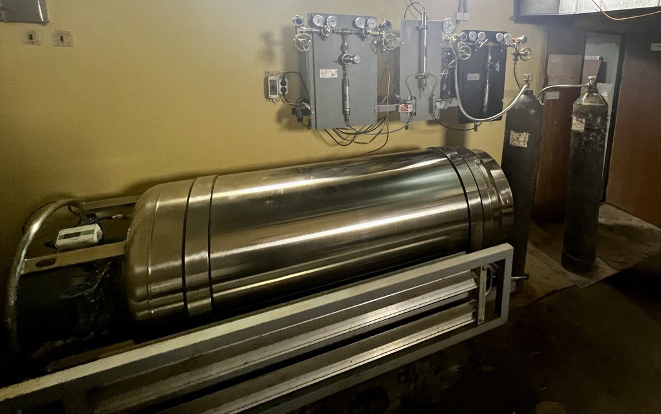
Gas system of detector TREK
Composition of the gas mixture:
94% Ar + 6% CO₂
Gas consumption per cluster is 15 l/h,
per plane is 240 l/h,
for the TREK is 480 l/h
Ar
Ar
СО₂
СО₂

Slide 19
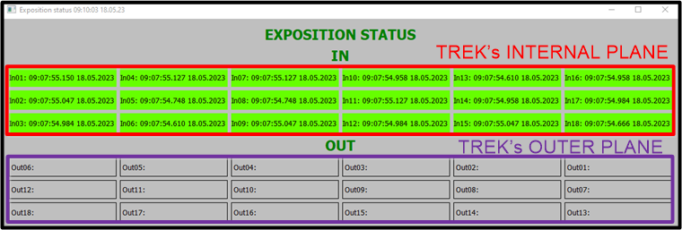
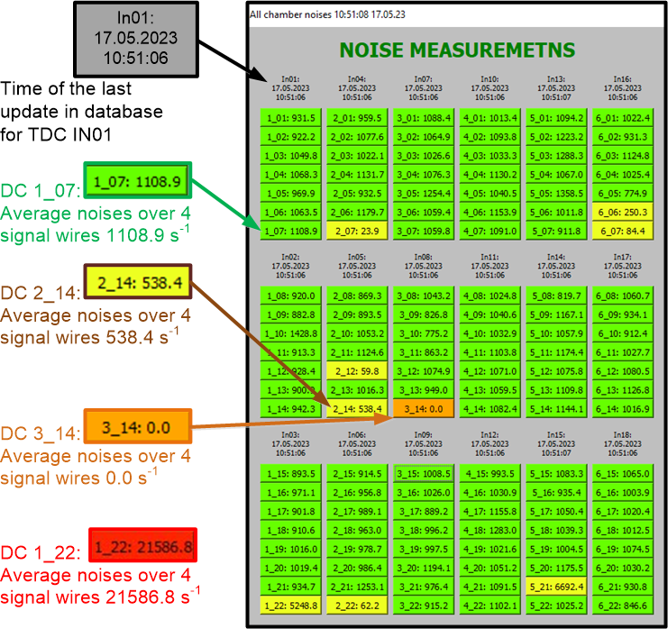
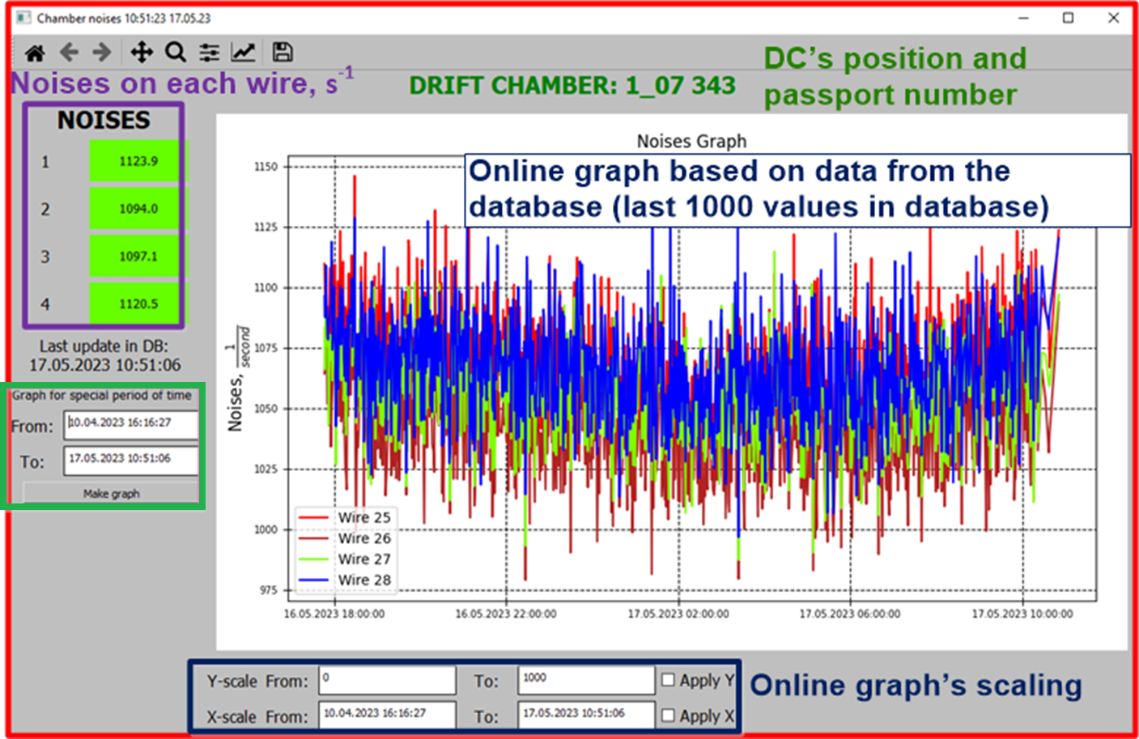
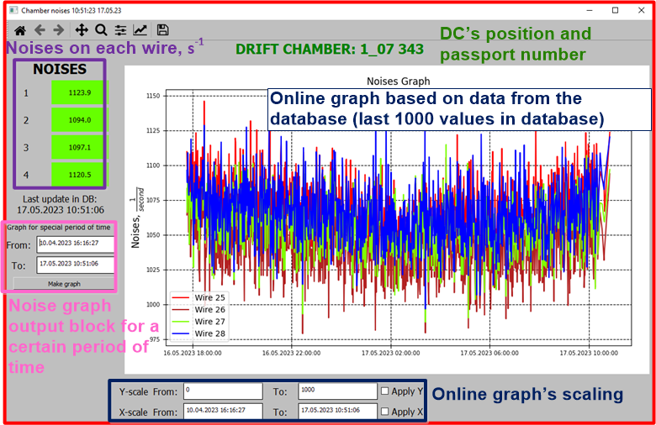
Software Interface
Noise output block for a certain period of time

Slide 20
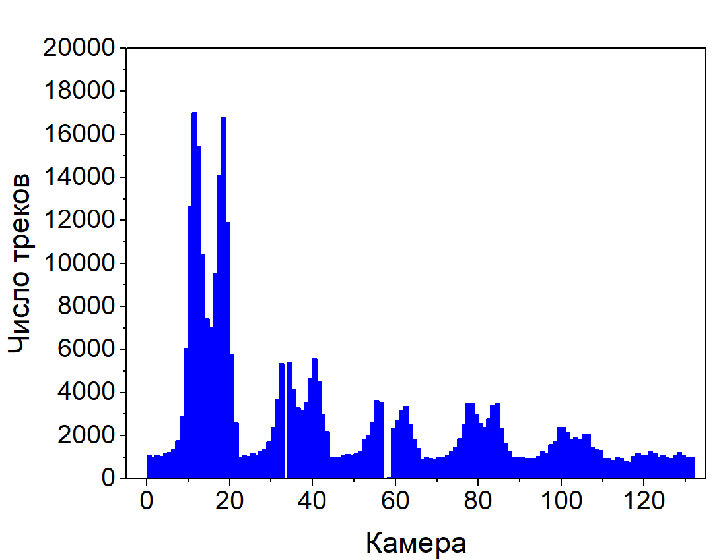
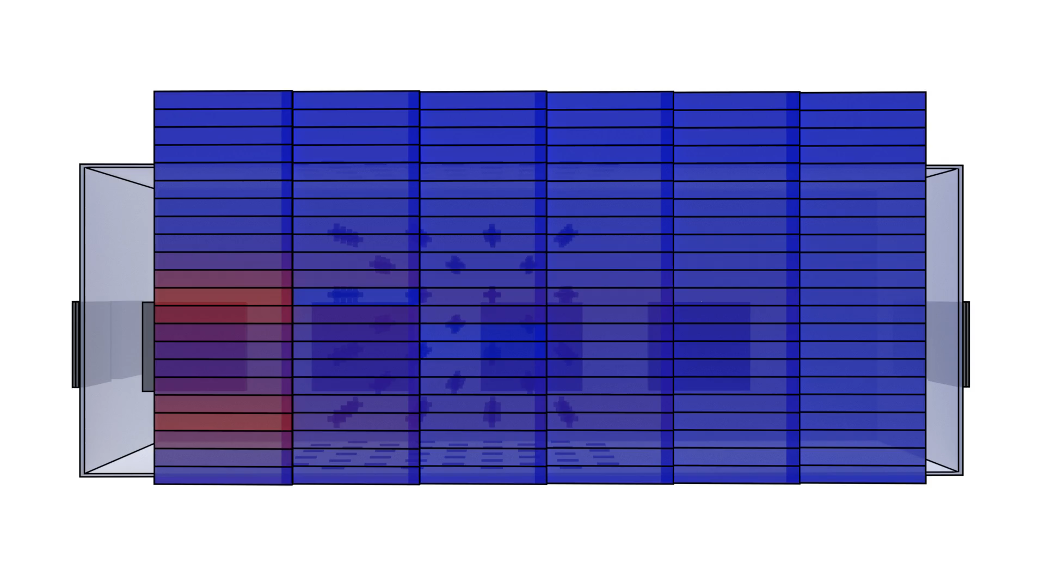
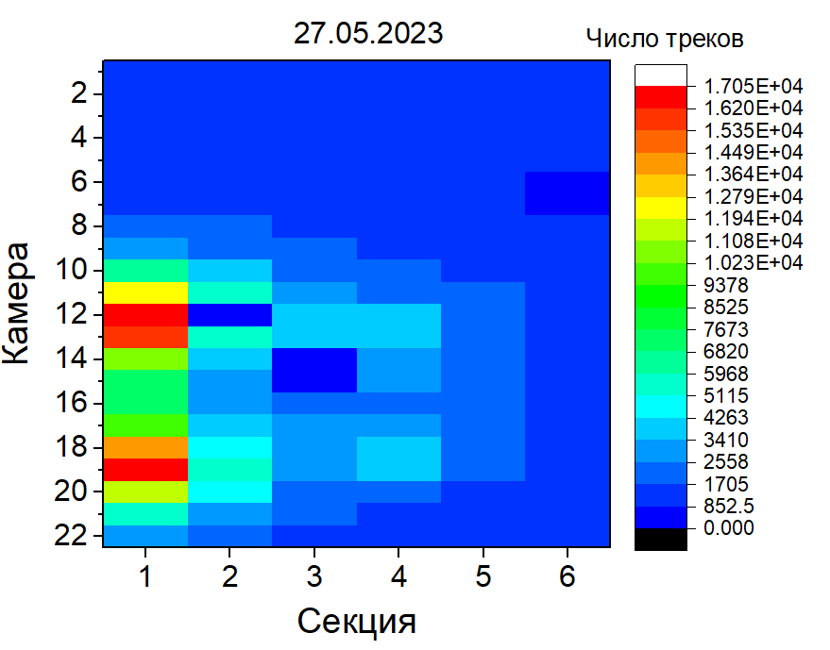
Single-particle events in the TREK
350,000 events per day
Number of tracks
Drift chambers
Number of tracks
Drift chambers
Visualization of single events
20
20
Section

Slide 21
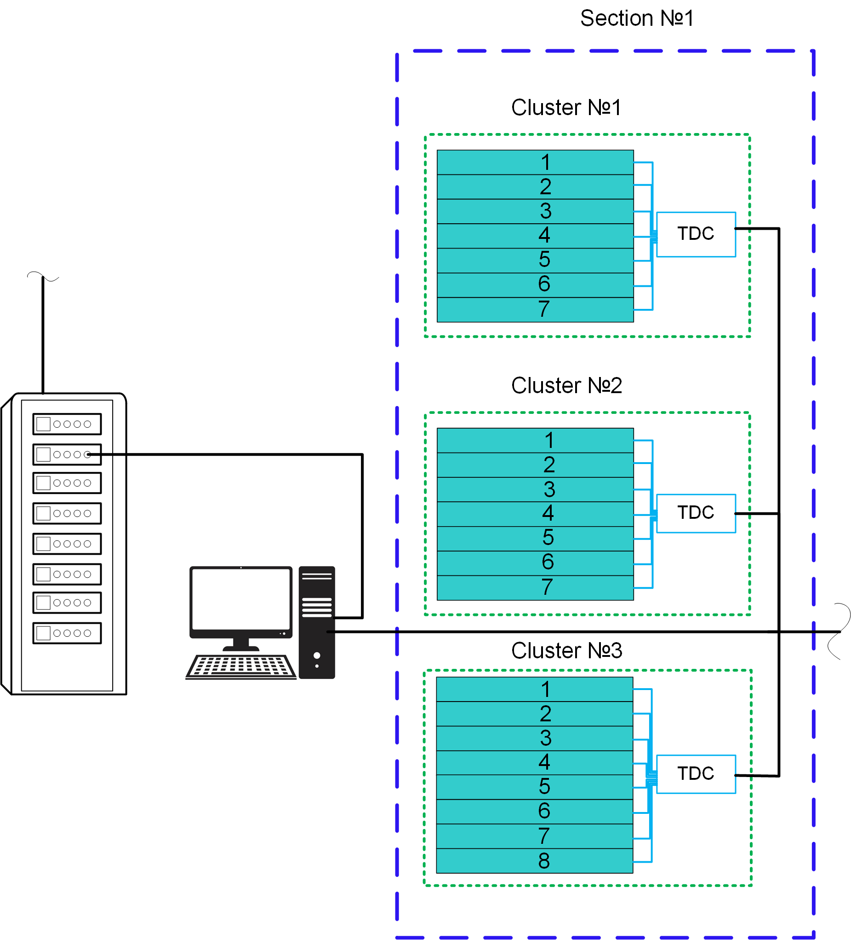
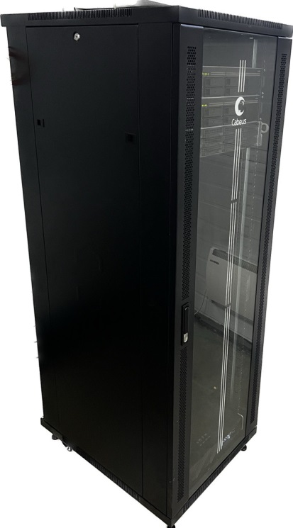
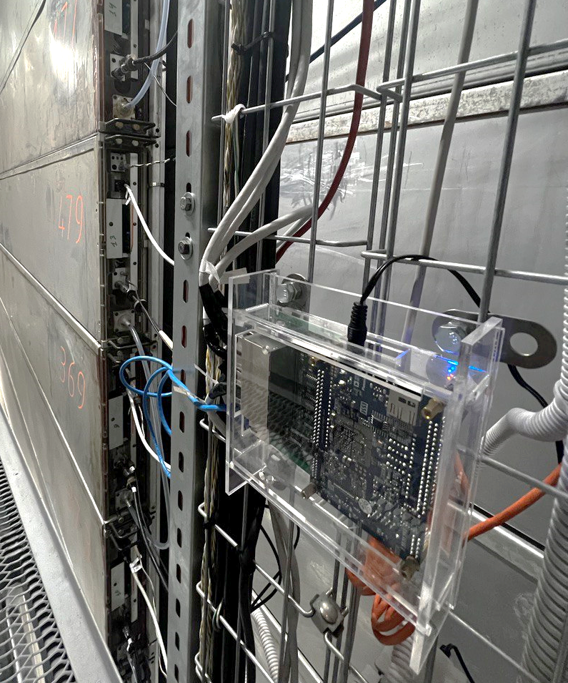
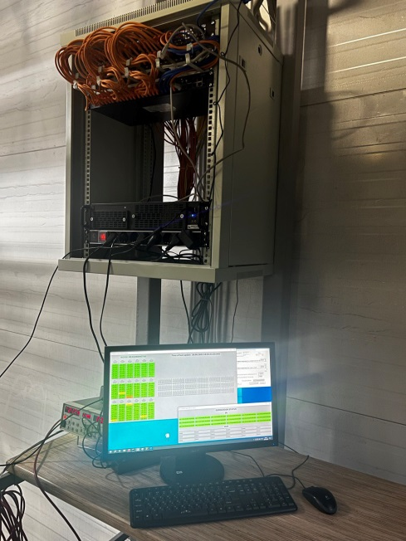
Data acquisition and TDC
Server
~1 300 000
events per day
Computer
Time-to-digital converter (TDC):
- Altera Cyclone V (FPGA + CPU);
- 8 interfaces for DCs’ connection;
- 32 LVDS channels;
- processing rate up to 1000 s⁻¹.

Slide 22
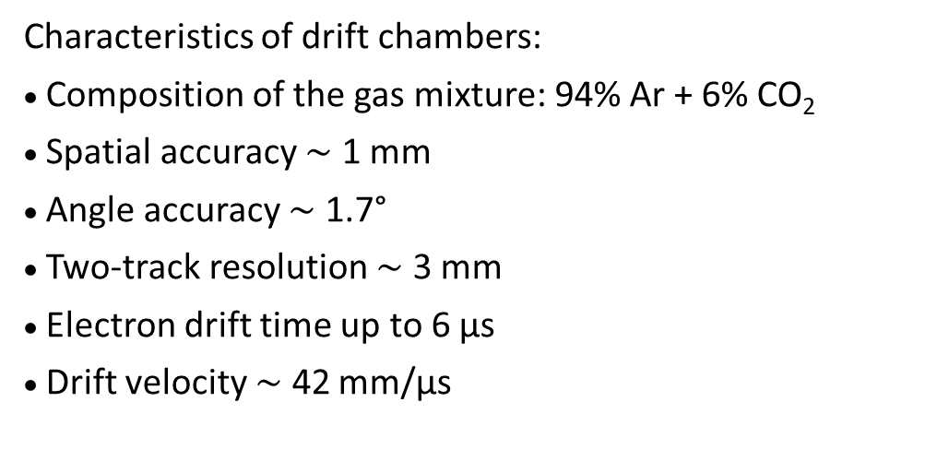
The principle of operation of the drift chamber
t
4
t
Field strength
3
t
2
60 mm
500 V/cm
t
1
250
mm
250
mm
Characteristics of drift chambers:
Composition of the gas mixture: 94% Ar + 6% CO₂
Spatial accuracy $\sim$ 1 mm
Angle accuracy $\sim$ 1.7°
Two-track resolution $\sim$ 3 mm
Electron drift time up to 6 μs
Drift velocity $\sim$ 42 mm/μs
–
field-forming wires,
–
signal wires,
–
cathode wires,
–
security wires.
Two types:
1) nDC (field-forming wires from -12 kV to 0 V;
cathodic wires 0 V; signal wires +2.2 kV)
2) pDC (field-forming wires from 0 kV to +12 kV;
cathodic wires 12 kV; signal wires +14.2 kV)

Slide 23
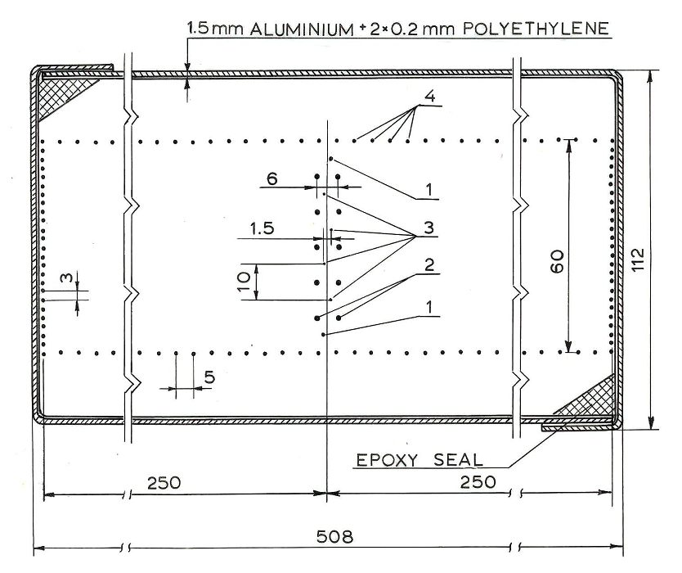
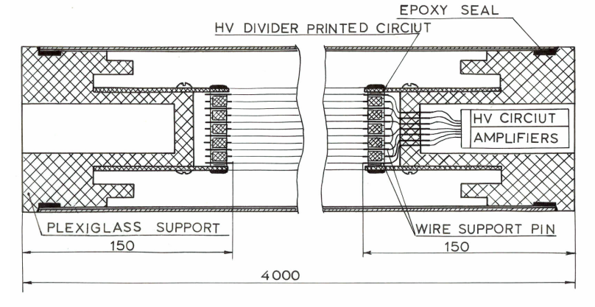
Drift Chamber
Cross section of the drift chamber
Longitudinal section of the drift chamber
23

Slide 24
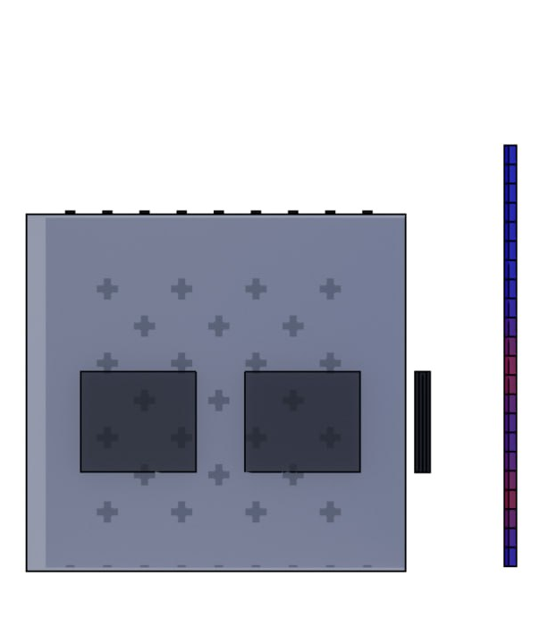
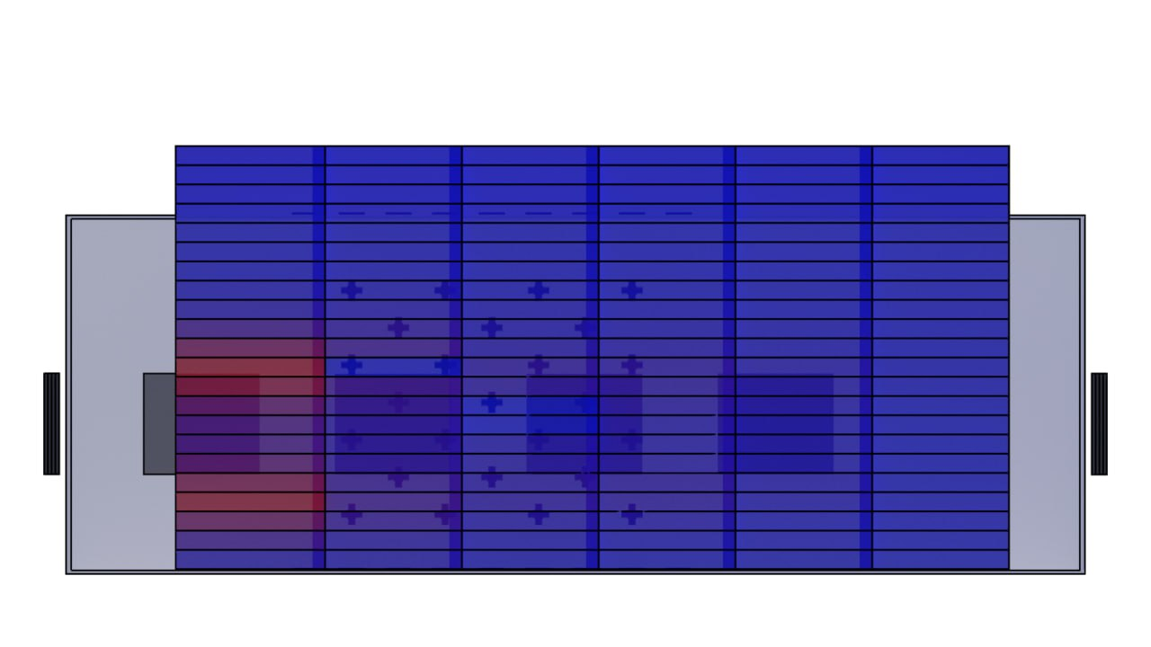
Single-particle events in the TREK

Slide 25
Inner plane TREK is mounted and connected
Outer plane TREK is mounted and connected
Filling the outer plane with drift chambers
Filling the inner plane with drift chambers
–
Mounted drift chambers
–
Mounted drift chambers

Slide 26
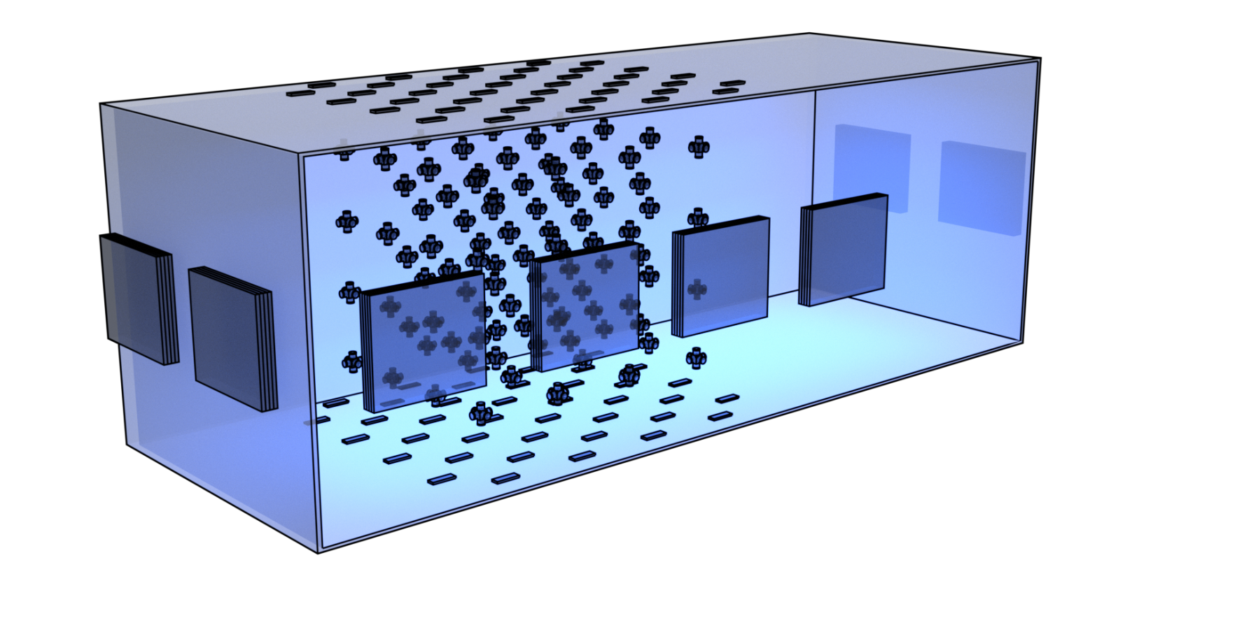
NEVOD-DECOR experiment
System of calibration telescopes (SCT)
DECOR
SCT
Model of the NEVOD-DECOR
Disadvantages: DECOR does not cover full NEVOD side surface and its area is not continuous.

