Slide 1
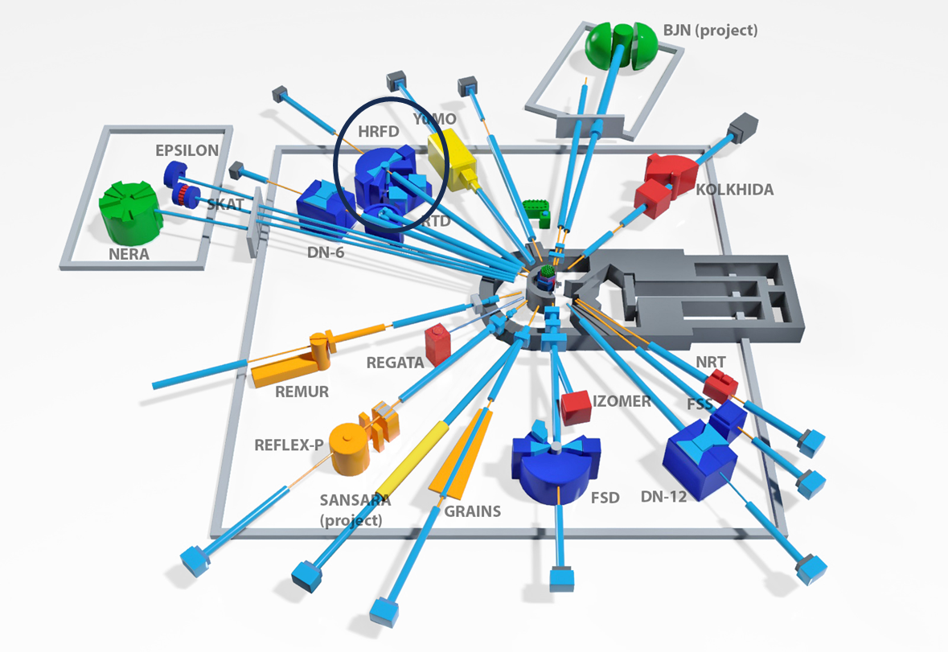
Wide-aperture backscattering detector (BSD-A) for the High-resolution Fourier diffractometer (HRFD)
The XXVII International Scientific Conference of Young Scientists and Specialists
(AYSS-2023)
Laboratory: Frank Laboratory of Neutron Physics - FLNP
Project leader: Milkov V.M.
Project deputy leader: Kurilkin A.K.
Speaker: Cao Van Hai – Engineer, Sector №1 Detectors and Electronics group, Department of Spectrometers Complex
Russia, October 30th 2023
Notes:
Hi, everyone. I’m Hai, from Sector - Sector №1 Dectors and Electronics group of Department of Spectrometers Complex IBR-2 – Laboratory of neutron physic.
would like to present to you about “Wide-aperture backscattering detector (BSD-A) for the High-resolution Fourier diffractometer”

Slide 2
Contents
Introduction
Scientific justification
Description of the wide-aperture backscattering detector (BSD)
The main geometric characteristics of the detector rings of the wide-aperture backscattering detector (BSD-A)
Status and stage of project implementation
Conclusion
Notes:
I’ve divided my presentation into five parts
In the first part I introduce about this project
Then in the second part will show you a little of scientific justification
The next part is “Status and stage of project implementation” chapter
Finally, I’ll go on to talk about some conclusion

Slide 3
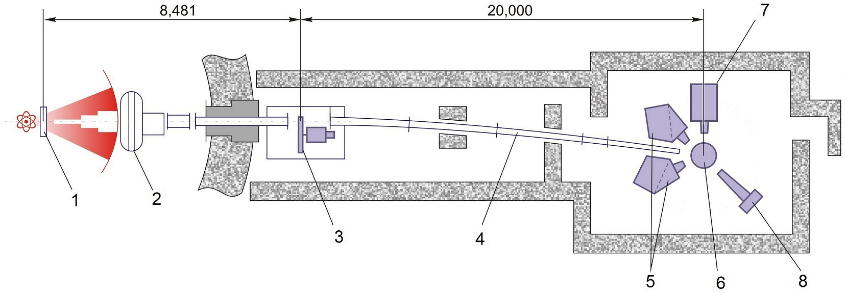
1. Introduction
The High-Resolution Fourier Diffractometer (HRFD) developed in the framework of collaboration between FLNP JINR (Dubna), PNPI (Gatchina) and VTT (Espoo, Finland) has been operating at the IBR-2 reactor since 1994. In the past few years, some of the key units that became morally obsolete or worn out, have been replaced. Particularly, in 2016 a new mirror neutron guide and fast Fourier chopper were put into operation and previously there had been a complete replacement in the data acquisition and experiment control electronics.
1 – Moderator
2 – Background chopper
3 – Fourier Chopper
4 – Neutron guide
5 – Backscattering detector
The existing ⁶Li-glass detector has a high sensitivity to the γ-background
insufficiently large solid angle: ~ 0.16 sr = low data set rate
6 – Sample - neutron flux at the sample location (10⁷ n/cm²/s)
7 – 90°- detector
8 – PSD detector
Fig. 1. Scheme of HRFD at the IBR-2 reactor (distances in mm).
At present, the most important element of the program for further modernization of HRFD is the replacement of existing backscattering detectors with a new version.

Slide 4
2. Scientific justification
In 2017 it was proposed to replace the existing backscattering detectors shown in Fig. 1 with a new wide-aperture scintillation detector based on the ZnS(Ag)/⁶LiF scintillator using combined electronic-geometric focusing. Its implementation will make it possible to radically improve the parameters of the HRFD diffractometer and bring it to the leading positions in the world.
The estimates show that the use of a new wide-aperture detector will allow an approximately two- to three-fold increase in the number of conducted experiments, in this regard the accuracy of the obtained structural information will substantially increase, as well as the capabilities of the diffractometer to perform experiments under various external conditions on the sample will significantly expand.

Slide 5
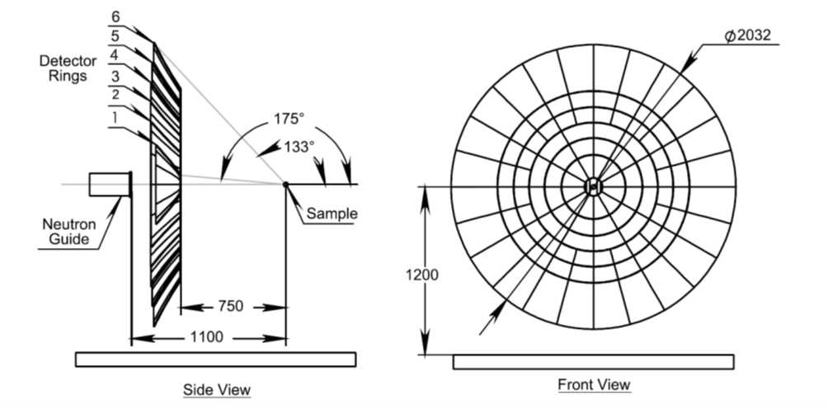
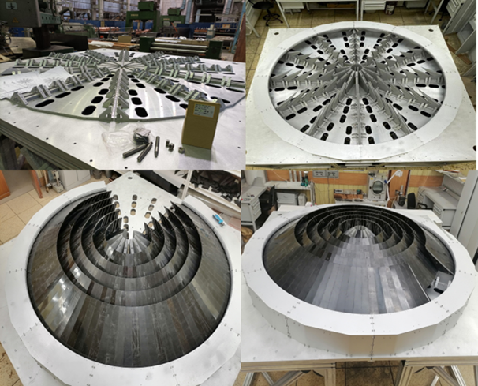
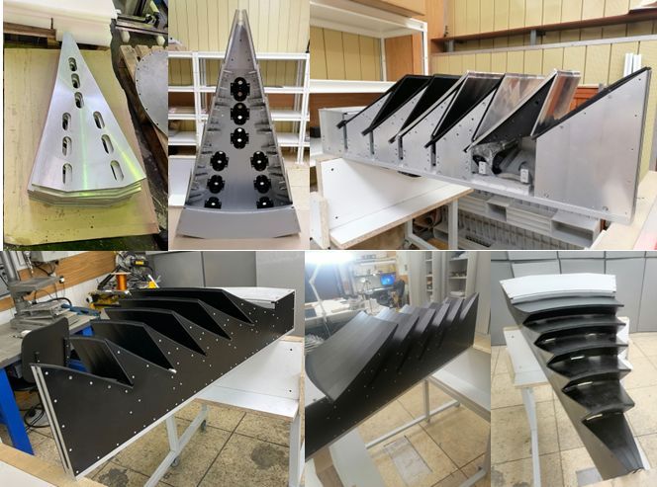
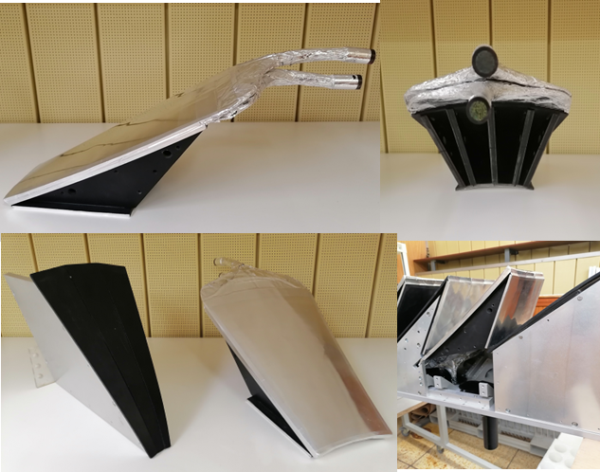
3. Description of the wide-aperture backscattering detector (BSD-A)
Fig. 2. Schematic of the large-aperture backscattering detector.
Fig. 3. General view of BSD.
Fig. 4. General view of one 30° sector for BSD.
Fig. 5. Fragments of a 30° sector for BSD.
The detector has a ring structure reflecting the axial symmetry of the neutron scattering on the sample. The detector comprises 6 rings of scintillation screens. The three outer rings are divided into sectors of 15º, and the three internal ones – into sectors of 30°. The detector consists of 12 identical 30° sectors independent of each other. Six rings completely cover the scattering angle interval 2Ɵ=(133-175)º. The total solid angle of the detector is Ω_{D}≈2.0 sr.
To provide high and ultrahigh resolution, the detector is based on a thin 0.42 mm thick ZnS(Ag)/⁶LiF scintillation screen. The collection and transmission of light from scintillation screens on photomultipliers is carried out using optical WLS fibers, glued on both sides of the scintillator.
Each sector in the schematic is an independent detector element. A scintillation screen in each sector is not solid, but consists of smaller, tightly fitted to each other fragments which follow the surface shape of space-time focusing with the required accuracy.
The output of each photomultiplier is connected to the data acquisition and accumulation system (MPD-32) developed at the FLNP.

Slide 6
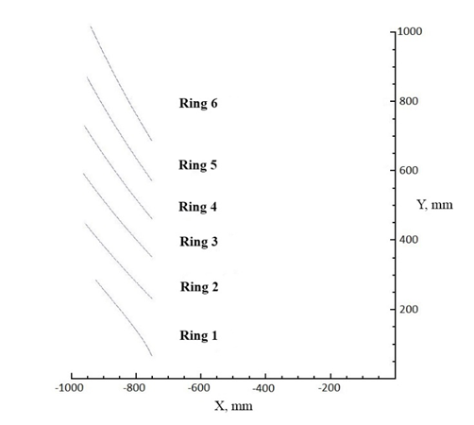
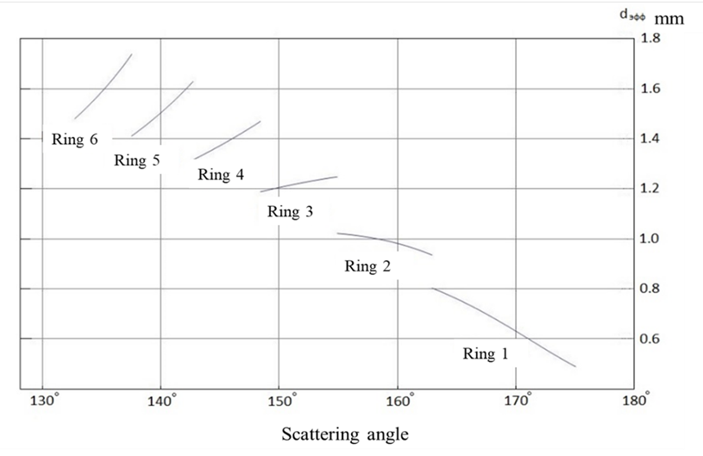
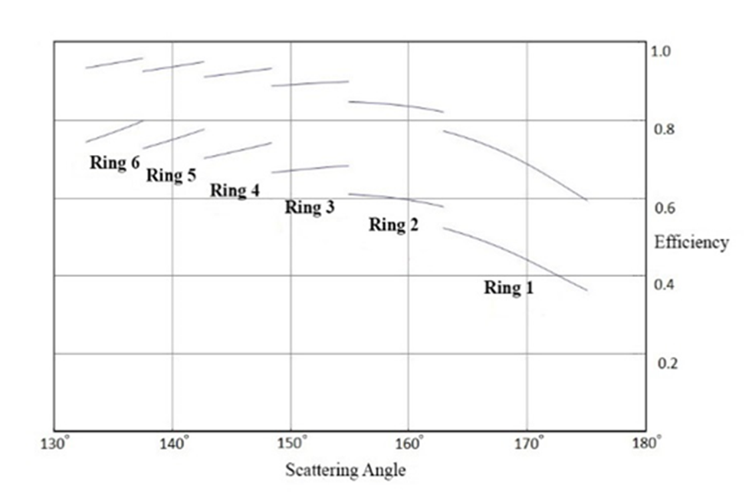
4. The main geometric characteristics of the detector rings of the wide-aperture backscattering detector (BSD-A)
Fig. 8. Dependence of the detector effective thickness (d_{eff}) on the scattering angle.
Fig. 9. Dependence of the detector efficiency on the scattering angle for one and two scintillator layers, calculated for a neutron wavelength of 1.8 Å.
Fig. 7. Shape of the detector elements of the rings.

Slide 7
4. Status and stage of project implementation
As a part of the technical project, the following were manufactured (mechanical part):
Detector elements based on ZnS(Ag)/⁶LiF for all sectors (12 pcs.) Fig. 10;
Carrier plate of the BSD;
Plates and sidewalls of all sectors of the BSD Fig. 11;
Bearing frame of the BSD. The frame construction material - AD31 alloy Fig. 11;
Parts from boron carbide and epoxy resin for the assembly of housings of all sectors.
Checking of the assemblability of the segments plates of the wide-aperture backscattering detector (BSD) of the HRFD diffractometer was carried out
Fig. 10. Fragments of a 30° sector for BSD
Fig. 11. General view of one 30° sector for BSD

Slide 8
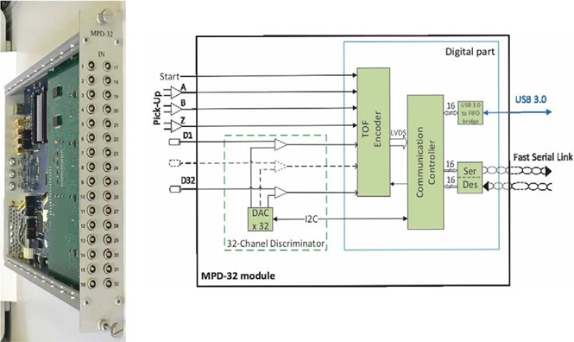
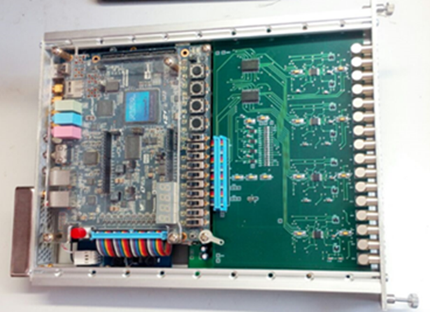
4. Status and stage of project implementation
As a part of the technical project, the following were manufactured (data acquisition system):
8 blocks MPD-32 for the BSD on the HRFD diffractometer Fig. 12.
The development and debugging of the built-in programmable logic (FPGA) of MPD-32 units for organizing a multi-module data acquisition system with a fast inter-unit communication channel is in the progress.
For laboratory tests, a programmable unit with a reactor signals, choppers and detectors simulator for the data acquisition system on the HRFD diffractometer has been developed Fig.13.
16 CAEN amplifier units are ordered. These blocks are an alternative to previously planned Phillips Scientific blocks.
Along with the works listed above, a large number of consumables was purchased.
Fig. 12. Photo and block diagram of the MPD-32 module
Fig. 13. Unit simulator of HRFD diffractometer signals

Slide 9
Expected results
The proposed renewal of the project “Construction of a wide-aperture backscattering detector (BSD-A) for the HRFD diffractometer” is aimed at completing the work on the creation of a new BSD detector, putting it into operation and obtaining the first experimental results. The project implementation period is 2 years (from 2024 to 2025).
Within the framework of the proposed project it is planned in 2024 to 2025:
Manufacture of spare units for the MPD32-USB3 data acquisition and accumulation system in the amount of 4 pcs to ensure uninterrupted operation of the detector.
Purchase of spare sets of photomultipliers in the amount of 10 pcs.
Adjustment of CAEN amplifier modules in accordance with the required parameters (these modules can replace the Phillips Scientific modules planned in the project).
Manufacture of a set (432 pcs.) of I/O and measuring cables.
Dismantling of the BSD detector and installation of the BSD-A detector on HRFD.
Adjustment of analog electronics, data acquisition and accumulation systems based on MPD32-USB 3 modules, as well as related software.
Checking the conditions for time focusing and adjusting the position of the detector if necessary.

Slide 10
5. Conclusion
The completion of work on this project will provide an opportunity to obtain a new world-class instrument, which will undoubtedly be in demand among researchers from both JINR and other organizations, including the foreign ones.
The new wide-aperture detector will allow to radically improve the parameters of HRFD. First, it concerns the luminosity of the diffractometer, which is supposed to be increased by about 10 times. This will allow to increase the number of conducted experiments by approximately two to three times, and in this respect will make it possible to substantially improve the accuracy of the obtained structural information, as well as to significantly enhance the capabilities of the diffractometer in performing experiments when various external influences are set on the sample.
The physical start of the detector at the HRFD facility is scheduled for 2024.

Slide 11
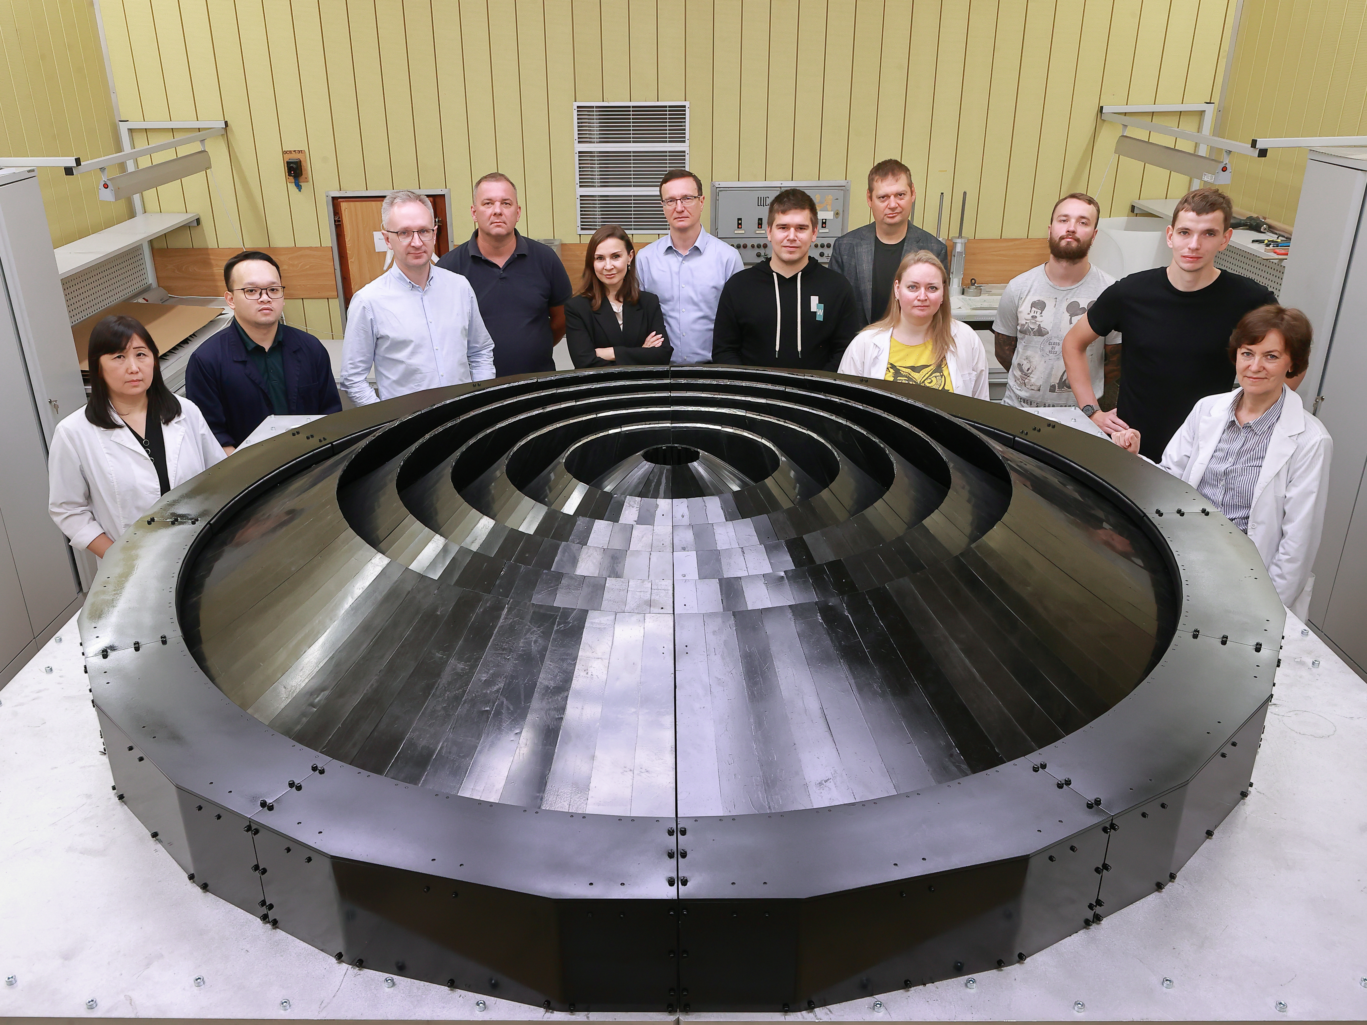
Thank you for your attention!

