Slide 1
Development of Next-Gen Event Visualization Platform for BM@N
Notes:
In high-energy physics experiments the ability to display both detector geometry and particle tracks has become an essential feature, required for physicists to better understand particular collision events as well as to present the physical results to a wider audience. Currently, most experimental collaborations build their own event display solutions with little to no unification between them. In this work, a new event visualization solution for the BM@N experiment is presented, a fixed target experiment of the NICA project.

Slide 2
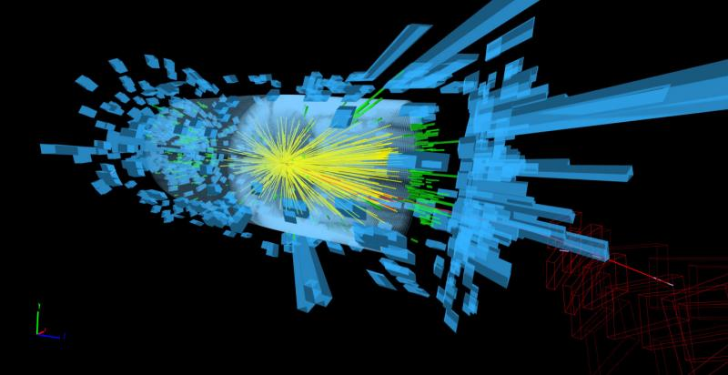
Why?
Notes:
In this event display, protons collide at 13 teraelectronvolts. This image was made during Compact Muon Solenoid experiment. These days to create a display, experiment teams run software that converts the data into graphical objects. These graphics are then rendered in a specialised application. The details of the display – views, colours, what is shown and what is not – depend on the particular use-case.
The problem is that visualizations highly depend on certain experiment, on platform and overall needs additional, often very expensive, efforts to be displayed

Slide 3
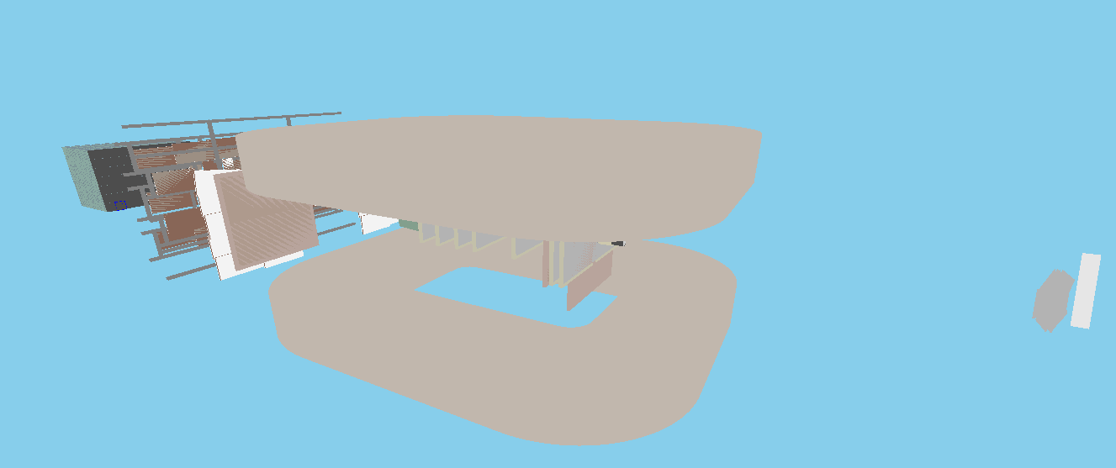
VisionForge
https://github.com/SciProgCentre/visionforge
Notes:
How to do better?
• Create language-agnostic visualization object model.
• Make the model property-based so changes could be communicated as
small patches.
• Support multiple renderers and multiple data sources.
• Multiplatform implementation

Slide 4
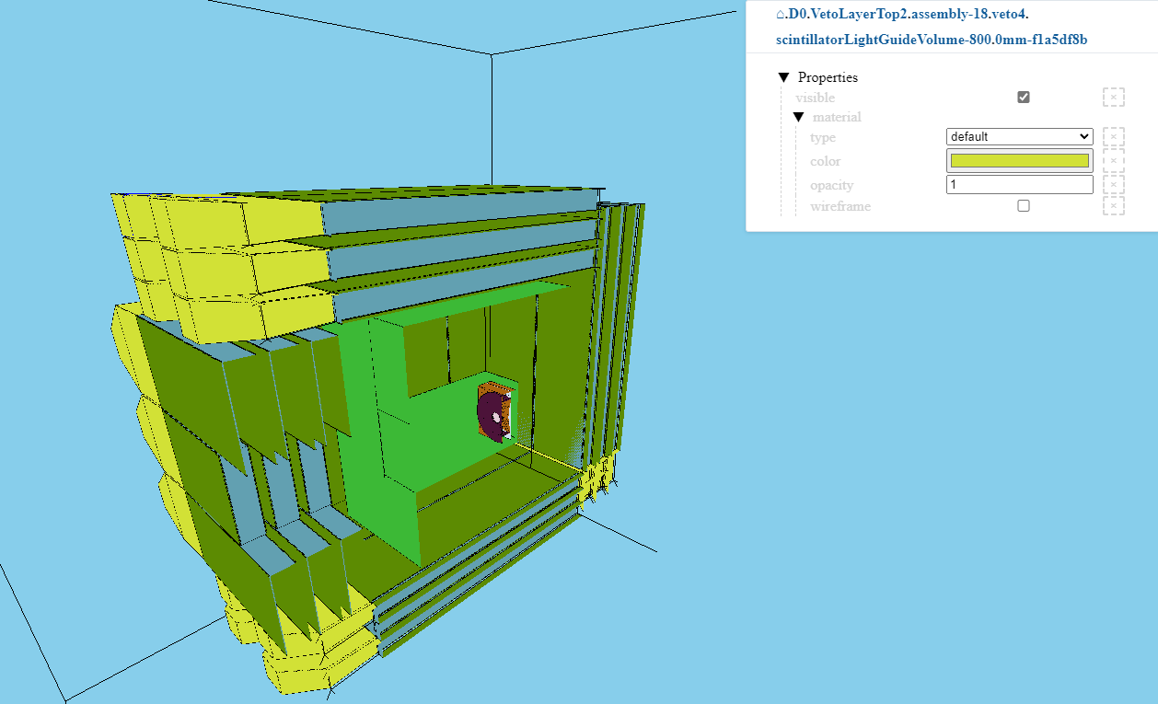
Basic concepts
VisionForge is a visualization library written in Kotlin-Multiplatform.
Core mechanics supports JVM, JS and Native builds (Wasm soon to be delivered).
Primary rendering frontend for 3D is Three-JS (https://threejs.org/).
D0 geometry for Baby-IAXO
Notes:
VisionForge - a platform for creating next-generation visualization systems
- Distributed dynamic system
o A model for visualization can be created on one node, transferred to
another node and rendered there.
o Nodes can exchange updates to the data model
o If only one value in the tree has changed, only that value will be
passed on the update
- Optimizations and performance
o The BM@N geometry model includes over 400,000 primitives
o A geometry or group of geometries can be defined as a prototype -
then multiple objects can use this prototype without copying the
geometry when rendering, only adding properties such as color
- Developed in Kotlin-Multiplatform

Slide 5
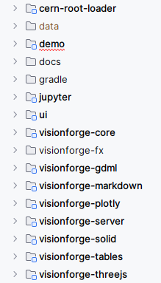
VisionForge modules
Core functionality and properties modules.
Object model for 3D.
Three-JS 3D renderer.
Plotly integration (via Plotly-kt) for 2D and 3D plots).
Tables rendering.
Markup rendering.
Notes:
• 3D visualization of complex experimental set-ups
• Event display such as particle tracks, etc.
• Scales up to few hundred thousand elements
• Camera move, rotate, zoom-in and zoom-out
• Scene graph as an object tree with property editor
• Settings export and import
• Multiple platform support

Slide 6
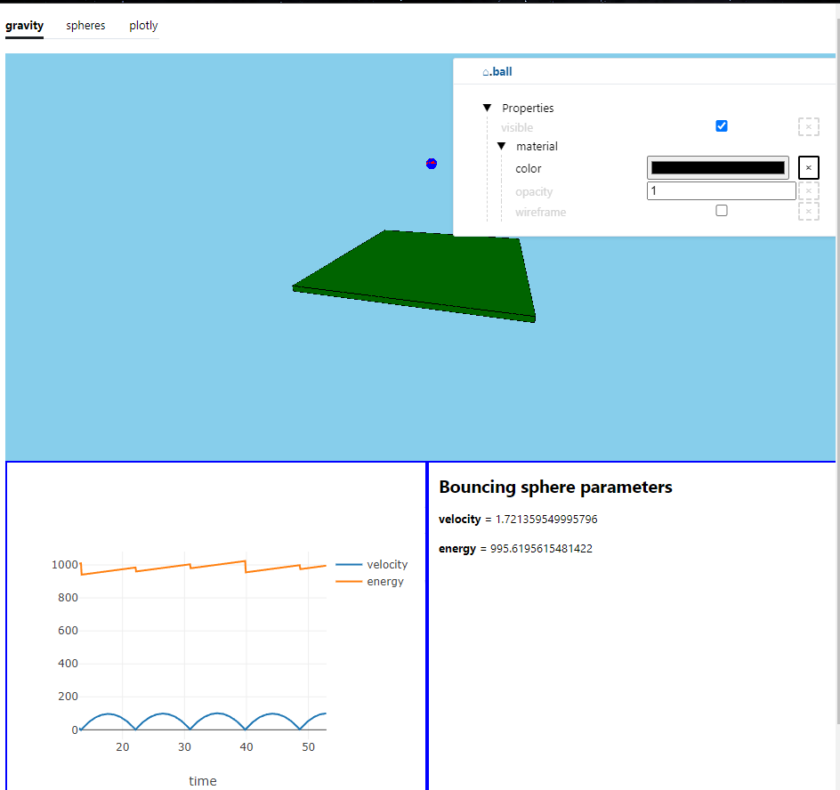
Not only 3D - dashboards
3D rendering with three-js
Dynamic plot with Plotly-kt
Dynamic markdown rendering.
https://npm.mipt.ru/demos/vf-dynamic/
Notes:
Here we can see ball bouncing and its parameters are rendered and visualized dynamically, such as velocity and energy.

Slide 7
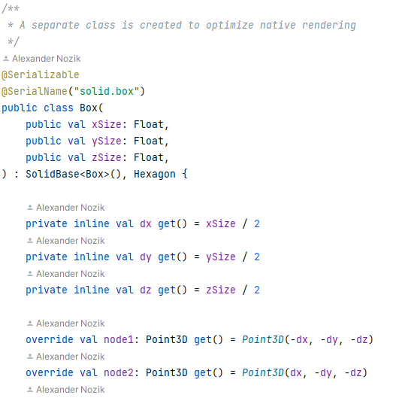
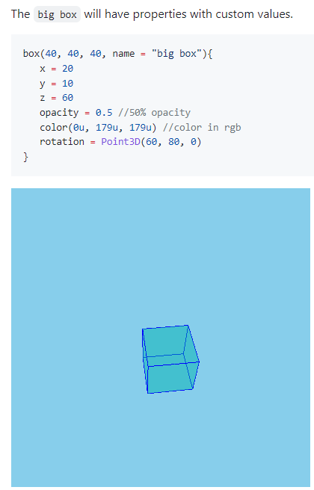
VisionForge-solid object model
Notes:
• Arguments (like geometric parameters) passed in a constructor and
can’t be changed.
• Properties could be changed and are observed.
• Rotations are passed as Euler angles (like Root), rotation matrices or
quaternions.
• Solid groups are true trees with name-based navigation

Slide 8
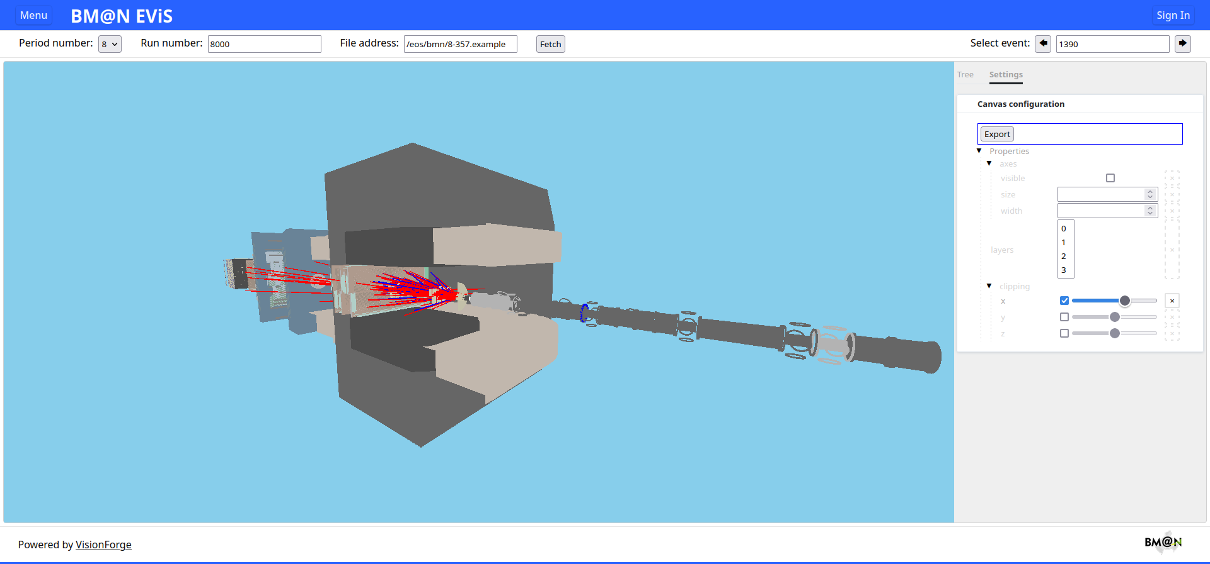
More complex visualization
Notes:
This is a more complex visualization, displaying the geometry of the BM@N experimental setup as it was at the last session (Run 8 this year), with the tracks of one of the recorded events shown in blue and red

Slide 9
General scheme of VisionForge visualization system operation when displaying data from ROOT files
Initial object model
Data server (visapi)
Data model manager
Visualization service
ROOT macros exec
REST API request/
response
Async update
ROOT files
Additional data request
Provides geometry and particle track data
Converts data to visualization object model
Renders visualization object model
Notes:
Now we convert ROOT objects to JSON using ROOT's own tools, but it's not very efficient. Why? (зачитать следующий слайд)

Slide 10
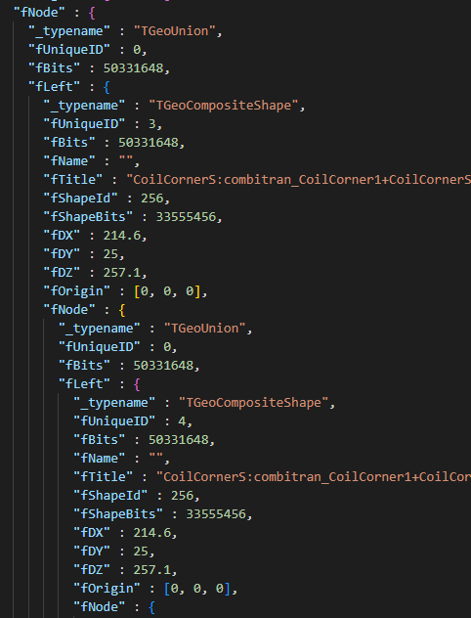
What is wrong with ROOT?
Impractical object model
Could be properly read only from ROOT itself
Model is not observable (can re-render only the whole model, not its parts)
Notes:
The visionforge framework can be used to visualize geometry and events from external, non-Kotlin based systems, such as ROOT. This will require a plugin to convert data model of the external system to that of visionforge.
Possible approaches:
• Read ROOT format and convert it to Vision Object Model.
• Create a ROOT plugin that converts TGeoManager to VOM on
the ROOT side.
• Convert TGeoManager to JSON via TBufferJSON.
Performing the integration is a work currently in progress.

Slide 11
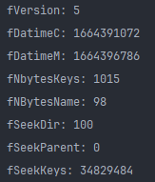
KROOTIO - headers
Notes:
ROOT file reader for Kotlin/Java, written on Kotlin. It doesn't depend on ROOT version or any ROOT component. Compatible with .root files and .bin files that have ROOT structure.
The reader treats files as binary files and reads them byte-wise, processing bytes according to the structure, unpacking them as intended types. Reading headers doesn’t require any additional classes to be written, since it just reads byte sequence that was packed according to certain rules.

Slide 12
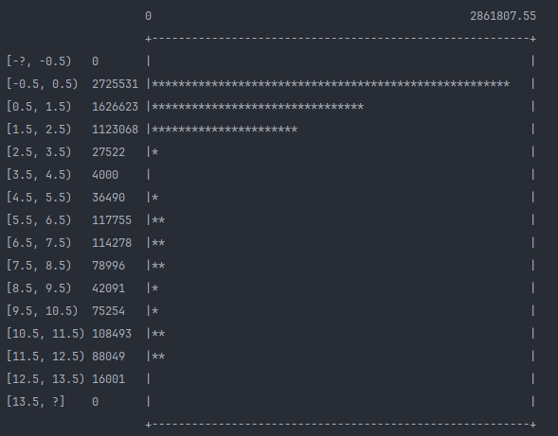
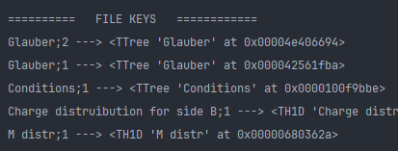
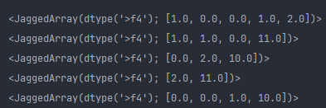
KROOTIO - data
Notes:
When it comes to data, additional classes are needed. Reader reads data for each key entry, gets its headers and data stored in it. Depending on type of the key, data is read as a certain class. We can choose, from which keys to retrieve data, which parts of data we want to see or use.
The classes are the ones that are defined in ROOT structure, like TTRee, TBranch, TH’s, vectors; streamed classes, like TArray, TObject, TString, etc.
Classes are mainly implemented using so-called class generator. Once reader sees marking of class it has not seen yet, it creates its code automatically. Basically, in most cases it works as is, but some minor changes might be needed.

Slide 13
Future work
Smart layering algorithm to render large geometries (like BM@N).
Integration with BM@N software layout.
Finish ROOT integration.
Other rendering engines support.
Notes:
- Smart layering algorithm to render large geometries (like BM@N).
- Integration with BM@N software layout.
- Finish ROOT integration.
- Other rendering engines support (for example, Scenery).

