Slide 1
XXVII International Conference of Young Scientists and Specialists (AYSS-2023)
New Algorithms for Processing Neutron Tomography Data Based on Convolutional Neural Networks
B. Bakirov^{1,2,3}, S.E. Kichanov¹
¹Joint Institute for Nuclear Research
²Kazan Federal University
³Institute of Archaeology, RAS

Slide 2
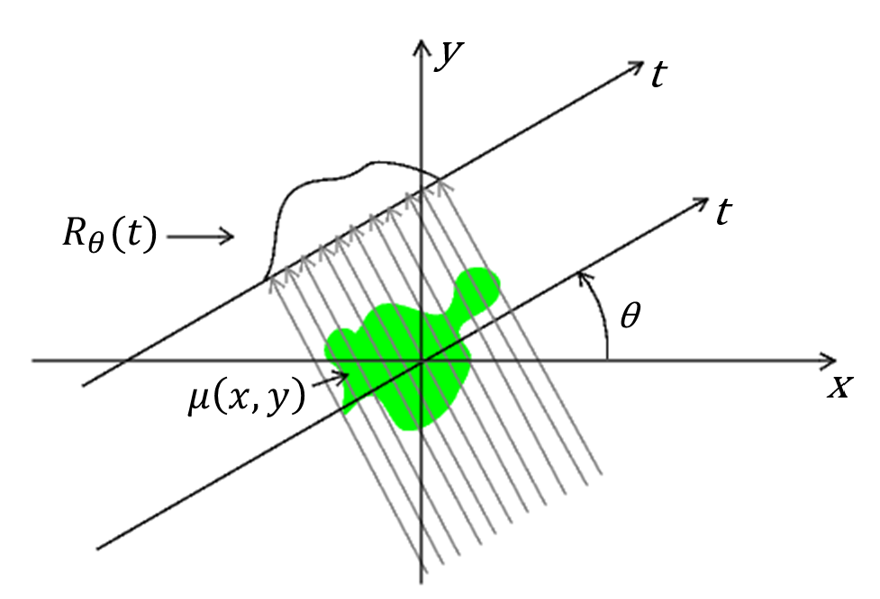
How does neutron tomography work?
$$I=I_{0}e^{−\int{μ\left(x, y\right)ds}}$$
$$μ=\sum{\frac{σ×ρ×N_{A}}{m_{molar}} }$$
$$σ=σ_{abs}+σ_{coh}+σ_{inc}$$
I ‒ transmitted neutron intensity
I₀ ‒ incident neutron intensity
s ‒ thickness
μ ‒ attenuation coefficient
A set of such angular projections $R_{θ}$ for one slice of the studied sample is called a sinogram.
$$\int{μ\left(x, y\right)ds=−ln⁡(\frac{I}{I_{0}}})= R_{θ}(t)$$
$R_{θ}\left(t\right)$‒ the Radon transform of the function $μ\left(x, y\right)$
Conventional Reconstruction Methods:
Fourier transformation (FBP, DFR)
Solving a system of equations (SIRT, SART etc.)
2

Slide 3
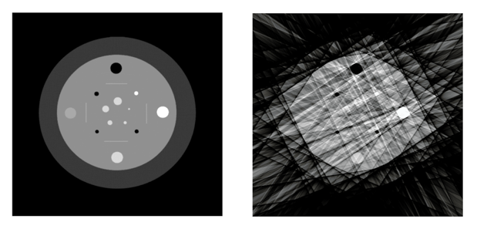
The required number of projections for reconstruction
Theoretically – infinite number of projections
In practice – upper limit about 360 projections
What if we want to further reduce the number of projections?
Bad quality
Modern deep learning algorithms
3

Slide 4
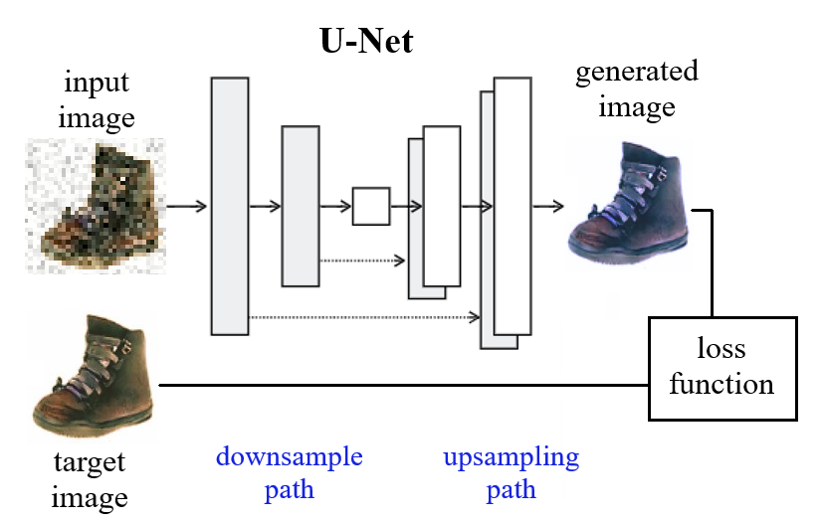
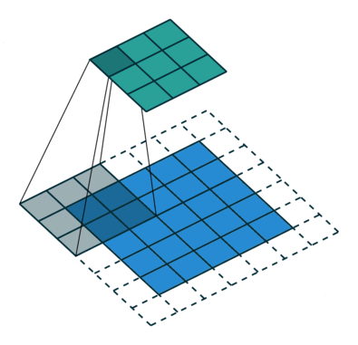
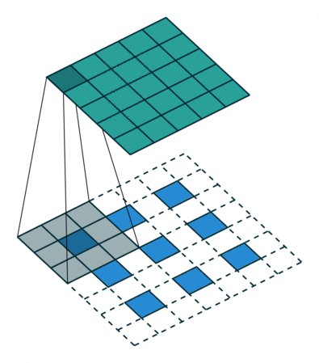
Convolutional neural networks for images
Building blocks of the convolution neural network.
Architecture of the convolution neural network.
Input
Output
Convolution
Normalization
+
Activation
Skip Connection
Visualization of convolution and deconvolution layers.
4

Slide 5
Implementation of the convolutional neural network
Input
Image
Output
Image
Number of kernels in each layer
Main Parameters
Images in dataset | Trainable params | Kernel size | Activation function | Dropout | Optimizer | Time per epoch
~30000 | ~18·10⁶ | 5x5 | LeakyReLU | 0.2 | Nadam | 300 sec
Computations were held on the basis of the HybriLIT heterogeneous computing platform (LIT, JINR).
5

Slide 6
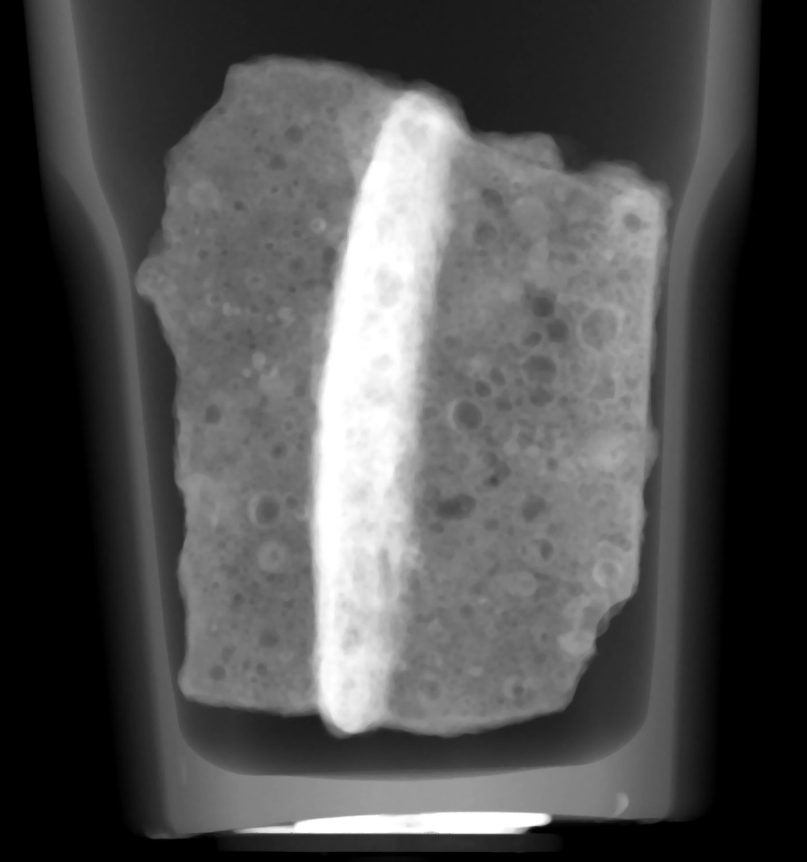
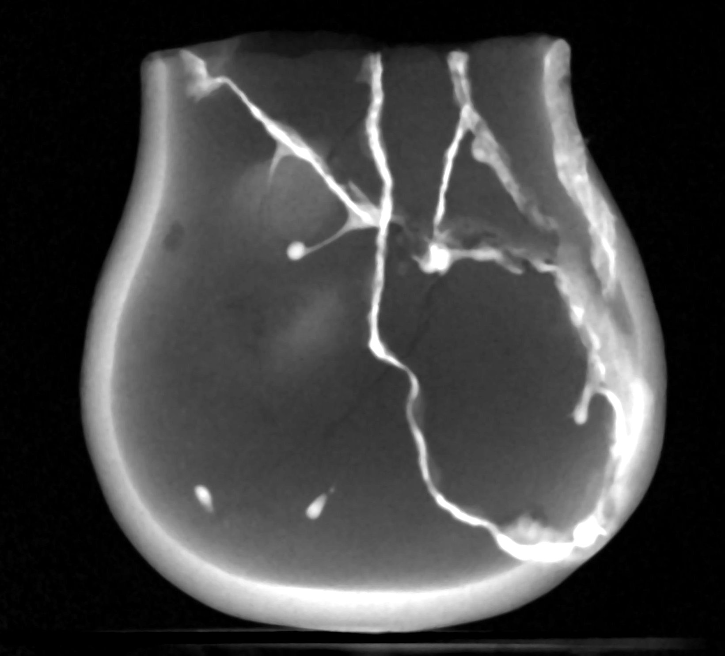
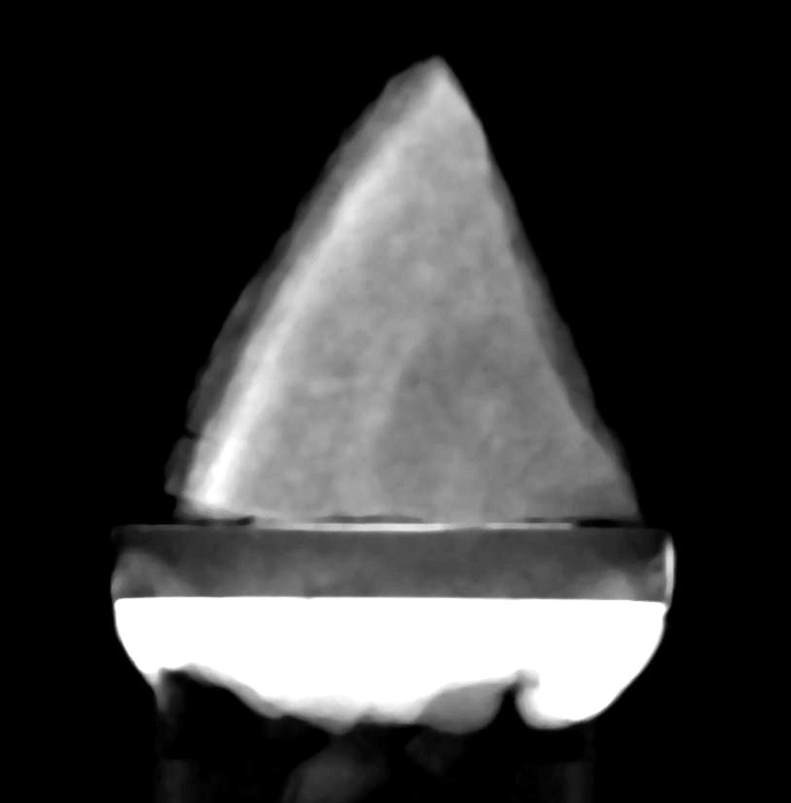
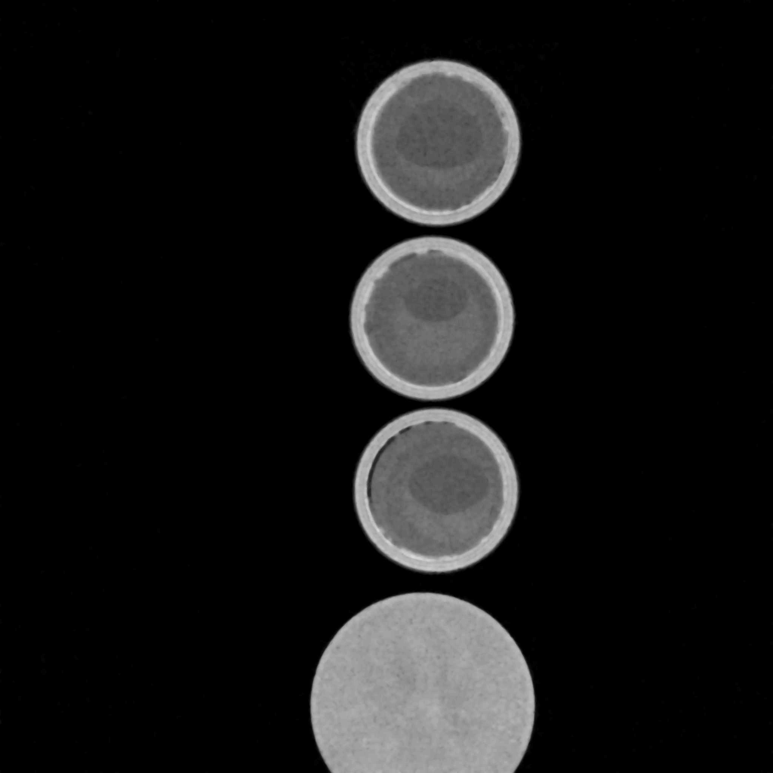
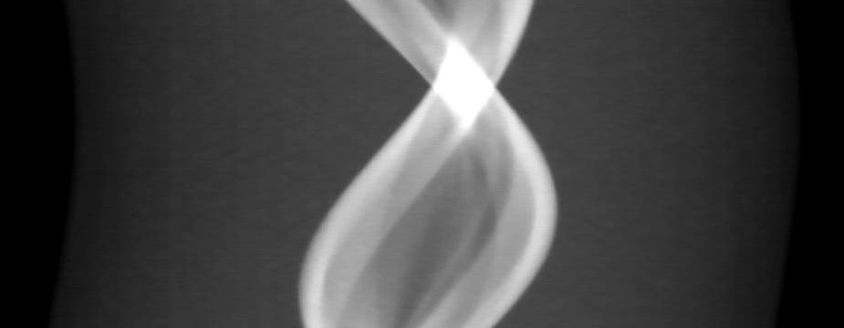
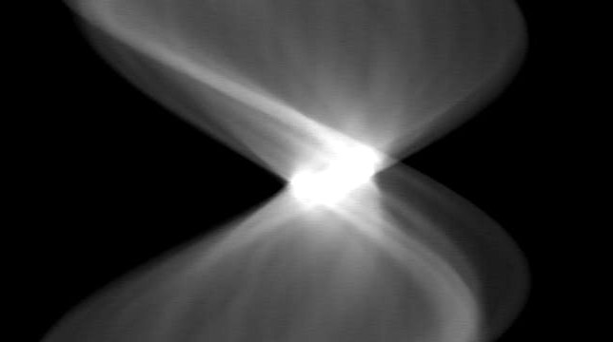
Preparation of a training dataset
6

Slide 7
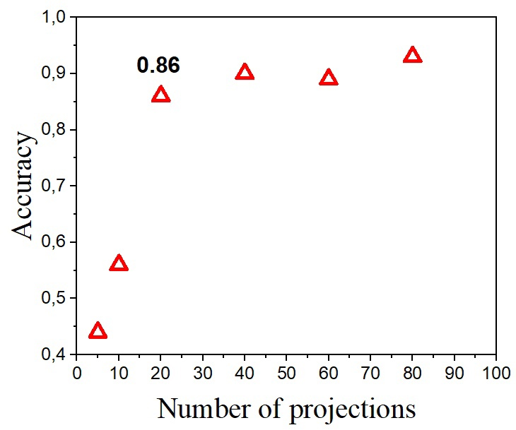
Determination of the required number of projections
80% of data
20% of data
10% of data
(%)
7

Slide 8
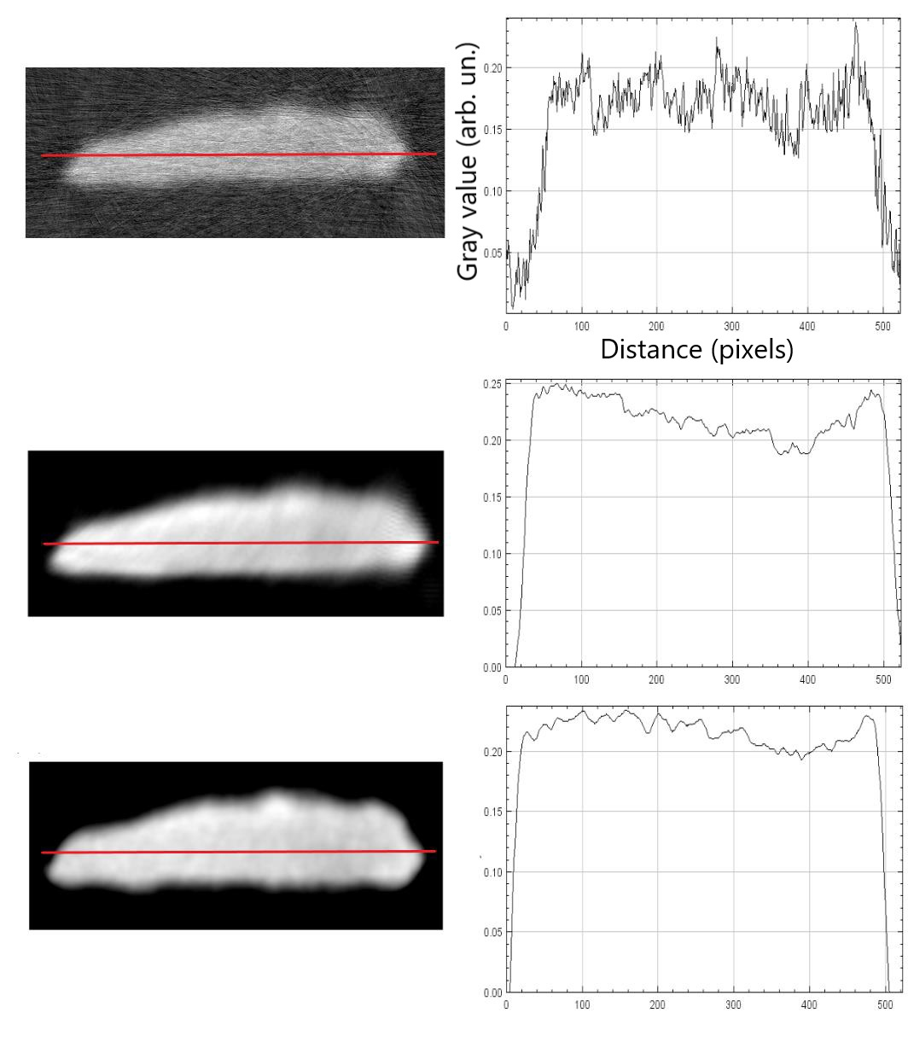
The results of training a CNN
0.19
20%
20%+CNN
100%
Structure SIMilarity
SSIM:
0.88
1.0
8

Slide 9
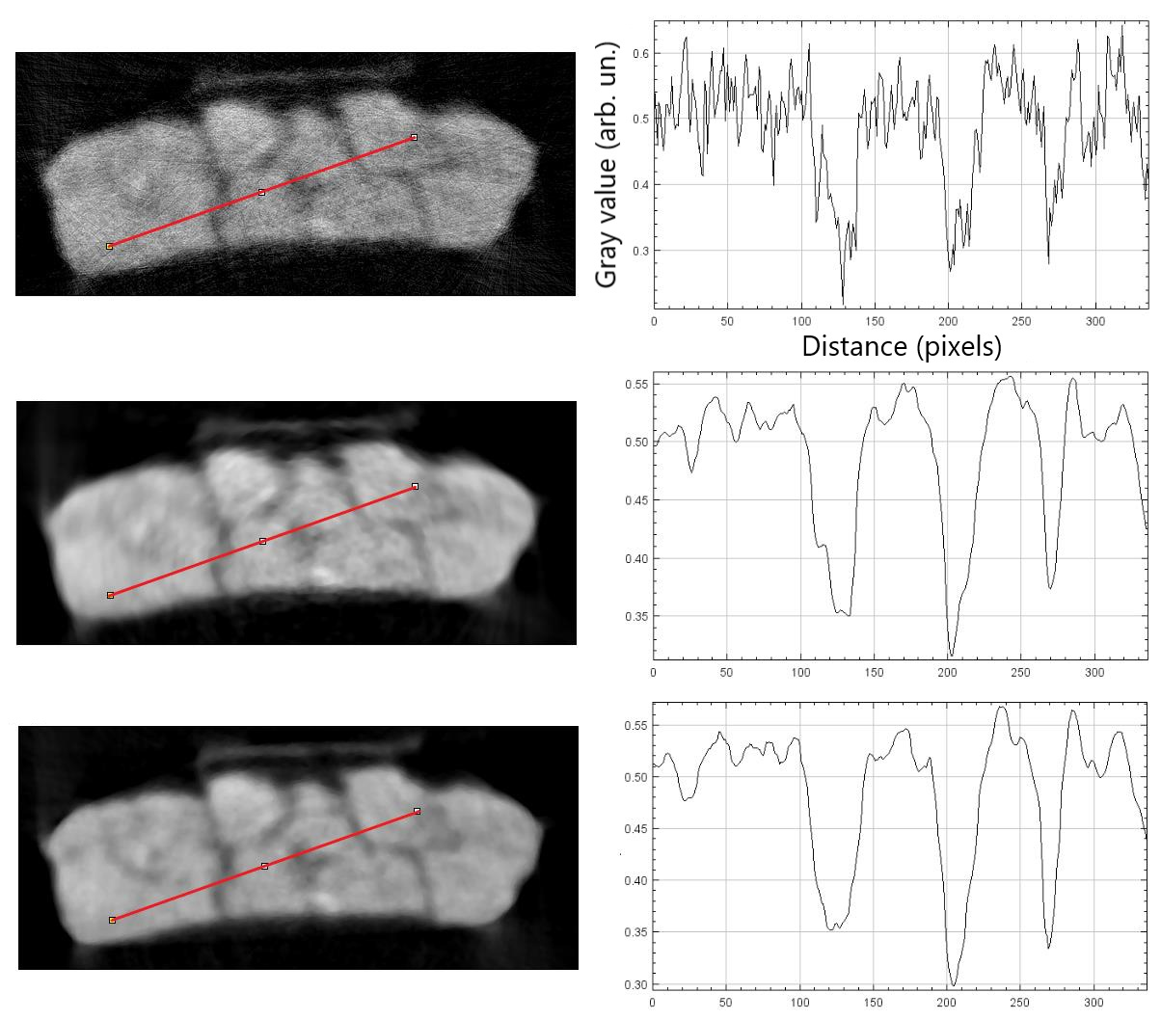
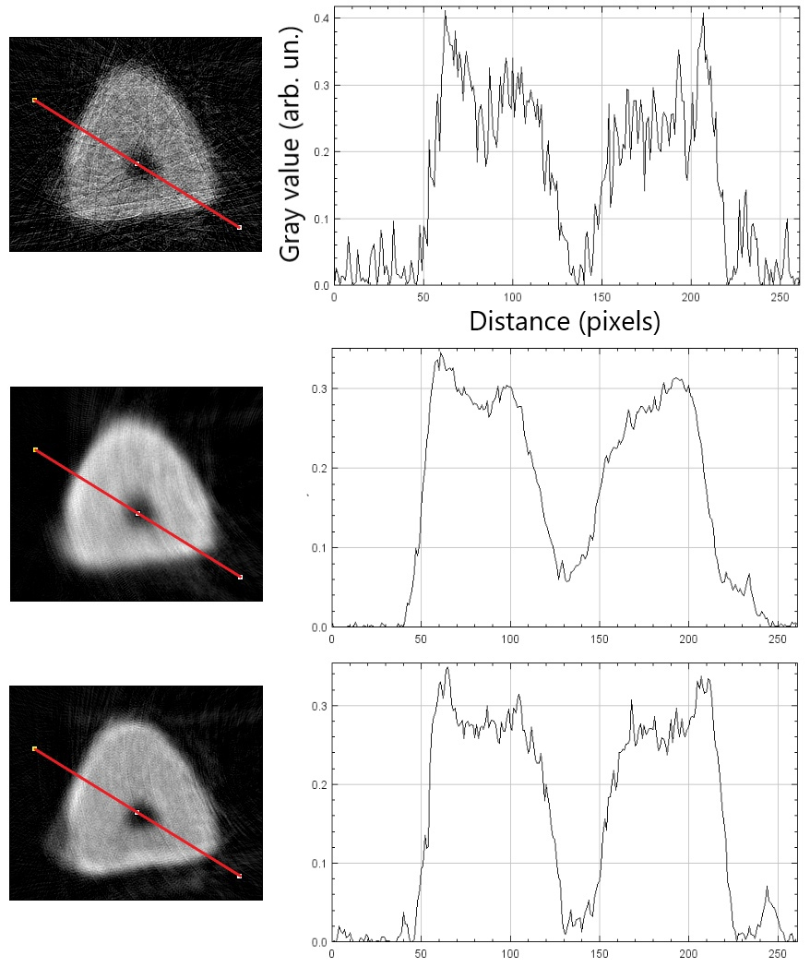
The results of training a CNN
SSIM:
0.33
0.09
20%
20%
+
CNN
100%
0.89
0.77
1.0
1.0
9

Slide 10
Intermediate results
A method for reconstructing three-dimensional neutron tomography data using deep learning algorithms based on convolutional neural networks was developed.
The required number of neutron radiographic projections was determined for the reconstruction of three-dimensional models using a convolutional neural network.
Using a convolutional neural network, three-dimensional models of some cultural heritage objects were obtained from incomplete data.
Qualitative and quantitative estimates of the effectiveness of the algorithm based on a convolutional neural network were obtained.

