Slide 1
A Review of the Impact of Zinc Oxide Nanostructure Morphology on Perovskite Solar Cell Performance
PRESENTED BY
M Manabeng
SUPERVISED BY
Dr TD Malevu

Slide 2
Presentation outline
INTRODUCTION
SOLAR ENERGY
SOLAR CELLS
ZNO BASED PEROVSKITE SOLAR CELLS
SYNTHESIS METHODS
CHALLENGES AND FUTURE DIRECTIONS OF ZnO PEROVSKITE SOLAR CELLS
CONTRIBUTION TO KNOWLEDGE
REFERENCES

Slide 3
Introduction
Global warming (${CO}_{2}$ emmissions, deforestation, methane gas, CFCs)
Ozone depletion
Cost of living (reduces bills)
Unfavourable weather conditions
Health concerns
Deforestation
Gas emmissions
Bad weathers

Slide 4
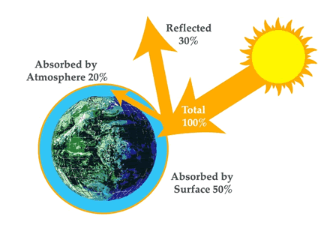
Solar Energy
What is solar energy?
The type of energy generated by the sun.
ADVANTAGES | DISADVANTAGES
Renewable resource | Weather dependent
Abundant | Costly
Reduces electricity bills | Requires more space
Diverse applications
Can be stored in batteries

Slide 5
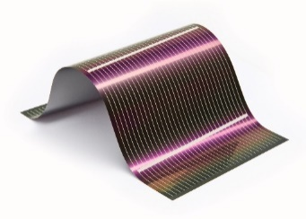
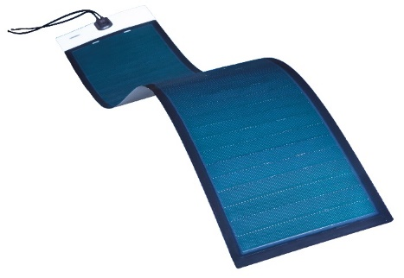
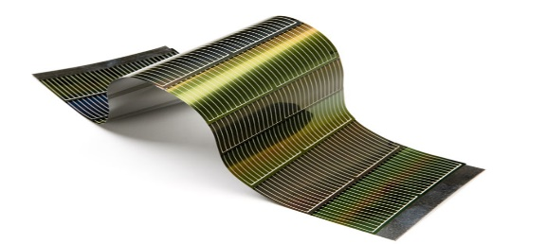
SOLAR CELLS
1st generation
2nd generation
3rd generation
DSSCs
Perovskite solar cells
Hybrids nanomaterials
High efficiency + Thin-films
Lightweight
Less expensive
Less stable
ղ < 20%
ղ= 25%
Wafer based PV cells
High efficiency
Stable lifespan
Expensive + Heavy
Flexible thin-film PV
Stable lifespan
Less expensive
low efficiency
Well-developed and Commercial available in PV market
Small lab-based PV cells

Slide 6
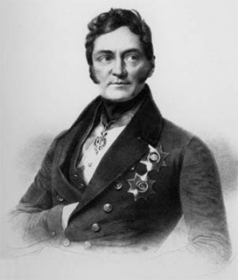
PEROVSKITE SOLAR CELLS
Lev Alekseyevich Perovski
(1792-1856)
Tsutomu Miyasaka
Produced the first perovskite solar cell in 2009

Slide 7
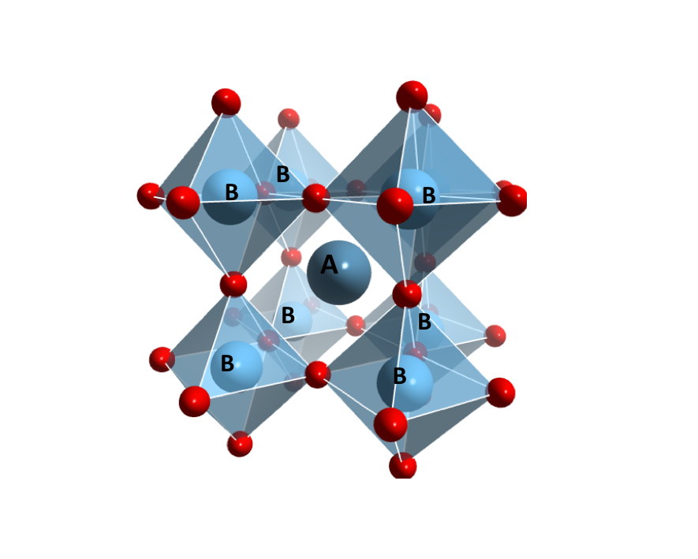
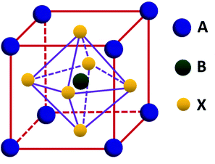
PEROVSKITE STRUCTURE
Basic crystal structure ABX₃
ABX₃
B SITE CATION- Mn^2+, Cd^2+, Cu2+, Pb^2+

Slide 8
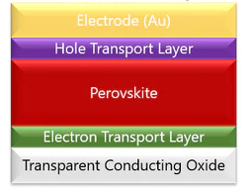
Perovskite solar cells
ETL
ZnO
TiO₂

Slide 9
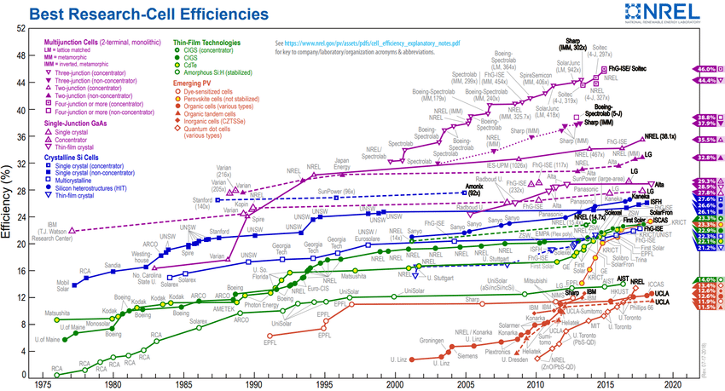
CONT…
national renewable energy laboratory

Slide 10
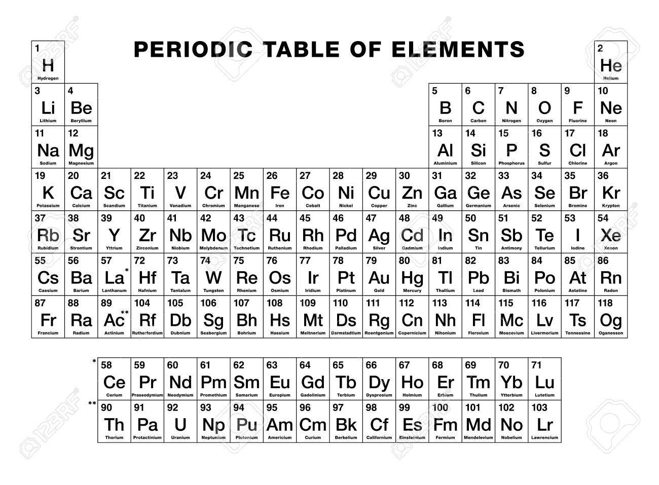
CONT…

Slide 11
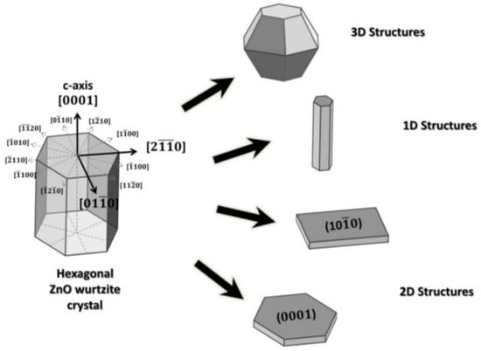
WHY ZINC OXIDE
Non toxic
Cheap to synthesize
Wide band gap of 3,37 eV that other metal oxides
Large binding energy of 60 MeV
Biocompatible
High infrared reflectivity
Chemically stable
High electron mobility
A range of morphology

Slide 12
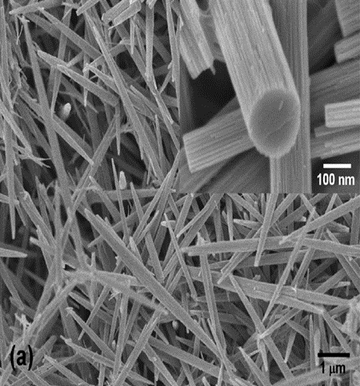
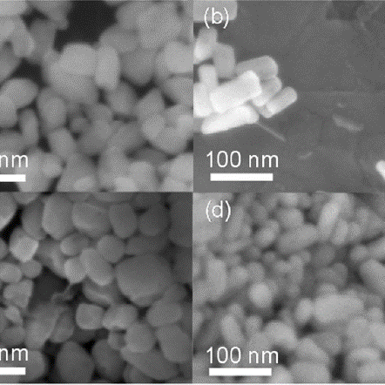
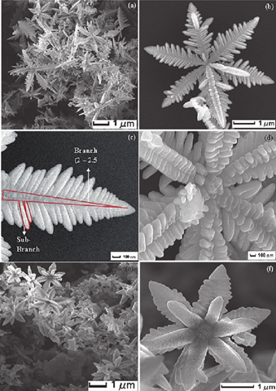
1D nanorods
2D nanopellets
3D snowflakes

Slide 13
Synthesis methods
Method | Mode | Pros | Cons
Chemical | Hydrothermal, sol-gel, prylosis, precipitation, microwave, bath deposition, thermal deposition, micro-elusion | Supports many precursors, and conditions. Allows tuning of morphology, size, and geometry | A large number of surfactants, poor solubility for some precursors, poor temperature stability of micro-emulsions, and pH issues
Physical | Laser ablation, ball milling, melt mixing, physical vapour deposition, sputtering | Technically simple, chemically pure, uniform nanoparticles, applicable zinc surface | Needs higher energy, temperature and pressure, are expensive, and radiation fallout
Green | Plant extraction, biochemical, microorganisms | Cost-effective, fewer toxic chemicals, use natural antimicrobe activity | Hard to tune size, shape, and growth rate. Endotoxin fallout, rarely reported in the literature

Slide 14
Challenges and Future directions of ZnO Based PSCs
Extrinsic
Thermochemical
stability
Light stability
Oxidation and photo oxidation stability
Device thermal stability
Electrode
degradation
Thermodynamics and phase
Intrinsic
Band structure and defects
Stability issues
Moisture stability

Slide 15
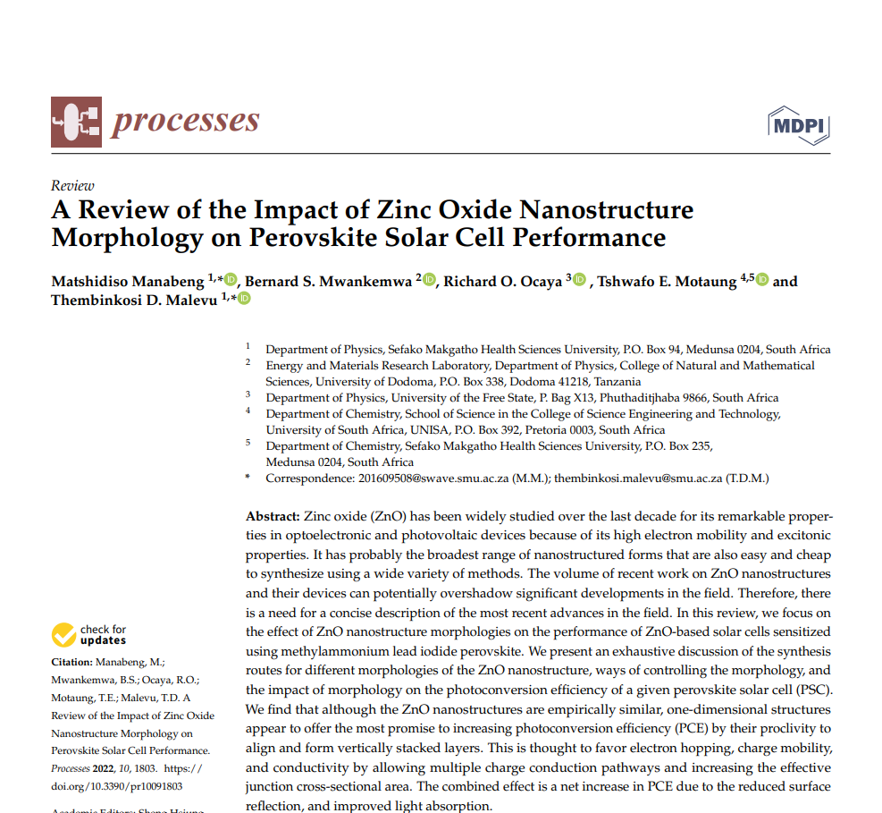
EXPECTED CONTRIBUTION OF KNOWLEDGE
Manabeng, M., Mwankemwa, B.S., Ocaya, R.O., Motaung, T.E. and Malevu, T.D., 2022. A Review of the Impact of Zinc Oxide Nanostructure Morphology on Perovskite Solar Cell Performance. Processes, 10(9), p.1803.

Slide 16
REFERENCES
1. Mahmood, K., Swain, B.S. and Amassian, A., 2014. Double-layered ZnO nanostructures for efficient perovskite solar cells. Nanoscale, 6(24), pp.14674-14678.
2. Xu, F., Dai, M., Lu, Y. and Sun, L., 2010. Hierarchical ZnO nanowire− nanosheet architectures for high power conversion efficiency in dye-sensitized solar cells. The Journal of Physical Chemistry C, 114(6), pp.2776-2782.
3. Feng, Y., Ji, X., Duan, J., Zhu, J., Jiang, J., Ding, H., Meng, G., Ding, R., Liu, J., Hu, A. and Huang, X., 2012. Synthesis of ZnO@ TiO2 core–shell long nanowire arrays and their application on dye-sensitized solar cells. Journal of Solid State Chemistry, 190, pp.303-308.
4. Duan, J., Xiong, Q., Wang, H., Zhang, J. and Hu, J., 2017. ZnO nanostructures for efficient perovskite solar cells. Journal of Materials Science: Materials in Electronics, 28(1), pp.60-66.
5. Djurišić, A.B. and Leung, Y.H., 2006. Optical properties of ZnO nanostructures. small, 2(8‐9), pp.944-961.
6. Pal, U., Serrano, J.G., Santiago, P., Xiong, G., Ucer, K.B. and Williams, R.T., 2006. Synthesis and optical properties of ZnO nanostructures with different morphologies. Optical Materials, 29(1), pp.65-69.
7. Fodjouong, G.J., Feng, Y., Sangare, M. and Huang, X., 2013. Synthesis of ZnO nanostructure films by thermal evaporation approach and their application in dye-sensitized solar cells. Materials science in semiconductor processing, 16(3), pp.652-658.
8. Li, D. and Haneda, H., 2003. Morphologies of zinc oxide particles and their effects on photocatalysis. Chemosphere, 51(2), pp.129-137.
9. Duan, J., Xiong, Q., Wang, H., Zhang, J. and Hu, J., 2017. ZnO nanostructures for efficient perovskite solar cells. Journal of Materials Science: Materials in Electronics, 28(1), pp.60-66.
10. Shouli, B., Liangyuan, C., Dianqing, L., Wensheng, Y., Pengcheng, Y., Zhiyong, L., Aifan, C. and Liu, C.C., 2010. Different morphologies of ZnO nanorods and their sensing property. Sensors and Actuators B: Chemical, 146(1), pp.129-137.

Slide 17
Acknowledgments
Sent to
Supervisor
Dr. Malevu T.D
Financial Support
National Research Foundation

