Slide 1
About the Modern African Nuclear DEtector LAboratory (MANDELA) @ , UWC, South Africa
Supervisors: Prof. Jose Orce-Gonzalez , Dr. Nikita Bernier (UWC)

Slide 2
Content
Overview of the MANDELA.
Aims and Objectives:
Energy Resolution and sampling time computations
Set-up 250 MHz PIXIE-16 digitizer from XIA at MANDELA @ UWC.
ADCs, FPGAs and DSP.
Scientific motivation:
Trapezoid filter
Xia4ids & POLL2 code fragments.

Slide 3
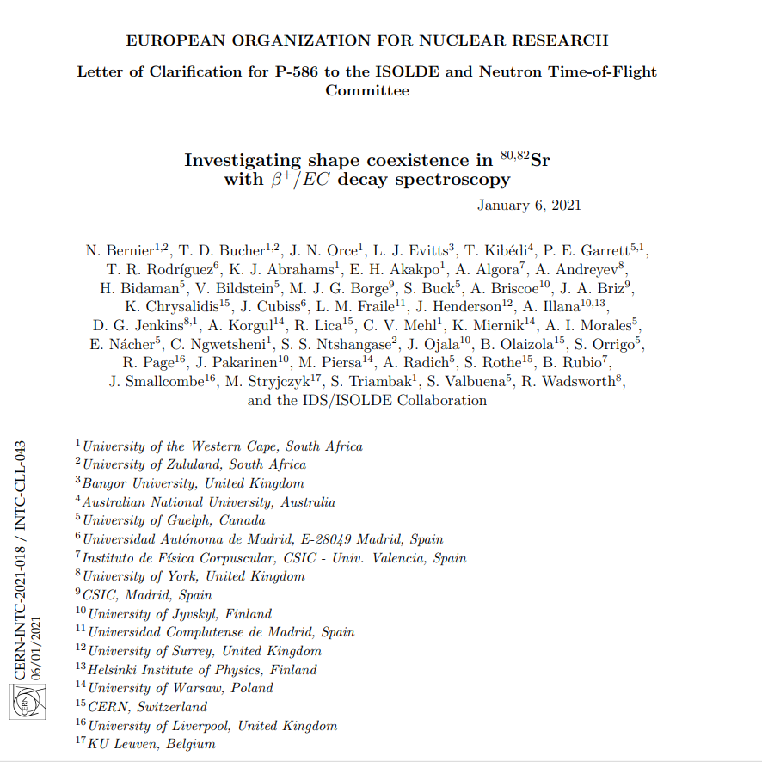

Slide 4
Modern African Nuclear Detector LAboratory (MANDELA) at the University of the Western Cape and the University of Zululand in strong collaboration with the University of York, UK Funded by Science and Technology Facilities Council (STFC), UK, and local funding from UWC, NRF and the Department of Science and Technology (DST).
UWC & UZ background: UWC & UZ consists of diverse student bodies, mainly supporting students from historically disadvantaged backgrounds in South Africa (SA).
UWC’s Modern African Nuclear DEtector LAboratory (MANDELA) is equipped with a double photon counting setup using NaI (Tl) scintillation detectors, Analogs and digital NIM; CEAN digitizers and 250-MHz Pixie-16 digitizer from XIA . This digitizer is similar to the 100-MHz Pixie-16 digitizers in use at IDS.
Aim:
ADC electronics
Upskill young people
MANDELAB (University of Zululand/University of the Western Cape)

Slide 5
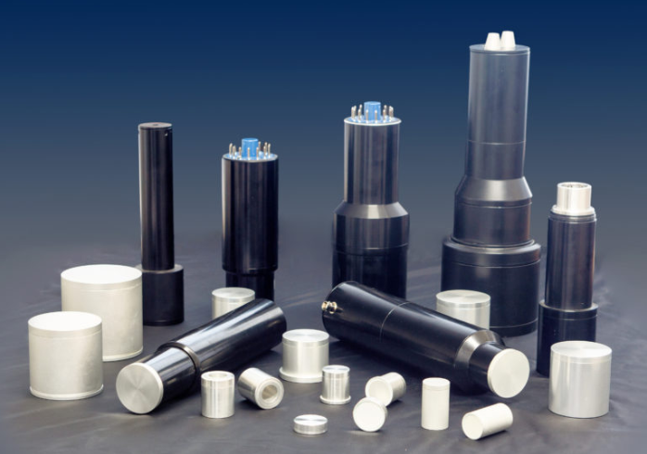
NaI (Tl) Scintillation detectors and probes in standard and custom sizes for γ-spectrometry

Slide 6
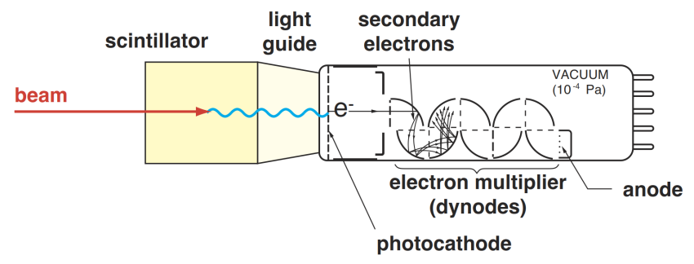
Scintillation Mechanism

Slide 7
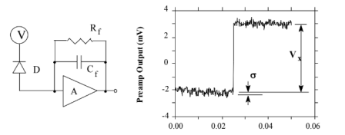
Signal Processing
Radiation
signal
Time
Q = Energy
Radioactive Source
Registration equipment
Detector
Rise time
Decay time
Preamp Output [mV]
Preamplifier
Time (ms)

Slide 8
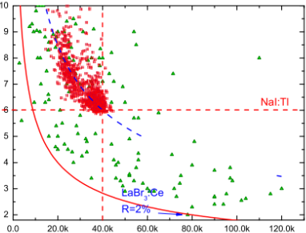
Motivation of the Study
Energy resolution (% fwhm @ 662 [keV])
Scintillation yield (photons per MeV)

Slide 9
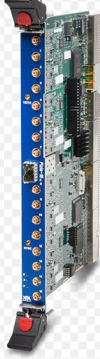
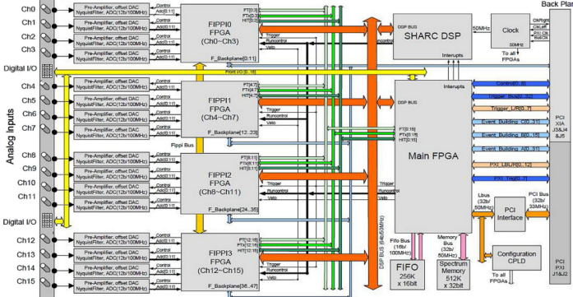
PIXEI-16 ADC Spectrometer
1
2
3
4

Slide 10
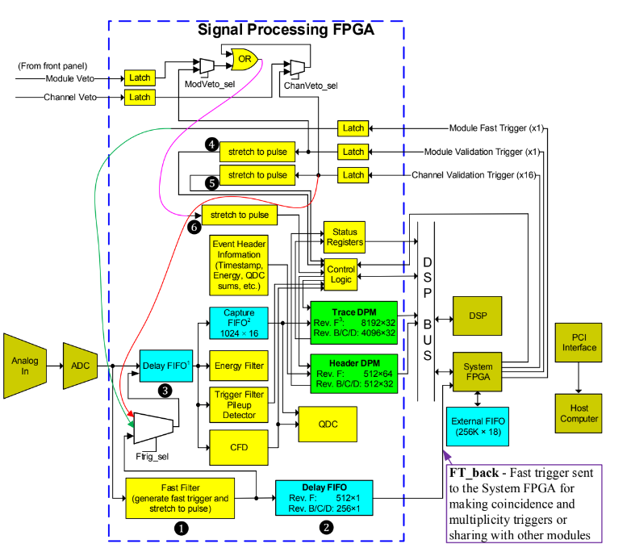
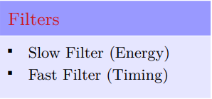
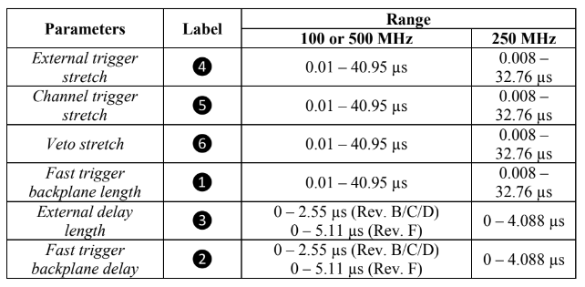
FIFO Delays
The main feature of digital systems is reliance on numerical algorithms that operates on digitized representations of the electrical pulse from a detector.

Slide 11
Experimental Hall @ the ISOLDE β-decay kinetics focusing, spectroscopy studies of the decay products collocations of short-lived precursor nuclei.
(Data Acquisition code)
Summary of Run Types
(EXP-data)

Slide 12
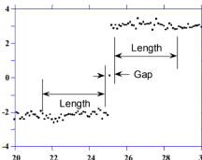
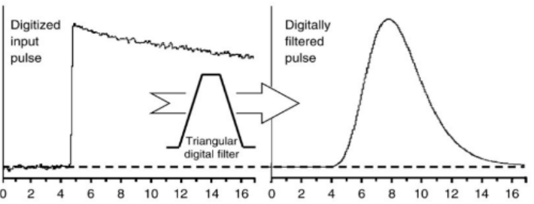
Analog - Digital transforms algorithms
Preamp Output [mV]
Preamp Output [mV]
Time [μs]
Time [μs]
Digitized Input pulse
Digitally filtered pulse
Relative Amplitude
Preamp Output [mV]
Time [μs]
Time [μs]

Slide 13
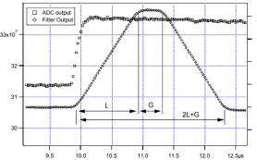
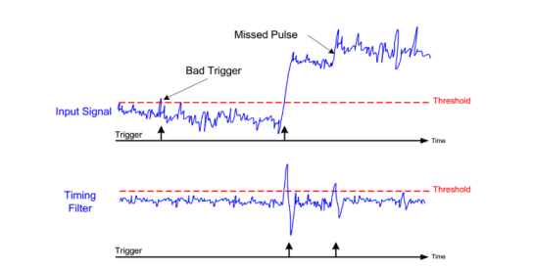
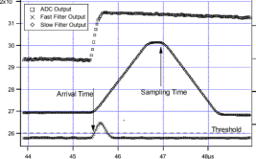
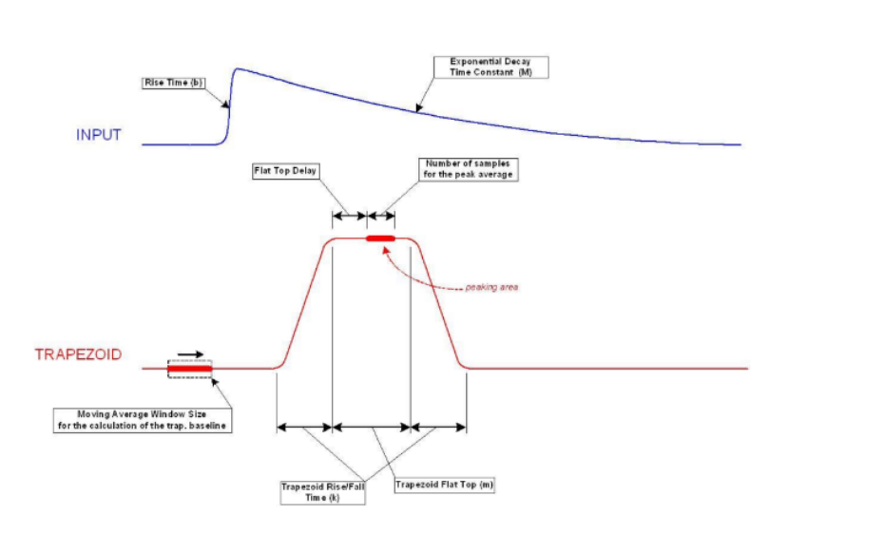
Extracting digital parameters from digital prototype data
Fast trapezoidal filter Rise time, Flattop and threshold pulse trigger detection.
Slow trapezoidal filter Risetime and Flattop pulse height computation.
ADC Units
Bad Trigger
Missed Pulse
Input Signal
Threshold
Trigger
Time
Timing Filter
Threshold
Time [μs]
Trigger
Time
ADC Units
Number of samples
for the peak average
Flat Top Delay
Peaking area
TRAPEZOID
Moving Average Window Size
Fat Top
Time [μs]
Rise Time & Tau

Slide 14
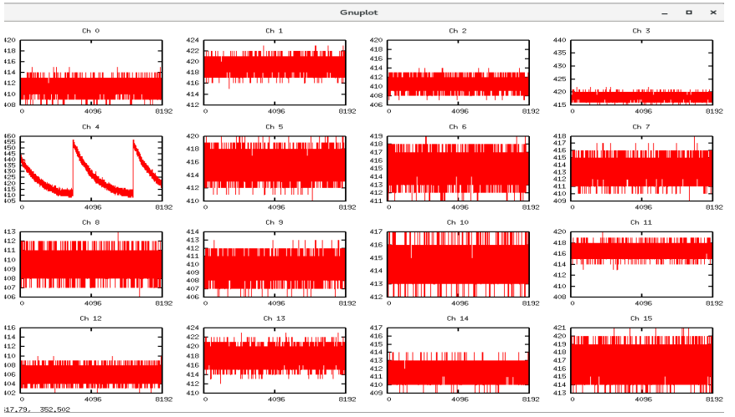
Testing BNC-BNC connectors with digital sciascope

Slide 15
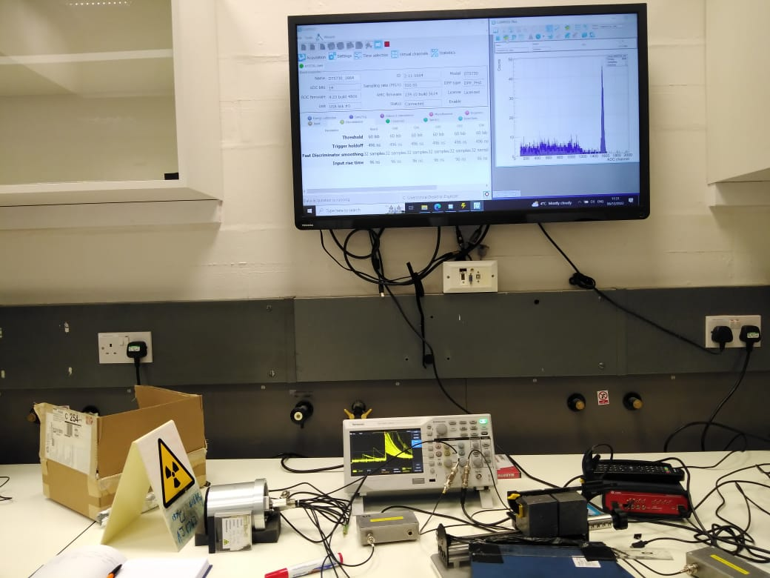
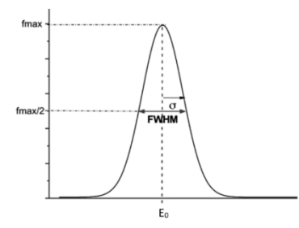
Setting digital parameters for optimum performance of NaI(Tl) scintillator detectors
V(t) [mV]
Time [μs]
fmax
V(t) [mV]
½(fmax)
Energy Resolution expression:
Time [μs]
μ

Slide 16
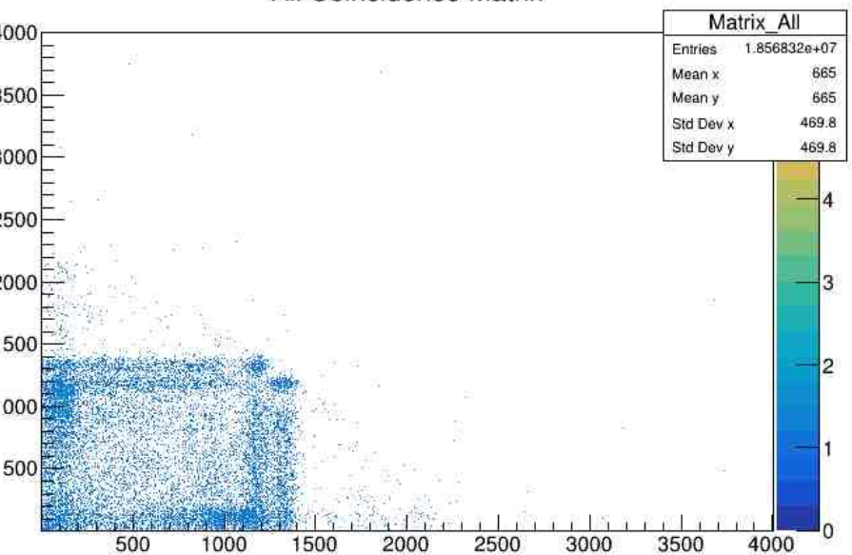
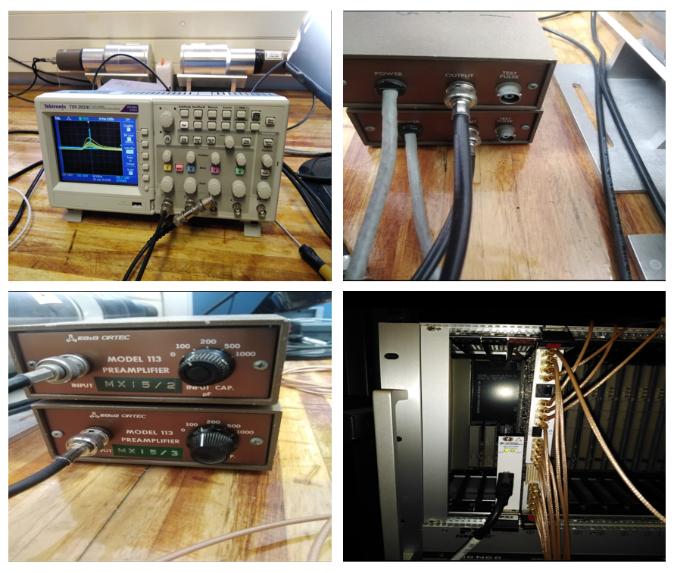
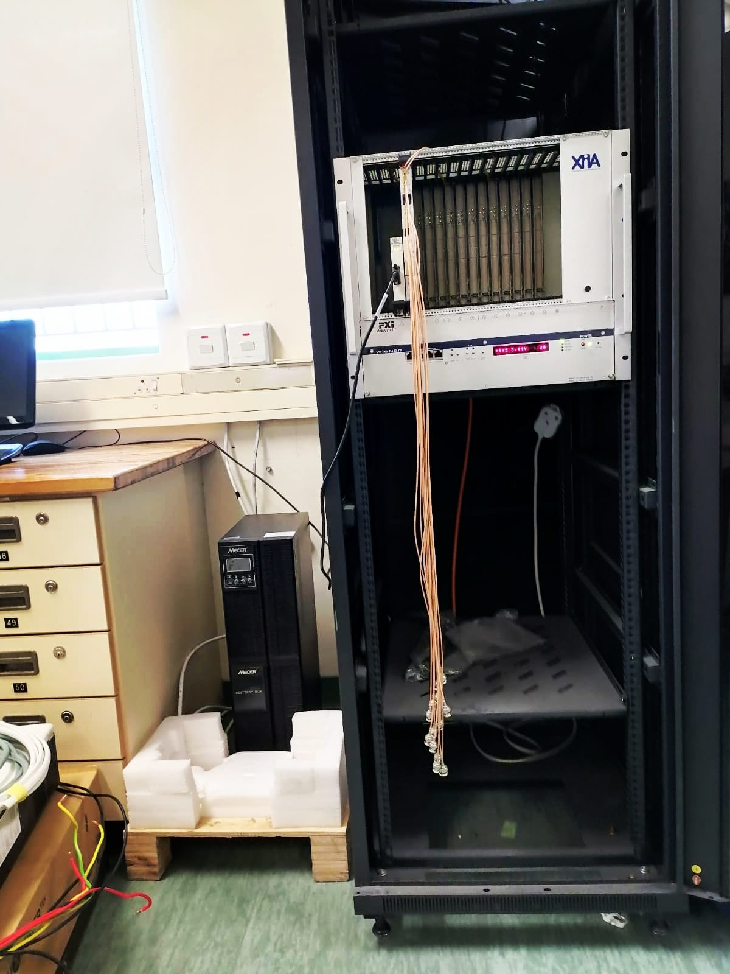
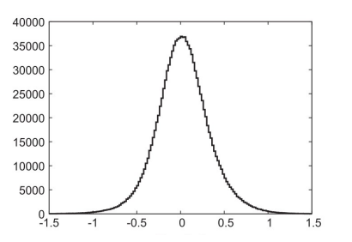
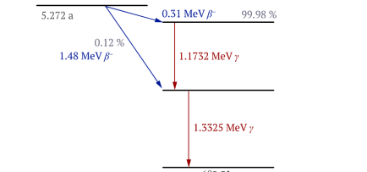
γ-γ Coincidence experimental demonstrations
All Coincidence Matrix
A
C
E
Energy [KeV]
Co-60
B
D
Energy [KeV]
Typical prompt γ − γ coincidence matrix for a Co-60 source using NaI(Tl) detector
Time Difference Spectrum
Co-60
Counts
Ni-60
Decay Scheme of C0-60 source excitation energies and corresponding transitional probabilities
Time [μs]

Slide 17
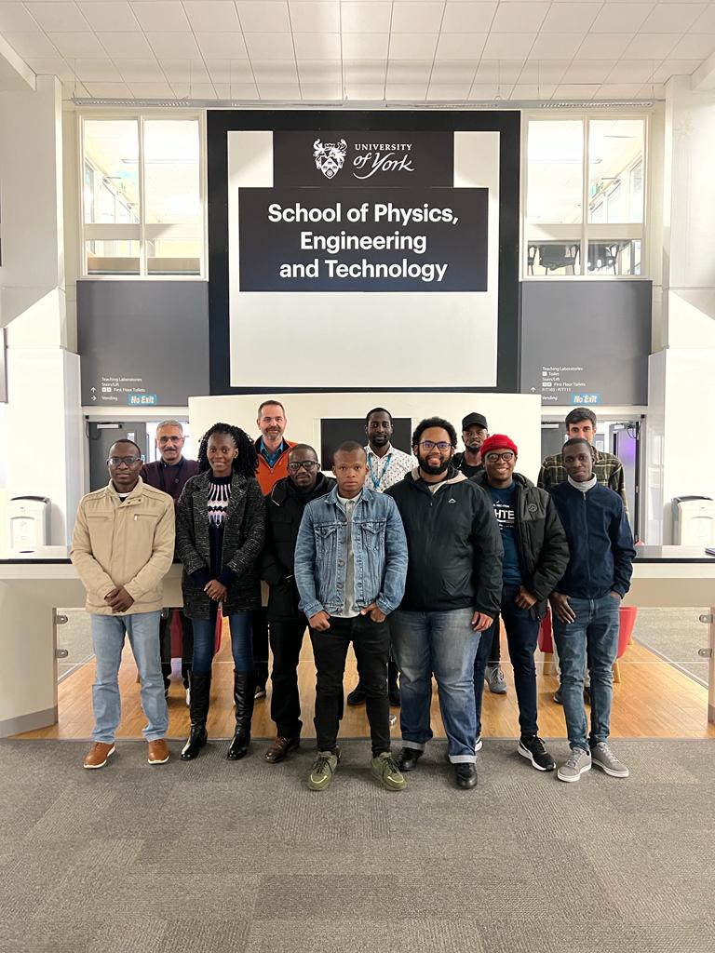
Thank you for your attention

