Slide 1

Cryogenic gas-filled ion stopping cell as an instrument for experimental study of the heaviest nuclei
Speaker: Vedeneev Viacheslav Yurievich,
Junior scientific researcher of the Flerov Laboratory of Nuclear Reactions
AYSS Conference, JINR, DUBNA. 30th October-3rd November 2023.

Slide 2
Planned installation for the high precision nuclei mass measurements. Why?
Mass measurement allows to determine the full binding energy of the nucleus - the integral characteristic of all atomic and nuclear forces which is the key for solving the fundamental physics problems, which includes nuclear physics, astrophysics, physics of fundamental interactions and symmetries, neutrino physics. The number of nuclides with the lifetime significantly higher then the typical time of nuclear interaction (10⁻²³ s) should reach 7000, 288 of which are stable. Of about 3200 nuclides have already been synthesized, thus, experimentally proving its existence. The masses of about 2000 nuclides have already been measured with different proximities.
For the determination of proton and neutron shells location, it is enough to know the nuclide mass with the relative accuracy (ΔM/M) of ~10⁻⁶.
For the study of nuclear deformation phenomena and searching of so-called “halo-nuclei”, it is necessary to know the masses of investigated nuclei as minimum as 10⁻⁷, and also for the correct scribing of the heaviest nuclei formation in astrophysical processes of fast neutron (r-process) and proton (rp-process) capture.
For the weak interaction theory the mass resolution should be at least 10⁻⁸.
For the identification of the neutrino type the cognition of stable mother and daughter nuclei masses ratio with the precision of 10⁻⁹.
In measurements of nuclide pairs masses ratio, such as ³He/³H, ¹⁸⁷Re/¹⁸⁷Os and ¹⁶³Ho/¹⁶³Dy for the possibility of neutrino mass definition at the level of a few hundreds of meV/c² the precision of 10⁻¹¹ is required.
In summary, we get a possibility of a new isotopes of superheavy elements studying with Z≥110. 27 of 47 which are already been synthesized, have a lifetime exceeding 100 ms.

Slide 3
Possible plan of the installation composition
The installation will be consisted of:
Heavy ion beam from cyclotron*.
Target box.
Gas-filled recoil pre-separator.
Cryogenic gas-filled stopping cell (“Gas catcher”).
Radio-frequency quadrupole transportation system.
Multi-Reflection Time-of-Flight Mass Spectrometer (MR-TOF-MS).
Penning trap-based mass spectrometer.
Concrete shielding.

Slide 4
How does the gas catchers work?
Gas flow
Constant electric field
Radiofrequency electric field
Summary effect

Slide 5
Main Characteristics and motivation of the “Cryocell”
Not influenced from any physical and/or chemical environment properties.
No need in additional ionization.
Significantly shorter separation and extraction time in comparison to solid or liquid states ion catchers (~30-40 ms).
Significantly higher conversion coefficient of the fluxes of reaction products with heavy ions at energies 5-10 MeV/nucleon into low energy secondary beam (≥ 70%).
Dimensions: length 300 mm, diameter 250 mm.
Buffer gas: helium of the highest purity (99.99999%). Work pressure: P ≤ 10 mbar for the temperature T ≤ 40 K.
Gas flow through the cell: ~1 Torr*l/s.
Extraction efficiency: ~30%.
Significantly lower temperature and energy derivation in comparison to classic method of solid ISOL and beam emittance (3π*mm*mrad).

Slide 6
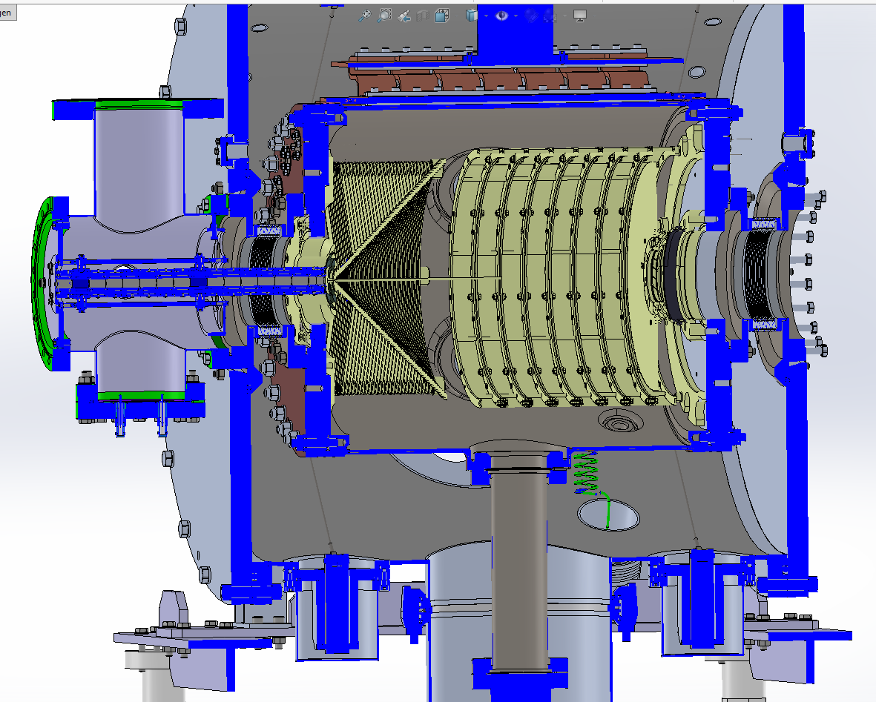
Model axial cut
Cryorefrigerator
De Laval nozzle
Transport RF-quadrupole
Entrance window
Electrostatic DC-cage
RF-funnel
Inner “cold” chamber
Outer “warm” chamber
© by S.A. Eliseev

Slide 7
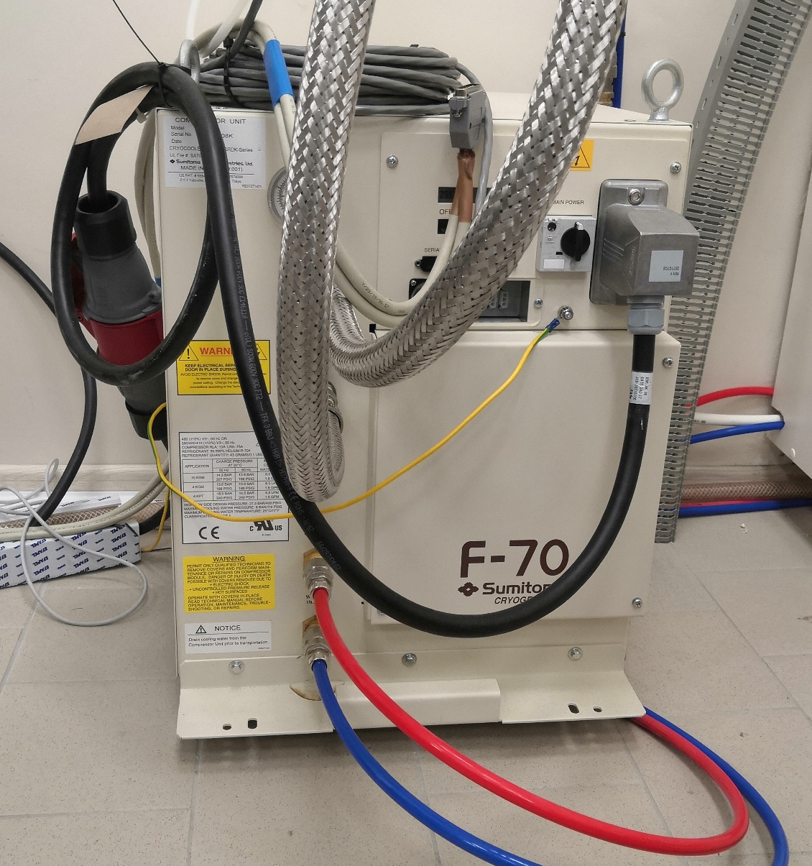
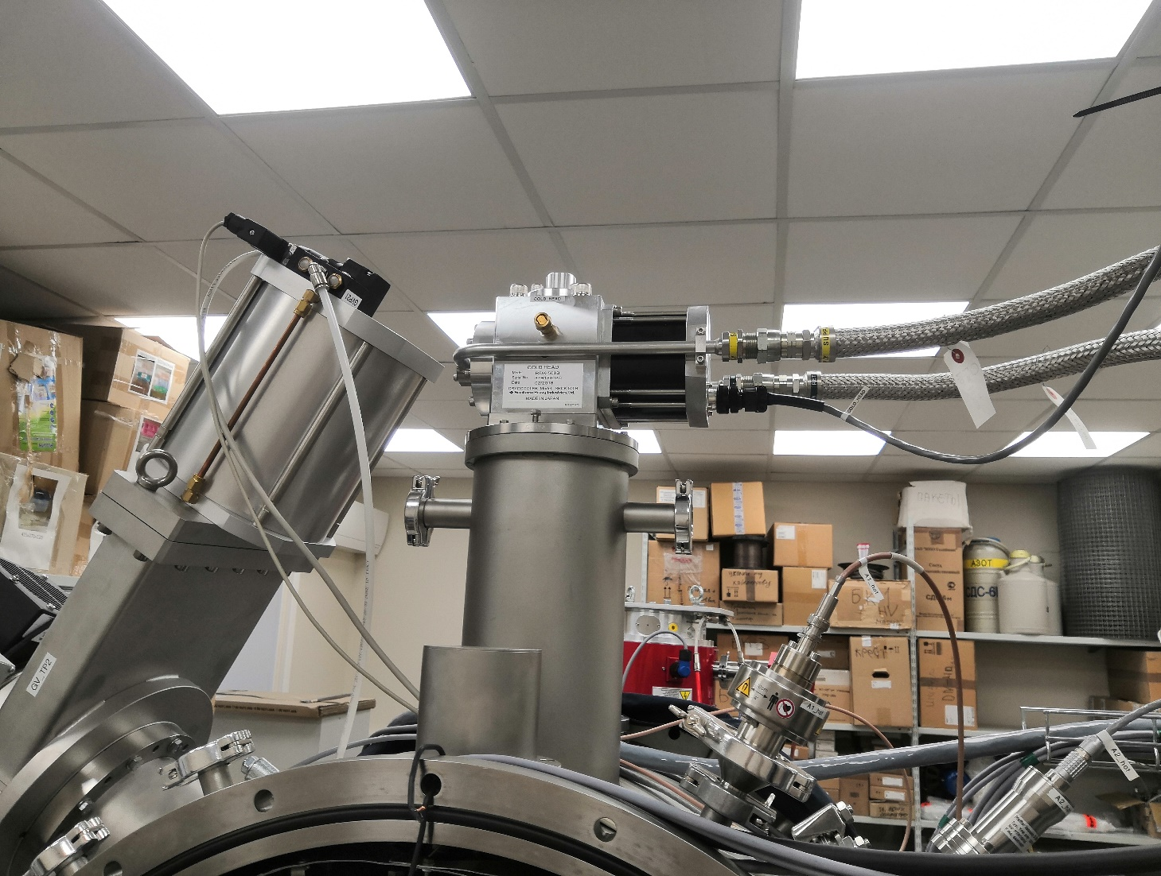
Cryogenic system
Represented by the Sumitomo RDK-500B refrigerator.
Minimal reachable temperature is 14 К.

Slide 8
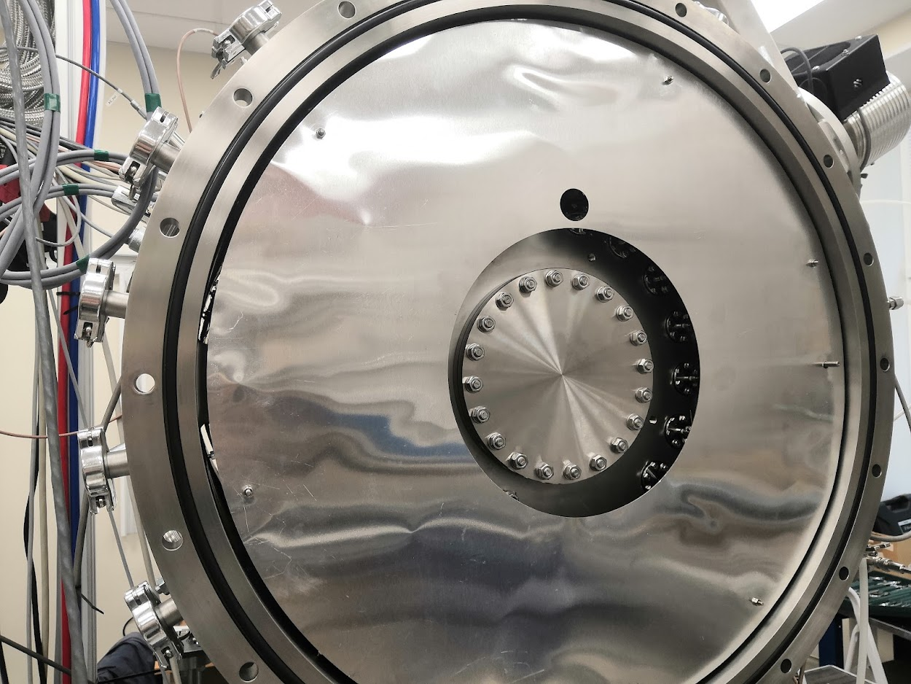
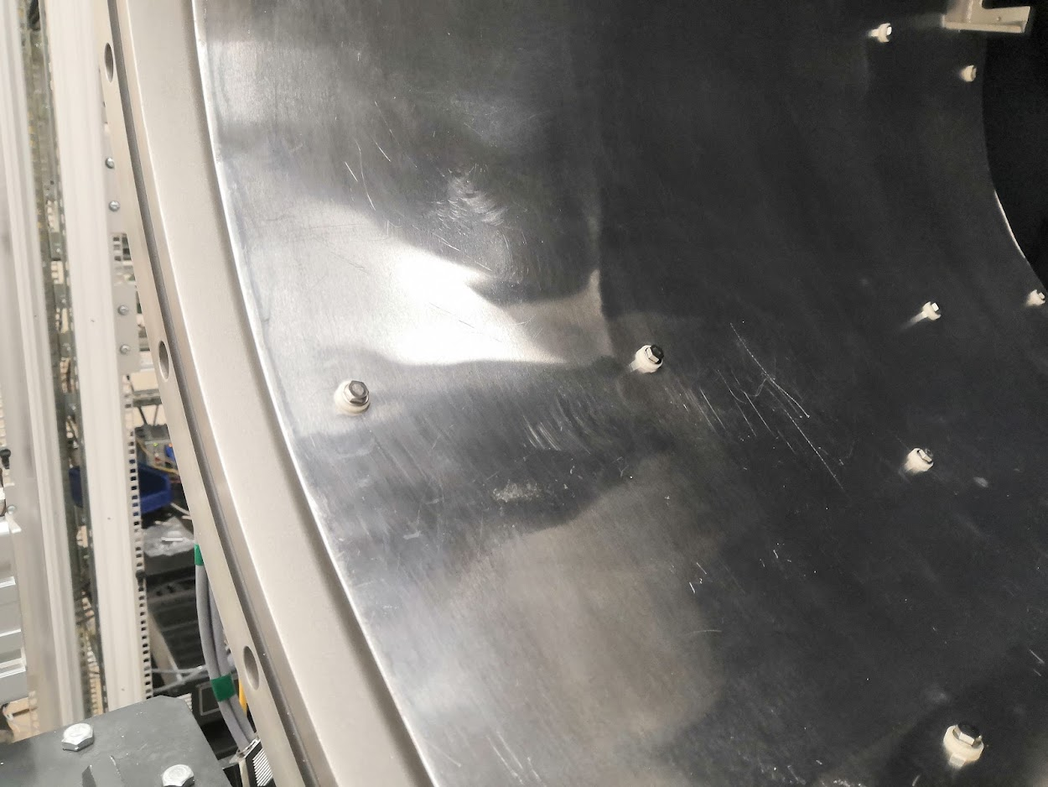
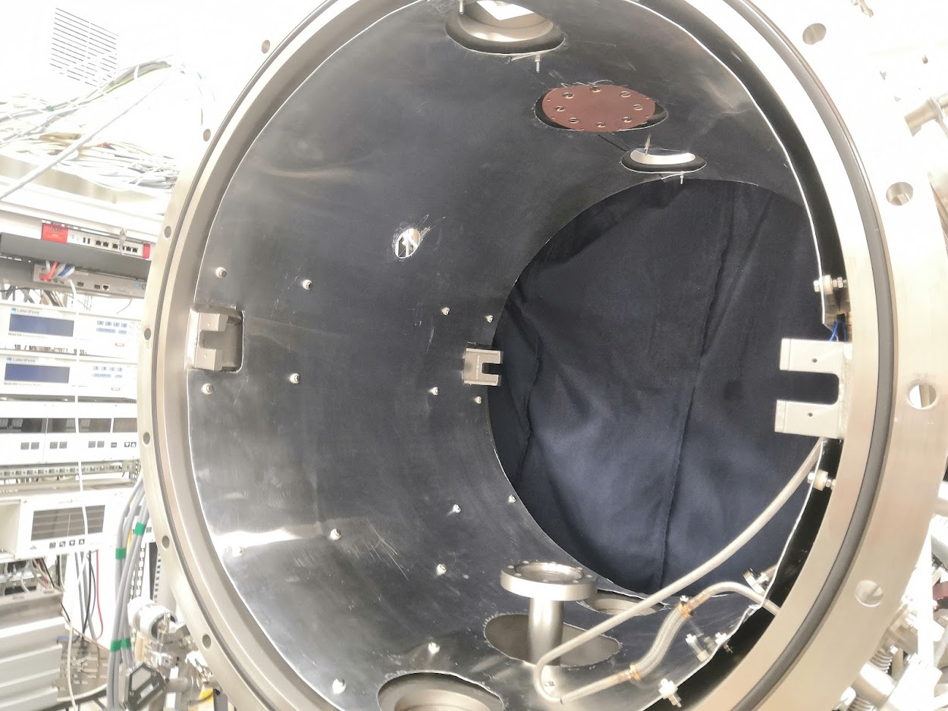

Slide 9
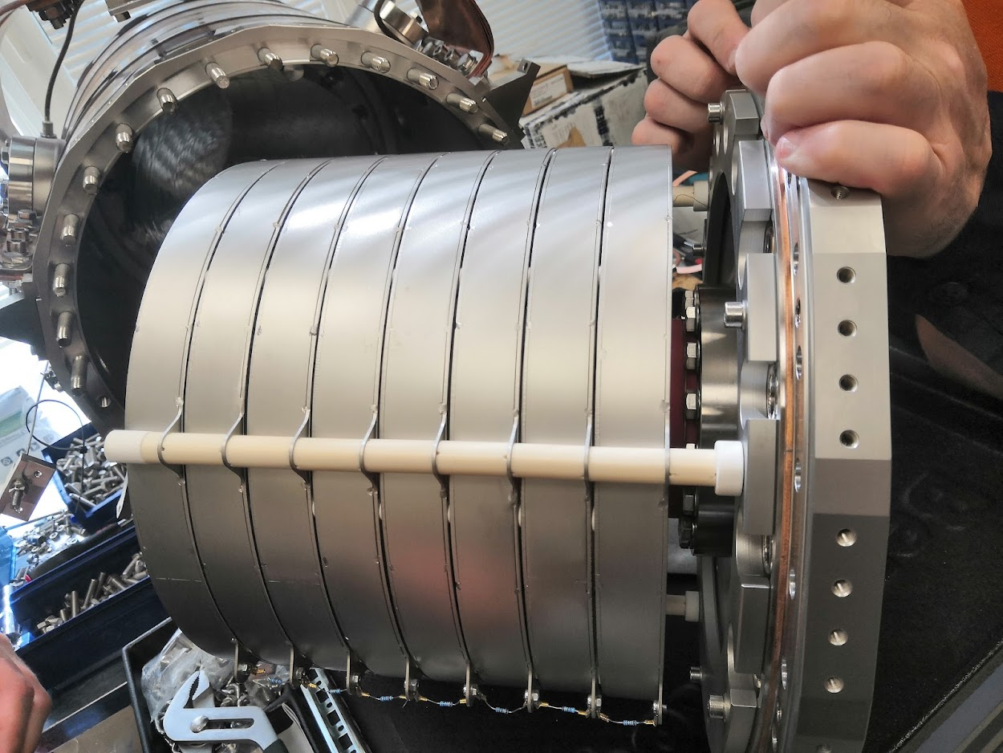
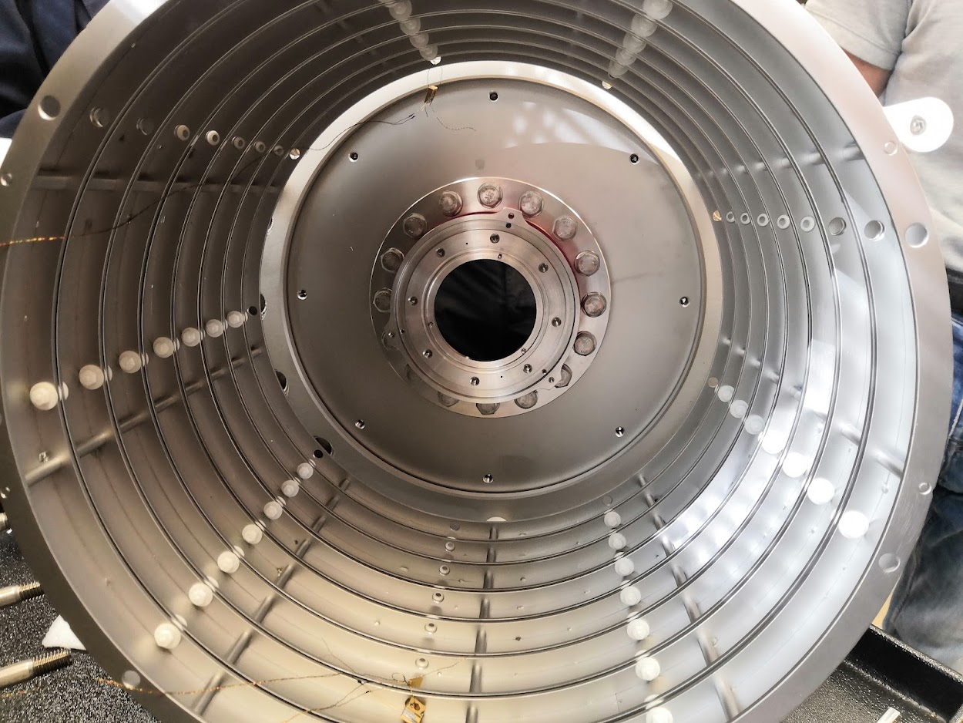
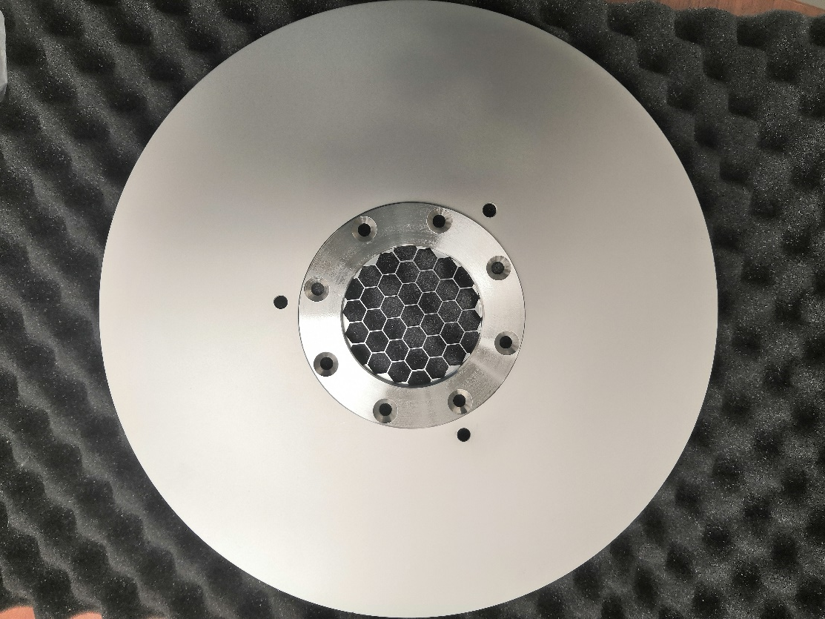

Slide 10
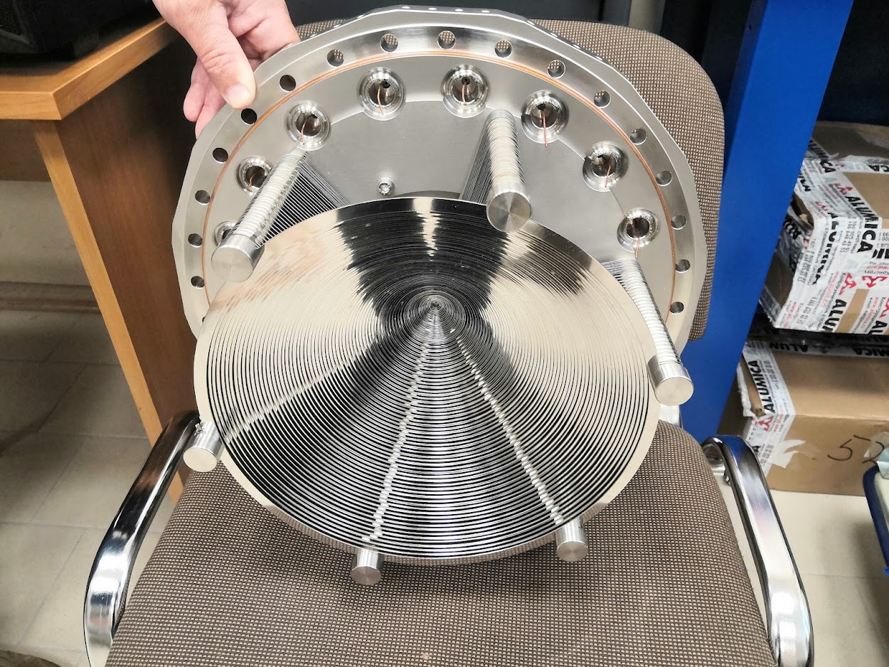
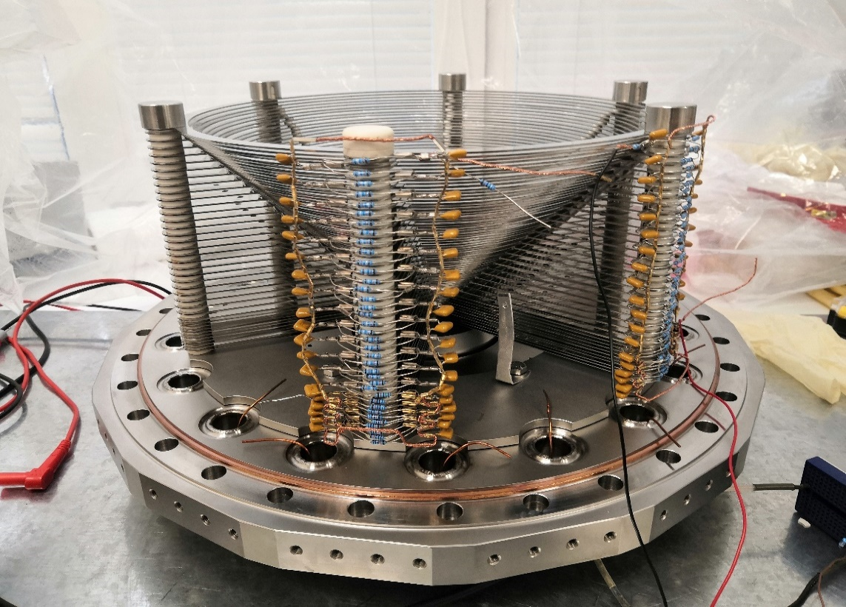
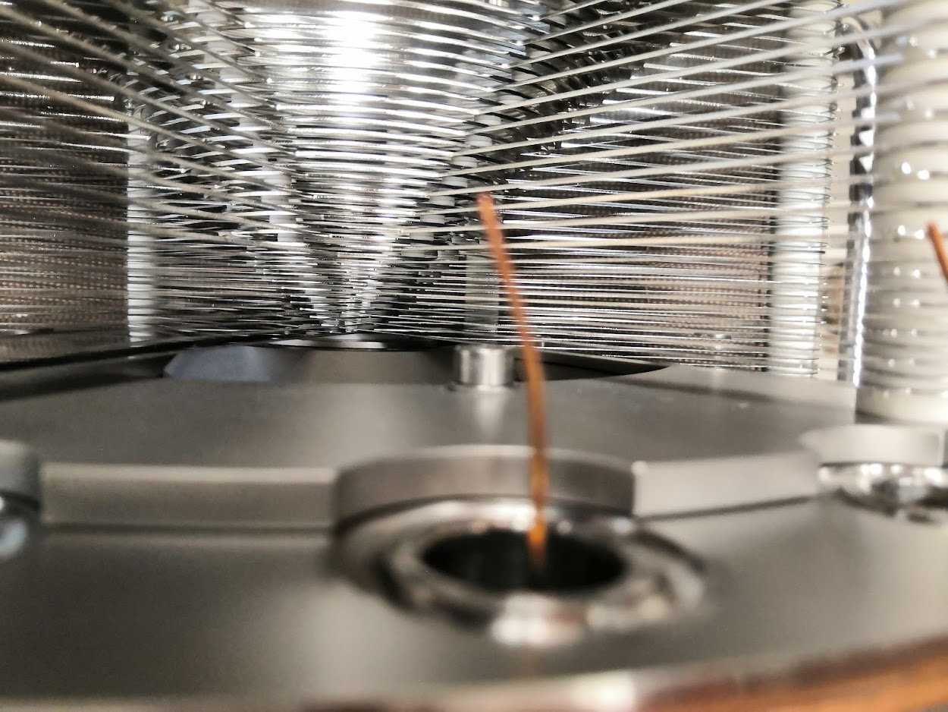
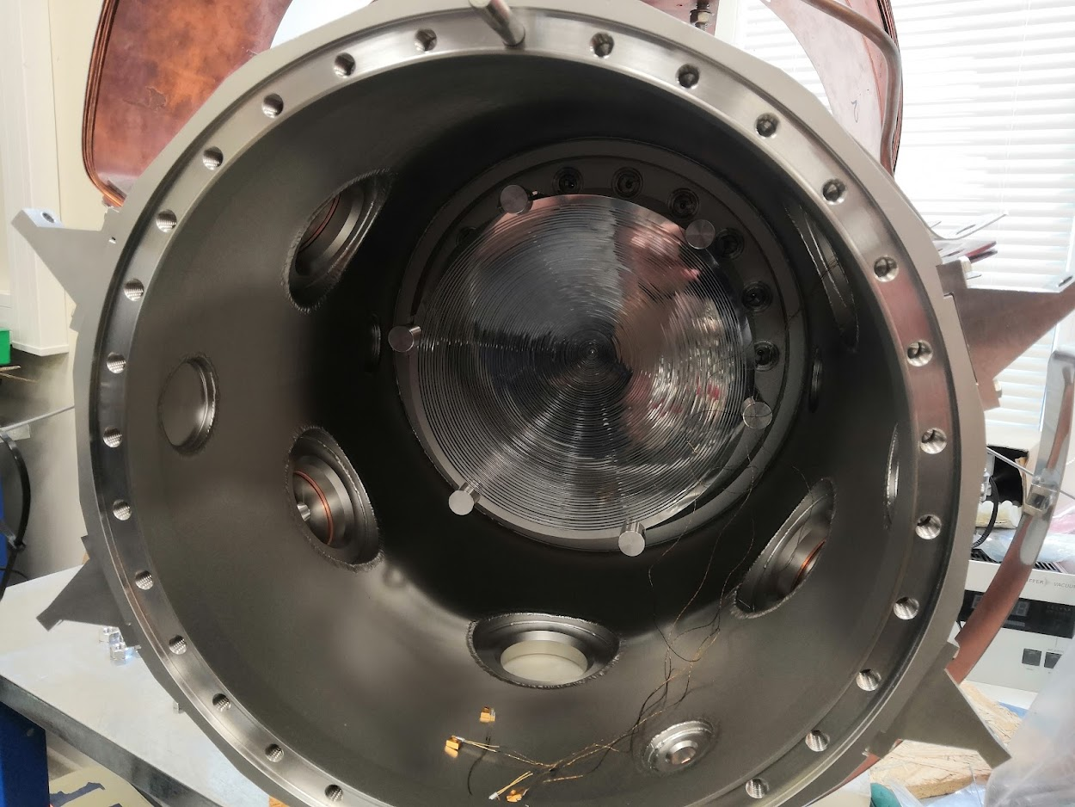

Slide 11
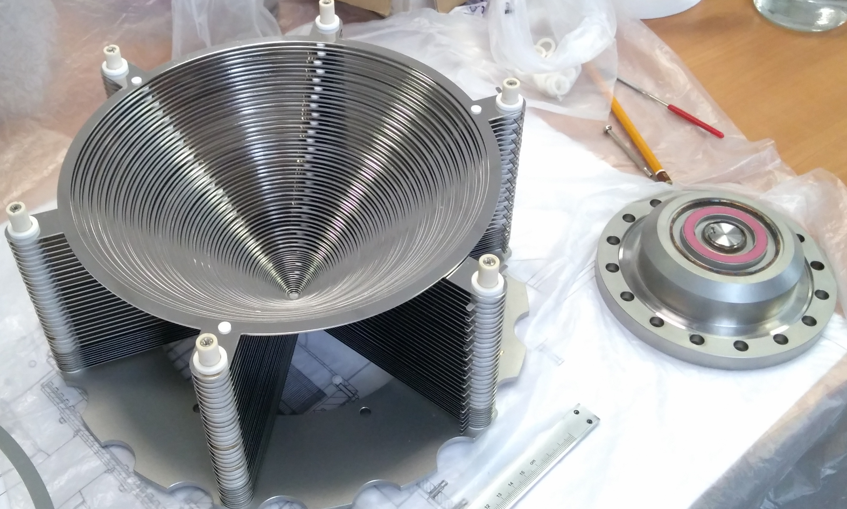
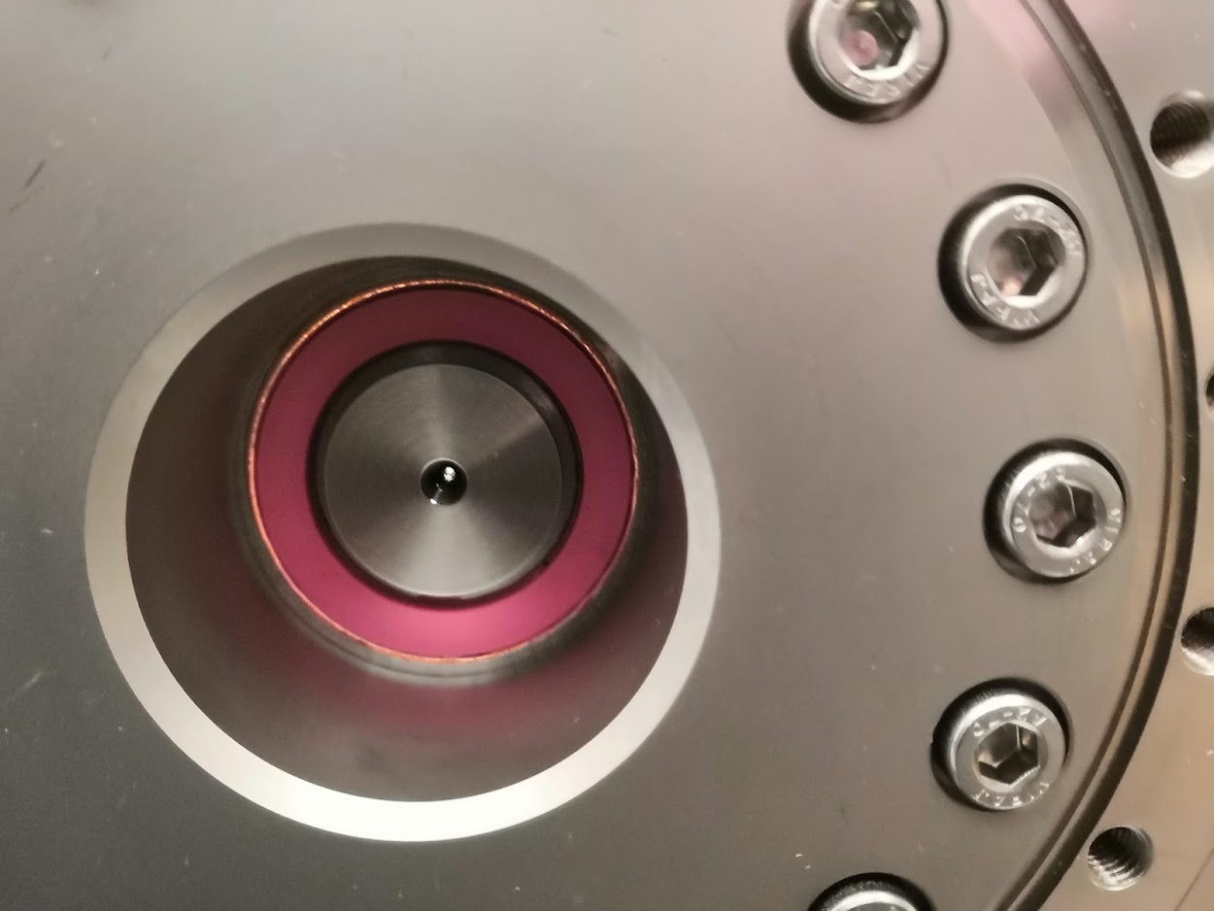
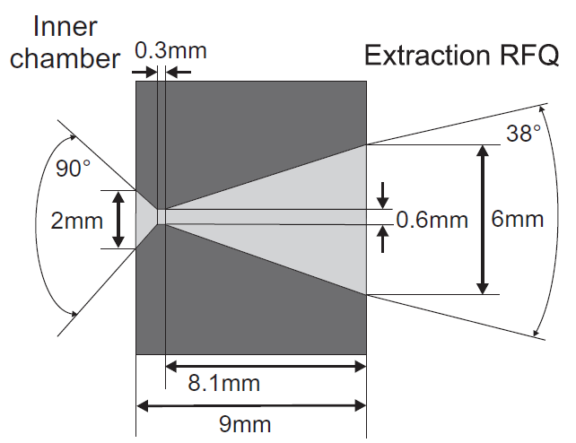
RF funnel and the de Laval supersonic nozzle

Slide 12
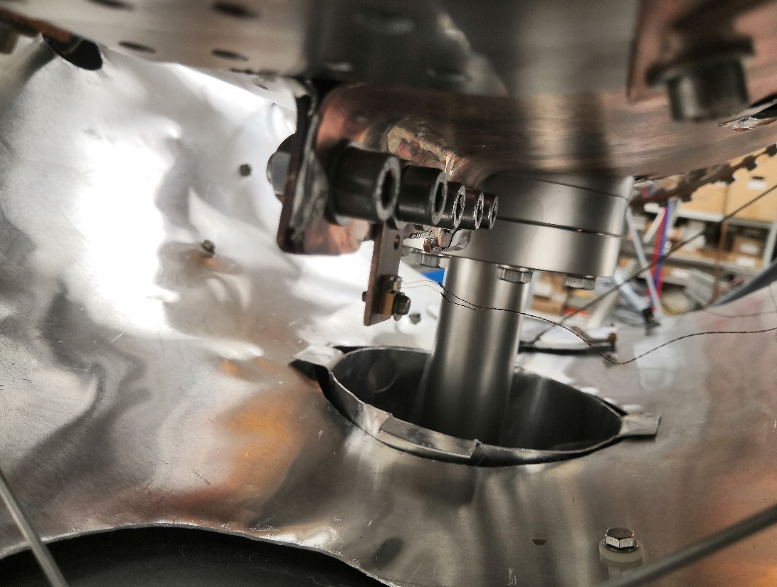
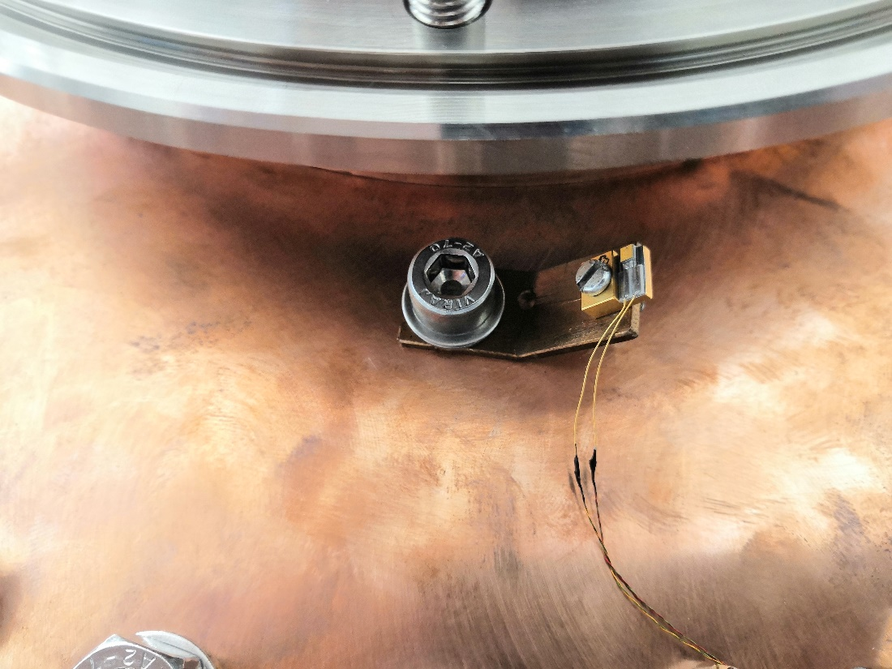
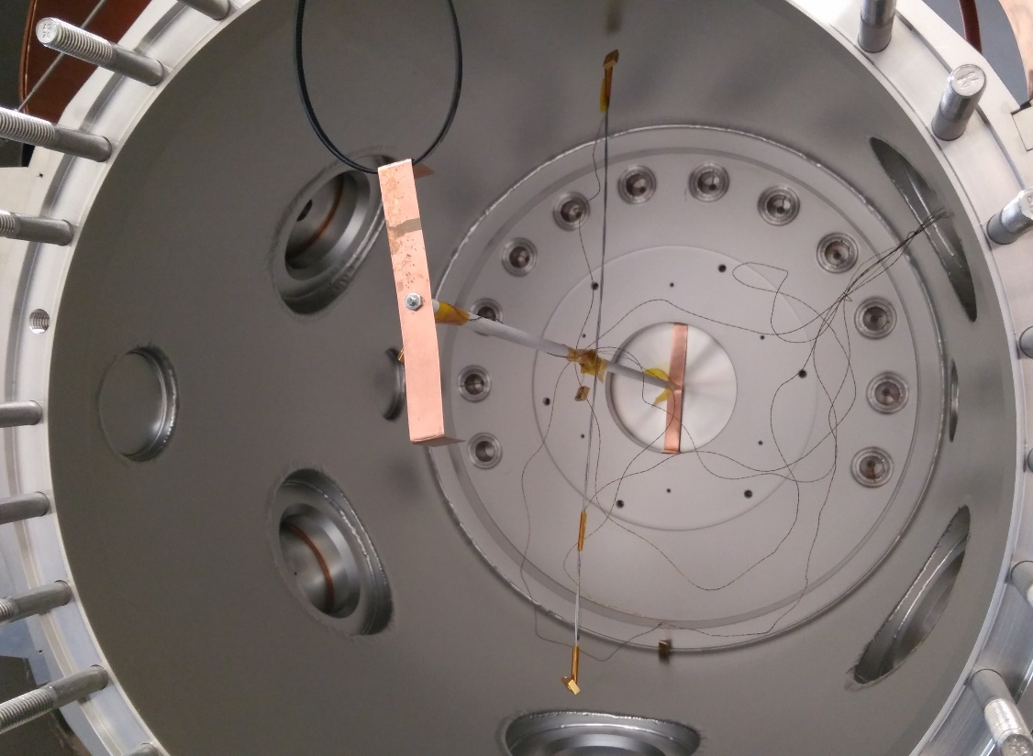
A cryogenic thermoresistors are being used Cernox CX-1050-BO-1.4L type from Lakeshore cryotronix. Temperature range from 1.4 К to 325 К.
Mounted on:
Top copper plate-distributor;
Copper plating of the inner chamber;
Copper flexible heat conductors;
Both flanges;
Helium inlet pipe;
Inside the chamber on the improvised cross.

Slide 13
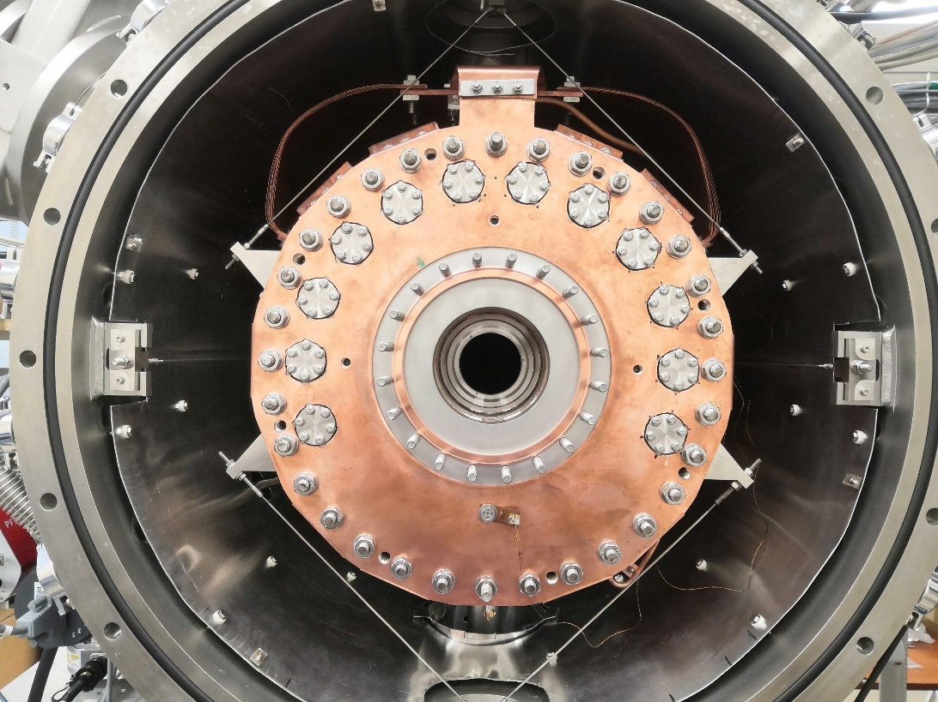
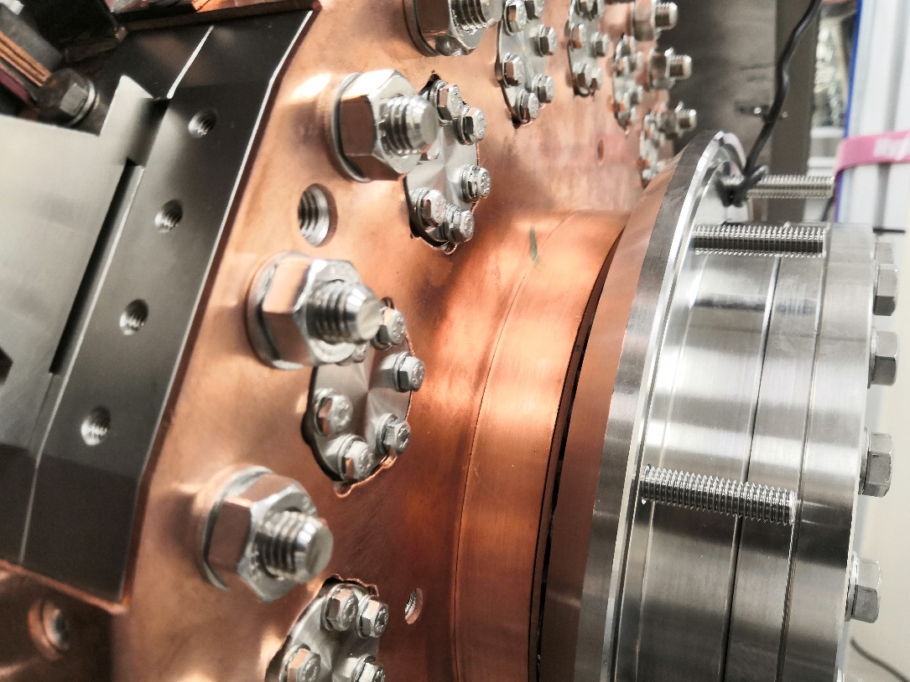
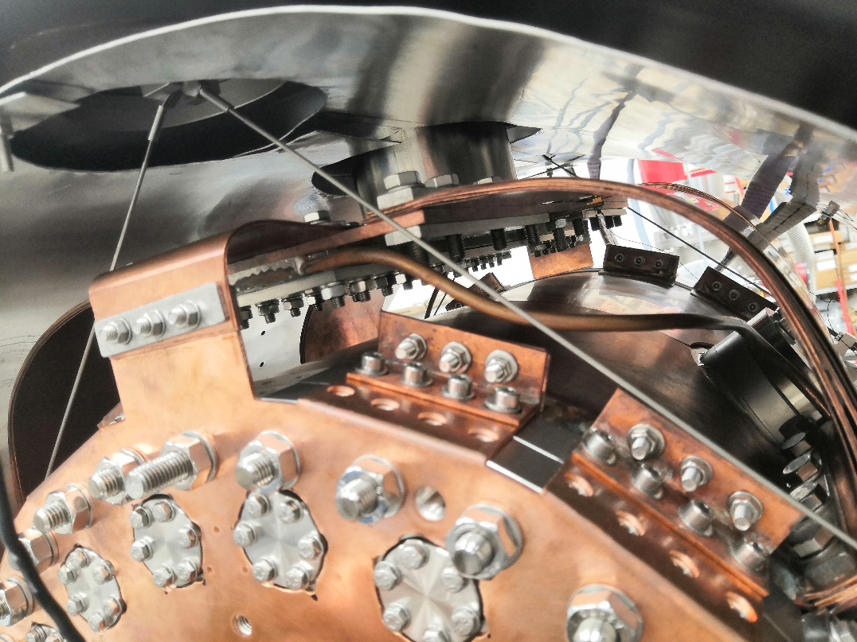
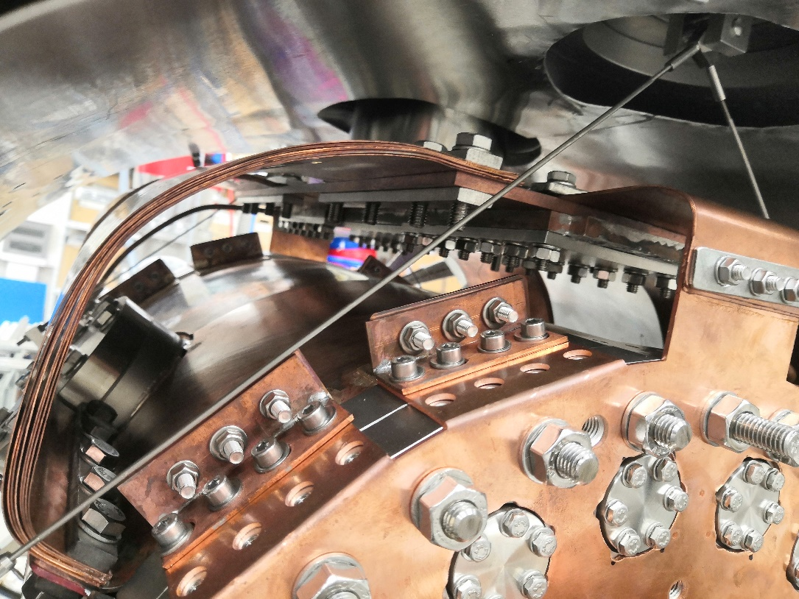

Slide 14
Cryocooling test without vacuum thermal shielding
Gas inlet started
The limit – 45-50 К. This means about 120-130 W of heat load.

Slide 15
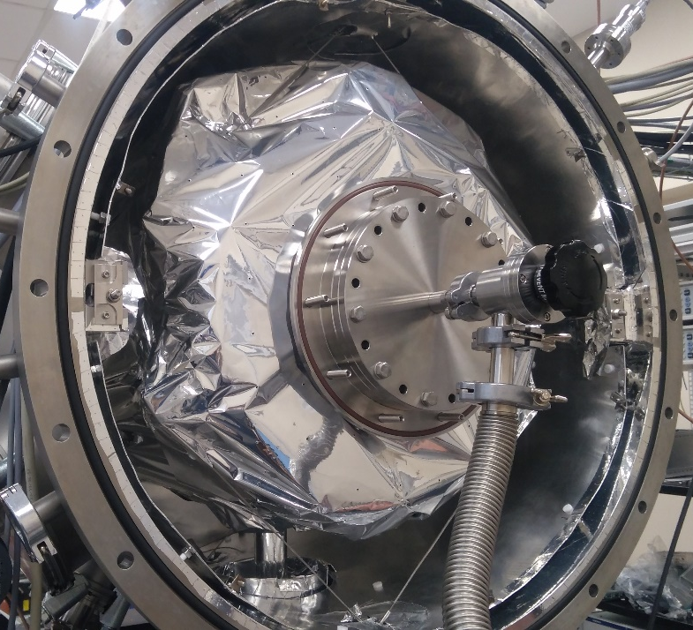
Cryocooling test with vacuum thermal shielding
20 К means about 50-60 W of heat load.

Slide 16
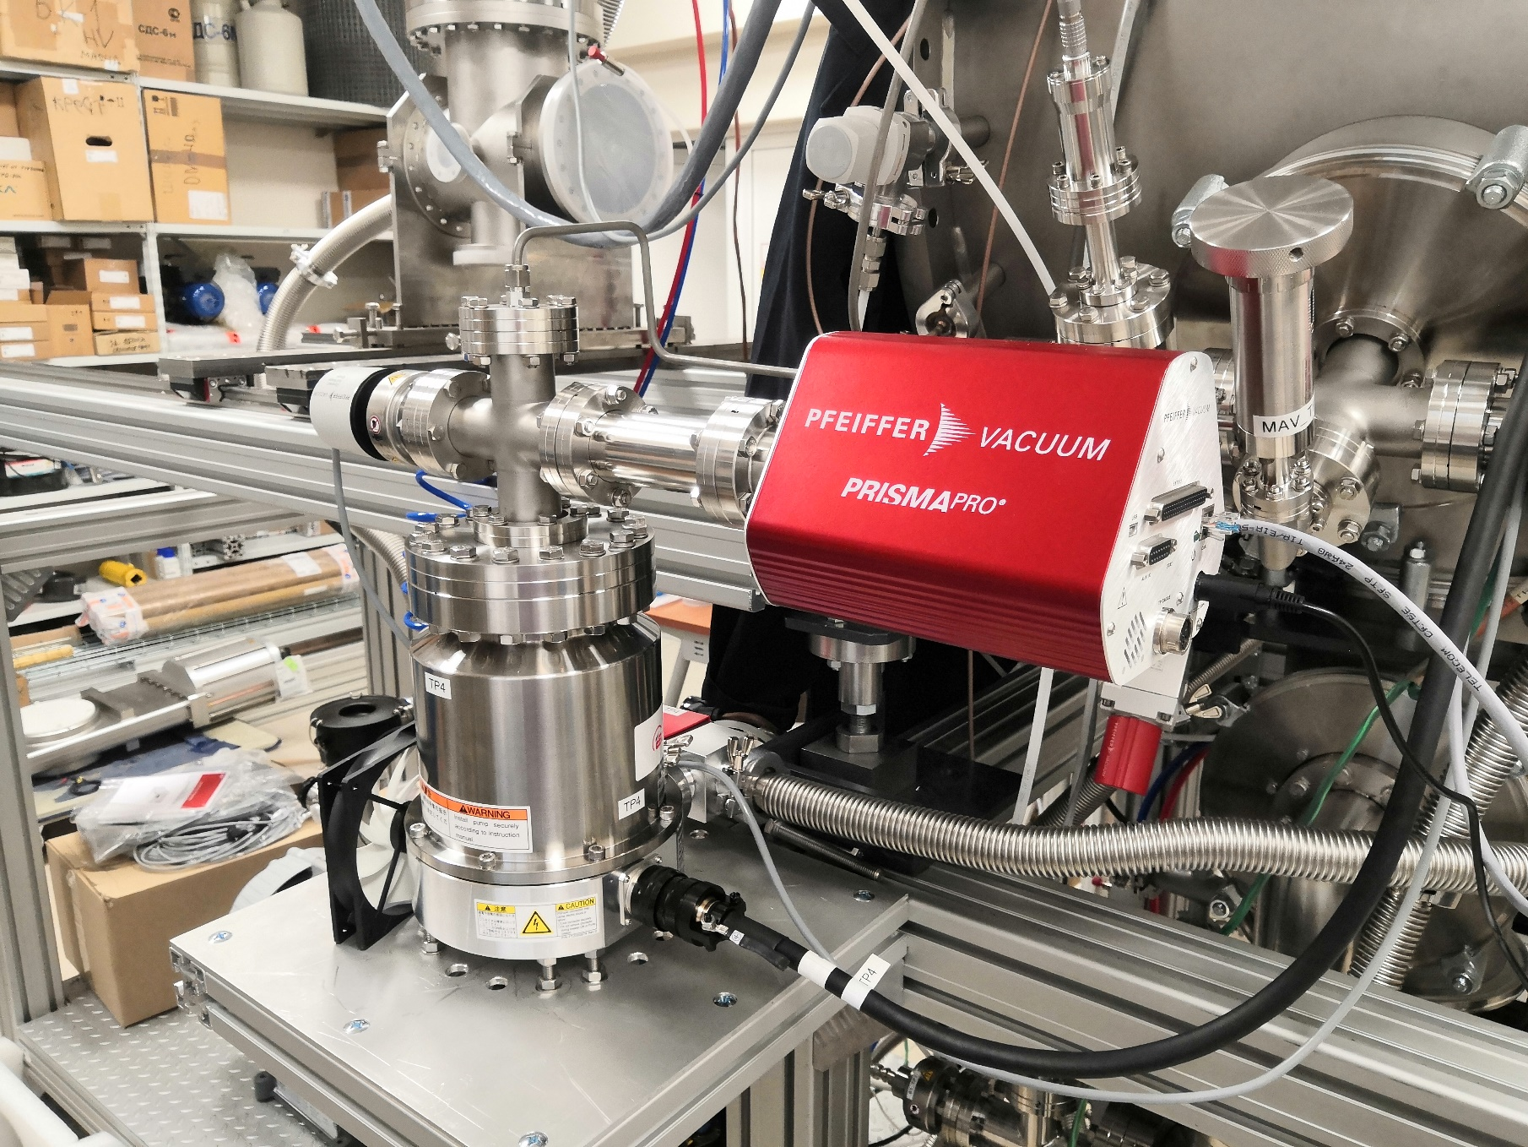
Quadrupole mass-analyzer of residual gas PRISMA Pro QMG 250
Masses range: 1-200 a.m.u.
Sensors: Faraday cup and electron emission amp.
Type of IS: open with filament from Y₂0₃ with Ir deposition.
Minimal detecting treshold: 3х10⁻¹⁵ Torr – in the electronic amplification mode.
Maximum pressure in chamber: 3.75х10⁻⁴ Torr и 3.75х10⁻⁵ Torr for the Faraday cup and electron emission amp respectively.
Mass resolution: 20 points between neighboring 40 and 41 a.m.u.

Slide 17
Difference between the abundances of gas components of the air in the room and cryogenic temperatures.
H,H₂,He
N₂
№ | Gas | Т_{melt}, К | Т_{boil}, К | Abundance., % (by vol.)
1. | Nitrogen (N₂) | 63,13 | 77,33 | 78,084
2. | Oxygen (O₂) | 54,35 | 90,17 | 20,946
3. | Carbon dioxide (CO₂) | 216,54 | 194,63 | 0,03
4. | Carbon monoxide (CO) | 68,12 | 81,64 | 0,00001
5. | Argon (Ar) | 83,84 | 87,24 | 0,934
6. | Hydrogen (H₂) | 13,95 | 20,37 | 0,0005
7. | Neon (Ne) | 24,62 | 27,21 | 0,001818
8. | Krypton (Kr) | 115,44 | 119,92 | 0,000114
9. | Xenon (Xe) | 161,29 | 165,18 | 0,0000087
10. | Methane (CH₄) | 90,65 | 111,56 | 0,0002
11. | Helium (He) | 1,74 | 4,206 | 0,000524
O₂
OH, H₂O
C,CH,O,N
CO₂
Ar
Ne
Different organic structures

Slide 18
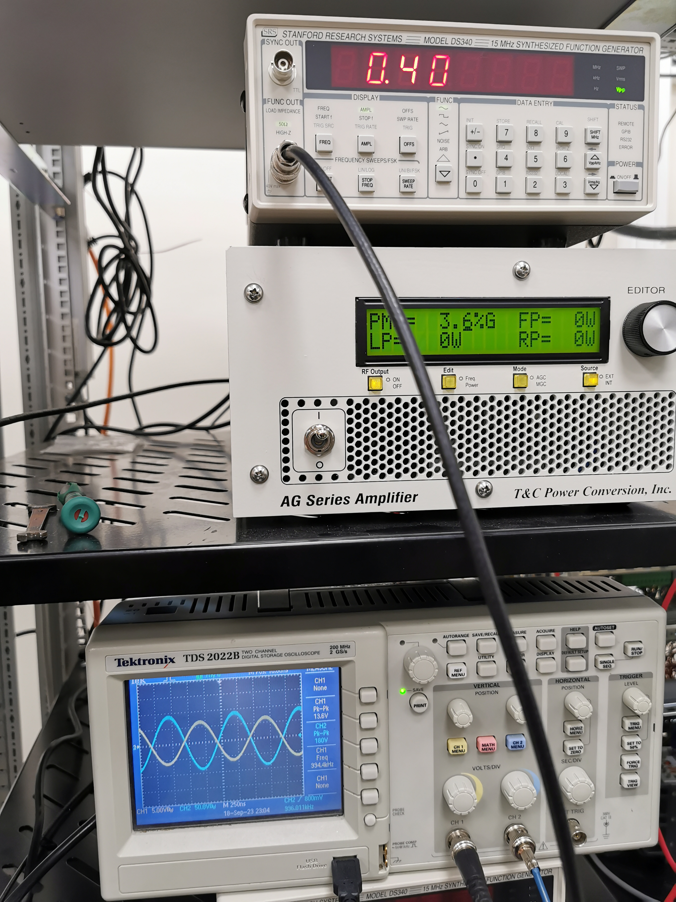
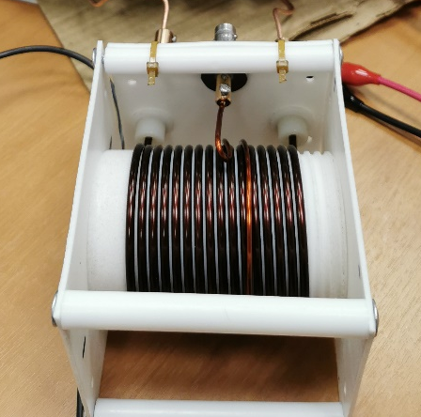

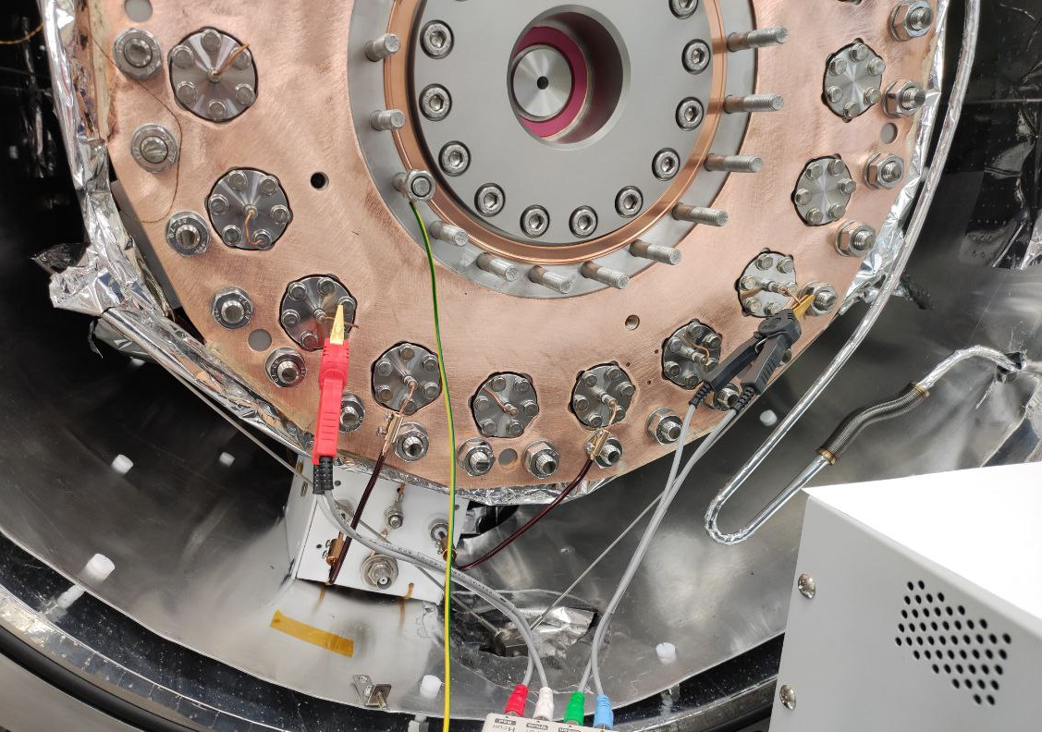
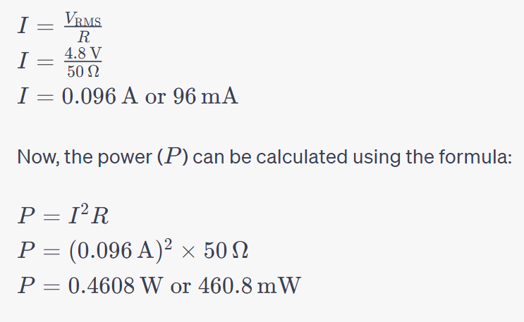
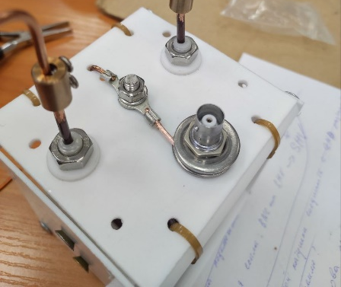

RF Funnel Transformer.
  Transformer Matching formula:
Required parameters are ~1 MHz and up to 180 Vpp
at lowest possible power consumption
Transformer Matching suppose to match primary coil at 50 Ω
Amplitude at input is 13.6 Vpp for 180 Vpp output amplitude.
$$\frac{Z_{p}}{Z_{s}}={\left(\frac{N_{p}}{N_{s}}\right)}^{2}$$
Zp | 50 Ω | Np | 1.32
Zs | 7.28 kΩ | Ns | 16
  Circuit resonate at 996 kHz
  Power @ 50 Ω @ 180 Vpp: ~ 0.5 W

Slide 19
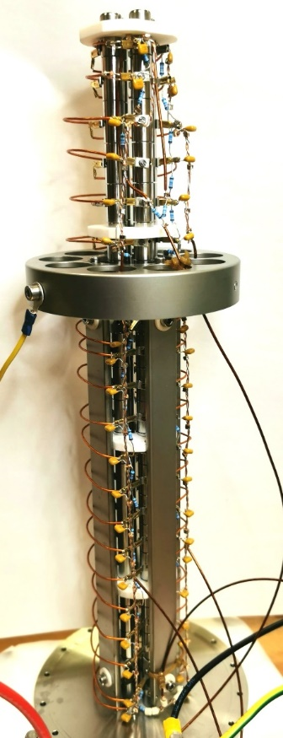
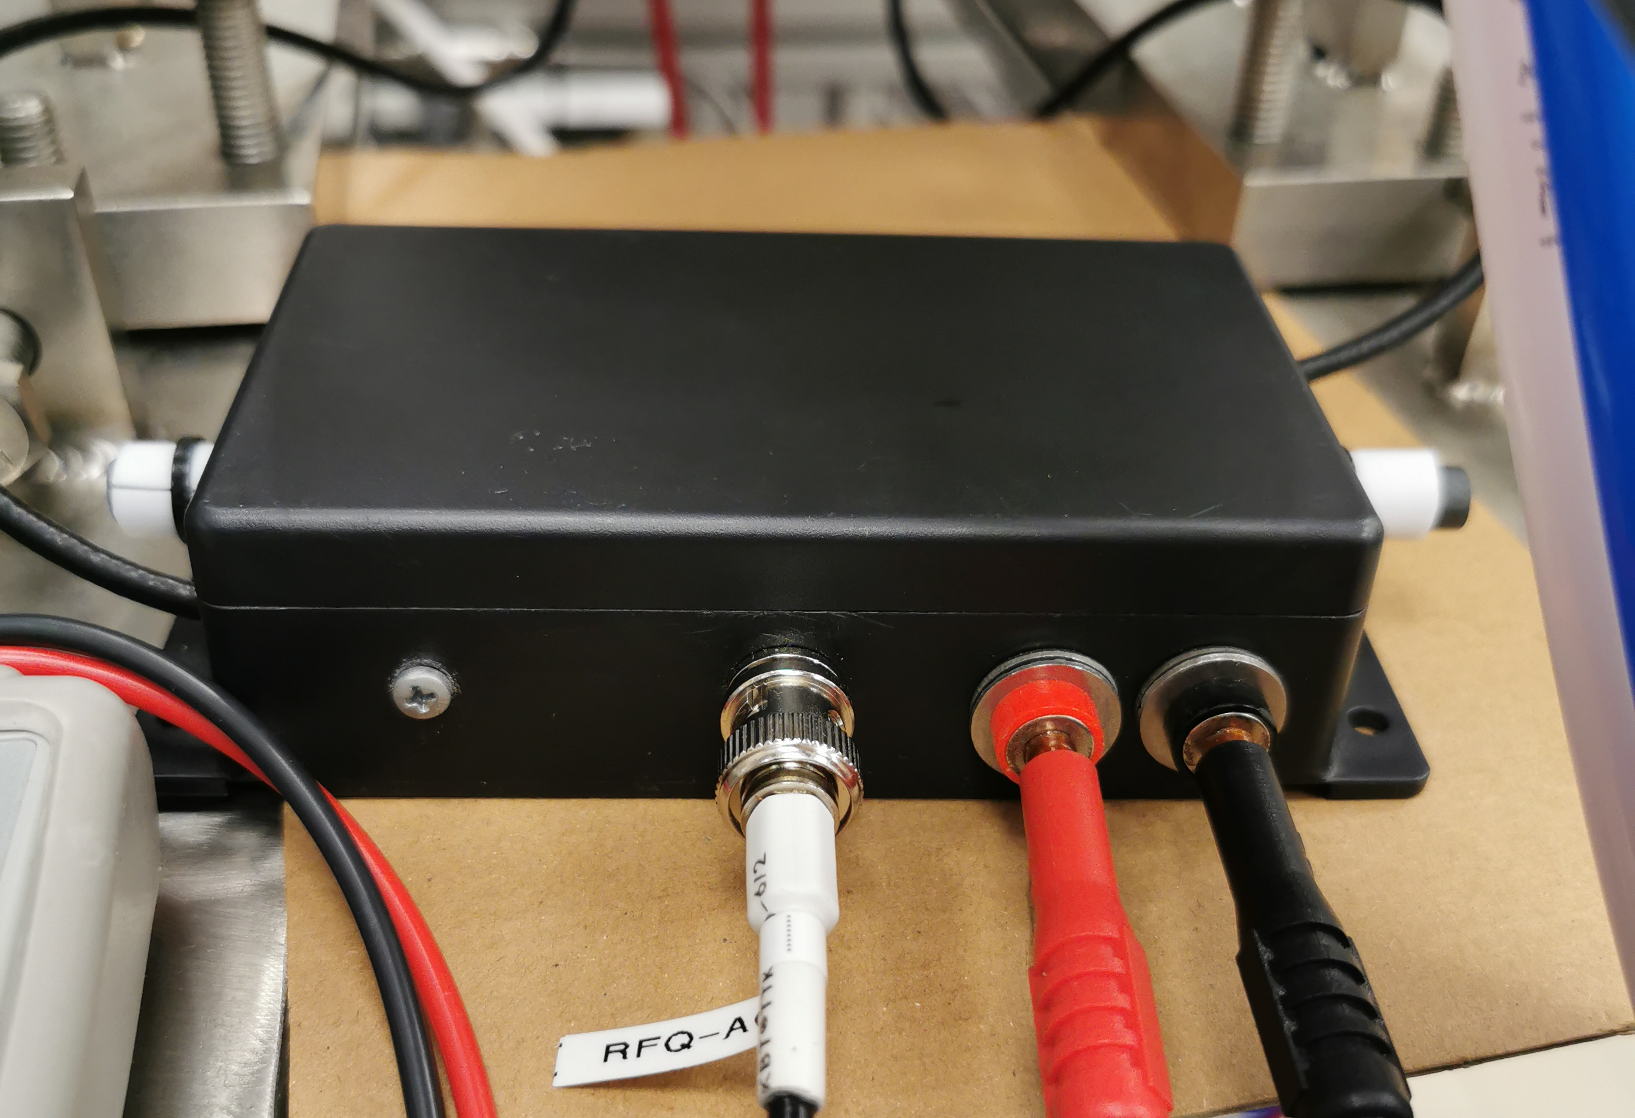
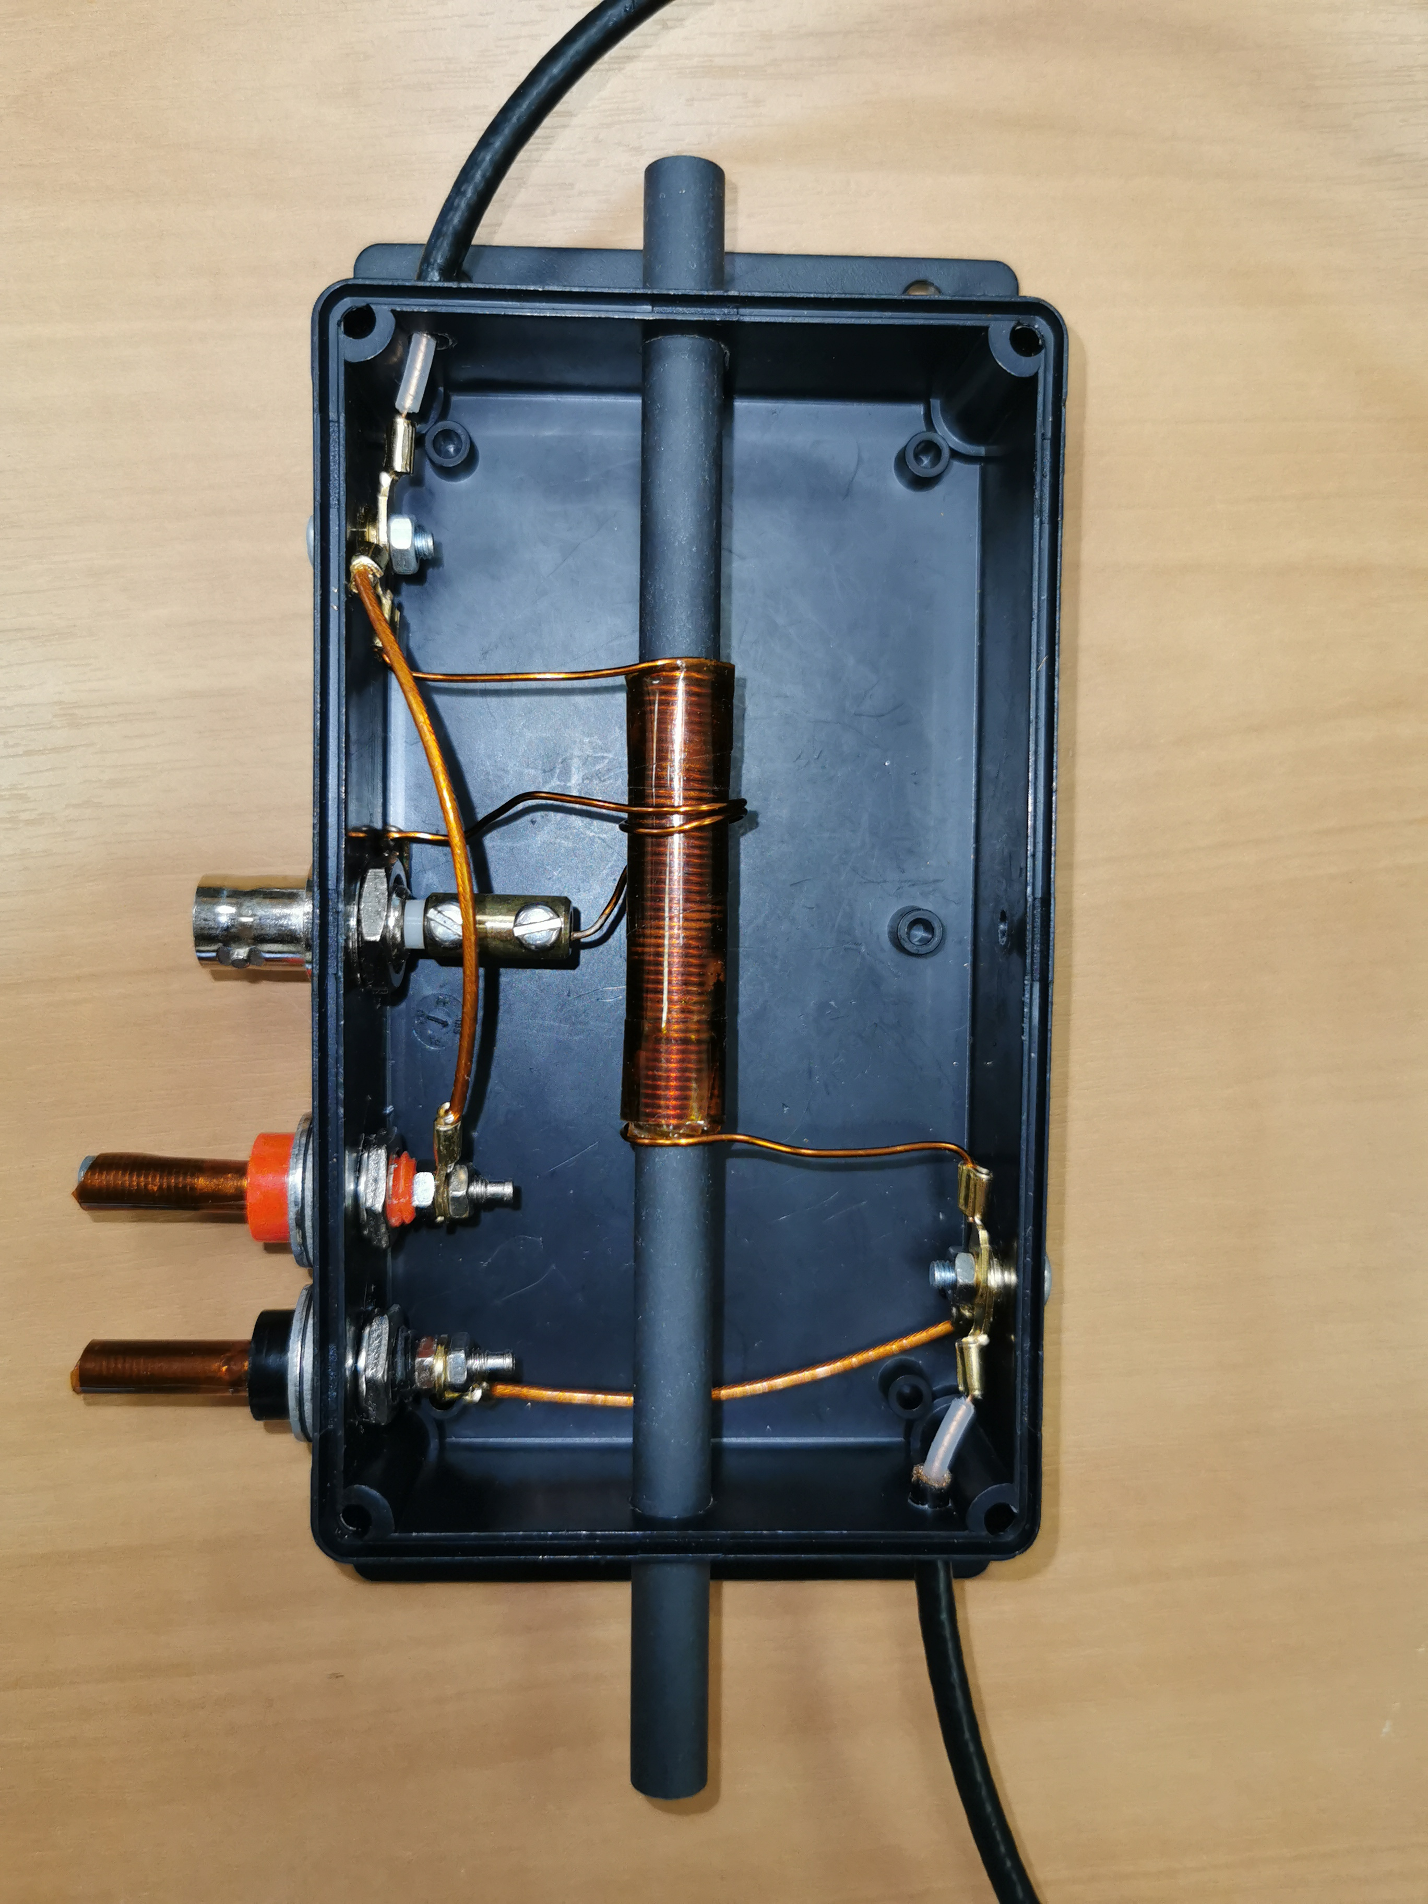
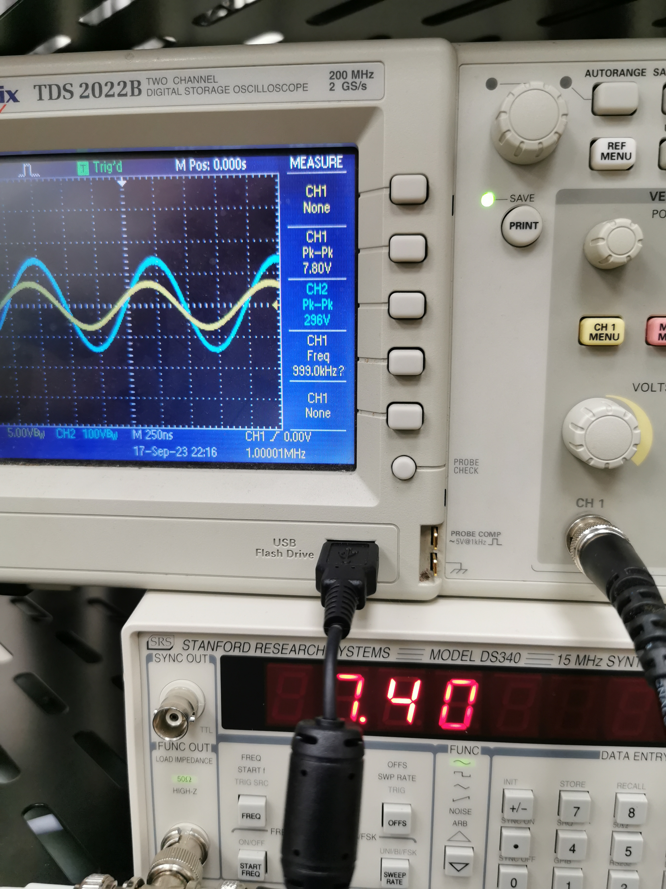
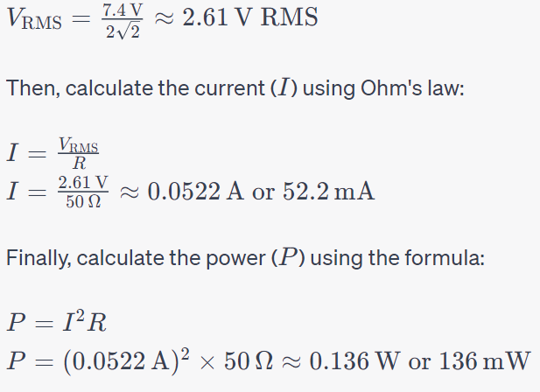
RF Quadrupole resonant circuit.
Required parameters are ~1 MHz and up to 300 Vpp
Zp | 50 Ω | Np | 1.24
Zs | 81 kΩ | Ns | 50
  Circuit resonate at 1 MHz
  Power @ 50 Ω @ 300 Vpp: ~ 0.15 W

Slide 20
Multi-electrode system test and searching for the resonance. Influence on the temperature of the inner chamber.
The deviation of the temperature
regarding to switching
on the power supplies.

Slide 21
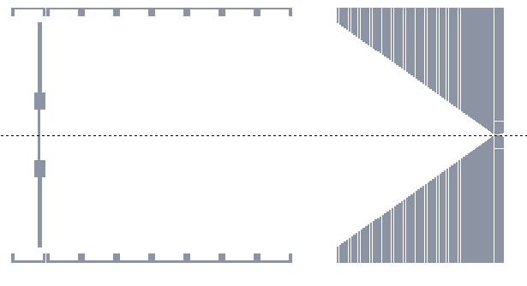
A determination of overall efficiency by method of inner emanation source.
Source
Metallized foil with “-” potential
RF Quadrupole
Aperture
Si detector
²²⁸Th → ²²⁴Ra → ²²⁰Rn → ²¹⁶Po → ²¹²Pb → ²¹²Bi → ²¹²Po → ²⁰⁸Pb
3.66 D
55.6 S
0.145 S
10.64 H
60.55 M
0.3 µS

Slide 22
Conclusion
In FLNR, JINR, a base for a new setup of a precise mass measurements is being built. The most crucial unit – a cryogenic gas-filled ion stopping cell was designed, manufactured and constructed.
The pumping and cryogenic cooling tests already performed, these systems are fully functional. The temperature of the inner chamber reached 20 K within 30±5 hours which is great and the differences between all of the detectors were less than 1 K. This means that thermal load by radiation does not exceed 60 W from all the walls of the outer chamber.
The tests of a quantitative and qualitative compounds with the help of the QMG250 quadrupole mass analyzer were also performed and had shown the exclusion of all the gases inside the air mixture.
The tests of the RF components were performed with success.
In the nearest future a complex test of the Cryocell unit with the emanation source to determine the overall efficiency and extraction time will be performed.

Slide 23
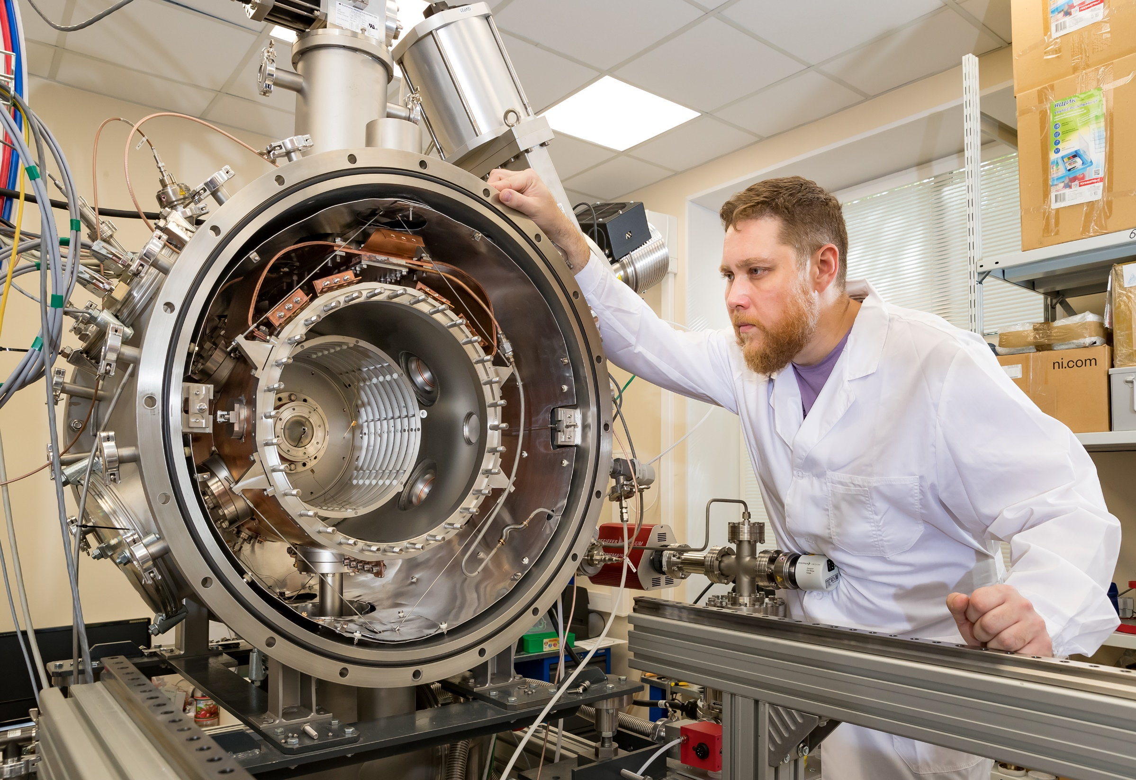
Thank you for attention

