Slide 1
Ural Federal University
& M.N. Mikheev Institute of Metal Physics
Ural Branch of Russian Academy of Sciences
Ekaterinburg, Russia
Topology of the band structure and magnetic properties of RSb and RNiSb materials with R = Gd, Tb, Dy
Semyon T. Baidak
baidak@imp.uran.ru
XXVII International Scientific Conference of Young Scientists and Specialists (AYSS-2023), Oct 30 – Nov 3, 2023
Dubna

Slide 2
Co-authors
Roman D. Mukhachev
M.N. Mikheev Institute of Metal Physics of Ural Branch of Russian Academy of Sciences, Ekaterinburg, Russia
Alexey V. Lukoyanov
M.N. Mikheev Institute of Metal Physics of Ural Branch of Russian Academy of Sciences,
& Ural Federal University, Ekaterinburg, Russia

Slide 3
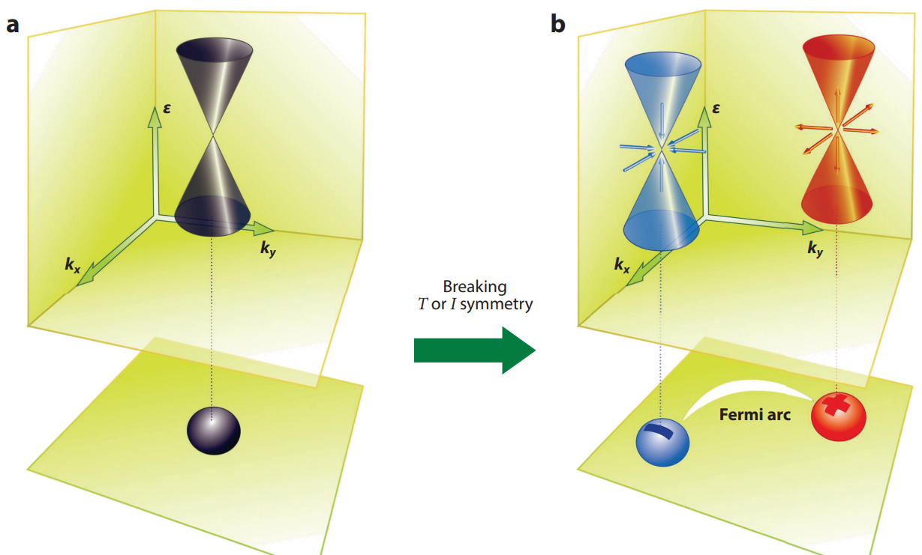
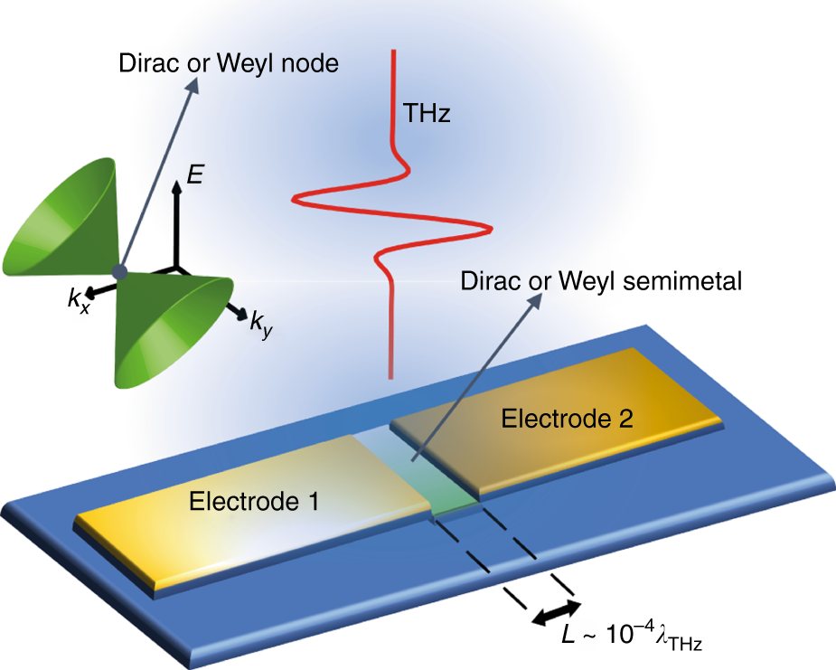
Introduction
Motivation to study RSb compounds
Topological features:
Band inversion
Dirac cones
Weyl fermions
Macroscopic properties:
Large magnetoresistance and other transport anomalies
Splitting of the Dirac cone into two Weyl cones.
[Annu. Rev. Condens. Matter Phys. 8, 289-309 (2017).]
Such materials could be used in quantum transistors, detectors, diodes, etc.
Schematic of the in-plane asymmetric device enabling an efficient low-energy photodetection. [Light Sci Appl 11, 124 (2022).]

Slide 4
Density functional theory (DFT)
Properties of the ground state of many-electron system are fully described by electron density
$$\left[−\frac{∇^{2}}{2}+V_{ion}\left(\vec{r}\right)+\int{\frac{n\left(\vec{r^{′}}\right)}{\left|\vec{r}−\vec{r^{′}}\right|}d\vec{r^{′}}}+V_{xc}\left[n\right]\left(\vec{r}\right)\right]φ_{i}\left(\vec{r}\right)=ε_{i}φ_{i}\left(\vec{r}\right)$$
Kohn-Sham equation:
$$n\left(\vec{r}\right)=\sum_{i}^{N}{{\left|φ_{i}(\vec{r})\right|}^{2}}$$
Electron density distribution:
$$V_{xc}\left[n\right]\left(\vec{r}\right)=\frac{δE_{xc}\left[n\right]}{δn\left(\vec{r}\right)}$$
Exchange-correlation potential:
$$E_{xc}^{GGA}\left[n\right]=\int{n\left(\vec{r}\right)ε_{xc}\left(n\left(\vec{r}\right),∇n\left(\vec{r}\right)\right)}d\vec{r}$$
GGA approximation:

Slide 5
Methods
The electronic structure calculations were conducted in the framework of DFT [1] in Quantum Espresso package [2] using GGA+U version of LSDA+U method [3]. The exchange correlation potential was employed in generalized gradient approximation (GGA) of Perdew-Burke-Ernzerhof (PBE) [4].
The Hund’s parameters (J) for Gd, Tb and Dy are 0.7 eV. The direct Coulomb interaction values (U) for Gd, Tb and Dy are 6.7, 5.4 and 5.8 eV respectively, for details see [5].
[1] Density Functional Theory of Atoms and Molecules, Oxford University Press (1989).
[2] J. Phys.: Condens. Matter. 21, 395502 (2009).
[3] Phys. Rev. B 44, 943 (1991).
[4] Phys. Rev. Lett. 77, 3865 (1996).
[5] Materials 16, 242 (2023).

Slide 6
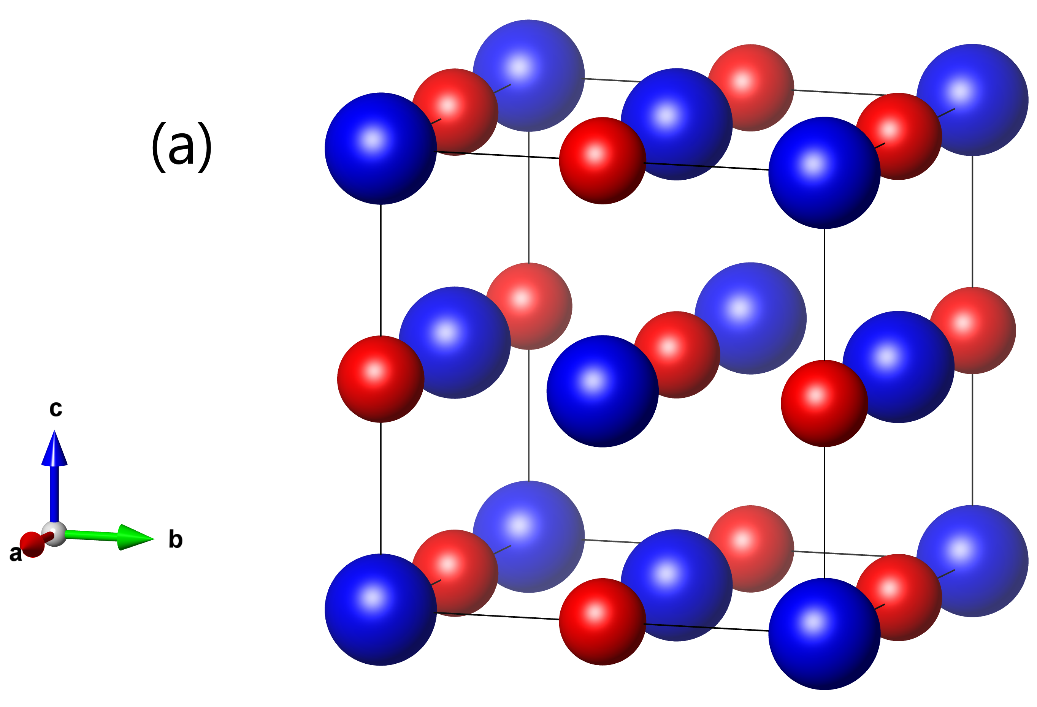
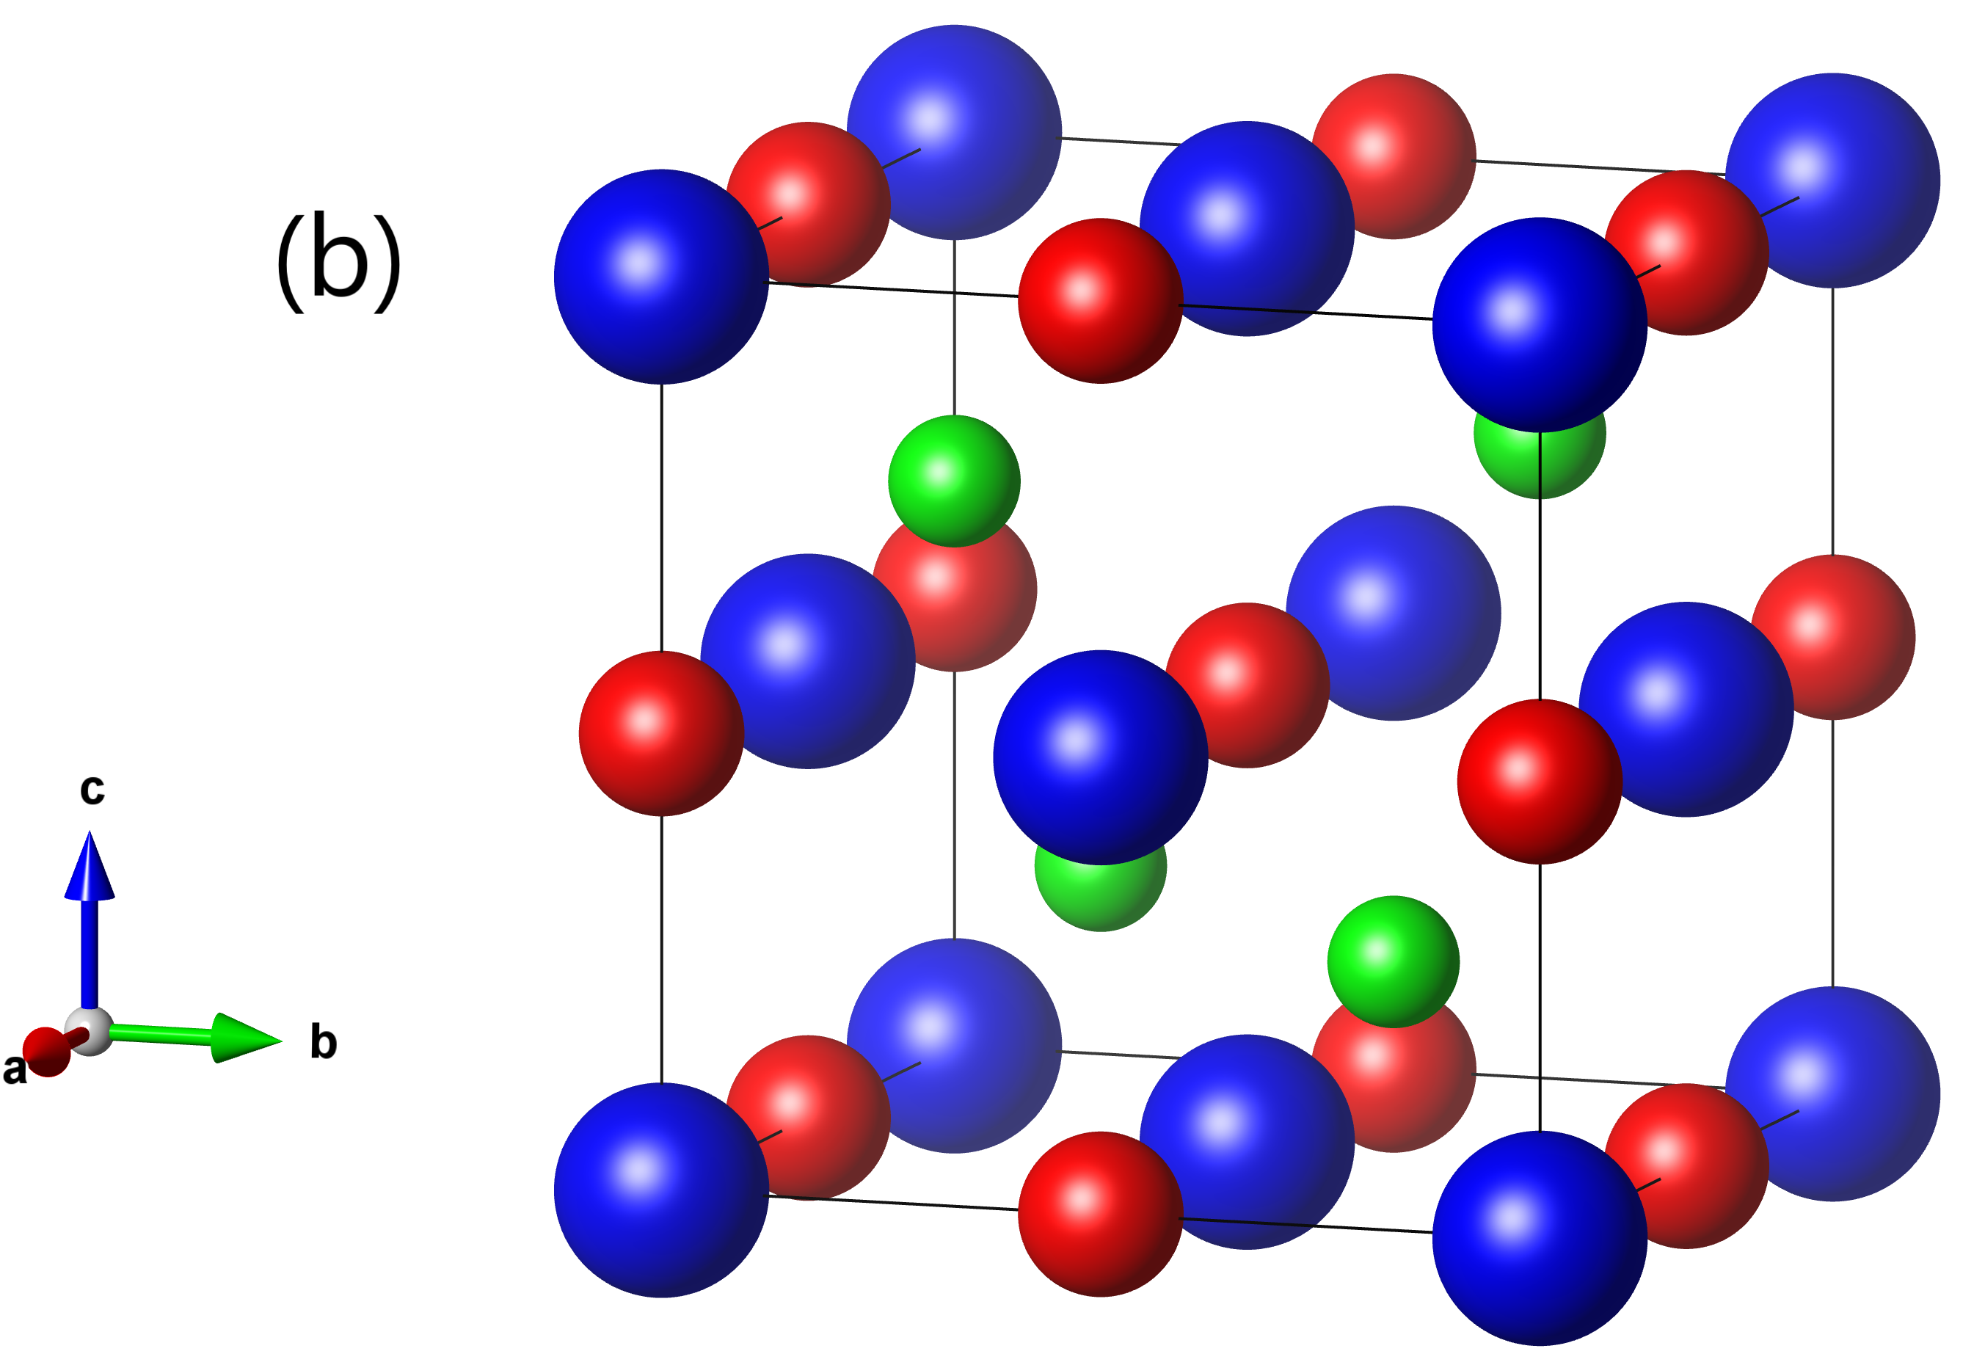
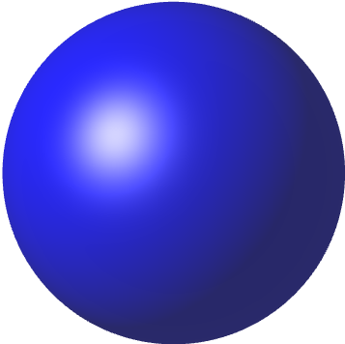
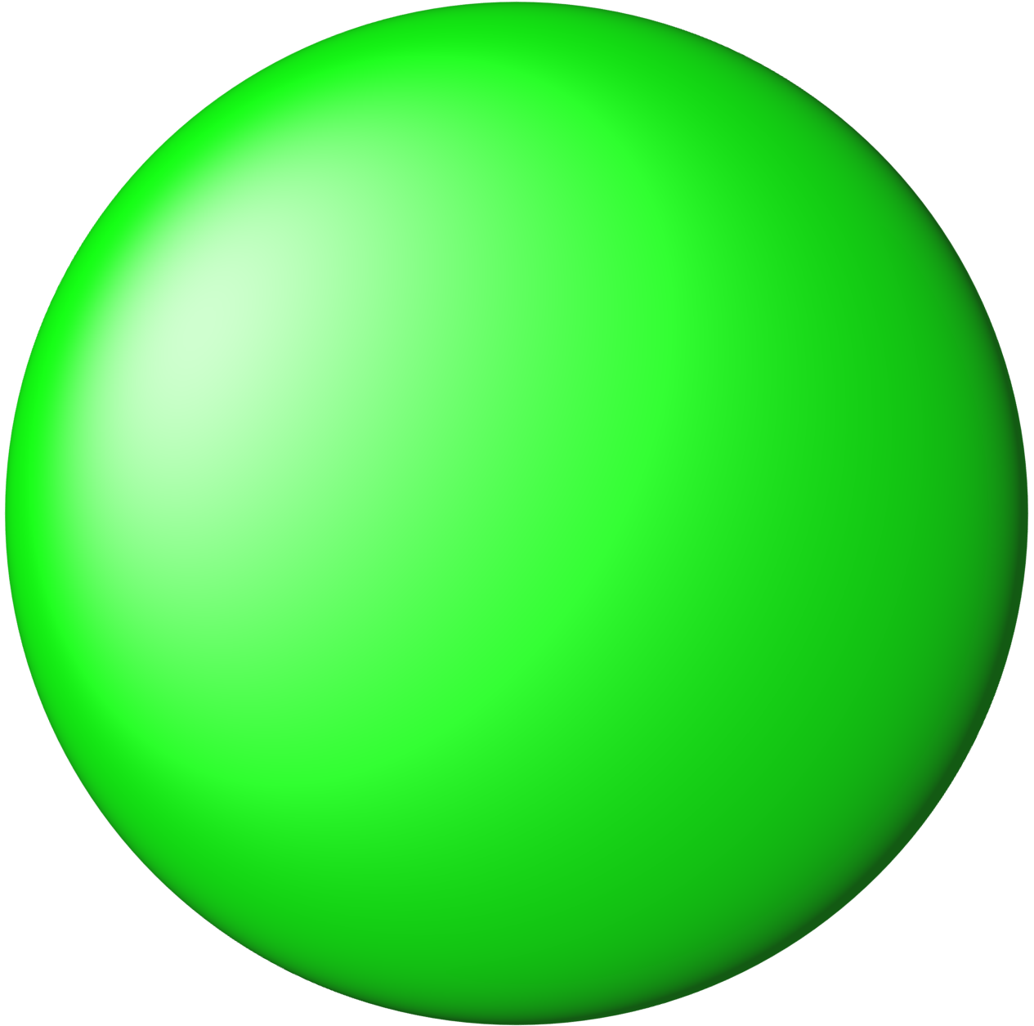
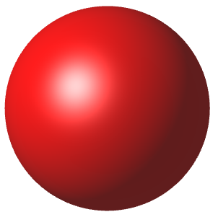
Crystal structure
RSb
RNiSb
Lattice parameters
Compound | Space Group (No.) | Lattice Parameters (Å)
 |  | a | b | c
GdSb [1] | 225 | 6.210 | 6.210 | 6.210
TbSb [1] | 225 | 6.170 | 6.170 | 6.170
DySb [1] | 225 | 6.150 | 6.150 | 6.150
GdNiSb [2] | 216 | 6.324 | 6.324 | 6.324
TbNiSb [2] | 216 | 6.304 | 6.304 | 6.304
DyNiSb [2] | 216 | 6.298 | 6.298 | 6.298
R
Ni
Sb
[1] J. Less Common Metals, 166, 221–227 (1990).
[2] J. Alloys Compd., 226, 81–86 (1995).

Slide 7
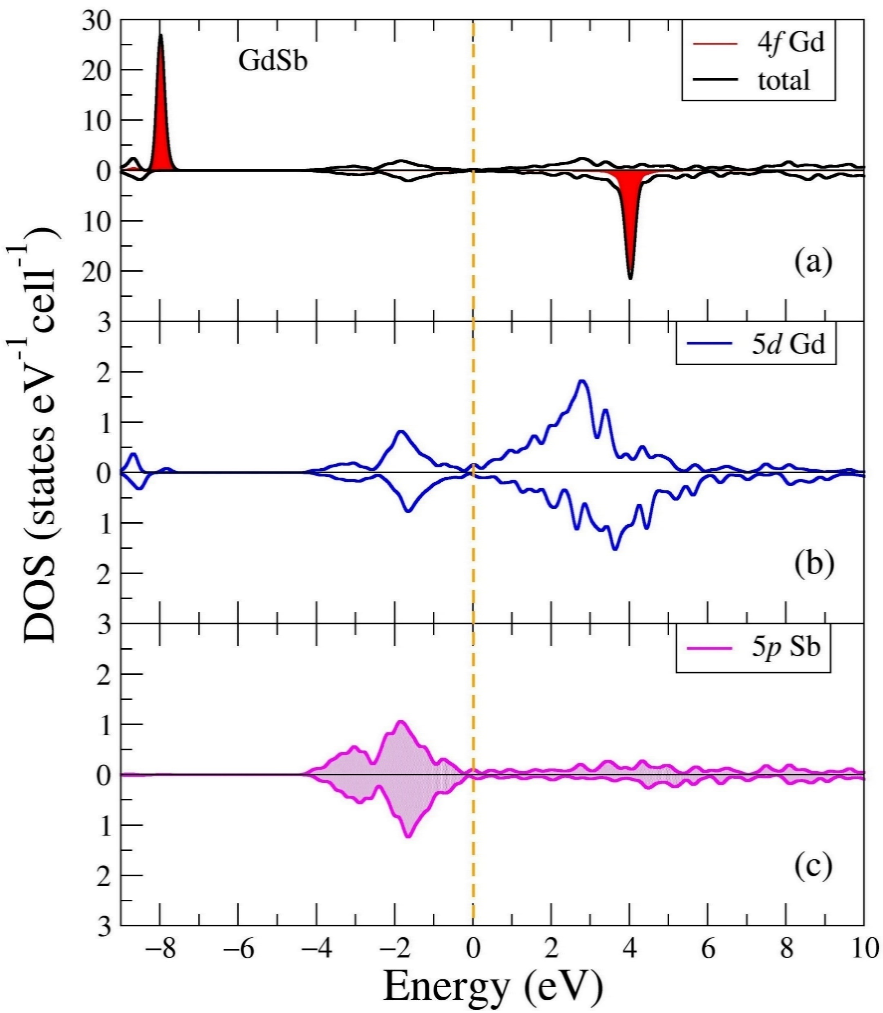
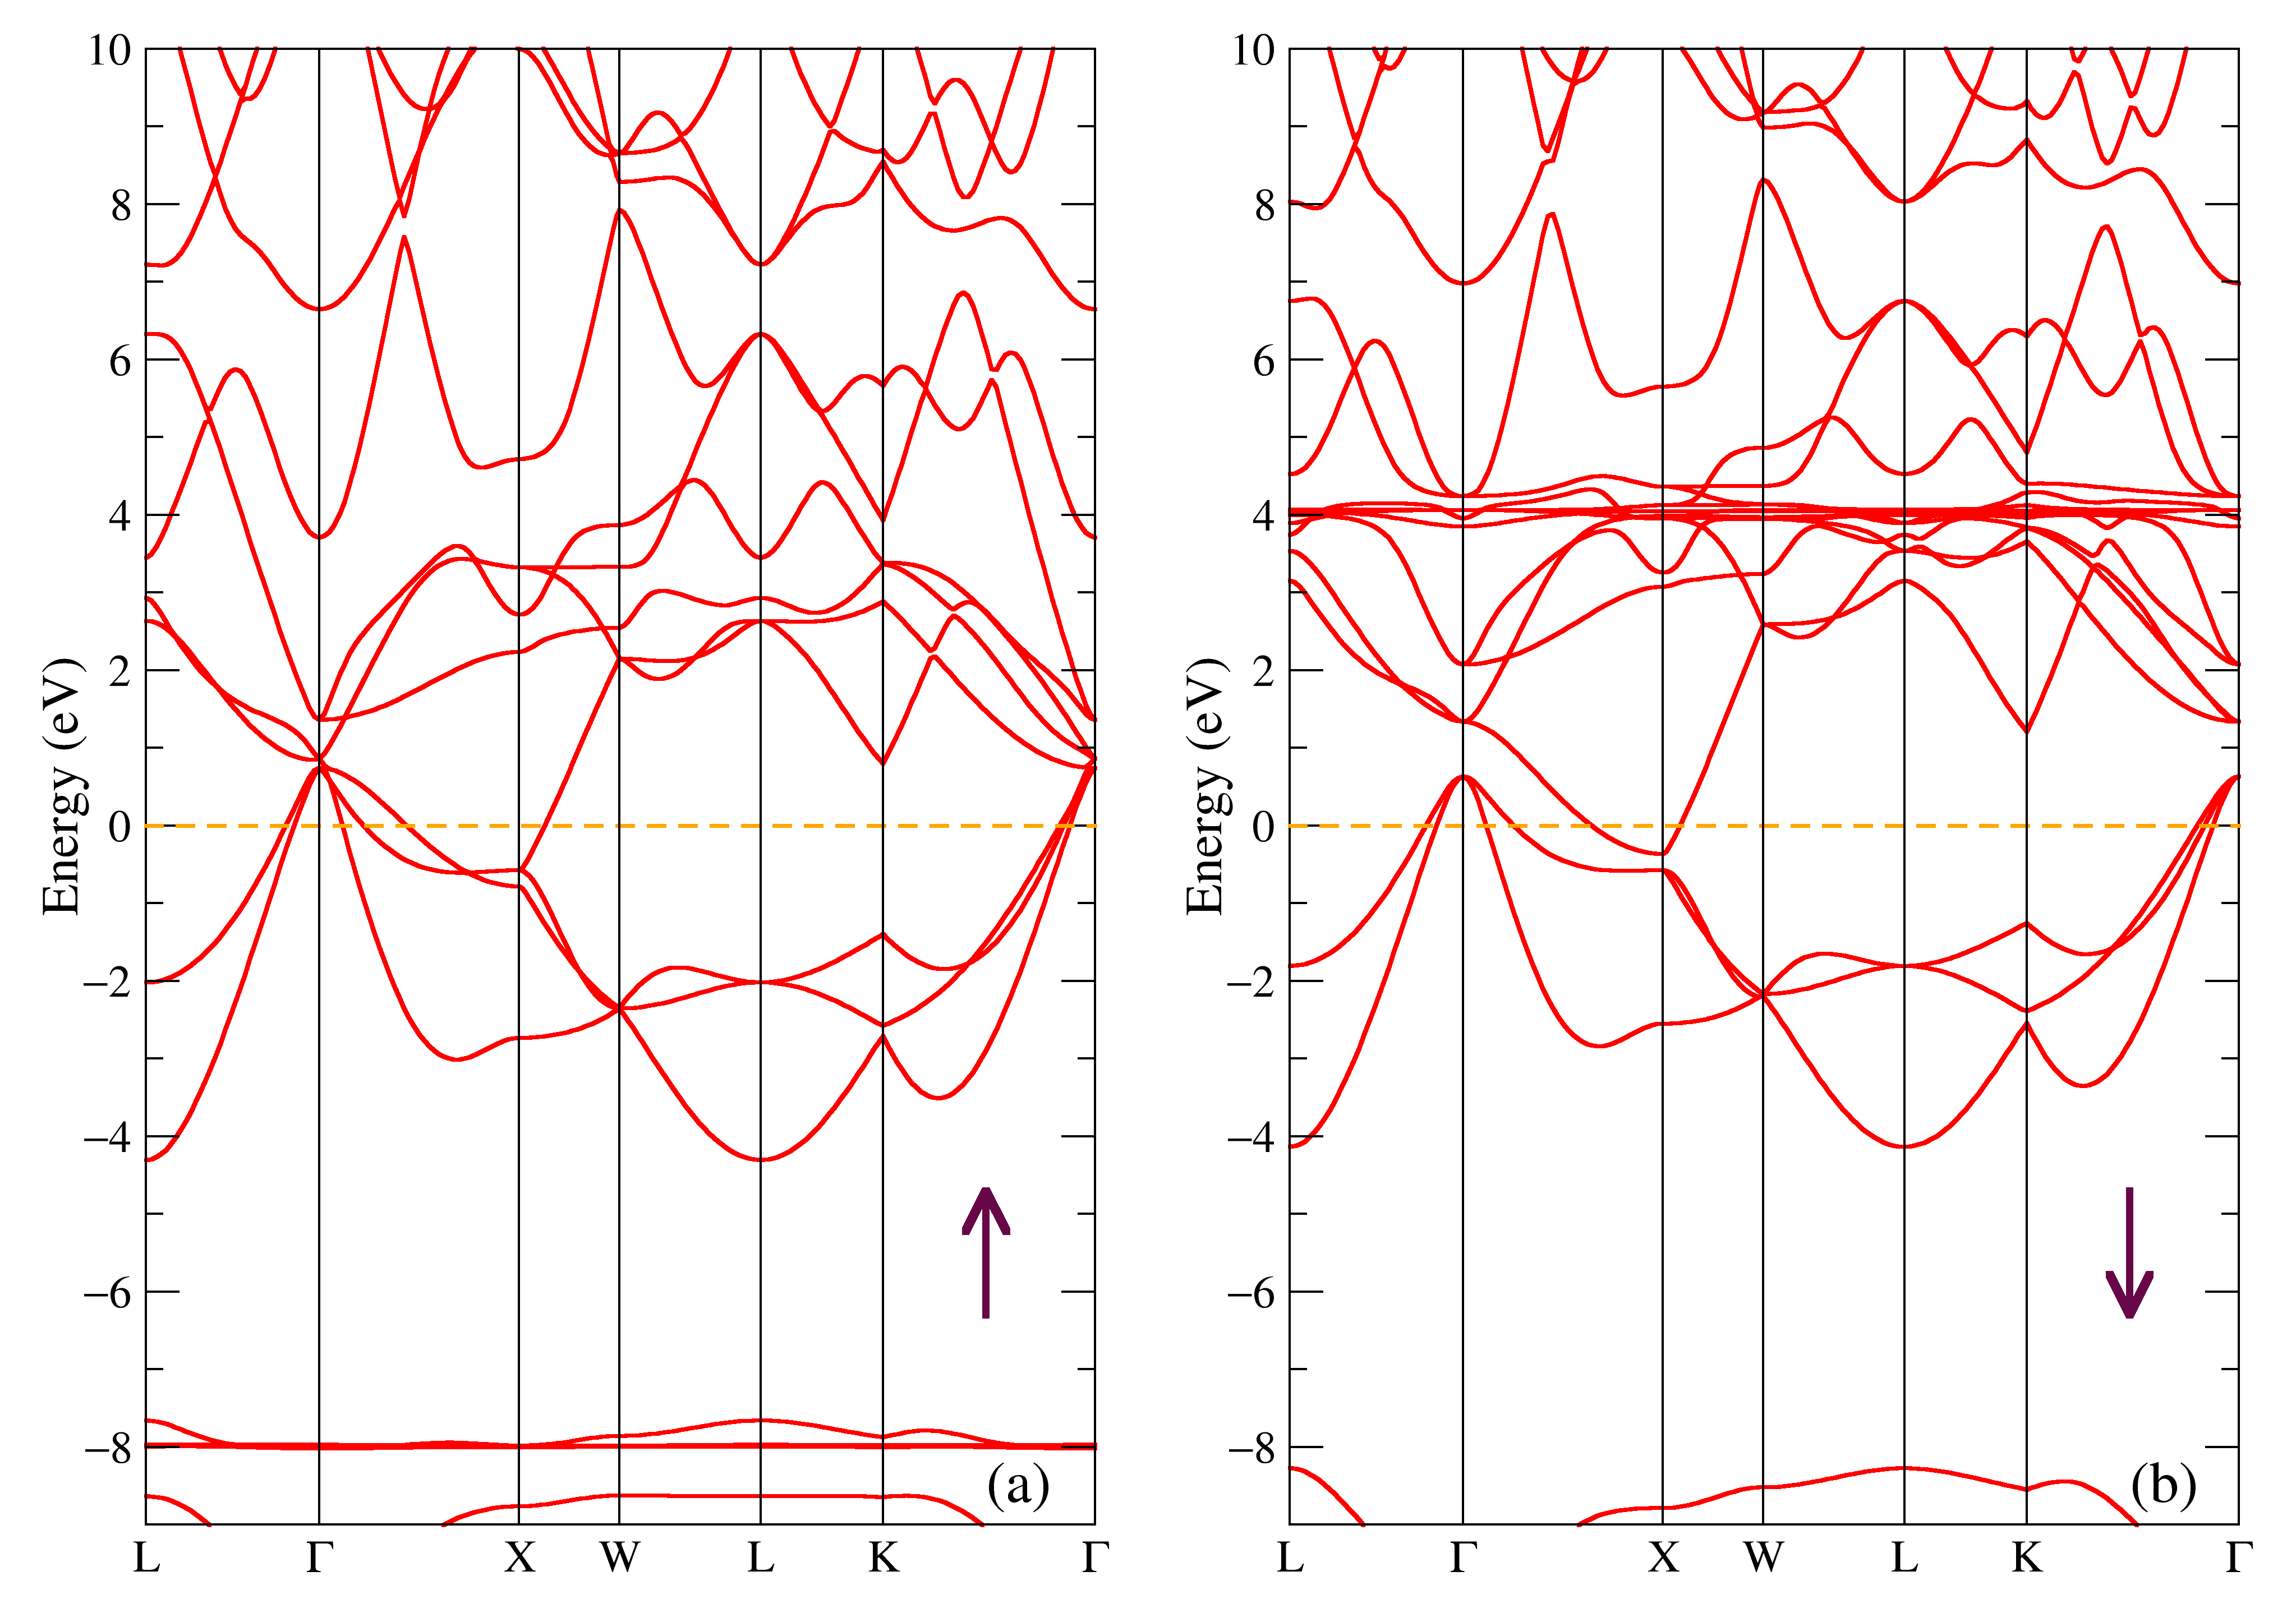
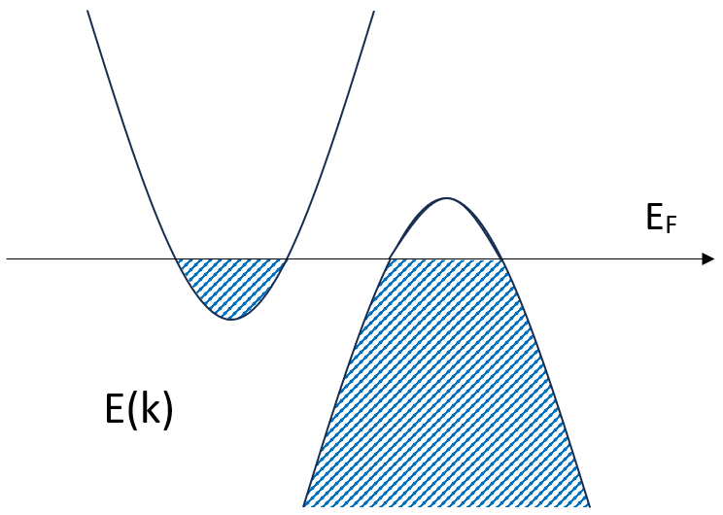
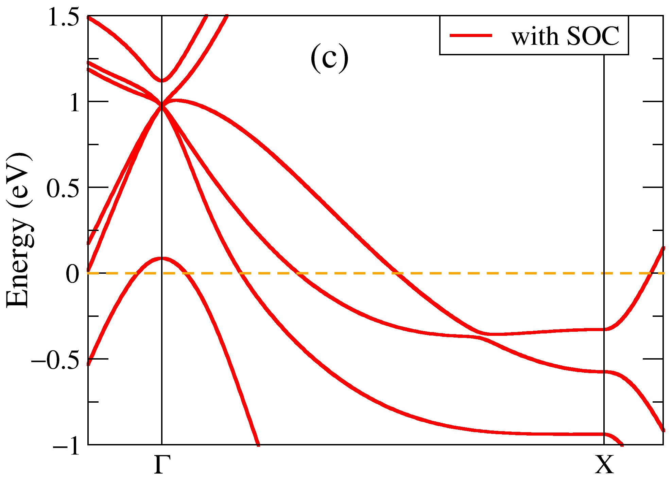
Electronic structure of GdSb
semimetal
From the band structure we find that GdSb is a semimetal. The electron pocket along Γ–X–W direction and hole pockets along the L–Γ–X direction were found in good agreement with the ARPES data [PRB 96, 035134 (2017)].

Slide 8
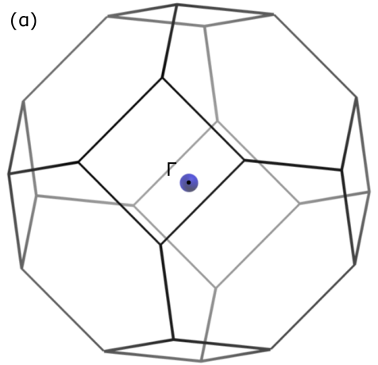
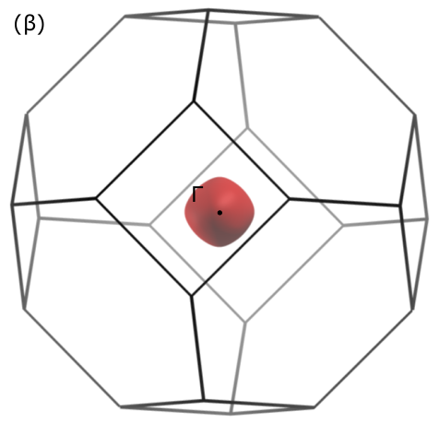
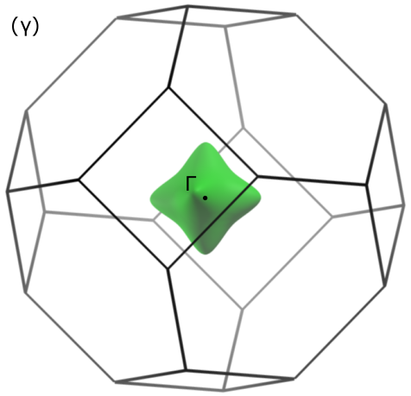
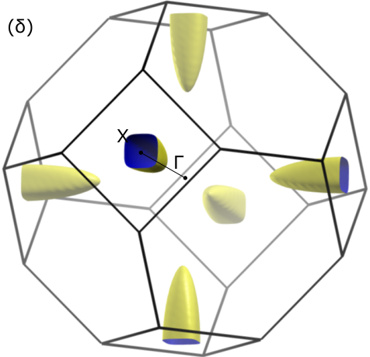
Fermi surfaces of GdSb
The number of spherical surfaces around the high-symmetry point Г and the parabolic Fermi surface near the point X.

Slide 9
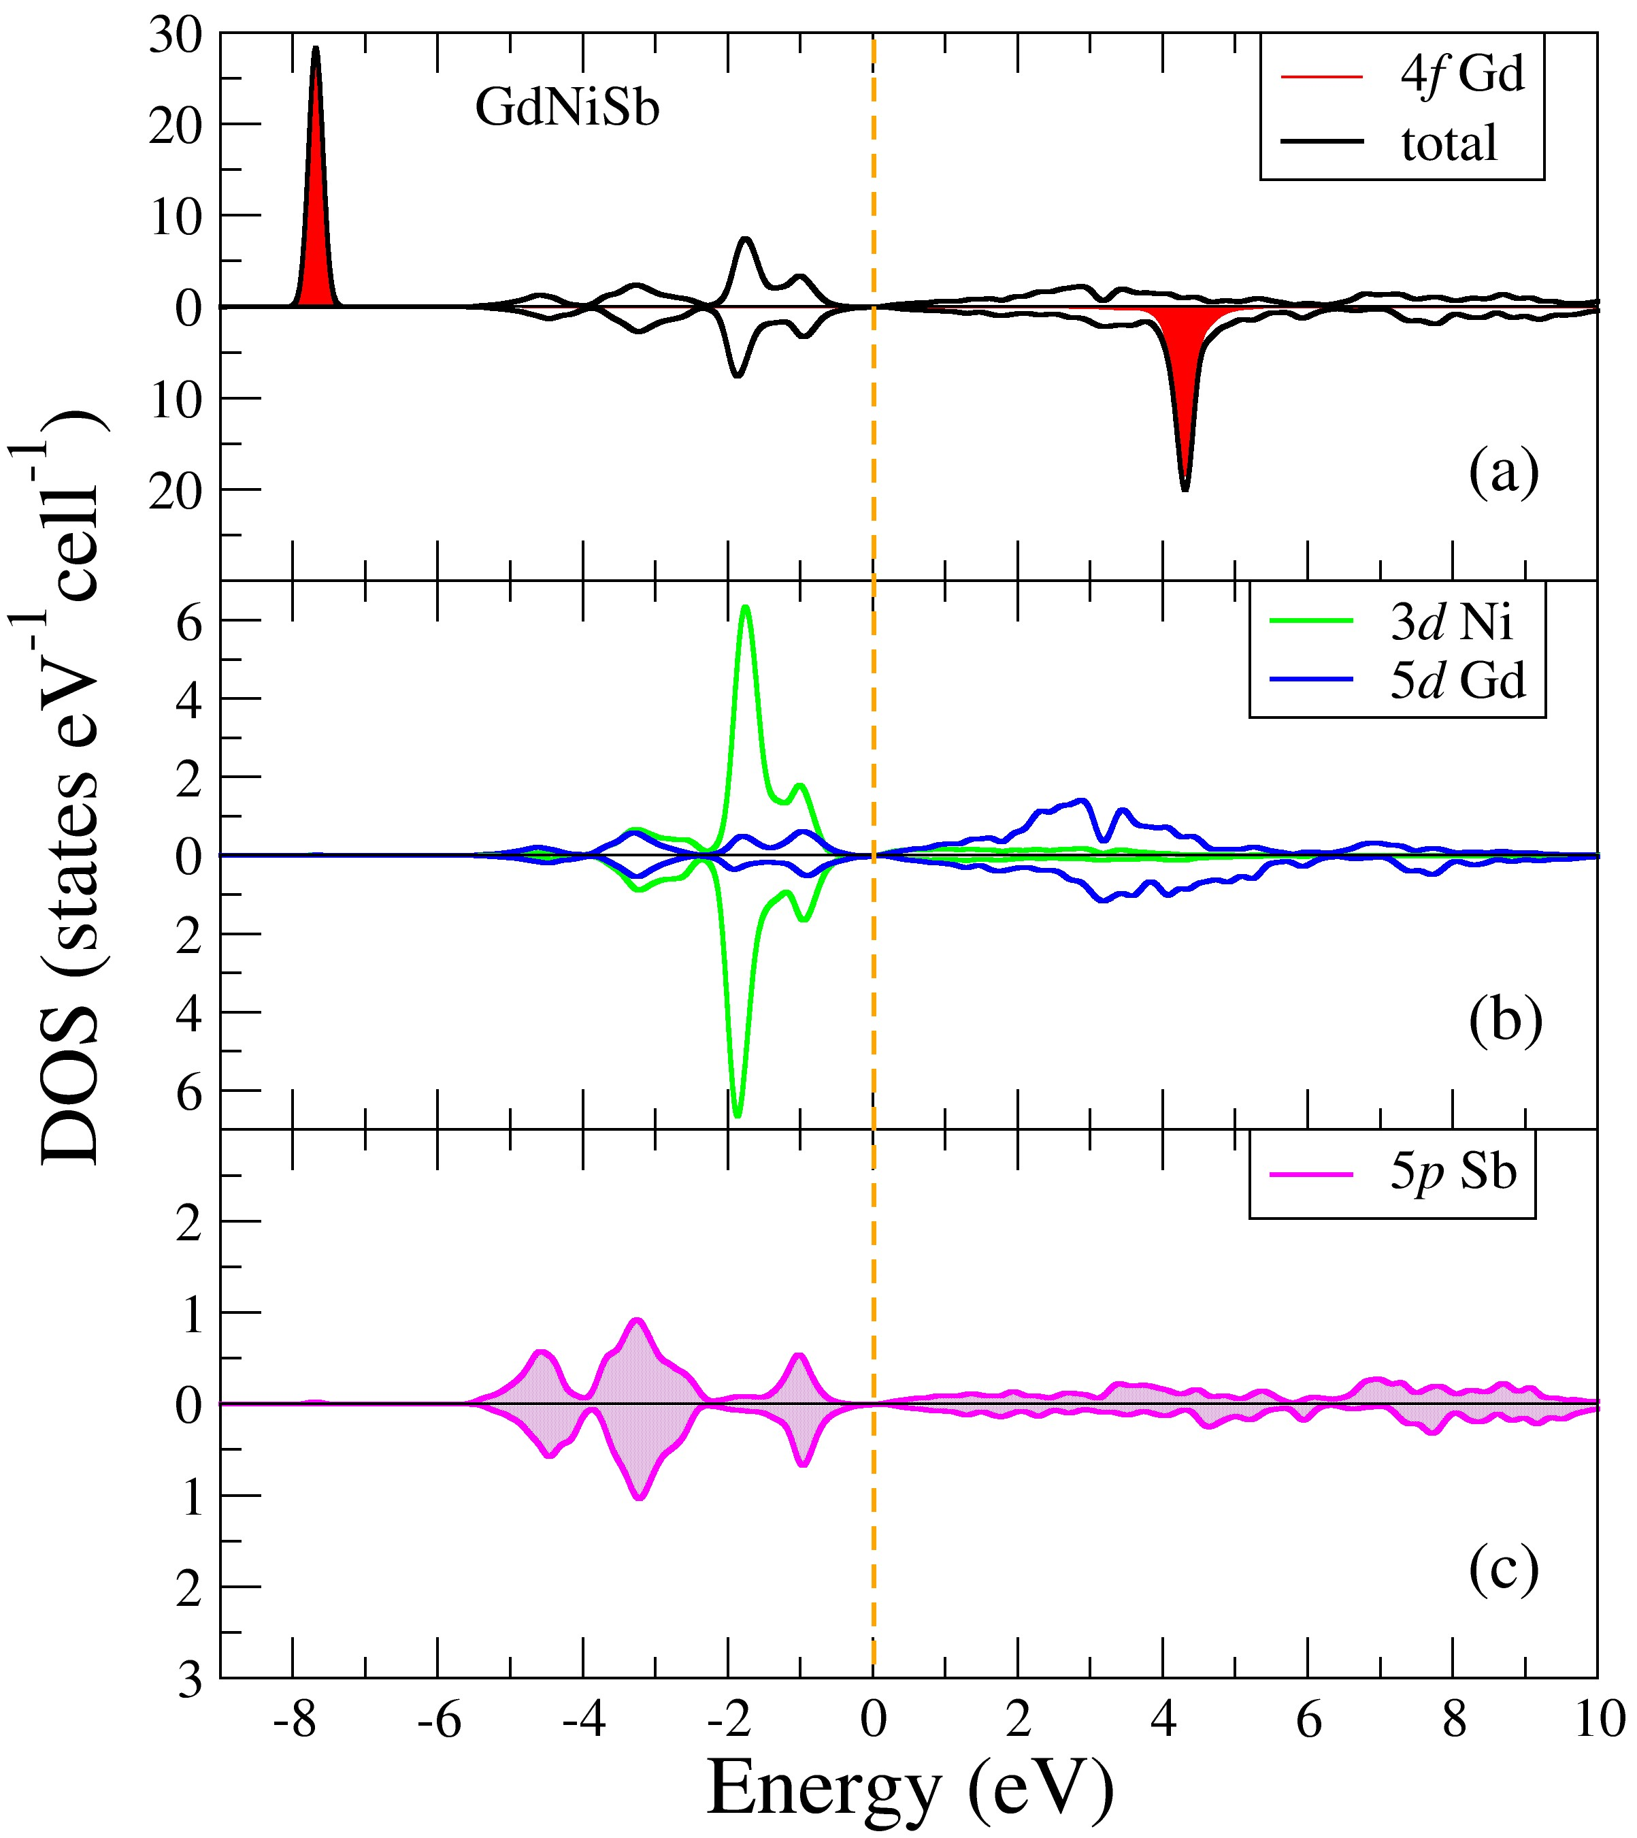
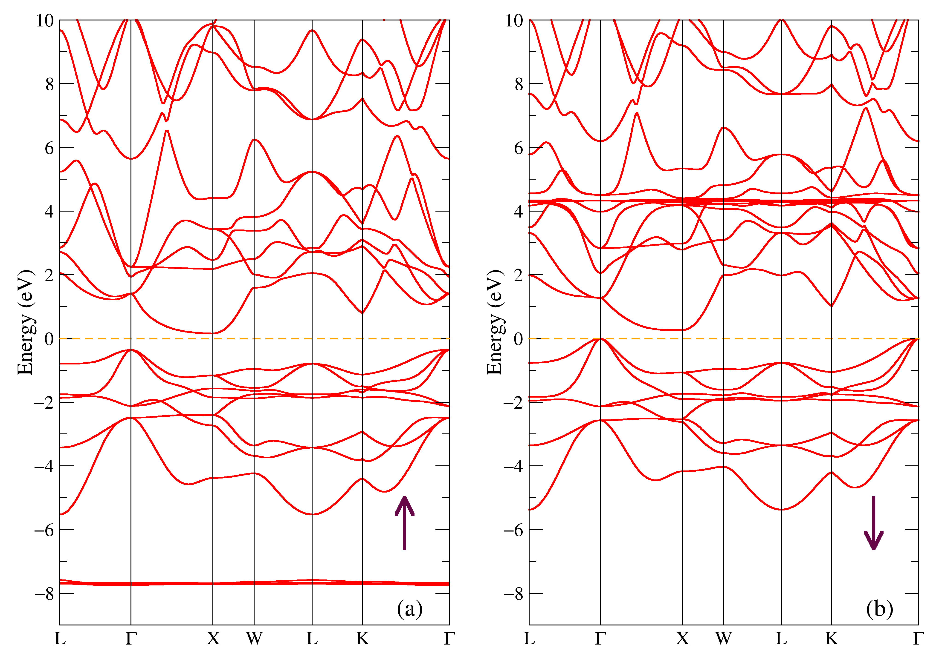
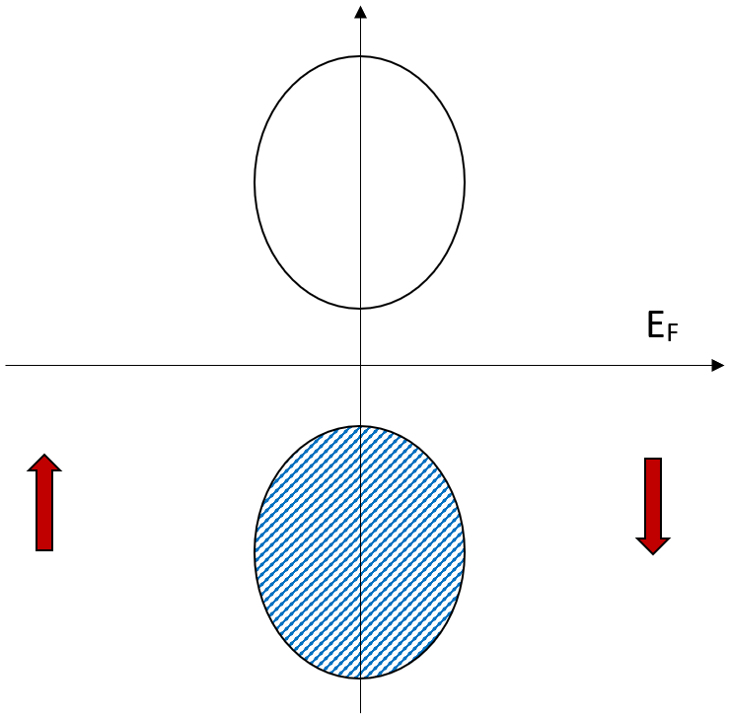
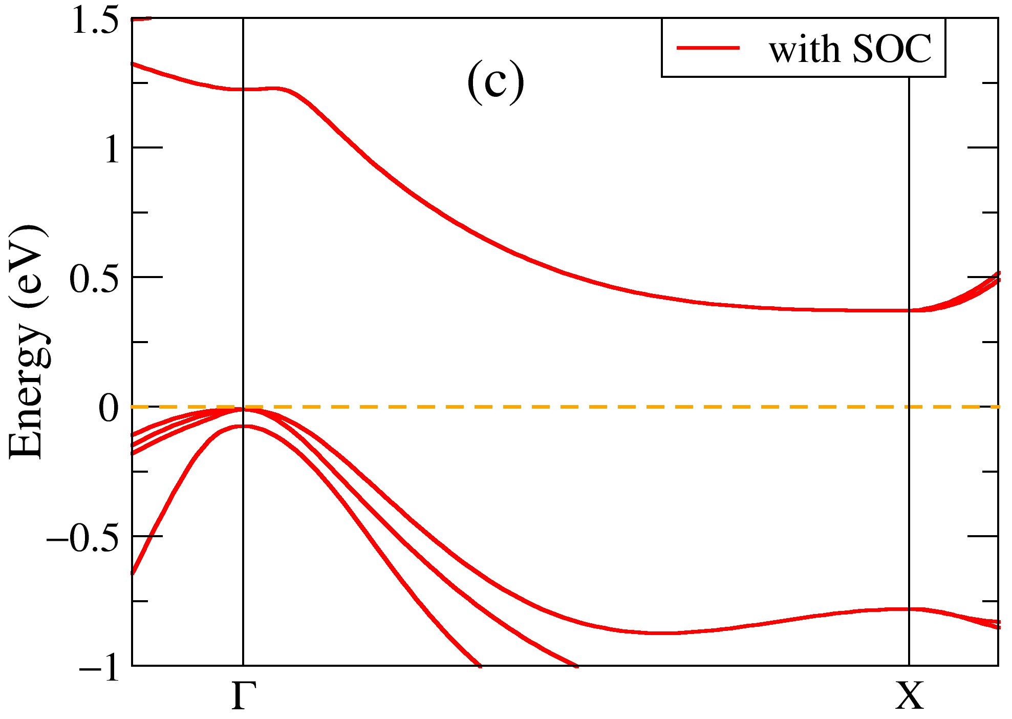
Electronic structure of GdNiSb
semiconductor
$$E_{g↑}=0.52 eV E_{g↓}=0.26 eV E_{g(SOC)}=0.38 eV$$
In the band structure the indirect gap between points Г and X is clearly seen and thus GdNiSb is a semiconductor.

Slide 10
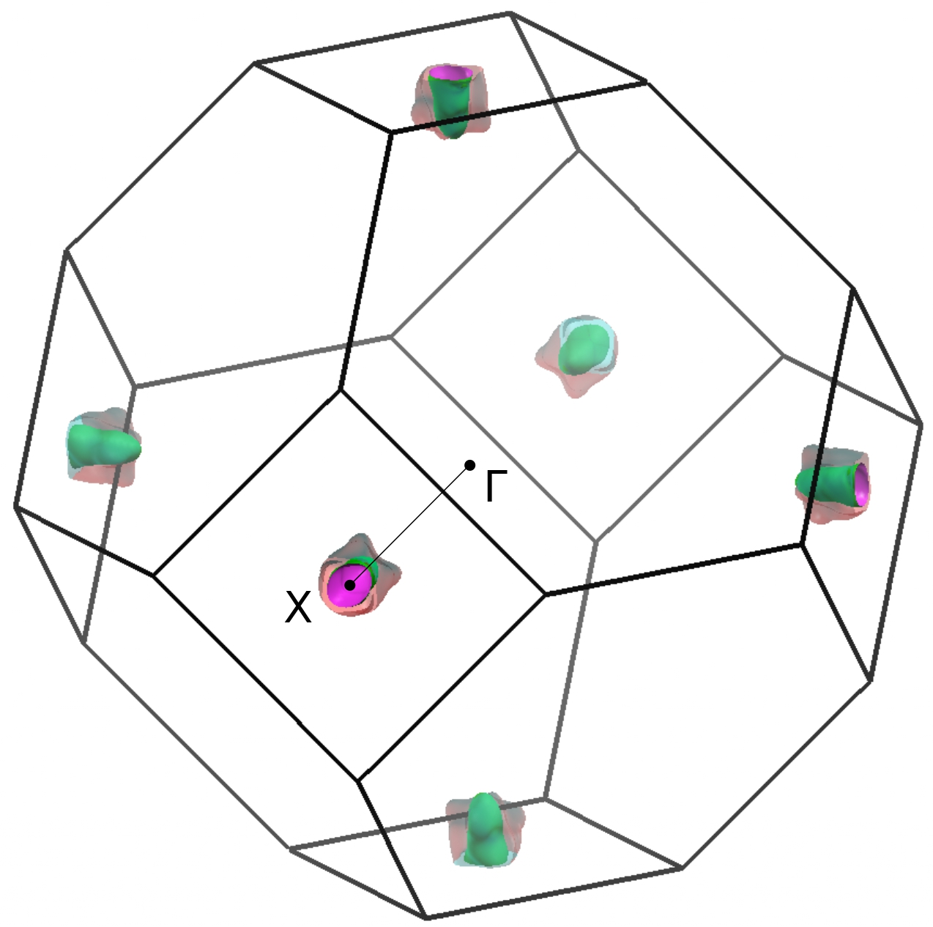
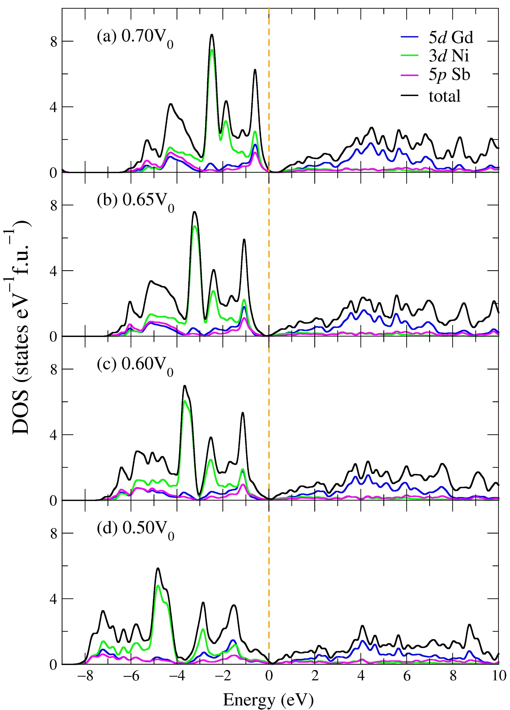
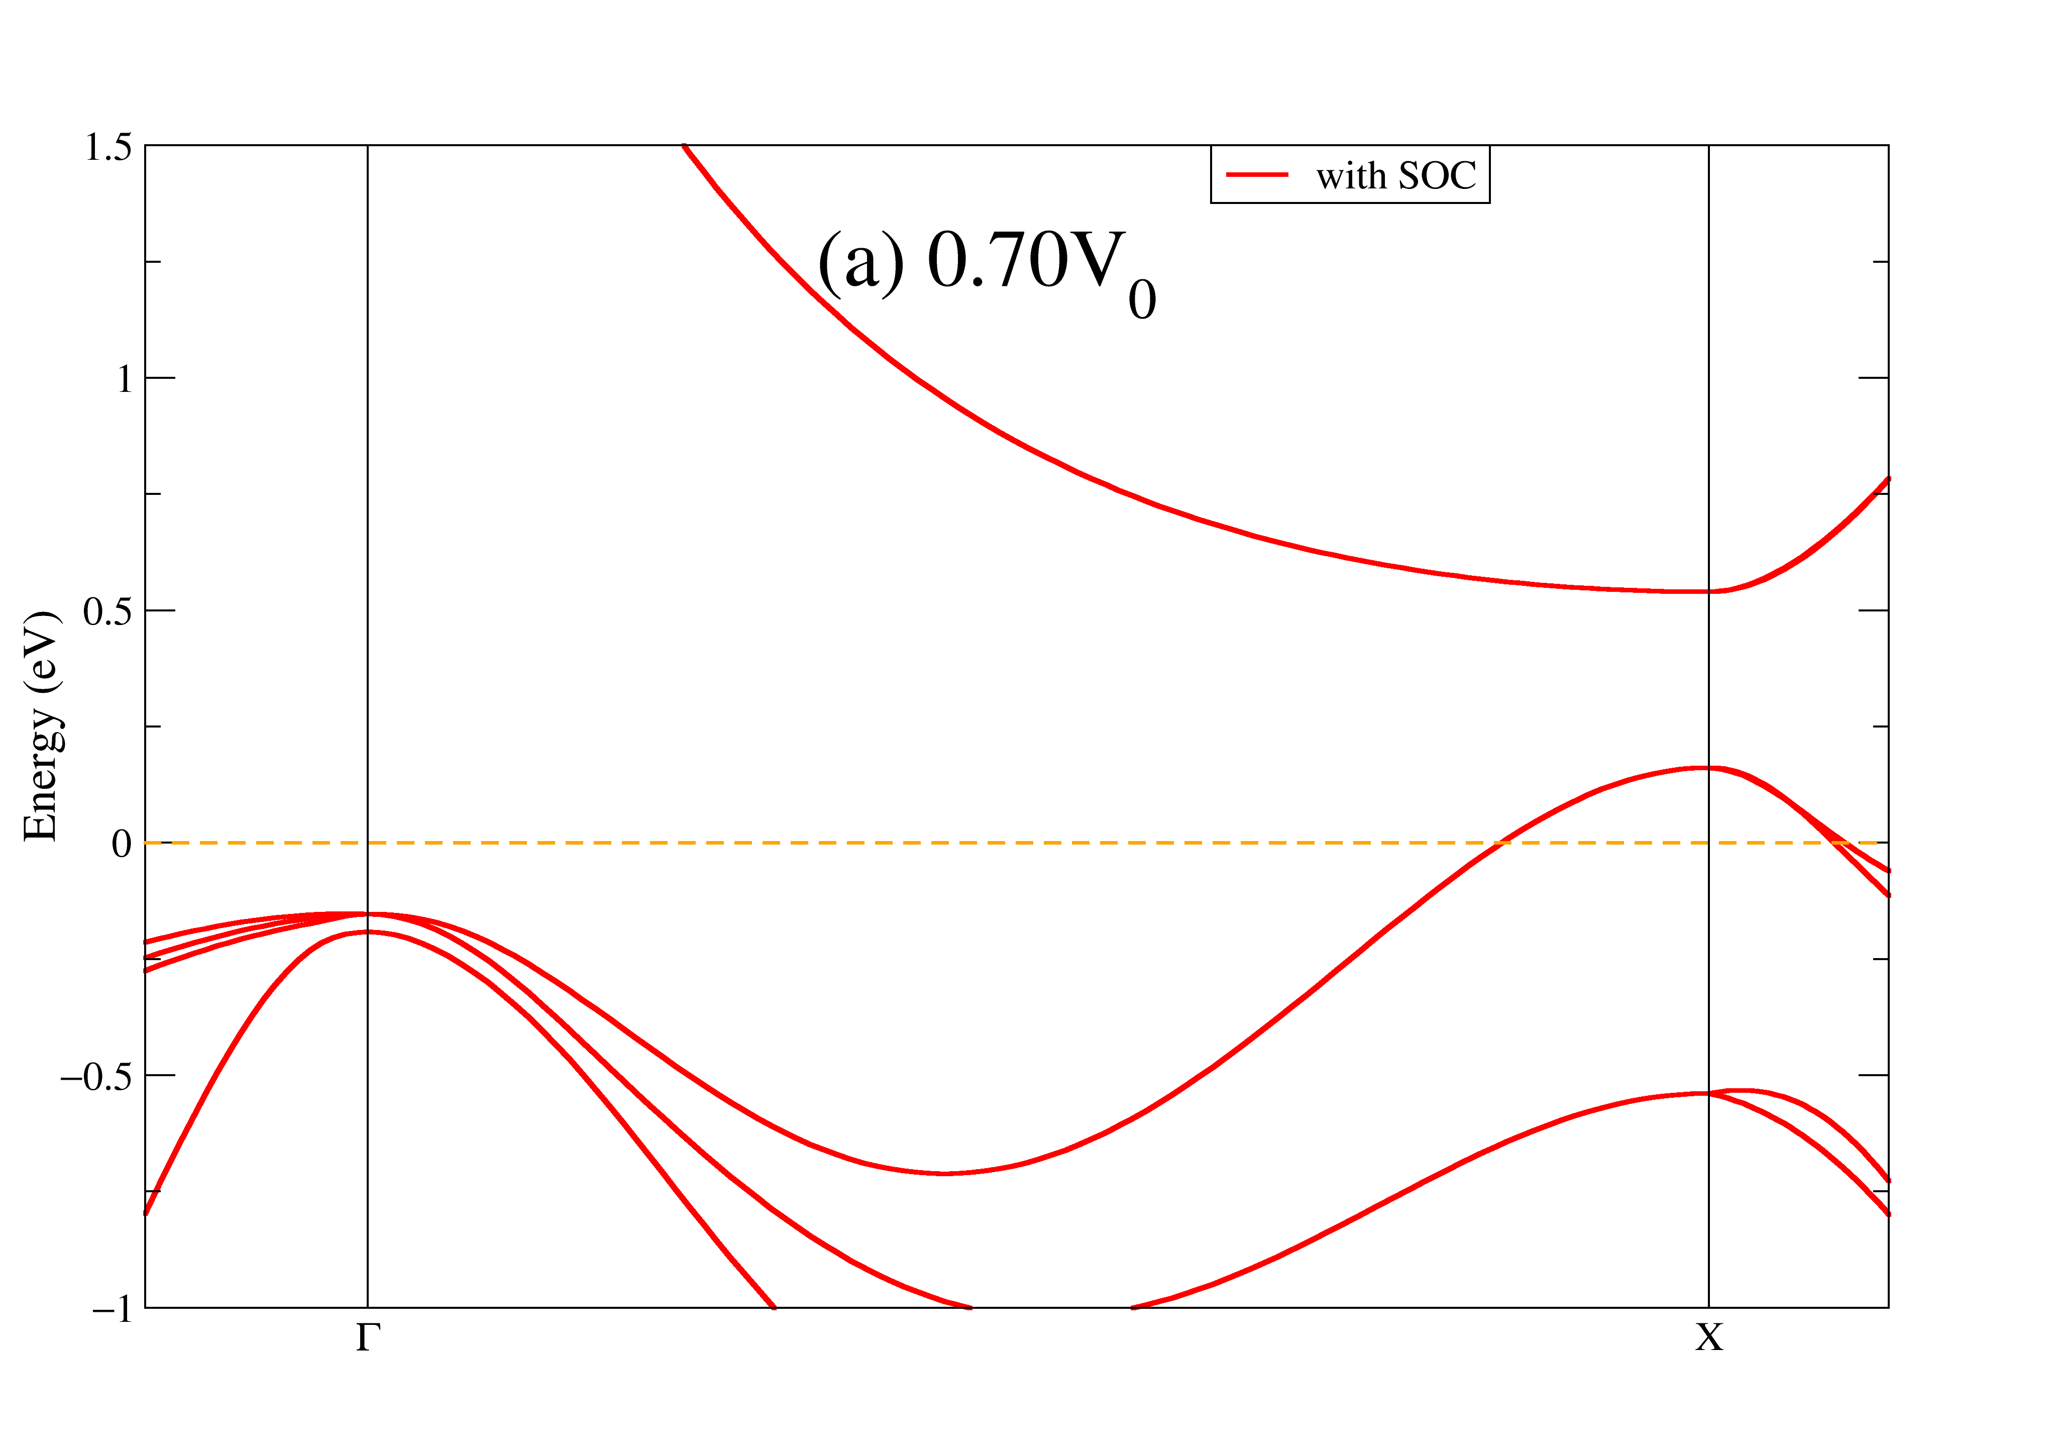
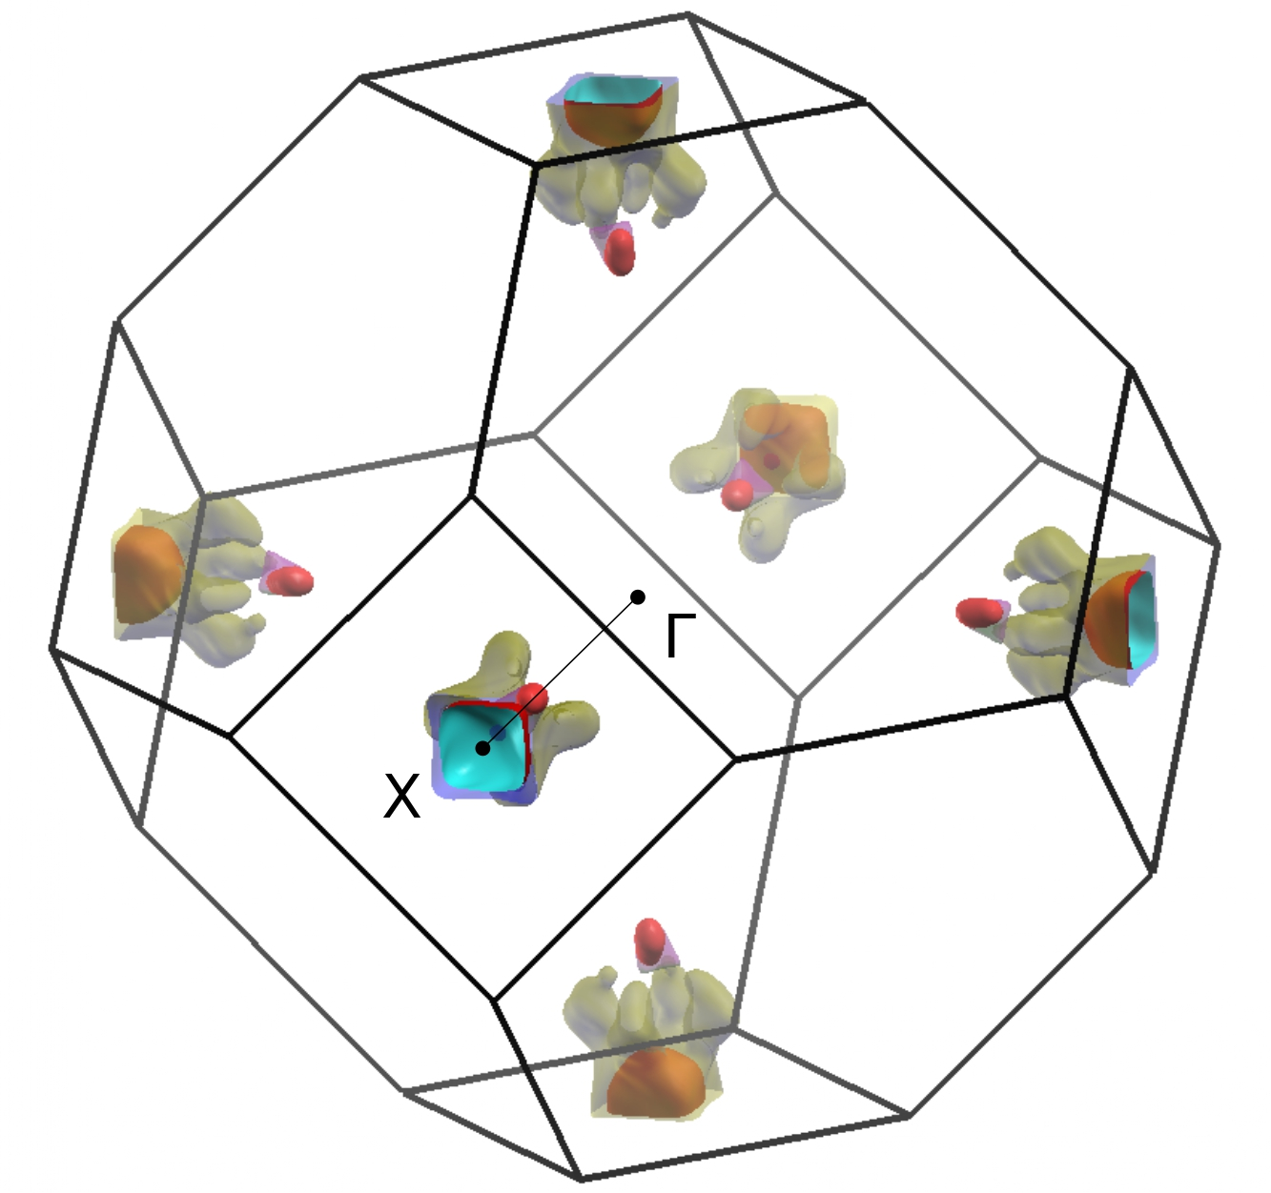
GdNiSb under pressure
(c) 0.60V₀
(d) 0.50V₀
transition
GdNiSb can undergo a semiconductor-to-metal transition under pressure

Slide 11
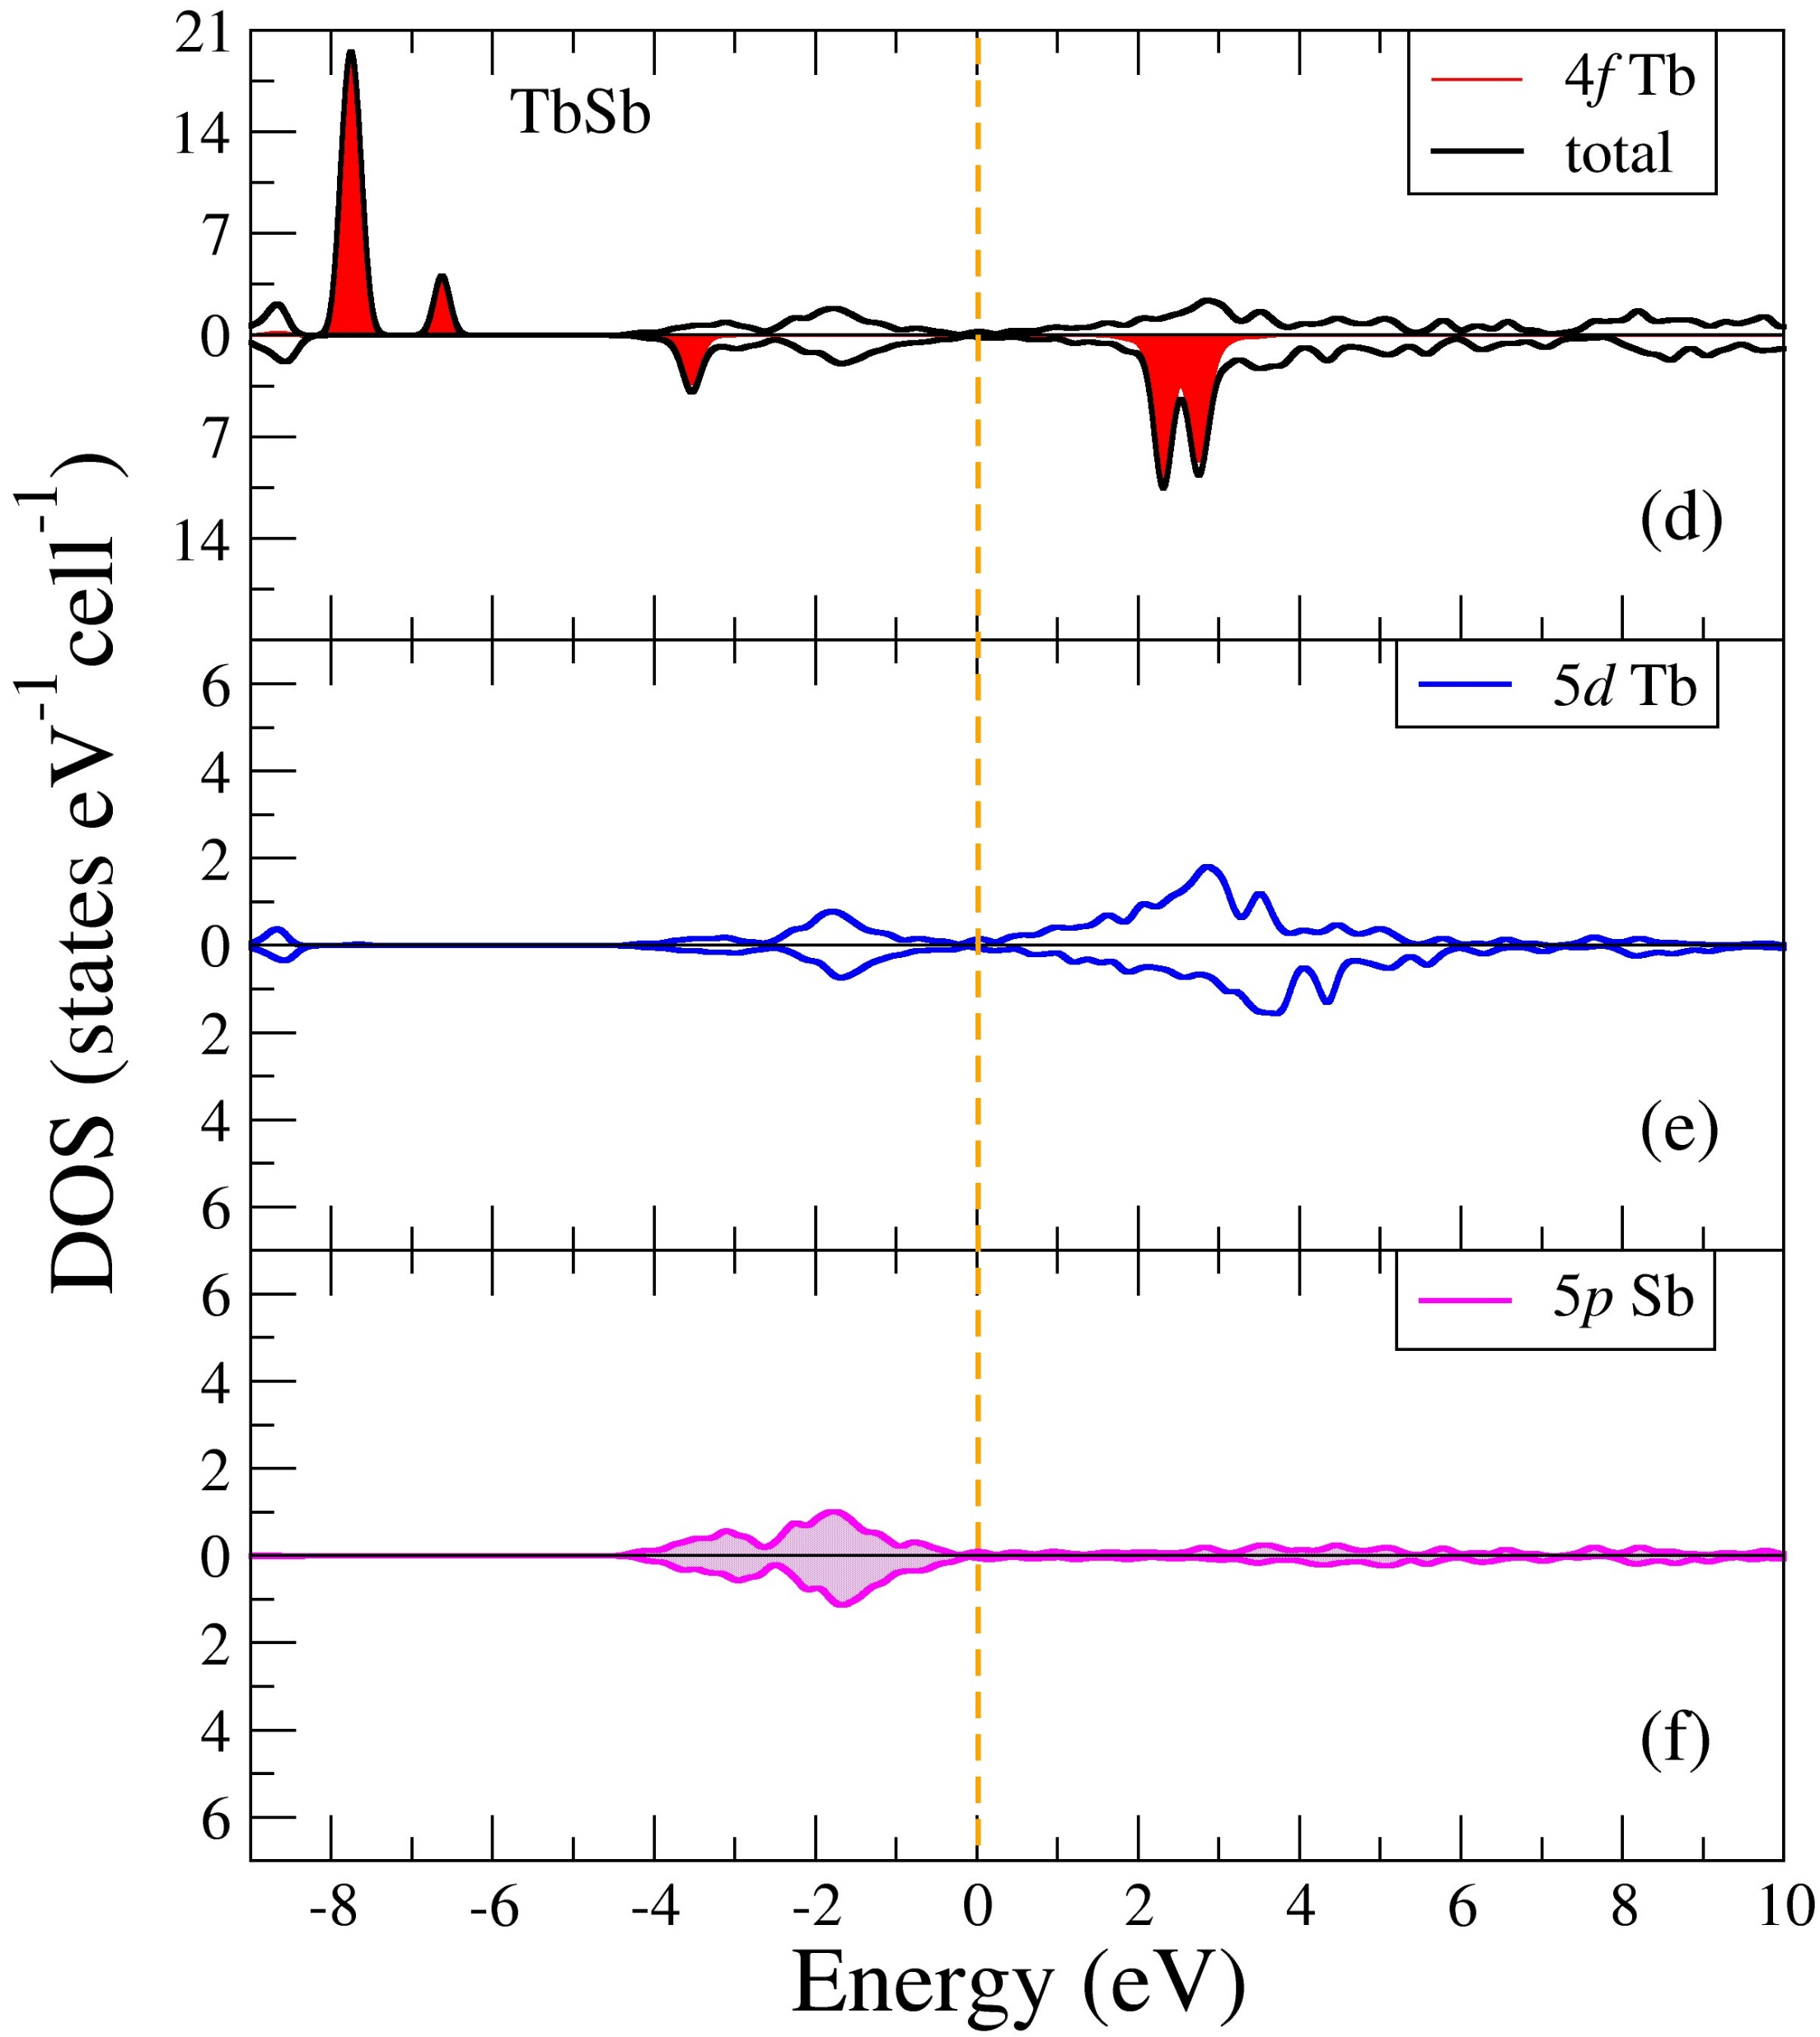
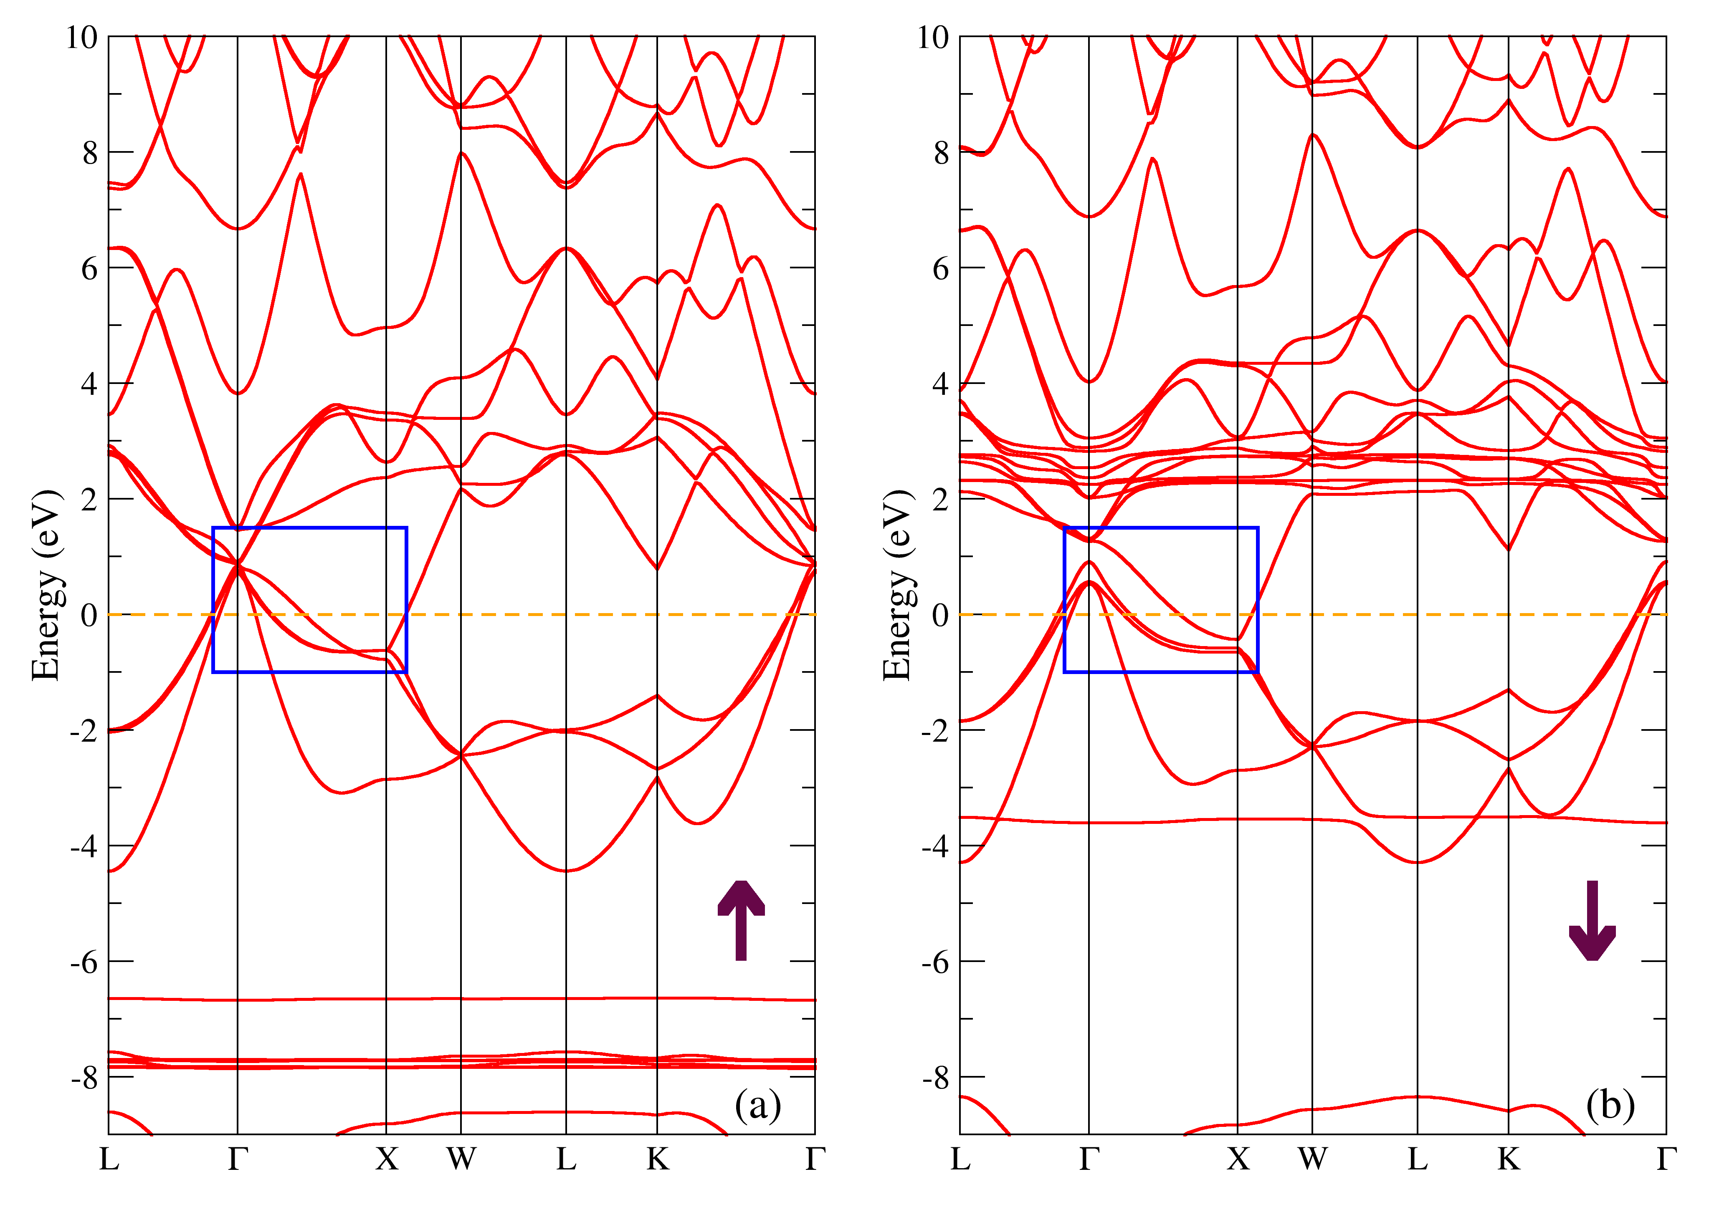
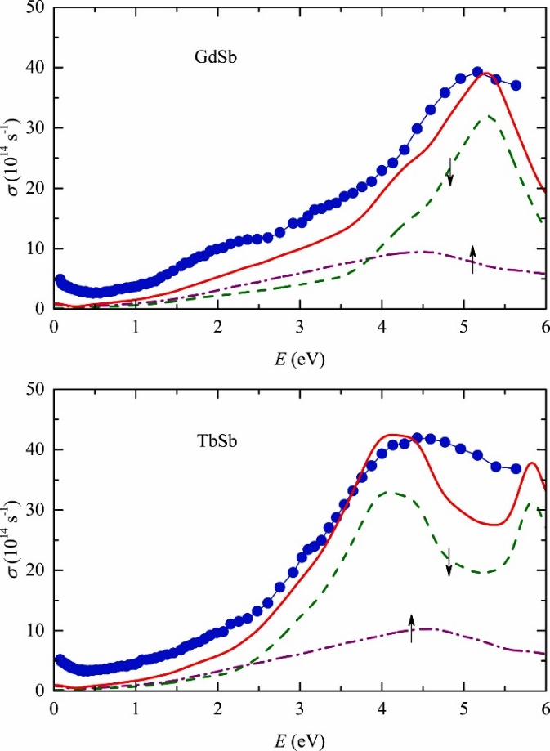
Electronic structure of TbSb
Optical conductivity spectra
$$E_{g↓}=0.67 eV$$
From the band structure we find that TbSb is a semimetal with the electron pocket and hole pockets. Optical conductivity spectra are in good agreement with experimental data [Solid State Sci. 136, 107085 (2023)].

Slide 12
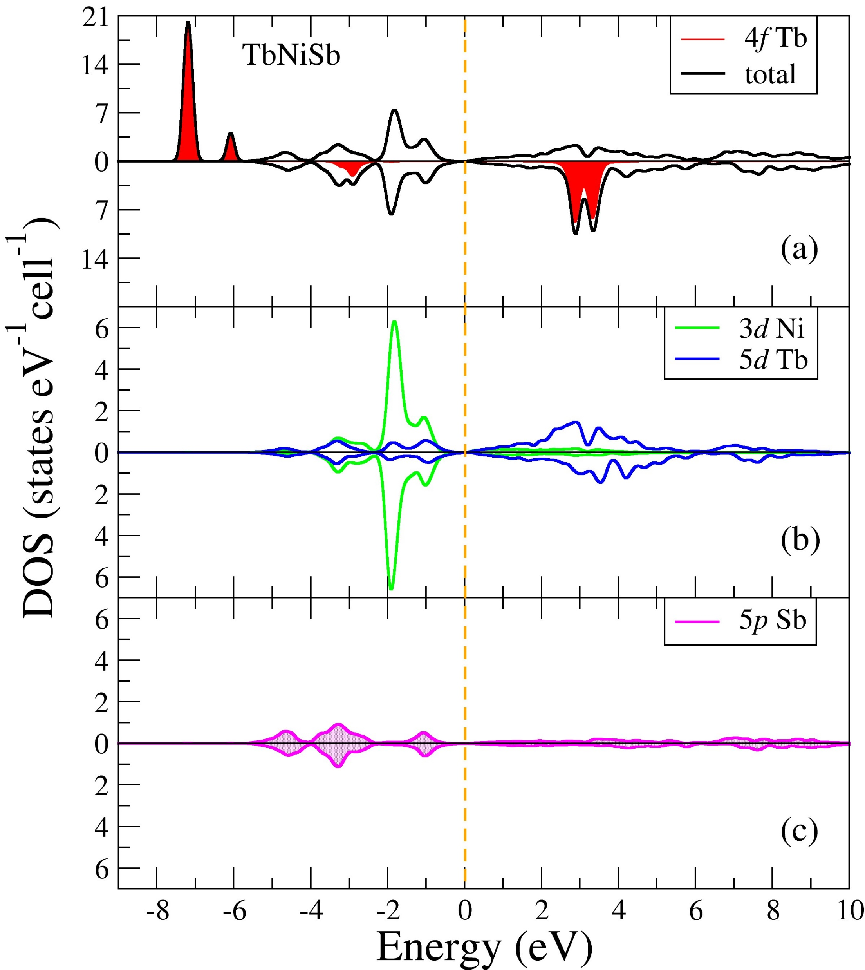
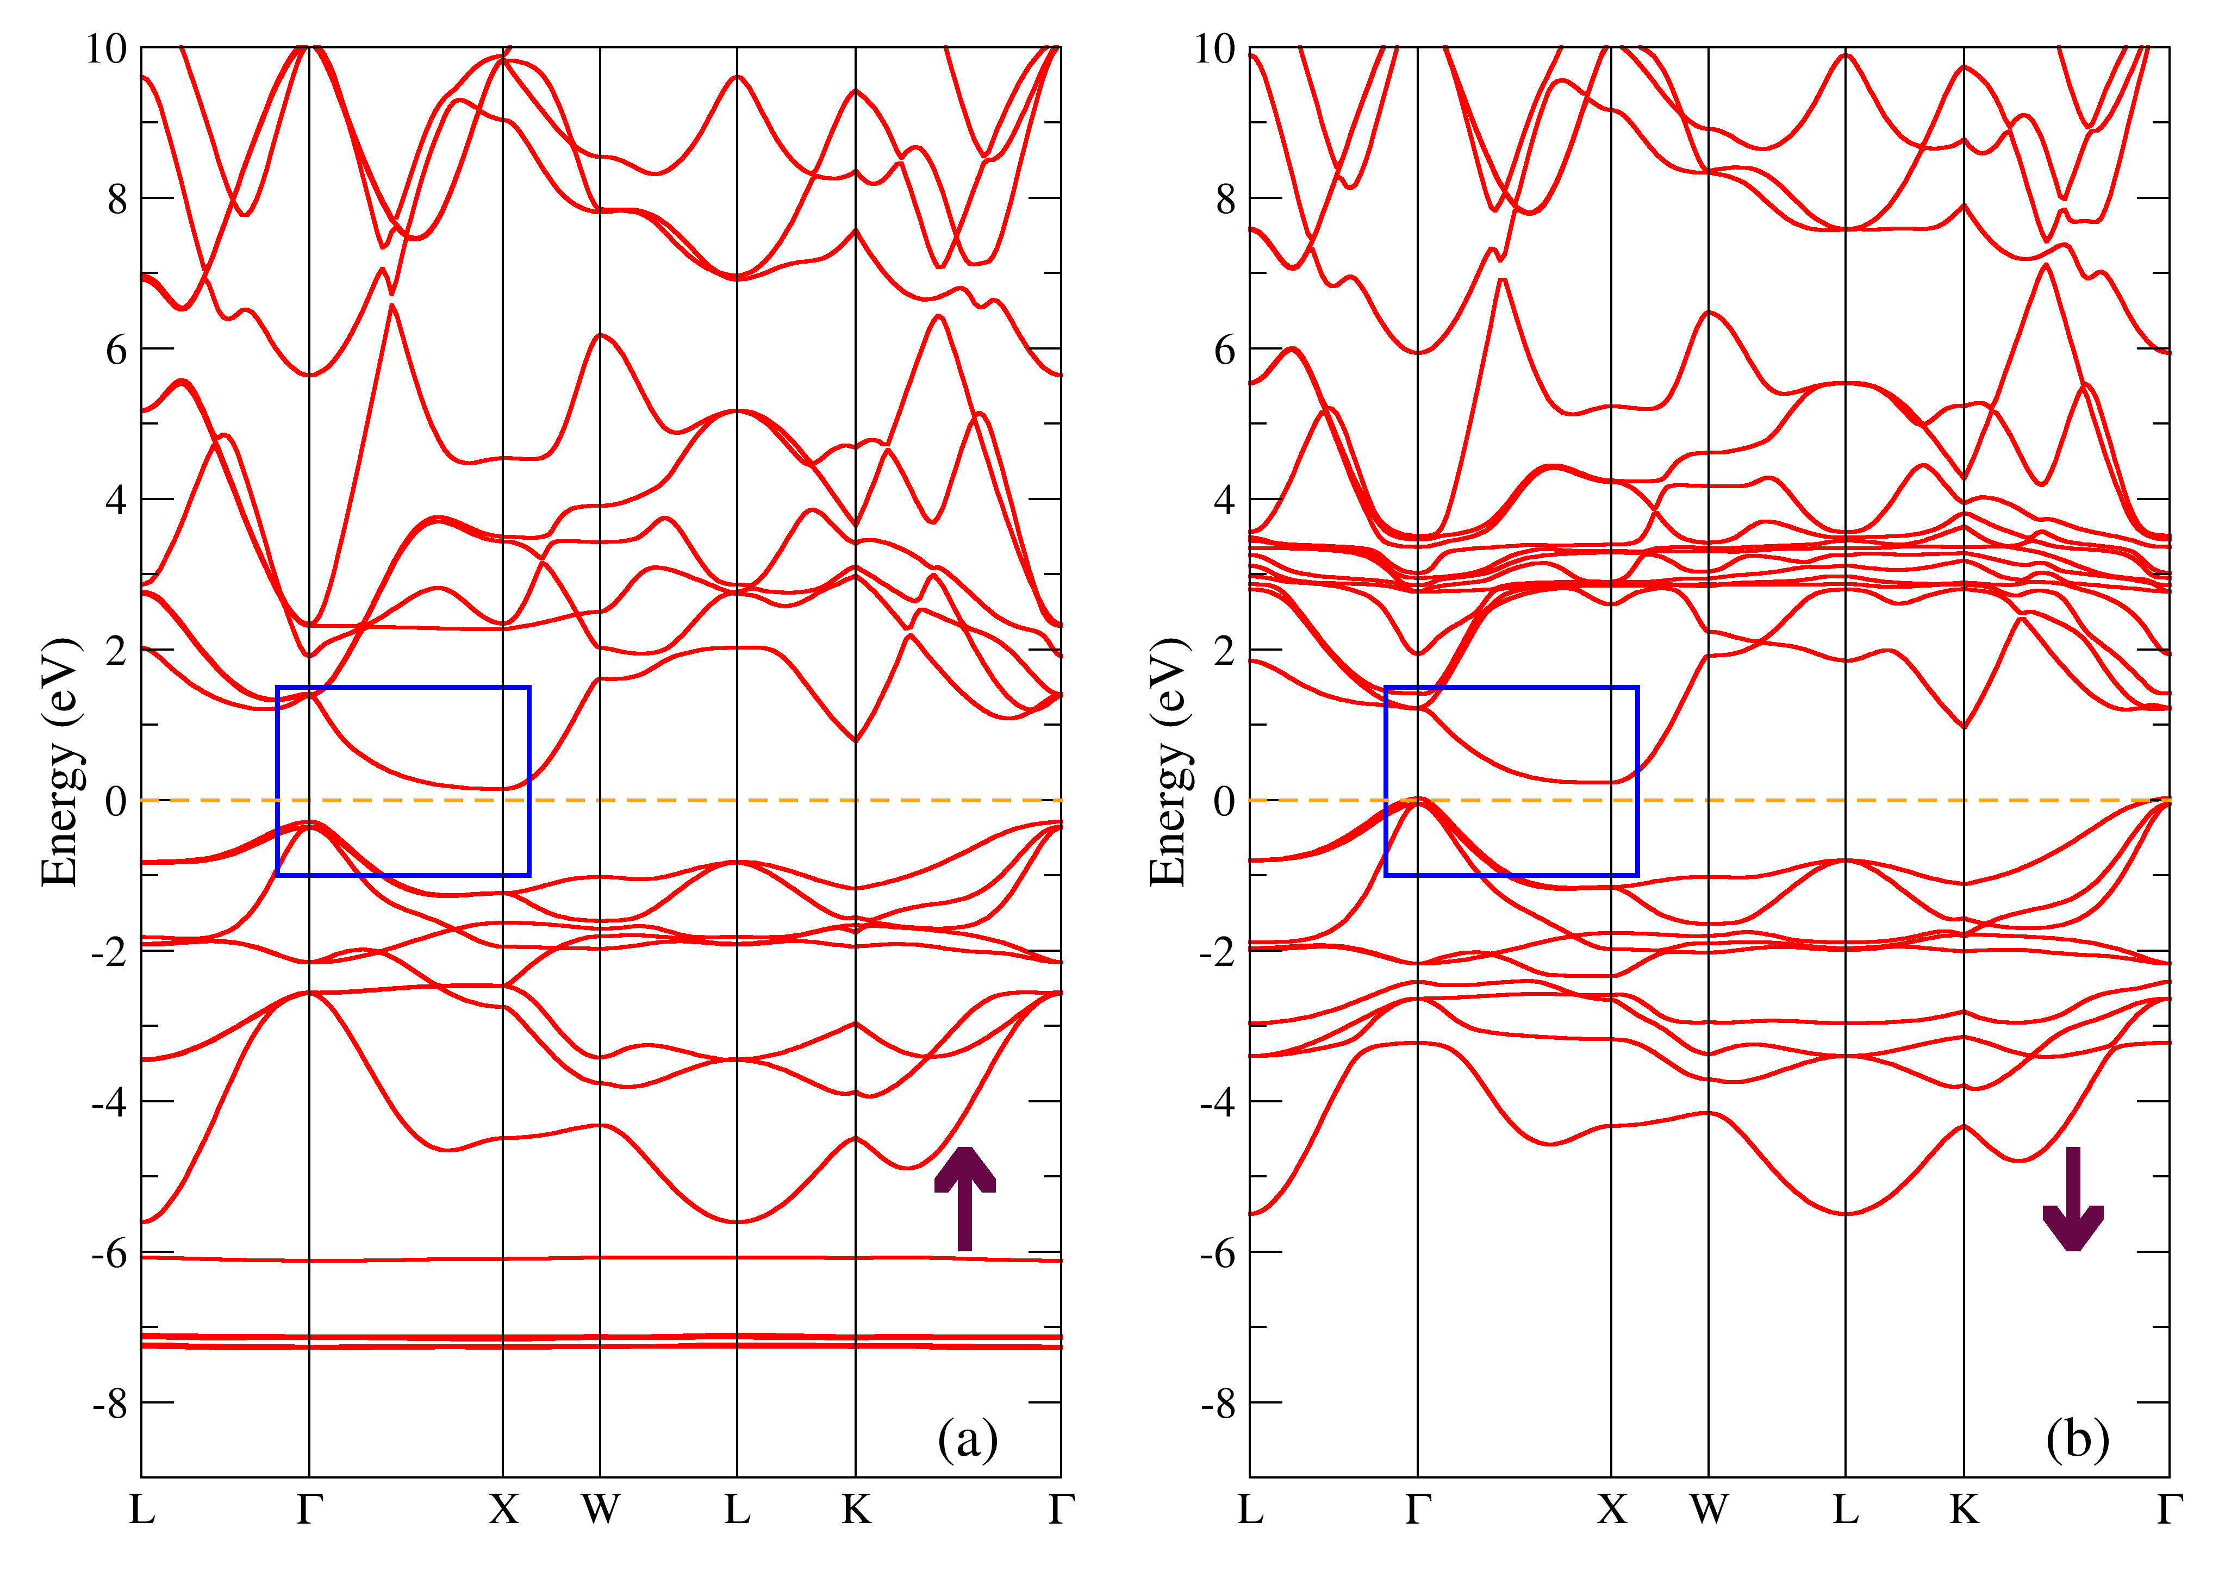
Electronic structure of TbNiSb
$$E_{g↑}=0.43 eV$$
$$E_{g↓}=0.21 eV$$
TbNiSb is a semiconductor with the indirect gap as it is seen from the band structure.

Slide 13
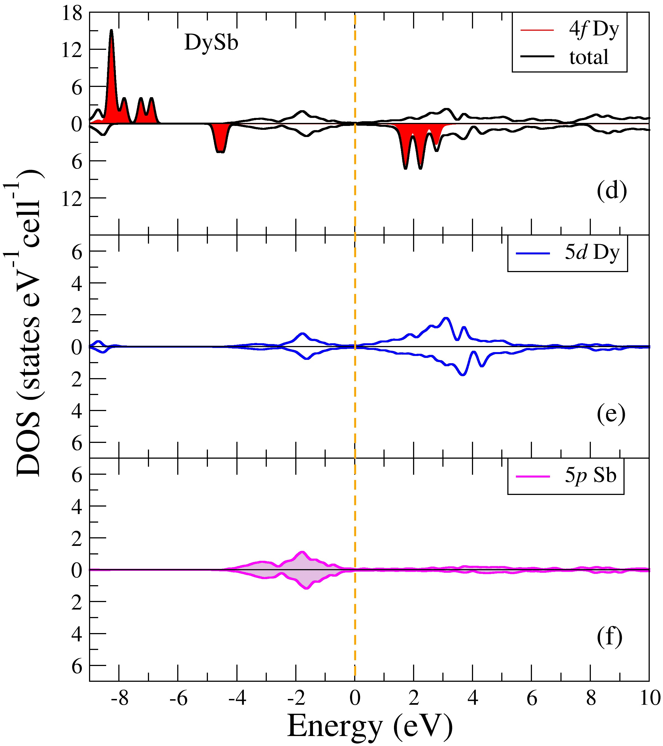
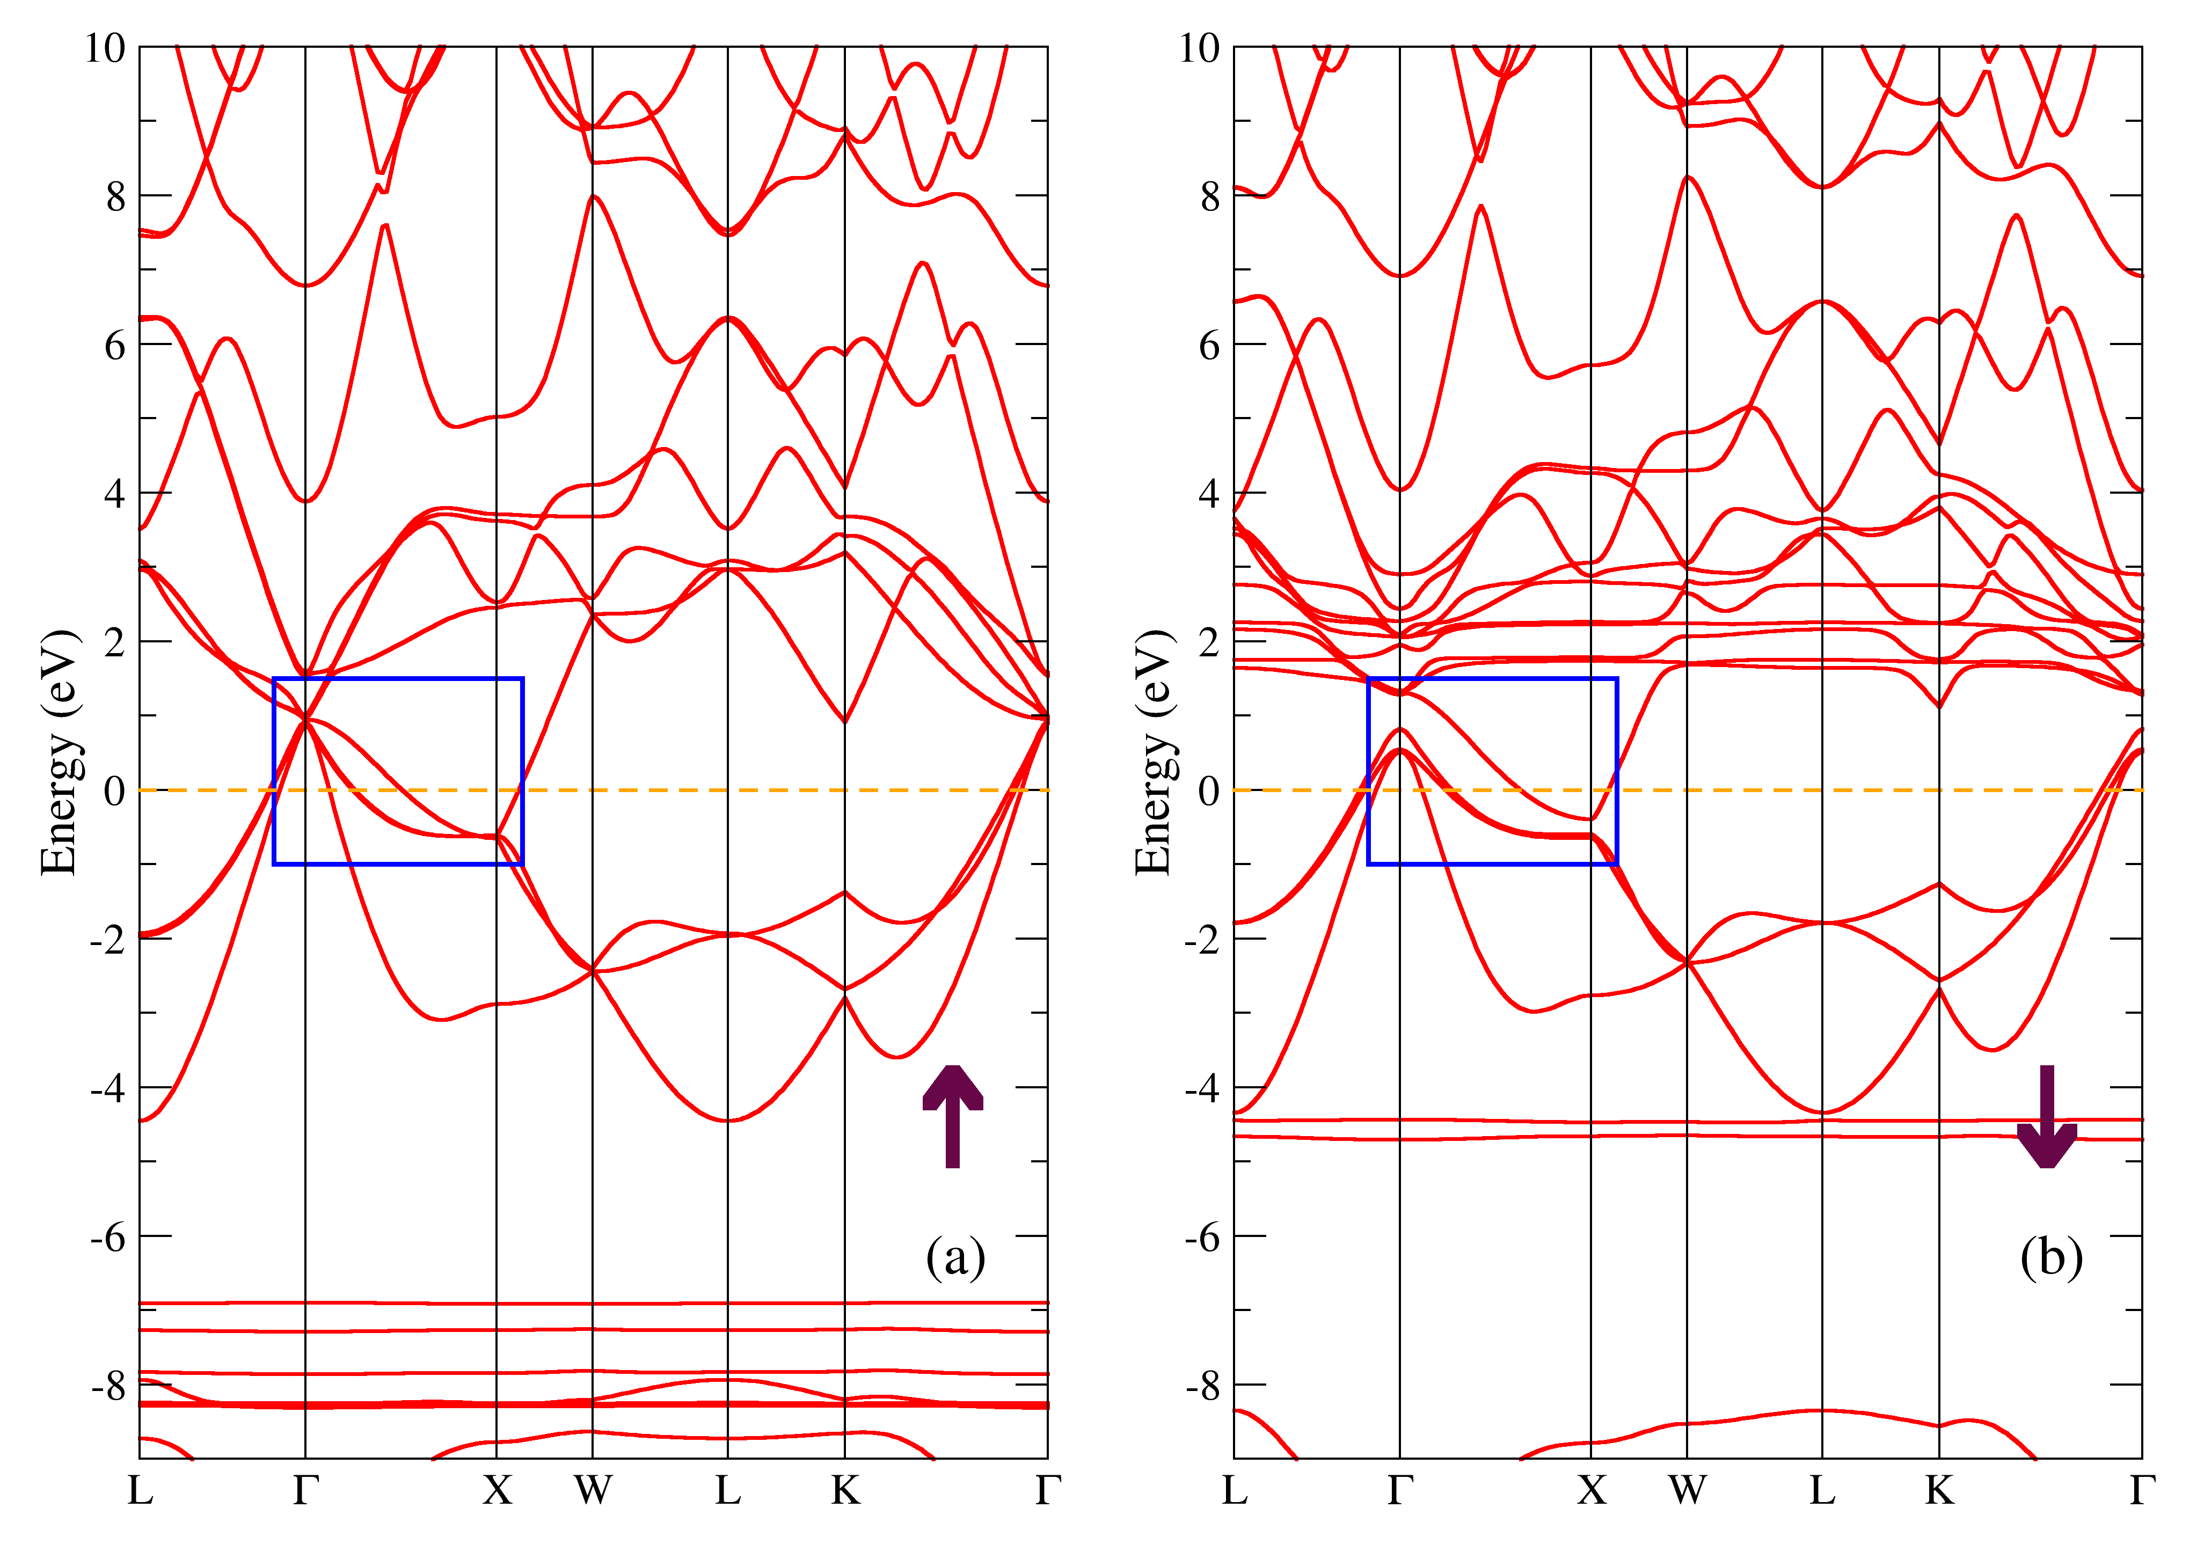
Electronic structure of DySb
DySb is a semimetal with the electron and hole pockets similar to the other investigated RSb compounds.

Slide 14
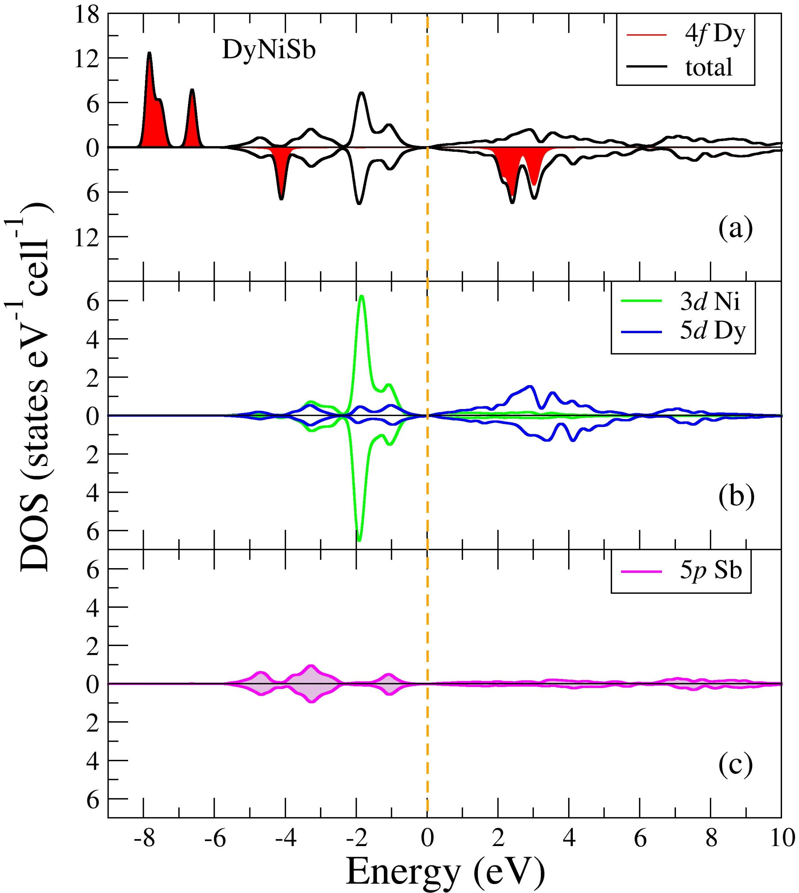
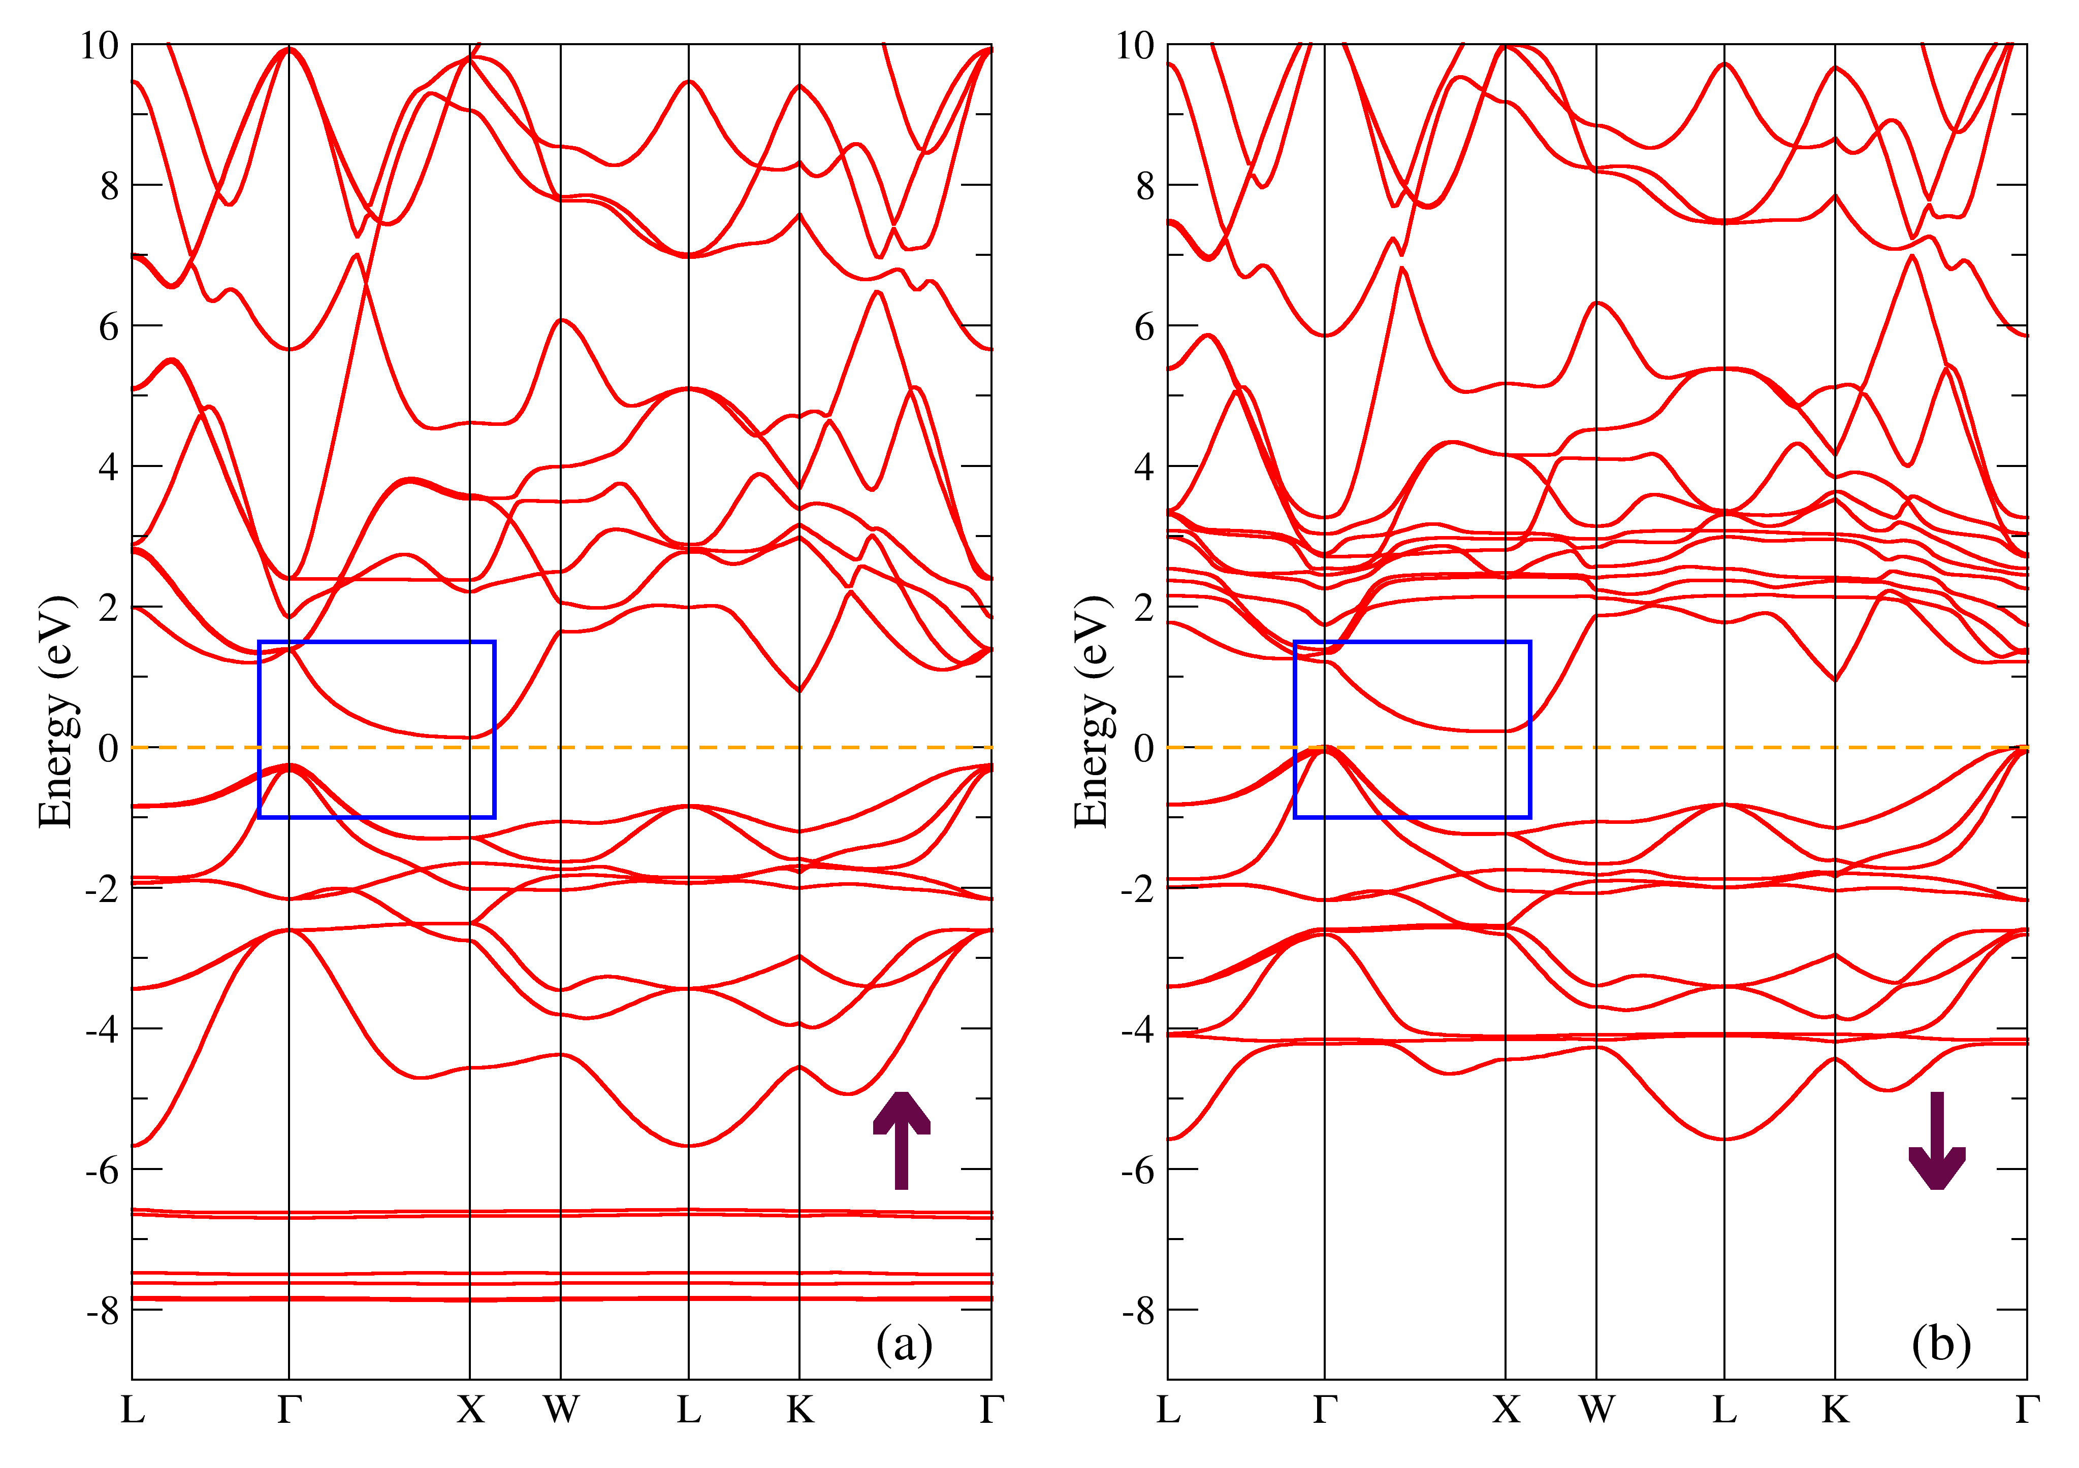
Electronic structure of DyNiSb
$$E_{g↑}=0.39 eV$$
$$E_{g↓}=0.21 eV$$
DyNiSb is a semiconductor with indirect gap similar to the other investigated RNiSb compounds.

Slide 15
Conclusions
Compound | Estimated magnetic moment (μ_{B}) | Experimental magnetic moment (μ_{B})
GdSb | 6.98 | -
TbSb | 9.64 | -
DySb | 10.56 | -
GdNiSb | 7.20 | 8.1(5) [1]
TbNiSb | 9.64 | 10.2(4) [1]
DyNiSb | 10.56 | 10.6(4) [1]
The RSb compounds are semimetals with the hole and electron pockets
The RNiSb compounds are semiconductors with the gap values of ~0.3 eV
The calculated magnetic moments and the optical conductivity spectra are in good agreement with the experimental results
The GdNiSb compound can undergo a semiconductor-to-metal transition under external pressure
The results of the research were published in several scientific journals
[1] J. Alloys Compd., 226, 81–86 (1995).
Acknowledgements
This study was supported by the grant of Russian Science Foundation No 22-42-02021.

Slide 16
Thank you for your attention!
Further reading:
“Common topological features in band structure of RNiSb and RSb compounds for R = Tb, Dy, Ho”, S.T. Baidak, A.V Lukoyanov, Materials 16, 242 (2023).
“Investigation of semimetallic properties of GdSb and TbSb compounds: A first-principle and optical study”, Yu.V. Knyazev, Yu.I. Kuz'min, S.T. Baidak, A.V Lukoyanov, Solid State Sciences 136, 107085 (2023).
“Semimetallic, half-metallic, semiconducting, and metallic states in Gd-Sb compounds”, S.T. Baidak, A.V. Lukoyanov, International Journal of Molecular Sciences 24, 8778 (2023).

