Slide 1
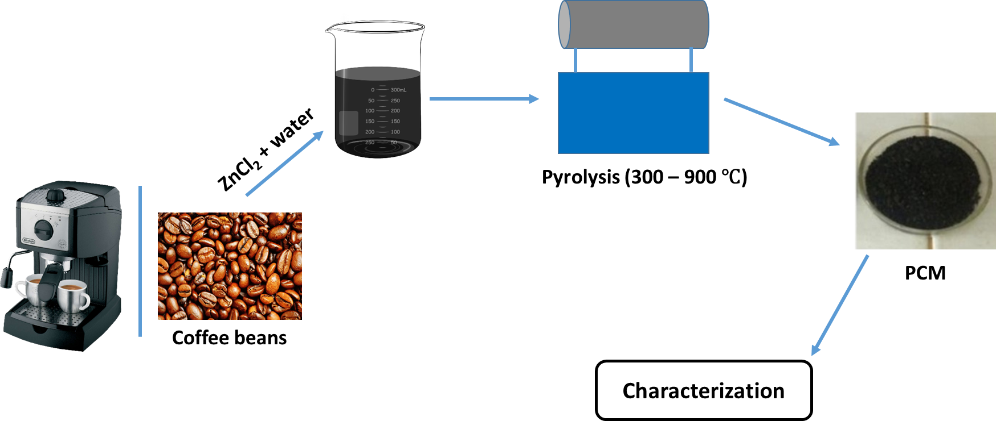
Sustainable Porous Carbon Electrode Material Derived from Biomass for Utilisation in Capacitive Deionisation
Lungile Hadebeª, Zamani Cele^{b}, Suresh Maddila^{c}, Sreekantha Joonalagaddaª, Bhekumuzi P. Gumbiª
ª School of Chemistry and Physics, University of KwaZulu-Natal, P.O. Box 54001, Durban 4001, South Africa
^{b}Council of Scientific & Industrial Research, Meiring Naudé Road, Brummeria, Pretoria 0001, South Africa
^{c}GITAM School of Sciences, Dr NTR Beach Road, Rushikonda, Visakhapatnam, Andhra Pradesh 530045, India
Email: 215080781@stu.ukzn.ac.za
Introduction
Results and discussion
Scarcity of potable water due to the constantly growing population.
Current water treatment technologies are costly and sophisticated.
Capacitive deionization as an energy-efficient water treatment technology.
Millions of tons of coffee grounds are produced as waste.
Uncontrolled disposal and its negative impacts.
Porous carbon material (PCM) can be derived from biomass such as coffee biowaste.
Reduces costs and promotes circular economy.
(a)
(b)
~22° – (002) graphitic structure
~43° – (100) diffraction modes
Characteristics of a disordered carbon structure
Aim
To fabricate and enhance properties of the low-cost PCM from coffee biowaste through the pyrolysis method for utilization in a capacitive deionization system.
Figure 2: (a) FTIR spectra and (b) XRD diffractograms of PCMs
Objectives
Table 2: Summary of the Raman spectroscopy results for PCMs
To activate coffee biomass using ZnCl₂ via the pyrolysis method.
To investigate the optimal temperature (300 – 900 °C) for the best properties.
To characterize synthesized nanomaterials using brunuaer-emmett-teller (BET), Fourier transform infrared spectroscopy (FTIR), x-ray diffraction (PXRD), Raman spectroscopy and thermogravimetric analysis (TGA).
Sample | D band | G band | I_{D}/I_{G}
PC300 | 1376 | 1573 | 0.87
PC400 | 1363 | 1599 | 0.85
PC500 | 1363 | 1586 | 0.86
PC600 | 1350 | 1599 | 0.84
PC700 | 1350 | 1598 | 0.84
PC800 | 1350 | 1599 | 0.84
PC900 | 1350 | 1599 | 0.84
Experimental
Figure 3: Raman spectra of PCMs
N₂
(a)
(b)
Figure 4:(a) Percentage wt. loss TGA and (b) percentage wt. loss TGA derivative of PCMs
Results and discussion
Conclusion
Table 1: Summary of the BET results for PCMs
PCMs were prepared from biomass of coffee waste grounds, utilizing a simple, and low-cost chemical activation technique, which requires a smaller amount of activating agent ZnCl₂. PC800 shows a micro-mesopore dominated carbon with a high surface area and pore volume. The presence of a disordered carbon structure, observed from Raman spectroscopy and confirmed by XRD, leads to more active sites for the adsorption of ions on the surface of the material while decreasing the electric conductivity.
Sample | S_{BET} | Pore volume | Pore diameter
PC300 | 0.000 | 0.0087 | -
PC400 | 0.000 | 0.0051 | -
PC500 | 19.722 | 0.0107 | 2.1743
PC600 | 14.580 | 0.0179 | 4.9200
PC700 | 15.390 | 0.0197 | 5.1144
PC800 | 795.251 | 0.4259 | 2.1424
PC900 | 586.251 | 0.3155 | 2.1508
References
W.-H. Chen, J.-T. Du, K.-T. Lee, H. C. Ong, Y.-K. Park and C.-C. Huang, Chemosphere, 2021, 275, 129999
Y. Y. Gan, W.-H. Chen, H. C. Ong, H.-K. Sheen, J.-S. Chang, T.-H. Hsieh and T. C. Ling, Energy, 2020, 210, 118579
3. B. C. Krueger, G. D. Fowler, M. R. Templeton and B. Moya, Water Research, 2020, 169, 115253
4. Z.-H. Huang, Z. Yang, F. Kang and M. Inagaki, Journal of Materials Chemistry A, 2017, 5, 470-496
5. B. M. Comer and A. J. Medford, ACS Sustainable Chemistry & Engineering, 2018, 6, 4648-4660
1
Figure 1: Nitrogen adsorption-desorption isotherms for PCMs

