Slide 1

A. Goltsman
JINR, FLNR, Dubna
A new focal plane recoil gas stopping chamber for study of chemistry of super heavy elements at SHE Factory

Slide 2
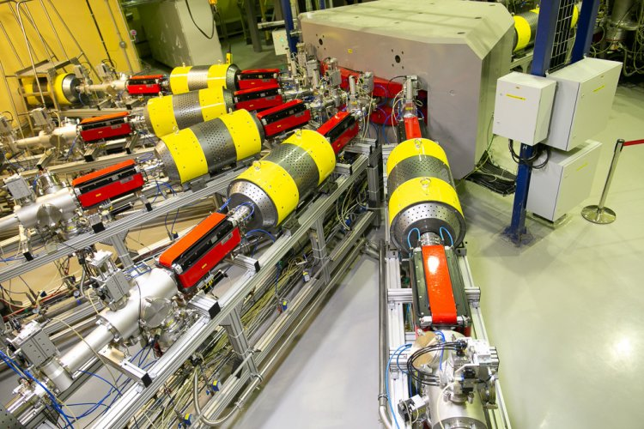
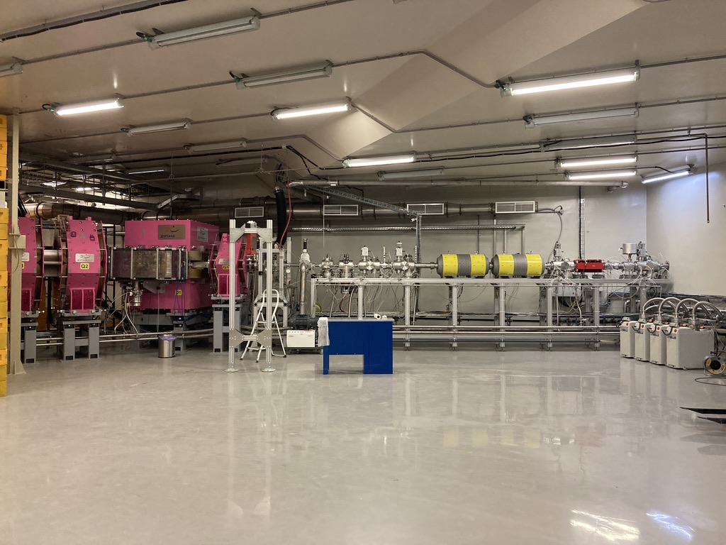
Experimental method
In gas phase experiments on the chemistry of superheavy elements at SHE Factory, nuclei recoiled from an irradiated target are separated from the beam and other-by products of nuclear reactions with a physical separator, focused in the focal plane and injected through a thin entrance window into a gas stopping chamber.
DC-280
GRAND

Slide 3
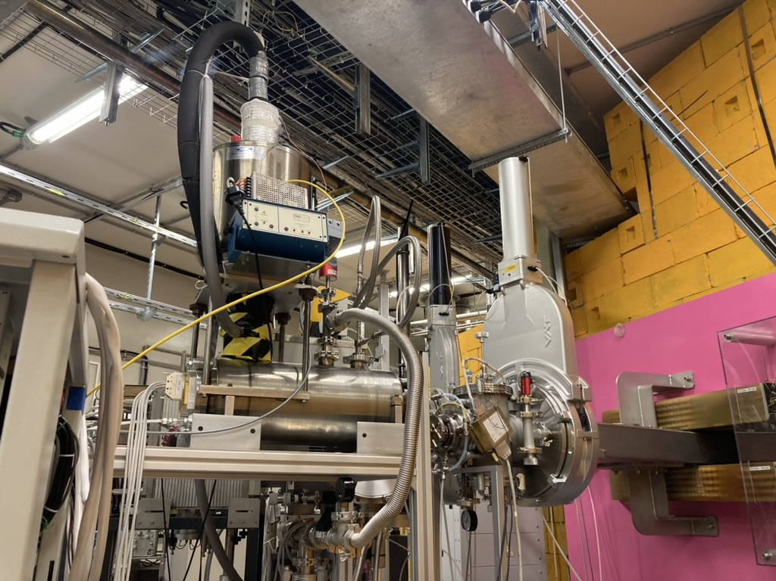
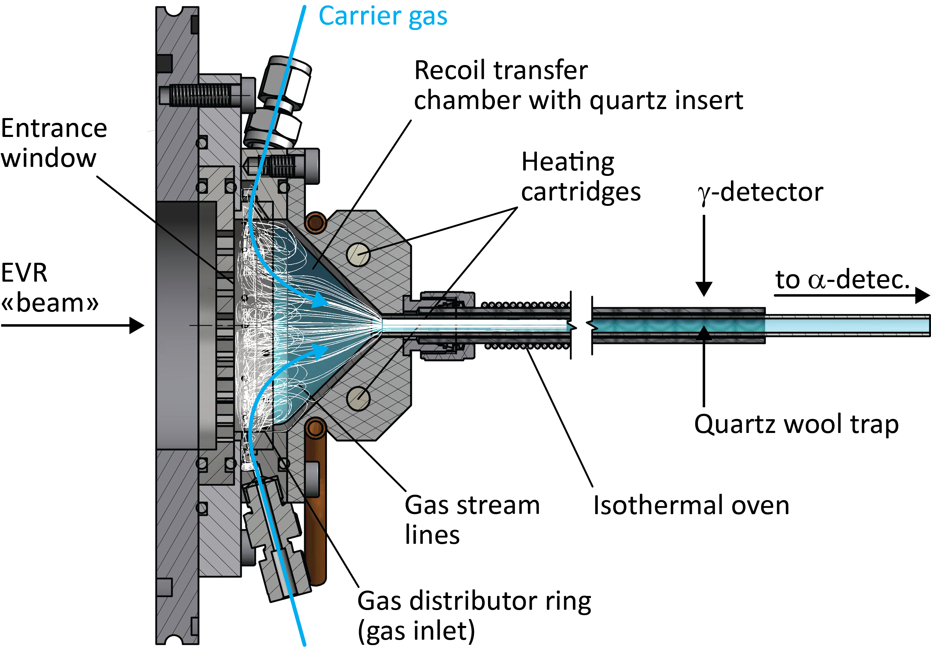
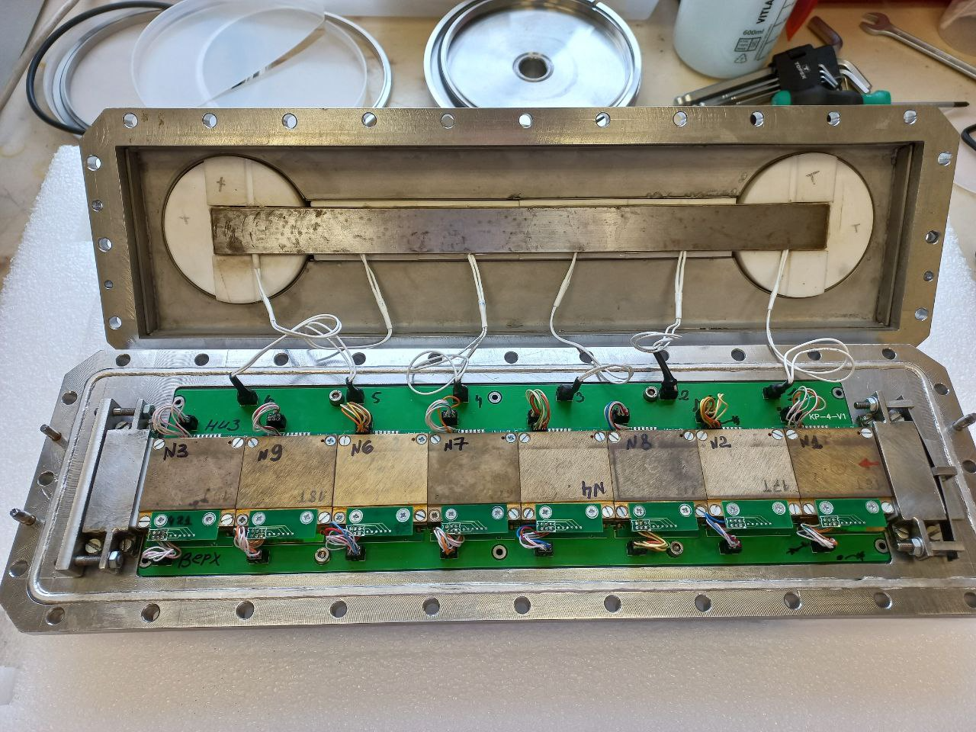
Experimental method
Recoil nuclei, stopped in a gas mixture, are transported through a capillary by a gas flow to the chromatographic column of the chemical detection setup Cryodetector.
Experimental setup
Recoil gas stopping chamber
Cryodetector

Slide 4
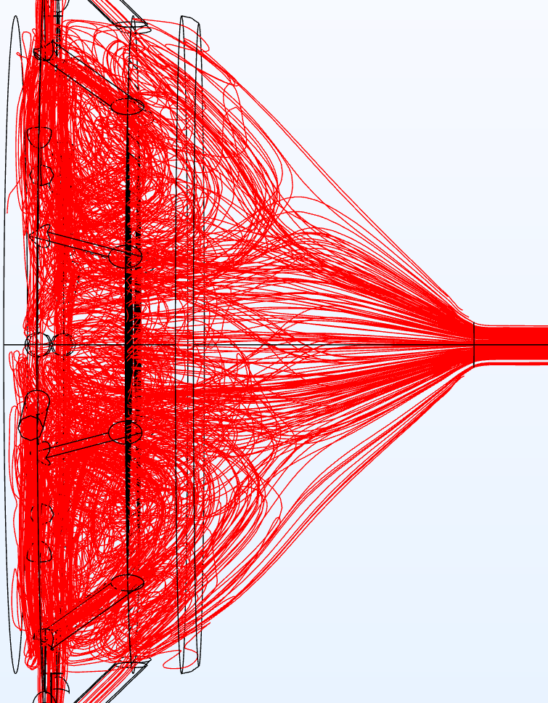
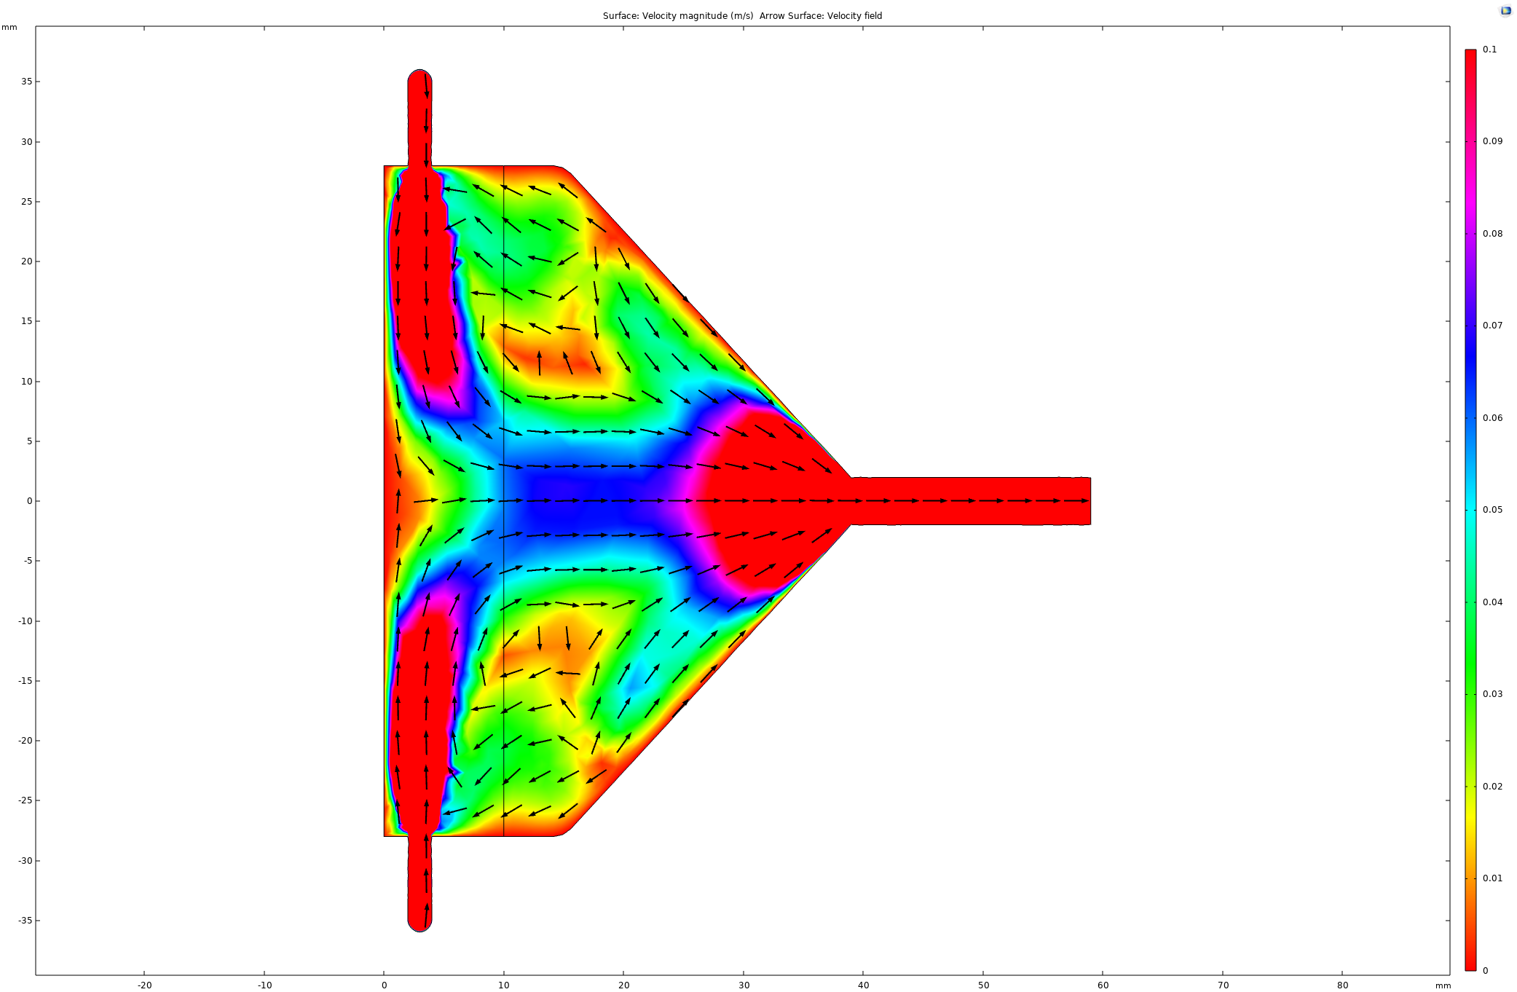
Efficiency calculation of recoil gas stopping chamber
CFD simulation
Flow direction
Velocity profile

Slide 5
Efficiency calculation of recoil gas stopping chamber
The calculation of the transport efficiency was made on the basis of the estimated braking depth of the recoil in gas
In November 2022, an experimental determination of the stopping range close in energy to No was carried out
The transport time was also determined by short-lived mercury (the first front is 0.25 s, the average transport time is 5 s).

Slide 6
Experiment with Fl and Cn
With this camera, it was possible to register Cn and Fl in one chain in the detector
• the area of the "image" in the focal plane of the separator GRAND,
• recoil stopping range in separating foil and transport gas,
• the minimum possible time of removal of recoil cores from the chamber,
• the highest possible efficiency of removal of short-lived isotopes of Cn and Fl,
• the inner surface of the chamber is inert with respect to volatile elements.
Hg, Cn, Fl distribution
l/s
Mev
s
proportion of registered particles, %
Strip mumber

Slide 7
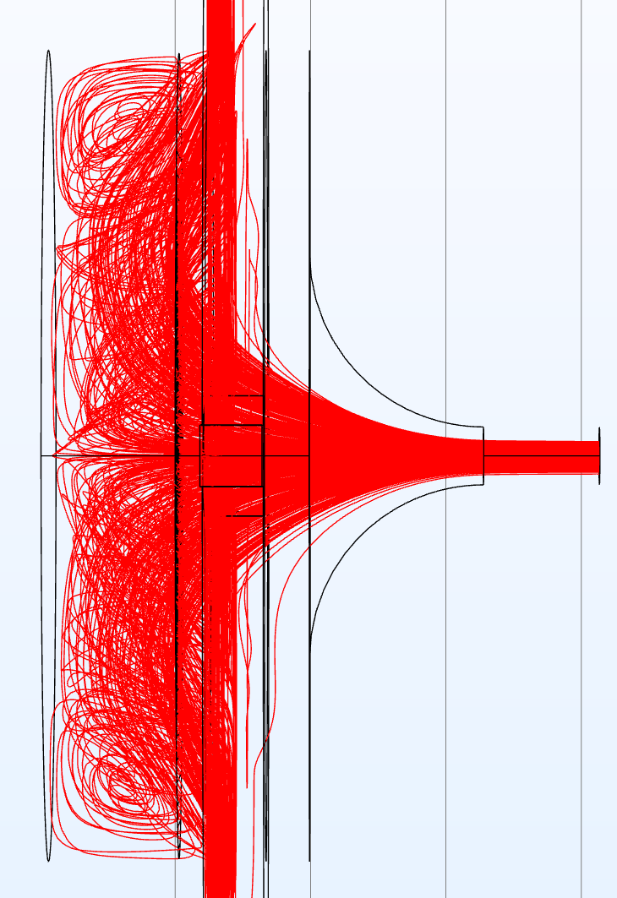
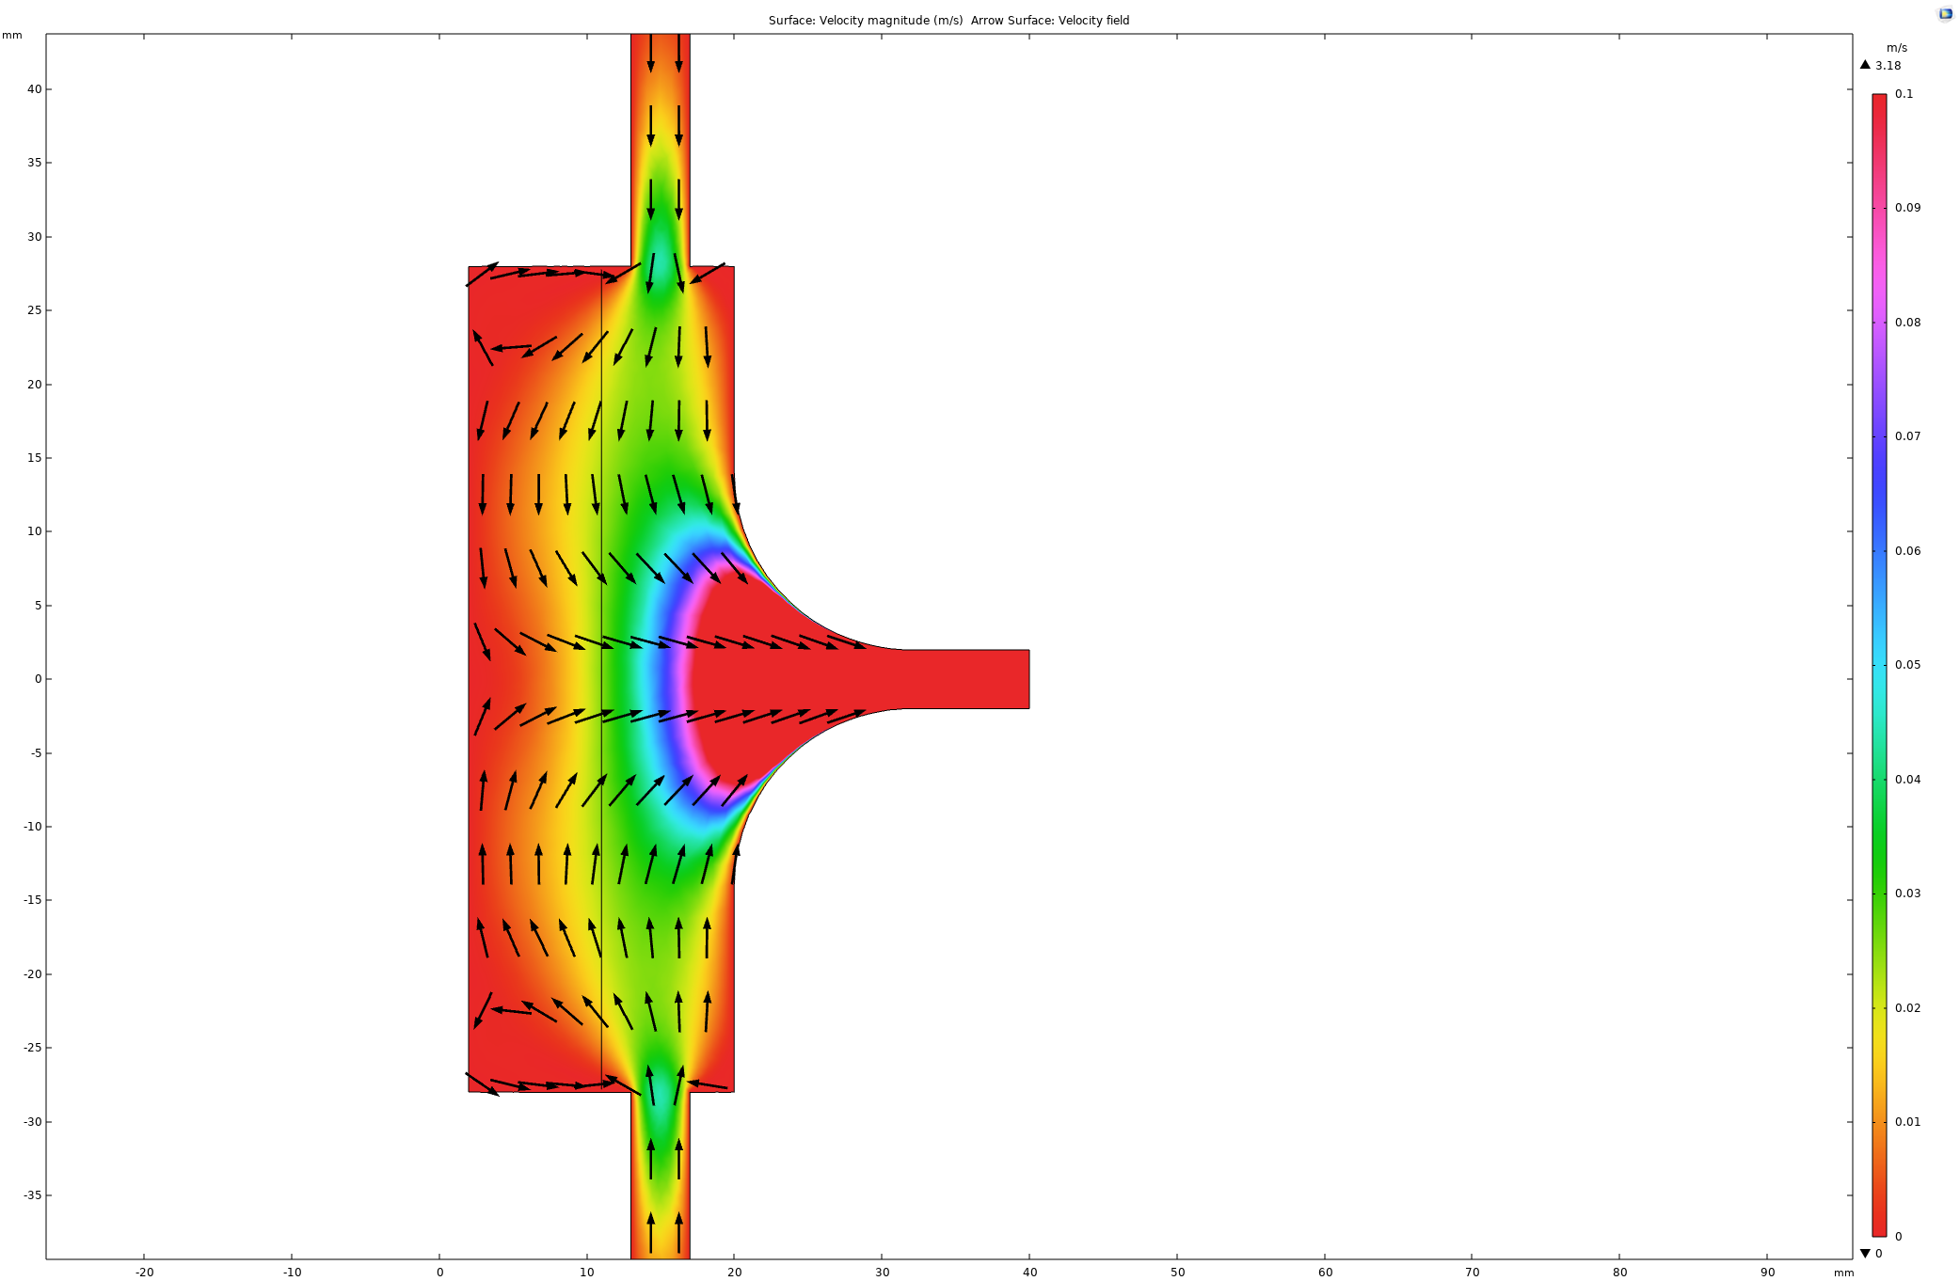
New recoil gas stopping chamber
Flow direction
Velocity profile
recoils

Slide 8
New recoil gas stopping chamber
Transport efficiency
Existent recoil gas stopping chamber
New recoil gas stopping chamber

Slide 9
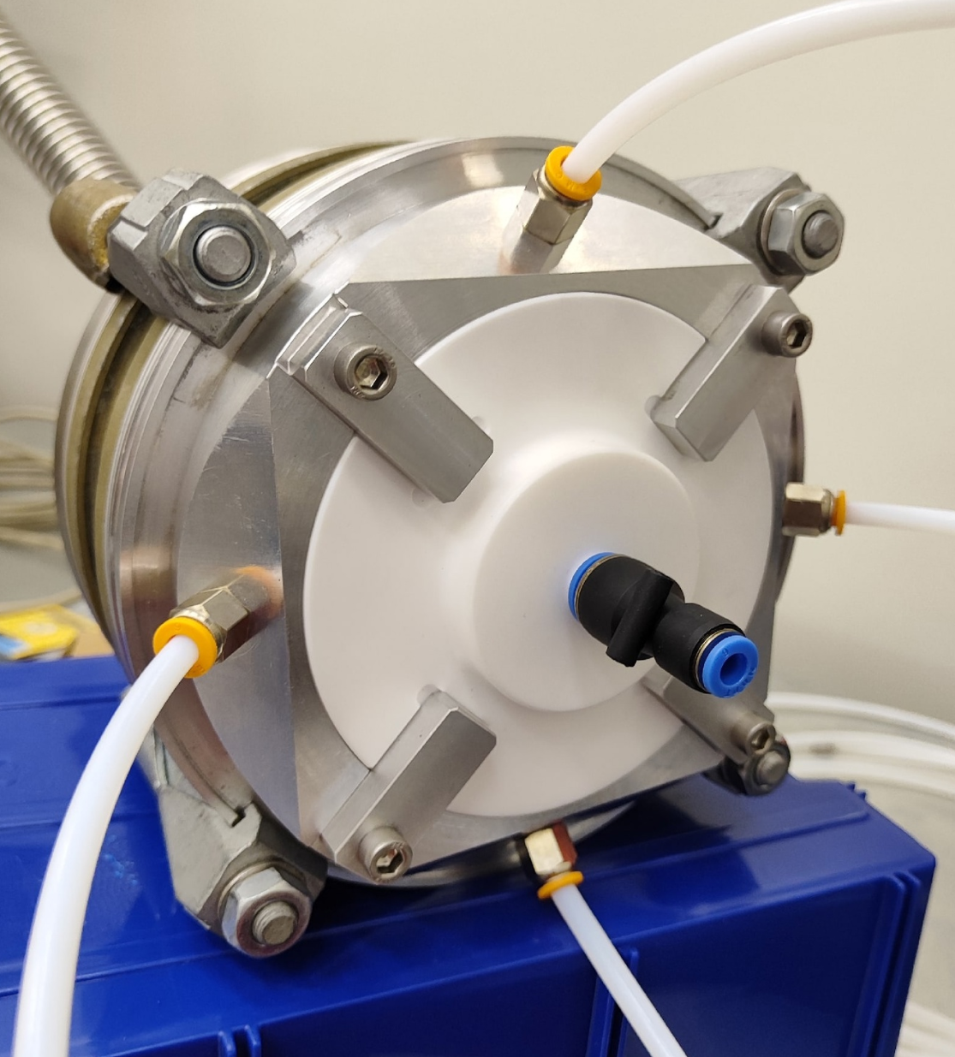
Conclusion
According to the simulation results, the new chamber is ~3 times more efficient than the old one.
The new chamber has already been made.
The experimental determination of the effectiveness will be carried out in the second half of November.

Slide 10
Thanks for your attention!

