Slide 1
Efficiency assessment of IRT-T research reactor cooling system by machine learning methods
Postgraduate student: Maxim K. Kublinskiy, group A3-43
Scientific supervisor: Artem G. Naymushin, PhD, Associate Professor of NFCD, Head of the Educational and Scientific Center "Research Nuclear Reactor"
30 October 2023

Slide 2
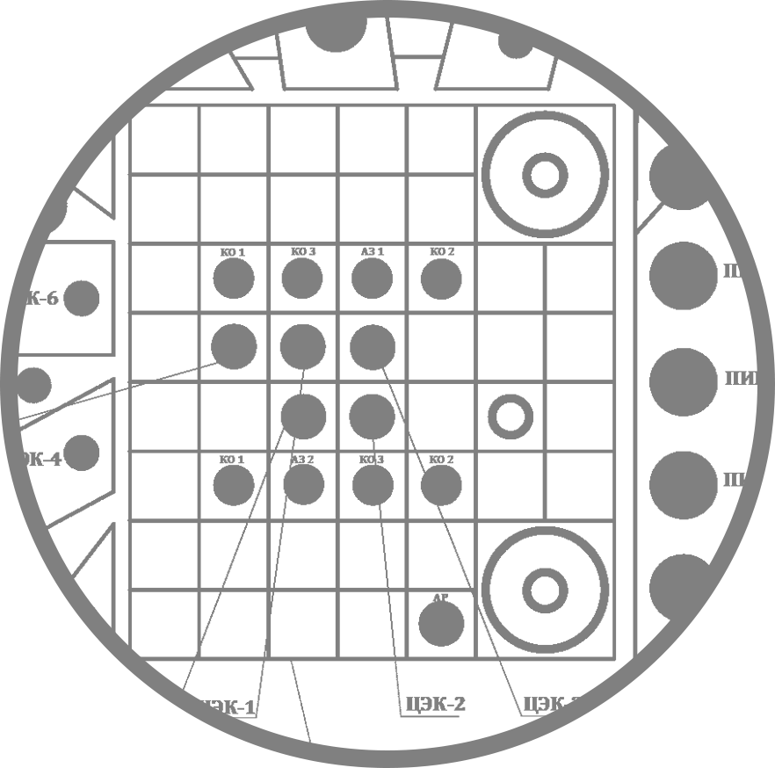
Research POSSIBILITIES
ISOTOPE DESIGN
NUCLEAR MEDICINE
Isotope development complex
Hot camera complex
Isotopes for medical and technological purposes ³²P, ⁹⁰Y, ⁹⁹Mo, ¹⁷⁷Lu, ¹⁵³Sm
Radiopharmaceuticals
Clean rooms complex
Neutron capture therapy
Neutron-transmutation doping of semiconductor materials
Silicon doping complex
Тс^{99м} generation
RADIATION TECHNOLOGIES
NUCLEAR EDUCATION
Neutron activation analysis
Modification of the optical properties of semiprecious minerals
Neutron capture therapy
World-class educational programs
Virtual simulators and simulators
Element Analysis

Slide 3
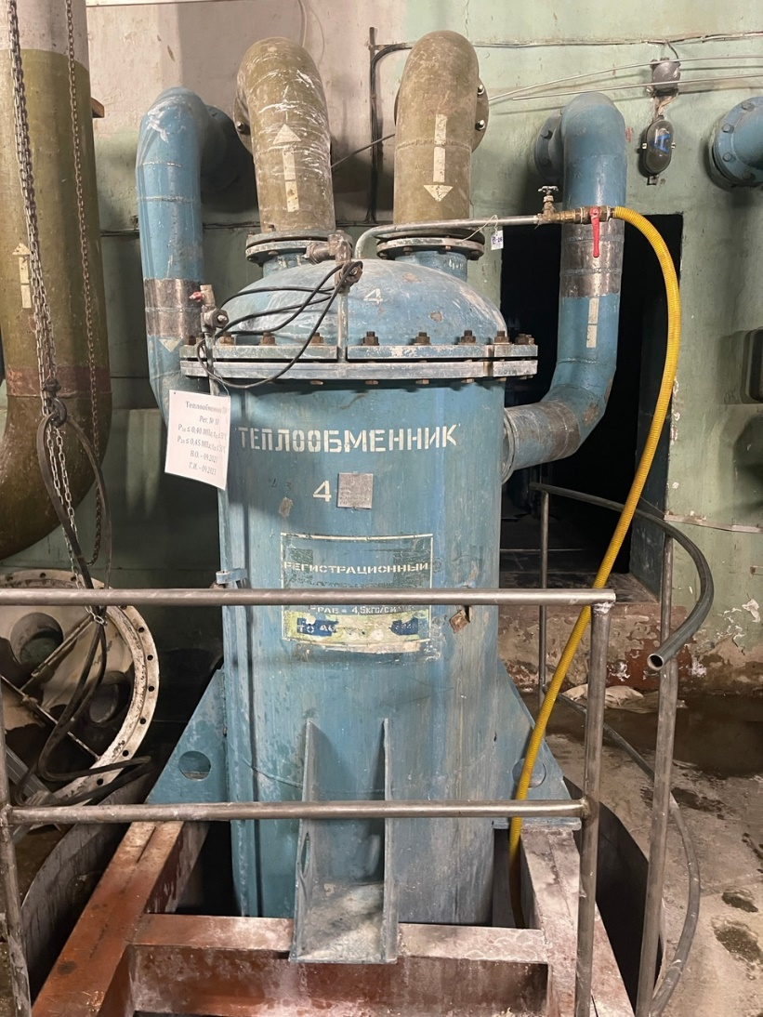
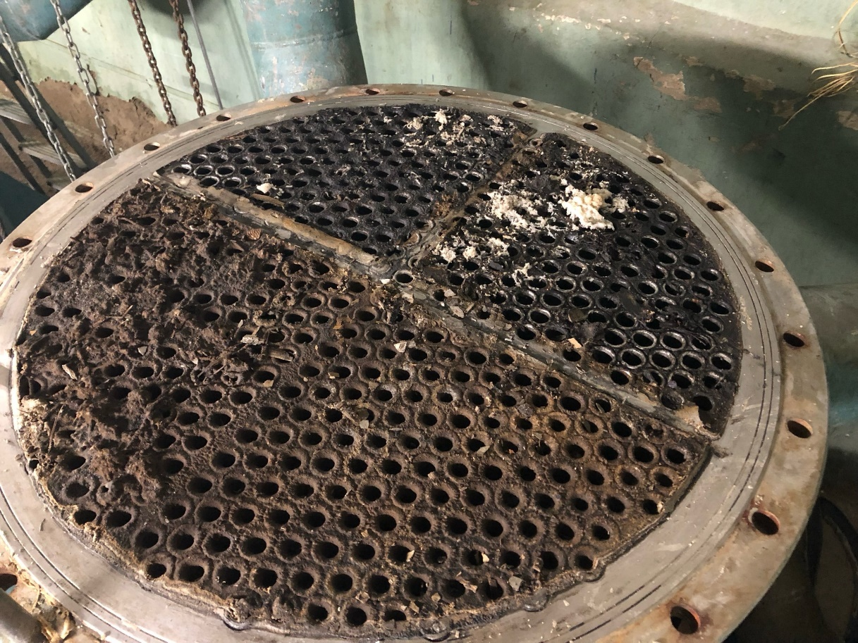
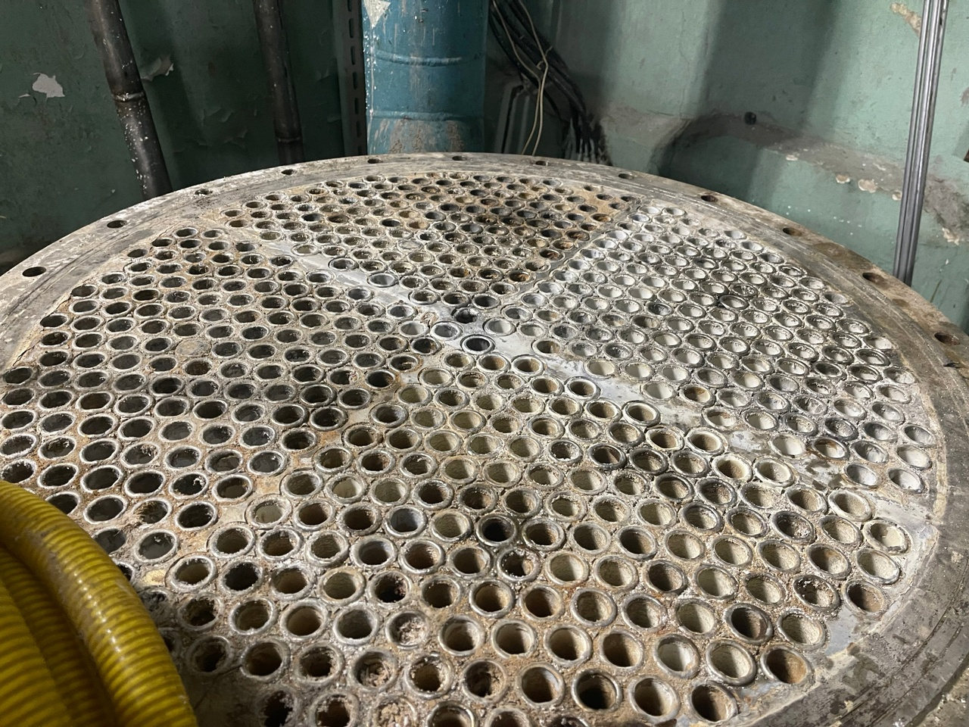
Relevance
Maintaining proper operating conditions for research nuclear facilities is an important factor in ensuring the safety and implementation of high-tech research.
Correct evaluation of secondary cooling circuit operation is one of these operating conditions.

Slide 4
PURPOSE and tasks
The purpose:
to develop the machine learning model of the IRT-T cooling system to evaluate and predict temperature difference on secondary circuit.
Tasks:
to develop the unique preprocessing software to evaluate SCADA System data;
to evaluate preprocessing transformers influence on training accuracy;
to estimate the best machine learning model on Time Series and Default (80/20) Folds.

Slide 5
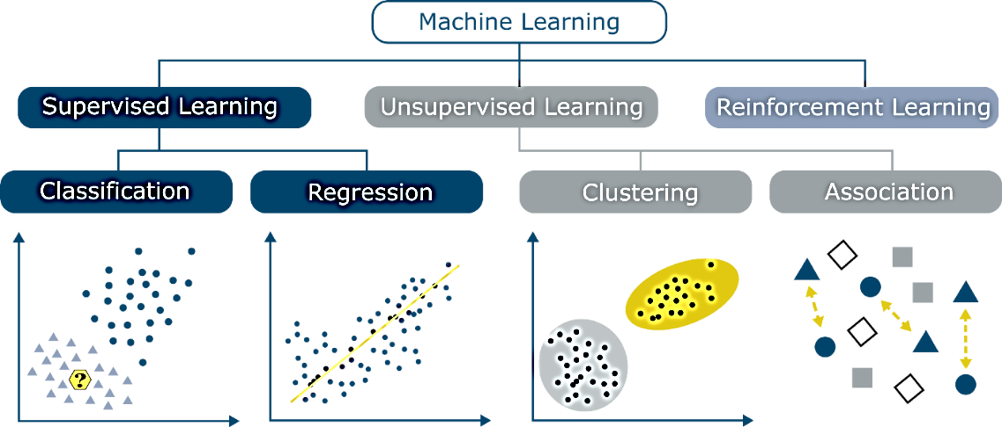
Machine learning
Learning tracking algorithms study the relationship between predictive variables and the results of selected training data sets, and learning formulas are used to prepare models to classify new data.

Slide 6
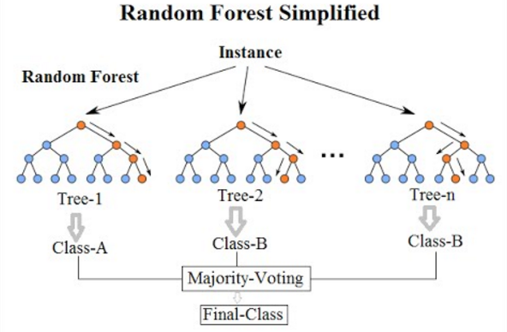
Supervised learning
is an approach to creating artificial intelligence (AI), where a computer algorithm is trained on input data that has been labeled for a particular output.
Supervised learning
Regression
Classification
Gradient Boost Regression (GBR);
Gaussian Process Regression (GPR);
Multilayer Perception (MLP);
Stochastic Gradient Descent with Warm Restarts (SGDR).

Slide 7
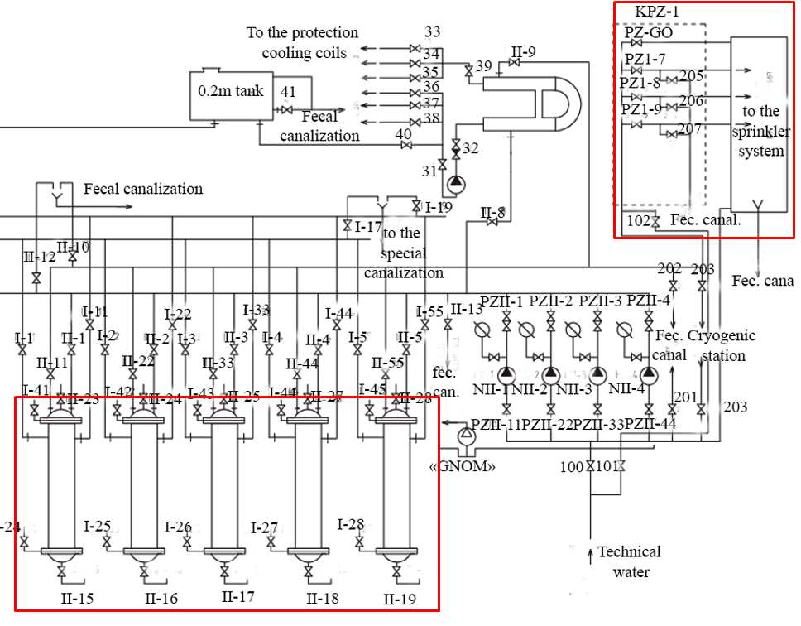
Secondary cooling circuit of irt-t reactor
to primary circuit

Slide 8
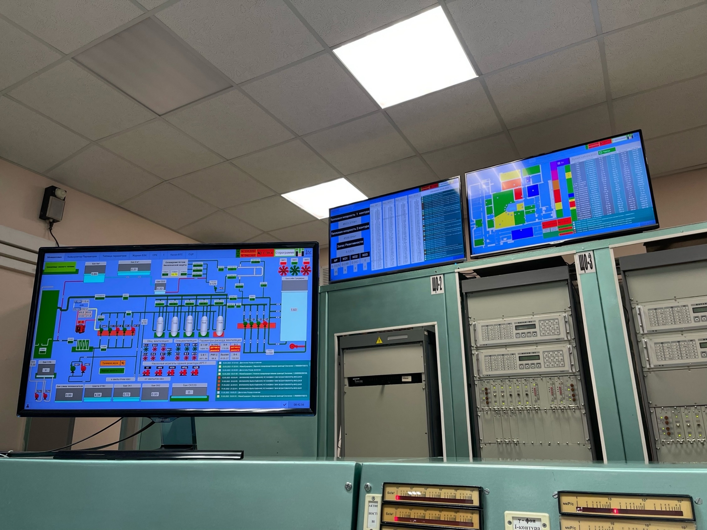
Simple scada software complex
Simple SCADA software complex was developed in 2019 by service department of IRT-T for simplification of management and informational support for the personnel who is responsible for reactor operation.

Slide 9
Software basis for research work
Pandas
SCLearn
Jupyter
is a web-based interactive computing platform that combines live code, equations, narrative text, visualizations.
IAPWS
is a library for calculation of water and steam properties for Python.
NumPY

Slide 10
Decision tree for the model of heat exchanger
CSV FILE
The following structure formats the decision tree. Preprocessing, analytics and data engineering go together in one file.
Model construction has its internal steps that have to be done before the final evaluation.
Preprocessing
Analytics
Data Engineering
Model
Preprocessing (transform)
Model choice
Cross validation
Result
Result isn’t satisfactory Result is satisfactory
5.Final model

Slide 11
CSV-file preprocessing
Downloading the data from SimpleSCADA
Initial preprocessing through CsvRefactorer function
Subsequent analysis
Reading
Export
Time Bounds
Grouping
Length Check

Slide 12
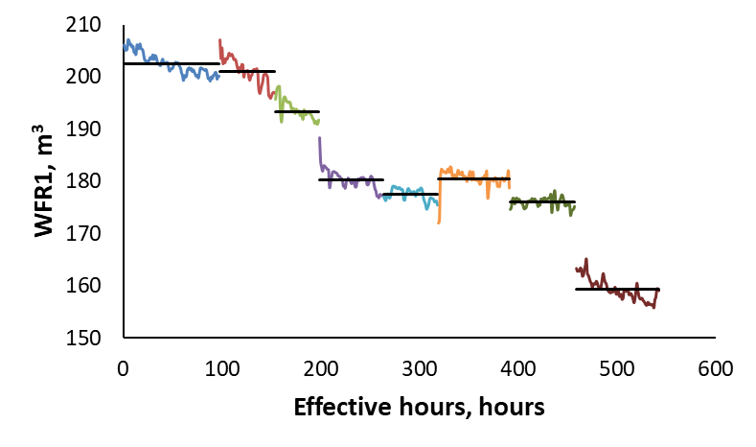
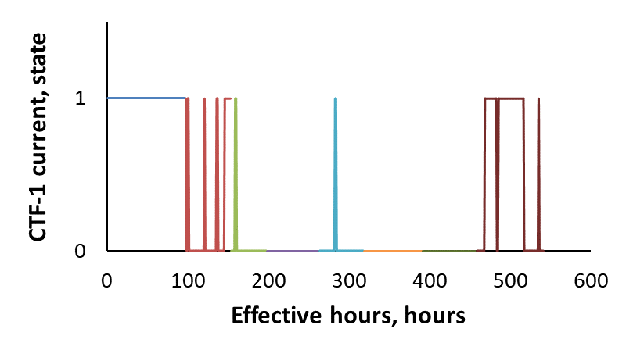
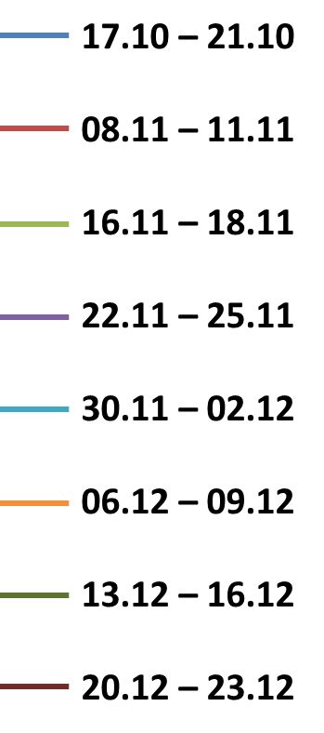
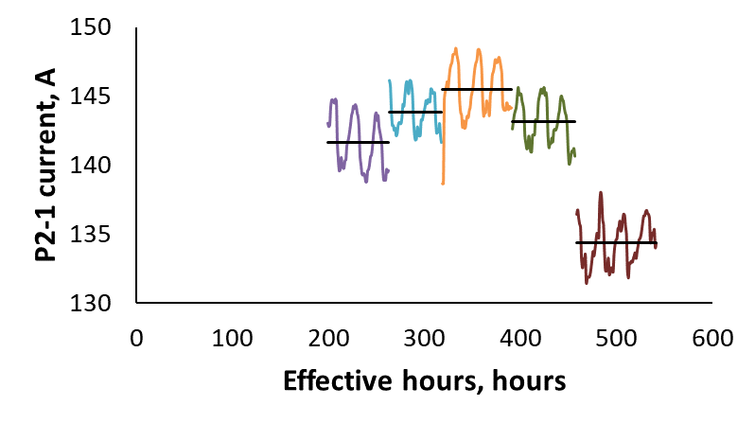
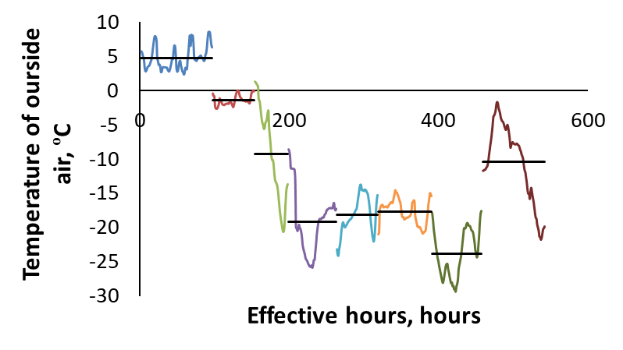
Data analysis
Notes:
17.10 – 21.10

Slide 13
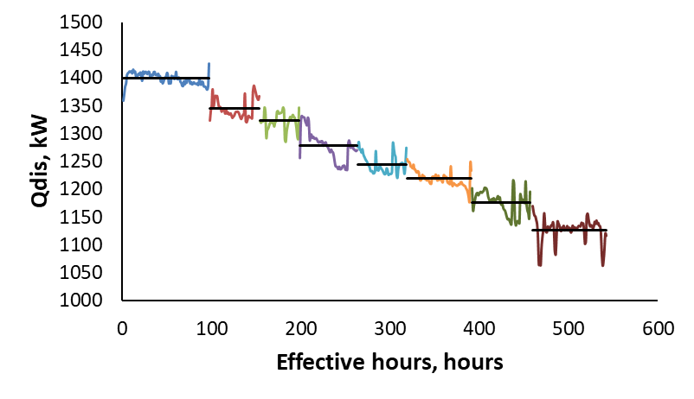
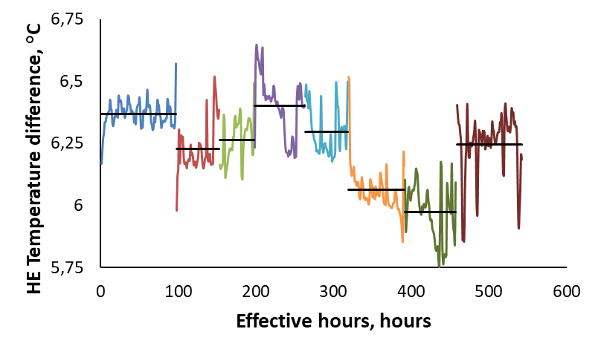
DATA ENGINEERING
Initially that was decided to determine total heat transfer coefficient, but due to complexity of calculations work was switched to studying on thermal power and temperature difference of the secondary circuit because these parameters are proportional to each other.

Slide 14
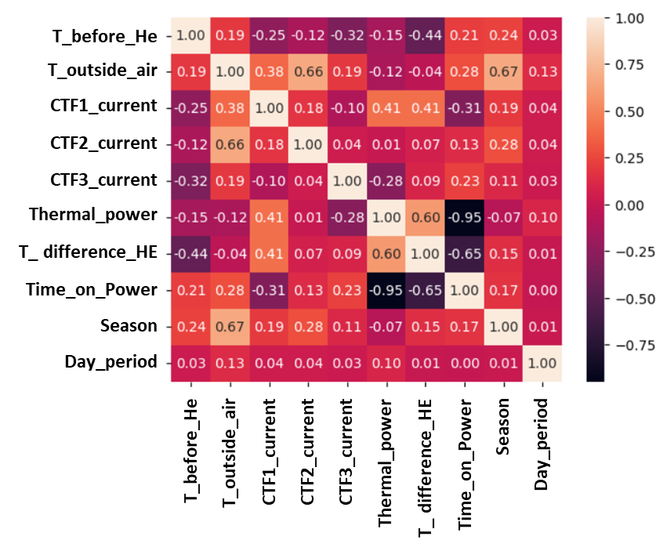
REGRESSION MODEL basis
That was decided that the most important parameters for analysis are:
Temperature before heat exchangers;
Temperature of the outside air;
Cooling tower fans currents;
Temperature difference on heat exchangers.
For proper study of the model it is necessary to build the heat map of parameters to see the correlation between parameters.
For example, dT increases when CTF1 in operation, and decreases with increasing of temperature before heat exchangers.

Slide 15
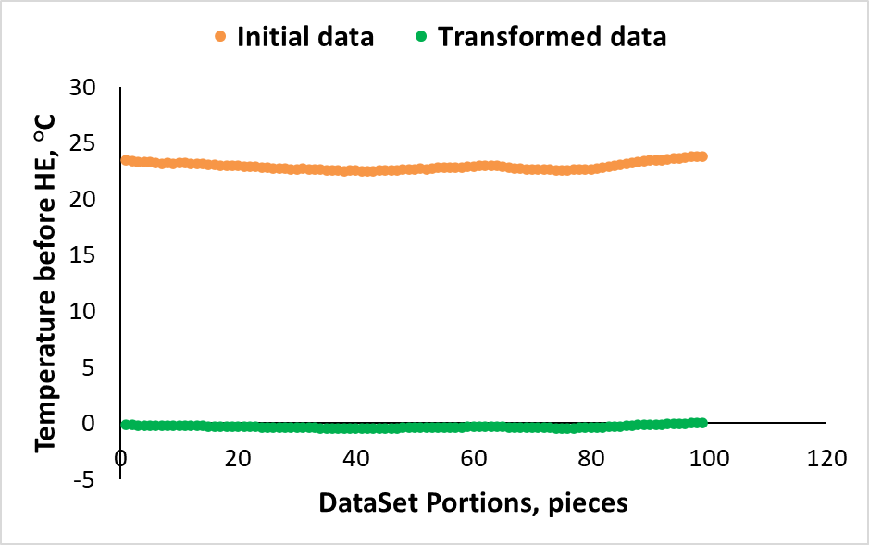
Transformers for dataset
The idea was to develop Column Transformer function. The preprocessed data has to be changed in the view which is easier to machine to learn.
The thing is about taking the values of the dataset, finding the average value, which is represented as 0 and matching deviations from 0 in positive or negative side.
For example was taken little part of data set for temperature before HE. Average temperature was nearly 22.8 °C so that was prescribed as 0 and deviations are formed. This method allows to improve accuracy of calculations for all parameters.

Slide 16
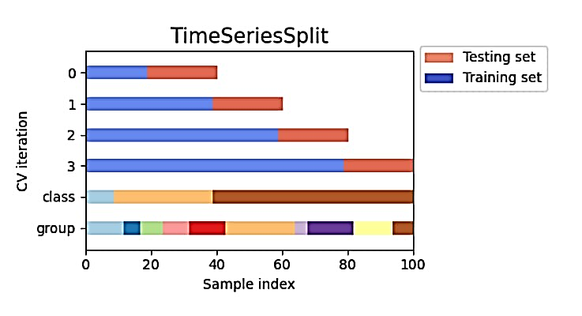
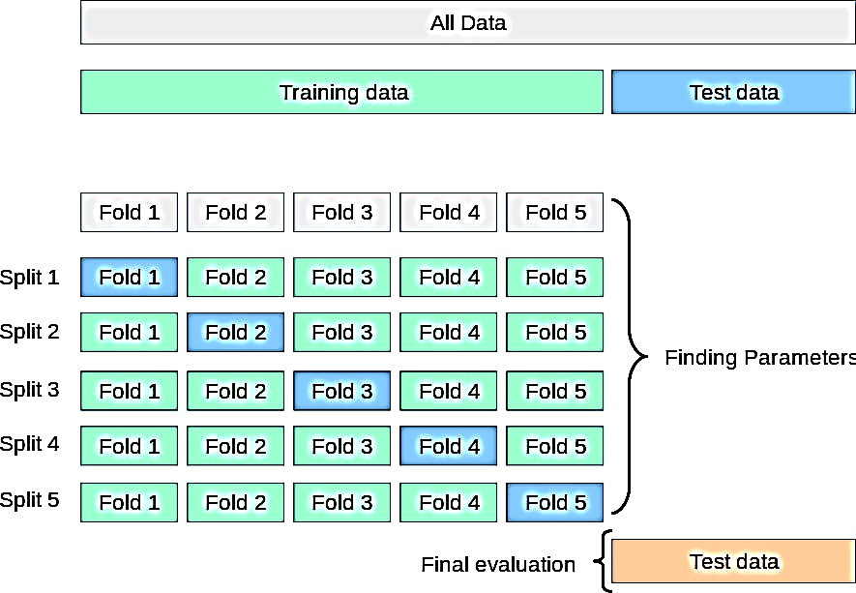
REGRESSION MODEL basis
Splitting time series on the parts is a simple idea. The supervisor needs to choose a part as a training set (usually bigger) and as a test set. Then the process of cross validation comes when different splits are chosen for training and test. This way the model gets studied.
The more trainings – the better result in the end.
Using 80/20 for training/testing the data leads to smoothing the data and seems to be optimal for machine learning.

Slide 17
REGRESSION MODELs choice
 | With transformers |  | Without transformers
Model | Mean Error, °C | Root Error, °C | Mean Error, °C | Root Error, °C
KNeigbours | 0.14 +/- 0.02 | 0.16 +/- 0.02 | 0.18+/- 0.08 | 0.26 +/- 0.08
Multylayer perception | 0.55 +/- 0.08 | 0.63 +/- 0.08 | 1.46 +/- 0.08 | 1.23 +/- 0.05
Gaussian processed regression | 0.13 +/- 0.03 | 0.15 +/- 0.03 | 0.52 +/- 0.02 | 0.75 +/- 0.04
Gradient boost regression | 0.12 +/- 0.01 | 0.14 +/- 0.02 | 0.13 +/- 0.02 | 0.15 +/- 0.02
Stochastic Gradient Descent with Warm Restarts | 0.76 +/- 0.07 | 0.88 +/- 0.08 | Crashes during calculations | Crashes during calculations
That is clearly visible that GBR shows the least error. 0.1 of °C is a perfect result for machine learning. Transformers is really important step because it decreases deviation.

Slide 18
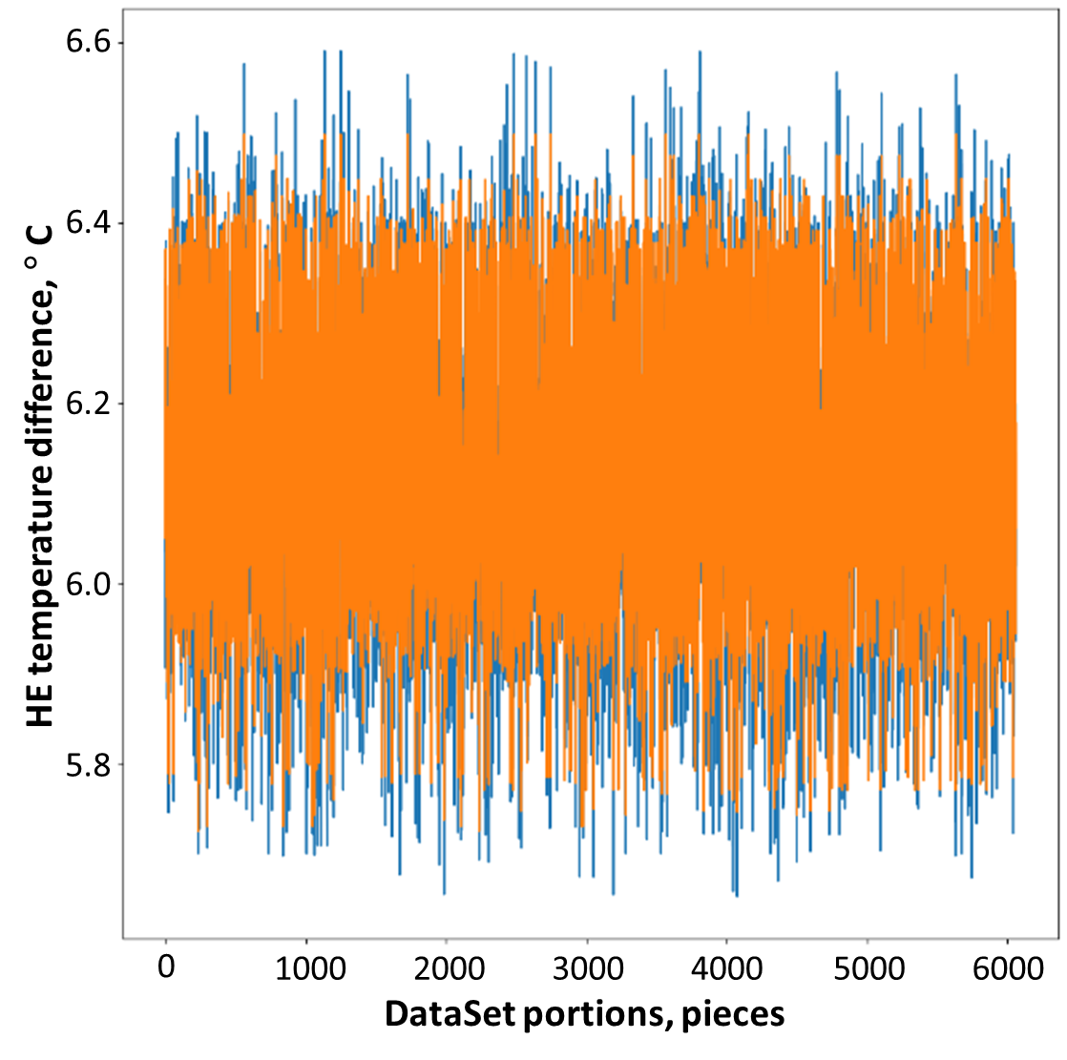
DT prediction with GBR
Predict
Default split (80/20) for training shows very good result.
Using the simple square analysis for the whole DataSet interval such results were obtained.
Prediction figure covers the real one on 0.90.
So the accuracy of prediction for the model is nearly 90 %.
Real

Slide 19
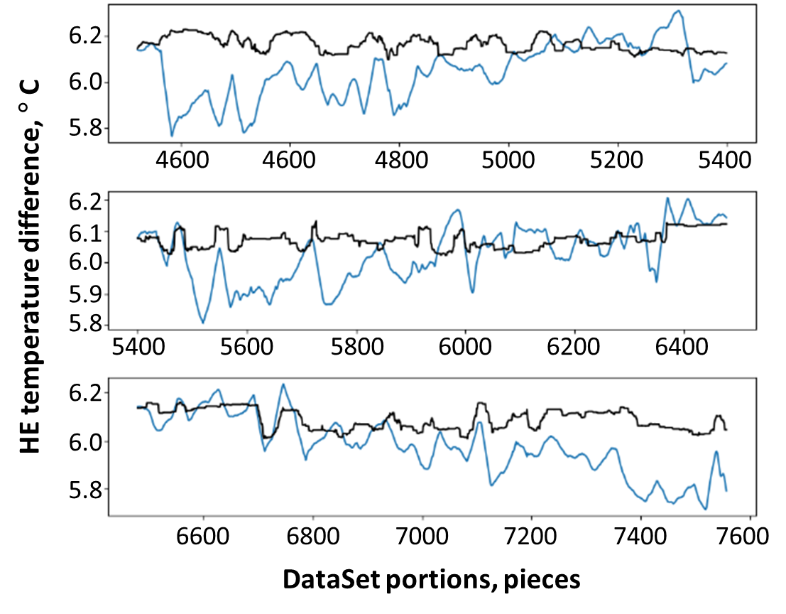
DT prediction with GBR
Final result is represented via graphs from Time Series, where blue line is a real state and black one – testing the model on unknown data.
The most important thing that model sees the peaks of the data, deviation from real state is not more than 0.1÷0.2 °C.
Even that model version can be used in manufacturing That deviation can be smoothed by adding more data and trainings.
Predict
Real

Slide 20
Conclusion
The unique CSVRefactorer utility was developed as preprocessing software for CSV-files from Simple SCADA system. That allows to reconstruct the files, divide the columns and differ time borders in 1 hour.
Transformers (One Hot Encoder + Standart Scaler) assembly was used for that study to make data in the more understandable for machine model way. That allows to decrease the error of modelling and improving the accuracy by 20 %.

Slide 21
Conclusion
The estimation of different machine learning models was made. According to the obtained data of temperature difference the best results is Gradient Boosting Regressor model with accuracy of about 0.1 °C.
Using that model for month and week estimation for the personnel 90 % accuracy of prediction might be obtained.

Slide 22
Efficiency assessment of IRT-T research reactor cooling system by machine learning methods
Postgraduation student: Maxim K. Kublinskiy, group A3-43
E-mail: mkk4@tpu.ru
Phone number: +7 (913) 882–29–19
30 October 2023

