Slide 1
Correlators in 6d-fishnet models
Ayss-2023
Iakhibbaev R.M.
BLTP JINR

Slide 2
Outline
Largrangian of biscalar fishnet model in arbitrary dimension
Graph-building operator and spectrum (+6d)
Exact correlation function
Strong coupling
Regge limit in Mellin amplitudes
Conclusion

Slide 3
Biscalar fishnet models in arbitrary dimensions
Kazakov,Olivucci’18
Lagrangian
Generalized Green’s functions
Propagators
No mother theory
No unitarity
Non-local in the general case
But exactly solvable (and conformal… sometimes)

Slide 4
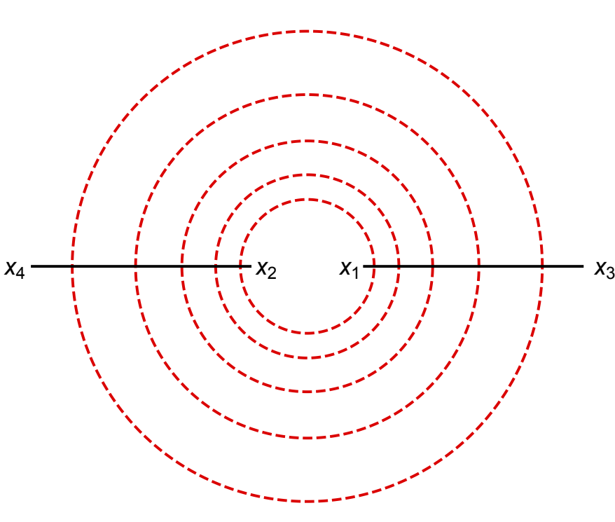
Graph-building operator and spectrum
Kazakov,Olivucci’18
Gromov, Korchemsky’19
Graph-building operator
2J point correlation function
Eigenvalues of graph-building operator
Geometric progression to sum up all actions of GBO:

Slide 5
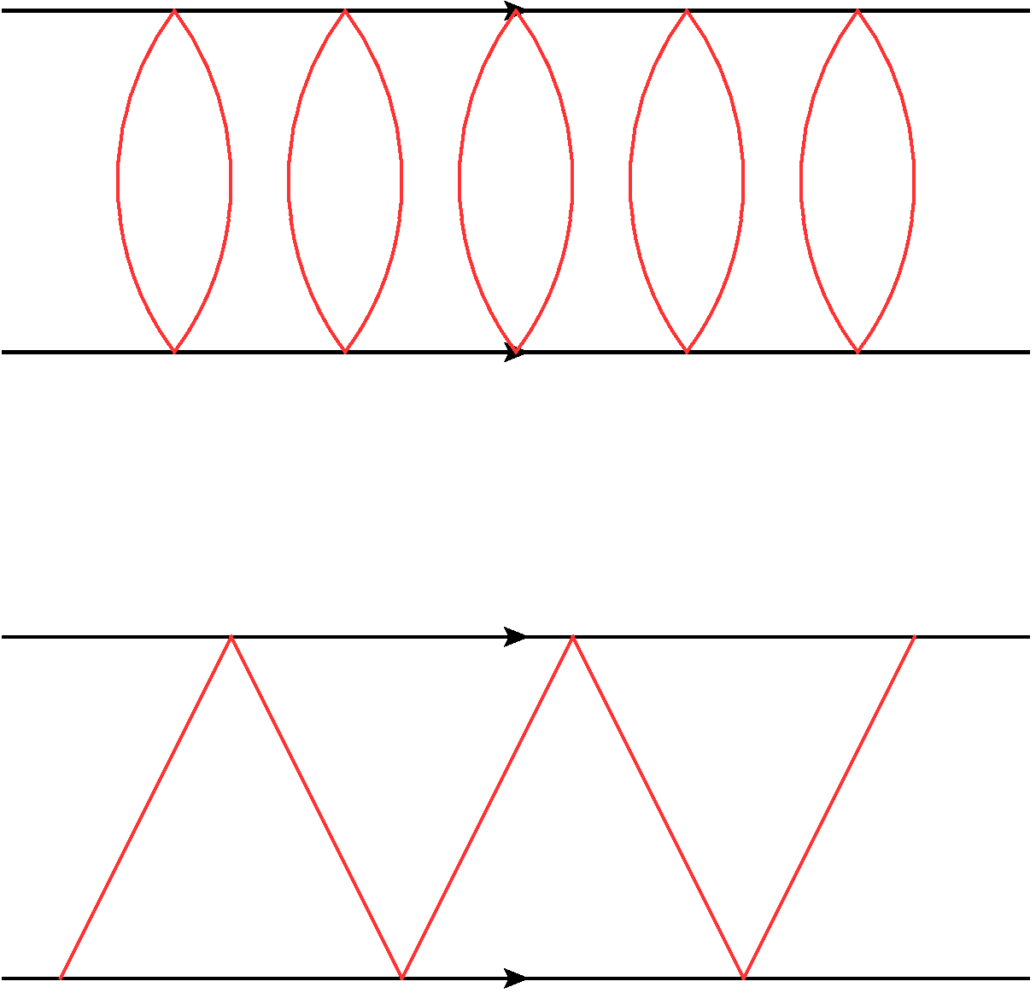
Diagram types
0-magnon
1-magnon
Have many applications (6d (1,1) SYM, or 4D N=4 SYM)
Close to conformal zig-zag diagrams (but general)

Slide 6
Zero-magnon spectrum
Eigenvalue of graph-building operator in 0-magnon case
Examples

Slide 7
One-magnon spectrum
Eigenvalue of graph-building operator in 1-magnon case
Examples

Slide 8
Exact correlation function
Kazakov,Olivucci’18
Exact 2J function:
OPE:
Structure constant
Conformal block

Slide 9
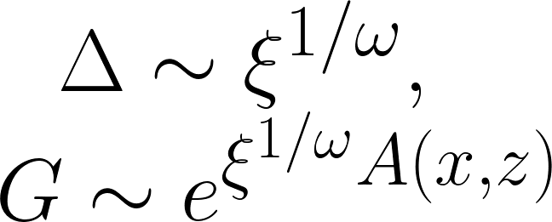
Strong coupling in 6d
Strong coupling regime comes from large spins
At large spin limit conformal block reduces to:
Correlation function can be obtained by steepest descent
For general
correlation function:
Valid also in the one-magnon case

Slide 10
Mellin amplitudes in Regge limit 6d
Chowdhury, Haldar,Ken’19
Correlation function
Factorization:
Simplification
Regge limit

Slide 11
Regge limit of Mellin amplitudes (weak coupling)
Leading Regge trajectory
Regge Mellin amplitude
LLA:
Coefficients of LA’s:

Slide 12
One-magnon Mellin amplitudes (weak coupling)
Correlation function in Mellin represesentation
Regge limit
LLA
Even spins
Coefficients of LA’s:
Odd spins

Slide 13
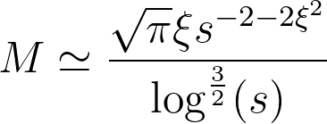
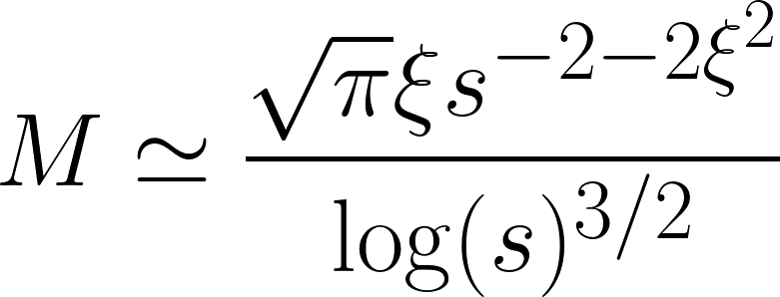
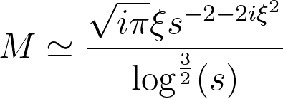
Regge limit of Mellin amplitudes (strong coupling)
Leading contribution comes from
Regge Mellin amplitude
Zero-magnon:
One-magnon:

Slide 14
Conclusion and prospectives
We computed spectrum for non-isotropic fishnets in 6d
We found exact correlation function
Exact Regge limits in terms of Mellin amplitudes (weak/strong coupling)
Celestial Mellin amplitudes for fishchain models to test
Multipoint amplitudes and correlation functions (splitting overlaps of wavefunctions?)
Spectrum for two-magnon operator

Slide 15
Thanks for attention

