Slide 1
Functional studies of a new microbial proteorhodopsin from Sphingomonas paucimobilis
Speaker: Sidorov Daniil
DBMP MIPT
Dubna, 2023 y.

Slide 2
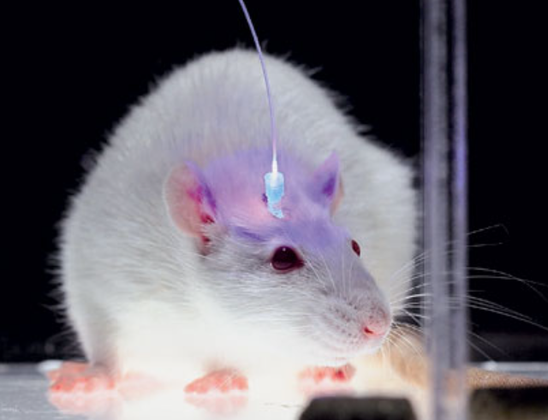
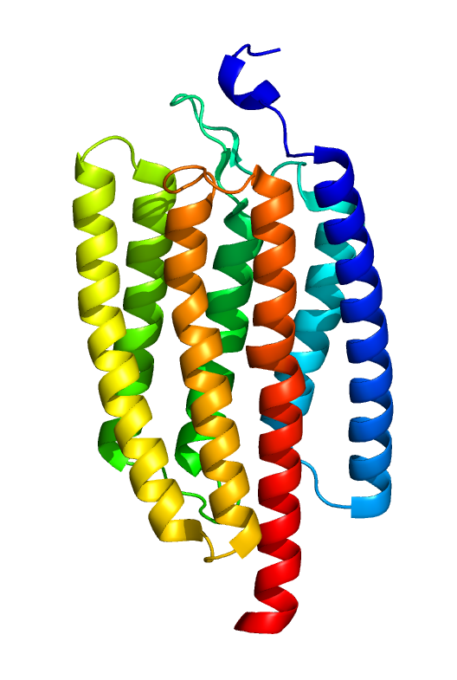
Introduction
Optogenetics
Nerve cell research
First application
ChR2
PDB ID: 6EID
https://www.nkj.ru/archive/articles/25571/
Notes:
Первый открытый микробный родопсин – BR. Ну и ещё открыли другие родопсины. В начале 2000х было много внимания к родопсинам, так как начала развиваться оптогенетик (управление и исследование нервной деятельностью)

Slide 3
Main methods of research
Registration of photocurrents (method of registration of photocurrents of proteoliposomes adsorbed on bilipid membrane (BLM), method of local potential fixation (patch-clamp))
Changes in ion concentration (pH measurement in cell suspension, fluorescence spectroscopy)
Time-resolved spectroscopy

Slide 4
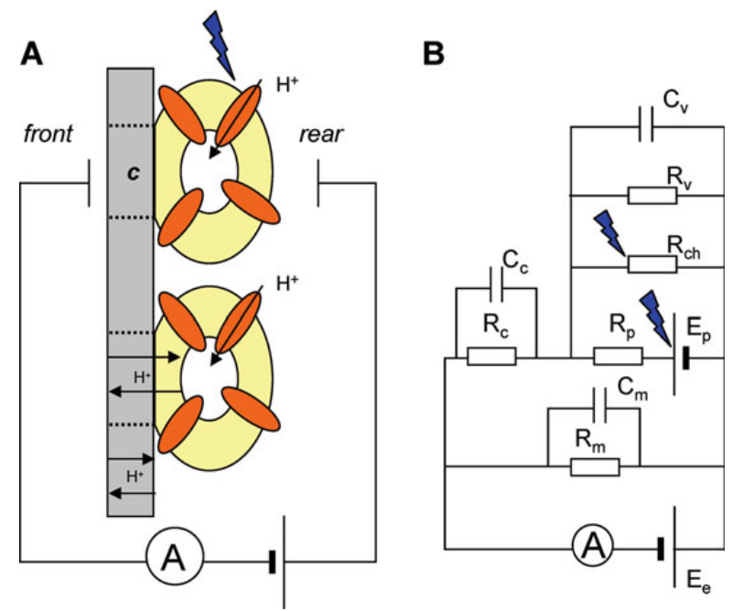
Schematic diagram of the installation for the BLM method

Slide 5
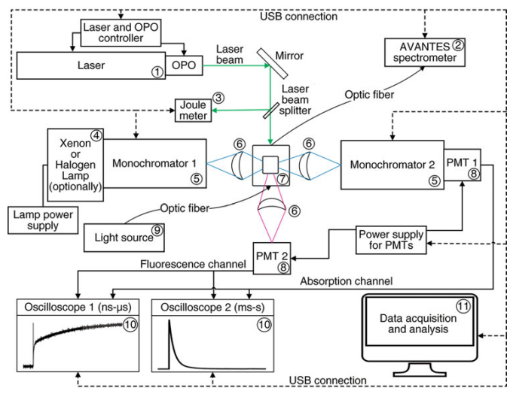
Time-resolved spectroscopy
https://link.springer.com/protocol/10.1007/978-1-0716-2329-9_8#DOI
Notes:
PMT -> ФЭУ

Slide 6
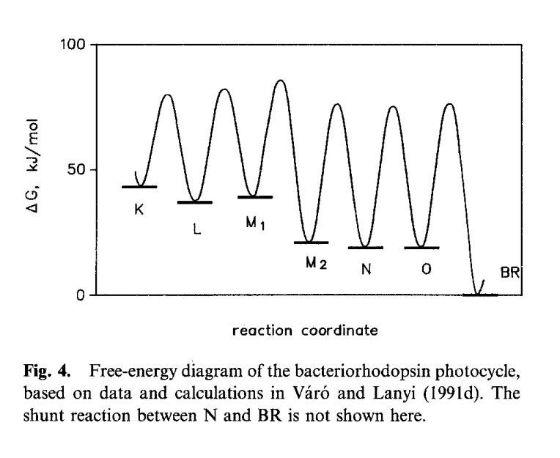
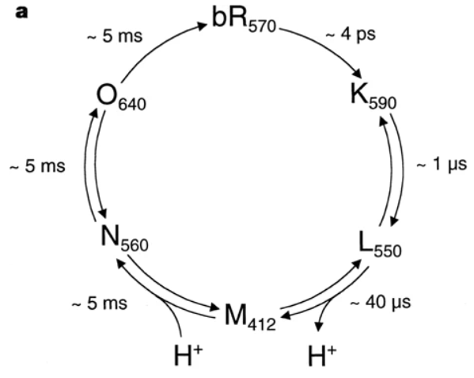
Photocycle and transition diagram for bR
Into the cytosol
Outside the cell
https://www.nature.com/articles/44623
https://link.springer.com/article/10.1007/BF00762675
Notes:
Кружочки, абсолютные и относительные спектры, диаграммы переходов (BR)

Slide 7
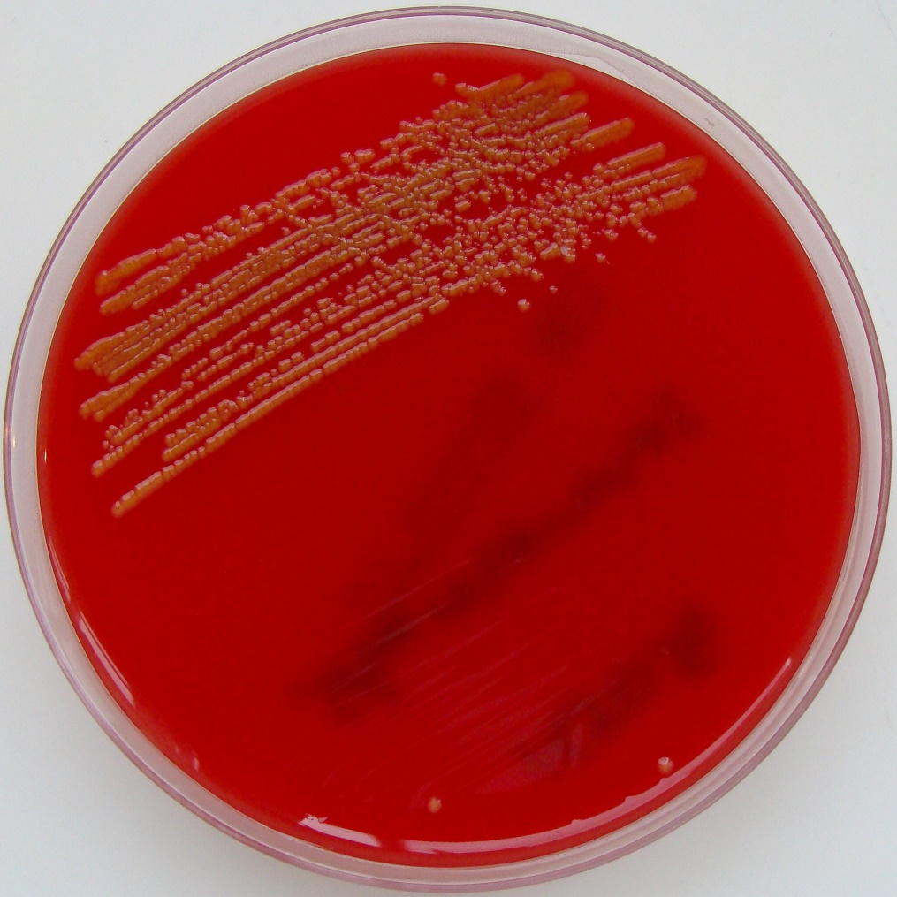
Sphingomonas paucimobilis
https://commons.wikimedia.org/wiki/File:Sphingomonas_paucimobilis_on_Columbia_Horse_Blood_Agar.jpg
Notes:
Ген SpaR принадлежит бактерии sphingamonus …, ктоторая принадлжети (семейство, род, вид), является апартунистом, используется в сельхоз промышленности

Slide 8
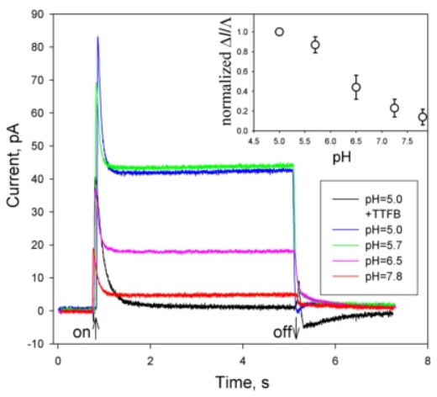
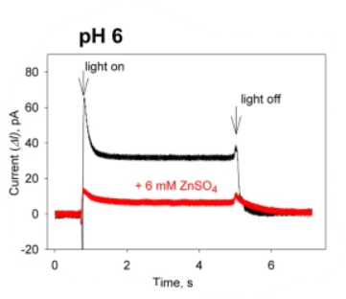
Results for SpaR
https://www.nature.com/articles/s42004-023-00884-8

Slide 9
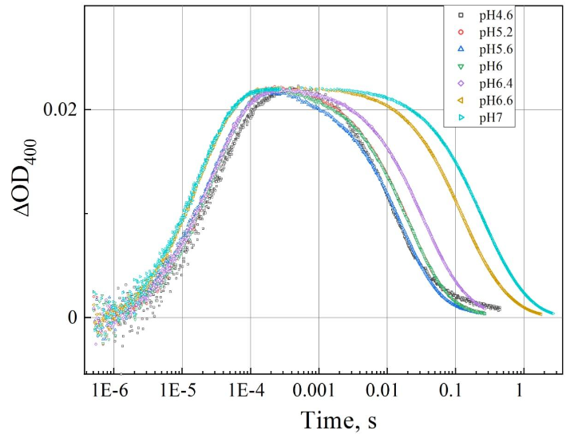
Results for SpaR
Notes:
Спектры! Extended data 9 PspR

Slide 10
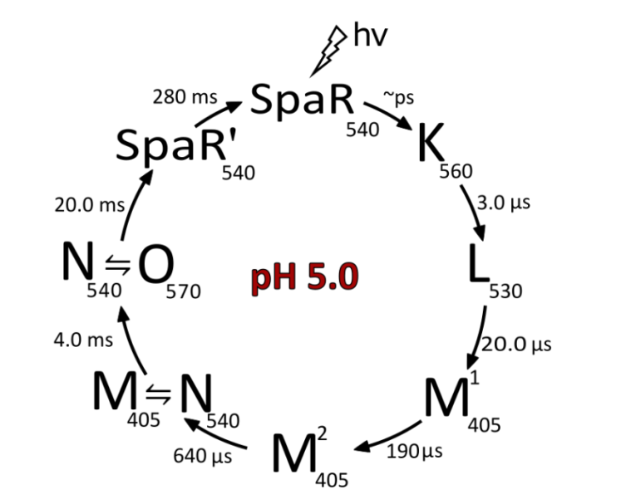
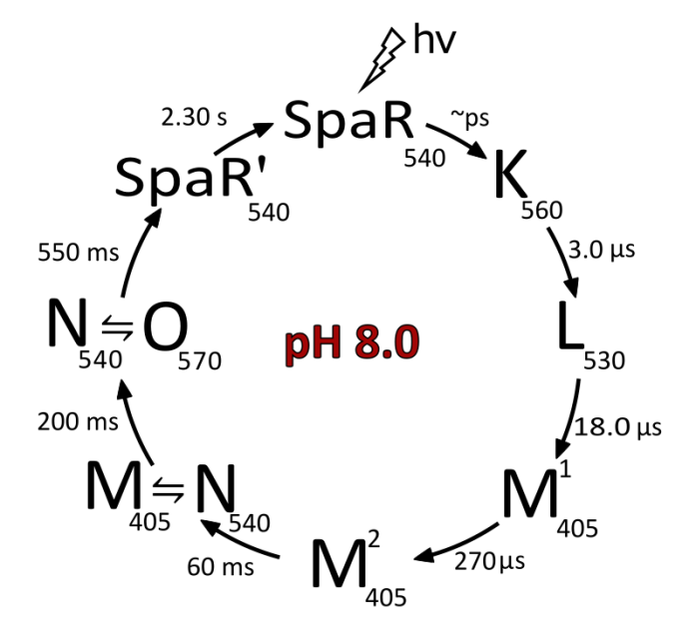
Times of the transitions of interest
Photocycles for SpaR
 | t, ms SpaR (pH = 5.0) | t, ms SpaR (pH = 8.0)
M¹ → M² | 0.19 | 0.27
M² → M↔N | 0.64 | 60.0
M↔N → N↔O | 4.00 | 200
Notes:
Появление О состояния (комментарий) M1-M2, M-N, N-O Таблица!!!

Slide 11
Conclusions
Expression, isolation, purification, functional tests
Dependence of efficiency on zinc ions and pH of the medium
SpaR is a representative of proteins from a family with a DTG/DTS motif; it is hypothesized that other proteins in this family may have similar properties

Slide 12
Thank you for your attention!

Slide 13
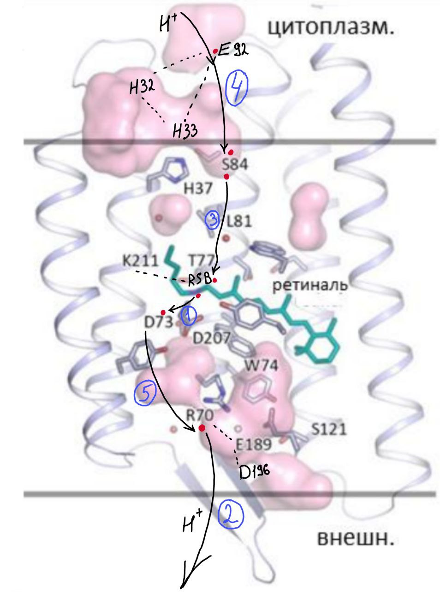
Структура SpaR
1) L→M¹
2) M¹→M²
3) M²→N
4) N→O
5) O→SpaR

Slide 14
Practical application
Action potential triggering, membrane depolarization and hyperpolarization
Cytosolic pH control
Controlling the triggering of apoptosis
Improvements in CAR-T therapy (against cancer)

