Slide 1
Studying of factors affecting the stoichiometry of the ATP synthase c‑ring.
A.V. Minaeva, S.D. Osipov¹, A.V. Vlasov^{1,2,3}, A.I. Kuklin*^{1,4}
¹Research Center for Molecular Mechanisms of Aging and Age-Related Diseases, Moscow Institute of Physics and Technology, 141700 Dolgoprudny, Russia
²Institute of Crystallography, RWTH Aachen University, 52066 Aachen, Germany
³Joint Institute for Nuclear Research, 141980 Dubna, Russia
⁴Physikalische Biochemie, Fachbereich Chemie, Technische Universität Darmstadt, Alarich-Weiss-Straße 4, 64287, Darmstadt, Germany
MIPT, 2021

Slide 2
Introduction
The F_{o}F₁ model of ATP synthase from spinach chloroplasts (Spinacia Oleracea) (PDB ID = 6FKF)
$N/3$ is the number of protons spent on the synthesis of 1 ATP molecule
Vlasov et al. 2022 «ATP synthase FOF1 structure, function, and structure‑based drug Design», Cellular and Molecular Life Sciences (2022) 79:179 doi.org/10.1007/s00018-022-04153-0

Slide 3
Introduction
Phylogenetic tree with published structural data on F-type ATP synthases
Vlasov et al. 2022 «ATP synthase FOF1 structure, function, and structure‑based drug Design», Cellular and Molecular Life Sciences (2022) 79:179 doi.org/10.1007/s00018-022-04153-0

Slide 4
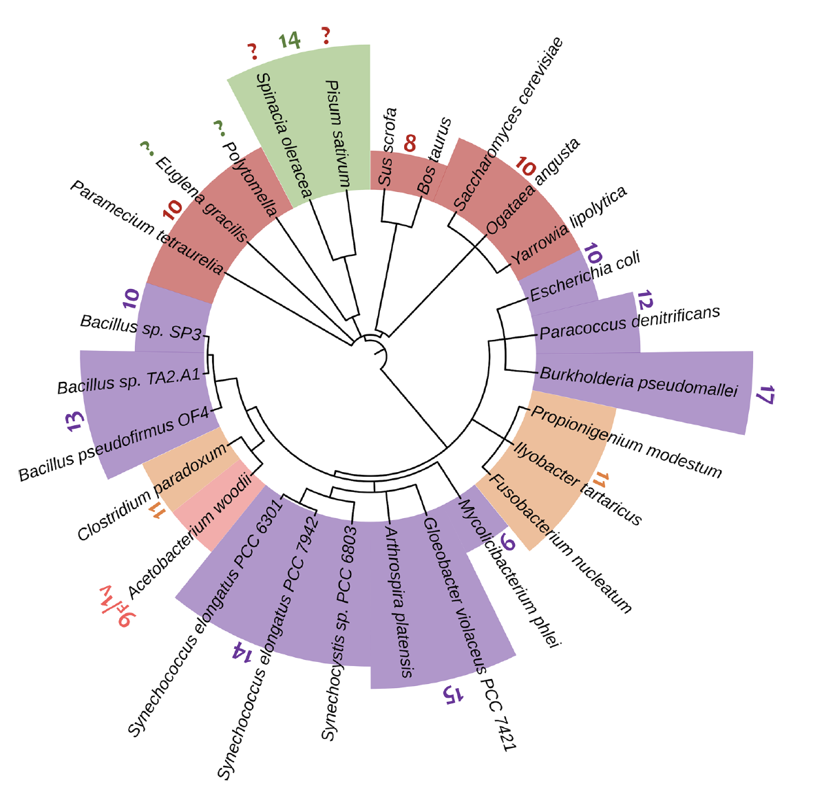
Introduction
Phylogenetic tree with published structural data on the stoichiometry of c-rings of F-type ATP synthases*
*C-ring of Acetobacterium
woodii $F/V$-type (Na⁺), the stoichiometry ${9F}/{1V}$
Vlasov et al. 2022 «ATP synthase FOF1 structure, function, and structure‑based drug Design», Cellular and Molecular Life Sciences (2022) 79:179 doi.org/10.1007/s00018-022-04153-0

Slide 5
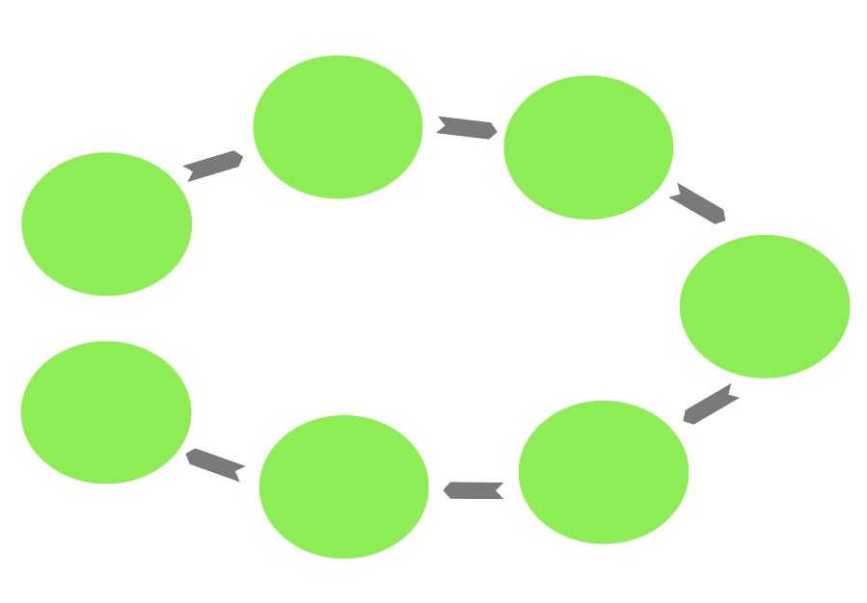
Scheme of the experiment
Analytical expression under different conditions
Overexpression
Assembling a genetic construct
Cell lysis
Visualization of results
Precipitation with ammonium sulfate
Solubilization

Slide 6
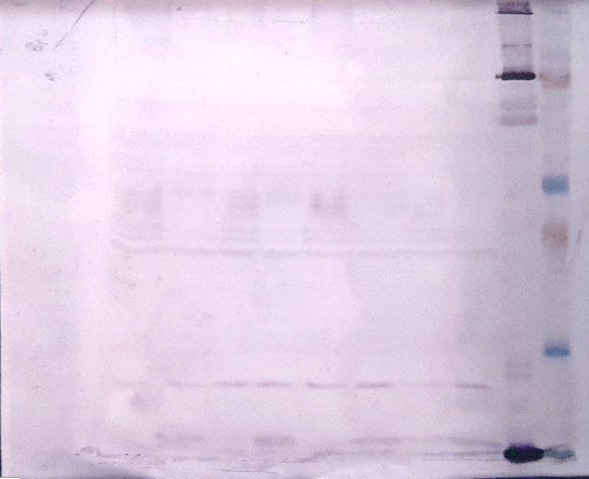
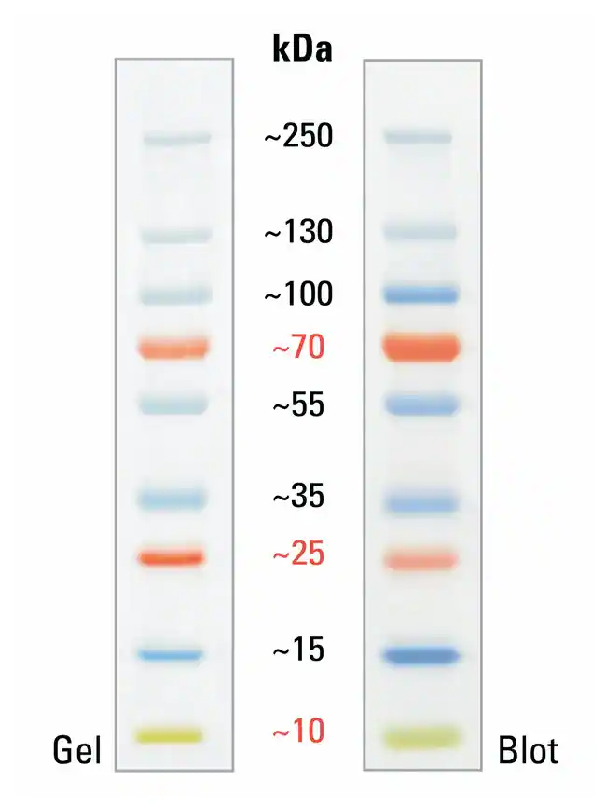
Results
Expression of pBKT7R_His8Tr_AtpH
Lysate Top10 sonificated in LB
Lysate Top 10 sonificated in LB, 5 minutes at T=95° in the buffer for SDS PAGE
Lysate Top10 sonificated in mQ
Lysate Top 10 sonificated in mQ, 5 minutes at T=95° in the buffer for SDS PAGE
Lysate Top10 sonificatedin LB
Lysate Top 10 sonificatedin LB, 5 minutes at T=95° in the buffer for SDS PAGE
Lysate Top10 sonificatedin mQ
Lysate Top 10 sonificatedin mQ, 5 minutes at T=95° in the buffer for SDS PAGE
1
2
3
4
5
6
7
8
ATP synthase

Slide 7
Results
Expression of c-ring in pBKT7R:atpH under different conditions
BL21 pBKT7R:atpH lysate expressed in TB with the addition of IPTG
BL21 pBKT7R:atpH lysate expressed in TB with lactose addition
BL21 pBKT7R:atpH lysate expressed in CM with addition of IPTG
BL21 pBKT7R:atpH lysate expressed in CM with addition of lactose
BL21 pBKT7R:atpH lysate expressed in LB with addition of IPTG
BL21 pBKT7R:atpH lysate expressed in LB with lactose addition
BL21 pBKT7R:atpH lysate expressed in 2YT with addition of IPTG
BL21 pBKT7R:atpH lysate expressed in 2YT with the addition of lactose
1
2
3
4
5
6
7
8
ATP synthase

Slide 8
Results
Expression of c-ring in pBKT7R:atpH under different conditions
C41 pBKT7R:atpH lysate expressed in TB with the addition of IPTG
C41 pBKT7R:atpH lysate expressed in TB with lactose addition
C41 pBKT7R:atpH lysate expressed in CM with addition of IPTG
C41 pBKT7R:atpH lysate expressed in CM with addition of lactose
C41 pBKT7R:atpH lysate expressed in LB with addition of IPTG
C41 pBKT7R:atpH lysate expressed in LB with lactose addition
C41 pBKT7R:atpH lysate expressed in 2YT with addition of IPTG
C41 pBKT7R:atpH lysate expressed in 2YT with the addition of lactose
1
2
3
4
5
6
7
8
ATP synthase

Slide 9
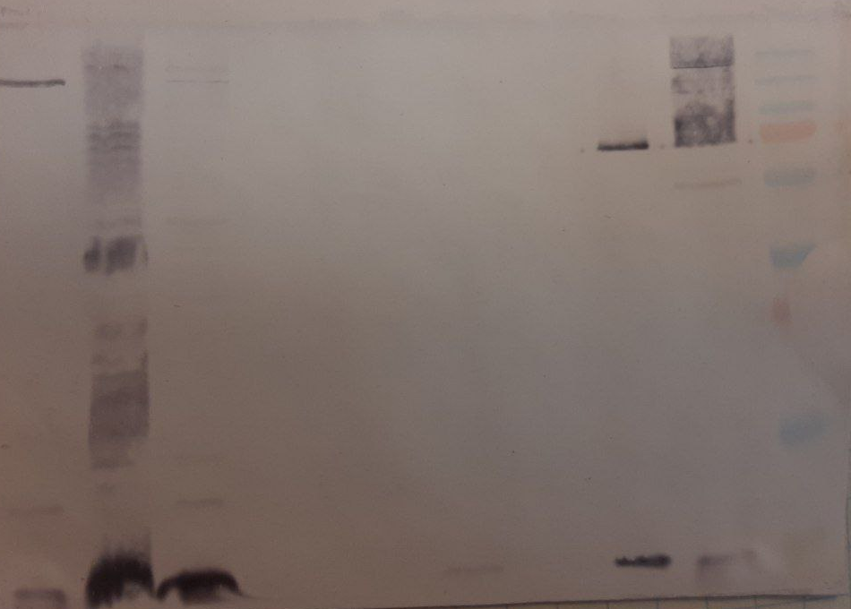
Results
Stages of isolation and purification of protein from E.coli C41 pBKT7R:atpH
Clarified Cell Lysate
Sediment after solubilization
Solubilizate
Precipitation with ammonium sulfate 3M
Precipitation with ammonium sulfate 2.5M
Precipitation with ammonium sulfate 2M
Precipitation with ammonium sulfate 1.5M
1
2
3
4
5
6
7
ATP synthase
Native c-ring

Slide 10
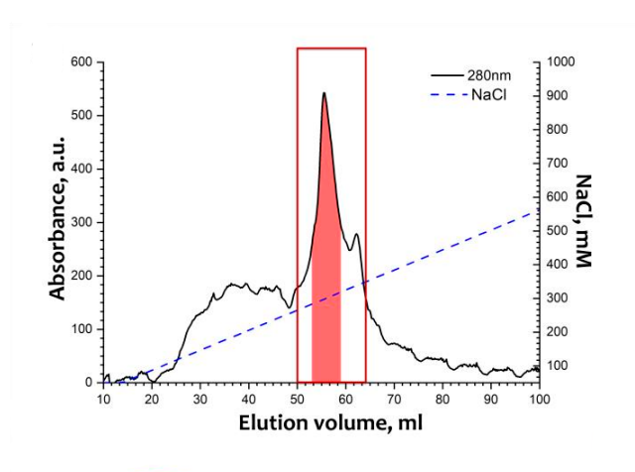
Results
Chromatogram of absorption of samples of native ATP synthase from spinach chloroplasts. Absorption was recorded at 280, 430 and 663 nm (black, orange and green lines, respectively). The NaCl concentration is shown by a blue dotted line.
Osipov S. D. et al. Evidence for the I-Shaped Dimers of a Plant Chloroplast FoF1-ATP Synthase in Response to Changes in Ionic Strength. – 2023

Slide 11
Results
a)
b)
c)
a) The Patterson function of the scattering curve
b) Reduced low‑resolution structure
c) Reduced low-resolution structure superimposed on the known cF_{o}F₁ ATP synthase protein map (PDB ID: 6FKF)

Slide 12
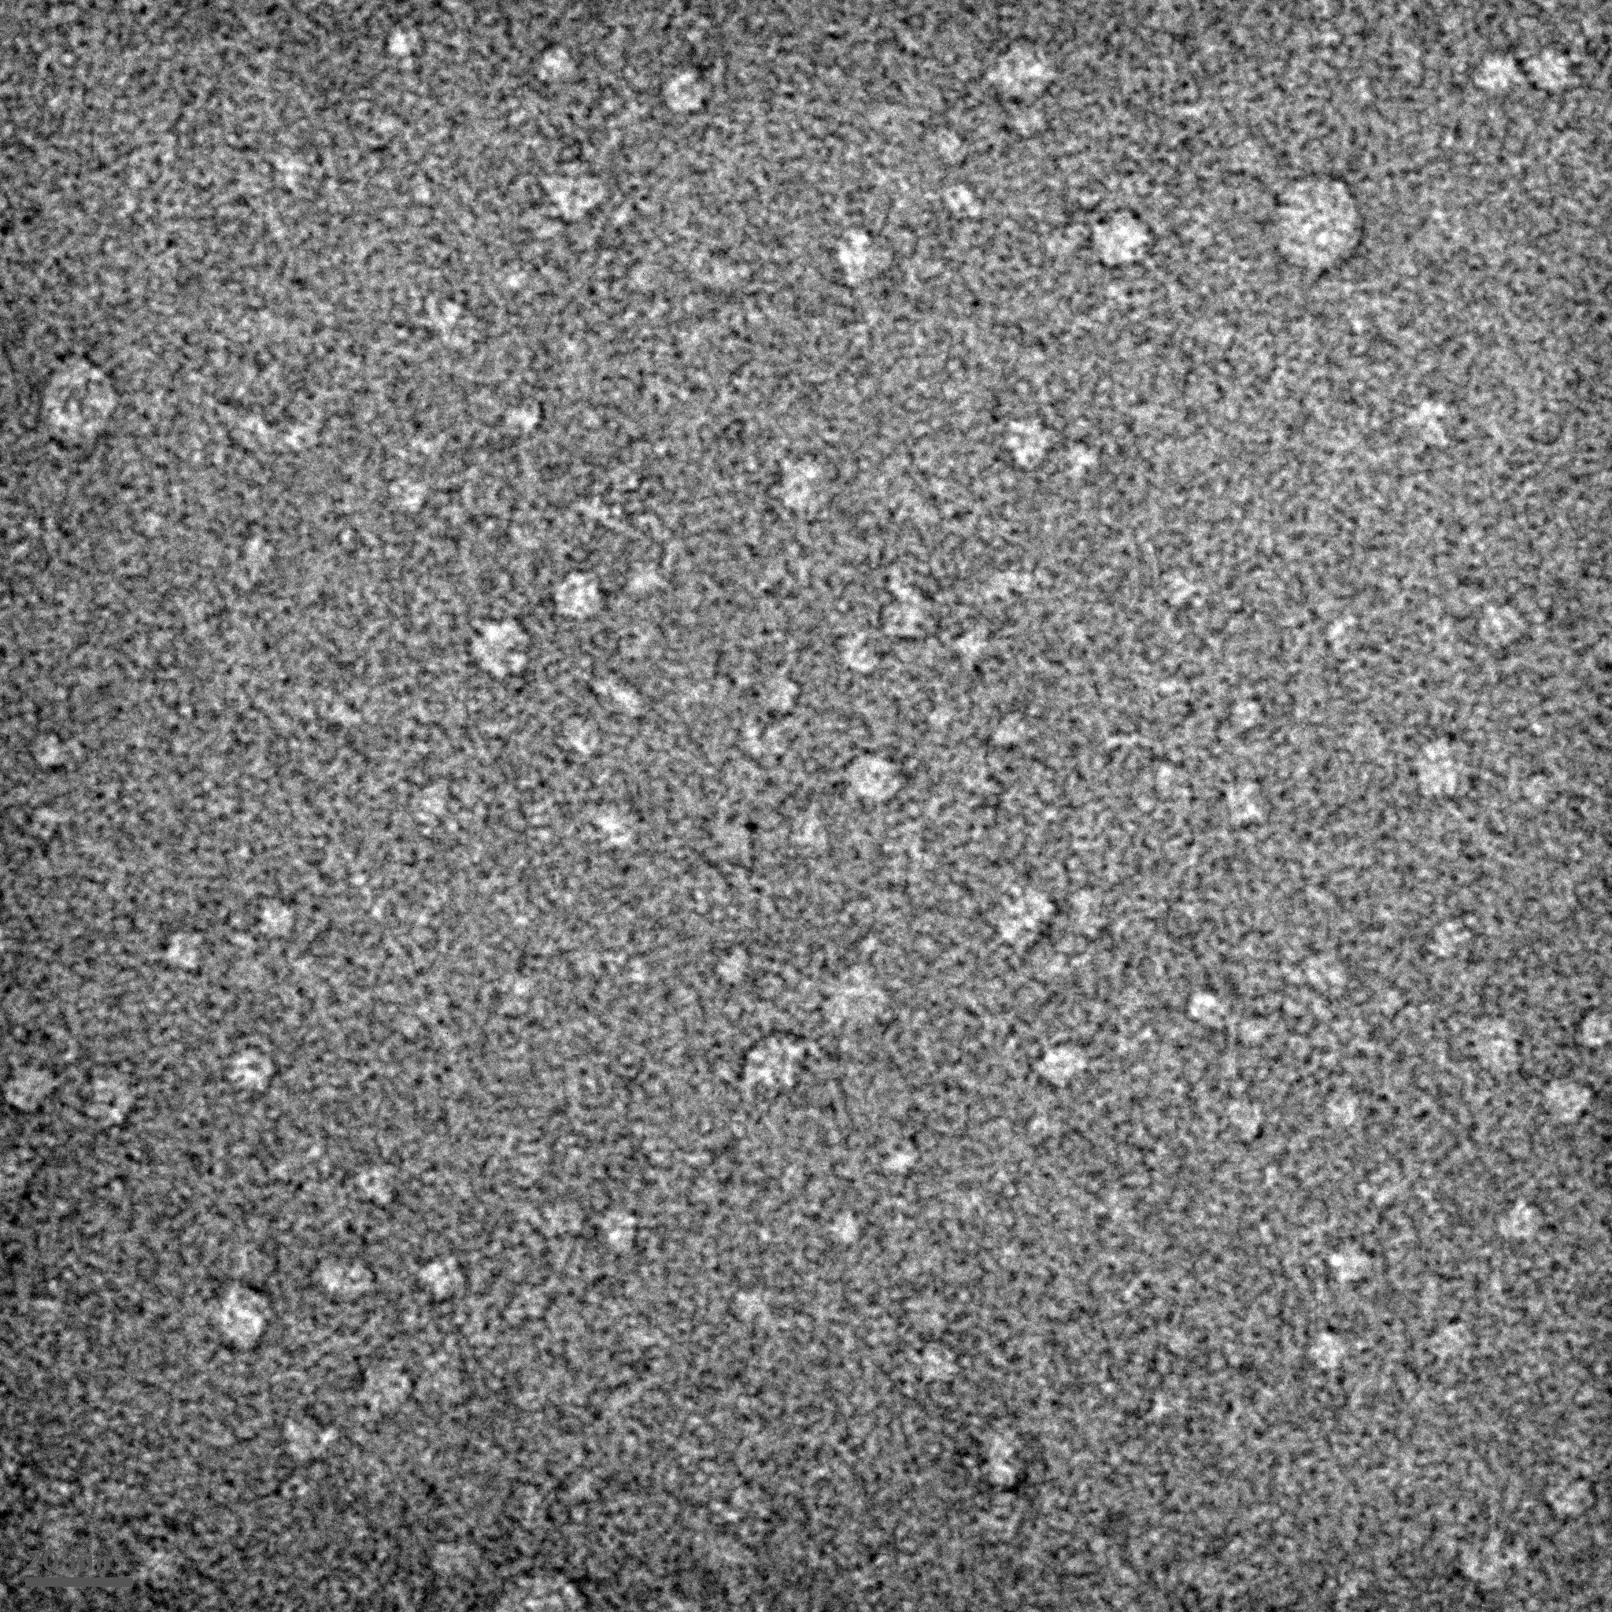
Results
Isolated and purified native c-ring of ATP synthase from spinach chloroplasts.
The image obtained using the method of negative contrast transmission electron microscopy and its fragment, which is overlaid with a high‑resolution model of the c-ring structure
(PDB ID:6TQJ) in scale.
20 nm
20 нм

Slide 13
Conclusion
The recombinant c-ring ATP synthase gene from spinach chloroplasts without His-tag was cloned in E.coli BL21 cells under different expression conditions.
The recombinant c-ring ATP synthase gene from spinach chloroplasts without His-tag was cloned in E.coli C41 cells under different expression conditions.
The screening of expression conditions was carried out, the conditions under which the assembly is carried out as efficiently as possible were found.
Native c‑ring and ATP synthase from spinach chloroplasts were isolated and purified.
​ATP synthase and c‑ring were studied by electron microscopy and small‑angle X-ray scattering.

Slide 14
Results
Expression of c-ring in pBKT7R:atpH
Lysate TOP 10 pBKT7R:atpH
Lysate TOP 10 pBKT7R:atpH, 5 minutes at T=95° in the buffer for SDS-PAGE
Lysate TOP 10 pBKT7R:atpH
Lysate TOP 10 pBKT7R:atpH, 5 minutes at T=95° in the buffer for SDS-PAGE
Lysate TOP 10 pBKT7R:atpH
Lysate TOP 10 pBKT7R:atpH, 5 minutes at T=95° in the buffer for SDS-PAGE
1
2
3
4
5
6
ATP synthase

Slide 15
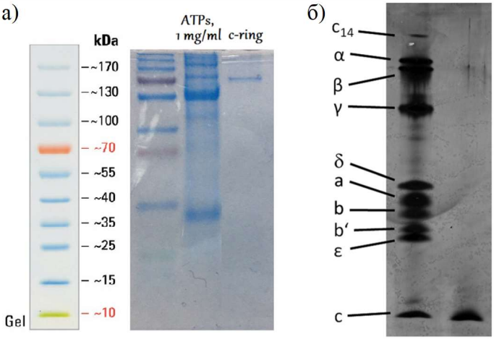
Results
Native c-ring and ATP synthase from spinach chloroplasts
b)
ATPs
c)
C-ring
a) The results of gel electrophoresis visualized with Coomassie method
b) Results of western-blotting
c) Subunit composition of purified spinach ATP synthase F_{o}F₁

