Slide 2
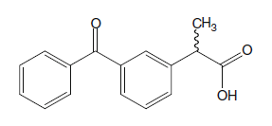
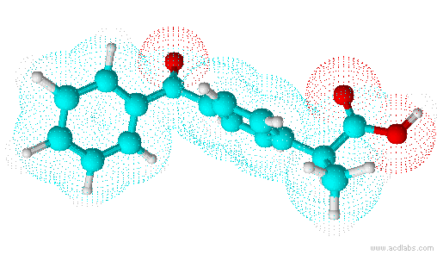
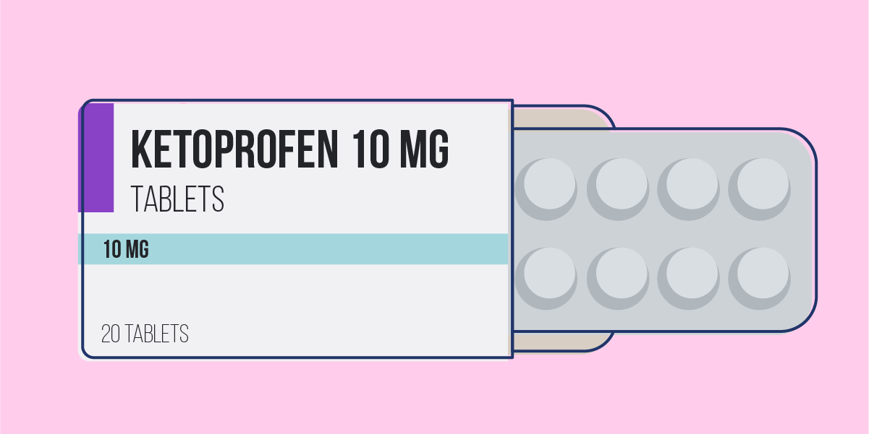
Ketoprofen - well-known representative of non-steroidal anti-inflammatory drug from the group of propionic acid derivatives.
IUPAC Name: 2-(3-benzoylphenyl)propanoic acid
high analgesic
anti-inflammatory
antipyretic activity
Fig. 1. Chemical structure of ketoprofen
Formula:
C₁₆ H₁₄ O₃
Molecular weight: 254.28 g/mol
Fig. 2. 3D structure of ketoprofen
2

Slide 4
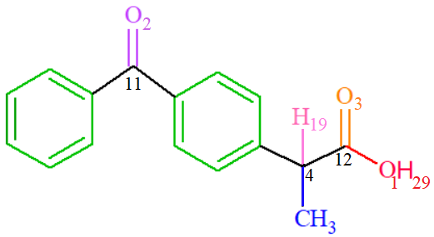
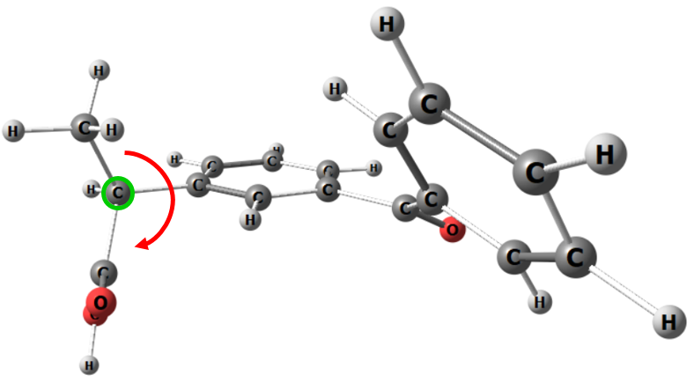
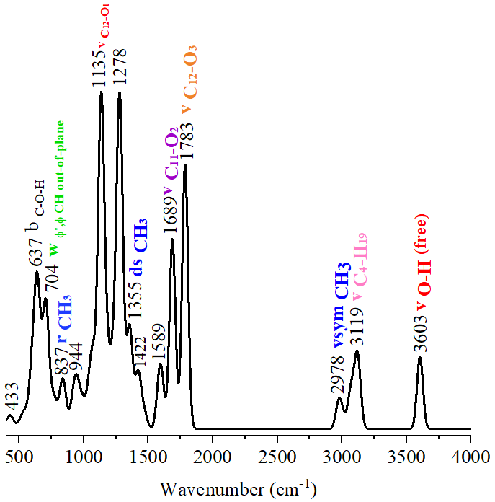
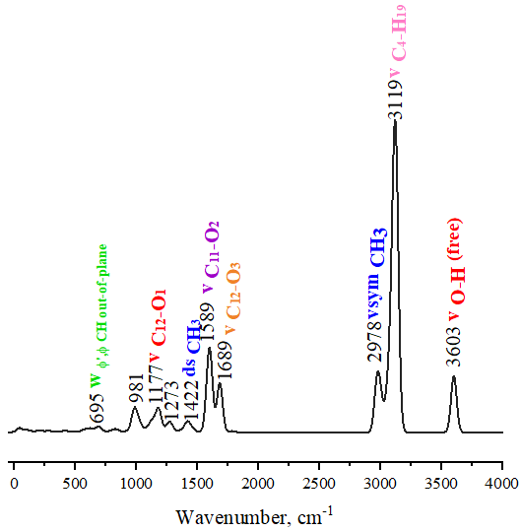
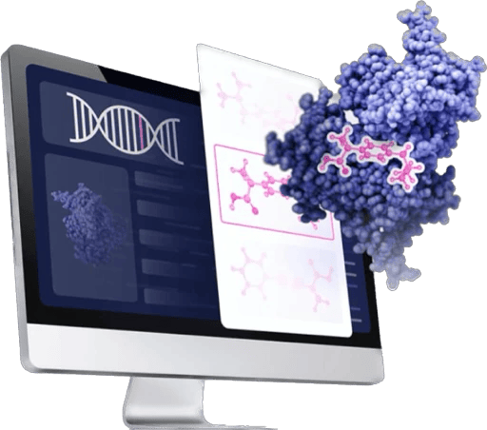
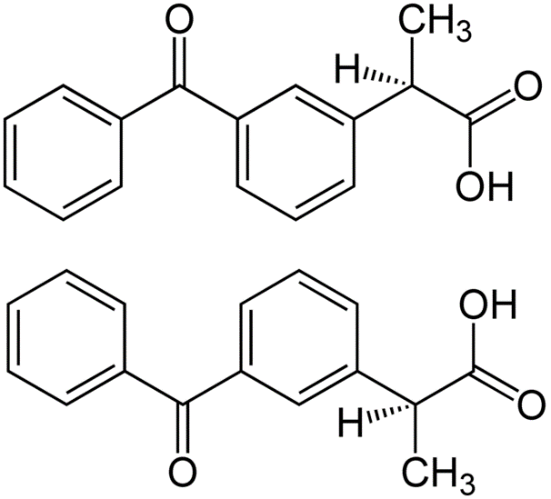
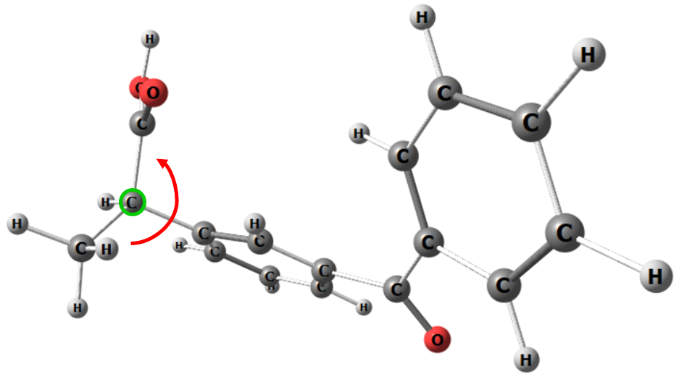
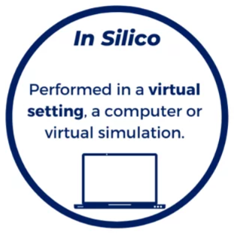
In silico IR and Raman spectroscopy of ketoprofen
Calculated spectra
DFT calculation on the BP86/def2-SVP level of theory (ORCA)^{[1]}
IR-spectrum
S enantiomer of ketoprofen
(biologically active)
Raman-spectrum
R enantiomer of ketoprofen
[1] Neese F. et al. The ORCA quantum chemistry program package //The Journal of chemical physics. – 2020. – Т. 152. – №. 22. – С. 224108.
4

Slide 5
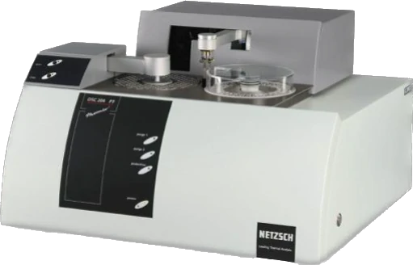
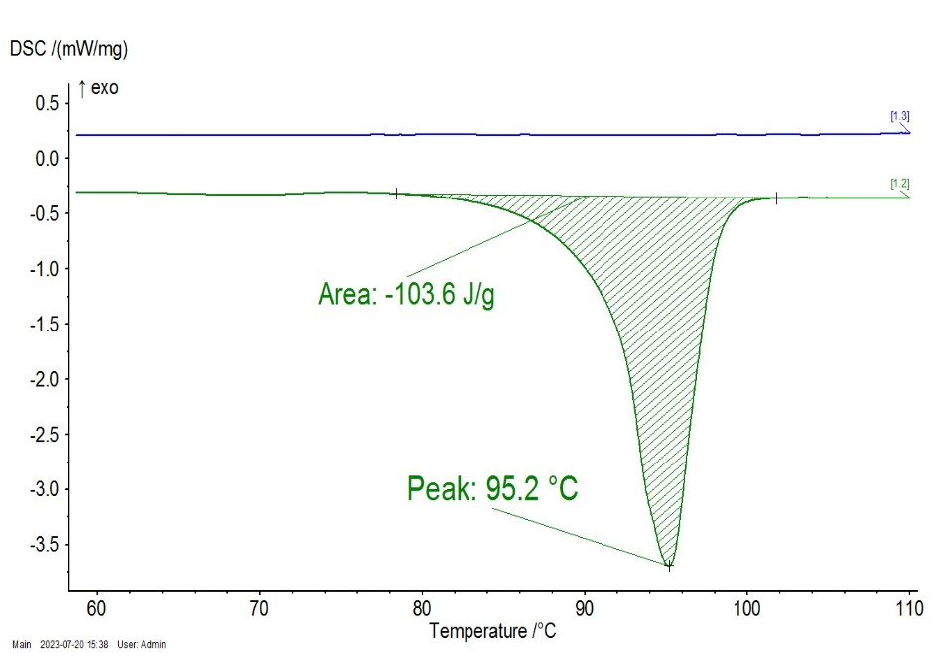
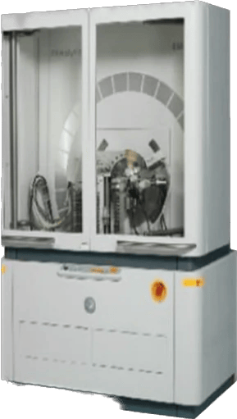
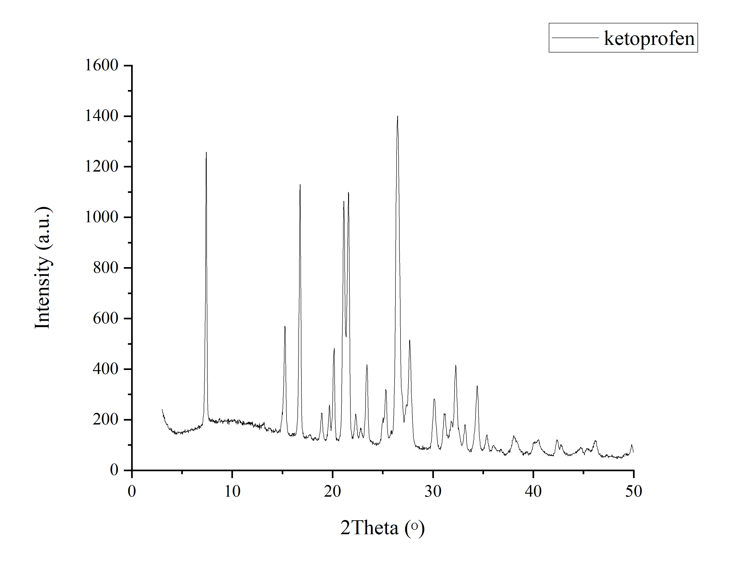
Differential Scanning Calorimetry (DSC) of ketoprofen
Melting point = 95.2 ˚C
The melting point of the sample corresponds to the racemic mixture of ketoprofen.
NETZSCH DSC 204 F1 Phoenix
calorimeter (FLnP JINR)
Heating rate - 10°C/min;
Inert atmosphere (Ar); Temperature range:
25–100°С.
DSC curve of ketoprofen sample
X-Ray powder diffraction (XRPD) of ketoprofen
X-Ray powder diffractogram of the ketoprofen sample contains sharp peaks which are indicate the crystalline structure of the object.
By the X-ray powder diffraction and DSC, it was confirmed that the ketoprofen sample is in a crystalline form and corresponds to a racemic mixture of ketoprofen.
X-ray Diffractometer
EMPYREAN (PANalytical) (FLnP JINR)
NETZSCH DSC 204 F1 Phoenix
calorimeter
Radiation: Co metal target; Kα filter; λ=1,7889 Å;
The range 2θ: 5-60°.
X-ray diffractogram of ketoprofen sample
5

Slide 6
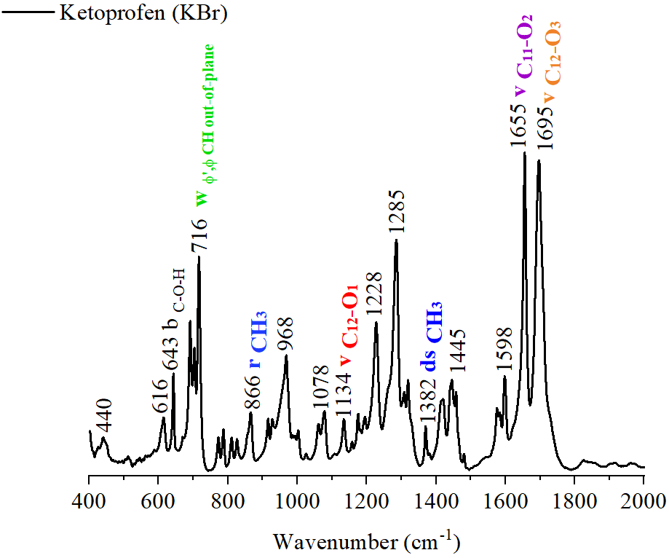
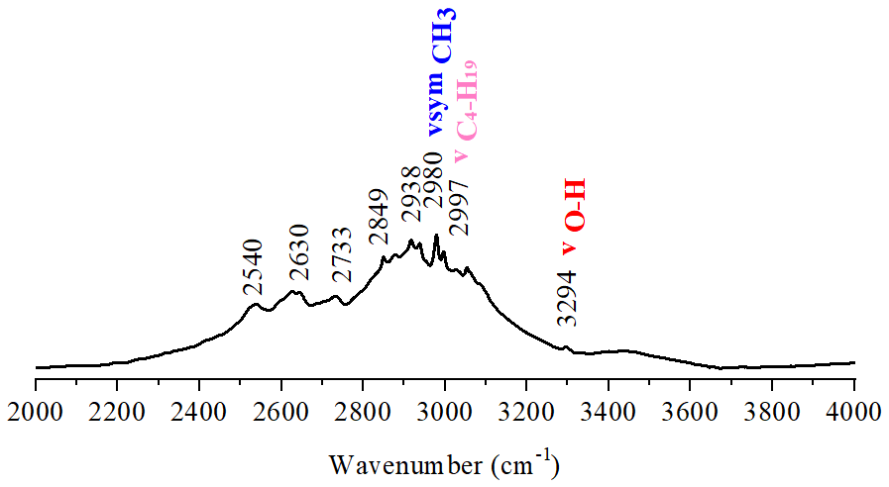
Fourier-transform infrared spectroscopy (FTIR) of ketoprofen
Stretching of the carbonyl bonds
Hydroxide group stretching
Stretching with deformation of aromatic rings bonds
Experimental spectrum
The frequencies were correlated with the oscillation modes by matching the calculated and experimental data.
Nicolet iS5 FTIR spectrometer
The IR spectrum of ketoprofen in a KBr disks (about 0.3% (by weight)) was recorded at the Kurchatov Institute Research Center (Сomplex of NBICS-technologies).
The range 400-4000 cm⁻¹
Type: IR transmission spectroscopy
6

Slide 7
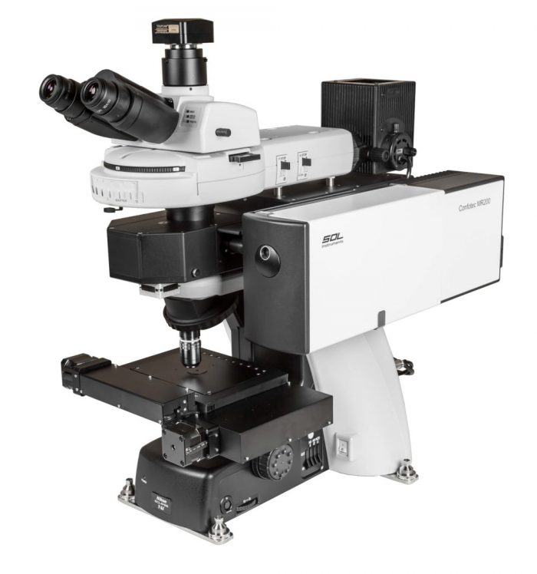
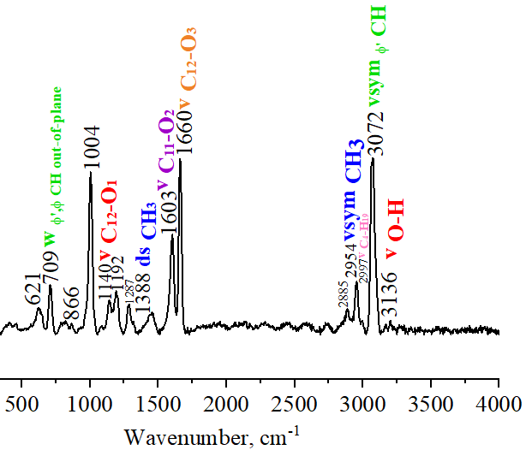
Raman-spectroscopy
Experimental spectrum
Microimage of a ketoprofen sample
Confotec MR200 microspectrometer combined with NIKON Ni upright microscope (FLnP JINR)
The frequencies were correlated with the oscillation modes by matching the calculated and experimental data.
Measuring range:
400-4000 cm⁻¹
λ = 473 nm
7

Slide 8
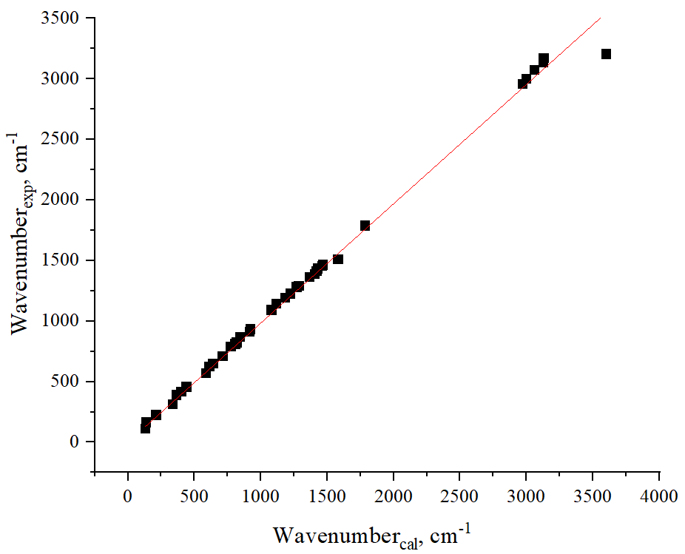
Experimental vs in silico IR and Raman spectroscopy of ketoprofen
ν_{exp} = (0,99± 0,00)*ν_{cal}
ν_{exp} = (0,984± 0,006)*ν_{cal}
R = 0,99953
R = 0,99833
For IR spectroscopy
For Raman- spectroscopy
There is a good agreement between the experimental and calculated in the DFT approximation oscillation frequencies of ketoprofen with a values of the coefficients of linear correlation.
The selected level of theory (BP86/def2-SVP) corresponds well to the experimentally obtained spectra and is suitable for predicting the parameters of IR and Raman spectrum of ketoprofen.
8

Slide 9
Main characteristics of investigated ketoprofen sample determined by experimental methods correspond to those given in the literature for racemic mixture.
By the X-ray powder diffraction and DSC, it was confirmed that the ketoprofen sample is in a crystalline form and corresponds to a racemic mixture of ketoprofen.
A joint analysis of the experimental and molecular modeling data was carried out. As a result, assignment of peaks in the experimental IR and Raman spectra of ketoprofen with main structural fragments of ketoprofen was performed. The most intensive peaks in these spectra corresponds to the v(C-O) and v(C=O) vibrations.
There is a good agreement between the experimental and calculated in the DFT approximation oscillation frequencies of ketoprofen using the selected level of theory (BP86/def2-SVP).
9

Slide 10
Acknowledgments
Frank Laboratory of Neutron Physics
Alexander V. Belushkin,
Gregory M. Arzumanyan,
Tatiana N. Vershinina,
Olga Yu. Ponomareva,
Dorota Marta Chudoba,
Elena V. Raksha,
Alexander B. Eresko,
Kahramon Mamatkulov
Kazan Federal
University
Institute of Physics
Liudmila I. Savostina
Kurchatov Complex of NBICS-nature like technologies
Sergey N. Malakhov
10

