Slide 1
Characterization of ibuprofen by IR-spectroscopy and other complementary methods
Student of KFU: Gergelezhiu Polina
Scientific supervisors:
Liudmila Savostina Ph.D.,
Associate professor of the department
«Physics of molecular Systems» of KFU;
Dorota Chudoba Ph.D.,
Scientific Secretary, FLNP JINR;
Elena Raksha Ph.D.,
Senior researcher, FLNP JINR.

Slide 2
Purpose and objectives
Purpose of the study is the complex investigation of ibuprofen by experimental and quantum-chemical methods in order to reveal the key structural parameters that characterize the properties of this compound in the condensed matter.
The main tasks of the study are:
investigation of ibuprofen by NMR spectroscopy;
characterization of ibuprofen by DSC method;
determination of the main characteristics of ibuprofen by powder X-ray diffraction;
investigation of ibuprofen sample by FTIR and Raman spectroscopy;
calculations of vibrational frequencies of ibuprofen enantiomers by DFT methods;
joint analysis of the results of experimental studies and molecular modeling.
2

Slide 3
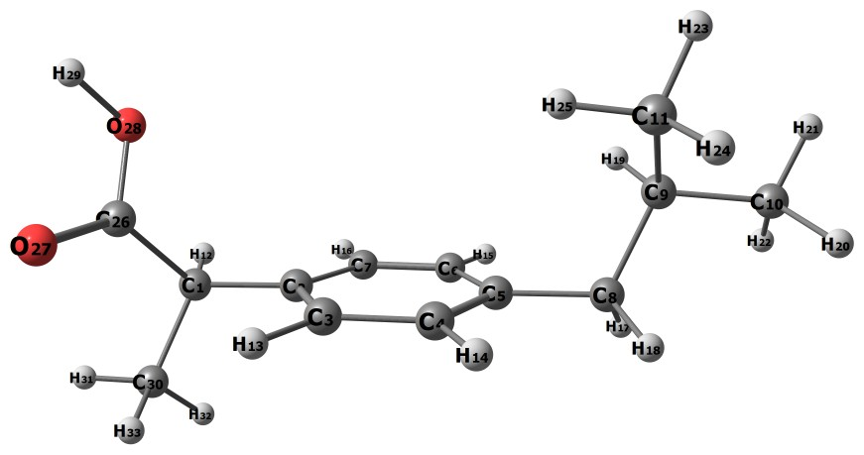
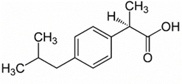
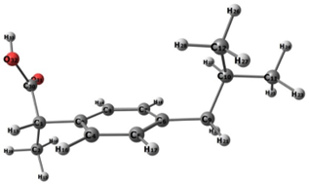
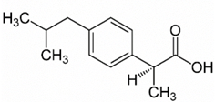
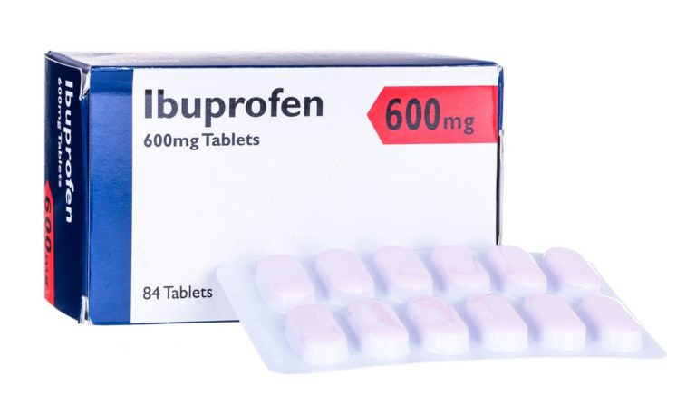
Object
S(+)-ibuprofen
active
R(-)-ibuprofen
Molecular formula: C₁₃H₁₈O₂
Chemical name: 2-[4-(2-methylpropyl) phenyl] propanoic acid
Molecular weight: 206.28 g/mol
3

Slide 4
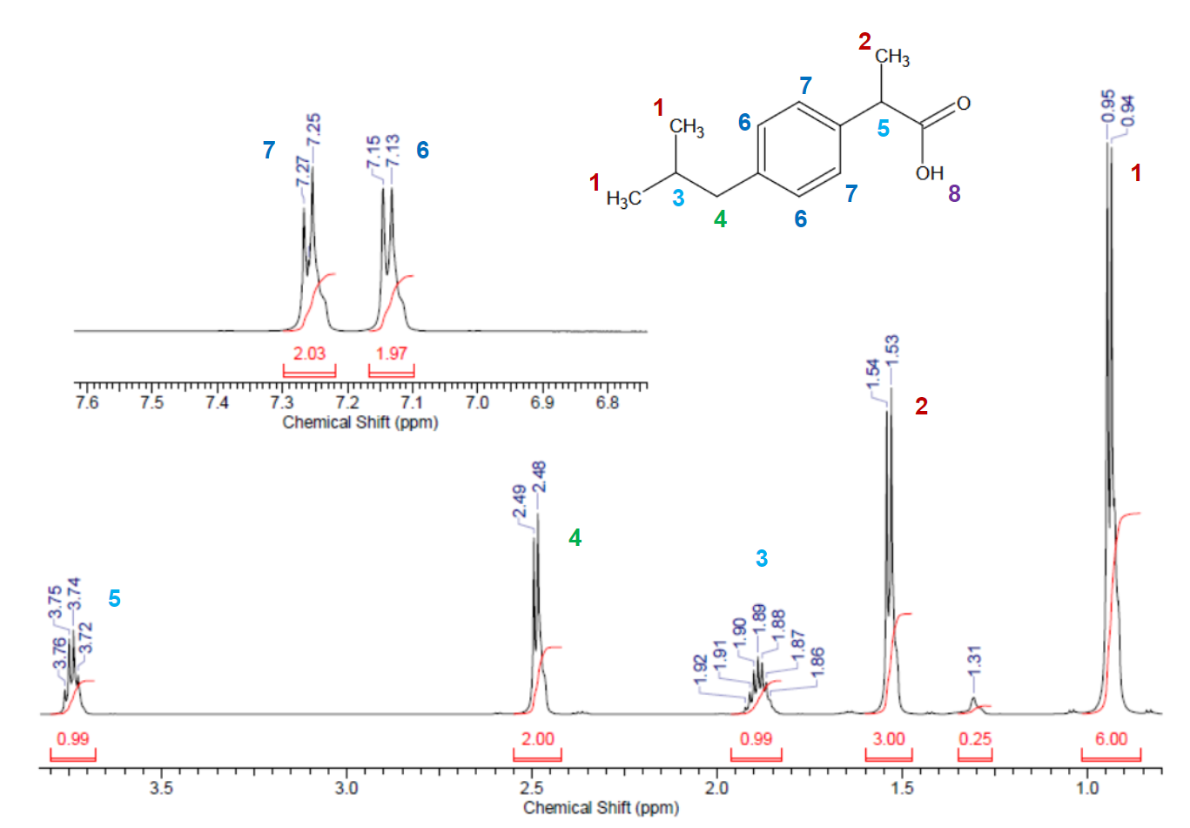
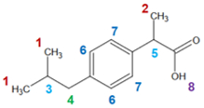
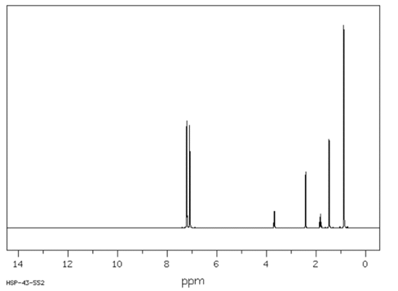
¹Н NMR-spectrum of ibuprofen
NMR spectrometer Bruker AVANCE III 600 MHz at FRC Kazan Scientific Center of the Russian Academy of Science.
The obtained spectrum of ibuprofen was compared with coresponding one from the database of organic compounds SDBS [1] (the frequency of the spectrometer is 400 MHz).
1
7 6
2
4
5
3
The sample contains pure ibuprofen and it can be used for further studies.
4
[1] Aist. [Electronic resource]: – URL: https://www.aist.go.jp/index_en.html /. – Access mode: open.

Slide 5
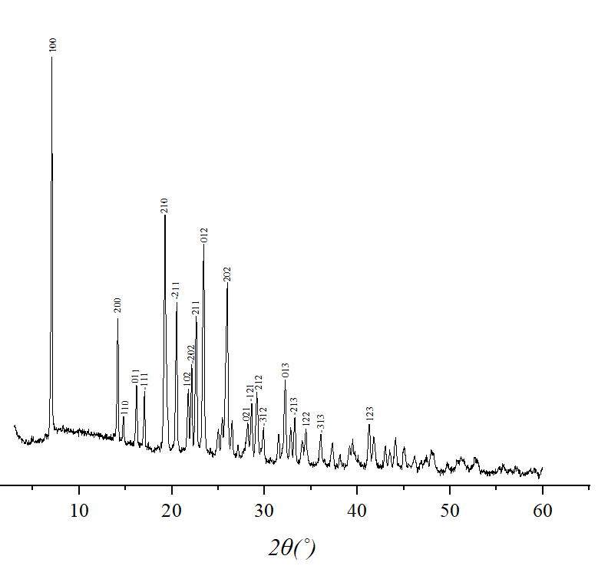
X-ray powder diffraction of the ibuprofen
The peaks recommended for the identification of ibuprofen racemate correspond to the interplane distances:
d = 5.35 Å (210),
d = 4.411 Å (012),
d = 3.991 Å (202).
PAN Analytical Diffractometer
Co metal target, Kα filter, voltage 40 kV, 40 mA current, 2θ˚ range: 5-60°.
Crystallographic parameters | Values from ^{[2]} | Values estimated with Pcw^{[3]}
a (Å) | 14.667 | 14.690
b (Å) | 7.899 | 7.916
c (Å) | 10.731 | 10.754
Alpha (˚) | 90.000 | 90.000
Beta (˚) | 99.460 | 99.434
Gamma (˚) | 90.000 | 90.000
Volume (m³) | 1.226*10⁻²⁷ | 1.233*10⁻²⁷
The ibuprofen sample under study was in a crystalline state and did not contain amorphous phases. The crystal structure parameters obtained from the experimental diffraction pattern confirmed that ibuprofen powder has a monoclinic type of structure.
2. ICCDD PDF-4. [Electronic resource]: – URL: https://www.icdd.com/ . – Access mode: close.
3. The program PowderCell is a crystallographic tool for visualization of crystal structures.
5

Slide 6
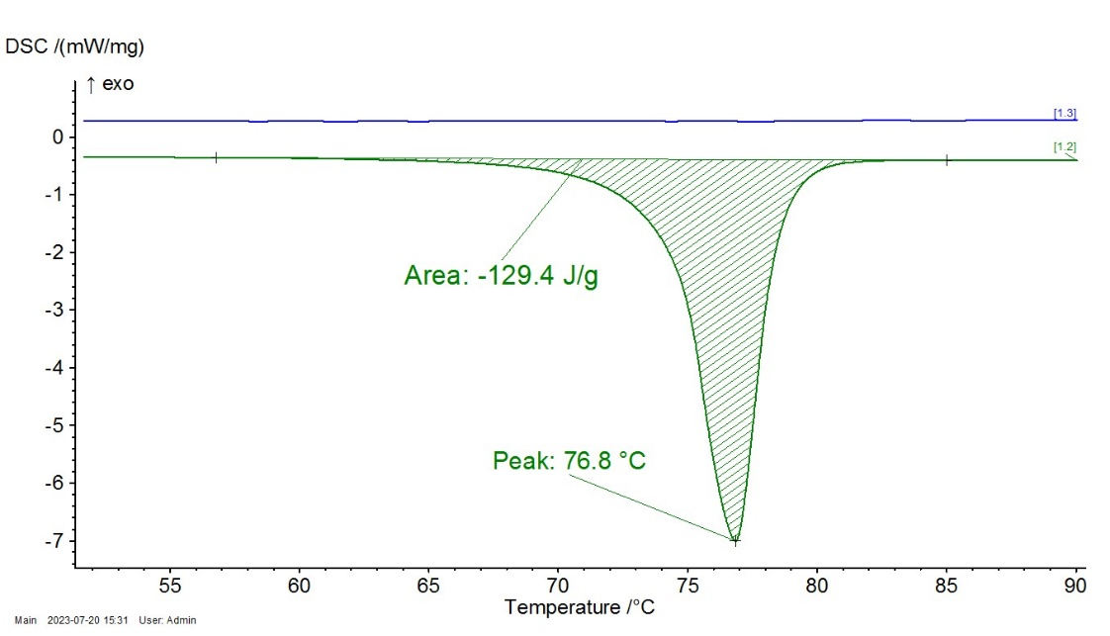
DSC of the ibuprofen
Differential Scanning Calorimetry (DSC) experiments were carried out in a DSC 204 F1 from Netzsch with a heating rate of 10 ˚C/min. A small amount of sample 3,3 mg was enclosed in a hermetic aluminum pan. The measurements were carried out in an argon atmosphere. Heating was carried out up to 100 ˚C.
The melting point of the sample corresponds to the racemic mixture of ibuprofen
6

Slide 7
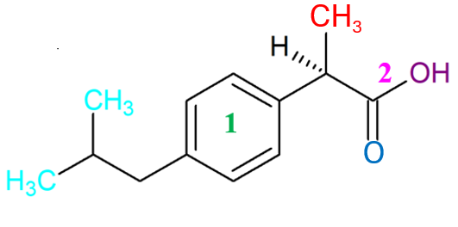
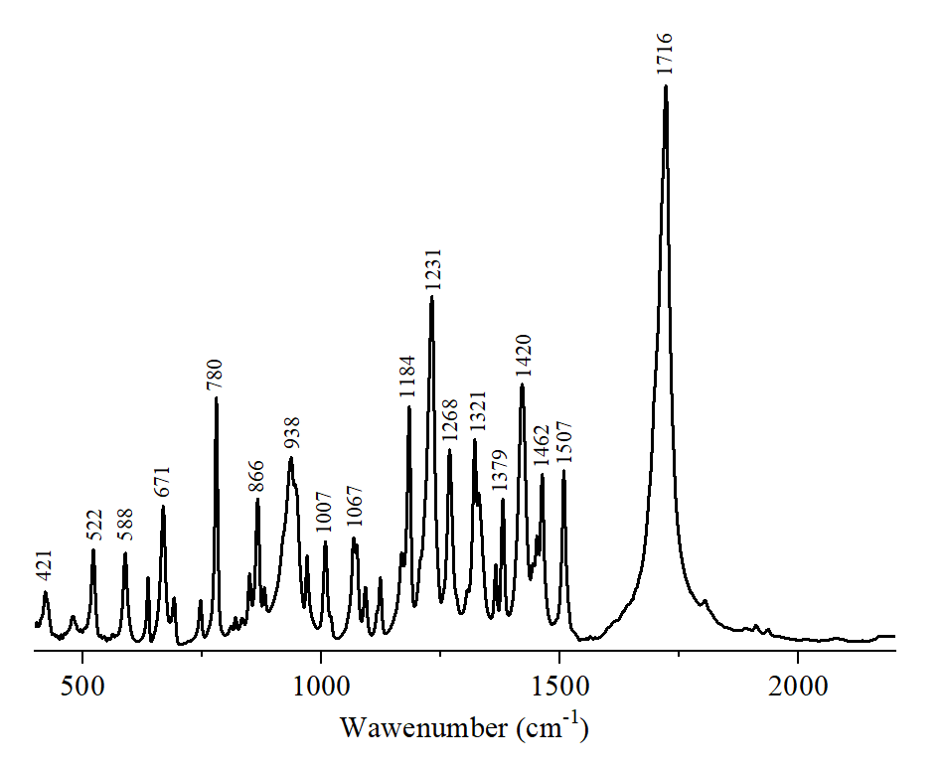
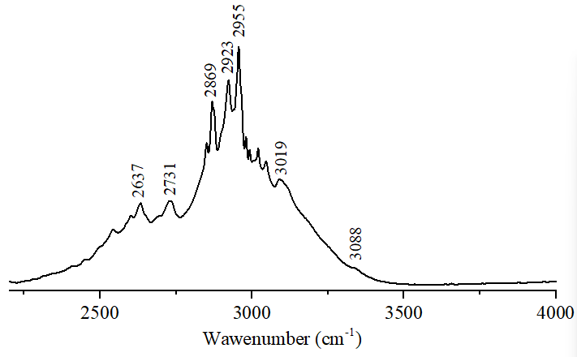
IR spectrum of the ibuprofen
Infrared spectra of ibuprofen in KBr disks (ca. 0.3% (w/w)) were recorded at room temperature on a Nicolet IS5 FTIR spectrometer, in the range 400–4000 cm⁻¹.
Using the DFT method, frequencies were correlated with oscillation modes.
Wavenumber (cm⁻¹)
7

Slide 8
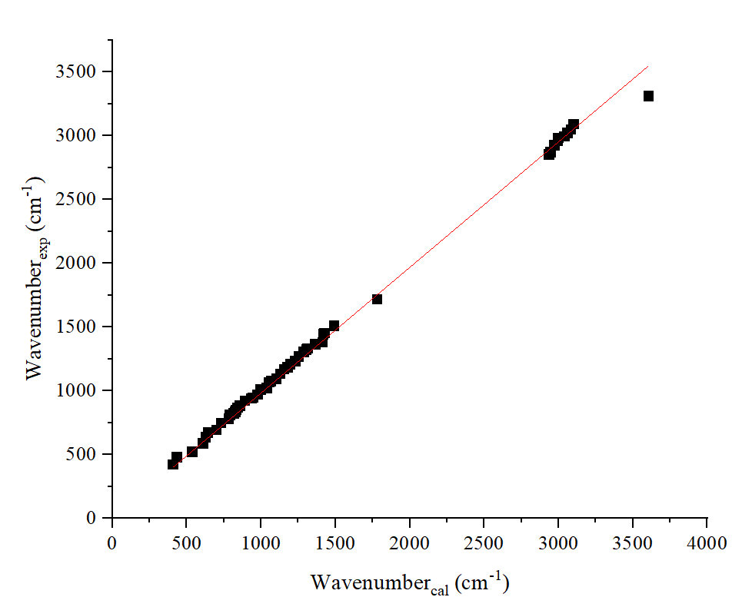
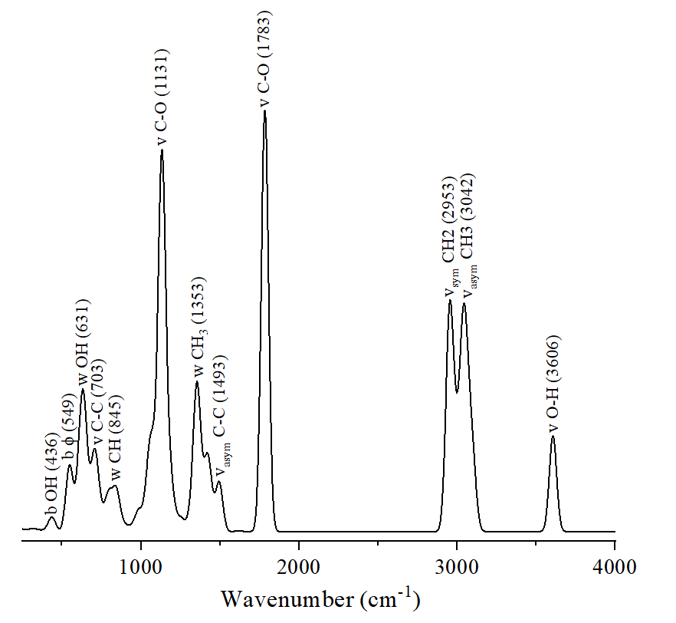
IR spectrum of the ibuprofen
The calculation by the DFT method was performed in the ORCA software with the BP86/def2-TZVP theory level.
ν_{exp}=(0,984±0,004)*ν_{cal}
R= 0,99966
The theoretically calculated spectrum agrees well with the spectrum obtained experimentally, which means that the level of theory chosen is well suited for predicting the parametrs IR spectrum of ibuprofen.
8

Slide 9
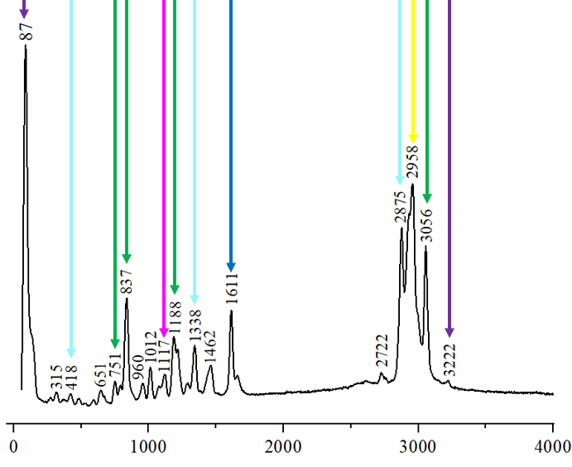
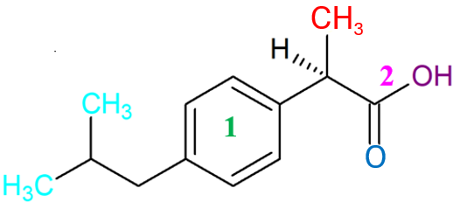
Raman spectrum of the ibuprofen
Confotec MR200 microspectrometer in combination with NIKON Ni direct microscope
Blue laser with a wavelength of 473 nm.
The measurement range is 200-4000 cm-1.
Microimage of an ibuprofen sample
9
Wavenumber (cm⁻¹)

Slide 10
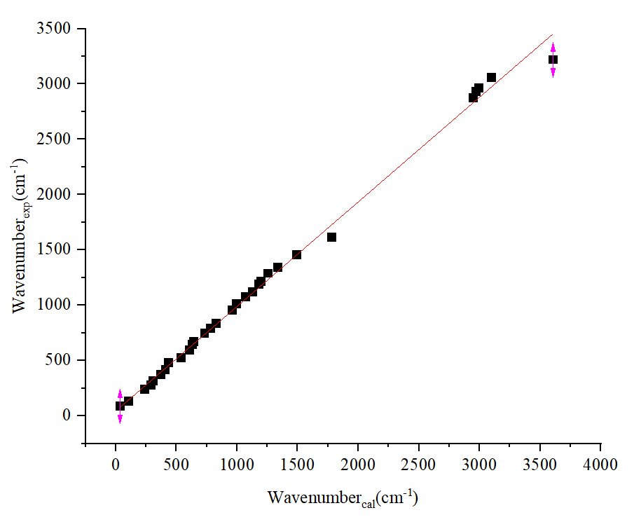
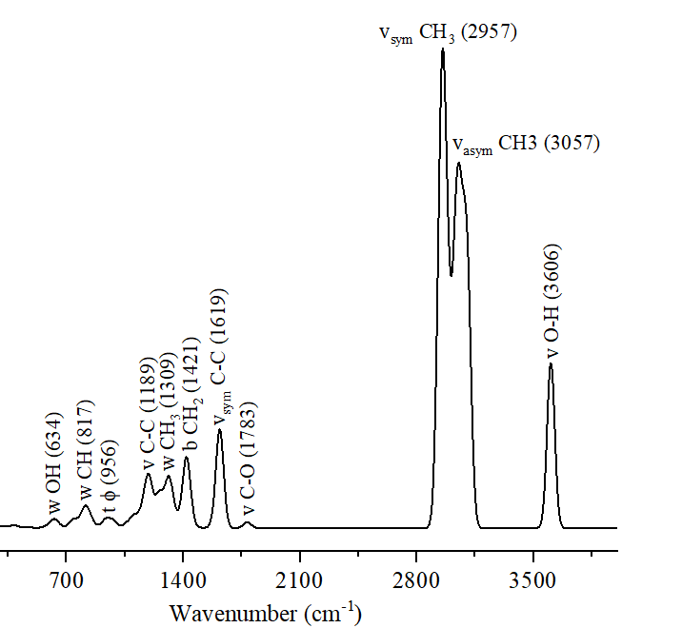
Raman spectrum of the ibuprofen
The calculation by the DFT method was performed in the ORCA software with the BP86/def2-TZVP theory level.
ν_{exp}=(0,945±0,012)*ν_{cal}
R= 0,99793
Conclude that the theoretically calculated spectrum agrees well with the spectrum obtained experimentally, which means that the level of theory chosen is well suited for predicting parametrs Raman spectrum of ibuprofen.
10

Slide 11
Conclusion
Using ¹H NMR the ibuprofen sample was identified and confirmed its purity.
By the method of powder X-ray diffraction, it was shown that the ibuprofen sample is in crystalline form and corresponds to a racemic mixture of ibuprofen.
The melting point (76.8 °C) of the sample obtained using the DSC method corresponds to the melting point for ibuprofen racemate.
Based on a joint analysis of the literature data and the results of molecular modeling, the peaks in the experimental IR and RAMAN spectra of ibuprofen were correlated with the types of oscillations of the main structural fragments of ibuprofen. The most intense signals in these spectra correspond to valence vibrations of C-O and C=O bonds, as well as valence vibrations of C-H bonds of methyl groups.
Linear correlations between the experimental and calculated in the approximation of the DFT method of ibuprofen oscillation frequencies are obtained. The theoretical BP86/def2-TZVP level may be recommended for further ibuprofen studies.
11

Slide 12
Acknowledgments
National Research Centre "Kurchatov Institute"
FIC KazanSC RAS
IR-spectrum:
Malakhov S.N.
NMR-spectrum:
Turanov A.N.
Kazan Federal University
Scientific supervisors:
Savostina L.I.
The Joint Institute for Nuclear Research.
X-ray diffractometry: Vershinina T.N., Raman spectrum: Arzumanyan G.M.,
DSC: Ponomareva O.Y.
Scientific supervisors:
Chudoba D.M.,
Raksha E.V.
Sample preparation: Eresko A.B.
Organization assistance: Belushkin A.V.
12

Slide 13
Thank you for your attention!

