Slide 1



The XXVII International Scientific Conference
of Young Scientists and Specialists (AYSS-2023)
30 October - 3 November 2023
Electron string ion source (ESIS) ion trap
control system development
Butenko Elizaveta
LHEP JINR engineer

Slide 2
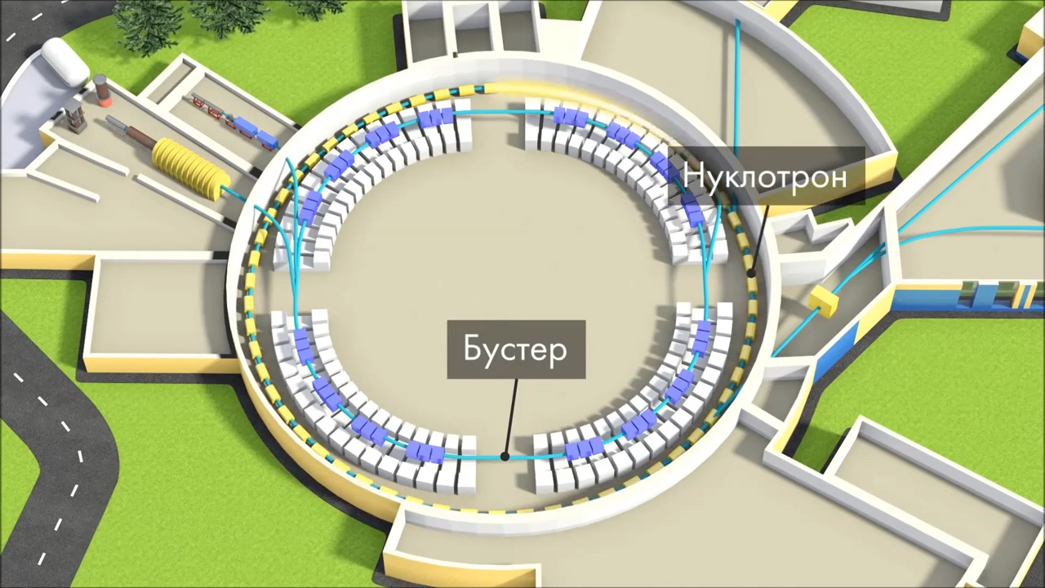
NICA injection complex
Heavy ion injector
Nuclotron
Light ions
& polarized protons
Booster
AYSS 2023
Butenko Elizaveta
2/17

Slide 3
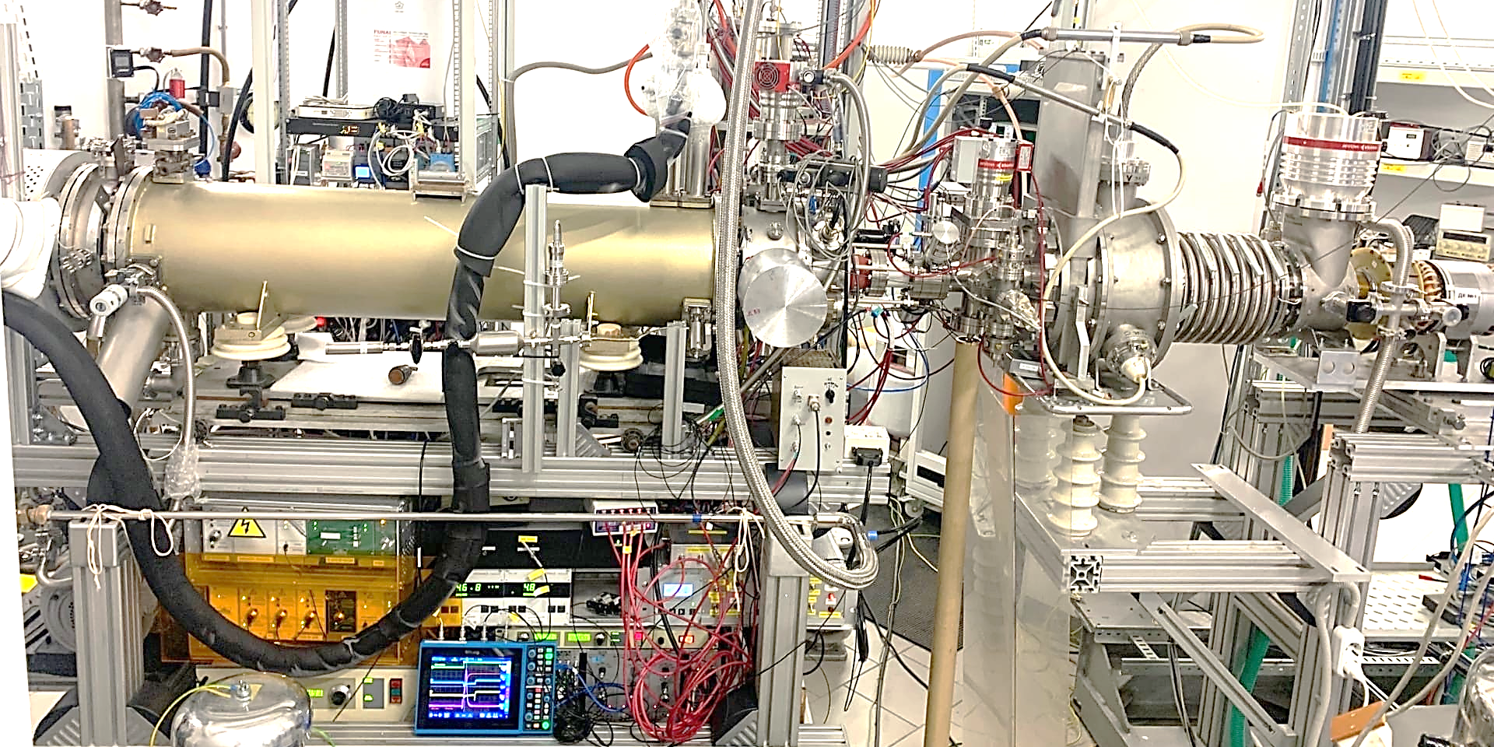
Heavy ion source KRION 6T
Ion source KRION-6T
HILAC LEBT
Ions produced and injected: ⁷⁸Kr¹⁷⁺ ¹²⁴Xe⁴¹⁺ ⁴⁰Ar¹⁶⁺ ⁷⁹Au³²⁺ …
5.4 T SC solenoid
electron string
highly charged ions
pulsed ion source
cryogenic
unique technology
AYSS 2023
Butenko Elizaveta
3/17

Slide 4
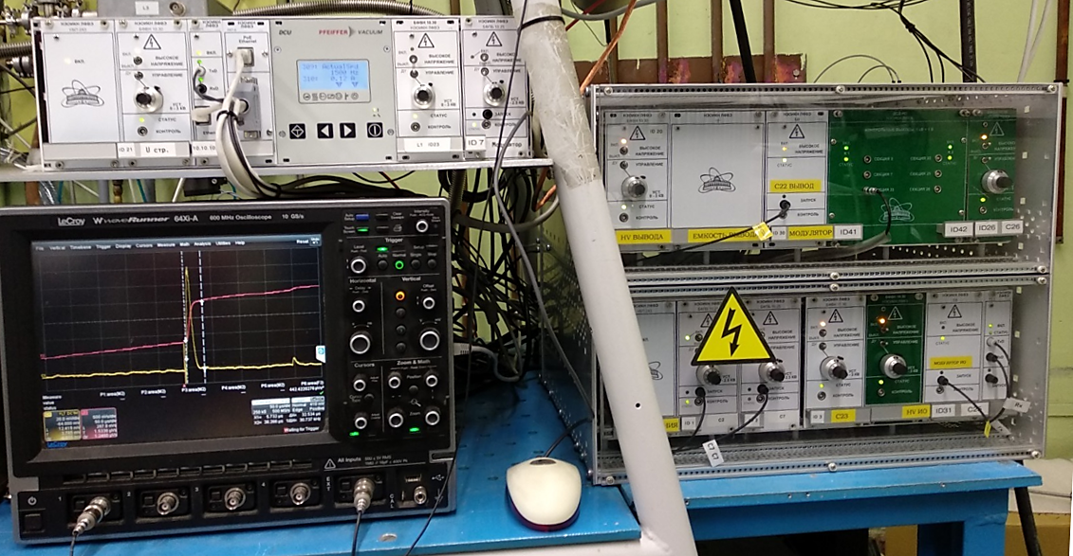
KRION 6T electronics
Slow control
thermometry
vacuum
HV electrodes
electron gun supply
synchronization
Ion trap and extraction system
DC barrier modules
pulsed barriers modules
extraction modules
interface modules
Beam diagnostics
beam profile monitor
oscilloscopes
ion collectors
ToF system
AYSS 2023
Butenko Elizaveta
4/17

Slide 5
KRION 6T electronics
Slow control
thermometry
vacuum
HV electrodes
electron gun supply
synchronization
Ion trap and extraction system
DC barrier modules
pulsed barriers modules
extraction modules
interface modules
The main goal
To decrease the beam duration (8us -> ~4us) for further multiple injection
AYSS 2023
Butenko Elizaveta
5/17

Slide 6
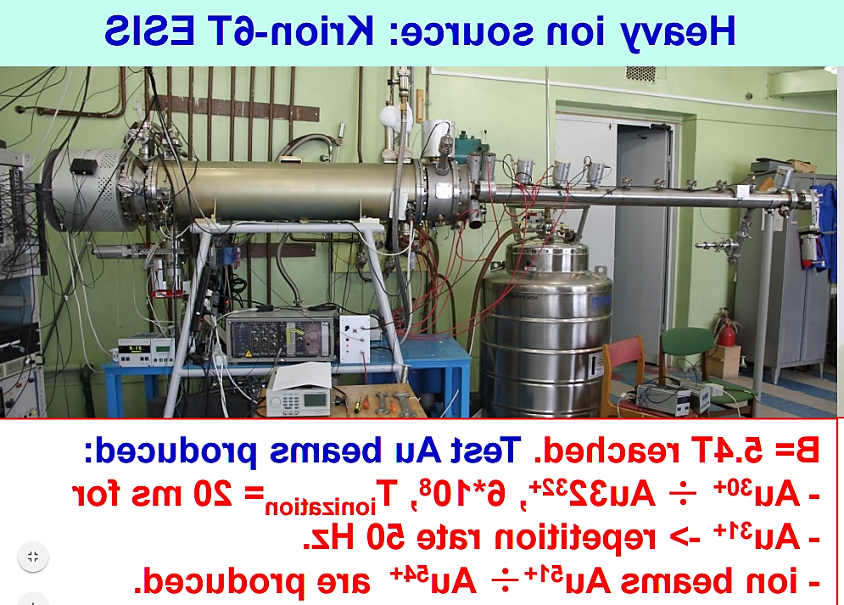
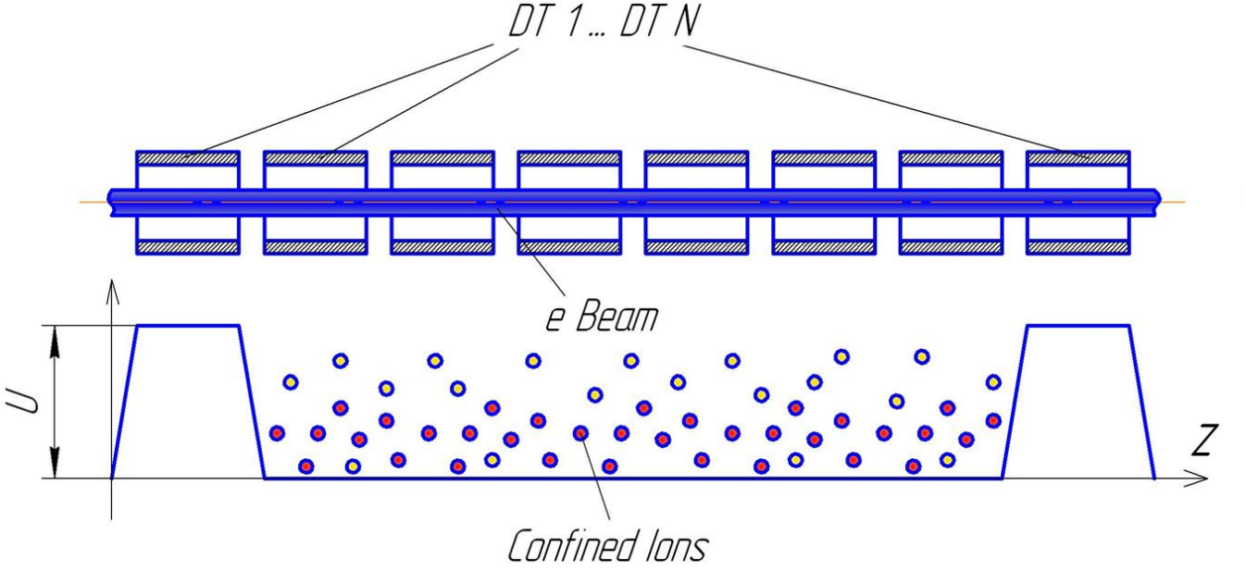
Structure
AYSS 2023
Butenko Elizaveta
6/17

Slide 7
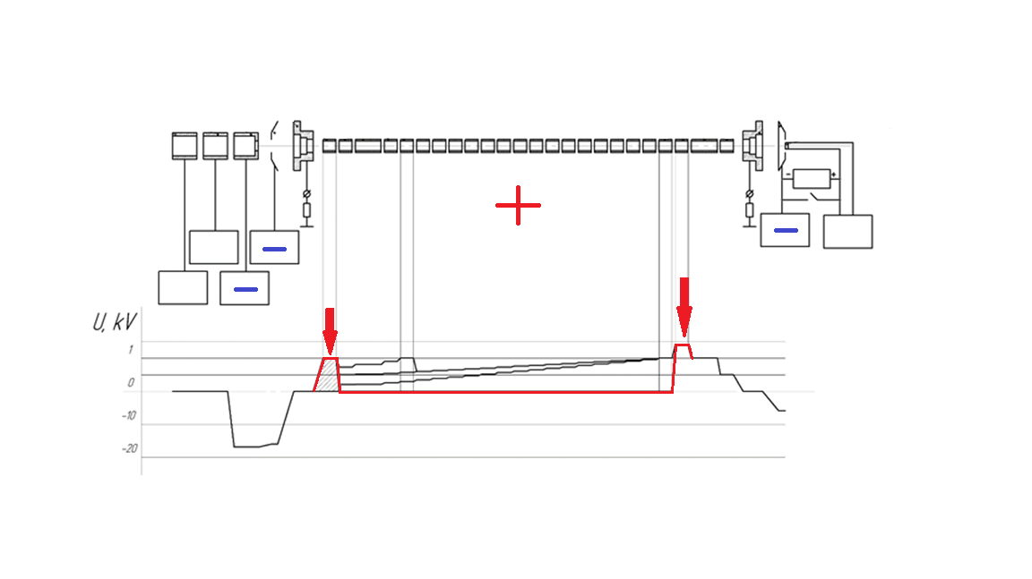
Potential barriers
AYSS 2023
Butenko Elizaveta
7/17

Slide 8
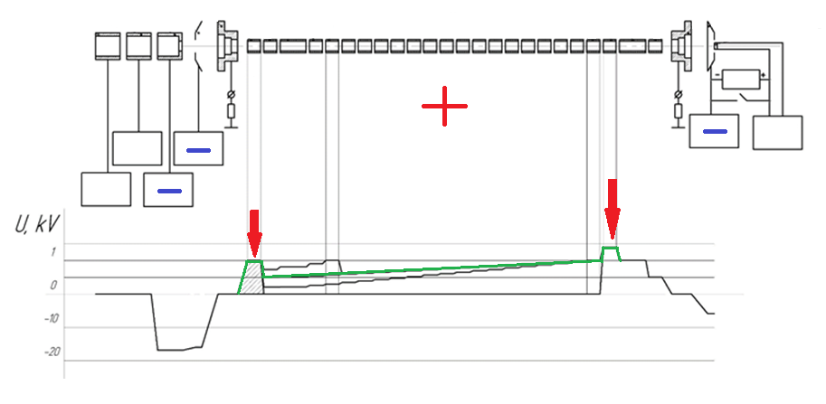
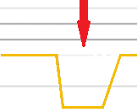
Beam extraction
AYSS 2023
Butenko Elizaveta
8/17

Slide 9
Beam extraction
- Ions
- potential
AYSS 2023
Butenko Elizaveta
9/17

Slide 10
Beam extraction
- Ions
- potential
AYSS 2023
Butenko Elizaveta
10/17

Slide 11
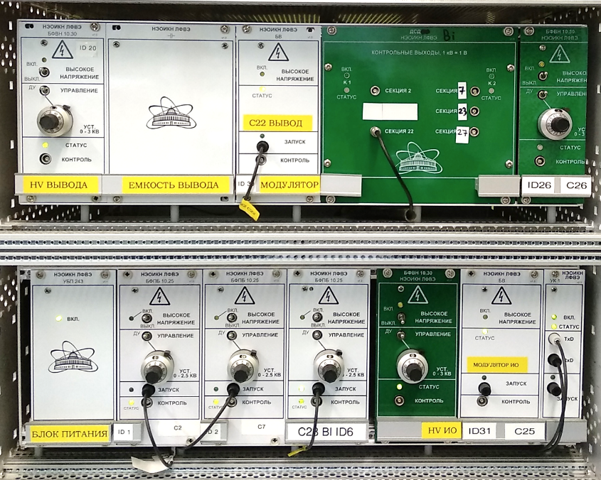
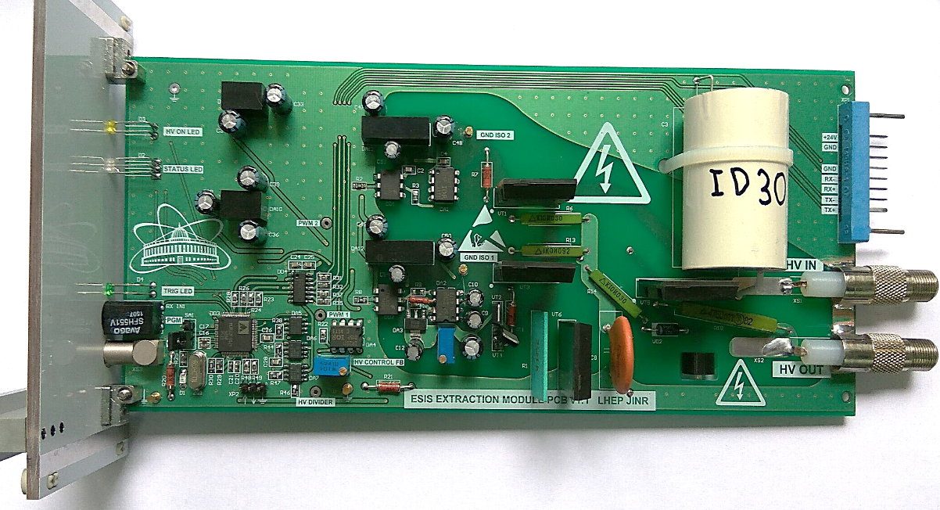
Ion motion control system (is now operated)
Advantages
isolated
flexible
Modbus RTU
modular (3U cases)
AYSS 2023
Butenko Elizaveta
11/17

Slide 12
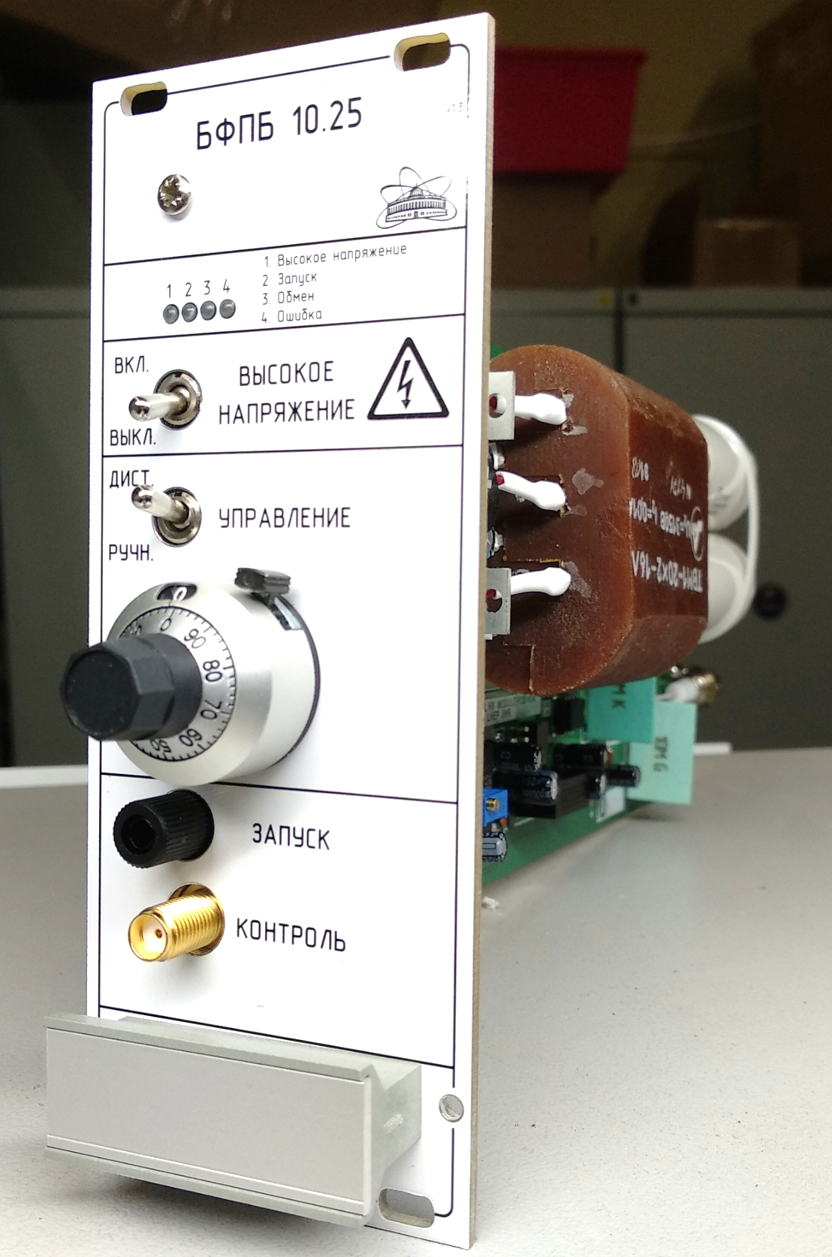
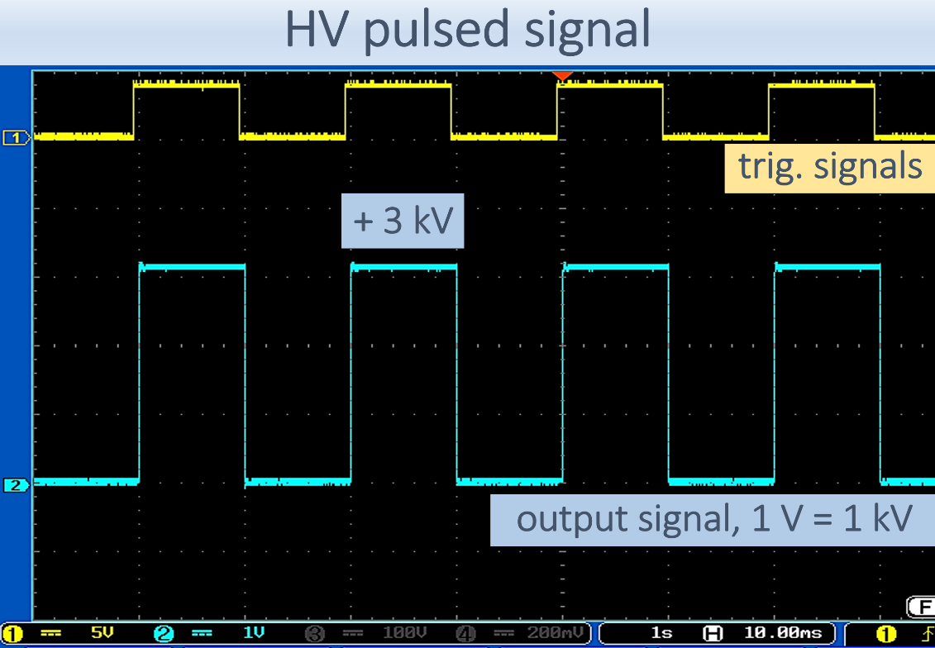
Potential barrier module
Output: 0 … +2.5 kV
Edges time: ~ 5 us
Max load current: 10 mA
Supply: + 24 V, 300 mA
Overcurrent, short protection
Hand & Remote control (Modbus RTU)
AYSS 2023
Butenko Elizaveta
12/17

Slide 13
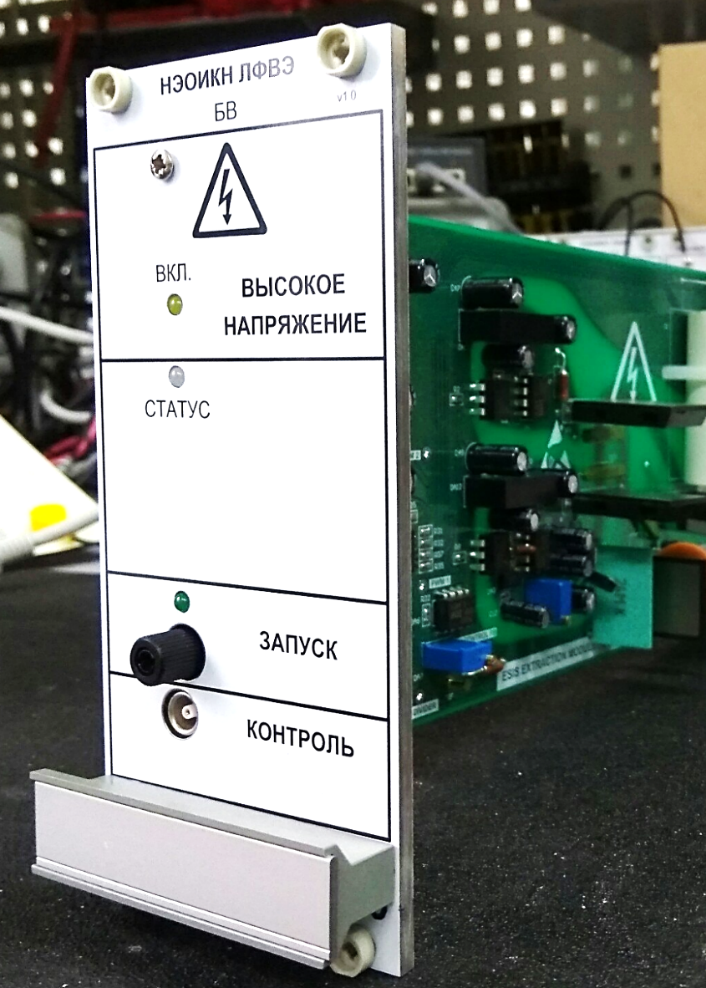
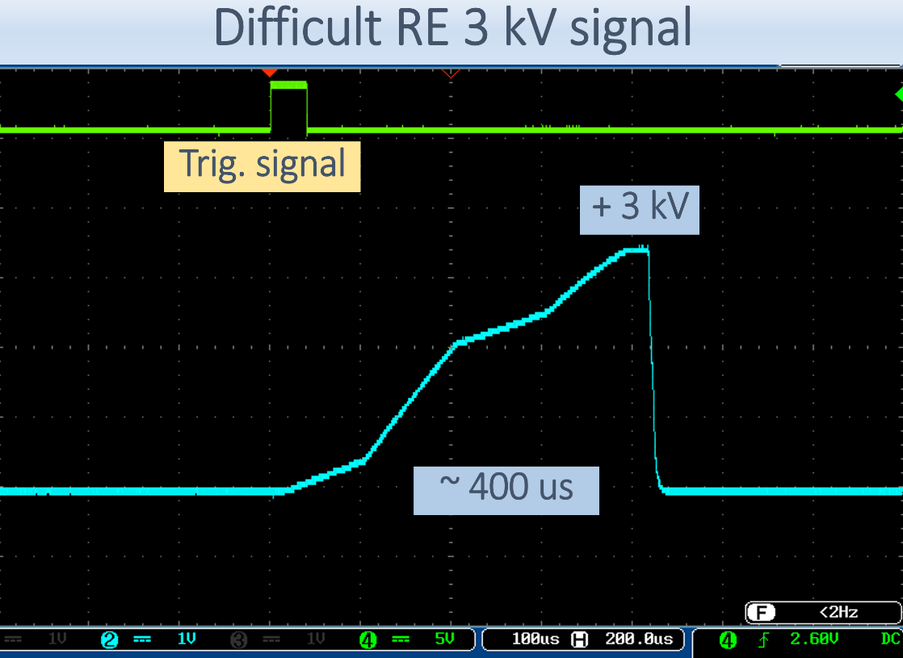
Ion extraction module
Up to 3 kV pulse rising edge control
Short circuit protection
Supply: + 24 V, 300 mA
Hand & Remote control
Overcurrent, short protection
Hand & Remote control (Modbus RTU)
AYSS 2023
Butenko Elizaveta
13/17

Slide 14
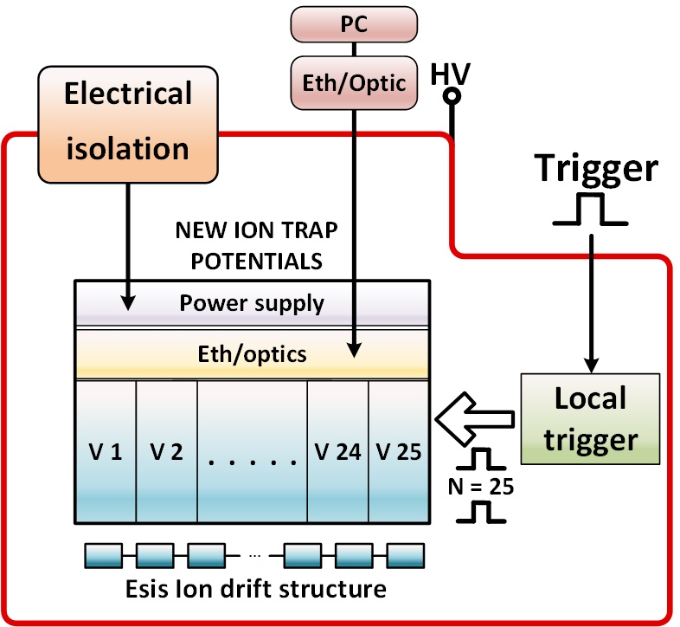
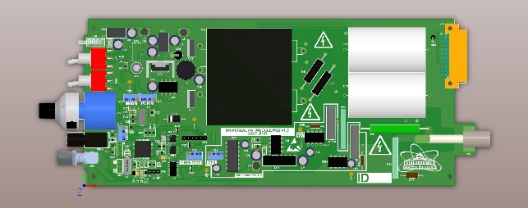
New ion motion control system
Independent structure sections power supply allows to imitate a traveling wave
AYSS 2023
Butenko Elizaveta
14/17

Slide 15
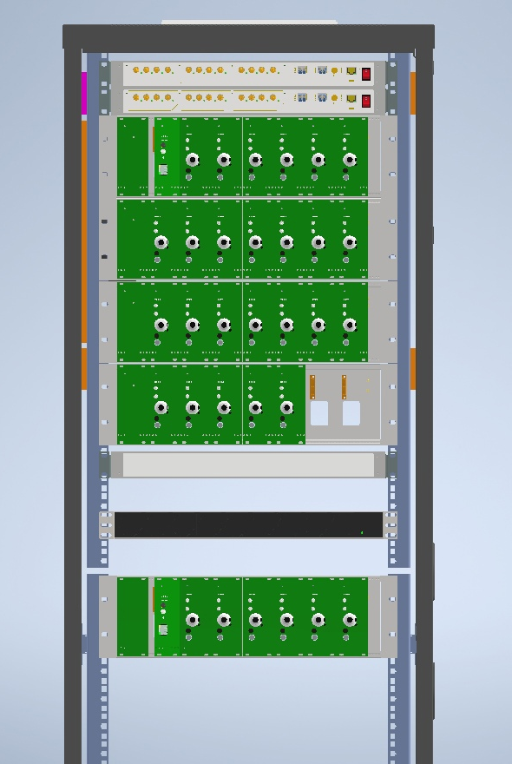
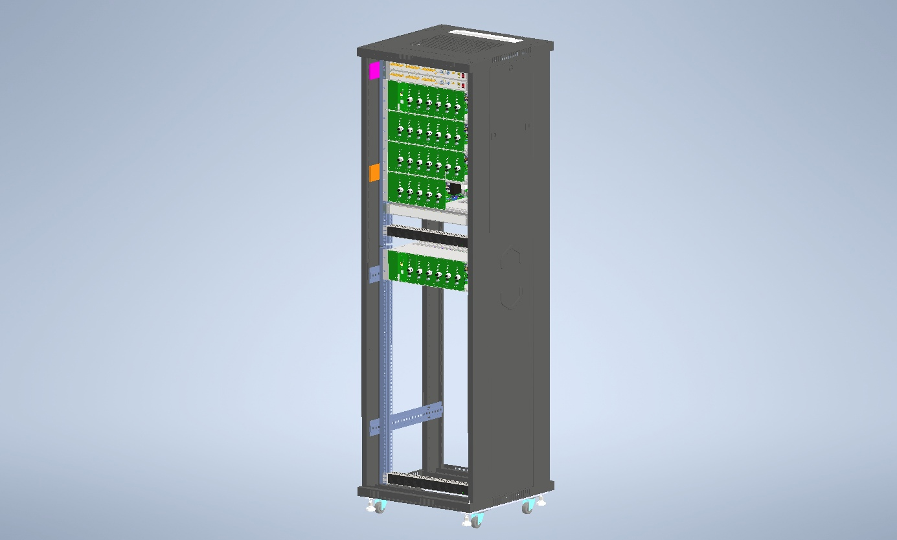

New ion motion control system
Trigger
Optic
HV modules
Power Supply
To PC
AYSS 2023
Butenko Elizaveta
15/17

Slide 16

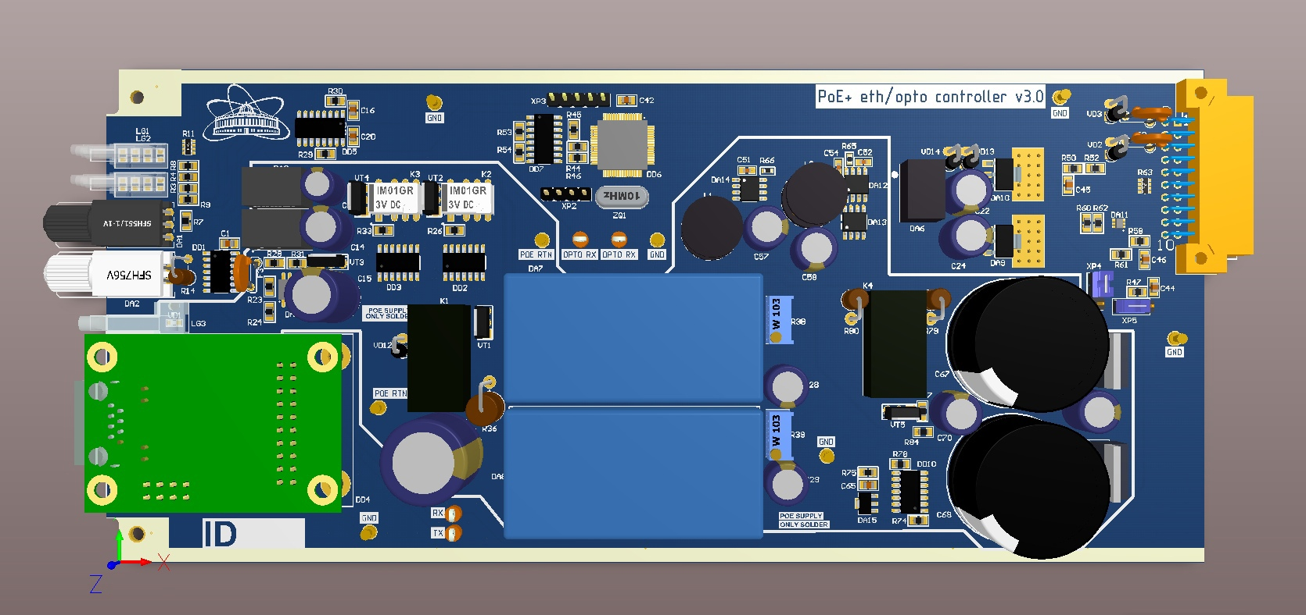
New ion motion control system
HV module
Eth/Optic converter
AYSS 2023
Butenko Elizaveta
16/17

Slide 17


Summary
The new ion trap control system configuration, which is under construction now, is a novel development and has not been used before
Applied technical solutions will allow to decrease the beam duration and make beam formation process more controllable for different type of ions
The ion source could be able to operate more flexible
The new ion trap control system is planned to be put into operation by the end of 2023
Literature: E.D. Donets et al., ESIS ions injection, holding and extraction control system // EPJ Web of Conferences 177, 08002 (2018)
AYSS 2023
Butenko Elizaveta
17/17

