Slide 1
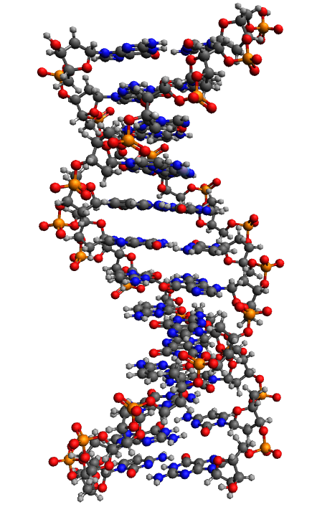
Calculation of the model of the spectrum of interaction with macromolecules by the method of finding symmetries
Anastasia A. Kharlamova
Higher School of Natural Sciences and Technologies
Northern (Arctic) Federal University named after M.V. Lomonosov
Kharlamova.anastasya2015@yandex.ru

Slide 2
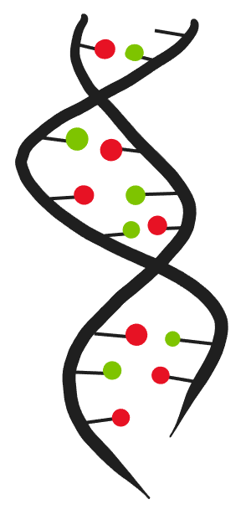
Introduction
Theory of calculation of the polyatomic structure
The DNA model under study
Parameters of the mathematical model
Simulation results - Spectrum graphs
Conclusions
2

Slide 3
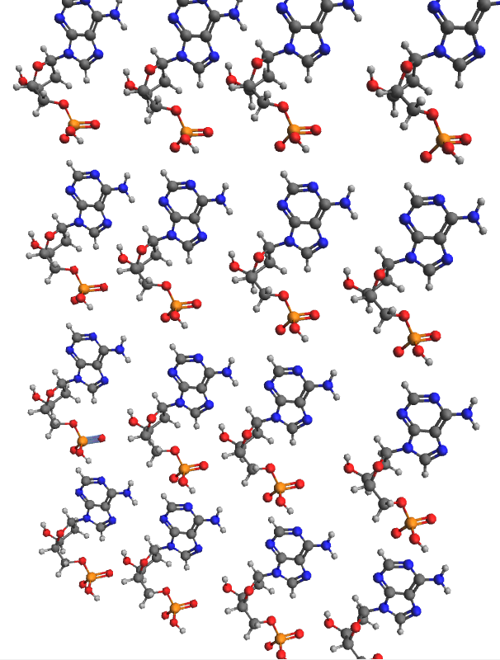
What is the relevance of the study.
Macromolecules are complex multi-atomic substances.
They do not have a simple, ordered structure, they are composed of different atoms, poorly amenable to crystallization. This cause difficulties to analyze them.
4

Slide 4
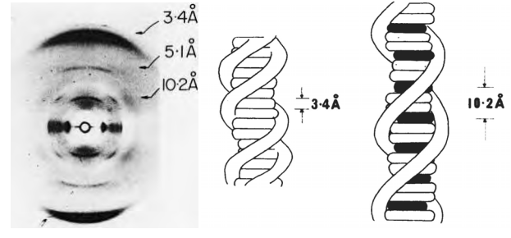
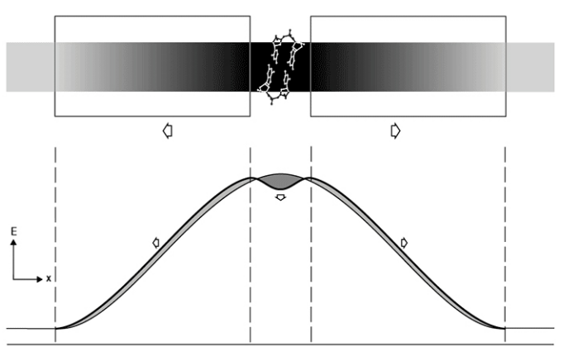
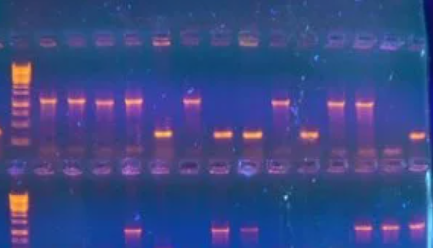
There are two groups of the main methods used to analyze macromolecules.
The first methods are physico-chemical: gel electrophoresis, colouring, nanopores.
The second method: X-ray analysis.
3

Slide 5
The first methods have a number of disadvantages.
The main disadvantage: these methods do not work at the atomic level.
They do not give information about the arrangement of atoms in the system.
If we talk about a DNA molecule, these methods could show the location of nucleotides, but not atoms.
X-ray analysis also does not give an idea of the atomic composition of the molecule.
The main disadvantage is the necessity of using crystallization.
But approximately 40% of protein compounds cannot be fully crystallized.
5

Slide 6
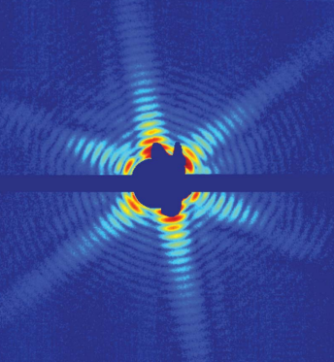
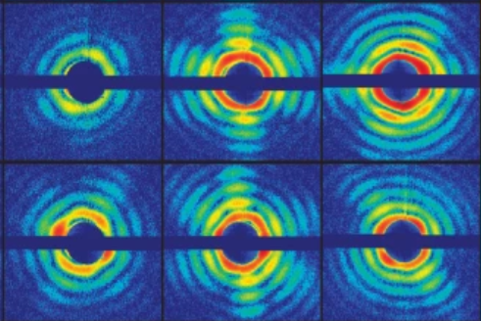
Modern experiments:
The structure of the enzyme
Trypanosoma brucei
Mimivirus
Confirmation of the lysozyme model
40,000 structures of protein compounds
6

Slide 7
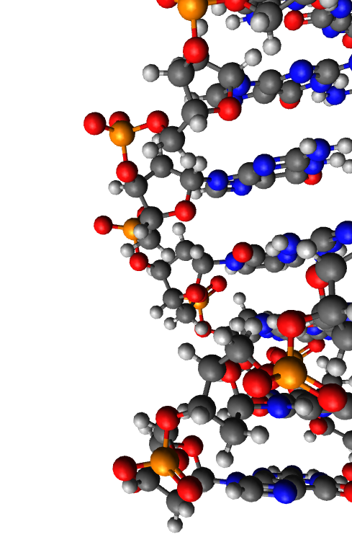
Theory
electromagnetic field strength USPs (ultrashort laser pulses)
interference factor
number of electrons in the atom of the i - grade
number of atoms of the i - grade
form factor of the atom of the i - grade with the corresponding electron density
D.N.Makarov, A.A.Kharlamova, “Scattering of X-ray Ultrashort Pulses by Complex Polyatomic Structures,” International Journal of Molecular Sciences, Vol 163, December 2021.
7

Slide 8
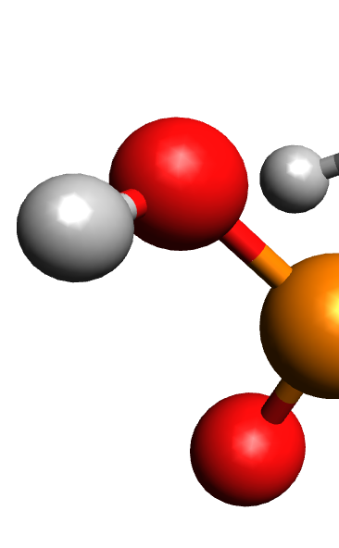
Theory
number of atoms of the i - grade
radius vector that specifying the position of the atoms of the corresponding variety
momentum vector of the USPs falling on the multi-atom system
8

Slide 9
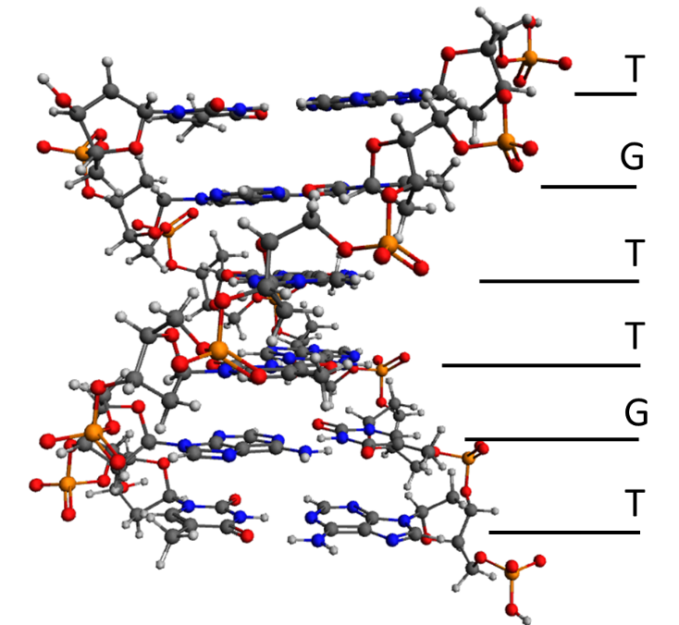
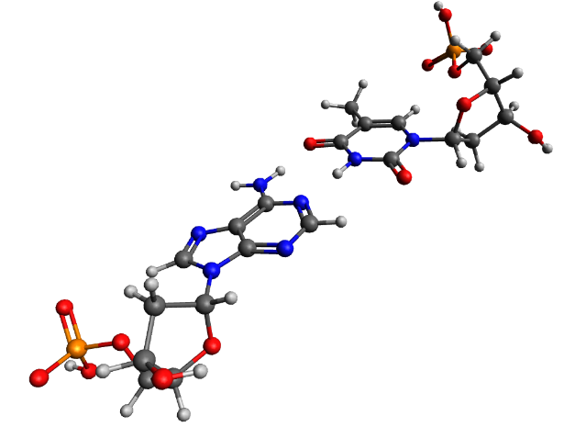
Theory
Escherichia coli str. K-12 substr. MG1655
9

Slide 10
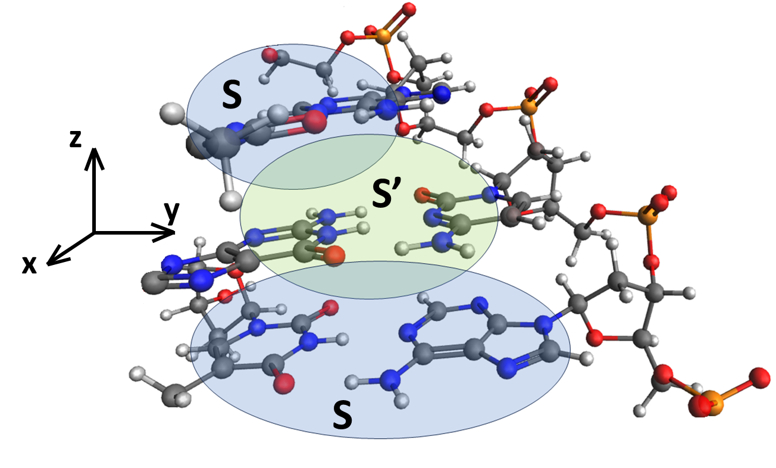
Theory
10

Slide 11
Theory
some asymmetry in the system
the number of symmetries in the system
radius is a vector that specifying the position of the symmetry α or β
momentum vector of the USPs falling on the multi-atom system
radius is a vector specifying the position of atoms of grade i in symmetry
11

Slide 12
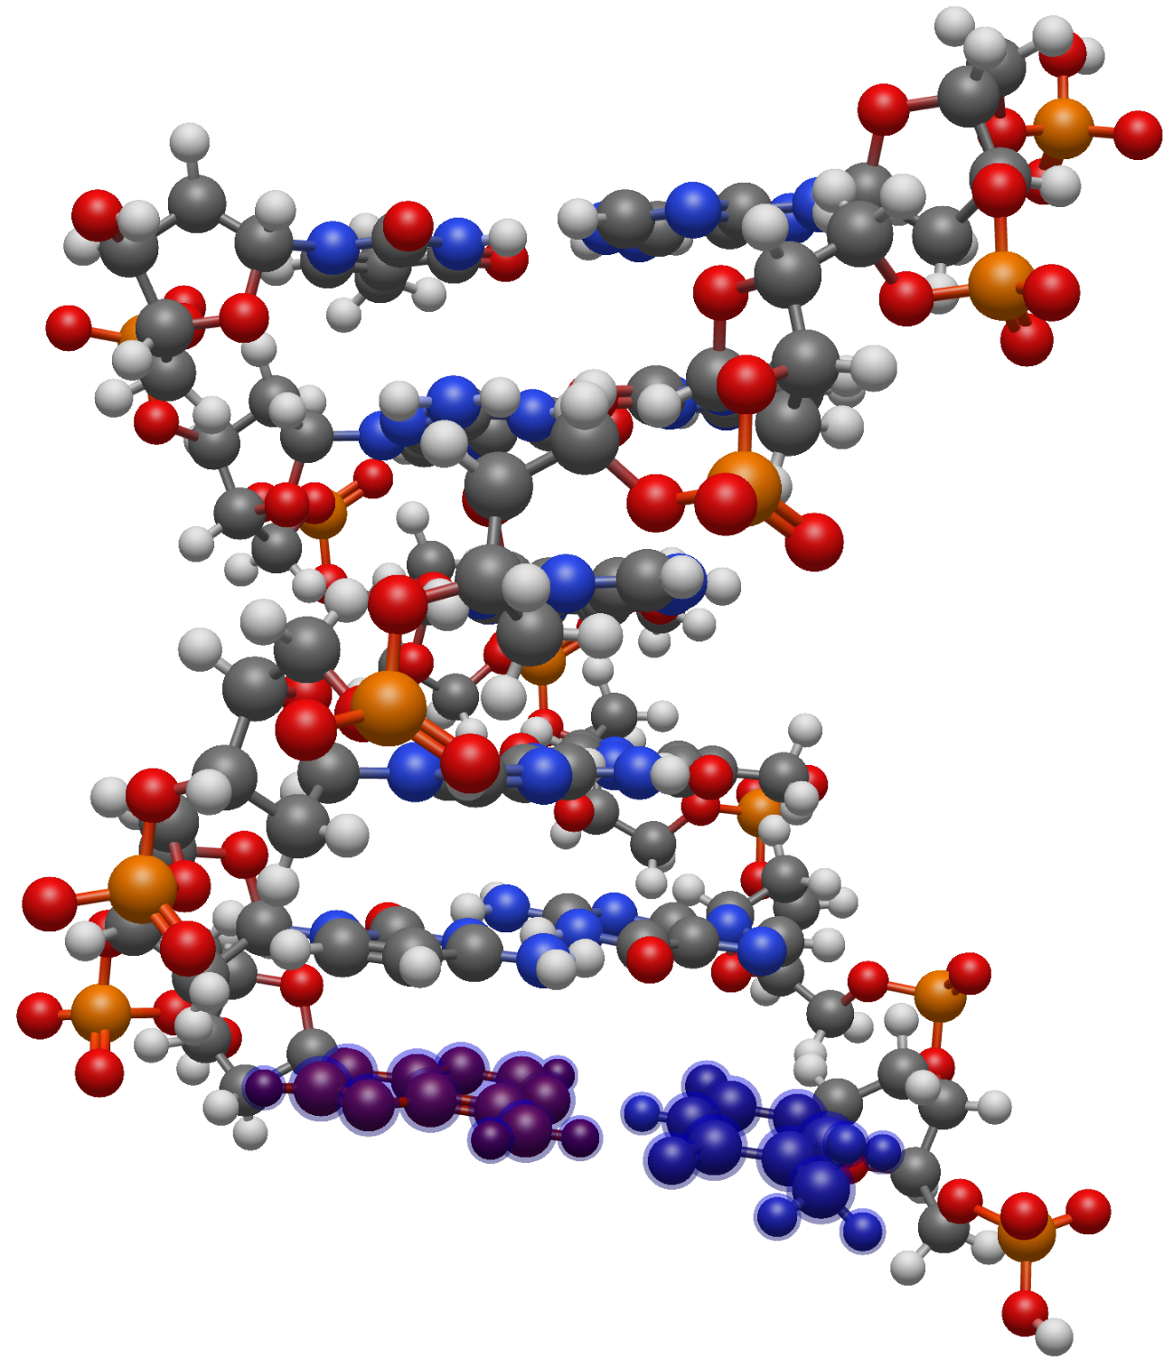
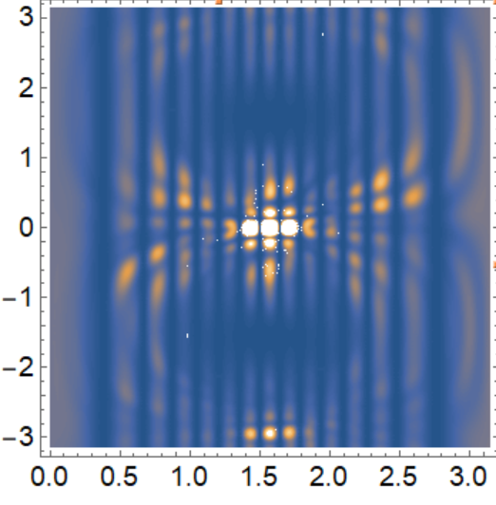
Object for Modeling
0.0
0.1
12

Slide 13
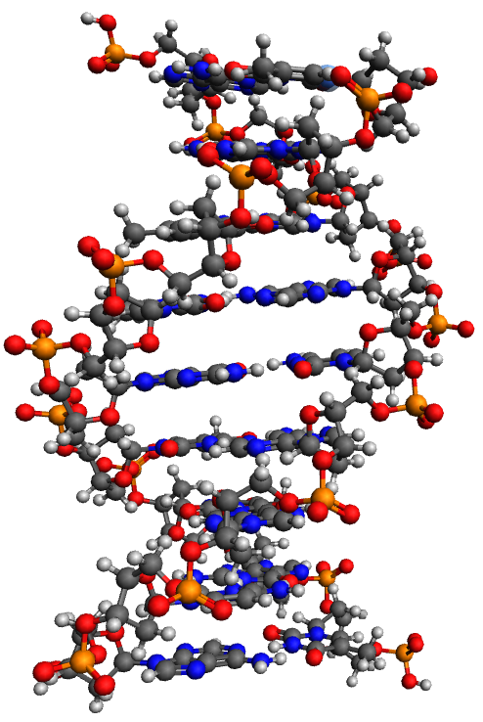
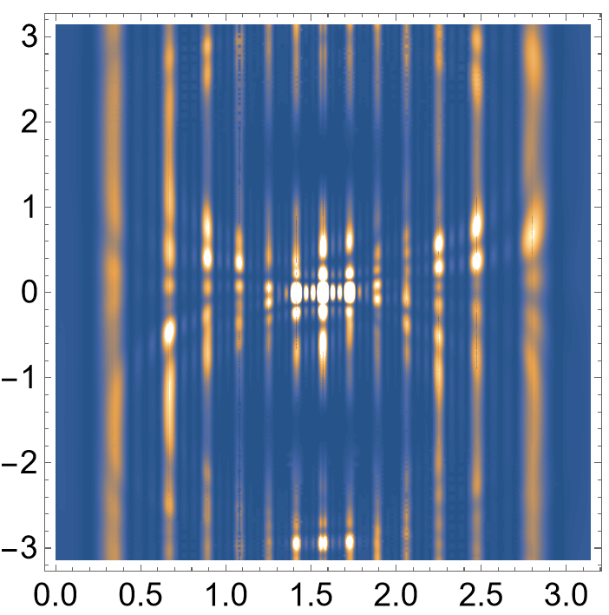
Object for Modeling
0.0
0.1
13

Slide 14
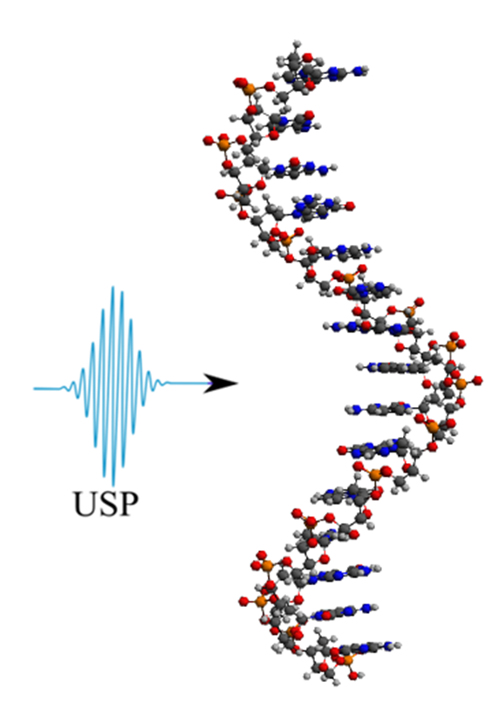
Object for Modeling
The following parameters were used in the simulation:
The main axis of DNA runs along the molecule, orthogonally to its bases
The pulse falls on the system at an angle of 90 degrees to the main axis
system parameter ϴ - angle between the helix axis and the scattering direction
ɸ - angle between the helix axis and the projection on the plane perpendicular to the helix axis, the calculations were performed in spherical coordinates
The results in all figures are normalized to the maximum value of the scattering spectrum.
14

Slide 15
Conclusions
Mathematical modeling of the scattering spectra of ultrashort laser pulses based on the theory of sudden perturbation is carried out
An analytical formula is presented and the principle of calculating the polyatomic structure using the coordinates of atoms is explained
As a result, mathematical models of USPs spectra for two types of symmetries is performed
According to the results, the models show the presence of repeating areas, which is indicated by a change in the brightness of the central spots on the graphs
15

Slide 16
Thanks for your attention!
16

