Slide 1
THE QUANTUM ENTANGLEMENT OF NON-MONOCHROMATIC PHOTONS IN LINEAR BEAM SPLITTER
Place
Thematic
Image
Tsykareva Yu.V.
Scientific supervisor – Makarov D.N.,
Dr. Phys.-Math.Sci.
Northern Arctic Federal University
named after M.V. Lomonosov
aisonoka@gmail.com

Slide 2
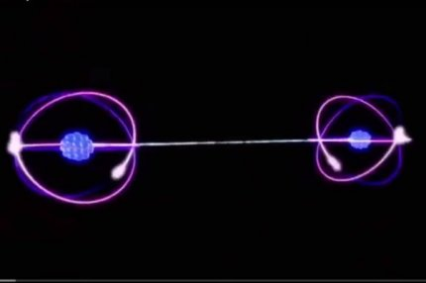
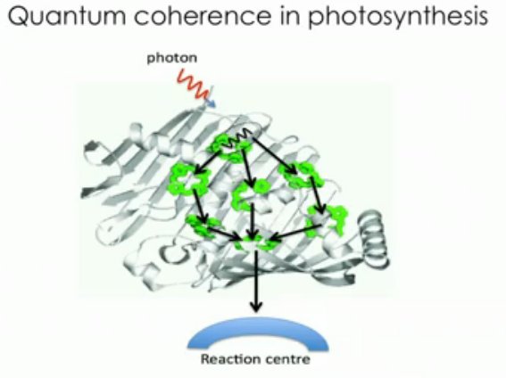
Application
HOM interference appears in many cases, both in fundamental studies of quantum mechanics and in practical implementations of quantum technologies.
Teleportation of the quantum state
Quantum cryptography
Quantum computing algorithms
Biophysics (photosynthesis)
Quantum metrology

Slide 3
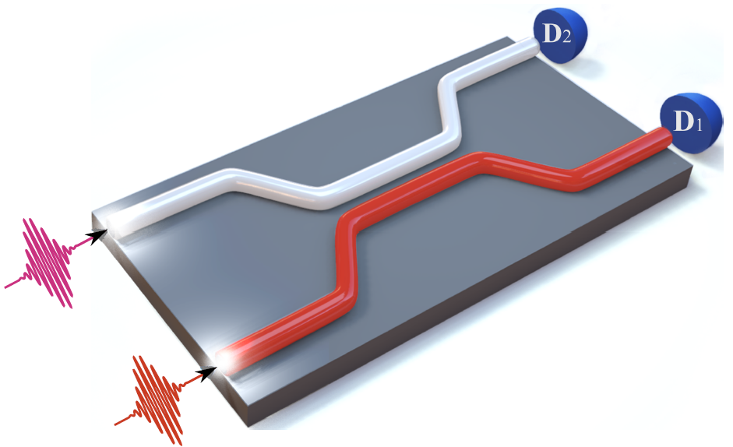
Linear Beam Splitter (BS)
Well-known transformations for a linear beam splitter:
R | - reflection coefficient
T | - transmission coefficient
φ | - phase difference
[1] Makarov D N 2020 Phys. Rev. E 102 052213
[2] Makarov D N and Tsykareva Yu V 2022 Entropy 24 49

Slide 4
Monochromatic photon case
Hamiltonian of the photon system
The non-stationary Schrodinger equation
Wave function of photons at the output ports of BS
Condition for quantum numbers:
Decomposed wave function into Schmidt modes
 | - Schmidt mode
 | - wave functions of a pure state of system’s oscillators
[1] Makarov D N 2020 Phys. Rev. E 102 052213
[2] Makarov D N and Tsykareva Yu V 2022 Entropy 24 49

Slide 5
Measures of entanglement
Schmidt parameter
Von-Neumann entropy
If we find the Schmidt mode, we can calculate the quantum entanglement of the system, and that is the main difficulty in calculating quantum entanglement.
[1] Makarov D N 2020 Phys. Rev. E 102 052213
[2] Makarov D N 2018 Scientific Reports 8 8204

Slide 6
Monochromatic photon case
Calculating Schmidt mode [1] :
[1] Makarov D N 2020 Phys. Rev. E 102 052213

Slide 7
Monochromatic photon case

Slide 8
Non-monochromatic photon case
Wave function of photons at the output ports of BS
- the joint spectral amplitude (JSA) of the two-mode wave function
The probability of detecting photons at output states
Gaussian distribution
- the dispersion

Slide 9
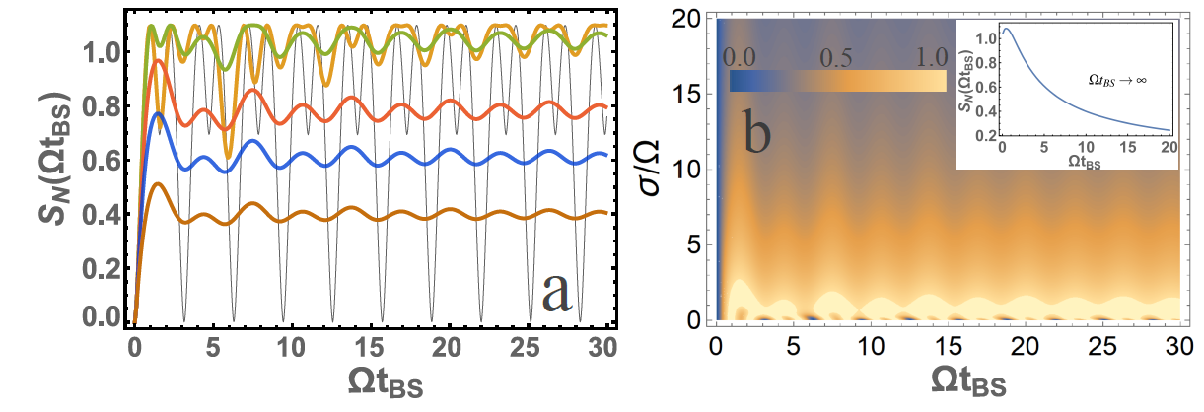
Non-monochromatic photon case
For input photons s₁=1 s₂=1
for
Line | σ/Ω
Brown | 10
Blue | 5
Red | 3
Orange | 1
Green | 1/3
Black | 0

Slide 10
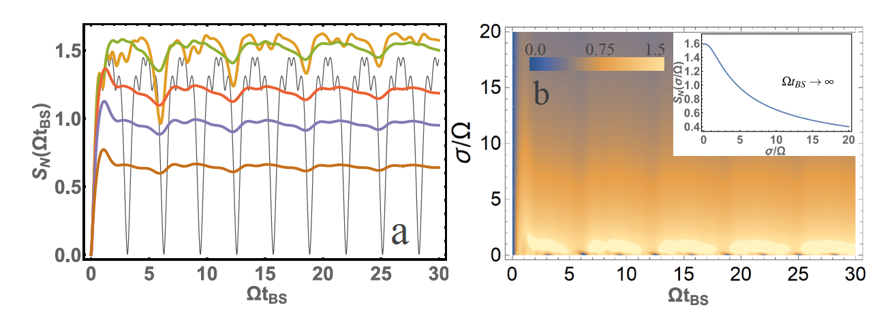
Non-monochromatic photon case
For input photons s₁=0 s₂=2
Line | σ/Ω
Brown | 10
Blue | 5
Red | 3
Orange | 1
Green | 1/3
Black | 0
For input photons s₁=1 s₂=3

Slide 11
Hong-Ou-Mandel effect on a “conventional” waveguide beam splitter
The HOM effect was first experimentally demonstrated by Hong et al. in 1987 [1].
The effect is thought to occur when two identical single-photon waves hit the BS 1:1 (with reflection coefficients R and transmittance T close to 1/2), one at each input port. When the photons are identical, they will cancel each other out.
The theoretical explanation of the HOM effect, based on constant coefficients R and T and bosonic photon statistics, is quite simple (Makarov, D.N, Theory of HOM interference on coupled waveguides, Optics Letters. 45 (2020) 6322–6325)
A schematic of the HOM interference experiment can be shown in Fig.1 (right), with the difference that we consider “conventional” BS. The detector coincidence rate will drop to zero when identical input photons completely overlap in time. This is called the Hong-Ou-Mandel dip, or HOM dip.

Slide 12
Let us consider the general case not restricted to identical and monochromatic photons and to simultaneous registration by photon detectors. . In this case we have to consider the output state as
We will assume the coefficients R and φ to be constant, i.e. consider “conventional” BS. Consider the probability P_{1,2} of co-detection of photons at 1 and 2 detectors (correlation between the two detectors). If our coincidence gate window takes counts for time T_{D}, then the frequency of coincidence between detectors 1 and 2 is proportional
The calculation of the correlation function (1) can be found in various papers depending on the JSA function φ(ω₁, ω₂). As a result, the correlation function in general form will be at R = T = 1/2
Here is example of the calculated correlation functions P_{1,2} (Fock states):

Slide 13
Hong-Ou-Mandel effect on a frequency-dependent waveguide beam splitter
The calculation of the correlation function is carried out in the same way as it is done in the case of “conventional” BS, with the only difference that we consider the coefficients R, T and φ to be frequency dependent and do not fix their values. P_{1,2} is normalized so that with t_{BS} = 0 the probability is P_{1,2} = 1.
Let us present the results of calculating the value of P_{1,2} for the case
The function (7) allows us to analyze the value of P1,2 for two cases that are of practical interest: spontaneous parametric down-conversion (SPDC), for example, for Ω_{p} = 2ω₀; ω₀ = ω₀₁ = ω₀₂; σ₁ = σ₂ = σ is SPDC of type I, where σp is the bandwidth of the pump beam, ω0 and σ are the central frequency and the bandwidth, respectively, for both the signal and the idle beams. The second case/on the other hand if we consider σ_{p} → ∞ in (7), then this will be the case of Fock states.

Slide 14
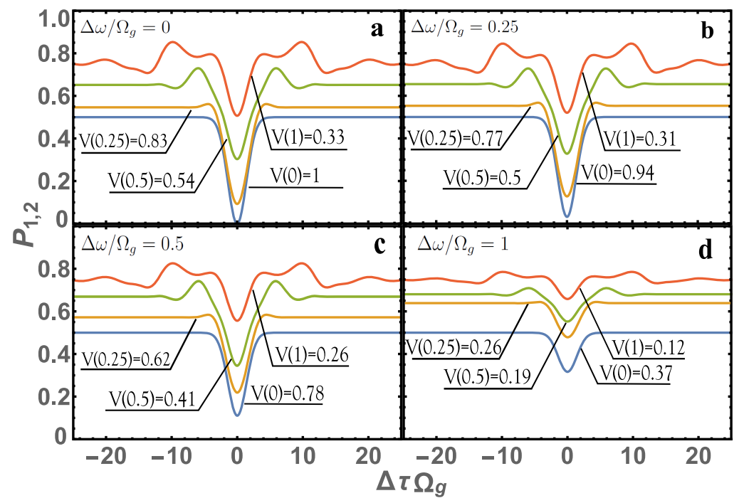
Visibility V(Ωg/Ω) =
Dependence of P1,2 on ∆τΩg (HOM dip). Case (a) corresponds to fully identical photons and cases (b), (c), (d) correspond to non-identical photons. line color corresponds to: red at Ωg/Ω = 1, green at Ωg/Ω = 0.5, brown at Ωg/Ω = 0.25, blue at Ωg/Ω = 0). The case Ωg/Ω = 0 and visibility V(0) corresponds to the previously known HOM interference theory with constant coefficients T = R = ½.

Slide 15
Conclusions
There are a the essential difference between quantum entanglement of monochromatic and non-monochromatic photons on the waveguide BS
For very large values of Ω, it is possible to obtain analytical expressions
A linear beam splitter is a good source for quantum entangled photons
The maximum value of quantum entanglement is achieved precisely in the case of non-monochromatic photons
Differences from standard HOM theory can be very large;
The fundamental conclusion in the theory of HOM interference a mean-square fluctuation of the coefficients of transmission T and reflection R, which leads to a nonzero value of P1,2 in the case of identical photons. This conclusion is was not previously obtained;
This theory is applicable for most sources of photons, this was illustrated with spontaneous parametric down-conversion (SPDC) and Fock states cases.

Slide 16
Thank you for your attention!

