Slide 1
Bruno Pontecorvo and neutron physics
M.G.Sapozhnikov
LHEP, JINR

Slide 2
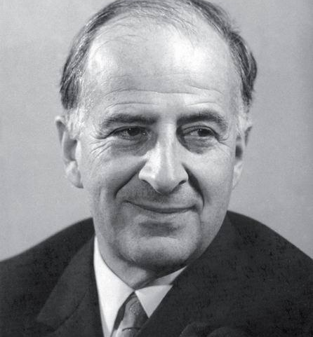
Almost all main ideas of the modern neutrino physics was suggested by Bruno Pontecorvo.
Val Telegdi
Few of us in particle physics can boast of a single original and important idea. Bruno wealth of seminal suggestions establish him as a truly unique contributor to the the advance of particle physics in the past half century.
J.Steinberger

Slide 3
Six Nobel Prizes for B. Pontecorvo's ideas
The possibility of observing neutrinos from nuclear reactors. F.Reines, 1962.
Method of neutrino detection. (Cl-Ar method). R.Davies, 2002.
Proportional mode of operation of counters. A basis for the development of a proportional chamber. G.Charpak , 1992.
Distinguishing ν_{e} from ν_{μ} . L.Lederman, J.Steinberger, M.Schwartz, 1988
Neutrino astrophysics and registration of cosmic neutrinos.
M. Koshiba, 2002
Oscillations of solar neutrinos. A.Macdonald and T.Kajita 2015. S.S.Gershtein, 2013

Slide 4
Two more…
1934. Discovery of neutron slowing down
1941. Neutron logging

Slide 5
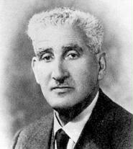
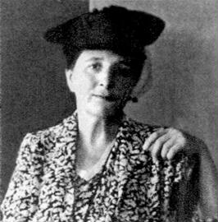
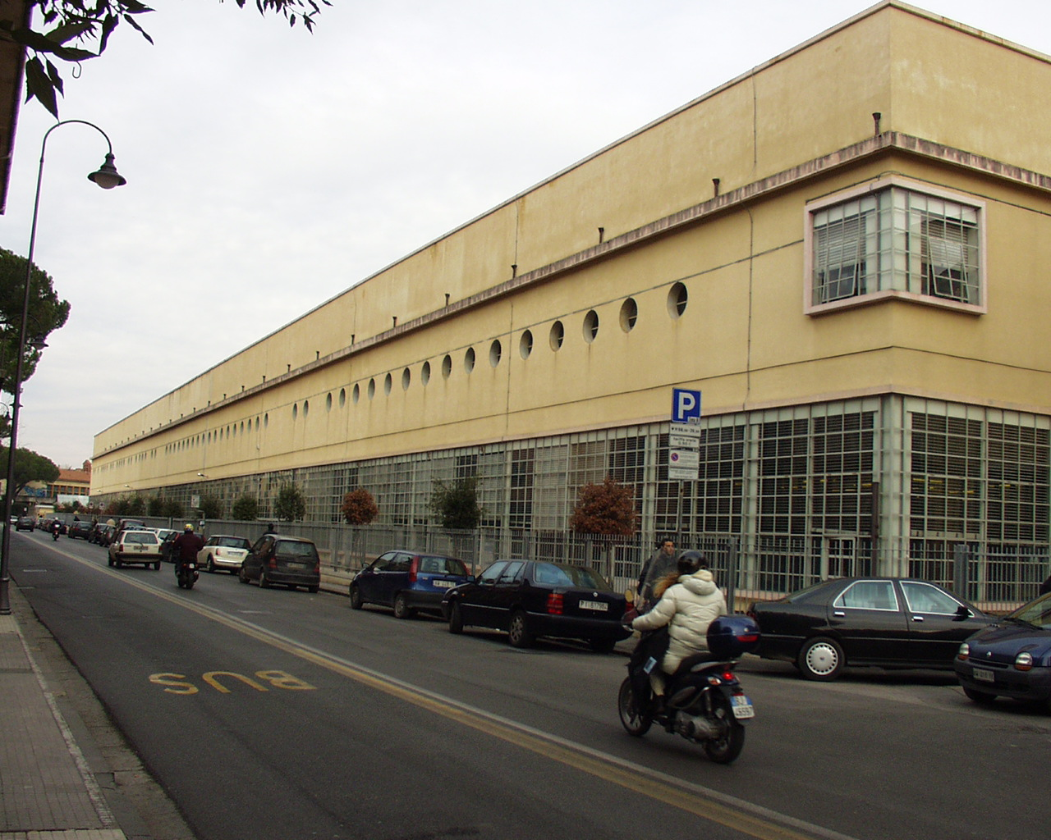
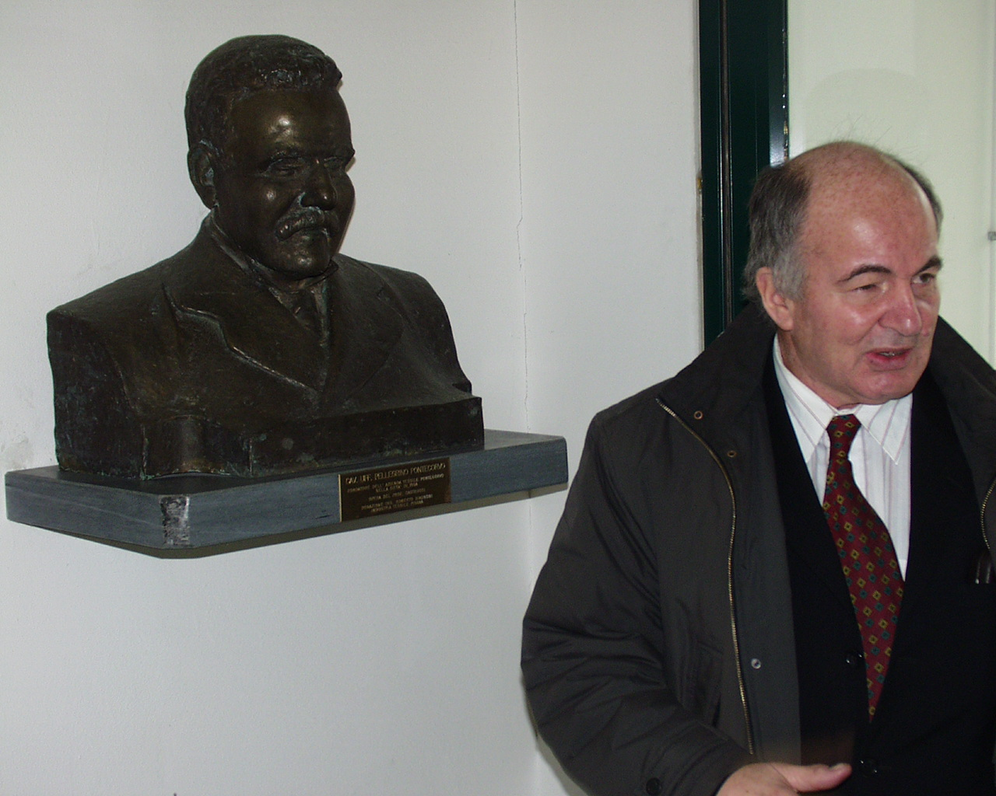
Born at 22.08.1913, Marina di Pisa
Parents – Massimo and Maria
Grandfather – Pellegrino Pontecorvo
Textile business
strada P.Pontecorvo in Pisa

Slide 6
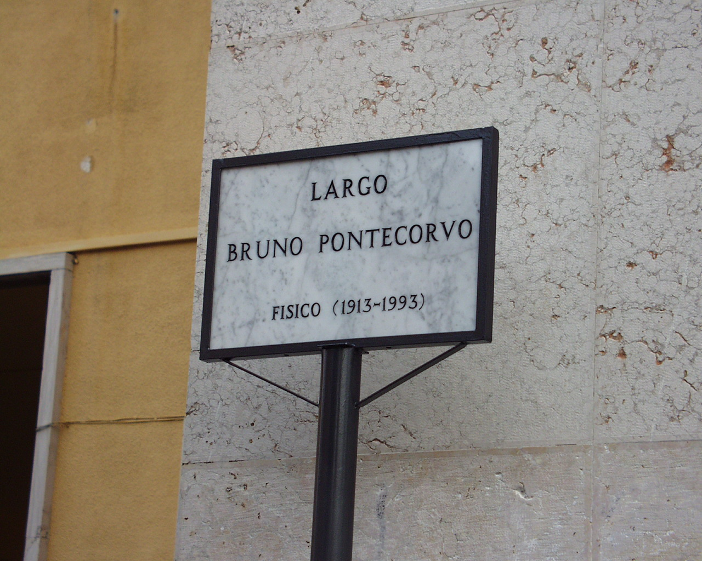
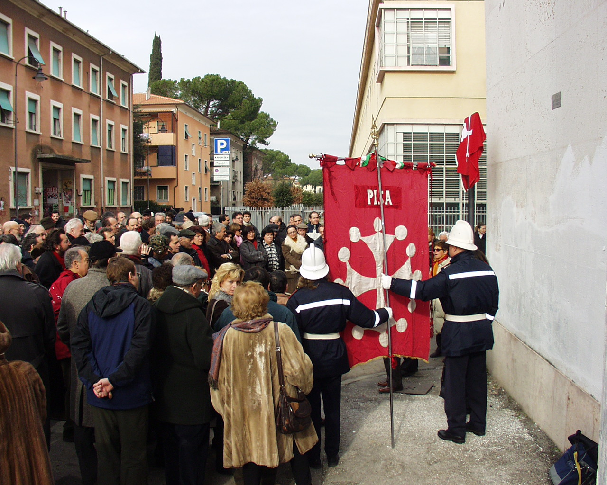
Opening Largo Pontecorvo in Pisa

Slide 7
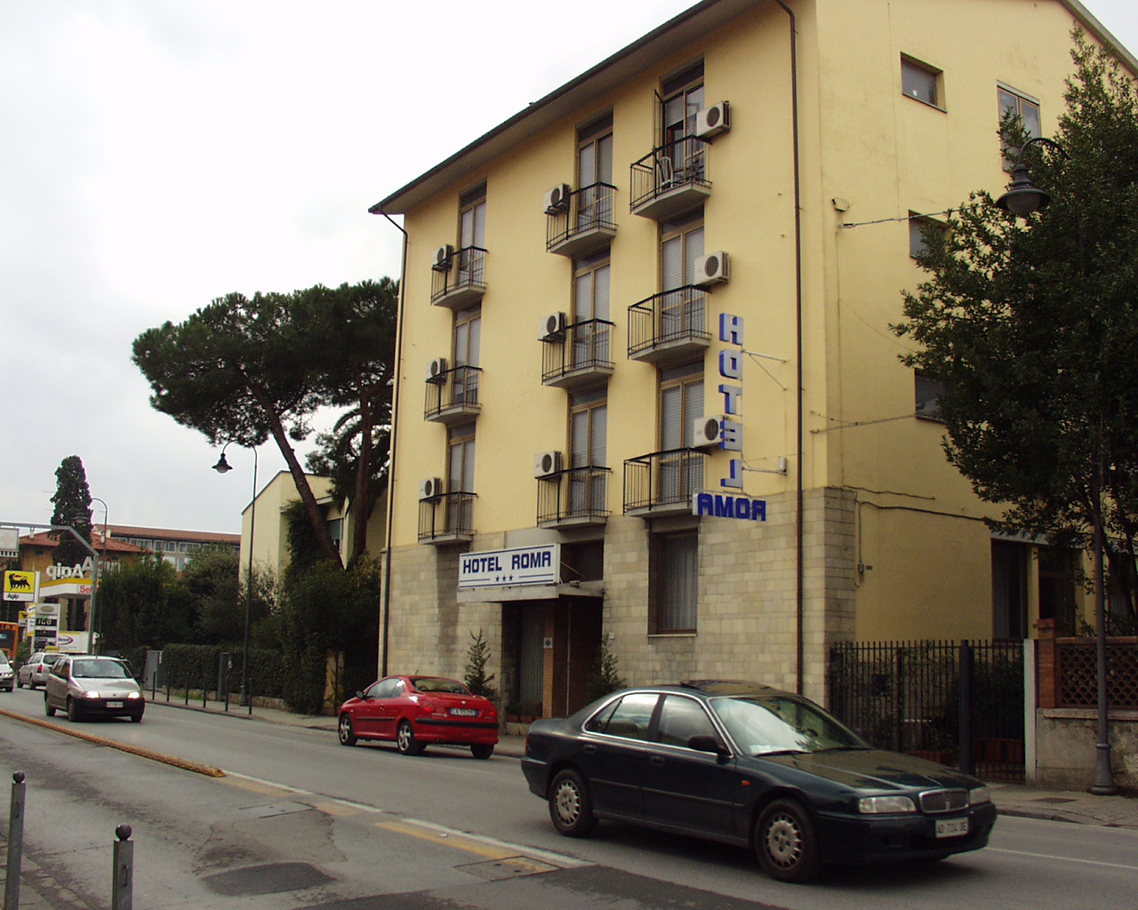
Pontecorvo family home
Four brothers and three sisters
Guido - Fellow of the Royal Society (England), biologist.
Gillo - a film director, president of the Venice Film Festival.

Slide 8
Road to Rome
"I was a moderately good student in school."
Jumped three grades in one year.
The most important thing in my life, however, was tennis, of which I am a profound theoretical expert to this day, of which I am sincerely convinced.
I entered the Facolta di Ingegneria dell'Universita di Pisa at the age of 16
I did not like drawing, so after the first two years I decided to leave engineering and enrol in the third year of physics. My brother, Guido, argued authoritatively: "Physics? That means you have to go to Rome. Fermi and Razzetti are there."
B.M.Pontecorvo, interview 1988
Defended his diploma at the age of 20 (110 points out of 110 possible).

Slide 9
Fermi: experimentalists and theoreticians
Fermi interview:
"Unfortunately, physicists today are divided into two categories - theorists and experimentalists. The demands on theoreticians are very high. If a theoretical physicist is not at a very high level, his work is meaningless. In this respect there is an analogy, say, between the profession of a theoretical physicist and the profession of an Egyptologist scientist. If the Egyptologist did not turn out to be an exceptionally bright scientist, it means that he simply made a mistake in his choice of profession.
As for experimental physicists, there is always an opportunity for a person of average abilities to be useful. An experimenter can, say, measure the density of different substances. This will be a very necessary work, although it does not require great intelligence."
Bruno was classified as an experimentalist.

Slide 10
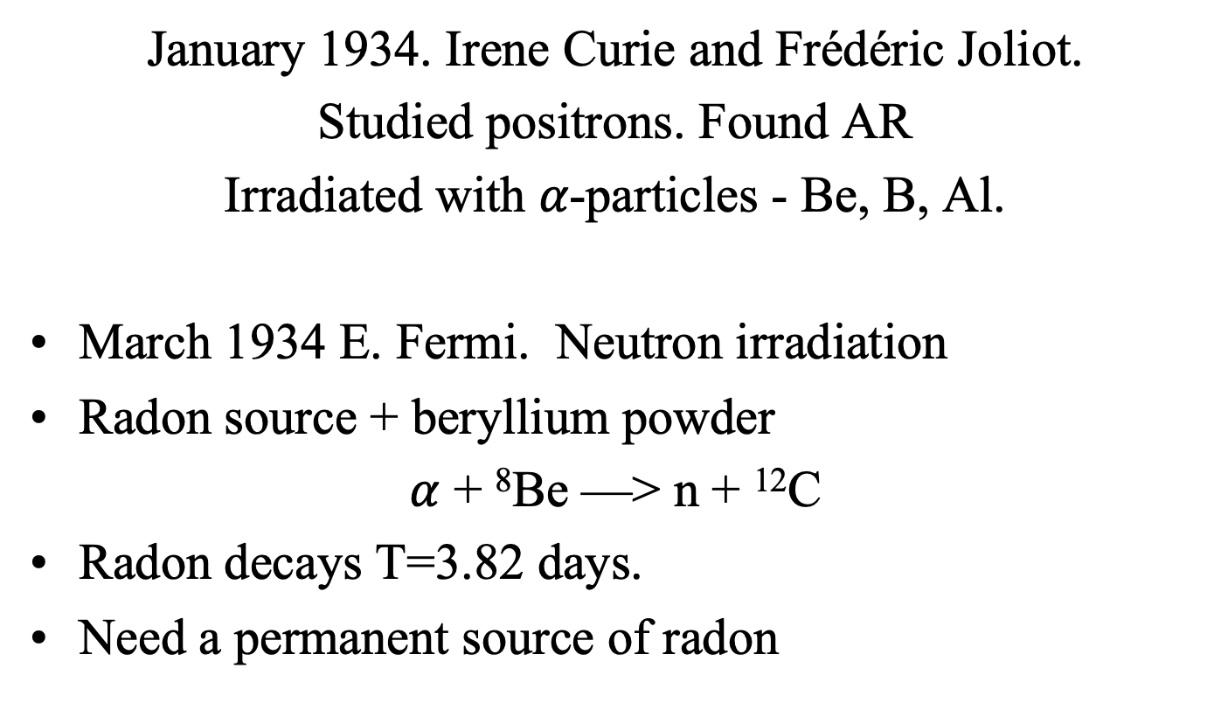
Artificial radioactivity
January 1934. Irene Curie and Frédéric Joliot.
Studied positrons. Found AR
Irradiated with 𝛼-particles - Be, B, Al.
March 1934 E. Fermi. Neutron irradiation
Radon source + beryllium powder
$α$ + ⁸Be —> n + ¹²C
Radon decays T=3.82 days.
Need a permanent source of radon

Slide 11
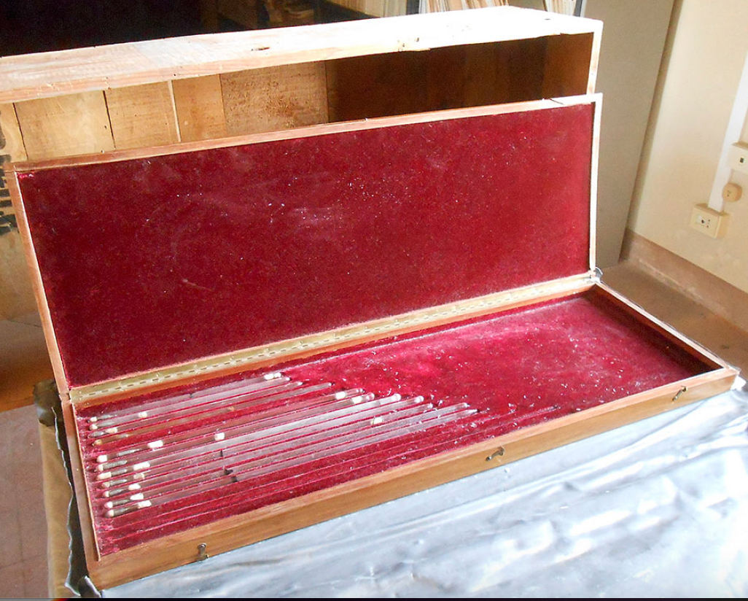
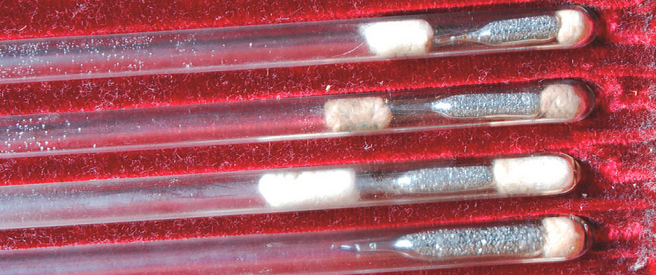
Sources of G. Trabacchi
(“Divine Providence»)
1.041 g of Ra

Slide 12
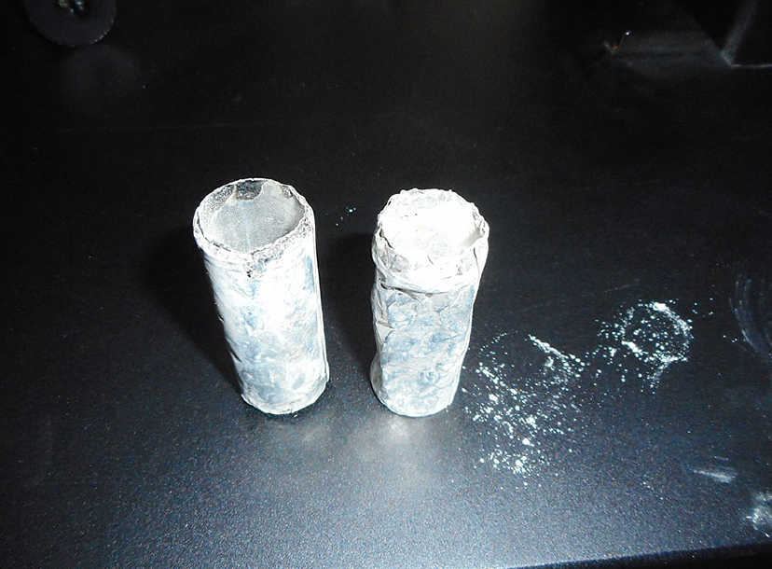
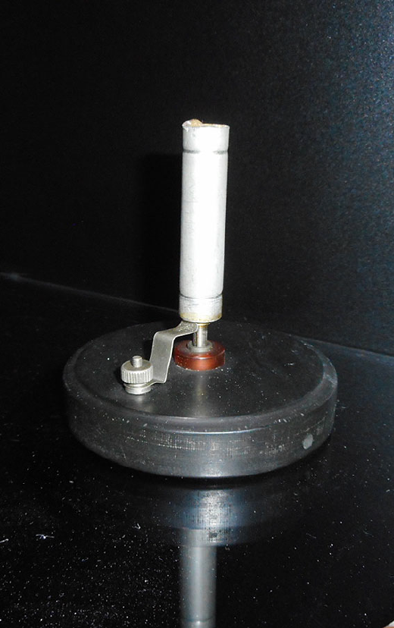
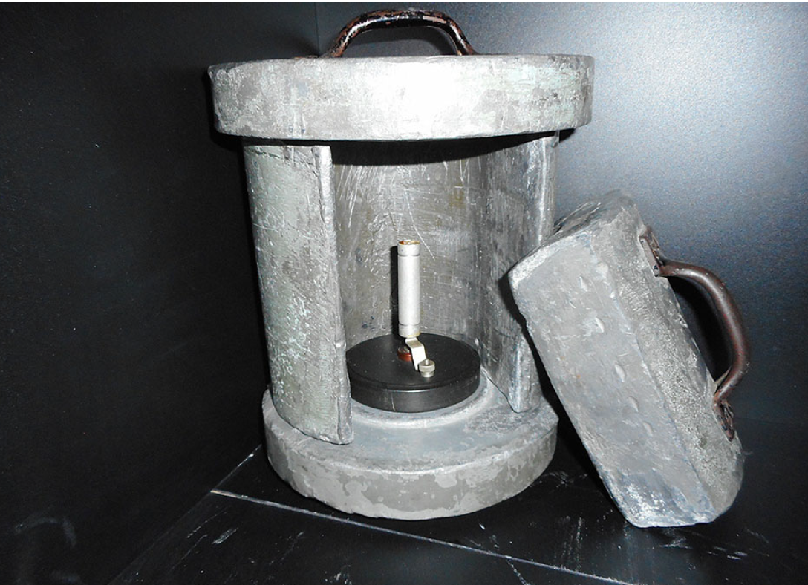
Experimental apparatus
Probes
Stand
Geiger counter

Slide 13
The effect of table
Study of induced radiation activity
The induced activity on a wooden table is greater than on a marble table ?
R
Geiger counter
Radioactive source
Probe
Bruno
Probe

Slide 14
The “castelletto” effect
R
No R² dependence
Radioactive
source
Probe
Lead box

Slide 15
Scientific approach:
We need to study the effects of lead
Fermi came along and took.... paraffin wedge.
”Con intuito phenomenale”
Lead
Paraffin wedge

Slide 16
Neutron slowdown
20 October, Fermi changes the lead wedge to a paraffin wedge.
21 October, conduct more experiments.
22 October, article is written.
23 October, magazine comes out with article.
E.Fermi, E.Amaldi, B.Pontecorvo, F.Rasetti, E.Segre «Influence of hydrogeneous substances on the radioactivity produced by neutrons"
On 26 October, Italian patent application No. 324,458 is filed.
A classic example of the practical application of nuclear physics

Slide 17
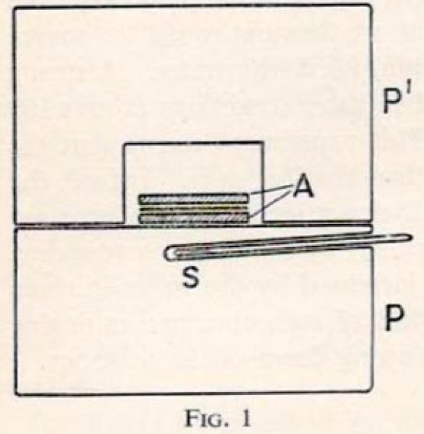
Patent №324 458.
"Even now I cannot forget Fermi's , sincere, hearty, childish laugh at Corbino's hint that the work in question might have had practical significance."
B. Pontecorvo
A device for studying neutron slowing down. S - neutron source, A - the substance under study, placed in a container of two paraffin blocks P and P'

Slide 18
Conclusions:
Close attention to all details of the experiment
Optimal choice of experimental conditions
Different results on the tables
Verification experiments:
  Radium source without beryllium has no effect. Effect of neutrons.
  Experiment with NaNO₃ gave no increase in activity. Effect of hydrogen
  Apart from silver, the effect is observed for copper and iodine. While in silicon, zinc and phosphorus no appreciable increase in activity is observed
Practical applications of basic research are possible

Slide 19
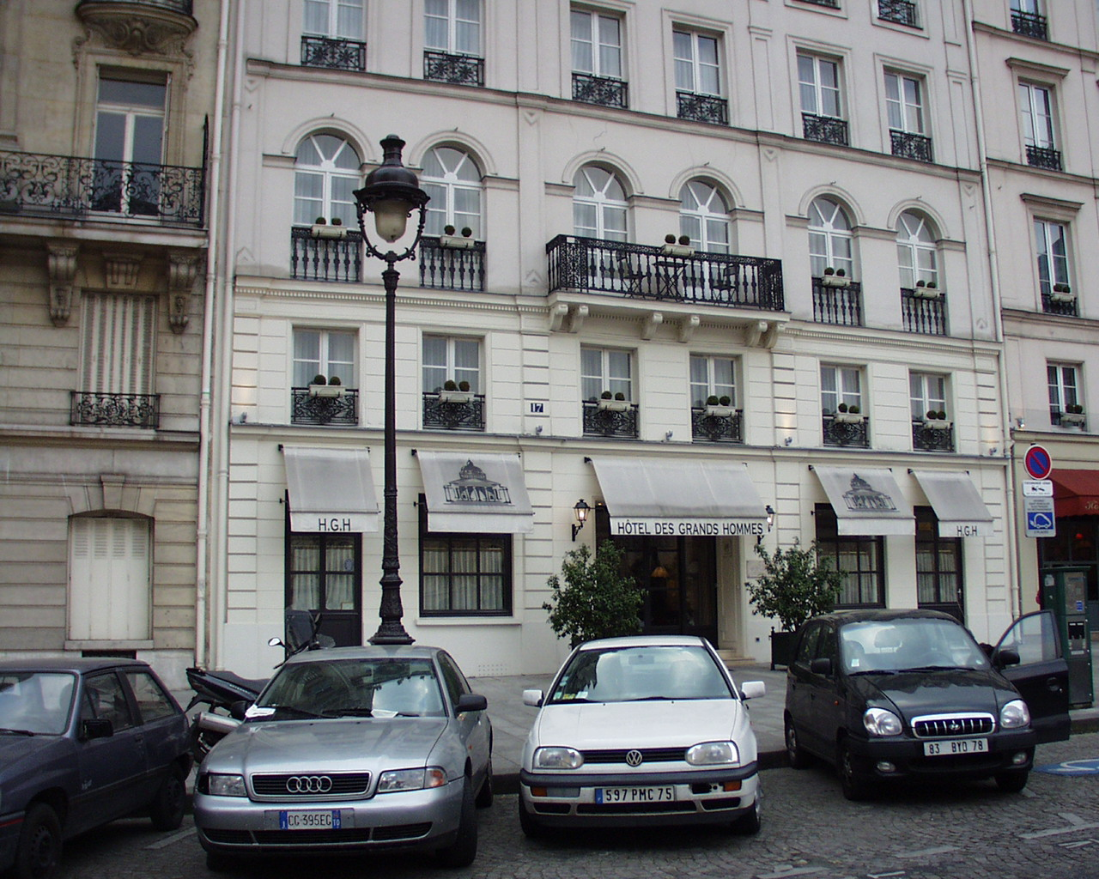
Paris, 1936-1940
For his research with neutrons, Bruno received a grant from the Ministry of Education to conduct research abroad and arrived in Paris on 29 February 1936 to work at the Radium Institute.
Hotel “Grand Hommes”

Slide 20
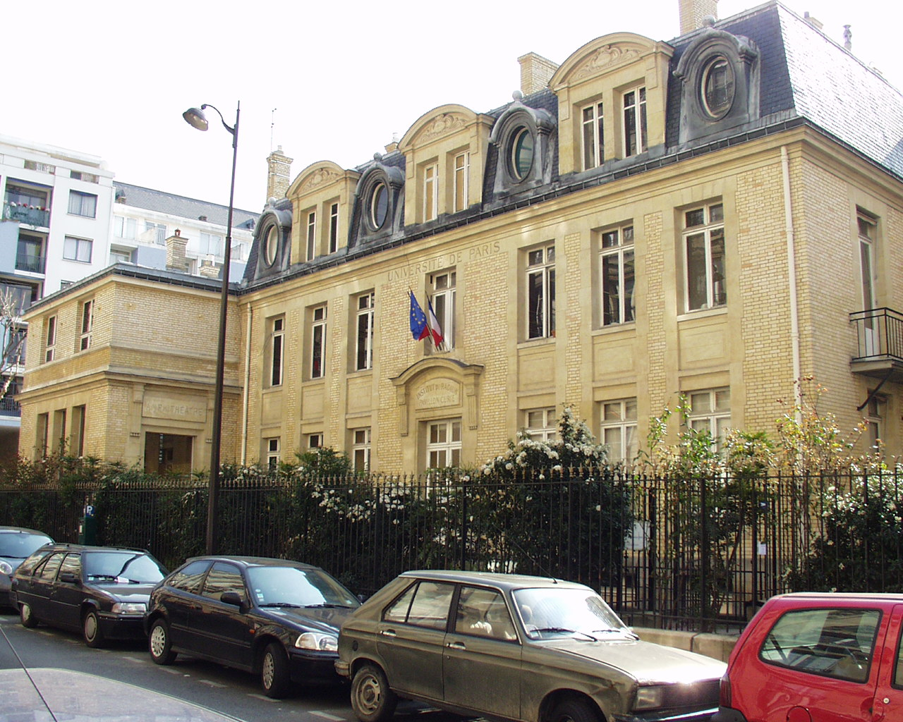
Radium Institute, Paris

Slide 21
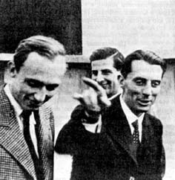
Working with F. Joliot-Curie
Study of nuclear isomerism: nuclei of the same mass and charge have different half-lives.
1935 I.V.Kurchatov, 3 states in two isotopes of bromine.

Slide 22
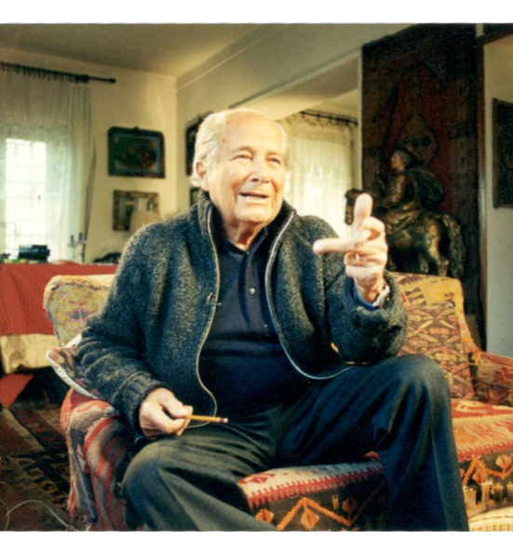
Communist
He joined the Italian Communist Party in 1939.
“Bruno became a Communist because he believed Communism would create a New Man – people that were better than they were before, and better than the people that exist today. And many Italian intellectuals believed in that. For example, I too was a Communist”
“He had a very passionate belief in the Soviet Union, perhaps a very childish and naive belief. I remember when the radio broadcasts the Kremlin chimes Bruno would come up to the radio especially to listen to those Kremlin chimes. Those were the sounds – the chimes – of his dreams”
Gillo Pontecorvo, Interview from the film “Bruno Pontecorvo”.

Slide 23
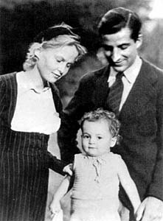
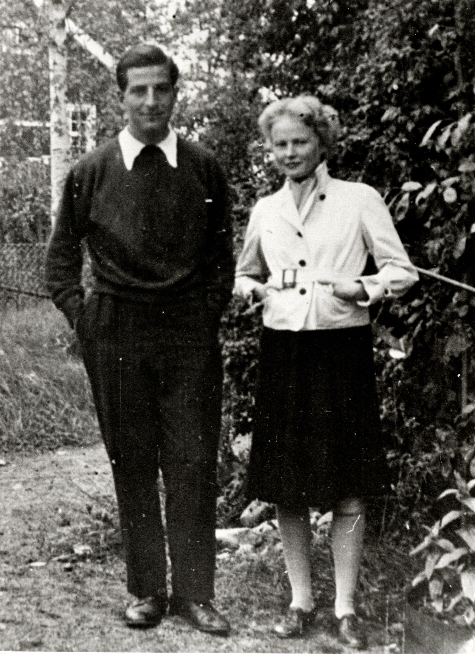
Marianne
1940, married Marianne Nordblom.

Slide 24
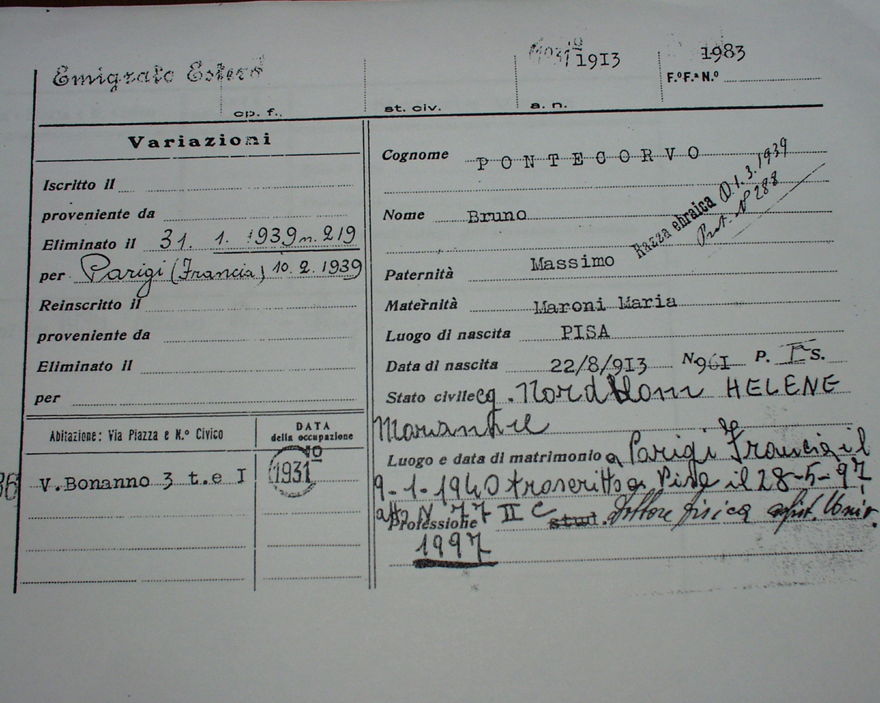
First choice -1937
Return to Italy to run for a permanent position?
Mussolini's racist laws, 1938.

Slide 25
Atomic race
April 1939, Joliot's collaborators H. Halban and L. Kovarski showed that fission of uranium releases more than one neutron
May 1939 Joliot-Curie files three patents for the use of the chain reaction and for the atomic bomb.
January 1940 Joliot convinces the French government to buy back all deuterium, (Norsk Hydro, Norway).
March 1940. the French military takes the entire available stockpile of 185kg heavy water to Paris
Joliot ordered von Halban, Kowarski and Pontecorvo to transport the heavy water to England. Bruno was not given a visa:
" Dr Pontecorvo, an employee of Prof Joliot, is mildly undesirable, can only be admitted to military work in case of extreme necessity, but even so must be kept under surveillance."

Slide 26
Escape from Paris
May, 1940 Emilio Segre was looking for a job at Well Serveys Inc. (WSI), Tulsa, USA. He turned it down and recommended Bruno.
May, 1940 Bruno received a job offer at WSI.
13 June, 1940 - escape from Paris: Bruno, Gillo, E. Sereny, Salvatore Luria on bicycles to Toulouse.
20 August, 1940 - Bruno (family) + sister Giuliana and her husband in New York City

Slide 27
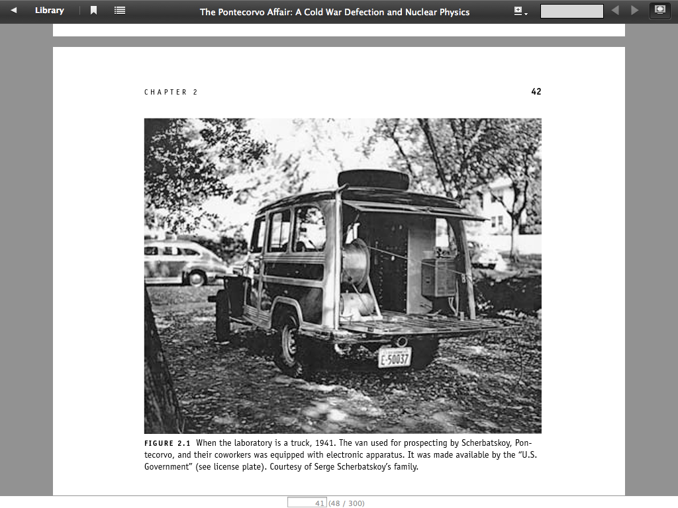
USA, 1940-1943
Working at Wells Survey, Inc. Tulsa Oklahoma
Searching for oil using nuclear-physical methods
Measured the radioactivity of rocks

Slide 28
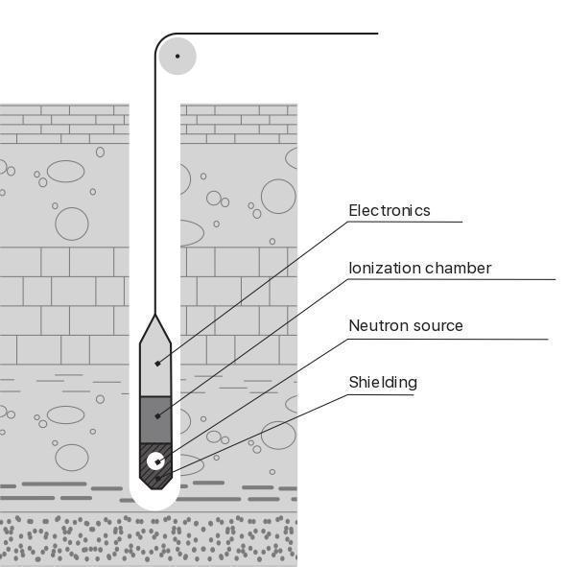
Neutron logging
He proposed to inject a Ra-Be neutron source into the borehole and register γ -quanta from the matter surrounding the borehole

Slide 29
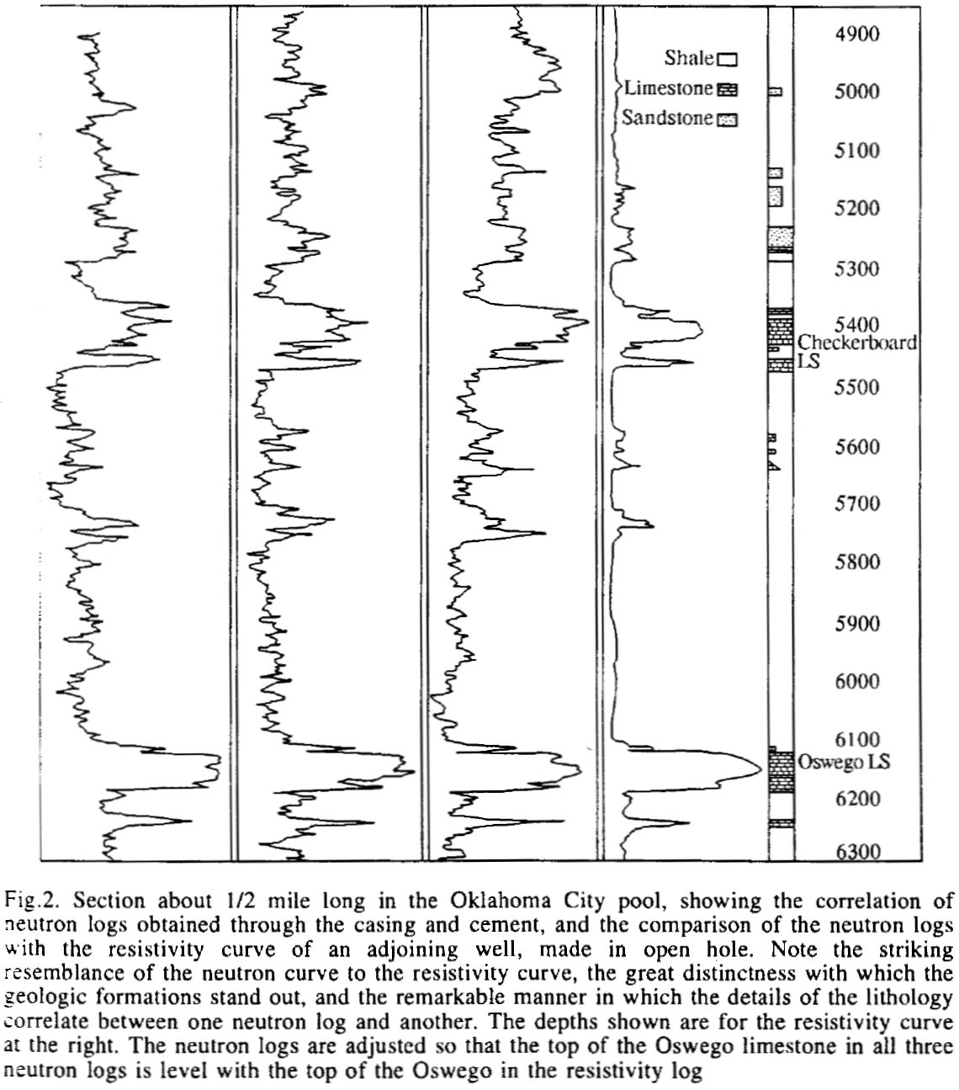
Neutron logging-2
Neutron logs
Resistivity log

Slide 30
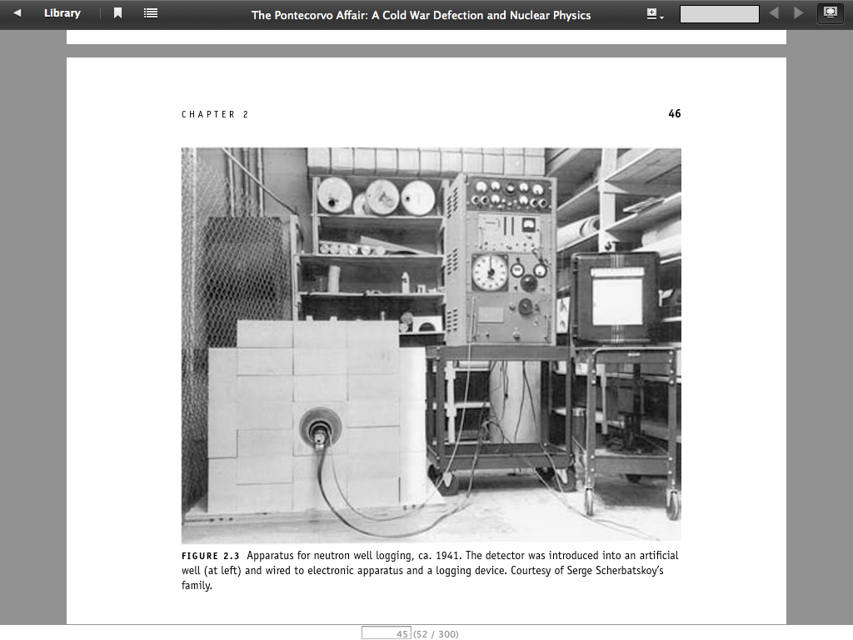
Neutron logging-3
Artificial well – different substances.
40 reports, 2 articles and 4 patents, all owned by Wells Servey.

Slide 31
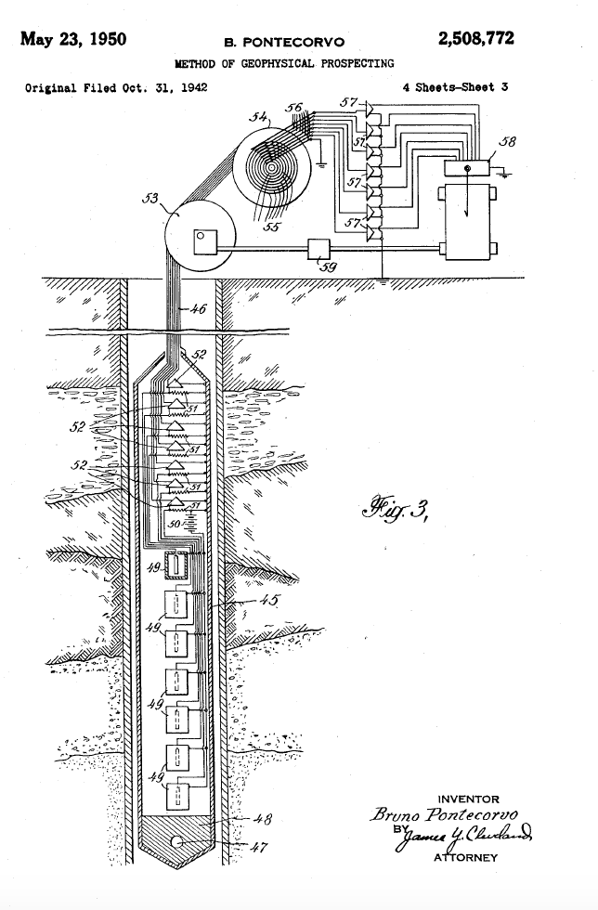
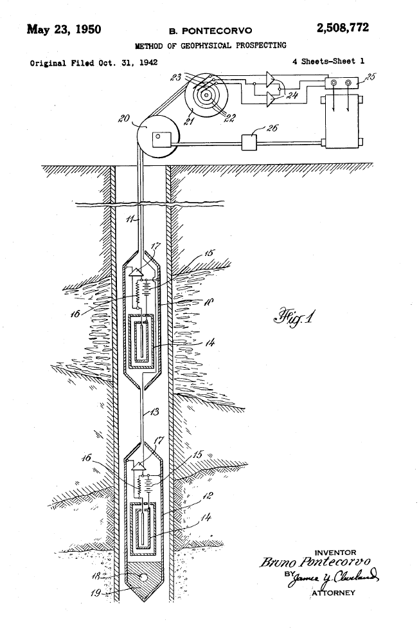
Template patent
A geophysical exploration method comprising exposing the environment surrounding a borehole to radioactive radiation, measuring radiation from the environment at various points from the source of the radiation.
Bruno patented:
(n,𝛄) –
(n,n’) -
(𝛄, 𝛄’) - logging

Slide 32
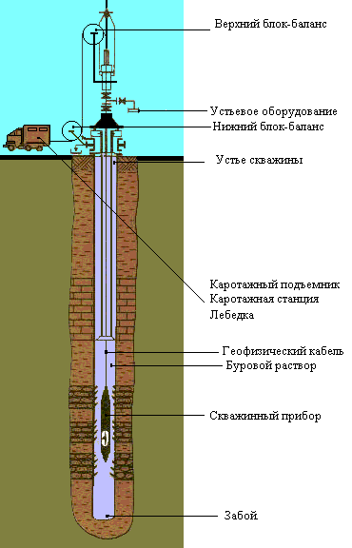
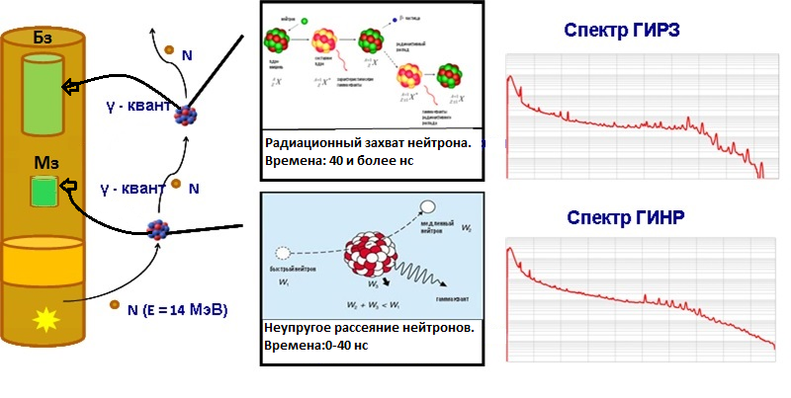
Pontecorvo’s ideas today
Во время записи с применением импульсного нейтронного генератора происходит регистрация энергетических спектров неупругого рассеяния (ГИНР) и радиационного захвата (ГИРЗ)
Детекторы (ближний и дальний)
Источник излучения
(нейтронный генератор)

Slide 33
Neutron logging-3
"Neutron logging. A new geological method based on nuclear physics".
The first practical use of nuclear physics.
Obligatory procedure for the inspection of all new wells
Most lovely…
Ra-Be source - fast neutrons
How would one find a source of lower energy neutrons?
Meeting with L. Kowarski, H. Halban, E. Fermi

Slide 34
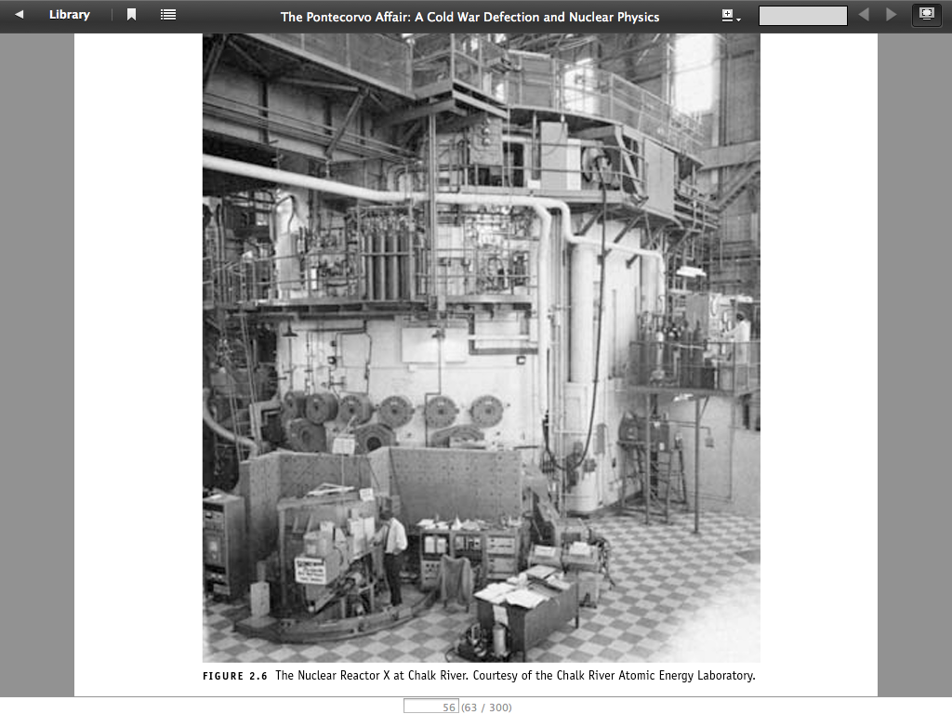
Chalk River (1943-1949)
1943 Anglo-Canadian Research Reactor Project "Tube Alloys".
Chalk River NRX deuterium nuclear reactor
Calculated reactor size, conducted experiments on the interaction of neutrons with reactor materials.

Slide 35
What was Bruno doing in Chalk River?
Proposed the first method of neutrino detection, 1946.
(pondered a real experience with a lorry ).
The universality of the weak interaction, 1947.
Muon decays into 3 particles. No decay μ→eγ, 1948.
New mode of operation of proportional counters, 1949.
First limit on neutrino mass (m<500 eV) from ³H decay measurements, 1949.

Slide 36
First method of neutrino registration, 1946
“I have done a terrible thing. I have postulated a particle that cannot be detected”
W.Pauli
H.Bethe, R.Peierls, 1932
Interaction cross section of neutrinos with matter
E_{ν} ∼ 1 MeV: σ ∼ 10⁻⁴³ cm²
(H₂O) ∼ 10²⁰ cm = 35 light years
B.Pontecorvo 1946
ν + ³⁷Cl →e⁻ + ³⁷Ar
Argon -37 is radioactive,
half-life T=35.04 days
Electron capture e⁻ + ³⁷Ar→ ³⁷Cl with Auger-electron 2.82 keV
10 atoms of ³⁷Ar per month from 10³⁰ atoms of substance!

Slide 37
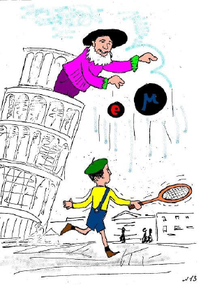
Universality of the weak interaction, 1947
We notice that the probability (about 10⁶ sec⁻¹) of capture of a bound negative meson is of the order of the probability of ordinary K-capture processes…
We assume that this is significant and wish to discuss the possibility of a fundamental analogy between β-processes and processes of emission or absorption of charged mesons.
Phys.Rev. 72 (1947) 246

Slide 38
Muon decays, 1948
The Conversi-Pancini-Piccioni experiment
"As soon as I read the paper by Conversi et al. ... I was literally captivated by the particle we now call the muon. It was indeed an intriguing particle: 'ordered' by Yukawa and discovered by Anderson, it was, as Conversee et al. discovered, actually nothing like the Yukawa particle!
I felt myself swept by the antidogmatic wind and started asking a lot of questions like:
  - Why does the spin of a muon have to be integer?
  - Who says a muon must decay into an electron and a neutrino, not an electron and two neutrinos or an electron and a photon?
  - Is the charged particle flying out when the muon decays an electron?
  - Are particles other than the electron and neutrino emitted in muon decay?
  - In what form is energy released when a muon is captured by the nucleus?"

Slide 39
What was Bruno doing in Chalk River?
"We worked in the reactor laboratory and therefore felt some guilt in dealing with cosmic rays. It is true that our head, V. Sargent ... favoured our activities. Still, I can't forget how reluctant Ted and I were to spend lab funds and how happy we were when Ted invented the 'threshold amplifier' which saved a lot of counters, allowing us to greatly increase the efficiency of photon registration."
B.Pontecorvo

Slide 40
Harwell, 1949-1950
February 1948, received British citizenship.
January 1949. The family settled in Abingdon.
9 November 1949, E. Segre denounces Bruno's communist views
15 December 1949, FBI informs MI6:
Informant A, who had proved his reliability in communist-related matters, confirms the reliability of informant B, who testified that he was acquainted with three persons in Paris who worked under Professor Langevin and were exposed to the communist virus. These were Bruno Pontecorvo, Sergio de Benedetto and Salvatore Luria.

Slide 41
Denunciations and interrogations
1 March 1950. - Harwell interrogation. Bruno confesses to having visited Gillo.
2 March 1950 information from Sweden:
"In Enskede, a suburb of Stockholm, lives Mrs PONTE KORVO, of Swedish nationality, married to an Italian-born subject whose real nationality is unknown. Mr PONTE CORVO lives in England, where he works at the British Atomic Installation. Frue PONTE CORVO was in England in the summer of 1949 with her two sons. Both she and her husband are recognised communists."
6 April - Second Harwell interrogation
" Pontecorvo's case does not fall within the standards of immediate dismissal, but we will not be relieved if he stays where he is working now."
24 July 1950 - accepted a job at the University of Liverpool
25 July 1950 - left on leave

Slide 42
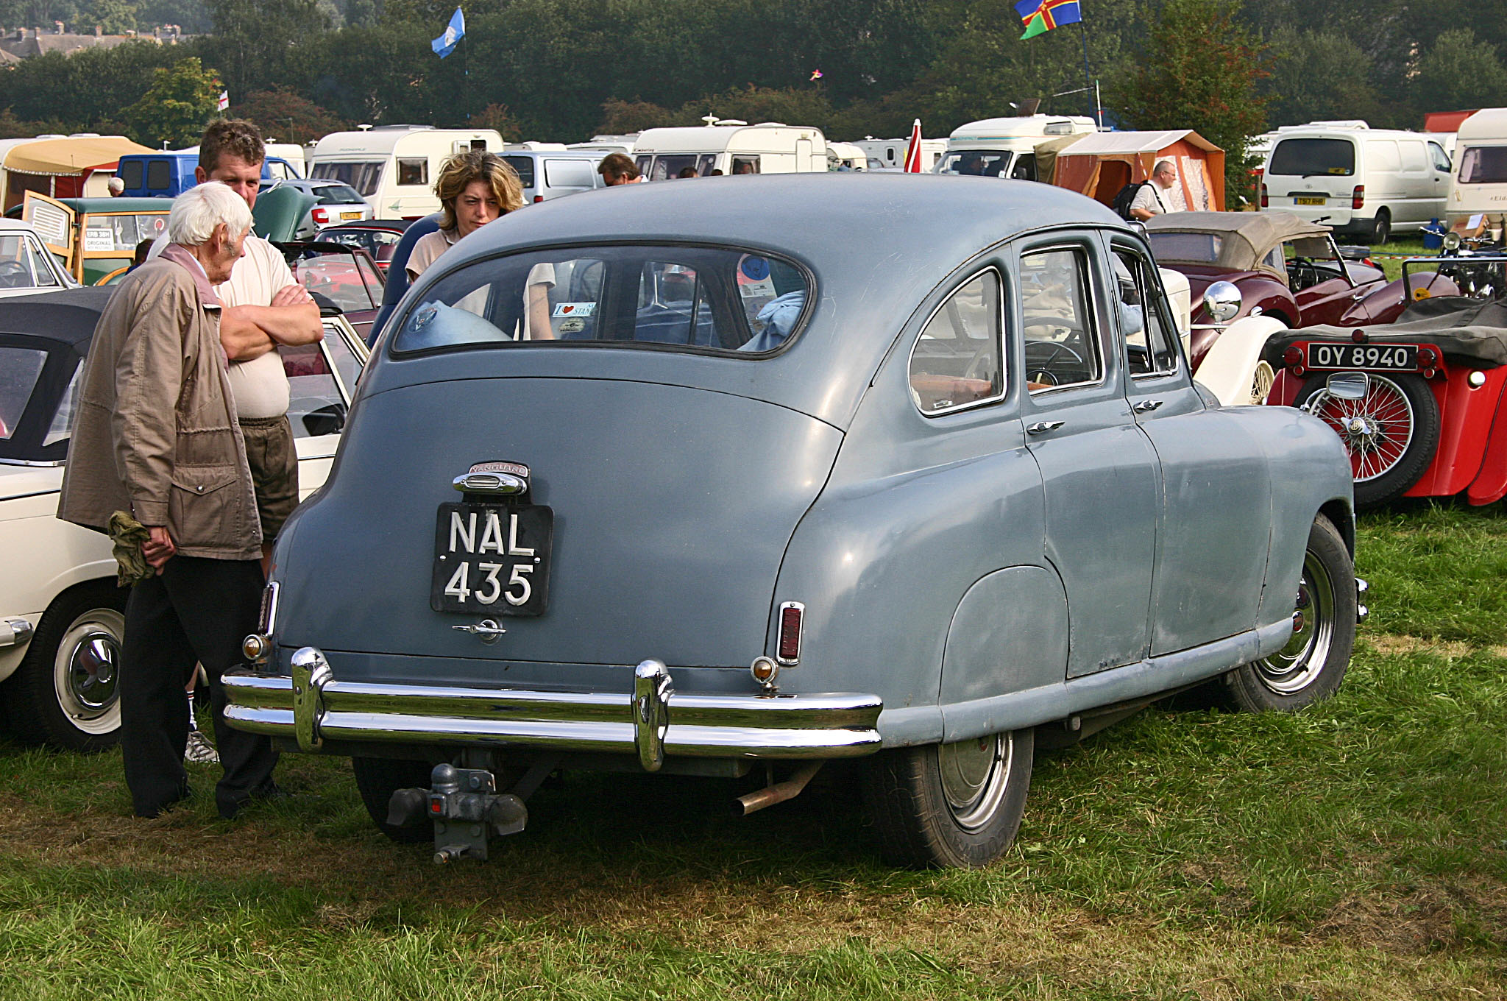
Holidays in Rome, August 1950
Bruno+Marianne+Anna+Gil (12 years old) + Tito (6 years old) + Antonio (5 years old)
St Tropez - Switzerland - Lake Como - Dolomites - Rome - Circeo

Slide 43
Patent case
1936 - Italian patent for slowing down neutrons
1940 - American patent + use for production of radioisotopes.
1943 - Fermi and Segre. Compensation for use of patent. Contract with patent attorney G. Gianini.
1 million $+100,000 until 1957.
Segre's denunciation - desire to remove an extra (communist).
1950 г. - Gianini sues for $10 million.

Slide 44
Аugust 1950
22 August - patent case, $10 million lawsuit against the US government.
23 August. Bruno suddenly decides to return to Rome.
25 August. Sent a telegram to his parents that because of the illness of the children and the breakdown of the car in Chamonix to them will not come to them, and will return to England. Went to Circeo to pick up his family.
27 August. Again to Rome. Left little Antonio at Ladispoli.
29 August. Left my Vangard for repairs. Booked tickets for Stockholm.
30 August. Purchased the tickets.
1 September. Flew to Stockholm
2 September Helsinki.
1 November Dubna

Slide 45
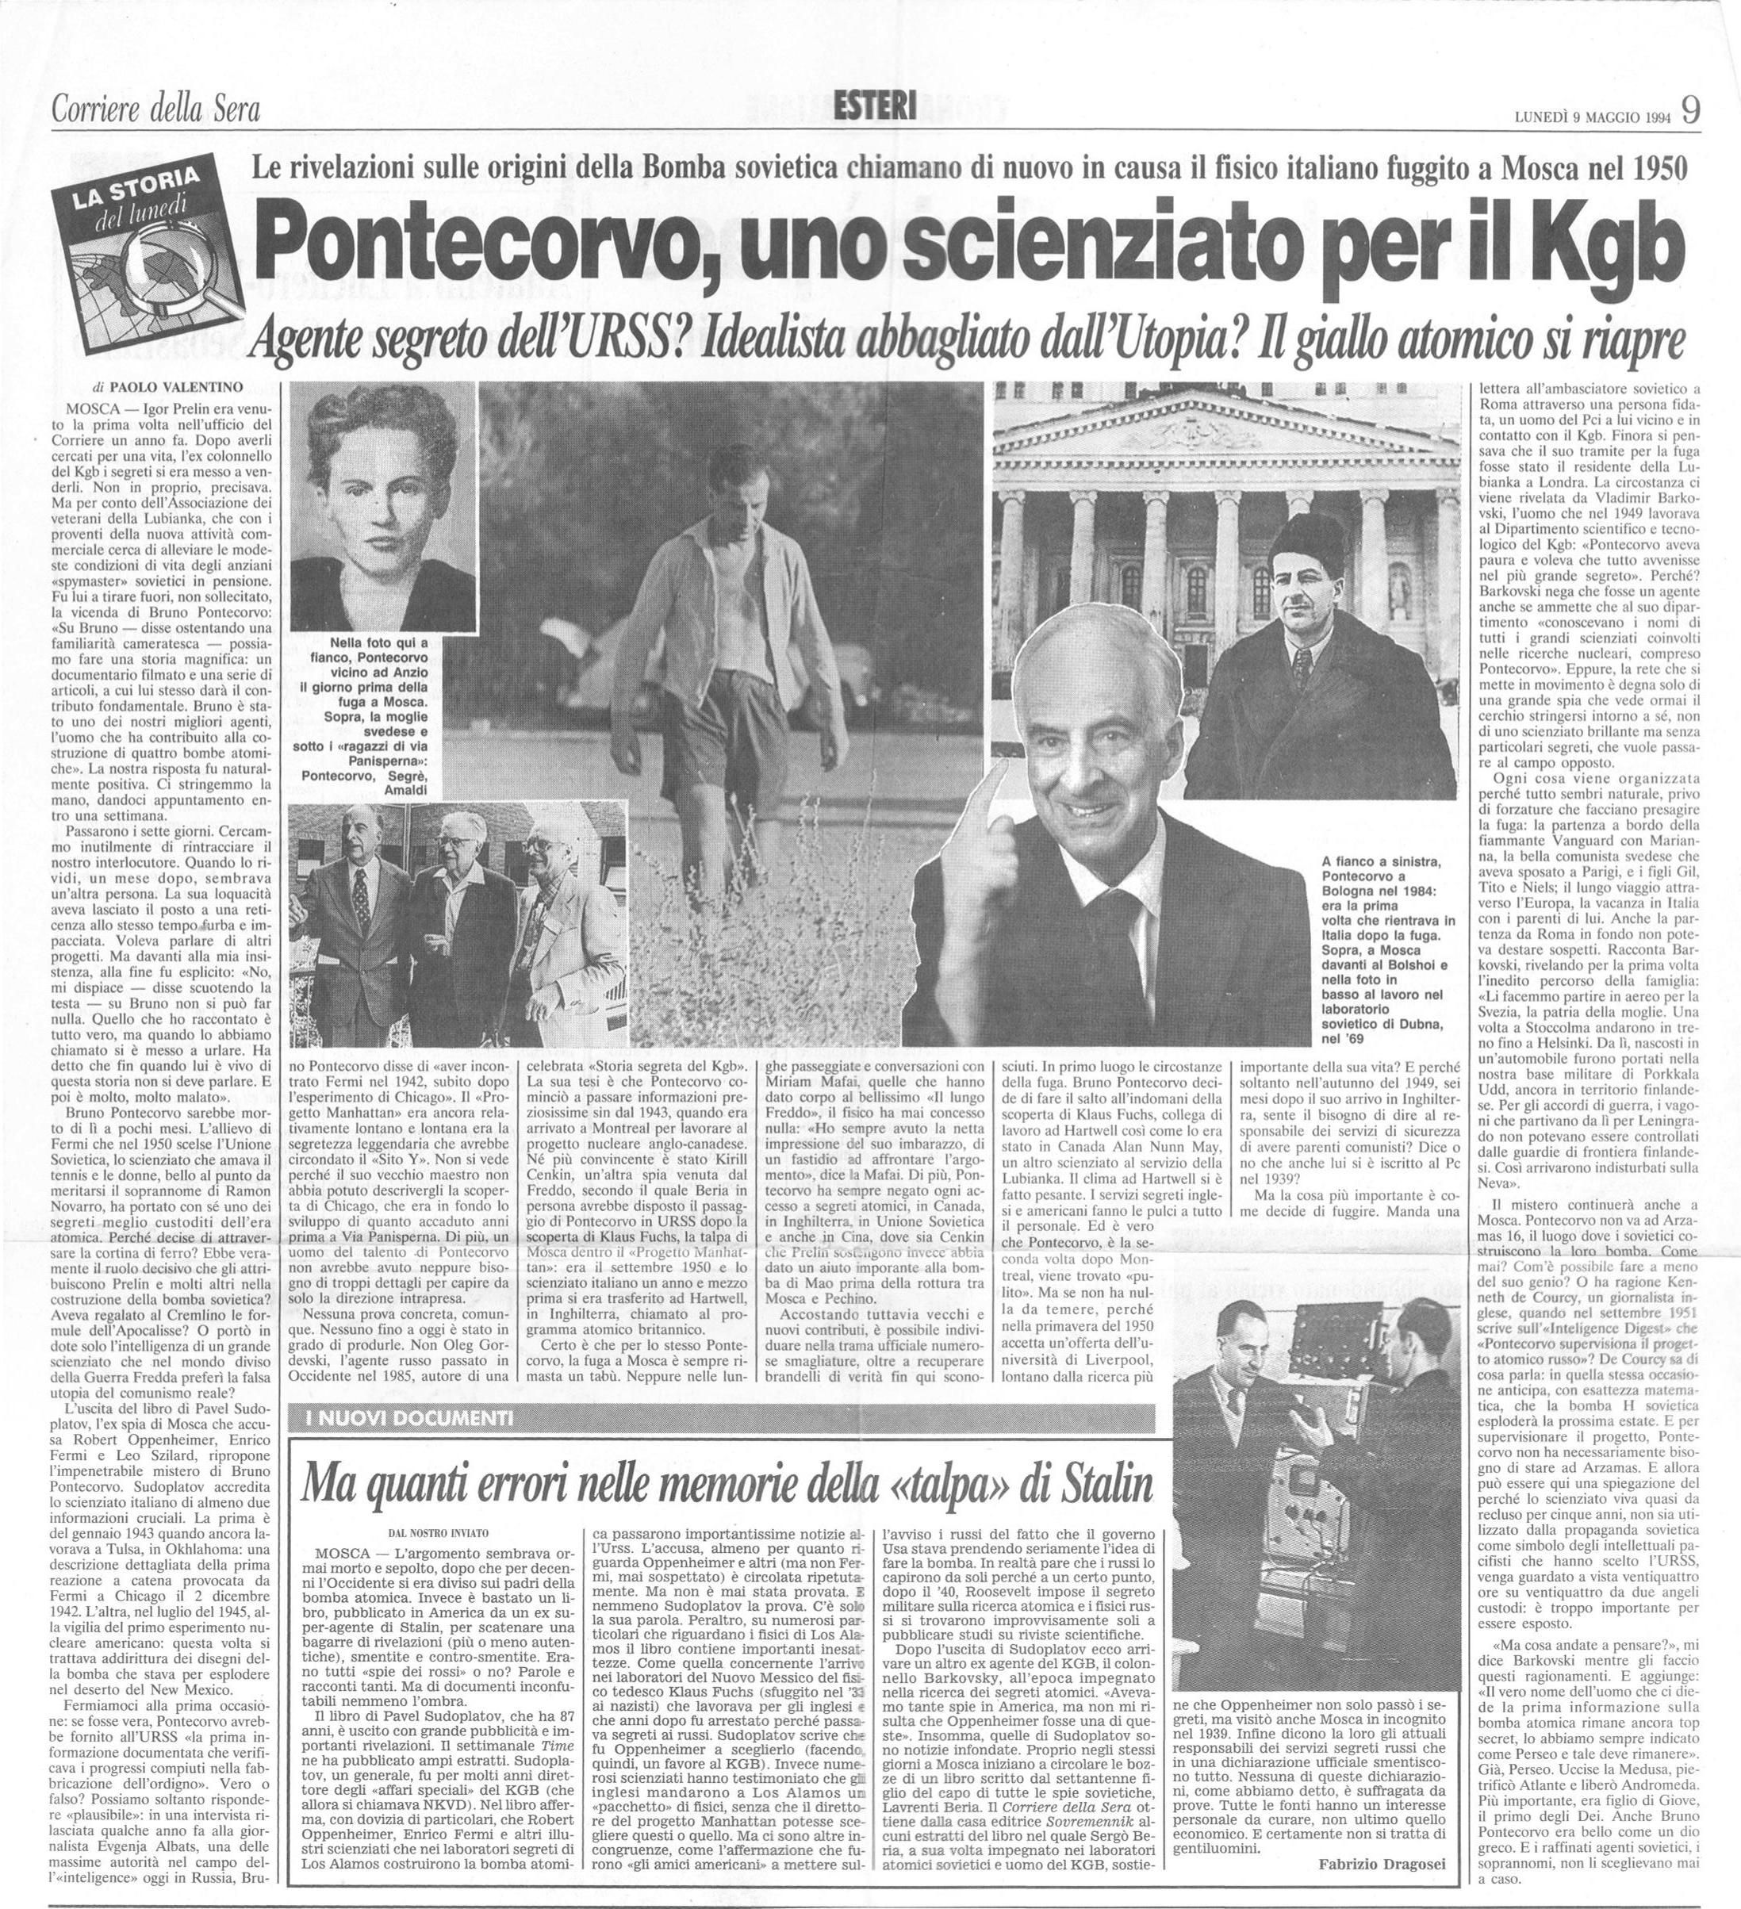
So what has happened?
"Bruno was very worried about the interrogations and wanted the whole operation to be conducted under great secrecy. As a result, the scientist was evacuated according to KGB plans intended for secret agents. Barkovsky denied any connection between Pontecorvo and the agents relaying information from the Manhattan Project.”

Slide 46
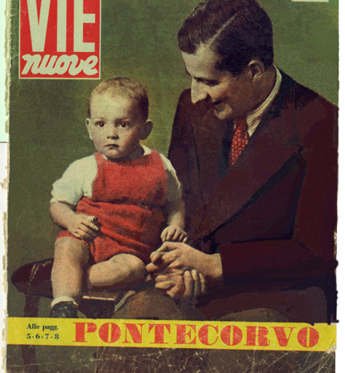
What did B. Pontecorvo do between 1950-1955?
A bomb?
Nuclear reactors?
Looking for uranium?
A Chinese bomb?
Neutron logs?
Why was it classified?

Slide 47
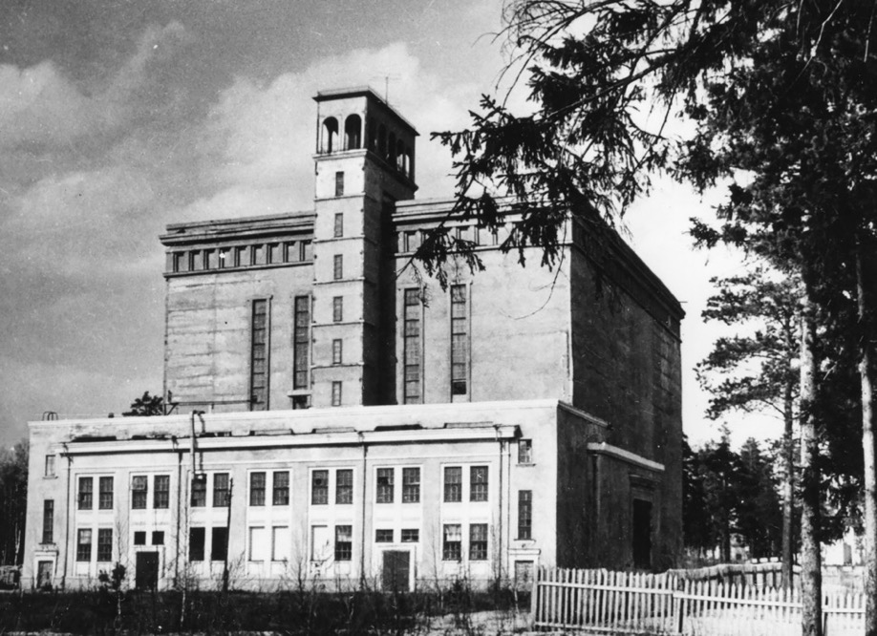
Worked on
“Ustanovka M"
Best accelerator in the world at thаt time – protons, 490 MeV
Berkeley – 390 MeV
Harwell – 170 MeV
Built in 3 years

Slide 48
Is Dubna a Stalinist Skolkovo (Silicon Valley)?
To Comrade L.P. Beria
1. The present level of knowledge about the atomic nucleus and cosmic rays makes it possible to assume that by means of particles accelerated to energies of 250 million volts and higher, it is possible to proceed to discoveries of new physical phenomena (discovery of new elements, new ways of obtaining atomic energy from cheaper sources than uranium).
2. To produce particles of such energy it is necessary, as calculations show, to have a powerful cyclotron with a pole diameter of at least 3.5 metres. ...
26 January 1946 I.V.Kurchatov

Slide 49
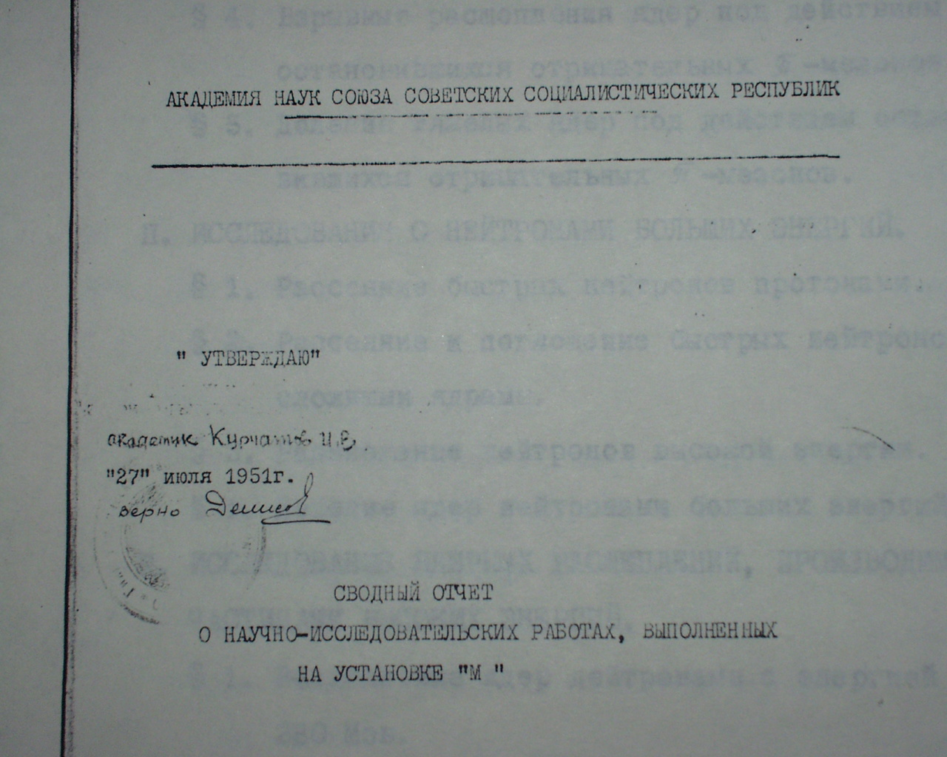
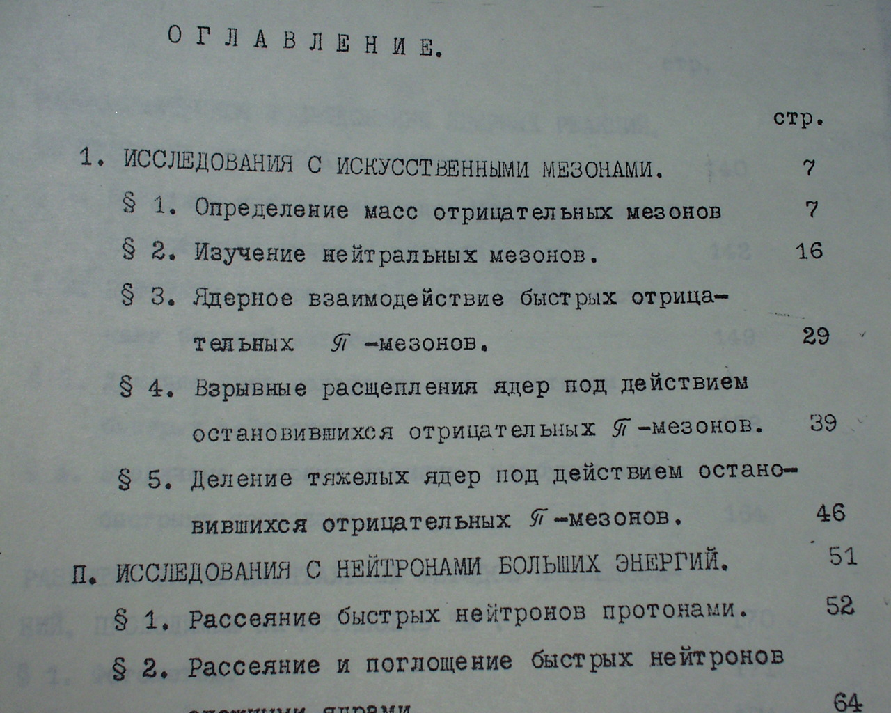
"There will be no oats...”
V.P.Dzhelepov
No military applications

Slide 50
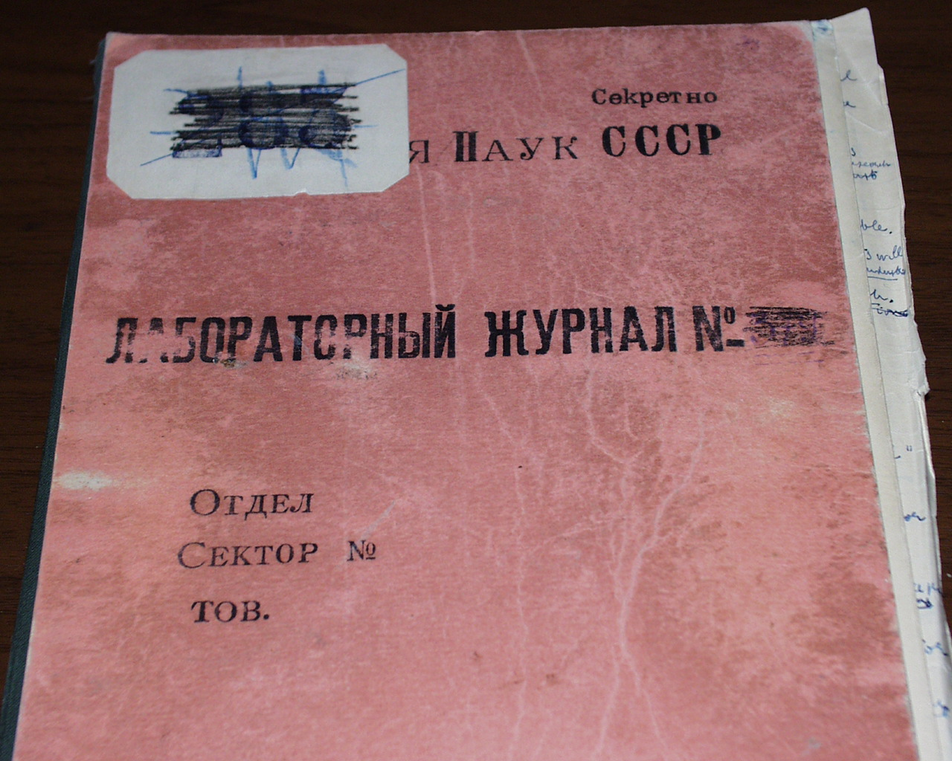
The first secret logbook of
B. Pontecorvo
in Dubna
Notes:
dhjk

Slide 51
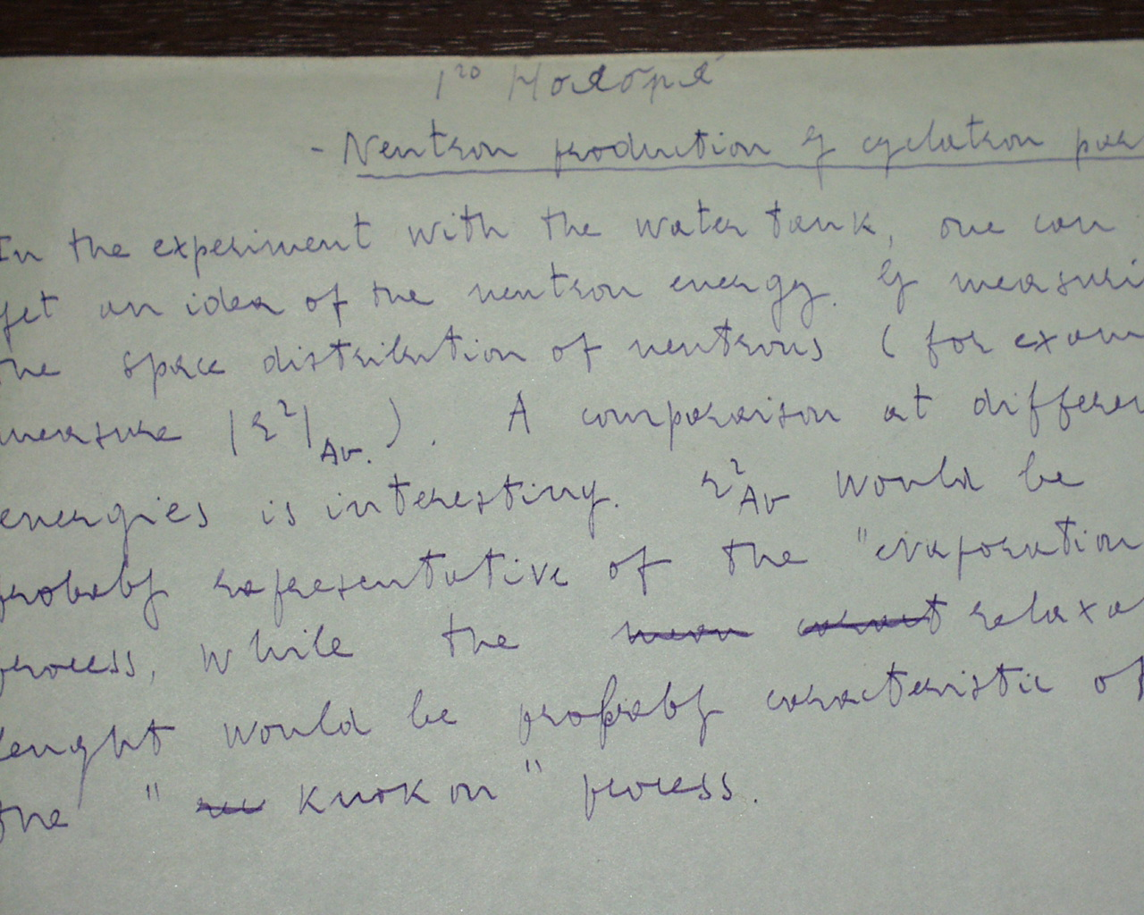
The first entry is from 1 ноября 1950.

Slide 52
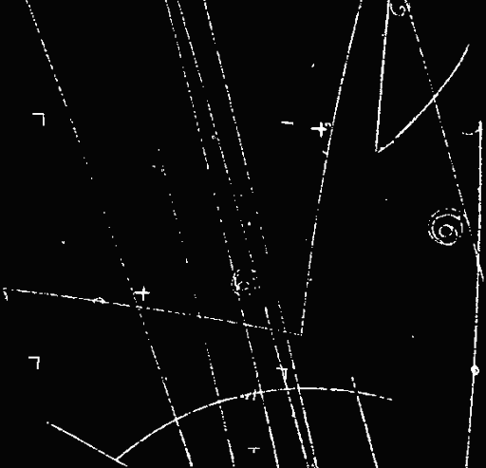
The associative production of strange particles
V-particles are born often, but they take a long time to fly.
Born in pairs?

Slide 53
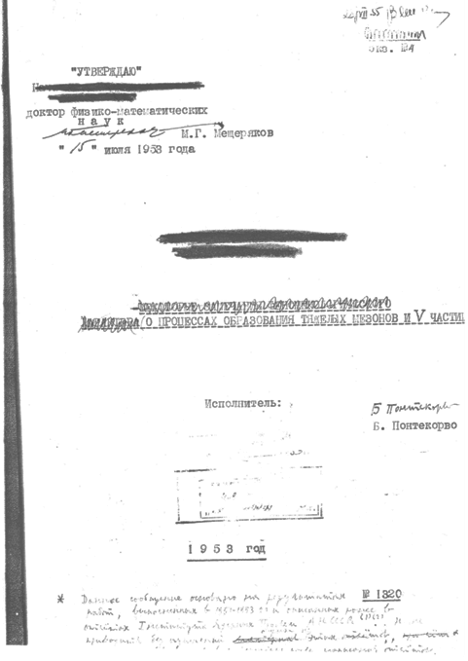

Slide 54
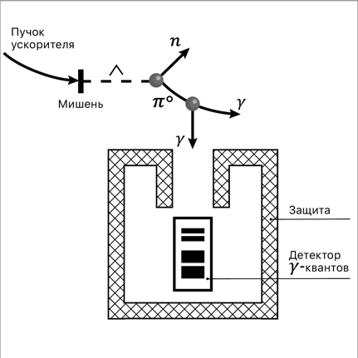
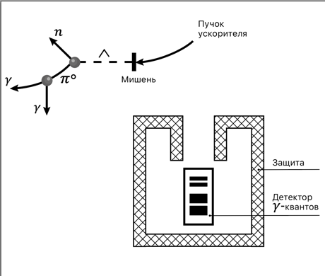
The paired birth of strange particles
N + N → N + Λ , Λ → n + π⁰ , π⁰ → 2 γ

Slide 55
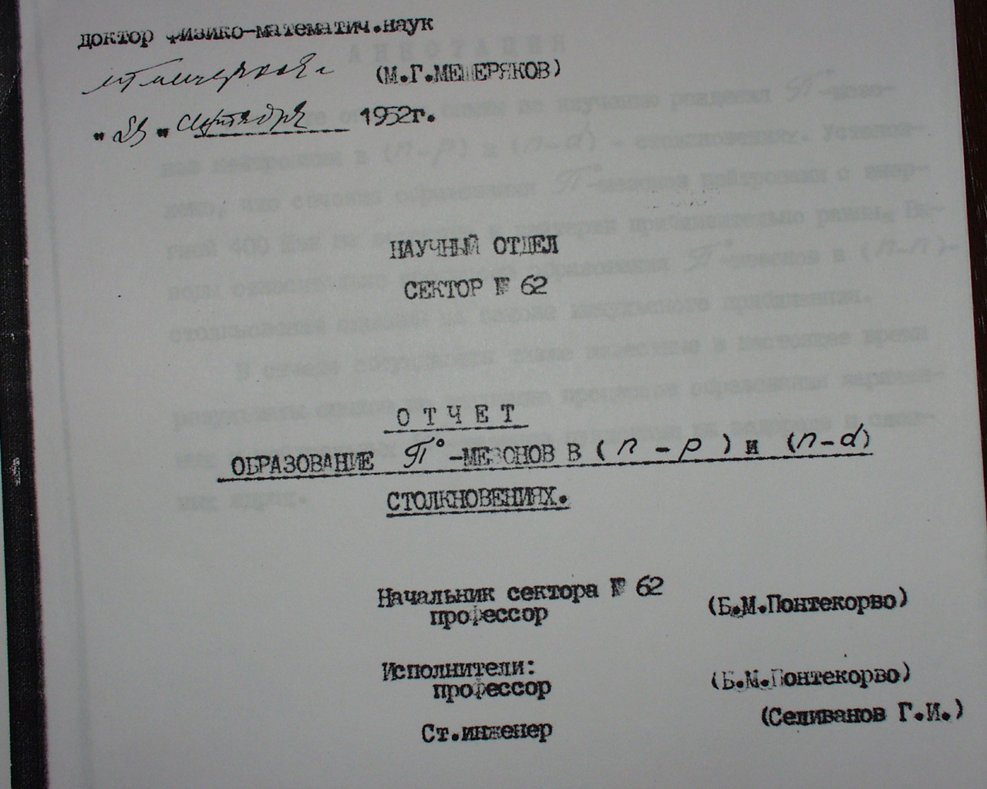

Slide 56
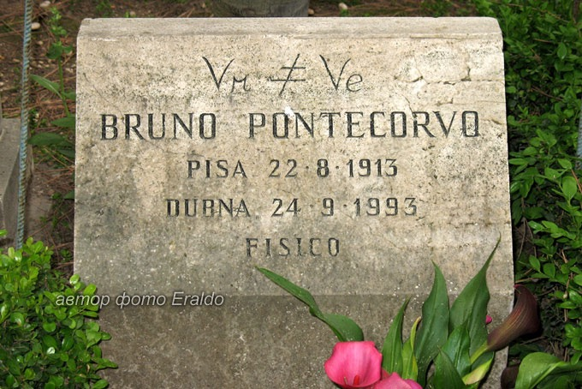
Proposal for 500 A proton cyclotron on 800 MeV, 1958.
Rochester conference in Kiev, 1959.
Are the electron and muon neutrinos identical?
“.... for people working on muons in the old times, the question about different types of neutrinos has always been present.“
B.P."The infancy and youth of neutrino physics"

Slide 57
B.Pontecorvo, "Electron and muon neutrinos", 1959
“Models of new accelerators are being discussed now in which
the intensity of the accelerated protons may be increased as much as by
three orders of magnitude”.
The neutrino beam from decays of stopped muons with E_{ν} ~ 35 MeV.
μ⁺ →e⁺ + ‾ν_{μ} + ν_{e}
        ‾ν_{μ} + p → μ⁺ + n
        ‾ν_{μ} + p → e⁺ + n
M.Schwartz, L.Lederman, J.Steinberger, 1959
Tо measure high-energy neutrinos to study σ(νp) for unitarity crisis in weak interactions
AGS exp N11, "Study of neutrino interactions, search for intermediate boson“
The neutrino beam from decays of π (1GeV) – E_{ν} ∼220 MeV
"The net result is that in 1959 Pontecorvo proposes to address the right question but with hopeless technique… and Schwartz addresses a problem that doesn't solved until the 1982 discovery of the W but his proposal is the right experiment to solve ν_{μ}≠ν_{e} problem…."
L.Lederman, Neutrino'94 Conference

Slide 58
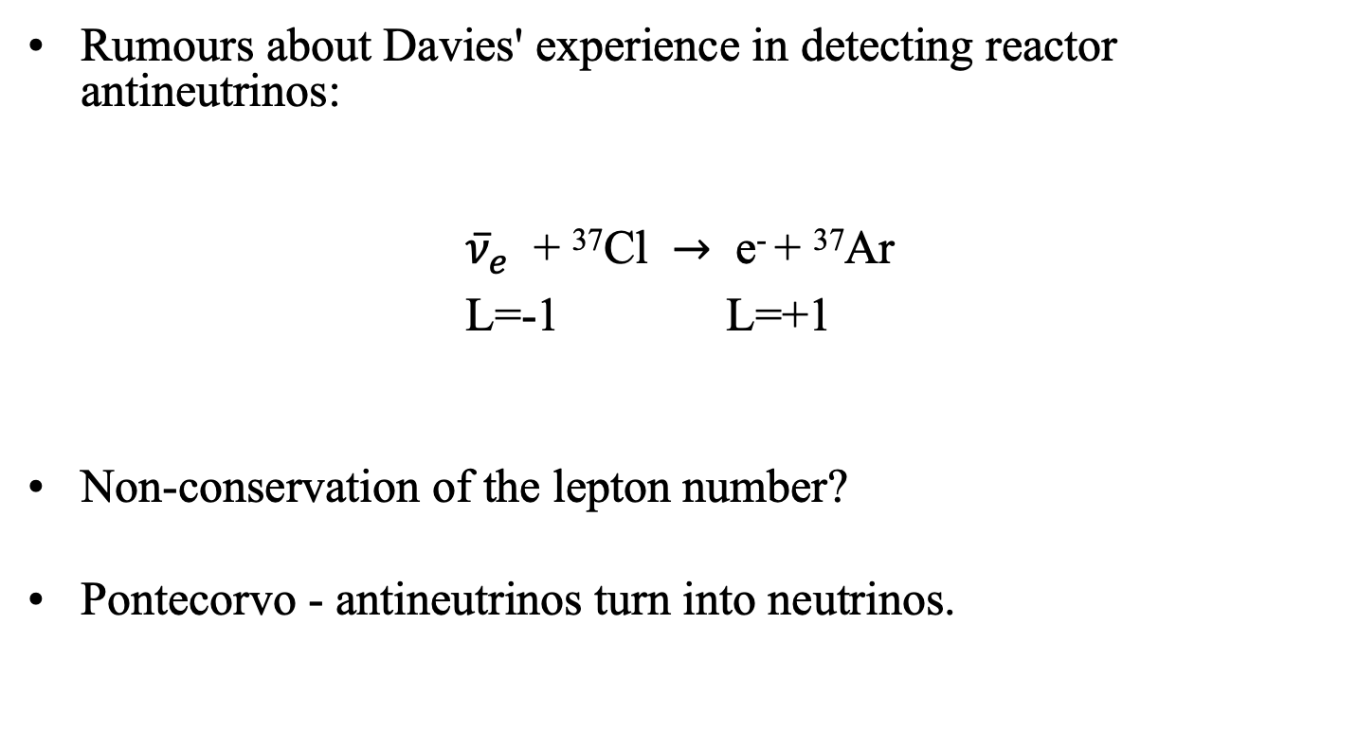
Neutrino oscillations
Rumours about Davies' experience in detecting reactor antineutrinos:
${\overline{ν}}_{e}$ + ³⁷Cl $→$ e⁻ + ³⁷Ar
L=-1 L=+1
Non-conservation of the lepton number?
Pontecorvo - antineutrinos turn into neutrinos.

Slide 59
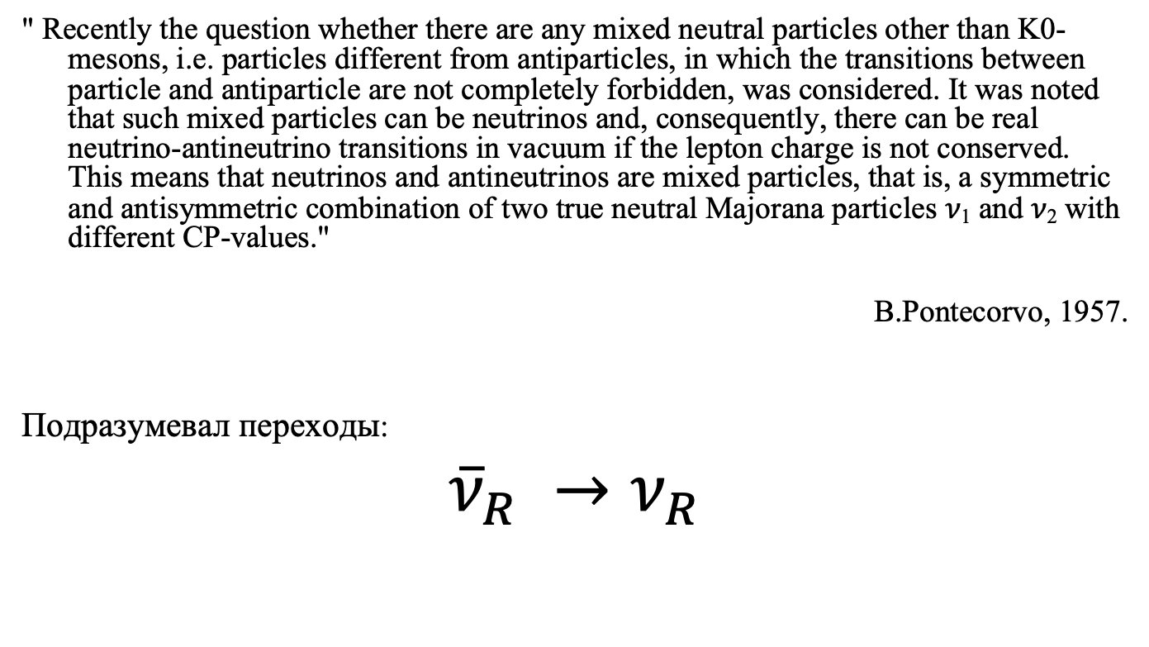
Neutrino oscillations-2
" Recently the question whether there are any mixed neutral particles other than K0-mesons, i.e. particles different from antiparticles, in which the transitions between particle and antiparticle are not completely forbidden, was considered. It was noted that such mixed particles can be neutrinos and, consequently, there can be real neutrino-antineutrino transitions in vacuum if the lepton charge is not conserved. This means that neutrinos and antineutrinos are mixed particles, that is, a symmetric and antisymmetric combination of two true neutral Majorana particles 𝜈₁ and 𝜈₂ with different CP-values."
B.Pontecorvo, 1957.
Подразумевал переходы:
${\overline{ν}}_{R} →ν_{R}$

Slide 60
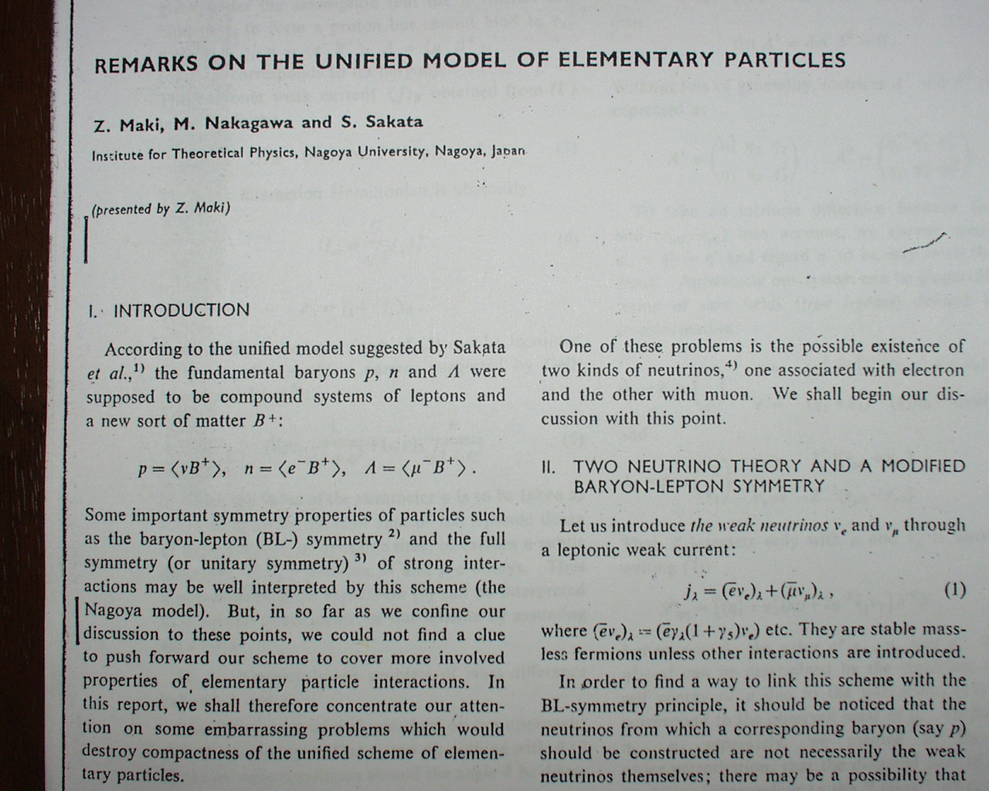
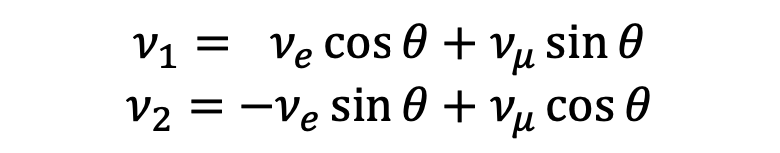
Maki-Nakagawa-Sakata (MNS)
The neutrino is part of the proton
$p=\left(ν B^{+}\right), n=\left(e^{−}B^{+}\right), Λ=\left(μ^{−}B^{+}\right)$
What if there are two neutrinos?
"the true neutrinos that are part of the corresponding baryon are not necessarily neutrinos involved in weak interactions".
$$ν_{1}={ ν}_{e}\cos{θ}+ν_{μ}\sin{θ}$$
$$ν_{2}={−ν}_{e}\sin{θ}+ν_{μ}\cos{θ}$$
$$p=\left(ν_{1} B^{+}\right), n=\left(e^{−}B^{+}\right), Λ=\left(μ^{−}B^{+}\right), p′=\left(ν_{2} B^{+}\right)$$
Where's the baryon p' ? It doesn't exist in nature...

Slide 61

Search for the superstrong weak interaction
First high-energy neutrino experiment at accelerator (V.Veksler, A.Tyapkin, B.Pontecorvo) 1961
From 9 runs – 8 were OK
If 10 will be OK – we start writing a paper
No, we will increase the shielding!

Slide 62
Pontecorvo reactions
1989, Coffee Discussion:
Antiproton annihilation on nuclei - what new can be expected compared to annihilation on free nucleons?
Annihilation with one meson in the final state

Slide 63


I never made a bomb, not in the West, not in China, not in the USSR

Slide 64

Role of leader, 1976
“The leader should not demand from his employees that they should be similar to him.”
“There are people which like to spend day and night in the experimental hall (the most typical is Yu.D.Prokoshkin). That is nice feature but nobody proved that all people must behave like that and that is the only way for a successful scientist.”

Slide 65

The leader should use different characters and different features of the members of the team. The strength of the group is just in complementarity of different features”

Slide 66

“Agreement between B.Pontecorvo and M.Balandin”, 1970
1. M.Balandin obliged from 1 November of 1970 NOT to come to work to the laboratory. He should stay home and prepare his PhD. As exception, he could come to the library.
4. The PhD must be practically ready by January 1971. Meaning of the word “practically” could be judged by B.Pontecorvo and G.Selivanov.
5. If these points will not be fulfilled the promises of B.Pontecorvo to M.Balandin will be invalid.

Slide 67

The teacher
Professor of Moscow State University 1961-1966
Head of the chair on elementary particle physics
1966-1986

Slide 68

“Take note that when one saying that this experimentalist has clever hands, it means, mainly, that he has clever head. More than 70% of great experiments was not only done but also suggested by the experimentalists themselves.”

Slide 69


The sportsman

Slide 70


Parkinson’s decease

Slide 71

What the neutrino physics could do for kolkhoznik from Ryazan?
Fundamental scientific researches is the responsibility of mankind.
Fundamental researches inevitably yields practical applications.

Slide 72
We don’t know exactly what practical outcome will be from investigation of the structure and properties of the elementary particles. But we are absolutely sure that these investigations will lead to the practical benefits. The prove of that is the whole history of physics.
Developing science we are working in this way for the good of our children, for the good of next generations.
        B.Pontecorvo

Slide 73

22.08.1913 - 24.09.1993

